Slide 1
Study of Virtual Pepper-Pot

Slide 2
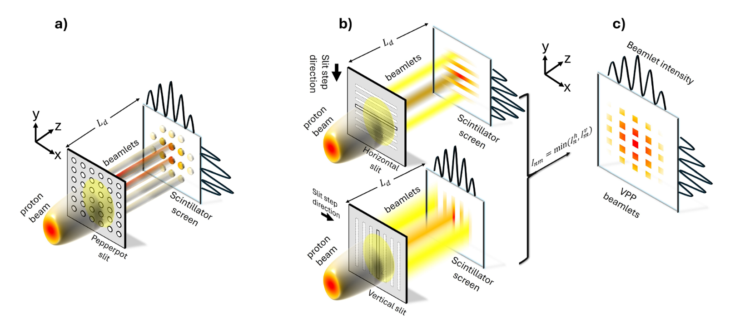
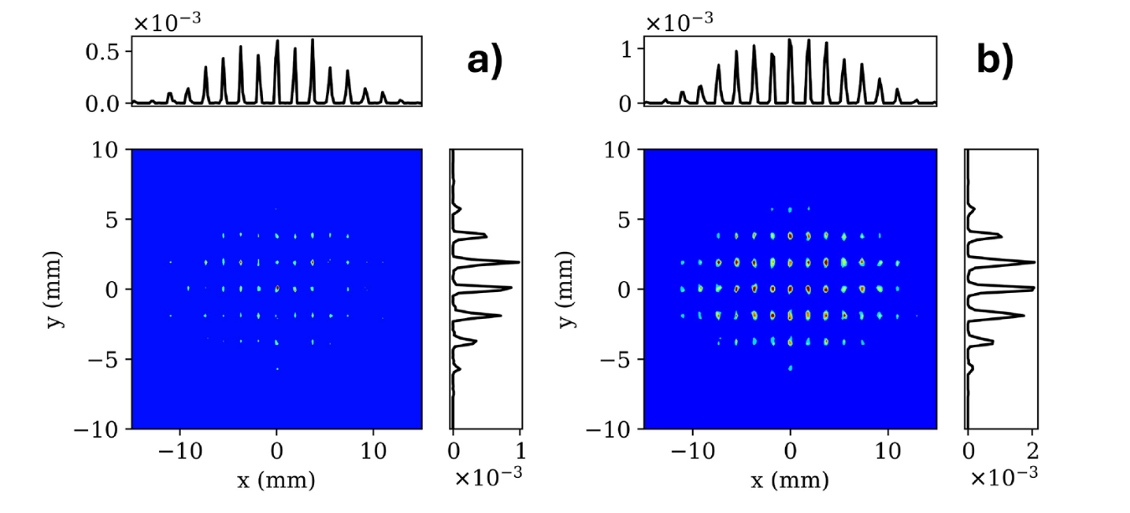
Introduction
[1]E. Cosgun et al., “Characterization and benchmarking of complete 4D transverse phase space for high-intensity ion beams using novel virtual pepper-pot technique,” Sci Rep, vol. 15, no. 1, p. 40761, Nov. 2025, doi: 10.1038/s41598-025-24550-2.
Pepper Pot
Virtual Pepper Pot
What is the Virtual Pepper-Pot (VPP)?
Full 4D phase space reconstruction
Generate pepper-pot like image using slit scan
Motivation
Limitation of conventional method “Pepper-pot (PP)”
Resolution & Signal trade-off
Dense holes ↔ Beamlets overlap
Small apertures ↔ Reduced signal (Low SNR)

Slide 3
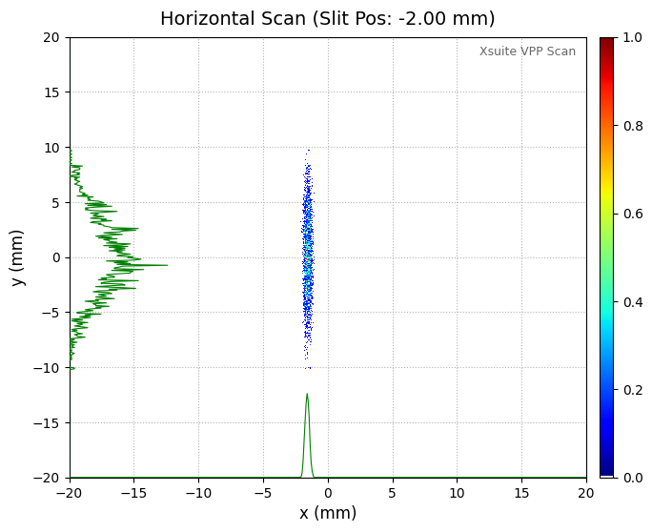
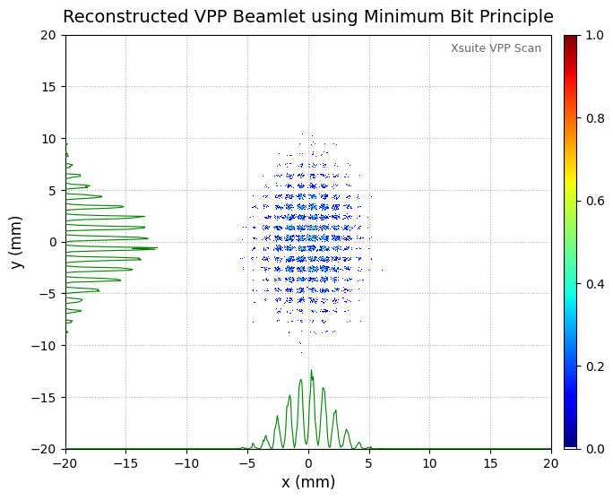
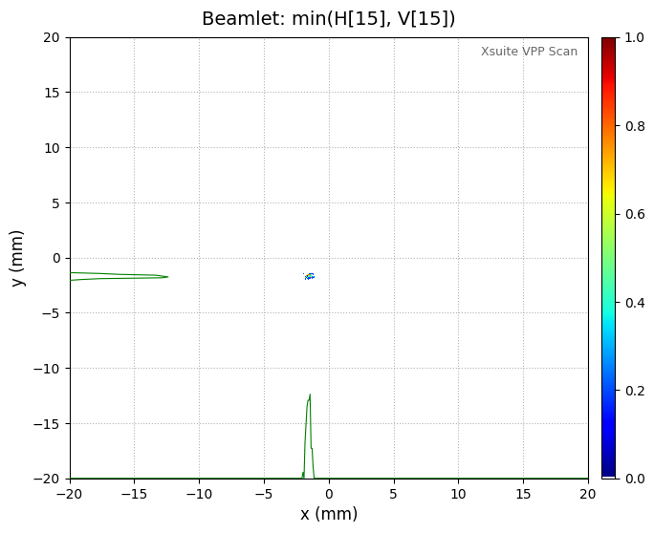
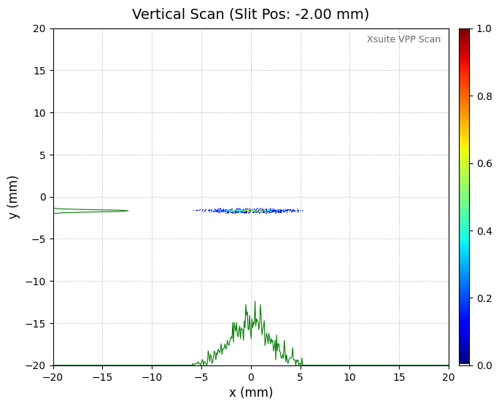

Principle of VPP
1) VPP Image Processing
Pepper Pot
Virtual Pepper Pot
Minimum Bit Principle
$$I_{VPP}\left(n, m\right)=\min{(I_{n}^{h}, I_{m}^{v})}$$
: Select the minimum intensity between horizontal and vertical slit scans to represent the physically overlapping beam fraction and avoid overestimation
$$I_{VPP}\left(n,m\right)=\min{(I_{n}^{h}, I_{m}^{v})}$$

Slide 4
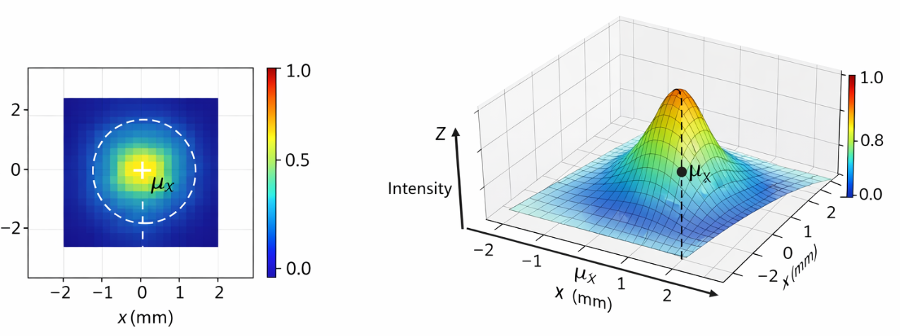

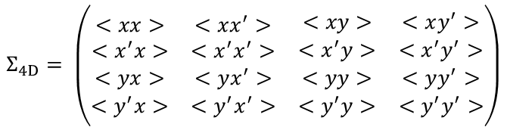

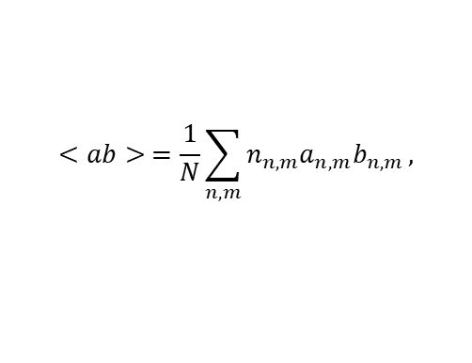
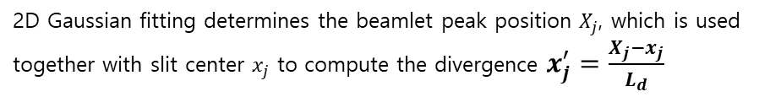




2) Reconstruction
2D Gaussian Fitting
$$I\left(x,y\right)=I_{0}exp⁡(−\frac{{\left(x−μ_{x}\right)}^{2}}{2σ_{x}^{2}}−\frac{{\left(y−μ_{y}\right)}^{2}}{2σ_{y}^{2}})$$
y (mm)
2D Gaussian fitting determines the beamlet peak position $X_{j}$, which is used together with slit center $x_{j}$ to compute the divergence $x_{j}^{′}=\frac{X_{j}−x_{j}}{L_{d}}$
y (mm)
$$Σ_{4D}= \left(\begin{matrix}\begin{matrix}<xx> & <xx^{′}> \\ <x^{′}x> & <x^{′}x^{′}>\end{matrix} & \begin{matrix}<xy> & <xy^{′}> \\ <x^{′}y> & <x^{′}y^{′}>\end{matrix} \\ \begin{matrix}<yx> & <yx^{′}> \\ <y^{′}x> & <y^{′}x^{′}>\end{matrix} & \begin{matrix}<yy> & <yy^{′}> \\ <y^{′}y> & <y^{′}y^{′}>\end{matrix}\end{matrix}\right)$$
$$<ab> =\frac{1}{N}\sum_{n,m}{n_{n,m}a_{n,m}b_{n,m}},$$
Using these data, the emittance and Twiss parameters at the slit position are reconstructed
$$ε_{x}=\sqrt{<xx><x^{′}x^{′}>−<xx^{′}>^{2}}$$
$$ε_{4d}=\sqrt{det{(Σ}_{4d})}$$
$$β_{x}=\frac{<xx>}{ε_{x}}$$
$$α_{x}=−\frac{<xx^{′}>}{ε_{x}}$$
$$σ_{x}=\sqrt{<xx>}$$

Slide 5

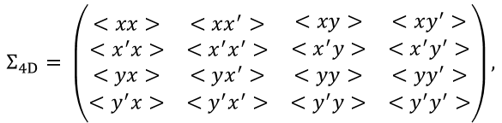

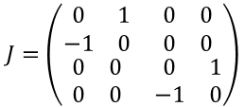
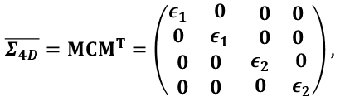

Coupled system
Full 4D phase space reconstruction allows evaluation of coupling through eigen-emittance
Eigen-emittance
In the presence of transverse coupling, the projected emittances $ε_{x}, ε_{y}$ are no longer conserved invariants of the system
⇒ Eigen-emittances $ε_{1}, ε_{2}$ are symplectic invariants of the 4D phase space matrix
$$Σ_{4D}= \left(\begin{matrix}\begin{matrix}<xx> & <xx^{′}> \\ <x^{′}x> & <x^{′}x^{′}>\end{matrix} & \begin{matrix}<xy> & <xy^{′}> \\ <x^{′}y> & <x^{′}y^{′}>\end{matrix} \\ \begin{matrix}<yx> & <yx^{′}> \\ <y^{′}x> & <y^{′}x^{′}>\end{matrix} & \begin{matrix}<yy> & <yy^{′}> \\ <y^{′}y> & <y^{′}y^{′}>\end{matrix}\end{matrix}\right),$$
$$\overline{Σ_{4D}}={MCM}^{T}=\left(\begin{matrix}\begin{matrix}ε_{1} & 0 \\ 0 & ε_{1}\end{matrix} & \begin{matrix}0 & 0 \\ 0 & 0\end{matrix} \\ \begin{matrix}0 & 0 \\ 0 & 0\end{matrix} & \begin{matrix}ε_{2} & 0 \\ 0 & ε_{2}\end{matrix}\end{matrix}\right),$$
$$J=\left(\begin{matrix}\begin{matrix}0 & 1 \\ −1 & 0\end{matrix} & \begin{matrix}0 & 0 \\ 0 & 0\end{matrix} \\ \begin{matrix}0 & 0 \\ 0 & 0\end{matrix} & \begin{matrix}0 & 1 \\ −1 & 0\end{matrix}\end{matrix}\right)$$
{
$$\det\left(Σ_{4d}\right)={\left(ε_{1}ε_{2}\right)}^{2}$$
$$tr\left[{\left(Σ_{4D}J\right)}^{2}\right]=tr\left[{\left(\overline{Σ_{4D}}J\right)}^{2}\right]=−2(ε_{1}^{2}+ε_{2}^{2})$$
$$ε_{1, 2}=\frac{1}{2}\sqrt{−tr\left[{\left(Σ_{4D}J\right)}^{2}\right]±\sqrt{tr^{2}\left[{\left(Σ_{4D}J\right)}^{2}\right]−16\det\left(Σ_{4d}\right)}}$$
Coupling factor
$$t=\frac{ε_{x}ε_{y}}{ε_{1}ε_{2}}−1≥0$$
$t≈0$ means that the beam is uncoupled

Slide 6
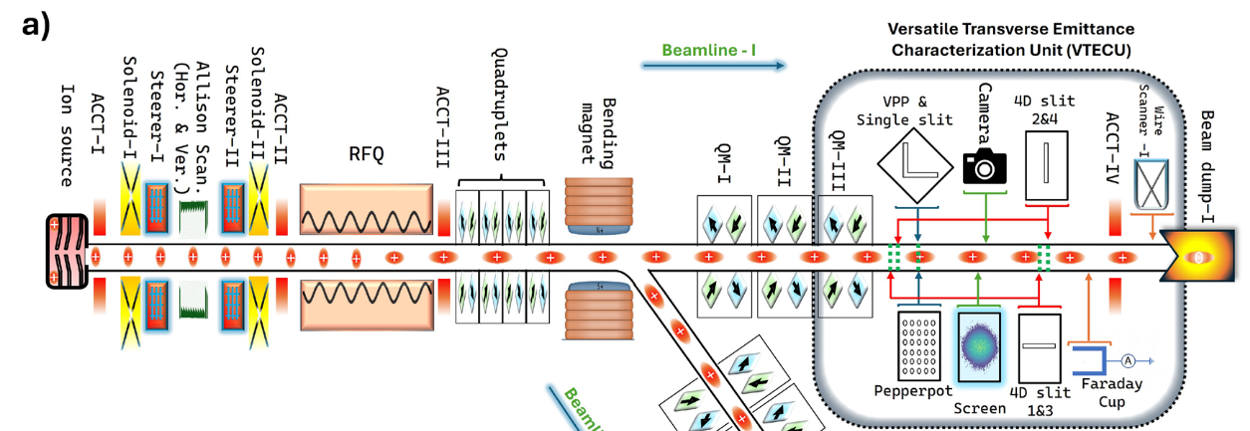
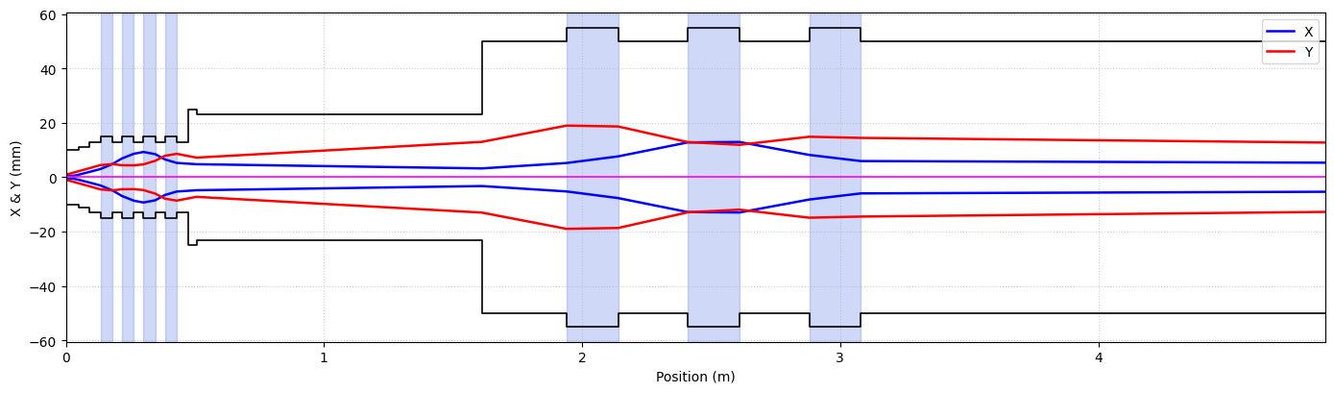
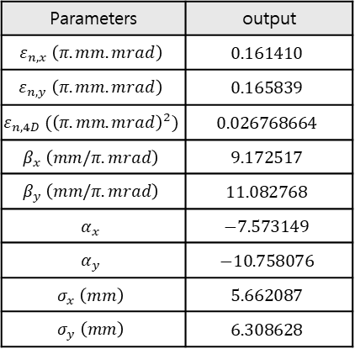
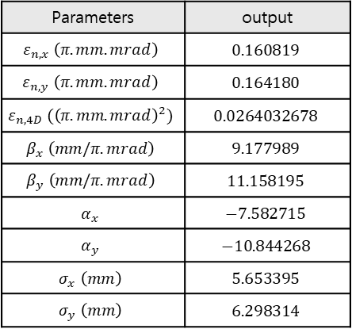
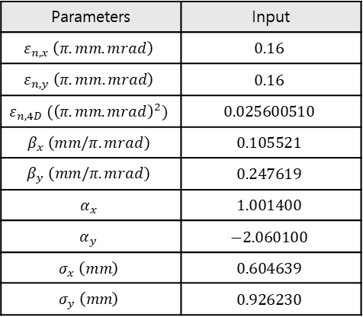
Simulation Setting: From TraceWin to Xsuite
Lattice
<KOMAC BTS layout>
Xsuite Simulation Lattice
Particles
Input Beam : After the RFQ
Proton, 1 MeV, 3σ-truncated 6D Gaussian beam
Macro particles = 100,000
No collective effects (e.g. Space charge effect)
TraceWin Simulation Data
Xsuite Simulation Data
Parameters | output
$$ε_{n, x} \left(π.mm.mrad\right)$$ | $$0.160819$$
$$ε_{n, y} \left(π.mm.mrad\right)$$ | $$0.164180$$
$$ε_{n,4D} ({\left(π.mm.mrad\right)}^{2})$$ | $$0.0264032678$$
$$β_{x} \left(mm/π.mrad\right)$$ | $$9.177989$$
$$β_{y} \left(mm/π.mrad\right)$$ | $$11.158195$$
$$α_{x}$$ | $$−7.582715$$
$$α_{y}$$ | $$−10.844268$$
$$σ_{x} \left(mm\right)$$ | $$5.653395$$
$$σ_{y} \left(mm\right)$$ | $$6.298314$$
Parameters | output
$$ε_{n, x} \left(π.mm.mrad\right)$$ | $$0.161410$$
$$ε_{n, y} \left(π.mm.mrad\right)$$ | $$0.165839$$
$$ε_{n,4D} ({\left(π.mm.mrad\right)}^{2})$$ | $$0.026768664$$
$$β_{x} \left(mm/π.mrad\right)$$ | $$9.172517$$
$$β_{y} \left(mm/π.mrad\right)$$ | $$11.082768$$
$$α_{x}$$ | $$−7.573149$$
$$α_{y}$$ | $$−10.758076$$
$$σ_{x} \left(mm\right)$$ | $$5.662087$$
$$σ_{y} \left(mm\right)$$ | $$6.308628$$
TraceWin Simulation Data
Parameters | Input
$$ε_{n, x} \left(π.mm.mrad\right)$$ | $$0.16$$
$$ε_{n, y} \left(π.mm.mrad\right)$$ | $$0.16$$
$$ε_{n, 4D} ({\left(π.mm.mrad\right)}^{2})$$ | $$0.025600510$$
$$β_{x} \left(mm/π.mrad\right)$$ | $$0.105521$$
$$β_{y} \left(mm/π.mrad\right)$$ | $$0.247619$$
$$α_{x}$$ | $$1.001400$$
$$α_{y}$$ | $$−2.060100$$
$$σ_{x} \left(mm\right)$$ | $$0.604639$$
$$σ_{y} \left(mm\right)$$ | $$0.926230$$

Slide 7
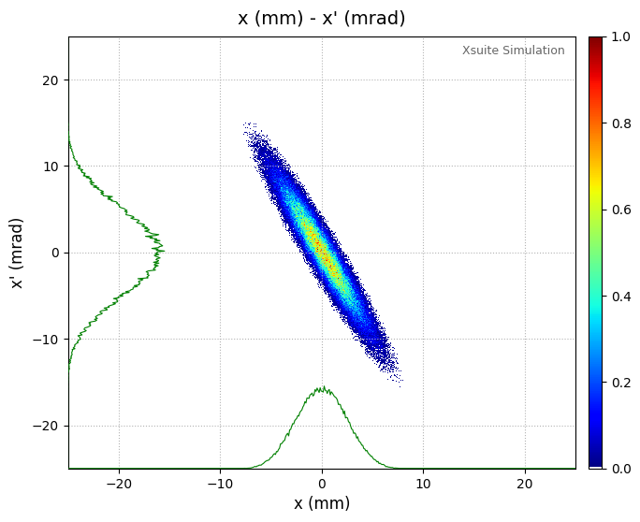
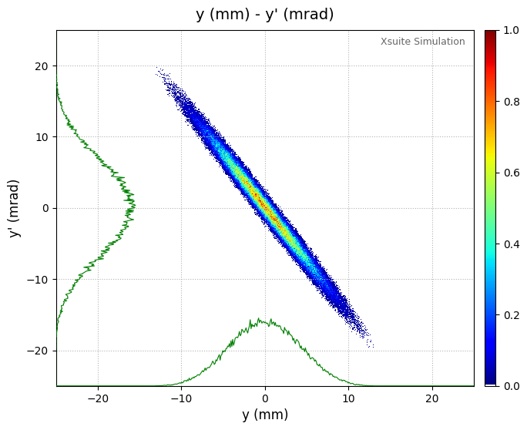
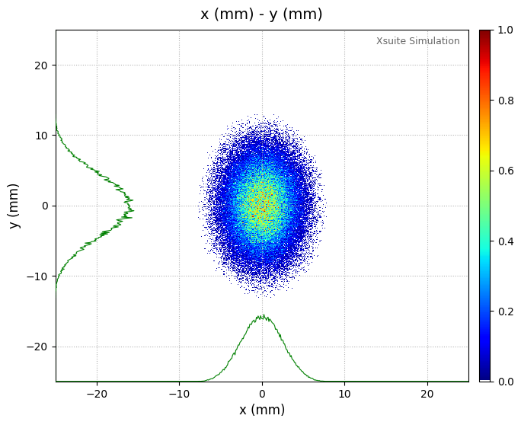
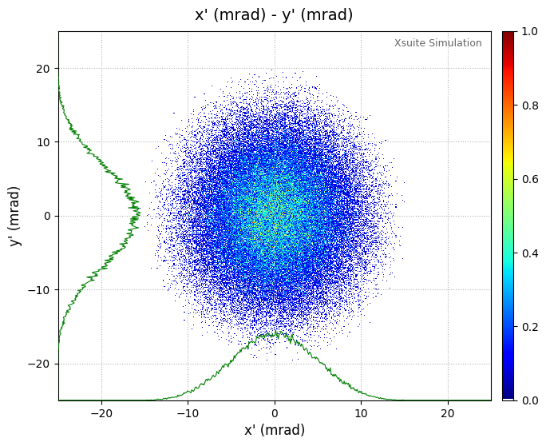
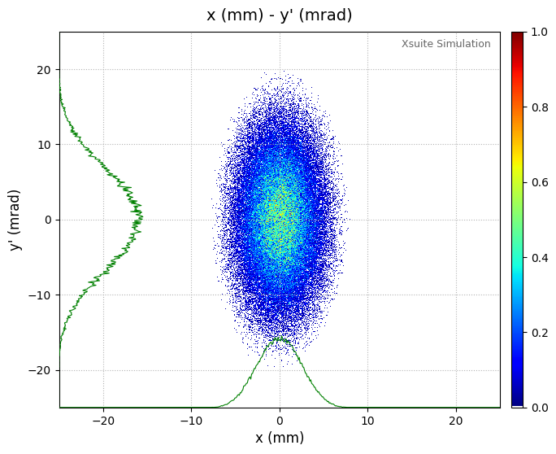
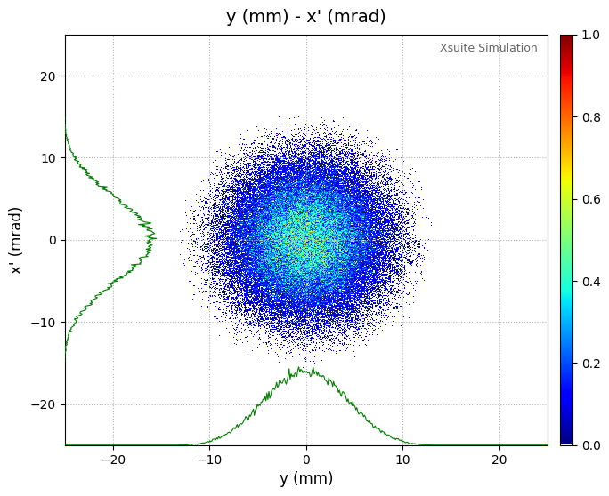
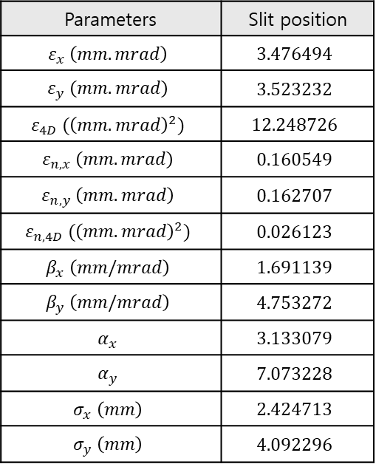
Ground Truth at Slit Position
Slit position (m): 3.2m
Screen position (m): 3.31m
Slit width (mm): 0.2mm
Parameters | Slit position
$$ε_{x} \left(mm.mrad\right)$$ | $$3.476494$$
$$ε_{y} \left(mm.mrad\right)$$ | $$3.523232$$
$$ε_{4D} ({\left(mm.mrad\right)}^{2})$$ | $$12.248726$$
$$ε_{n, x} \left(mm.mrad\right)$$ | $$0.160549$$
$$ε_{n, y} \left(mm.mrad\right)$$ | $$0.162707$$
$$ε_{n,4D} ({\left(mm.mrad\right)}^{2})$$ | $$0.026123$$
$$β_{x} \left(mm/mrad\right)$$ | $$1.691139$$
$$β_{y} \left(mm/mrad\right)$$ | $$4.753272$$
$$α_{x}$$ | $$3.133079$$
$$α_{y}$$ | $$7.073228$$
$$σ_{x} \left(mm\right)$$ | $$2.424713$$
$$σ_{y} \left(mm\right)$$ | $$4.092296$$
Space charge effect를 꺼서 논문과 parameter 수치가 다름.
Scan index 수를 맞추기 위해 빔 사이즈 기준으로 복원 위치 선정.

Slide 8
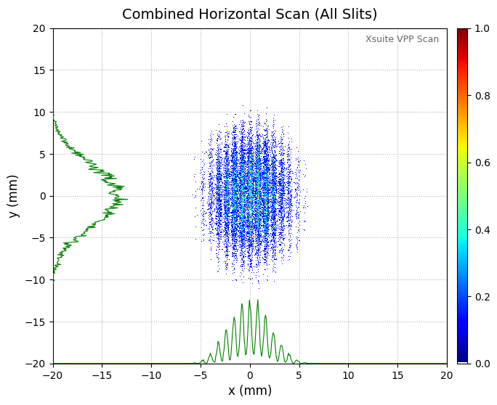
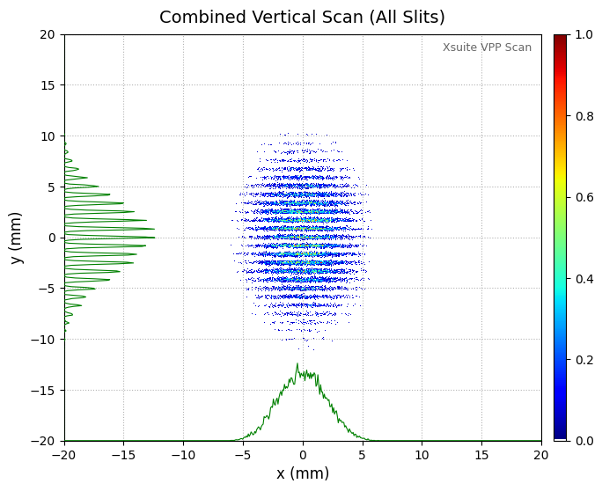
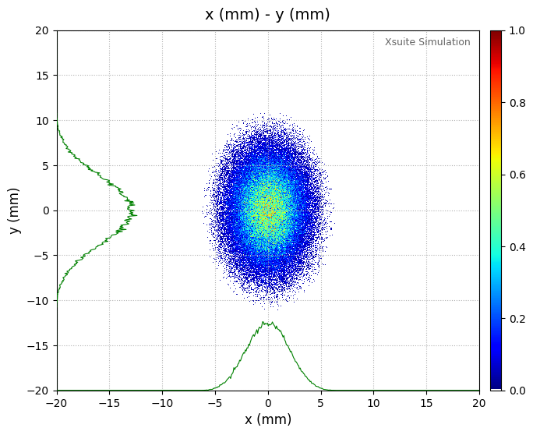
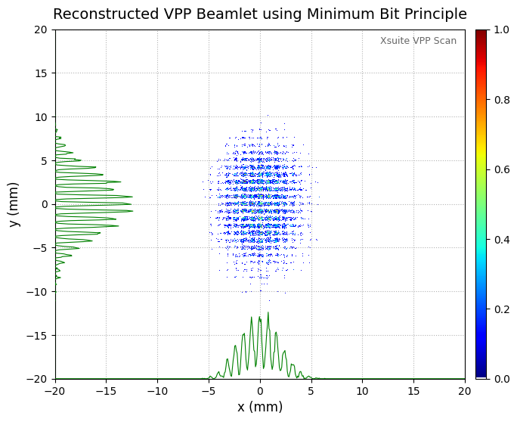
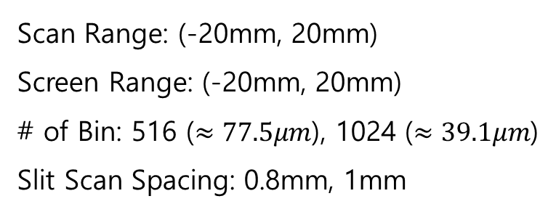

Virtual Pepper-Pot Image Processing
Bins: 516
Slit Scan Spacing: 0.8mm
Scan Range: (-20mm, 20mm)
Screen Range: (-20mm, 20mm)
# of Bin: 516 ($≈77.5μm$), 1024 ($≈39.1μm$)
Slit Scan Spacing: 0.8mm, 1mm
$$I_{VPP}\left(n,m\right)=\min{(I_{n}^{h}, I_{m}^{v})}$$
Screen Position Ground Truth

Slide 9
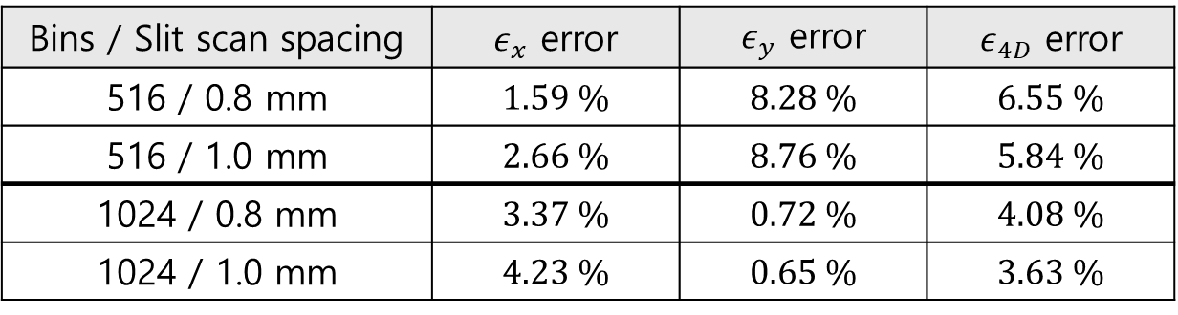
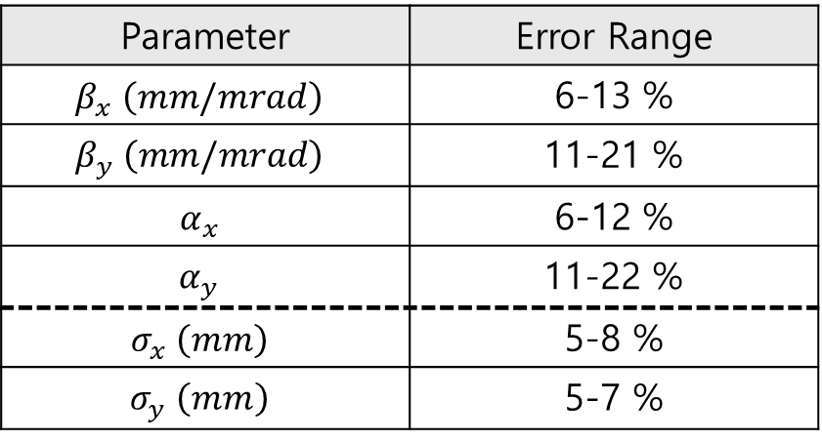
Reconstruction Accuracy
Emittance
Bins / Slit scan spacing | $ε_{x}$ error | $ε_{y}$ error | $ε_{4D}$ error
516 / 0.8 mm | 1.59 % | 8.28 % | 6.55 %
516 / 1.0 mm | 2.66 % | 8.76 % | 5.84 %
1024 / 0.8 mm | 3.37 % | 0.72 % | 4.08 %
1024 / 1.0 mm | 4.23 % | 0.65 % | 3.63 %
Higher bin resolution significantly improves $ε_{y}$ and $ε_{4D}$ accuracy
Slit spacing has relatively minor influence compared to bin number
Twiss parameters & Beam size
Parameter | Error Range
$$β_{x} \left(mm/mrad\right)$$ | 6-13 %
$$β_{y} \left(mm/mrad\right)$$ | 11-21 %
$$α_{x}$$ | 6-12 %
$$α_{y}$$ | 11-22 %
$$σ_{x} \left(mm\right)$$ | 5-8 %
$$σ_{y} \left(mm\right)$$ | 5-7 %
Twiss parameters show higher sensitivity compared to emittance reconstruction due to error propagation
Twiss parameter errors are reduced by nearly half when increasing bins from 516 to 1024

Slide 10
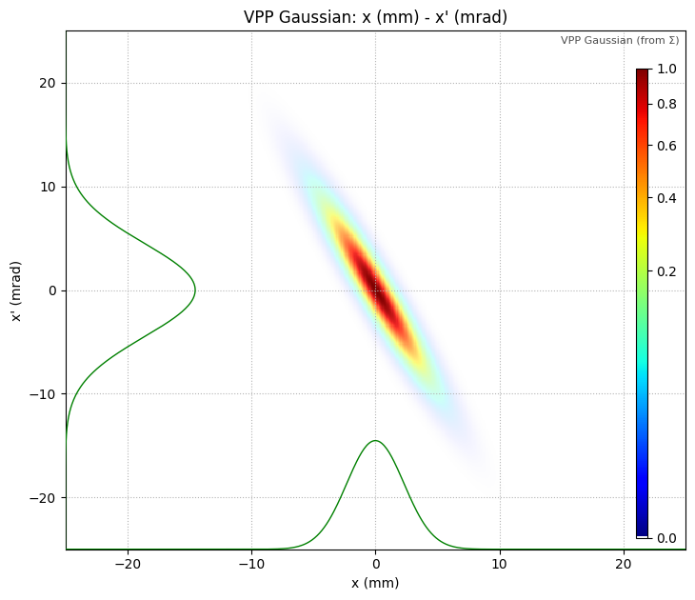
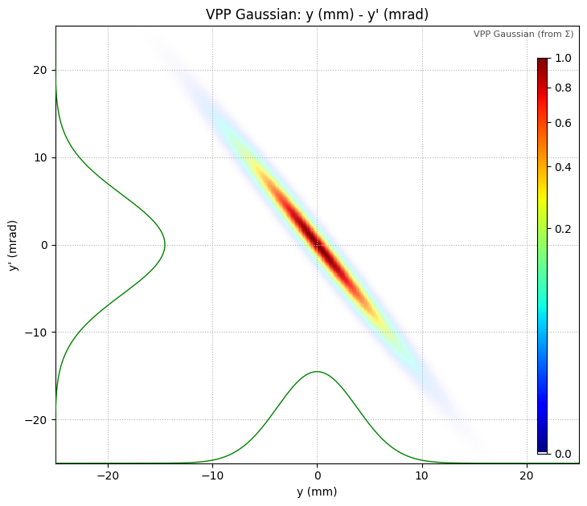
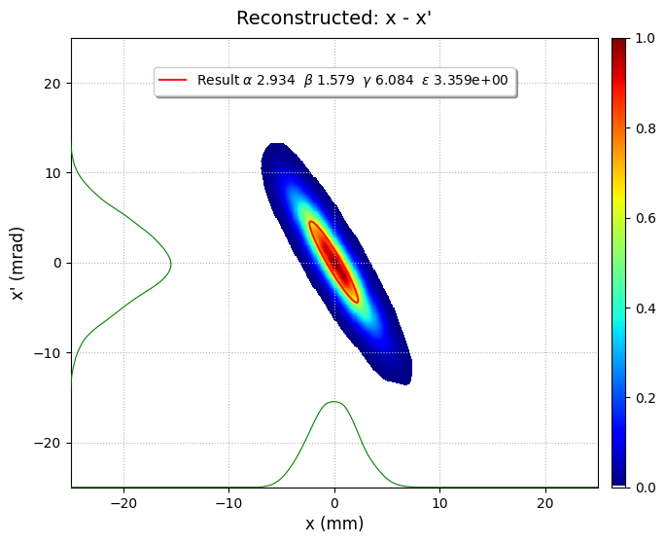
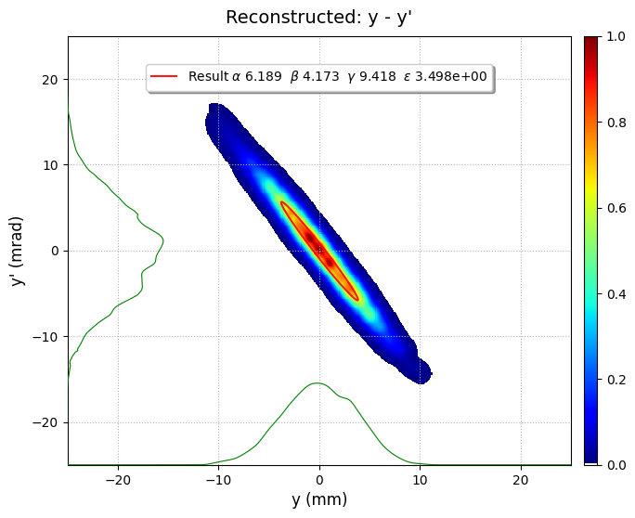
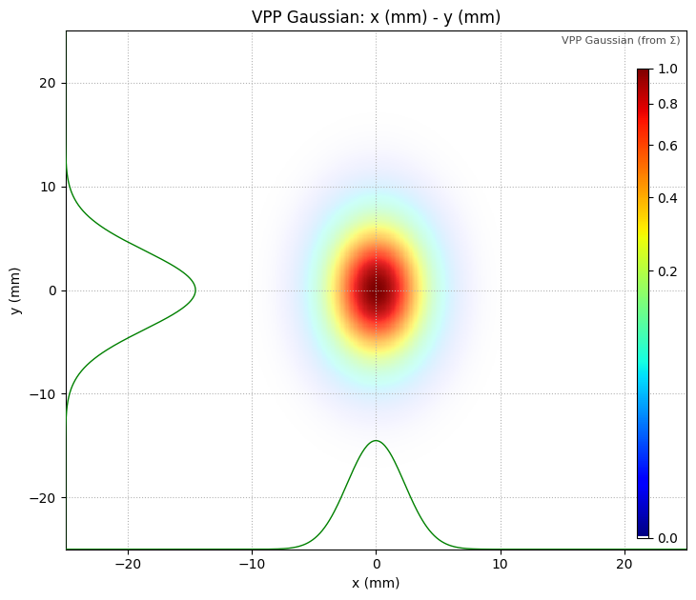
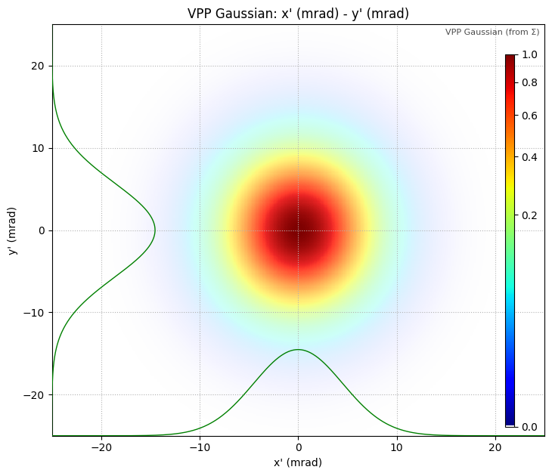
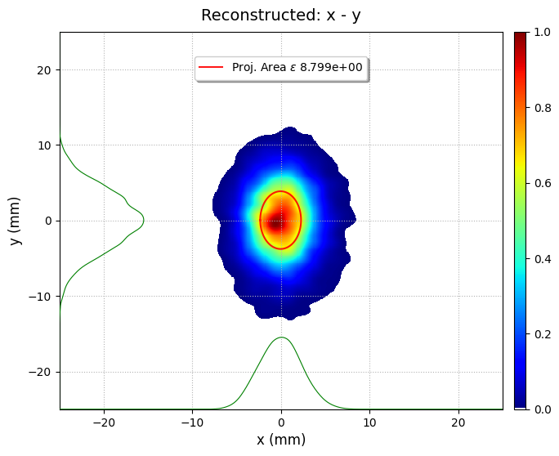
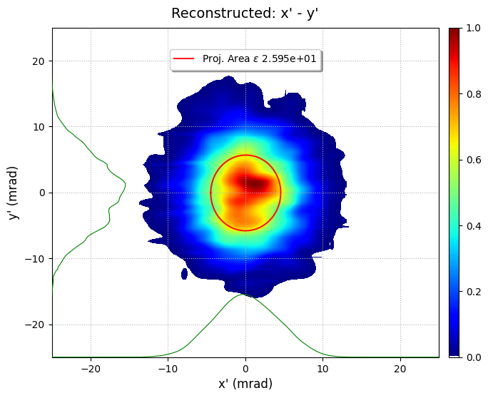
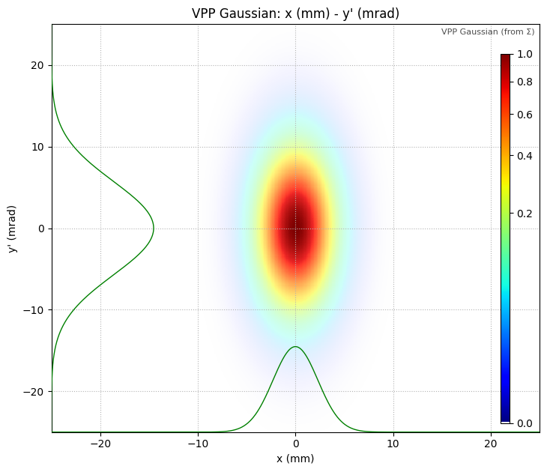

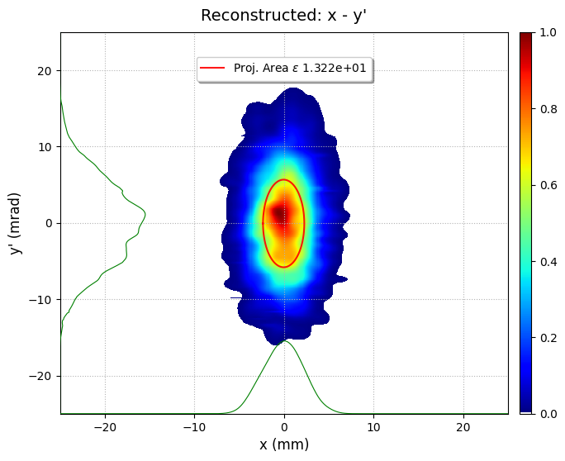
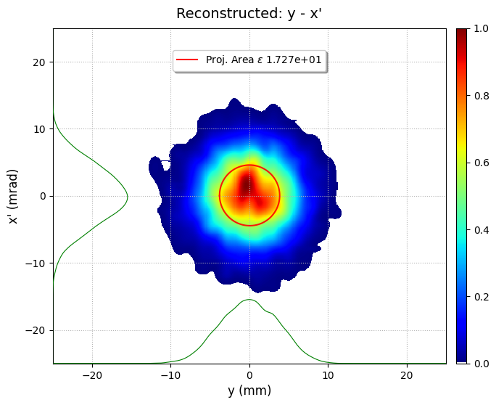
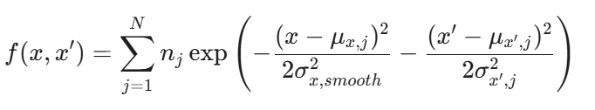
Slit Position Ground Truth
Recon: Assuming Gaussian distribution
Recon: Gaussian Mixture Model

Slide 11
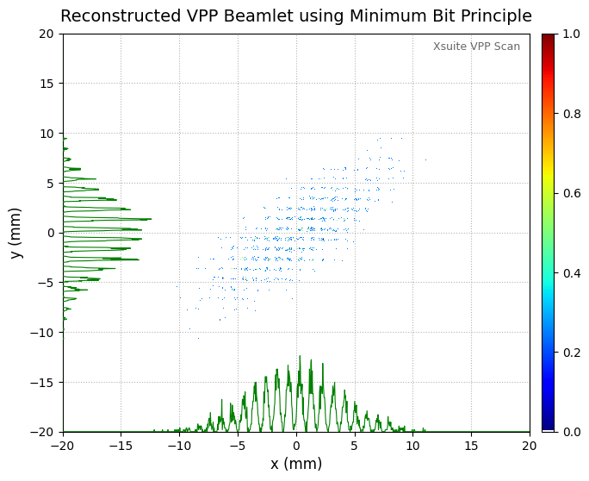
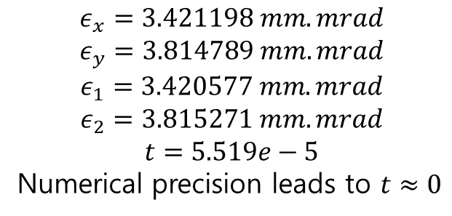
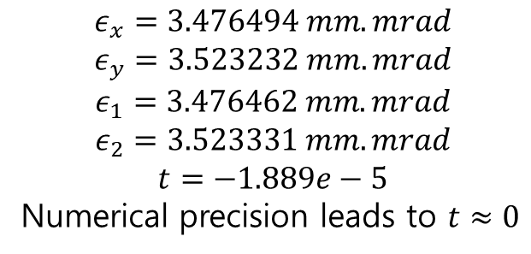
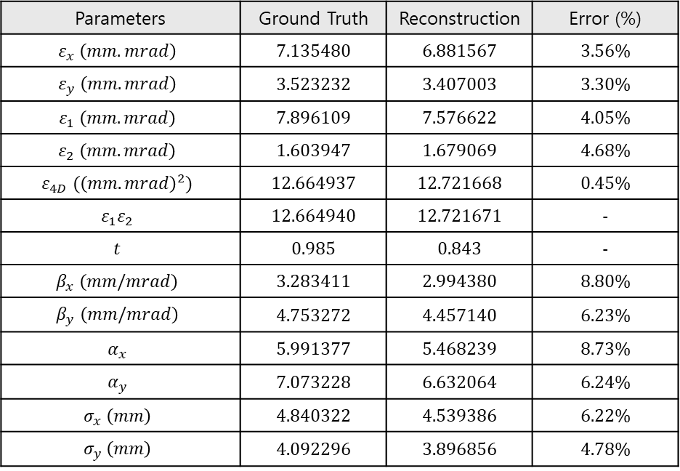

Ground truth
$$ε_{x}=3.476494 mm.mrad$$
$$ε_{y}=3.523232 mm.mrad$$
$$ε_{1}=3.476462 mm.mrad$$
$$ε_{2}=3.523331 mm.mrad$$
$$t=−1.889e−5$$
Numerical precision leads to $t≈0$
Reconstruction
$$ε_{x}=3.421198 mm.mrad$$
$$ε_{y}=3.814789 mm.mrad$$
$$ε_{1}=3.420577 mm.mrad$$
$$ε_{2}=3.815271 mm.mrad$$
$$t=5.519e−5$$
Numerical precision leads to $t≈0$
임의의 coupling
Parameters | Ground Truth | Reconstruction | Error (%)
$$ε_{x} \left(mm.mrad\right)$$ | 7.135480 | 6.881567 | 3.56%
$$ε_{y} \left(mm.mrad\right)$$ | 3.523232 | 3.407003 | 3.30%
$$ε_{1} \left(mm.mrad\right)$$ | 7.896109 | 7.576622 | 4.05%
$$ε_{2} \left(mm.mrad\right)$$ | 1.603947 | 1.679069 | 4.68%
$$ε_{4D} ({\left(mm.mrad\right)}^{2})$$ | 12.664937 | 12.721668 | 0.45%
$$ε_{1}ε_{2}$$ | 12.664940 | 12.721671 | -
$$t$$ | 0.985 | 0.843 | -
$$β_{x} \left(mm/mrad\right)$$ | 3.283411 | 2.994380 | 8.80%
$$β_{y} \left(mm/mrad\right)$$ | 4.753272 | 4.457140 | 6.23%
$$α_{x}$$ | 5.991377 | 5.468239 | 8.73%
$$α_{y}$$ | 7.073228 | 6.632064 | 6.24%
$$σ_{x} \left(mm\right)$$ | 4.840322 | 4.539386 | 6.22%
$$σ_{y} \left(mm\right)$$ | 4.092296 | 3.896856 | 4.78%
$$x ←x+ky, k=0.8$$

Slide 12
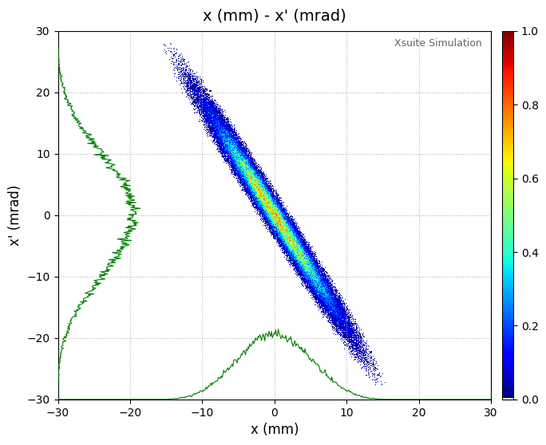
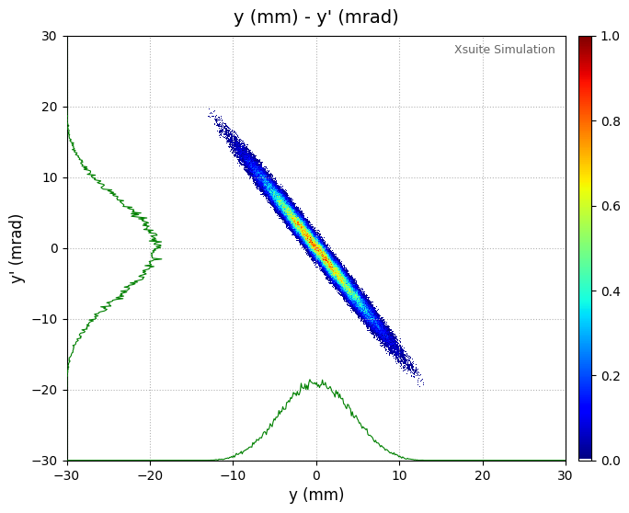










Slit Position Ground Truth
Recon: Gaussian Mixture Model

Slide 13
Summary & Plan
Summary
Virtual Pepper-Pot technique enables full 4D transverse phase space reconstruction
Under high-resolution conditions, reconstruction errors are below 10%, and below 5% for emittance
Simulations with intentionally introduced coupling confirm that Virtual Pepper-Pot successfully reconstructs transverse coupling effects
Plan
Conduct simulations based on eLABs Gun1 data and implement the “differential slit method”
Study and simulate the solenoid scan for validation of the Virtual Pepper-Pot reconstruction and experimental comparison
Measure solenoid scan data at PAL-XFEL in March or August

Slide 14

Reconstruction
Parameters | Ground Truth | Reconstruction (bins = 516) (slit space: 0.8mm) | Reconstruction (bins = 516) (slit space: 1mm) | Reconstruction (bins = 1024) (slit space: 0.8mm) | Reconstruction (bins = 1024) (slit space: 1mm)
$$ε_{x} \left(mm.mrad\right)$$ | $$3.476494$$ | 3.421198 | 3.384118 | 3.359351 | 3.329536
$$ε_{y} \left(mm.mrad\right)$$ | $$3.523232$$ | 3.814789 | 3.831987 | 3.497718 | 3.546107
$$ε_{4D} ({\left(mm.mrad\right)}^{2})$$ | $$12.248726$$ | 13.050429 | 12.964562 | 11.748464 | 11.804704
$$β_{x} \left(mm/mrad\right)$$ | $$1.691139$$ | 1.511921 | 1.464033 | 1.579179 | 1.511645
$$β_{y} \left(mm/mrad\right)$$ | $$4.753272$$ | 3.748305 | 3.826055 | 4.172718 | 4.209248
$$α_{x}$$ | $$3.133079$$ | 2.809510 | 2.751108 | 2.933928 | 2.843531
$$α_{y}$$ | $$7.073228$$ | 5.519916 | 5.658486 | 6.188546 | 6.247286
$$σ_{x} \left(mm\right)$$ | $$2.424713$$ | 2.274331 | 2.225861 | 2.303262 | 2.243452
$$σ_{y} \left(mm\right)$$ | $$4.092296$$ | 3.781400 | 3.829020 | 3.820339 | 3.863476

Slide 15


Parameters | Ground Truth | Recon error (%) (bins: 516) (slit space: 0.8mm) | Recon error (%) (bins: 516) (slit space: 1mm) | Recon error (%) (bins: 1024) (slit space: 0.8mm) | Recon error (%) (bins: 1024) (slit space: 1mm)
$$ε_{x} \left(mm.mrad\right)$$ | $$3.476494$$ | 1.59 % | 2.66 % | 3.37 % | 4.23 %
$$ε_{y} \left(mm.mrad\right)$$ | $$3.523232$$ | 8.28 % | 8.76 % | 0.72 % | 0.65 %
$$ε_{4D} ({\left(mm.mrad\right)}^{2})$$ | $$12.248726$$ | 6.55 % | 5.84 % | 4.08 % | 3.63 %
$$β_{x} \left(mm/mrad\right)$$ | $$1.691139$$ | 10.60 % | 13.43 % | 6.62 % | 10.61 %
$$β_{y} \left(mm/mrad\right)$$ | $$4.753272$$ | 21.14 % | 19.51 % | 12.21 % | 11.45 %
$$α_{x}$$ | $$3.133079$$ | 10.33 % | 12.19 % | 6.36 % | 9.24 %
$$α_{y}$$ | $$7.073228$$ | 21.96 % | 20.00 % | 12.51 % | 11.68 %
$$σ_{x} \left(mm\right)$$ | $$2.424713$$ | 6.20 % | 8.20 % | 5.01 % | 7.48 %
$$σ_{y} \left(mm\right)$$ | $$4.092296$$ | 7.60 % | 6.43 % | 6.65 % | 5.59 %
$${ σ}_{x} <σ_{y}$$
$$σ_{x}^{′}>σ_{y}^{′}$$

