Slide 1
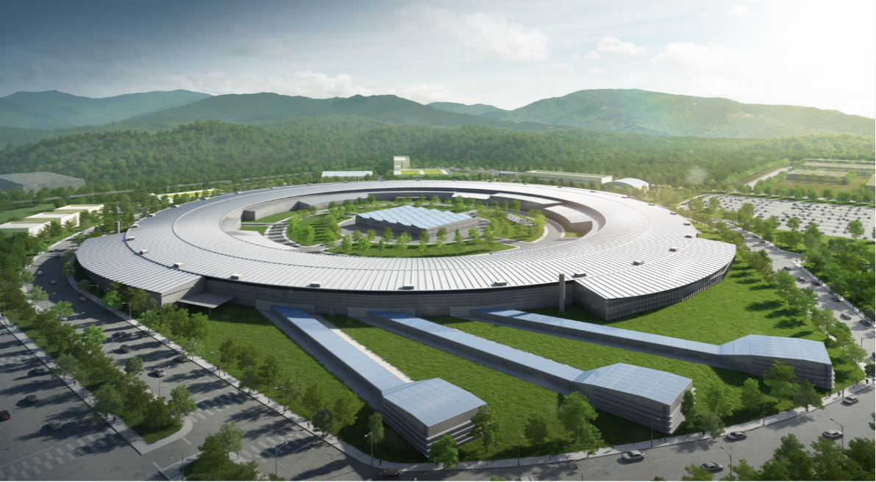

JKPS (02/20)
A machine-learning based closed orbit feedback for the SSRF storage ring
류연찬
Control Group
Pohang Accelerator Laboratory, POSTECH
20, FEB. 2026

Slide 2
JKPS (02/20)
Outline
Chosen Reason
Principle
Orbit Feedback, Machine Learning
Experiment Research
Environment RF Feedback / ML Feedback / SOFB / Long-term test
Discussions
2

Slide 3
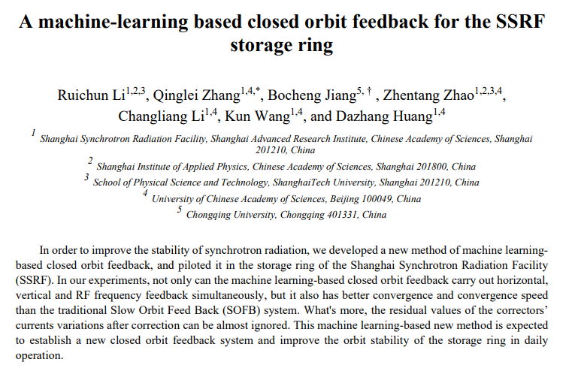
JKPS (02/20)
Introduction
Chosen Reason
Want to study about ML/AI
Application of Orbit Feedback
EPICS CA 통신
3

Slide 4
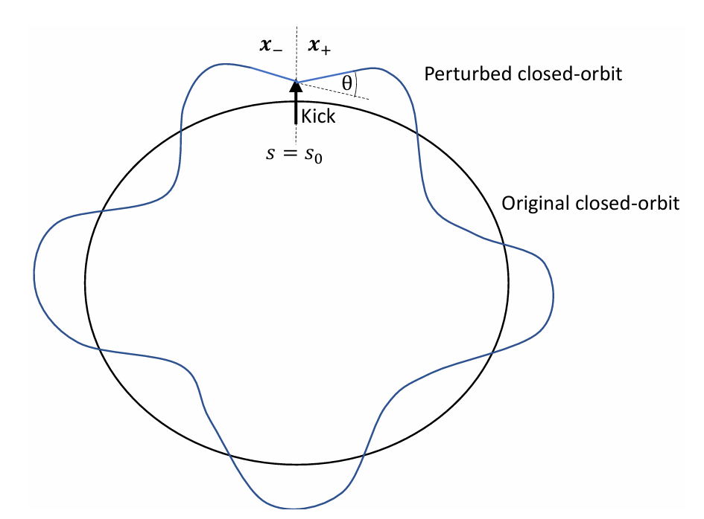
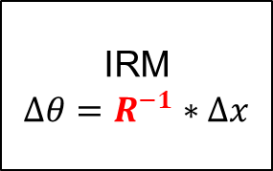
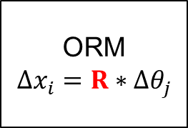
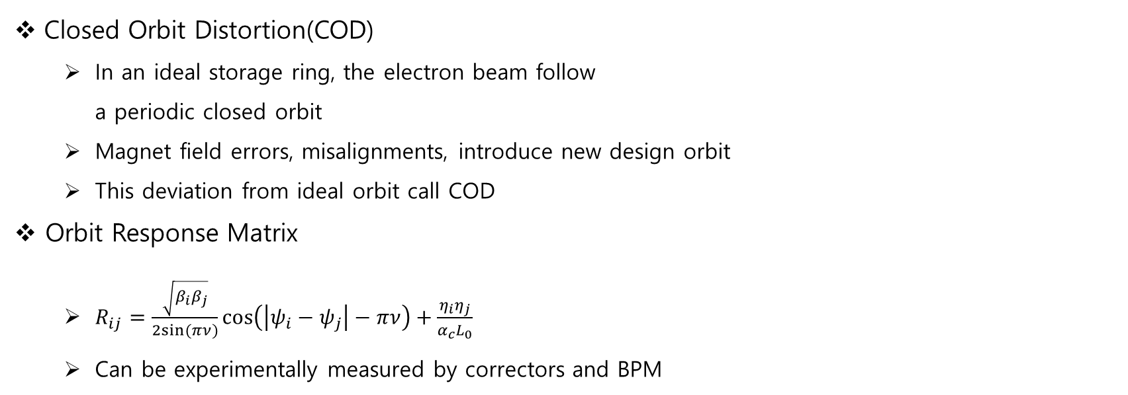
JKPS (02/20)
Principle – Orbit Feedback
Closed Orbit Distortion(COD)
In an ideal storage ring, the electron beam follow a periodic closed orbit
Magnet field errors, misalignments, introduce new design orbit
This deviation from ideal orbit call COD
Orbit Response Matrix
$R_{ij}=\frac{\sqrt{β_{i}β_{j}}}{2sin⁡(πν)}\cos\left(\left|ψ_{i}−ψ_{j}\right|−πν\right)+\frac{η_{i}η_{j}}{α_{c}L_{0}}$
Can be experimentally measured by correctors and BPM
Closed Orbit Distortion
Pseudo-Inverse
ORM
$$Δx_{i}=R∗Δθ_{j}$$
IRM
$Δθ=R^{−1}∗Δx$
Relation of ORM and IRM
4

Slide 5
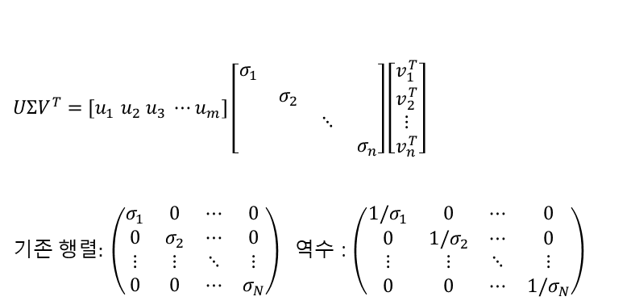
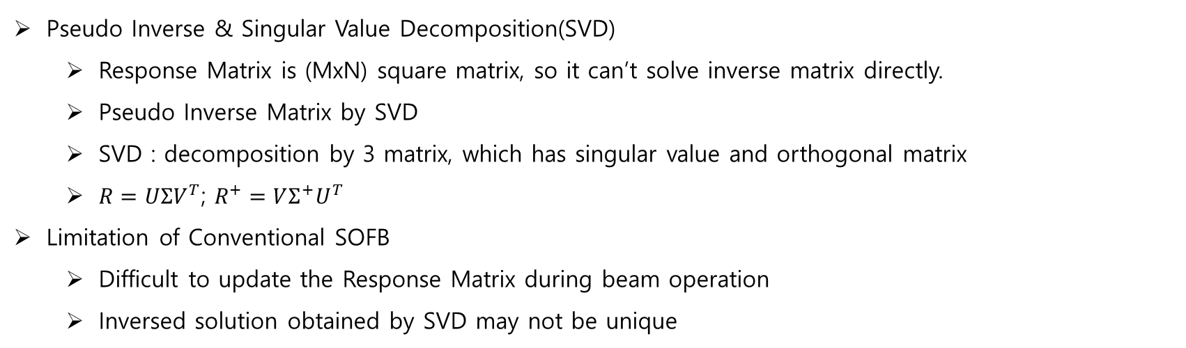
JKPS (02/20)
Principle – Orbit Feedback
Pseudo Inverse & Singular Value Decomposition(SVD)
Response Matrix is (MxN) square matrix, so it can’t solve inverse matrix directly.
Pseudo Inverse Matrix by SVD
SVD : decomposition by 3 matrix, which has singular value and orthogonal matrix
$R=UΣV^{T}$; $R^{+}=VΣ^{+}U^{T}$
Limitation of Conventional SOFB
Difficult to update the Response Matrix during beam operation
Inversed solution obtained by SVD may not be unique
$UΣV^{T}=[u_{1} u_{2} u_{3} ⋯u_{m}]\left[\begin{matrix}σ_{1} & & & \\ & σ_{2} & & \\ & & ⋱ & \\ & & & σ_{n}\end{matrix}\right]\left[\begin{matrix}v_{1}^{T} \\ v_{2}^{T} \\ ⋮ \\ v_{n}^{T}\end{matrix}\right]$
기존$행렬: \left(\begin{matrix}σ_{1} & 0 & ⋯ & 0 \\ 0 & σ_{2} & ⋯ & 0 \\ ⋮ & ⋮ & ⋱ & ⋮ \\ 0 & 0 & ⋯ & σ_{N}\end{matrix}\right)$ 역수 : $\left(\begin{matrix}1/σ_{1} & 0 & ⋯ & 0 \\ 0 & 1/σ_{2} & ⋯ & 0 \\ ⋮ & ⋮ & ⋱ & ⋮ \\ 0 & 0 & ⋯ & 1/σ_{N}\end{matrix}\right)$
5

Slide 6
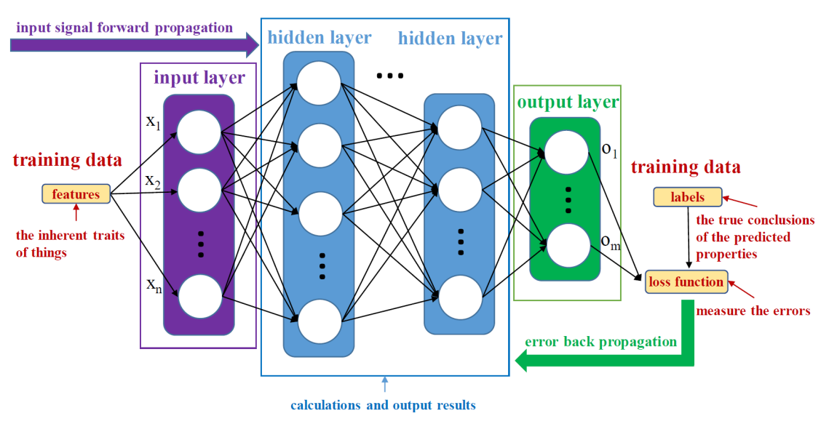
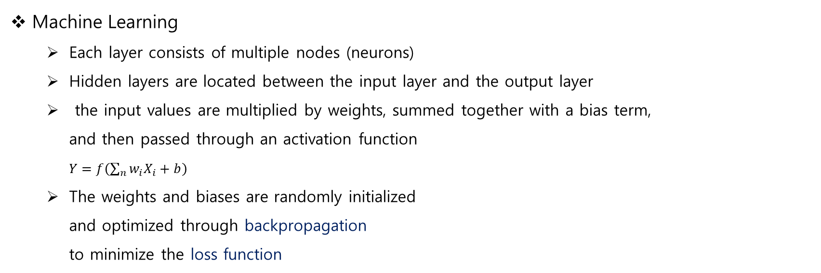
JKPS (02/20)
Principle – Machine Learning
Machine Learning
Each layer consists of multiple nodes (neurons)
Hidden layers are located between the input layer and the output layer
the input values are multiplied by weights, summed together with a bias term, and then passed through an activation function $Y=f\left(\sum_{n}{w_{i}X_{i}}+b\right)$
The weights and biases are randomly initialized and optimized through backpropagation to minimize the loss function
Weight
bias
6

Slide 7
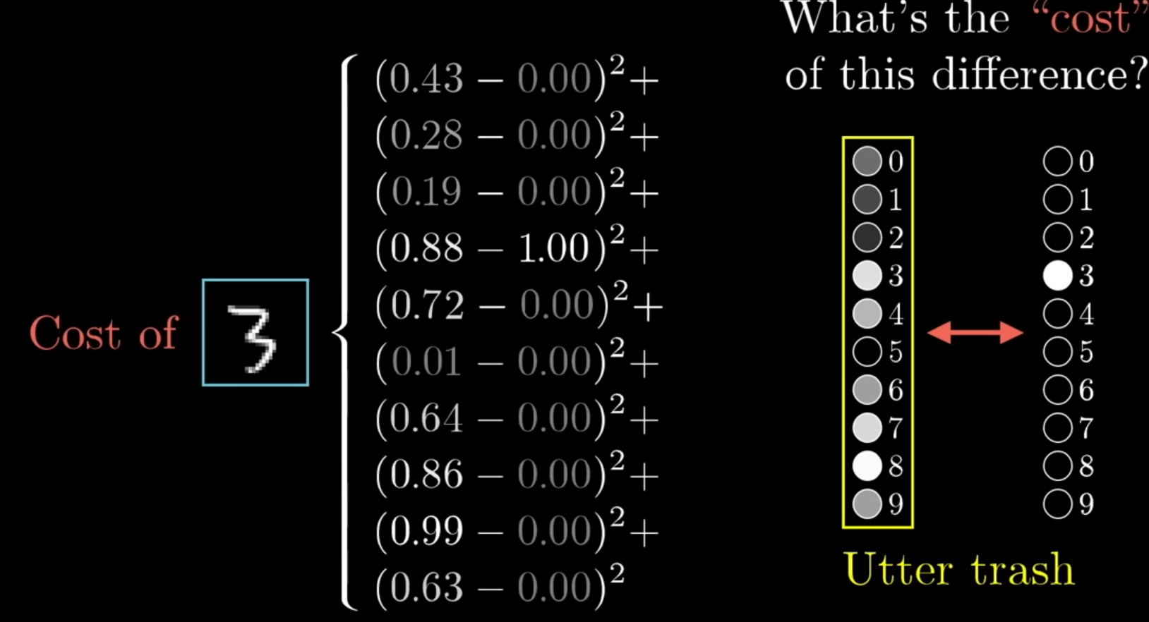
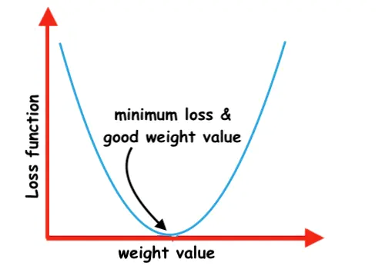
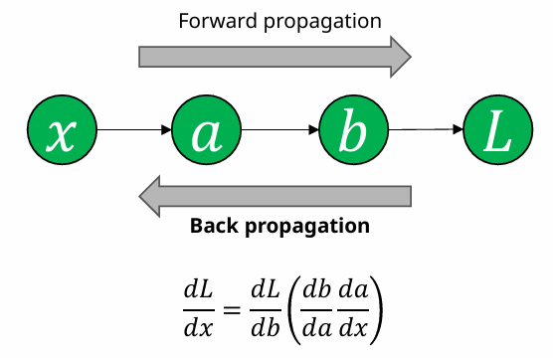
JKPS (02/20)
Principle – Machine Learning
Loss function
Quantifies the difference between the predicted values and the true values
During training, the weights and biases are iteratively updated to minimize the loss function
Backpropagation
Optimize the weights and biases to minimize the loss function
Backpropagation
Loss function
7

Slide 8
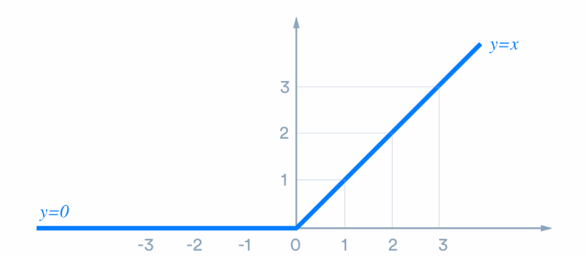
JKPS (02/20)
Experiment Research
Neural network model (Environment)
Keras for learning modules and API based on TensorFlow (with Python)
Learning rate : 0.01 (for backpropagation)
100 nodes each at 3 hidden layers
Activation function : Rectified Linear Unit(ReLU). f(x)=max(0,x)
Storage Ring ML Environment
Collect data by EPICS
Input : 138 BPM / Output : 80 Corrector and RF
Top-up mode (201~202 mA)
40 min for measure. 800 sets. (700 for training, 100 for test)
Rectified Linear Unit
8

Slide 9
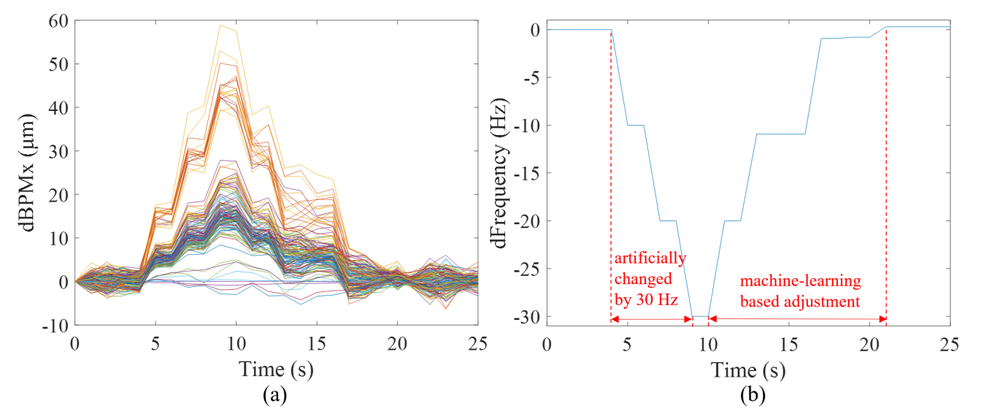
JKPS (02/20)
Experiment Research - RF
Result for 4 experiments
RF Feedback / ML Feedback / SOFB / Long-term test
RF Feedback
Reduce 30 dB. limit change 10 dB once
After 9th seconds, RF change reduce 30 dB
RF main freqency back to original value within 10 seconds
RF Feedback
9

Slide 10
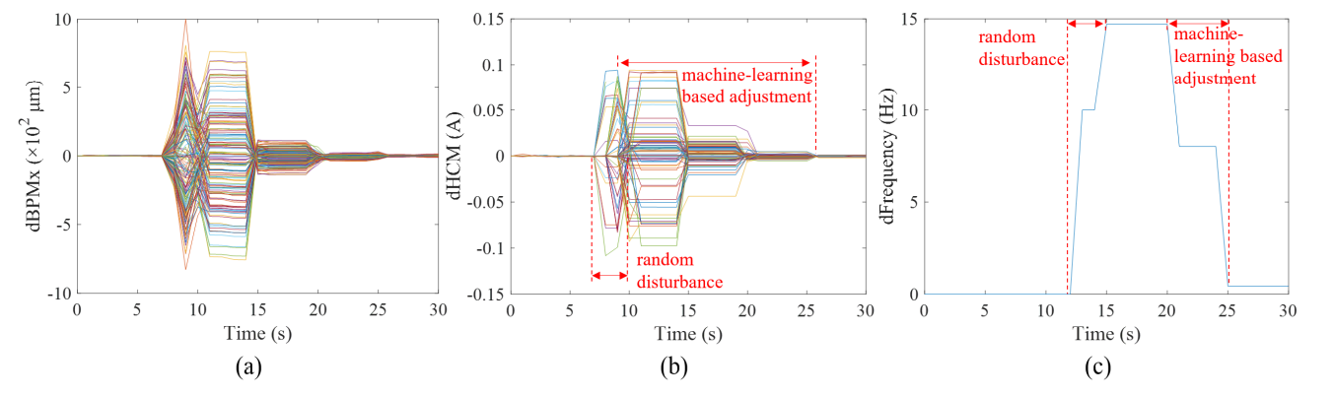
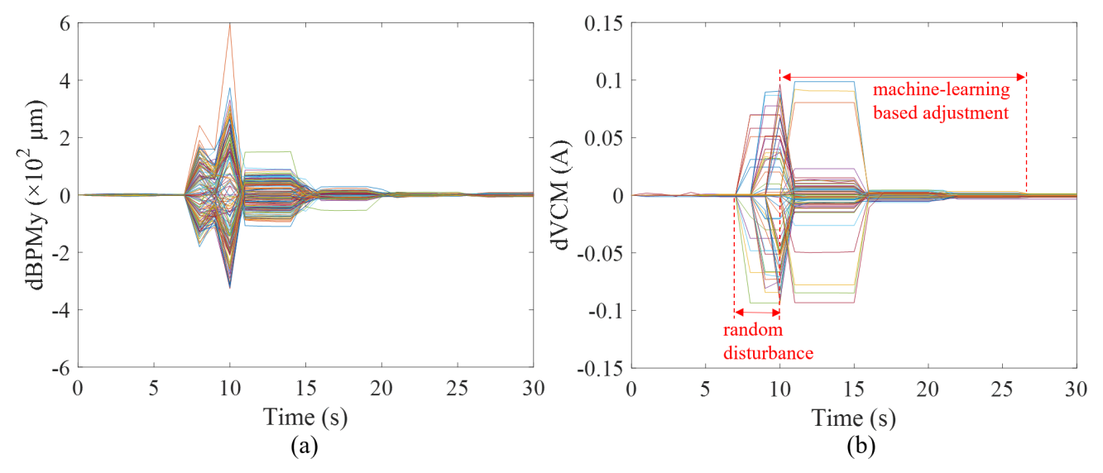
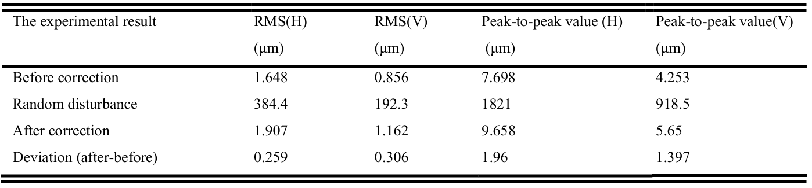
JKPS (02/20)
Experiment Research – ML Feedback
ML Feedback (Joint of RF and Corrector)
5 seconds feedback at a time
Gave random disturbance by corrector
Increased RF freqency by 15 dB
Can corrector orbit back near previous level
RF also corrected back initial values
RF Frequency→
↑Horizontal
↓Vertical
14

Slide 11
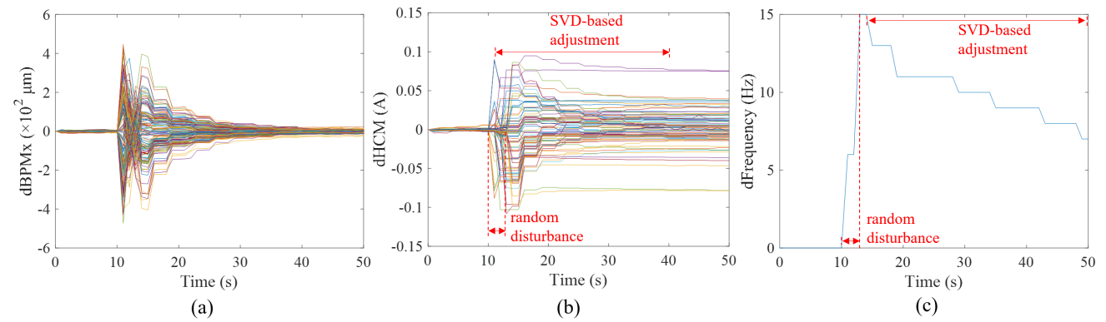
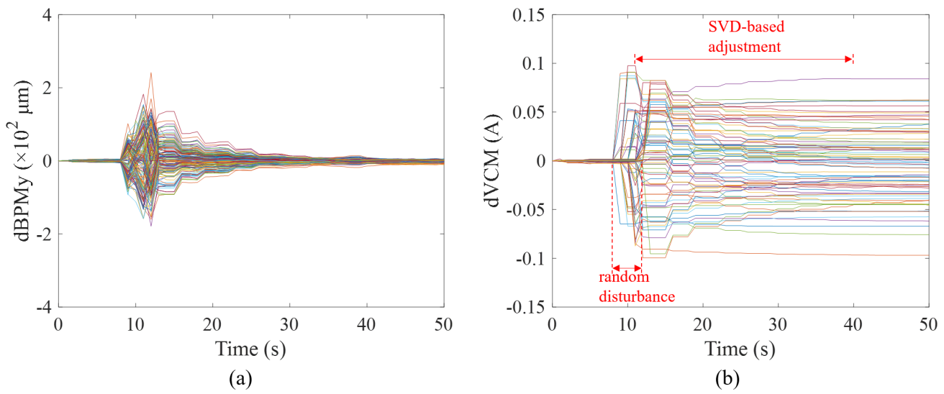
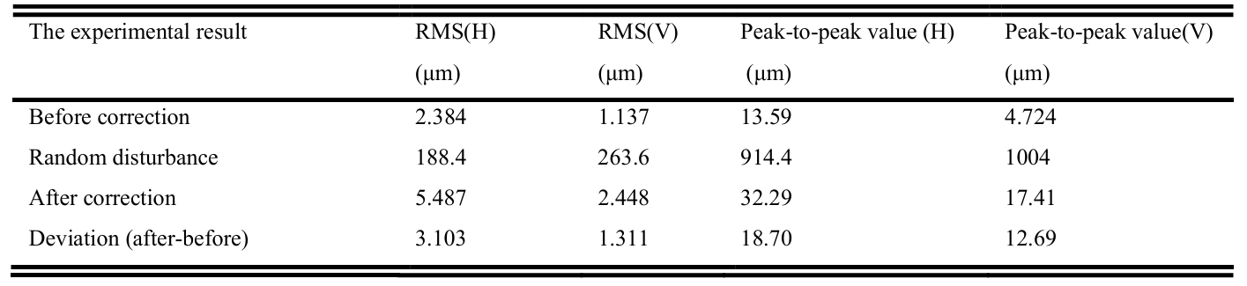
JKPS (02/20)
Experiment Research – SOFB
Slow Orbit Feedback (SOFB)
3 seconds feedback at a time
Beam Position seem to be match
(Different with ML) Residual current at Corrector
Also seen RF doesn’t meet
Reason of this happen
SOFB use many corrector even if need one corrector
ML can locate corrector to correct orbit
RF Frequency→
↑Horizontal
↓Vertical
15

Slide 12
JKPS (02/20)
Compare with ML and SOFB
←Horizontal
Vertical →
ML Feedback ↑
SOFB ↓
112

Slide 13
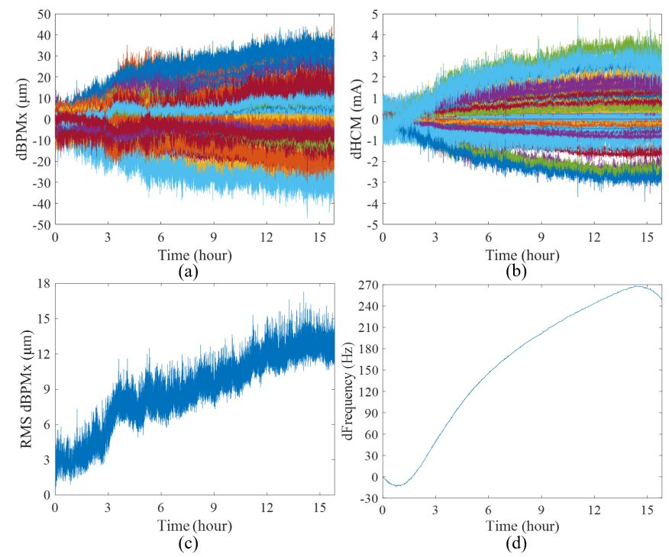
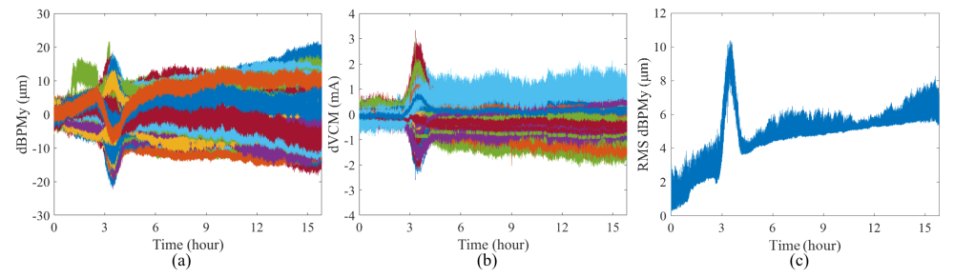
JKPS (02/20)
Experiment Research – Long Term
16 hours operation test
3pm~7am(next morning)
RF Freq. variation by environment temperature
Fluctuation at 3rd hours supposed to be unstable of machine
RF Frequency →
↑3pm
7am↑
 | Horizontal | Vertical
Max. Orbit Drift | 40 μm | 20 μm
RMS BPM | 15 μm | 8 μm
↑Horizontal
↓Vertical
16

Slide 14
JKPS (02/20)
Discussion
Does ML guarantee Orbit Stability?
Mapping from BPM reading to appropriate corrector currents
Seem like it doesn’t mean for Orbit stable
But It’s good for prevent saturation of corrector current
Maybe also good at capture drift-related nonlinearities
14

