Slide 1
Study of bunch shortening
2026-01-22, Pohang, South Korea
Young Min Park
Division of Advanced Nuclear Engineering (DANE), POSTECH

Slide 2
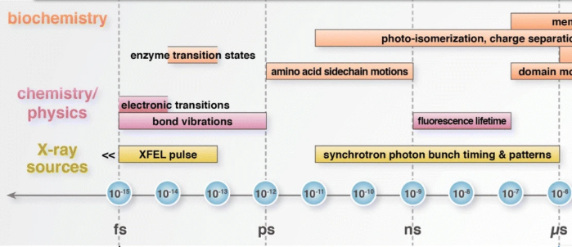
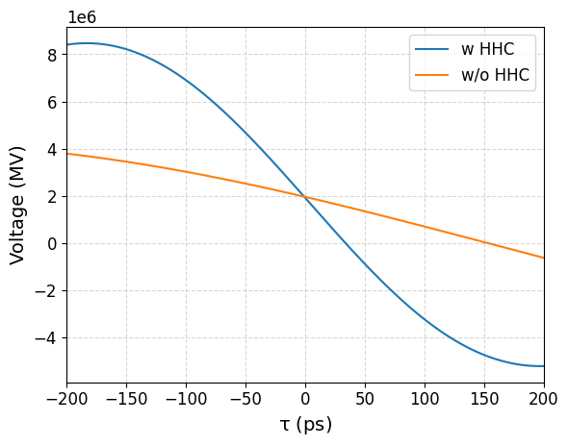
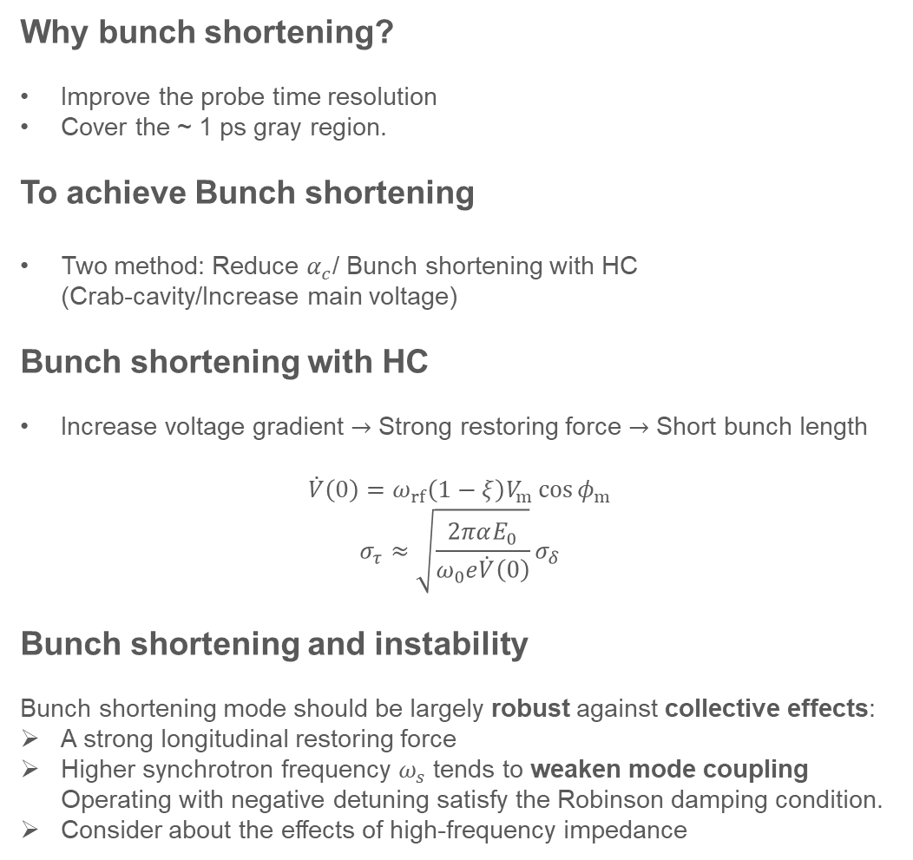
Bunch shortening
Why bunch shortening?
Improve the probe time resolution
Cover the ~ 1 ps gray region.
To achieve Bunch shortening
Two method: Reduce $α_{c}$/ Bunch shortening with HC (Crab-cavity/Increase main voltage)
Bunch shortening with HC
Increase voltage gradient $→$ Strong restoring force $→$ Short bunch length
$$\dot{V}\left(0\right)=ω_{rf}\left(1−ξ\right)V_{m}\cos{φ_{m}}$$
$$σ_{τ}≈\sqrt{\frac{2παE_{0}}{ω_{0}e\dot{V}\left(0\right)}}σ_{δ}$$
Bunch shortening and instability
Bunch shortening mode should be largely robust against collective effects:
A strong longitudinal restoring force
Higher synchrotron frequency $ω_{s}$ tends to weaken mode coupling Operating with negative detuning satisfy the Robinson damping condition.
Consider about the effects of high-frequency impedance
Gray region
2

Slide 3
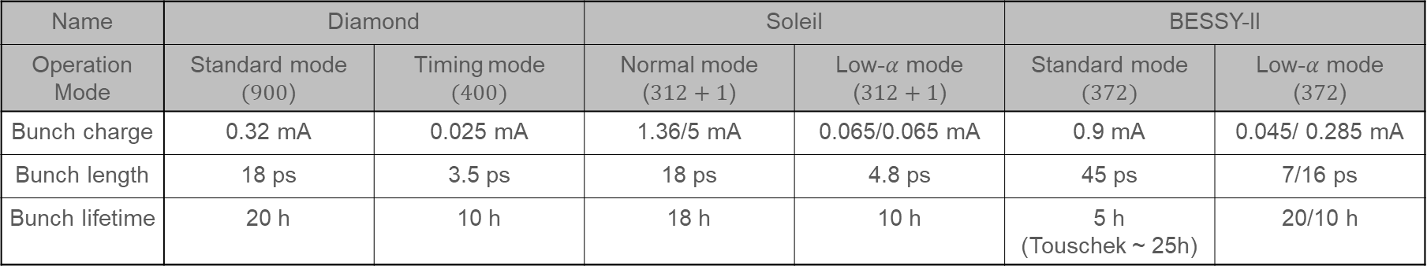
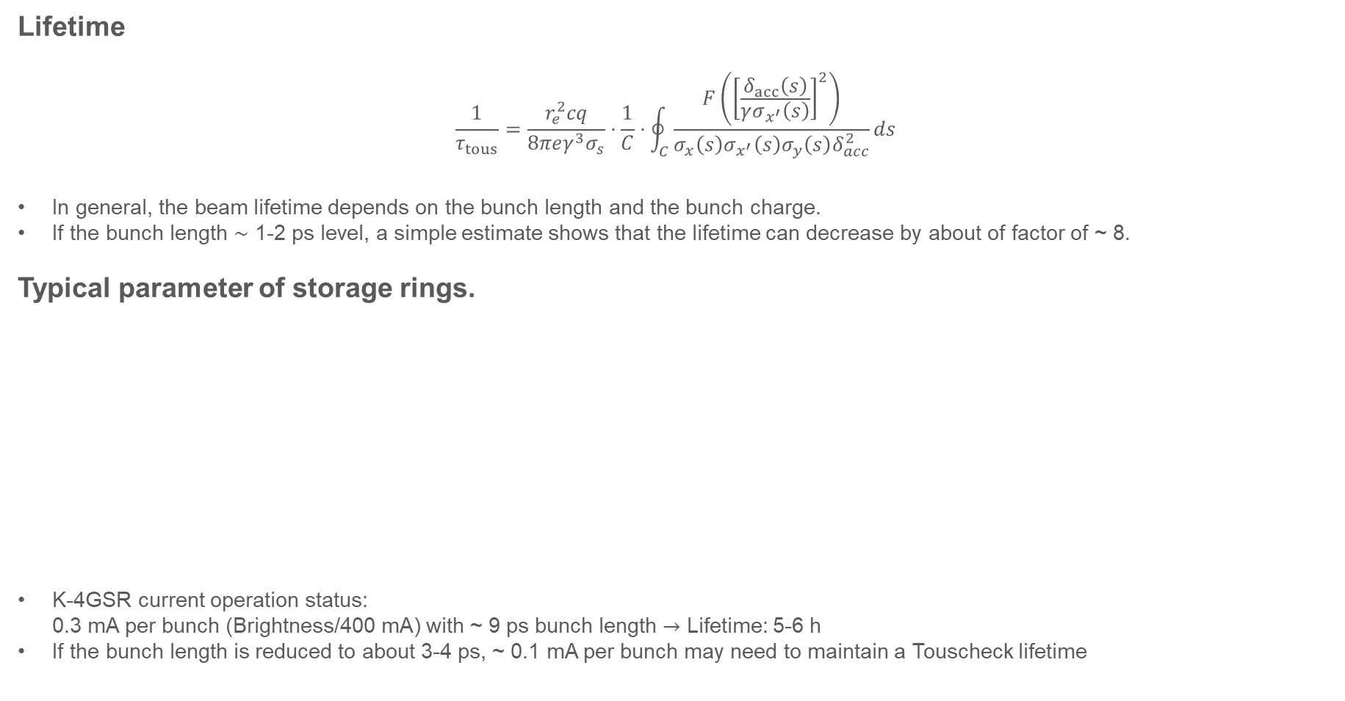
Lifetime of low-alpha mode
Lifetime
$$\frac{1}{τ_{tous}}=\frac{r_{e}^{2}cq}{8πeγ^{3}σ_{s}}⋅\frac{1}{C}⋅\oint_{C}{\frac{F\left({\left[\frac{δ_{acc}\left(s\right)}{γσ_{x^{′}}\left(s\right)}\right]}^{2}\right)}{σ_{x}\left(s\right)σ_{\begin{aligned}x^{′} \\ \end{aligned}}\left(s\right)σ_{y}\left(s\right)δ_{acc}^{2}}}ds$$
In general, the beam lifetime depends on the bunch length and the bunch charge.
If the bunch length $\sim$ 1-2 ps level, a simple estimate shows that the lifetime can decrease by about of factor of ~ 8.
Typical parameter of storage rings.
K-4GSR current operation status: 0.3 mA per bunch (Brightness/400 mA) with ~ 9 ps bunch length $→$ Lifetime: 5-6 h
If the bunch length is reduced to about 3-4 ps, ~ 0.1 mA per bunch may need to maintain a Touscheck lifetime
Name | Diamond |  | Soleil |  | BESSY-II
Operation Mode | Standard mode $(900$) | Timing mode $$(400)$$ | Normal mode ($312+1$) | Low-$α$ mode ($312+1$) | Standard mode $$(372)$$ | Low-$α$ mode ($372$)
Bunch charge | 0.32 mA | 0.025 mA | 1.36/5 mA | 0.065/0.065 mA | 0.9 mA | 0.045/ 0.285 mA
Bunch length | 18 ps | 3.5 ps | 18 ps | 4.8 ps | 45 ps | 7/16 ps
Bunch lifetime | 20 h | 10 h | 18 h | 10 h | 5 h (Touschek ~ 25h) | 20/10 h
3

Slide 4
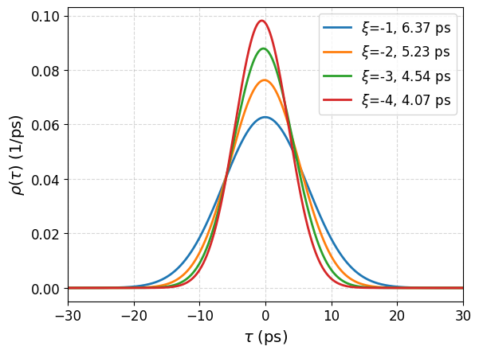
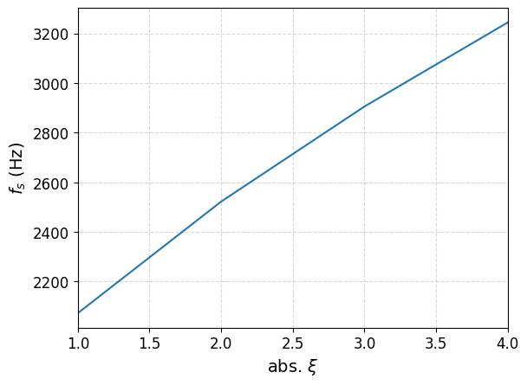
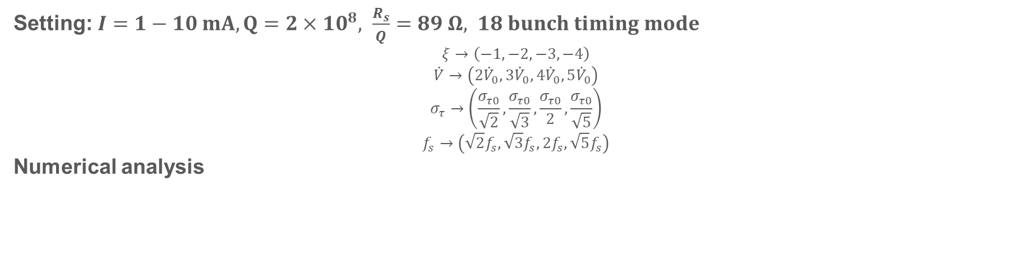
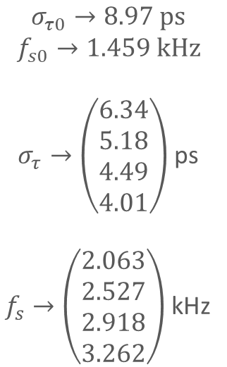
Bunch shortening setting
Setting: $I=1−10 mA, Q=2×10^{8}, \frac{R_{s}}{Q}=89 Ω, 18 bunch timing mode$
$$ξ→\left(−1,−2,−3,−4\right)$$
$$\dot{V}→\left(2{\dot{V}}_{0},3{\dot{V}}_{0},4{\dot{V}}_{0},5{\dot{V}}_{0}\right)$$
$$σ_{τ}→\left(\frac{σ_{τ0}}{\sqrt{2}},\frac{σ_{τ0}}{\sqrt{3}},\frac{σ_{τ0}}{2},\frac{σ_{τ0}}{\sqrt{5}}\right)$$
$$f_{s}→\left(\sqrt{2}f_{s},\sqrt{3}f_{s},2f_{s},\sqrt{5}f_{s}\right)$$
Numerical analysis
3.244 kHz
$$σ_{τ0}→8.97 ps$$
$$f_{s0}→1.459 kHz$$ $σ_{τ}→\left(\begin{matrix}6.34 \\ 5.18 \\ 4.49 \\ 4.01\end{matrix}\right)$ ps
$f_{s}→\left(\begin{matrix}2.063 \\ 2.527 \\ 2.918 \\ 3.262\end{matrix}\right)$ kHz
2.905 kHz
2.522 kHz
2.072 kHz
4

Slide 5
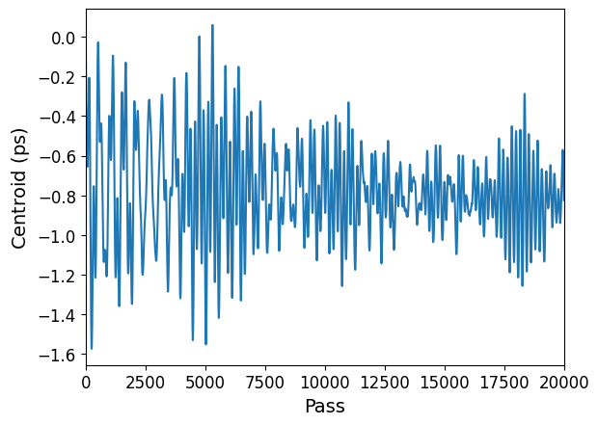
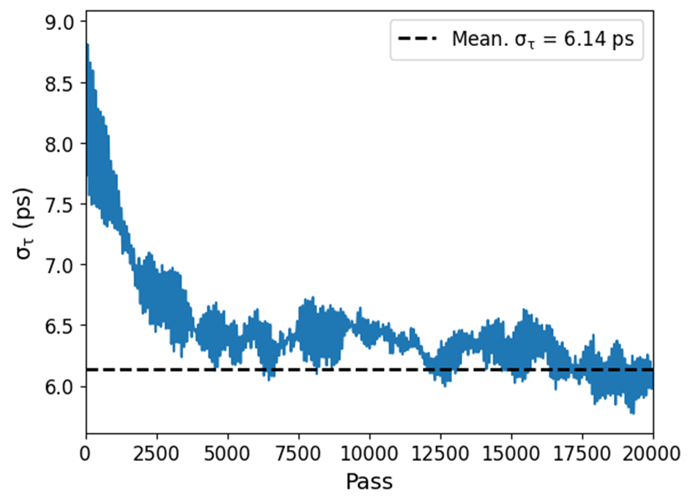
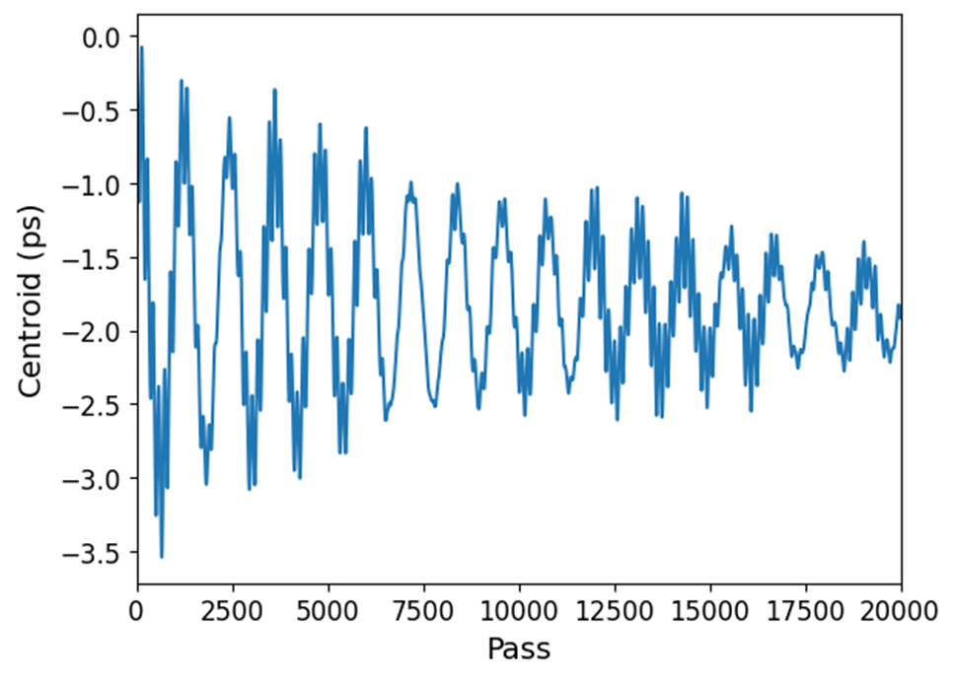
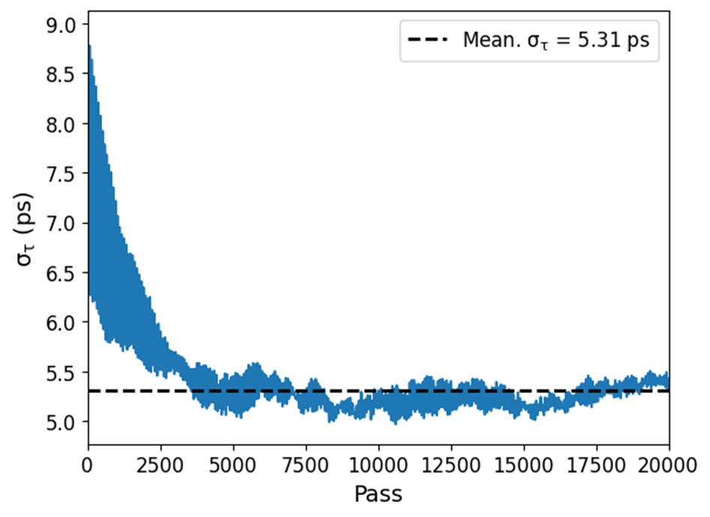
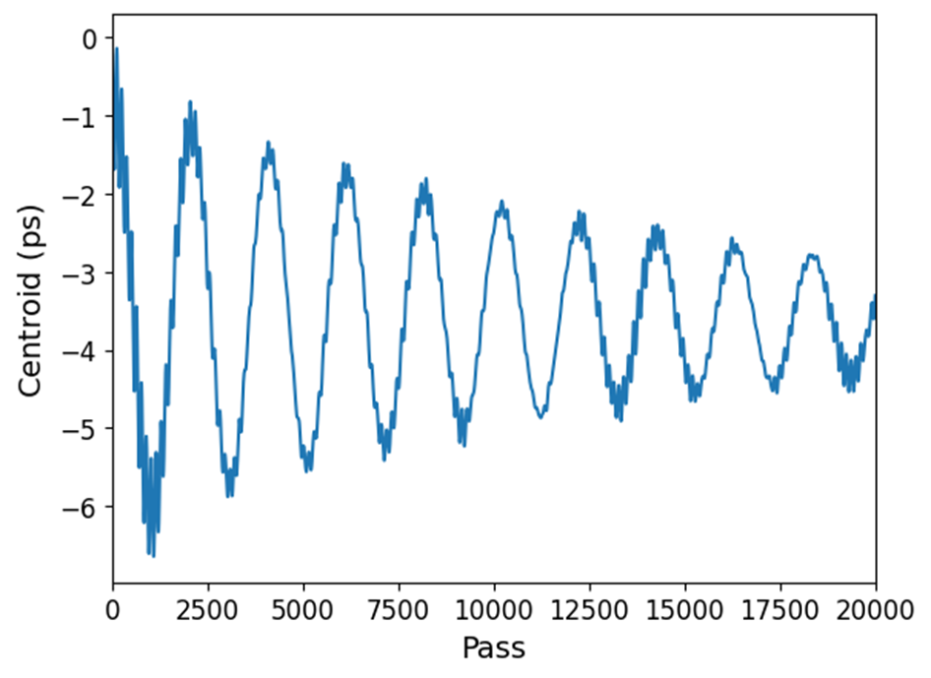
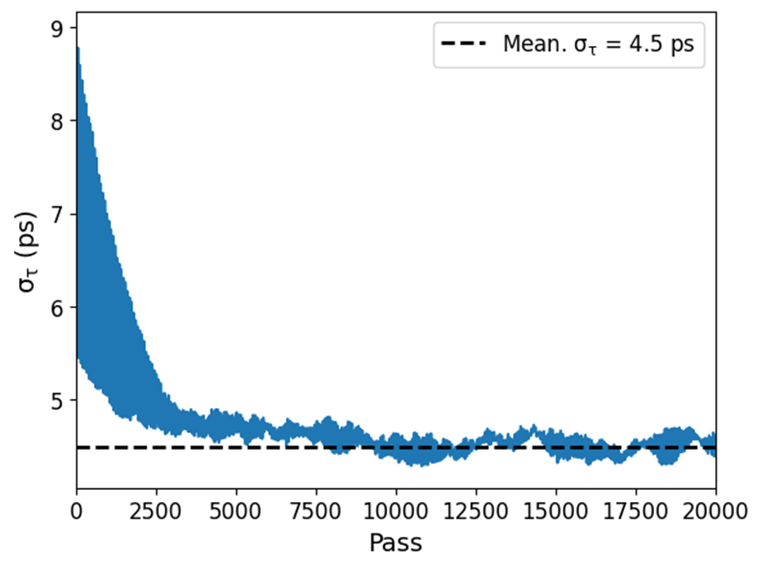
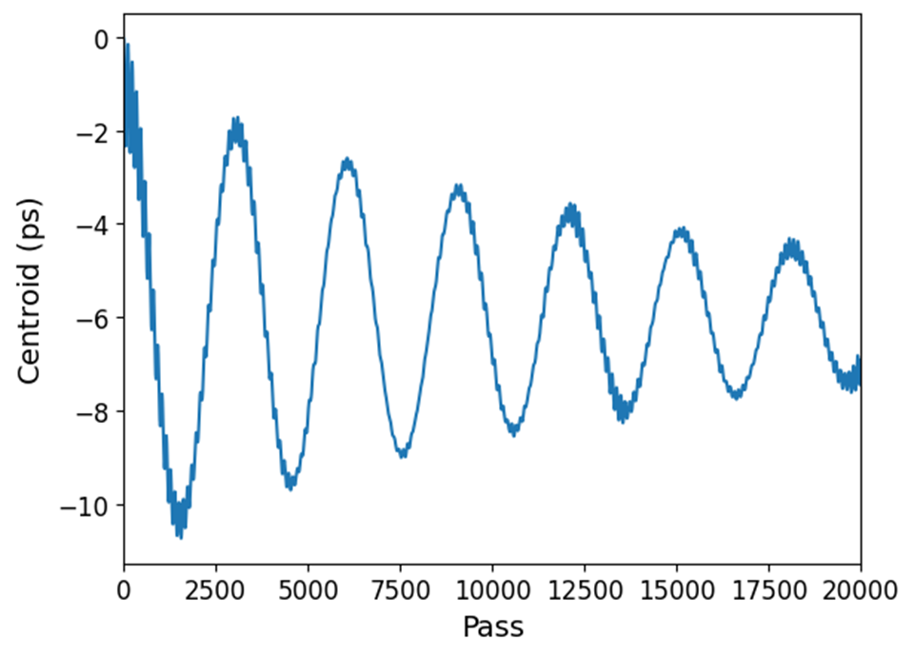
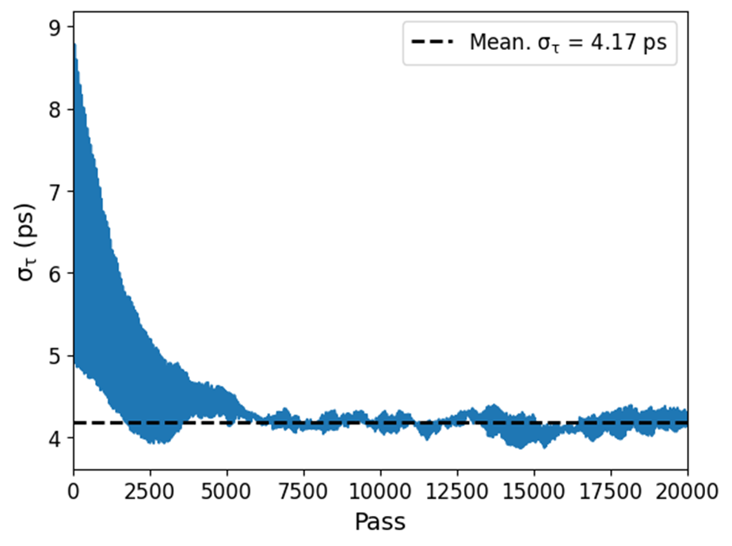
Simulation result
I = 10 mA
$$\left(Δf=−1.082 kHz, ξ=−1,V_{h}=1.23 MV\right)$$
$$\left(Δf=−0.549 kHz, ξ=−2,V_{h}=2.42 MV\right)$$
$$\left(Δf=−0.367 kHz, ξ=−3,V_{h}=3.62 MV\right)$$
$$\left(Δf=−0.276 kHz, ξ=−4,V_{h}=4.83 MV\right)$$
5

Slide 6
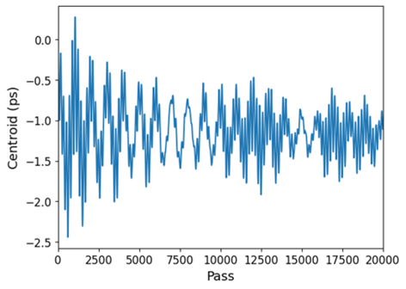
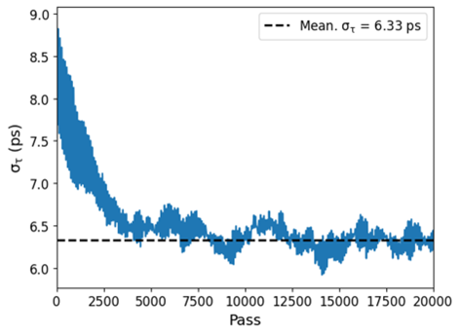
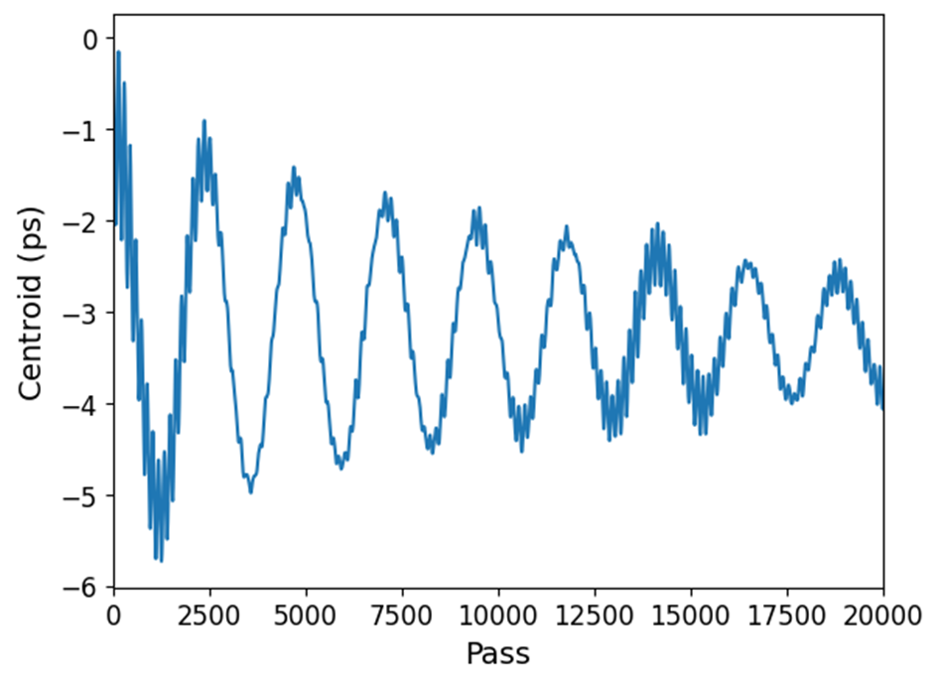
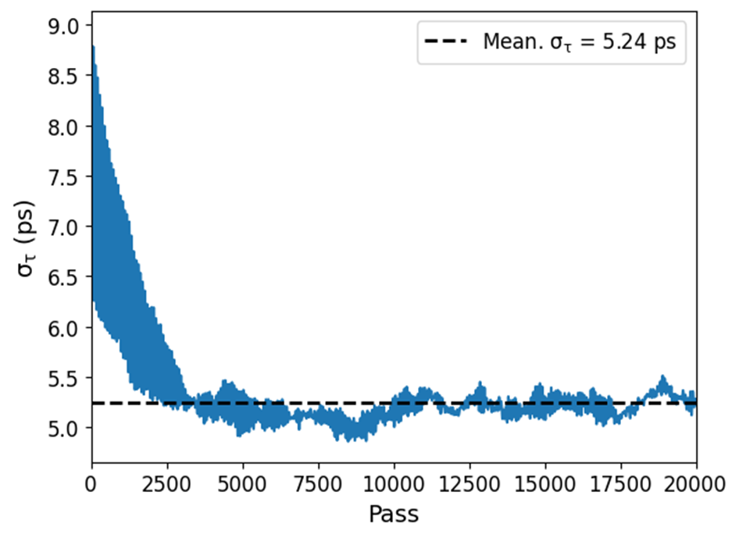
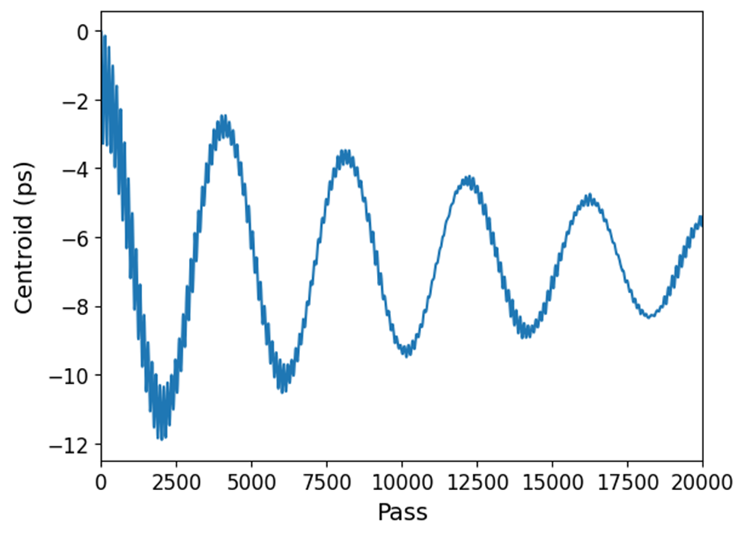

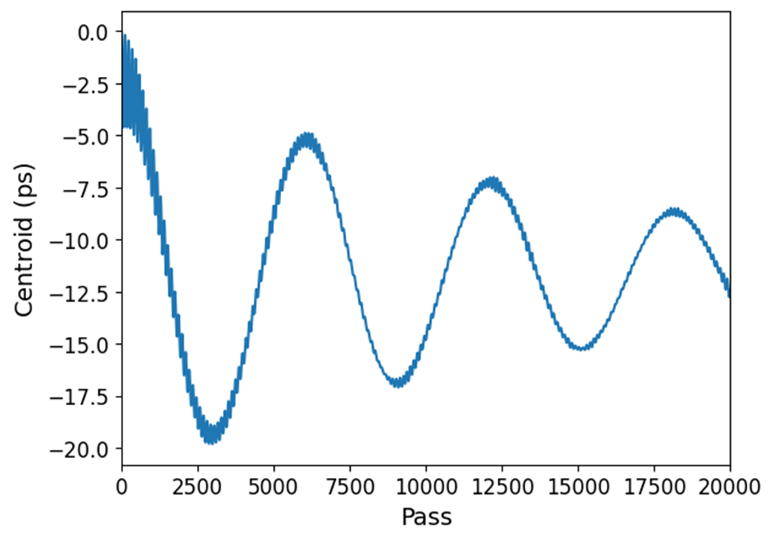
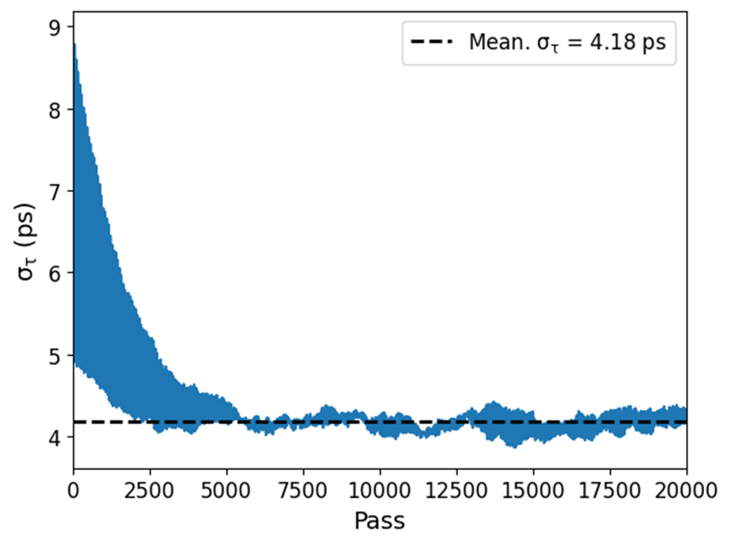
Simulation result
I = 5 mA
$$\left(Δf=−0.541 kHz, ξ=−1,V_{h}=1.23 MV\right)$$
$$\left(Δf=−0.275 kHz, ξ=−2,V_{h}=2.42 MV\right)$$
$$\left(Δf=−0.184 kHz, ξ=−3,V_{h}=3.62 MV\right)$$
$$\left(Δf=−0.138 kHz, ξ=−4,V_{h}=4.83 MV\right)$$
6

Slide 7
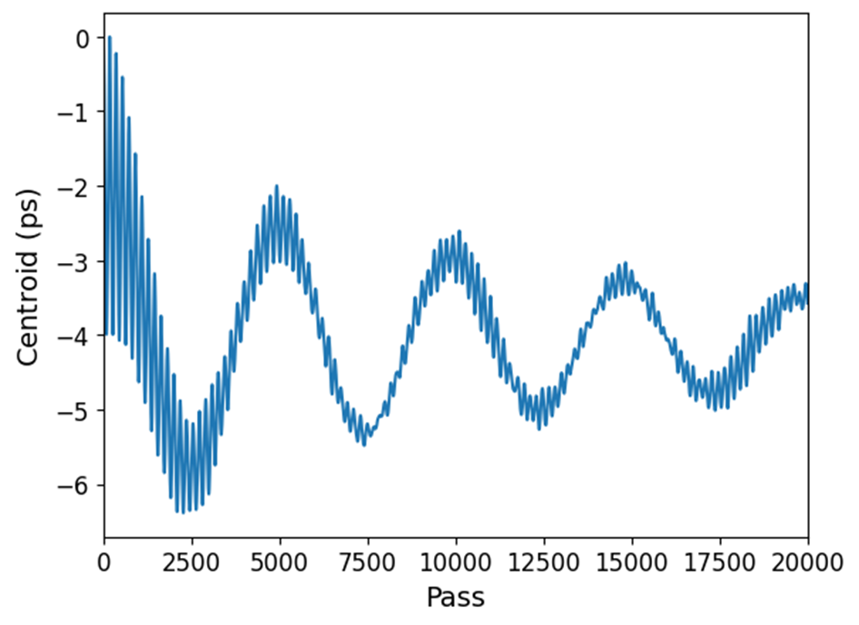
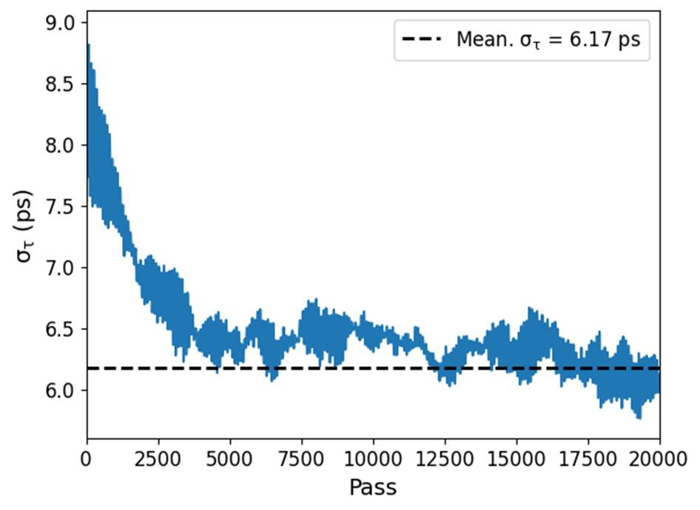
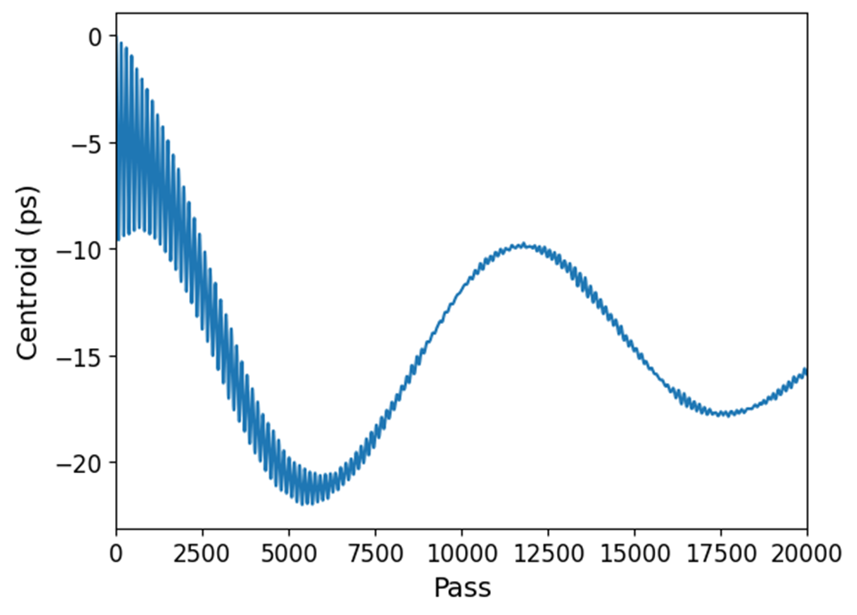
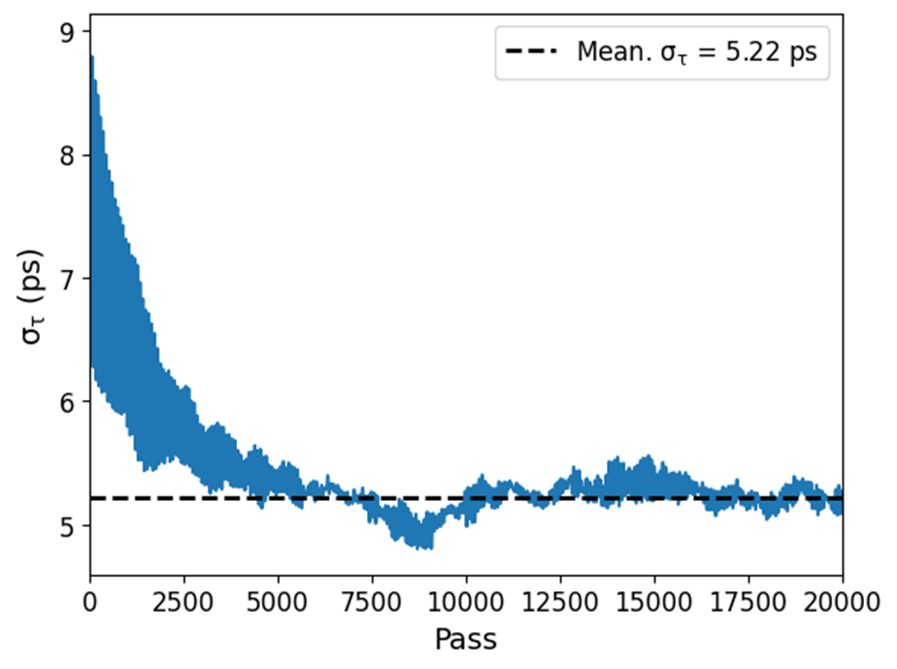
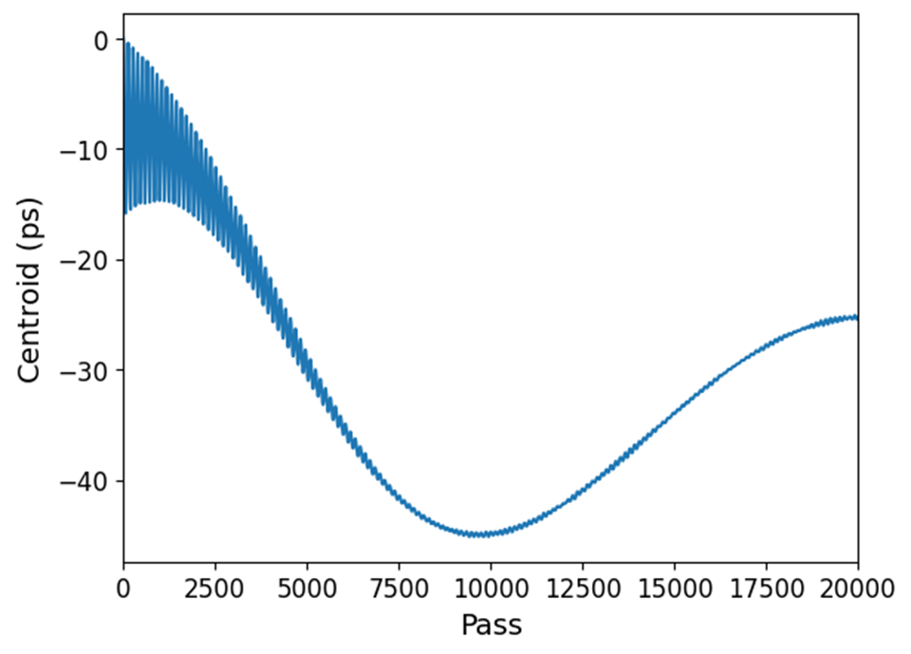
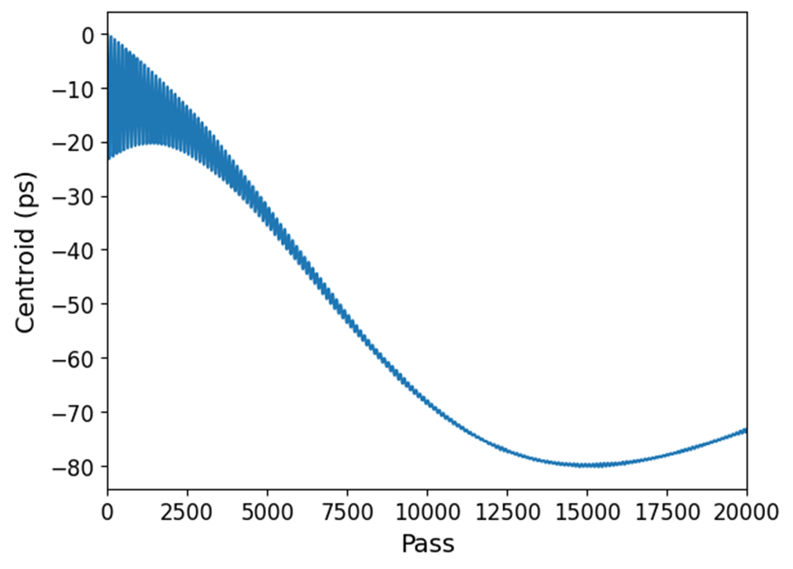
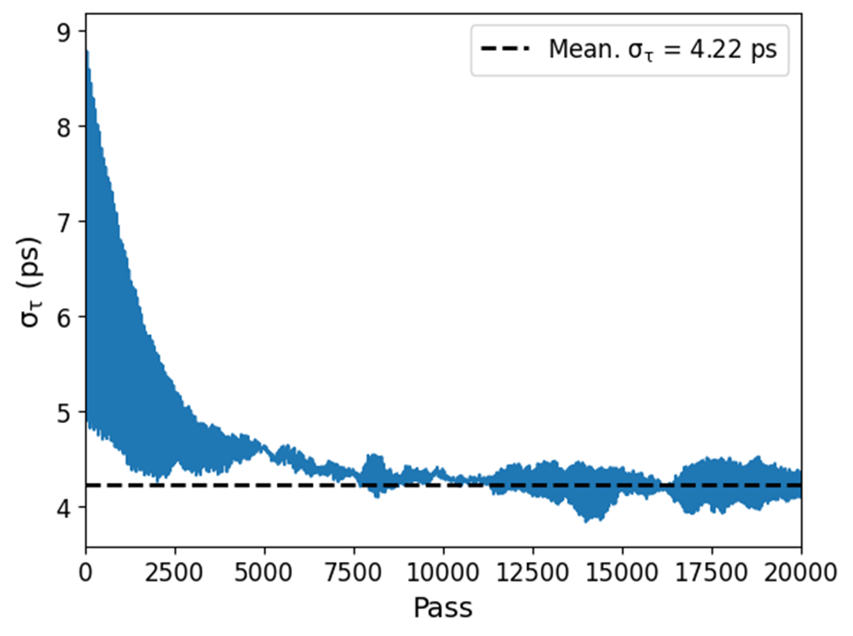
Simulation result
I = 1 mA
$$\left(Δf=−0.108 kHz, ξ=−1,V_{h}=1.23 MV\right)$$
$$\left(Δf=−0.055 kHz, ξ=−2,V_{h}=2.42 MV\right)$$
$$\left(Δf=−0.037 kHz, ξ=−3,V_{h}=3.62 MV\right)$$
$$\left(Δf=−0.027 kHz, ξ=−4,V_{h}=4.83 MV\right)$$
7

Slide 8
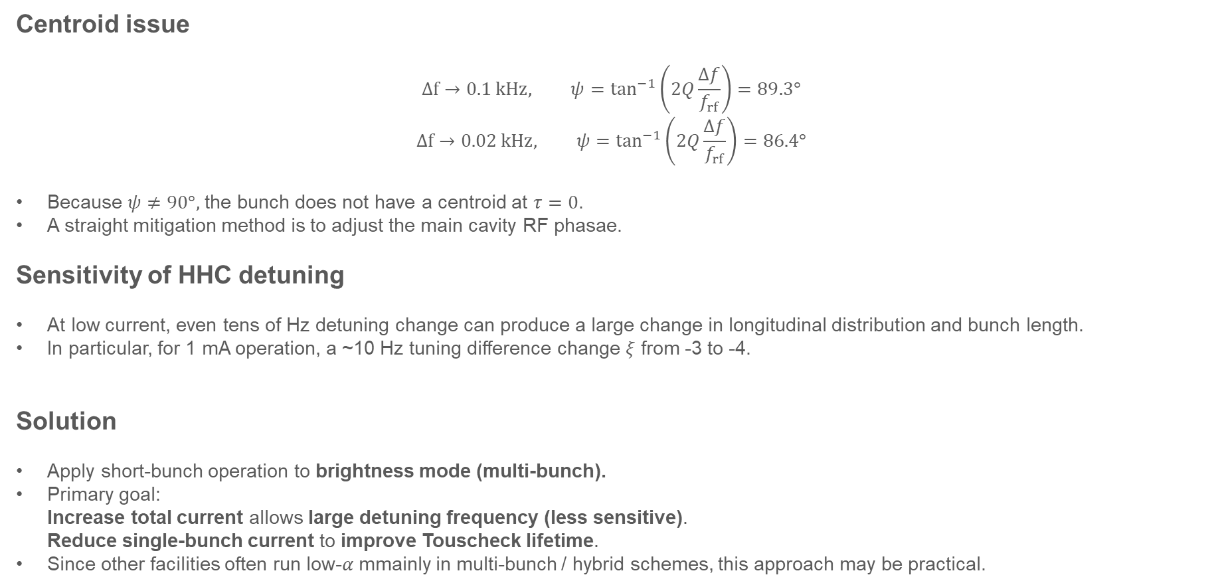
Some issues about result
Centroid issue
$$Δf→0.1 kHz, ψ=\tan^{−1}\left(2Q\frac{Δf}{f_{rf}}\right)=89.3°$$
$$Δf→0.02 kHz, ψ=\tan^{−1}\left(2Q\frac{Δf}{f_{rf}}\right)=86.4°$$
Because $ψ≠90°,$ the bunch does not have a centroid at $τ=0$.
A straight mitigation method is to adjust the main cavity RF phasae.
Sensitivity of HHC detuning
At low current, even tens of Hz detuning change can produce a large change in longitudinal distribution and bunch length.
In particular, for 1 mA operation, a ~10 Hz tuning difference change $ξ$ from -3 to -4.
Solution
Apply short-bunch operation to brightness mode (multi-bunch).
Primary goal: Increase total current allows large detuning frequency (less sensitive). Reduce single-bunch current to improve Touscheck lifetime.
Since other facilities often run low-$α$ mmainly in multi-bunch / hybrid schemes, this approach may be practical.
8

Slide 9
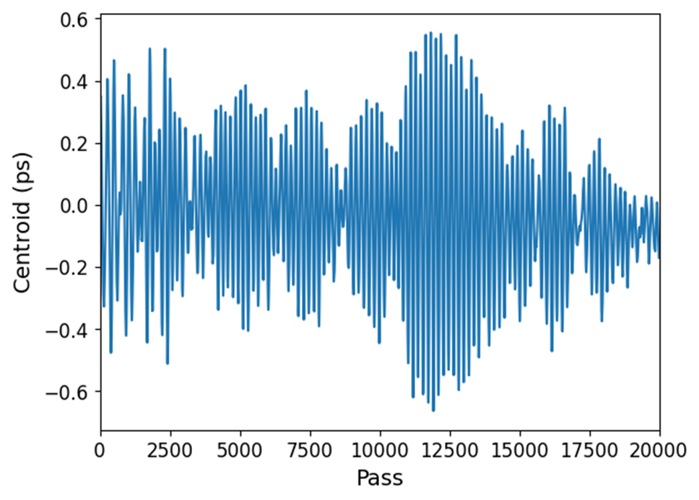
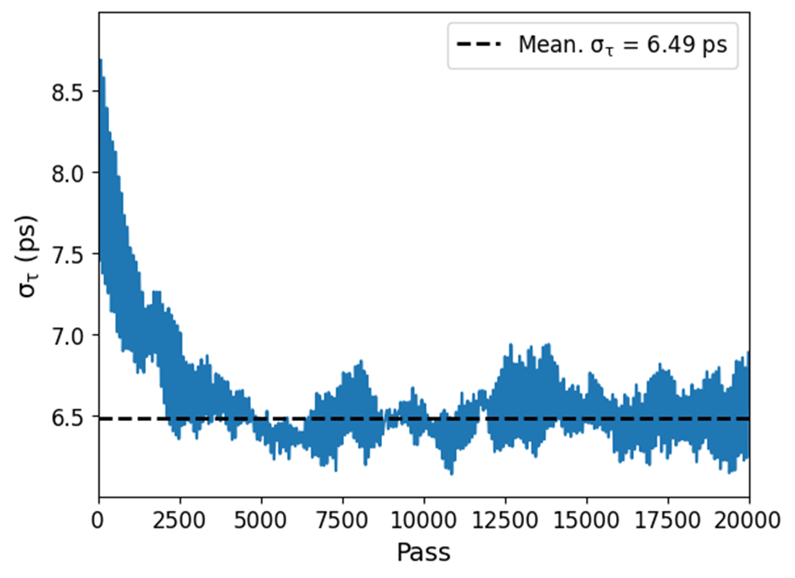
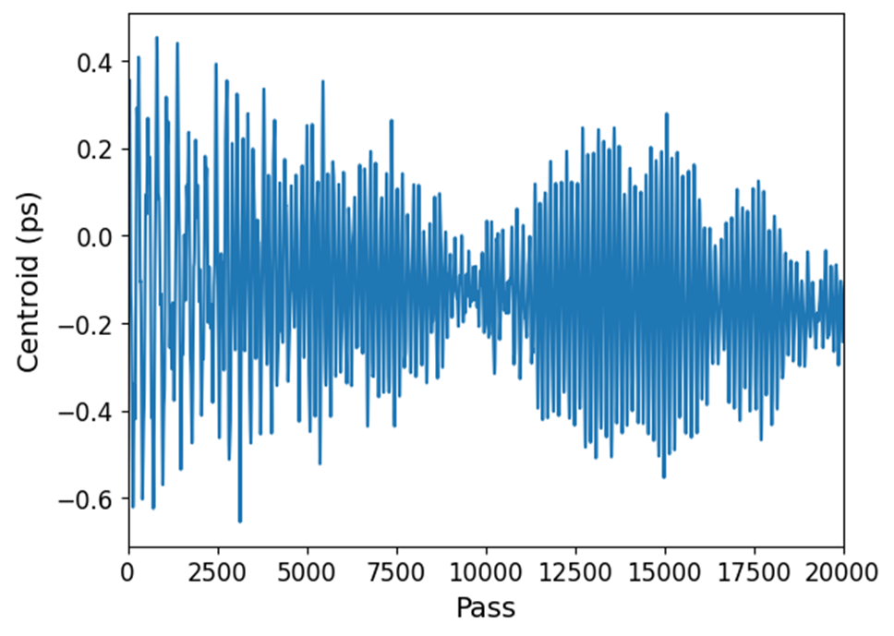
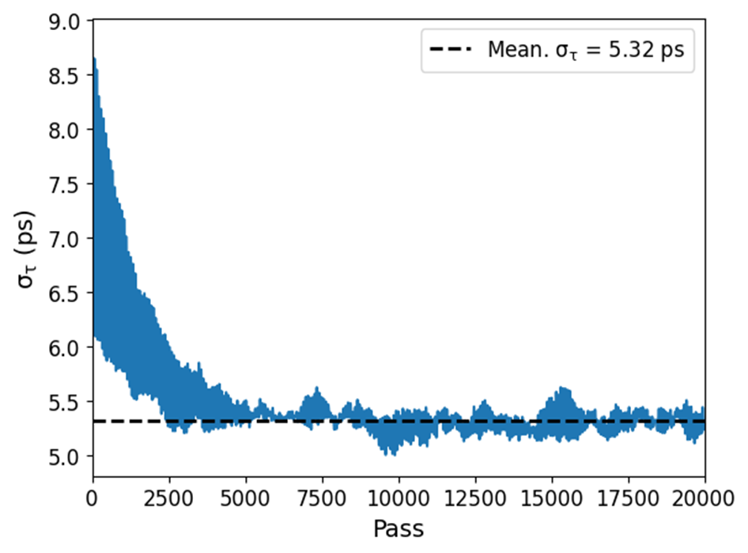
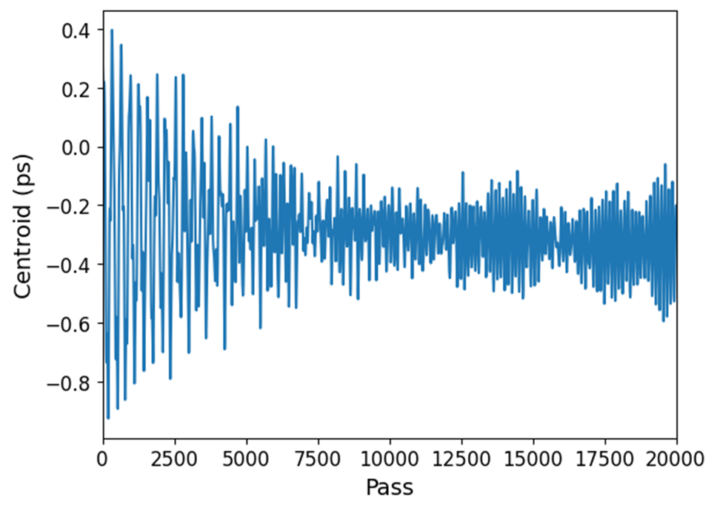
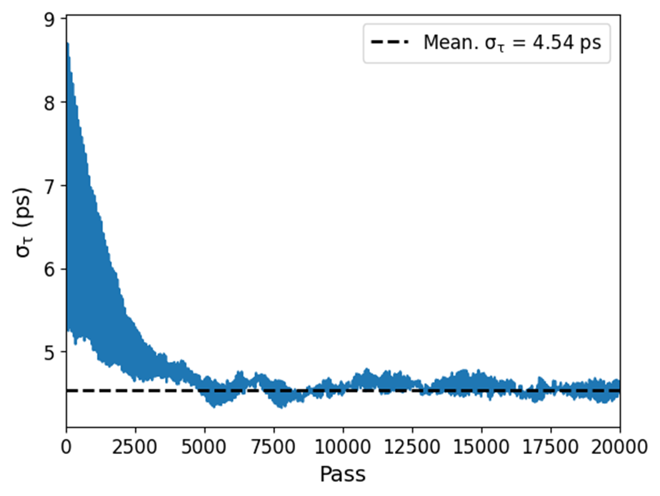
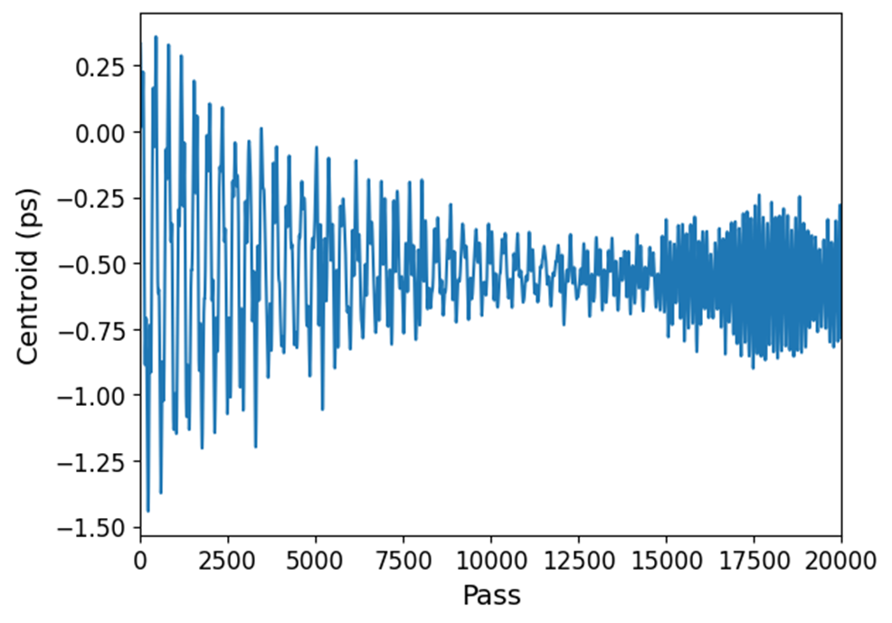
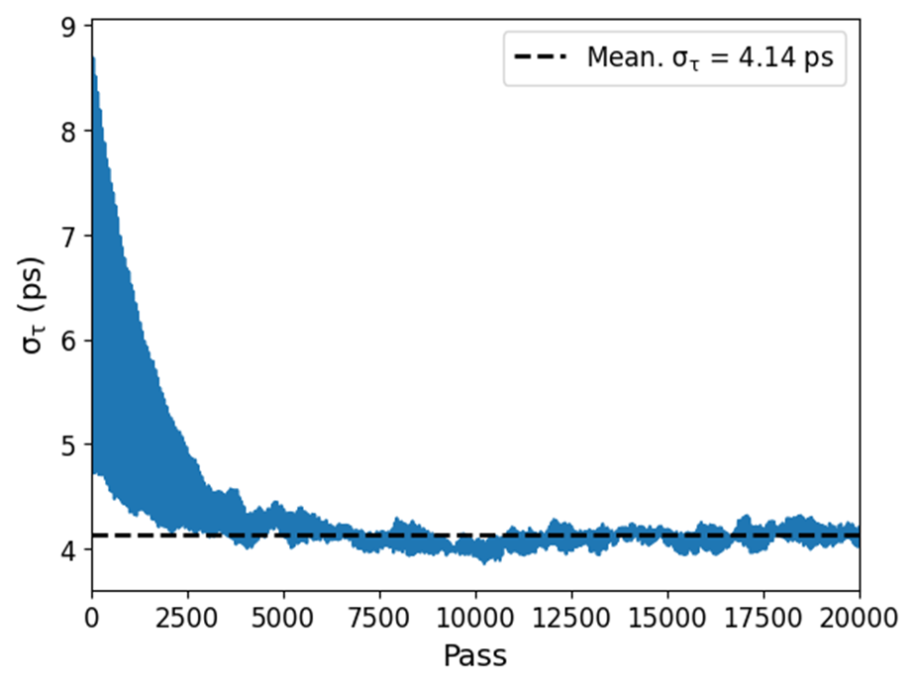
Bunch shortening with brightness mode
Setting: $I=100 mA, Q=2×10^{8}, \frac{R_{s}}{Q}=89 Ω, 1332 bunch brightness mode$
$$\left(Δf=−10.818 kHz, ξ=−1,V_{h}=1.23 MV\right)$$
$$\left(Δf=−5.495 kHz, ξ=−2,V_{h}=2.42 MV\right)$$
$$\left(Δf=−3.675 kHz, ξ=−3,V_{h}=3.62 MV\right)$$
$$\left(Δf=2.759 kHz, ξ=−4,V_{h}=4.83 MV\right)$$
9

Slide 10
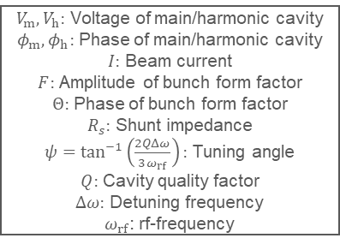
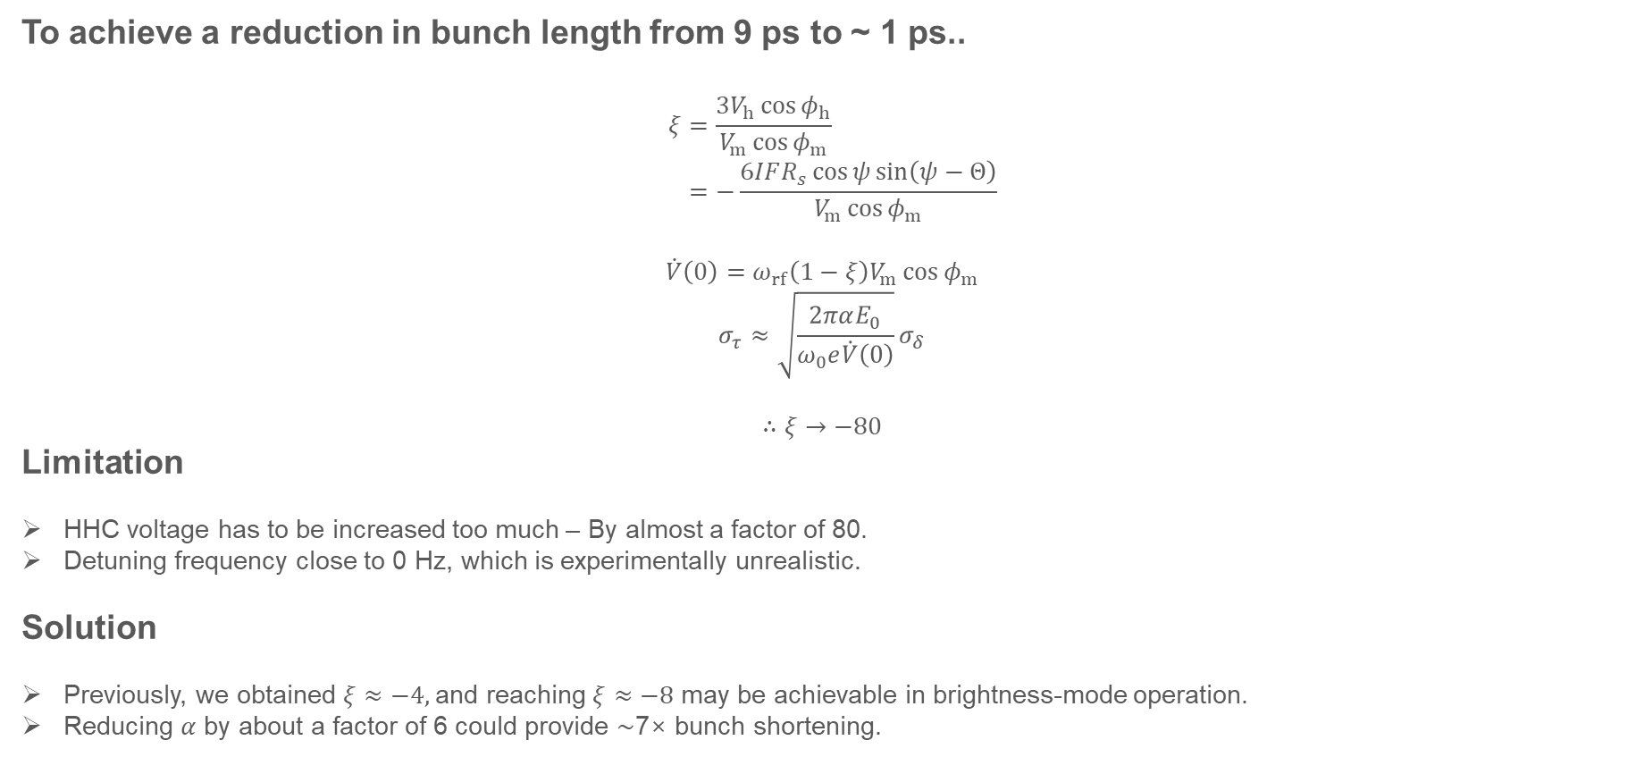
Bunch shortening to ~ 1 ps.
To achieve a reduction in bunch length from 9 ps to ~ 1 ps..
$$ξ=\frac{3V_{h}\cos{φ_{h}}}{V_{m}\cos{φ_{m}}} \\ =−\frac{6IFR_{s}\cos{ψ}\sin\left(ψ−Θ\right)}{V_{m}\cos{φ_{m}}}$$
$$\dot{V}\left(0\right)=ω_{rf}\left(1−ξ\right)V_{m}\cos{φ_{m}}$$
$$σ_{τ}≈\sqrt{\frac{2παE_{0}}{ω_{0}e\dot{V}\left(0\right)}}σ_{δ}$$
$$∴ξ→−80$$
Limitation
HHC voltage has to be increased too much – By almost a factor of 80.
Detuning frequency close to 0 Hz, which is experimentally unrealistic.
Solution
Previously, we obtained $ξ≈−4,$and reaching $ξ≈−8$ may be achievable in brightness-mode operation.
Reducing $α$ by about a factor of 6 could provide ∼7× bunch shortening.
$V_{m},V_{h}:$ Voltage of main/harmonic cavity
$φ_{m},φ_{h}:$ Phase of main/harmonic cavity
$I:$ Beam current
$F:$ Amplitude of bunch form factor
$Θ:$ Phase of bunch form factor
$R_{s}:$ Shunt impedance
$ψ=\tan^{−1}\left(\frac{2QΔω}{3ω_{rf}}\right):$ Tuning angle
$Q:$ Cavity quality factor
$Δω:$ Detuning frequency
$ω_{rf}$: rf-frequency
10

Slide 11
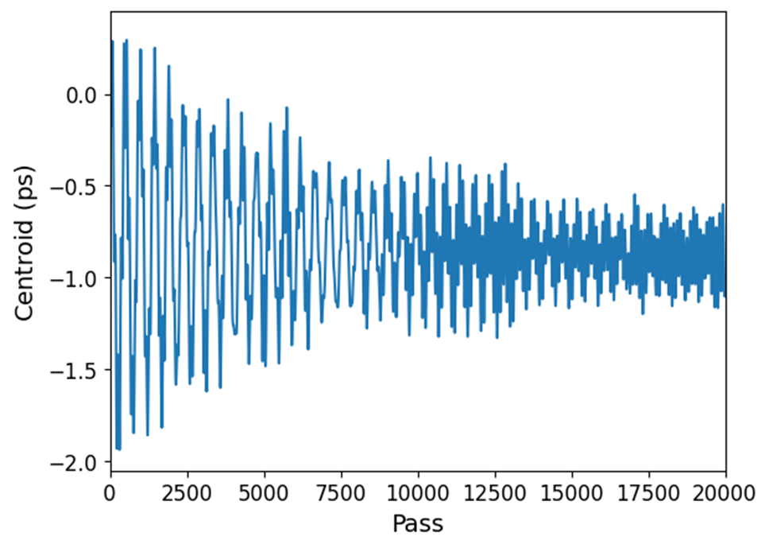
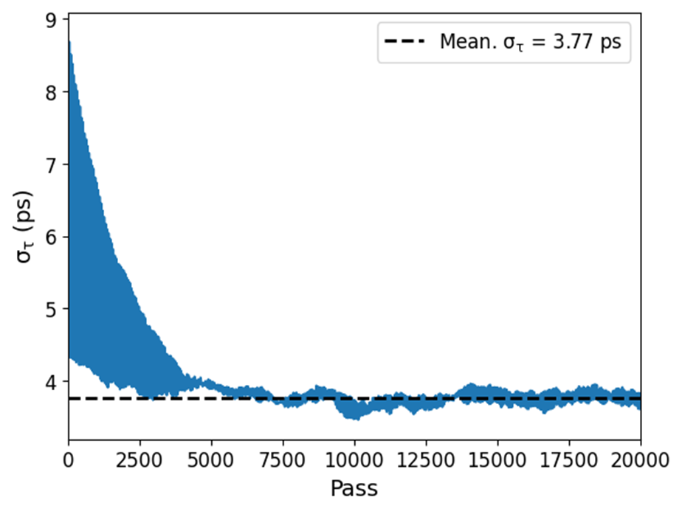
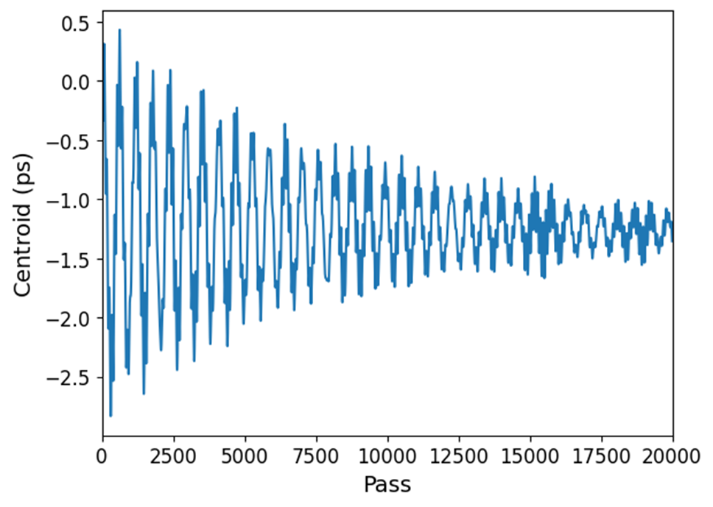
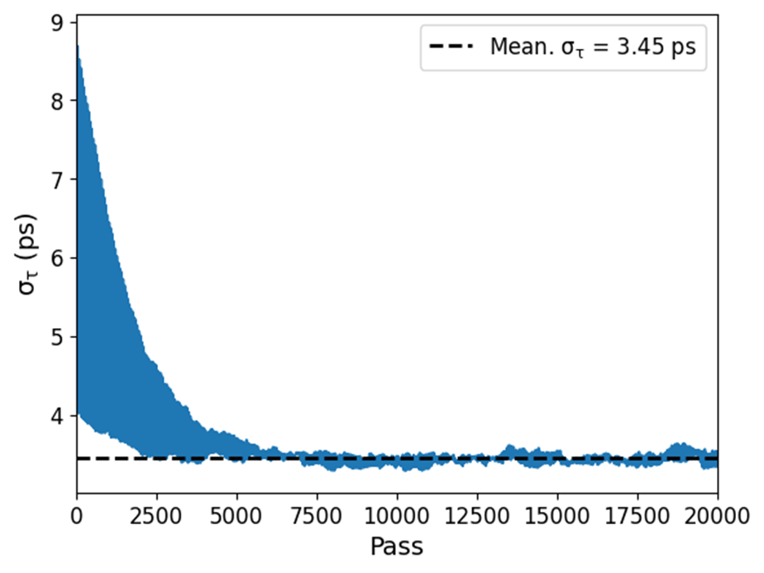
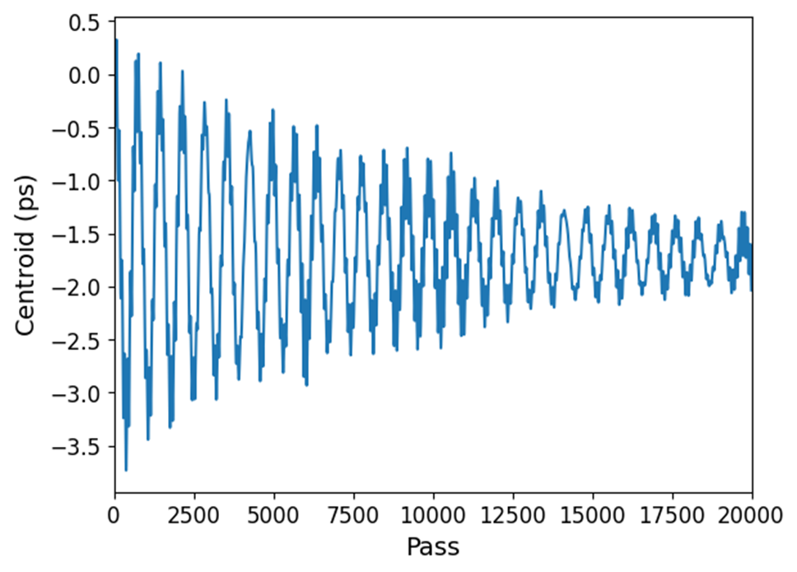
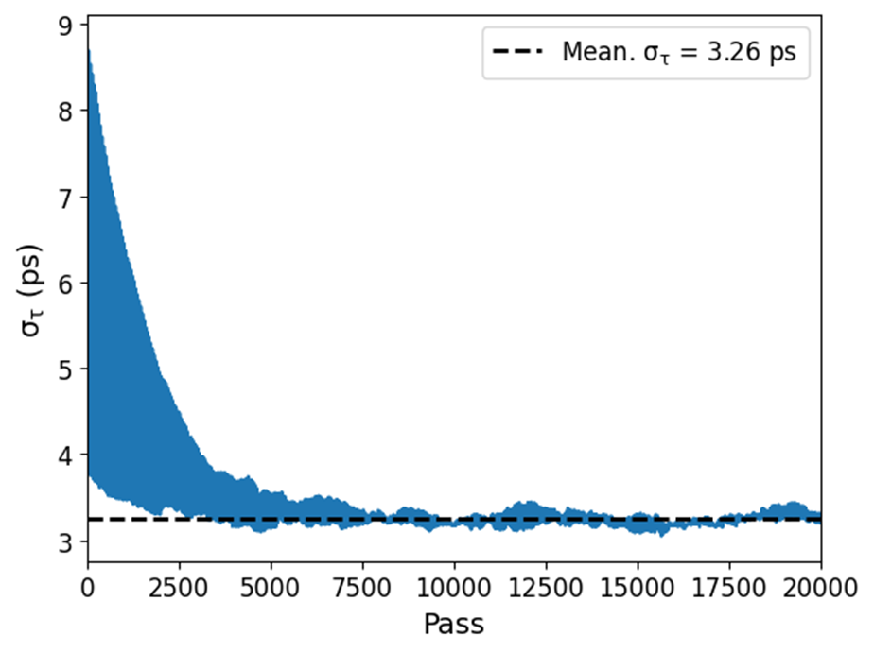
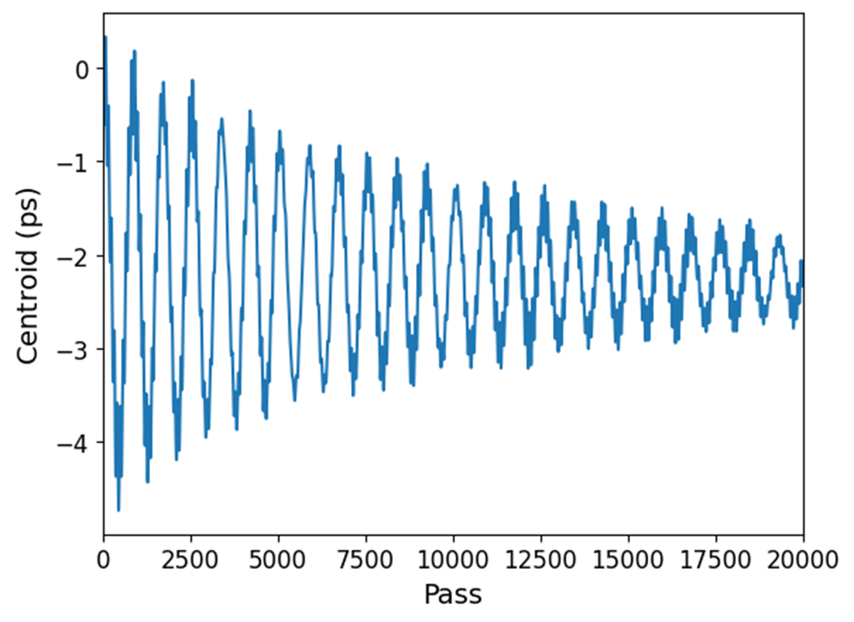
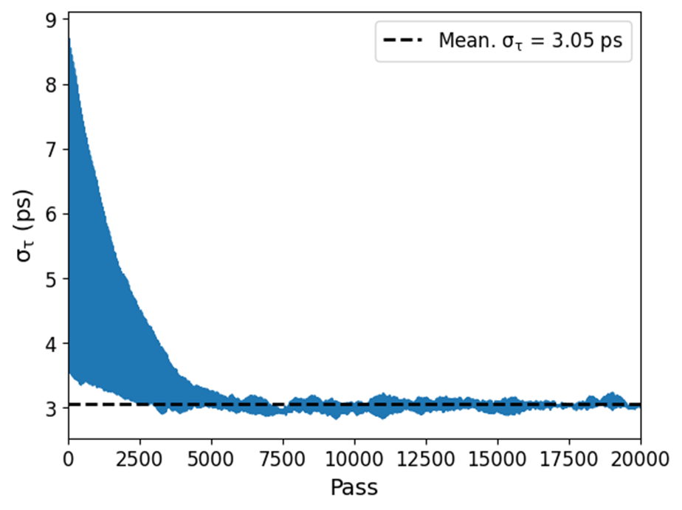
Feasible operating Range of $ξ$
Setting: $I=100 mA, Q=2×10^{8}, \frac{R_{s}}{Q}=89 Ω, 1332 bunch brightness mode$
$$\left(Δf=−2.209 kHz, ξ=−5, V_{h}=6.03 MV\right)$$
$$\left(Δf=−1.841 kHz, ξ=−6, V_{h}=7.24 MV\right)$$
$$\left(Δf=−1.579 kHz, ξ=−7, V_{h}=8.44 MV\right)$$
$$\left(Δf=−1.381 kHz, ξ=−8, V_{h}=9.65 MV\right)$$
11

Slide 12




Coherent/Incoherent frequency
Setting: $I=100 mA, Q=2×10^{8}, \frac{R_{s}}{Q}=89 Ω, 1332 bunch brightness mode$
In principle, increase $ξ→$ increase $V^{′}\left(0\right)→$ large synchrotron frequency $ω_{s}$.
However, the coherent frequency shows a decreasing trend as $ξ$ increases, indicating that a cavity mode is being excited.
Nevertheless, since this cavity mode satisfied the damping condition, the beam motion remains stable.
Cavity mode: Appears when the detuning frequency $Δω$ close to $ω_{s}$.
Analytic result of Coherent/Incoherent frequency and FFT result.
ELEGANT Coh. : Coherent frequency of the beam.
ELEGANT Incoh. : Single particle frequency
12

Slide 13












Reducing 𝛼
ILMaxtrix $→$ $α_{c}=3.8×10^{−5}, 2.5×10^{−5}, 1.9×10^{−5}, 1.2×10^{−5}$
Setting: $\left(Δf=−1.381 kHz, ξ=−8, V_{h}=9.65 MV\right)$
$$\left(α_{c}=3.8×{10}^{−5}\right)$$
$$\left(α_{c}=2.5×{10}^{−5}\right)$$
$$\left(α_{c}=1.9×{10}^{−5}\right)$$
$$\left(α_{c}=1.2×{10}^{−5}\right)$$
13

Slide 14
Thank you for your attention!
14

