Slide 1
2026/05/08 meeting
장원

Slide 2
List of contents
1. Surrogate model for PAL-XFEL injector
-Make simulation for training data.
-Choose best settings for simulation.
2. Cherenkov diffraction radiation

Slide 3
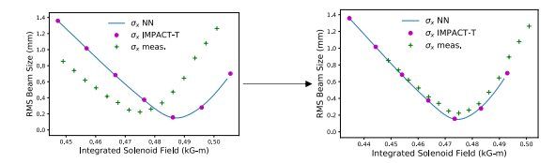
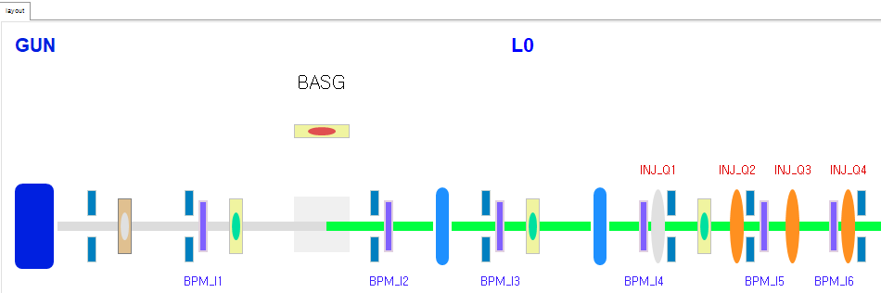
Surrogate model for PAL-XFEL injector
Purpose:
Calibrate surrogate models(automated approach)
Key concept
1. Data-driven model, but predicts simulation results
2. Transfer learning to fine tuning(model calibration)
Challenge:
Machine settings change with each tuning. Efficient model retraining for slightly varying INJ parameters is key for simulation calibration.

Slide 4
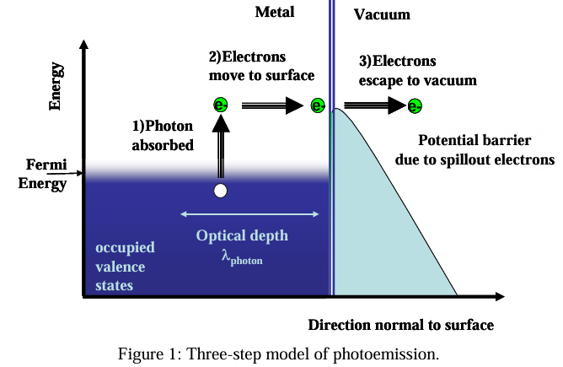
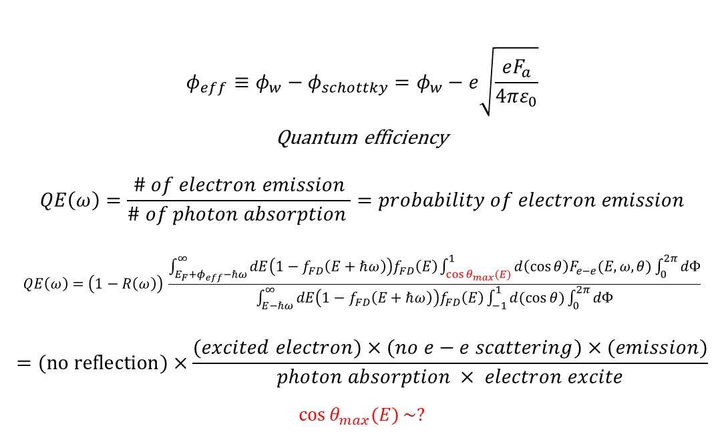
3-step model
Simulation for training data(fast and realistic) -gun
1. Photon absorption
2. Excited electron drifts to surface
3. Schottky effect and abrupt change in electron angle across metal-vacuum
$$φ_{eff}≡φ_{w}−φ_{schottky}=φ_{w}−e\sqrt{\frac{eF_{a}}{4πε_{0}}}$$
Quantum efficiency
$$QE\left(ω\right)=\frac{\# of electron emission}{\# of photon absorption }=probability of electron emission$$
$$QE\left(ω\right)=\left(1−R\left(ω\right)\right) \frac{\int_{E_{F}+φ_{eff}−ℏω}^{∞}{dE\left(1−f_{FD}\left(E+ℏω\right)\right)f_{FD}\left(E\right)}\int_{\cos{θ_{max}(E)}}^{1}{d\left(\cos{θ}\right)F_{e−e}(E,ω,θ)}\int_{0}^{2π}{dΦ}}{\int_{E−ℏω}^{∞}{dE\left(1−f_{FD}\left(E+ℏω\right)\right)f_{FD}\left(E\right)}\int_{−1}^{1}{d(\cos{θ})}\int_{0}^{2π}{dΦ}}$$
$$=(no reflection)×\frac{(excited electron)×(no e−e scattering)×(emission)}{photon absorption × electron excite}$$
$$\cos{θ_{max}(E)}\sim ?$$

Slide 5
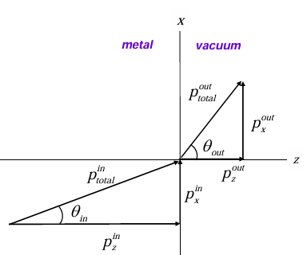
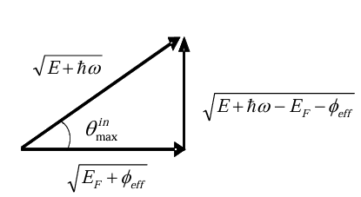
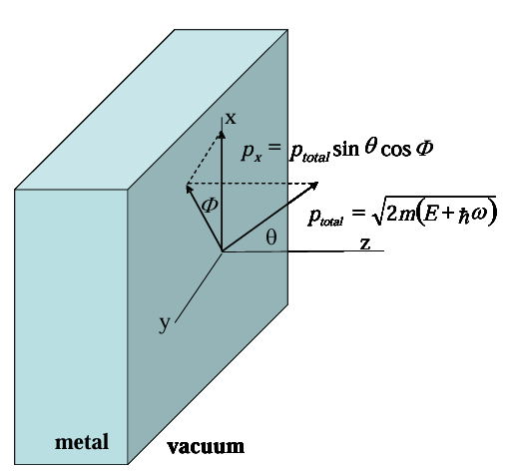

3-Step model
Excited photon energy: $E+ℏω$
It decreases as it escapes from cathode: $E+hω−E_{F}−φ_{eff}$
$$→p_{total}^{in}=\sqrt{2m(E+ℏω)}, p_{total}^{out}=\sqrt{2m(E+ℏω−E_{F}−φ_{eff})}$$
Only $p_{z}$ is important to overcome barrier
$$p_{z}=\sqrt{2m(E+ℏω)}\cos{θ_{in}}≥\sqrt{2m\left(E_{F}+φ_{eff}\right)}$$
$$\cos{θ_{max}^{in}}=\sqrt{\frac{E_{F}+φ_{eff}}{E+ℏω}}$$
By Snell’s law
$$p_{x}^{in}=p_{x}^{out}$$
$$p_{total}^{in}\sin{θ_{in}}=p_{total}^{out}\sin{θ_{out} }$$
$$→\sin{θ_{out}}=\sin{θ_{in}}\sqrt{\frac{E+ℏω}{E+ℏω−E_{F}−φ_{eff}}}$$

Slide 6

3-Step model
$$σ_{p_{x}}^{2}=\frac{<p_{x,out}^{2}>}{{\left(mc\right)}^{2}}=\frac{\int_{ }^{ }{p_{x}^{2}}f_{emit}dΩ}{\int_{ }^{ }{f_{emit}dΩ}}$$
$$σ_{p_{x}}^{2}= \frac{\int_{E_{F}+φ_{eff}−ℏω}^{∞}{dE\left(1−f_{FD}\left(E+ℏω\right)\right)f_{FD}\left(E\right)}\int_{\cos{θ_{max}(E)}}^{1}{d\left(\cos{θ}\right)}\int_{0}^{2π}{dΦ p_{x}^{2}}\int_{0}^{∞}{ds f(s,E,θ,ω)}}{{\left(mc\right)}^{2}\int_{E_{F}+φ_{eff}−ℏω}^{∞}{dE\left(1−f_{FD}\left(E+ℏω\right)\right)f_{FD}\left(E\right)}\int_{\cos{θ_{max}(E)}}^{1}{d(\cos{θ})}\int_{0}^{2π}{dΦ}\int_{0}^{∞}{ds f(s,E,θ,ω)}}$$
$$σ_{p_{x}}=\sqrt{\frac{ℏω−φ_{eff} }{3mc^{2}}}$$
$$(ε_{n}=σ_{x}σ_{p_{x}})$$
Notice: Initial electron distribution can vary depending on the cathode surface roughness and UV distribution.

Slide 7
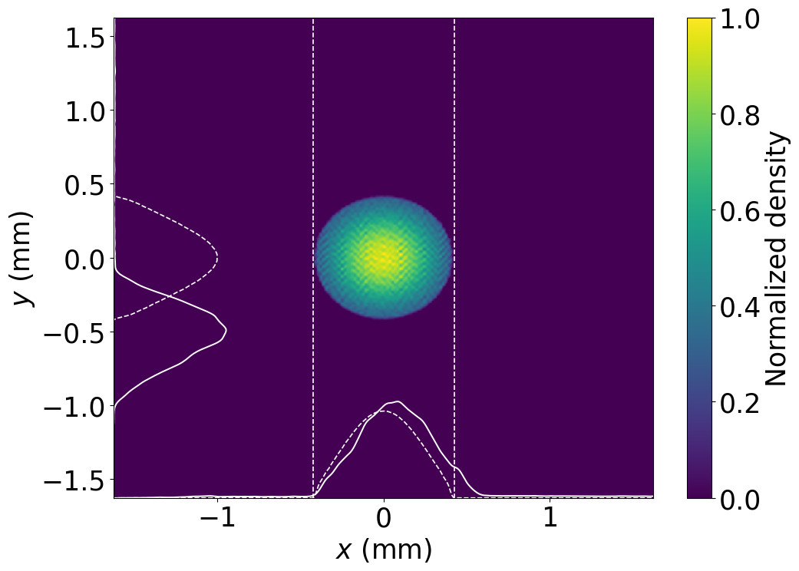
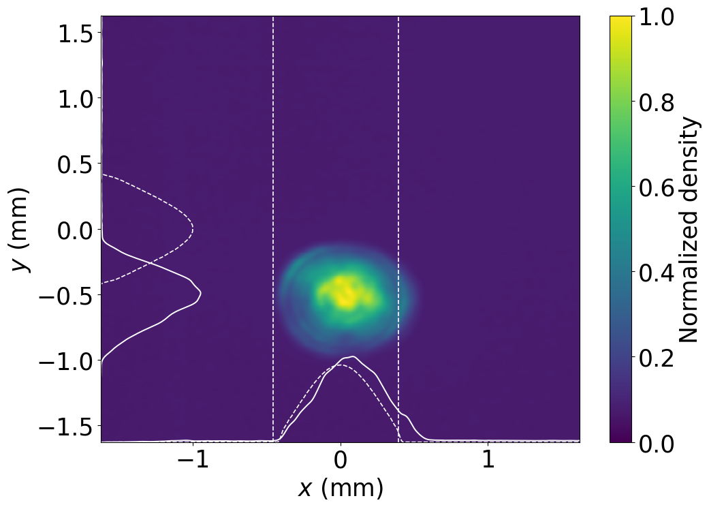
Ideal Particle distribution
UV laser
Generate $x,x^{′},y,y^{′},z,z′$ by 3-step model.
Change $x,y$ into UV laser

Slide 8
Simulation convergence test
(# of macroparticle/ # of cells)
Comparison of beam parameters along the entire lattice.
Comparison of beam at the end of Injector(PCA)
Comparison the result of solenoid scan.

Slide 9
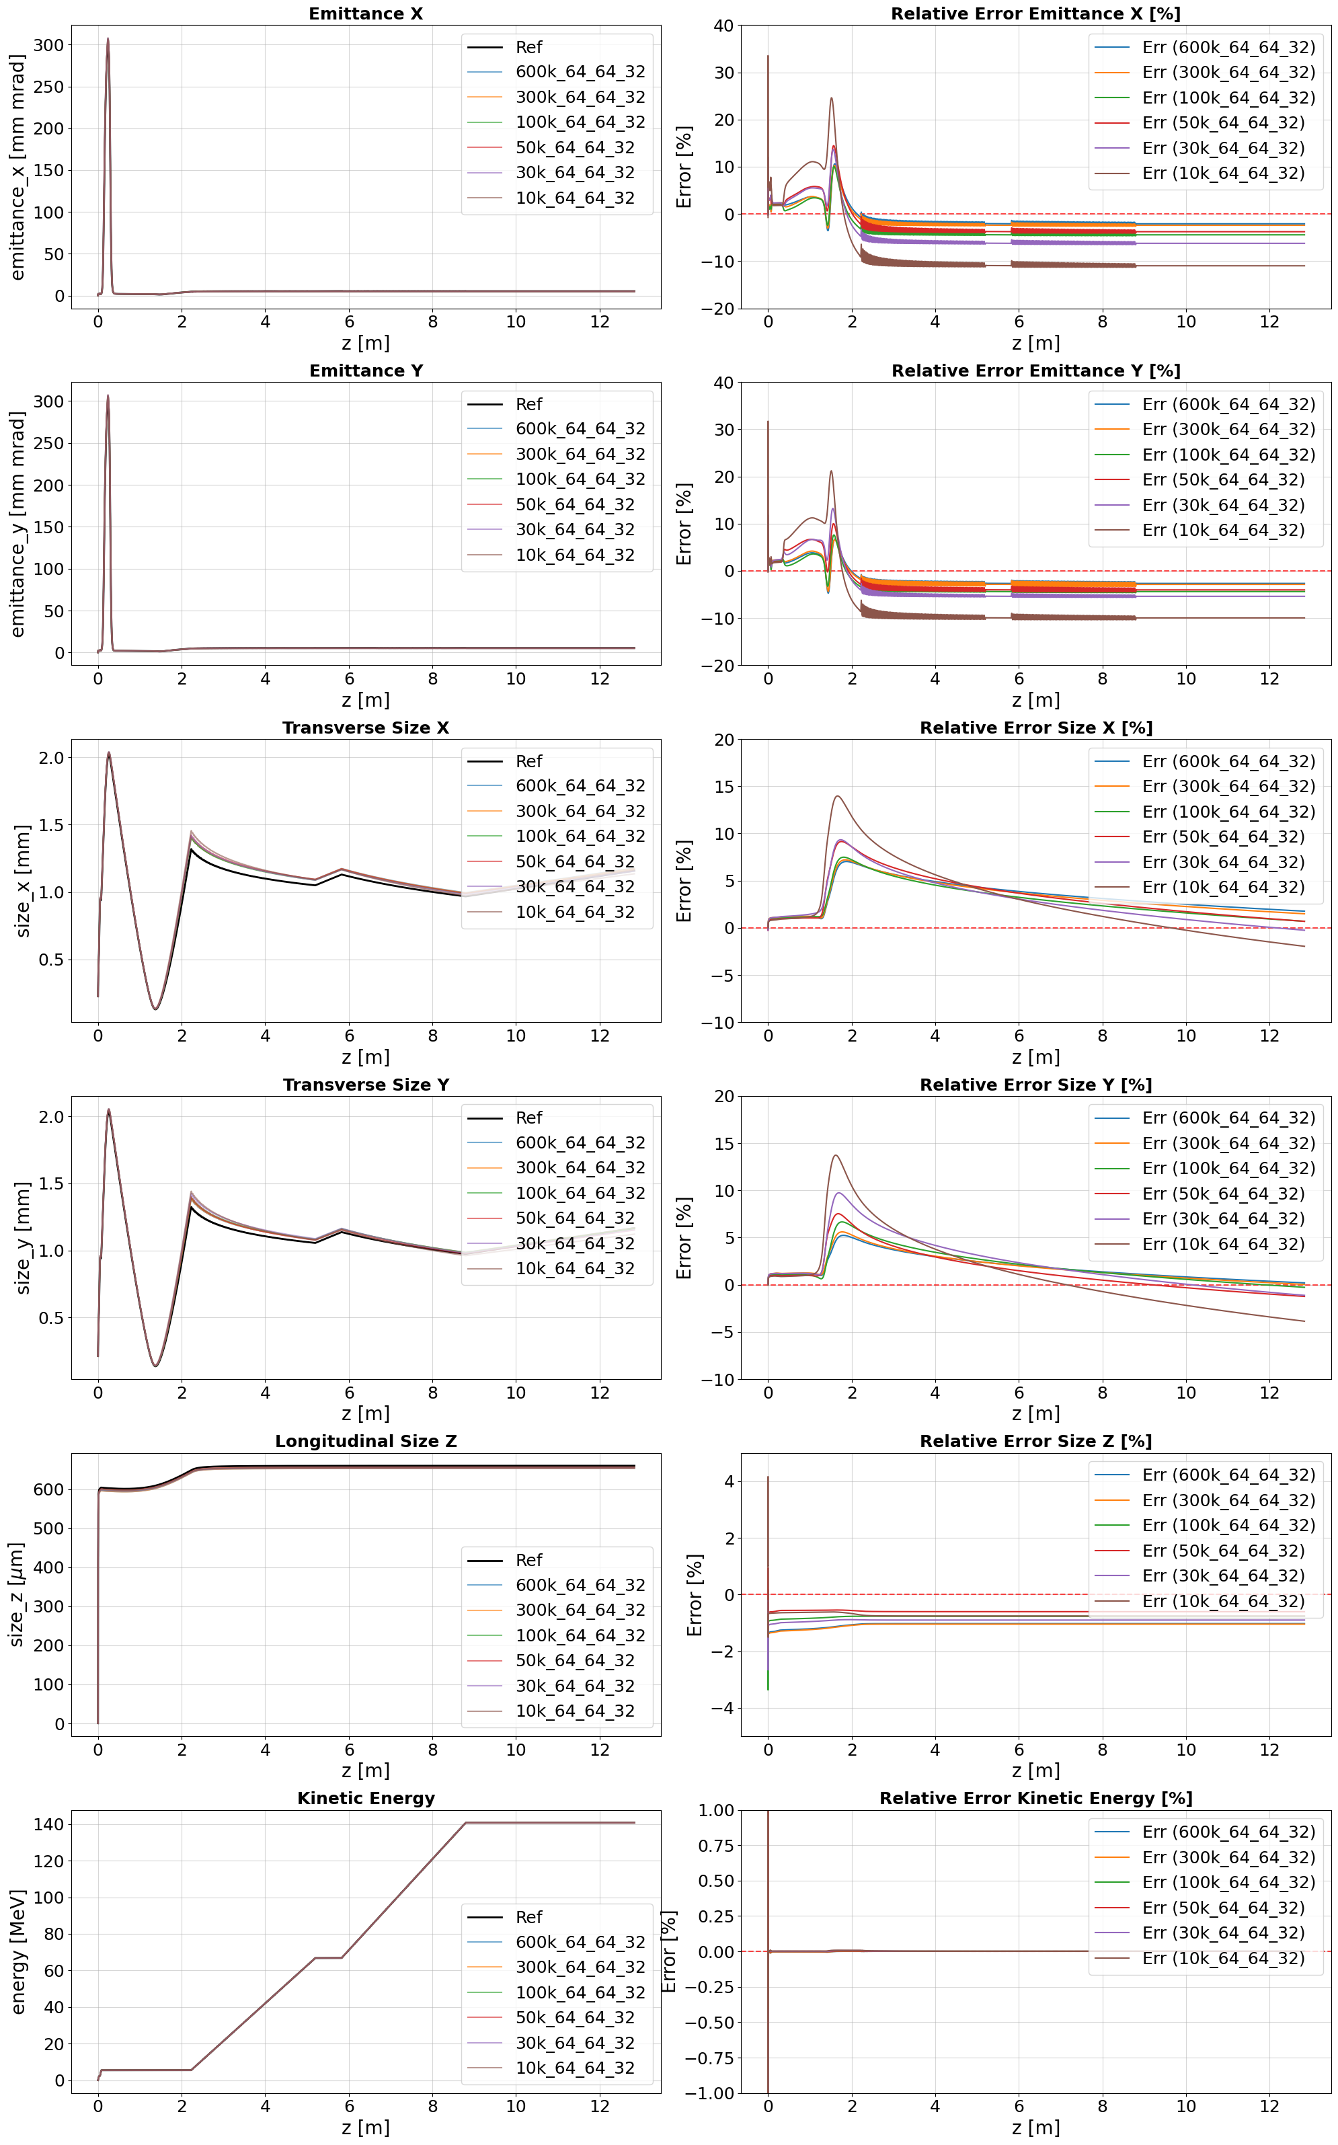
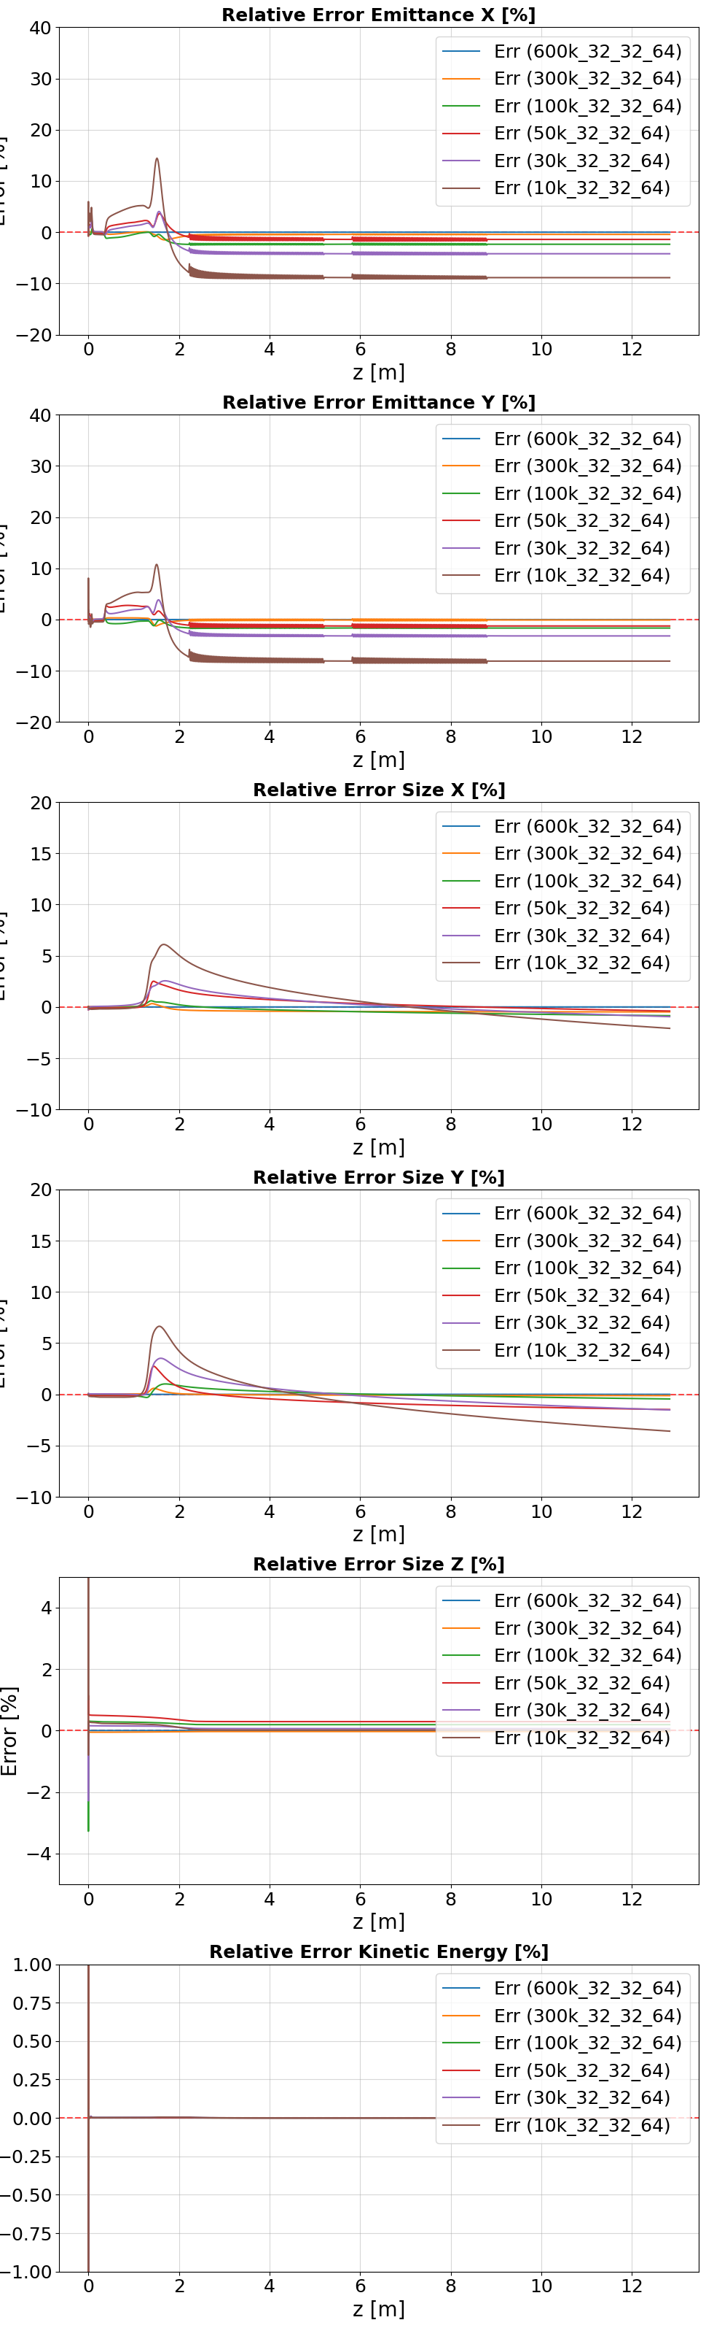
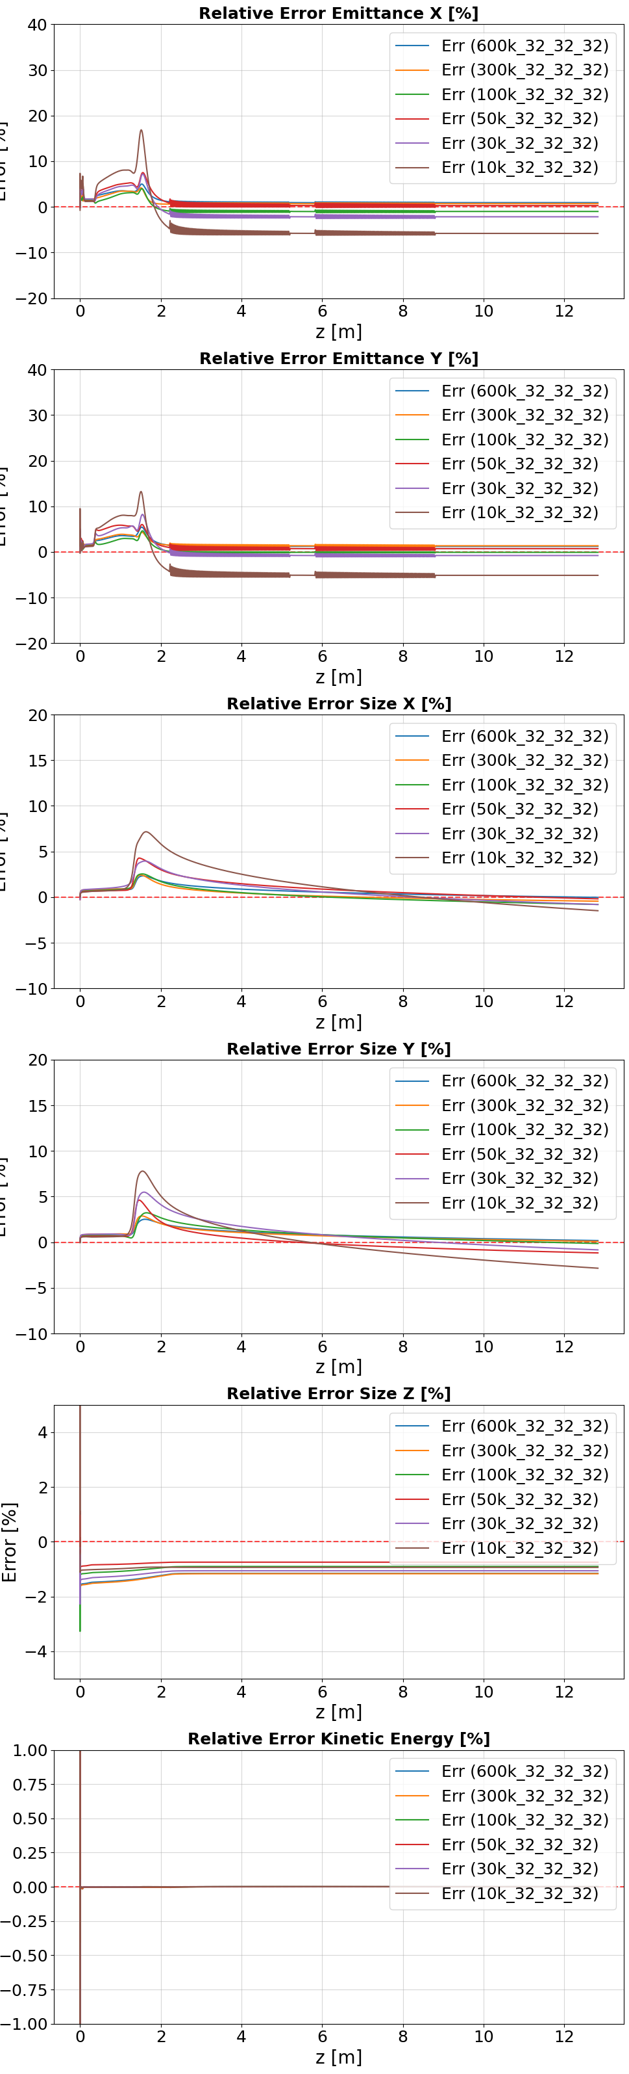
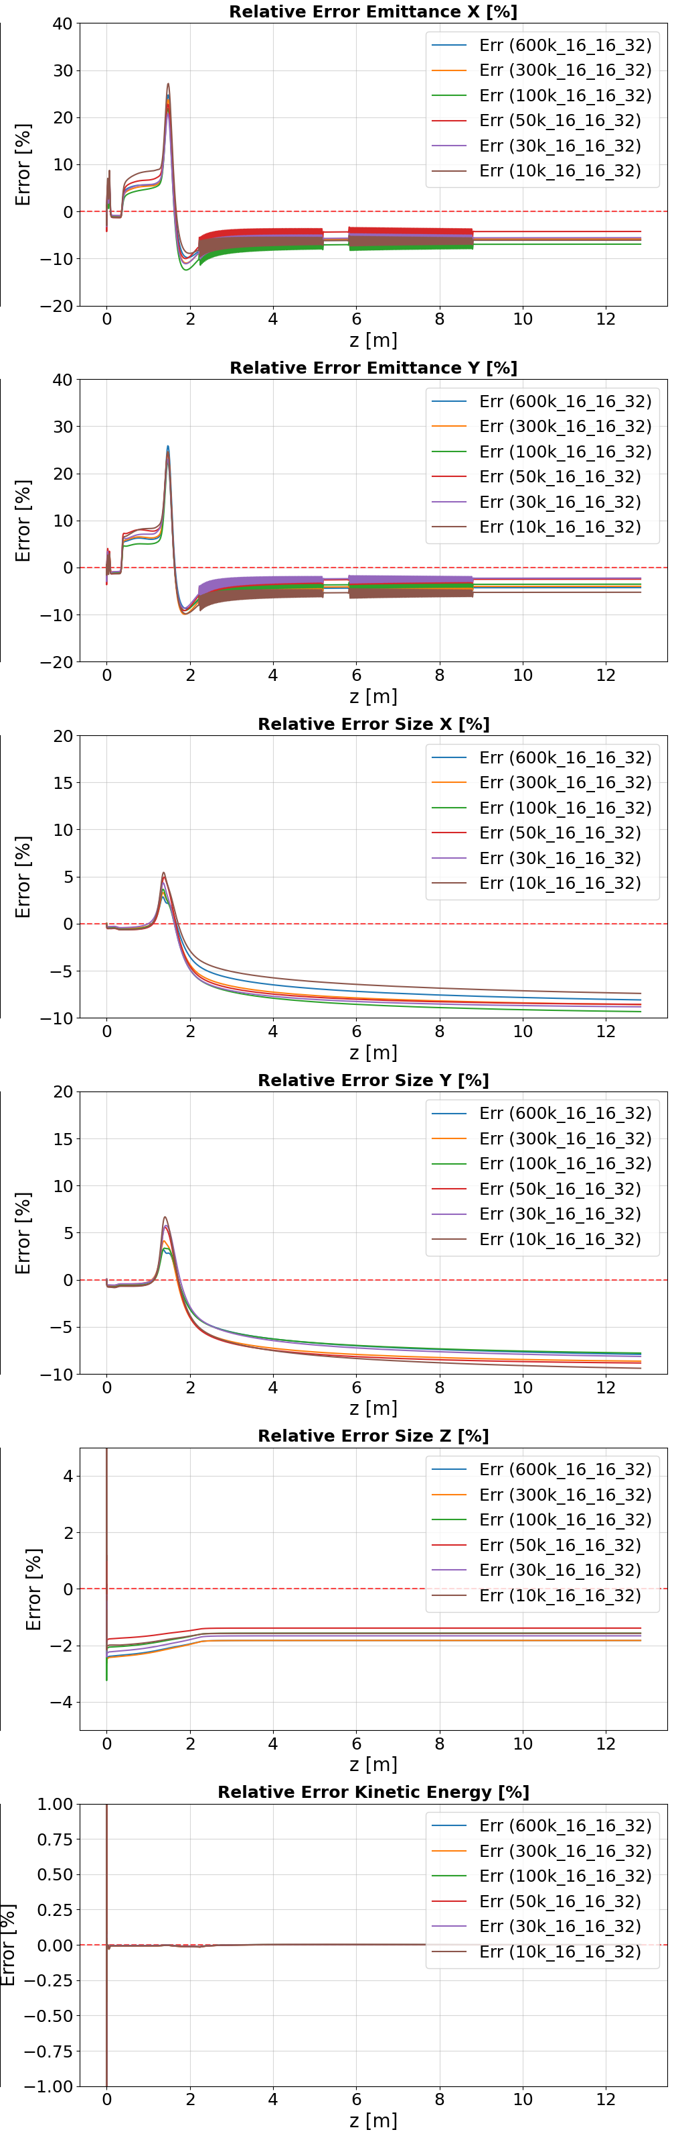

Slide 10
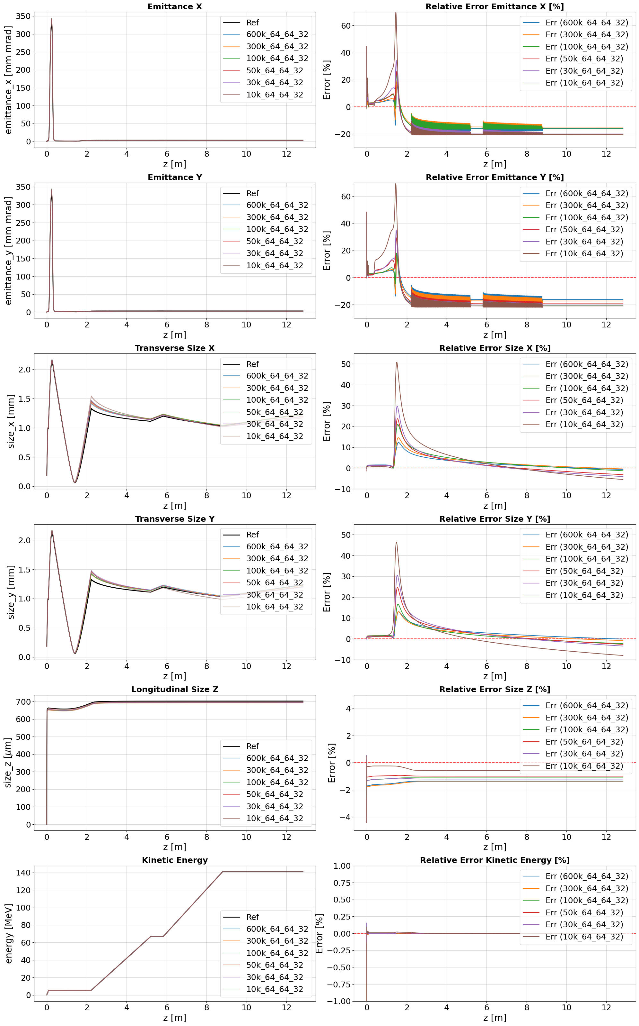
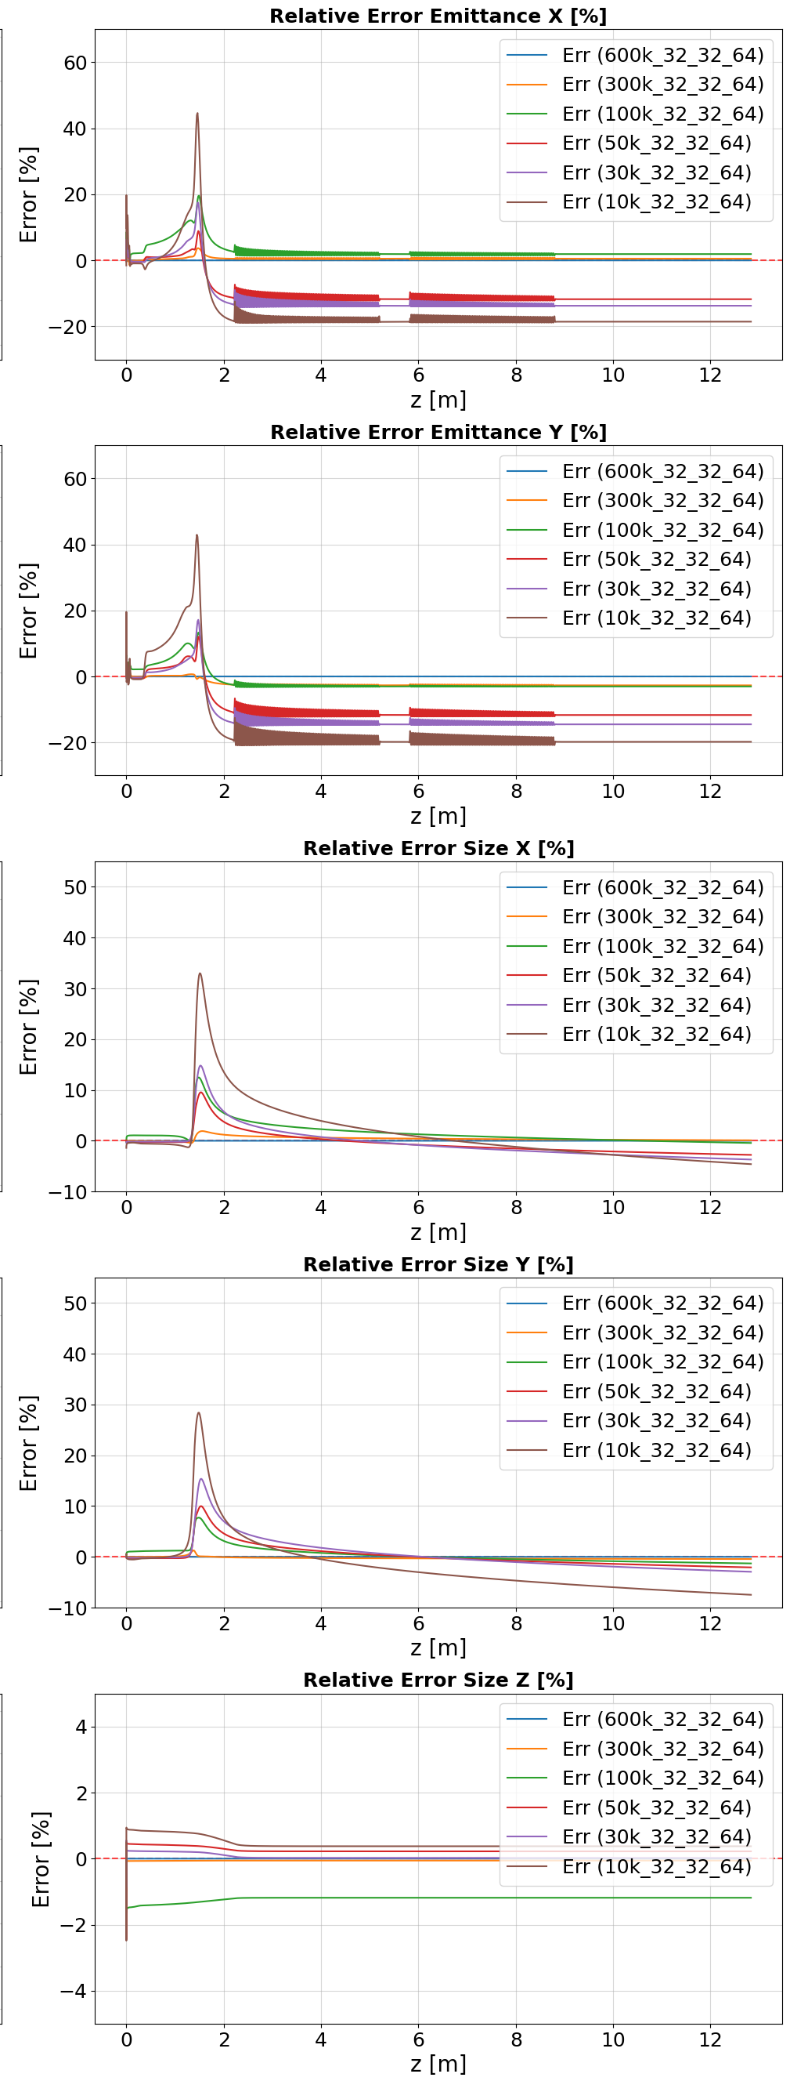
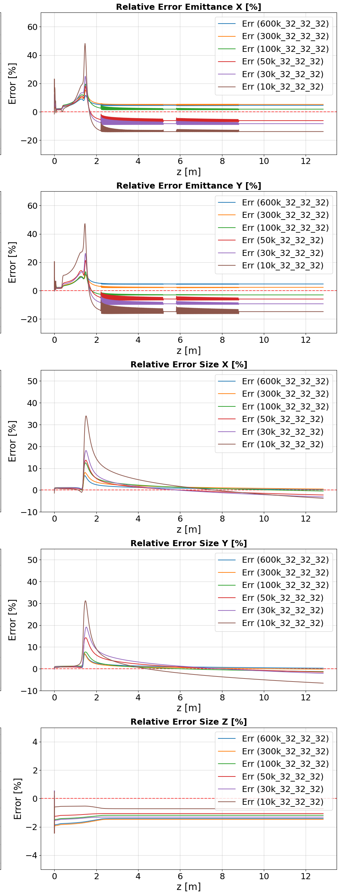
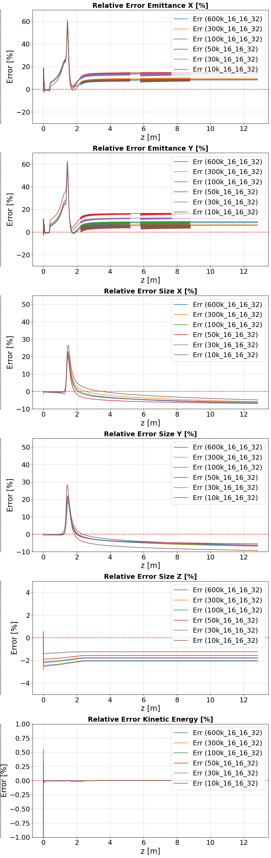
 | 64/64/32 | 32/32/64 | 32/32/32 | 16/16/32
600k | 4.58 | 9.16 (ref) | 18.31 | 73.24
300k | 2.29 | 4.58 | 9.16 | 36.62
150k | 1.14 | 2.29 | 4.58 | 18.31
100k | 0.76 | 1.52 | 3.05 | 12.21
50k | 0.38 | 0.76 | 1.52 | 6.10
30k | 0.23 | 0.46 | 0.92 | 3.66
15k | 0.07 | 0.15 | 0.31 | 1.22
64_64_32: up to 50k
32_32_64: up to 30k
32_32_32: up to 30k
16_16_32: X

Slide 11
Convergence test(# of macroparticle/ # of cells
Comparison of beam parameters along the entire lattice.
Comparison of beam at the end of Injector(PCA)
Comparison the result of solenoid scan.

Slide 12
After gun
screen3
600k
600k
300k
300k
110k
110k
50k
50k
30k
30k
10k
10k

Slide 13
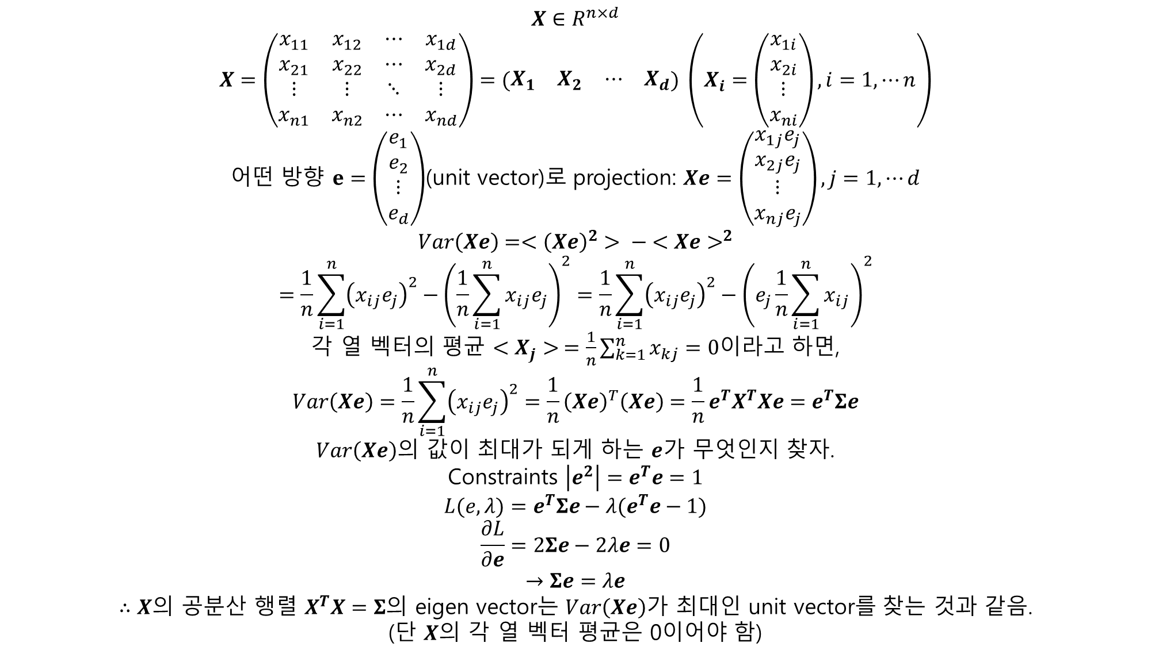
$X∈R^{n×d}$
$$X=\left(\begin{matrix}x_{11} & x_{12} & ⋯ & x_{1d} \\ x_{21} & x_{22} & ⋯ & x_{2d} \\ ⋮ & ⋮ & ⋱ & ⋮ \\ x_{n1} & x_{n2} & ⋯ & x_{nd}\end{matrix}\right)=(\begin{matrix}X_{1} & X_{2} & ⋯ & X_{d}\end{matrix}) \left(X_{i}=\left(\begin{matrix}x_{1i} \\ x_{2i} \\ ⋮ \\ x_{ni}\end{matrix}\right), i=1,⋯n\right)$$
어떤 방향 $e=\left(\begin{matrix}e_{1} \\ e_{2} \\ ⋮ \\ e_{d}\end{matrix}\right)$(unit vector)로 projection: $Xe=\left(\begin{matrix}x_{1j}e_{j} \\ x_{2j}e_{j} \\ ⋮ \\ x_{nj}e_{j}\end{matrix}\right), j=1,⋯d$
$$Var\left(Xe\right)=<{\left(Xe\right)}^{2}> − <Xe>^{2}$$
$$=\frac{1}{n}\sum_{i=1}^{n}{{\left(x_{ij}e_{j}\right)}^{2}}−{\left(\frac{1}{n}\sum_{i=1}^{n}{x_{ij}e_{j}}\right)}^{2}=\frac{1}{n}\sum_{i=1}^{n}{{\left(x_{ij}e_{j}\right)}^{2}}−{\left(e_{j}\frac{1}{n}\sum_{i=1}^{n}{x_{ij}}\right)}^{2}$$
각 열 벡터의 평균 $<X_{j}> =\frac{1}{n}\sum_{k=1}^{n}{x_{kj}}=0$이라고 하면,
$$Var\left(Xe\right)=\frac{1}{n}\sum_{i=1}^{n}{{\left(x_{ij}e_{j}\right)}^{2}}=\frac{1}{n}{\left(Xe\right)}^{T}\left(Xe\right)=\frac{1}{n}e^{T}X^{T}Xe=e^{T}Σe$$
$Var\left(Xe\right)$의 값이 최대가 되게 하는 $e$가 무엇인지 찾자.
Constraints $\left|e^{2}\right|=e^{T}e=1$
$$L(e,λ)=e^{T}Σe−λ(e^{T}e−1)$$
$$\frac{∂L}{∂e}=2Σe−2λe=0$$
$$→Σe=λe$$
$∴X$의 공분산 행렬 $X^{T}X=Σ$의 eigen vector는 $Var\left(Xe\right)$가 최대인 unit vector를 찾는 것과 같음.
(단 $X$의 각 열 벡터 평균은 0이어야 함)

Slide 14
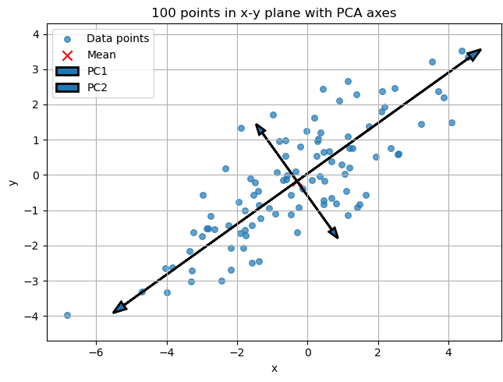
$X$의 공분산 행렬 $X^{T}X=Σ$의 eigen vector는 $Var\left(Xe\right)$가 최대인 unit vector를 찾는 것과 같음.
(단 $X$의 각 열 벡터 평균은 0이어야 함)
Eigen value 크기=eigen vector의 기여도

Slide 15
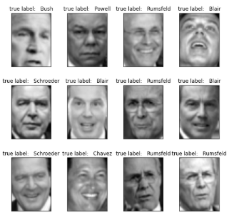
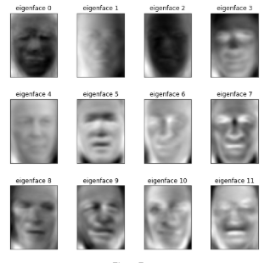
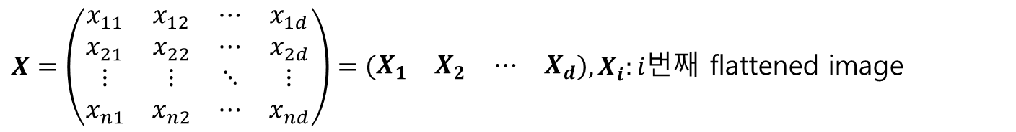
Application https://www.geeksforgeeks.org/machine-learning/ml-face-recognition-using-eigenfaces-pca-algorithm/
$X=\left(\begin{matrix}x_{11} & x_{12} & ⋯ & x_{1d} \\ x_{21} & x_{22} & ⋯ & x_{2d} \\ ⋮ & ⋮ & ⋱ & ⋮ \\ x_{n1} & x_{n2} & ⋯ & x_{nd}\end{matrix}\right)=\left(\begin{matrix}X_{1} & X_{2} & ⋯ & X_{d}\end{matrix}\right), X_{i}:i번$째 flattened image
Get eigen vectors
PCA
원본 이미지는 eigen vector의 선형조합을 얻을 수 있음.
eigen vector로의 projection값을 보고 이미지 간의 유사도 판단 가능

Slide 16
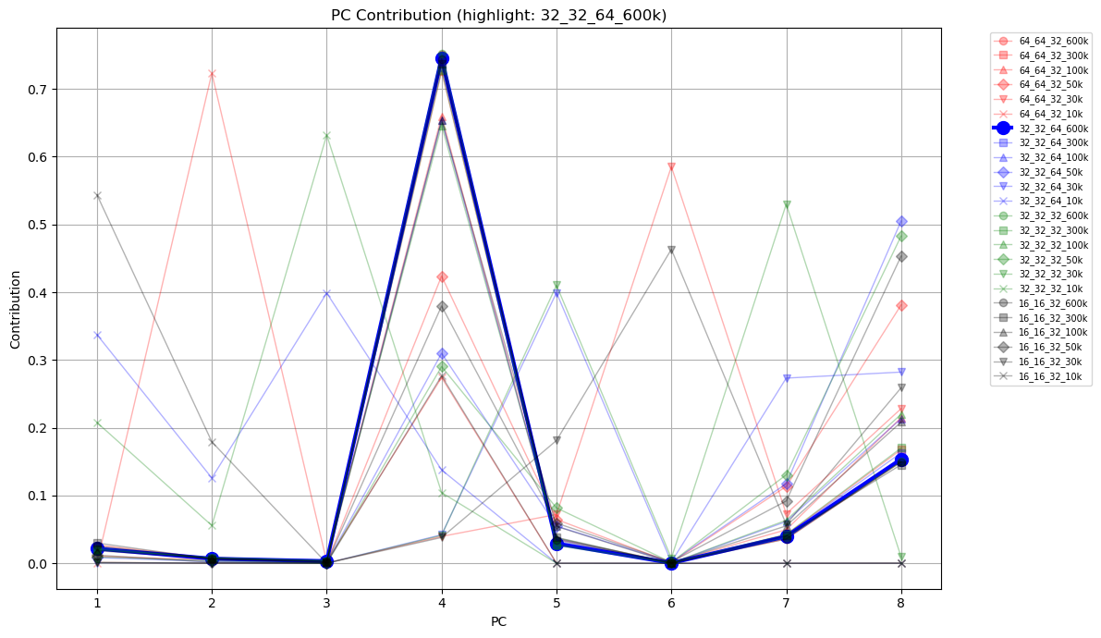
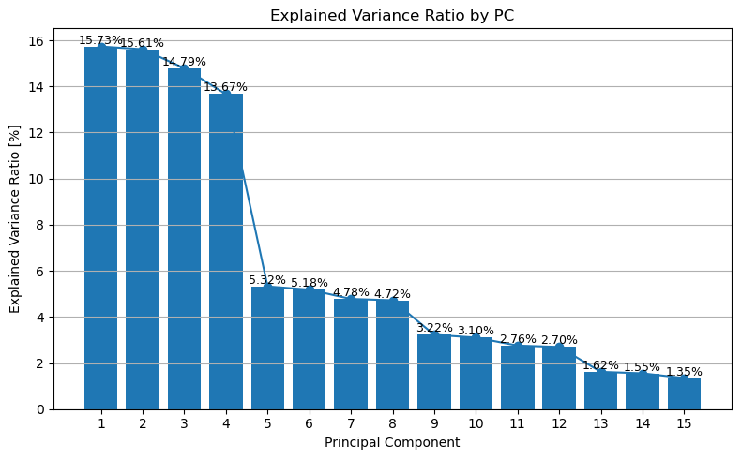
Screen 1
600k
300k
110k
50k
30k
10k

Slide 17
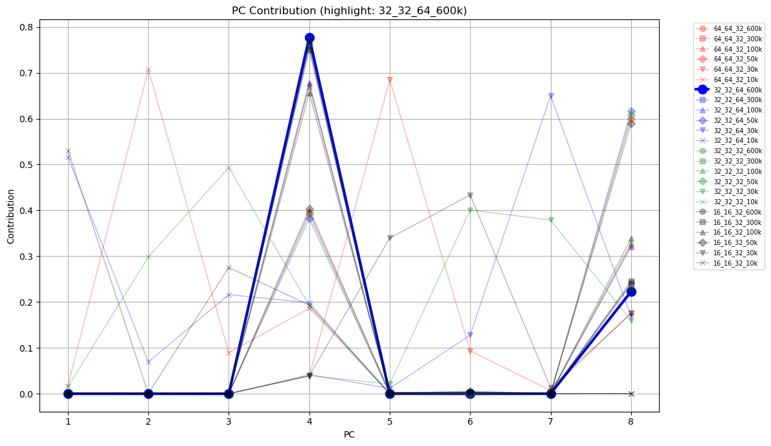
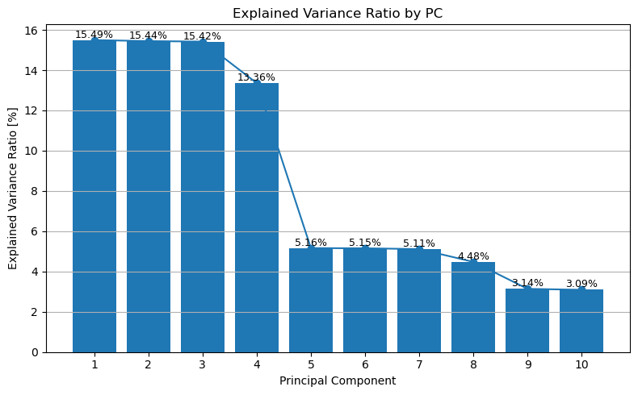
Screen 3
600k
300k
110k
50k
30k
10k

Slide 18
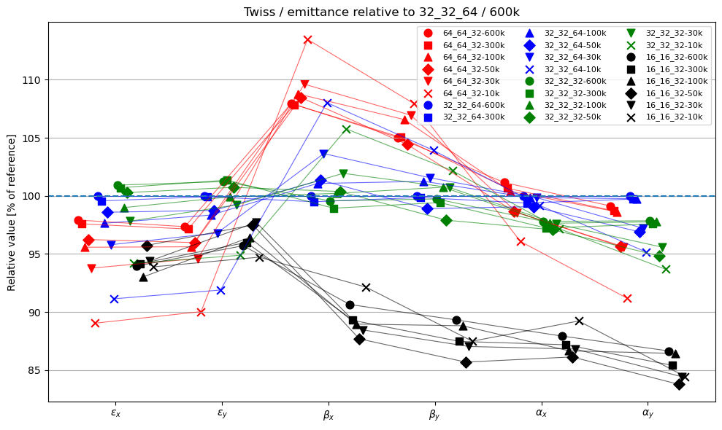

Slide 19
Convergence test(# of macroparticle/ # of cells
Comparison of beam parameters along the entire lattice.
Comparison of beam at the end of Injector(PCA)
Comparison the result of solenoid scan.

Slide 20
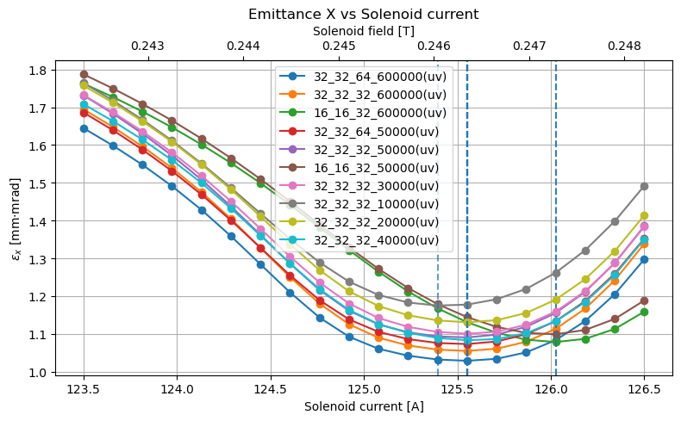
Screen3
125.395A
(0.246041 T)
125.553A
(0.246351 T)
126.026A
(0.247280 T)

Slide 21
32X32X32 / 30,000 cells is the best setting for our research.

Slide 22
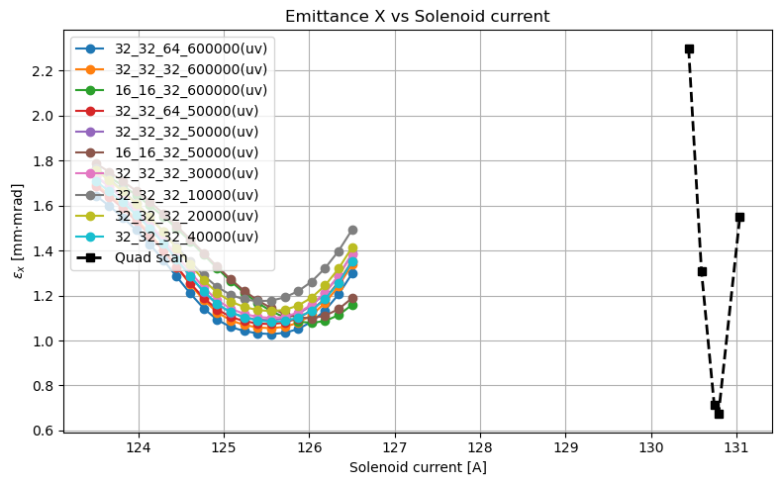
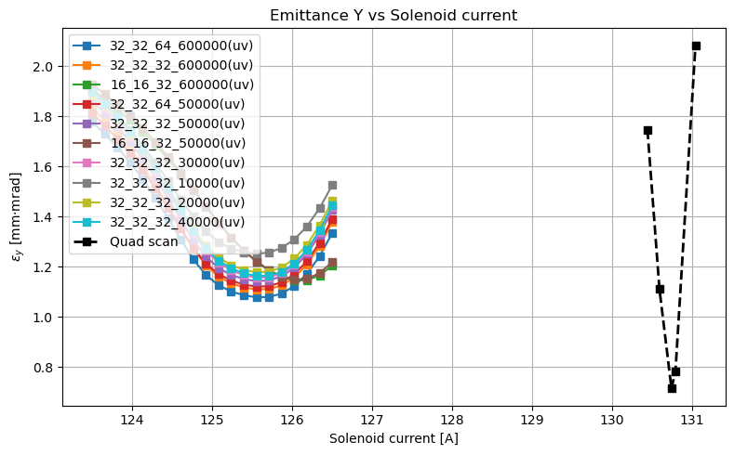
Solenoid current is not calibrated.
Change beam parameters to match the data.

Slide 23
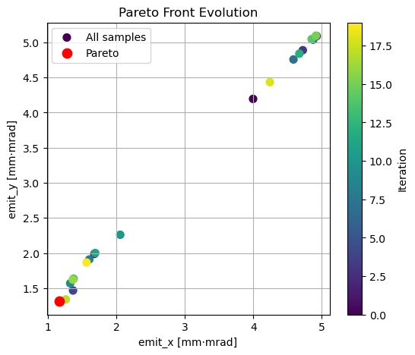
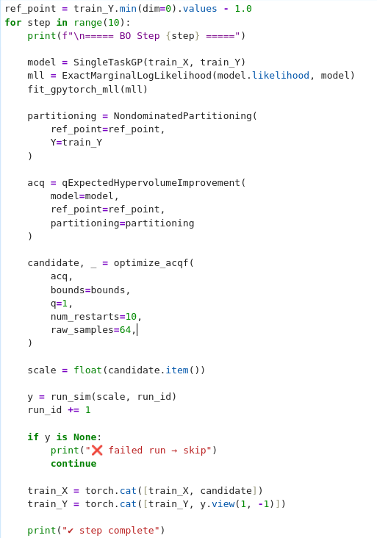
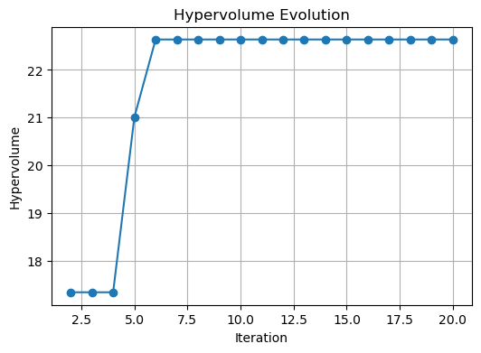
Practice MOBO

Slide 24
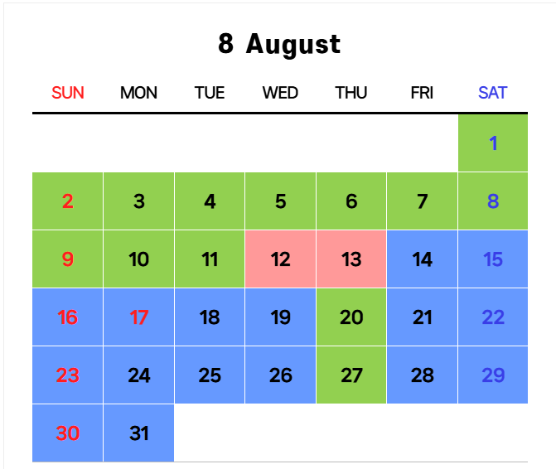
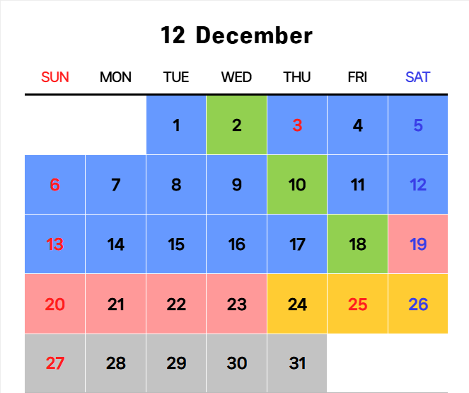

Slide 25
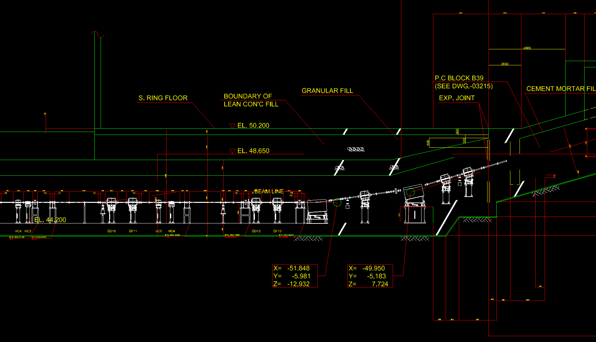

Slide 26
