Slide 1
2026/01/23 meeting
장원

Slide 2
List of contents
Cherenkov diffraction radiation
-Analytic calculation of the ChDR spectrum for a general triangular prism(including angle)
2. PAL-XFEL injector
-Introduce research progress
-current stage

Slide 3
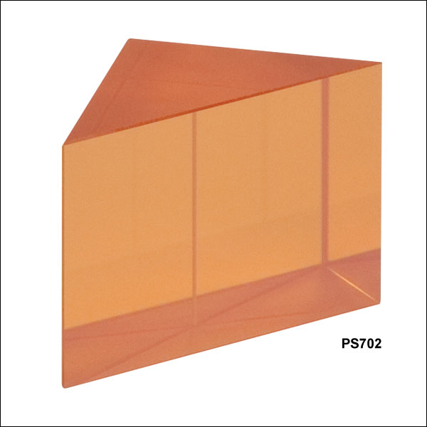

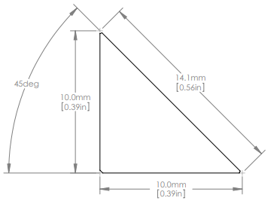
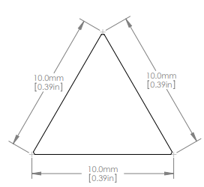
ZnSe Right-Angle Prism(600nm~16um)- Thorlabs
Planned experiment
-Right-angle prism
Changes
-Equilateral triangle prism
ChDR spectrum formula needs to be revised.

Slide 4

Polarization radiation generated in a cylindrical channel in a screen of finite thickness and radius
Let’s consider, homogeneous, isotropic, nonmagnetic u=1
$$σ\left(ω\right)=\frac{iω}{4π}\left(1−ε\left(ω\right)\right), γ=\frac{E}{mc^{2}}=\frac{1}{\sqrt{1−β^{2}}}$$
$$∇×\vec{H}=−\frac{iω}{c}\vec{E}+\frac{4π}{c}{(\vec{j}}^{pol})$$
$$∇×\vec{E}=\frac{iω}{c}\vec{H}$$
Basic field
$$∇×{\vec{H}}^{0}=−\frac{iω}{c}{\vec{E}}^{0}$$
$$∇×{\vec{E}}^{0}=\frac{iω}{c}{\vec{H}}^{0}$$
$${\vec{j}}^{pol}=σ\left({\vec{E}}^{0}+{\vec{E}}^{pol}\left({\vec{j}}_{pol}\right)\right) \left({\vec{E}}^{0}:from eletron field without material, {\vec{E}}^{pol}:polarization current\right)$$
$$∇×{\vec{H}}^{pol}=−\frac{iω}{c}{\vec{E}}^{pol}+\frac{4π}{c}{\vec{j}}^{pol}$$
$$∇×{\vec{E}}^{pol}=\frac{iω}{c}{\vec{H}}^{pol}$$
$$\left(∇^{2}+\frac{ω^{2}}{c^{2}}\right){\vec{H}}^{pol}=−\frac{4π}{c}∇×{\vec{j}}^{pol}$$
$$\left(∇^{2}+\frac{ω^{2}}{c^{2}}\right){\vec{H}}^{pol}=−\frac{4π}{c}σ∇×\left({\vec{E}}^{0}+{\vec{E}}^{pol}\right)$$
$∇×{\vec{E}}^{pol}=\frac{iω}{c}{\vec{H}}^{pol} 대$입
$$\left(∇^{2}+\frac{ω^{2}}{c^{2}}+\frac{4πiωσ}{c^{2}}\right){\vec{H}}^{pol}=−\frac{4π}{c}σ∇×{\vec{E}}^{0}$$
$$\left(∇^{2}+ε\frac{ω^{2}}{c^{2}}\right){\vec{H}}^{pol}=−\frac{4π}{c}σ∇×{\vec{E}}^{0}$$

Slide 5
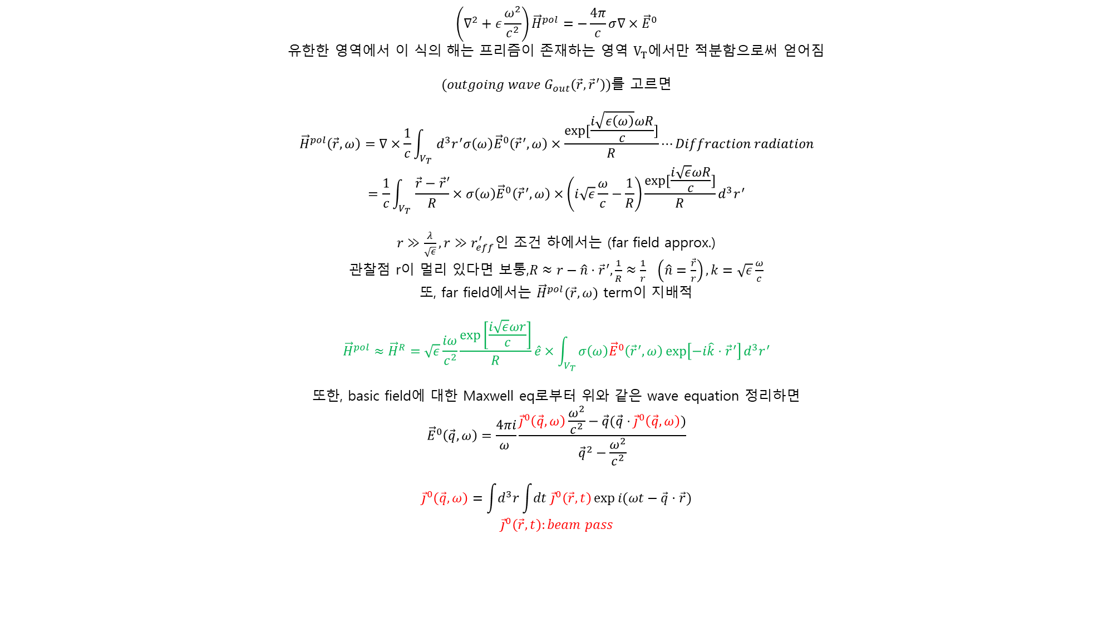
$$\left(∇^{2}+ε\frac{ω^{2}}{c^{2}}\right){\vec{H}}^{pol}=−\frac{4π}{c}σ∇×{\vec{E}}^{0}$$
유한한 영역에서 이 식의 해는 프리즘이 존재하는 영역 $V_{T}에$서만 적분함으로써 얻어짐
$(outgoing wave G_{out}\left(\vec{r},{\vec{r}}^{′}\right))를$ 고르면
$${\vec{H}}^{pol}\left(\vec{r},ω\right)=∇×\frac{1}{c}\int_{V_{T}}{d^{3}r^{′}σ\left(ω\right){\vec{E}}^{0}\left({\vec{r}}^{′},ω\right)×\frac{\exp{[\frac{i\sqrt{ε\left(ω\right)}ωR}{c}]}}{R}}⋯Diffraction radiation$$
$$=\frac{1}{c}\int_{V_{T}}{\frac{\vec{r}−\vec{r}′}{R}×σ\left(ω\right){\vec{E}}^{0}\left({\vec{r}}^{′},ω\right)×\left(i\sqrt{ε}\frac{ω}{c}−\frac{1}{R}\right)\frac{\exp{[\frac{i\sqrt{ε}ωR}{c}]}}{R}d^{3}r^{′}}$$
$r≫\frac{λ}{\sqrt{ε}},r≫r_{eff}^{′}인$ 조건 하에서는 (far field approx.)
관찰점 r이 멀리 있다면 보통,$R≈r−\hat{n}⋅{\vec{r}}^{′}, \frac{1}{R}≈\frac{1}{r} \left(\hat{n}=\frac{\vec{r}}{r}\right), k=\sqrt{ε}\frac{ω}{c}$
또, far field에서는 ${\vec{H}}^{pol}\left(\vec{r},ω\right)$ term이 지배적
$${\vec{H}}^{pol}≈{\vec{H}}^{R}=\sqrt{ε}\frac{iω}{c^{2}}\frac{\exp\left[\frac{i\sqrt{ε}ωr}{c}\right]}{R}\hat{e}×\int_{V_{T}}{σ\left(ω\right){\vec{E}}^{0}\left({\vec{r}}^{′},ω\right)\exp\left[−i\hat{k}⋅{\vec{r}}^{′}\right]d^{3}r^{′}}$$
또한, basic field에 대한 Maxwell eq로부터 위와 같은 wave equation 정리하면
$${\vec{E}}^{0}\left(\vec{q},ω\right)=\frac{4πi}{ω }\frac{{\vec{j}}^{0}\left(\vec{q},ω\right)\frac{ω^{2}}{c^{2}}−\vec{q}(\vec{q}⋅{\vec{j}}^{0}\left(\vec{q},ω\right))}{{\vec{q}}^{2}−\frac{ω^{2}}{c^{2}}}$$
$${\vec{j}}^{0}\left(\vec{q},ω\right)=\int{d^{3}r}\int{dt {\vec{j}}^{0}\left(\vec{r},t\right)\exp{i(ωt−\vec{q}⋅\vec{r})}}$$
$${\vec{j}}^{0}\left(\vec{r},t\right):beam pass$$

Slide 6
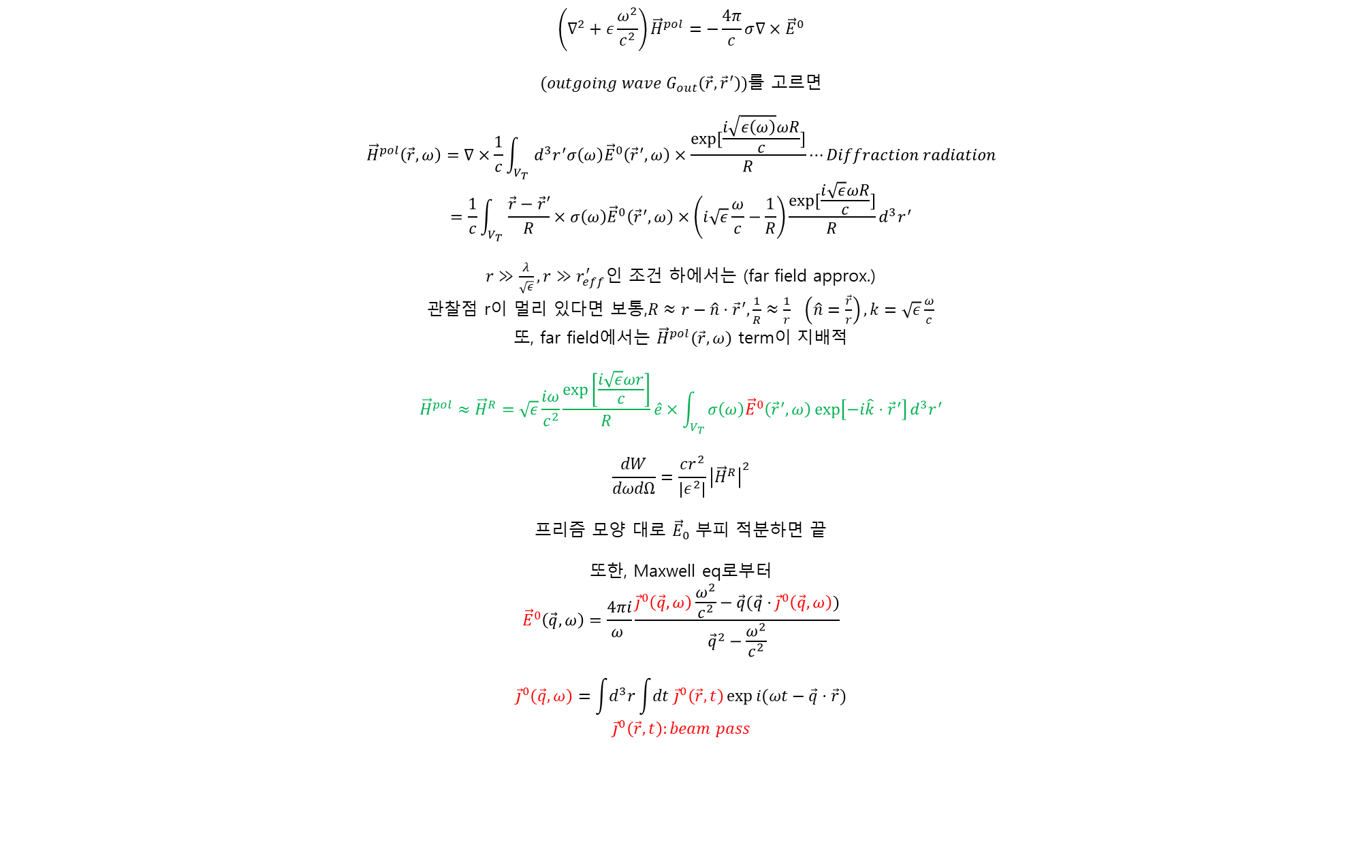
$$\left(∇^{2}+ε\frac{ω^{2}}{c^{2}}\right){\vec{H}}^{pol}=−\frac{4π}{c}σ∇×{\vec{E}}^{0}$$
$(outgoing wave G_{out}\left(\vec{r},{\vec{r}}^{′}\right))를$ 고르면
$${\vec{H}}^{pol}\left(\vec{r},ω\right)=∇×\frac{1}{c}\int_{V_{T}}{d^{3}r^{′}σ\left(ω\right){\vec{E}}^{0}\left({\vec{r}}^{′},ω\right)×\frac{\exp{[\frac{i\sqrt{ε\left(ω\right)}ωR}{c}]}}{R}}⋯Diffraction radiation$$
$$=\frac{1}{c}\int_{V_{T}}{\frac{\vec{r}−\vec{r}′}{R}×σ\left(ω\right){\vec{E}}^{0}\left({\vec{r}}^{′},ω\right)×\left(i\sqrt{ε}\frac{ω}{c}−\frac{1}{R}\right)\frac{\exp{[\frac{i\sqrt{ε}ωR}{c}]}}{R}d^{3}r^{′}}$$
$r≫\frac{λ}{\sqrt{ε}},r≫r_{eff}^{′}인$ 조건 하에서는 (far field approx.)
관찰점 r이 멀리 있다면 보통,$R≈r−\hat{n}⋅{\vec{r}}^{′}, \frac{1}{R}≈\frac{1}{r} \left(\hat{n}=\frac{\vec{r}}{r}\right), k=\sqrt{ε}\frac{ω}{c}$
또, far field에서는 ${\vec{H}}^{pol}\left(\vec{r},ω\right)$ term이 지배적
$${\vec{H}}^{pol}≈{\vec{H}}^{R}=\sqrt{ε}\frac{iω}{c^{2}}\frac{\exp\left[\frac{i\sqrt{ε}ωr}{c}\right]}{R}\hat{e}×\int_{V_{T}}{σ\left(ω\right){\vec{E}}^{0}\left({\vec{r}}^{′},ω\right)\exp\left[−i\hat{k}⋅{\vec{r}}^{′}\right]d^{3}r^{′}}$$
$$\frac{dW}{dωdΩ}=\frac{cr^{2}}{\left|ε^{2}\right|}{\left|{\vec{H}}^{R}\right|}^{2}$$
프리즘 모양 대로 ${\vec{E}}_{0}$ 부피 적분하면 끝
또한, Maxwell eq로부터
$${\vec{E}}^{0}\left(\vec{q},ω\right)=\frac{4πi}{ω }\frac{{\vec{j}}^{0}\left(\vec{q},ω\right)\frac{ω^{2}}{c^{2}}−\vec{q}(\vec{q}⋅{\vec{j}}^{0}\left(\vec{q},ω\right))}{{\vec{q}}^{2}−\frac{ω^{2}}{c^{2}}}$$
$${\vec{j}}^{0}\left(\vec{q},ω\right)=\int{d^{3}r}\int{dt {\vec{j}}^{0}\left(\vec{r},t\right)\exp{i(ωt−\vec{q}⋅\vec{r})}}$$
$${\vec{j}}^{0}\left(\vec{r},t\right):beam pass$$

Slide 7






$$ϕ$$
$$α$$
$$θ$$
$$α:tilt angle of electron$$
$$φ, a:prism shape$$
$$φ$$
$$a$$

Slide 8
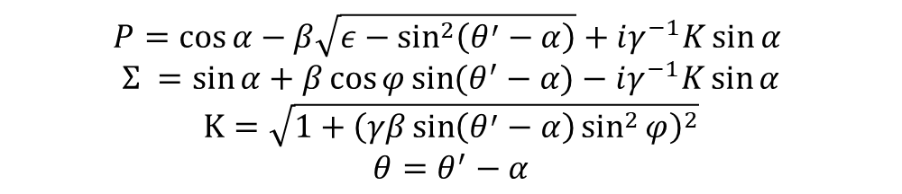
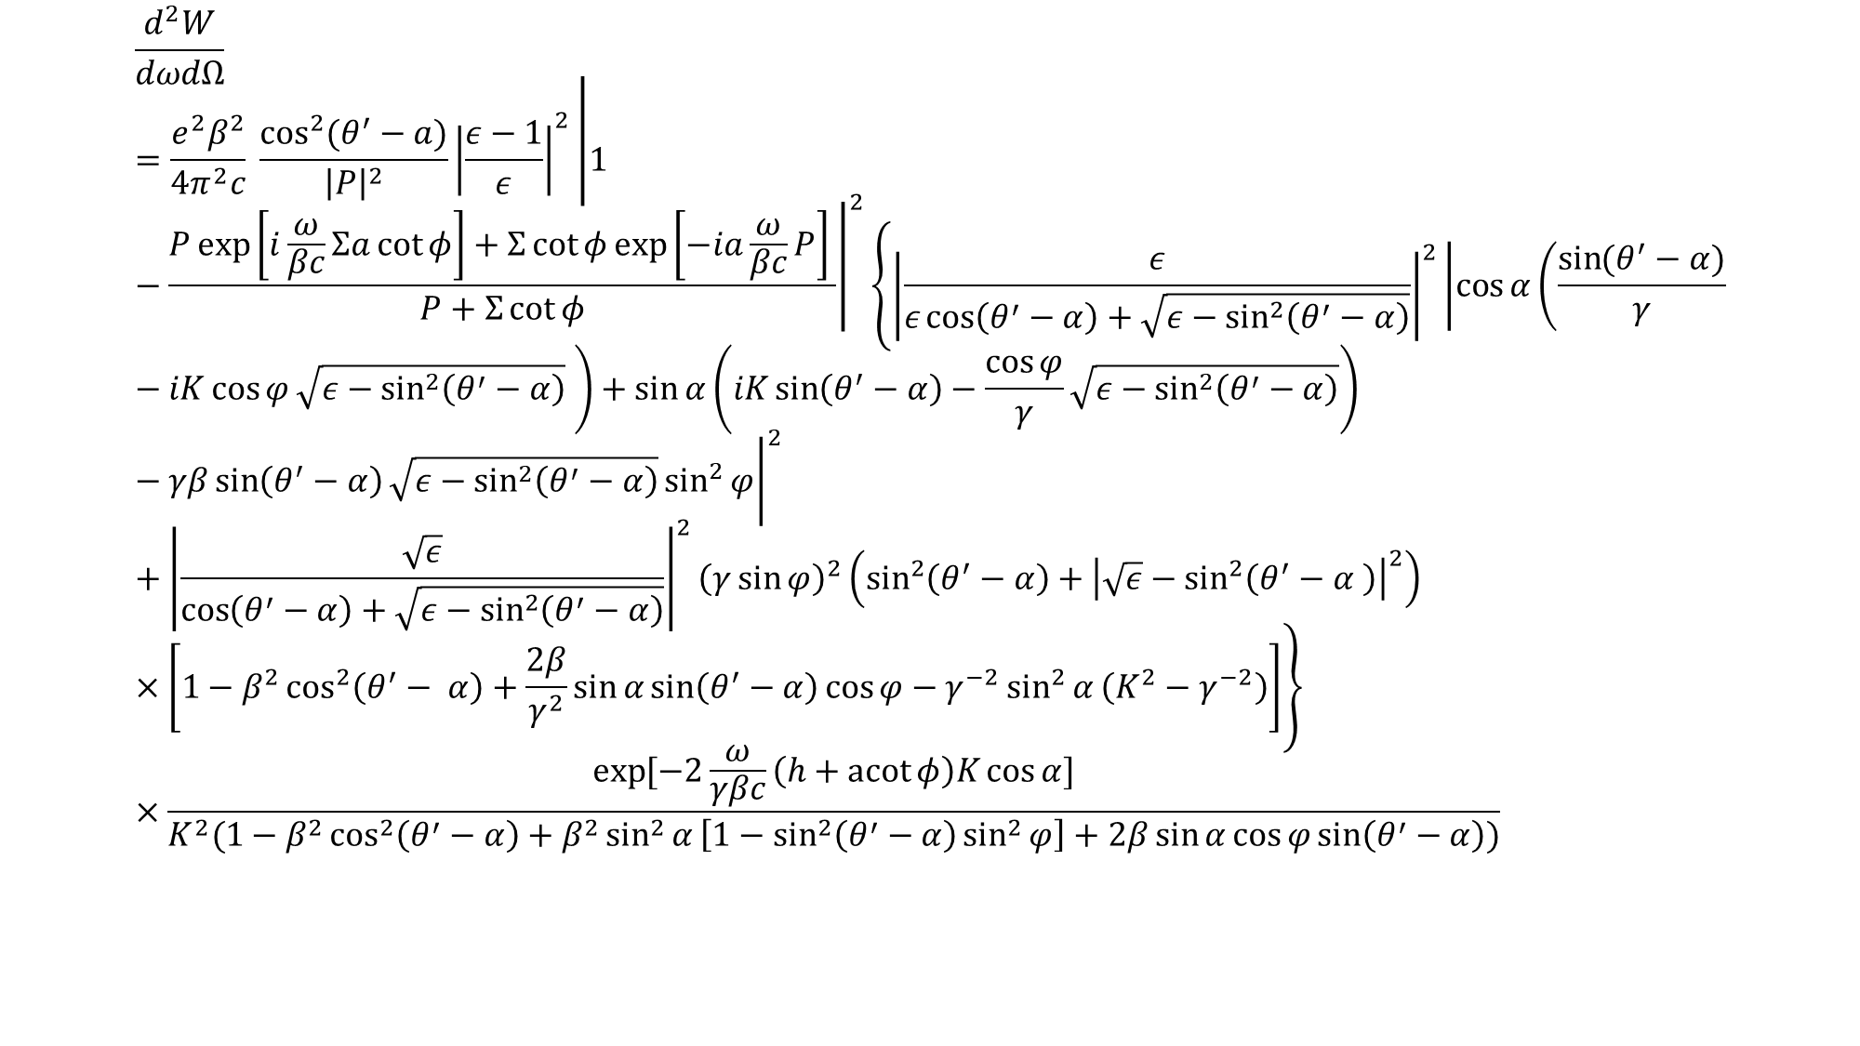
$$\frac{d^{2}W}{dωdΩ}=\frac{e^{2}β^{2}}{4π^{2}c} \frac{\cos^{2}{(θ^{′}−a)}}{{\left|P\right|}^{2}}{\left|\frac{ε−1}{ε}\right|}^{2}{\left|1−\frac{P\exp\left[i\frac{ω}{βc}Σa\cot{φ}\right]+Σ\cot{φ\exp\left[−ia\frac{ω}{βc}P\right]} }{P+Σ\cot{φ}}\right|}^{2}\left\{{\left|\frac{ε}{ε\cos\left(θ^{′}−α\right)+\sqrt{ε−\sin^{2}\left(θ^{′}−α\right)}}\right|}^{2}{\left|\cos{α}\left(\frac{\sin{(θ^{′}−α})}{γ}−iK\cos{φ}\sqrt{ε−\sin^{2}\left(θ^{′}−α\right)} \right)+\sin{α}\left(iK\sin\left(θ^{′}−α\right)−\frac{\cos{φ}}{γ}\sqrt{ε−\sin^{2}\left(θ^{′}−α\right)}\right)−γβ\sin\left(θ^{′}−α\right)\sqrt{ε−\sin^{2}\left(θ^{′}−α\right)}\sin^{2}{φ}\right|}^{2}+{\left|\frac{\sqrt{ε}}{\cos\left(θ^{′}−α\right)+\sqrt{ε−\sin^{2}\left(θ^{′}−α\right)}}\right|}^{2}{\left(γ\sin{φ}\right)}^{2}\left(\sin^{2}\left(θ^{′}−α\right)+{\left|\sqrt{ε}−\sin^{2}\left(θ^{′}−α \right)\right|}^{2}\right)×\left[1−β^{2}\cos^{2}\left(θ^{′}− α\right)+\frac{2β}{γ^{2}}\sin{α}\sin\left(θ^{′}−α\right)\cos{φ}−γ^{−2}\sin^{2}{α}\left(K^{2}−γ^{−2}\right)\right]\right\}×\frac{\exp{[−2\frac{ω}{γβc}\left(h+\operatorname{acot}{φ}\right)K\cos{α}]}}{K^{2}(1−β^{2}\cos^{2}\left(θ^{′}−α\right)+β^{2}\sin^{2}{α}\left[1−\sin^{2}\left(θ^{′}−α\right)\sin^{2}{φ}\right]+2β\sin{α}\cos{φ}\sin\left(θ^{′}−α\right))}$$
$$P=\cos{α}−β\sqrt{ε−\sin^{2}\left(θ^{′}−α\right)}+iγ^{−1}K\sin{α}$$
$$Σ =\sin{α}+β\cos{φ}\sin{(θ^{′}−α)}−iγ^{−1}K\sin{α}$$
$$K=\sqrt{1+{\left(γβ\sin\left(θ^{′}−α\right)\sin^{2}{φ}\right)}^{2}}$$
$$θ=θ^{′}−α$$

Slide 9
PAL-XFEL Injector/ Research progress
1. Make surrogate model based on neural network(NN) for PAL-XFEL injector
2. Matching surrogate model and measurement
3. Application of surrogate model

Slide 10
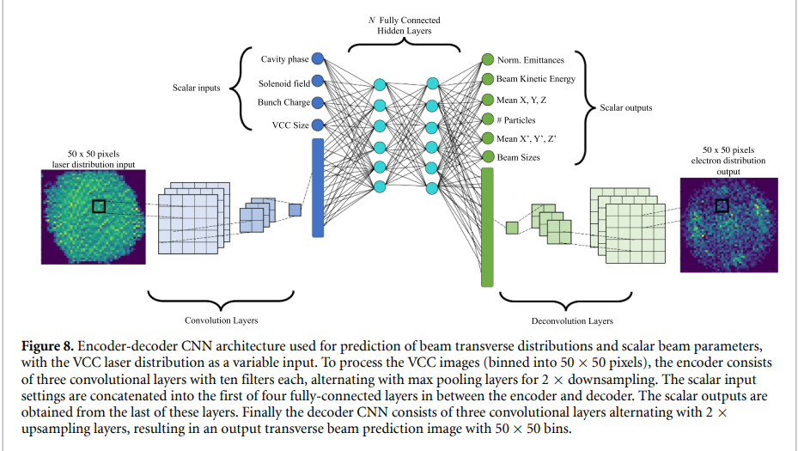
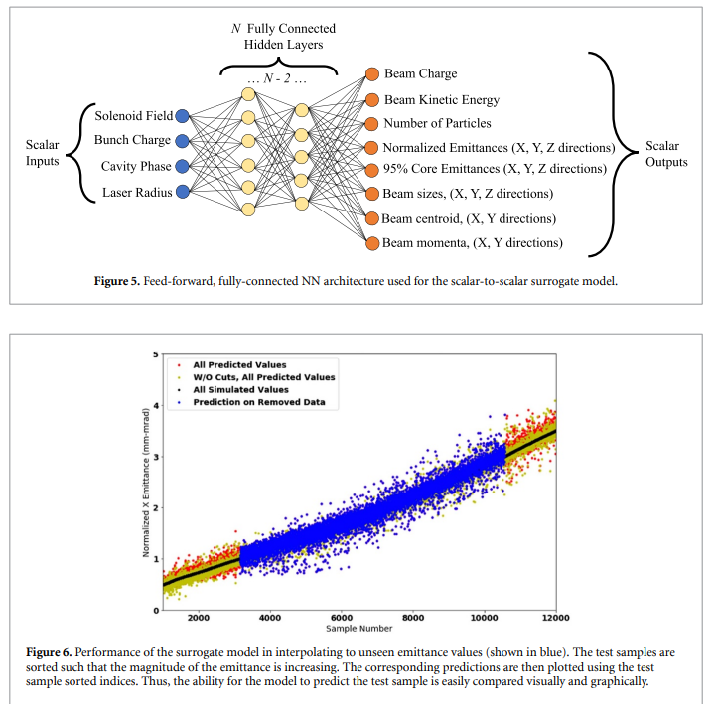
PAL-XFEL Injector/ Research progress
Make surrogate model based on neural network(NN) for PAL-XFEL injector
Gupta, L., Edelen, A., Neveu, N., Mishra, A., Mayes, C., and Kim, Y.-K.
Scalar model
Vector model
A neural network-based surrogate model will be developed and validated using simulation results.

Slide 11
PAL-XFEL Injector/ Research progress
Gupta, L., Edelen, A., Neveu, N., Mishra, A., Mayes, C., and Kim, Y.-K.
A. 스칼라(scalar) 모델용 데이터
생성 방법: ASTRA의 표준 particle generator 사용
  입력으로 laser radius(레이저 반지름)만 제공 (레이저 이미지 사용 X)
랜덤 샘플링한 입력 변수:
  laser radius
  cathode cavity RF phase
  beam charge
  solenoid strength
각 샘플 구성:
  (입력) 위 스칼라 값들
  (출력) emittance, beam size 등 벌크(scalar) 빔 파라미터
B. 이미지 기반(CNN) 모델용 데이터
생성 방법: LUME-ASTRA로 시뮬레이션 생성
  입력 레이저 분포를 2종으로 생성/사용
    이상적인 SG(super-Gaussian) 레이저 분포
    실측 VCC 레이저 이미지 기반 분포
입력 설정값 샘플링: 레이저 프로파일(이미지) 하나당
  2000개의 랜덤 input setting 포인트 생성 → ASTRA 시뮬레이션 수행
데이터 규모(시뮬레이션 샘플 수):
  SG 기반 약 60,000 샘플
  VCC 기반 약 70,000 샘플
출력(타깃):
  YAG에서 측정될 것 같은 전자빔 횡단 분포(50×50 bin)
    normalized emittance, beam size 등 스칼라 통계량
    (추가로) 빔 분포의 **스칼라 extent(가로/세로 범위)**도 예측 대상에 포함
Frame work: TensorFlow, Keras
Loss function: Mean Squared Error (MSE) 최소화
Optimizer: Adam
Validation of NN and simulation agreement
Then, agreement between measurements and predictions must be verified, but only a limited amount of measurement data is expected.
Using a transfer learning technique.

Slide 12
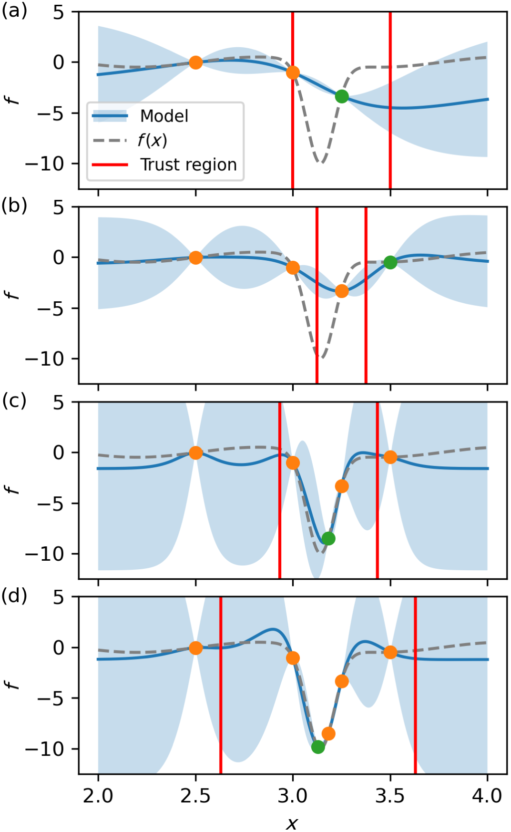
Application
Multi-objective regionalized Bayesian optimization(MORBO): An multi-objective algorithm that restricts optimization of the acquisition function to within a so-called trust region
As optimization progresses, the size of the trust region changes based on the number of consecutive successes or failure
R. Roussel et al. Phys. Rev. Accel. Beams 27. (2024).

Slide 13
Current stage

Slide 14
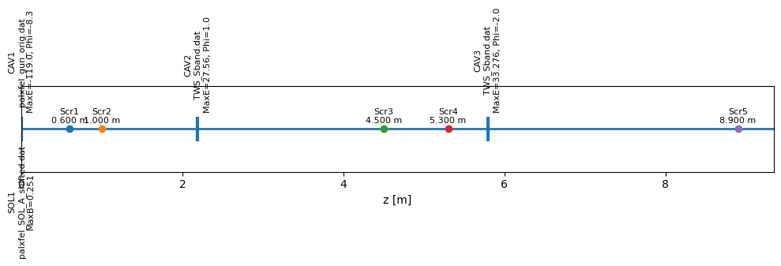
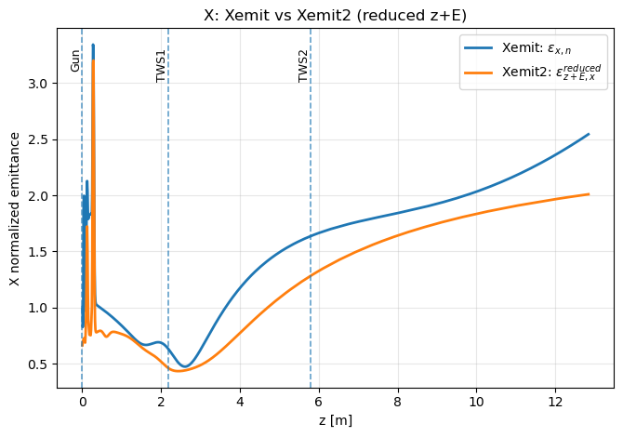
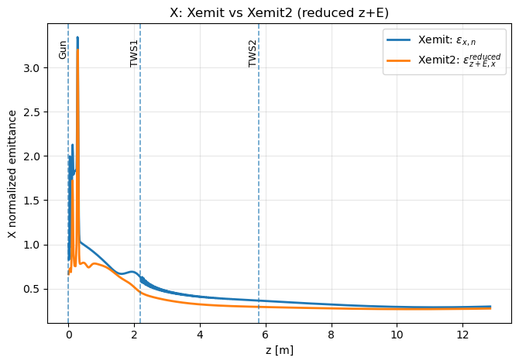

Practicing ASTRA simulation
 | TWS1(~2.19m) | TWS2(~5.79m) | Solenoid
Run1 | O | O | O
Run2 | X | X | O
Run4 | O | X | O
Run1
Run2:
RF 없으면 진동하다 발산
Run4
두 번째 RF는 energy gain 목적

Slide 15
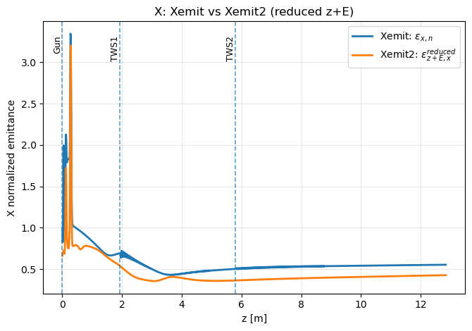
Practicing ASTRA simulation
z_peak=1.9296m 로 RF 이동

Slide 16
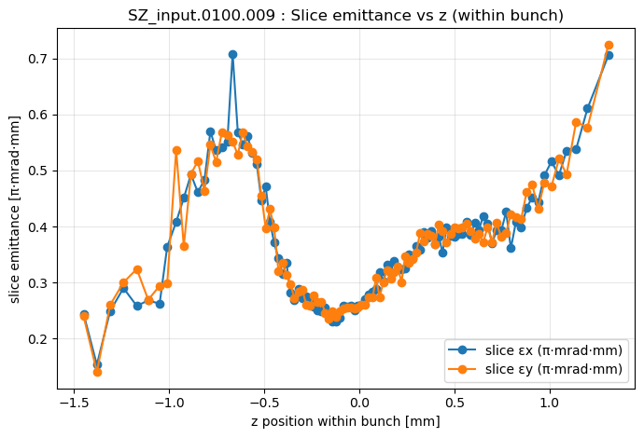
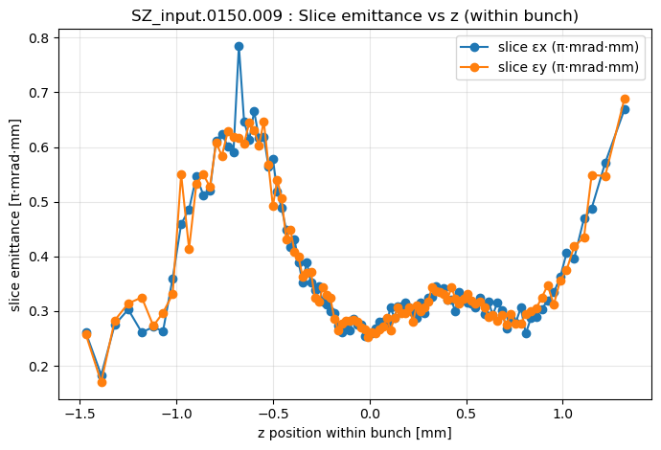
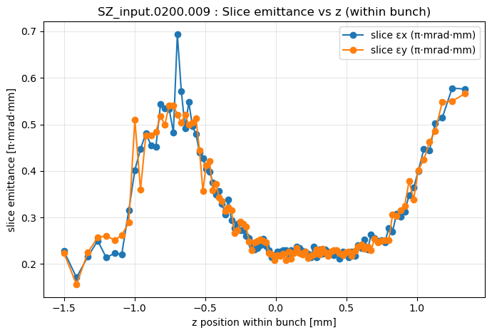
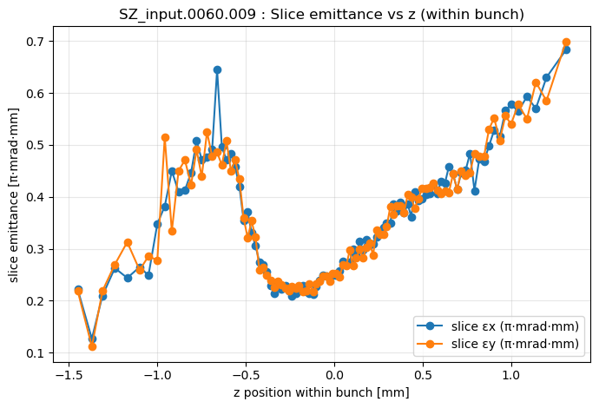
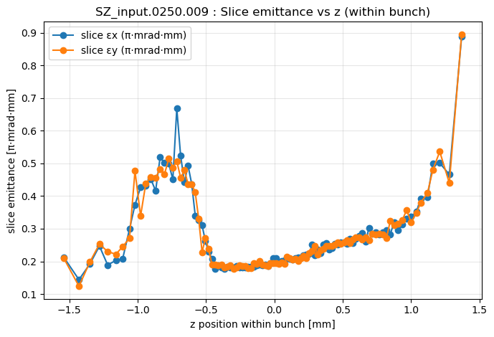
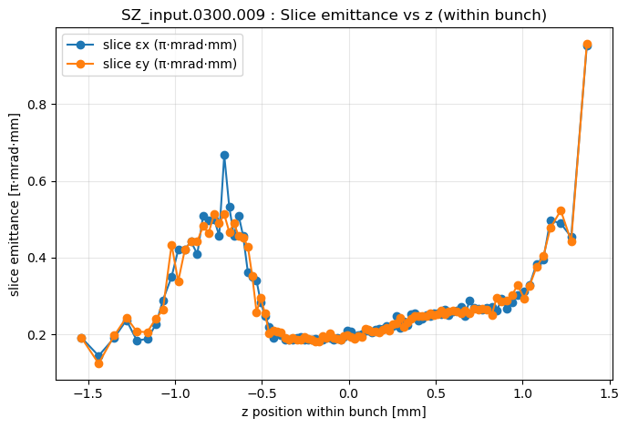
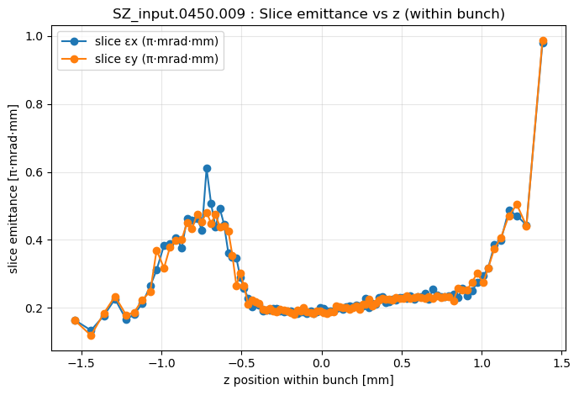

Slide 17
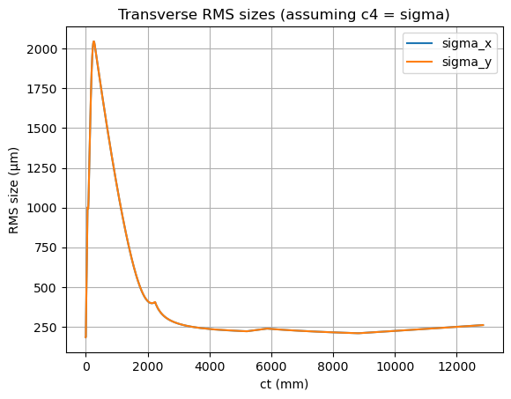
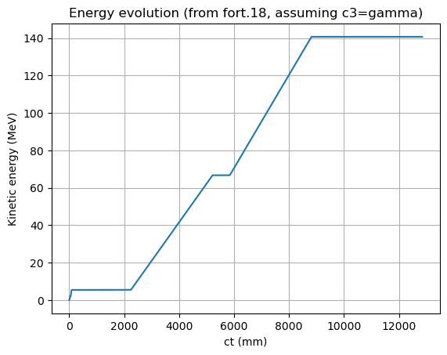
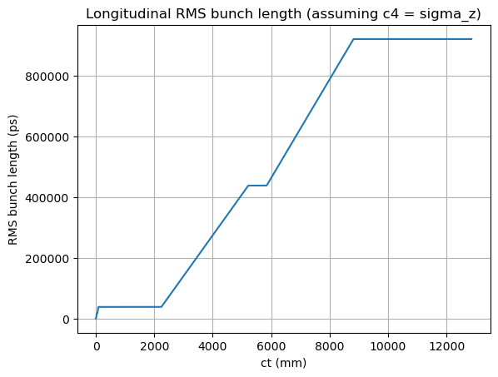
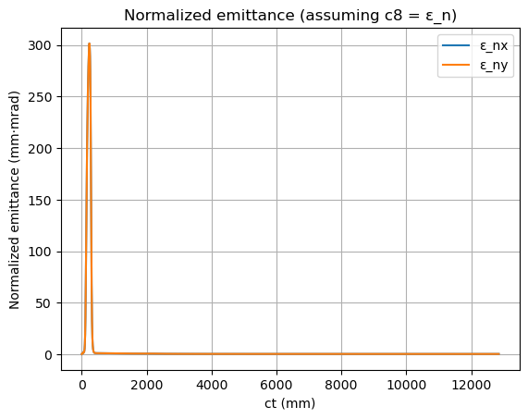
Practicing Impact-T

