Slide 1

Polarization radiation generated in a cylindrical channel in a screen of finite thickness and radius
Let’s consider, homogeneous, isotropic, nonmagnetic u=1
$$σ\left(ω\right)=\frac{iω}{4π}\left(1−ε\left(ω\right)\right), γ=\frac{E}{mc^{2}}=\frac{1}{\sqrt{1−β^{2}}}$$
$$∇×\vec{H}=−\frac{iω}{c}\vec{E}+\frac{4π}{c}{(\vec{j}}^{pol})$$
$$∇×\vec{E}=\frac{iω}{c}\vec{H}$$
Basic field
$$∇×{\vec{H}}^{0}=−\frac{iω}{c}{\vec{E}}^{0}$$
$$∇×{\vec{E}}^{0}=\frac{iω}{c}{\vec{H}}^{0}$$
$${\vec{j}}^{pol}=σ\left({\vec{E}}^{0}+{\vec{E}}^{pol}\left({\vec{j}}_{pol}\right)\right) \left({\vec{E}}^{0}:from eletron field without material, {\vec{E}}^{pol}:polarization current\right)$$
$$∇×{\vec{H}}^{pol}=−\frac{iω}{c}{\vec{E}}^{pol}+\frac{4π}{c}{\vec{j}}^{pol}$$
$$∇×{\vec{E}}^{pol}=\frac{iω}{c}{\vec{H}}^{pol}$$
$$\left(∇^{2}+\frac{ω^{2}}{c^{2}}\right){\vec{H}}^{pol}=−\frac{4π}{c}∇×{\vec{j}}^{pol}$$
$$\left(∇^{2}+\frac{ω^{2}}{c^{2}}\right){\vec{H}}^{pol}=−\frac{4π}{c}σ∇×\left({\vec{E}}^{0}+{\vec{E}}^{pol}\right)$$
$$\left(∇^{2}+\frac{ω^{2}}{c^{2}}+\frac{4πiωσ}{c^{2}}\right){\vec{H}}^{pol}=−\frac{4π}{c}σ∇×{\vec{E}}^{0}$$
$$\left(∇^{2}+ε\frac{ω^{2}}{c^{2}}\right){\vec{H}}^{pol}=−\frac{4π}{c}σ∇×{\vec{E}}^{0}$$

Slide 2

$$\left(∇^{2}+ε\frac{ω^{2}}{c^{2}}\right){\vec{H}}^{pol}=−\frac{4π}{c}σ∇×{\vec{E}}^{0}$$
유한한 영역에서 이 식의 해는 전류가 존재하는 영역 $V_{T}에$서만 적분함으로써 얻어짐
$(outgoing wave G_{out}\left(\vec{r},{\vec{r}}^{′}\right))를$ 고르면
$${\vec{H}}^{pol}\left(\vec{r},ω\right)=∇×\frac{1}{c}\int_{V_{T}}{d^{3}r^{′}σ\left(ω\right){\vec{E}}^{0}\left({\vec{r}}^{′},ω\right)×\frac{\exp{[\frac{i\sqrt{ε\left(ω\right)}ωR}{c}]}}{R}}⋯Diffraction radiation$$
$$=\frac{1}{c}\int_{V_{T}}{\frac{\vec{r}−\vec{r}′}{R}×σ\left(ω\right){\vec{E}}^{0}\left({\vec{r}}^{′},ω\right)×\left(i\sqrt{ε}\frac{ω}{c}−\frac{1}{R}\right)\frac{\exp{[\frac{i\sqrt{ε}ωR}{c}]}}{R}d^{3}r^{′}}$$
$r≫\frac{λ}{\sqrt{ε}},r≫r_{eff}^{′}인$ 조건 하에서는 (far field approx.)
관찰점 r이 멀리 있다면 보통,$R≈r−\hat{n}⋅{\vec{r}}^{′}, \frac{1}{R}≈\frac{1}{r} \left(\hat{n}=\frac{\vec{r}}{r}\right), k=\sqrt{ε}\frac{ω}{c}$
또, far field에서는 ${\vec{H}}^{pol}\left(\vec{r},ω\right)$ term이 지배적
$${\vec{H}}^{pol}≈{\vec{H}}^{R}=\sqrt{ε}\frac{iω}{c^{2}}\frac{\exp\left[\frac{i\sqrt{ε}ωr}{c}\right]}{R}\hat{e}×\int_{V_{T}}{σ\left(ω\right){\vec{E}}^{0}\left({\vec{r}}^{′},ω\right)\exp\left[−i\hat{k}⋅{\vec{r}}^{′}\right]d^{3}r^{′}}$$
$${\vec{E}}^{0}\left(\vec{r},ω\right)=\frac{eω}{πv^{2}γ}×\left(\frac{\vec{ρ}}{ρ}K_{1}\left[\frac{ωρ}{vγ}\right]−\frac{i}{γ }\frac{\vec{v}}{v}K_{0}\left[\frac{ωρ}{vγ}\right]\right)\exp{[i\frac{ω}{v}z]} (cylindrical coordi)$$
또한, Maxwell eq로부터
$${\vec{E}}^{pol}≈{\vec{E}}^{R}=−\frac{1}{\sqrt{ε}}\hat{k}×{\vec{H}}^{R}$$

Slide 3
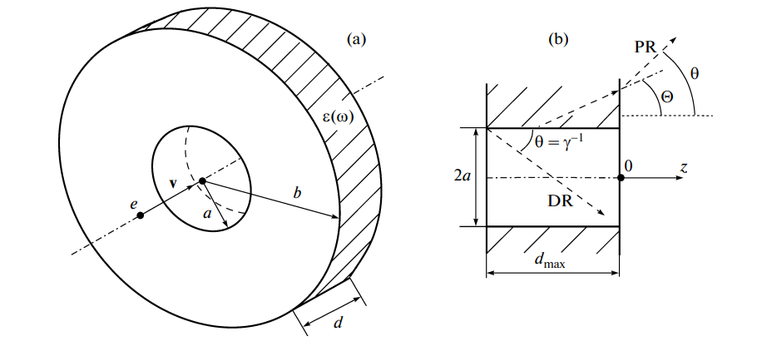


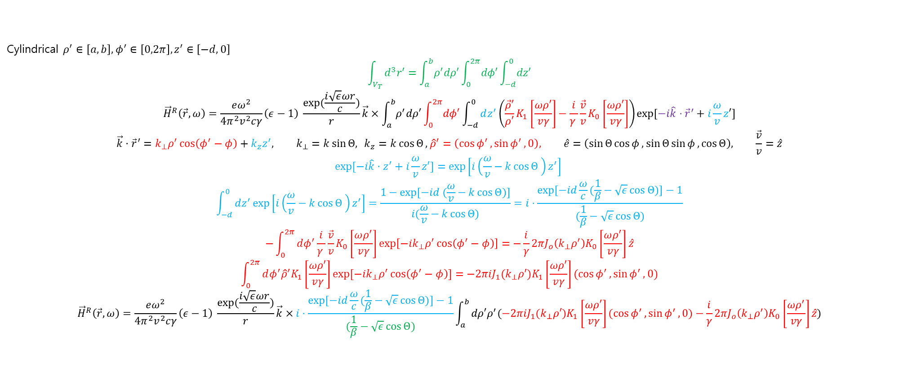
$${\vec{H}}^{pol}≈{\vec{H}}^{R}=\sqrt{ε}\frac{iω}{c^{2}}\frac{\exp\left[\frac{i\sqrt{ε}ωr}{c}\right]}{R}\hat{e}×\int_{V_{T}}{σ\left(ω\right){\vec{E}}^{0}\left({\vec{r}}^{′},ω\right)\exp\left[−i\hat{k}⋅{\vec{r}}^{′}\right]d^{3}r^{′}}$$
$${\vec{E}}^{pol}≈{\vec{E}}^{R}=−\frac{1}{\sqrt{ε}}\vec{e}×{\vec{H}}^{R}$$
$${\vec{E}}^{0}\left(\vec{r},ω\right)=\frac{eω}{πv^{2}γ}×\left(\frac{\vec{ρ}}{ρ}K_{1}\left[\frac{ωρ}{vγ}\right]−\frac{i}{γ }\frac{\vec{v}}{v}K_{0}\left[\frac{ωρ}{vγ}\right]\right)\exp{[i\frac{ω}{v}z]} (cylindrical coordi)$$
$$\vec{k}=\frac{\sqrt{ε}ω}{c}\hat{e}, σ\left(ω\right)=\frac{iω}{4π}(ε−1)$$
분$모에\frac{1}{β}−\sqrt{ε}\cos{Θ}$주목, Cherenkov pole
$$\cos{Θ}=\frac{ω}{kv}=\frac{1}{nβ}$$
$nβ>1일$ 때 cherenkov radiation 발생!!!!
Cylindrical $ρ^{′}∈\left[a,b\right], φ^{′}∈\left[0,2π\right], z^{′}∈\left[−d,0\right]$
$$\int_{V_{T}}{d^{3}r′}=\int_{a}^{b}{ρ^{′}dρ′}\int_{0}^{2π}{dφ′}\int_{−d}^{0}{dz′}$$
$${\vec{H}}^{R}\left(\vec{r},ω\right)=\frac{eω^{2}}{4π^{2}v^{2}cγ}\left(ε−1\right) \frac{\exp{(\frac{i\sqrt{ε}ωr}{c})}}{r}\vec{k}×\int_{a}^{b}{ρ^{′}dρ′}\int_{0}^{2π}{dφ′}\int_{−d}^{0}{dz^{′}\left(\frac{\vec{ρ}′}{ρ′}K_{1}\left[\frac{ωρ′}{vγ}\right]−\frac{i}{γ }\frac{\vec{v}}{v}K_{0}\left[\frac{ωρ′}{vγ}\right]\right)\exp{[−i\hat{k}⋅{\vec{r}}^{′}+i\frac{ω}{v}z′]}}$$
$$\vec{k}⋅{\vec{r}}^{′}=k_{⊥}ρ^{′}\cos\left(φ^{′}−φ\right)+k_{z}z^{′}, k_{⊥}=k\sin{Θ,} k_{z}=k\cos{Θ},{\hat{ρ}}^{′}=\left(\cos{φ^{′}},\sin{φ^{′}},0\right), \hat{e}=\left(\sin{Θ}\cos{φ},\sin{Θ}\sin{φ},\cos{Θ}\right), \frac{\vec{v}}{v}=\hat{z}$$
$$\exp{[−i\hat{k}⋅z^{′}+i\frac{ω}{v}z′]}=\exp\left[i\left(\frac{ω}{v}−k\cos{Θ} \right)z^{′}\right]$$
$$\int_{−d}^{0}{dz^{′}\exp\left[i\left(\frac{ω}{v}−k\cos{Θ} \right)z^{′}\right]}=\frac{1−\exp{[−id (\frac{ω}{v}−k\cos{Θ})]}}{i(\frac{ω}{v}−k\cos{Θ})}=i⋅\frac{\exp{[−id\frac{ω}{c}(\frac{1}{β}−\sqrt{ε}\cos{Θ})]}−1}{(\frac{1}{β}−\sqrt{ε}\cos{Θ)}}$$
$$−\int_{0}^{2π}{dφ^{′}\frac{i}{γ }\frac{\vec{v}}{v}K_{0}\left[\frac{ωρ^{′}}{vγ}\right]\exp\left[−ik_{⊥}ρ^{′}\cos\left(φ^{′}−φ\right)\right]}=−\frac{i}{γ}2πJ_{o}\left(k_{⊥}ρ^{′}\right)K_{0}\left[\frac{ωρ^{′}}{vγ}\right]\hat{z}$$
$$\int_{0}^{2π}{dφ^{′}{\hat{ρ}}^{′}K_{1}\left[\frac{ωρ′}{vγ}\right]\exp{[−ik_{⊥}ρ^{′}\cos\left(φ^{′}−φ\right)]}}=−2πiJ_{1}(k_{⊥}ρ′)K_{1}\left[\frac{ωρ′}{vγ}\right](\cos{φ^{′}},\sin{φ^{′}},0)$$
$${\vec{H}}^{R}\left(\vec{r},ω\right)=\frac{eω^{2}}{4π^{2}v^{2}cγ}\left(ε−1\right) \frac{\exp{(\frac{i\sqrt{ε}ωr}{c})}}{r}\vec{k}×i⋅\frac{\exp{[−id\frac{ω}{c}(\frac{1}{β}−\sqrt{ε}\cos{Θ})]}−1}{(\frac{1}{β}−\sqrt{ε}\cos{Θ)}}\int_{a}^{b}{dρ′ρ^{′}(−2πiJ_{1}(k_{⊥}ρ′)K_{1}\left[\frac{ωρ′}{vγ}\right](\cos{φ^{′}},\sin{φ^{′}},0)−\frac{i}{γ}2πJ_{o}\left(k_{⊥}ρ^{′}\right)K_{0}\left[\frac{ωρ^{′}}{vγ}\right]\hat{z})}$$

Slide 4

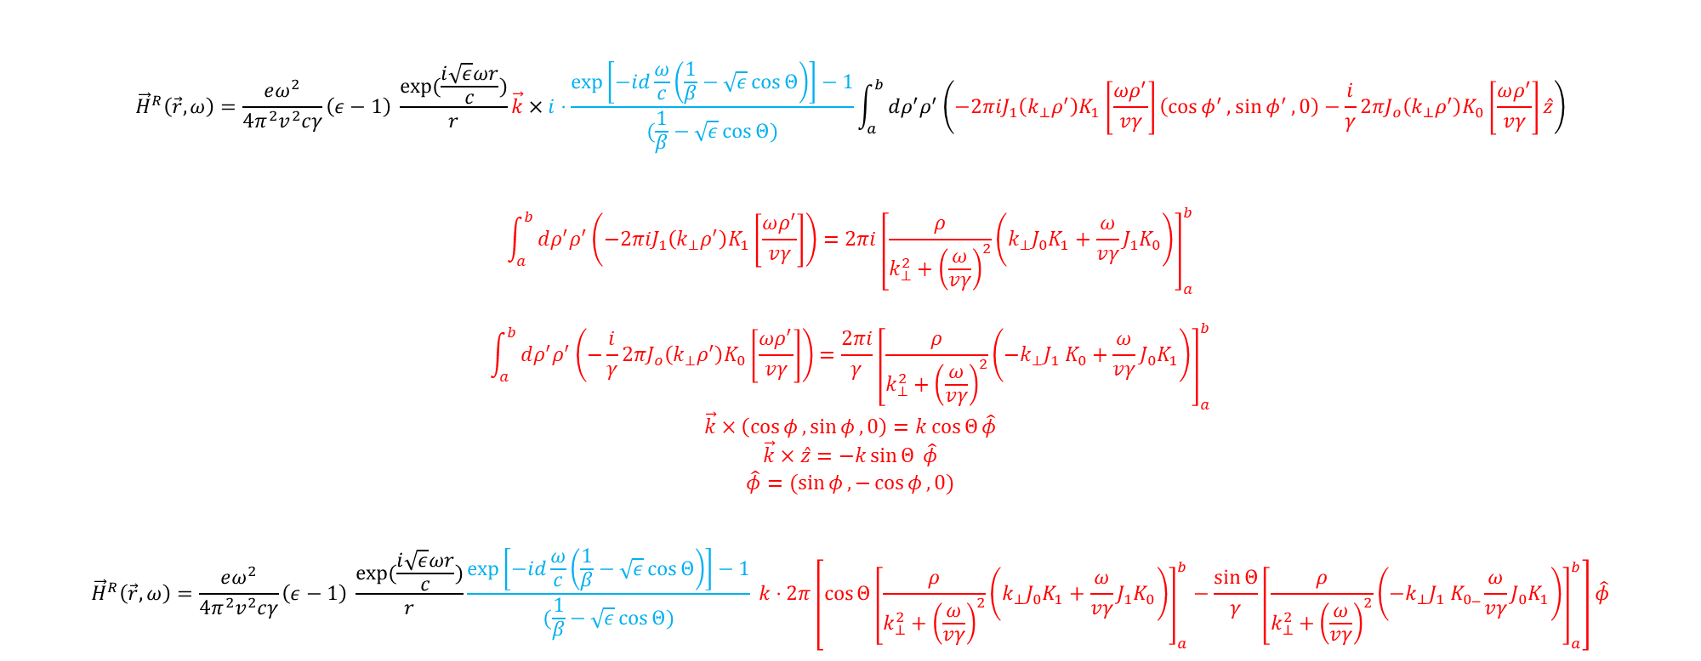
$${\vec{H}}^{R}\left(\vec{r},ω\right)=\frac{eω^{2}}{4π^{2}v^{2}cγ}\left(ε−1\right) \frac{\exp{(\frac{i\sqrt{ε}ωr}{c})}}{r}\vec{k}×i⋅\frac{\exp\left[−id\frac{ω}{c}\left(\frac{1}{β}−\sqrt{ε}\cos{Θ}\right)\right]−1}{(\frac{1}{β}−\sqrt{ε}\cos{Θ)}}\int_{a}^{b}{dρ^{′}ρ^{′}\left(−2πiJ_{1}\left(k_{⊥}ρ^{′}\right)K_{1}\left[\frac{ωρ^{′}}{vγ}\right]\left(\cos{φ^{′}},\sin{φ^{′}},0\right)−\frac{i}{γ}2πJ_{o}\left(k_{⊥}ρ^{′}\right)K_{0}\left[\frac{ωρ^{′}}{vγ}\right]\hat{z}\right)}$$
$$\int_{a}^{b}{dρ^{′}ρ^{′}\left(−2πiJ_{1}\left(k_{⊥}ρ^{′}\right)K_{1}\left[\frac{ωρ^{′}}{vγ}\right]\right)}=2πi{\left[\frac{ρ}{k_{⊥}^{2}+{\left(\frac{ω}{vγ}\right)}^{2}}\left(k_{⊥}J_{0}K_{1}+\frac{ω}{vγ}J_{1}K_{0}\right)\right]}_{a}^{b}$$
$$\int_{a}^{b}{dρ^{′}ρ^{′}\left(−\frac{i}{γ}2πJ_{o}\left(k_{⊥}ρ^{′}\right)K_{0}\left[\frac{ωρ^{′}}{vγ}\right]\right)}=\frac{2πi}{γ}{\left[\frac{ρ}{k_{⊥}^{2}+{\left(\frac{ω}{vγ}\right)}^{2}}\left(−k_{⊥}J_{1} K_{0}+\frac{ω}{vγ}J_{0}K_{1}\right)\right]}_{a}^{b}$$
$$\vec{k}×\left(\cos{φ},\sin{φ},0\right)=k\cos{Θ}\hat{φ}$$
$$\vec{k}×\hat{z}=−k\sin{Θ} \hat{φ}$$
$$\hat{φ}=(\sin{φ},−\cos{φ},0)$$
$${\vec{H}}^{R}\left(\vec{r},ω\right)=\frac{eω^{2}}{4π^{2}v^{2}cγ}\left(ε−1\right) \frac{\exp{(\frac{i\sqrt{ε}ωr}{c})}}{r}\frac{\exp\left[−id\frac{ω}{c}\left(\frac{1}{β}−\sqrt{ε}\cos{Θ}\right)\right]−1}{(\frac{1}{β}−\sqrt{ε}\cos{Θ)}} k⋅2π\left[\cos{Θ}{\left[\frac{ρ}{k_{⊥}^{2}+{\left(\frac{ω}{vγ}\right)}^{2}}\left(k_{⊥}J_{0}K_{1}+\frac{ω}{vγ}J_{1}K_{0}\right)\right]}_{a}^{b}−\frac{\sin{Θ}}{γ}{\left[\frac{ρ}{k_{⊥}^{2}+{\left(\frac{ω}{vγ}\right)}^{2}}\left(−k_{⊥}J_{1} K_{0}_\frac{ω}{vγ}J_{0}K_{1}\right)\right]}_{a}^{b}\right]\hat{φ}$$
$$(\frac{1}{β}−\sqrt{ε}\cos{Θ)}$$

Slide 5
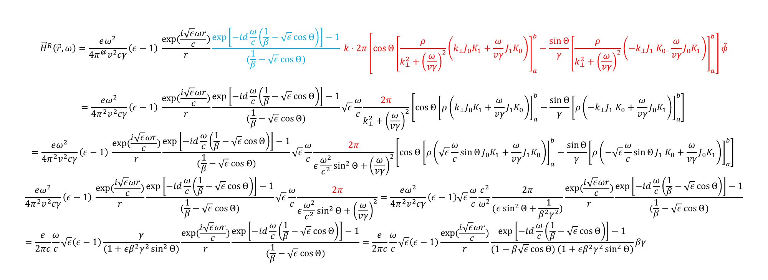

$${\vec{H}}^{R}\left(\vec{r},ω\right)=\frac{eω^{2}}{4π^{@}v^{2}cγ}\left(ε−1\right) \frac{\exp{(\frac{i\sqrt{ε}ωr}{c})}}{r}\frac{\exp\left[−id\frac{ω}{c}\left(\frac{1}{β}−\sqrt{ε}\cos{Θ}\right)\right]−1}{(\frac{1}{β}−\sqrt{ε}\cos{Θ)}} k⋅2π\left[\cos{Θ}{\left[\frac{ρ}{k_{⊥}^{2}+{\left(\frac{ω}{vγ}\right)}^{2}}\left(k_{⊥}J_{0}K_{1}+\frac{ω}{vγ}J_{1}K_{0}\right)\right]}_{a}^{b}−\frac{\sin{Θ}}{γ}{\left[\frac{ρ}{k_{⊥}^{2}+{\left(\frac{ω}{vγ}\right)}^{2}}\left(−k_{⊥}J_{1} K_{0}_\frac{ω}{vγ}J_{0}K_{1}\right)\right]}_{a}^{b}\right]\hat{φ}$$
$$=\frac{eω^{2}}{4π^{2}v^{2}cγ}\left(ε−1\right) \frac{\exp{(\frac{i\sqrt{ε}ωr}{c})}}{r}\frac{\exp\left[−id\frac{ω}{c}\left(\frac{1}{β}−\sqrt{ε}\cos{Θ}\right)\right]−1}{(\frac{1}{β}−\sqrt{ε}\cos{Θ)}}\sqrt{ε}\frac{ω}{c}\frac{2π}{k_{⊥}^{2}+{\left(\frac{ω}{vγ}\right)}^{2}}\left[\cos{Θ}{\left[ρ\left(k_{⊥}J_{0}K_{1}+\frac{ω}{vγ}J_{1}K_{0}\right)\right]}_{a}^{b}−\frac{\sin{Θ}}{γ}{\left[ρ\left(−k_{⊥}J_{1} K_{0}+\frac{ω}{vγ}J_{0}K_{1}\right)\right]}_{a}^{b}\right]$$
$$=\frac{eω^{2}}{4π^{2}v^{2}cγ}\left(ε−1\right) \frac{\exp{(\frac{i\sqrt{ε}ωr}{c})}}{r}\frac{\exp\left[−id\frac{ω}{c}\left(\frac{1}{β}−\sqrt{ε}\cos{Θ}\right)\right]−1}{(\frac{1}{β}−\sqrt{ε}\cos{Θ)}}\sqrt{ε}\frac{ω}{c}\frac{2π}{ε\frac{ω^{2}}{c^{2}}\sin^{2}{Θ}+{\left(\frac{ω}{vγ}\right)}^{2}}\left[\cos{Θ}{\left[ρ\left(\sqrt{ε}\frac{ω}{c}\sin{Θ}J_{0}K_{1}+\frac{ω}{vγ}J_{1}K_{0}\right)\right]}_{a}^{b}−\frac{\sin{Θ}}{γ}{\left[ρ\left(−\sqrt{ε}\frac{ω}{c}\sin{Θ}J_{1} K_{0}+\frac{ω}{vγ}J_{0}K_{1}\right)\right]}_{a}^{b}\right]$$
$$\frac{eω^{2}}{4π^{2}v^{2}cγ}\left(ε−1\right) \frac{\exp{(\frac{i\sqrt{ε}ωr}{c})}}{r}\frac{\exp\left[−id\frac{ω}{c}\left(\frac{1}{β}−\sqrt{ε}\cos{Θ}\right)\right]−1}{(\frac{1}{β}−\sqrt{ε}\cos{Θ)}}\sqrt{ε}\frac{ω}{c}\frac{2π}{ε\frac{ω^{2}}{c^{2}}\sin^{2}{Θ}+{\left(\frac{ω}{vγ}\right)}^{2}}=\frac{eω^{2}}{4π^{2}v^{2}cγ}\left(ε−1\right)\sqrt{ε}\frac{ω}{c}\frac{c^{2}}{ω^{2}}\frac{2π}{(ε\sin^{2}{Θ}+\frac{1}{β^{2}γ^{2}})}\frac{\exp{(\frac{i\sqrt{ε}ωr}{c})}}{r}\frac{\exp\left[−id\frac{ω}{c}\left(\frac{1}{β}−\sqrt{ε}\cos{Θ}\right)\right]−1}{(\frac{1}{β}−\sqrt{ε}\cos{Θ)}}=\frac{e}{2πc}\frac{ω}{c}\sqrt{ε}\left(ε−1\right)\frac{γ}{(1+εβ^{2}γ^{2}\sin^{2}{Θ})}\frac{\exp{(\frac{i\sqrt{ε}ωr}{c})}}{r}\frac{\exp\left[−id\frac{ω}{c}\left(\frac{1}{β}−\sqrt{ε}\cos{Θ}\right)\right]−1}{(\frac{1}{β}−\sqrt{ε}\cos{Θ)}}=\frac{e}{2πc}\frac{ω}{c}\sqrt{ε}\left(ε−1\right)\frac{\exp{(\frac{i\sqrt{ε}ωr}{c})}}{r}\frac{\exp\left[−id\frac{ω}{c}\left(\frac{1}{β}−\sqrt{ε}\cos{Θ}\right)\right]−1}{(1−β\sqrt{ε}\cos{Θ)}(1+εβ^{2}γ^{2}\sin^{2}{Θ})}βγ$$
$$\frac{dW}{dωdΩ}=\frac{cr^{2}}{\left|ε^{2}\right|}{\left|{\vec{H}}^{R}\right|}^{2}$$

