Slide 1
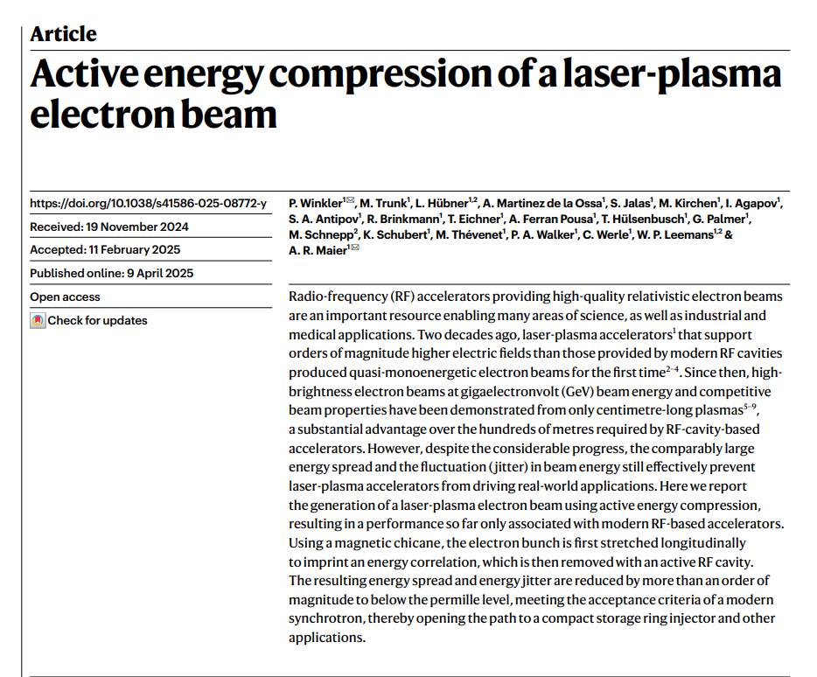
Active energy compression of a laser-plasma electron beam
2026-01-16, Pohang, South Korea
Young Min Park
Division of Advanced Nuclear Engineering (DANE), POSTECH

Slide 2
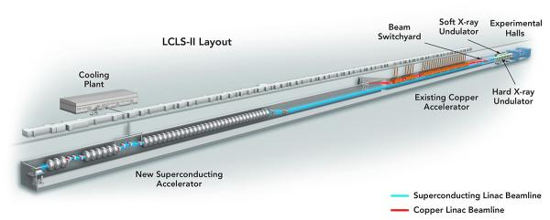
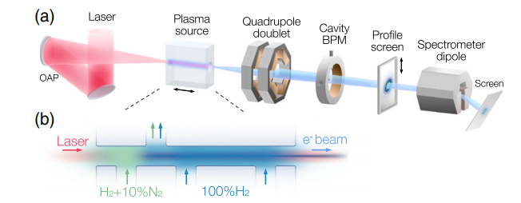
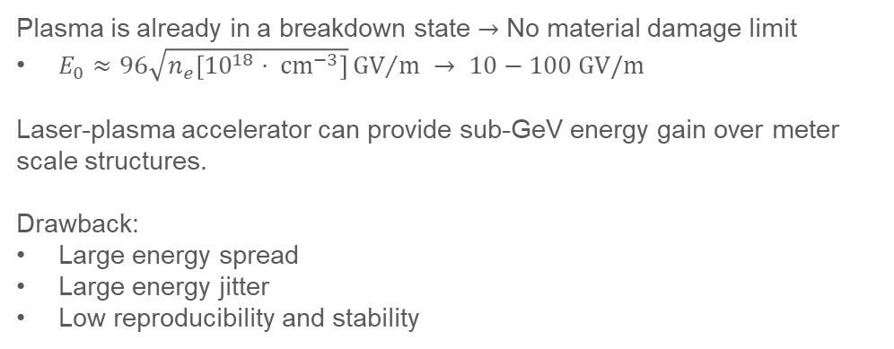
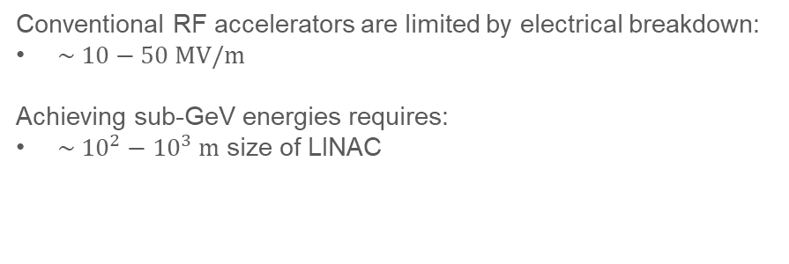
Introduction
Conventional RF accelerator:
Conventional RF accelerators are limited by electrical breakdown:
$\sim 10−50 MV/m$
Achieving sub-GeV energies requires:
$\sim {10}^{2}−{10}^{3} m$ size of LINAC
Laser-plasma accelerator:
Plasma is already in a breakdown state $→$ No material damage limit
$E_{0}≈96\sqrt{n_{e}\left[{10}^{18}⋅ cm^{−3}\right]}{GV}/m → 10−100 GV/m$
Laser-plasma accelerator can provide sub-GeV energy gain over meter scale structures.
Drawback:
Large energy spread
Large energy jitter
Low reproducibility and stability
Active energy compression
2

Slide 3
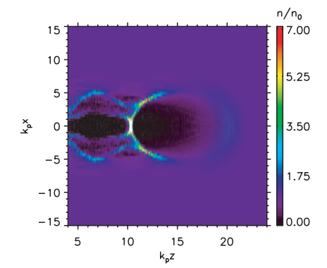
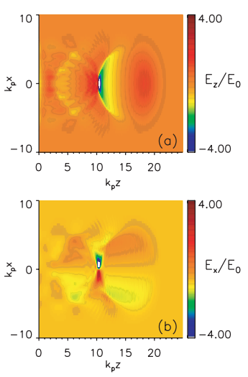
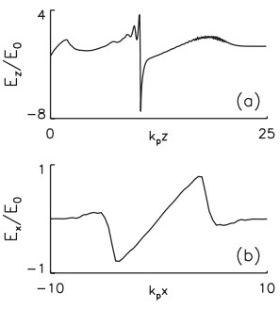
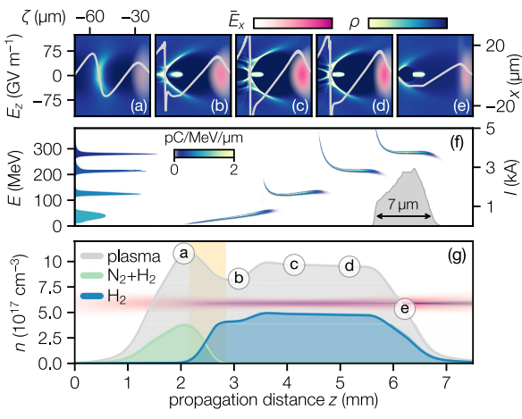
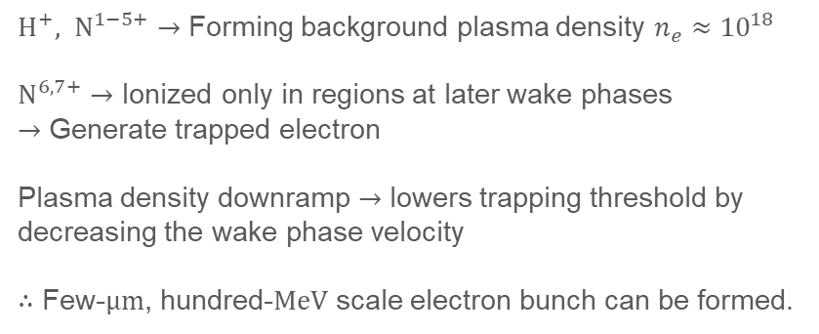
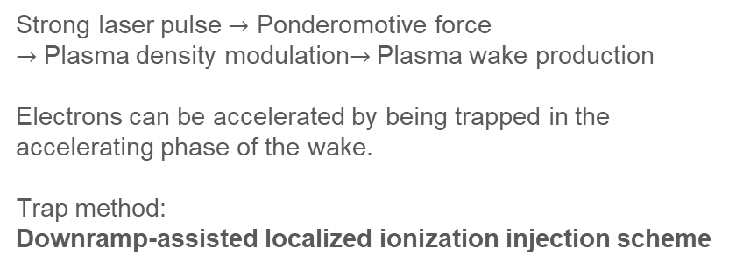
Laser-plasma accelerators
Laser-plasma accelerators
Oriented by Tajima et al., Laser Electron Accelerator, Phys. Rev. Lett, 1979.
Strong laser pulse $→$ Ponderomotive force $→$ Plasma density modulation$→$ Plasma wake production
Electrons can be accelerated by being trapped in the accelerating phase of the wake.
Trap method: Downramp-assisted localized ionization injection scheme
Downramp-assisted localized ionization injection scheme
$H^{+}, N^{1−5+}→$ Forming background plasma density $n_{e}≈{10}^{18}$
$N^{6,7+}→$ Ionized only in regions at later wake phases $→$ Generate trapped electron
Plasma density downramp $→$ lowers trapping threshold by decreasing the wake phase velocity
$∴$ Few-$μm$, hundred-$MeV$ scale electron bunch can be formed.
3

Slide 4
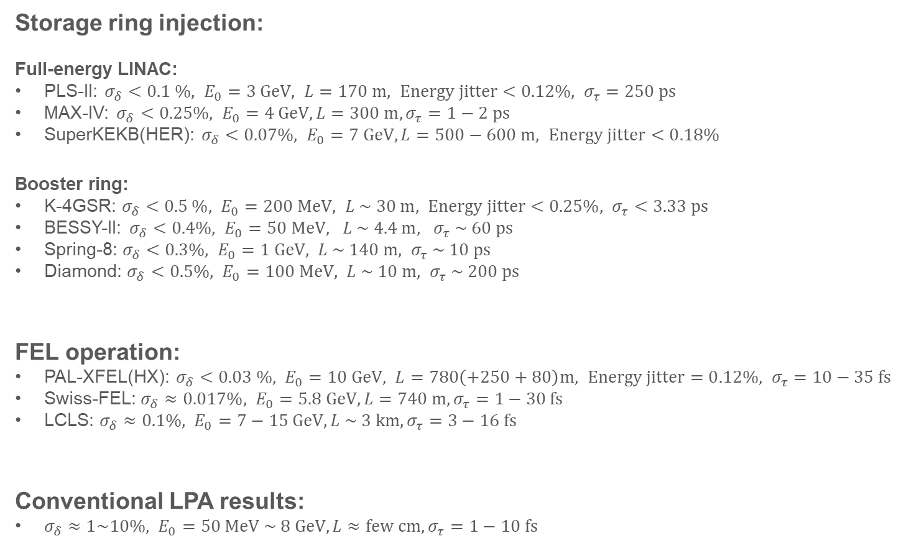
Required conditions of LINAC
Storage ring injection:
Full-energy LINAC:
PLS-II: $σ_{δ}<0.1 \%, E_{0}=3 GeV, L=170 m, Energy jitter<0.12\%, σ_{τ}=250 ps$
MAX-IV: $σ_{δ}<0.25\%, E_{0}=4 GeV, L=300 m, σ_{τ}=1−2 ps$
SuperKEKB(HER): $σ_{δ}<0.07\%, E_{0}=7 GeV, L=500−600 m, Energy jitter<0.18\%$
Booster ring:
K-4GSR: $σ_{δ}<0.5 \%, E_{0}=200 MeV, L \sim 30 m, Energy jitter<0.25\%, σ_{τ}<3.33 ps$
BESSY-II: $σ_{δ}<0.4\%, E_{0}=50 MeV, L \sim 4.4 m, σ_{τ} \sim 60 ps$
Spring-8: $σ_{δ}<0.3\%, E_{0}=1 GeV, L \sim 140 m, σ_{τ} \sim 10 ps$
Diamond: $σ_{δ}<0.5\%, E_{0}=100 MeV, L \sim 10 m, σ_{τ} \sim 200 ps$
FEL operation:
PAL-XFEL(HX): $σ_{δ}<0.03 \%, E_{0}=10 GeV, L=780\left(+250+80\right)m, Energy jitter=0.12\%, σ_{τ}=10−35 fs$
Swiss-FEL: $σ_{δ}≈0.017\%, E_{0}=5.8 GeV, L=740 m, σ_{τ}=1−30 fs$
LCLS: $σ_{δ}≈0.1\%, E_{0}=7−15 GeV, L \sim 3 km, σ_{τ}=3−16 fs$
Conventional LPA results:
$σ_{δ}≈1\sim 10\%, E_{0}=50 MeV \sim 8 GeV, L≈few cm, σ_{τ}=1−10 fs$
4

Slide 5
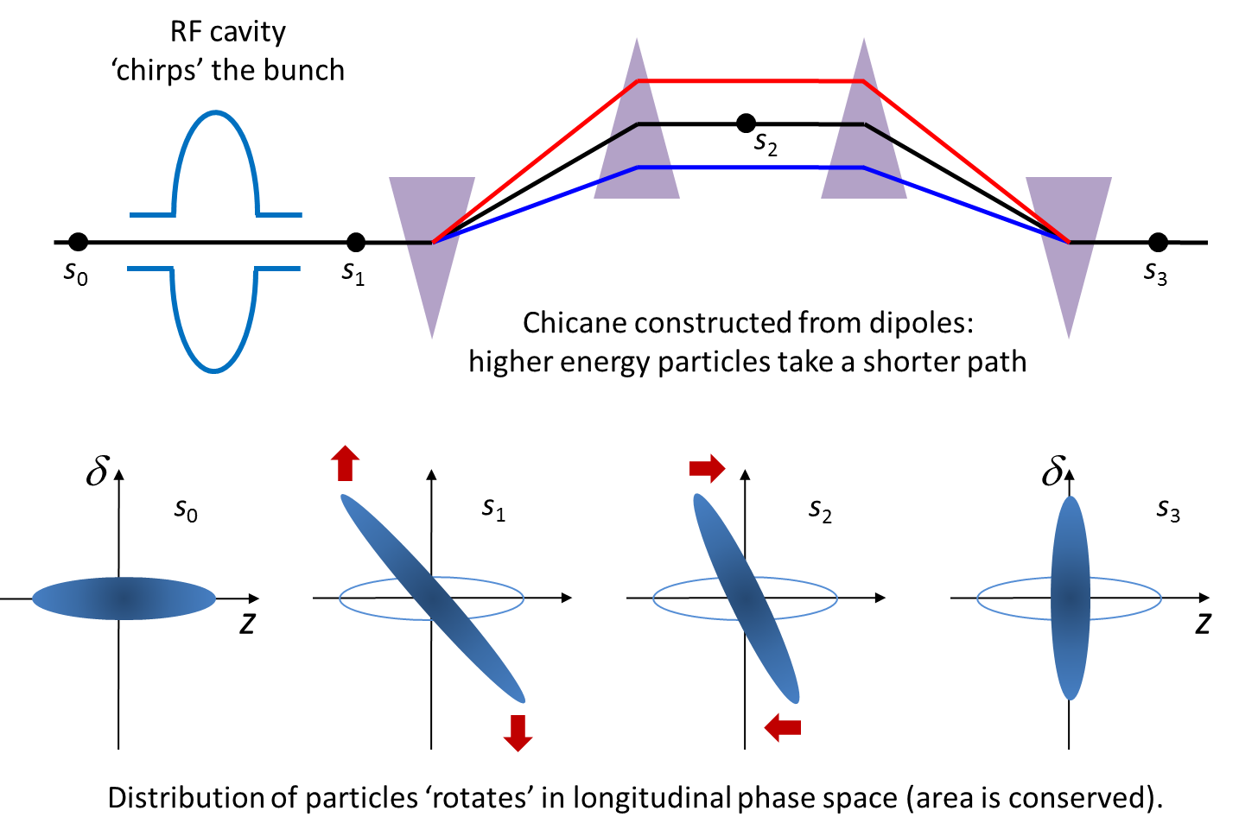
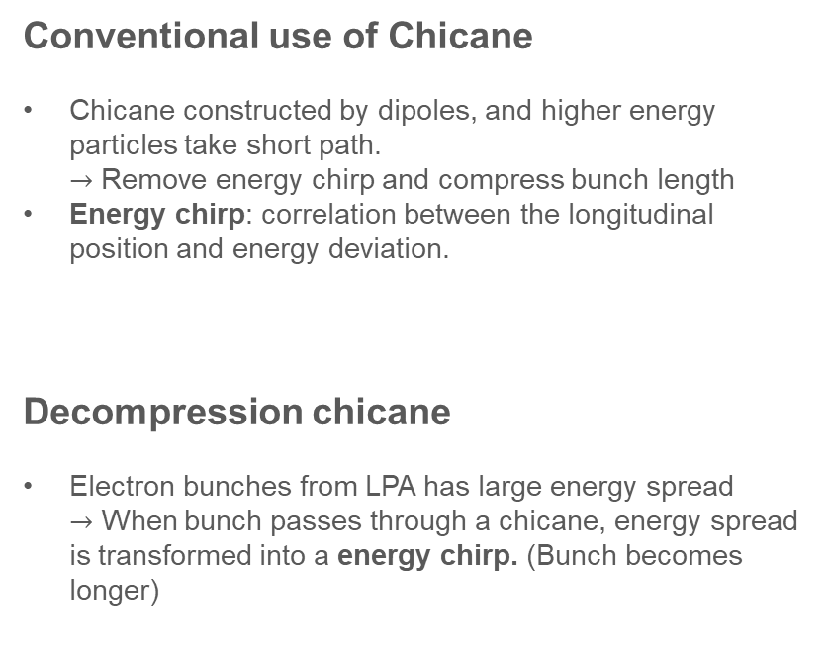
Main elements
Decompression Chicane
Conventional use of Chicane
Chicane constructed by dipoles, and higher energy particles take short path. $→$ Remove energy chirp and compress bunch length
Energy chirp: correlation between the longitudinal position and energy deviation.
Decompression chicane
Electron bunches from LPA has large energy spread $→$ When bunch passes through a chicane, energy spread is transformed into a energy chirp. (Bunch becomes longer)
5

Slide 6
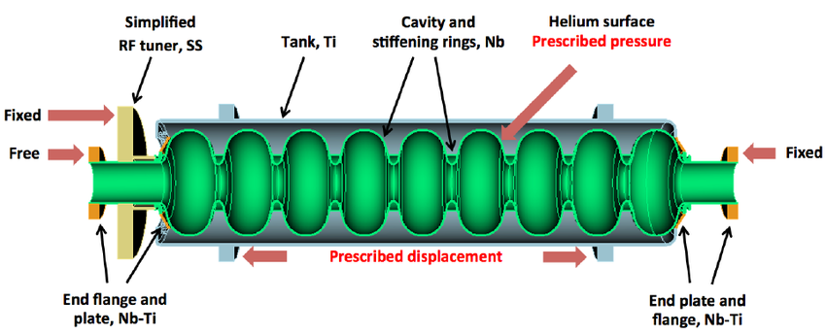
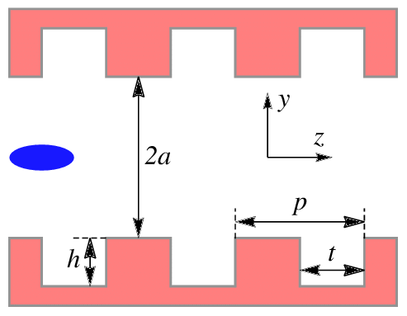
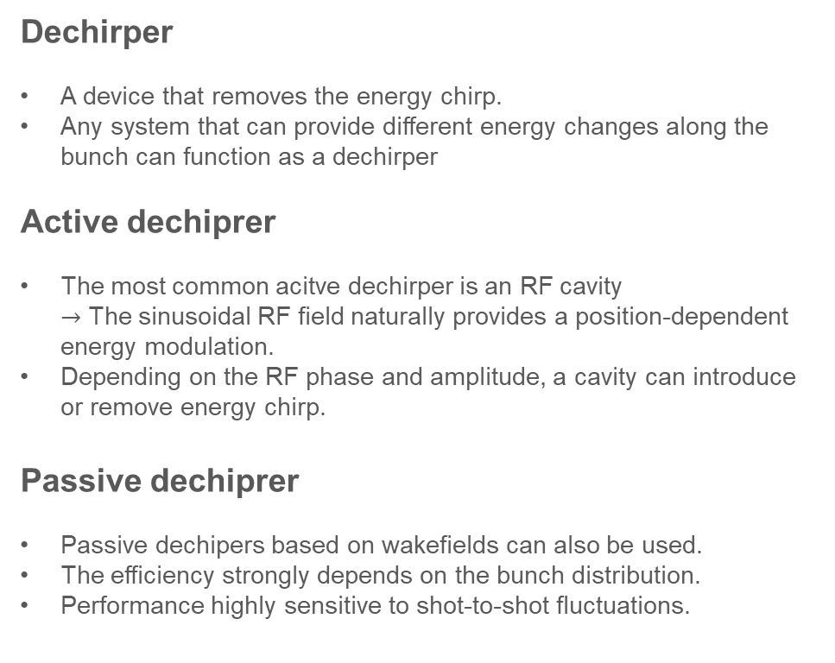
Main elements
Dechirper cavity
Active dechirper
Dechirper
A device that removes the energy chirp.
Any system that can provide different energy changes along the bunch can function as a dechirper
Active dechiprer
The most common acitve dechirper is an RF cavity $→$ The sinusoidal RF field naturally provides a position-dependent energy modulation.
Depending on the RF phase and amplitude, a cavity can introduce or remove energy chirp.
Passive dechiprer
Passive dechipers based on wakefields can also be used.
The efficiency strongly depends on the bunch distribution.
Performance highly sensitive to shot-to-shot fluctuations.
Passive dechirper
6

Slide 7
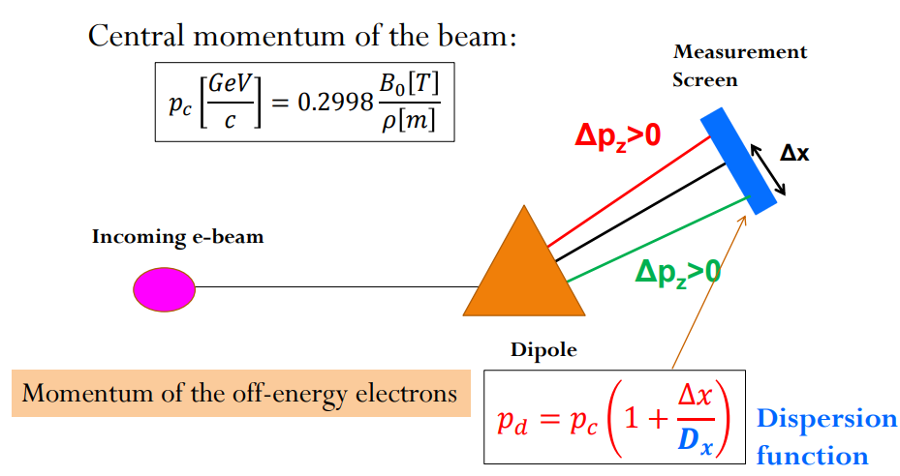
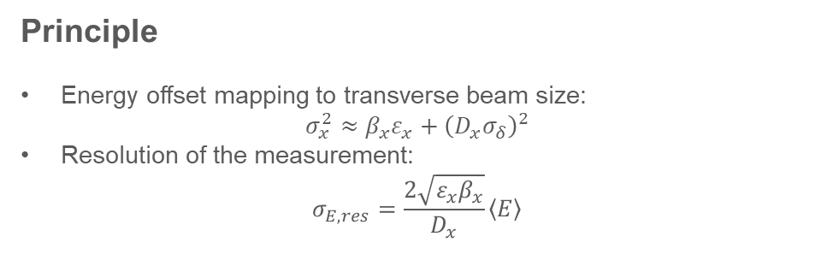
Main elements
Spectrometer
Principle
Energy offset mapping to transverse beam size:
$$σ_{x}^{2}≈β_{x}ε_{x}+{\left(D_{x}σ_{δ}\right)}^{2}$$
Resolution of the measurement: $σ_{E,res}=\frac{2\sqrt{ε_{x}β_{x}}}{D_{x}}\left\langle E\right\rangle$
7

Slide 8
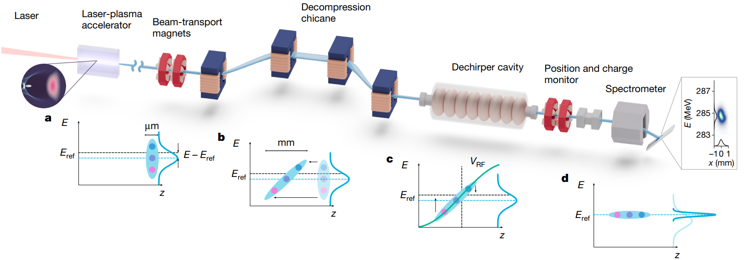
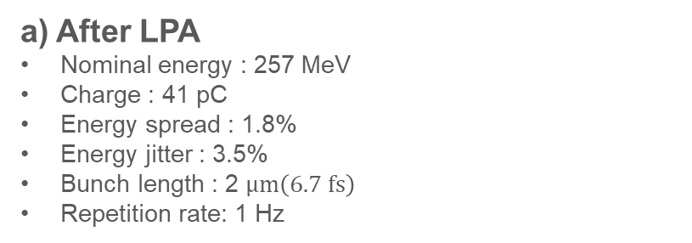
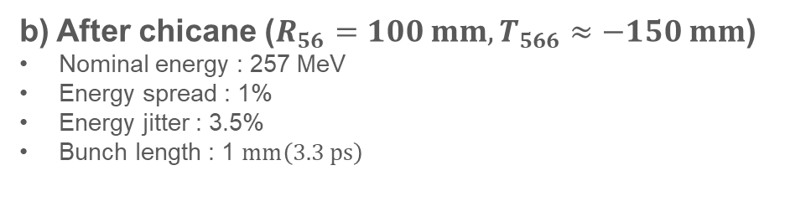
Active energy compression concept
a) After LPA
Nominal energy : 257 MeV
Charge : 41 pC
Energy spread : 1.8%
Energy jitter : 3.5%
Bunch length : 2 $μm\left(6.7 fs\right)$
Repetition rate: 1 Hz
b) After chicane ($R_{56}=100 mm, T_{566}≈−150 mm$)
Nominal energy : 257 MeV
Energy spread : 1%
Energy jitter : 3.5%
Bunch length : 1 $mm\left(3.3 ps\right)$
8

Slide 9
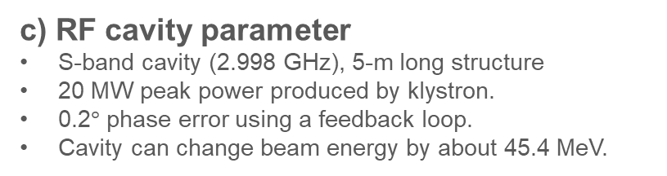
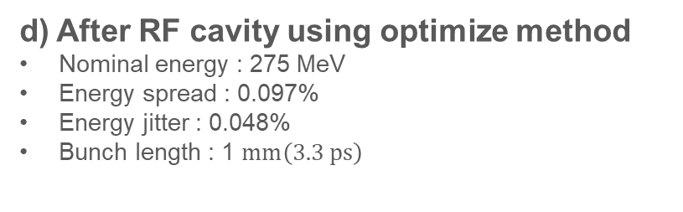
Active energy compression concept
c) RF cavity parameter
S-band cavity (2.998 GHz), 5-m long structure
20 MW peak power produced by klystron.
0.2$°$ phase error using a feedback loop.
Cavity can change beam energy by about 45.4 MeV.
d) After RF cavity using optimize method
Nominal energy : 275 MeV
Energy spread : 0.097%
Energy jitter : 0.048%
Bunch length : 1 $mm\left(3.3 ps\right)$
9

Slide 10
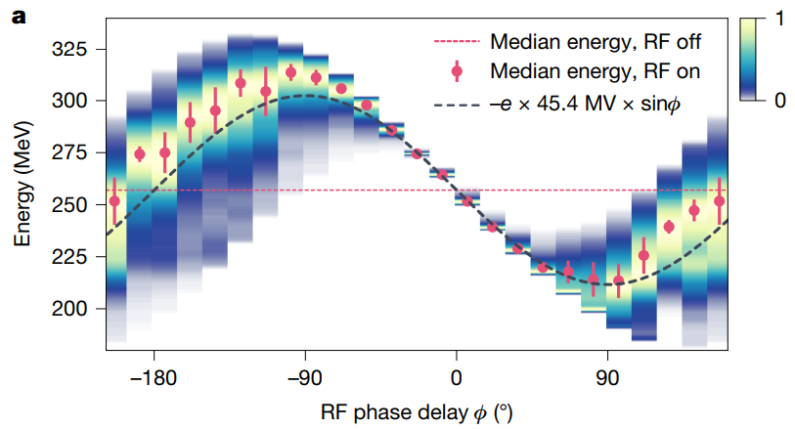
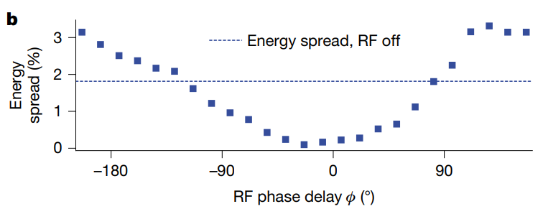
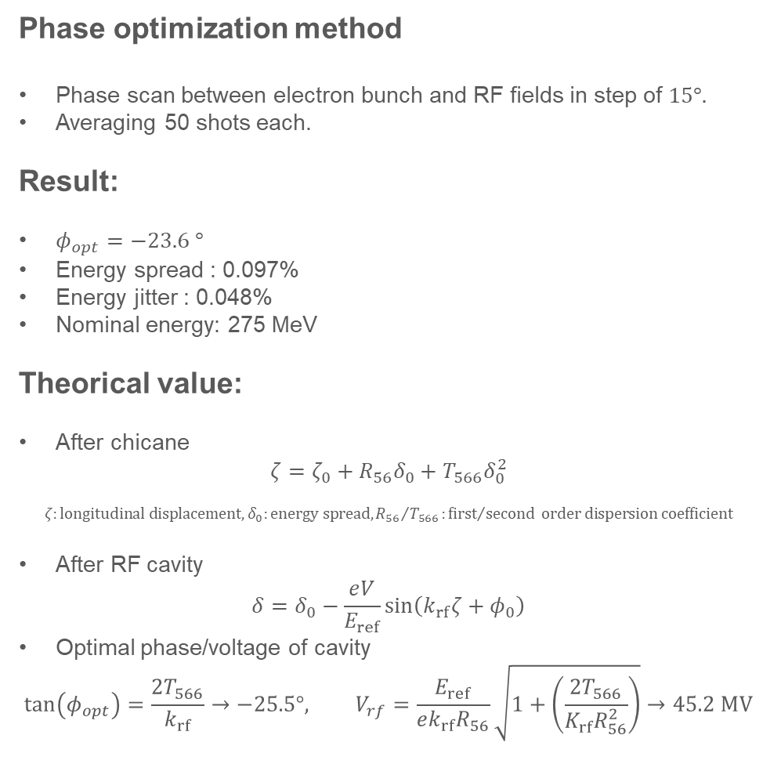
Phase scan result
Phase optimization method
Phase scan between electron bunch and RF fields in step of $15°.$
Averaging 50 shots each.
Result:
$φ_{opt}=−23.6 °$
Energy spread : 0.097%
Energy jitter : 0.048%
Nominal energy: 275 MeV
Theorical value:
After chicane
$$ζ=ζ_{0}+R_{56}δ_{0}+T_{566}δ_{0}^{2}$$
$$ζ:longitudinal displacement, δ_{0}:energy spread,{R_{56}}/{T_{566}}:{first}/{second} order dispersion coefficient$$
After RF cavity
$$δ=δ_{0}−\frac{eV}{E_{ref}}\sin\left(k_{rf}ζ+φ_{0}\right)$$
Optimal phase/voltage of cavity
$$\tan\left(φ_{opt}\right)=\frac{2T_{566}}{k_{rf}}→−25.5°, V_{rf}=\frac{E_{ref}}{ek_{rf}R_{56}}\sqrt{1+\left(\frac{2T_{566}}{K_{rf}R_{56}^{2}}\right)}→45.2 MV$$
10

Slide 11
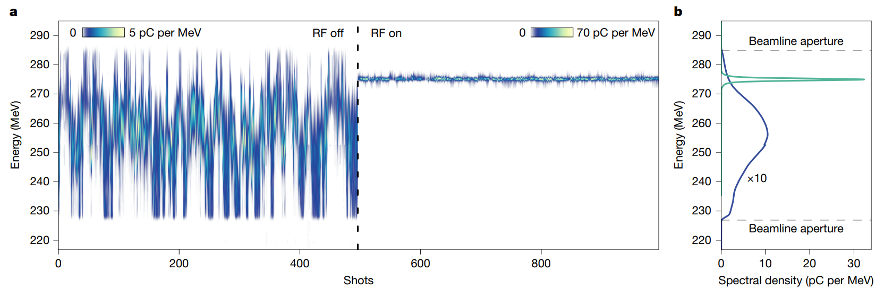
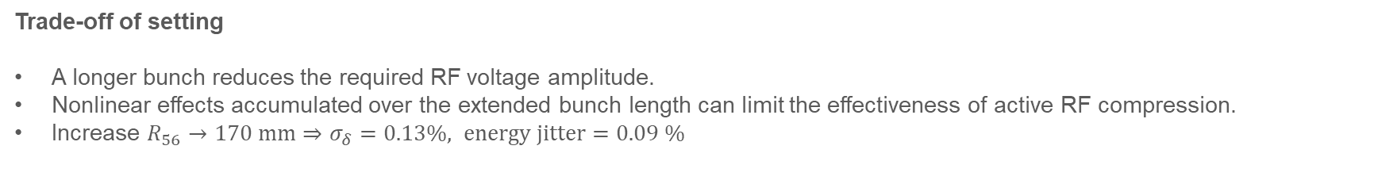
Final result
Spectra density of result
Trade-off of setting
A longer bunch reduces the required RF voltage amplitude.
Nonlinear effects accumulated over the extended bunch length can limit the effectiveness of active RF compression.
Increase $R_{56}→170 mm⇒σ_{δ}=0.13\%, energy jitter=0.09 \%$
11

Slide 12
Conclusion
Best-case energy compression achieved, but still has addition operating knobs to explore (bunch length, RF amplitude and phase).
Results: energy jitter: 0.048%/ energy spread 0.097% for 275 MeV electron.
Future framework:
X-band RF can compress higher energy electron due to large voltage gradient.
Longer bunch length can reduce rf cavity voltage requirements but has lower efficiency of active RF compression.
With high repetition, high power lasers, LPA could become a compact alternative to conventional RF injectors.
12

Slide 13
Thank you for your attention!
13

