Slide 1

2026. 01. 16, Pohang, S. Korea.
CAPhE Lab Meeting
Beam dynamics and Instability study
Department of Physics, POSTECH
Boseong Kwon

Slide 2
Contents
1. Progress of Studies
- Wake Fields and Impedance
- Linear Beam Optics
- Experience of ELEGANT
2. Future Plan
- Next Week Plan
- Long-Term Plan

Slide 3
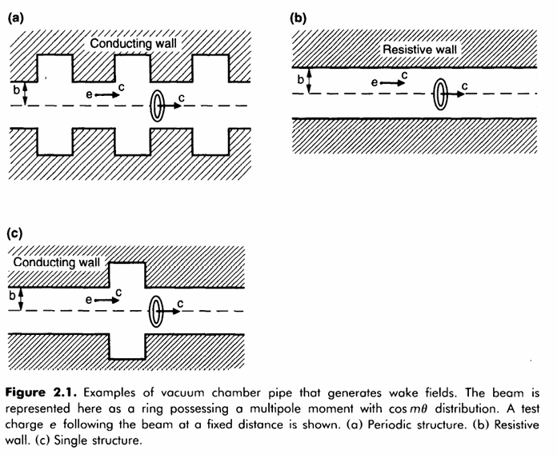
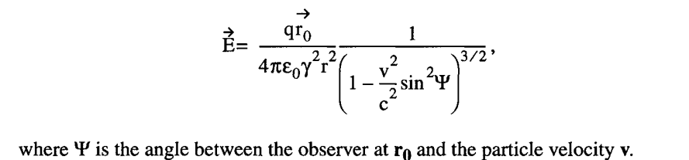
Concepts of Wake Fields
Issue of “Wake”
· Various accelerator elements(RF cavities, smooth pipes) result in the scattering or capture of beam-induced fields.
· Able to cause disturbances in the energy or angle of the traveling particles(Wake).
-> affects on beam instabillty and quality!

Slide 4
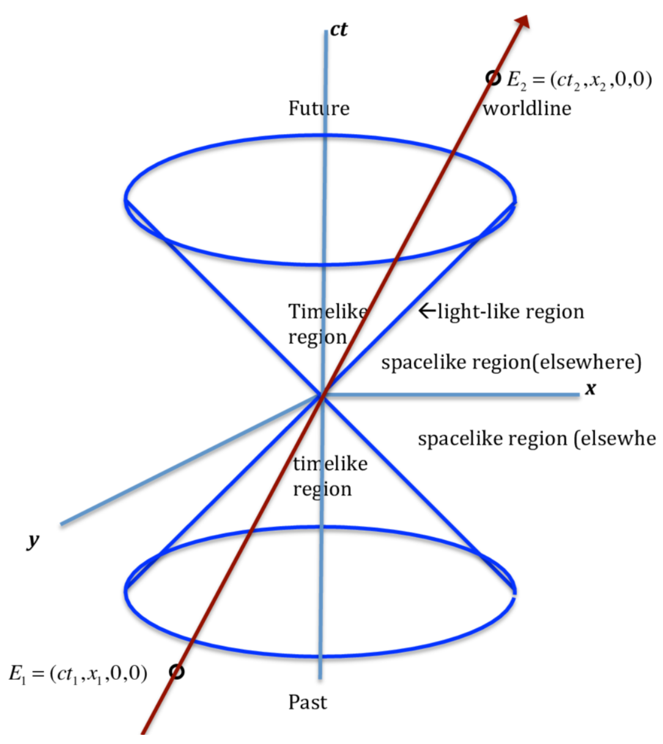
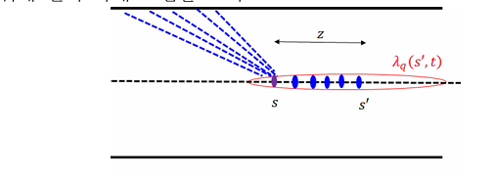

Concepts of Wake Fields
Physical origin of wake field
· Wake fields represent collective effects.
· Relativistic beam interacts with chamber structures Wake fields remain behind the source charge.
· Causality: no field ahead of the beam
z<0: wake exists!
z>0: no wake field
$$z ≡s −ct$$

Slide 5
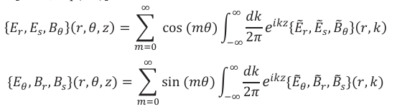
Concepts of Wake Fields
Wake fields in longitudinal space
· Using Maxwell equations, the fields can be described as m.
-> Divide cases m=0 or m>=1!
Why?
The shape of functions are different, It appears different phenomenon through
dominant term.
-> will explain later slides about this fact!

Slide 6
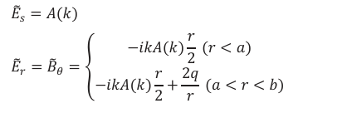








Concepts of Wake Fields
Wake fields when m=0
· Find A(k)! (with b.c. at r=b)
· Skin depth
related to field damping!
where,
$$\left|z\right|≫χ^{1/3}b$$
· Long range formula for wake field
applied in PLS-Ⅱ(∵ bunch interval~ 2ns)
· Short range formula for wake field
$$\left|z\right|≪χ^{1/3}b$$

Slide 7
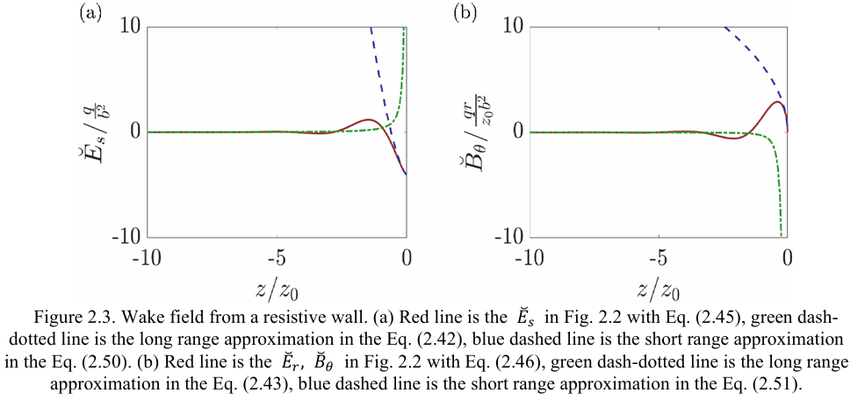
Concepts of Wake Fields
Graphs of wake fields in m=0

Slide 8
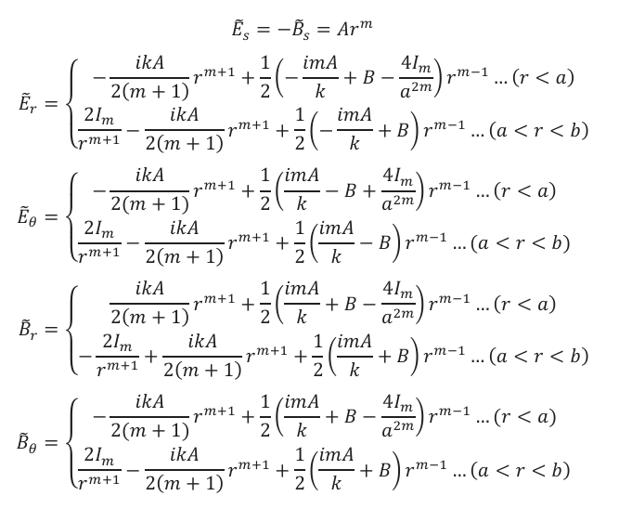
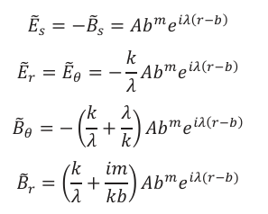

Concepts of Wake Fields
Wake fields when m >=1
in perfectly conducting wall
· Find A(k)! (with b.c. at r=b)
-> Can derive general formula!

Slide 9
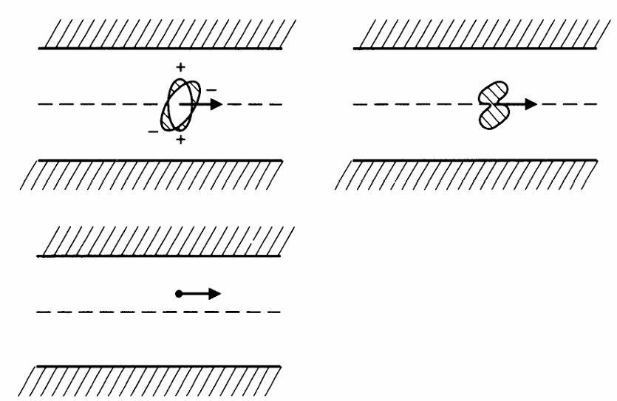

Concepts of Wake Fields
Wake field and beam distibution
· Wake field is independent of the detailed beam distribution! (not at potential, force!)
· The same wake field generates as long as the beam has the same moment.
(in this case, m=2)
$$m^{th}$$

Slide 10
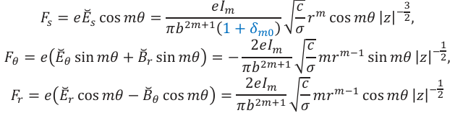
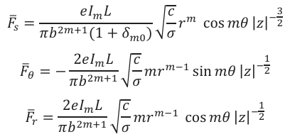
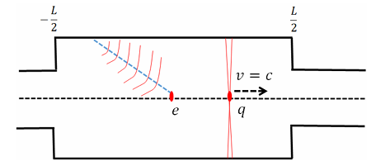




Concepts of Wake Function and Potential
Induction of wake function W(z)
· Force to test charge by each field component
· Resistive wall
· To determine the effect of the structure
-> Define the amount of force or field integrated
by distance!
where u is field component.
Build integrated field Maxwell eqns

Slide 11
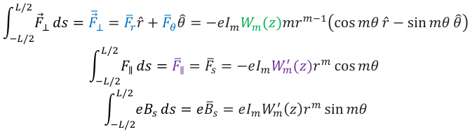
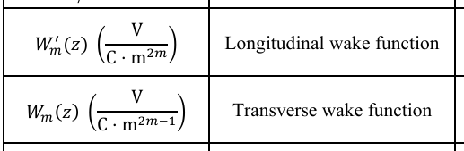
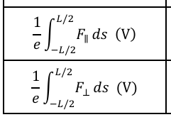
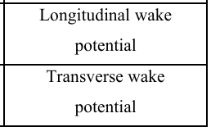
Concepts of Wake Function and Potential
Wake potential
· Work in the structure with length L
Define Work function as dependent term only z!

Slide 12


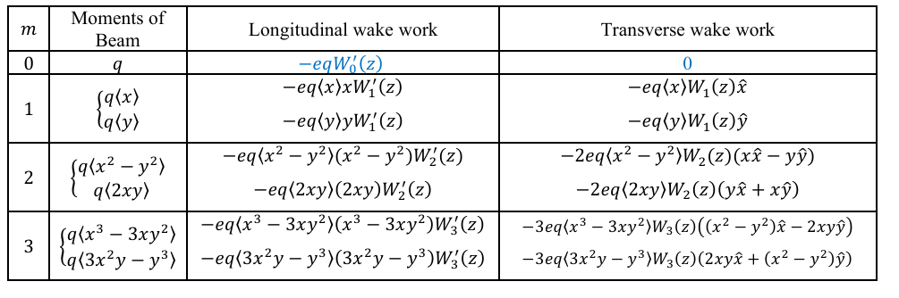
Concepts of Wake Function and Potential
Wake function in resistive wall
· General form of wake function
$$m^{th}$$
· Longitudinal & transverse work for moment
-> The wake field has the same effect as adding different types of magnets in the charge that follows!

Slide 13





Concepts of Wake Function and Potential
Properties of Wake function
· The propotional relation of wake potential
$${\overline{F}}_{∥,m}∝\frac{a^{2m}}{b^{2m}}\frac{1}{b^{2}}$$
$${\overline{F}}_{⊥,m}∝\frac{a^{2m−1}}{b^{2m−1}}\frac{1}{b^{2}}$$
· Case m = 0
· Case m >=1
$${\overline{F}}_{∥,0}∝\frac{1}{b^{2}}, {\overline{F}}_{⊥,0}=0$$
$$\frac{{\overline{F}}_{⊥,0}}{{\overline{F}}_{∥,0}}=\frac{b}{a}≫1$$
-> Can consider only longitudinal wake effect.
-> Usually b>>a, only transverse wake effect.
· Case higher order term
$$\frac{a^{2}}{b^{2}}$$
-> the Transverse wake work also increases by as the m increases, can negelected!
∴ The longitudinal wake work only thinks of m=0, and the transverse wake work only thinks of m=1!

Slide 14


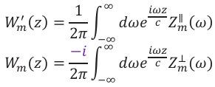
Impedance: Frequency Domain
Induction of impedance
· Impedance allows direct comparison with RF and instability theory.
· Fourier transform of wake function equivalent description in frequency
domain.
· Define longitudinal impedance
· Fourier transform relation between wake field & impedance

Slide 15
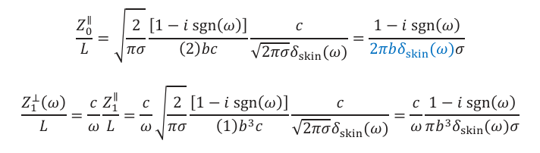
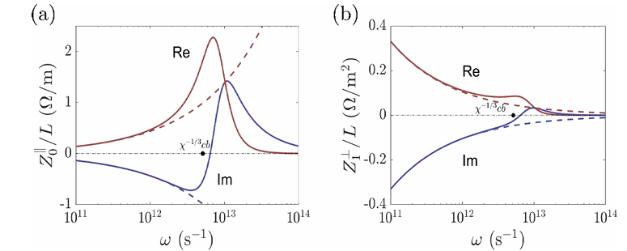

Impedance: Frequency Domain
Impedance in resistive wall
· Can calculate in the same way as the previously induced method, the longitude impedance and the transverse impedance.
Graphs of impedances divided by real part and imaginary part
$$ω≪χ^{1/3}bc$$
-> In , dotted lines and solid lines match well!

Slide 16
Linear Beam Optics
Issues on understanding instability
· Instability <- linear beam optics + wake field & impedance
· But no basic knowledge about linear beam optics.
-> Need to understand linear beam optics!
· Solve the equations analytic.
· Simulate fundamental elements by using program ELEGANT.

Slide 17
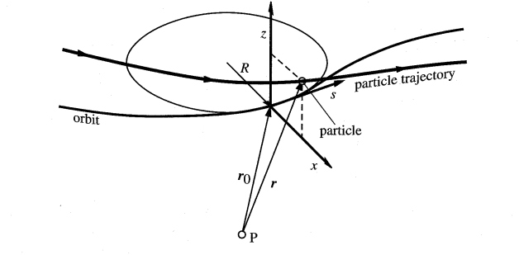
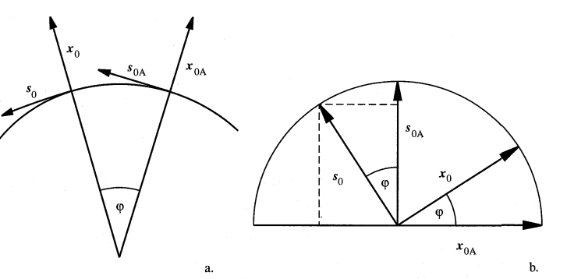
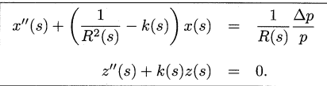

Concepts of Linear Beam Optics
Induction of Hill’s equation
· Equations of motion in a coordinate system
· Derive the equation of motion of a charged particle in a pure magnetic field
$$\ddot{r} = \frac{e}{m}(\dot{r}×B)$$
Hill’s equation
Where k is quadrupole strength, R is radius of trajectory.

Slide 18

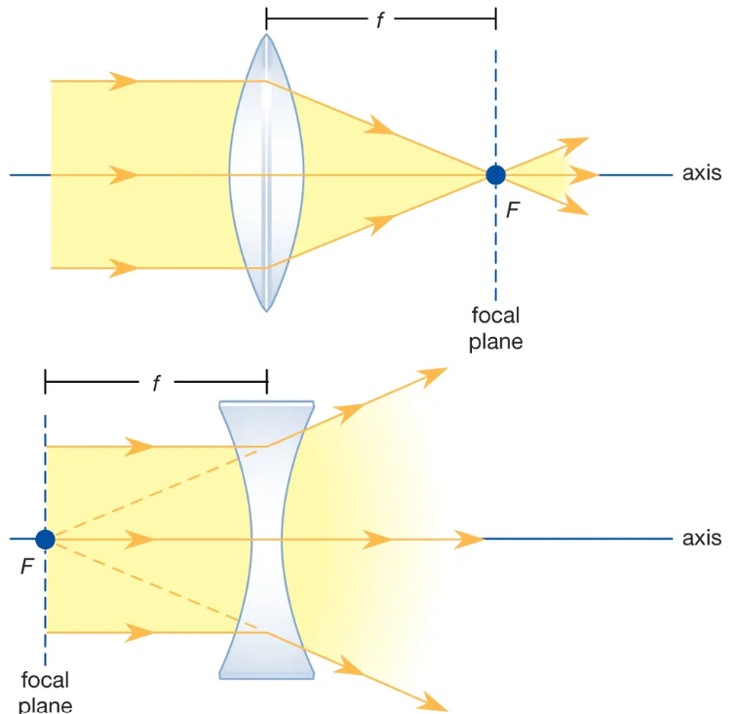
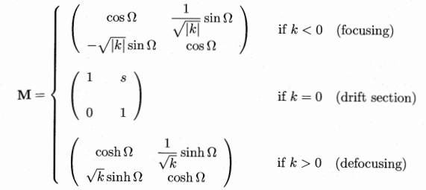



Concepts of Linear Beam Optics
Particle trajectories and transfer matrices
$$\frac{Δp}{p}≪1$$
· When there is no bending(1/R->0) and
change the form
· Solve above equation, get transfer matrices
$$Ω = \sqrt{\left|k\right|}s$$
Where ,

Slide 19





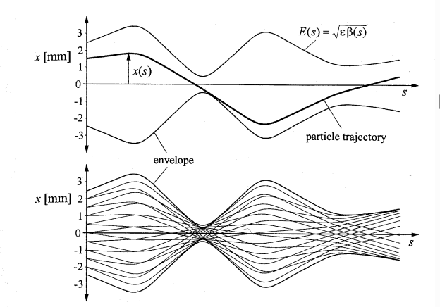
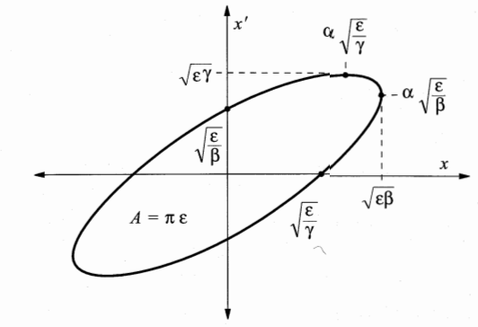
Concepts of Linear Beam Optics
Beta function and betatron oscillation
· Actually, k is not a constant, depends on s.
· Let the solution
· Define beta function
· The solution is...
Where
· Beta function means the amplitude of particle envelope!
x-x’ phase diagram(ellipse)

Slide 20
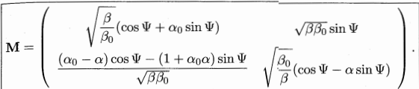

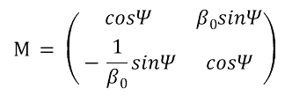





Concepts of Linear Beam Optics
Determination of the transfer matrix from the beta function
· The general structure matrix
$$β=β_{0} , α=α_{0}$$
· The periodic structure matrix ( )
$$M = \left(\begin{matrix}cosΨ+α_{0}sinΨ & β_{0}sinΨ \\ −γsinΨ & cosΨ−α_{0}sinΨ\end{matrix}\right)$$
· Able to find analytic also by using simulation program!
$$α_{0 }=0$$
· The symmetry structure matrix ( )
$$β_{0 }=\sqrt{−\frac{m_{12}}{m_{21}}}$$
$$M = \left(\begin{matrix}cosΨ & β_{0}sinΨ \\ −\frac{1}{β_{0}}sinΨ & cosΨ\end{matrix}\right)$$
$$M=\left(\begin{matrix}m_{11} & m_{12} \\ m_{21} & m_{22}\end{matrix}\right)$$
$$Ψ=\cos^{−1}(\frac{m_{11}+m_{22}}{2})$$

Slide 21
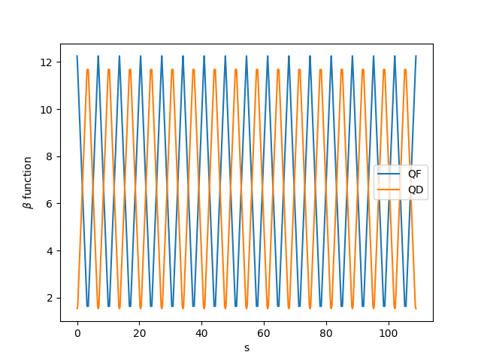


Experience of ELEGANT
Determine the transfer matrix
· Plot the graph of beta function
-> The peak values don’t change when sync is matched.
but for unmatched beam, peak values are different!
Verify beta0 value
· Measured values
· Calculated values
$$β_{y,0}=1.53656027$$
$$β_{x,0}=12.2563169$$
$$β_{y,0}=1.53656027$$
$$β_{x,0}=12.2563166$$

Slide 22
Summary
Wake fields and Impedance
· The wake field has the same effect as adding different types of magnets in the charge that follows.
· The longitudinal wake work only thinks of m=0, and the transverse wake work only thinks of m=1.
· Impedance is the Fourier transform of wake function equivalent description in frequency domain.
Linear beam optics and simulation
· Beta function means the amplitude of particle envelope.
· It is important to get transfer matrix in simulation.

Slide 23
Research Plan
Next week plan
· Understand wakes and impedance when beam has distribution more clearly.
· Start studying about the basic concepts of instability.
· Simulate linear beam optics for more parameters in FODO lattice.
Long-term plan(~Feb.)
· Simulate linear beam optics not only FODO lattice, also PLS by adding bending magnet.
· Understand the concepts of various instabilities.
· Learn another simulation program except Elegant.

Slide 24
Thank you!

Slide 25
References
1] Ch. 2 of Physics of Collective Beam Instabilities in High Energy Accelerators, 1993, Alex Chao.
2] Formula of Wake Fields and Impedances, 2024, 박영민, 심치현, 박용운.
3] Impedance of accelerator components, 1997, John N. Corlett.
4] The Panofsky-Wenzel Theorem and General Relations for the Wake Potential, 1994, S. Vaganian, H. Henke.
5] The Physics of Particle Accelerators an Introduction, 2000, Klaus Wille.

