Slide 1
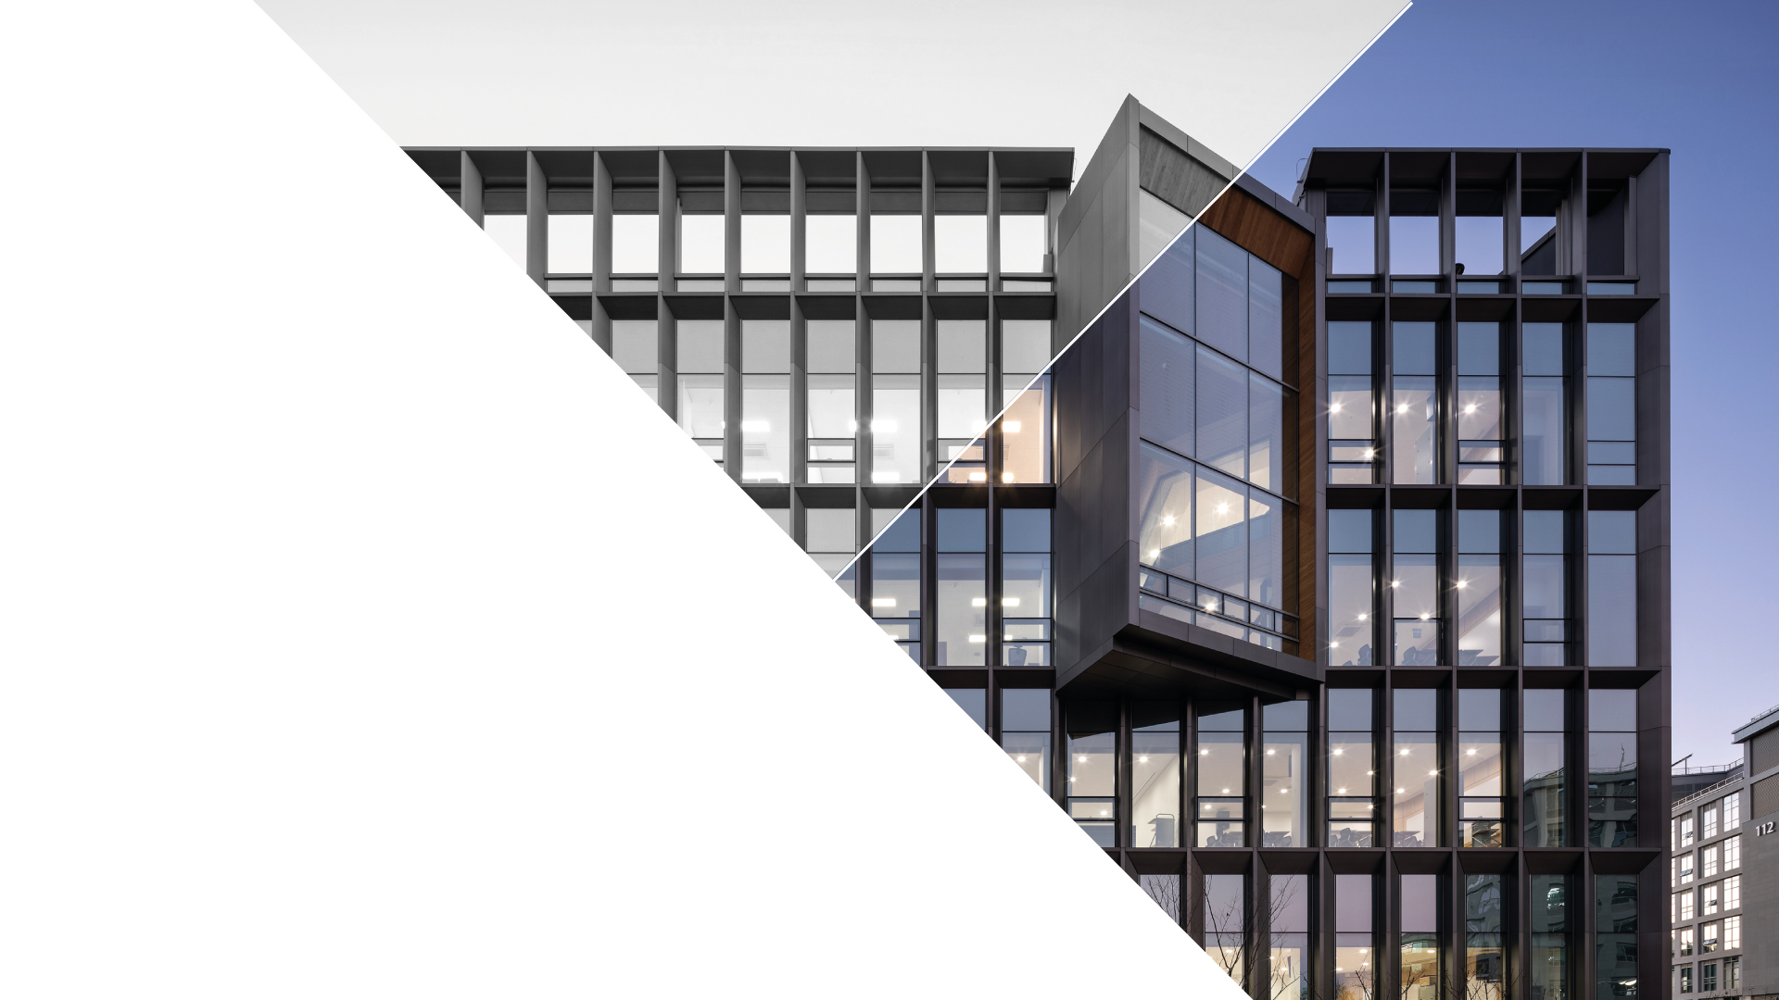

Status Report
January 16, 2026
Soyeon Kim
CONTACT
Department of Physics
4th Natural Science Building 108
https://physics.unist.ac.kr/

Slide 2

2
CONTENTS
1. Active energy compression of a laser-plasma electron beam
03
Equipment Description 04
Paper Analysis 09
Simulation Results 11
2. Future Plan
17

Slide 3
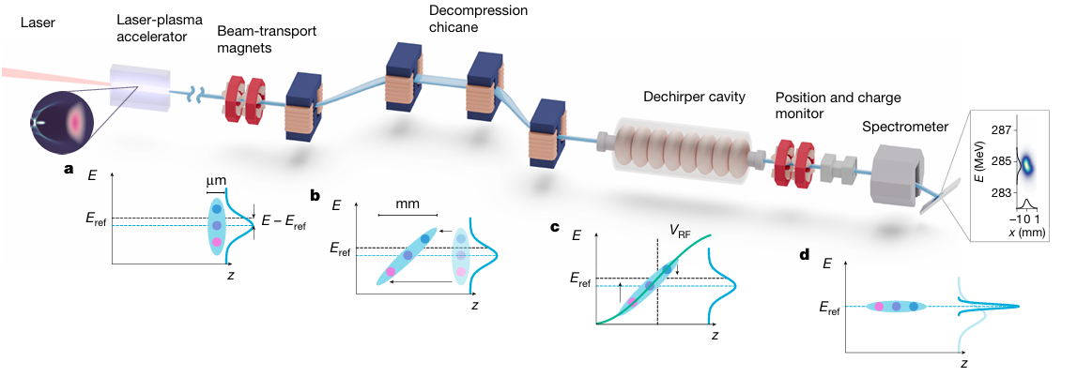
Active energy compression of a laser-plasma electron beam
3
Objectives
▪ Overcoming the limitations of plasma accelerators: While laser-plasma accelerators (LPAs) offer the advantage of compact size, they have faced practical challenges in industrial and research applications due to their large energy spread and significant energy jitter compared to conventional RF accelerators.
▪ Generating high-quality electron beams: The goal of this study was to demonstrate that the energy spread and jitter of LPA-generated beams can be reduced to the permille level (less than 0.1%), matching the performance of modern RF accelerators. This would enable their use in real-world applications such as synchrotron injectors and free-electron lasers (FELs).

Slide 4
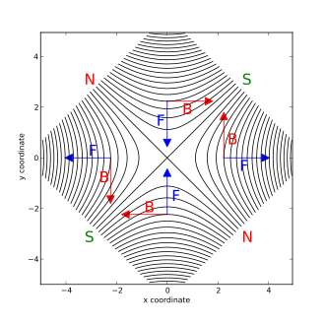
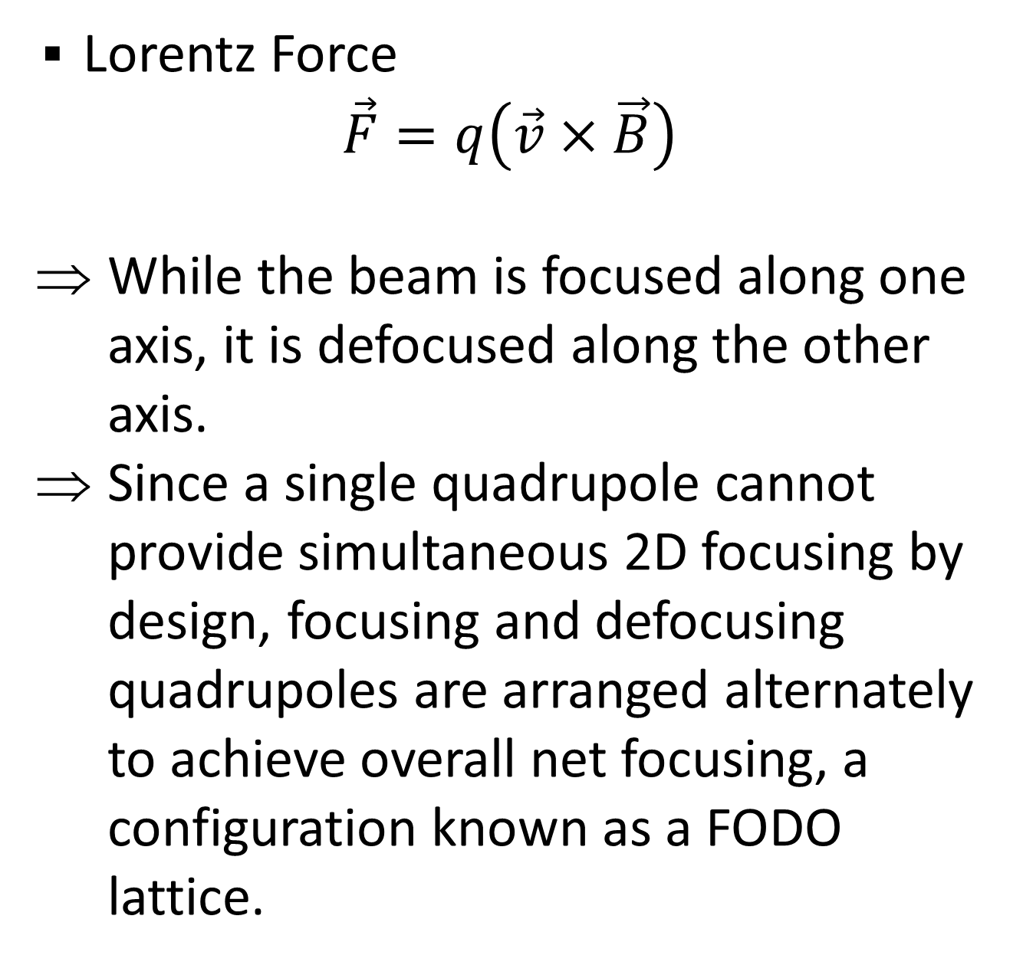
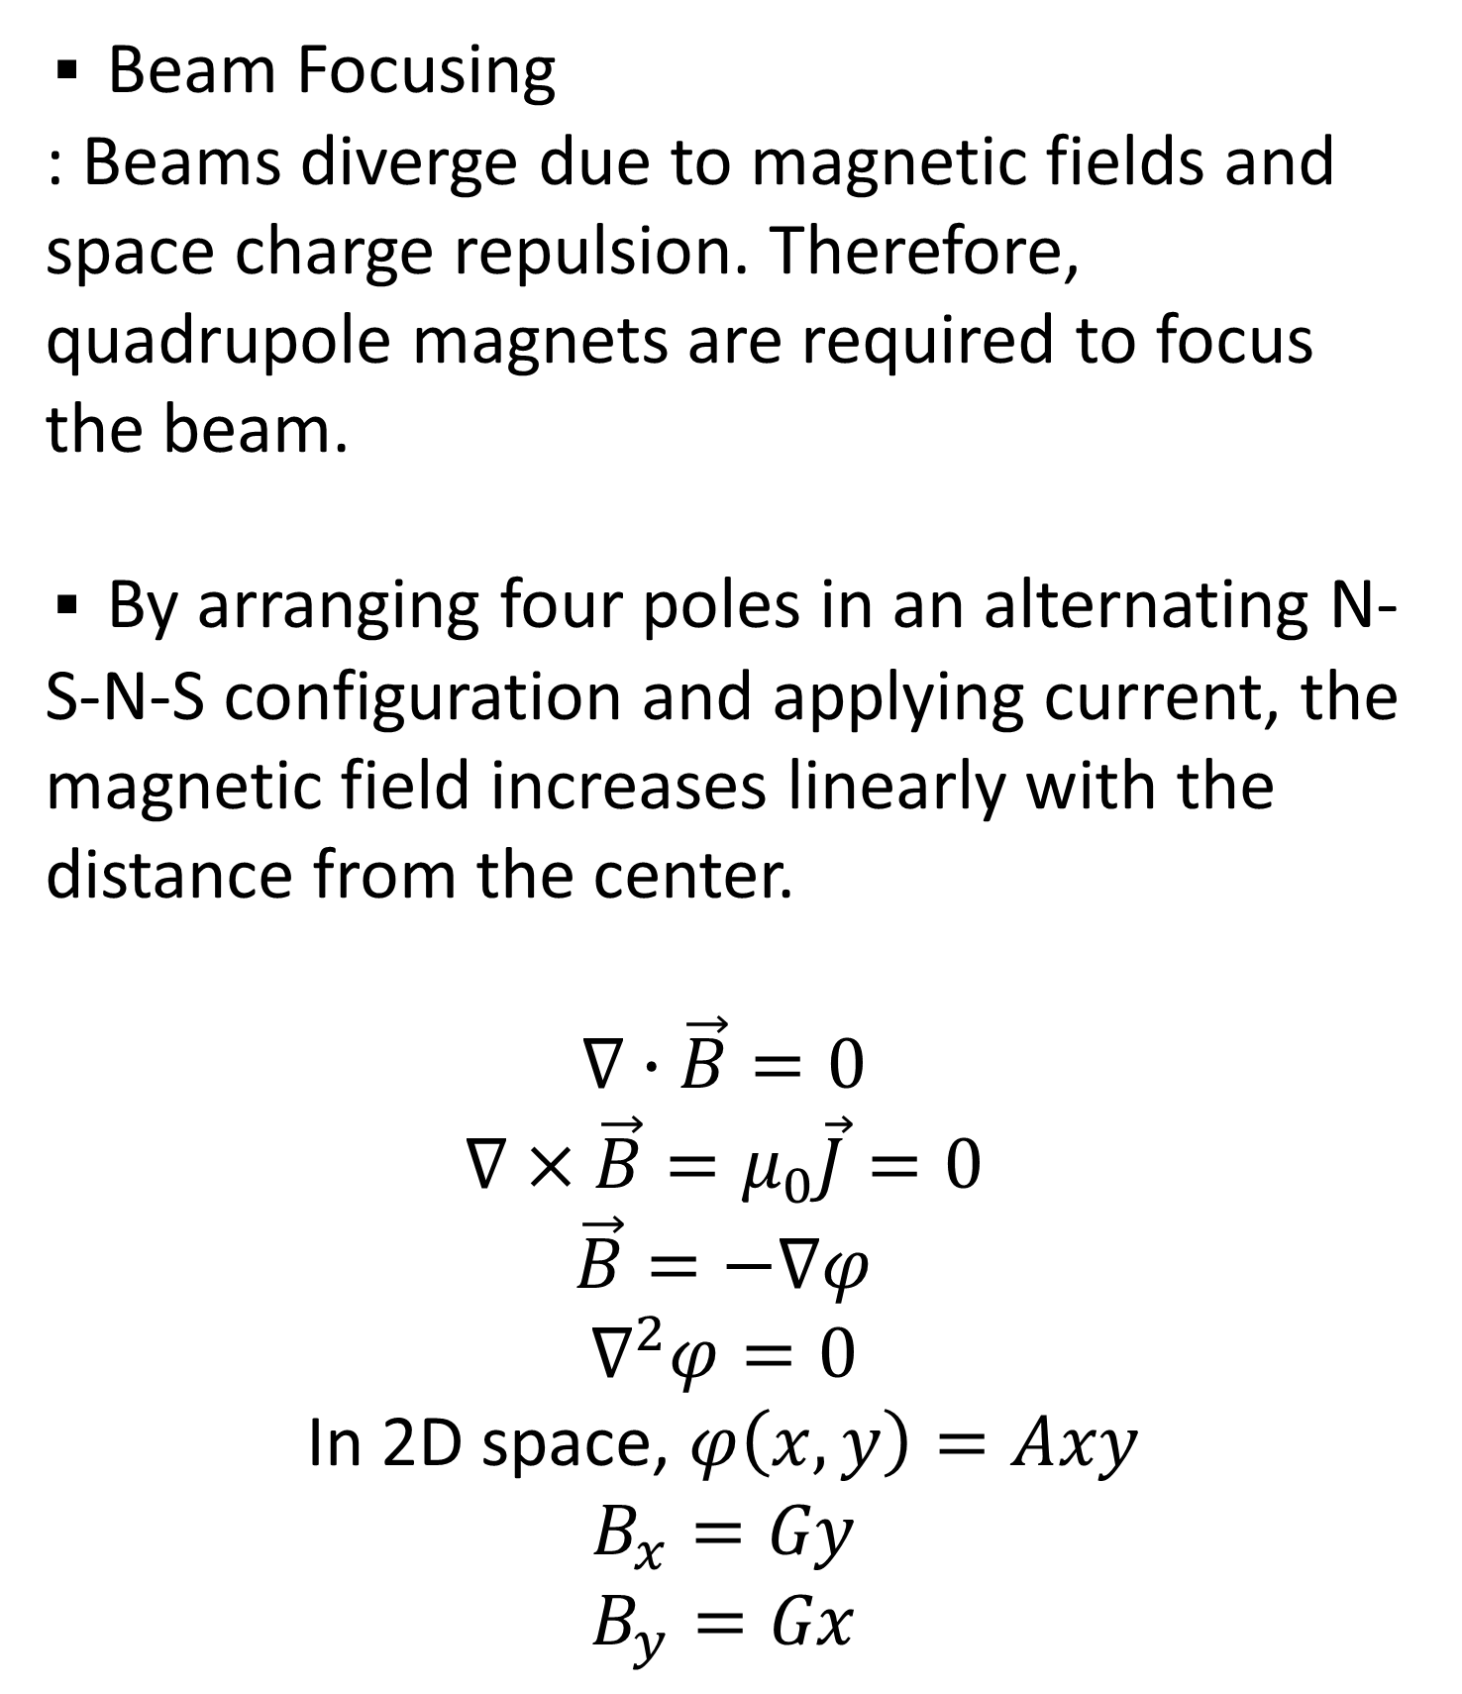
Quadrupole Magnets
4
▪ Beam Focusing
: Beams diverge due to magnetic fields and space charge repulsion. Therefore, quadrupole magnets are required to focus the beam.
▪ By arranging four poles in an alternating N-S-N-S configuration and applying current, the magnetic field increases linearly with the distance from the center.
$$∇∙\vec{B}=0$$
$$∇×\vec{B}=μ_{0}\vec{J}=0$$
$$\vec{B}=−∇φ$$
$$∇^{2}φ=0$$
In 2D space, $φ\left(x, y\right)=Axy$
$$B_{x}=Gy$$
$$B_{y}=Gx$$
▪ Lorentz Force
$$\vec{F}=q\left(\vec{v}×\vec{B}\right)$$
While the beam is focused along one axis, it is defocused along the other axis.
Since a single quadrupole cannot provide simultaneous 2D focusing by design, focusing and defocusing quadrupoles are arranged alternately to achieve overall net focusing, a configuration known as a FODO lattice.

Slide 5
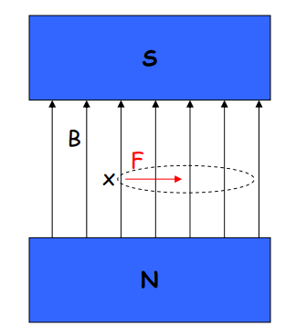
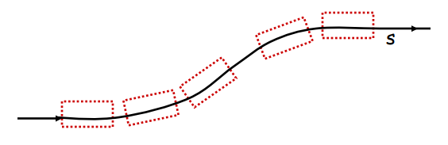
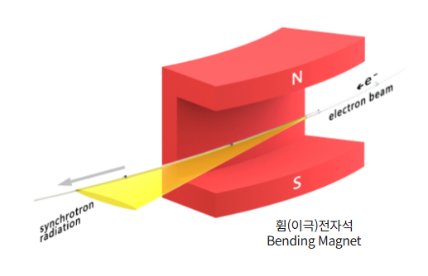
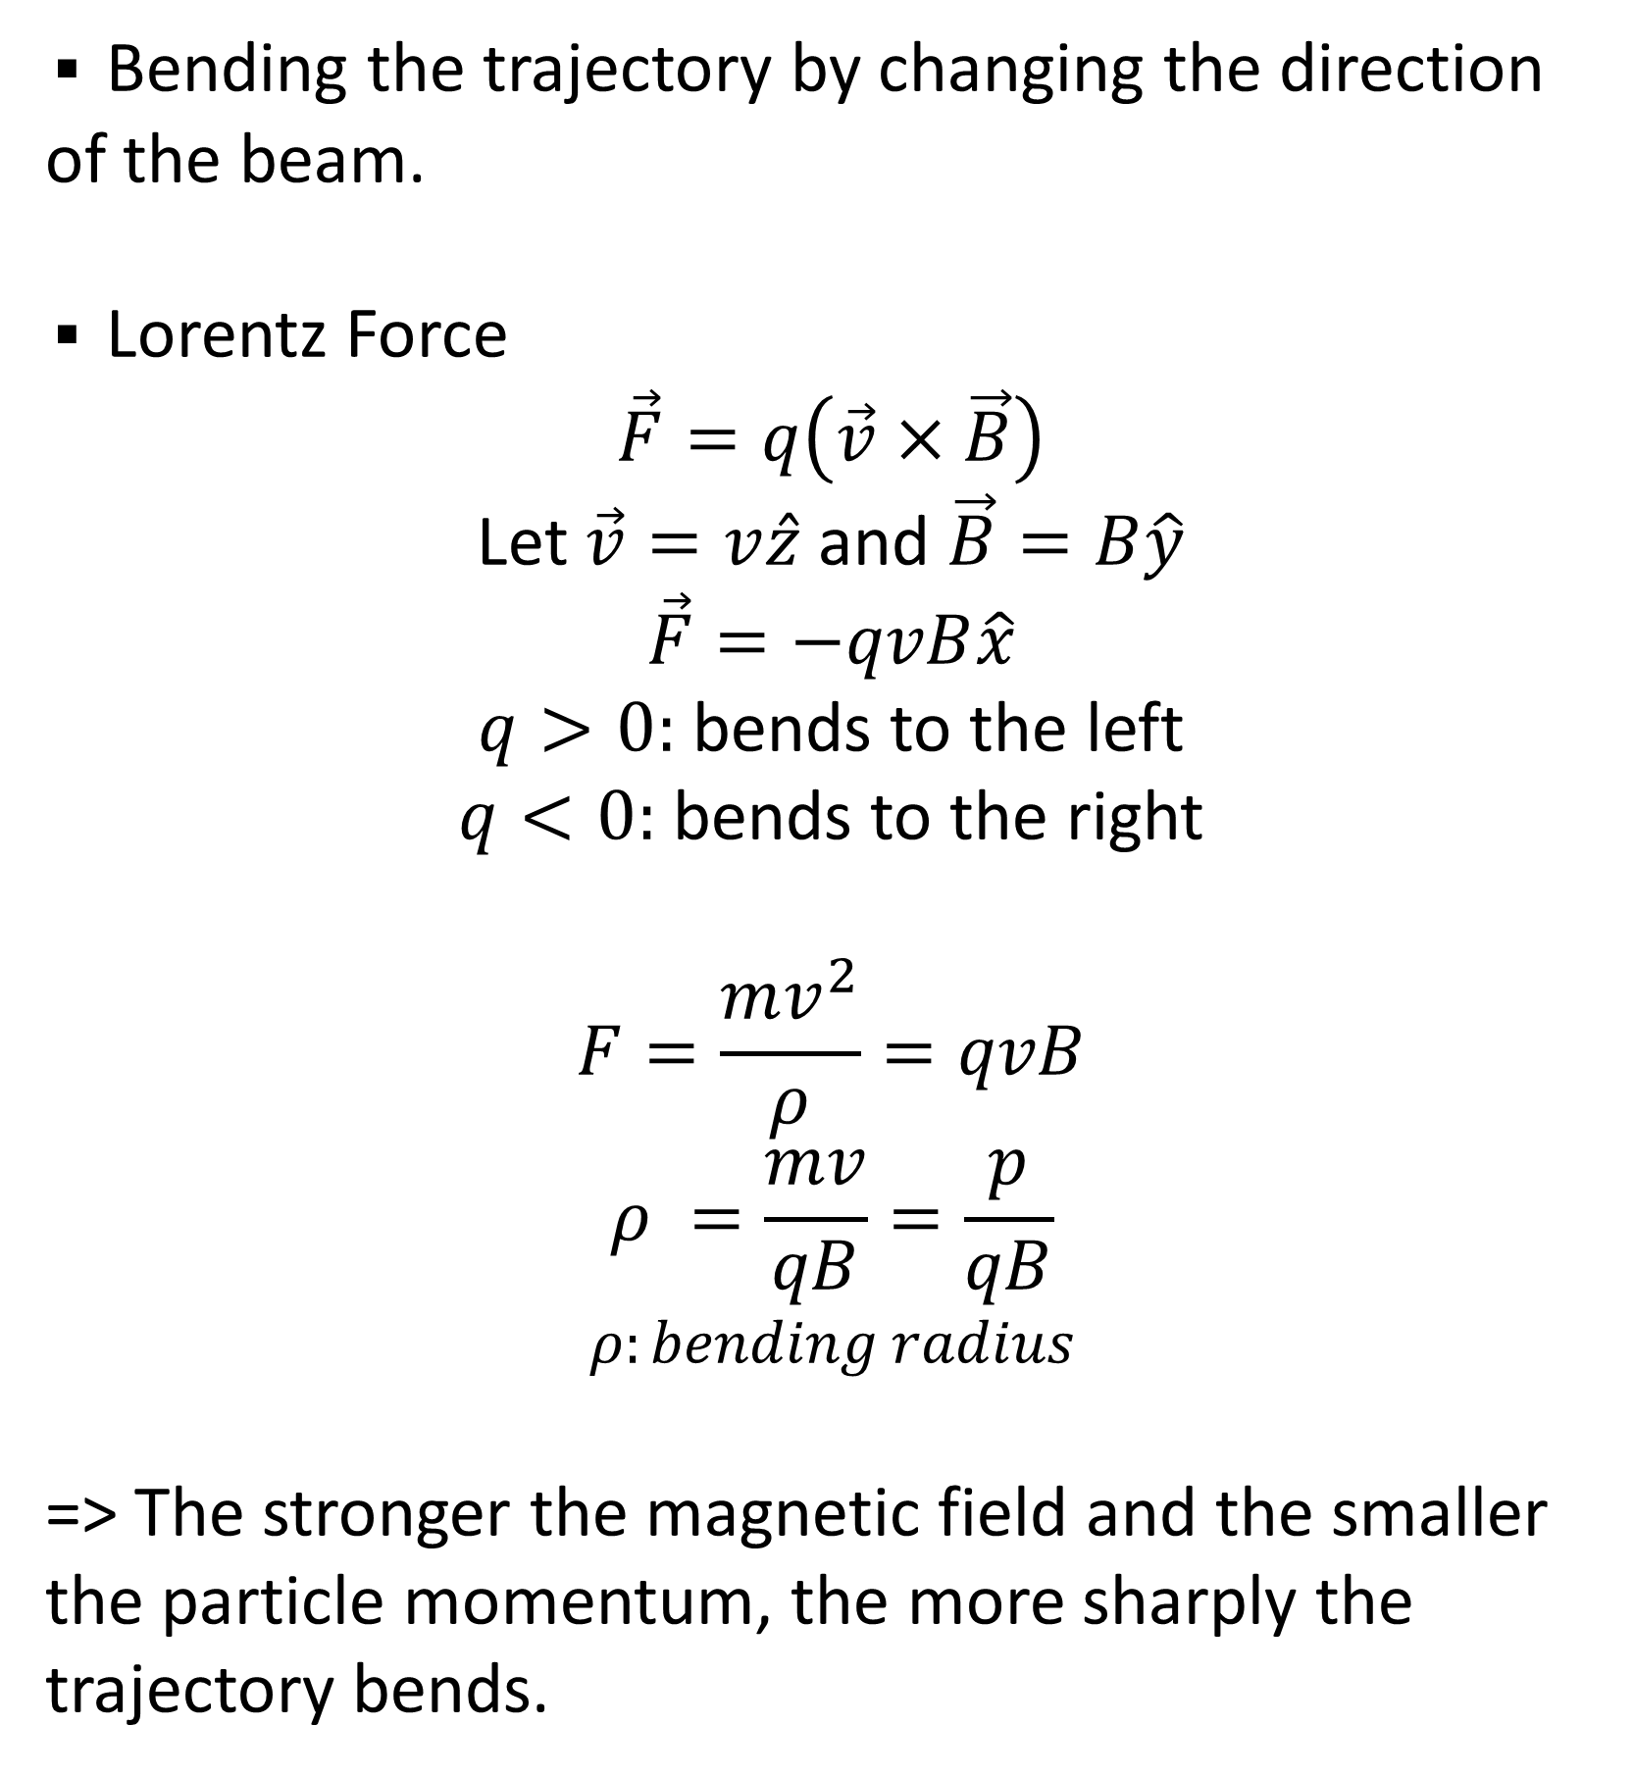
Dipole Magnets
5
▪ Bending the trajectory by changing the direction of the beam.
▪ Lorentz Force
$$\vec{F}=q\left(\vec{v}×\vec{B}\right)$$
Let $\vec{v}=v\hat{z}$ and $\vec{B}=B\hat{y}$
$$\vec{F}=−qvB\hat{x}$$
$q>0:$ bends to the left
$q<0:$ bends to the right
$$F=\frac{mv^{2}}{ρ}=qvB$$
$$ρ =\frac{mv}{qB}=\frac{p}{qB}$$
$$ρ:bending radius$$
=> The stronger the magnetic field and the smaller the particle momentum, the more sharply the trajectory bends.

Slide 6
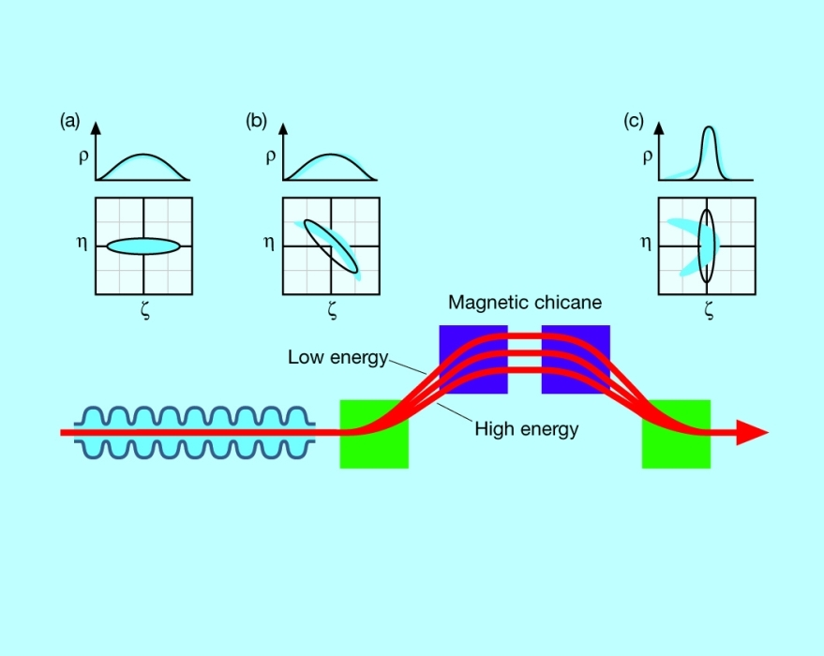
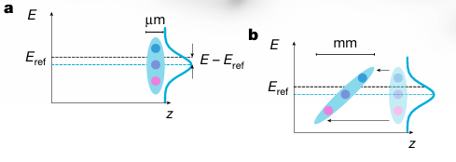
Magnetic Chicane vs. Decompression Chicane
6
▪ Magnetic Chicane
▪ Decompression Chicane
The chicane thereby introduces energy-dependent path-length differences that effectively stretch the bunch longitudinally and induces an energy–position correlation (energy chirp).

Slide 7
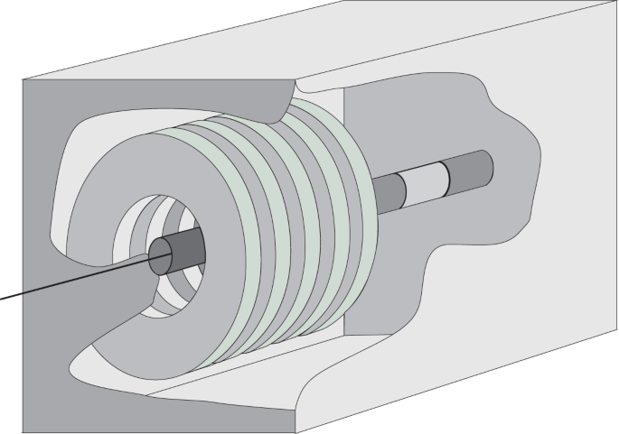
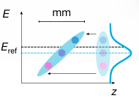
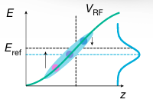
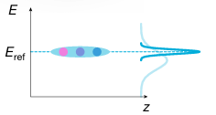
RF Cavity vs. Dechirper Cavity (Active RF Cavity)
7
▪ RF Cavity
▪ Active RF Cavity
A dechirper cavity is a device used to remove the energy–position correlation (chirp) of an electron beam.
An external power source (klystron) is used to control the RF waveform’s phase and amplitude.
The cavity operates near the zero-crossing of the RF field so that the average beam energy is preserved.
RF cavity is a device that uses high-frequency electric fields to repeatedly accelerate particle bunches, keeps the particles at an acceleratable RF phase, and provides bunching and phase stability in the process.

Slide 8
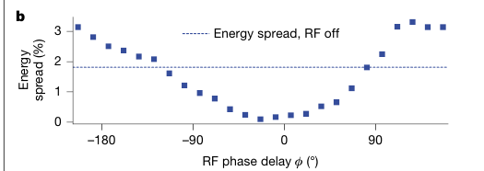
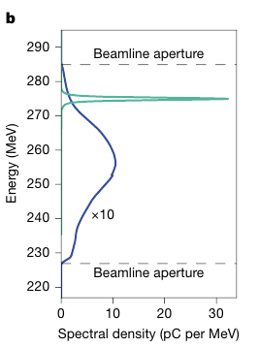
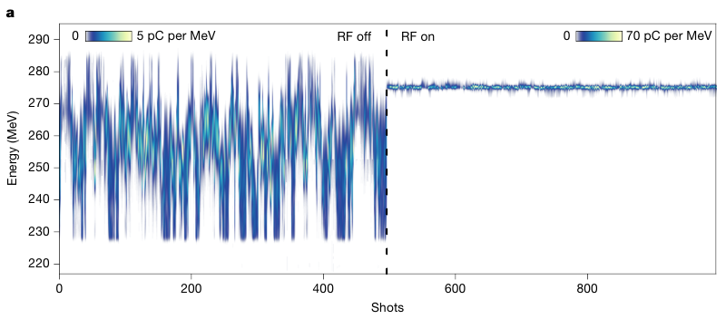
Active energy compression of a laser-plasma electron beam
9
Results
RF OFF
Energy jitter: 3.5%
Energy spread: 1.8%
RF ON
Energy jitter: 0.048%
Energy spread: 0.097%
▪ The minimum energy spread is achieved at an RF phase of −23.6°.
▪ The chirp after the chicane is not perfectly linear but carries a certain degree of curvature. While an RF phase of 0 degrees can provide linear correction, it is unable to compensate for this curvature. To correct for the curvature of the chirp, a phase of -23.6 degrees is necessary instead of 0 degrees.
▪ Stretching the electron bunch more lowers the energy chirp and thus reduces the required RF amplitude and thus power to operate the cavity.

Slide 9
Active energy compression of a laser-plasma electron beam
10
Conclusions
▪ The experiment demonstrated that it is possible to obtain high-quality, high-stability electron beams from laser-plasma accelerators, comparable to those of modern large-scale RF accelerators.
▪ By achieving an energy spread and jitter of less than 0.1%, this work has established the essential technical foundation for realizing compact, next-generation synchrotron storage ring injectors and high-performance free-electron lasers (FELs).
▪ This technology is expected to be scalable to higher energy ranges when combined with X-band RF technology and other advancements, accelerating the miniaturization and cost-reduction of accelerator facilities.

Slide 10
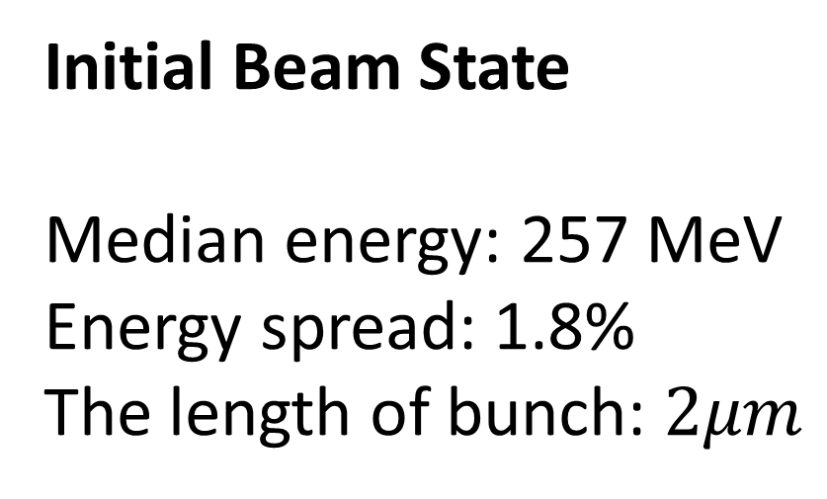
Active energy compression of a laser-plasma electron beam
11
Initial Beam State
Median energy: 257 MeV
Energy spread: 1.8%
The length of bunch: $2μm$
B2
B3
Drift: 0.5m
1.2m
B1
B4
0.4m
0.4m
Screen
QF1
QD1
QF2
QD2
LPA
Decompression Chicane
(Dipole magnets)
RF Cavity
Spectrometer
1.0m
1.5m
1.0m
Quadrupole magnets
Reproduce the experimental setup → Determine the RF phase at which the energy spread is minimized → Generate z–E phase space plots after the LPA, after the decompression chicane, and after the dechirper cavity, and obtain the energy spectra recorded at the spectrometer for both RF OFF and RF ON conditions.

Slide 11
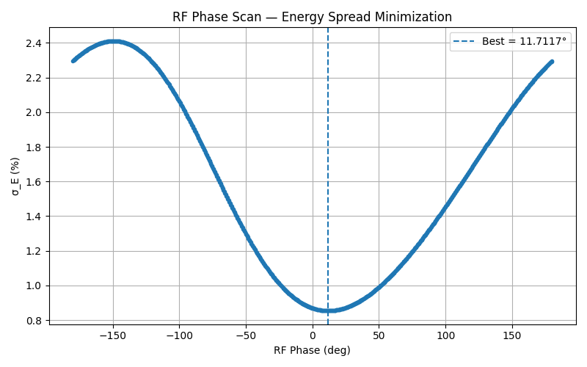
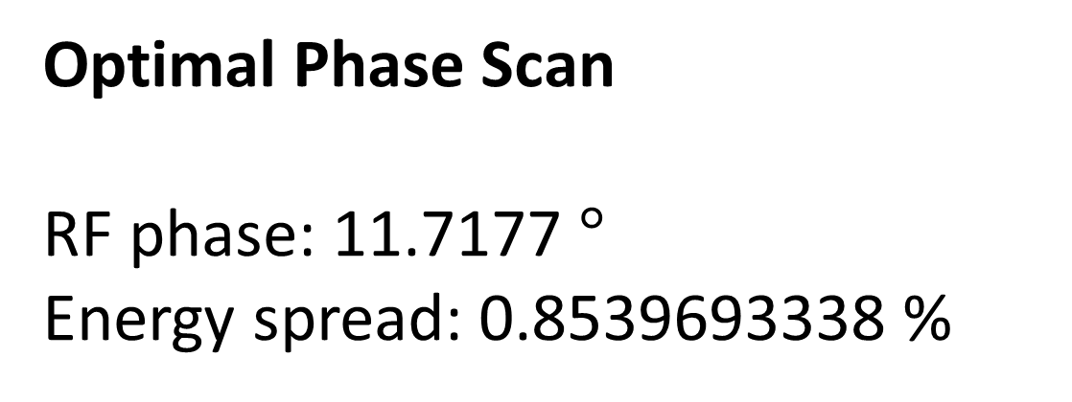
Active energy compression of a laser-plasma electron beam
12
Optimal Phase Scan
RF phase: 11.7177 $°$
Energy spread: 0.8539693338 %

Slide 12
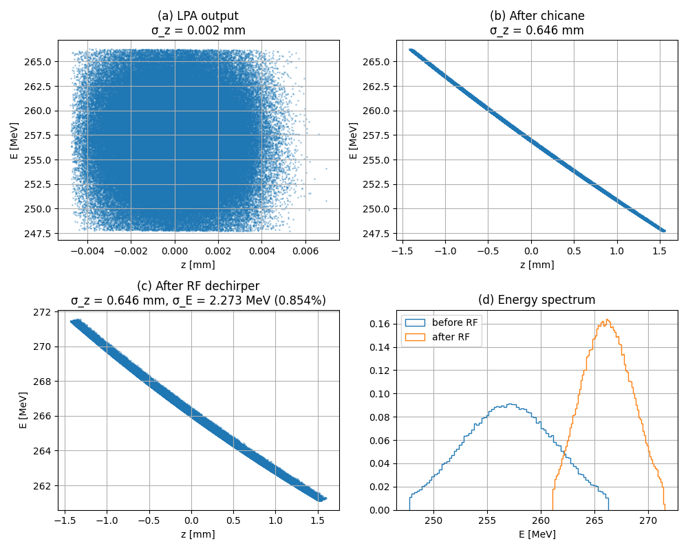
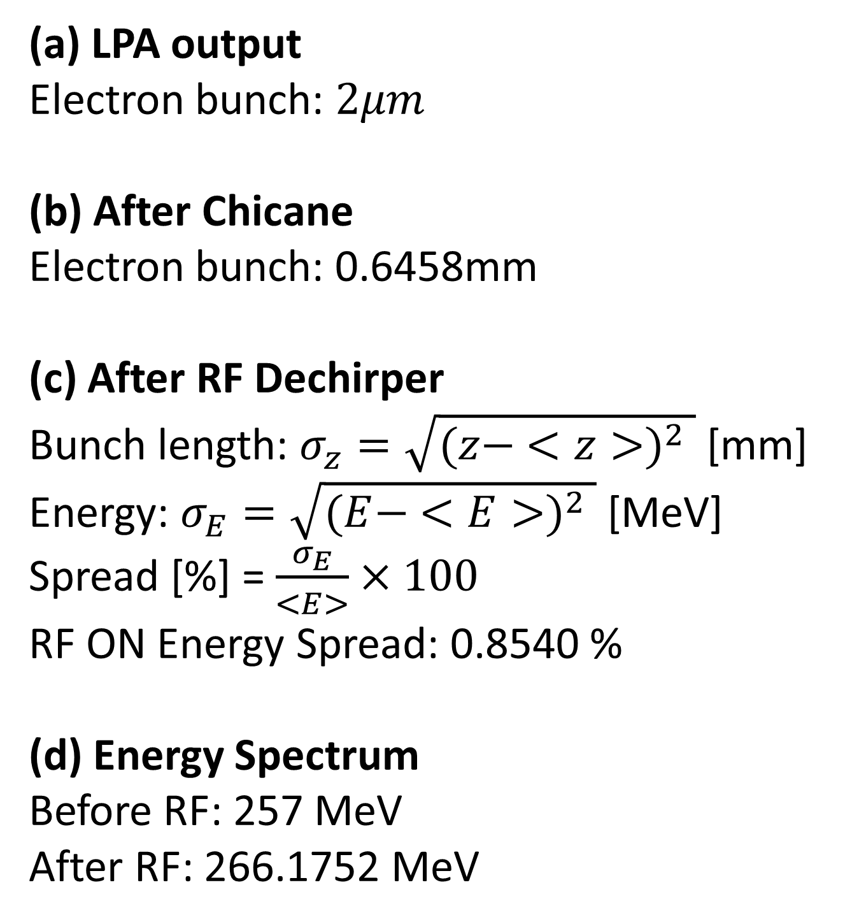
Active energy compression of a laser-plasma electron beam
13
(a) LPA output
Electron bunch: $2μm$
(b) After Chicane
Electron bunch: 0.6458mm
(c) After RF Dechirper
Bunch length: $σ_{z}=\sqrt{{(z− <z>)}^{2} }$ [mm]
Energy: $σ_{E}=\sqrt{{(E− <E>)}^{2} }$ [MeV]
Spread [%] = $\frac{σ_{E}}{<E>}×100$
RF ON Energy Spread: 0.8540 %
(d) Energy Spectrum
Before RF: 257 MeV
After RF: 266.1752 MeV

Slide 13
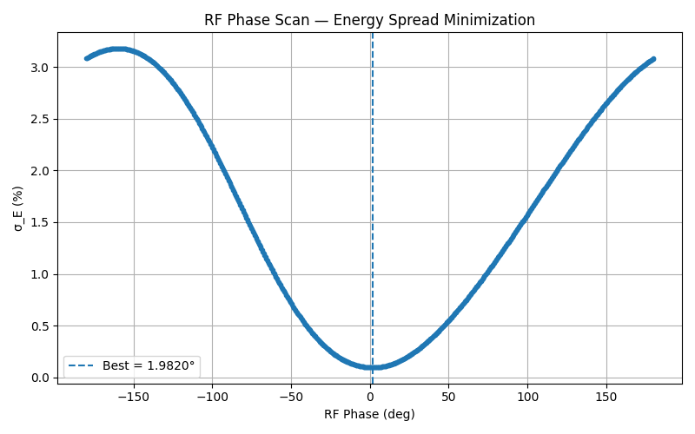
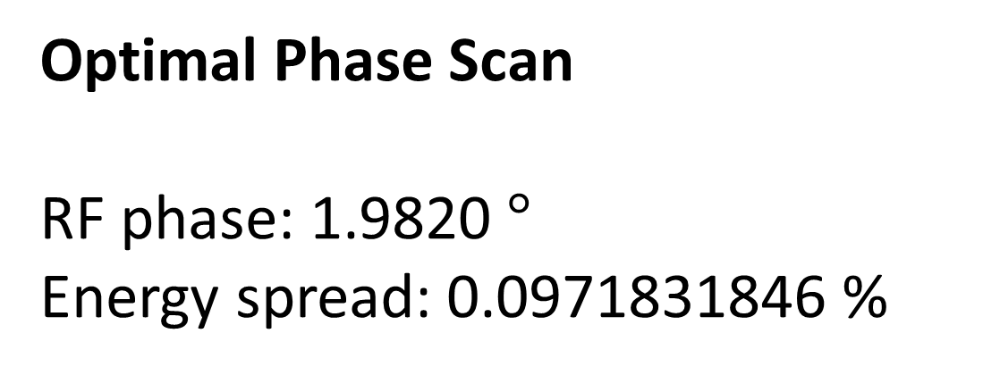
Active energy compression of a laser-plasma electron beam
14
Optimal Phase Scan
RF phase: 1.9820 $°$
Energy spread: 0.0971831846 %

Slide 14
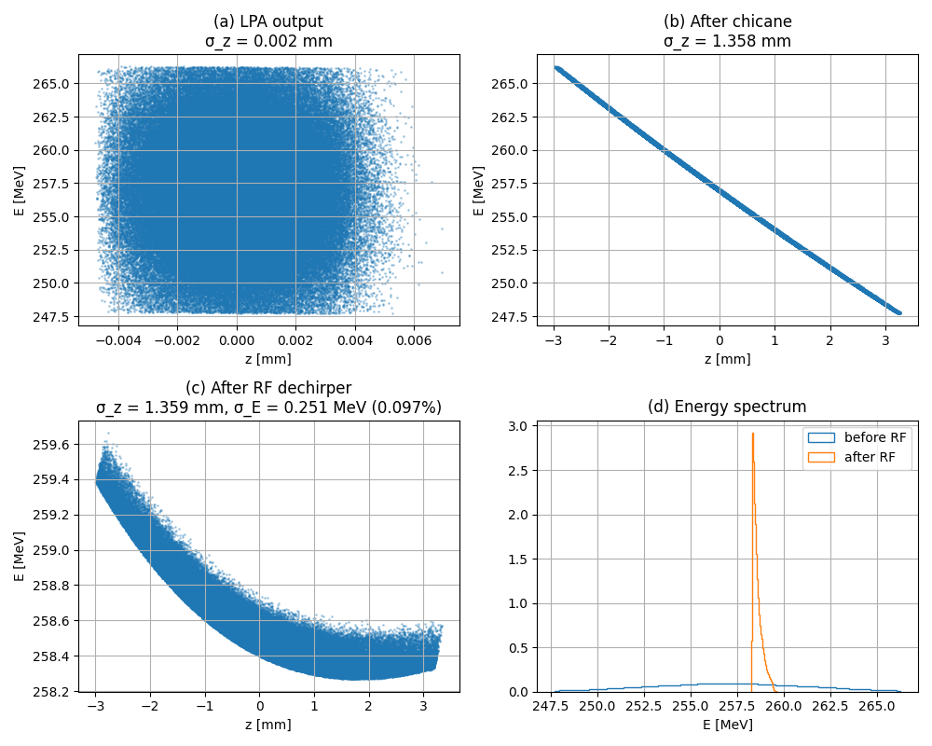
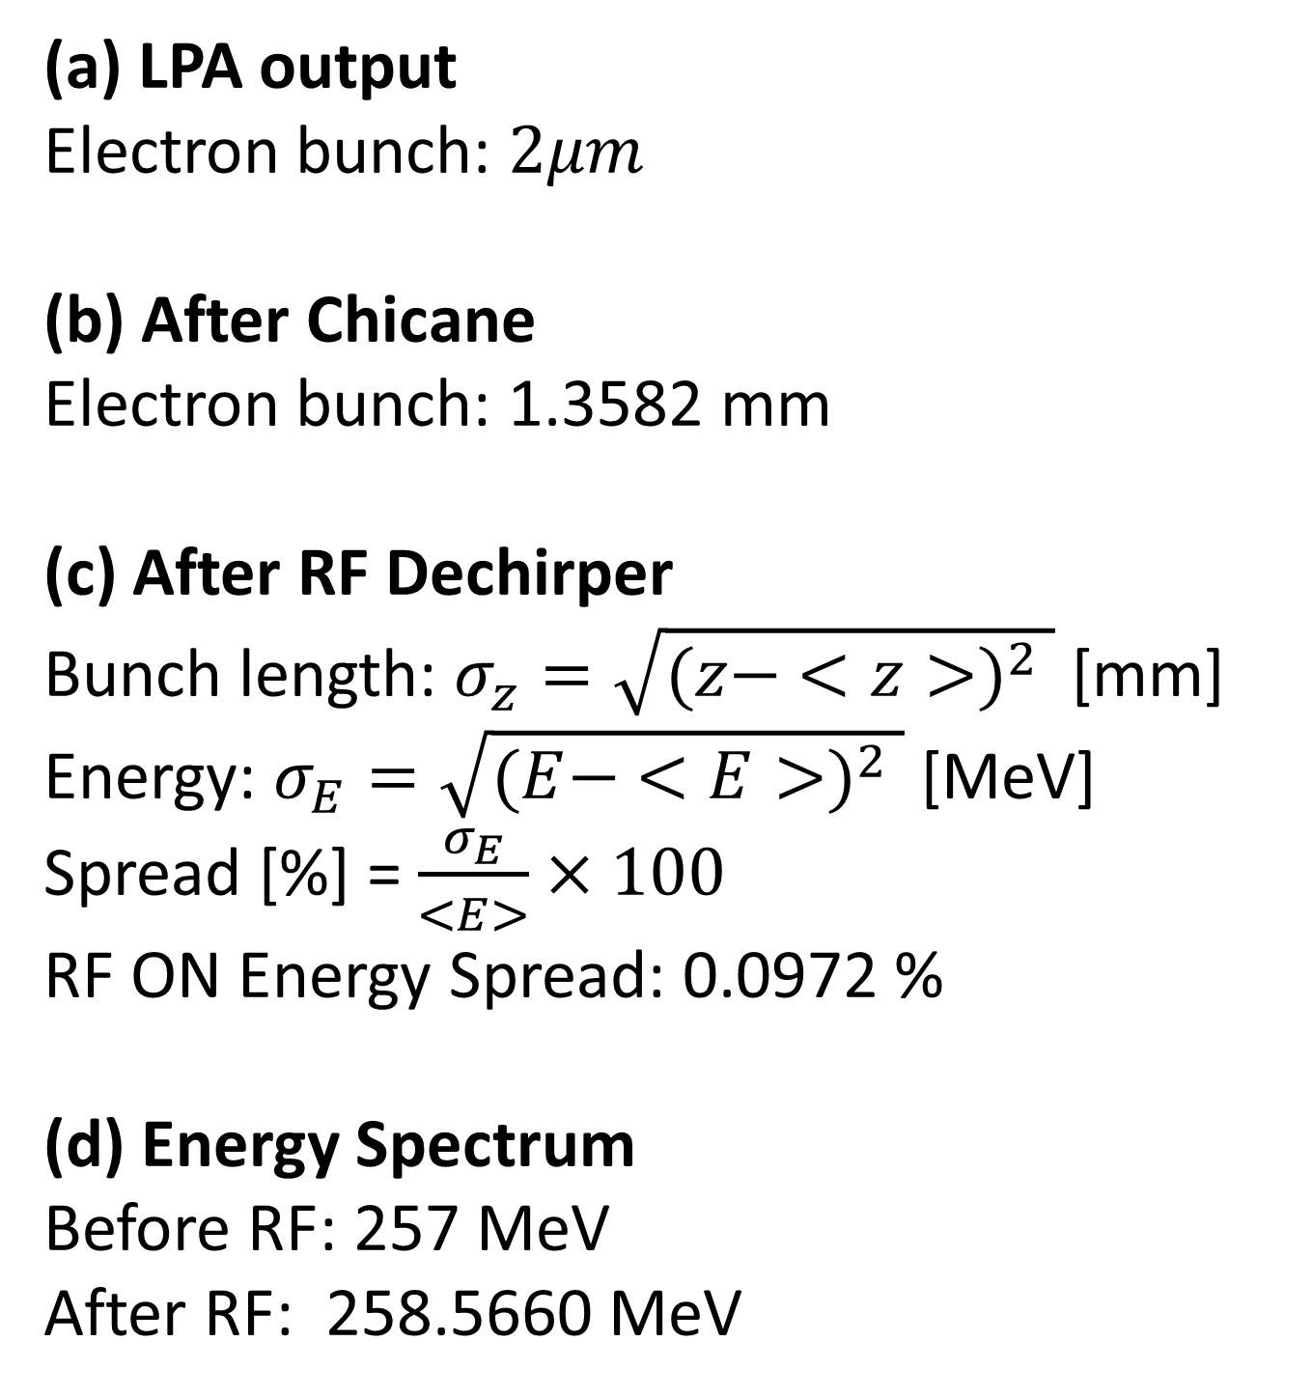
Active energy compression of a laser-plasma electron beam
15
(a) LPA output
Electron bunch: $2μm$
(b) After Chicane
Electron bunch: 1.3582 mm
(c) After RF Dechirper
Bunch length: $σ_{z}=\sqrt{{(z− <z>)}^{2} }$ [mm]
Energy: $σ_{E}=\sqrt{{(E− <E>)}^{2} }$ [MeV]
Spread [%] = $\frac{σ_{E}}{<E>}×100$
RF ON Energy Spread: 0.0972 %
(d) Energy Spectrum
Before RF: 257 MeV
After RF: 258.5660 MeV

Slide 15
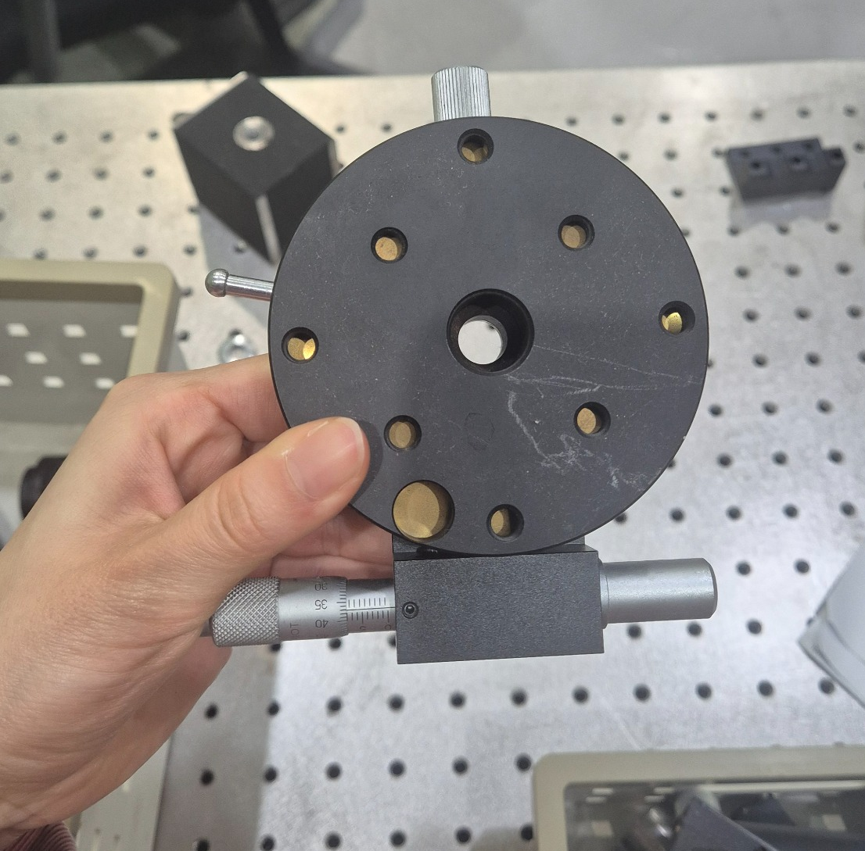
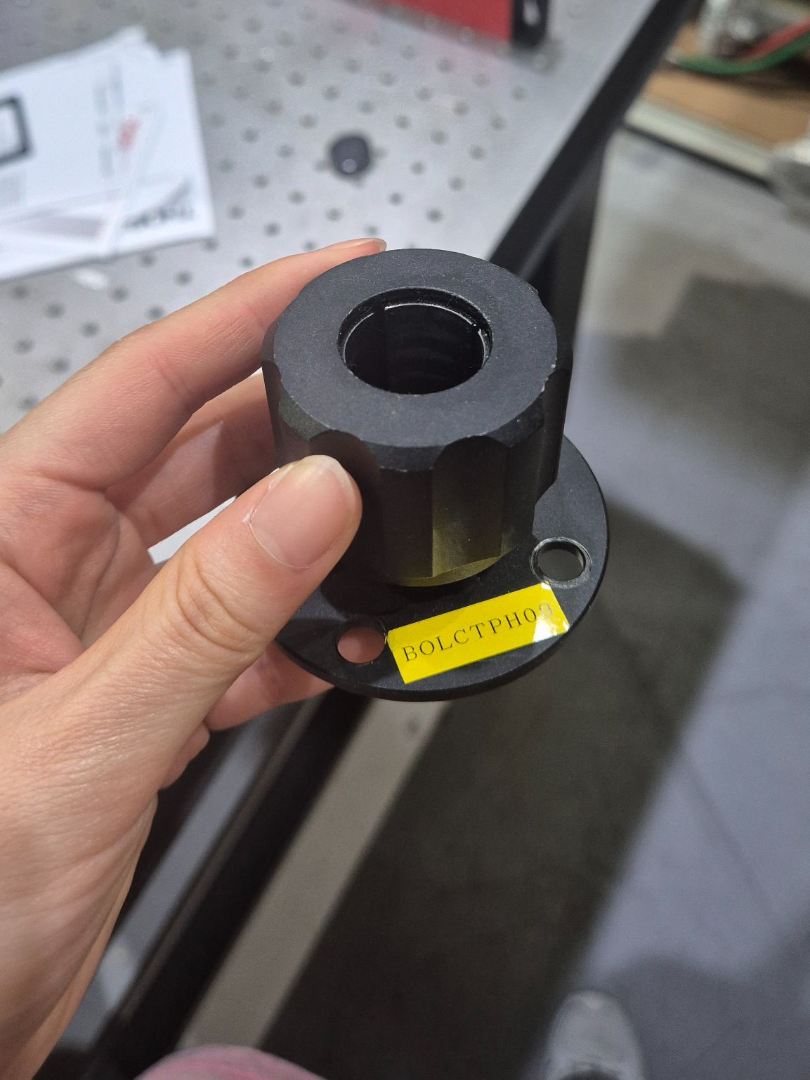
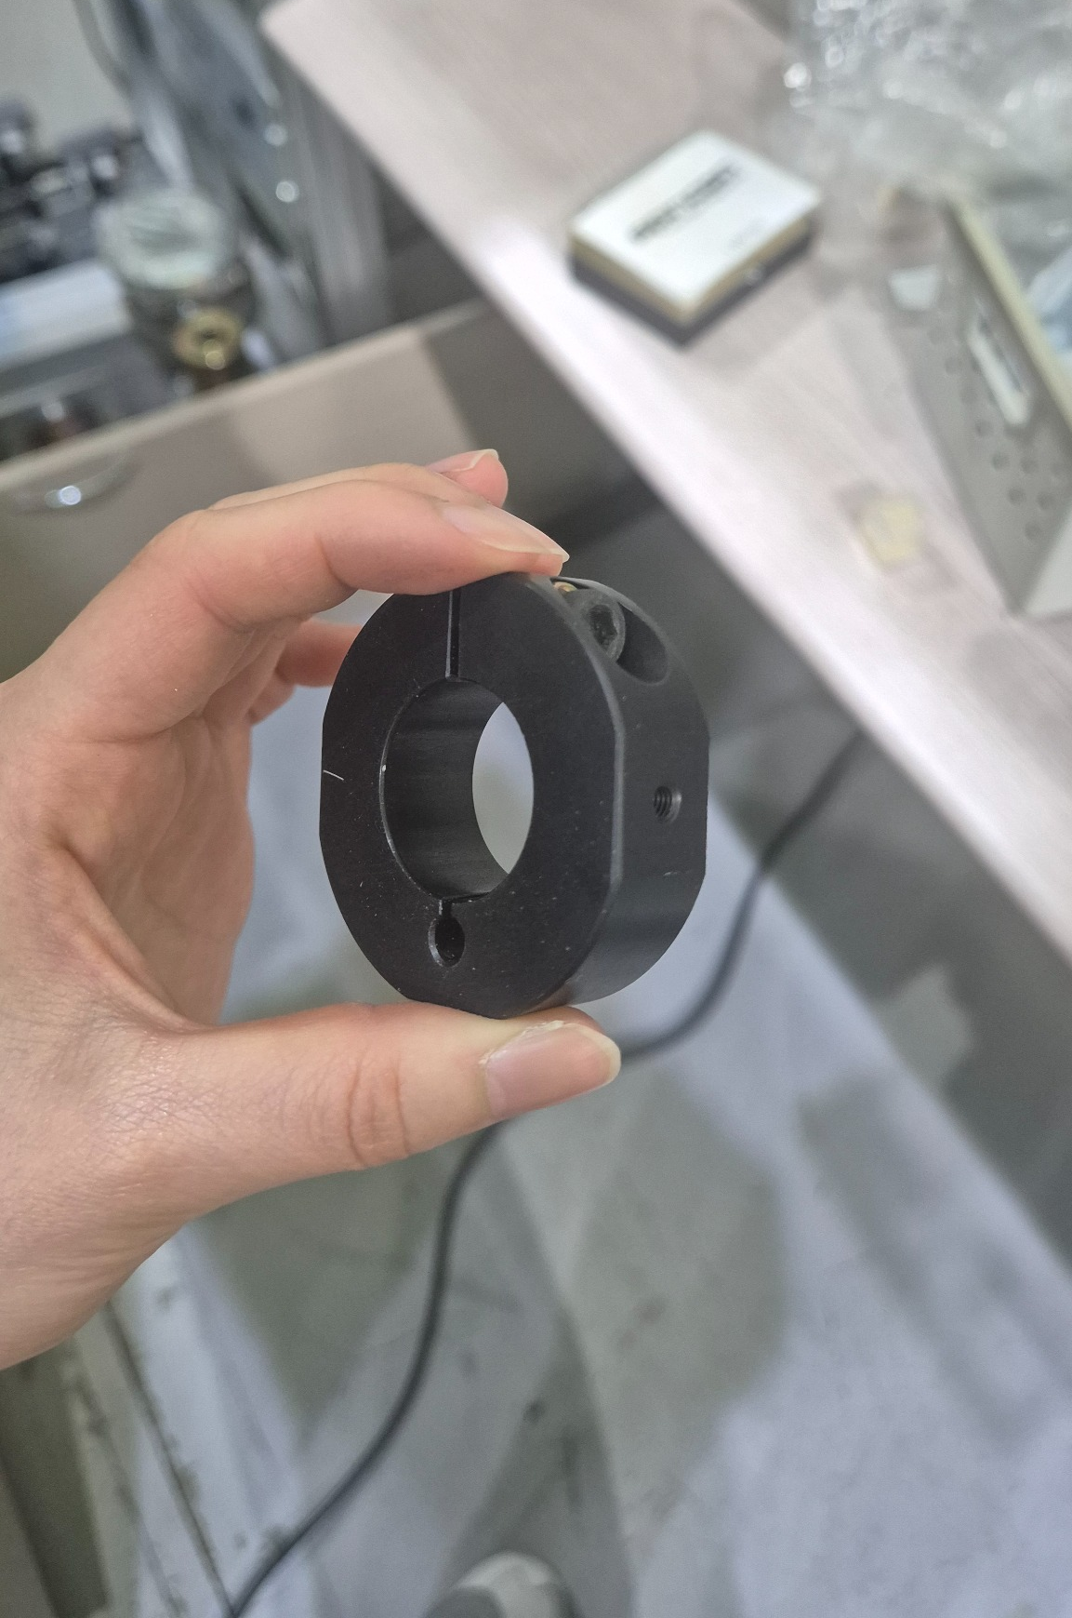
Classification Optical Equipment
16

Slide 16
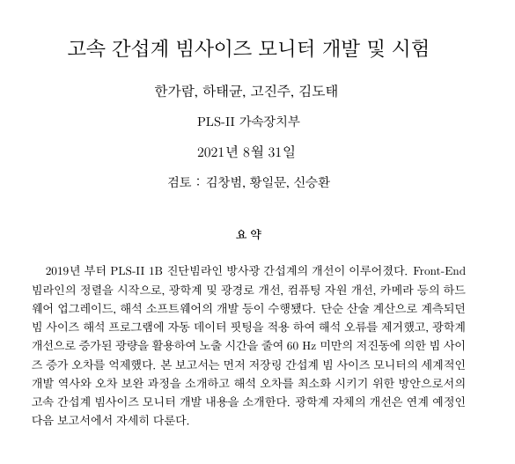
Future Plan
17
▪ The current setup uses a 257 MeV electron beam, but it is necessary to determine the RF cavity voltage for a more realistic 3 GeV beam.
▪ Jitter Analysis
▪ It will be verified whether increasing the electron bunch length reduces the required RF amplitude, as suggested in the literature.
▪ Interferometer 스터디 준비 (다음주 수요일까지)/ 광학 장치 리뷰, VISA, EPICS 연습 (~2월) with 송우진 박사님

Slide 17
THANK YOU

