Slide 1
2026/01/09 meeting
장원

Slide 2
List of contents
Frequency-dependent ground motion orbit amplification analysis
2. Studying about diagnostic method using Cherenkov Diffraction Radiation
3. Improving surrogate model/Neural network model accuracy for the PAL-XFEL photo-injector

Slide 3
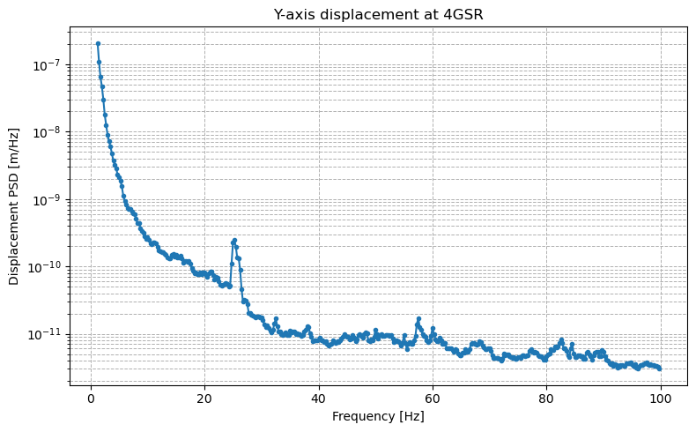
Ground motion orbit amplification-understanding coherence
Ground displacement measurement at 4GSR
The amplitude of low-frequency ground motion is very large.
According to previous studies [1], ground motions measured at two different locations exhibit coherence in the low-frequency region.

Slide 4
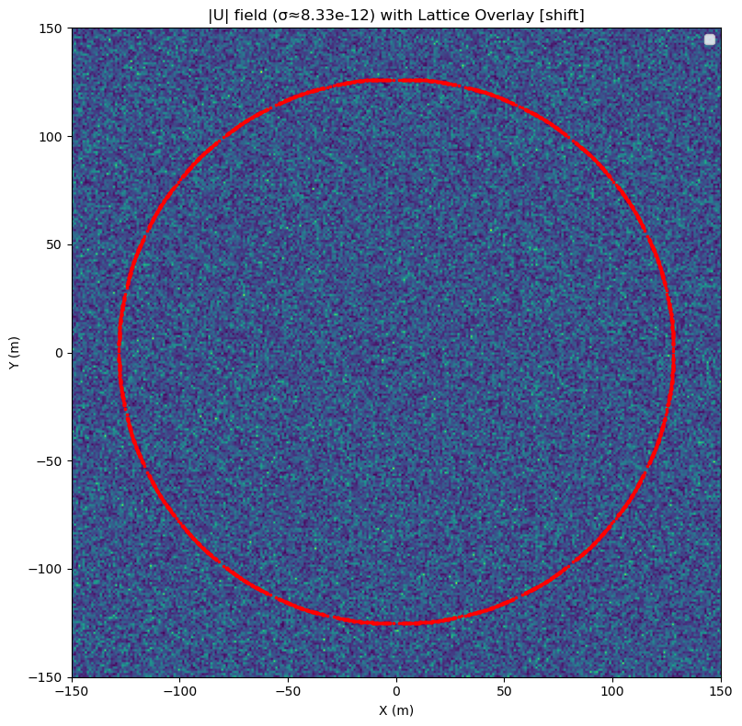
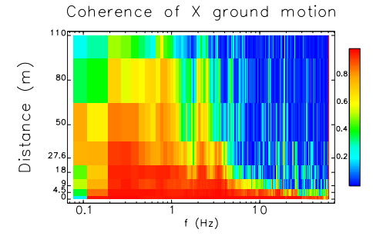
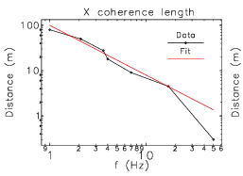
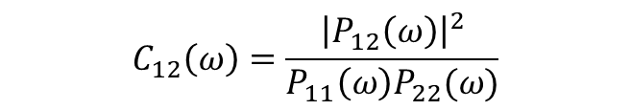
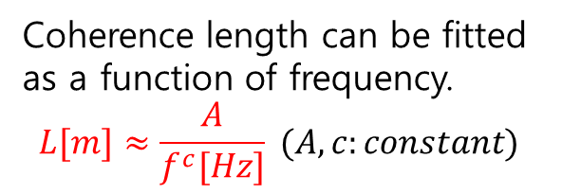
Ground motion orbit amplification-understanding coherence
1. Coherence length from coherent map
Displacements on storage ring
$$C_{12}\left(ω\right)=\frac{{\left|P_{12}\left(ω\right)\right|}^{2}}{P_{11}\left(ω\right)P_{22}(ω)}$$
Coherence length can be fitted as a function of frequency.
$$L[m]≈\frac{A}{f^{c}[Hz]} (A,c:constant)$$

Slide 5
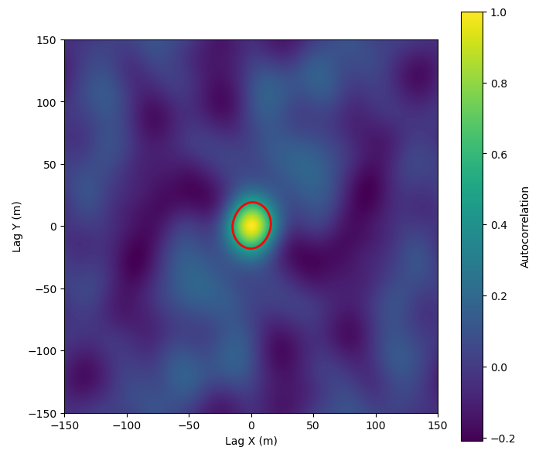


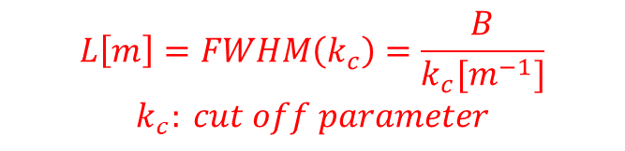
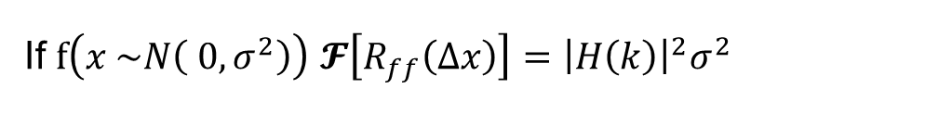

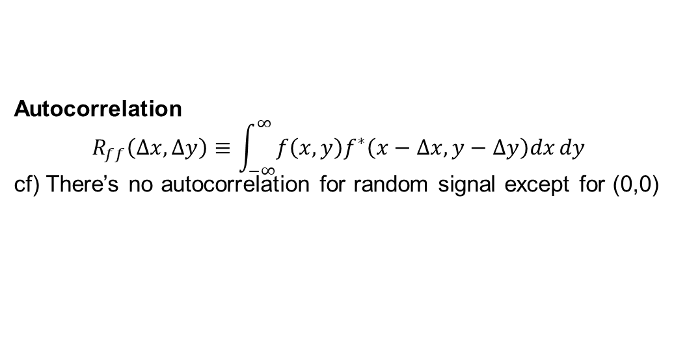
Ground motion orbit amplification-understanding coherence
2.. Coherence length from autocorrelation
Autocorrelation
$$R_{ff}\left(Δx,Δy\right)≡\int_{−∞}^{∞}{f\left(x,y\right)f^{∗}\left(x−Δx,y−Δy\right)dx}dy$$
cf) There’s no autocorrelation for random signal except for (0,0)
If $f\left(x \sim N\left( 0,σ^{2}\right)\right)$ $\text{𝓕}\left[R_{ff}\left(Δx\right)\right]={\left|H\left(k\right)\right|}^{2}σ^{2}$
Example for calculating autocorrelation
FWHM of Autocorrelation can be regarded as the correlation length.
$$L\left[m\right]=FWHM\left(k_{c}\right)=\frac{B}{k_{c}[m^{−1}]}$$
$$k_{c}: cut off parameter$$
$$⋯$$

Slide 6
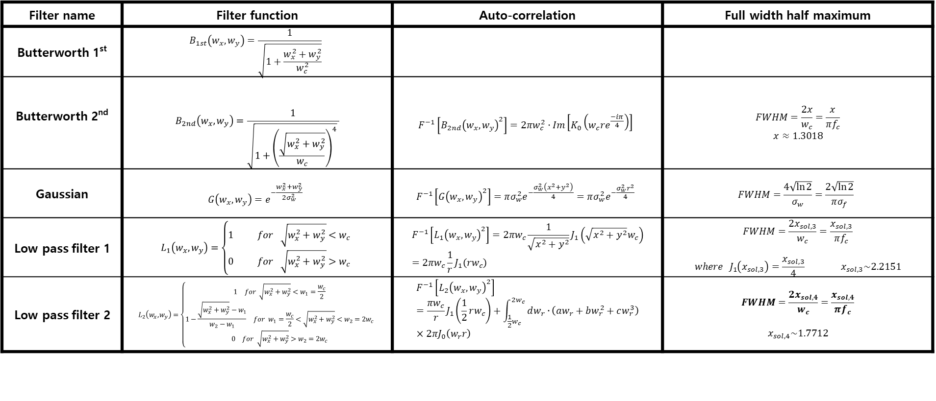
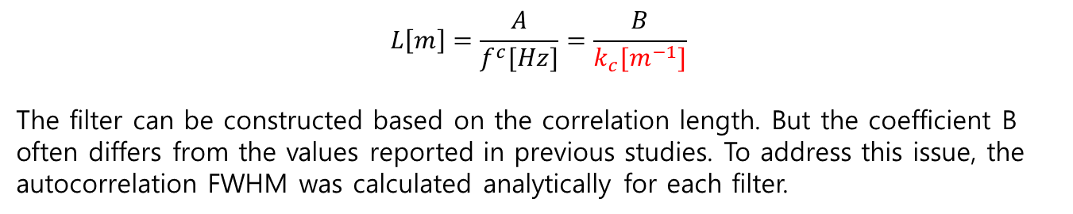
Ground motion orbit amplification-understanding coherence
$$L\left[m\right]=\frac{A}{f^{c}[Hz]}=\frac{B}{k_{c}[m^{−1}]}$$
The filter can be constructed based on the correlation length. But the coefficient B often differs from the values reported in previous studies. To address this issue, the autocorrelation FWHM was calculated analytically for each filter.
Filter name | Filter function | Auto-correlation | Full width half maximum
Butterworth 1st | $$B_{1st}\left(w_{x},w_{y}\right)=\frac{1}{\sqrt{1+\frac{w_{x}^{2}+w_{y}^{2}}{w_{c}^{2}}}}$$
Butterworth 2nd | $$B_{2nd}\left(w_{x},w_{y}\right)=\frac{1}{\sqrt{1+{\left(\frac{\sqrt{w_{x}^{2}+w_{y}^{2}}}{w_{c}}\right)}^{4}} }$$ | $$F^{−1}\left[{B_{2nd}\left(w_{x},w_{y}\right)}^{2}\right]=2πw_{c}^{2}⋅Im\left[K_{0}\left(w_{c}re^{\frac{−iπ}{4}}\right)\right]$$ | $$FWHM=\frac{2x}{w_{c}}=\frac{x}{πf_{c}}$$ $x≈1.3018$
Gaussian | $$G\left(w_{x},w_{y}\right)=e^{−\frac{w_{x}^{2}+w_{y}^{2}}{2σ_{w}^{2}}}$$ | $$F^{−1}\left[{G\left(w_{x},w_{y}\right)}^{2}\right]=πσ_{w}^{2}e^{−\frac{σ_{w}^{2}\left(x^{2}+y^{2}\right)}{4}}=πσ_{w}^{2}e^{−\frac{σ_{w}^{2}r^{2}}{4}}$$ | $$FWHM=\frac{4\sqrt{\ln{2}}}{σ_{w}}=\frac{2\sqrt{\ln{2}}}{πσ_{f}}$$
Low pass filter 1 | $$L_{1}\left(w_{x},w_{y}\right)=\left\{\begin{aligned}1 for \sqrt{w_{x}^{2}+w_{y}^{2}}<w_{c} \\ 0 for \sqrt{w_{x}^{2}+w_{y}^{2}}>w_{c}\end{aligned}\right.$$ | $$F^{−1}\left[{L_{1}\left(w_{x},w_{y}\right)}^{2}\right]=2πw_{c}\frac{1}{\sqrt{x^{2}+y^{2}}}J_{1}\left(\sqrt{x^{2}+y^{2}}w_{c}\right)=2πw_{c}\frac{1}{r}J_{1}\left(rw_{c}\right)$$ | $$FWHM=\frac{2x_{sol,3}}{w_{c}}=\frac{x_{sol,3}}{πf_{c}}$$ $$where J_{1}\left(x_{sol,3}\right)=\frac{x_{sol,3}}{4} x_{sol,3}\sim 2.2151$$
Low pass filter 2 | $$L_{2}\left(w_{x},w_{y}\right)=\left\{\begin{aligned}\begin{matrix}1 & for \sqrt{w_{x}^{2}+w_{y}^{2}}<w_{1}=\frac{w_{c}}{2}\end{matrix} \\ \begin{matrix}1−\frac{\sqrt{w_{x}^{2}+w_{y}^{2}}−w_{1}}{w_{2}−w_{1}} & for w_{1}=\frac{w_{c}}{2}<\sqrt{w_{x}^{2}+w_{y}^{2}}<w_{2}=2w_{c}\end{matrix} \\ \begin{matrix}0 & for \sqrt{w_{x}^{2}+w_{y}^{2}}>w_{2}=2w_{c}\end{matrix}\end{aligned}\right.$$ | $$F^{−1}\left[{L_{2}\left(w_{x},w_{y}\right)}^{2}\right]=\frac{πw_{c}}{r}J_{1}\left(\frac{1}{2}rw_{c}\right)+\int_{{\frac{1}{2}w}_{c}}^{{2w}_{c}}{dw_{r}∙}\left(aw_{r}+bw_{r}^{2}+cw_{r}^{3}\right)×2πJ_{0}\left(w_{r}r\right)$$ | $$FWHM=\frac{2x_{sol,4}}{w_{c}}=\frac{x_{sol,4}}{πf_{c}}$$ $$x_{sol,4}\sim 1.7712$$

Slide 7
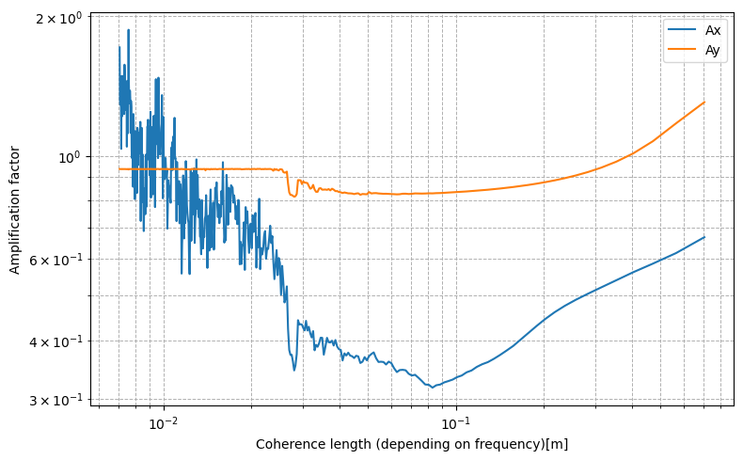
Then, the amplification was obtained from a random signal to which a well-made filter was applied.
Using gaussian filter
$$A_{x,}=\frac{Orbit x_{rms}}{Ground x_{rms}},, A_{y}=\frac{Orbit y_{rms}}{Ground y_{rms}},$$

Slide 8
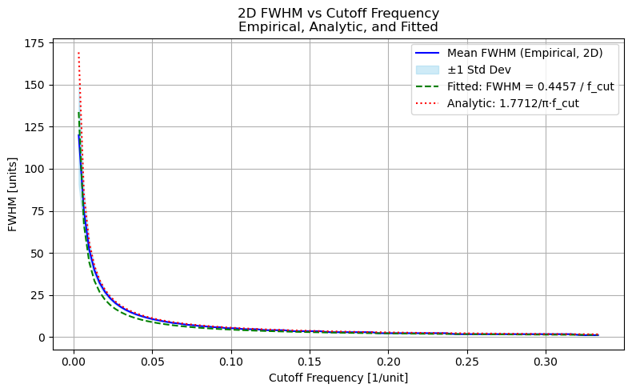
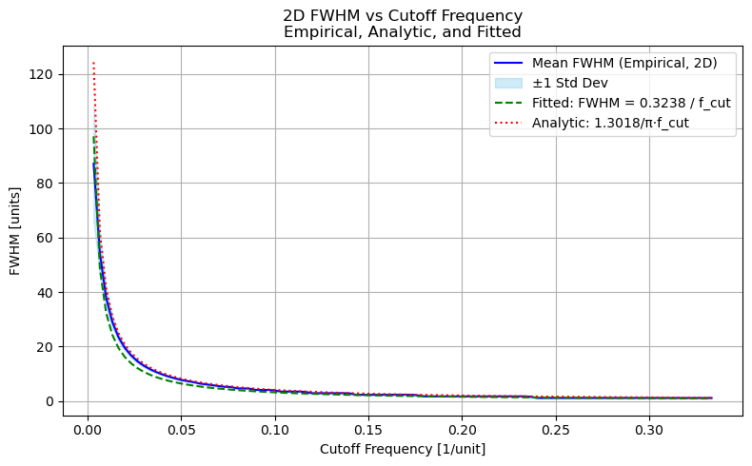
Gaussian filter
Lowpass filter

Slide 9

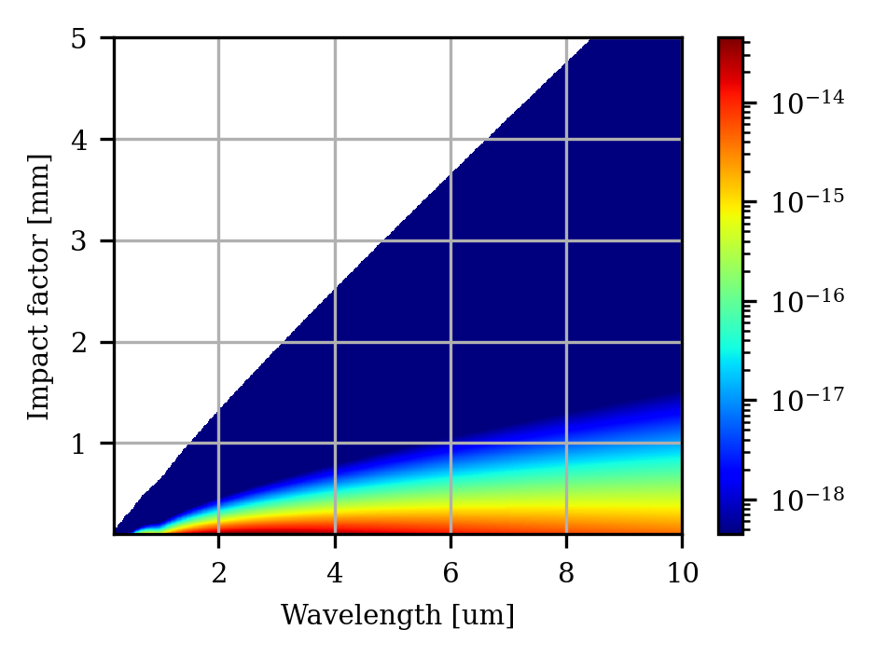
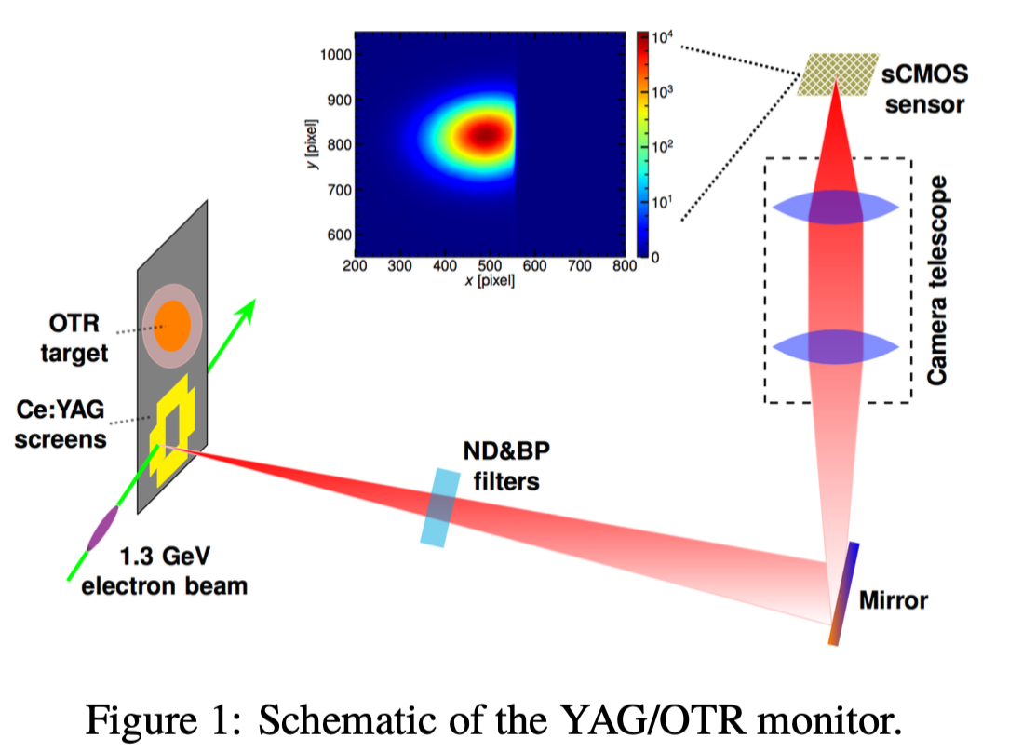
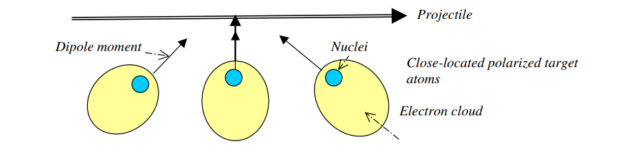





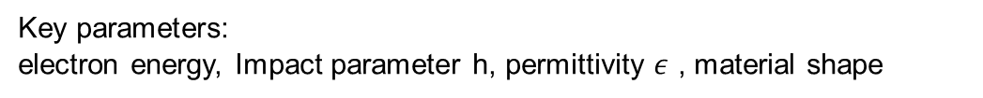
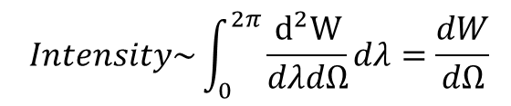
Cherenkov diffraction radiation/Application on Diagnostic
<Cherenkov radiation>
radiation spectrum: $\frac{d^{2}W}{dλdΩ}(θ, φ, λ)$
$$Intensity\sim \int_{0}^{2π}{\frac{d^{2}W}{dλdΩ}}dλ=\frac{dW}{dΩ}$$
$$ϕ$$
$$θ$$
Dielectric material
<Cherenkov diffraction radiation radiation>
Impact parameter, b
Electron
path
$Intensity∝N$(bunch profile)
Dielectric material (n)
$$θ_{ch}=\cos^{−1}{(\frac{1}{βn})}$$
Key parameters:
electron energy, Impact parameter h, permittivity $ε$ , material shape
bunch
Invasive measurement

Slide 10
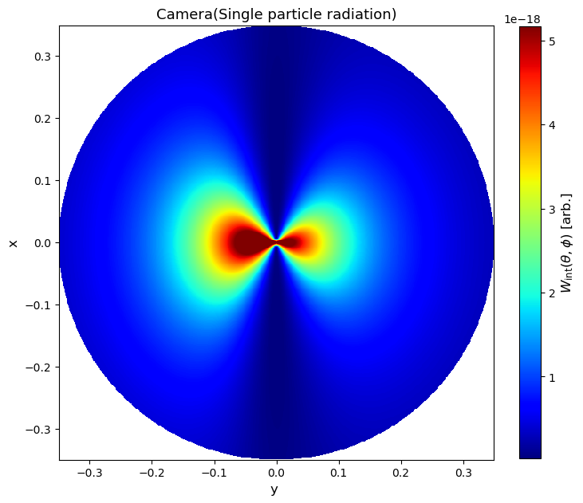
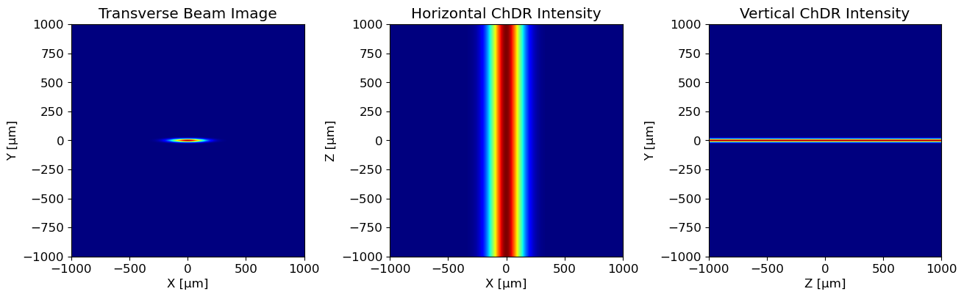
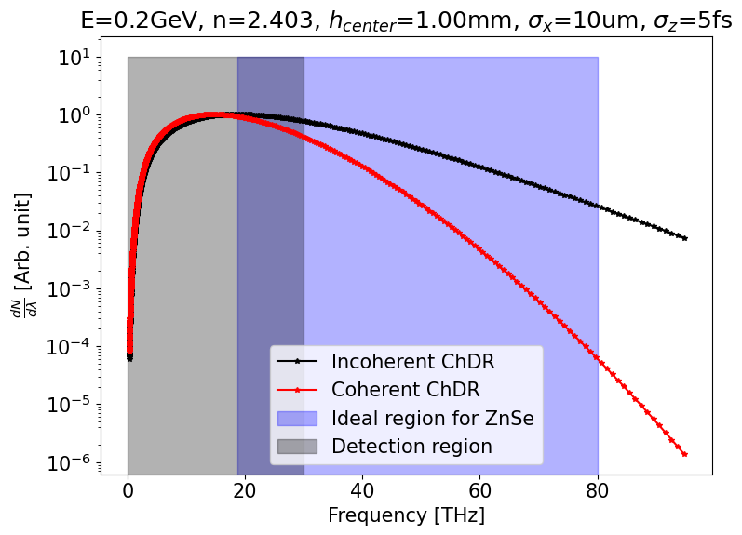
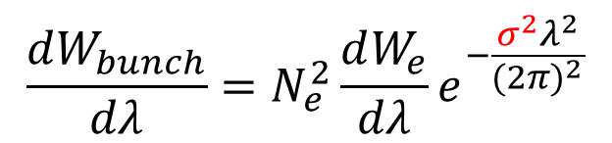
Study on measurement conditions for Cherenkov Diffraction Radiation
radiation spectrum:$\frac{d^{2}W}{dλdΩ}\sim \left(γ, h,ε, material shape, θ, φ, λ\right)$
1. Beam size monitor(incoherent ChDR)
Simulation of Electron beam profile
What we already know
(Incoherent / Single particle ChDR)
2. Bunch length monitor(Coherent ChDR)
$$\frac{dW_{bunch}}{dλ}=N_{e}^{2}\frac{dW_{e}}{dλ}e^{−\frac{σ^{2}λ^{2}}{{(2π)}^{2}}}$$
What we Measure
(Coherent ChDR)
What we want to know
(Bunch length)

Slide 11
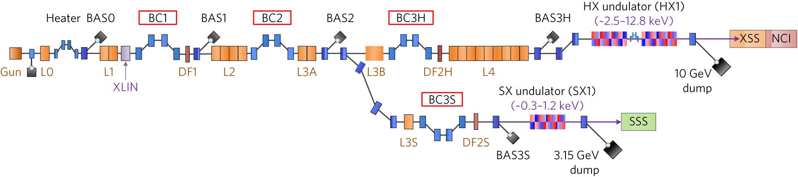
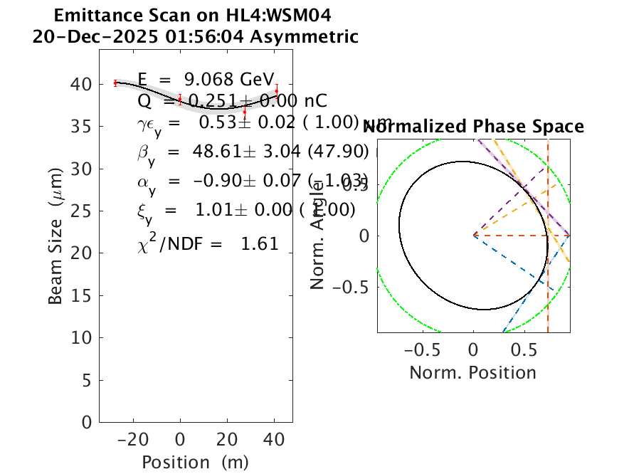
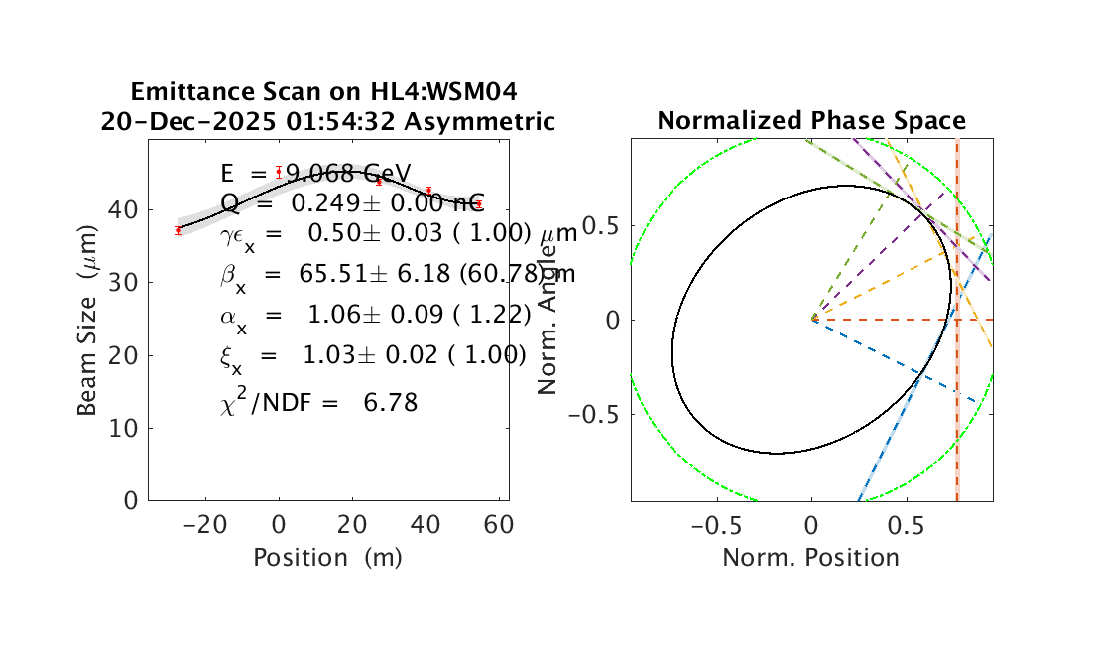
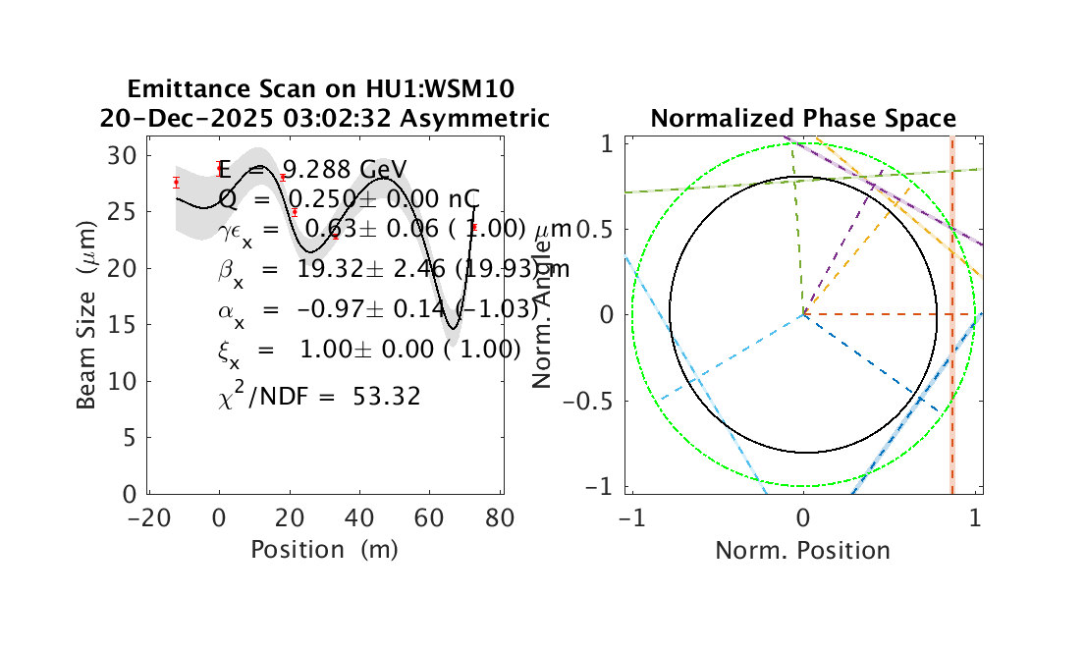
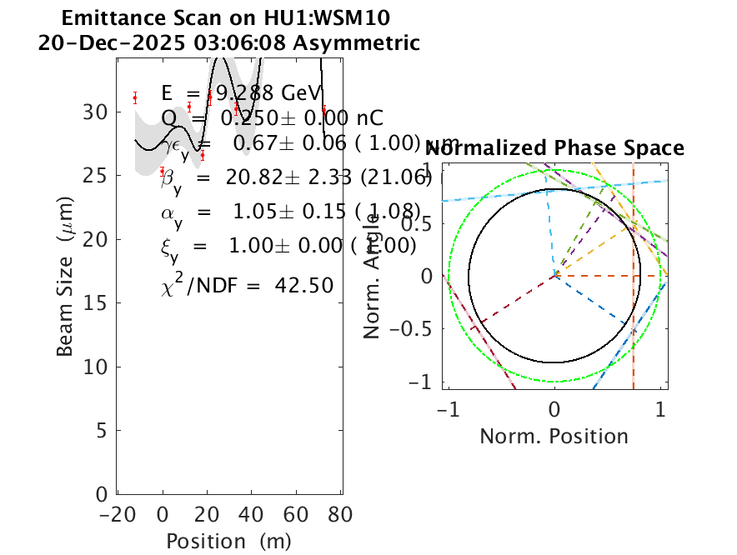
Emittance measurement at PAL-XFEL
HU1
HL4
INJ
HL1
Emittance is the most important parameter to be optimized for FEL performance
FODO lattice must be matched to maintain beam size through LINAC based on the Twiss parameter measurement
Emittance and Twiss parameters are measured by:
INJ, HL1: Quadrupole magnet scan method
HL4, HU1: Wire scanner (WSM) method
HL4: 5 WSM // HU1: 7 WSM
HL2, HL3, SU1: None

Slide 12
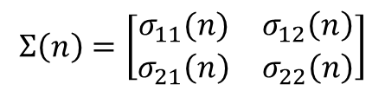
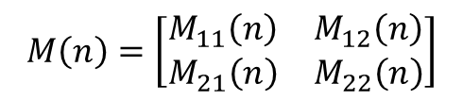
Emittance measurement using wire scanner: “Three grid” method
[Peter Forck, Lecture Notes on Beam Instrumentation and Diagnostics, JUAS (2009)]
Location
S0
S1
S2
S3
S4
M(1)
M(2)
M(3)
M(4)
Profile monitor (e.g., WSM or SCM)
→ Destructive method
S0: Reconstruction point
$$Σ\left(n\right)=\left[\begin{matrix}σ_{11}(n) & σ_{12}\left(n\right) \\ σ_{21}\left(n\right) & σ_{22}\left(n\right)\end{matrix}\right]$$
S1-4: Measurement point
$Σ\left(n\right)$: second-order moment beam matrix at n-th location
Quadrupole magnet
$$M\left(n\right)=\left[\begin{matrix}M_{11}\left(n\right) & M_{12}\left(n\right) \\ M_{21}\left(n\right) & M_{22}\left(n\right)\end{matrix}\right]$$
M(n): Transfer matrix

Slide 13
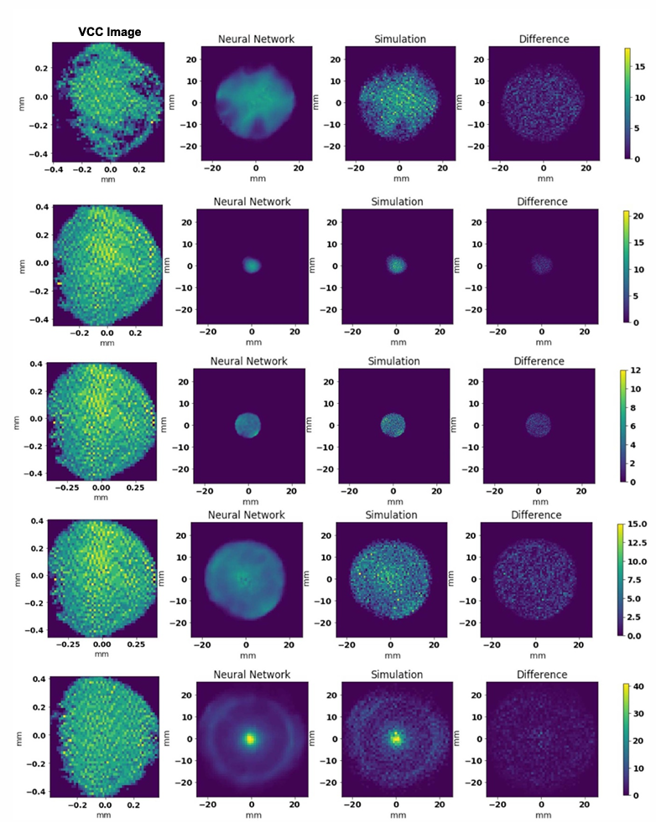
Improving surrogate model accuracy for the LCLS-2 injector frontend using convolutional neural networks and transfer learning
Even when the laser profile contains asymmetries, the CNN learns the relevant spatial features and reliability interpolates to previously unseen VCC patterns.

Slide 14
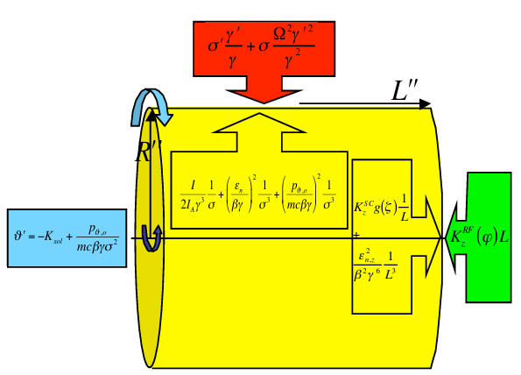
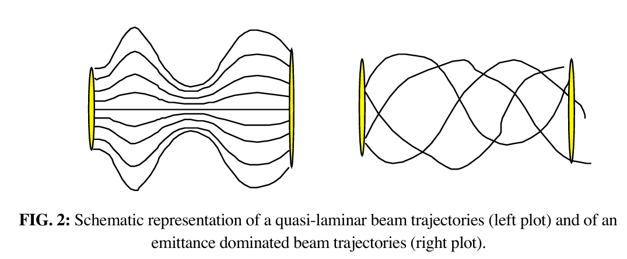

Beam envelope equation
$$σ^{′′}+σ^{′}\frac{γ′}{γ}+σ\frac{Ω^{2}γ^{′2} }{γ^{2}}=\frac{I}{2I_{A}}\frac{1}{σγ^{3}}+\frac{ε_{n}^{2}}{σ^{3}γ^{2}}+{\left(\frac{p_{θ}}{mc}\right)}^{2}\frac{1}{σ^{3}γ^{2}}$$
가속도 + adiabatic damping+ RF transverse 방향 focusing = space charge effect + emittance pressure + canonical angular momentum
Laminarity parameter $ρ$: envelope equation에서 space charge term과 emittance term 사이의 비율
$$ρ=\frac{space charge}{emittance pressure}=\frac{\frac{I}{2I_{A}}\frac{1}{σγ^{3}}}{\frac{ε_{n}^{2}}{σ^{3}γ^{2}}}=\frac{Iσ^{2}}{2γI_{A}(ε_{n}^{2})}=\frac{Iσ^{2}}{2γI_{A}(ε_{th}^{2}+ε_{B}^{2})} (ε_{n}^{2}=ε_{th}^{2}+ε_{B}^{2}+⋯)$$
$ρ≫1$ (space charge effect dominated regime) 일 때, - quasi laminar regime particle trajectories가 서로 교차 x, Correlated emittance oscillation 관측
빔이 점차 가속되면서 emittance dominated regime 진입($ρ≪1 )$

Slide 15
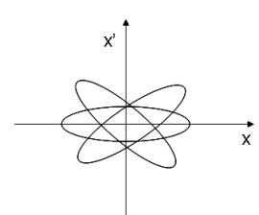
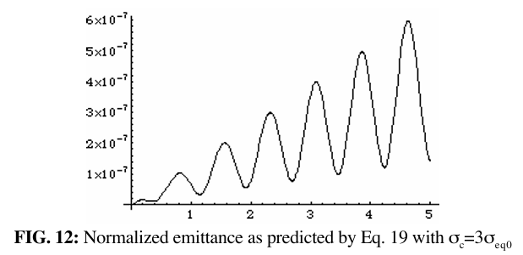

Emittance compensation: emittance oscillation
가속이 없는 긴 Solenoid를 지나는 상황 가정
$σ^{′′}+σ\frac{Ω^{2}γ^{′2} }{γ^{2}}−\frac{I}{2I_{A}}\frac{1}{σγ^{3}}=0$ 에서
$σ^{′′}+k^{2}σ=\frac{Ig(ζ)}{2I_{A}σγ^{3}}$
$$k=\frac{eB}{2mcγ},g\left(ζ\right)=\frac{1−ζ/L}{2\sqrt{{\left(1−\frac{ζ}{L}\right)}^{2}+A^{2}}}+\frac{ζ/L}{2\sqrt{{\left(ζ/L\right)}^{2}+A^{2}}}, A=\frac{R}{γL}$$
equilbirum solution을 찾기 위해 $σ^{′′}=0 으로$ 두면,
$$σ_{eq}\left(ζ,γ\right)=\sqrt{\frac{Ig(ζ)}{2I_{A}γ^{3}}}⋅\frac{1}{k}$$
$$σ\left(z,ζ,γ\right)=σ_{eq}\left(ζ,γ\right)+δσ\left(ζ,γ\right)\cos\left(\sqrt{2}k\left(γ\right)z\right) , δσ=σ_{c}−σ_{eq}$$
균일한 전하 분포를 가지는 원통형 bunch가 유의미한 correlated energy spread를 가지는 경우.
초기에 모든 slice가 같은 transverse size $σ_{c}$를 가짐.
주어진 외부 자기장 B에 대해 맞는 $γ_{0}를$ 갖는 slice만이 평형에 놓임. 그 외 slice는 진동

Slide 16
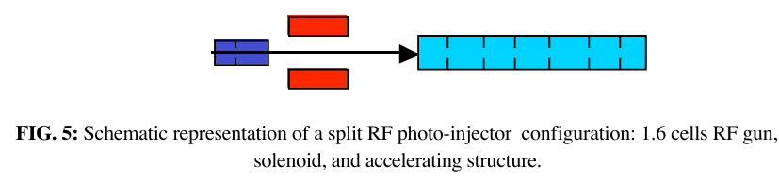
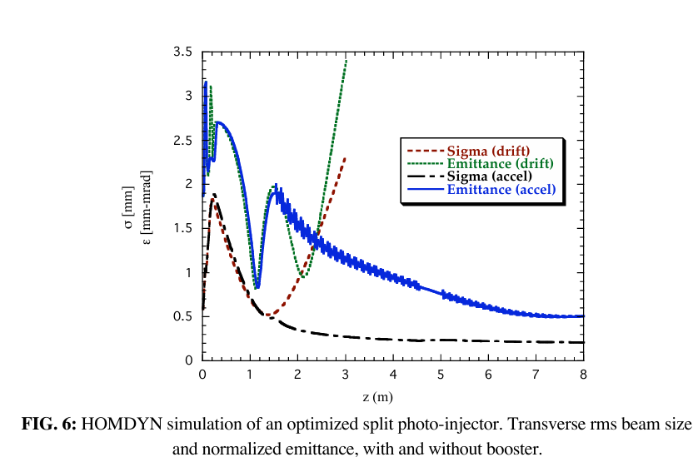
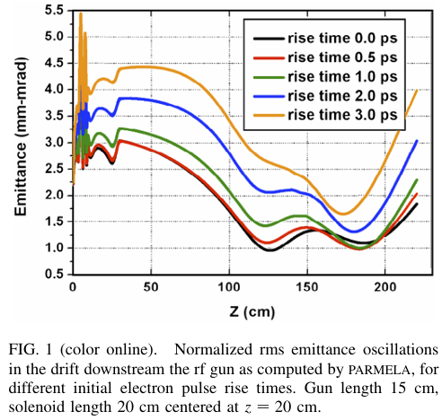
Emittance compensation: the concept of invariant envelope and the new working point
솔레노이드 세기 증가하면 진동 주기 짧아짐
emittance 최대값(slice-fan이 가장 크게 벌어졌을 때이면서 envelope 최소) 이곳에 booster 설치(가속).
Adiabatic damping에 의해 envelope oscillation 지연, fan이 닫히기만 함
두 번째 minimum에 도달하기 전에 beam energy가 충분히 커지면 space charge에 의한 emittance oscillation멈춤
Invariant envelope 매칭 조건이 만족되는 한 그 값을 매우 낮은 수준으로 고정할 수 있음---<emittance compensation>
booster

Slide 17
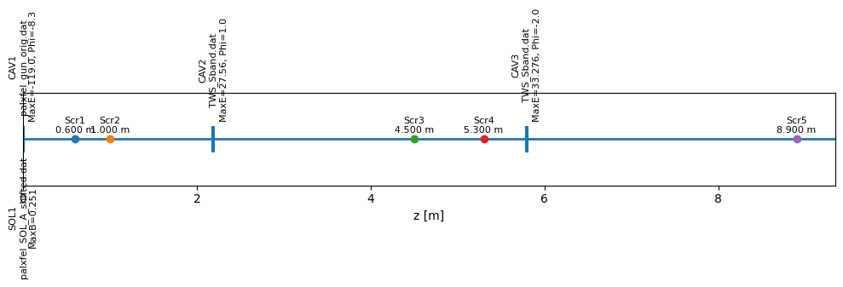
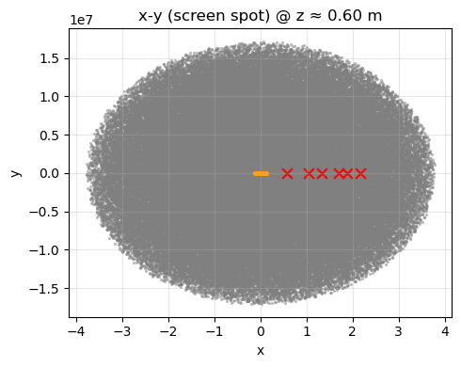
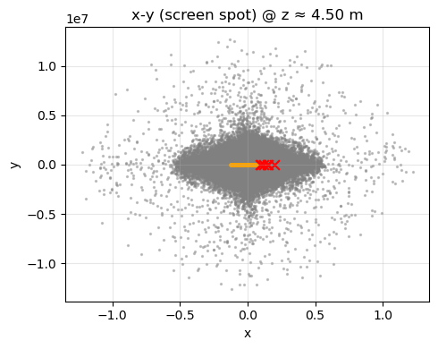
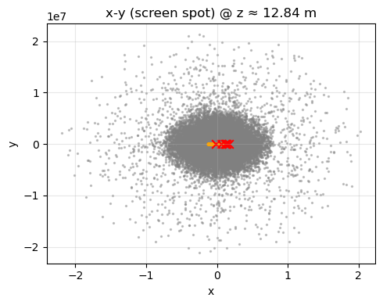
Practicing ASTRA simulation

Slide 18
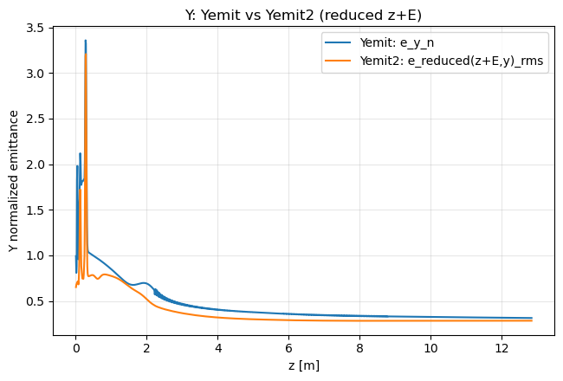
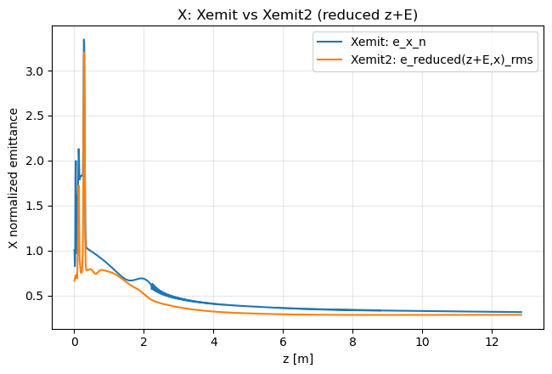
Practicing ASTRA simulation

Slide 19
Ground motion:
Find a quantitative(smoothness of the filtered displacement and autocorrelation, amplification factor……) that show the significant performance among different filters, especially at low frequency.
PAL-XFEL:
1.
Improve understanding of the XFEL machine
Practice ASTRA simulation
Learning NN model
2.
Simulate beam profile measurement using ChDR.
Emittance reconstruction via beam profiles from ChDR
일 | 월 | 화 | 수 | 목 | 금 | 토
11 | 12 | 13 | 14 | 15 | 16 | 17
18 | 19 | 20 | 21 | 22 | 23 | 24
25 | 26 | 27 | 28 | 29 | 30 | 31
1 | 2 | 3 | 4 | 5 | 6 | 7
8 | 9 | 10 | 11 | 12 | 13 | 14
15 | 16 | 17 | 18 | 19 | 20 | 21
22 | 23 | 24 | 25 | 26 | 27 | 28
USPAS
USPAS

Slide 20
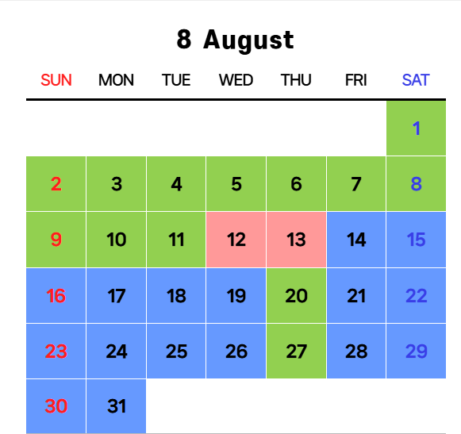
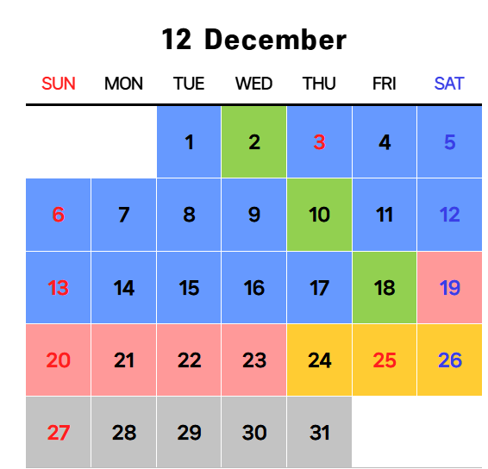
Obtain reliable learning model and obtain validation data from the real machine.

