Slide 1
CAPhE Mini Workshop
09.Jan.2026
Ji-young Choi

Slide 2
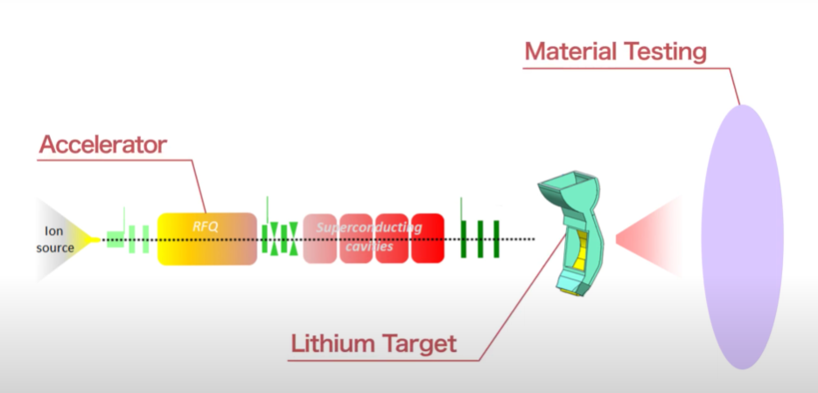
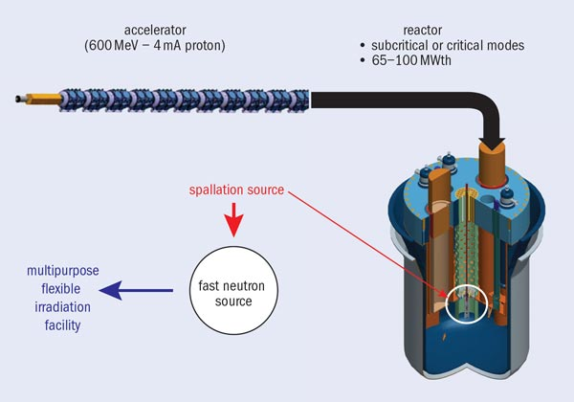
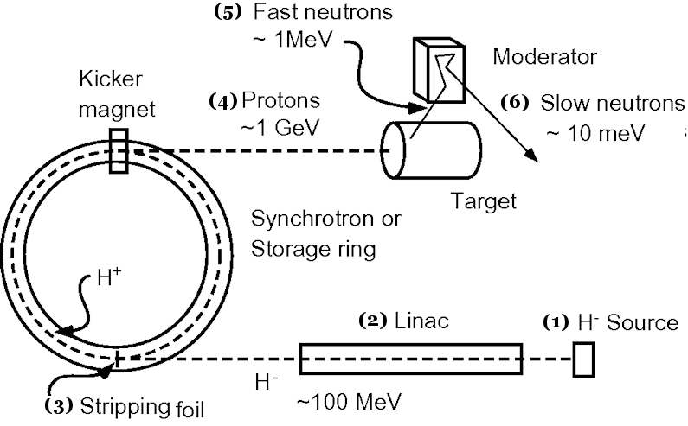

High-power Accelerators for Neutron Sources
Fusion materials irradiation
neutron sources
Accelerator Driven Systems
(ADS)
Spallation Neutron Sources
(SNS)
Test facility to find and qualify new advanced materials for fusion reactors
Transmutation of nuclear waste
Neutron scattering facility for materials science
CW, $(d, xn)$reaction, Linac
CW, Spallation reaction, Linac
Pulse, Spallation reaction, Linac & Ring

Slide 3
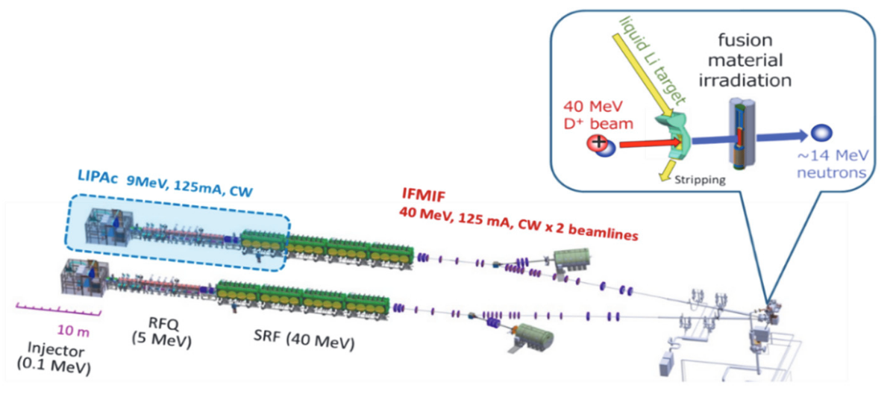
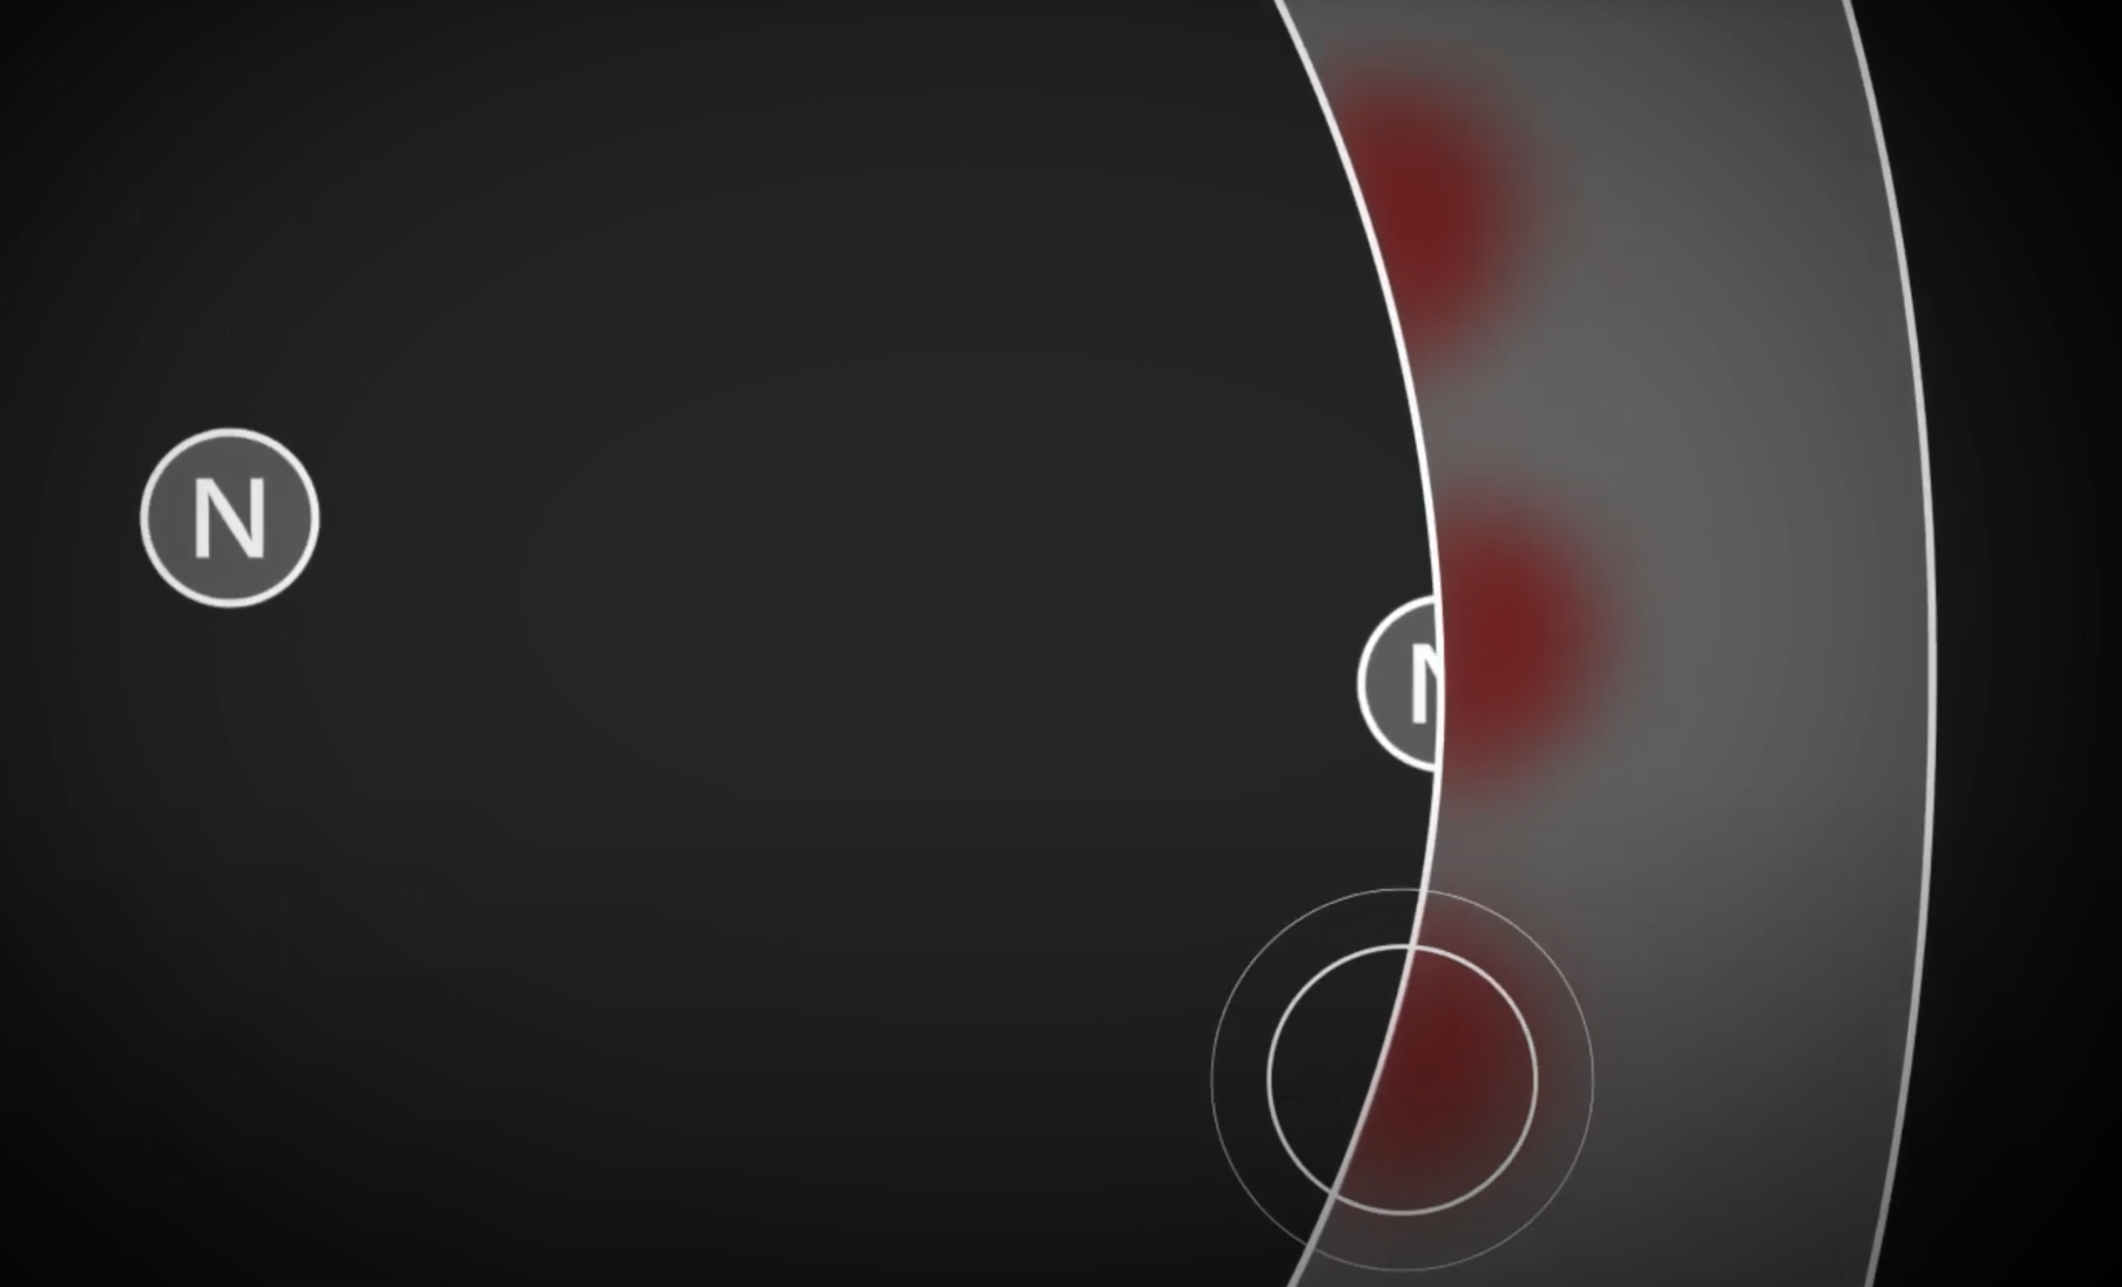
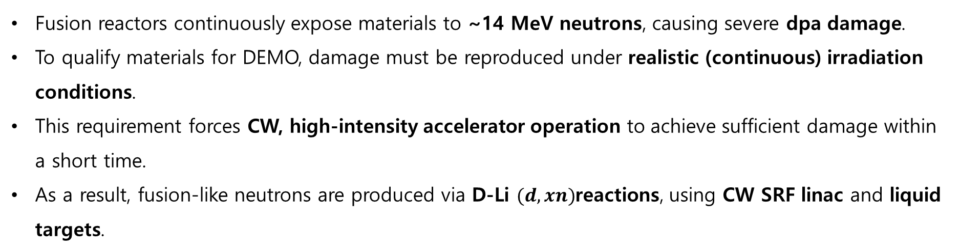
Fusion Materials Irradiation Neutron Sources
Fusion reactors continuously expose materials to ~14 MeV neutrons, causing severe dpa damage.
To qualify materials for DEMO, damage must be reproduced under realistic (continuous) irradiation conditions.
This requirement forces CW, high-intensity accelerator operation to achieve sufficient damage within a short time.
As a result, fusion-like neutrons are produced via D-Li $(d, xn)$reactions, using CW SRF linac and liquid targets.

Slide 4
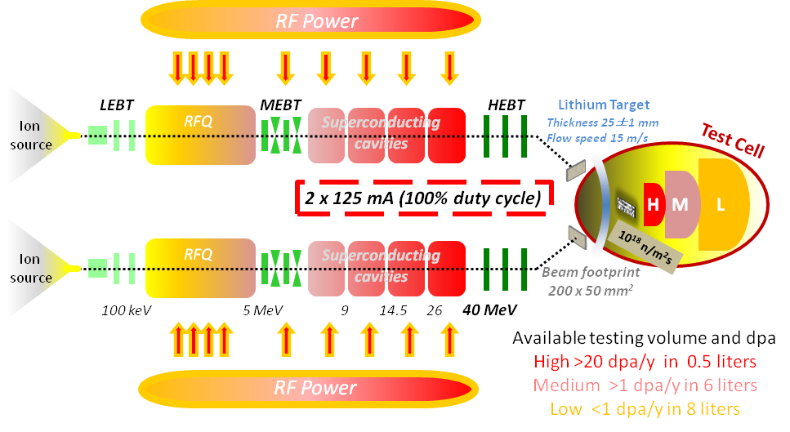
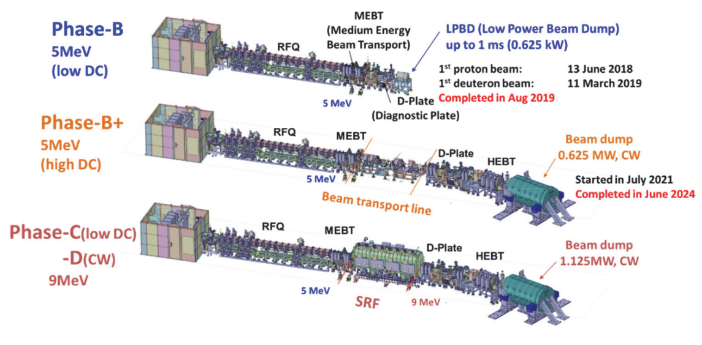
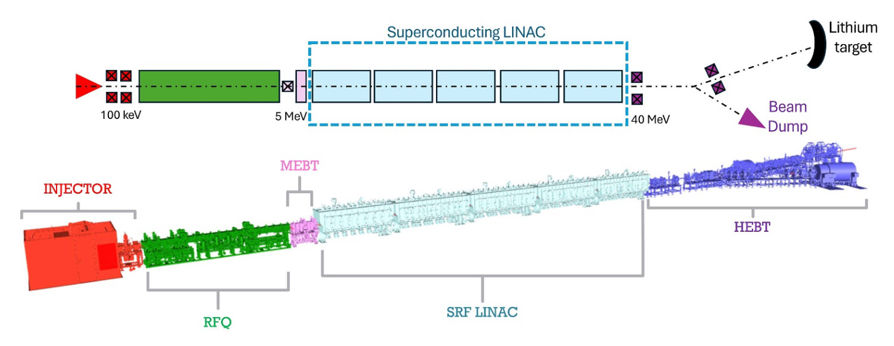
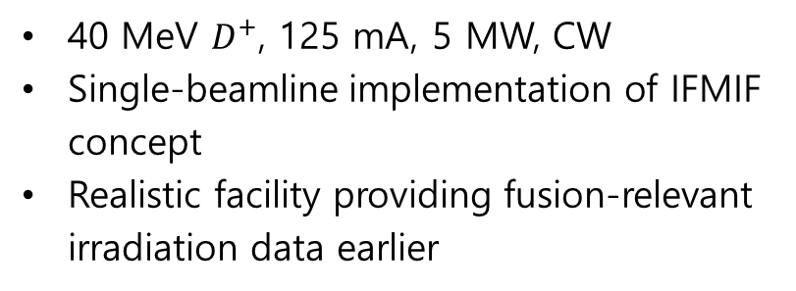
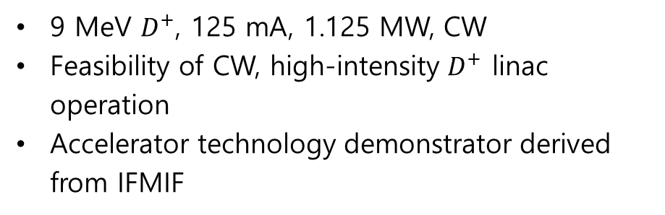
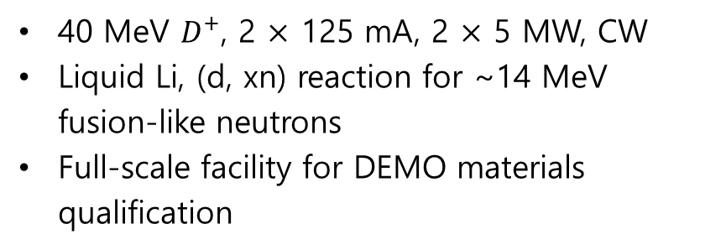
Fusion Materials Irradiation Neutron Sources: Current Status
40 MeV $D^{+}$, 2 $×$ 125 mA, 2 $×$ 5 MW, CW
Liquid Li, (d, xn) reaction for ~14 MeV fusion-like neutrons
Full-scale facility for DEMO materials qualification
IFMIF
IFMIF-LIPAc
9 MeV $D^{+}$, 125 mA, 1.125 MW, CW
Feasibility of CW, high-intensity $D^{+}$ linac operation
Accelerator technology demonstrator derived from IFMIF
IFMIF-DONES
40 MeV $D^{+}$, 125 mA, 5 MW, CW
Single-beamline implementation of IFMIF concept
Realistic facility providing fusion-relevant irradiation data earlier

Slide 5
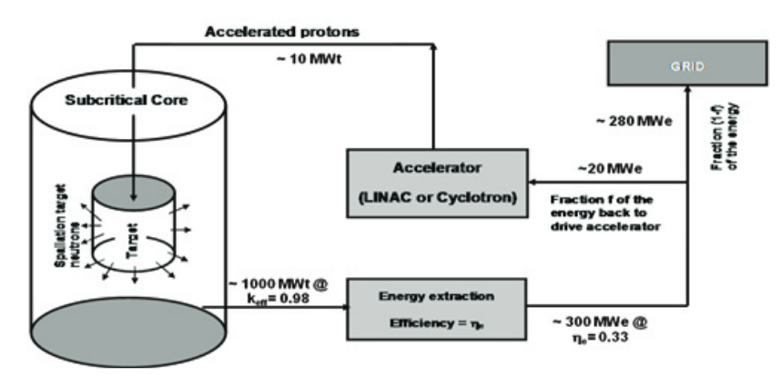
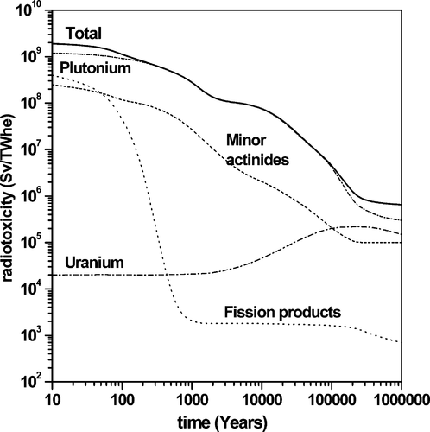
Accelerator Driven Systems (ADS)
Long-lived nuclear waste (minor actinides, plutonium) dominates long-term radiotoxicity.
To reduce long-term hazard, nuclear waste must be transmuted under controlled subcritical conditions.
This requires a CW, high-power accelerator to provide a stable external neutron source.
As a result, spallation neutrons are generated by high-power protons on heavy-metal targets.

Slide 6
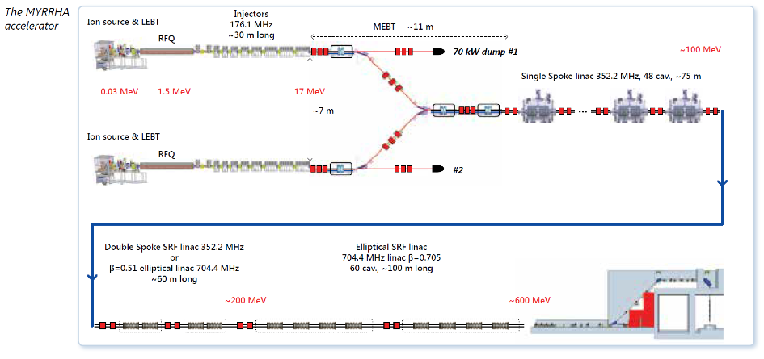
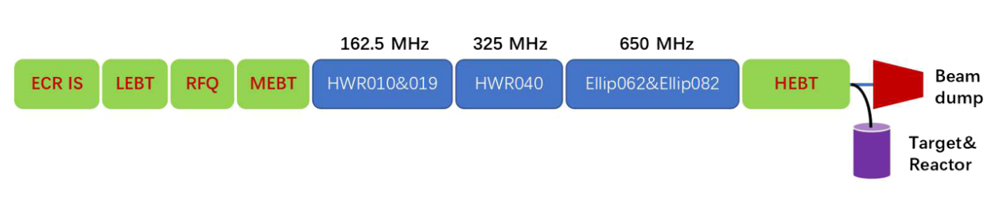
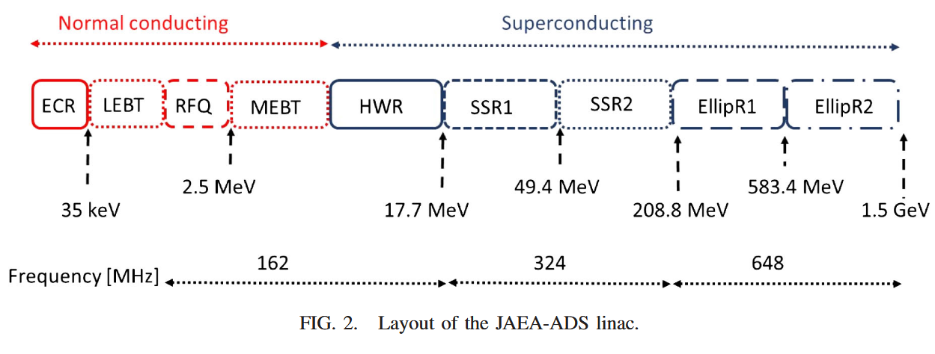
Accelerator Driven Systems (ADS): Current Status
600 MeV proton, 4 mA, 2.4 MW, CW
Lead-bismuth eutectic (LBE), spallation reaction for fast neutrons
Demonstration of the large-scale feasibility of nuclear waste transmutation
MYRRHA
CiADS
500 MeV proton, 5 mA, 2.5 MW, CW
Stepwise implementation toward industrial-scale ADS (C-ADS prototype)
C-ADS: Industrial facility, 1 GeV, 15 mA, 15 MW
JAEA-ADS
1.5 GeV proton, 20 mA, 30 MW, CW
Conceptual & design study toward future ADS implementation

Slide 7
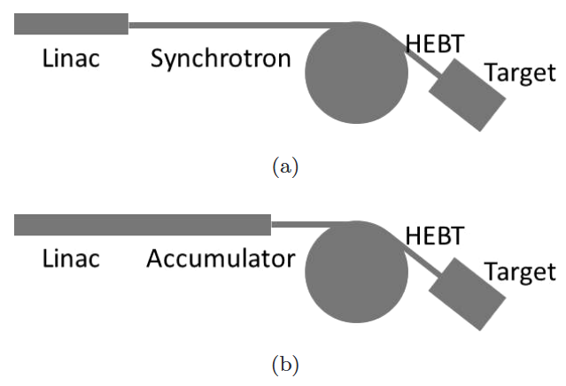
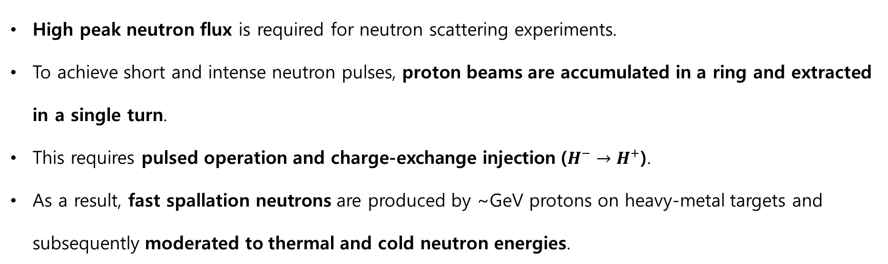
Spallation Neutron Sources (SNS)
High peak neutron flux is required for neutron scattering experiments.
To achieve short and intense neutron pulses, proton beams are accumulated in a ring and extracted in a single turn.
This requires pulsed operation and charge-exchange injection ($H^{−}→H^{+}$).
As a result, fast spallation neutrons are produced by ~GeV protons on heavy-metal targets and subsequently moderated to thermal and cold neutron energies.

Slide 8
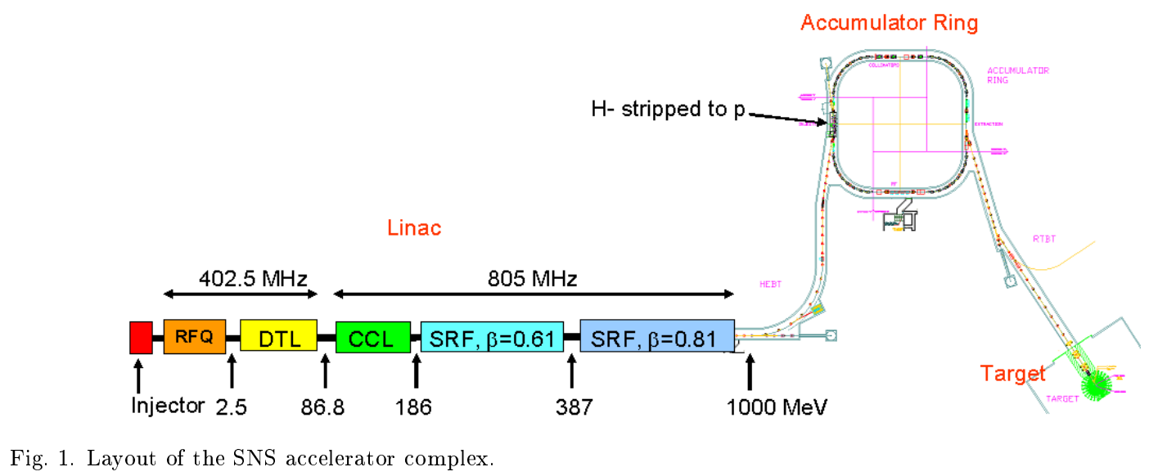
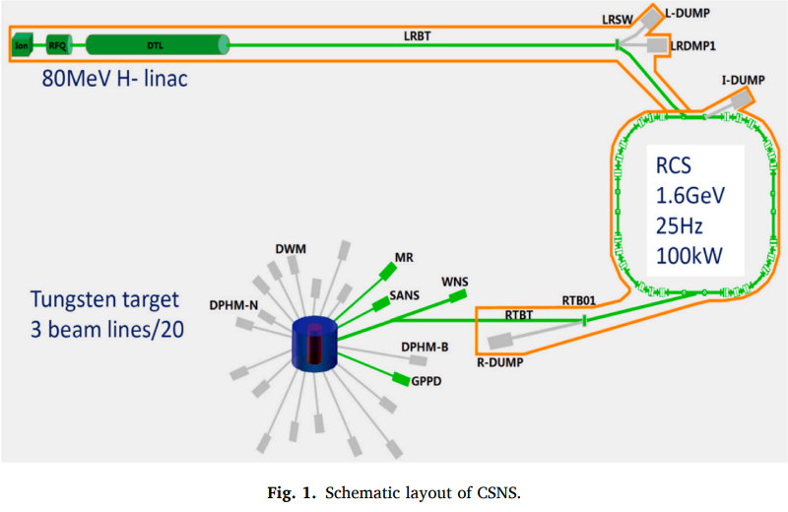
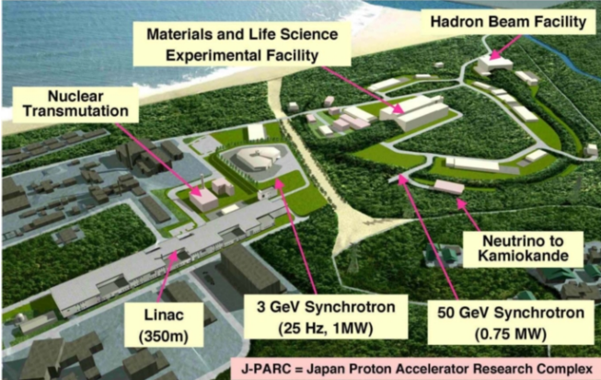
Spallation Neutron Sources (SNS): Current Status
1 GeV proton, 1.4 MW, pulsed operation (60 Hz)
High-energy linac (1 GeV) & Accumulator ring
Liquid mercury target & Rotating tungsten target (under construction) for spallation reaction
SNS
CSNS
1.6 GeV, 0.1 MW, pulsed operation (25 Hz)
Low-energy linac (80 MeV) & RCS (1.6 GeV)
Tungsten target for spallation reaction
J-PARC
3 GeV, 1 MW, pulsed operation (25 Hz)
Low-energy linac (400 MeV) & RCS (3 GeV)
3 GeV proton beam generate muons and neutrons

Slide 9
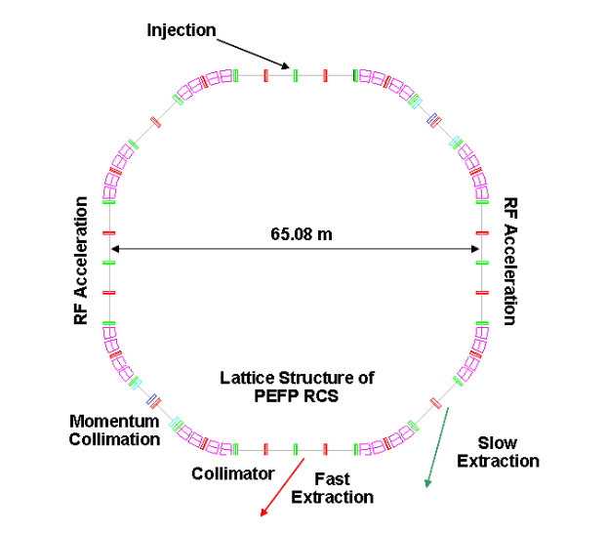
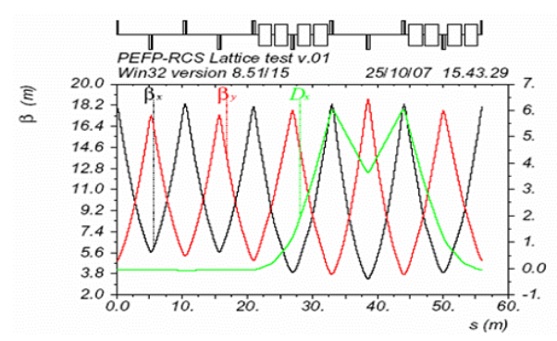
Xsuite - RCS Lattice Study
High-intensity RCS performance is strongly determined by lattice design
Lattice periodicity and structure affect resonance driving terms
Xsuite enables lattice design, optic design, tracking, etc.
Reproducing reference RCS lattices are as a baseline for further studies

Slide 10
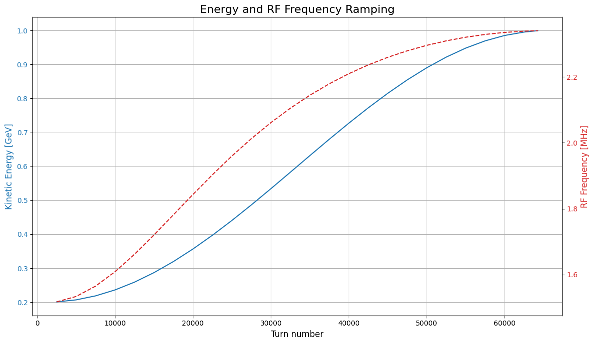
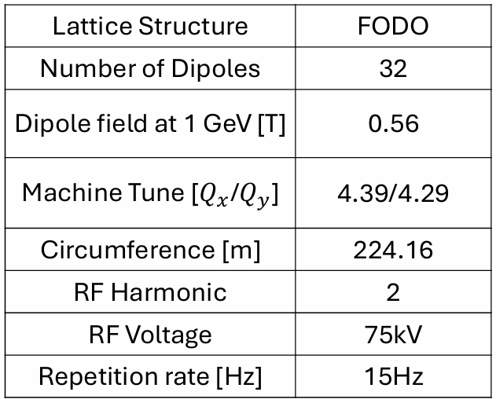
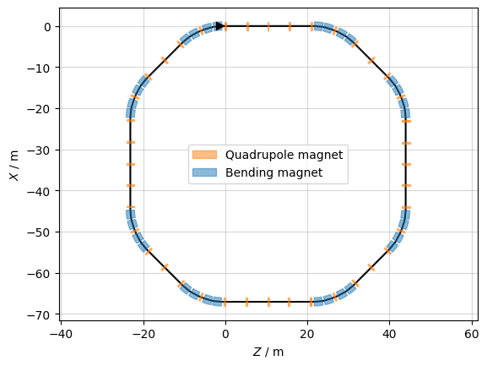
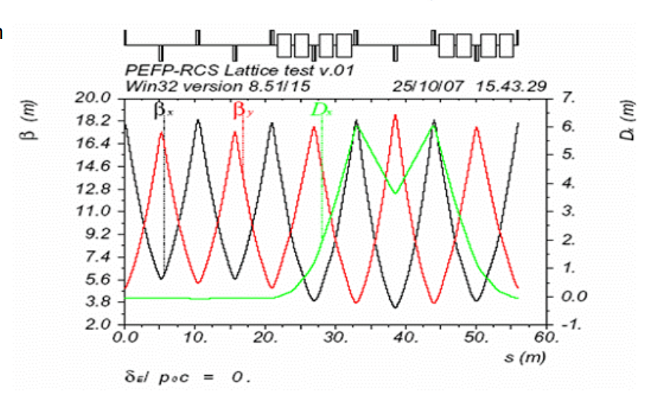
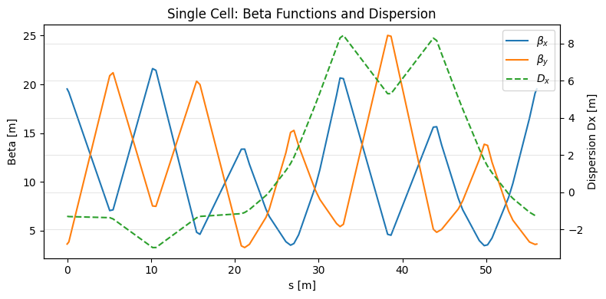








Initial RCS lattice constructed in Xsuite based on PEFP design
Acceleration cycle with energy and RF ramping implemented
Tune control applied via energy-dependent quadrupole scaling
Lattice functions differ from reference
⇒ Optics correction required
$$qf$$
$$qd$$
$$qf$$
$$qd$$
$$qf$$
$$qd$$
$$qf$$
$$qd$$
$$qf$$
$$qd$$
$$qf$$
RF Acceleration

Slide 11
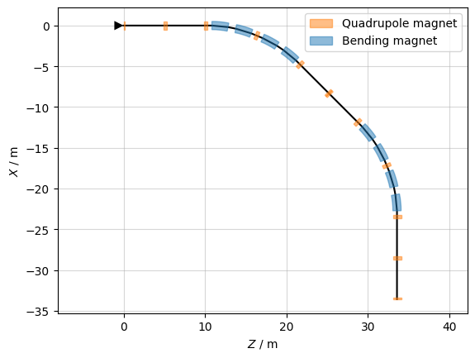
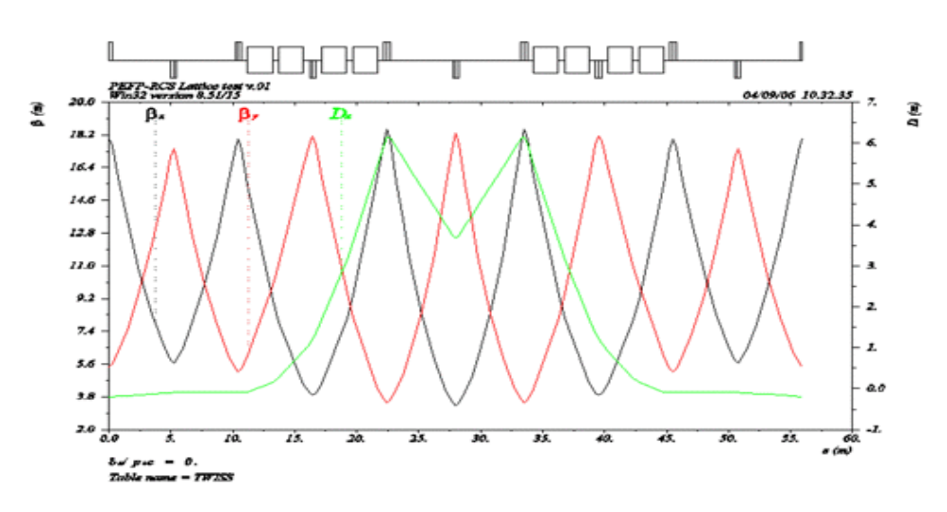
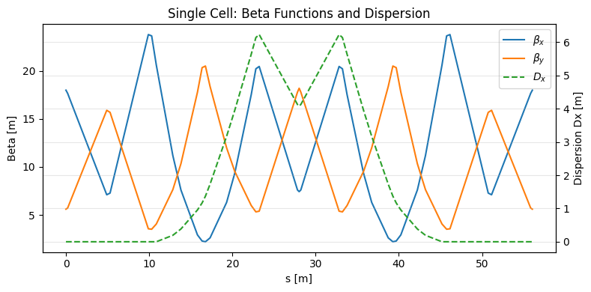
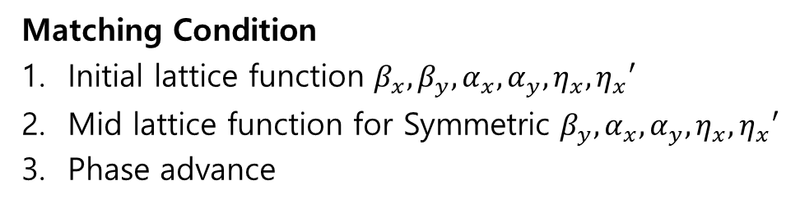
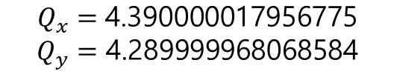
Quadrupole strengths were adjusted using matching conditions
Matching targets
- Symmetric lattice function conditions
- Reference lattice functions (PEFP RCS)
- Phase advance per cell
Matching Condition
Initial lattice function $β_{x}, β_{y}, α_{x}, α_{y}, η_{x}, η_{x}′$
Mid lattice function for Symmetric $β_{y}, α_{x}, α_{y}, η_{x}, η_{x}′$
Phase advance
$$Q_{x}=\text{4.390000017956775}$$
$$Q_{y}=\text{4.289999968068584}$$

Slide 12
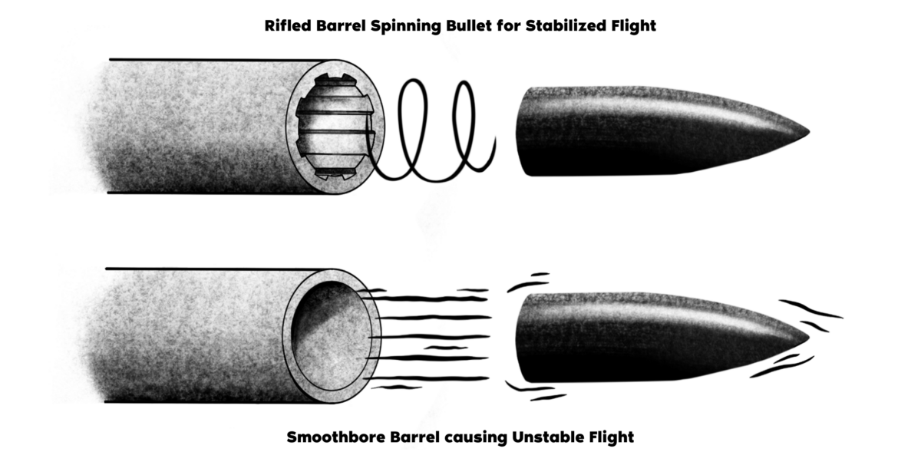
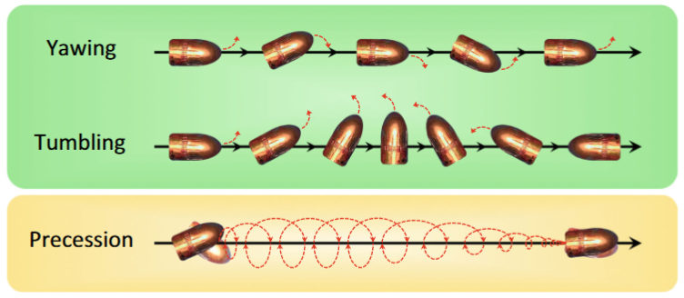
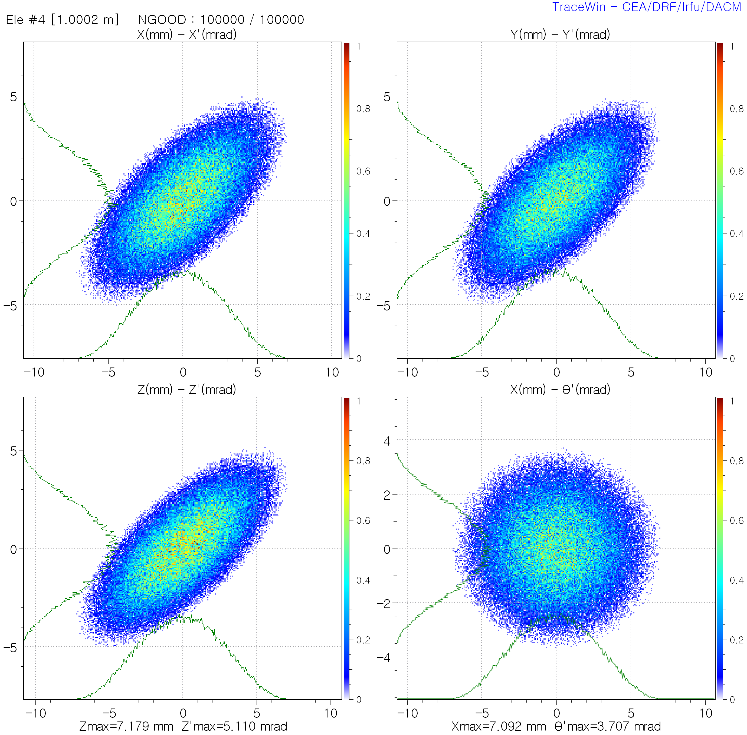
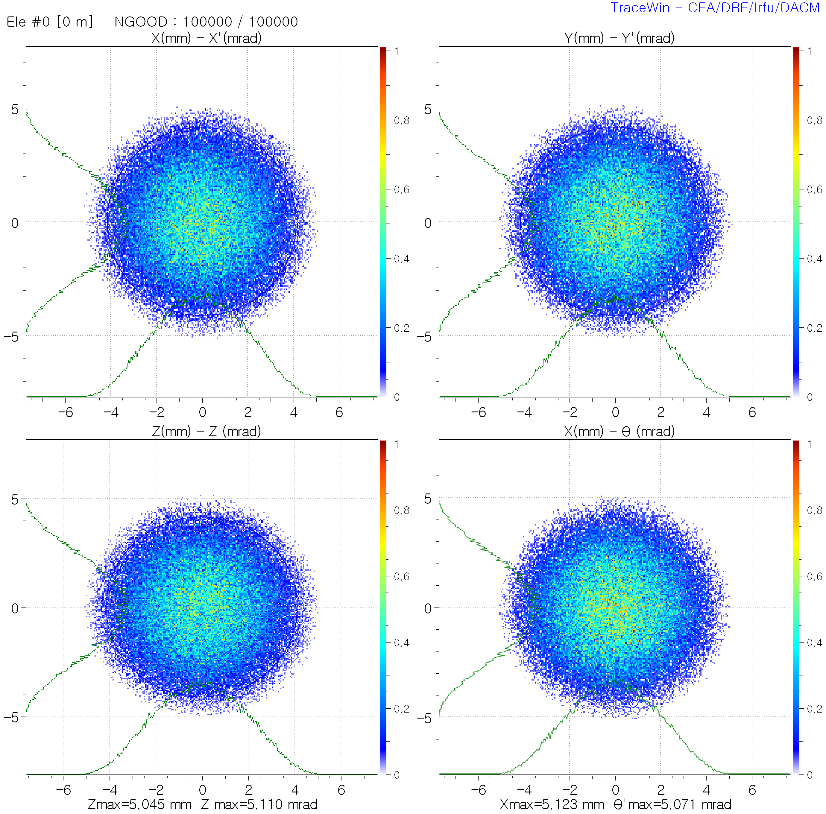
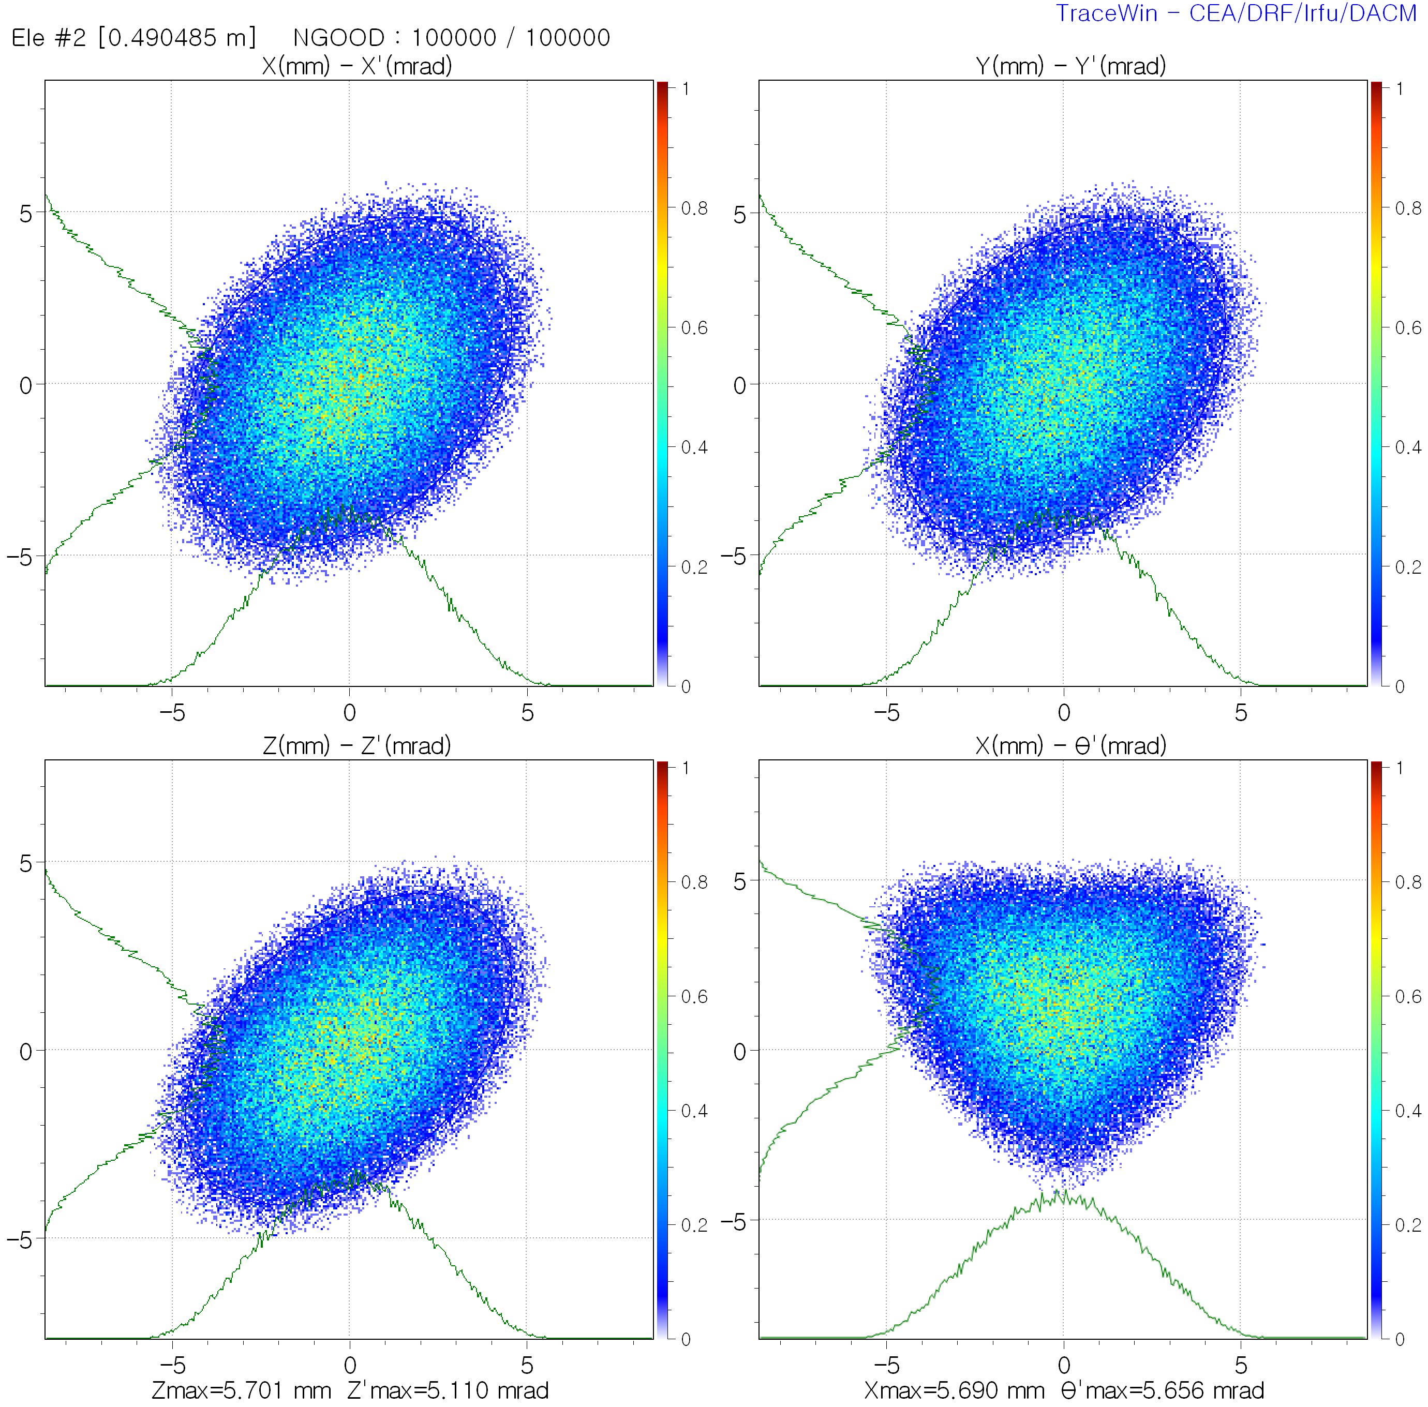
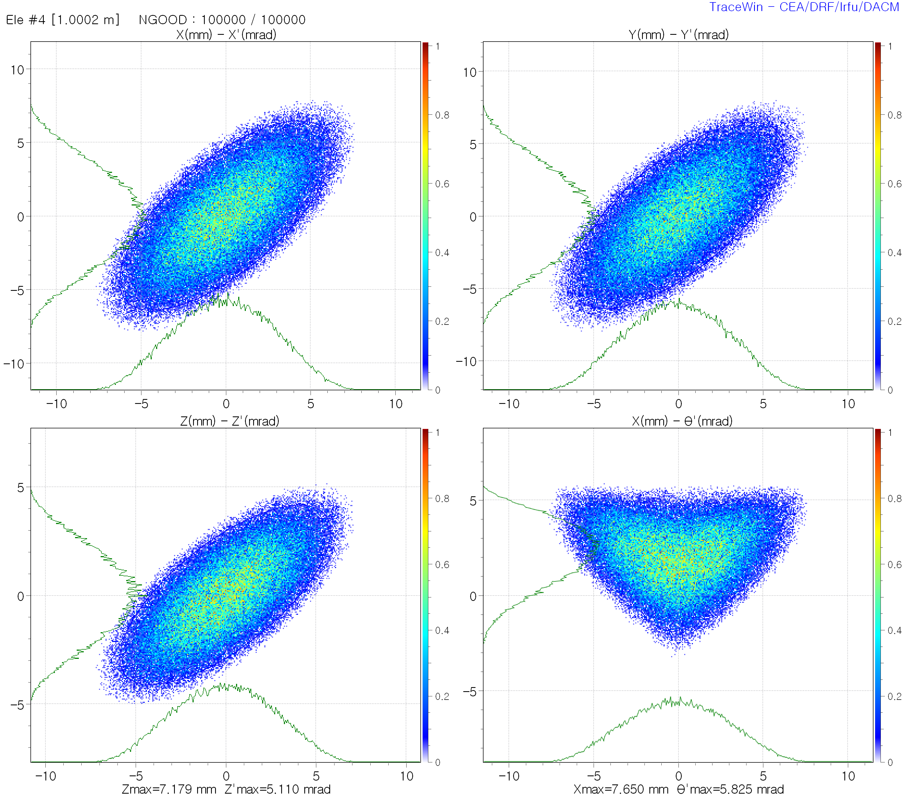








TraceWin – Spinning Beam
Tangential slope
$$θ^{′}=\frac{xy^{′}−yx′}{\sqrt{x^{2}+y^{2}}} →θ^{′}=rφ^{′}=r∙\frac{dφ}{dz}$$
$$H^{−}$$
Hadron accelerator: generation of spinning beams via a solenoid with charge stripping
$L_{can}=L_{mech}=0$
Solenoid
$$H^{−}→H^{+}$$
Charge Stripping
$$L_{can}=L_{mech}=0$$
$$L_{can}=L_{mech}+qr×A=0$$
$$A≠0, L_{mech}≠0$$
$$L_{mech}≅2qr×A$$

Slide 13
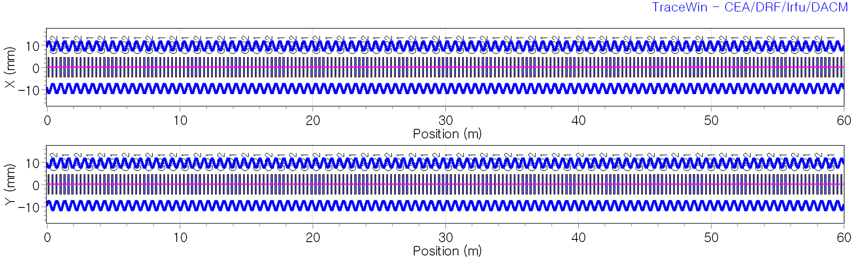
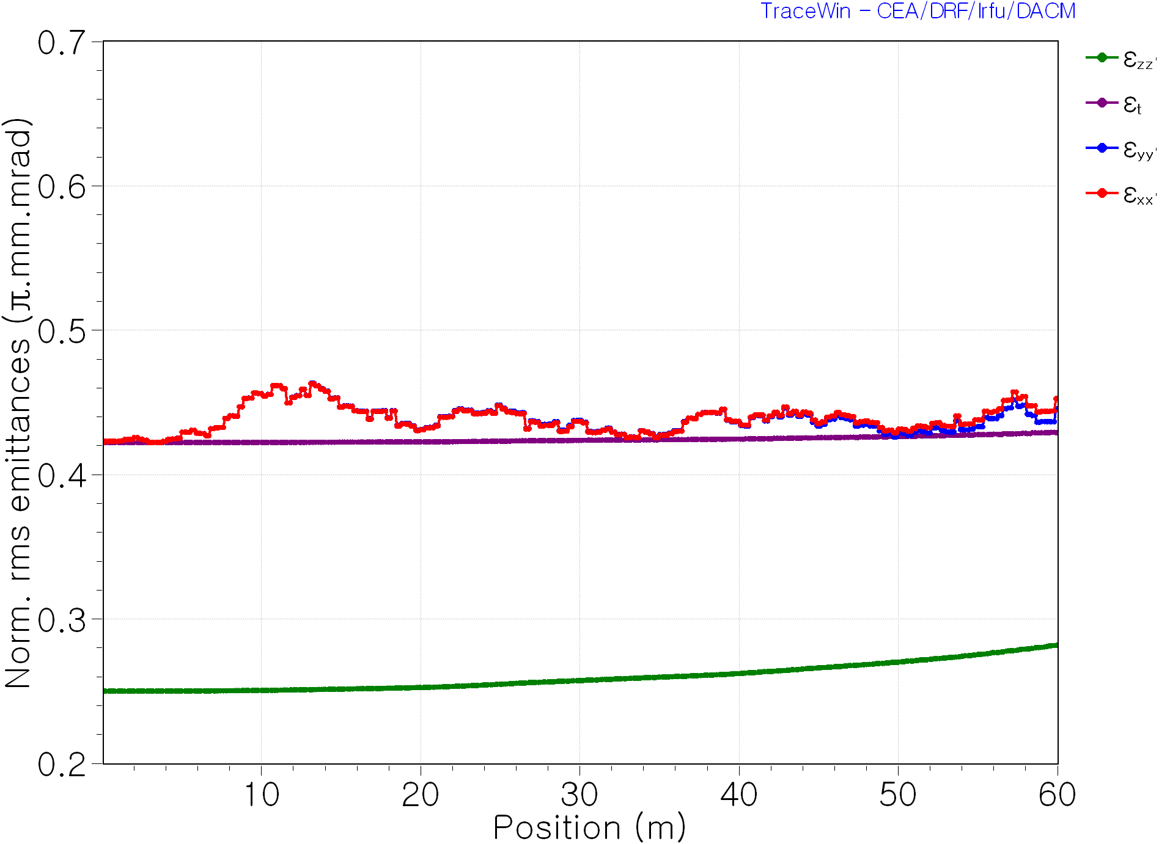
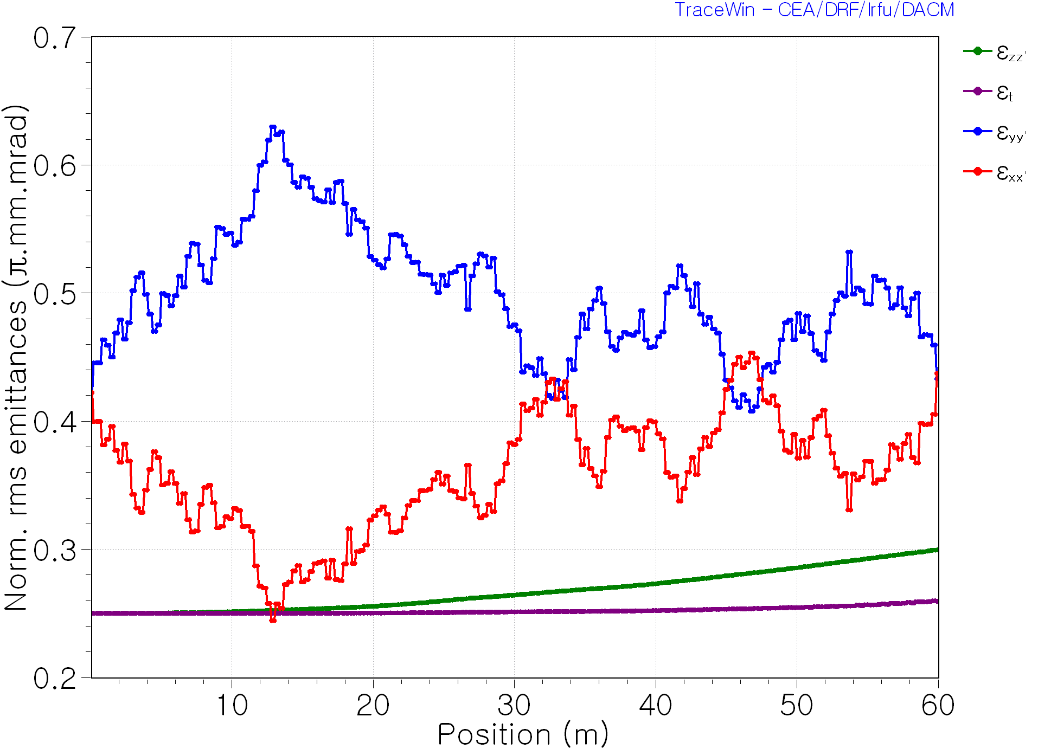
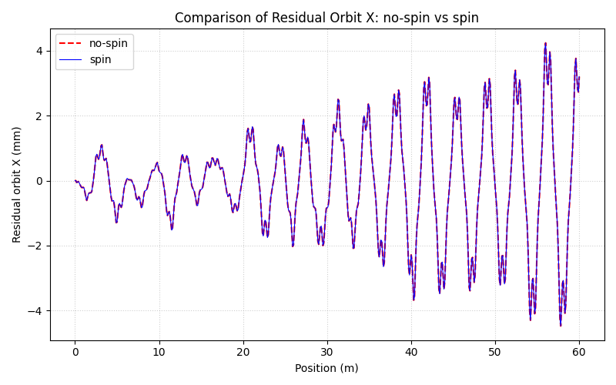
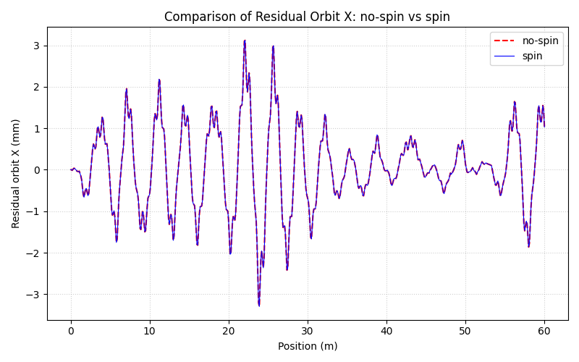

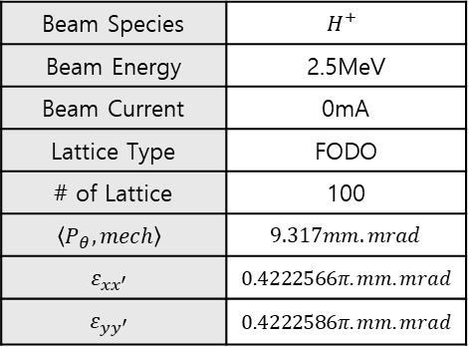


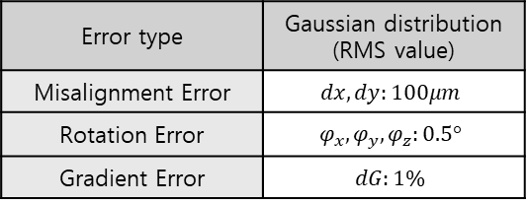

Beam Species | $$H^{+}$$
Beam Energy | 2.5MeV
Beam Current | 0mA
Lattice Type | FODO
# of Lattice | 100
$$\left\langle P_{θ},mech\right\rangle$$ | $$9.317mm.mrad$$
$$ε_{xx^{′}}$$ | $$0.4222566π.mm.mrad$$
$$ε_{yy^{′}}$$ | $$0.4222586π.mm.mrad$$
FODO lattice
Error type | Gaussian distribution (RMS value)
Misalignment Error | $$dx, dy:100μm$$
Rotation Error | $$φ_{x}, φ_{y}, φ_{z}:0.5°$$
Gradient Error | $$dG:1\%$$
No-spin Beam input
Spinning Beam input
$$ε_{xx^{′}} growth rate\left(\%\right):7.206\%$$
$$ε_{xx^{′}} growth rate\left(\%\right):3.584\%$$
$$ε_{yy^{′}} growth rate\left(\%\right):5.524\%$$
$$ε_{yy^{′}} growth rate\left(\%\right):2.594\%$$

Slide 14
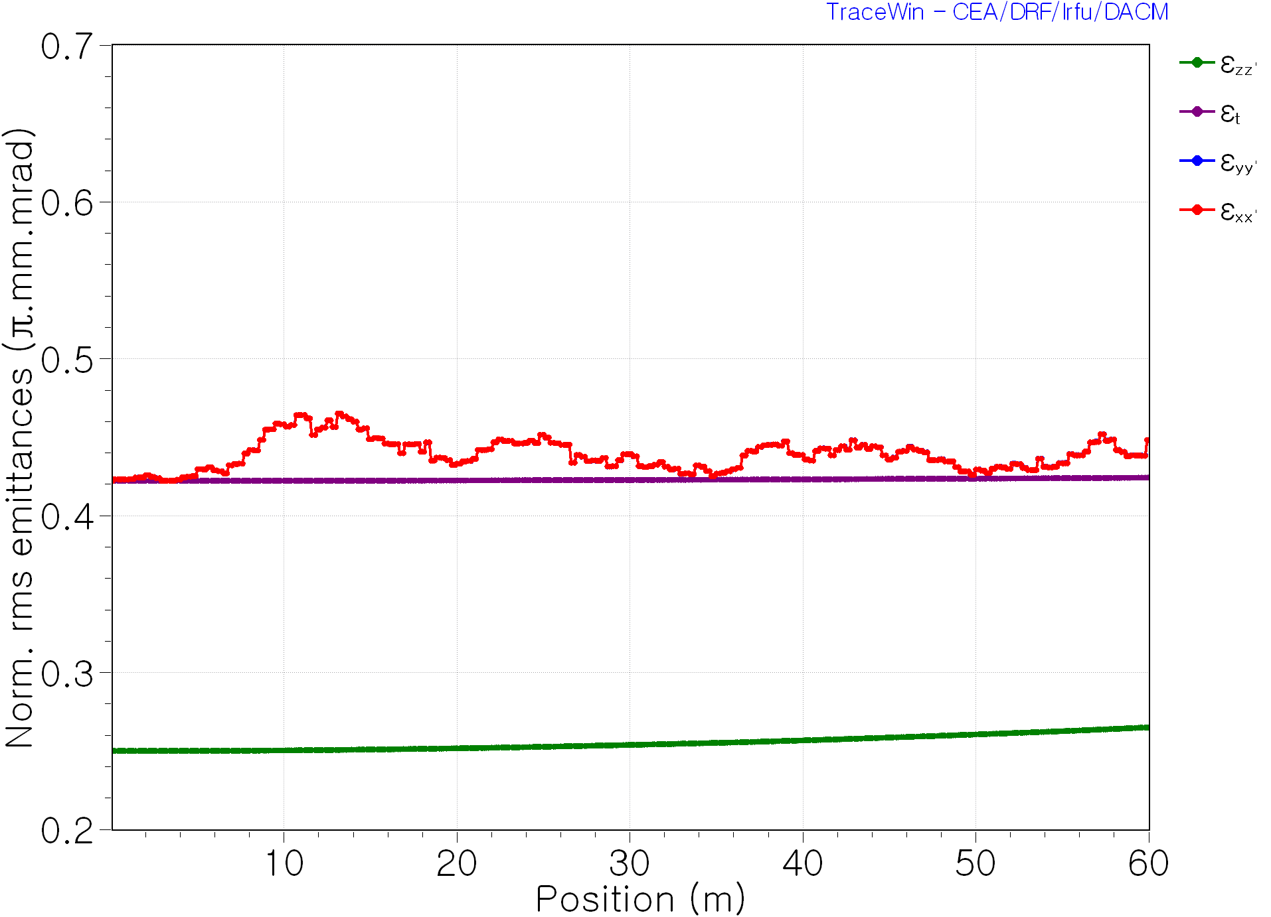
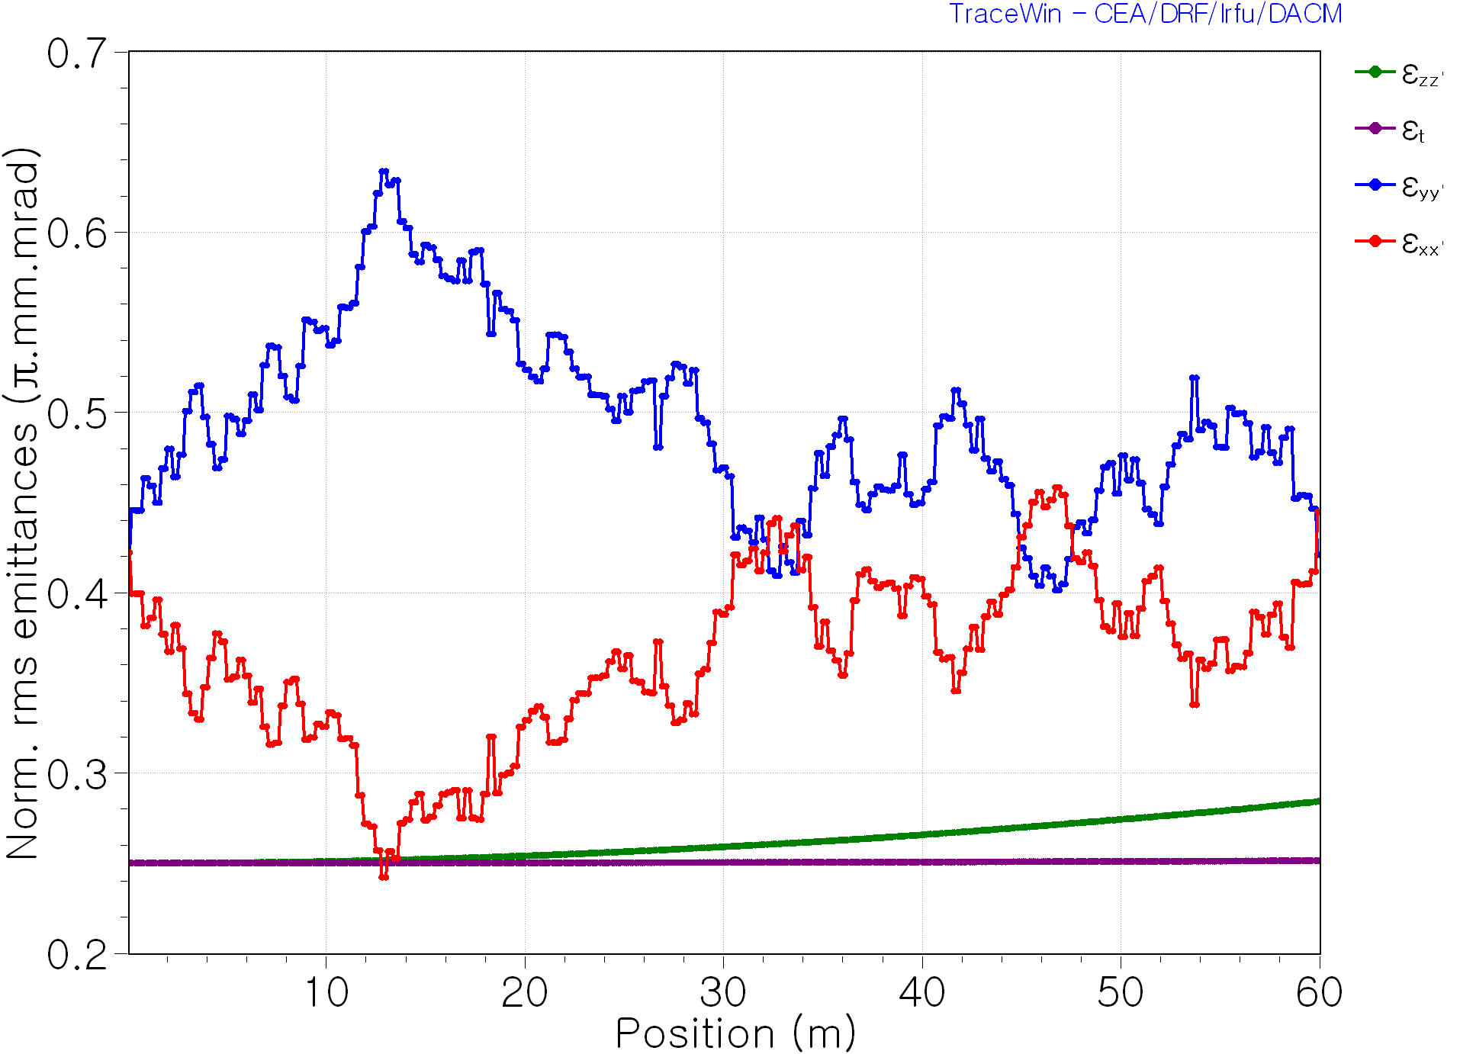
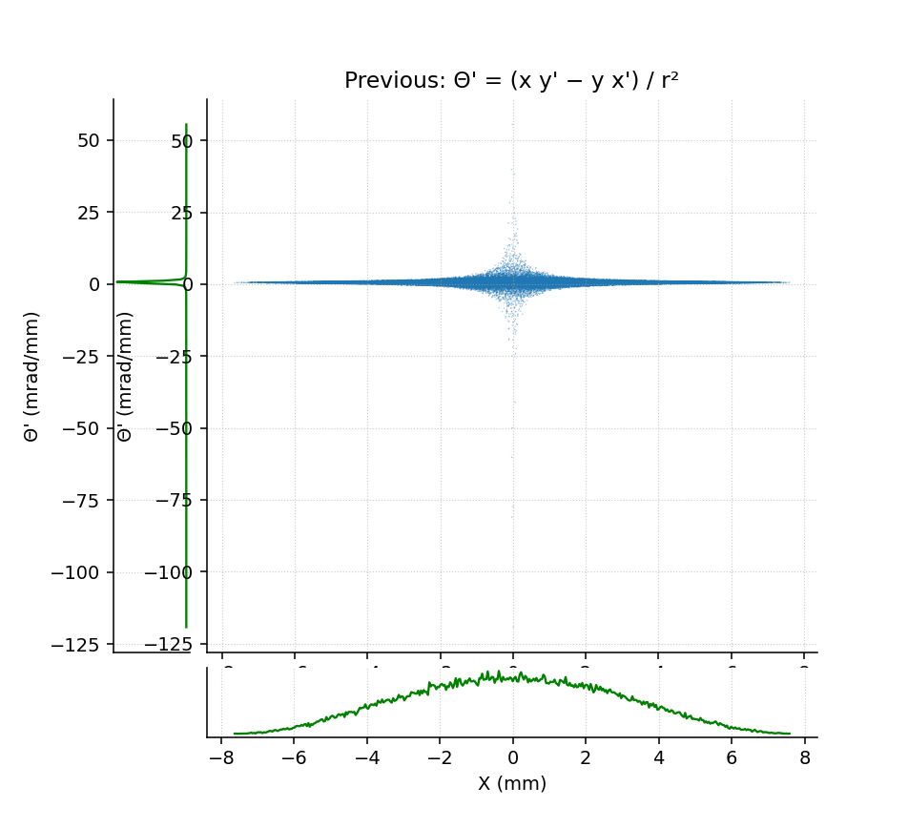







No-spin Beam input
Spinning Beam input
Error type | Gaussian distribution (RMS value)
Rotation Error | $$φ_{x}, φ_{y}, φ_{z}:0.5°$$
$$ε_{xx^{′}} growth rate\left(\%\right):6.139\%$$
$$ε_{xx^{′}} growth rate\left(\%\right):5.335\%$$
$$ε_{yy^{′}} growth rate\left(\%\right):6.169\%$$
$$ε_{yy^{′}} growth rate\left(\%\right):−0.266\%$$
Centroid dynamics unaffected by spinning beam.
Rotation errors lead to the most pronounced emittance growth suppression, accompanied by clear coupling between the projected $x−x′$ and $y−y′$ emittances.
Results are based on a single error realization. Monte Carlo studies are needed to confirm statistical robustness.
Angular slope
$$θ^{′}=\frac{xy^{′}−yx′}{x^{2}+y^{2}} →θ^{′}=φ^{′}=\frac{dφ}{dz}$$

Slide 15
Short Term Plan (~Feb.2026)
Literature & Concept Study
Accelerator-based high-power neutron sources survey: 해오름 과제 보고서
Study of key accelerator systems and beam dynamics in high-intensity rings
Virtual Pepper-Pot diagnostics
- Theoretical background study
TraceWin – Spinning Beam Study
Monte Carlo error studies
Systematic study of rotation errors
Understanding transverse coupling dynamics
Xsuite – RCS Lattice Study
FODO lattice optics modification and correction
Reproduction of SNS accumulator ring
- Learning simulation workflow and lattice design fundamentals

Slide 16
Long Term Plan (~2026)
Literature & Concept Study
Accelerator-based high-power neutron sources survey: 해오름 과제 보고서
Study of key accelerator systems and beam dynamics in high-intensity rings
Virtual Pepper-Pot diagnostics
- Theoretical background study
TraceWin – Spinning Beam Study
Monte Carlo error studies
Systematic study of rotation errors
Understanding transverse coupling dynamics
Xsuite – RCS Lattice Study
FODO lattice optics modification and correction
Reproduction of SNS accumulator ring
- Learning simulation workflow and lattice design fundamentals

