Slide 1
2025 Highlight
2026. 01. 09.
나창선

Slide 2
Beamline Measurement experiment
Contents
Beamline Detector Maintenance
Residual Gas Analysis (RGA)
X-ray communication studies
2026 Plan

Slide 3
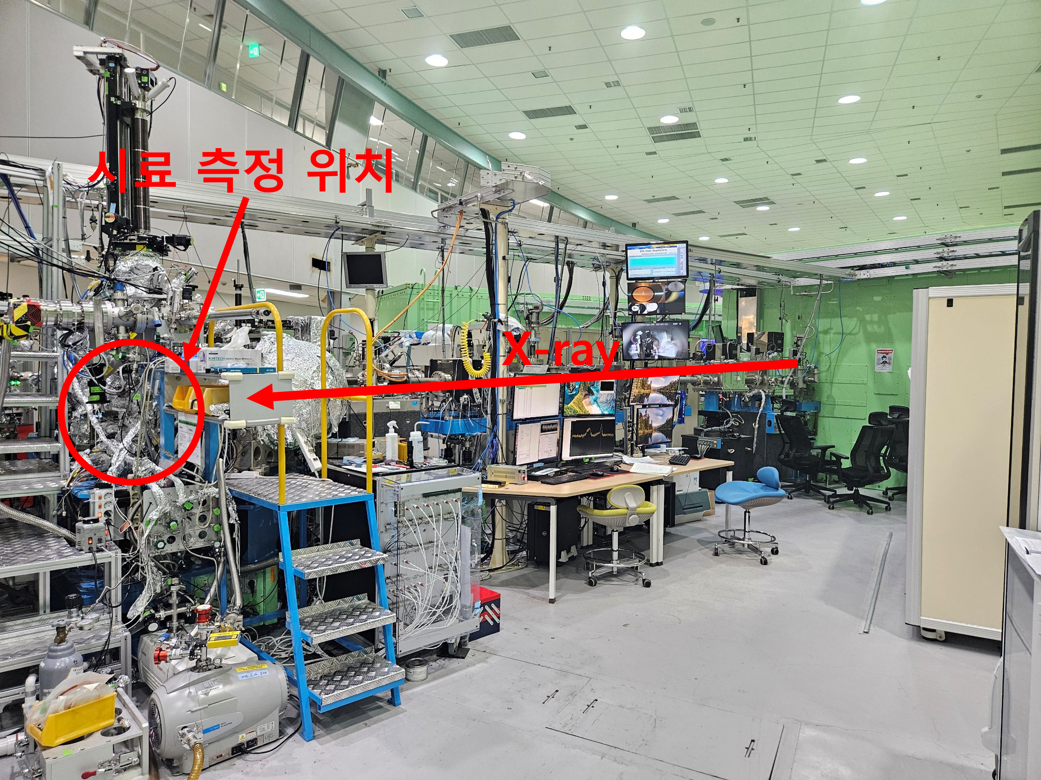
Introduction
The electron beam generated from accelerator passes through multiple stages before becoming experimental data.
After leaving the storage ring, X-rays are transported along the beamline and interact with samples at the end station.
This presentation focuses on the experimental workflow at the beamline.

Slide 4
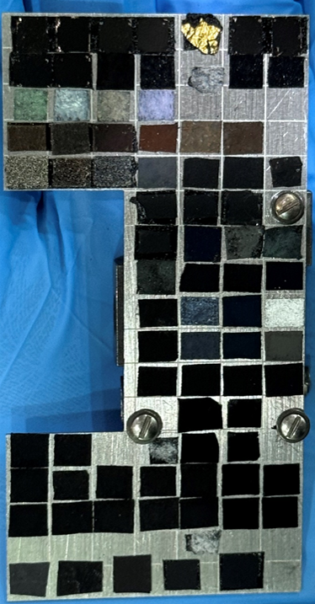
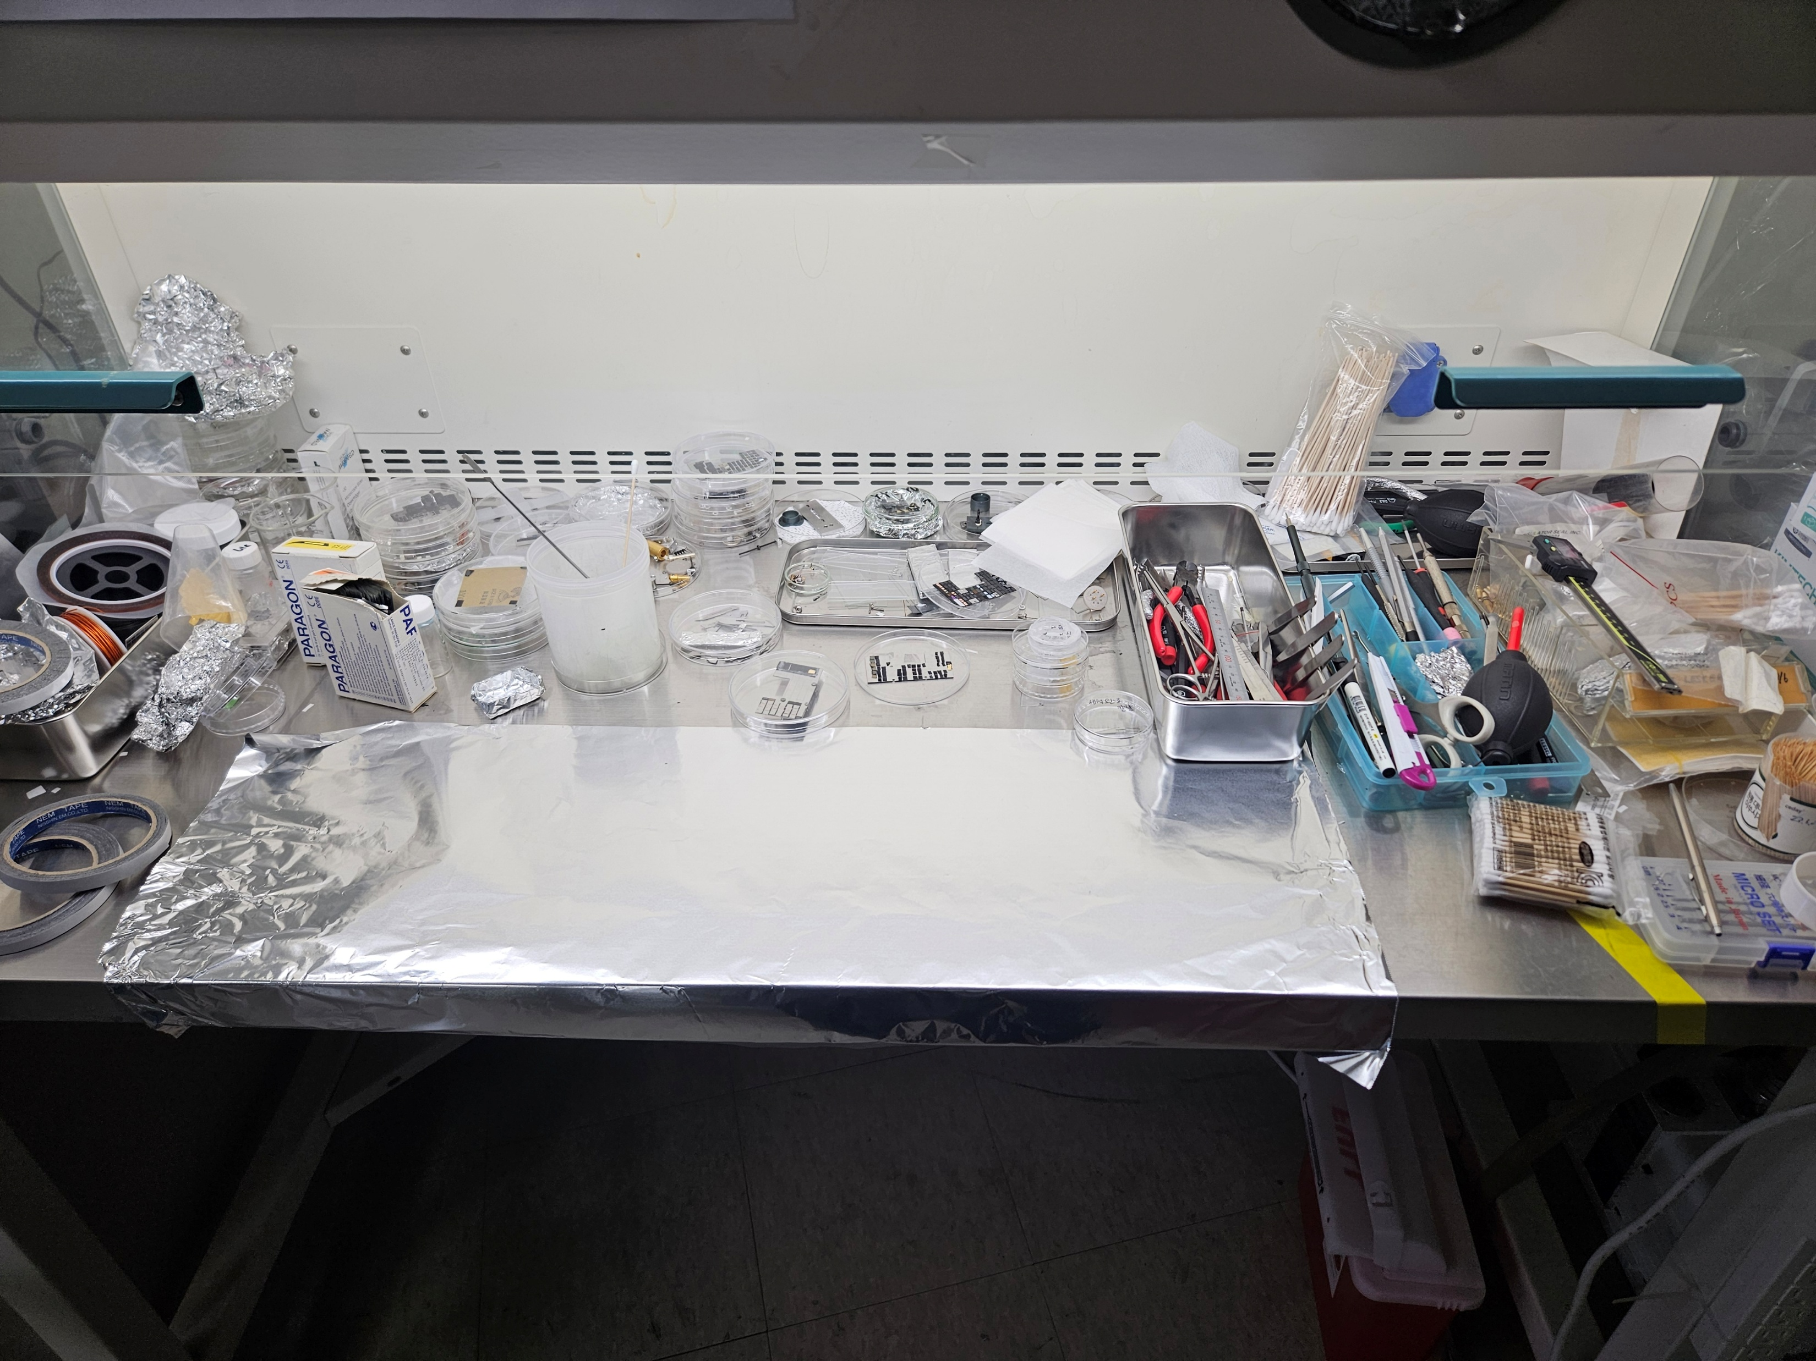
1. Beamline Measurement – Sample Preparation
Sample quantity: - Selection of an appropriate number of samples based on the allocated beamtime
Sample holder: - Beamline-specific sample holders were used
Cleaning tool: - Separate tools used for vacuum-compatible samples and external handling

Slide 5
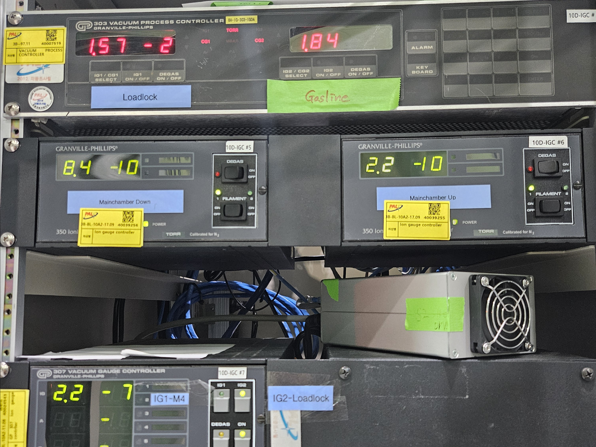
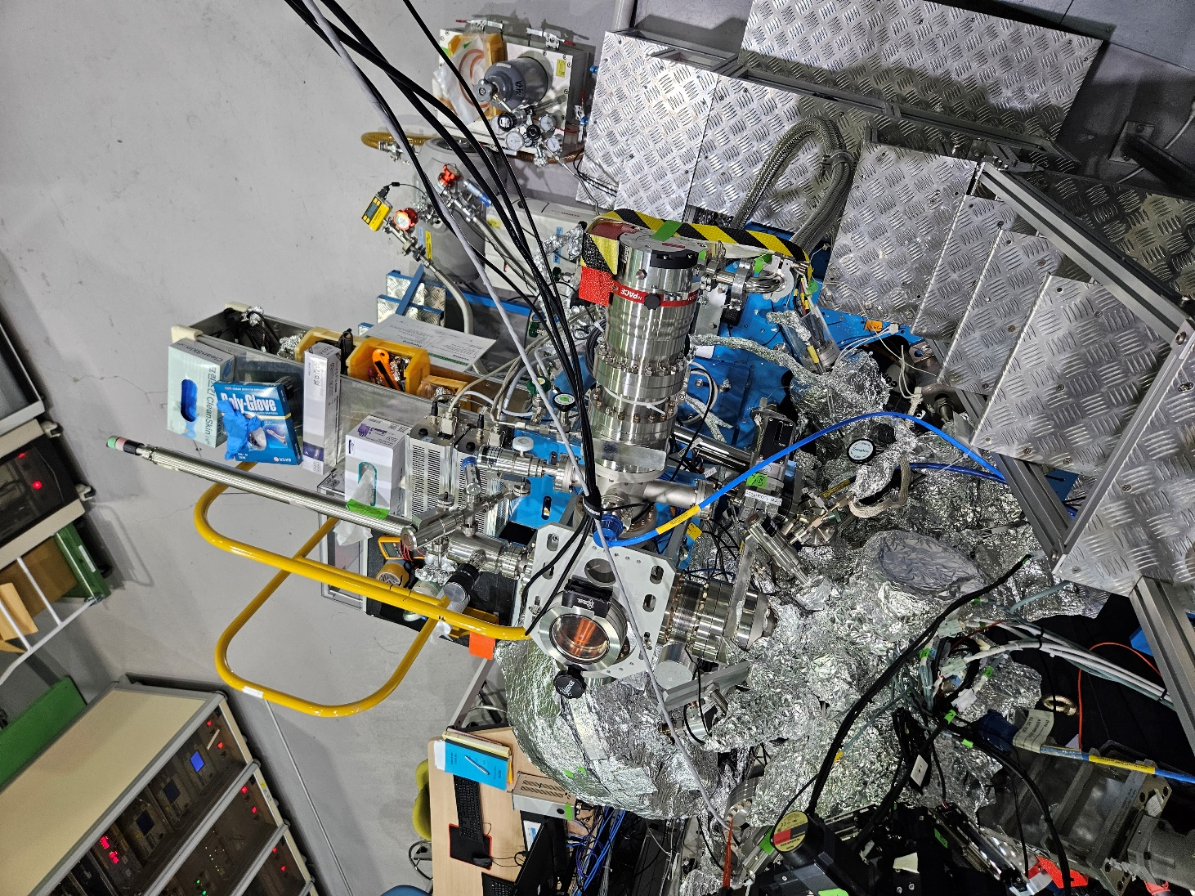
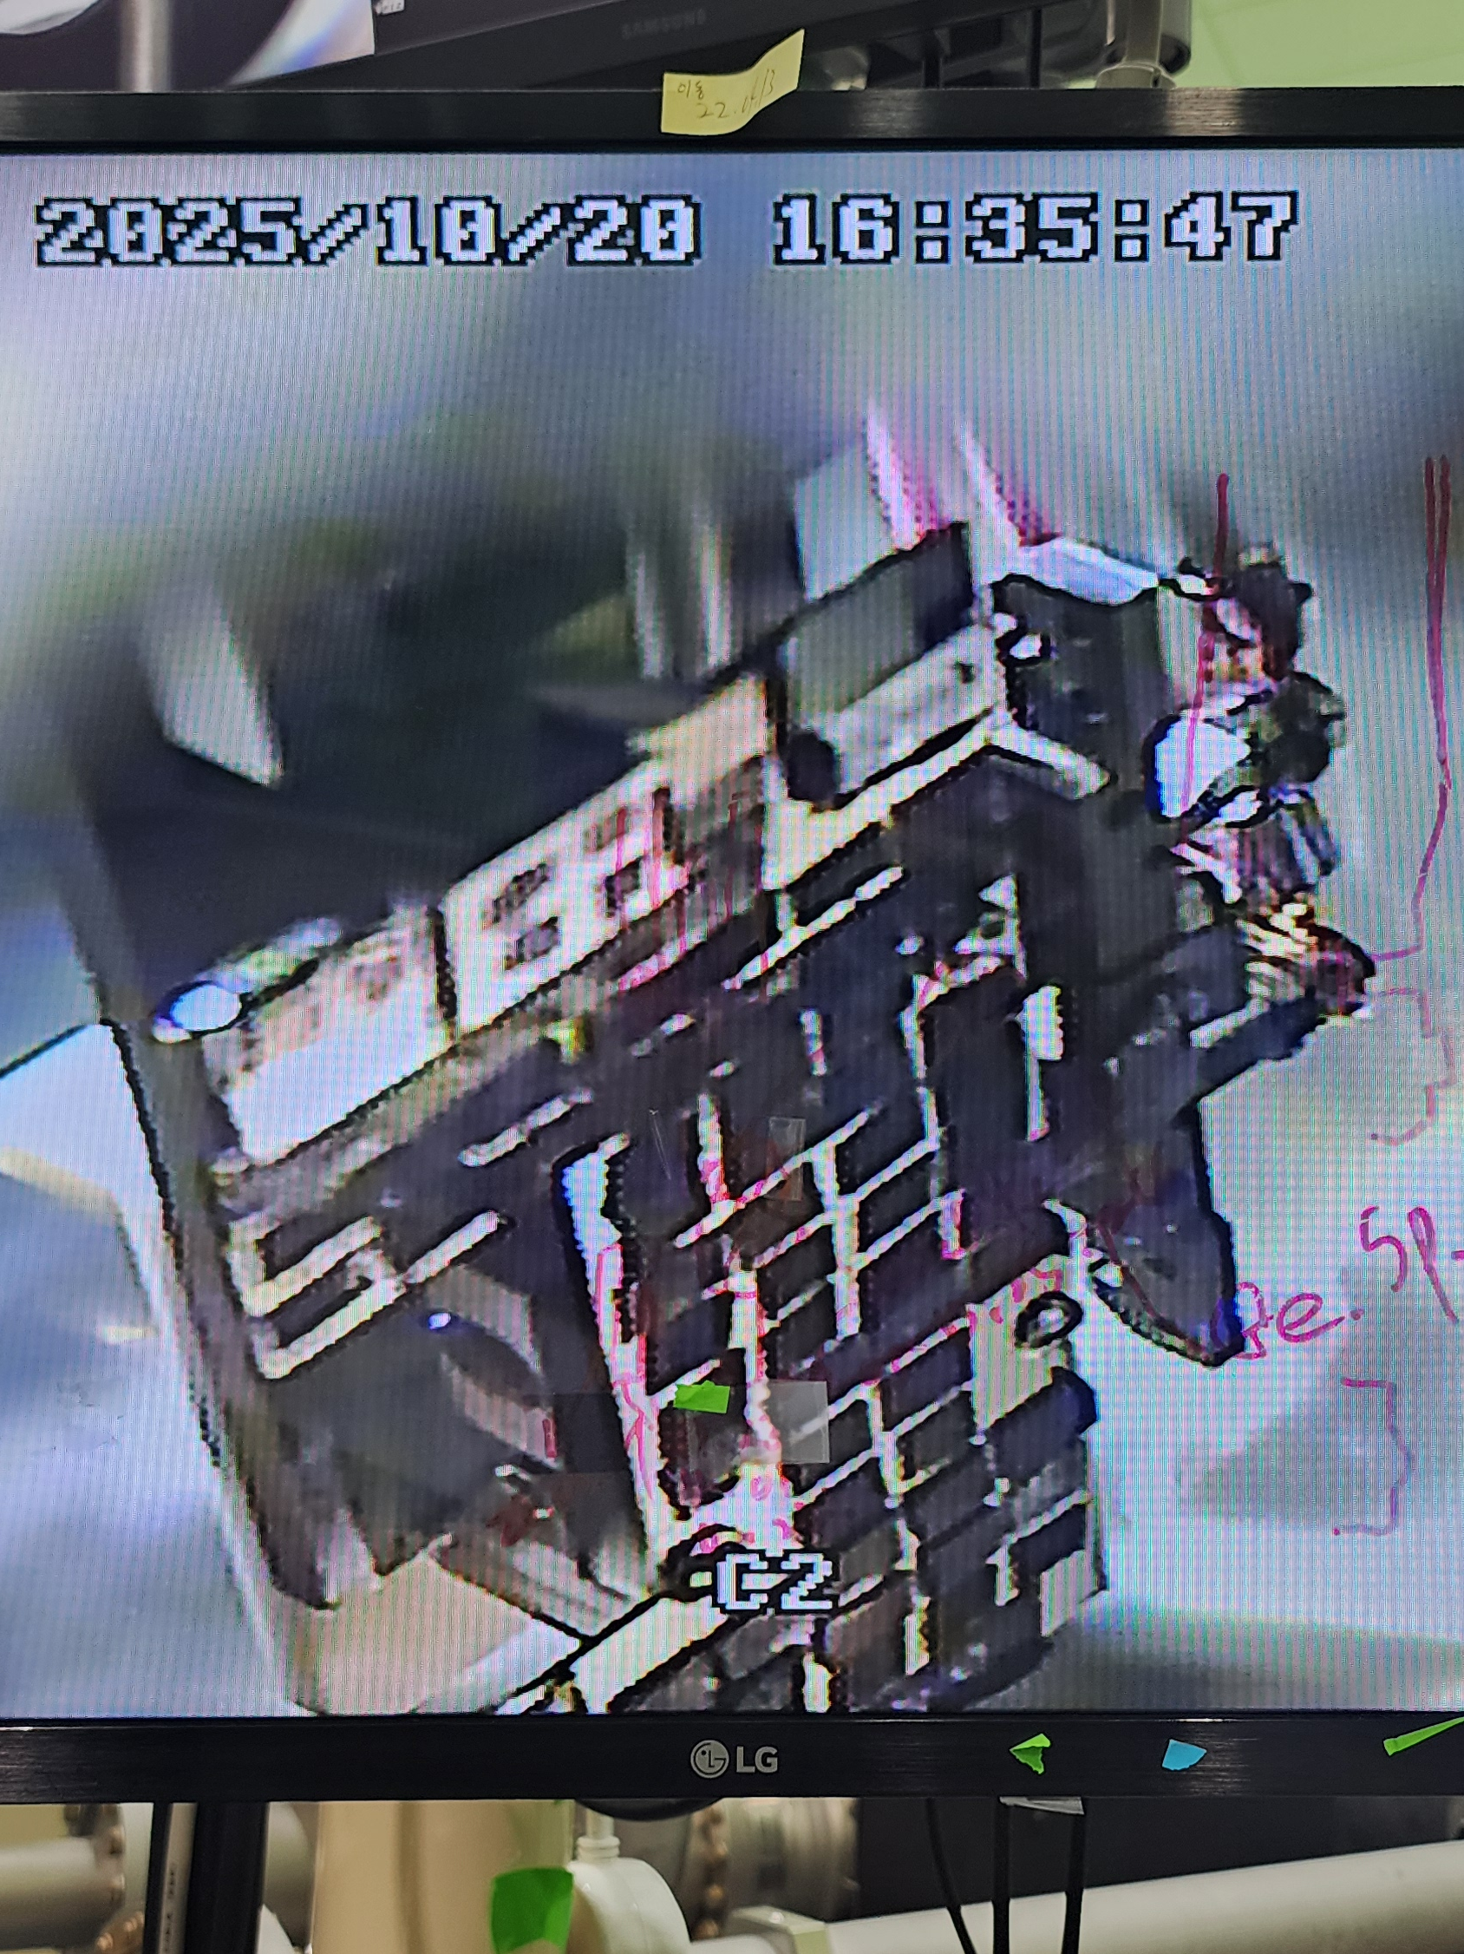
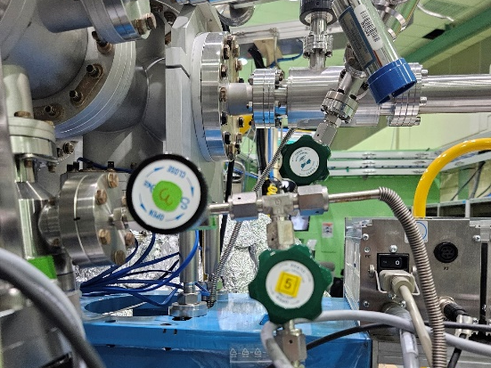
1. Beamline Measurement – Sample Loading and Vacuum
X-ray
측정용 챔버
Load-Lock Chamber
Sample loading performed with the highest priority on preventing contamination of the X-ray line.
load-lock and a measurement chamber are separate.
Sequential loading through gate valves to minimize contamination.
N₂ gas used during sample exchange

Slide 6
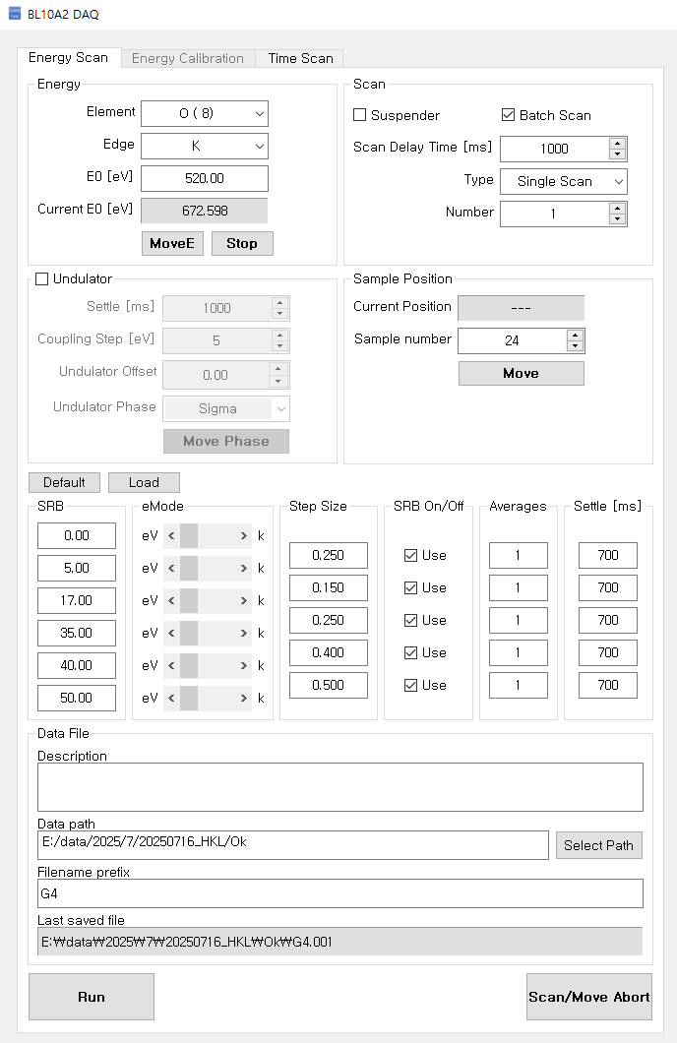
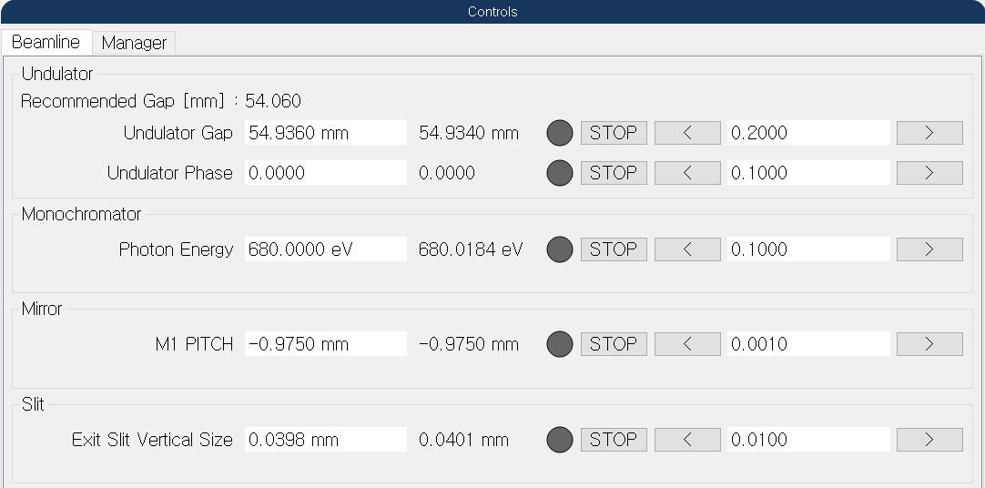
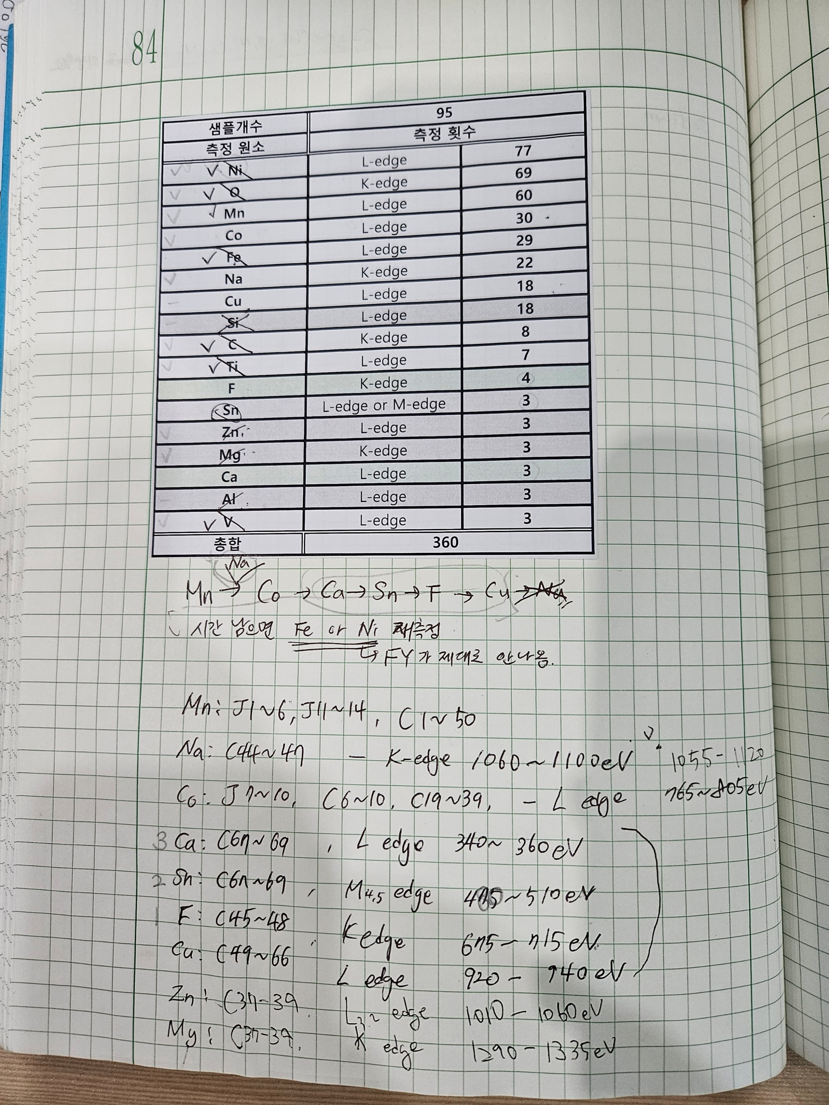
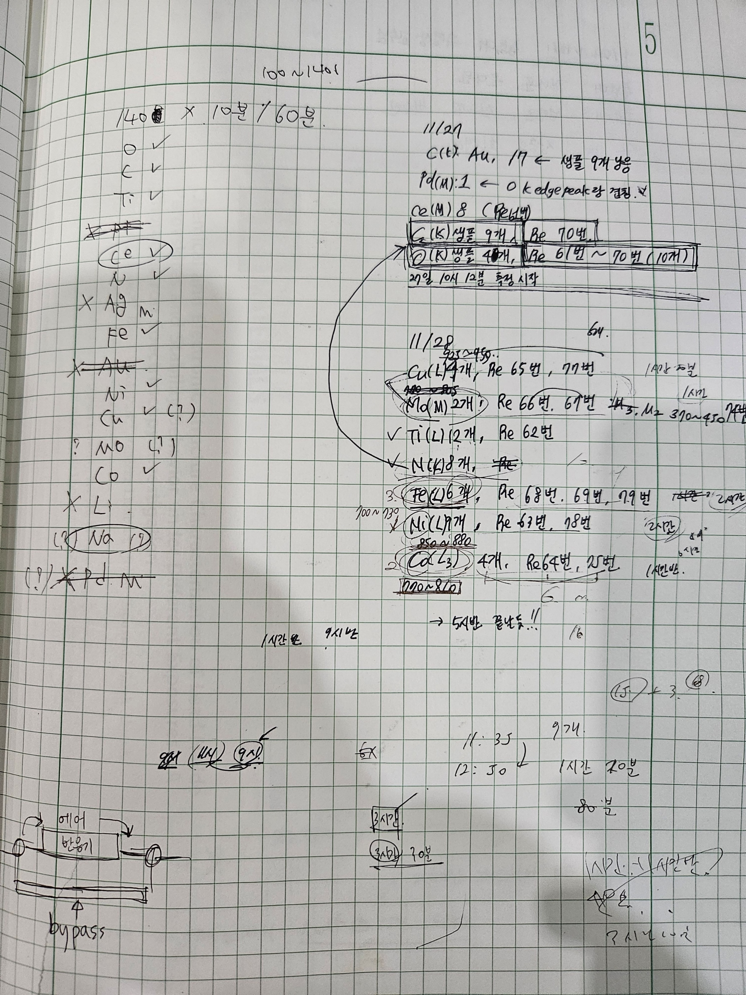
1. Beamline Measurement – Sample Measurement
Prior preparation is essential to complete measurements within the limited beamtime
Measurement settings and order prepared in advance for each sample
Measurements performed using predefined parameters

Slide 7
1. Beamline Measurement – Data Processing
Calibration
Calibration with reference sample
normalization
Normalization
Division of the measured signal (I) by the incident X-ray intensity (I₀)
I₀: X-ray intensity immediately before reaching the sample
I/I₀
Raw data
background subtraction
Removal of non-relevant background components
Baseline adjustment for comparison of peak energy positions
background subtraction
Normalized data

Slide 8
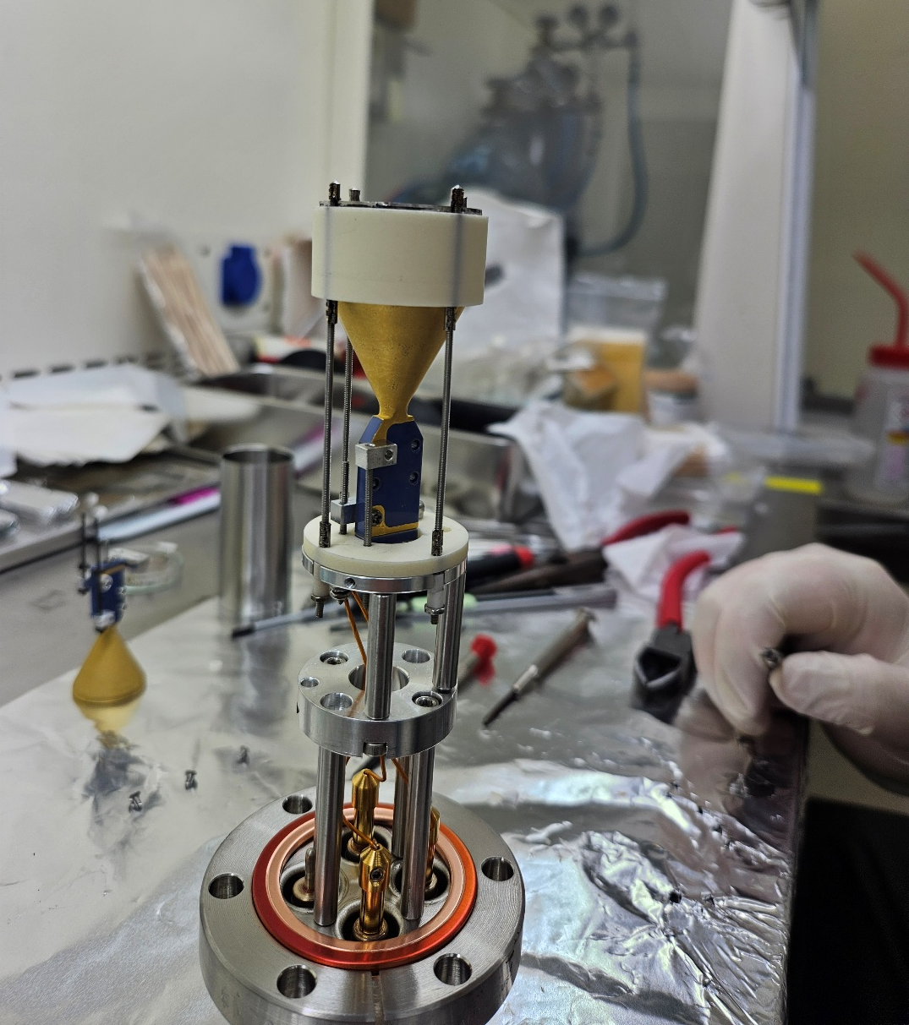
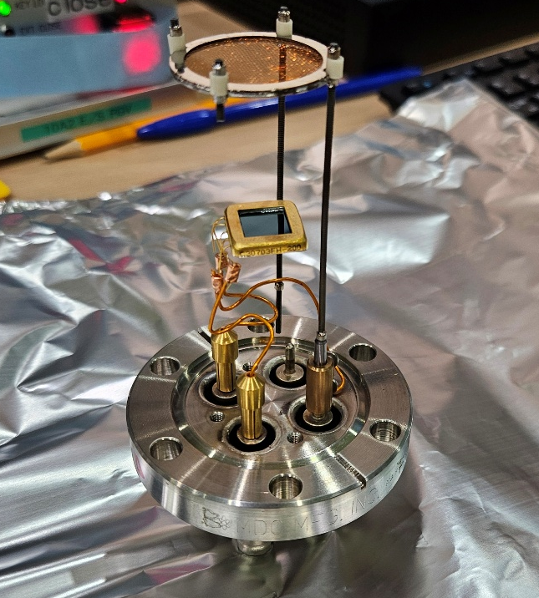
2. Beamline Detector Maintenance
PEY detector
FY detector

Slide 9
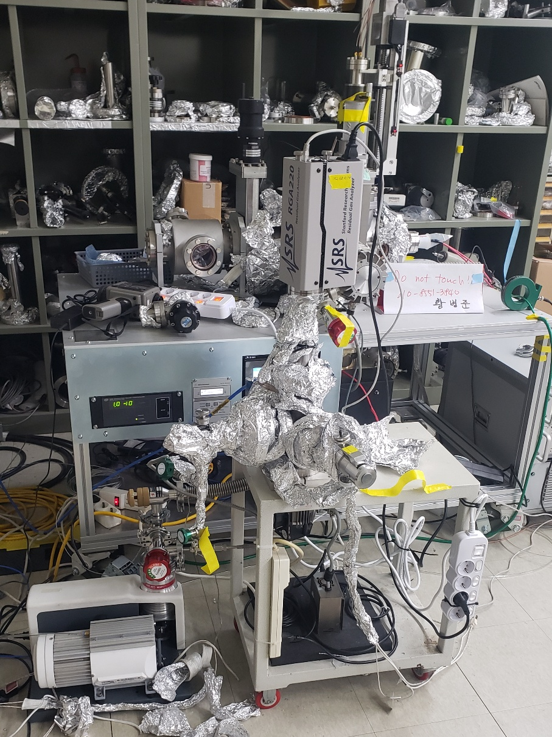
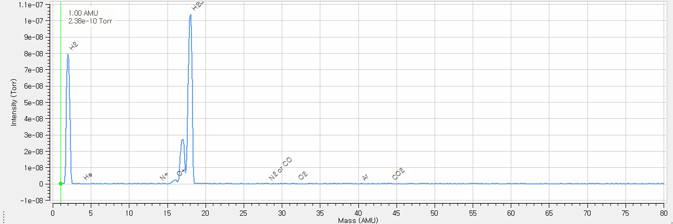
3. Residual Gas Analysis (RGA)
RGA
RGA ionizes gas molecules and analyzes them by mass using a quadrupole.
The mass spectrum is compared with a gas library to identify gas species.
Gas collection

Slide 10
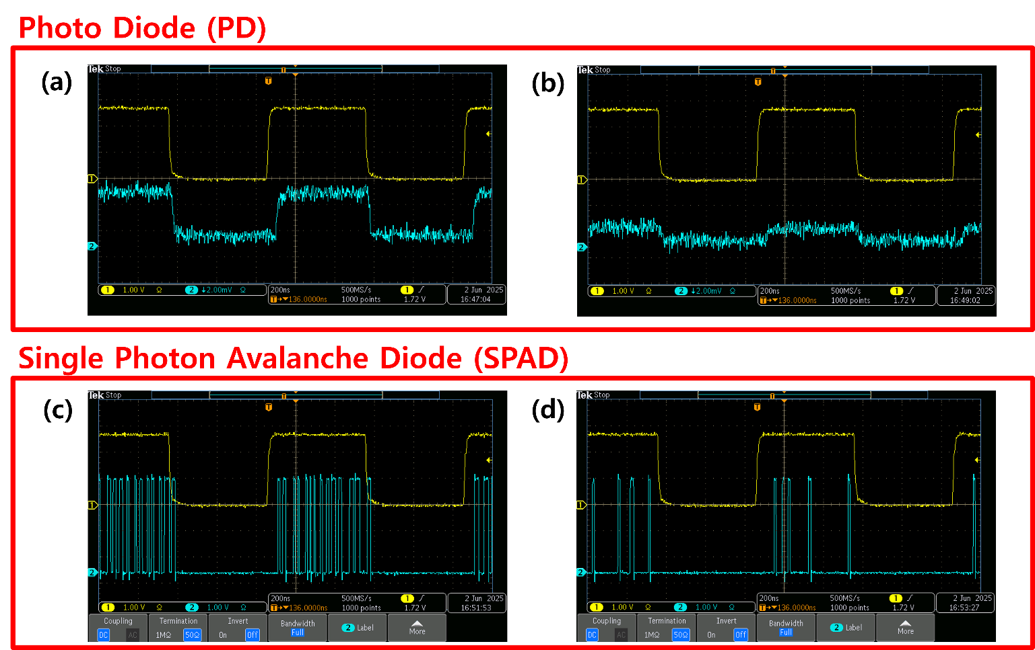
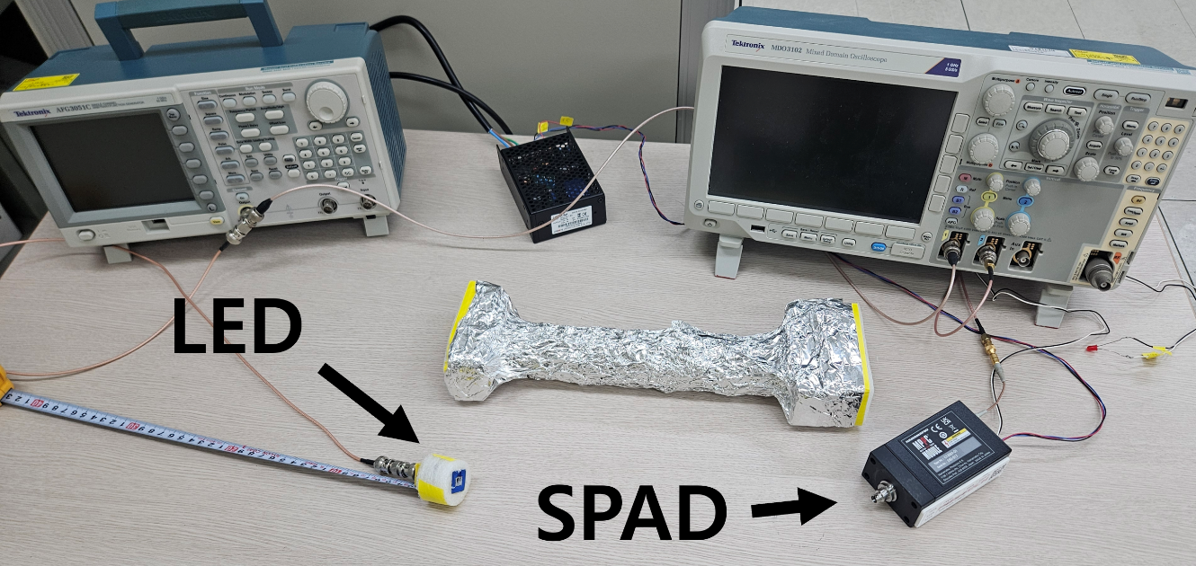
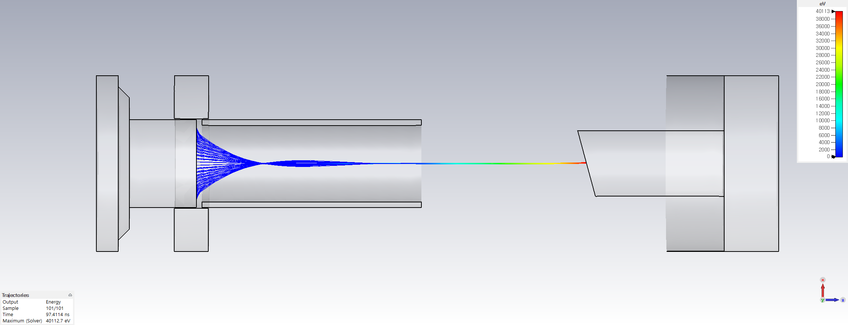
4. XCOM (X-ray communication)
Receiver for XCOM
Study on SPAD characteristics for XCOM receiver applications
Transmitter for XCOM
Reproduced a provided X-ray tube design in CST and simulated beam size variation.

Slide 11
2026 Short term plan (~2026. 02.)
석사논문 주제에 대해 진지하게 고민하고 방향성을 결정
CST, Egun code, Ansys등 simulation 프로그램 기술 습득
2026 Long term plan
과제 업무 지속
ADD시료측정 과제를 이어갈 예정(빔라인)
Research plan
석사논문 주제선택 및 석사논문 작성 시작
2회 이상 학회 참가

Slide 12
Thank You

Slide 13
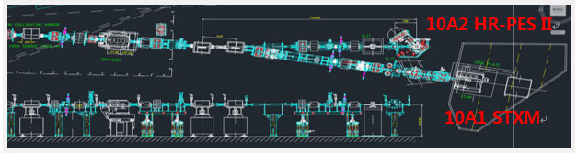
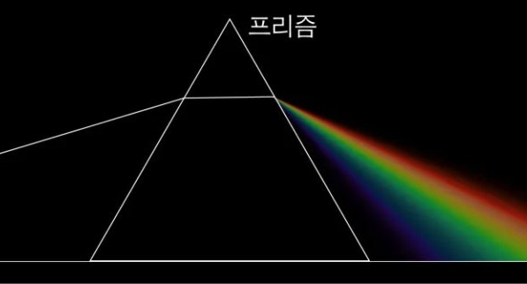
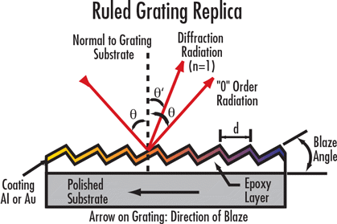
Appendix: Beamline, Grating

Slide 14
Appendix: I₀
I ∝ I₀ x S
I : 검출된 신호
I₀ : 시료에 도달하기 직전의 입사 X-ray 강도
S : 시료에서의 response

Slide 15
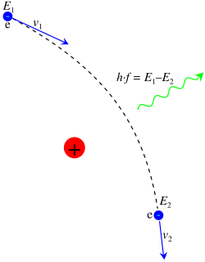
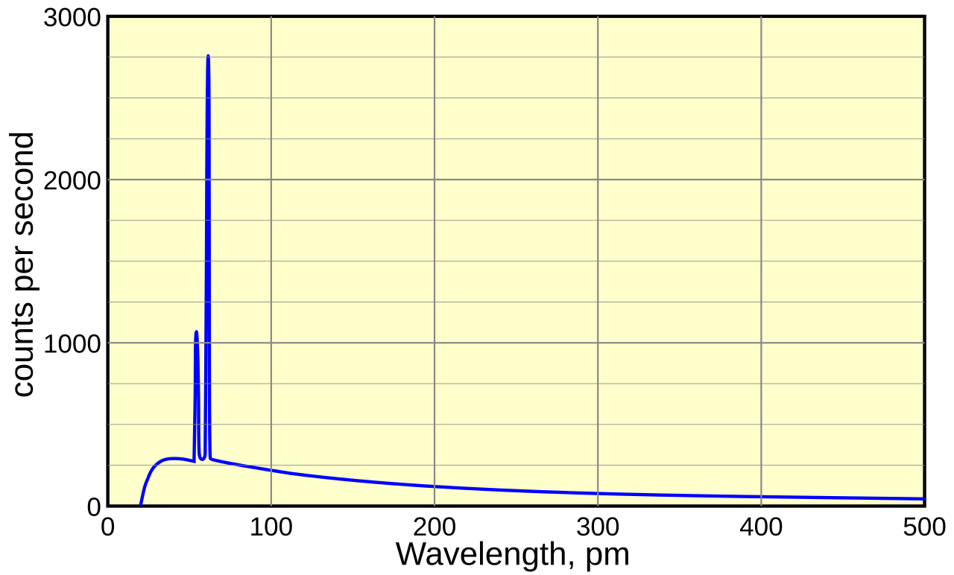
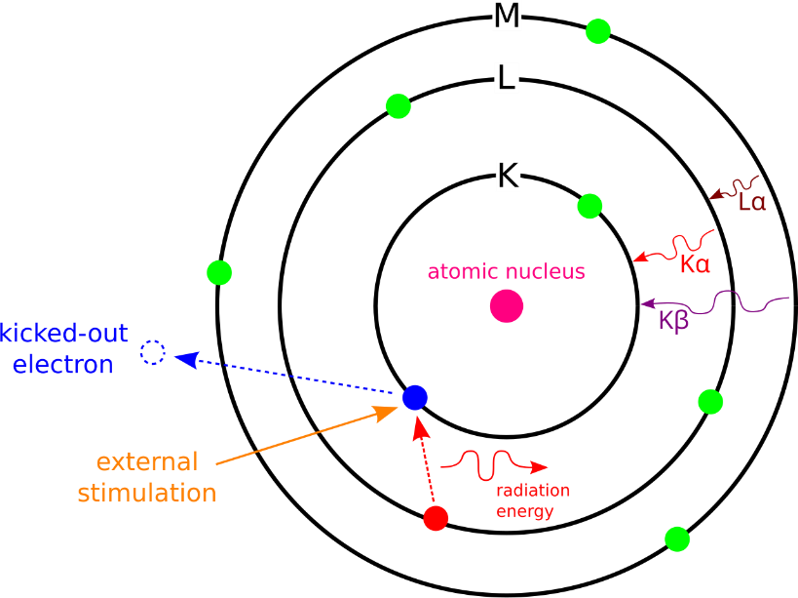
Appendix: X-ray tube Spectrum
bremsstrahlung
Continuous radiation: Bremsstrahlung; Sharp peaks: Characteristic lines.
The X-ray spectrum consists of bremsstrahlung and characteristic X-rays.
To enhance bremsstrahlung efficiency, high-Z targets such as W (74), Mo (42), and Cu (29) are used.
characteristic X-ray

Slide 16
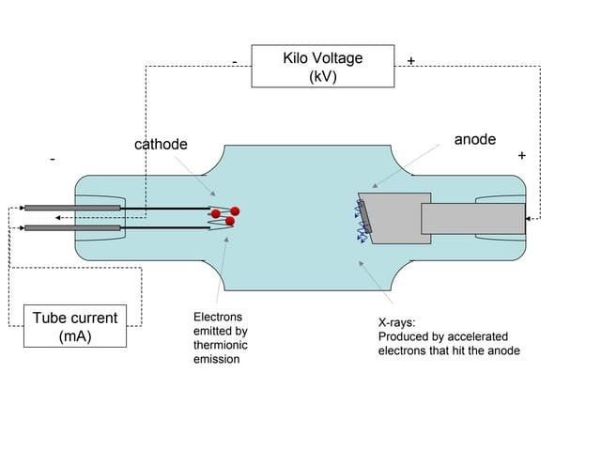
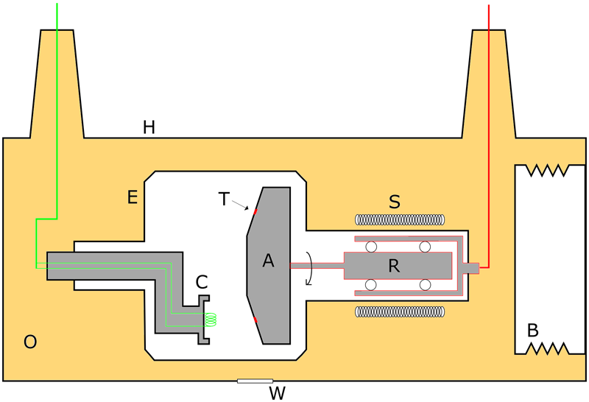

Appendix: Conventional X-ray Tube Operation
Heated tungsten cathode emits electrons by thermionic emission.
Electrons accelerate toward the anode and hit the target.
Only about 1% of the energy becomes X-rays.
The rest is converted into heat at the anode.
X-rays consist of bremsstrahlung and characteristic radiation.
Rotating anodes improve cooling in medical systems.
Stationary anodes are used for compact designs.

