Slide 1

CAPhE Workshop
2026.01.09
Junyeong Jeong

Slide 2
Contents
Preparation for graduation
  Paper (Segmented Capillary development)
  Additional project
    HVPS development
    Continuous gas injection
  Paper (Graduation)
    Not started yet

Slide 3
Paper (SC) - Introduction
Background & Motivation
  Laser Wakefield Acceleration (LWFA) enables ultra-high accelerating gradients beyond RF limits
  Multi-GeV electron beams achieved in cm-scale plasmas
  Growing demand for stability / reproducibility / practicality for plasma source
  (compact accelerators, radiation, medical use)
Plasma sources & Limitation
  Gas jets: strong gradients but poor stability & reproducibility
  Capillaries: excellent guiding & stability but limited practicality
Our Approach: Segmented Capillary (SC) Gas Cell
  Modular design separating:
    Gas injection
    Density-gradient formation
    Discharge / guiding
  Internal orifice generates localized density down-ramp inside a capillary
  Combines stability of capillaries with flexibility of gas-jet gradients

Slide 4
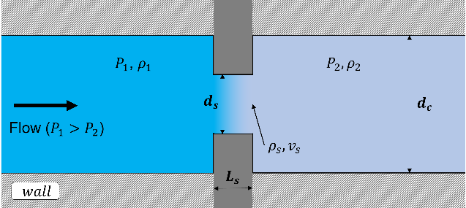
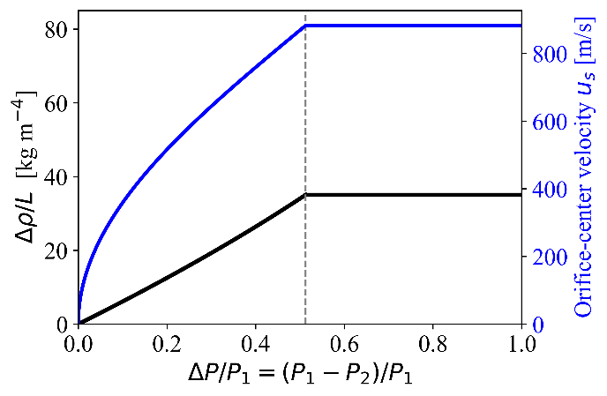

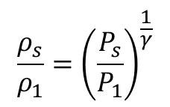
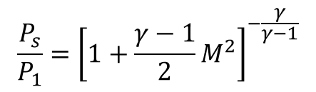
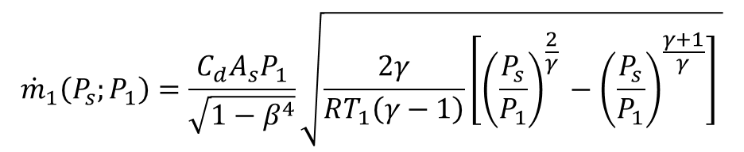
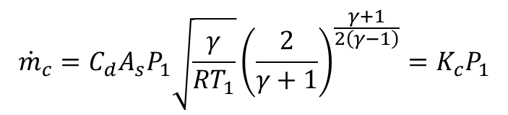
Paper (SC) – Fluid dynamics
$${\dot{m}}_{1}\left(P_{s};P_{1}\right)=\frac{C_{d}A_{s}P_{1}}{\sqrt{1−β^{4}}}\sqrt{\frac{2γ}{RT_{1}\left(γ−1\right)}\left[{\left(\frac{P_{s}}{P_{1}}\right)}^{\frac{2}{γ} }−{\left(\frac{P_{s}}{P_{1}}\right)}^{\frac{γ+1}{γ}}\right] }$$
$$\frac{P_{s}}{P_{1}}={\left[1+\frac{γ−1}{2}M^{2}\right]}^{−\frac{γ}{γ−1}}$$
$$\frac{ρ_{s}}{ρ_{1}}={\left(\frac{P_{s}}{P_{1}}\right)}^{\frac{1}{γ}}$$
$$v_{s}=Ma=M\sqrt{γRT_{s}}$$
$${\dot{m}}_{c}=C_{d}A_{s}P_{1}\sqrt{\frac{γ}{RT_{1}}}{\left(\frac{2}{γ+1}\right)}^{\frac{γ+1}{2\left(γ−1\right)}}=K_{c}P_{1}$$

Slide 5
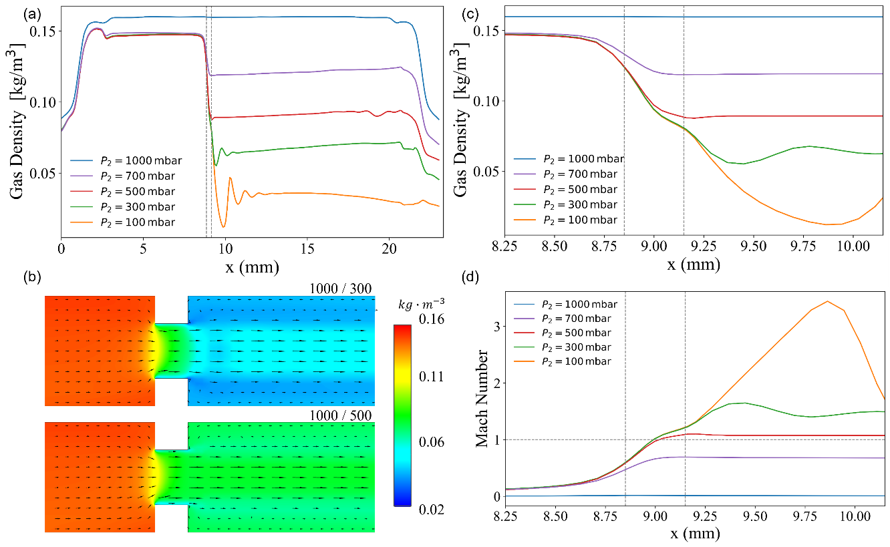
Paper (SC) – CFD simulation
Orifice (d=0.5mm) between 2 reservoirs
Mach number of flow > 1
→ Strengthen Vena Contracta

Slide 6
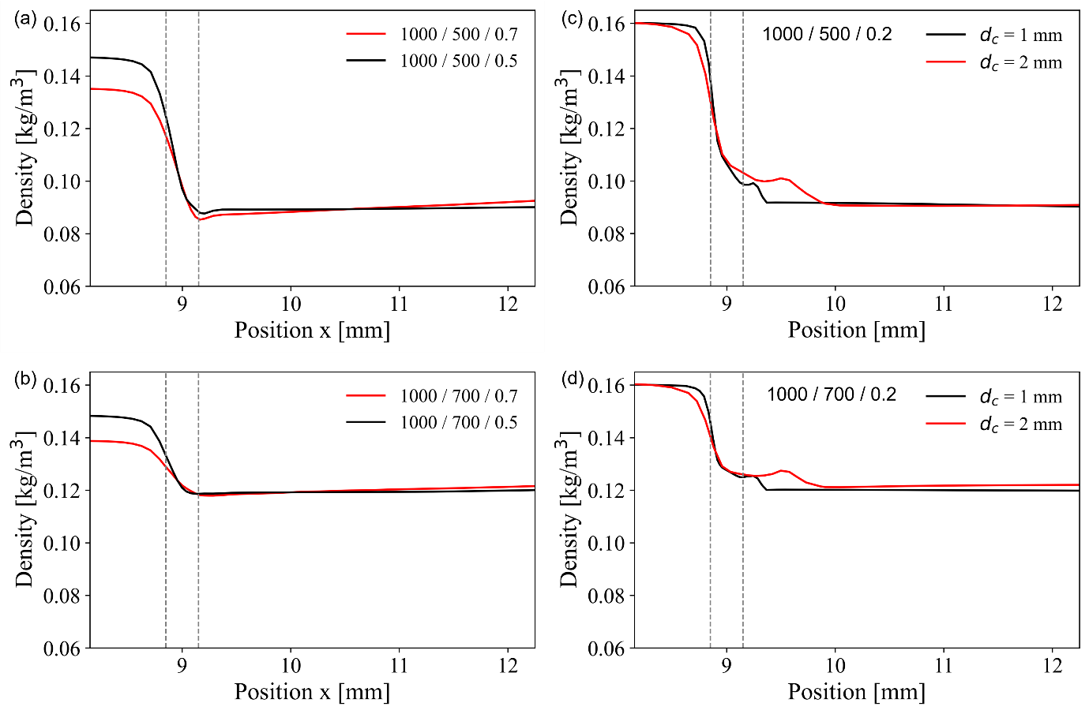
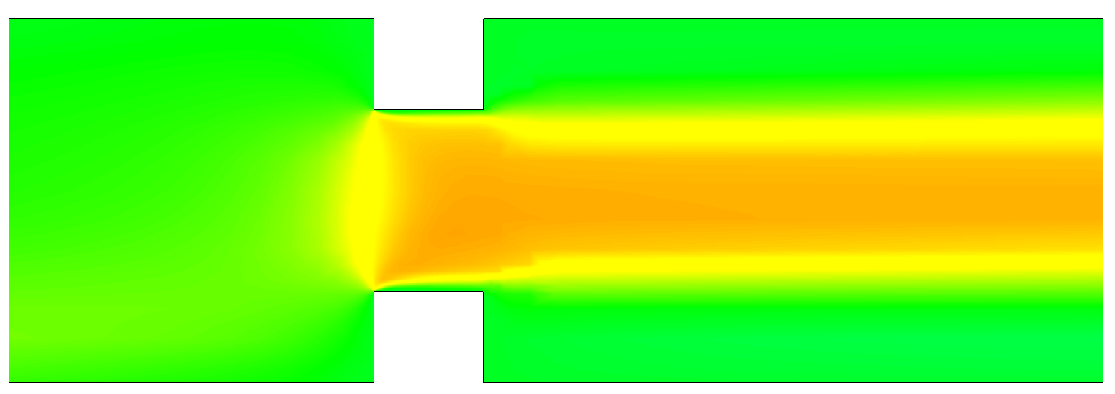
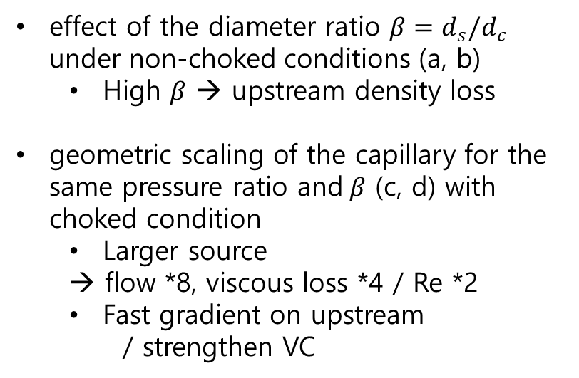
Paper (SC) – CFD simulation
effect of the diameter ratio $β=d_{s}/d_{c}$ under non-choked conditions (a, b)
  High $β$ → upstream density loss
geometric scaling of the capillary for the same pressure ratio and$β$ (c, d) with choked condition
  Larger source
  → flow *8, viscous loss *4 / Re *2
  Fast gradient on upstream
  / strengthen VC
VS

Slide 7
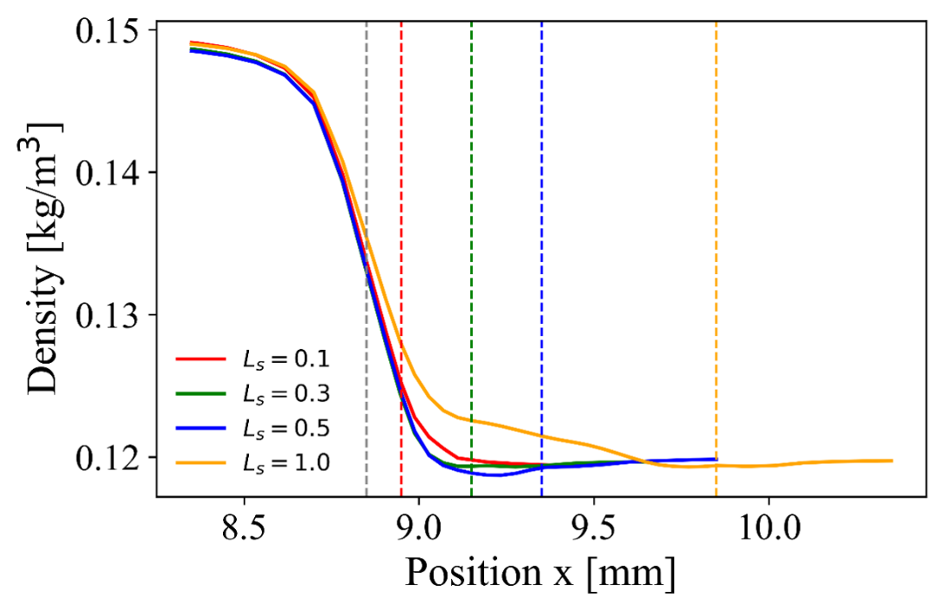
Paper (SC) – CFD simulation
effect of the orifice silt width

Slide 8
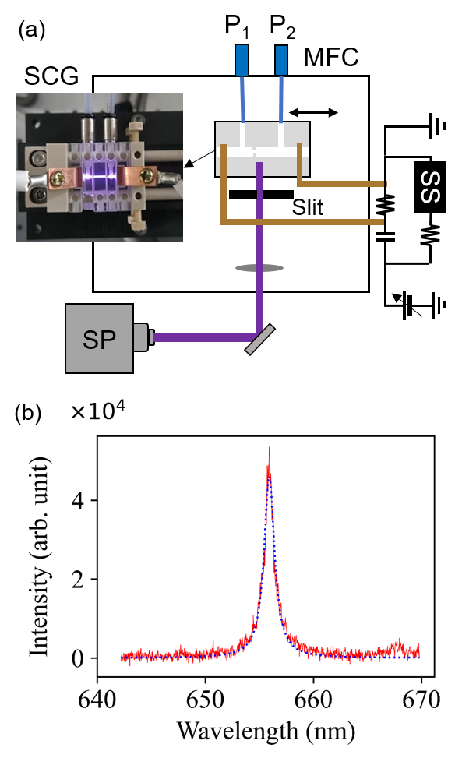
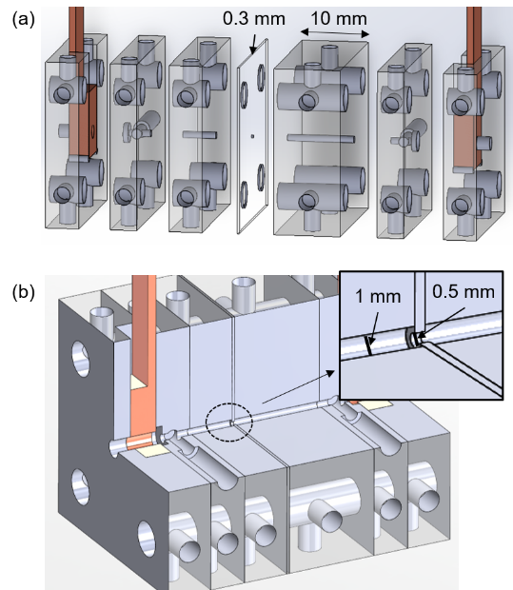
Paper (SC) – Experimental Setup

Slide 9
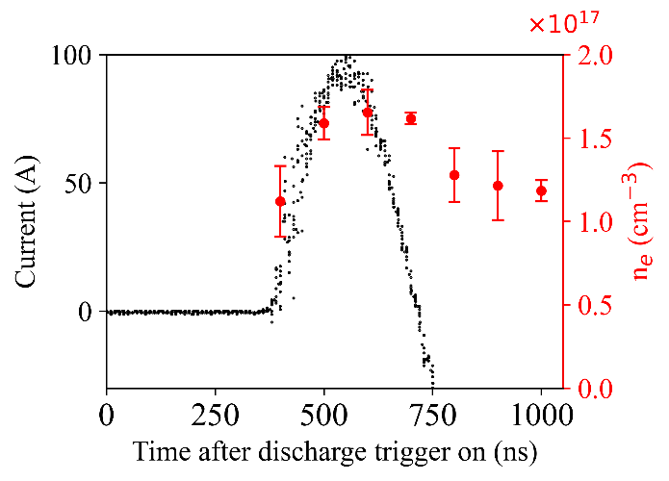
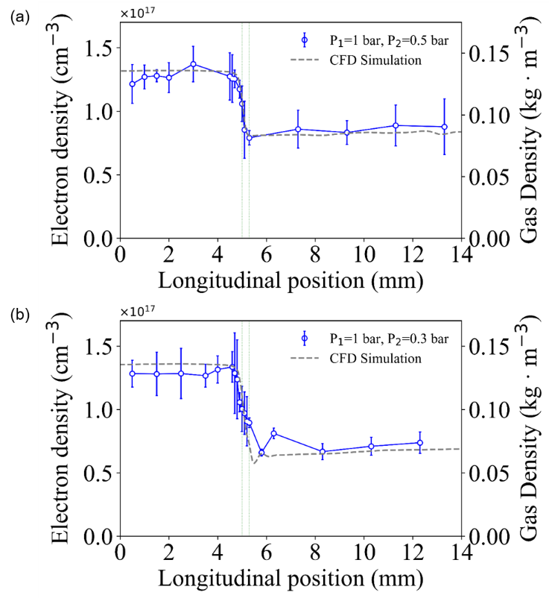
Paper (SC) – Result

Slide 10
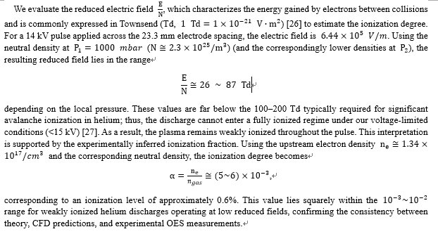
Paper (SC) – Discussion

Slide 11
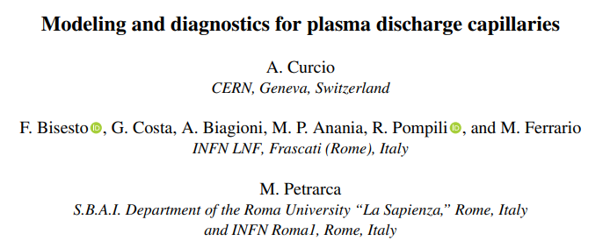
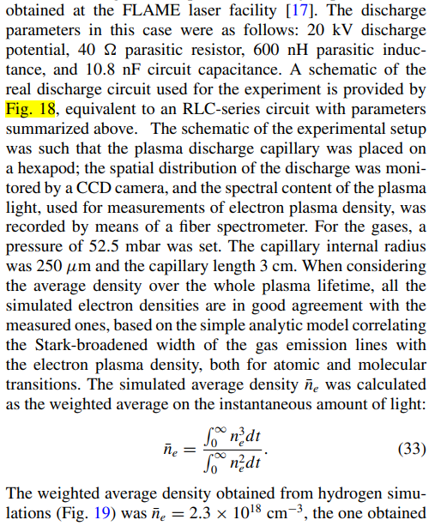
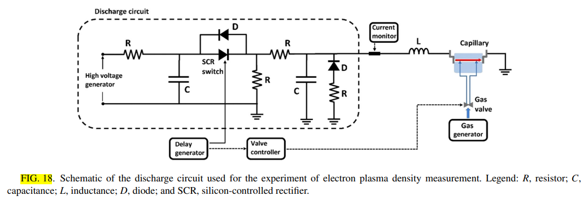
Background - Paper

Slide 12
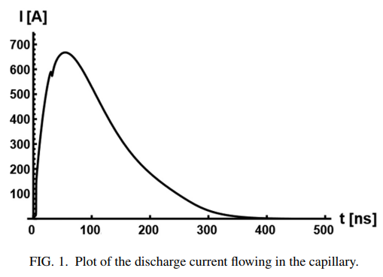
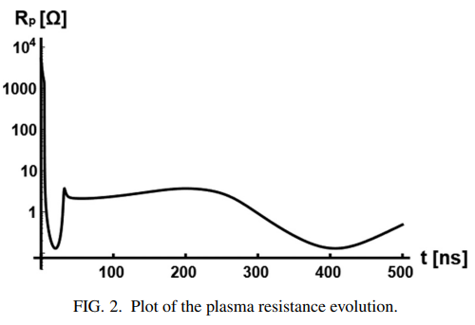
Background - Paper

Slide 13
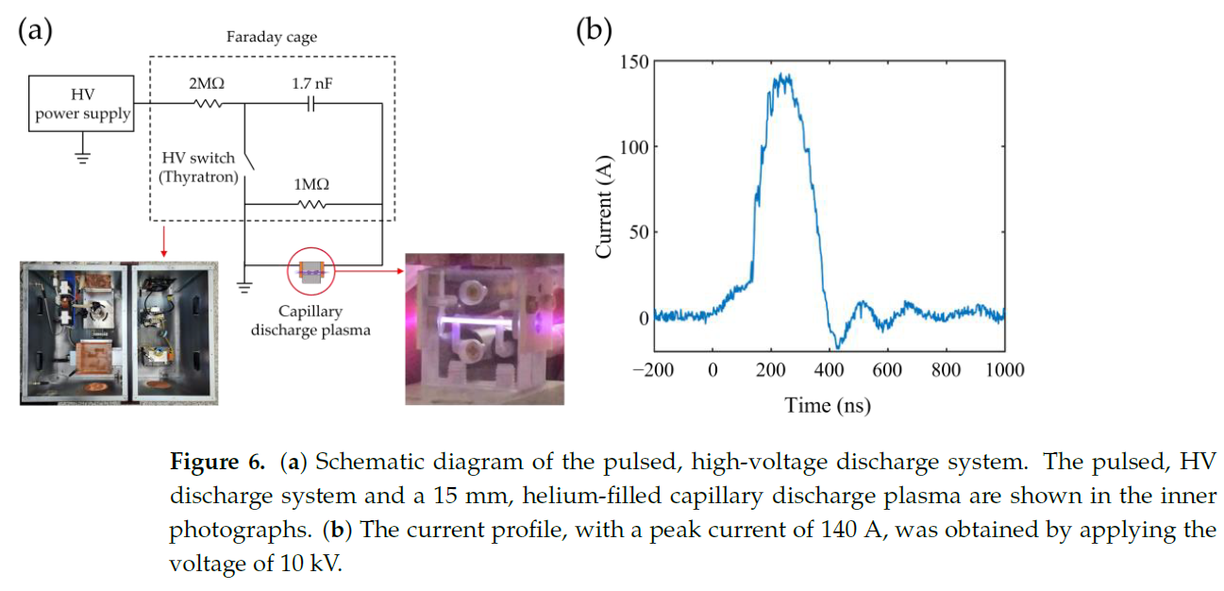
Background – PAL Thyratron

Slide 14
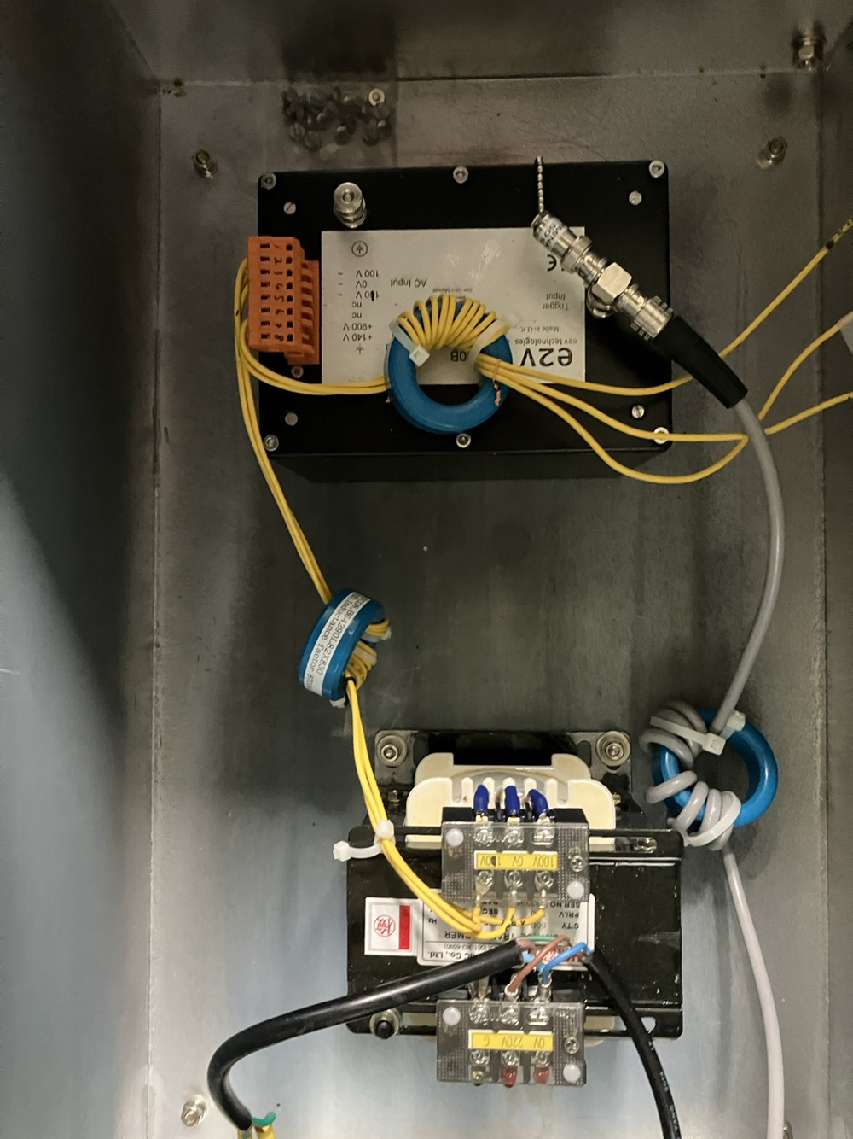
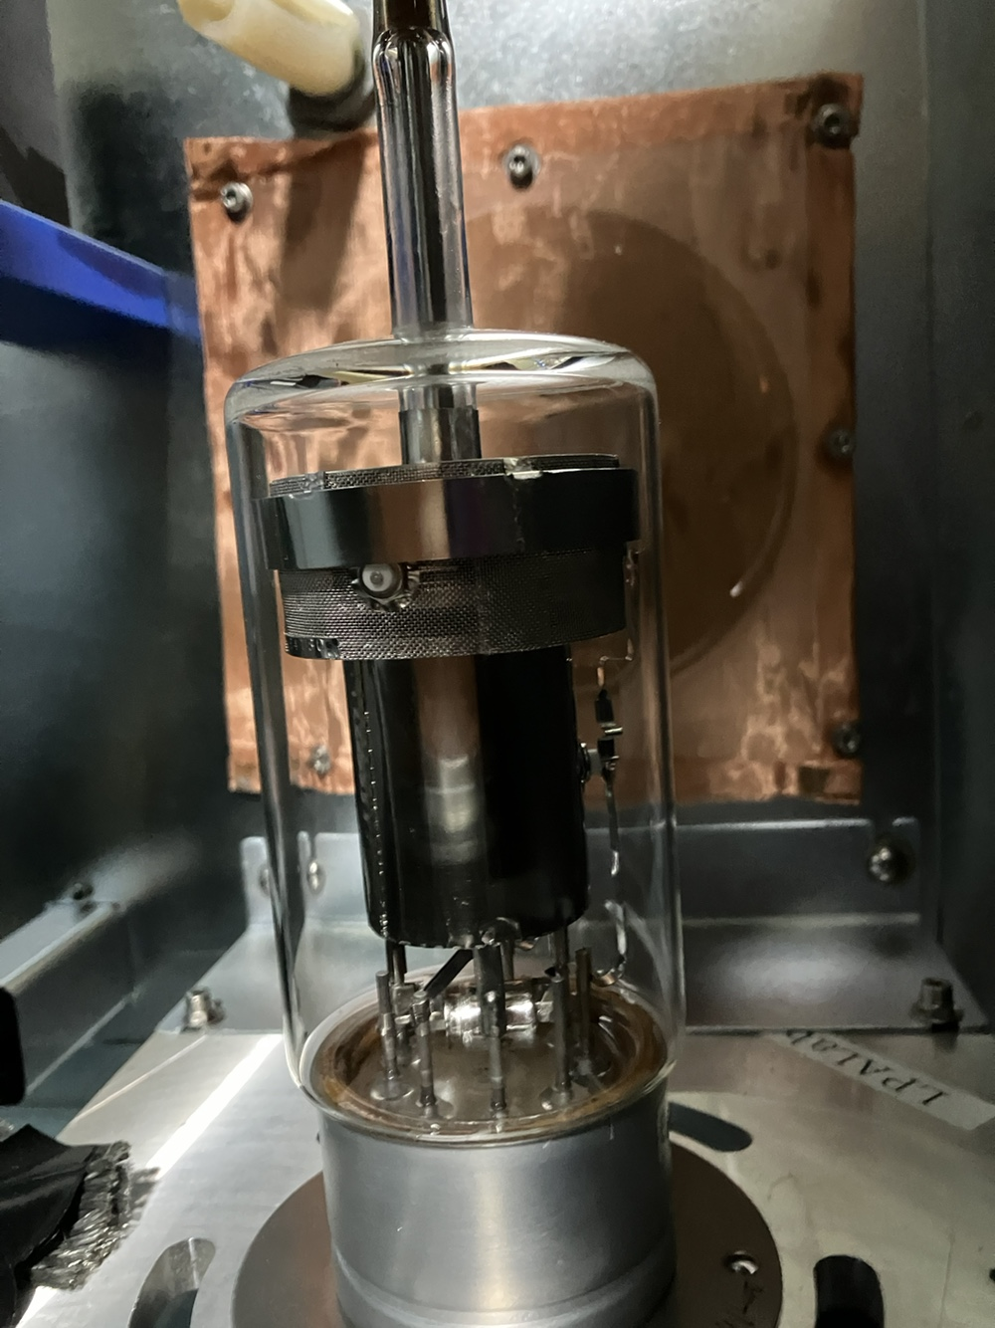
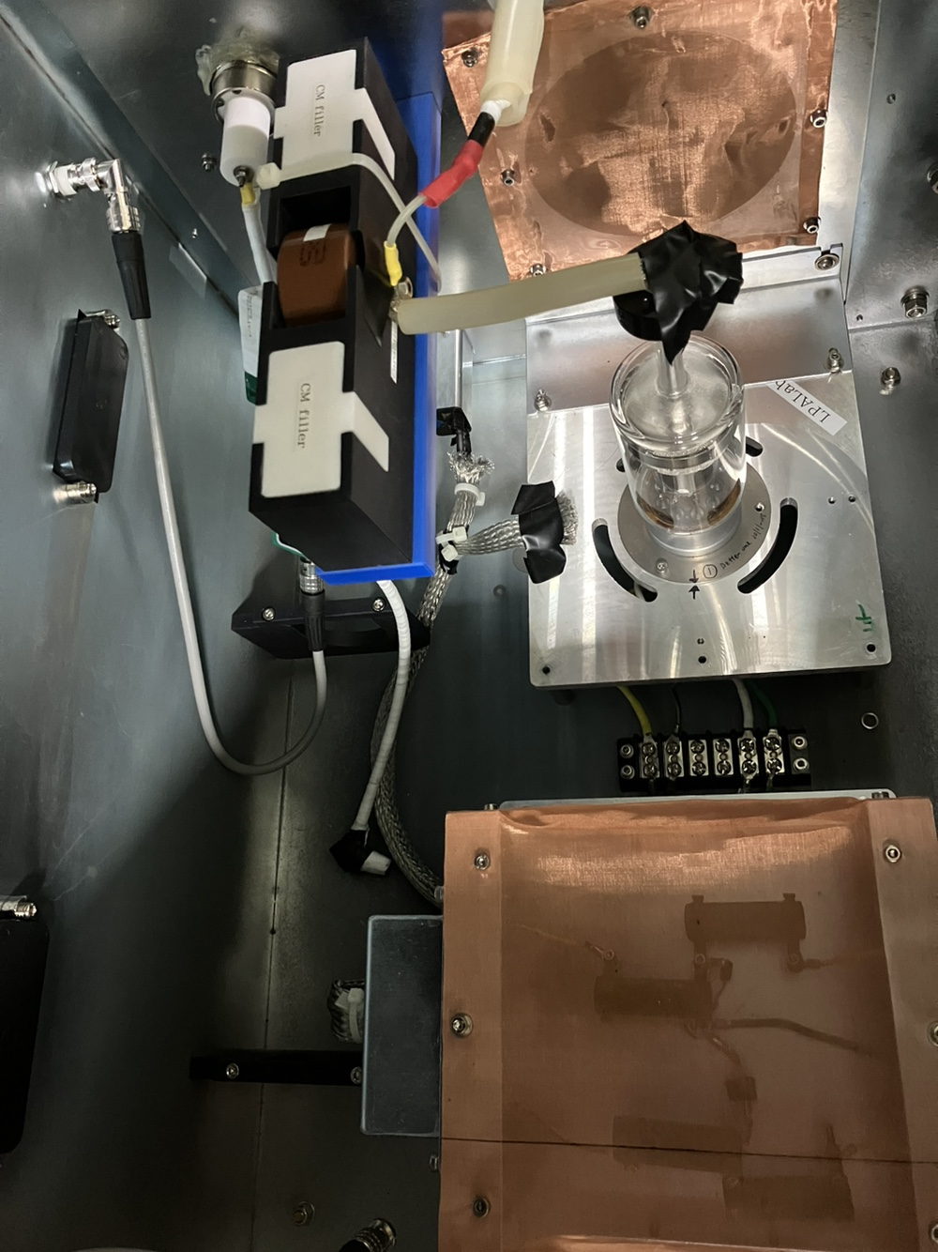
Background – PAL Thyratron

Slide 15
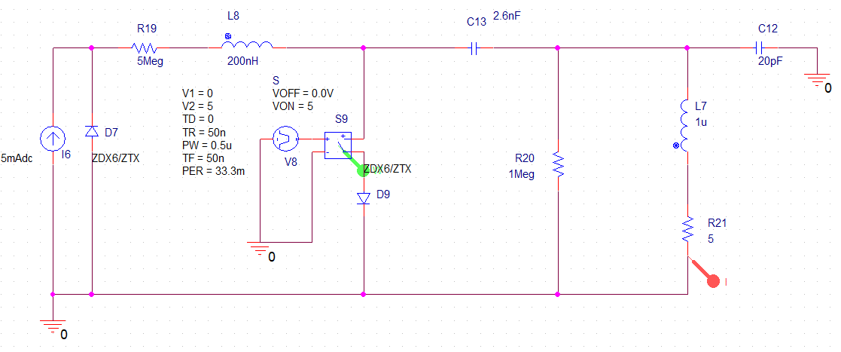
HVPS development

Slide 16
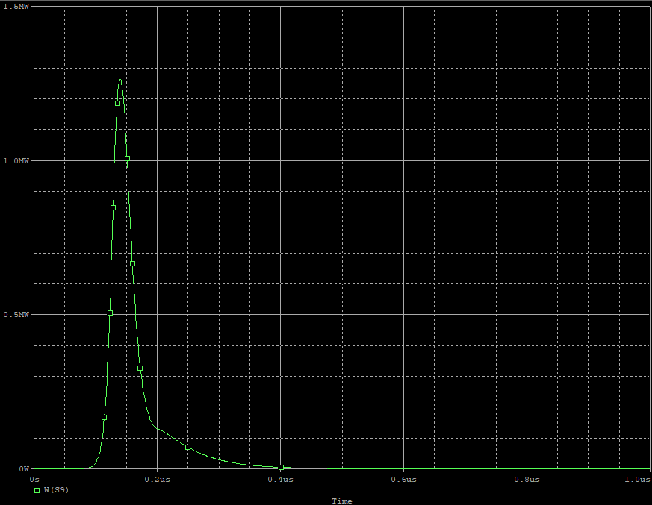
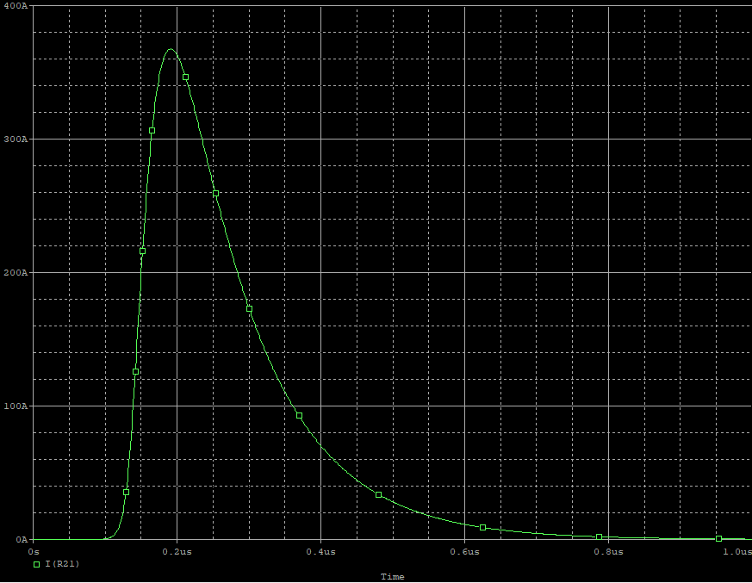
HVPS development

Slide 17
Plan
SC 논문 작성
  1월 중으로 마무리
  지금은 PIC simulation part 작성(정현명 씨)과 남인혁 교수님의 교정 대기중
졸업 논문
  1월 중으로 개요 확정하고 2월부터 작성 시작
  8월 졸업을 목표로 할 것 (재학 연한은 1년 연장하였음)
Afterworks
  고전압 펄스 생성기 제작
    Behlke 스위치 직구 (8000유로)
    자체 설계 기반으로 제작 의뢰
    (Co-worker) Grating crystal을 사용하여 분광기 제작
    (Co-worker) 기존 보유 챔버를 활용한 간섭계 제작
    완료되는 대로 방전 실험 후속 진행
  Continuous Flow
    1월 중으로 SC 기반 Cavity module 디자인 확정하여 3D 프린터를 통해 제작
    실험 준비는 1월까지 끝내고, 졸업 요건 충족 후 이어서 진행

