Slide 1
2026 CAPhE Workshop
Minseo Jeong

Slide 2
Ultrafast Electron Diffraction
Pump-probe imaging technique based on optical pump-probe spectroscopy and electron diffraction caused by ultrafast electron
D. Filippetto et al. Rev. Mod. Phys. (2022).

Slide 3
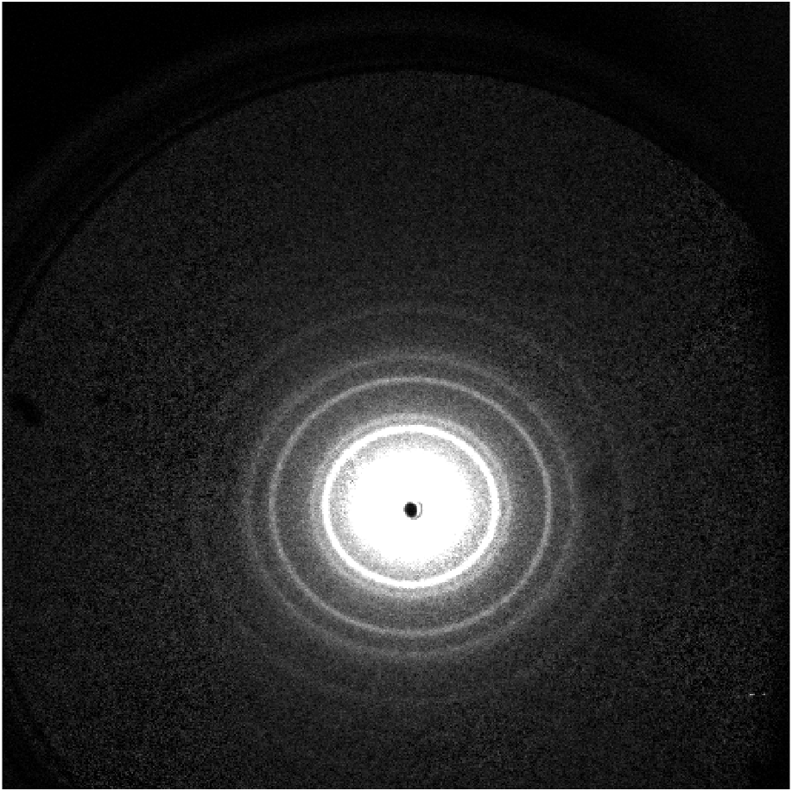
UED Facility in PAL-eLabs
UED diffraction pattern of Al (250318)

Slide 4
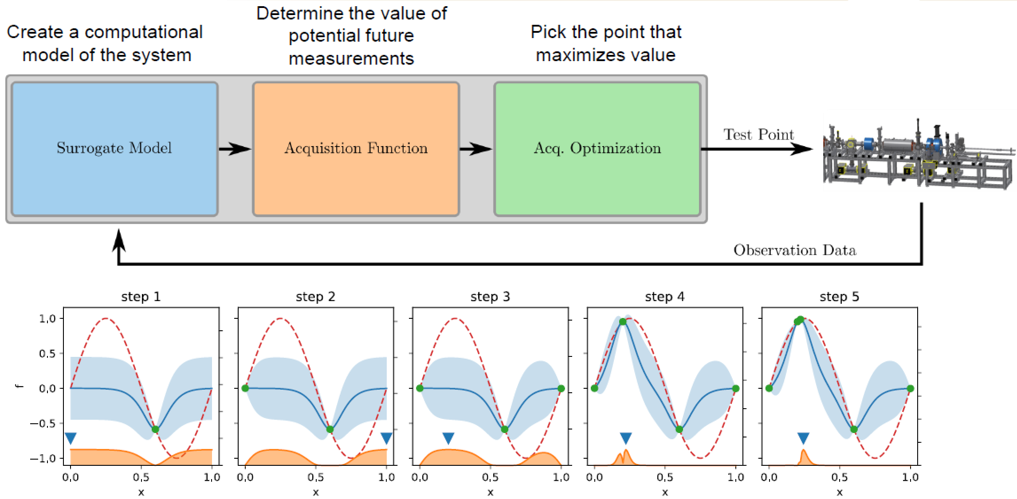
Research Highlights
Bayesian optimization: Model-based optimization algorithm using probability distribution model based on previous observations

Slide 5
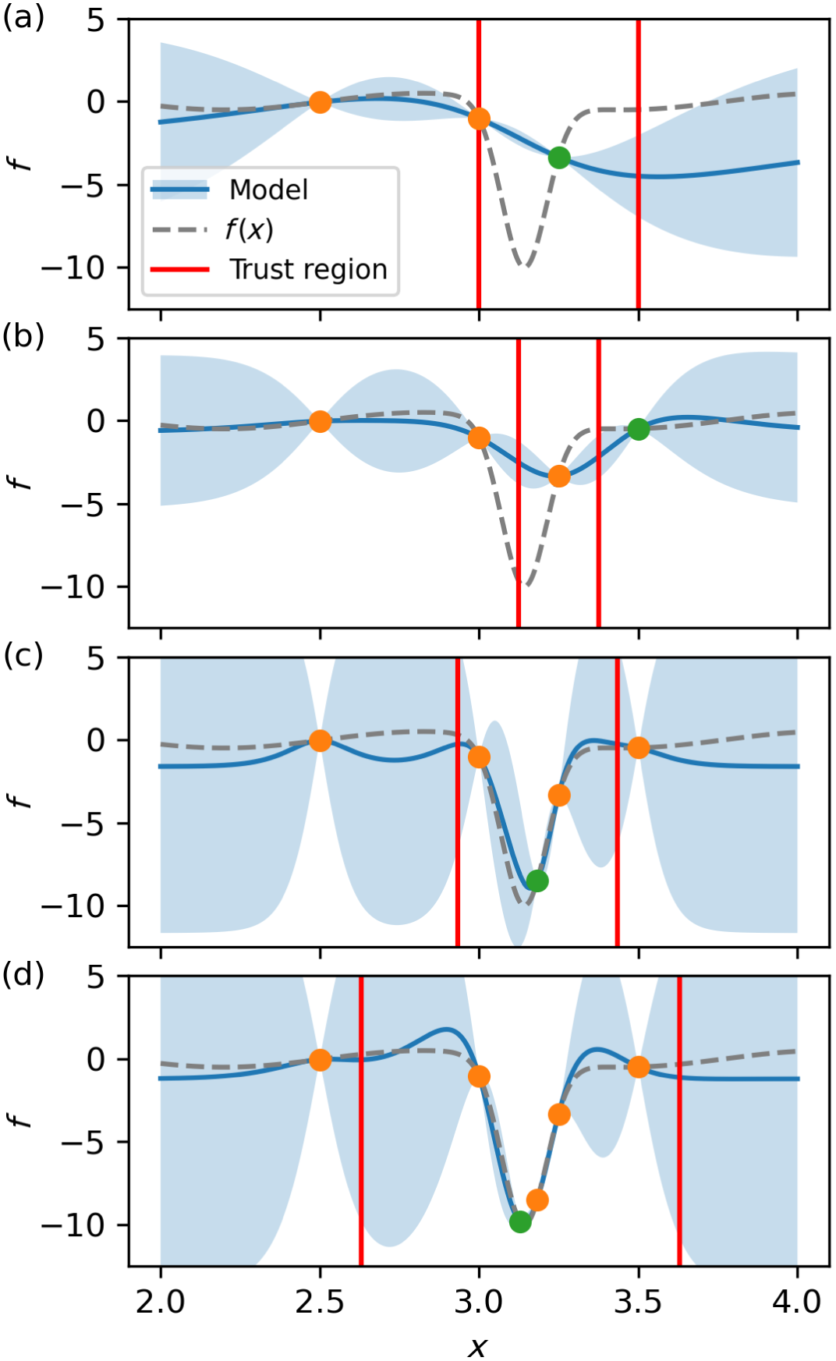
Research Highlights
Multi-objective regionalized Bayesian optimization(MORBO): An multi-objective algorithm that restricts optimization of the acquisition function to within a so-called trust region
As optimization progresses, the size of the trust region changes based on the number of consecutive successes or failure
R. Roussel et al. Phys. Rev. Accel. Beams 27. (2024).

Slide 6
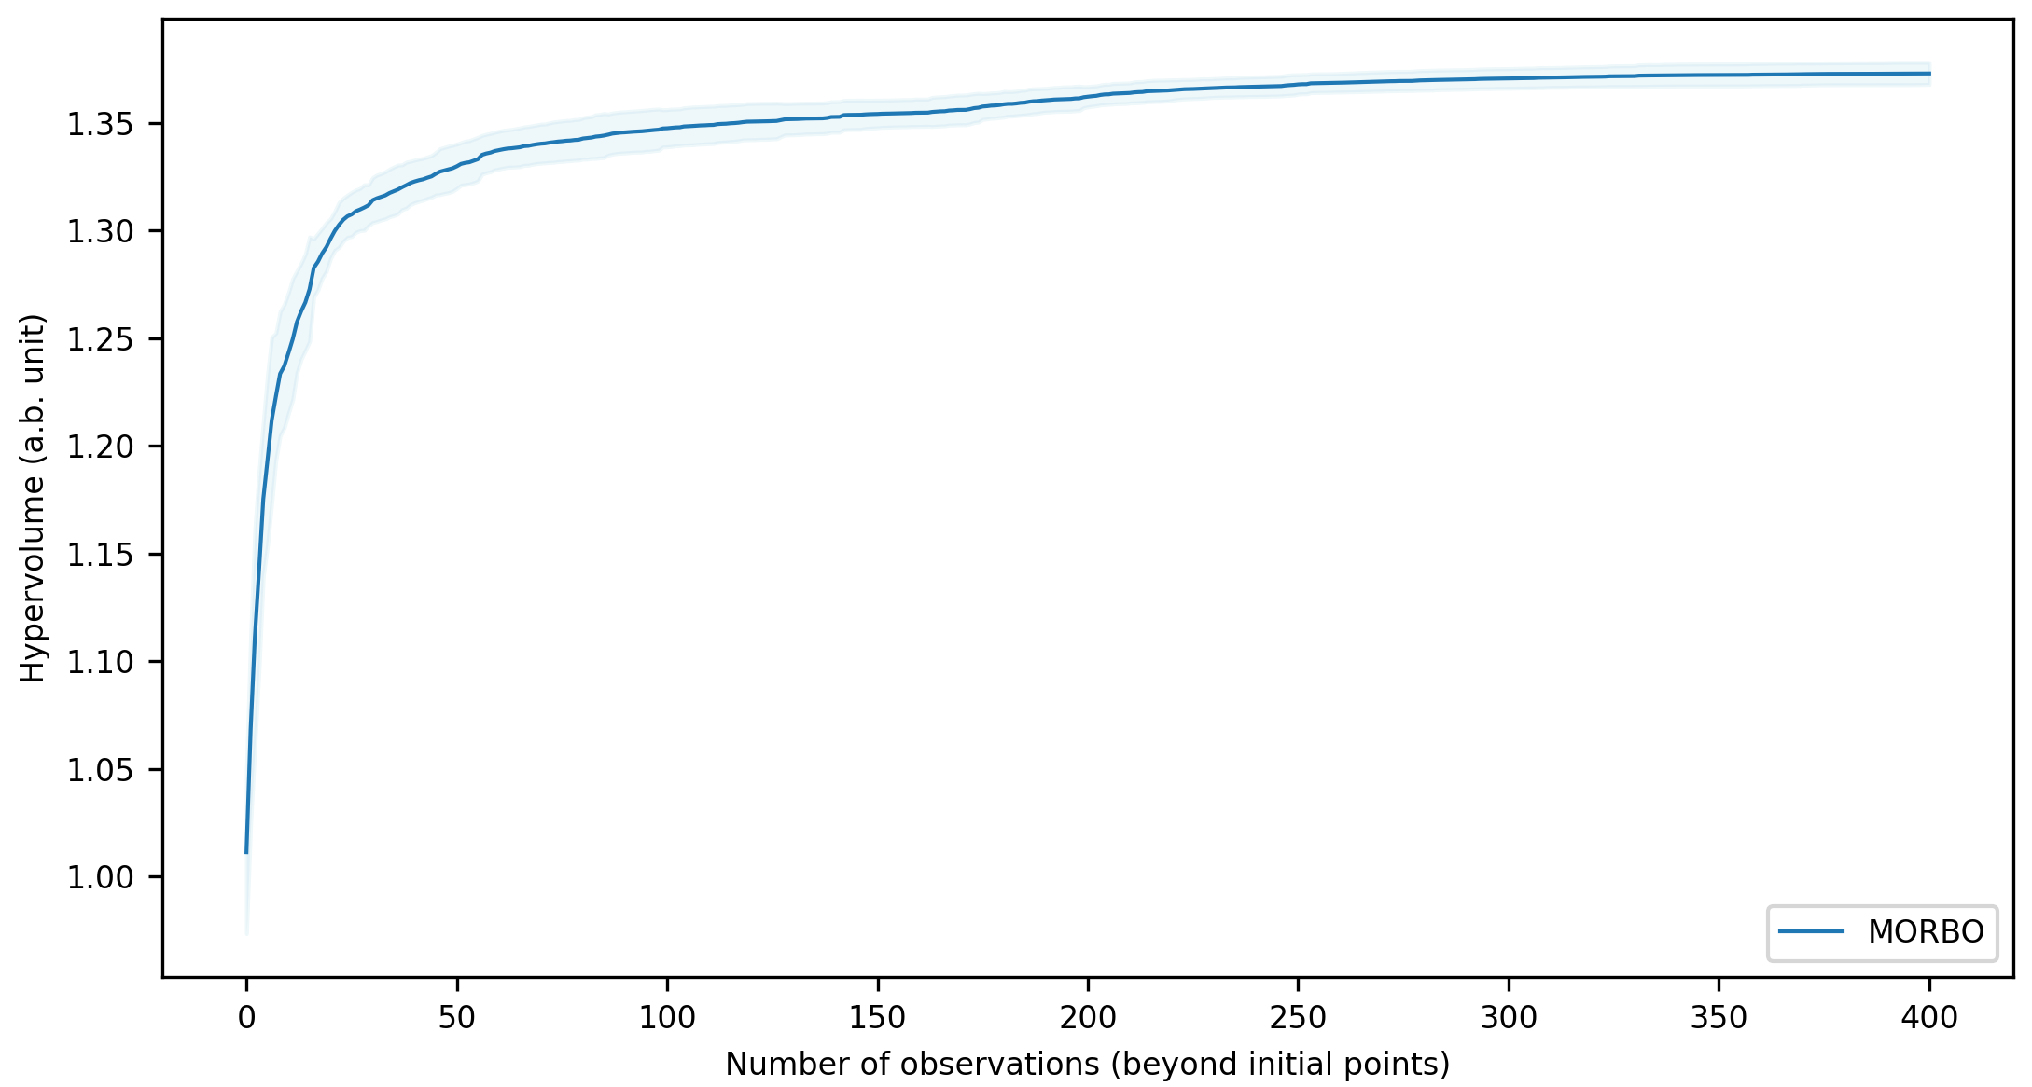
Research Highlights
Optimization of MeV-UED in PAL-eLabs
General particle tracer(GPT) simulation code
Input parameter: Strength and position of solenoids, bunch charge, RF gun phase, position of collimator
Objective parameter: Beam size, bunch length, q-resolution

Slide 7
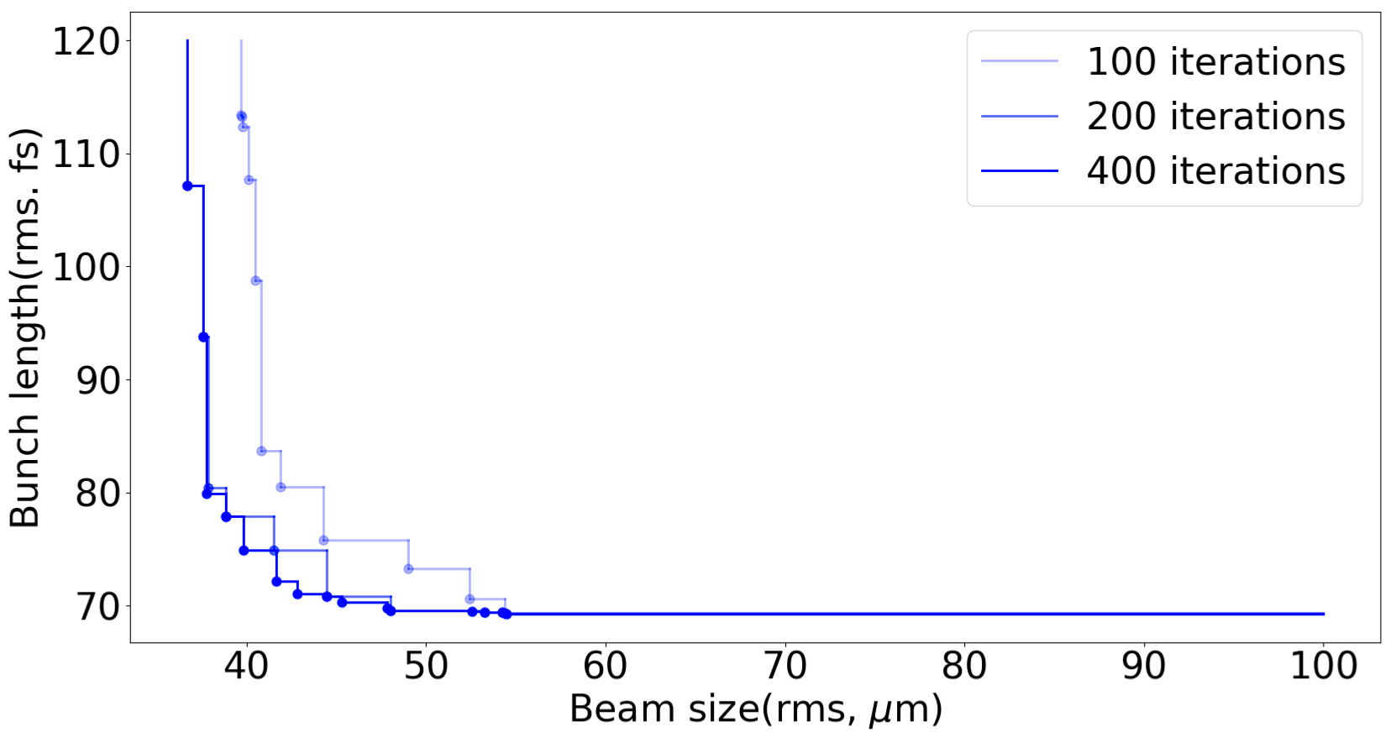
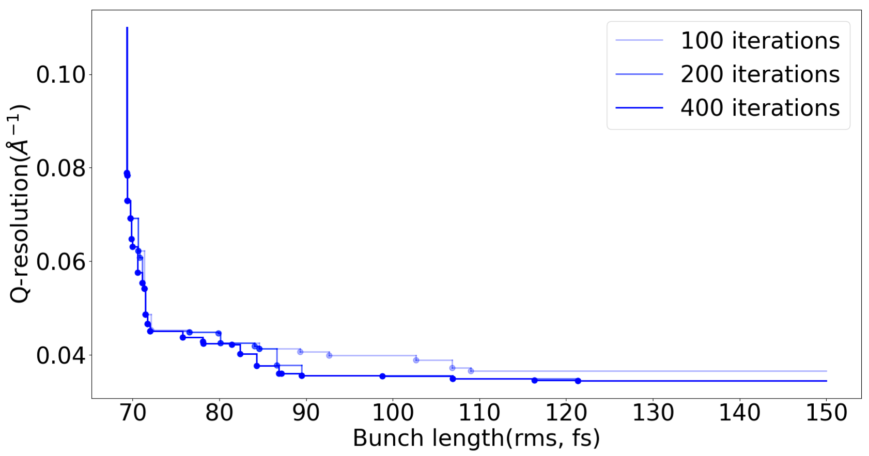
Research Highlights
Number of macroparticles: 10000
Number of iteration: 400

Slide 8
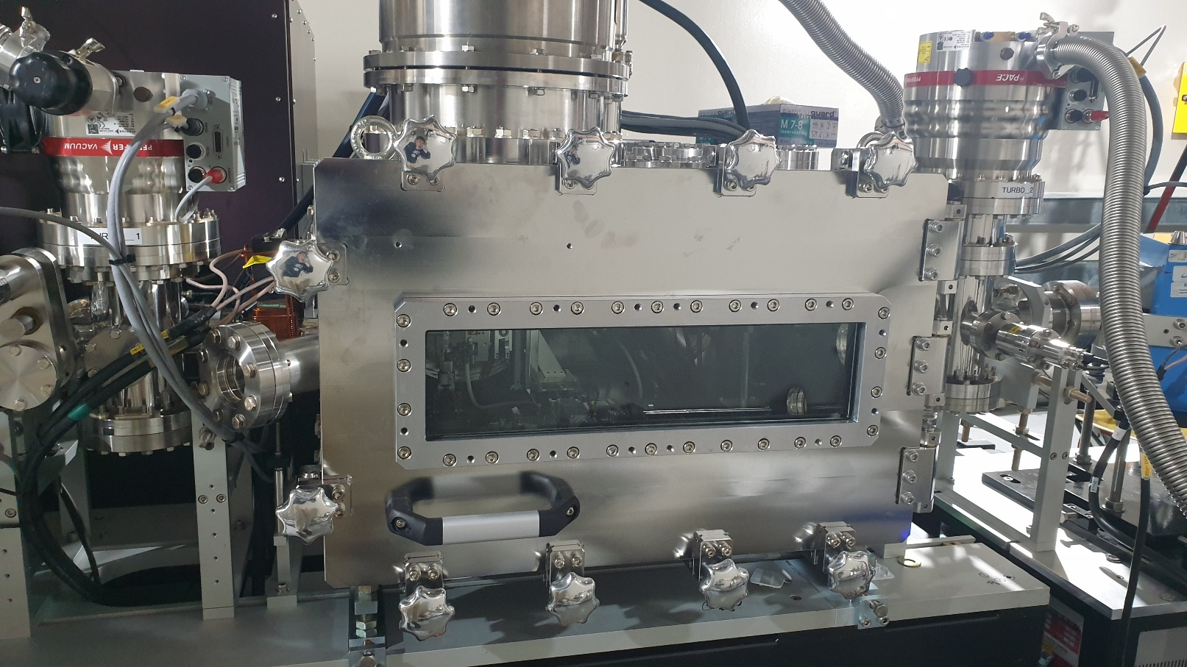
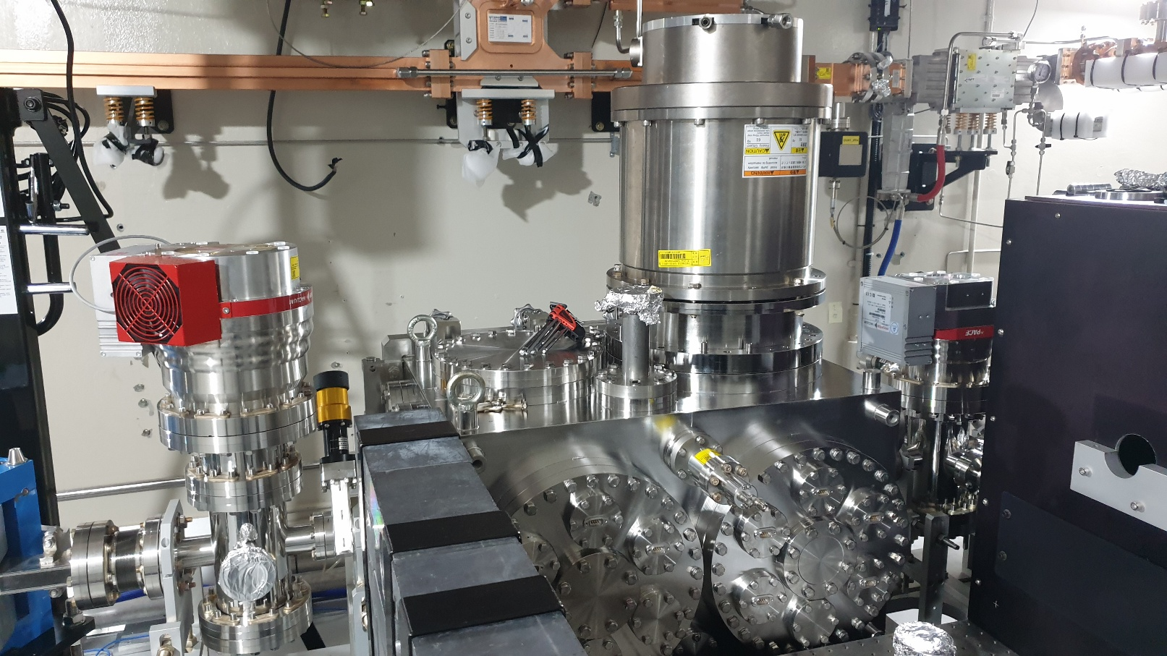
UED Experiment(with IBS)(~2026/08)
Installation of new sample chamber for gas UED(25/11~25/12)
Static gas UED experiment
Pump-probe experiment with solid sample
Current schedule is delayed due to vacuum issue, etc.

Slide 9
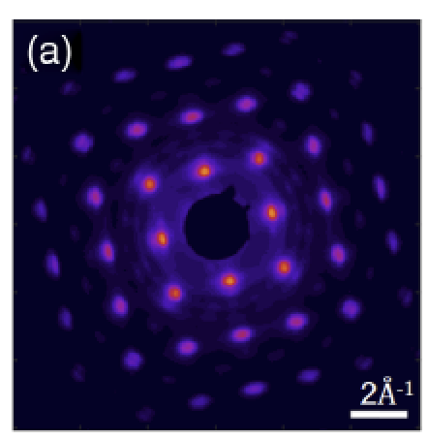
Optimization of UED parameters in PAL-eLabs
Measurement of beam size at the sample(completed)
Measurement of q-resolution by fitting of diffraction pattern with 2D Gaussian function(in process)
Upper limit of q-resolution can be determined by measuring the width of peaks
Optimization of bunch length can be cancelled due to absence of diagnostics of bunch length in MeV-UED
F. Qi. et al. Phys. Rev. Lett. (2020)

Slide 10
VPP Experiment(with Dr. Sung)
Virtual pepper pot(VPP): a method for characterization of 4D phase space based on the data from horizontal and vertical slit scan
Pepper pot
Virtual pepper pot
E. Cosgun et al. Sci. Rep. (2025).

Slide 11
Future Plan
MALAPA 2026(April)
Searching for next research topic(RF gun/THz/XFEL)
Research proposal(until fall semester of 2026)

