Slide 1
2025 Research Summary and Future plan
2026-01-09, Pohang, South Korea
Young Min Park
Division of Advanced Nuclear Engineering (DANE), POSTECH

Slide 2
Index
Higher Harmonic Cavity (HHC)
Short Term Plan (~ Feb.)
Long Term Plan (~2026.)
SC passive
Mode-coupling/PTBL/TBL
Simulation
NC active
New equilibrium method
Simulation
2

Slide 3
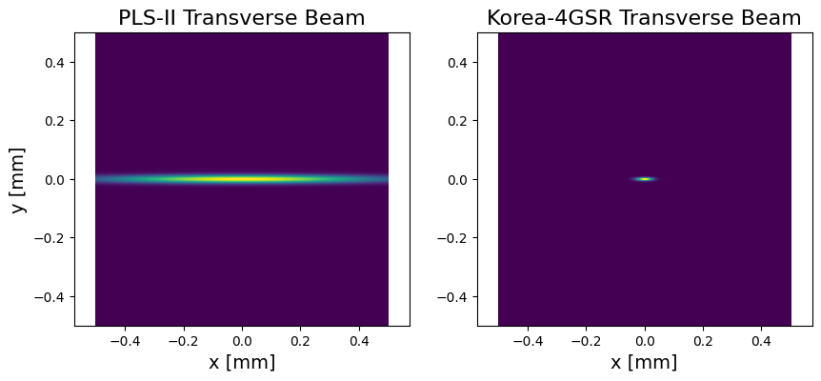
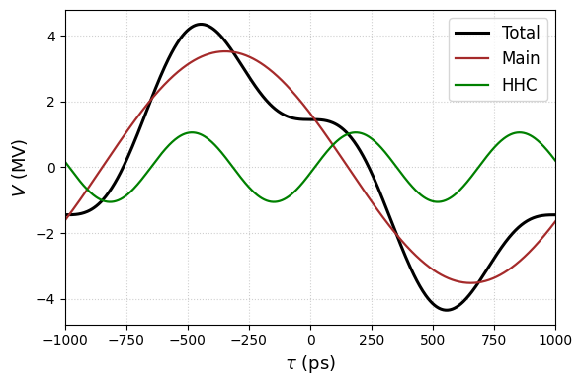
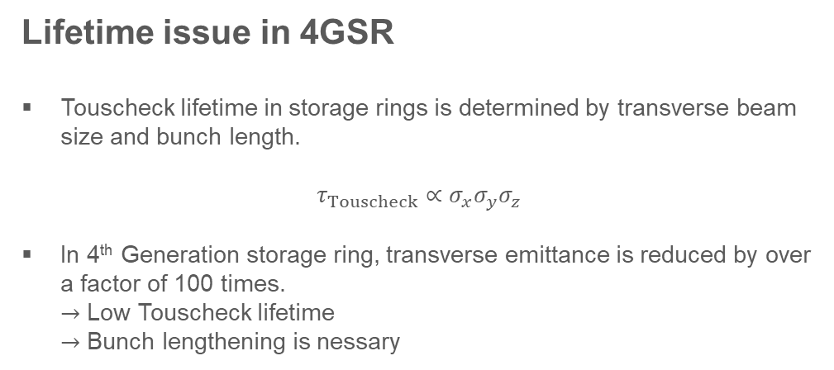



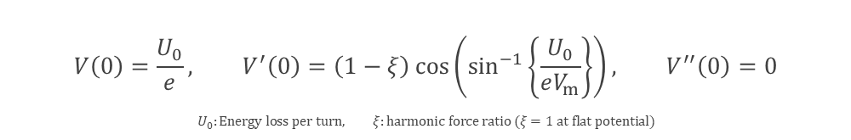
Higher Harmonic Cavity
Lifetime issue in 4GSR
Touscheck lifetime in storage rings is determined by transverse beam size and bunch length.
$$τ_{Touscheck}∝σ_{x}σ_{y}σ_{z}$$
In 4th Generation storage ring, transverse emittance is reduced by over a factor of 100 times. $→$ Low Touscheck lifetime $→$ Bunch lengthening is nessary
Lifetime $\sim 20 h$
Lifetime $\sim 6 h$
Bunch lengthening scheme
Installed Higher harmonic cavity(HHC) to reduce voltage gradient
Weakened restoring force can achieve bunch lengthening
Near Flat Potential(NFP) condition:
$$V\left(τ\right)=V_{m}\sin\left(ω_{rf}τ+φ_{m}\right)+V_{h}\sin\left(mω_{rf}τ+φ_{h}\right)$$
$$V_{m,h} :Voltage of main\&HHC cavity, ω_{rf}:rf−frequency, τ:bunch−arrival time,$$
$$m:harmonic order, φ_{m,h} :phase of main\&HHC cavity$$
$$V\left(0\right)=\frac{U_{0}}{e}, V^{′}\left(0\right)=\left(1−ξ\right)\cos\left(\sin^{−1}\left\{\frac{U_{0}}{eV_{m}}\right\}\right), V^{′′}\left(0\right)=0$$
$$U_{0}:Energy loss per turn, ξ:harmonic force ratio (ξ=1 at flat potential)$$
3

Slide 4
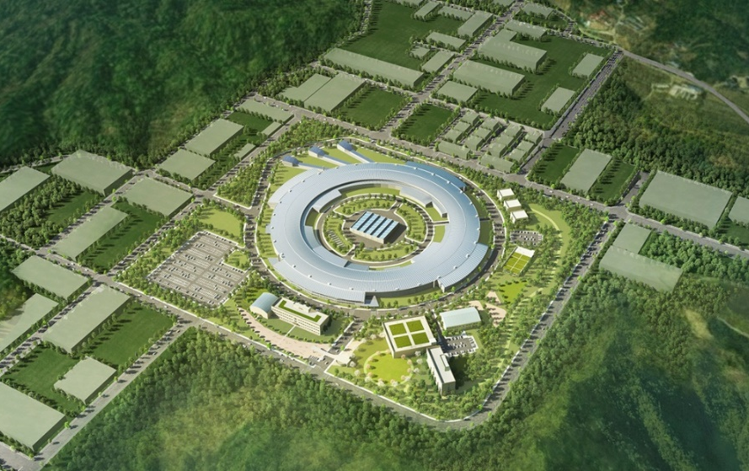
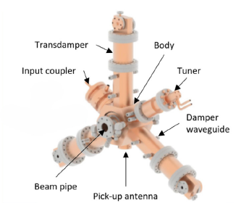
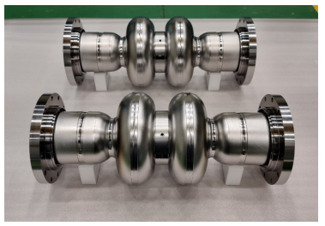
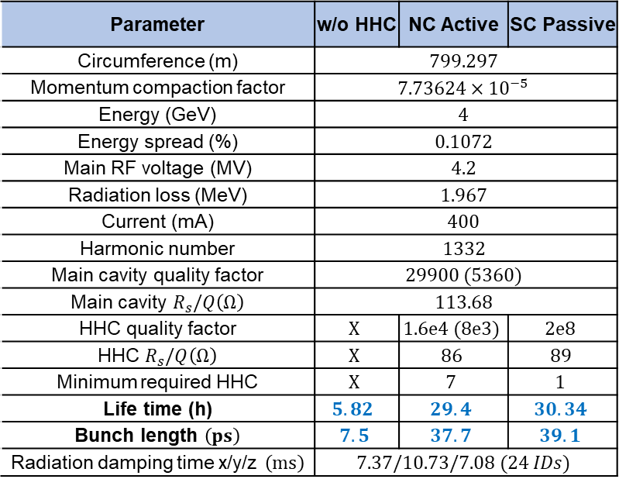
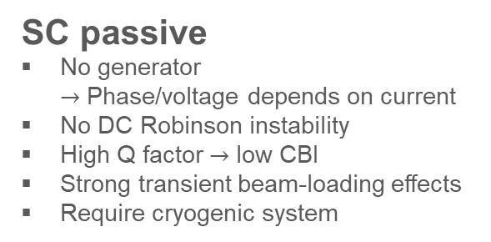
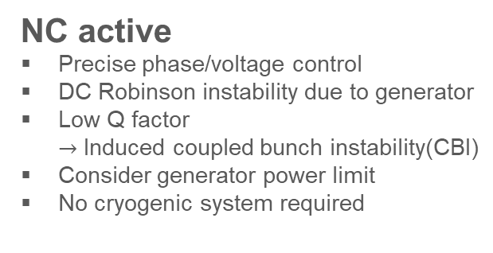
4GSR Parameter
Parameter | w/o HHC | NC Active | SC Passive
Circumference (m) | $$799.297$$
Momentum compaction factor | $$7.73624×{10}^{−5}$$
Energy (GeV) | $$4$$
Energy spread (%) | $$0.1072$$
Main RF voltage (MV) | $$4.2$$
Radiation loss (MeV) | $$1.967$$
Current (mA) | $$400$$
Harmonic number | $$1332$$
Main cavity quality factor | $$29900 (5360)$$
Main cavity $R_{s}/Q\left(Ω\right)$ | $$113.68$$
HHC quality factor | $$X$$ | $$1.6e4 (8e3)$$ | $$2e8$$
HHC $R_{s}/Q\left(Ω\right)$ | $$X$$ | $$86$$ | $$89$$
Minimum required HHC | $$X$$ | $$7$$ | $$1$$
Life time (h) | $$5.82$$ | $$29.4$$ | $$30.34$$
Bunch length $\left(ps\right)$ | $$7.5$$ | $$37.7$$ | $$39.1$$
Radiation damping time x/y/z $\left(ms\right)$ | $$7.37/10.73/7.08 (24 IDs)$$
NC active
Precise phase/voltage control
DC Robinson instability due to generator
Low Q factor $→$ Induced coupled bunch instability(CBI)
Consider generator power limit
No cryogenic system required
SC passive
No generator $→$ Phase/voltage depends on current
No DC Robinson instability
High Q factor $→$ low CBI
Strong transient beam-loading effects
Require cryogenic system
4

Slide 5
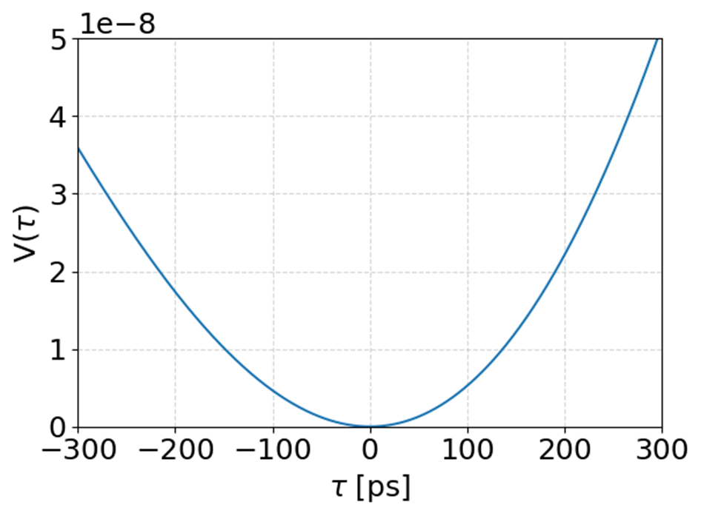
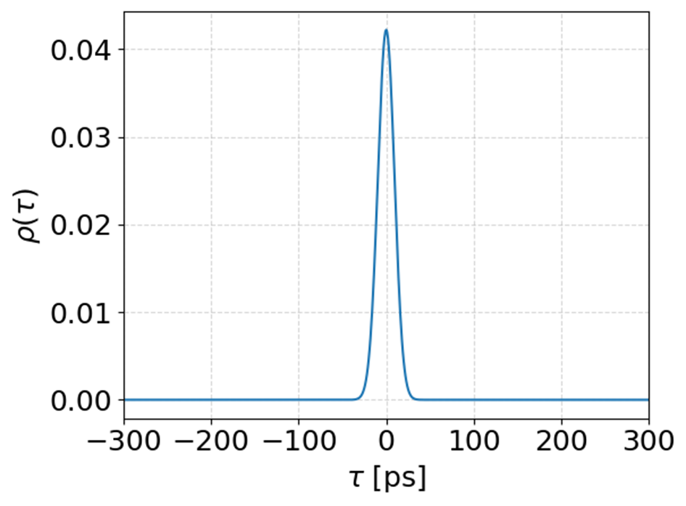
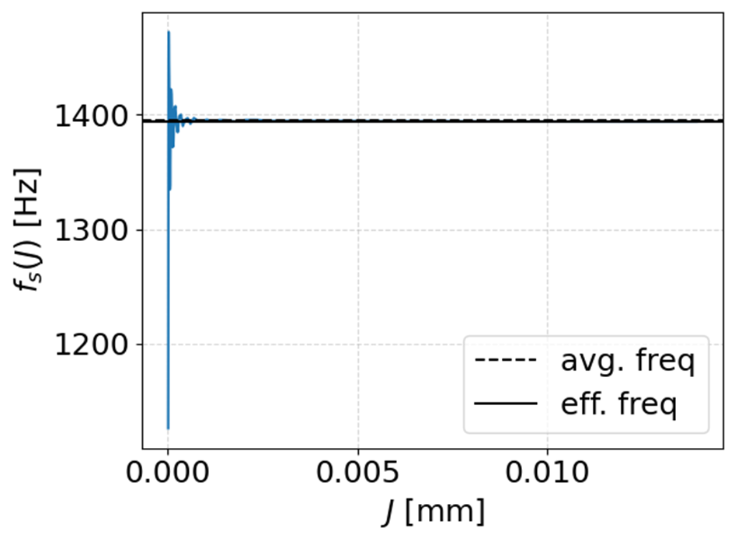
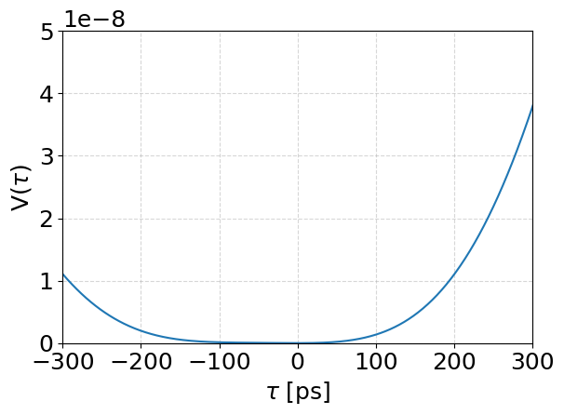
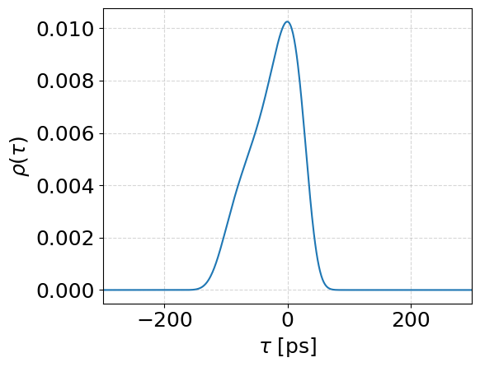
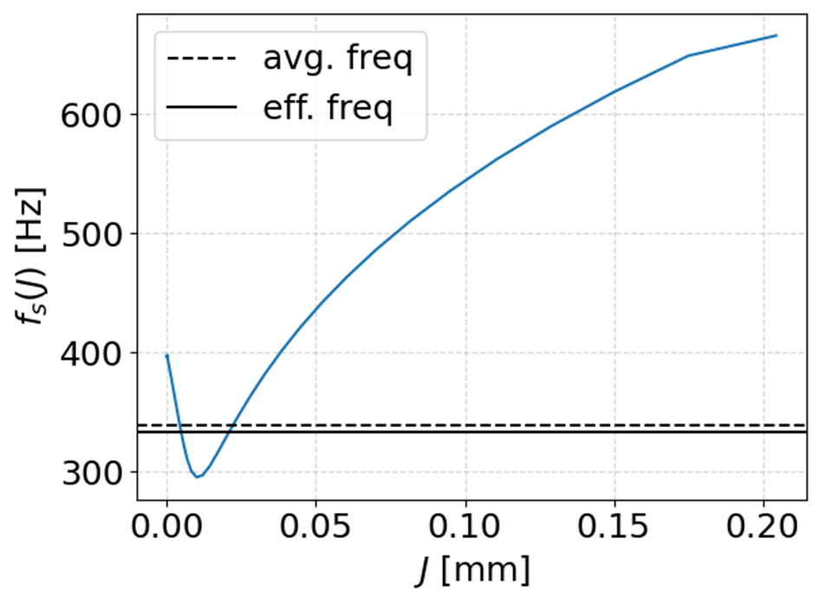
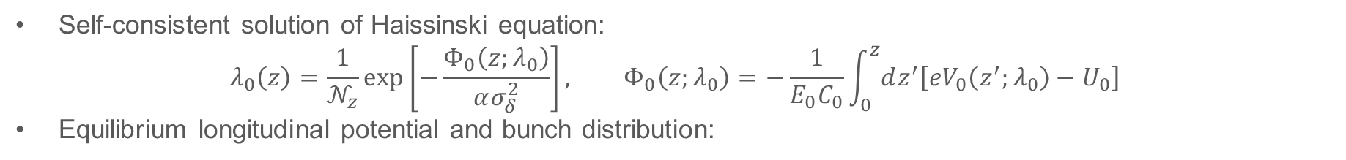

SC passive theory
SC passive
$λ_{0}:$ Longitudinal distribution
$𝒩_{z}:$ Normalization quantity
$Φ_{0}:$ Equilibrium Potential
$α:$ Momentum compaction factor
$σ_{δ}:$ Energy spread
$E_{0}:$ Particle’s energy
$C_{0}:$ Circumference
$V_{0}:$ Equilibrium Voltage
Self-consistent solution of Haissinski equation:
$$λ_{0}\left(z\right)=\frac{1}{𝒩_{z}}\exp\left[−\frac{Φ_{0}\left(z;λ_{0}\right)}{ασ_{δ}^{2}}\right], Φ_{0}\left(z;λ_{0}\right)=−\frac{1}{E_{0}C_{0}}\int_{0}^{z}{dz^{′}\left[eV_{0}\left(z^{′};λ_{0}\right)−U_{0}\right]}$$
Equilibrium longitudinal potential and bunch distribution:
Single RF: linear dynamics, quadratic potential, Gaussian bunch, constant synchrotron frequency
Double RF: non-linear dynamics, arbitrary potential, non-Gaussian bunch, amplitude-dependent synchrotron frequency
$\left(Q=2×10^{8}, Δf=39.74 kHz\right)$
5

Slide 6
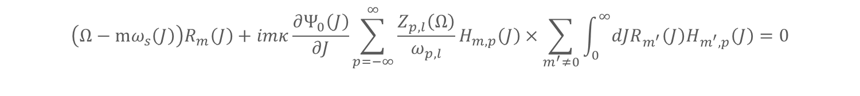
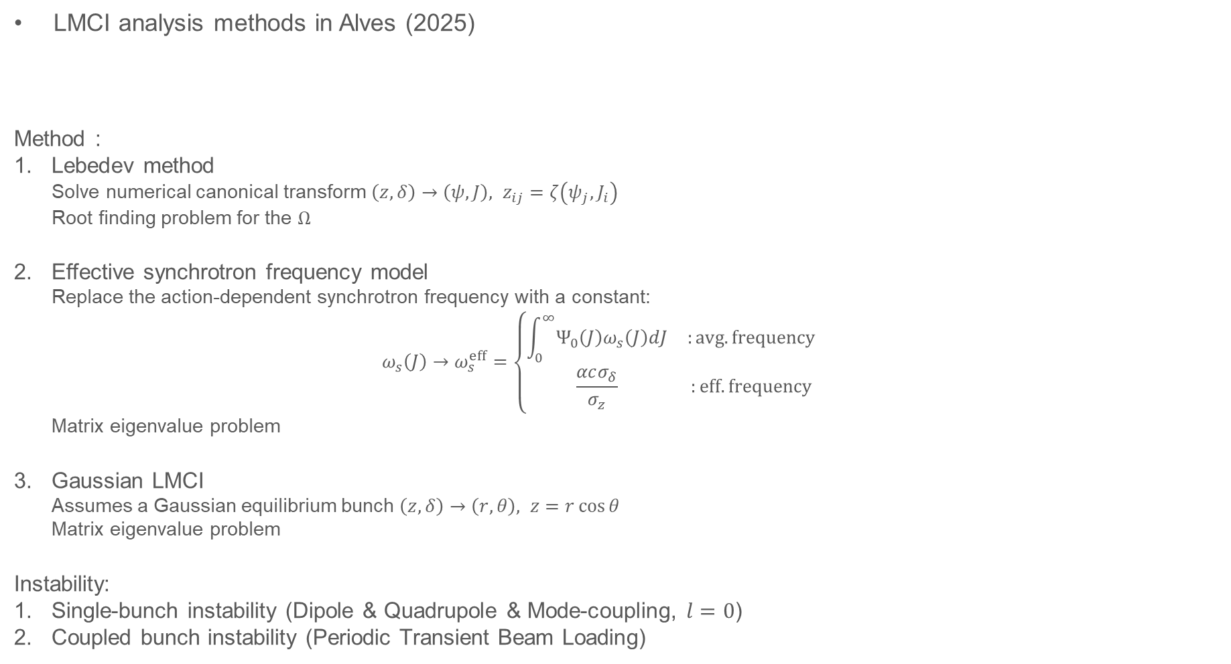
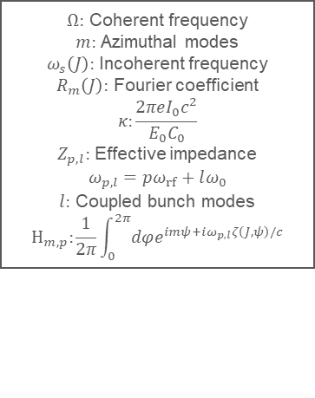
SC passive theory
LMCI analysis methods in Alves (2025)
Method :
Lebedev method Solve numerical canonical transform $\left(z,δ\right)→\left(ψ,J\right), z_{ij}=ζ\left(ψ_{j},J_{i}\right)$ Root finding problem for the $Ω$
Effective synchrotron frequency model Replace the action-dependent synchrotron frequency with a constant: $ω_{s}\left(J\right)→ω_{s}^{eff}=\left\{\begin{matrix}\int_{0}^{∞}{Ψ_{0}\left(J\right)ω_{s}\left(J\right)dJ} & :avg. frequency \\ \frac{αcσ_{δ}}{σ_{z}} & :eff. frequency\end{matrix}\right.$ Matrix eigenvalue problem
Gaussian LMCI Assumes a Gaussian equilibrium bunch $\left(z,δ\right)→\left(r,θ\right), z=r\cos{θ}$ Matrix eigenvalue problem
Instability:
Single-bunch instability (Dipole & Quadrupole & Mode-coupling, $l=0$)
Coupled bunch instability (Periodic Transient Beam Loading)
$Ω:$ Coherent frequency
$m:$ Azimuthal modes
$ω_{s}\left(J\right):$ Incoherent frequency
$R_{m}\left(J\right):$ Fourier coefficient
$$κ:\frac{2πeI_{0}c^{2}}{E_{0}C_{0}}$$
$Z_{p,l}:$ Effective impedance
$$ω_{p,l}=pω_{rf}+lω_{0}$$
$l:$ Coupled bunch modes
$$H_{m,p}:\frac{1}{2π}\int_{0}^{2π}{dφe^{imψ+iω_{p,l}ζ\left(J,ψ\right)/c}}$$
$$\left(Ω−mω_{s}\left(J\right)\right)R_{m}\left(J\right)+imκ\frac{∂Ψ_{0}\left(J\right)}{∂J}\sum_{p=−∞}^{∞}{\frac{Z_{p,l}\left(Ω\right)}{ω_{p,l}}}H_{m,p}\left(J\right)×\sum_{m^{′}≠0}{\int_{0}^{∞}{dJR_{m^{′}}\left(J\right)H_{m^{′},p}\left(J\right)}}=0$$
6

Slide 7
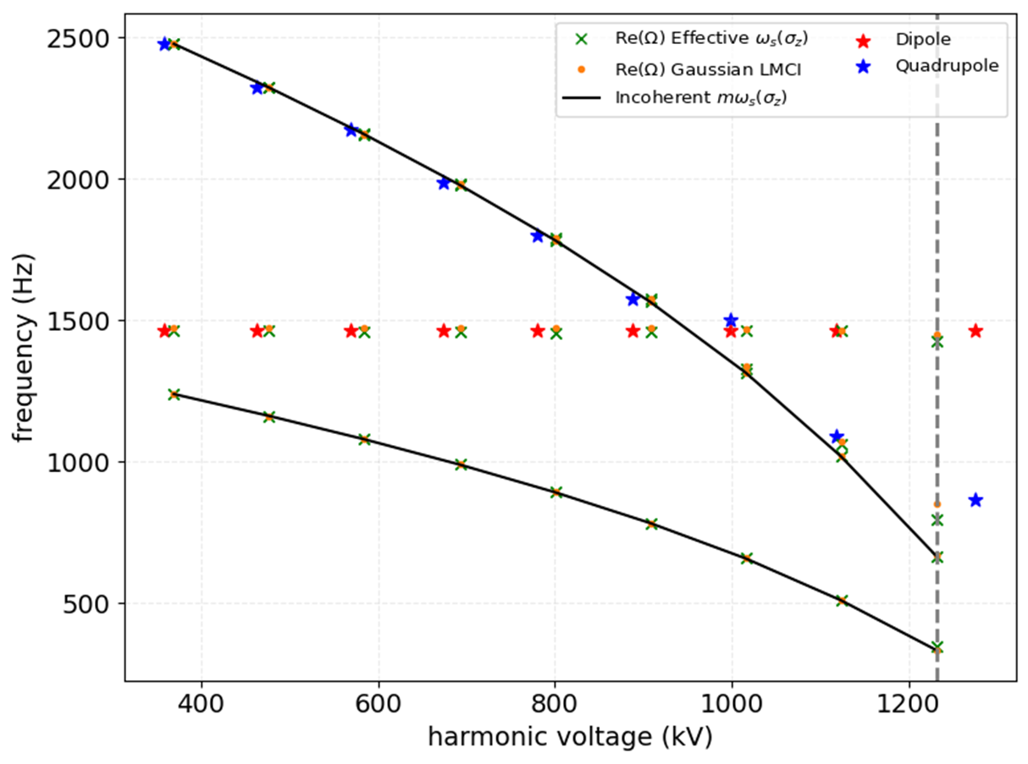
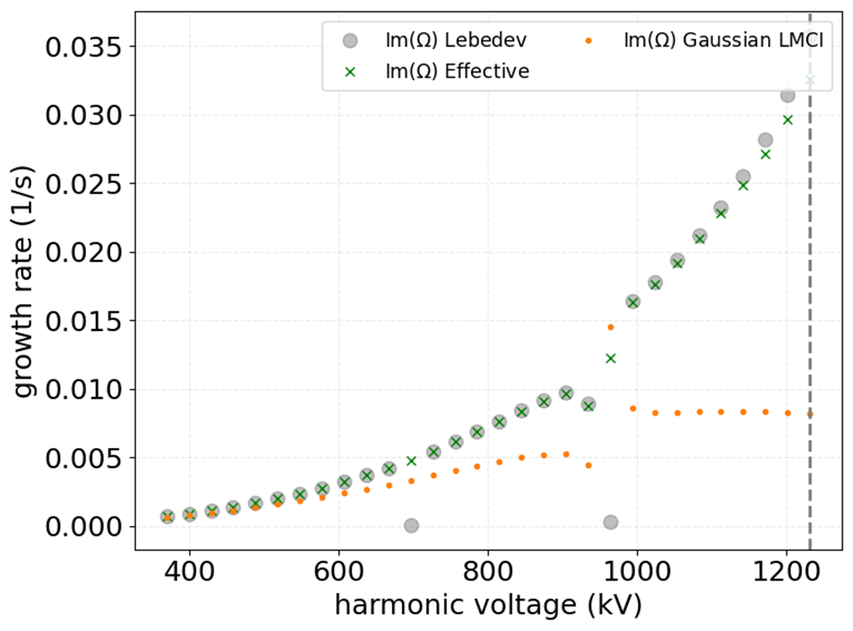
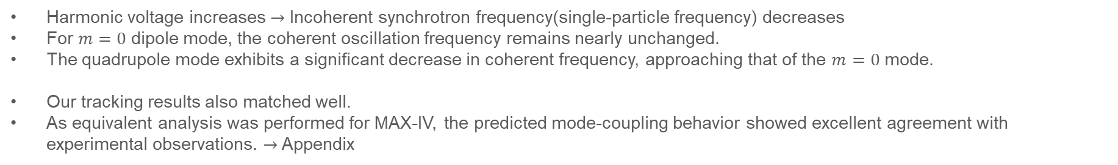
Mode-coupling Result
$Q=2×{10}^{8}, I=400 mA,$24 IDs cases
Coherent quadrupole mode
Mode coupling
Mode coupling
Coherent dipole mode
Harmonic voltage increases $→$ Incoherent synchrotron frequency(single-particle frequency) decreases
For $m=0$ dipole mode, the coherent oscillation frequency remains nearly unchanged.
The quadrupole mode exhibits a significant decrease in coherent frequency, approaching that of the $m=0$ mode.
Our tracking results also matched well.
As equivalent analysis was performed for MAX-IV, the predicted mode-coupling behavior showed excellent agreement with experimental observations. $→$ Appendix
7

Slide 8
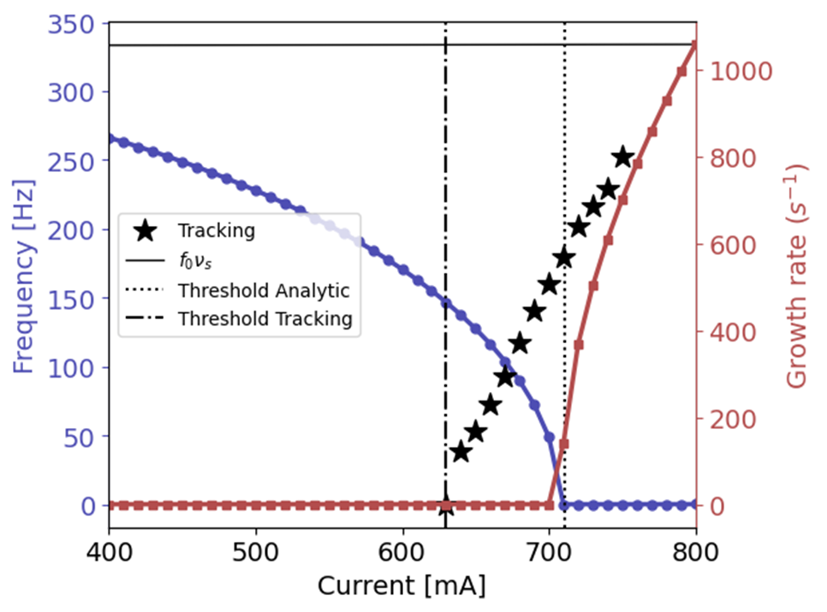
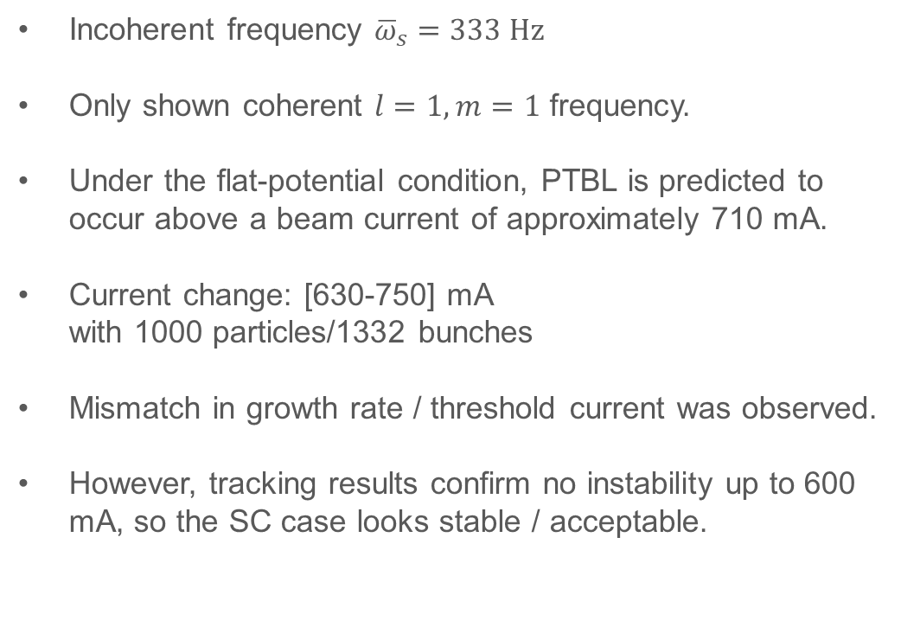
PTBL Result
PTBL occur
~ 710 mA
Incoherent frequency ${\overline{ω}}_{s}=333 Hz$
Only shown coherent $l=1,m=1$ frequency.
Under the flat-potential condition, PTBL is predicted to occur above a beam current of approximately 710 mA.
Current change: [630-750] mA with 1000 particles/1332 bunches
Mismatch in growth rate / threshold current was observed.
However, tracking results confirm no instability up to 600 mA, so the SC case looks stable / acceptable.
8

Slide 9
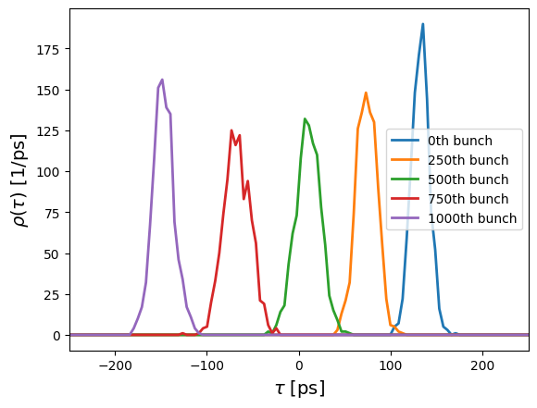
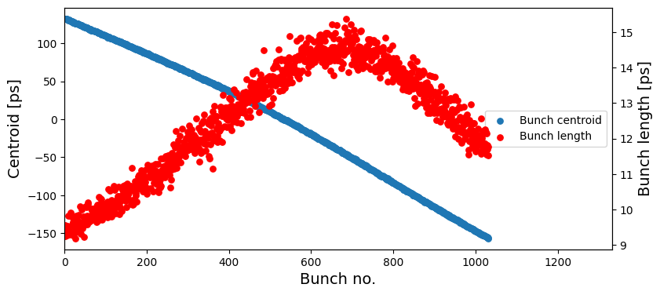
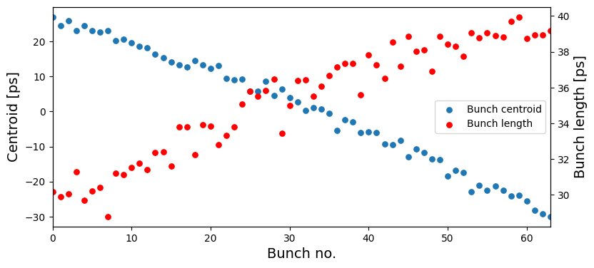
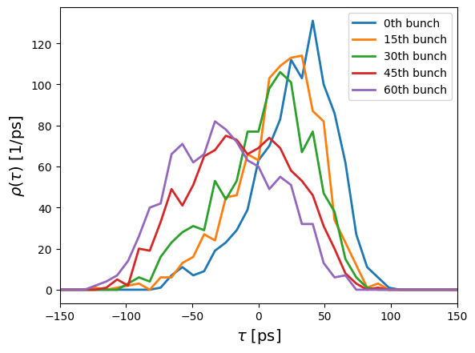
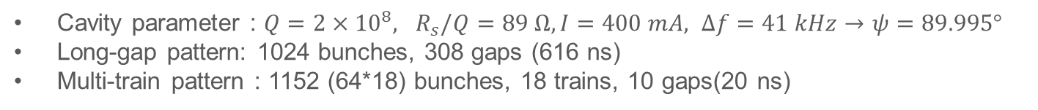
TBL Result
Arbitrary filling pattern
Cavity parameter : $Q=2×{10}^{8}, R_{s}/Q=89 Ω, I=400 mA, Δf=41 kHz→ψ=89.995°$
Long-gap pattern: 1024 bunches, 308 gaps (616 ns)
Multi-train pattern : 1152 (64*18) bunches, 18 trains, 10 gaps(20 ns)
Long-gap
Multi-train
9

Slide 10
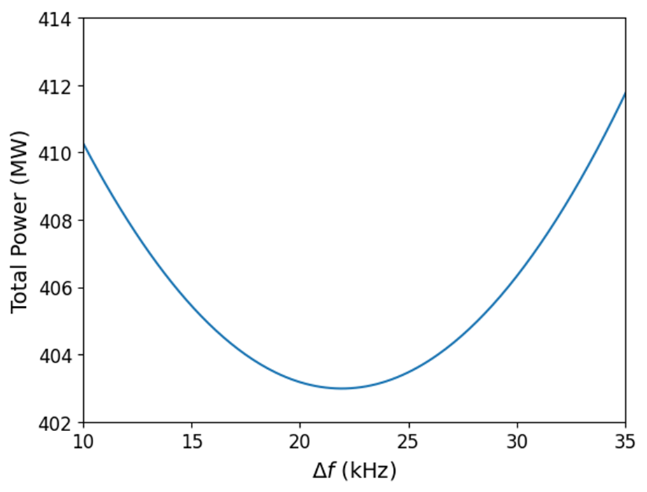
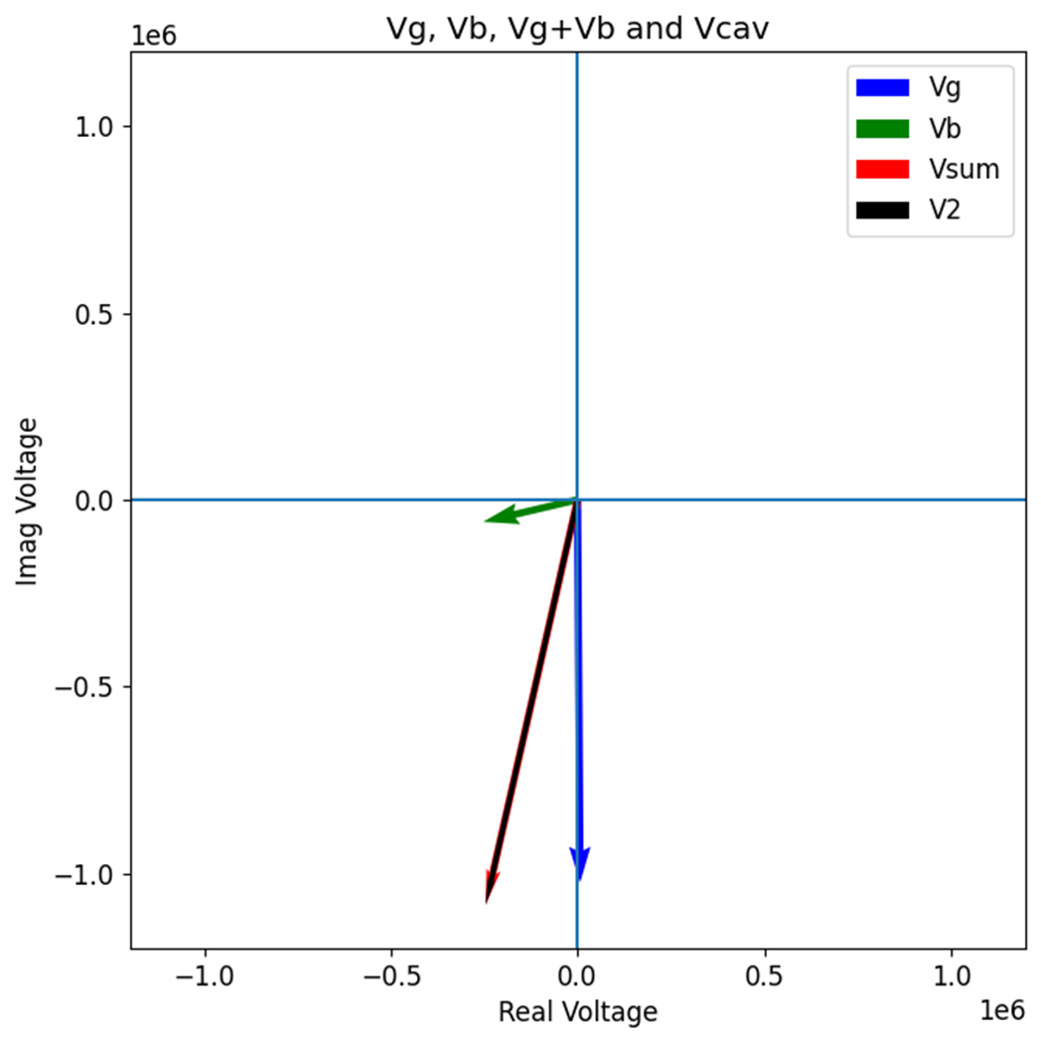



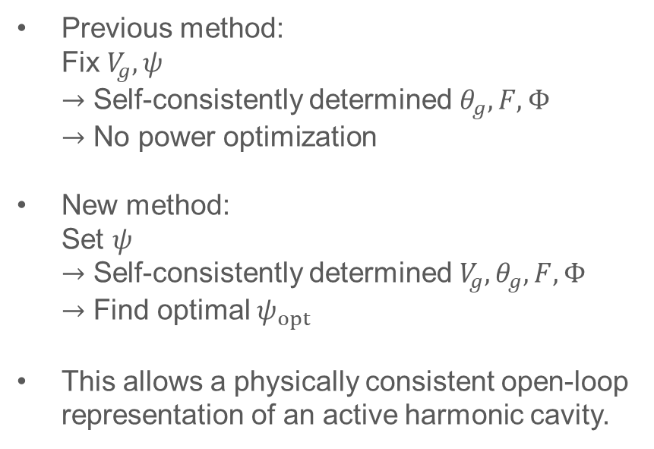




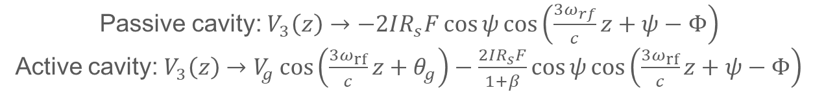


New equilibrium method
Passive cavity: $V_{3}\left(z\right)→−2IR_{s}F\cos{ψ}\cos\left(\frac{{3ω}_{rf}}{c}z+ψ−Φ\right)$
Active cavity: $V_{3}\left(z\right)→V_{g}\cos\left(\frac{3ω_{rf}}{c}z+θ_{g}\right)−\frac{2IR_{s}F}{1+β}\cos{ψ}\cos\left(\frac{{3ω}_{rf}}{c}z+ψ−Φ\right)$
$V_{g}:$ Generator voltage, $θ_{g}:$ Generator phase, $Fe^{iΦ}=\tilde{ρ}\left(ω_{3}\right), ψ:$ Tuning angle, $β:$ Cavity coupling
$$ξ=0.9,$$
$$Q=16000,$$
$$\frac{R_{s}}{Q}=86 Ω,$$
$$I=200 mA$$
[1]
Determine $V_{cav}, φ_{cav}$ with $ξ$
Previous method: Fix $V_{g}, ψ$ $→$ Self-consistently determined $θ_{g},F,Φ$ $→$ No power optimization
New method: Set $ψ$ $→$ Self-consistently determined $V_{g},θ_{g},F,Φ$ $→$ Find optimal $ψ_{opt}$
This allows a physically consistent open-loop representation of an active harmonic cavity.
Define $ψ$ range
Initialize $F=1,Φ=0$
Self-consistent iteration of $V_{g},θ_{g},F,Φ$
No
$$abs\left(F_{n}−F_{n−1}\right)<{10}^{−8}$$
$$and abs\left(Φ_{n}−Φ_{n−1}\right)<{10}^{−8} ?$$
Yes
Compute power $P$
Find $ψ$ that gives minimum $P\left(ψ\right)$
[1] A.Gamelin, “Equilibrium Bunch Density Distribution with Multiple Active and Passive RF Cavities”, IPAC21
10

Slide 11
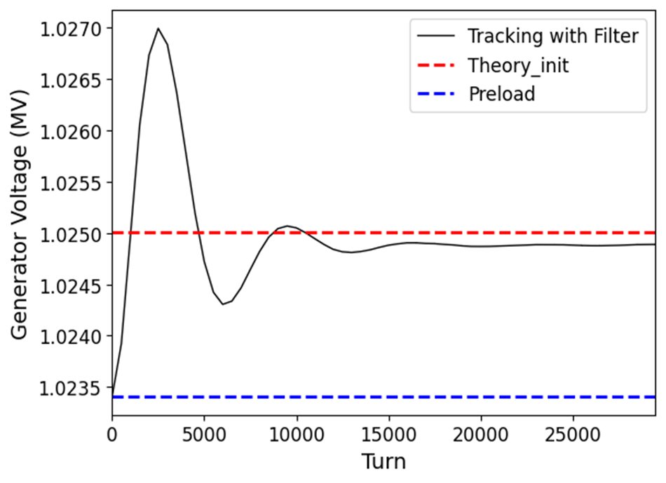
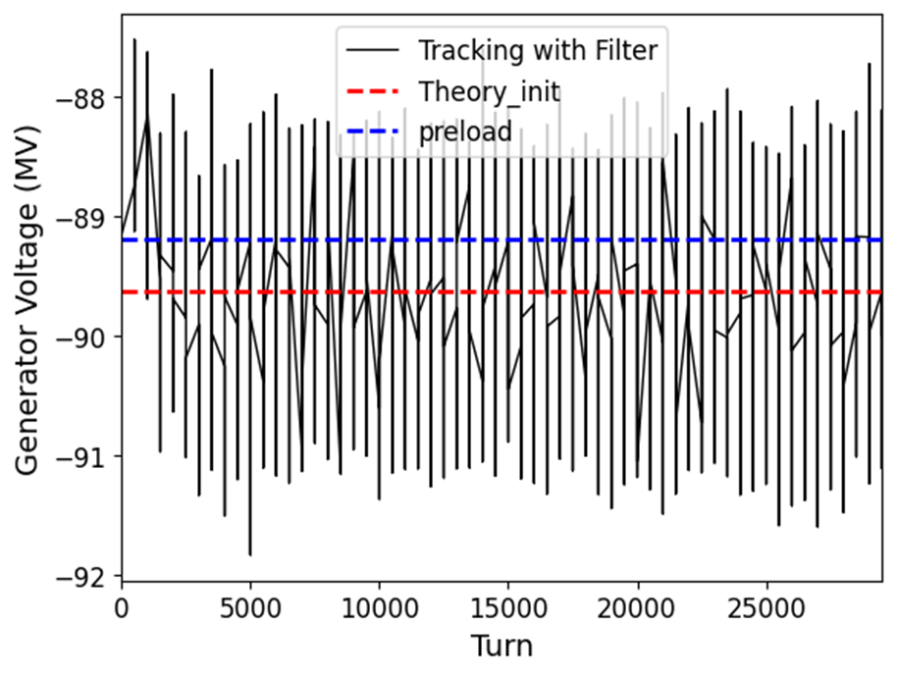
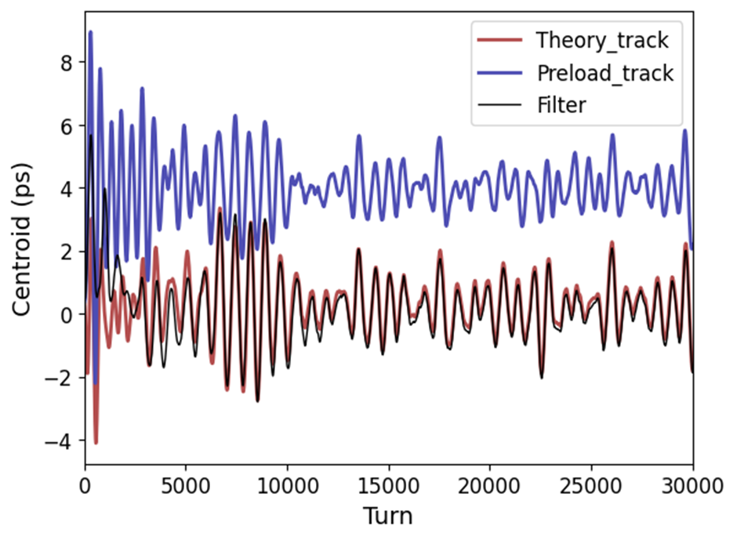
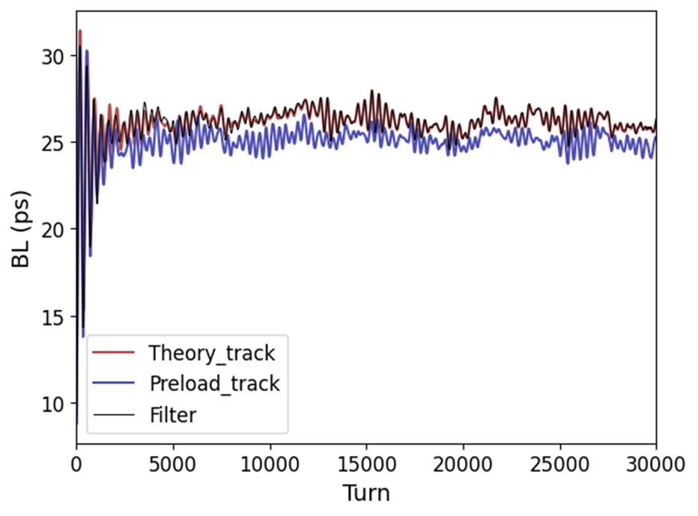
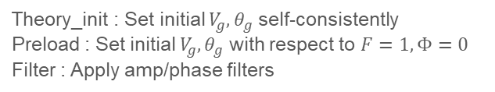
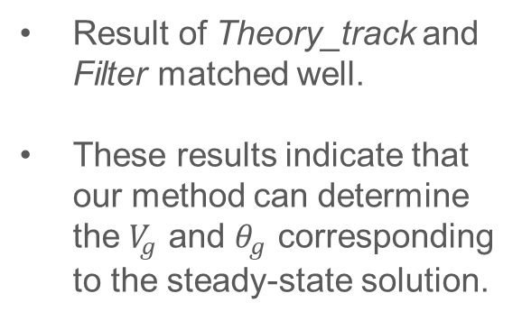
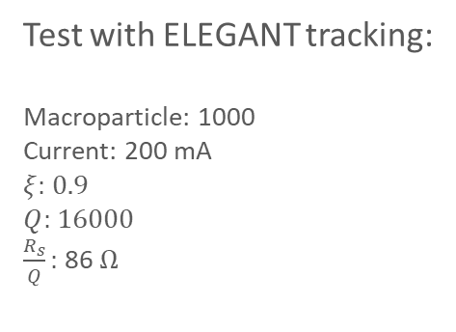
Equilibrium Result
Test with ELEGANT tracking:
Macroparticle: 1000
Current: 200 mA
$ξ:$ 0.9
$Q$: 16000
$\frac{R_{s}}{Q}:$ 86 $Ω$
Theory_init : Set initial $V_{g},θ_{g}$ self-consistently
Preload : Set initial $V_{g},θ_{g}$ with respect to $F=1,Φ=0$
Filter : Apply amp/phase filters
Result of Theory_track and Filter matched well.
These results indicate that our method can determine the $V_{g}$ and $θ_{g}$ corresponding to the steady-state solution.
11

Slide 12
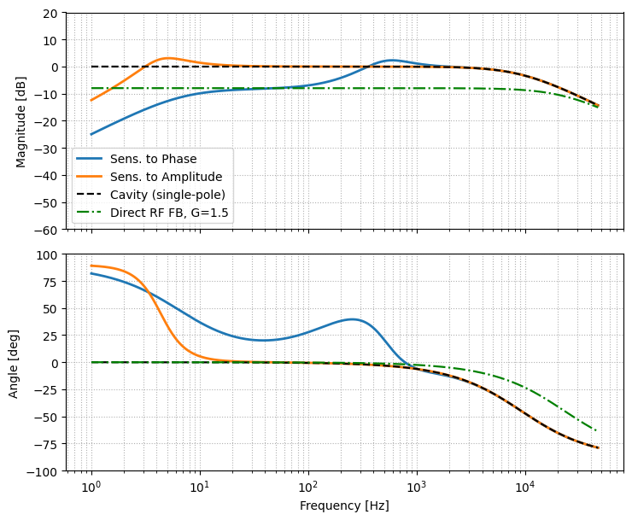
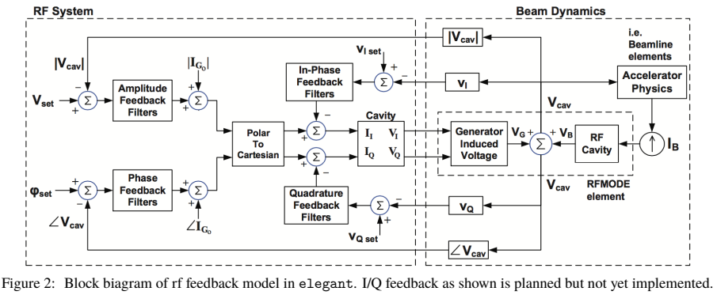

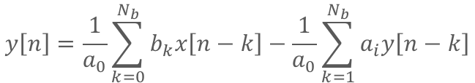
Short term plan (~ Feb.)
Submit paper (~ Jan.)
Explorer mode-coupling method to active cavity case
Main cavity LLRF & IIR Filter coefficient
Sensitivity $S\left(ω\right)=\frac{1}{1+L\left(ω\right)}, L\left(ω\right)=H\left(ω\right)Z\left(ω\right)$
Implemented
Not yet Implemented
LLRF in ELEGANT acts as an IIR filter in z-domain
In z-domain:
$$y\left[n\right]=\frac{1}{a_{0}}\sum_{k=0}^{N_{b}}{b_{k}x\left[n−k\right]}−\frac{1}{a_{0}}\sum_{k=1}^{N_{b}}{a_{i}y\left[n−k\right]}$$
$$H\left(z\right)=\frac{\sum_{i=0}^{m}{b_{i}z^{−i}}}{\sum_{i=0}^{r}{a_{i}z^{−i}}}$$
x[n]: Filter input(error signal), y[n]: Filter output(generator current)
$z=e^{iωT_{s}}:$ discrete-time complex variable, $T_{s}$: Feedback sampling period
12

Slide 13
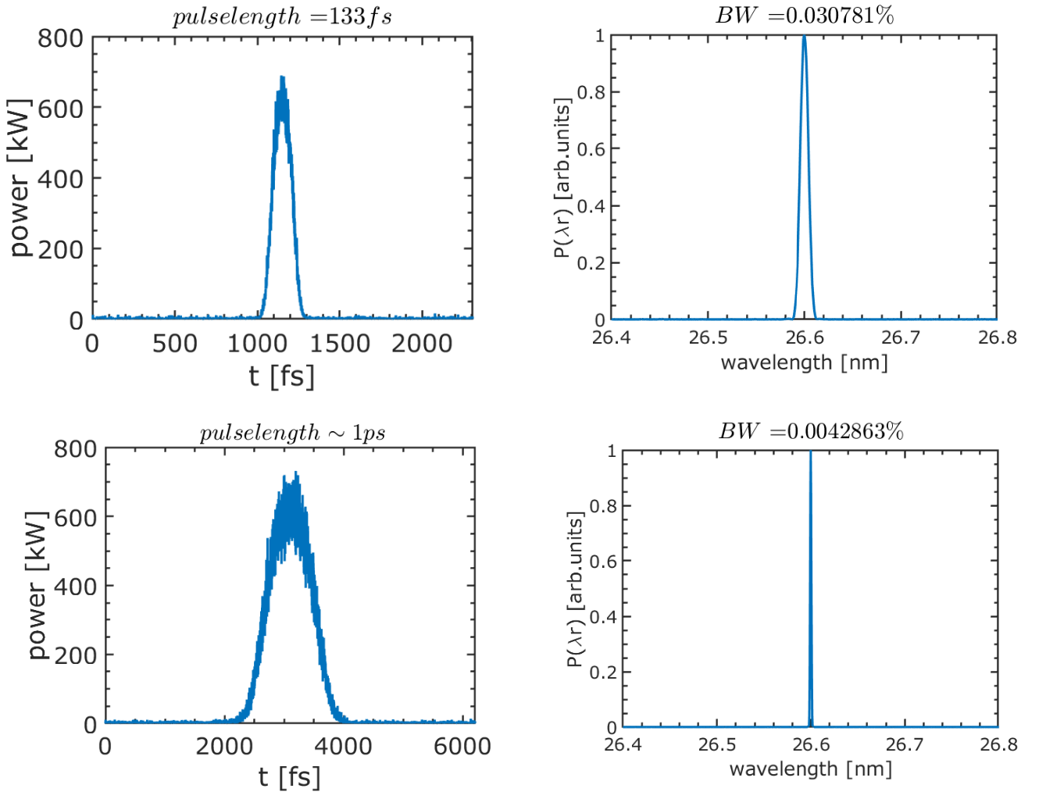
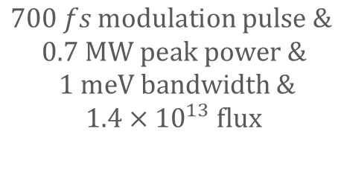
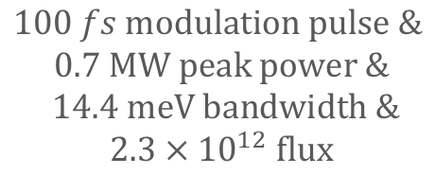
Short term plan (~ Feb.)
GENESIS Simulation (~ Feb.)
Radiation power estimation from the expected microbunch structure, using GENESIS simulations.
[1]
$$100 fs modulation pulse \&$$
$$0.7 MW peak power \&$$
$$14.4 meV bandwidth \&$$
$$2.3×{10}^{12} flux$$
$$700 fs modulation pulse \&$$
$$0.7 MW peak power \&$$
$$1 meV bandwidth \&$$
$$1.4×{10}^{13} flux$$
[1] Weihang Liu et al., A method for reversing the laser modulation in a Storage ring, arXiv:2405.10573v1, (2024)
13

Slide 14
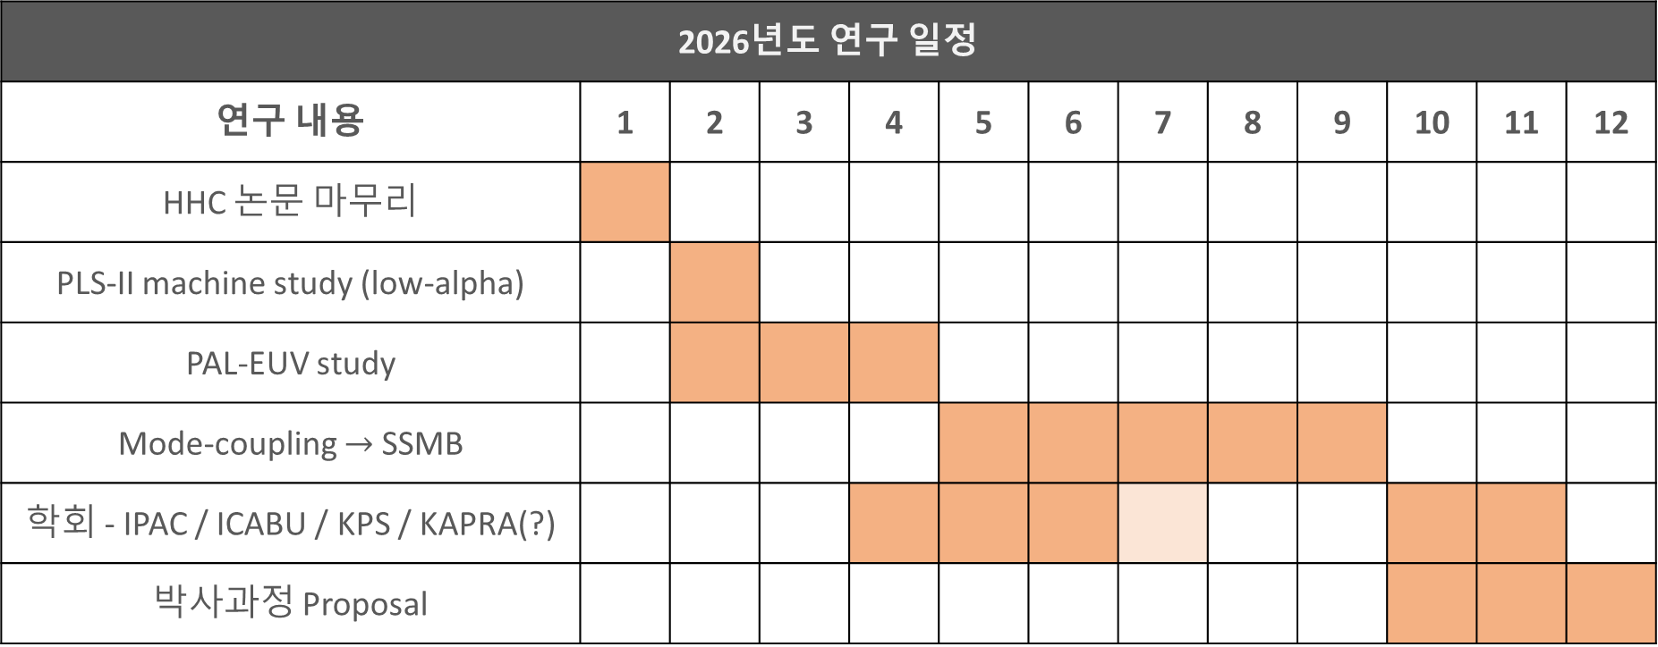
Long term plan (~2026)
2026년도 연구 일정
연구 내용 | 1 | 2 | 3 | 4 | 5 | 6 | 7 | 8 | 9 | 10 | 11 | 12
HHC 논문 마무리
PLS-II machine study (low-alpha)
PAL-EUV study
Mode-coupling $→$ SSMB
학회 - IPAC / ICABU / KPS / KAPRA(?)
박사과정 Proposal
14

Slide 15
Thank you for your attention!
15

Slide 16

Appendix. Linearized Vlasov equation
Linearized Vlasov describes wakefield driven coherent beam dynamics by treating the wake force as a perturbation around the equilibrium distribution, leading to azimuthal eigenmodes with coherent frequencies.
$$\frac{dΨ}{ds}=\frac{∂Ψ}{∂s}+\left\{Ψ,ℋ\right\}=0$$
$$Ψ\left(z,δ,s\right)=Ψ_{0}\left(z,δ\right)+Ψ_{1}\left(z,δ,s\right)→Ψ_{0}\left(z,δ\right)+Ψ_{1}\left(z,δ\right)e^{−iΩs/c}$$
$$ℋ\left(z,δ,s\right)=ℋ\left(z,δ\right)+ℋ_{1}\left(z,δ,s\right)→ℋ_{0}\left(z,δ\right)+ℋ_{1}\left(z,δ\right)e^{−iΩs/c}$$
Present: Gaussian bunch, polar coordinate [$\left(z,δ\right)→\left(φ,r\right)$] (Suzuki, 1983, mode-copling theory)
$$Ψ_{0}\left(z,δ\right)→Ψ_{0}\left(r\right), ℋ_{0}\left(z,δ\right)→ℋ_{0}\left(r\right)$$
$$\frac{∂Ψ}{∂s}+\left\{Ψ,ℋ\right\}=−iΩΨ_{1}\left(r\right)+c\frac{∂Ψ_{1}\left(r,φ\right)}{∂φ}\frac{∂ℋ_{0}\left(r\right)}{∂r}−c\frac{∂Ψ_{0}\left(r\right)}{∂r}\frac{∂ℋ_{1}\left(r,φ\right)}{∂φ} \\ =−iΩΨ_{1}\left(r\right)+ω_{s}\frac{∂Ψ_{1}\left(r,φ\right)}{∂φ}−c\frac{∂Ψ_{0}\left(r\right)}{∂r}\frac{∂ℋ_{1}\left(r,φ\right)}{∂φ}$$
Current: Non-gaussian bunch, action-angle coordinates [$\left(z,δ\right)→\left(ψ,J\right)$] (Venturini, 2018, passive HHC setting)
$$Ψ_{0}\left(z,δ\right)→Ψ_{0}\left(J\right), ℋ_{0}\left(z,δ\right)→ℋ_{0}\left(J\right)$$
$$\frac{∂Ψ}{∂s}+\left\{Ψ,ℋ\right\}=−iΩΨ_{1}\left(J\right)+c\frac{∂Ψ_{1}\left(ψ, J\right)}{∂ψ}\frac{∂ℋ_{0}\left(J\right)}{∂J}−c\frac{∂Ψ_{0}\left(J\right)}{∂J}\frac{∂ℋ_{1}\left(ψ,J\right)}{∂ψ} \\ =−iΩΨ_{1}\left(J\right)+ω_{s}\left(J\right)\frac{∂Ψ_{1}\left(ψ,J\right)}{∂ψ}−c\frac{∂Ψ_{0}\left(J\right)}{∂J}\frac{∂ℋ_{1}\left(ψ,J\right)}{∂ψ}$$
16

Slide 17

Appendix. Linearized Vlasov equation
Fourier expand $Ψ_{1}\left(ψ,J\right)$ according to:
$$Ψ_{1}\left(ψ,J\right)=\sum_{m≠0}{R_{m}\left(J\right)e^{imψ}}, \left(Ψ_{1} must be periodic in φ\right)$$
Perturbation term $ℋ_{1}\left(z\left(ψ,J\right);λ_{1}\right)$ can be expressed:
$$ℋ_{1}\left(z\left(ψ,J\right);λ_{1}\right)=\frac{eI_{0}}{E_{0}C_{0}}\sum_{p=−∞}^{∞}{{\tilde{λ}}_{1}\left(ω_{p,l}+Ω\right)Z_{p,l}\left(Ω\right)e^{−\frac{iω_{p,l}z\left(ψ,J\right)}{c}}}⋅\frac{c}{−iω_{p,l}}$$
$$ω_{p,l}=pω_{rf}+lω_{0}$$
$$\frac{∂ℋ_{1}}{∂ψ}=\frac{eI_{0}}{E_{0}C_{0}}\sum_{p=−∞}^{∞}{{\tilde{λ}}_{1}\left(ω_{p,l}+Ω\right)\frac{Z_{p,l}\left(Ω\right)}{−iω_{p,l}/c}\frac{∂}{∂ψ}e^{−\frac{iω_{p,l}z\left(ψ,J\right)}{c}}}$$
The final mode-coupling equation shown as below: (Multiply $e^{−inψ}$ and integrating over $ψ$)
$$\left(Ω−mω_{s}\left(J\right)\right)R_{m}\left(J\right)+imκ\frac{∂Ψ_{0}\left(J\right)}{∂J}\sum_{p=−∞}^{∞}{\frac{Z_{p,l}\left(Ω\right)}{ω_{p,l}}}H_{m,p}\left(J\right)×\sum_{m^{′}≠0}{\int_{0}^{∞}{dJR_{m^{′}}\left(J\right)H_{m^{′},p}\left(J\right)}}=0$$
17

Slide 18


Appendix. MAX-IV Mode-coupling result
18

Slide 19



Appendix. Equilibrium method
A.Gamelin, “Equilibrium Bunch Density Distribution with Multiple Active and Passive RF Cavities”, IPAC21
$V_{g}:$ Generator voltage, $θ_{g}:$ Generator phase, $Fe^{iΦ}=\tilde{ρ}\left(ω_{3}\right)$
Variable: $V_{g}, ψ$
Self-consistently determined variable: $θ_{g},F,Φ$
Conditions:
Active cavity: $V_{3}\left(z\right)→V_{g}\cos\left(\frac{3ω_{rf}}{c}z+θ_{g}\right)−\frac{2I_{avg}R_{s}F}{1+β}\cos{ψ}\cos\left(\frac{{3ω}_{rf}}{c}z+ψ−Φ\right)$
$$\frac{U_{0}}{e}=V_{1}\sin{θ_{1}}+V_{g}\cos{θ_{g}}−\frac{2I_{avg}R_{s}F}{1+β}\cos{ψ}\cos\left(ψ−Φ\right)$$
$$u_{a}\left(z;F,Φ\right)=u_{0}z+u_{1}\left[\cos\left(k_{1}z+φ_{1}\right)−\cos{φ_{1}}\right]+\frac{u_{3}F\cos{ψ}}{1+β}\left[\sin\left(k_{3}z+ψ−Φ\right)−\sin\left(ψ−Φ\right)\right]−\frac{u_{3}V_{g}}{2I_{avg}R_{s}}\left[\sin\left(k_{3}z+θ_{g}\right)−\sin{θ_{g}}\right]$$
$$ρ\left(z;F,Φ\right)=\frac{e^{−u\left(z;F,Φ\right)}}{\int_{−∞}^{∞}{e^{−u\left(z^{′};F,Φ\right)}dz^{′}}}$$
$$u_{0}:\frac{U_{0}}{\left(ασ_{δ}^{2}E_{0}C\right)}$$
$$u_{1}:\frac{eV_{1}c}{\left(ασ_{δ}^{2}E_{0}Cω_{rf}\right)}$$
$$u_{3}:\frac{2eI_{avg}R_{s}c}{\left(3ασ_{δ}^{2}E_{0}C_{0}ω_{rf}\right)}$$
19

Slide 20

Appendix. Equilibrium method
Paper’s approach: Fix $V_{g}$ and $ψ$
$$\tan{ψ}→\frac{2IR_{s}\sin{φ_{cav}}}{V_{cav}}, V_{g}→\left(2IR_{s}\sin{φ_{cav}}+V_{cav}\right)\cos{ψ}$$
This neglect the effects of $F,Φ$
New method incorporates this self-consistently.
Change the condition:
$$V_{cav}\sin{φ_{cav}}=V_{g}\cos{θ_{g}}−\frac{2I_{avg}R_{s}F}{1+β}\cos{ψ}\cos\left(ψ−Φ\right)$$
$$V_{cav}\cos{φ_{cav}}=\frac{2I_{avg}R_{s}F}{1+β}\cos{ψ}\sin\left(ψ−Φ\right)−V_{g}\sin{θ_{g}}$$
The generator voltage $V_{g}$ can be obtained self-consistently.
Then, for each $ψ,$ the power is evaluated, and the $ψ$ that gives the minimum power is identified as the optimal detuning.
20

Slide 21


Appendix. APS storage ring with Same IIR filter
21

Slide 22

Appendix. 4GSR LLRF Study
LLRF theory
Sensitivity to Beam Disturbance
Phase Feedback Filter(Different Sampling Period)
Sensitivity $S\left(ω\right)=\frac{1}{1+L\left(ω\right)}, L\left(ω\right)=H\left(ω\right)Z\left(ω\right)$
22

