Slide 1
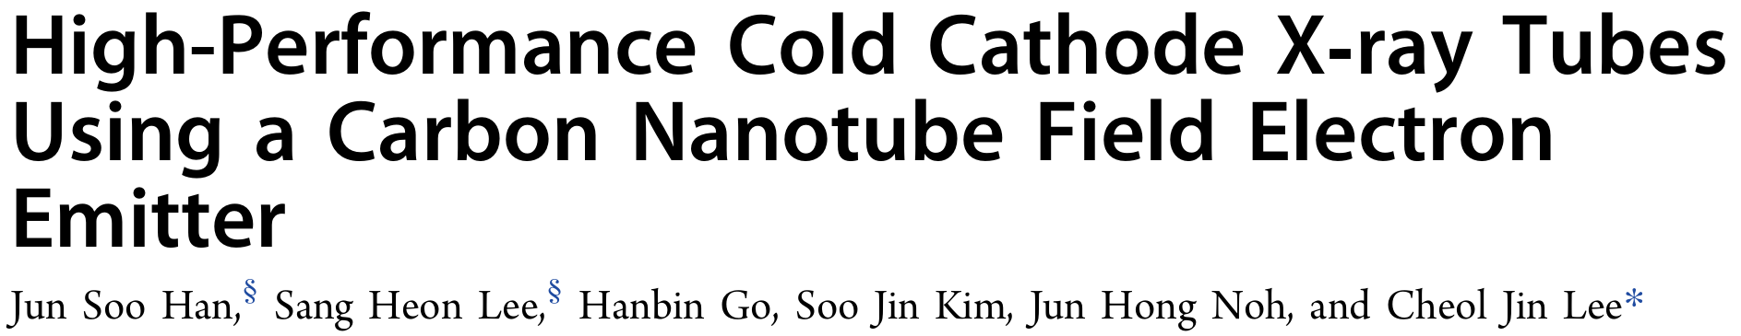
38th JKPS
2025. 12. 05.
나창선

Slide 2
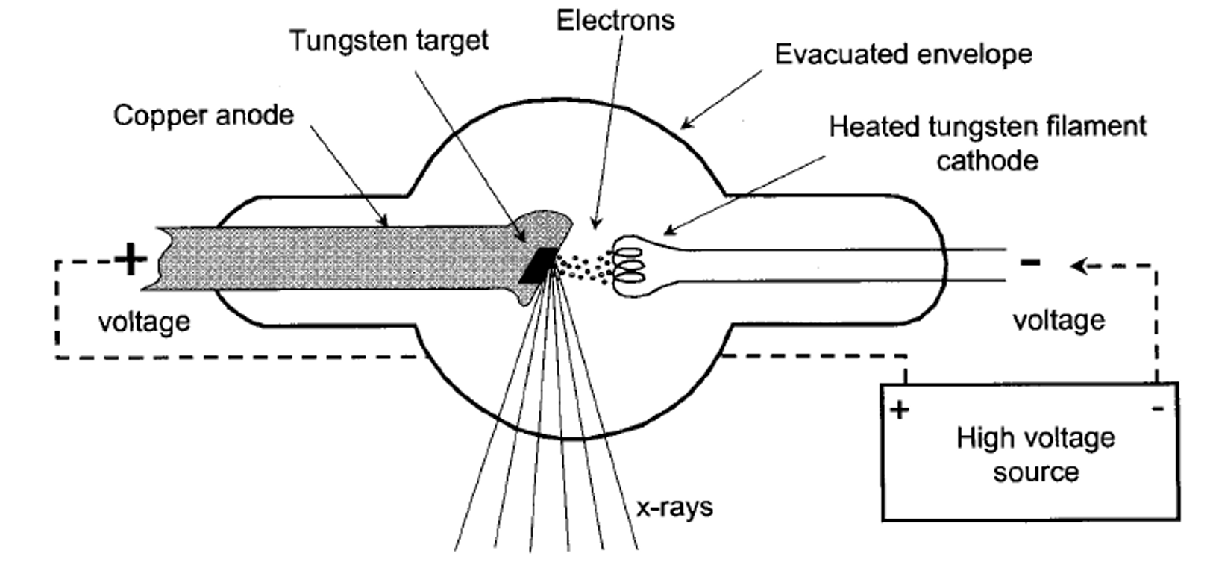
Introduction: X-ray tube
When a negative voltage is applied to the cathode, electrons are emitted and accelerated toward the anode.
When the electron beam strikes the target, X-rays are generated through bremsstrahlung and characteristic radiation.
Sharma SD. X-ray Tube and Generator (Module 6), PG Pathshala – Biophysics.

Slide 3
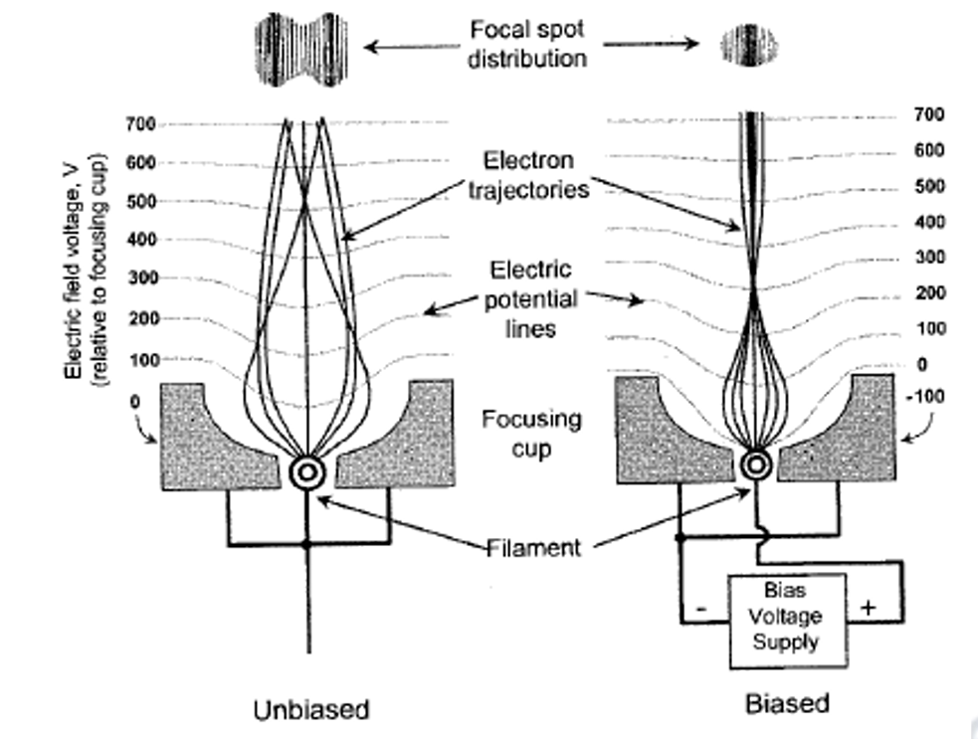
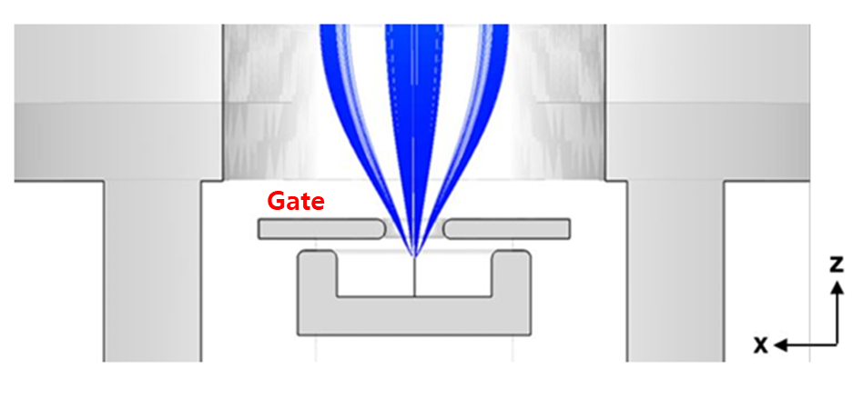
Introduction: Gate, Focusing cup
Gate
+
-
The gate extracts electrons from the CNT emitter and controls the tube current, which is strongly governed by the gate voltage.
The focusing cup shapes the emitted electron beam and improves focusing by guiding electrons toward the anode target.
(biased more negative than the emitter)

Slide 4
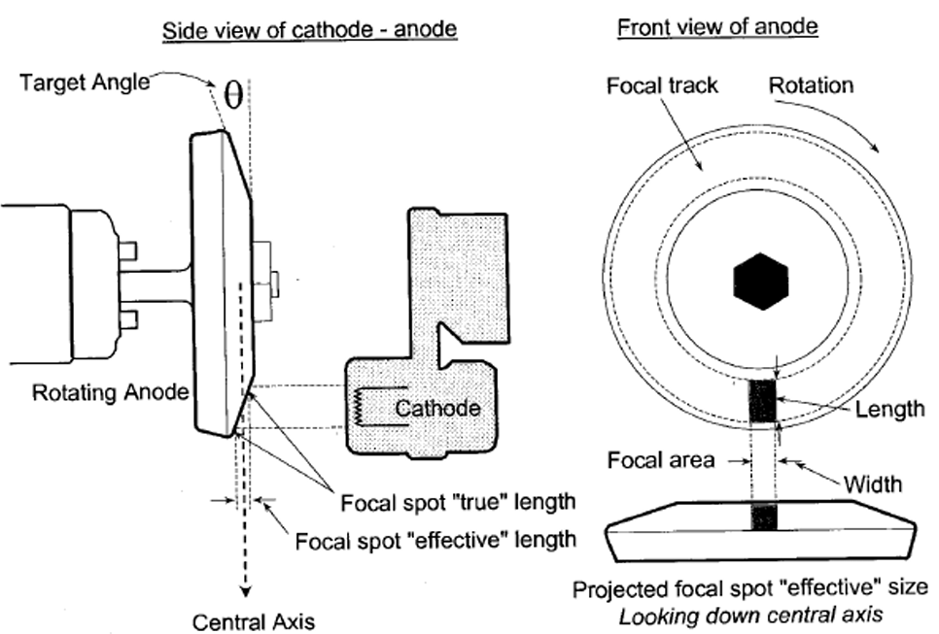
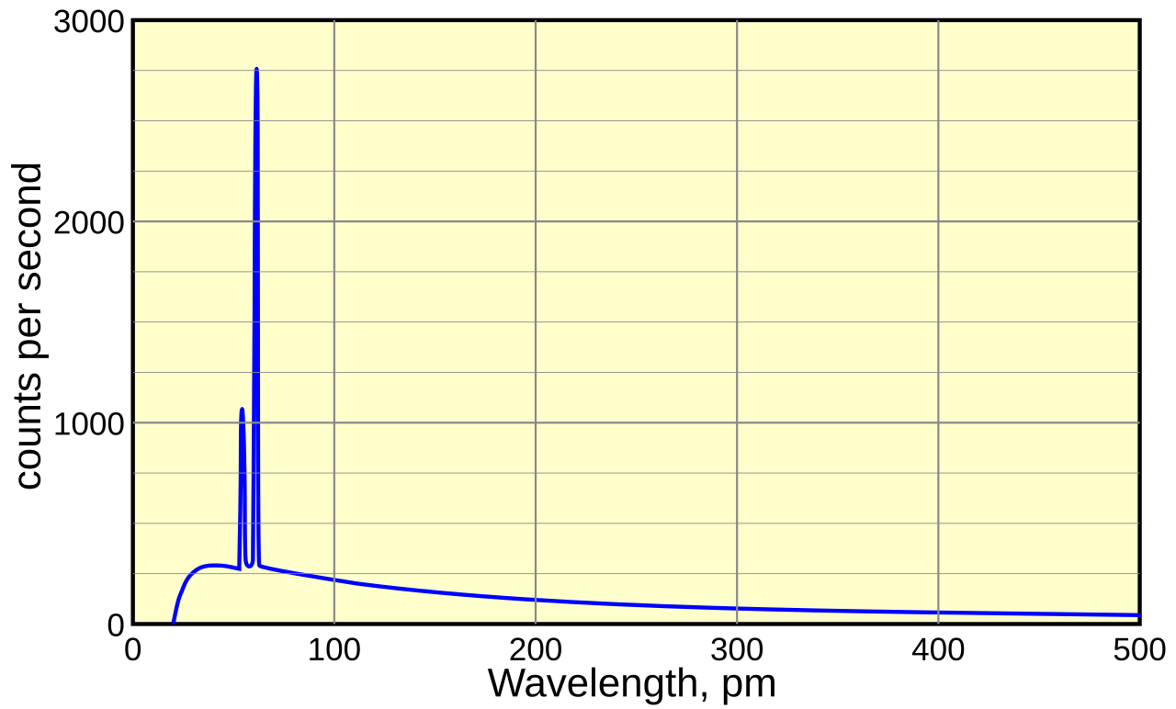
Introduction: Anode, X-ray generation
When the electron beam strikes the target, X-rays are generated.
Only about 1% of the electron energy becomes X-rays; The rest is change into heat at the anode.
→ Rotating anode improves heat dissipation
The X-ray spectrum consists of bremsstrahlung and characteristic X-rays.
To enhance bremsstrahlung efficiency, high-Z targets such as W (74), Mo (42), and Cu (29) are used.

Slide 5
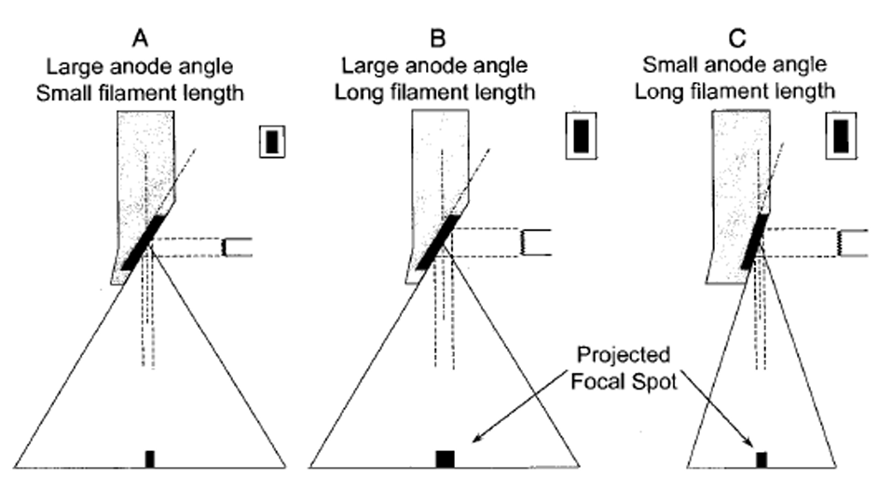
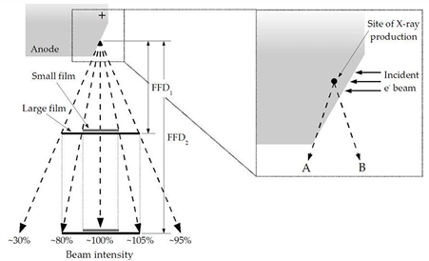
Introduction: Focal spot, Heel effect
The focal spot is determined by electron-beam focusing and the anode target angle.
X-rays travel different distances inside the angled anode, leading to absorption differences and a variation in beam intensity (heel effect).
In medical system, filters are used to equalize patient dose

Slide 6
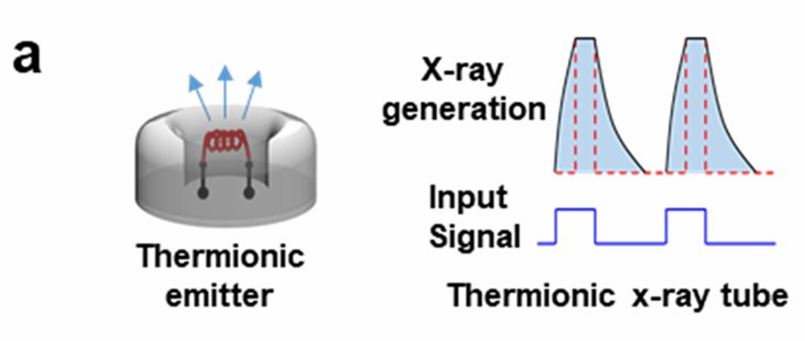
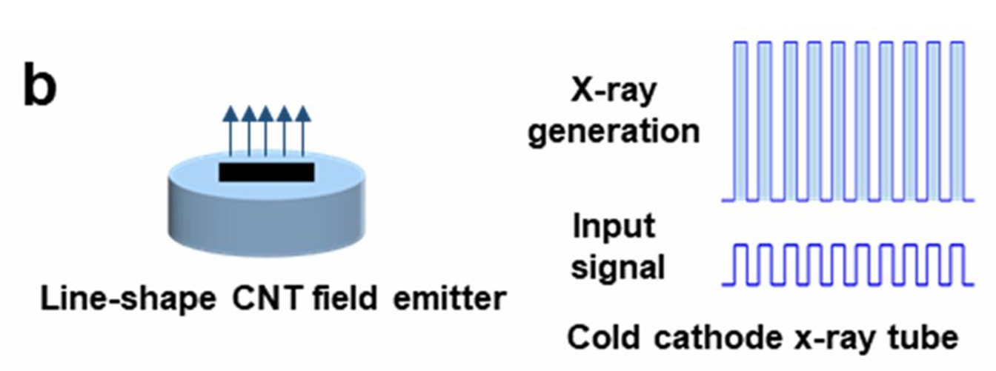
Motivation : emitter
Item | Thermionic | CNT Cold Cathode
Emission | Thermal | Field emission
Speed | Slow | Ultra-fast
Power | High | Low
Lifetime | Short | Long potential
Focusing | Hard (large emitter) | Easy (electrostatic)
Miniaturization | Poor | Excellent
Limitations of Previous CNT Emitters
Tube current ↔ focal spot size
Lower performance than thermionic cathodes.
Screening effect due to dense CNT tips.
→ This work proposes a new CNT film-based emitter structure to overcome these issues.

Slide 7
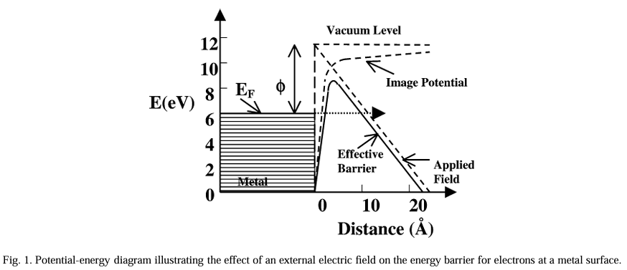
Field emission
The applied field reduces the effective work function, enabling quantum tunneling of electrons through the barrier without heating.

Slide 8
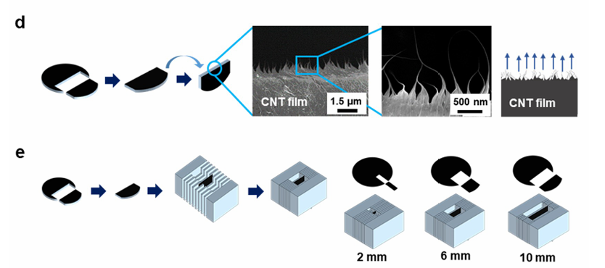
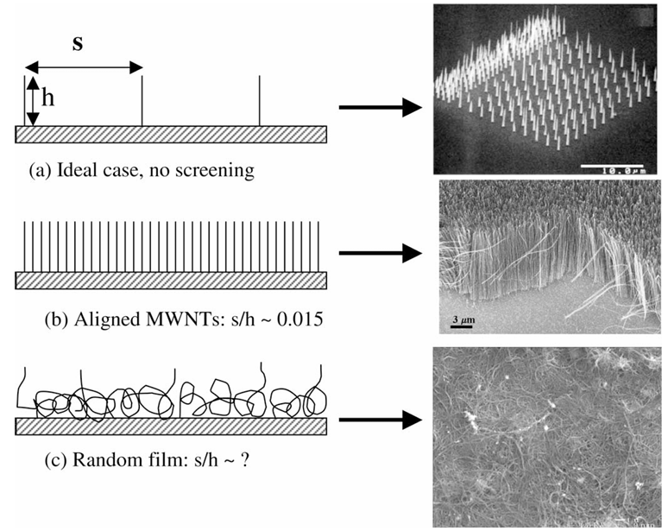
CNT Film
CNT films are cut to form sharp emitting edges.
Electrical annealing removes weak or damaged CNTs.
The CNT is mounted between cathode plates.
Example of previous CNT fabrication methods.
When the CNT tips are placed too close to each other, a screening effect occurs due to mutual electric-field interference.
2003_Y. Cheng, O. Zhou C. R. Physique 4 (2003) 1021–1033

Slide 9
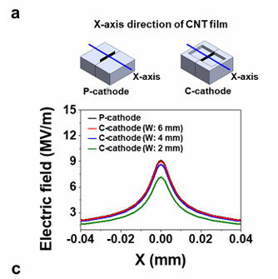
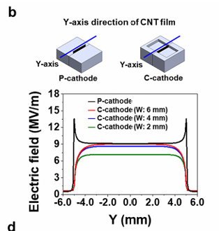
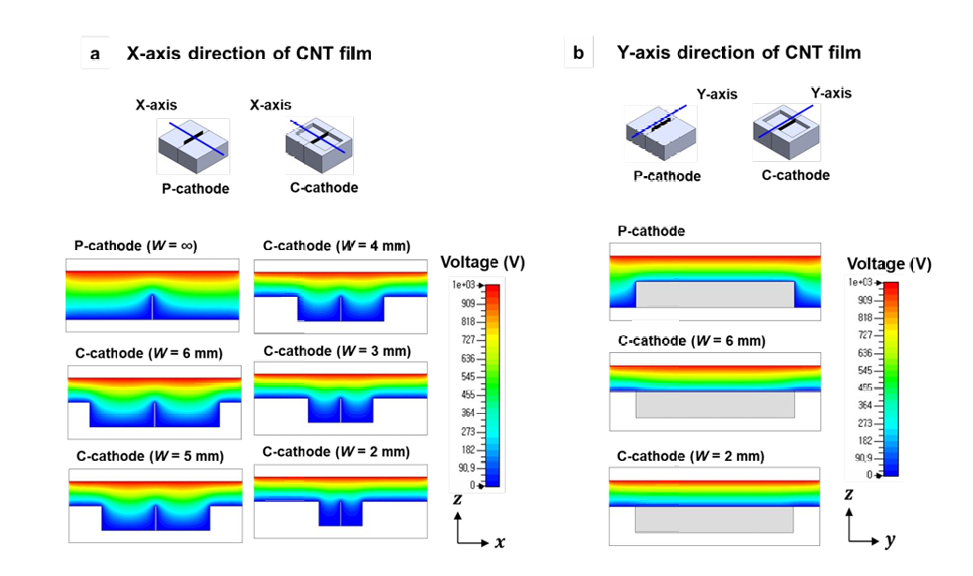
Cathode Geometry & CST Simulation
Arc discharge was observed in P-cathode
CST simulation showed that longer CNT films produced stronger electric fields in both the x- and y-directions.
CST simulation showed that longer CNT films are more focused.

Slide 10
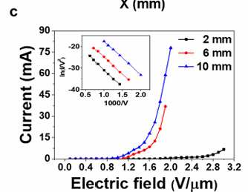
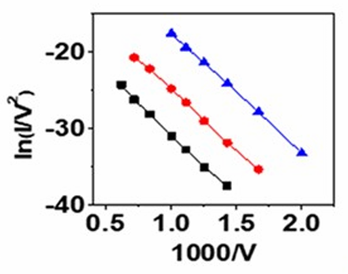
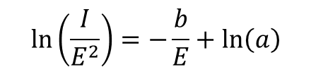
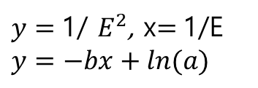
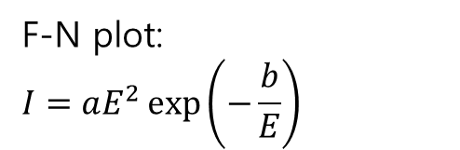
Effect of CNT Film Length
The current was measured using a diode structure consisting only of a cathode and an anode.
As the CNT film length increased, electron emission occurred at lower electric fields
(because the electrical load on each CNT tip becomes smaller)
The Fowler–Nordheim (F–N) plot was calculated.
If the plot shows a linear relationship, it indicates that the emission follows the field-emission mechanism
F-N plot:
$$I=aE^{2}\exp\left(−\frac{b}{E}\right)$$
$$\ln\left(\frac{I}{E^{2}}\right)=−\frac{b}{E}+\ln\left(a\right)$$
$y=$1/ $E^{2}$, x$=$1/E
$$y=−bx+ln(a)$$

Slide 11
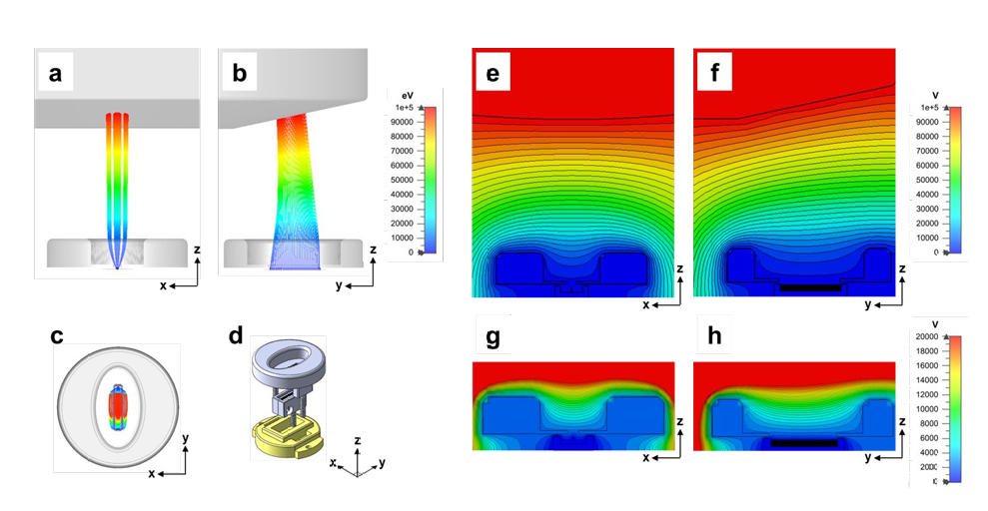
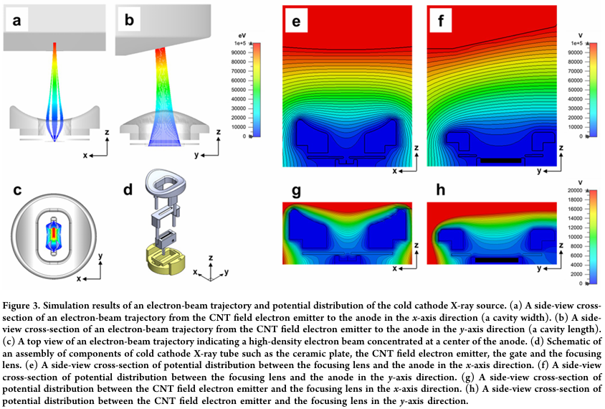
Focusing Structure Optimization
CST simulation
Curved-type focusing cup is more focused than flat-type focusing cup
(Curved-type is conventional type)

Slide 12
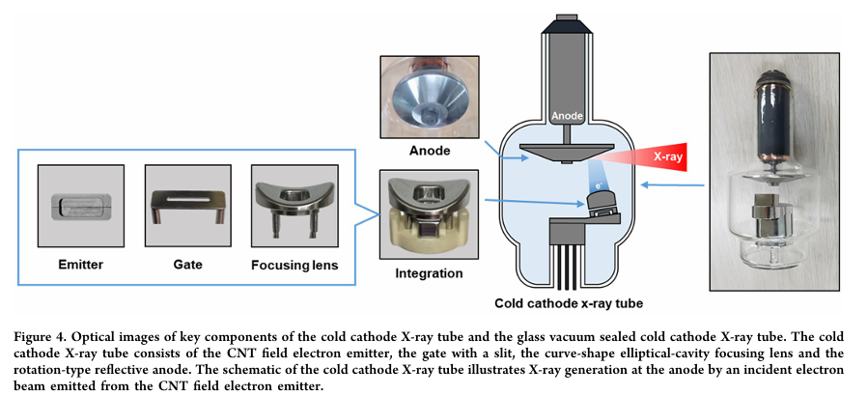
Fabricated CNT X-ray Tube

Slide 13
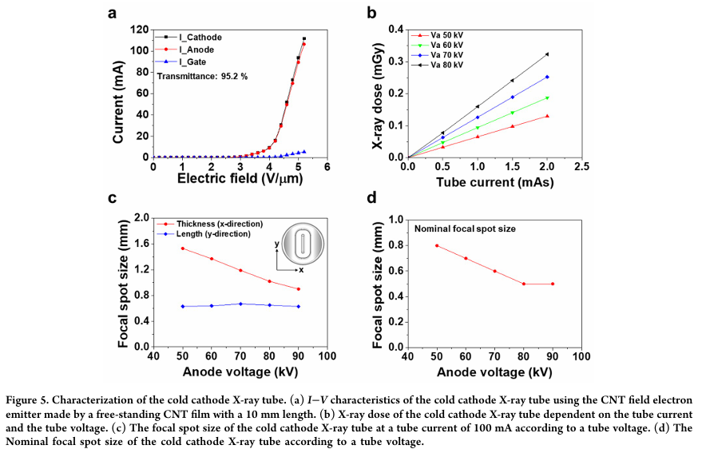
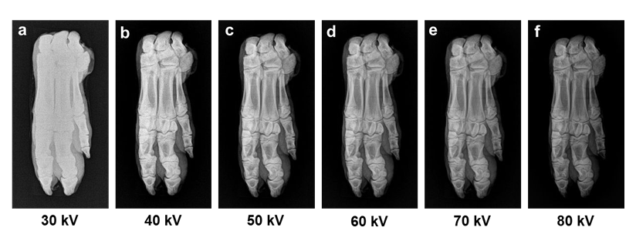
Experimental Results
Evaluated parameters:
• Tube current
• Current density
• X-ray dose
• Focal spot size

Slide 14
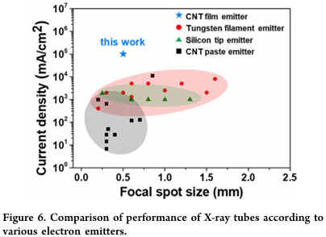
Comparison with Other Emitters
This emitter shows significantly higher current density at a smaller focal spot

Slide 15
Conclusion
CNT X-ray tube
CNT emitters generate electrons through quantum tunneling.
Fast response, simple structure, and long lifetime.
Simulation and result
Focusing behavior and electric-field distribution were analyzed using CST simulations.
The fabricated X-ray tube was evaluated in terms of tube current, current density, focal spot size, and X-ray dose.
The newly developed CNT film structure significantly improved the performance compared with previous CNT-based X-ray tubes.

Slide 16
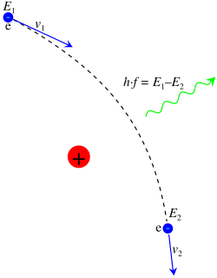
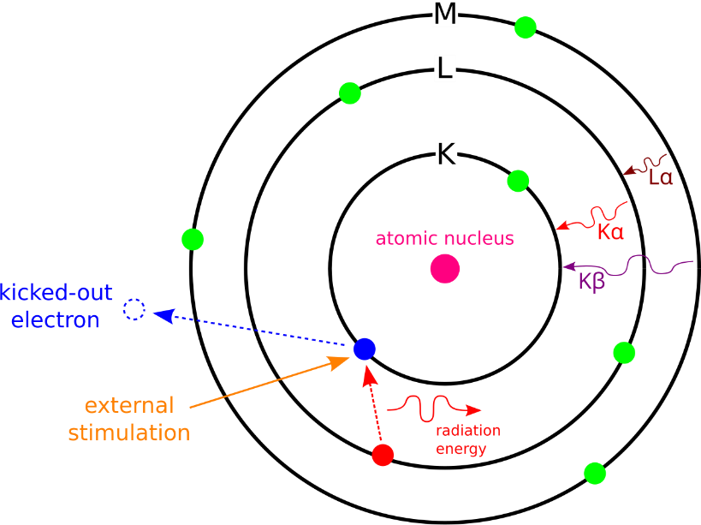
appendix
bremsstrahlung
characteristic X-ray

Slide 17
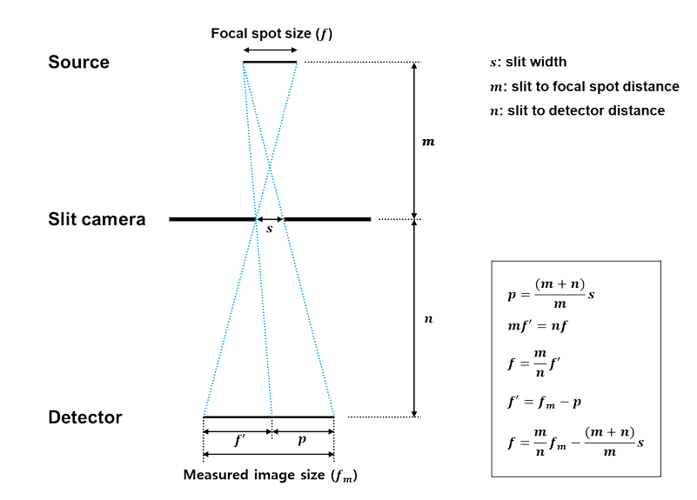
appendix

Slide 18



appendix
J: emission current density
E: local electric field
ϕ: work function
A,B: F–N 상수
Screening effect
S: Tip간 거리
H: Tip의 높이
r: tip의 반지름
무작정 거리를 벌리면 밀도가 줄어듬.
β: field enhancement factor
β 를 결정하는 요인
CNT 높이: 높을수록 β 증가
CNT 너비: 얇을수록 β 증가
CNT 팁간 간격: 너무 가까우면 screening effect 발생하여 β 감소
CNT 배열 방식: 배열 방식에 따라 달라짐

Slide 19
appendix
제작한 X-ray tube의 파라미터
구성 요소 | 파라미터 | 값
CNT Field Emitter | 두께 | 7 μm
 | 길이 | 10 mm
Cathode cavity | 폭 | 4 mm
 | 길이 | 10 mm
Gate | 전체 폭 | 8 mm
 | 전체 길이 | 21 mm
 | Slit 폭 | 1.5 mm
 | Slit 길이 | 12 mm
Focusing Lens (curve-shape elliptical) | cavity 폭 | 10 mm
 | cavity 길이 | 18 mm
 | cavity 높이 | 5 mm
 | 전체 렌즈 직경 | 27 mm
Anode (Rotation-type W–Ru) | 직경 | 3 inch
 | 경사각 | 12°
Component Gaps | CNT–Gate gap | 0.5 mm
 | Gate–Lens gap | 1.0 mm
 | Lens–Anode gap | 20 mm
Simulation Conditions | Gate voltage | 2500–2600 V
 | Anode voltage | 80 kV
 | Focusing lens voltage | 0 V

