Slide 1
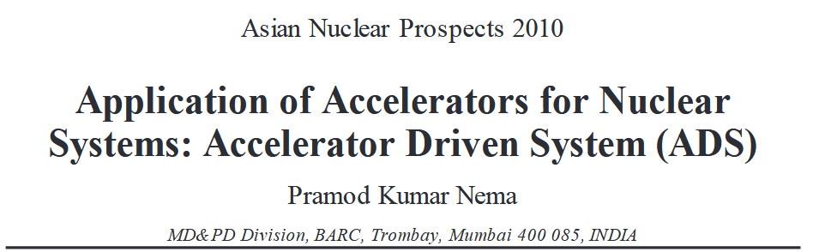
37th JKPS
Jiyoung Choi
DANE, POSTECH
28.Nov.2025

Slide 2
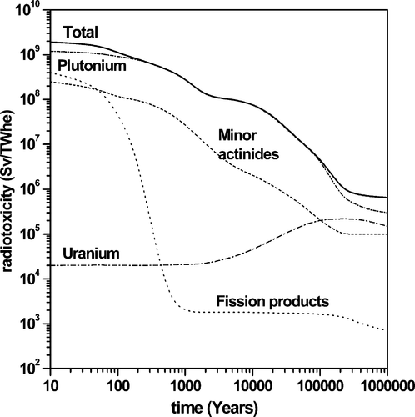
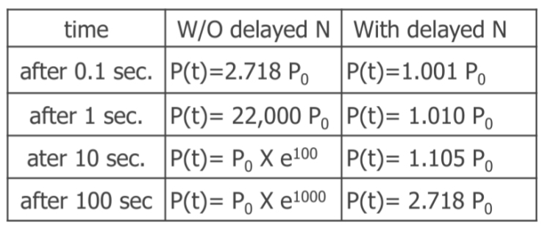
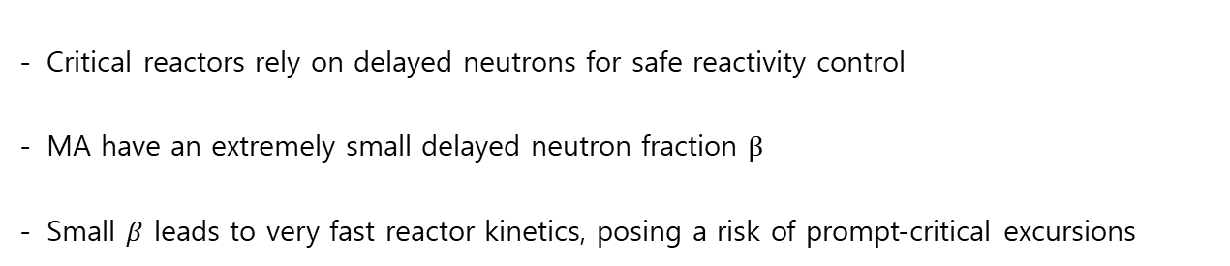
Introduction
Problem of the Current Nuclear Power Systems
Long-term radiotoxicity of spent nuclear fuel
Plutonium and Minor Actinides (MA: Np, Am, Cm, etc.) dominate long-term radiotoxicity
Their radiotoxicity persists for 10,000 – 100,000+ years
Plutonium and MA transmutation are essential for sustainable waste management
MA cannot be transmuted in critical reactors $(k=1)$
Critical reactors rely on delayed neutrons for safe reactivity control
MA have an extremely small delayed neutron fraction $β$
Small $β$ leads to very fast reactor kinetics, posing a risk of prompt-critical excursions
$⇒$ “Accelerator Driven System (ADS)” is the solution to MA transmutation

Slide 3
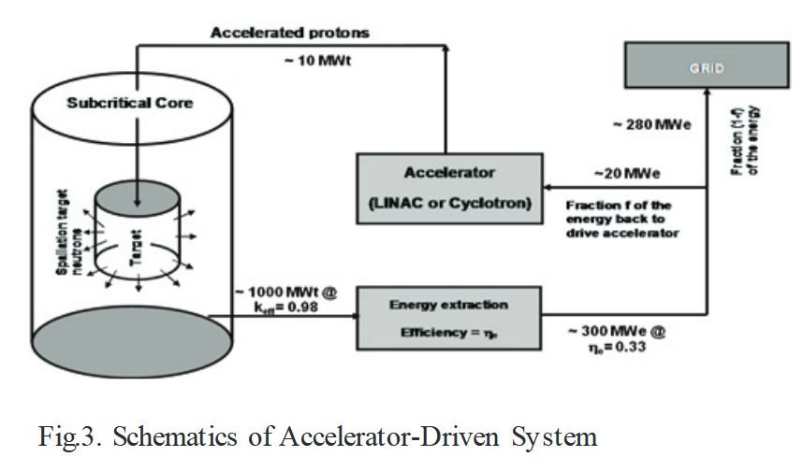
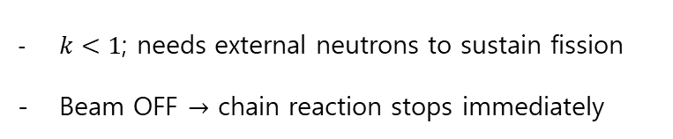
Accelerator Driven System (ADS)
Accelerator
High-power Continuous-Wave (CW) beam
Controls the power and shutdown behavior of the reactor
Spallation Target
Liquid material required due to extremely intense proton beam
High-Z (Pb, LBE) material producing ~20-30 neutrons/proton
Sub-critical Reactor
$k<1$; needs external neutrons to sustain fission
Beam OFF $→$ chain reaction stops immediately

Slide 4
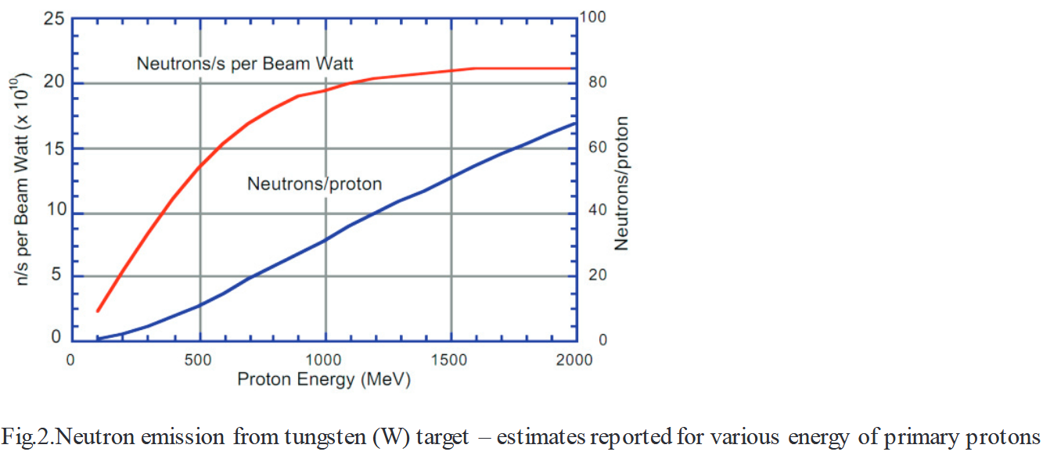
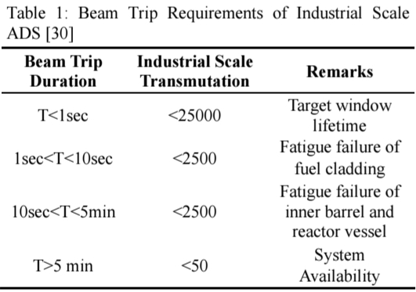
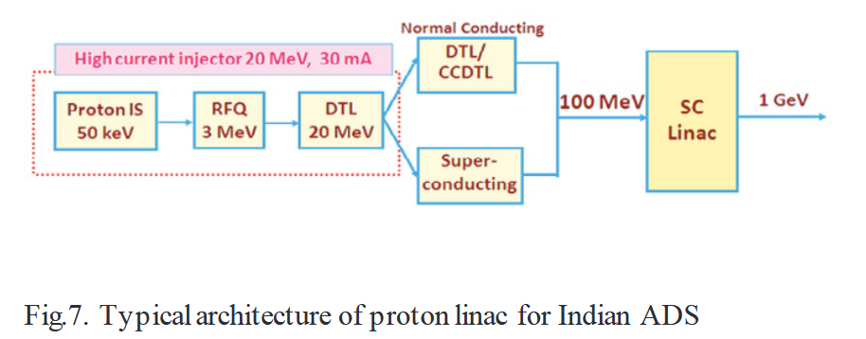
ADS - Accelerator
Optimal Proton Energy
Neutron yield increase with proton energy
Neutrons/Watt efficiency saturates near ~1.2 GeV
Optimal energy range: 800 MeV – 1 GeV
CW Operation & Beam Trip Limits
ADS reactor must receive a continuous external neutron source
Beam trips cause severe thermal shock to the target and reactor structure
Accelerator provides CW proton beam
For CW proton beam, SRF cavities are required

Slide 5
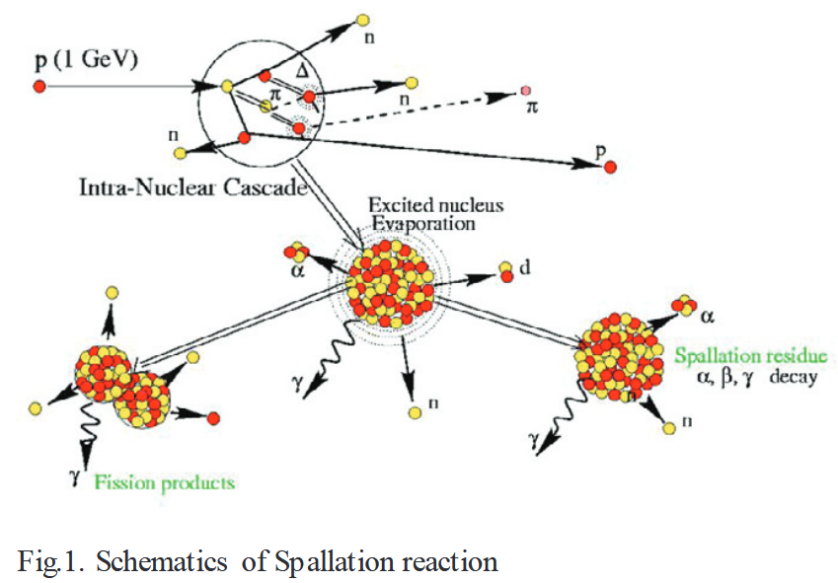
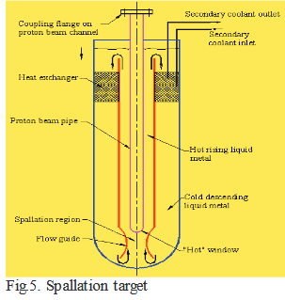
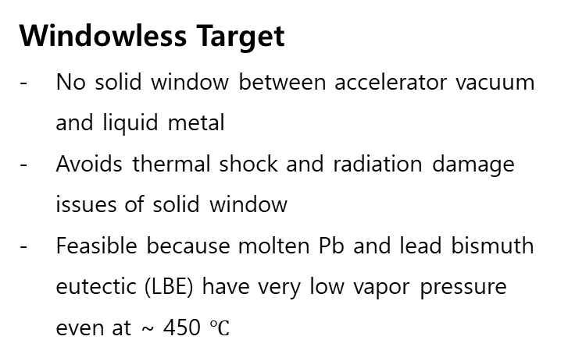
ADS – Spallation Target
Spallation Reaction Mechanism
High-energy protons collide with high-Z nuclei (Pb, LBE, W, etc.)
Two-step process:
1) Intra-nuclear cascade: Primary proton knocks out several protons and neutrons
2) Evaporation stage: Excited nucleus “boils off”, releasing neutrons and spallation residues or undergo further fission
Result: About 20 – 30 neutrons/proton at 800 MeV – 1 GeV
Liquid Metal Target required due to extremely high heat load (~ 1 $kW$/$cm^{3}$) from 10-15 MW proton beam
Beam Window
Separates accelerator vacuum from liquid target
Suffers from thermal shock and radiation damage
Beam Window lifetime is one of the limitation for high-power ADS
Windowless Target
No solid window between accelerator vacuum and liquid metal
Avoids thermal shock and radiation damage issues of solid window
Feasible because molten Pb and lead bismuth eutectic (LBE) have very low vapor pressure even at ~ 450 $℃$

Slide 6
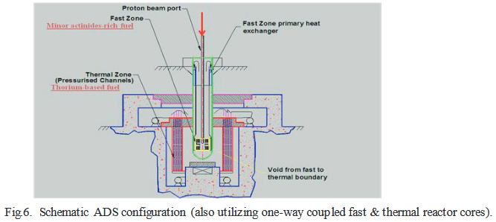

ADS – Sub-critical Reactor
$k<1$: Chain reaction cannot be sustained with out external neutrons
$$k=\frac{\# of neutrons in one generation}{\# of neutrons in previous generation}$$
External neutron source inserted through evacuated beam channel
Neutron flux peaks near the spallation target, then falls off exponentially with distance
High-energy spallation neutrons require enhanced shielding
Two-zone design: fast core burns MA, thermal core uses thorium

Slide 7
ADS for Minor Actinide Transmutation
MA-rich fuel shows unfavorable nuclear characteristics in critical reactors
Very low $β$, weak Doppler feedback, and positive coolant void worth
Nuclear characteristics of MA challenge reactor safety under critical conditions
ADS enables safe transmutation under sub-critical ($k<1$) conditions
Fast-spectrum neutrons from the spallation target enable highly efficient MA transmutation
Spallation neutrons have a fast spectrum, well-suited for fissioning MA
One ADS can transmute MA equivalent to ~ 8-10 LWRs
$k$ decreases from beginning of the cycle to end of the cycle due to MA consumption
Proton beam power must be increased to keep reactor power constant

Slide 8
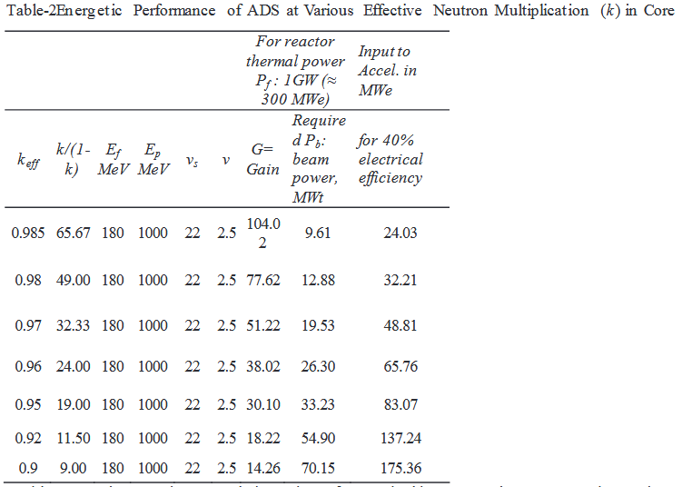

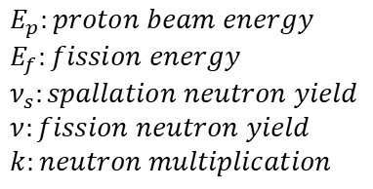
ADS Gain
$$G=\frac{E_{f}}{E_{p}}∙\frac{ν_{s}}{ν}∙\frac{k}{\left(1−k\right)}=G_{0}∙\frac{k}{(1−k)}$$
$$E_{p}:proton beam energy$$
$$E_{f}:fission energy$$
$$ν_{s}:spallation neutron yield$$
$$ν:fission neutron yield$$
$$k:neutron multiplication$$

Slide 9
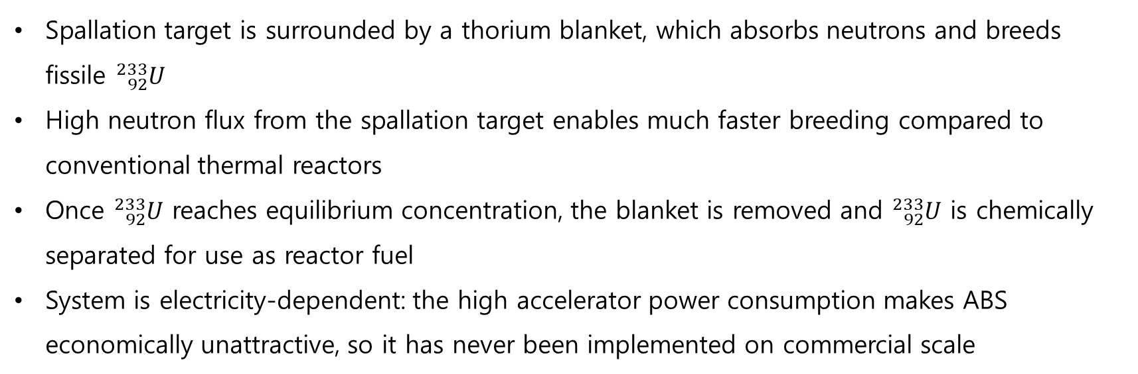
ADS for Thorium Utilization
1) Accelerator Breeder System (ABS)
$${}_{90}^{232}{Th}+ {}_{0}^{1}n → {}_{90}^{233}{Th} \underset{→}{β−} {}_{91}^{233}{Pa} \underset{→}{β−} {}_{92}^{233}U$$
Spallation target is surrounded by a thorium blanket, which absorbs neutrons and breeds fissile ${}_{92}^{233}U$
High neutron flux from the spallation target enables much faster breeding compared to conventional thermal reactors
Once ${}_{92}^{233}U$ reaches equilibrium concentration, the blanket is removed and ${}_{92}^{233}U$ is chemically separated for use as reactor fuel
System is electricity-dependent: the high accelerator power consumption makes ABS economically unattractive, so it has never been implemented on commercial scale

Slide 10
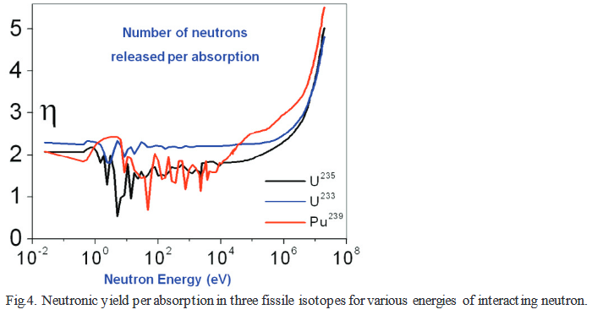
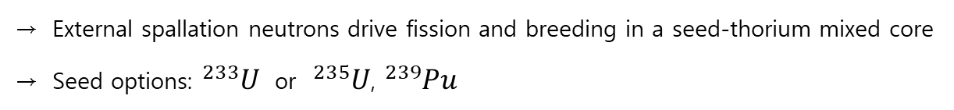
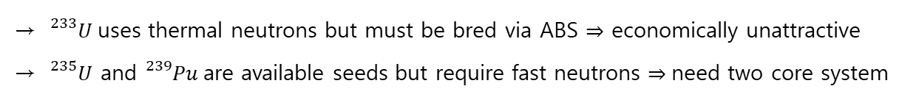
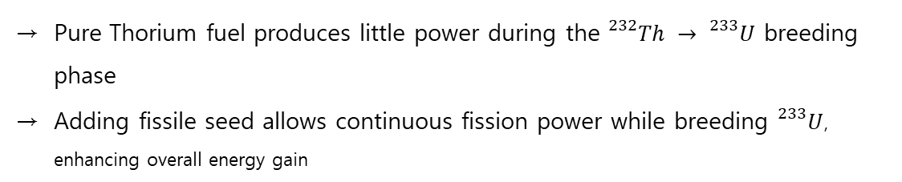
ADS for Thorium Utilization
2) Seed-loaded Thorium ADS (Sub-critical Reactor with Seed + Thorium Fuel)
Sub-critical core loaded with fissile seed and fertile Thorium
External spallation neutrons drive fission and breeding in a seed-thorium mixed core
Seed options: ${}_{}^{233}U$ or ${}_{}^{235}U$, ${}_{}^{239}{Pu}$
Seed-Thorium fuel enables simultaneous fission and breeding, improving power production and economics
Pure Thorium fuel produces little power during the ${}_{}^{232}{Th} → {}_{}^{233}U$ breeding phase
Adding fissile seed allows continuous fission power while breeding ${}_{}^{233}U$, enhancing overall energy gain
Seed material characteristics
${}_{}^{233}U$uses thermal neutrons but must be bred via ABS $⇒$ economically unattractive
${}_{}^{235}U$ and ${}_{}^{239}{Pu}$are available seeds but require fast neutrons $⇒$need two core system

Slide 11
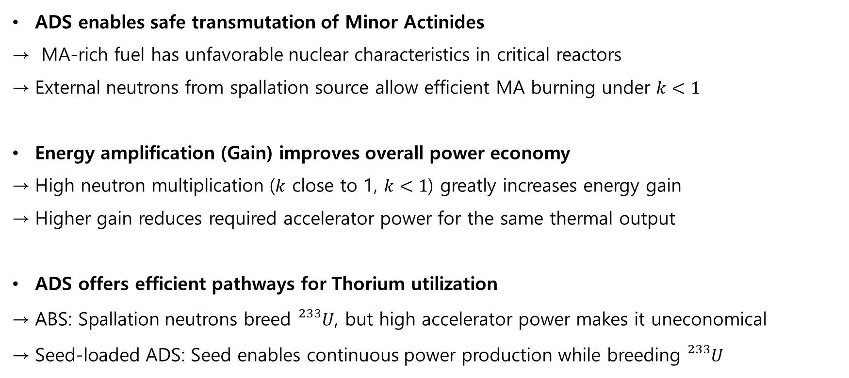
Summary
ADS enables safe transmutation of Minor Actinides
MA-rich fuel has unfavorable nuclear characteristics in critical reactors
External neutrons from spallation source allow efficient MA burning under $k<1$
Energy amplification (Gain) improves overall power economy
High neutron multiplication ($k$ close to 1, $k<1$) greatly increases energy gain
Higher gain reduces required accelerator power for the same thermal output
ADS offers efficient pathways for Thorium utilization
ABS: Spallation neutrons breed ${}_{}^{233}U$, but high accelerator power makes it uneconomical
Seed-loaded ADS: Seed enables continuous power production while breeding ${}_{}^{233}U$

Slide 12
Thank you for your attention

