Slide 1
Selection of Optimal Higher-Harmonic Cavity Type for Korea-4GSR under Collective Effects
2025-11-07, Pohang, South Korea
Young Min Park
Division of Advanced Nuclear Engineering (DANE), POSTECH

Slide 2
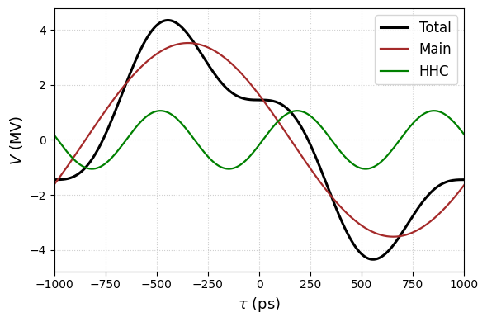
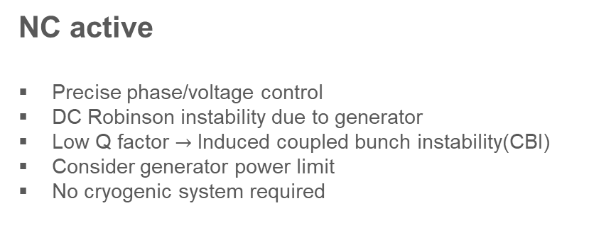
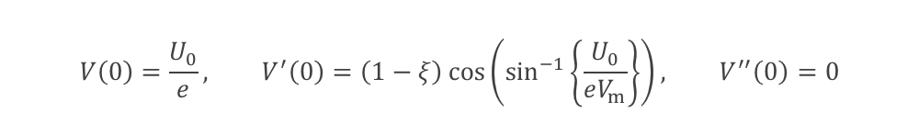

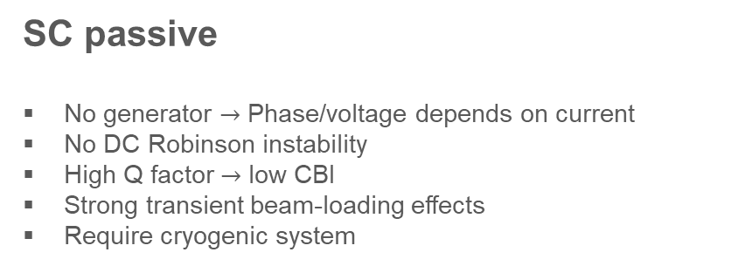
Review
Bunch lengthening scheme
Installed Higher harmonic cavity(HHC) to reduce voltage gradient
Weakened restoring force can achieve bunch lengthening
Near Flat Potential(NFP) condition:
$$V\left(τ\right)=V_{m}\sin\left(ω_{rf}τ+φ_{m}\right)+V_{h}\sin\left(mω_{rf}τ+φ_{h}\right)$$
$$V_{m,h} :Voltage of main\&HHC cavity, ω_{rf}:rf−frequency, τ:bunch−arrival time,$$
$$m:harmonic order, φ_{m,h} :phase of main\&HHC cavity$$
$$V\left(0\right)=\frac{U_{0}}{e}, V^{′}\left(0\right)=\left(1−ξ\right)\cos\left(\sin^{−1}\left\{\frac{U_{0}}{eV_{m}}\right\}\right), V^{′′}\left(0\right)=0$$
NC active
Precise phase/voltage control
DC Robinson instability due to generator
Low Q factor $→$ Induced coupled bunch instability(CBI)
Consider generator power limit
No cryogenic system required
SC passive
No generator $→$ Phase/voltage depends on current
No DC Robinson instability
High Q factor $→$ low CBI
Strong transient beam-loading effects
Require cryogenic system
2

Slide 3
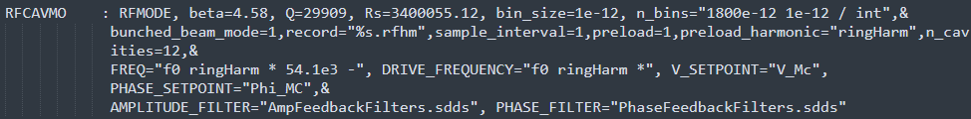
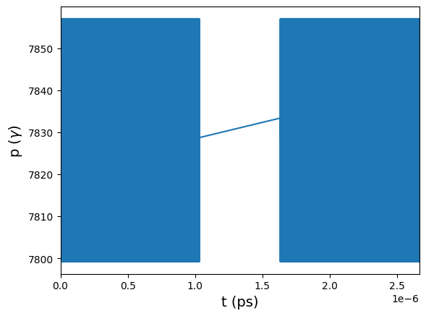
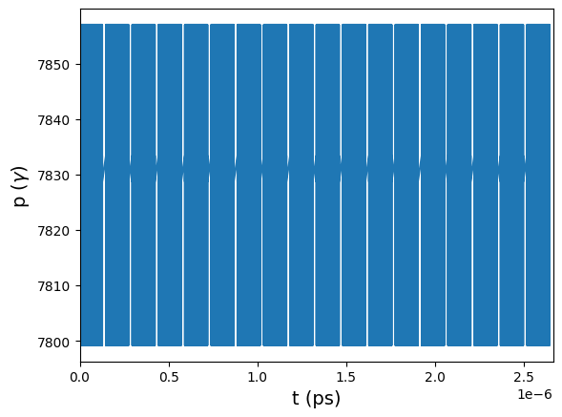


Overview
ELEGANT simulation
Before
Uniform filling pattern
Consider only main cavity beam loading
No longitudinal feedback system
After
NC active ($Q=16000, \frac{R_{s}}{Q}=87$)
Long gap distribution
SC passive ($Q=2e8, \frac{R_{s}}{Q}=89$)
(64+10)*18 distribution
3

Slide 4
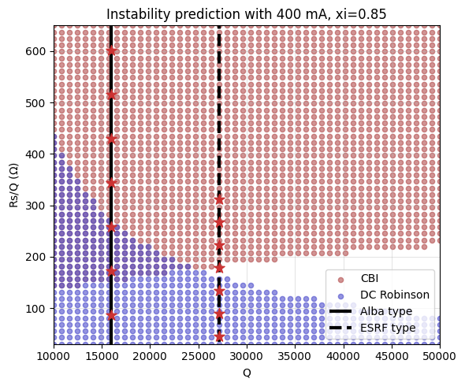
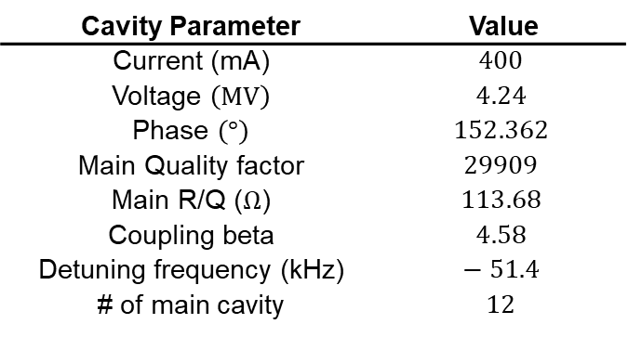
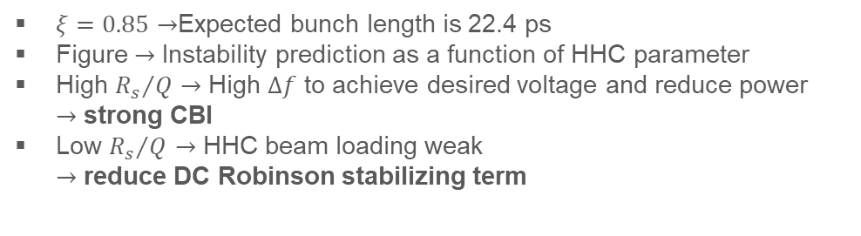
NC active
Cavity Parameter | Value
Current (mA) | $$400$$
Voltage $\left(MV\right)$ | $$4.24$$
Phase $\left(°\right)$ | $$152.362$$
Main Quality factor | $$29909$$
Main R/Q ($Ω$) | $$113.68$$
Coupling beta | $$4.58$$
Detuning frequency (kHz) | $$− 51.4$$
# of main cavity | $$12$$
$ξ=0.85→$Expected bunch length is 22.4 ps
Figure $→$ Instability prediction as a function of HHC parameter
High ${R_{s}}/Q$ $→$ High $Δf$ to achieve desired voltage and reduce power
$→$ strong CBI
Low ${R_{s}}/Q$ $→$ HHC beam loading weak
$→$ reduce DC Robinson stabilizing term
4

Slide 5
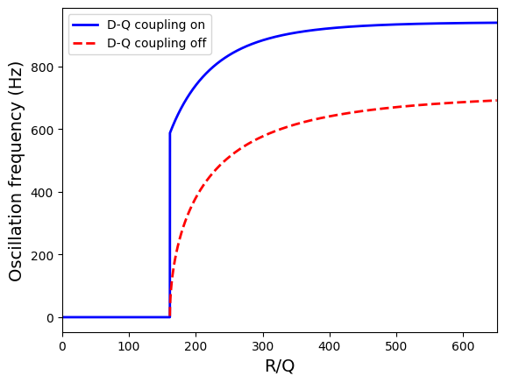
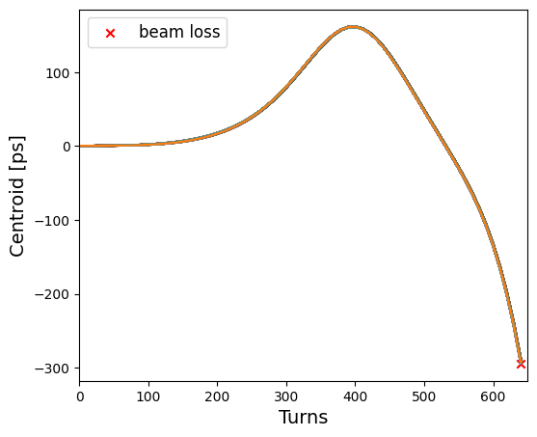
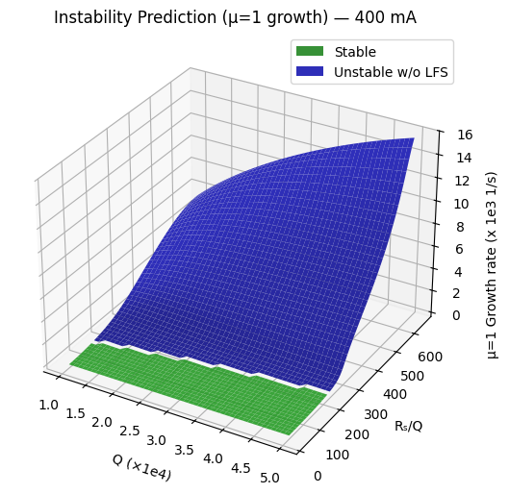
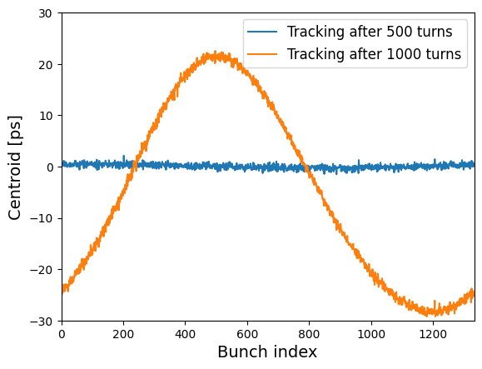
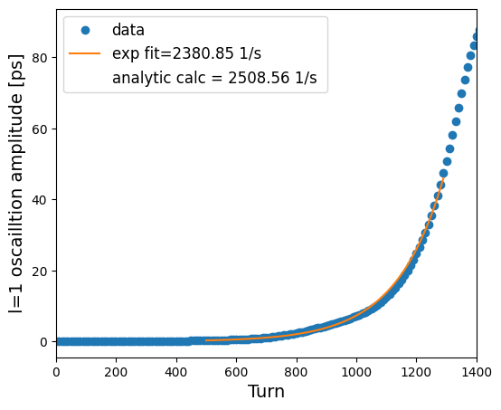
NC active
DC Robinson
ESRF type, 2 Cavities
CBI
ESRF type, 8 Cavities
5

Slide 6
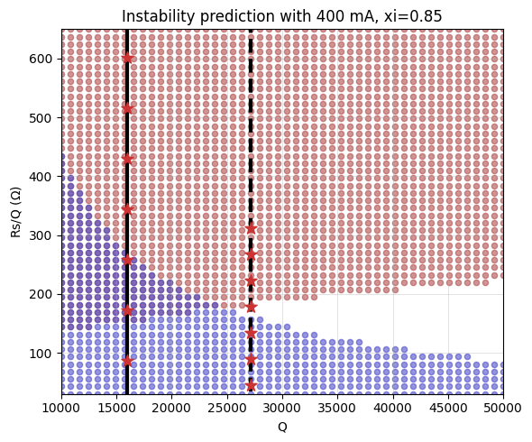
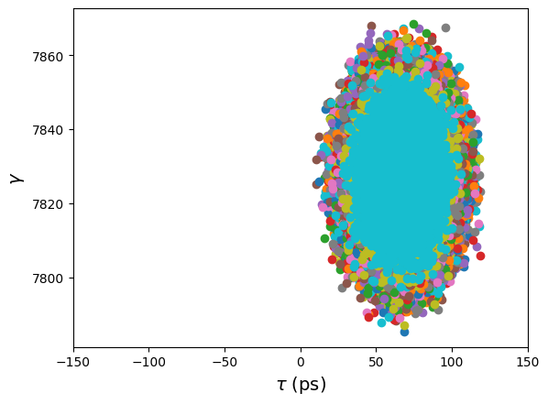
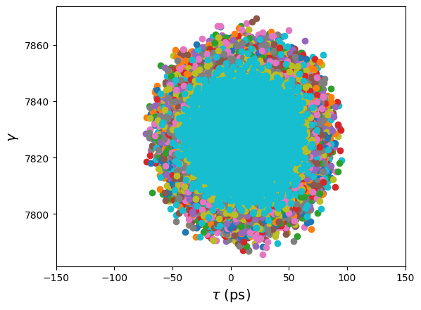
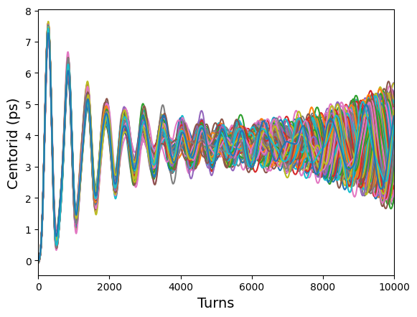
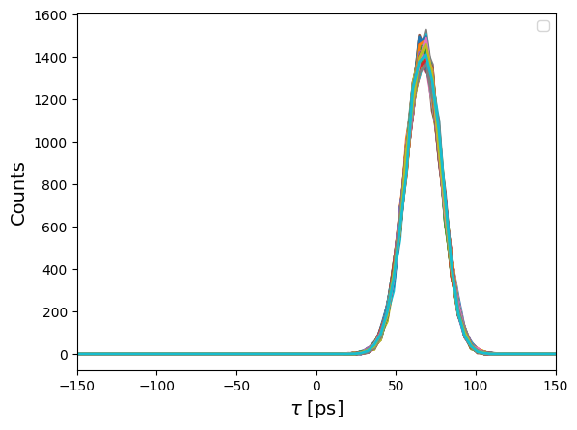
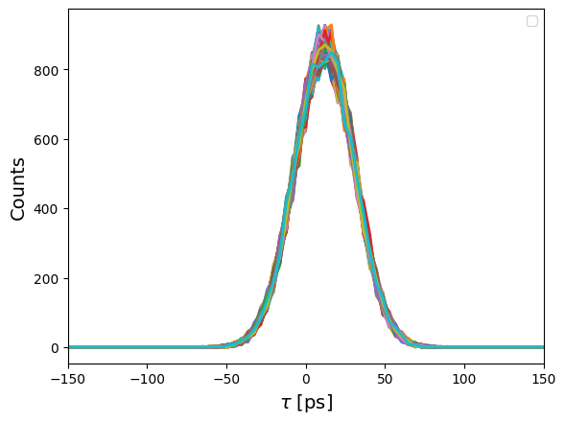
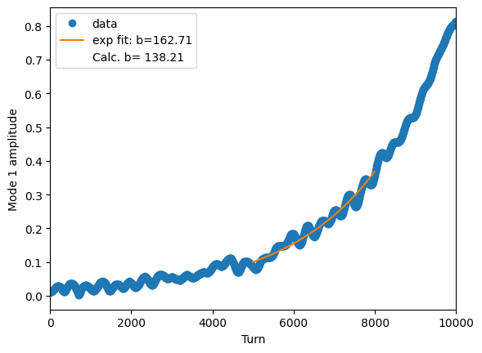

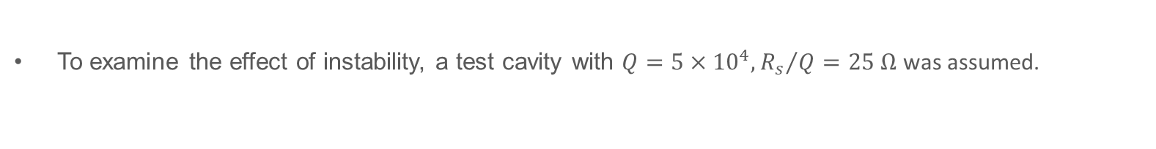
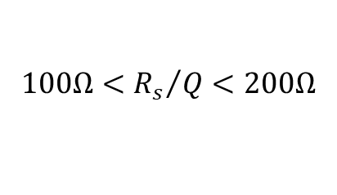
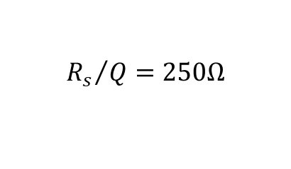
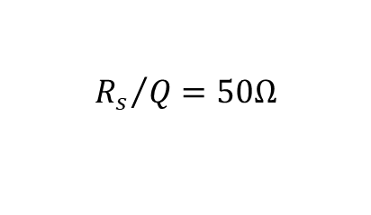

NC active
Test cavity
To examine the effect of instability, a test cavity with $Q=5×{10}^{4},{R_{s}}/Q=25 Ω$ was assumed.
$${R_{s}}/Q=50Ω$$
$$100Ω<{R_{s}}/Q<200Ω$$
$${R_{s}}/Q=250Ω$$
$$σ_{τ}≈19 ps$$
$$σ_{τ}≈11 ps$$
6

Slide 7
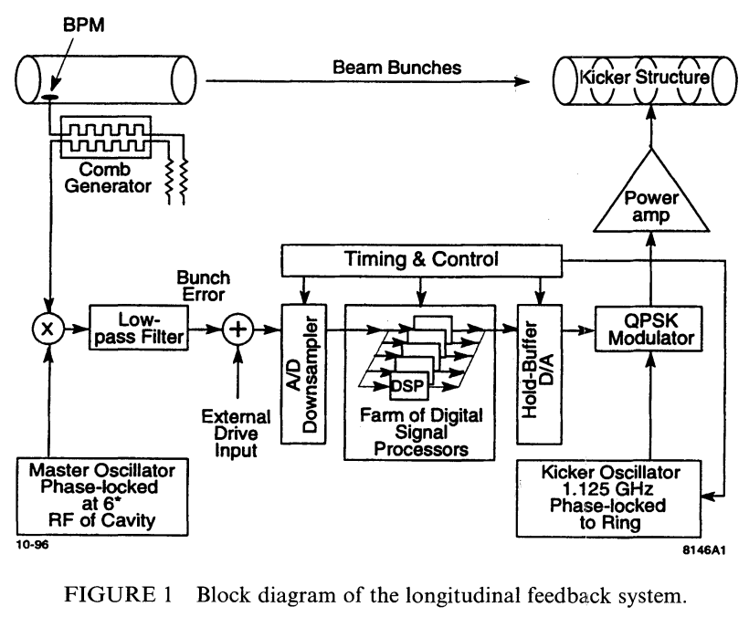
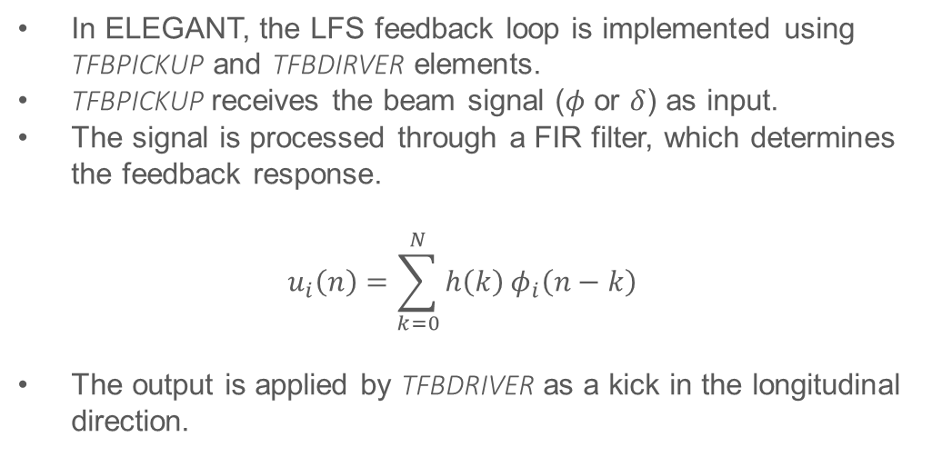
NC active with LFS
Proposed NC active cavity operating strategy
Raise $R/Q$ to a moderate level so that DC Robinson instability is avoided.
CBI can be mitigated with LFS, so choose an operating point where any CBI is within LFS damping capability.
Large $ξ$ reduces the DC-Robinson margin, $ξ≈0.85−0.9$ is a practical range. ($σ_{t}≈22\sim 26 ps$)
In ELEGANT, the LFS feedback loop is implemented using
TFBPICKUP and TFBDIRVER elements.
TFBPICKUP receives the beam signal ($φ$ or $δ$) as input.
The signal is processed through a FIR filter, which determines the feedback response.
$$u_{i}\left(n\right)=\sum_{k=0}^{N}{h\left(k\right)}φ_{i}\left(n−k\right)$$
The output is applied by TFBDRIVER as a kick in the longitudinal direction.
[1]
[1] S. PRABHAKAR, “OBSERVATION AND MODAL ANALYSIS OF COUPLED-BUNCH LONGITUDINAL INSTABILITIES VIA A DIGITAL FEEDBACK CONTROL SYSTEM”, slac-pub-7292, 1996
7

Slide 8
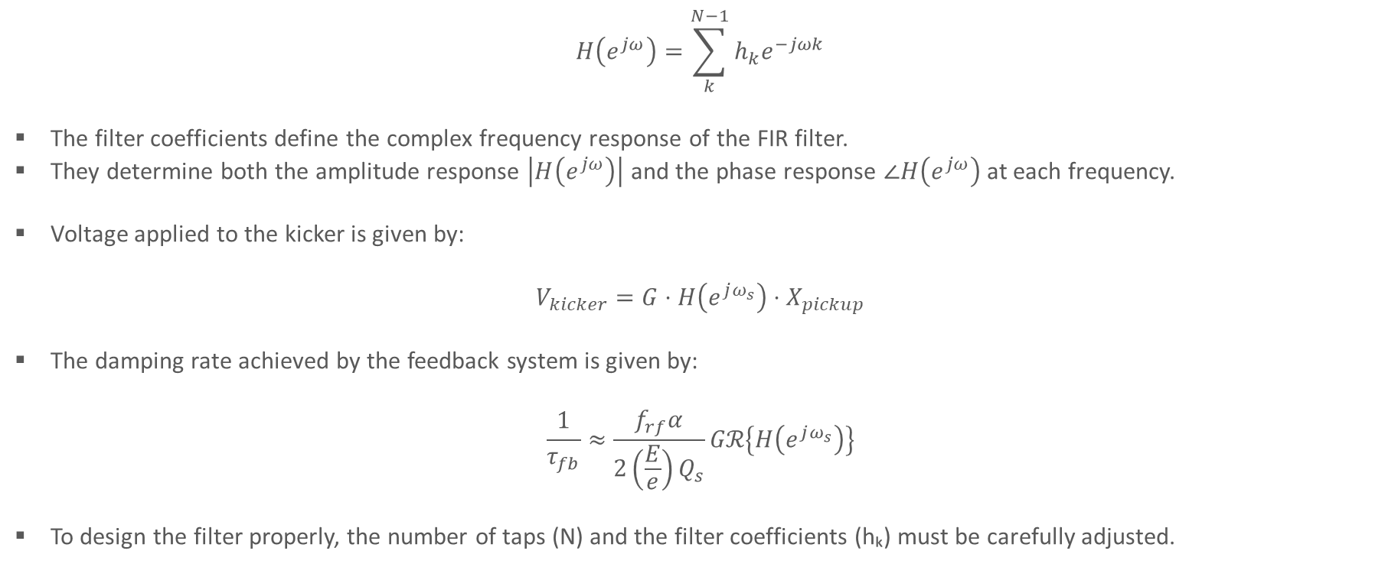
NC active with LFS
FIR filter and feedback gain
$$H\left(e^{jω}\right)=\sum_{k}^{N−1}{h_{k}e^{−jωk}}$$
The filter coefficients define the complex frequency response of the FIR filter.
They determine both the amplitude response $\left|H\left(e^{jω}\right)\right|$ and the phase response $∠H\left(e^{jω}\right)$ at each frequency.
Voltage applied to the kicker is given by:
$$V_{kicker}=G⋅H\left(e^{jω_{s}}\right)⋅X_{pickup}$$
The damping rate achieved by the feedback system is given by:
$$\frac{1}{τ_{fb}}≈\frac{f_{rf}α}{2\left(\frac{E}{e}\right)Q_{s}}Gℛ\left\{H\left(e^{jω_{s}}\right)\right\}$$
To design the filter properly, the number of taps (N) and the filter coefficients (hₖ) must be carefully adjusted.
8

Slide 9
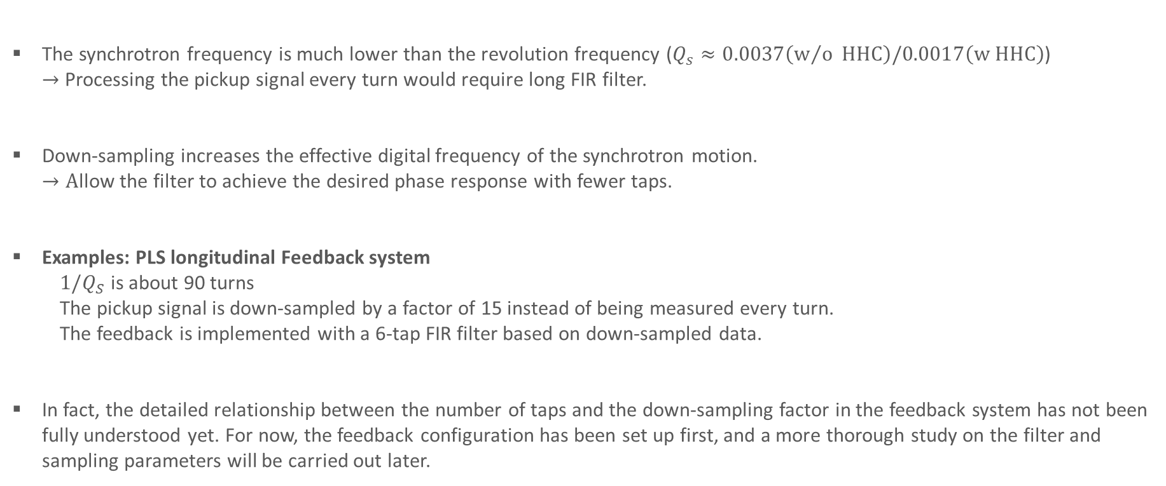
NC active with LFS
FIR filter and feedback gain
The synchrotron frequency is much lower than the revolution frequency ($Q_{s}≈0.0037\left(w/o HHC\right)/0.0017\left(w HHC\right)$)
$→$ Processing the pickup signal every turn would require long FIR filter.
Down-sampling increases the effective digital frequency of the synchrotron motion.
$→A$llow the filter to achieve the desired phase response with fewer taps.
Examples: PLS longitudinal Feedback system
  $1/Q_{S}$ is about 90 turns
  The pickup signal is down-sampled by a factor of 15 instead of being measured every turn.
  The feedback is implemented with a 6-tap FIR filter based on down-sampled data.
In fact, the detailed relationship between the number of taps and the down-sampling factor in the feedback system has not been fully understood yet. For now, the feedback configuration has been set up first, and a more thorough study on the filter and sampling parameters will be carried out later.
9

Slide 10
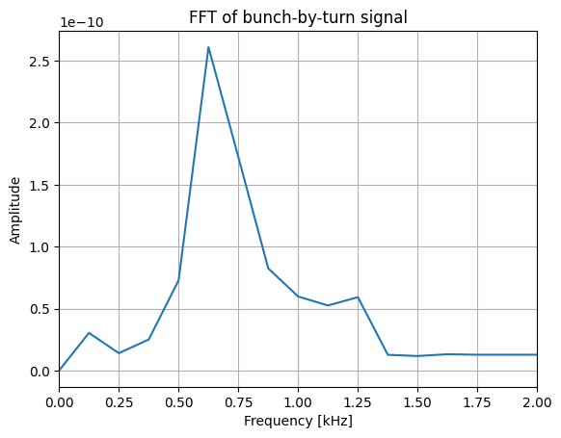
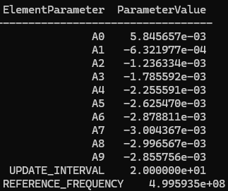
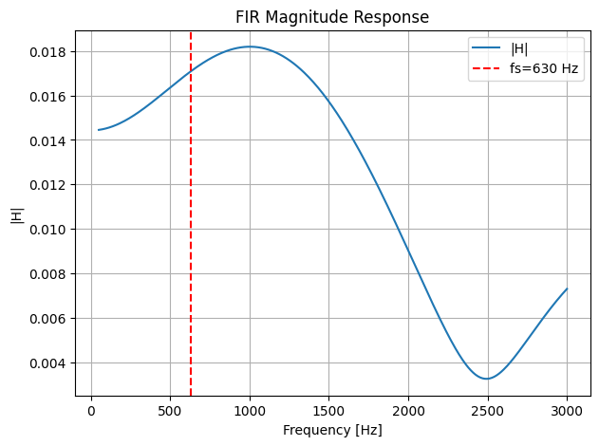
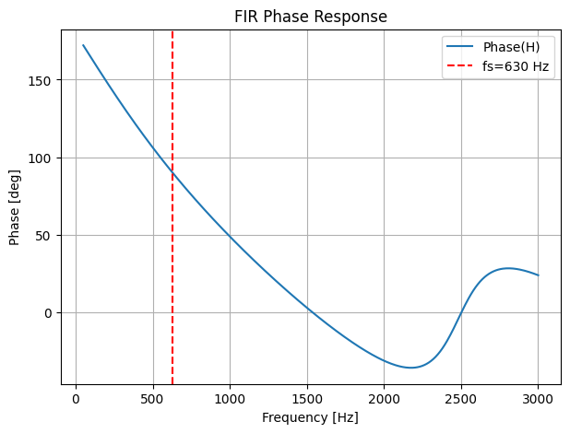
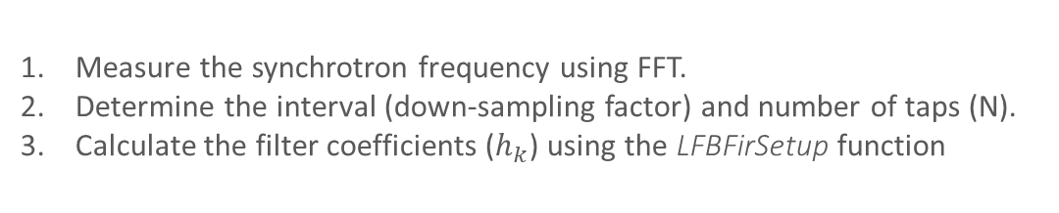
NC active with LFS
FIR filter and feedback gain
Using LFBFirSetup function in ELEGANT, the filter coefficients can be obtained by least-squares method to math the desired synchrotron frequency.
Measure the synchrotron frequency using FFT.
Determine the interval (down-sampling factor) and number of taps (N).
Calculate the filter coefficients ($h_{k}$) using the LFBFirSetup function
10

Slide 11
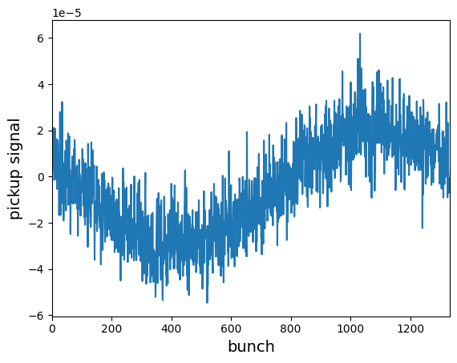
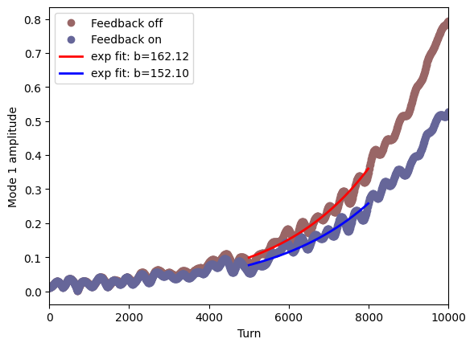
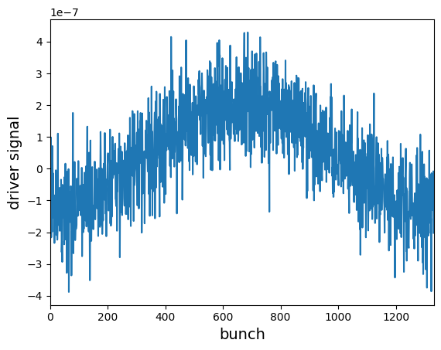
NC active with LFS
CBI with FIR feedback
Turn: 9000
Strength $k≈0.5$
A more detailed understanding of the effects of tap number, interval, and strength on the feedback system will be pursued.
11

Slide 12
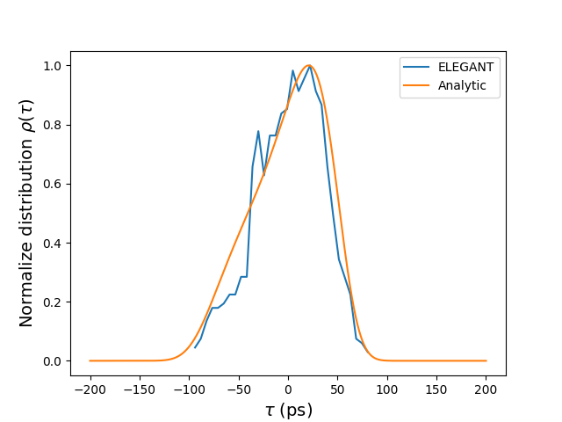
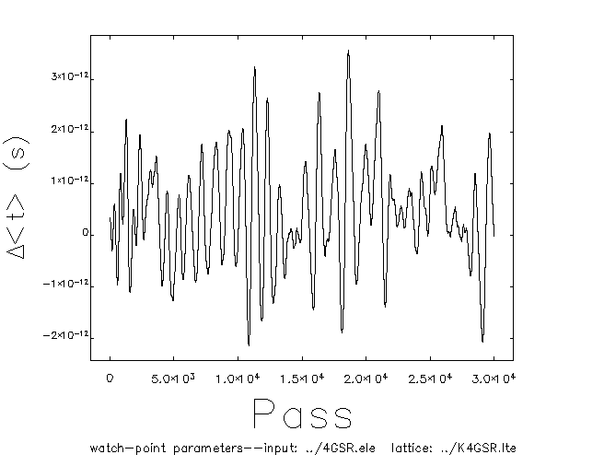
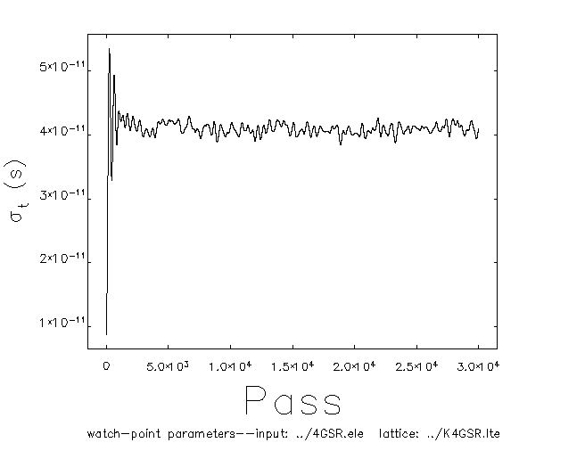

SC passive
Uniform filling pattern
Macroparticle simulations by elegant : 1332 bunches, 1000 particles per bunch
Cavity parameter : $Q=2×{10}^{8}, R_{s}/Q=89 Ω, I=400 mA, Δf=41 kHz→ψ=89.995°$
$$σ_{τ}≈39 ps$$
12

Slide 13
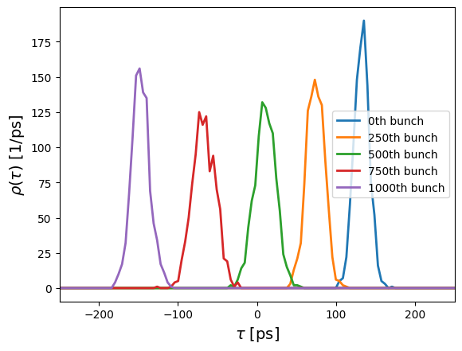
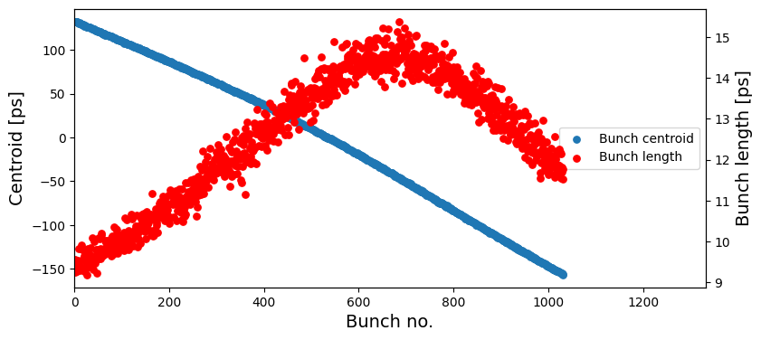
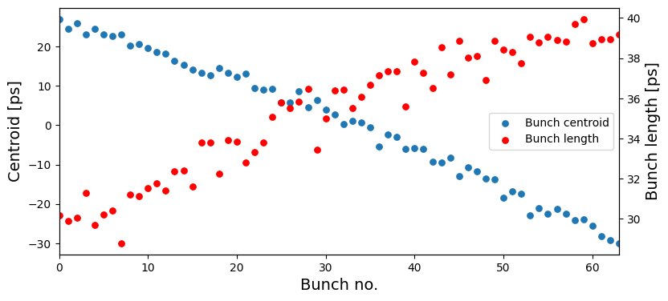
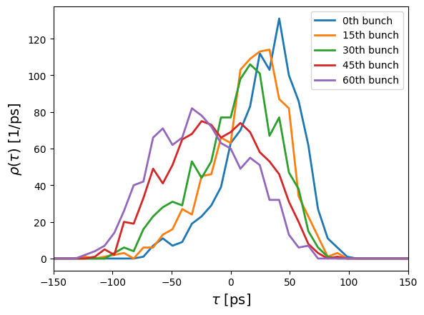
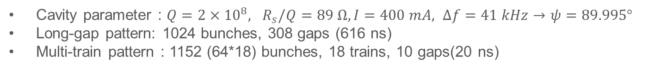
SC passive
Arbitrary filling pattern
Cavity parameter : $Q=2×{10}^{8}, R_{s}/Q=89 Ω, I=400 mA, Δf=41 kHz→ψ=89.995°$
Long-gap pattern: 1024 bunches, 308 gaps (616 ns)
Multi-train pattern : 1152 (64*18) bunches, 18 trains, 10 gaps(20 ns)
Long-gap
Multi-train
13

Slide 14
Summary & Future plan
NC Active Cavities:
  Instead of compensating for DC Robinson instability, an additional Longitudinal Feedback System may be required to suppress coupled-bunch instabilities.
  Considering the generator power limitation, it may be more effective to use multiple cavities with lower R/Q rather than a few high R/Q cavities.
SC Passive Cavities:
  The filling pattern should be divided into multiple bunch trains to reduce both transient effects and ion effects.
  From the stability point of view, this configuration is safe and reliable.
Future work: a more precise understanding of the LFS parameters — such as tap number, interval, and sampling frequency — is needed for further optimization.
14
[1] T. Olsson, Self-consistent calculation of transient beam loading in electron storage rings with passive harmonic cavities, Phys. Rev. Accel. Beams 21, (2018).

Slide 15
Thank you for your attention!
15

