Slide 1
Mode Locking in a Free-Electron Laser Amplifier

Slide 2
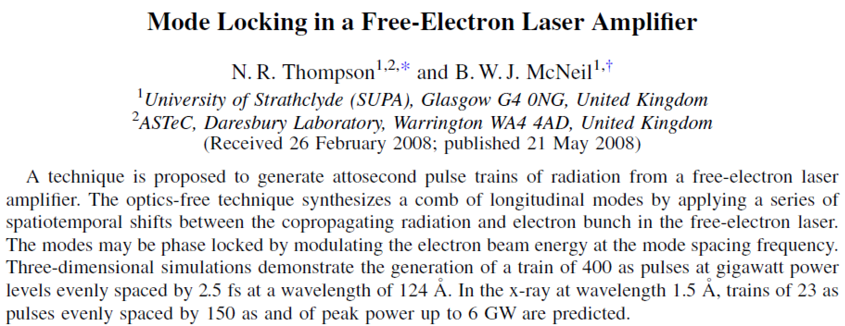

Slide 3
Introduction
Free electron laser(FEL): a device in which an electron beam and a beam of electromagnetic wave colinearly travel through an undulator, causing an energy modulation at the periodicity of the radiation wavelength, which turns into a density modulation(microbunching) and generates amplified, coherent radiations.
Self-amplification spontaneous emission(SASE): Initial microbunching is initiated not by external seed radiation, but by the spontaneous radiation within the in the first section of undulator
- can produce hard X-ray
- poor longitudinal coherence

Slide 4
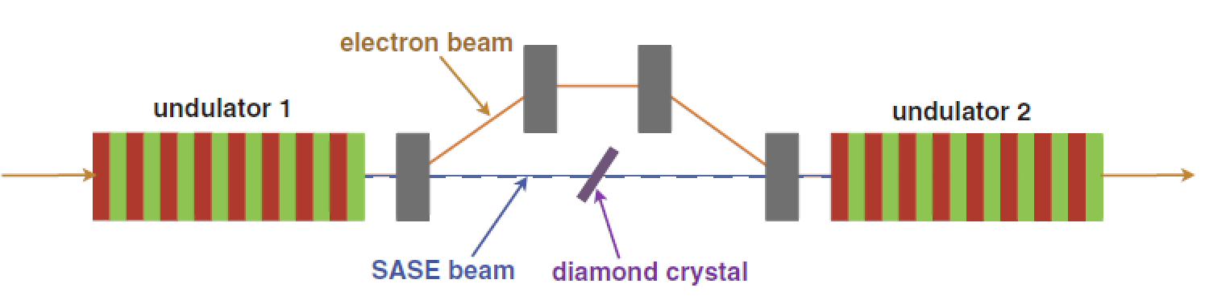
Self-seeding FEL
Self seeding FEL: FEL seed by monochromatized SASE FEL radiation
- bandwidth can be improved more than 10 times

Slide 5
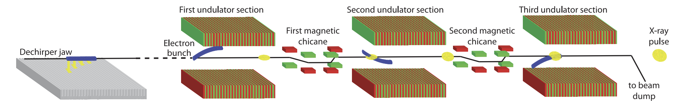
Fresh Slice Multi-stage Amplification
Electron beam tilted by RF deflector or dechirper is used
Pulse duration can be reduced by few fs
First demonstrated at LCLS with tilted beam and 3 stages of amplification
High pulse energy deviation
A. Lutman et al, PRL 120, 264801, 2018

Slide 6
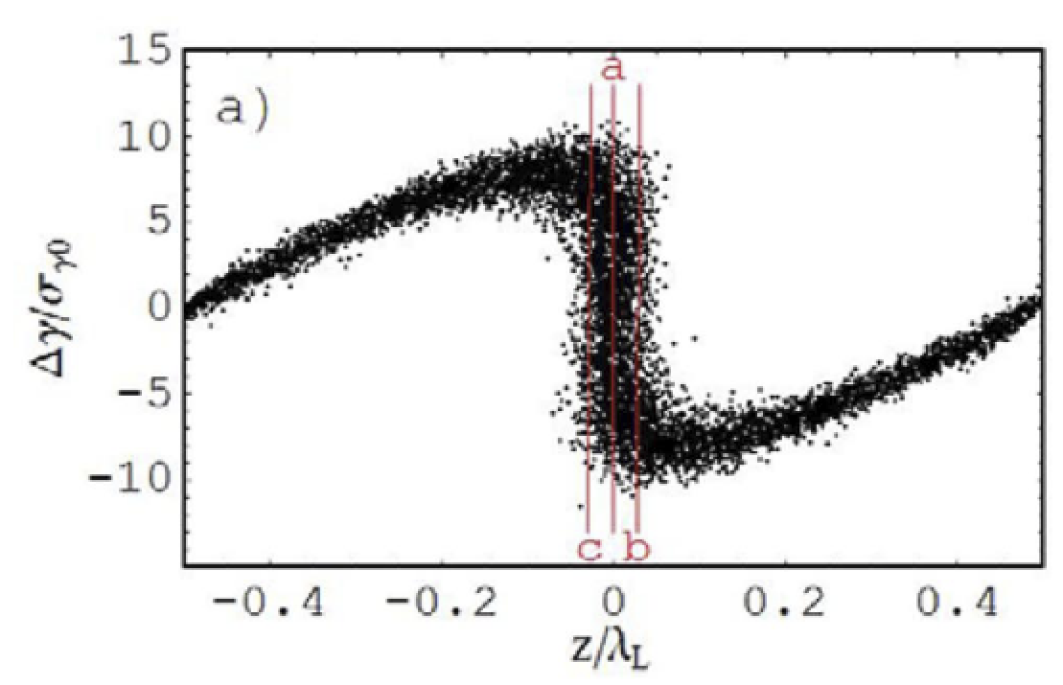
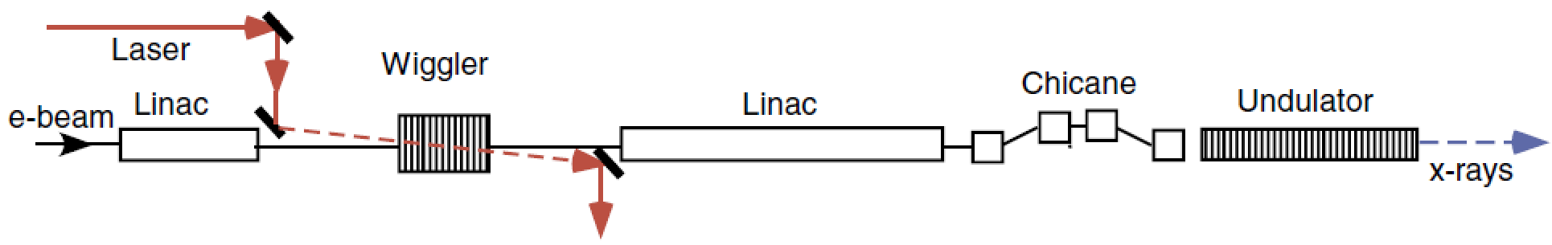
Enhanced SASE
Enhanced SASE(E-SASE): A technique in which an electron beam is energy modulated by optical laser which overlaps only a short longitudinal section of the electron beam
Energy modulation in the wiggler is converted to density modulation in chicane
Pulse duration can be reduced by a few hundred attoseconds
Greater peak x-ray output, and gain saturation in a shorter length of undulator
A. A. Zholents, Phys. Rev. ST Accel. Beams, 8:040701 (2005).

Slide 7
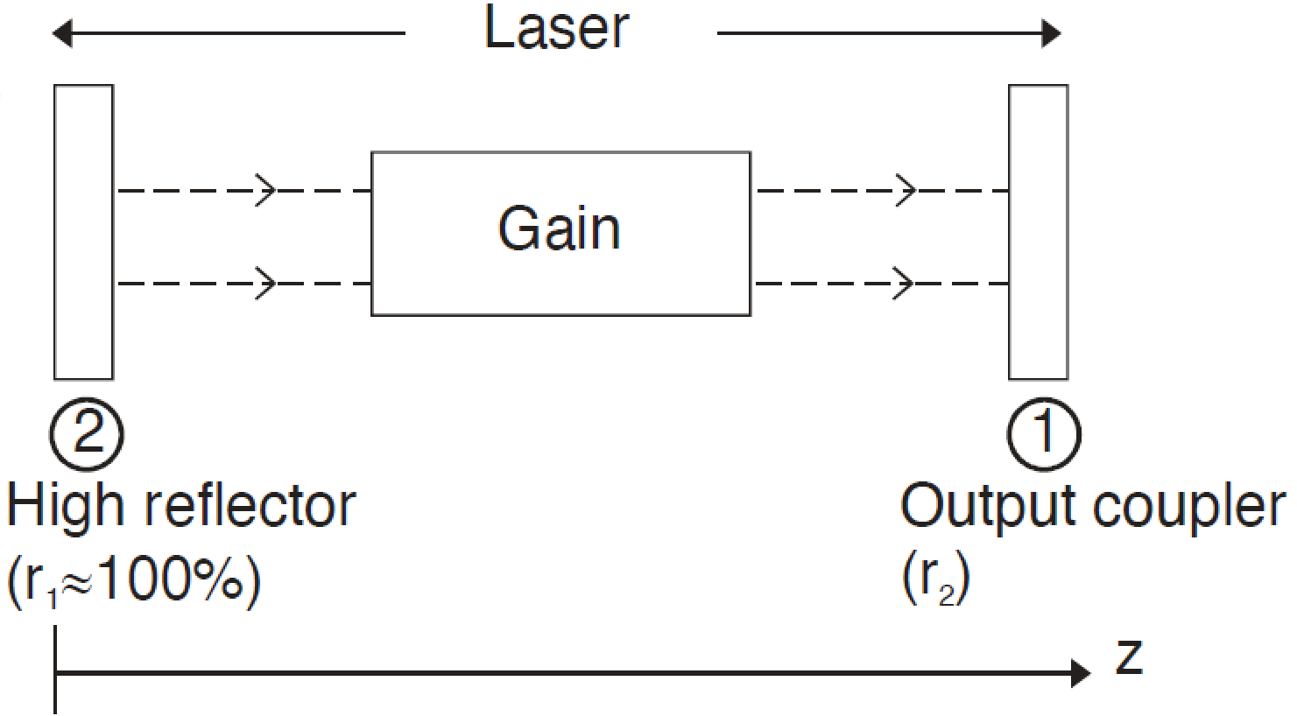
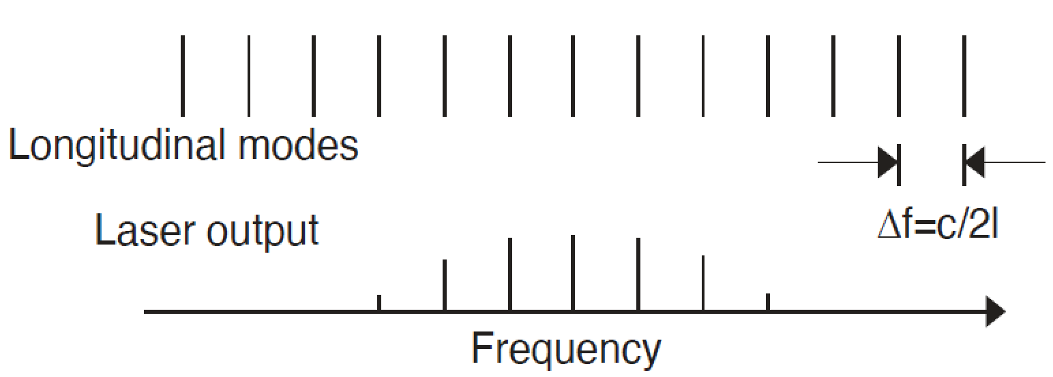
Mode-locked Laser
Mode-locked Laser: Laser whose phase between each modes is fixed

Slide 8
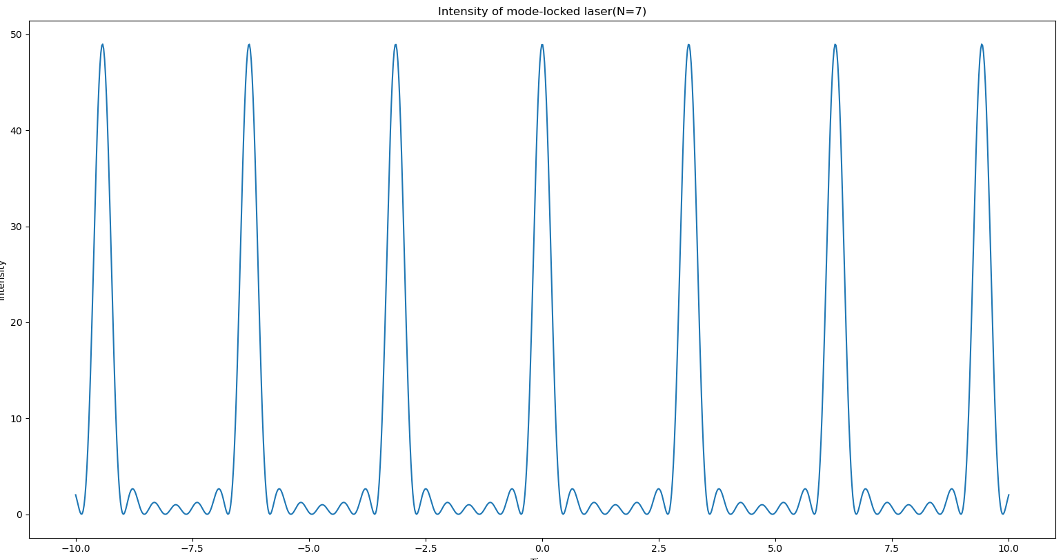
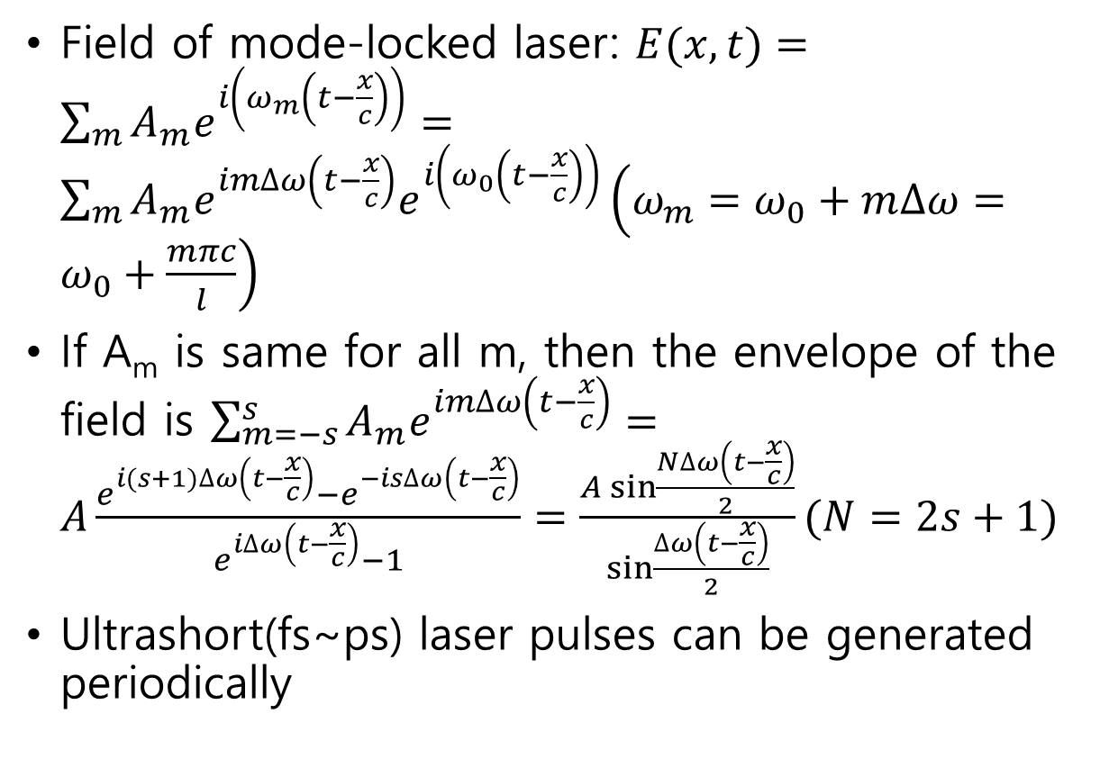
Mode-locked Laser
Field of mode-locked laser: $E(x,t)=\sum_{m}{A_{m}e^{i\left(ω_{m}\left(t−\frac{x}{c}\right)\right)}}=\sum_{m}{A_{m}e^{im∆ω\left(t−\frac{x}{c}\right)}e^{i\left(ω_{0}\left(t−\frac{x}{c}\right)\right)}}\left(ω_{m}=ω_{0}+m∆ω=ω_{0}+\frac{mπc}{l}\right)$
If A_{m} is same for all m, then the envelope of the field is $\sum_{m=−s}^{s}{A_{m}e^{im∆ω\left(t−\frac{x}{c}\right)}}=A\frac{e^{i(s+1)∆ω\left(t−\frac{x}{c}\right)}−e^{−is∆ω\left(t−\frac{x}{c}\right)}}{e^{i∆ω\left(t−\frac{x}{c}\right)}−1}=\frac{A\sin{\frac{N∆ω\left(t−\frac{x}{c}\right)}{2}}}{\sin{\frac{∆ω\left(t−\frac{x}{c}\right)}{2}}}(N=2s+1)$
Ultrashort(fs~ps) laser pulses can be generated periodically

Slide 9
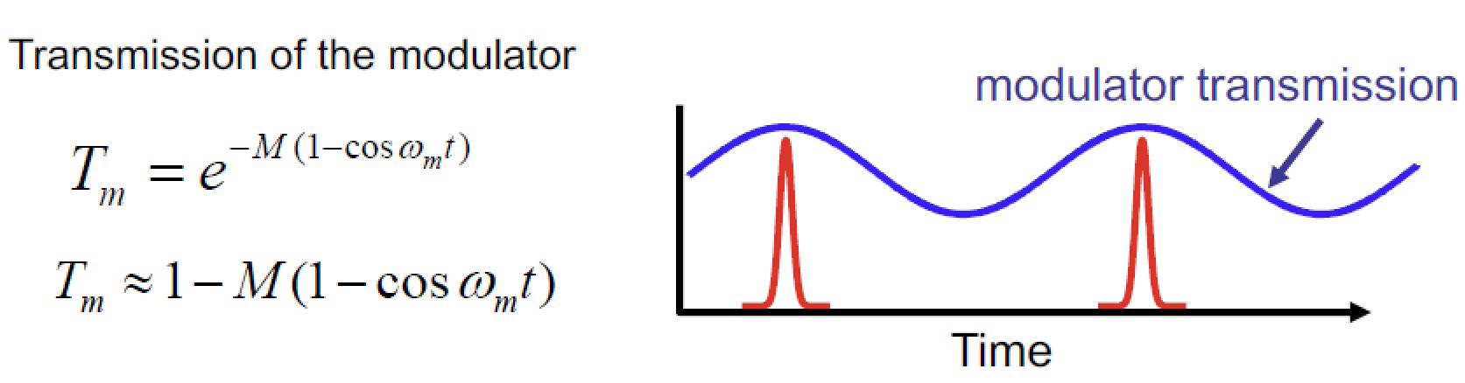
Mode-locked Laser
Active mode locking: demonstrating mode locking by periodically modulating amplitude or phase of modes
- Frequency of modulation should be same with frequency spacing between laser modes
$$e^{iω_{0}t}T_{M}≅e^{iω_{0}t}\left(1−M\right)+\frac{M}{2}e^{i\left(ω_{0}+ω_{M}\right)t}+\frac{M}{2}e^{i\left(ω_{0}−ω_{M}\right)t}$$

Slide 10
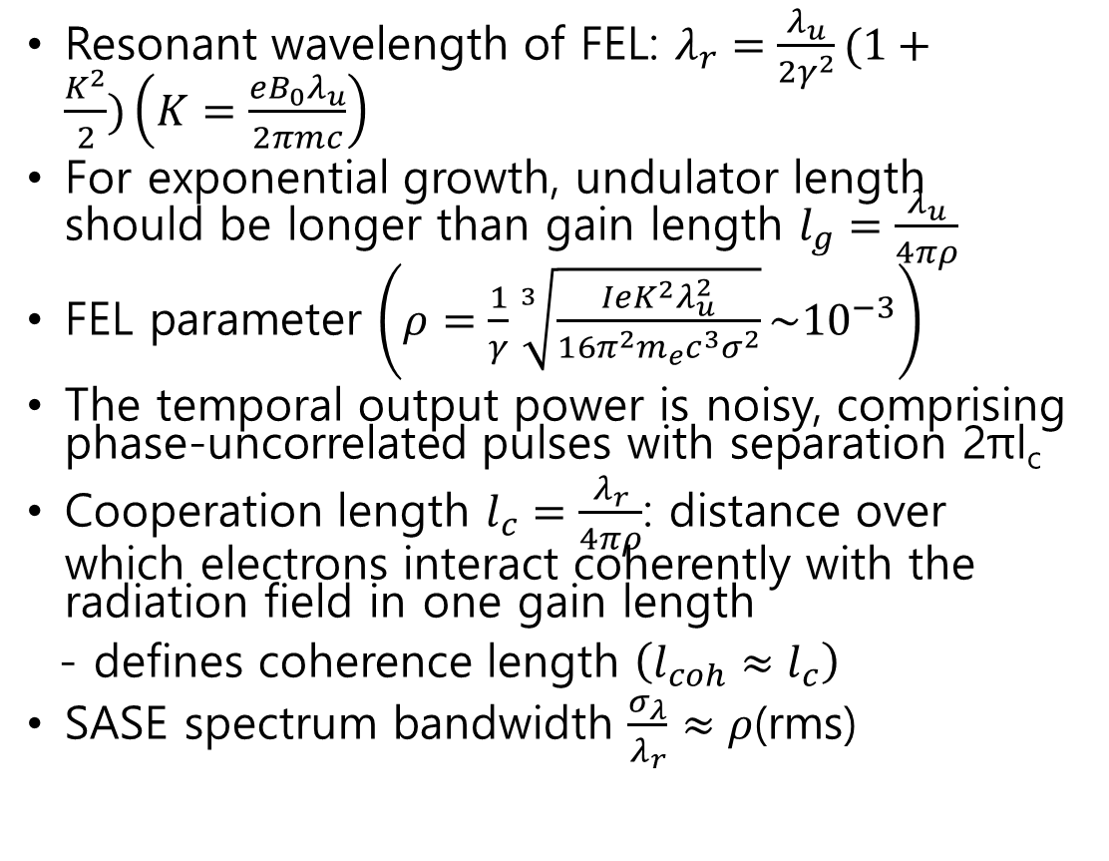
SASE XFEL
Resonant wavelength of FEL: $λ_{r}=\frac{λ_{u}}{2γ^{2}}(1+\frac{K^{2}}{2})\left(K=\frac{eB_{0}λ_{u}}{2πmc}\right)$
For exponential growth, undulator length should be longer than gain length $l_{g}=\frac{λ_{u}}{4πρ}$
FEL parameter $\left(ρ=\frac{1}{γ}\sqrt[3]{\frac{IeK^{2}λ_{u}^{2}}{16π^{2}m_{e}c^{3}σ^{2}}}\sim {10}^{−3}\right)$
The temporal output power is noisy, comprising phase-uncorrelated pulses with separation 2πl_{c}
Cooperation length $l_{c}=\frac{λ_{r}}{4πρ}$: distance over which electrons interact coherently with the radiation field in one gain length
- defines coherence length $\left(l_{coh}≈l_{c}\right)$
SASE spectrum bandwidth $\frac{σ_{λ}}{λ_{r}}≈ρ$(rms)

Slide 11
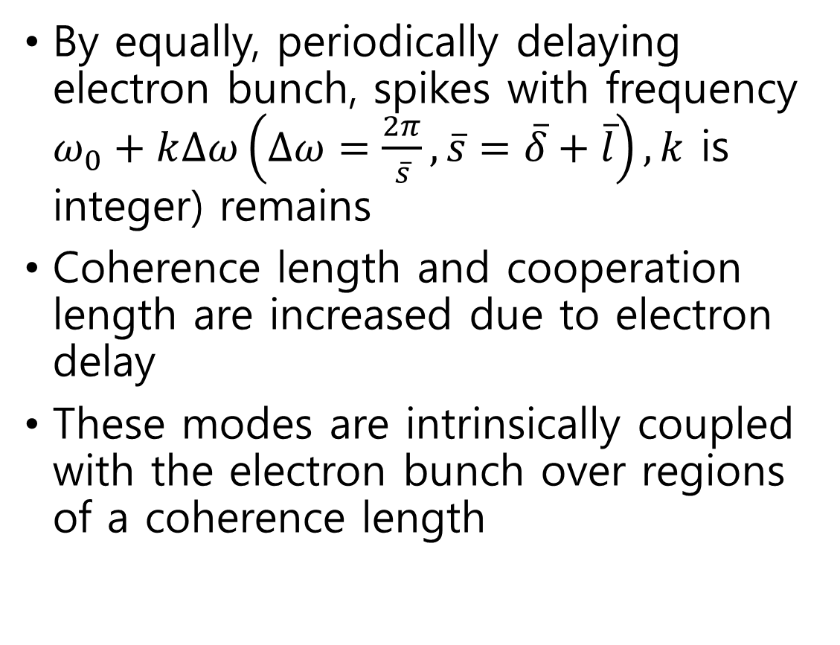
Mode-coupled/locked XFEL
By equally, periodically delaying electron bunch, spikes with frequency $ω_{0}+k∆ω\left(∆ω=\frac{2π}{\overline{s}},\overline{s}=\overline{δ}+\overline{l}\right),k$ is integer) remains
Coherence length and cooperation length are increased due to electron delay
These modes are intrinsically coupled with the electron bunch over regions of a coherence length

Slide 12

Mode-coupled/locked XFEL
Modes can be made to lock in phase by modulating the electron beam energy via laser with frequency same with $∆ω$
Phases of pulses are phase correlated over a distance $≫l_{coh}$

Slide 13
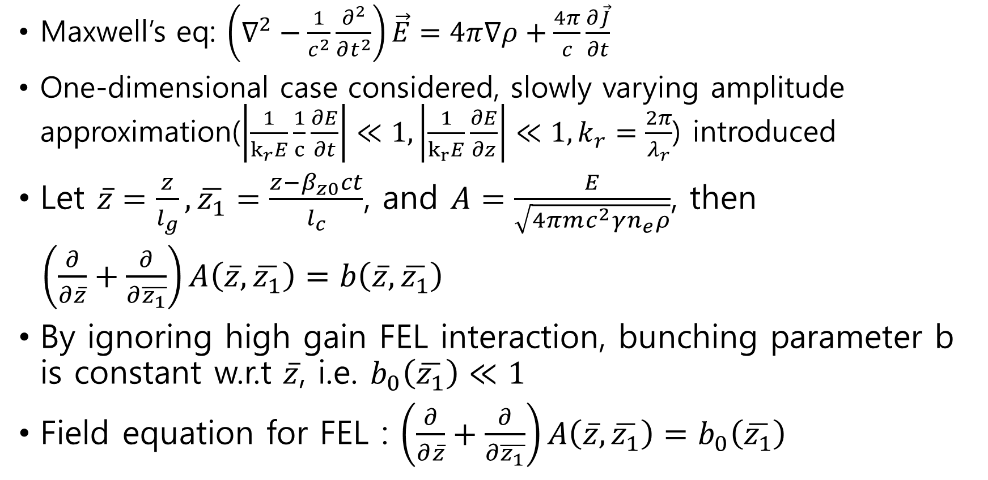
Mode-coupled/locked XFEL
Maxwell’s eq: $\left(∇^{2}−\frac{1}{c^{2}}\frac{∂^{2}}{∂t^{2}}\right)\vec{E}=4π∇ρ+\frac{4π}{c}\frac{∂\vec{J}}{∂t}$
One-dimensional case considered, slowly varying amplitude approximation($\left|\frac{1}{k_{r}E}\frac{1}{c}\frac{∂E}{∂t}\right|≪1,\left|\frac{1}{k_{r}E}\frac{∂E}{∂z}\right|≪1, k_{r}=\frac{2π}{λ_{r}}$) introduced
Let $\overline{z}=\frac{z}{l_{g}}, \overline{z_{1}}=\frac{z−β_{z0}ct}{l_{c}}$, and $A=\frac{E}{\sqrt{4πmc^{2}γn_{e}ρ}}$, then
$\left(\frac{∂}{∂\overline{z}}+\frac{∂}{∂\overline{z_{1}}}\right)A\left(\overline{z},\overline{z_{1}}\right)=b\left(\overline{z},\overline{z_{1}}\right)$
By ignoring high gain FEL interaction, bunching parameter b is constant w.r.t $\overline{z}$, i.e. $b_{0}\left(\overline{z_{1}}\right)≪1$
Field equation for FEL : $\left(\frac{∂}{∂\overline{z}}+\frac{∂}{∂\overline{z_{1}}}\right)A\left(\overline{z},\overline{z_{1}}\right)=b_{0}\left(\overline{z_{1}}\right)$

Slide 14
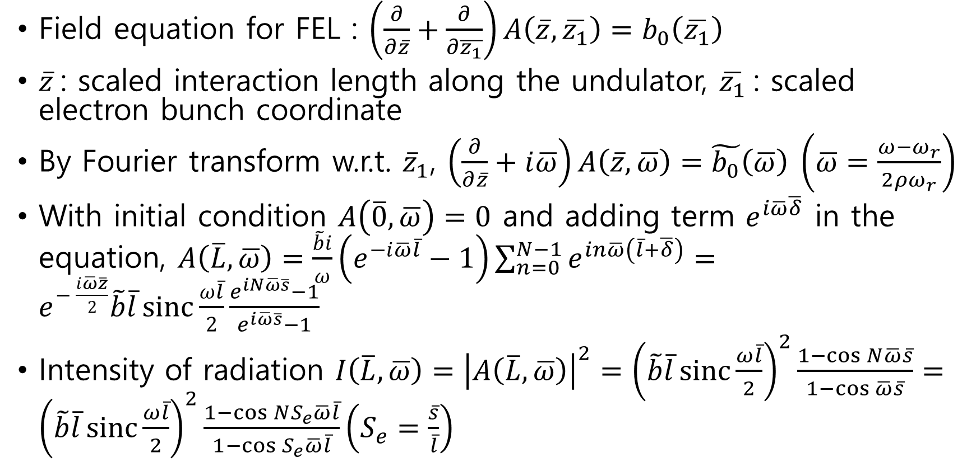
Mode-coupled/locked XFEL
Field equation for FEL : $\left(\frac{∂}{∂\overline{z}}+\frac{∂}{∂\overline{z_{1}}}\right)A\left(\overline{z},\overline{z_{1}}\right)=b_{0}\left(\overline{z_{1}}\right)$
$\overline{z}$: scaled interaction length along the undulator, $\overline{z_{1}}$: scaled electron bunch coordinate
By Fourier transform w.r.t. ${\overline{z}}_{1}$, $\left(\frac{∂}{∂\overline{z}}+i\overline{ω}\right)A\left(\overline{z},\overline{ω}\right)=\tilde{b_{0}}\left(\overline{ω}\right) \left(\overline{ω}=\frac{ω−ω_{r}}{{2ρω}_{r}}\right)$
With initial condition $A\left(\overline{0},\overline{ω}\right)=0$ and adding term $e^{i\overline{ω}\overline{δ}}$ in the equation, $A\left(\overline{L},\overline{ω}\right)=\frac{\tilde{b}i}{ω}\left(e^{−i\overline{ω}\overline{l}}−1\right)\sum_{n=0}^{N−1}{e^{in\overline{ω}\left(\overline{l}+\overline{δ}\right)}}=e^{− \frac{i\overline{ω}\overline{z}}{2}}\tilde{b}\overline{l}\operatorname{sinc}{\frac{ω\overline{l}}{2}}\frac{e^{iN\overline{ω}\overline{s}}−1}{e^{i\overline{ω}\overline{s}}−1}$
Intensity of radiation $I\left(\overline{L},\overline{ω}\right)={\left|A\left(\overline{L},\overline{ω}\right)\right|}^{2}={\left(\tilde{b}\overline{l}\operatorname{sinc}{\frac{ω\overline{l}}{2}}\right)}^{2}\frac{1−\cos{N\overline{ω}\overline{s}}}{1−\cos{\overline{ω}\overline{s}}}={\left(\tilde{b}\overline{l}\operatorname{sinc}{\frac{ω\overline{l}}{2}}\right)}^{2}\frac{1−\cos{NS_{e}\overline{ω}\overline{l}}}{1−\cos{S_{e}\overline{ω}\overline{l}}}\left(S_{e}=\frac{\overline{s}}{\overline{l}}\right)$

Slide 15
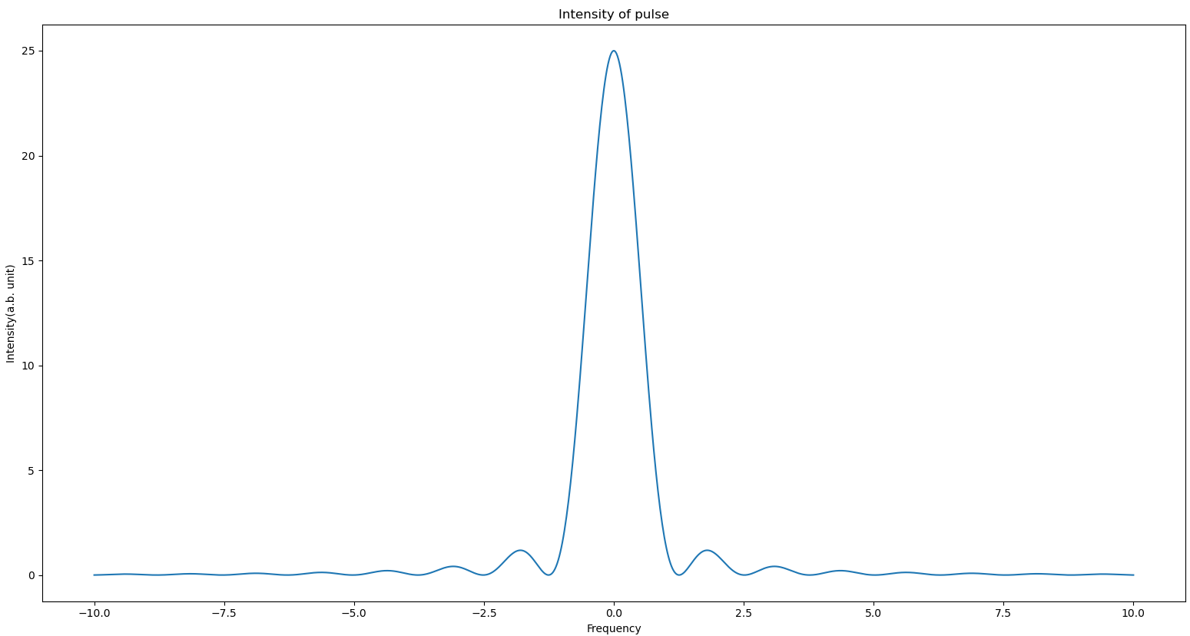
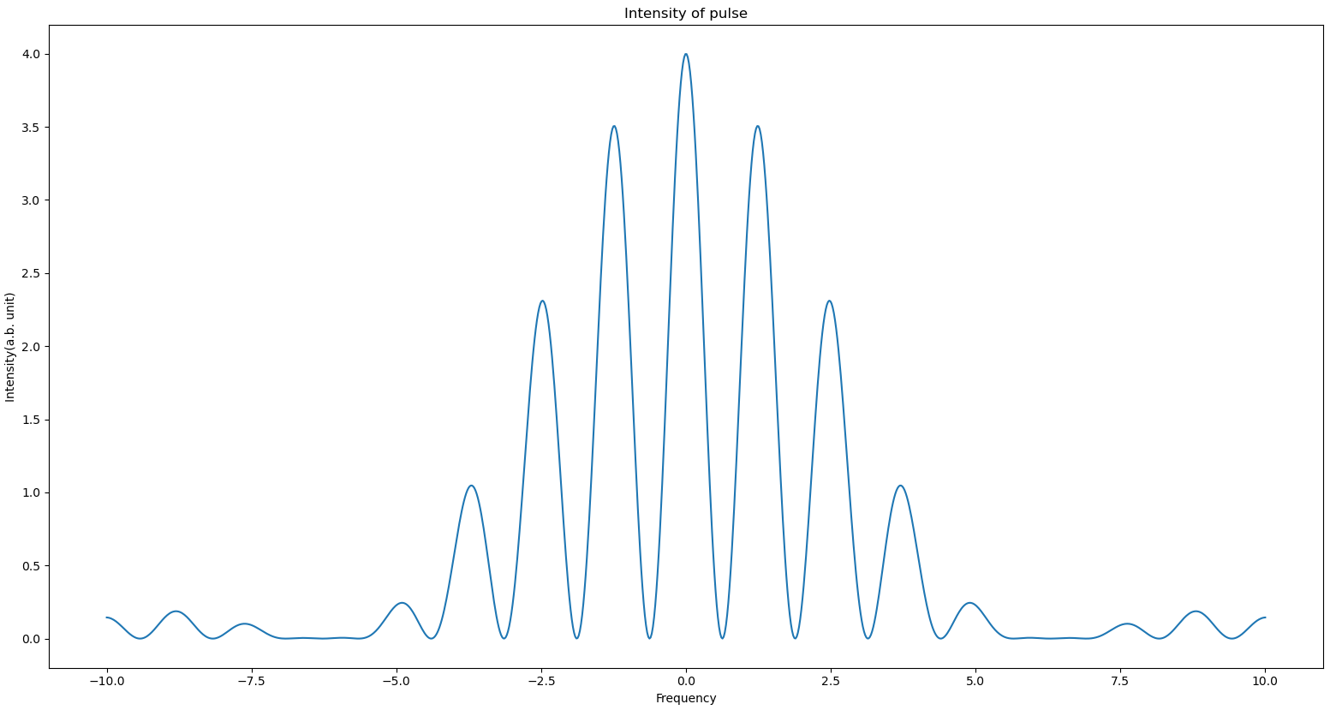
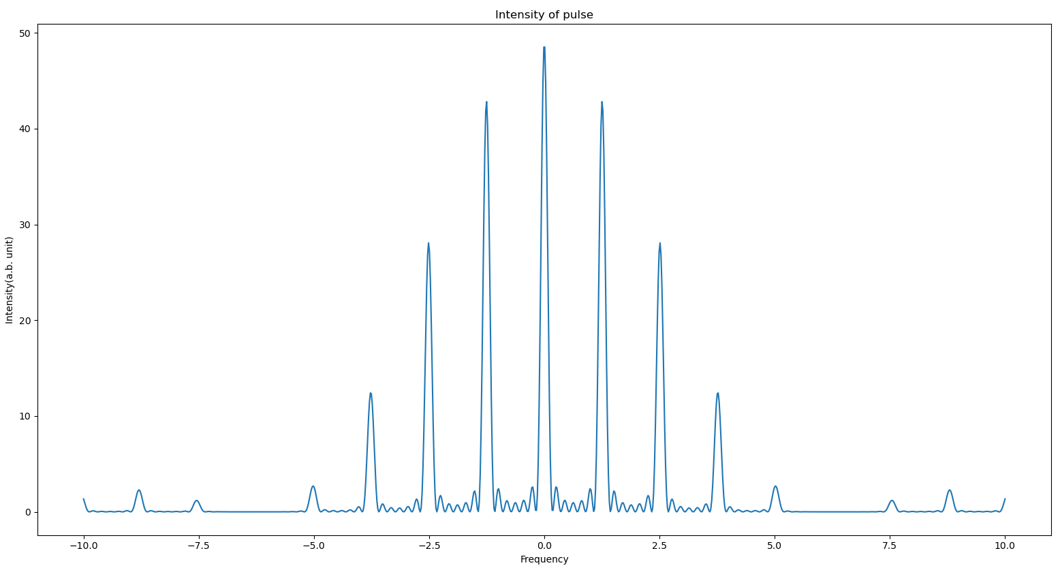

Mode-coupled/locked XFEL
Intensity of radiation $I\left(\overline{L},\overline{ω}\right)={\left|A\left(\overline{L},\overline{ω}\right)\right|}^{2}={\left(\tilde{b}\overline{l}\operatorname{sinc}{\frac{ω\overline{l}}{2}}\right)}^{2}\frac{1−\cos{N\overline{ω}\overline{s}}}{1−\cos{\overline{ω}\overline{s}}}={\left(\tilde{b}\overline{l}\operatorname{sinc}{\frac{ω\overline{l}}{2}}\right)}^{2}\frac{1−\cos{NS_{e}\overline{ω}\overline{l}}}{1−\cos{S_{e}\overline{ω}\overline{l}}}$ ($\overline{L}=N\overline{l}$)
Number of modes: 2N_{e}-1
Mode separation: $∆\overline{ω}=\frac{2π}{\overline{s}}$ corresponding $∆ω=\frac{2π}{T_{s}}=\frac{2πc}{s}$ (T_{s}: time taken for radiation to travel the slippage length)
Mode width: $δω∝{\left(S_{e}N\right)}^{−1}$
S_{e}=1, N=5
S_{e}=5, N=2
S_{e}=5, N=7

Slide 16
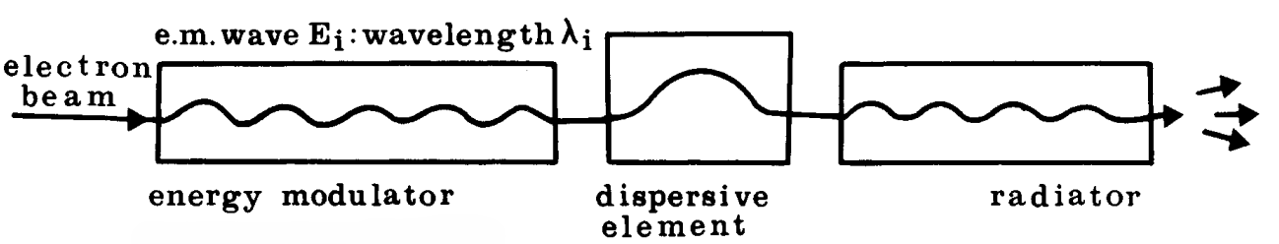
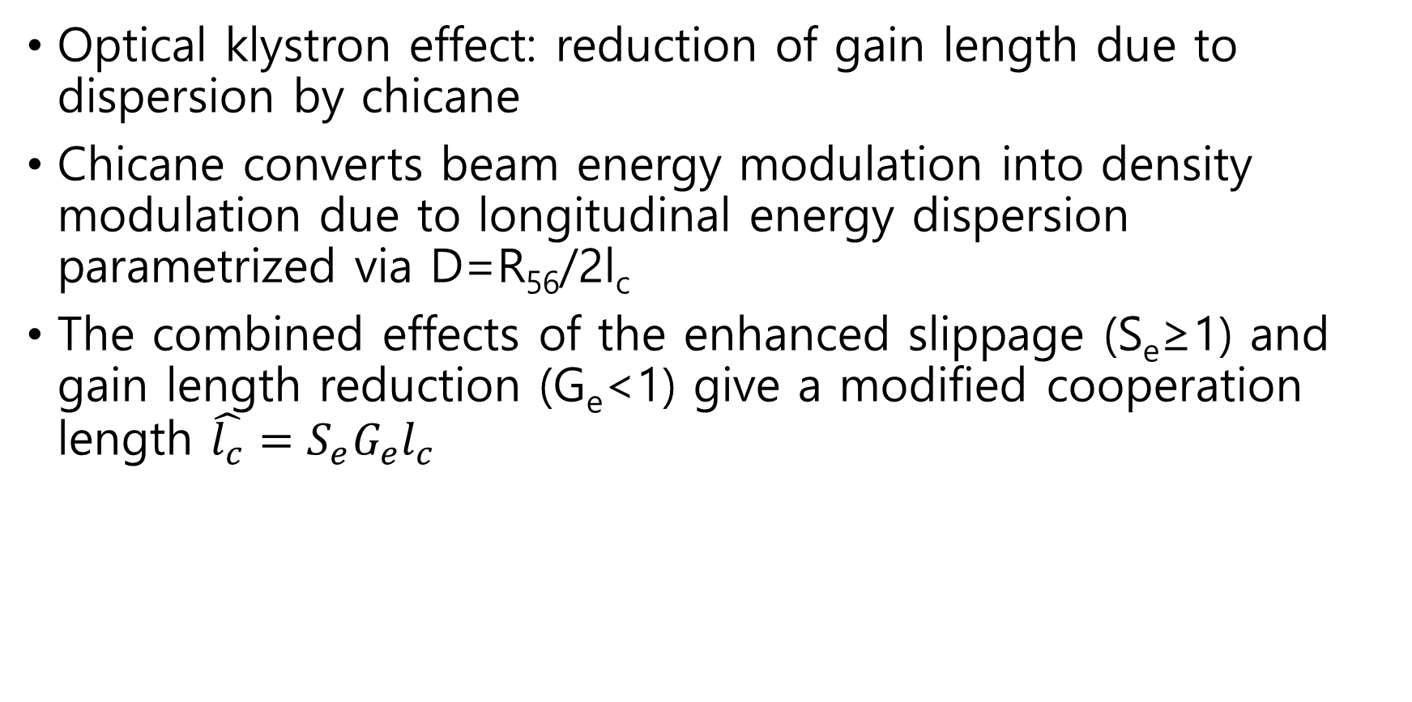
Mode-coupled/locked XFEL
Optical klystron effect: reduction of gain length due to dispersion by chicane
Chicane converts beam energy modulation into density modulation due to longitudinal energy dispersion parametrized via D=R₅₆/2l_{c}
The combined effects of the enhanced slippage (S_{e}≥1) and gain length reduction (G_{e}<1) give a modified cooperation length $\hat{l_{c}}=S_{e}G_{e}l_{c}$
R.Coisson, Particle Accelerators, (1981)

Slide 17
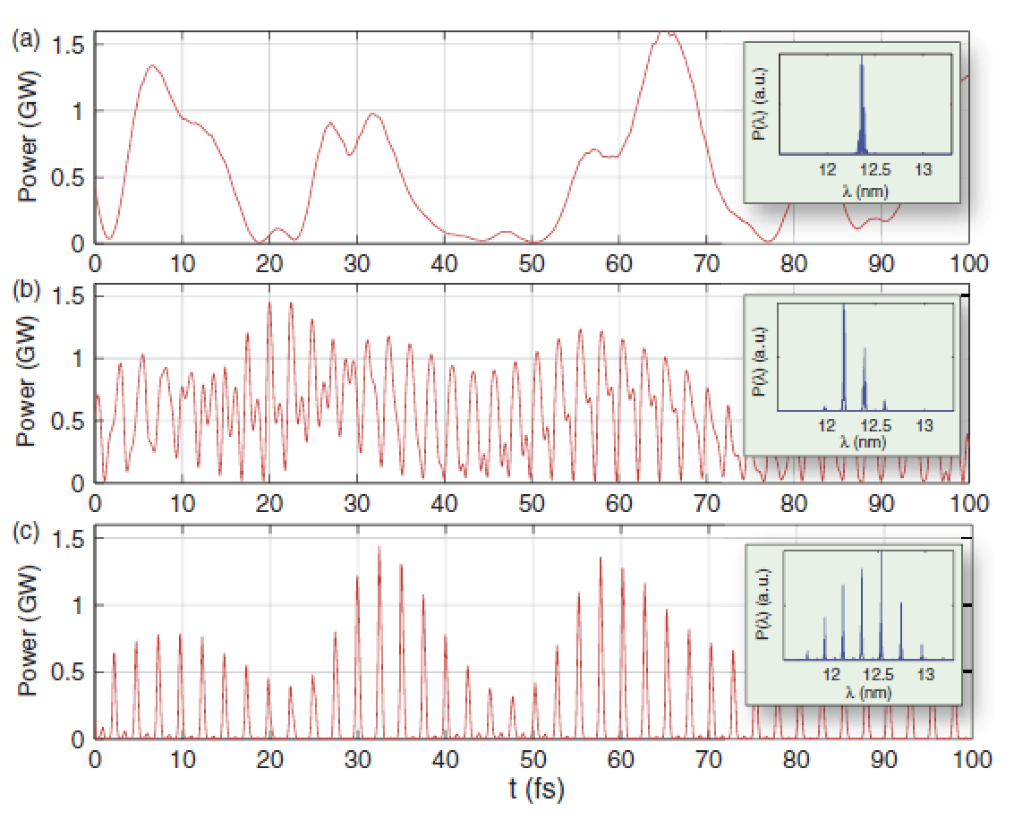
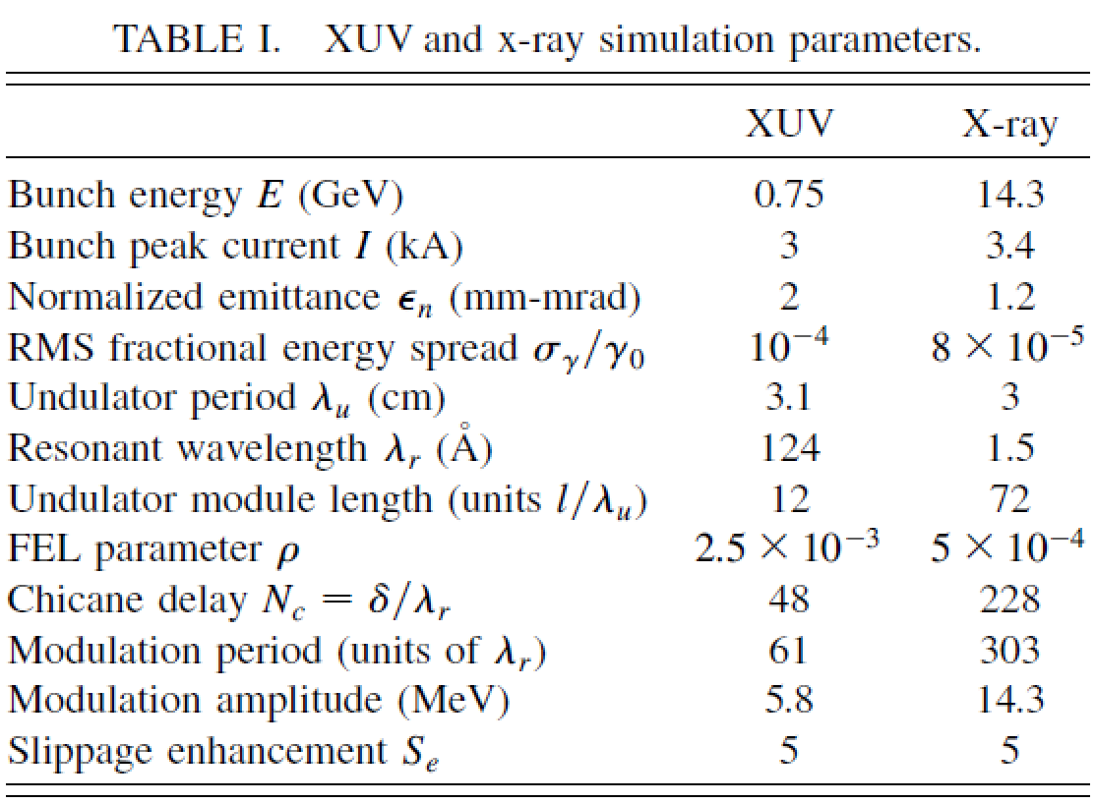
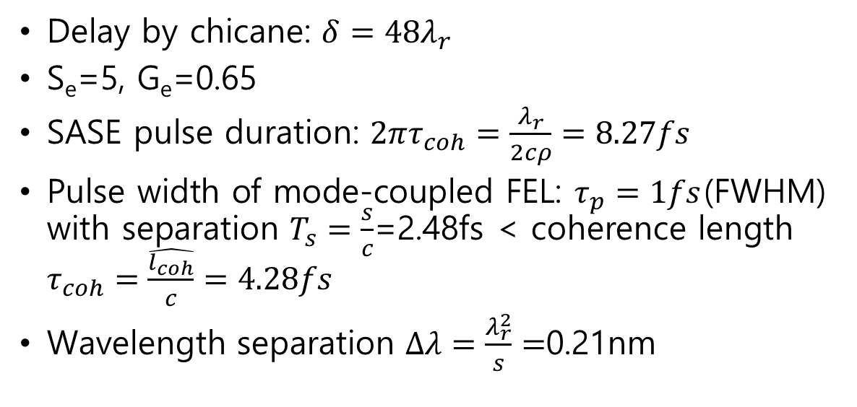
Simulation result(EUV)
Delay by chicane: $δ=48λ_{r}$
S_{e}=5, G_{e}=0.65
SASE pulse duration: $2πτ_{coh}=\frac{λ_{r}}{2cρ}=8.27fs$
Pulse width of mode-coupled FEL: $τ_{p}=1fs$(FWHM) with separation $T_{s}=\frac{s}{c}$=2.48fs < coherence length $τ_{coh}=\frac{\hat{l_{coh}}}{c}=4.28fs$
Wavelength separation $∆λ=\frac{λ_{r}^{2}}{s}=$0.21nm

Slide 18
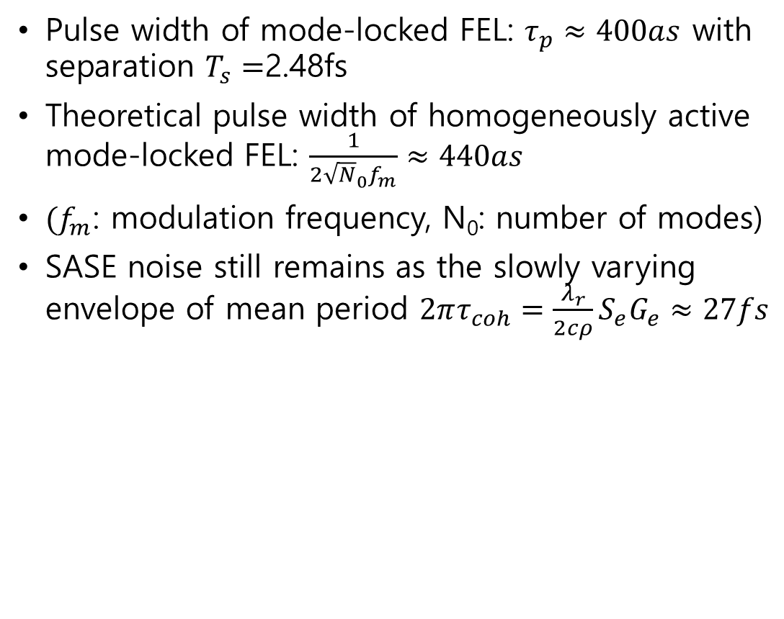
Simulation result(EUV)
Pulse width of mode-locked FEL: $τ_{p}≈400as$ with separation $T_{s}=$2.48fs
Theoretical pulse width of homogeneously active mode-locked FEL: $\frac{1}{2{\sqrt{N}}_{0}f_{m}}≈440as$
$(f_{m}$: modulation frequency, N₀: number of modes)
SASE noise still remains as the slowly varying envelope of mean period $2πτ_{coh}=\frac{λ_{r}}{2cρ}S_{e}G_{e}≈27fs$

Slide 19
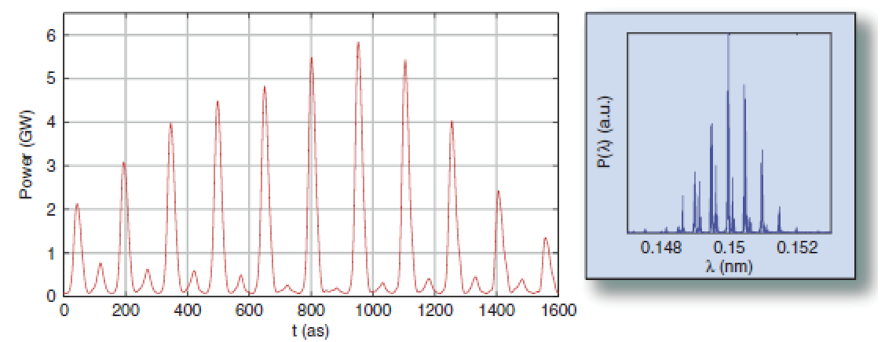

Simulation result(X-ray, LCLS)
Pulse width of mode-locked FEL: $τ_{p}≈23as$ with separation $T_{s}=\frac{s}{c}=\frac{300λ_{r}}{c}=$150as
Theoretical pulse width of homogeneously mode-locked FEL: $\frac{1}{2{\sqrt{N}}_{0}f_{m}}≈23as$

Slide 20
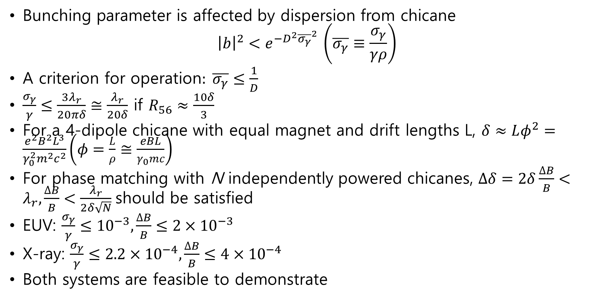
Simulation result
Bunching parameter is affected by dispersion from chicane
$${\left|b\right|}^{2}<e^{−D^{2}{\overline{σ_{γ}}}^{2} }\left(\overline{σ_{γ}}≡\frac{σ_{γ}}{γρ}\right)$$
A criterion for operation$: \overline{σ_{γ}}≤\frac{1}{D}$
$\frac{σ_{γ}}{γ}≤\frac{3λ_{r}}{20πδ}≅\frac{λ_{r}}{20δ}$ if $R_{56}≈\frac{10δ}{3}$
For a 4-dipole chicane with equal magnet and drift lengths L, $δ≈Lφ^{2}=\frac{e^{2}B^{2}L^{3}}{γ_{0}^{2}m^{2}c^{2}}\left(φ=\frac{L}{ρ}≅\frac{eBL}{γ_{0}mc}\right)$
For phase matching with N independently powered chicanes, $∆δ=2δ\frac{∆B}{B}<λ_{r},\frac{∆B}{B}<\frac{λ_{r}}{2δ\sqrt{N}}$should be satisfied
EUV: $\frac{σ_{γ}}{γ}≤{10}^{−3},\frac{∆B}{B}≤2×{10}^{−3}$
X-ray: $\frac{σ_{γ}}{γ}≤2.2×{10}^{−4},\frac{∆B}{B}≤4×{10}^{−4}$
Both systems are feasible to demonstrate

Slide 21
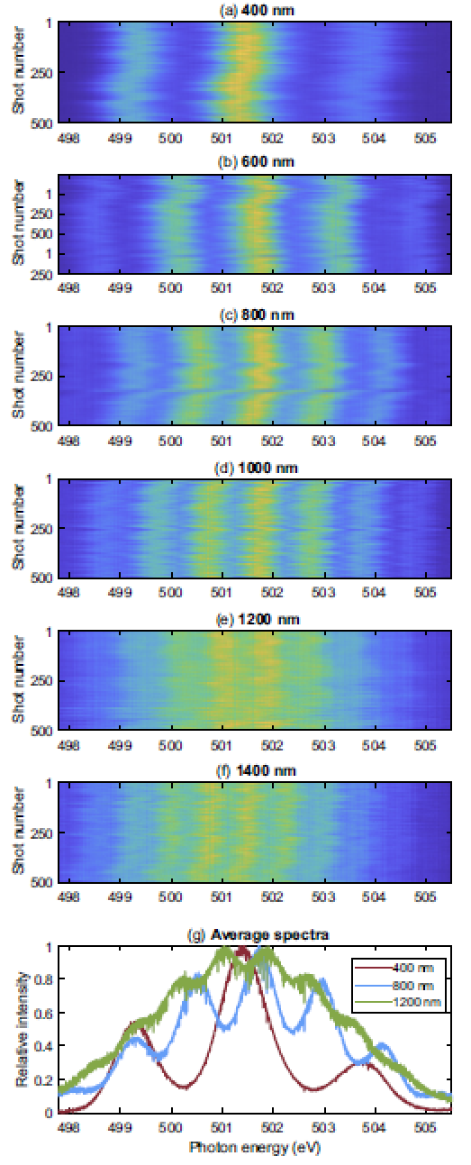
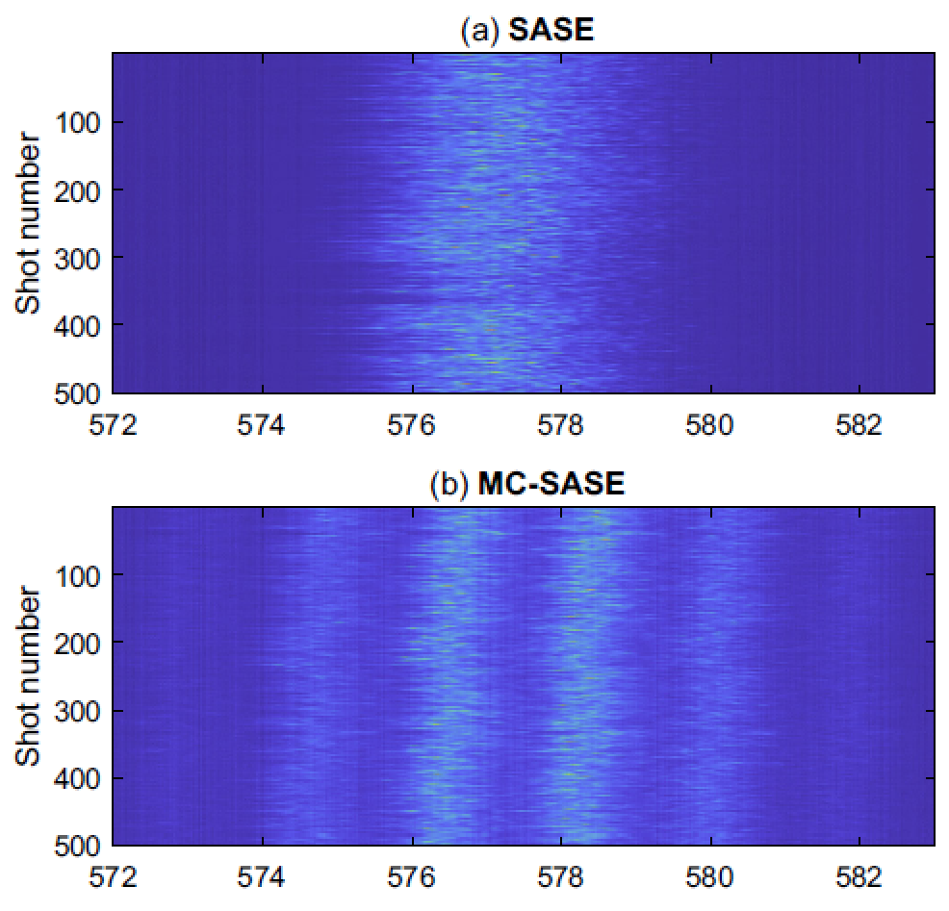
Experiment result in SwissFEL
Athos(3.4GeV)
16 undulators modules, 52 periods×3.8 cm≈2 m each
- nine undulators were used for MC-SASE
Photon energy: 500~600eV
Delay by chicane: 2fs(600nm)
E. Prat et al. PRL 133, 205001 (2024)

Slide 22
Conclusion
Mode-locking of FEL can be demonstrated by equally, periodically delaying electron bunch via chicane and modulator laser
Reduction of pulse length to tens~hundreds of attoseconds
Limitation: lower spectral brightness compared to SASE, undulator shorter than saturation length required, wavelength of modulator laser should be changed when changing electron delay

