Slide 1
Spinning Beam
2025-10-31

Slide 2
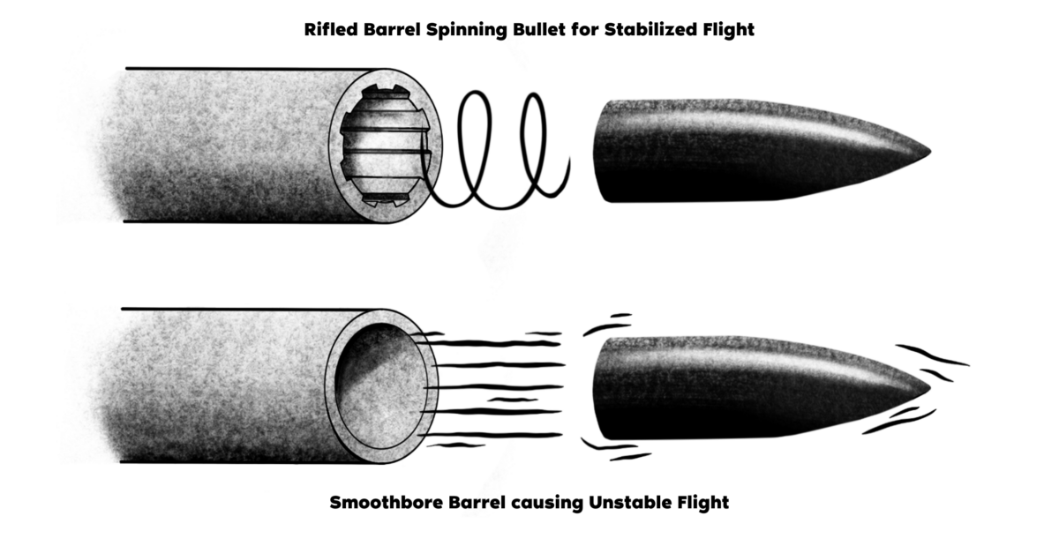
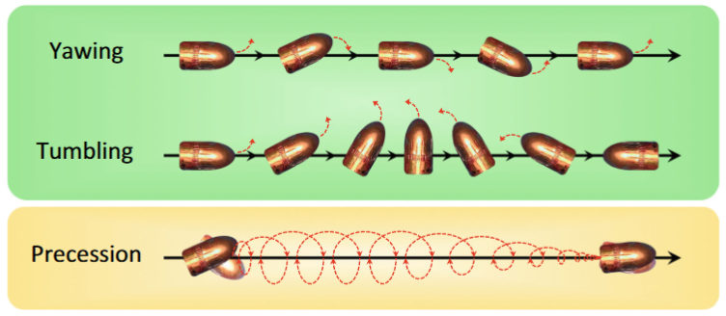
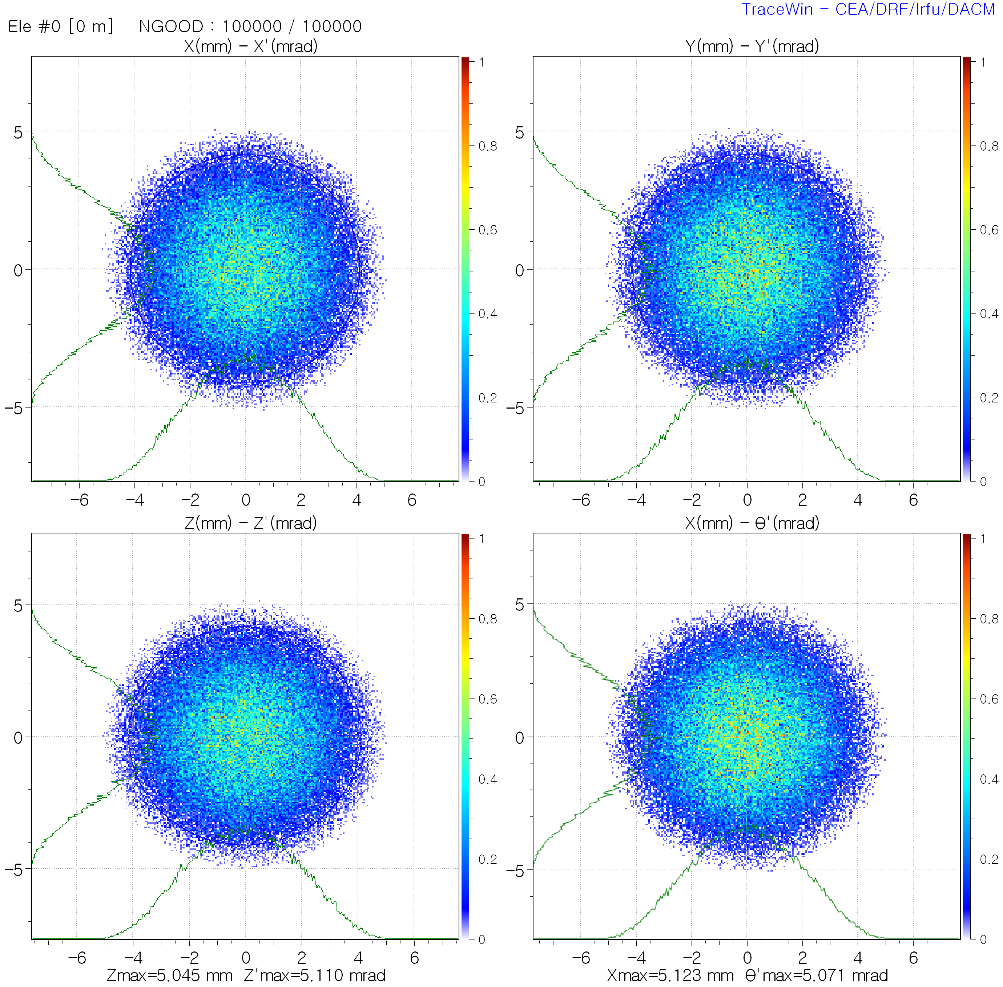
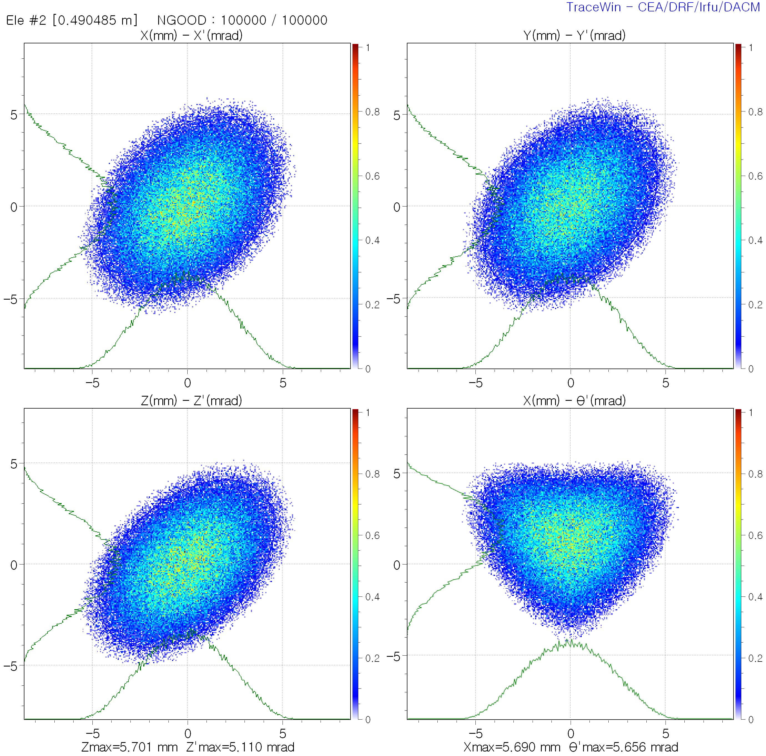
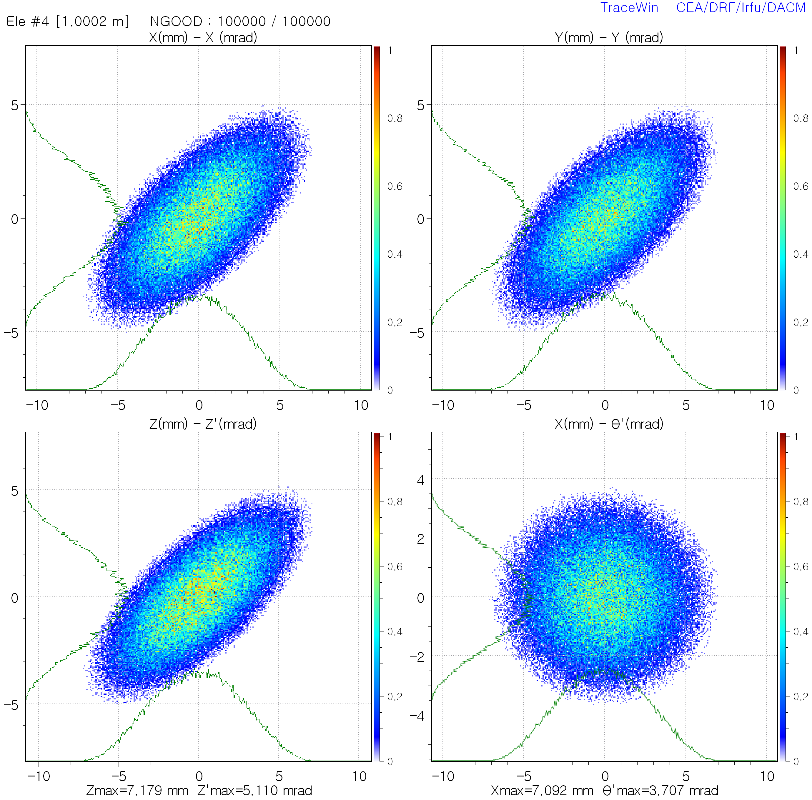





Spinning Bullet $→$Spinning Beam
Electron accelerator: generate spinning beams by applying B-field at the electron beam gun position
Hadron accelerator: generate spinning beams using a solenoid and charge stripping
Solenoid
$$L_{can}=L_{mech}=0$$
$$L_{can}=L_{mech}+qr×A=0$$
$L_{can}=L_{mech}=0$
$$A≠0, L_{mech}≠0$$

Slide 3
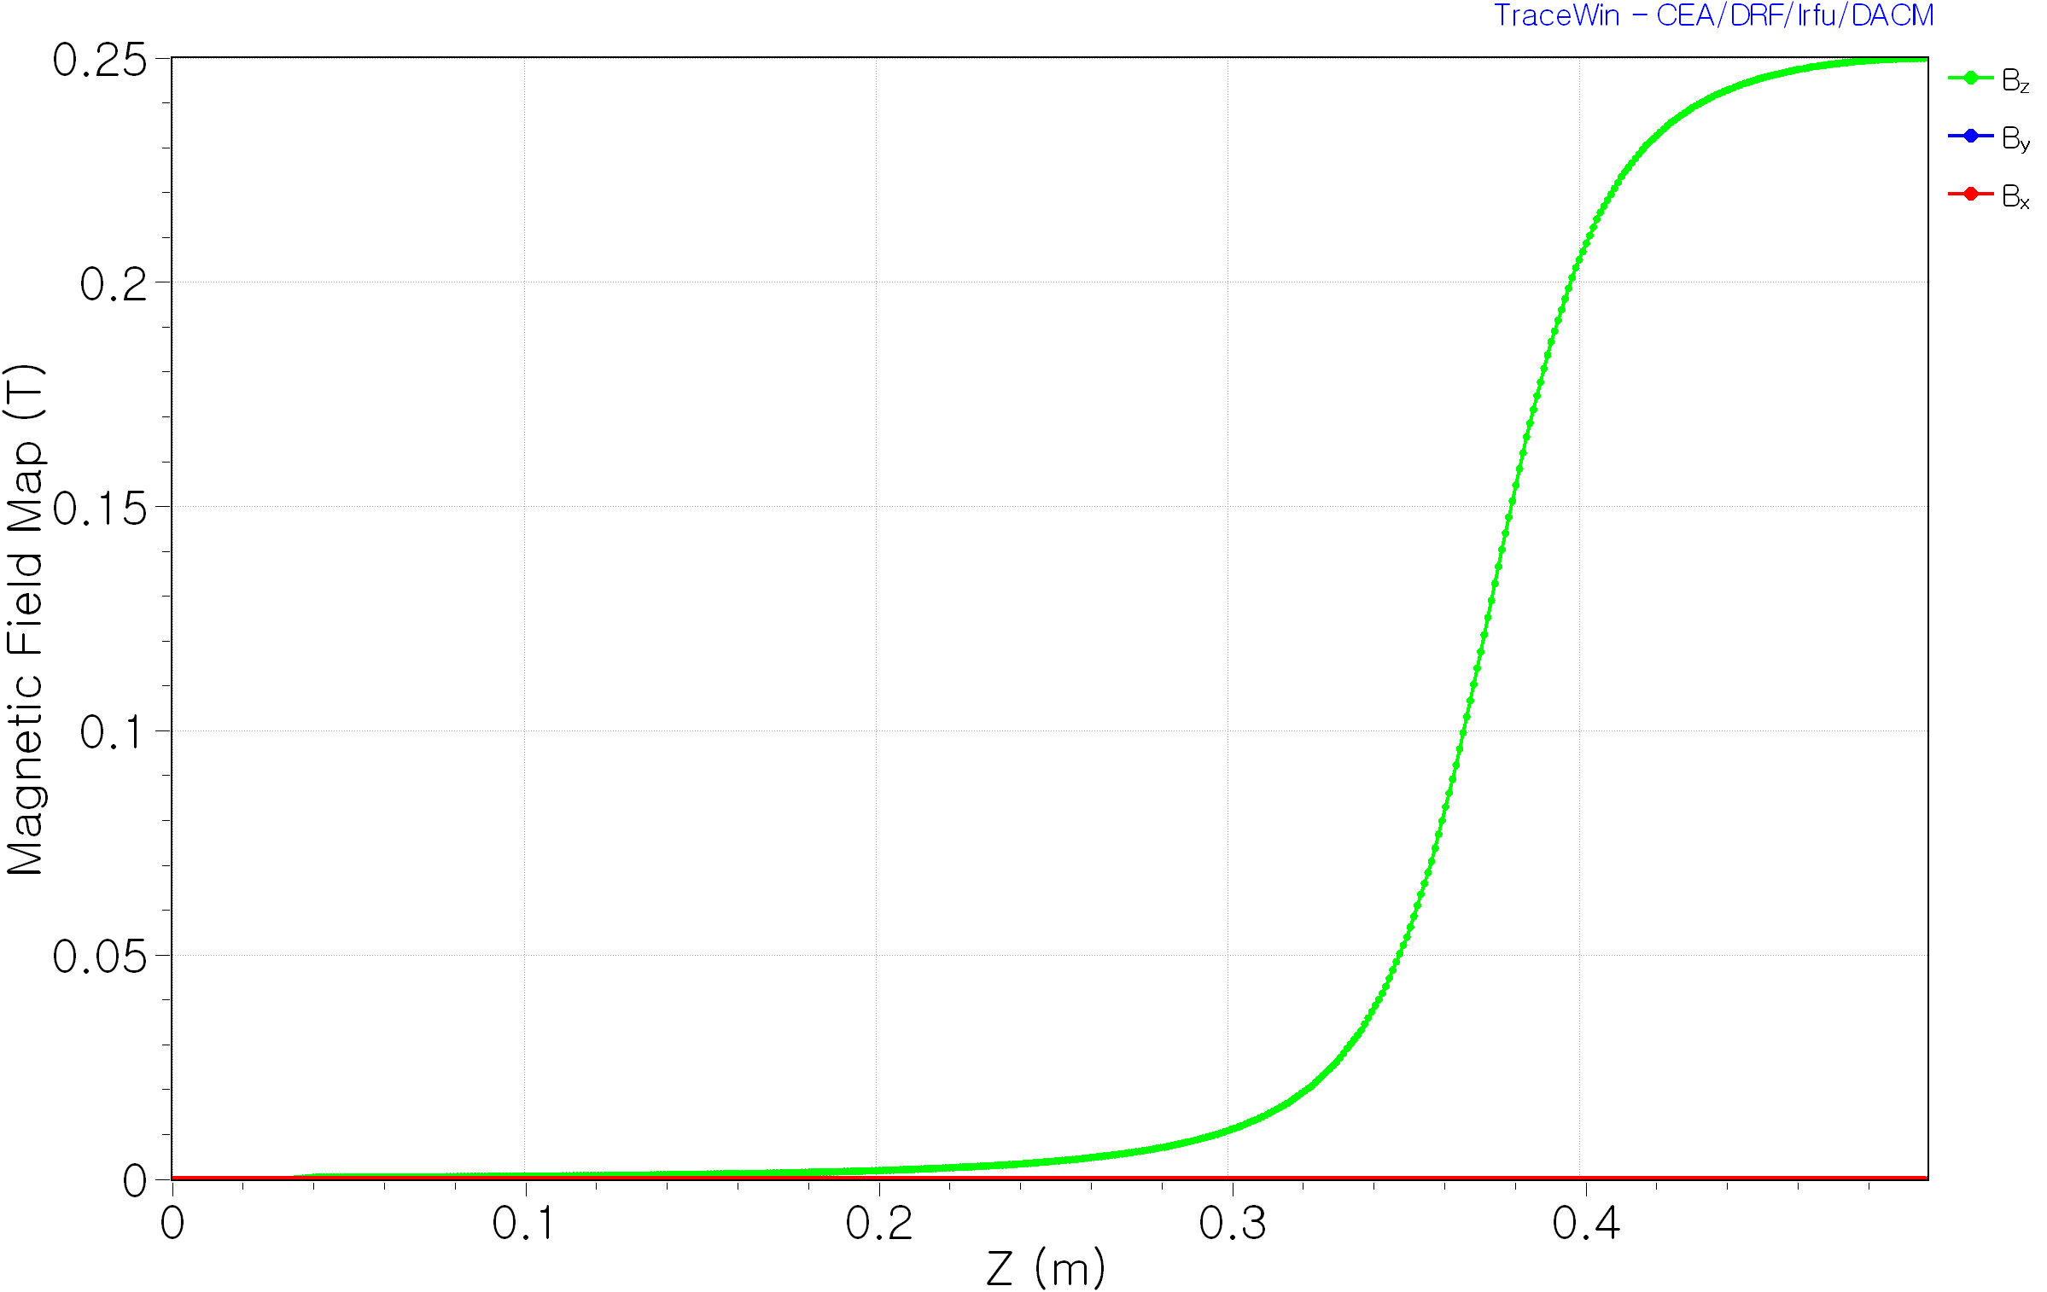
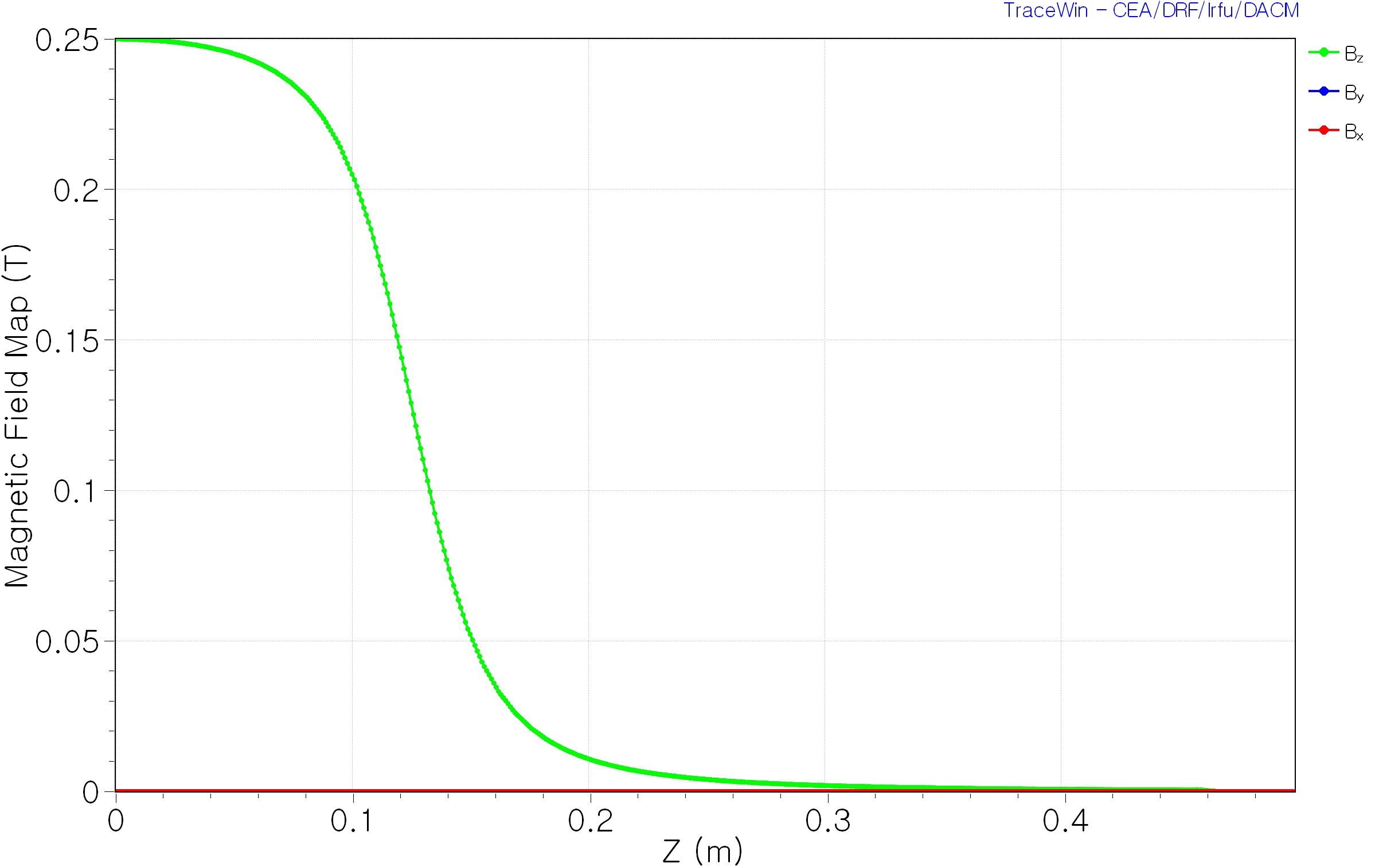
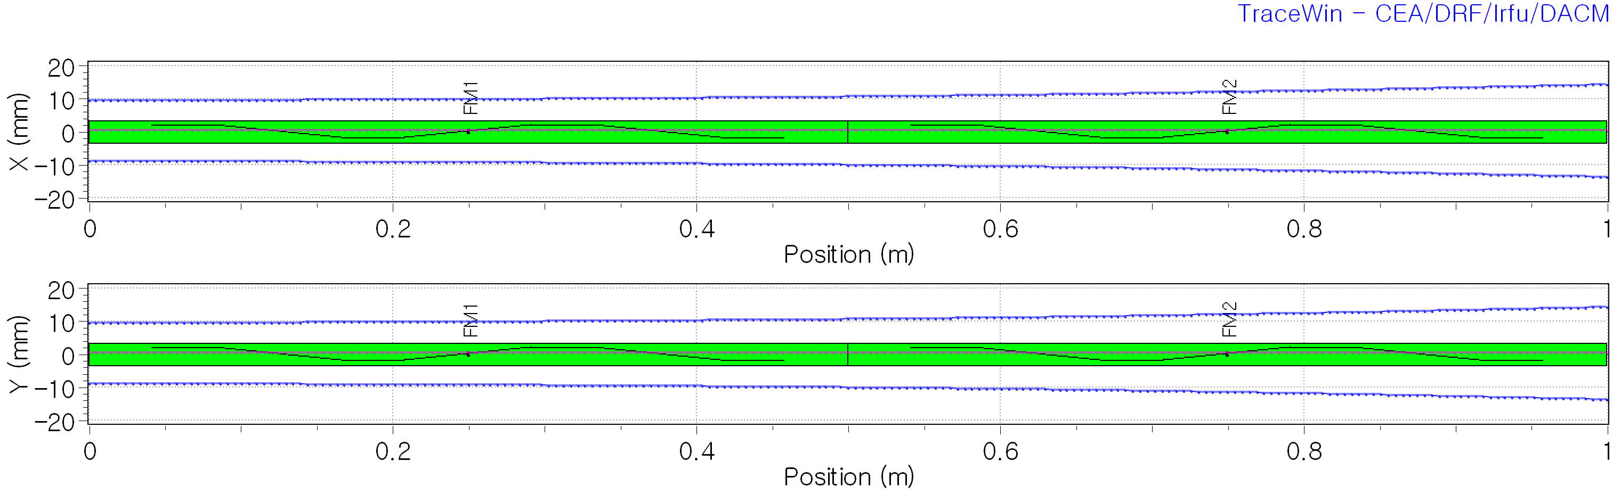
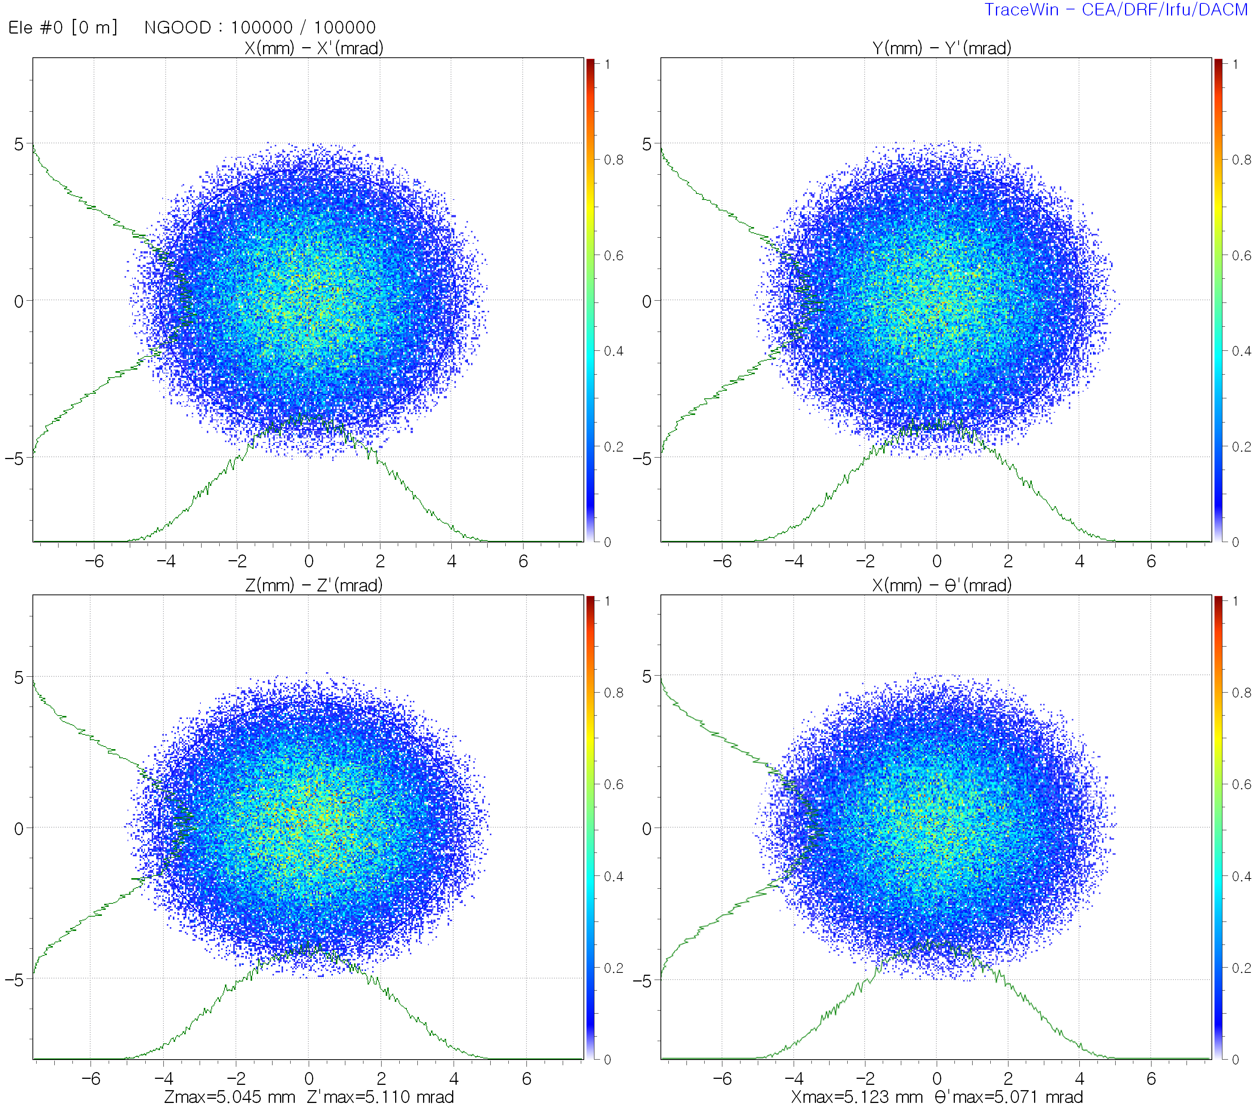
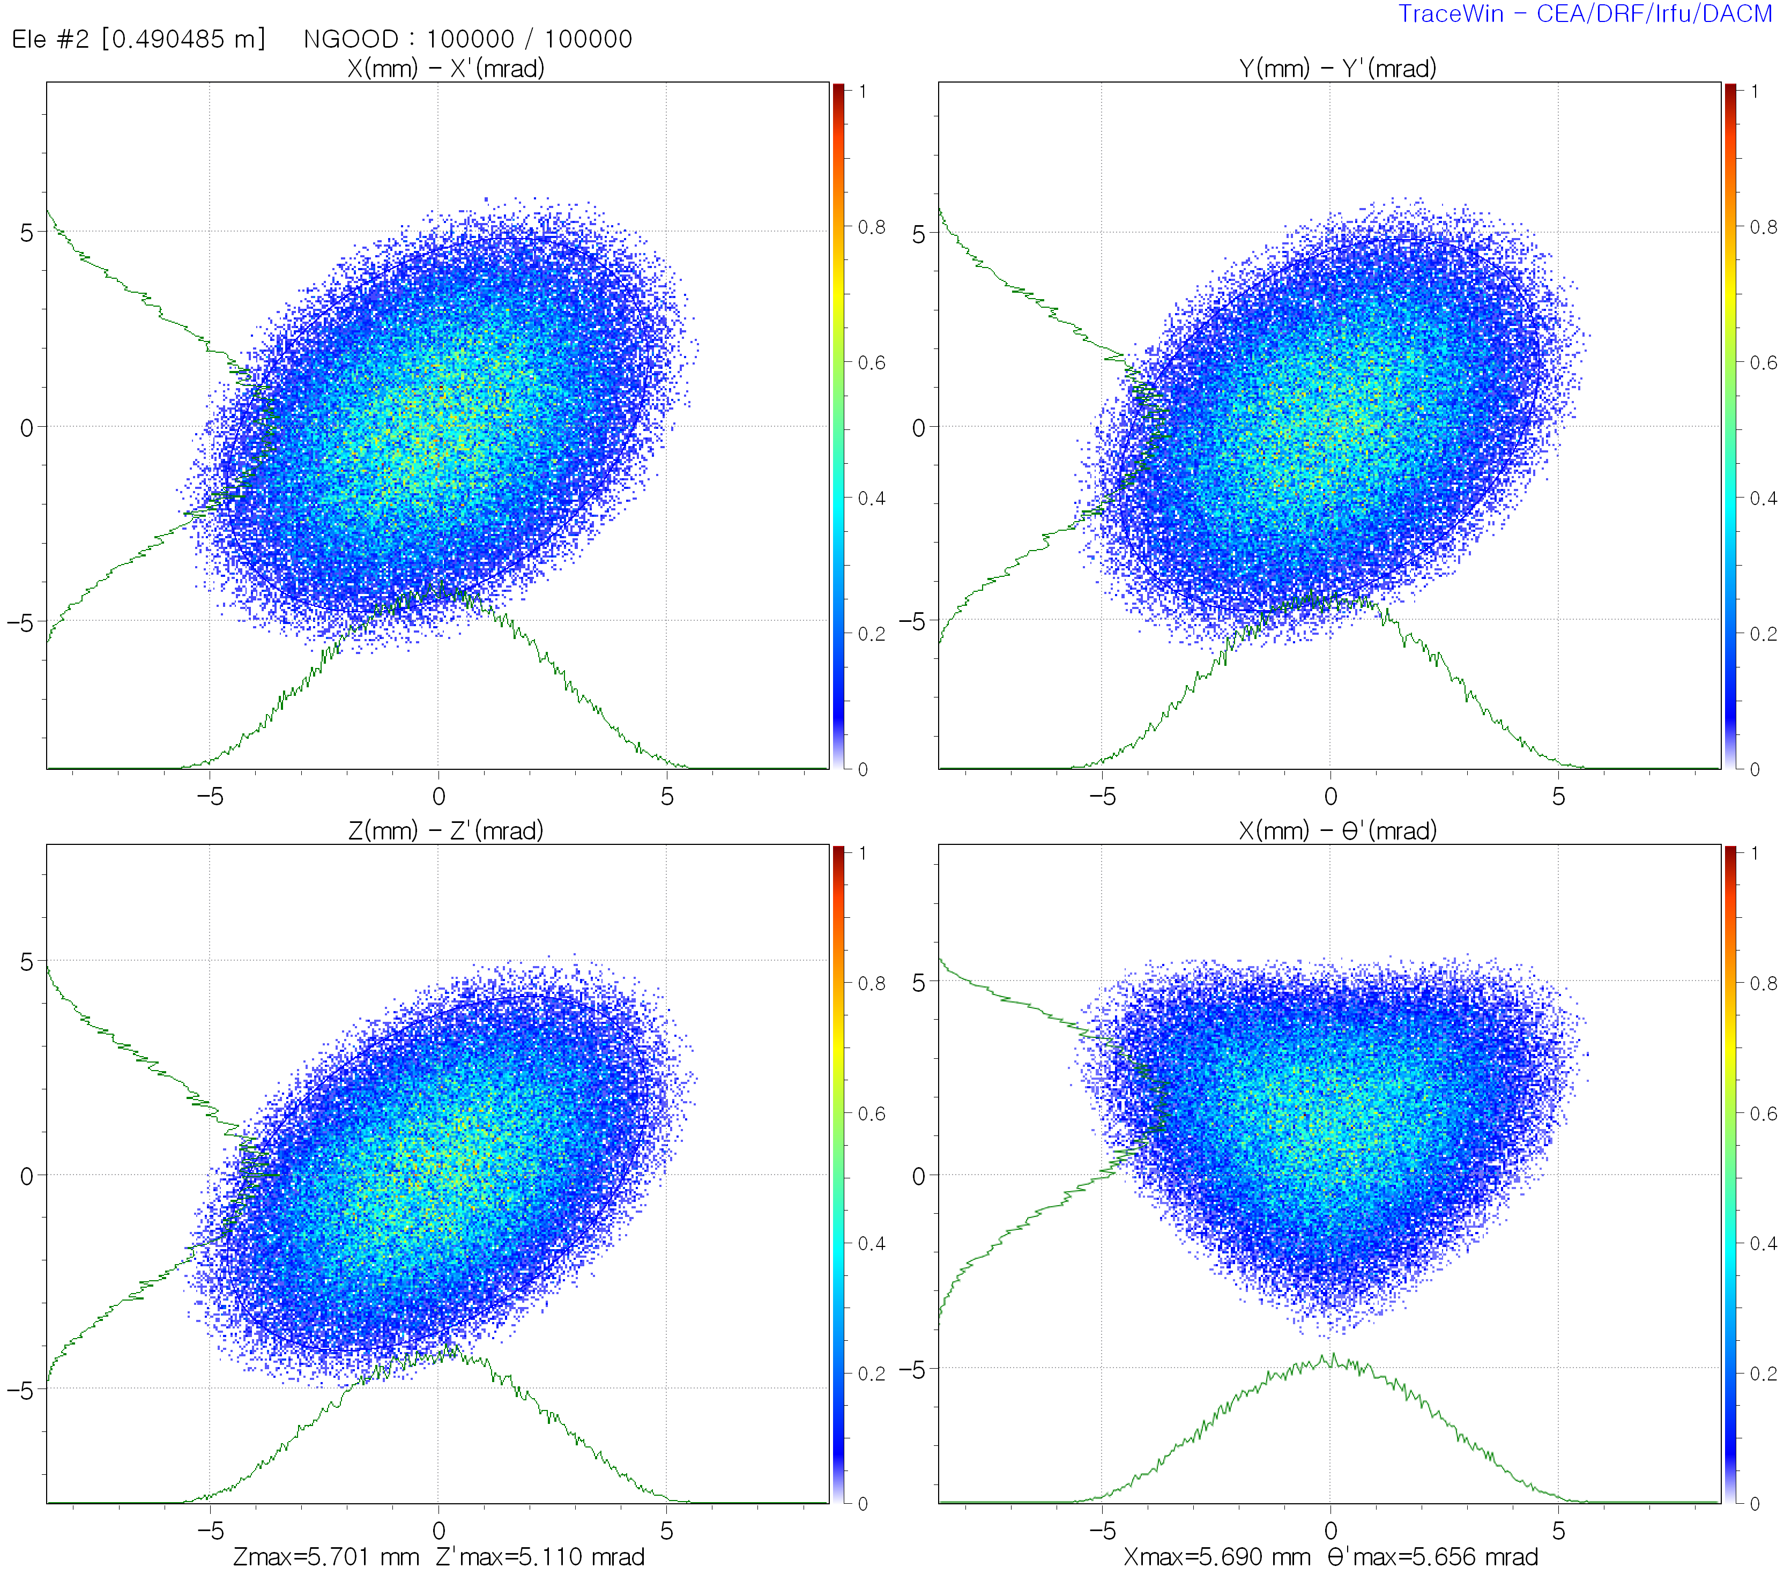
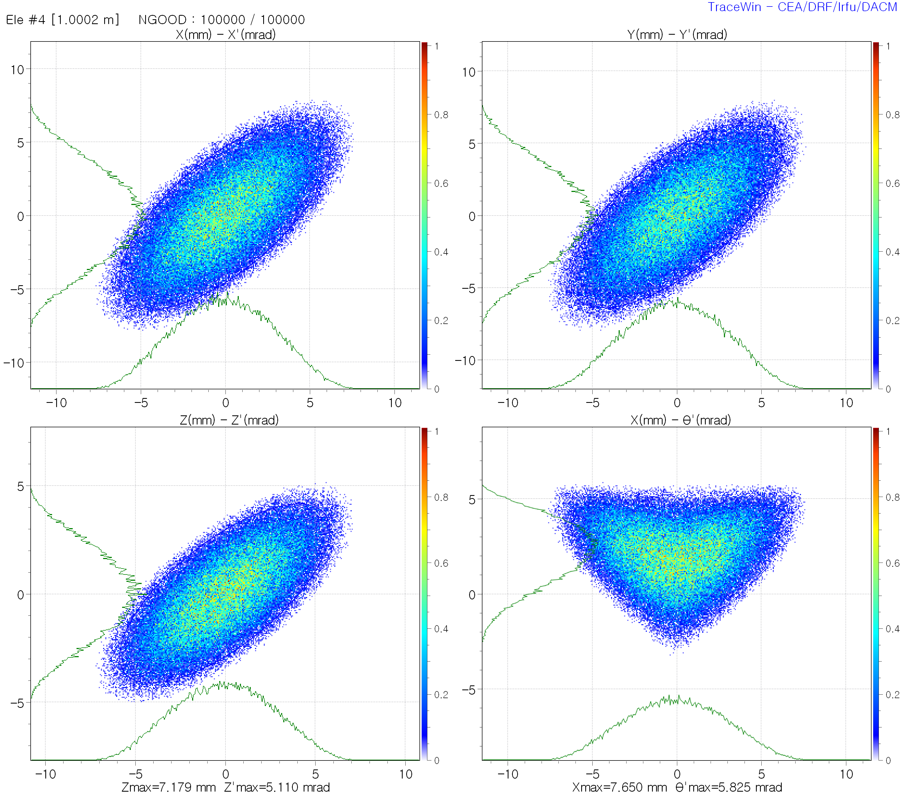

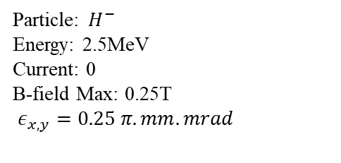



Spinning Beam Generation
$$H^{−}→H^{+}$$
Particle: $H^{−}$
Energy: 2.5MeV
Current: 0
B-field Max: 0.25T
$ε_{x,y}=0.25 π.mm.mrad$
Input $H^{−}$
$$\left\langle P_{θ}\right\rangle =0mm.mrad$$
Charge stripping $H^{−}→H^{+}$ $\left\langle P_{θ}\right\rangle =4.625mm.mrad$
Output $H^{+}$
$$\left\langle P_{θ}\right\rangle =9.322mm.mrad$$

Slide 4
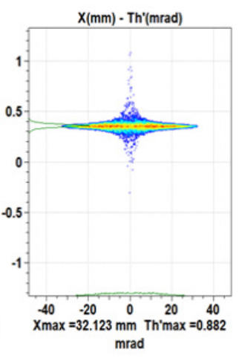
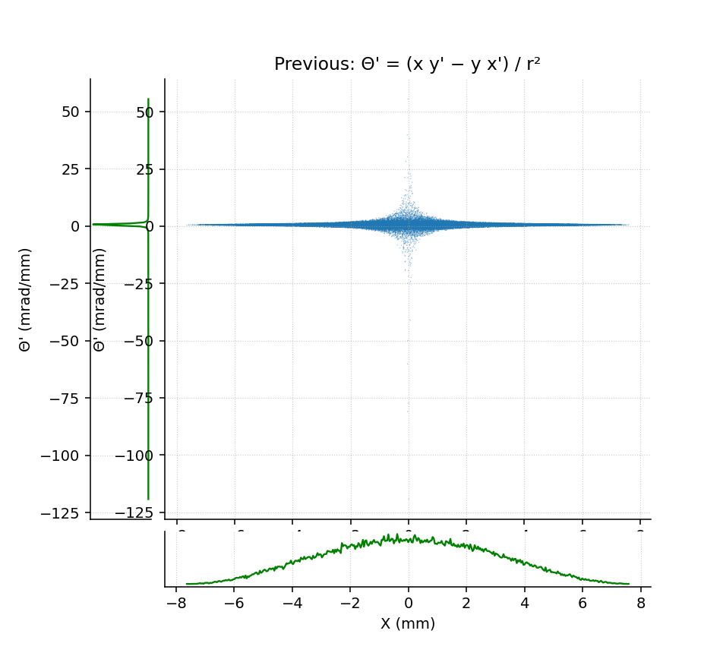
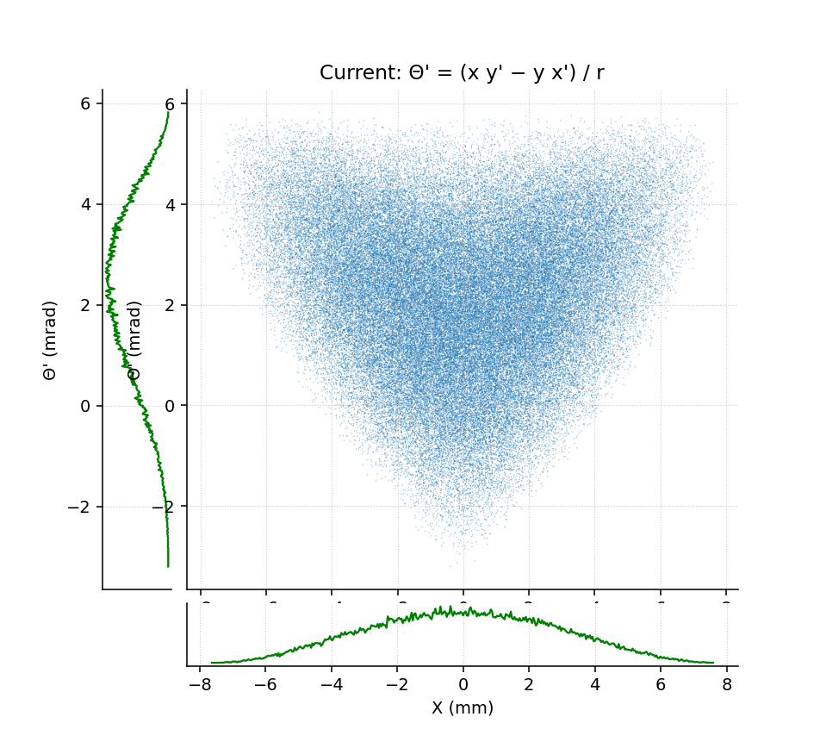
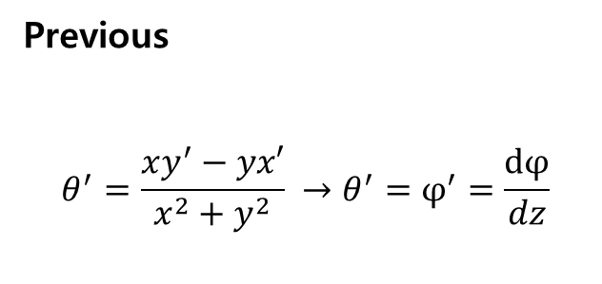
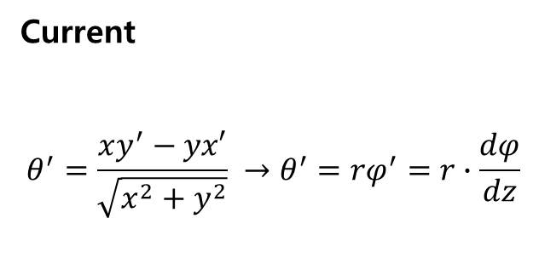
Previous
$$θ^{′}=\frac{xy^{′}−yx′}{x^{2}+y^{2}} →θ^{′}=φ^{′}=\frac{dφ}{dz}$$
Current
$$θ^{′}=\frac{xy^{′}−yx′}{\sqrt{x^{2}+y^{2}}} →θ^{′}=rφ^{′}=r∙\frac{dφ}{dz}$$

Slide 5
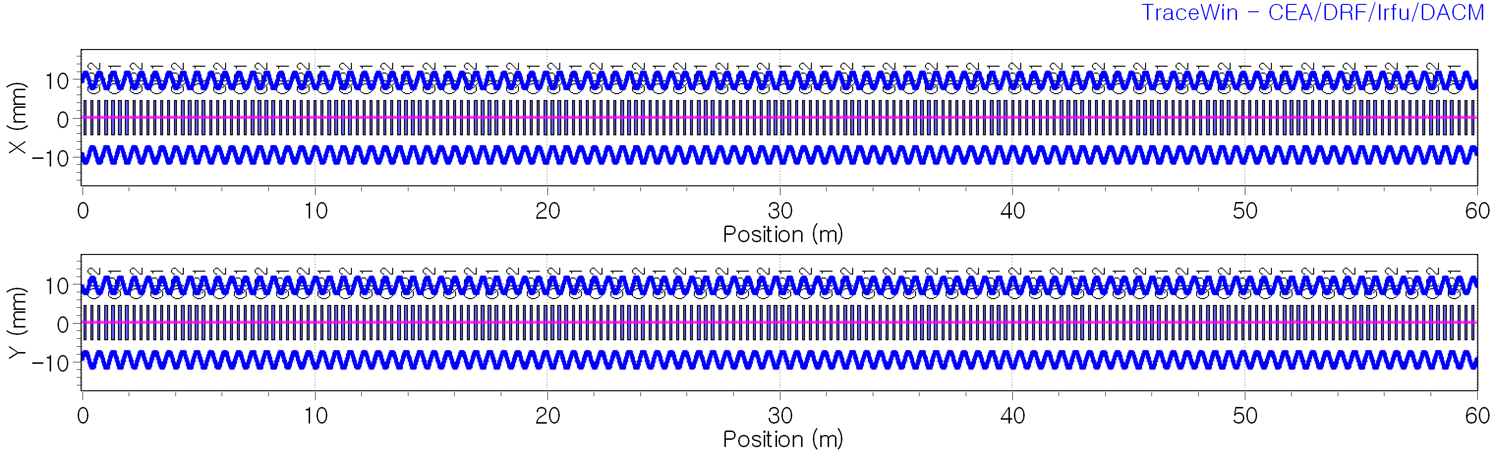
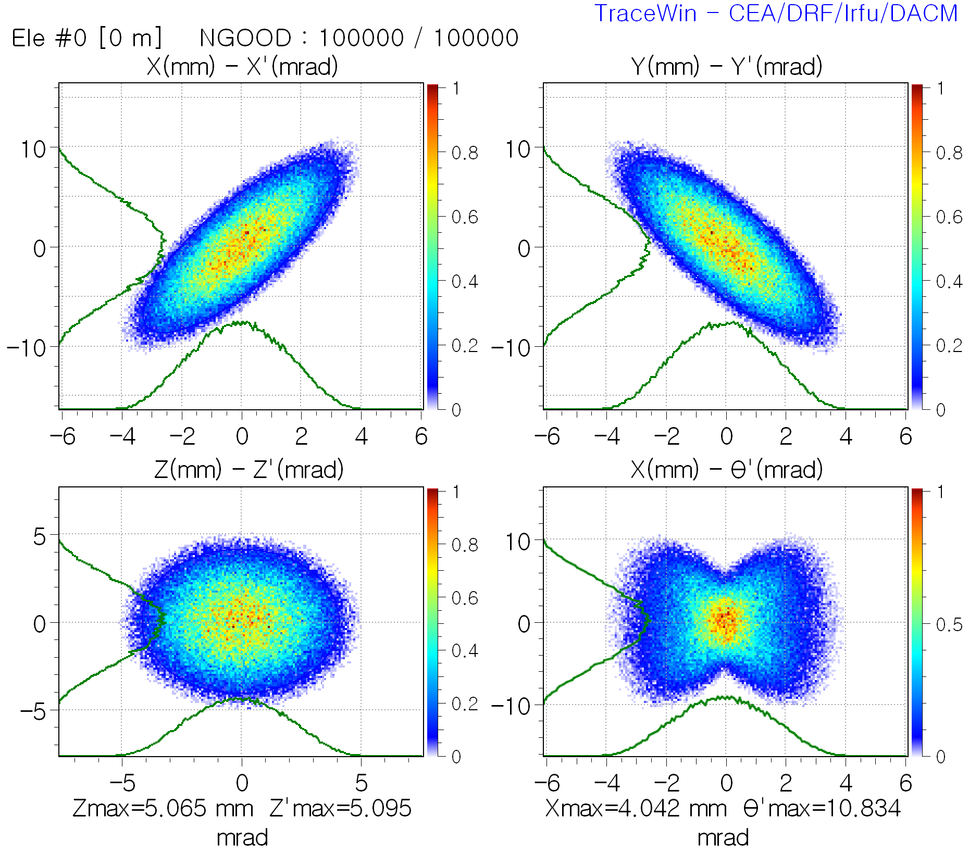
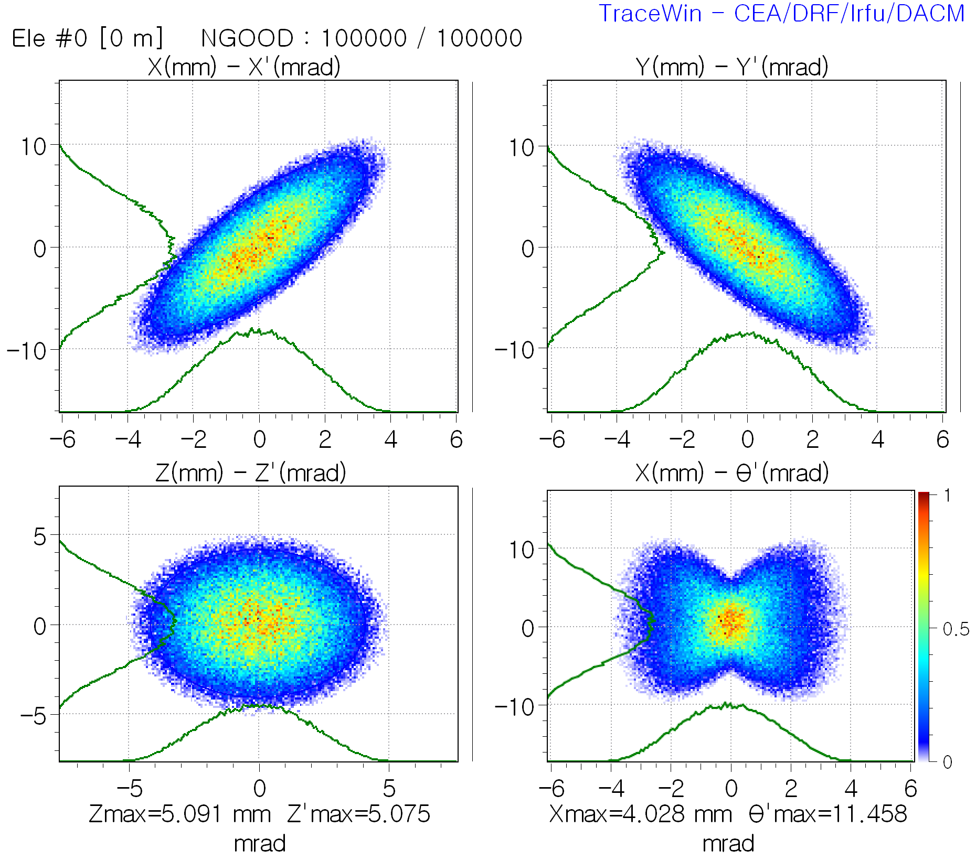
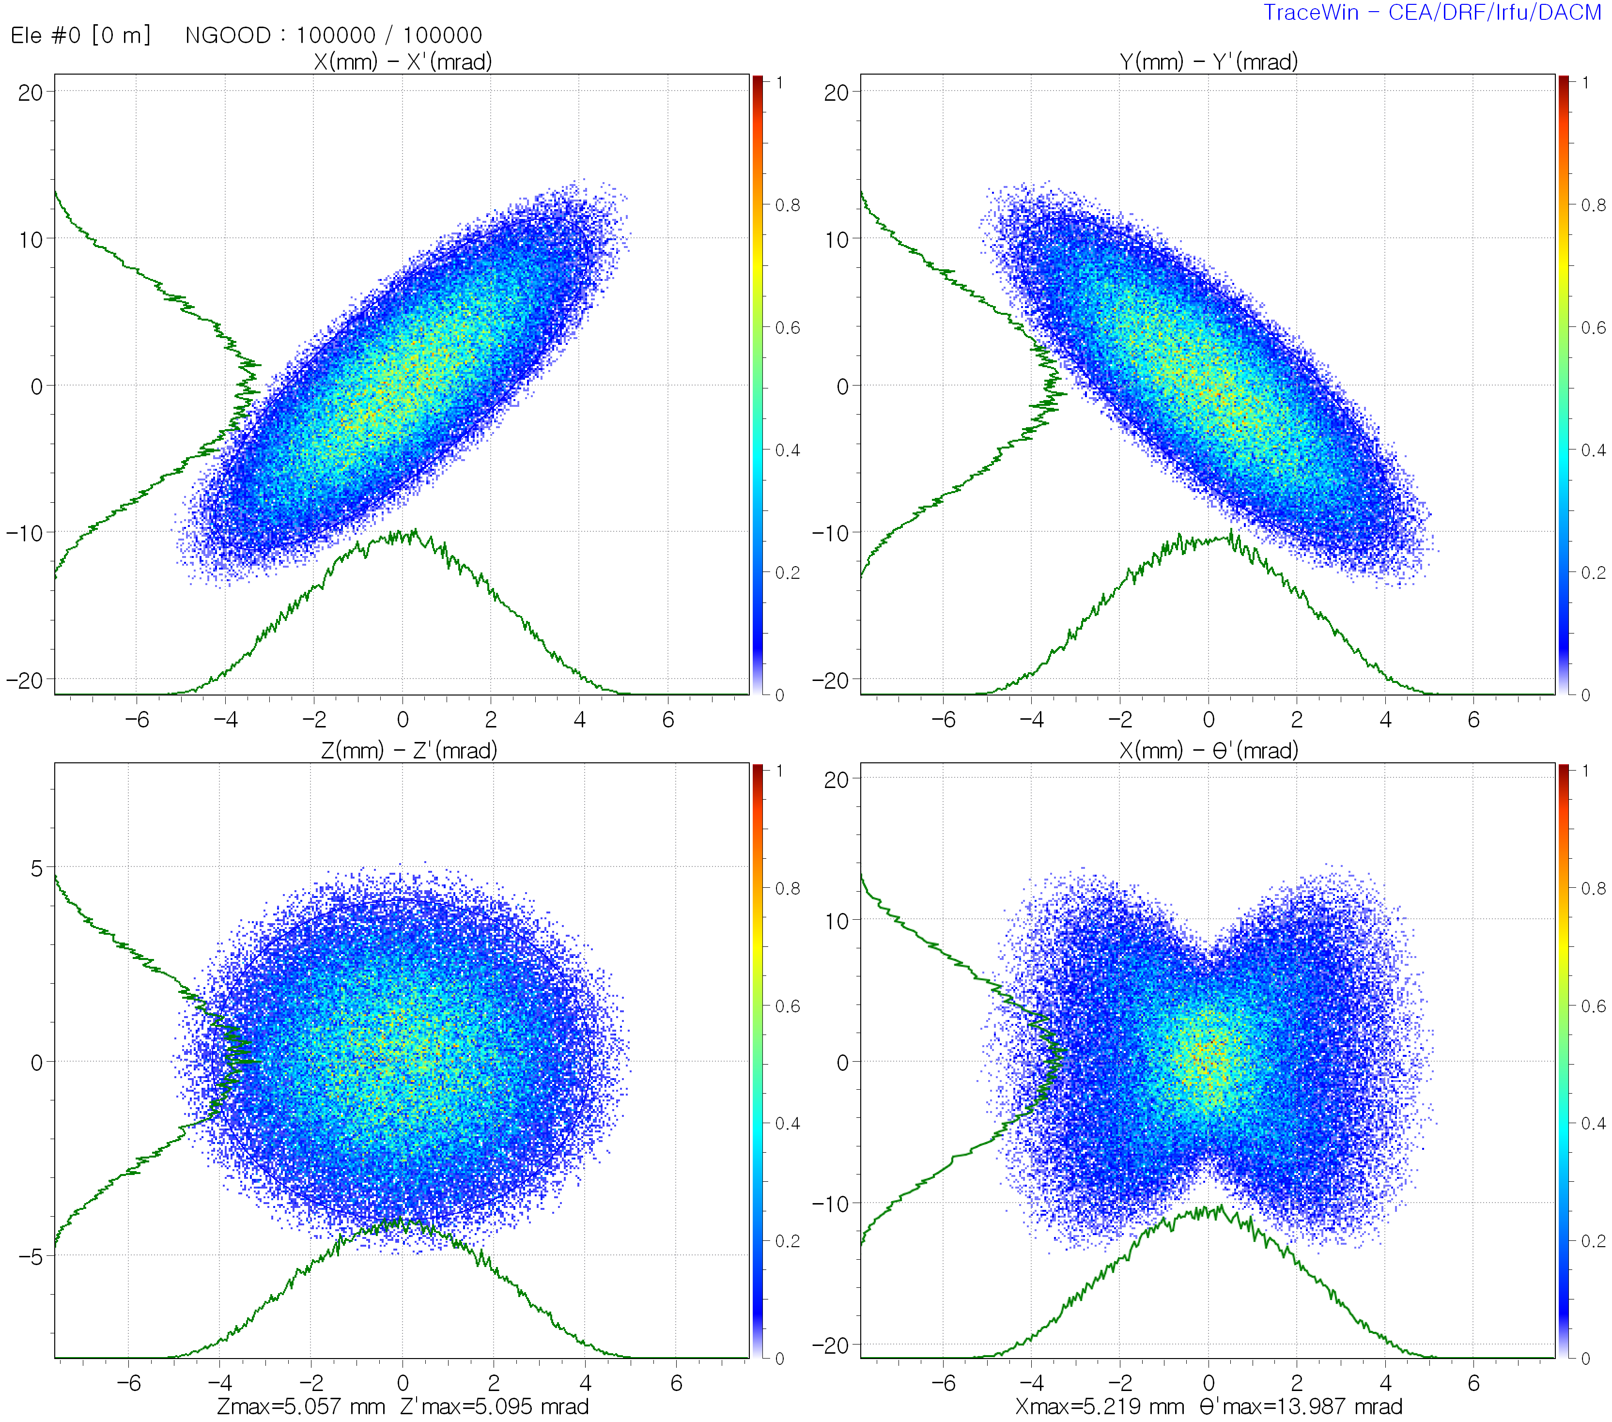
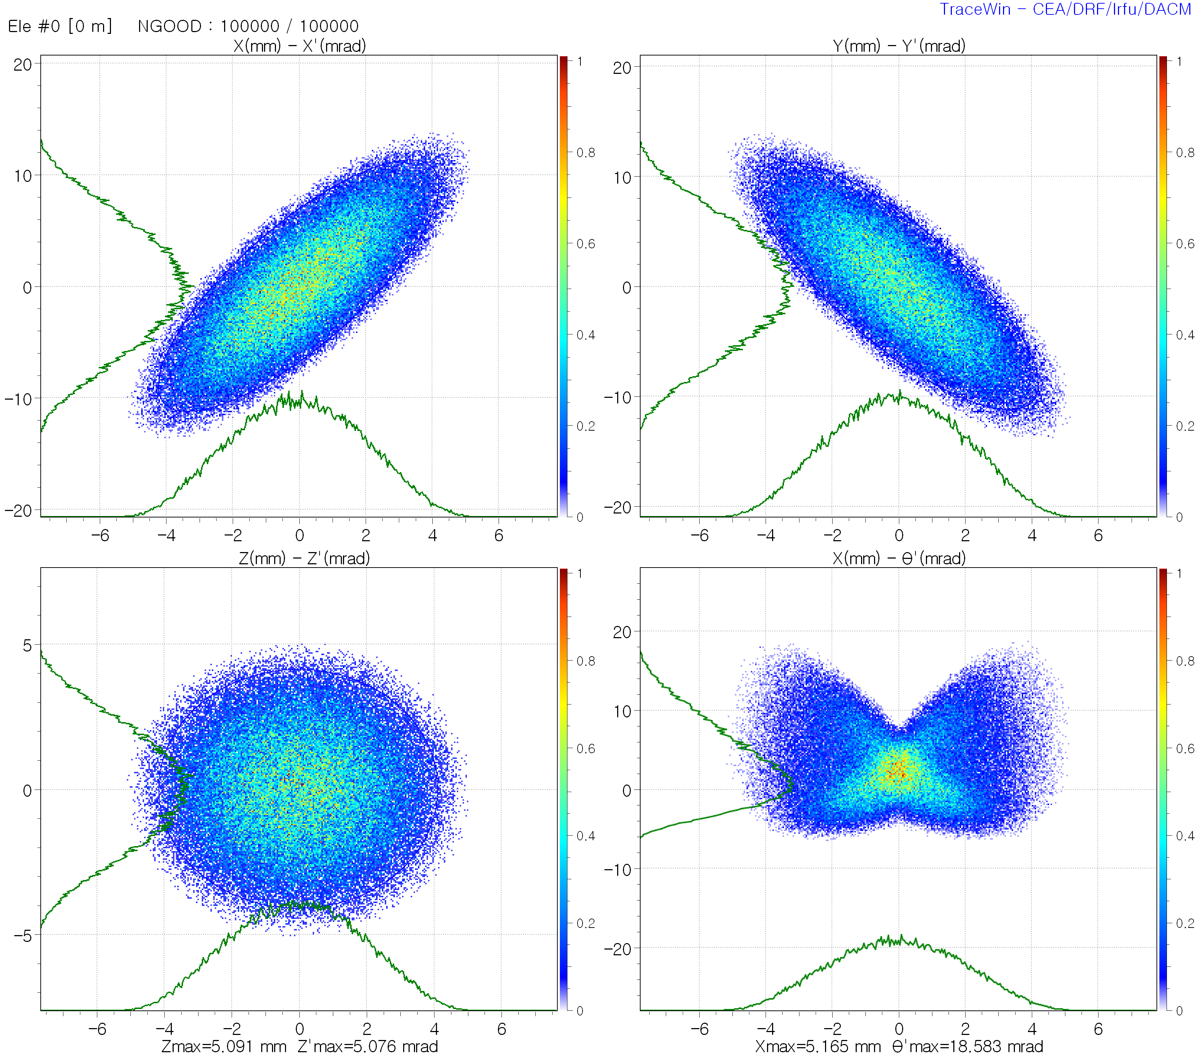



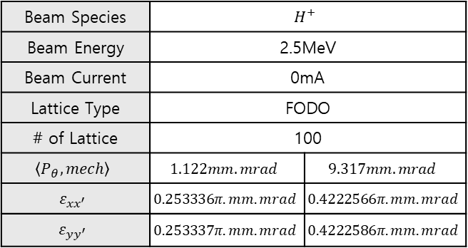

Spinning Beam Error Study
FODO lattice
Beam Species | $$H^{+}$$
Beam Energy | 2.5MeV
Beam Current | 0mA
Lattice Type | FODO
# of Lattice | 100
$$\left\langle P_{θ},mech\right\rangle$$ | $$1.122mm.mrad$$ | $$9.317mm.mrad$$
$$ε_{xx^{′}}$$ | $$0.253336π.mm.mrad$$ | $$0.4222566π.mm.mrad$$
$$ε_{yy^{′}}$$ | $$0.253337π.mm.mrad$$ | $$0.4222586π.mm.mrad$$
No-spin Beam input
Spinning Beam input
No-spin Beam input
Spinning Beam input
$$\left\langle P_{θ,mech}\right\rangle =0 mm∙mrad$$
$$\left\langle P_{θ,mech}\right\rangle =1.122 mm∙mrad$$
$$\left\langle P_{θ,mech}\right\rangle =0 mm∙mrad$$
$$\left\langle P_{θ,mech}\right\rangle =9.317 mm∙mrad$$

Slide 6
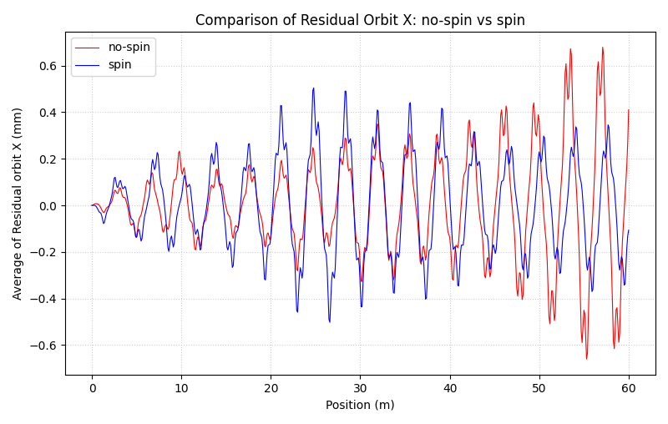
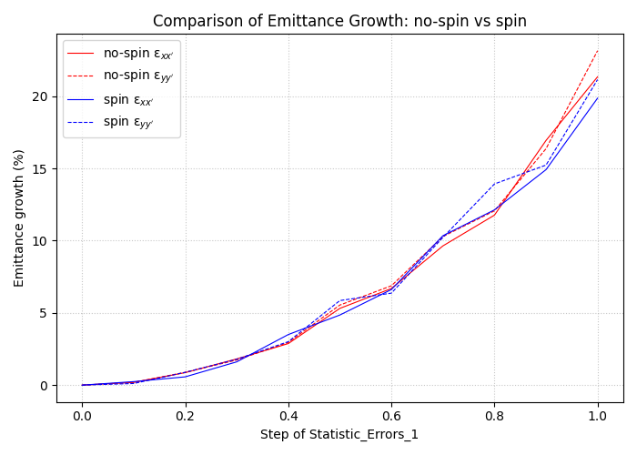
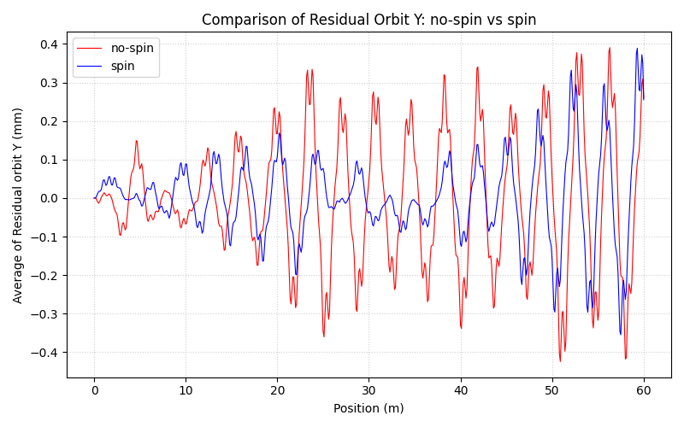
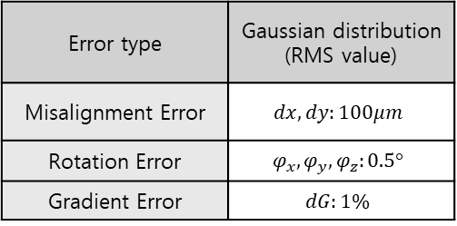

# of random seed 100
@ Error 100%
Error type | Gaussian distribution (RMS value)
Misalignment Error | $$dx, dy:100μm$$
Rotation Error | $$φ_{x}, φ_{y}, φ_{z}:0.5°$$
Gradient Error | $$dG:1\%$$
$$\left\langle P_{θ,mech}\right\rangle =1.122 mm∙mrad$$

Slide 7
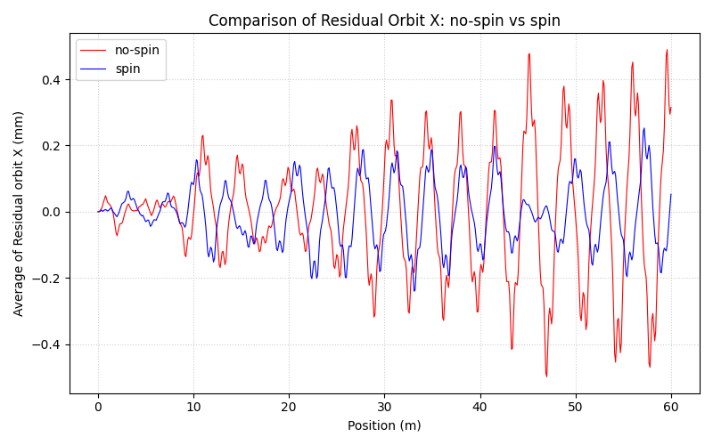
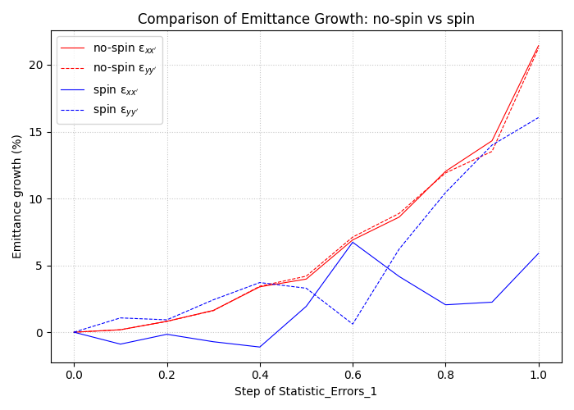
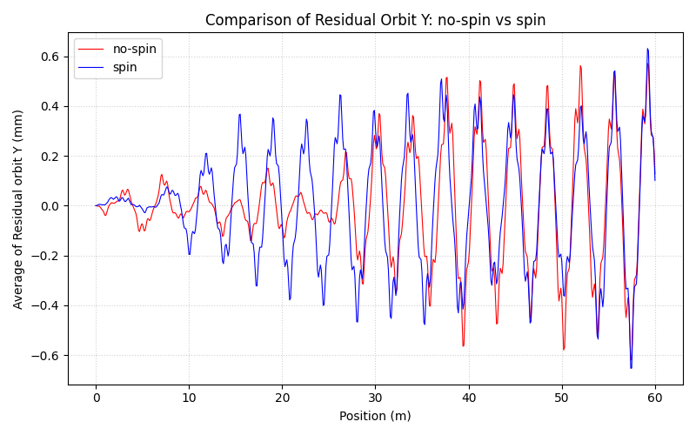

# of random seed 100
@ Error 100%
Error type | Gaussian distribution (RMS value)
Misalignment Error | $$dx, dy:100μm$$
Rotation Error | $$φ_{x}, φ_{y}, φ_{z}:0.5°$$
Gradient Error | $$dG:1\%$$
$$\left\langle P_{θ,mech}\right\rangle =9.317 mm∙mrad$$

Slide 8
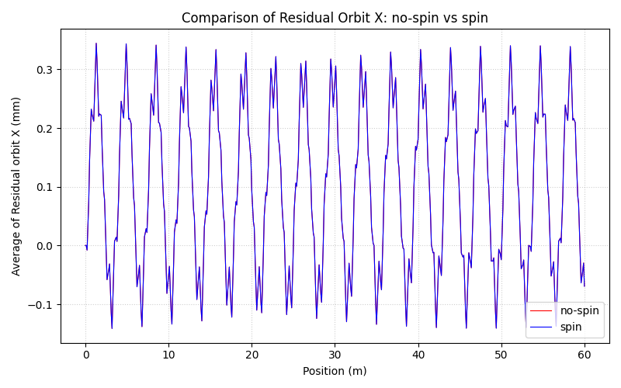
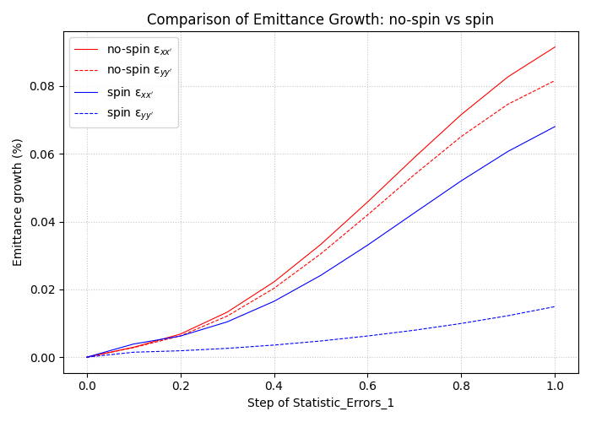
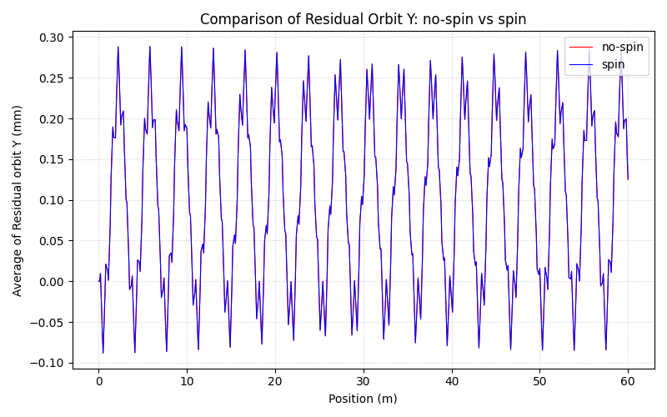
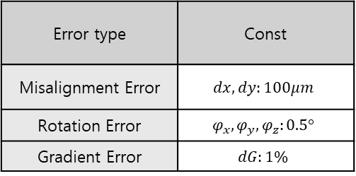
# of random seed 30
@ Error 100%
Error type | Const
Misalignment Error | $$dx, dy:100μm$$
Rotation Error | $$φ_{x}, φ_{y}, φ_{z}:0.5°$$
Gradient Error | $$dG:1\%$$
$$\left\langle P_{θ,mech}\right\rangle =9.317 mm∙mrad$$

Slide 9
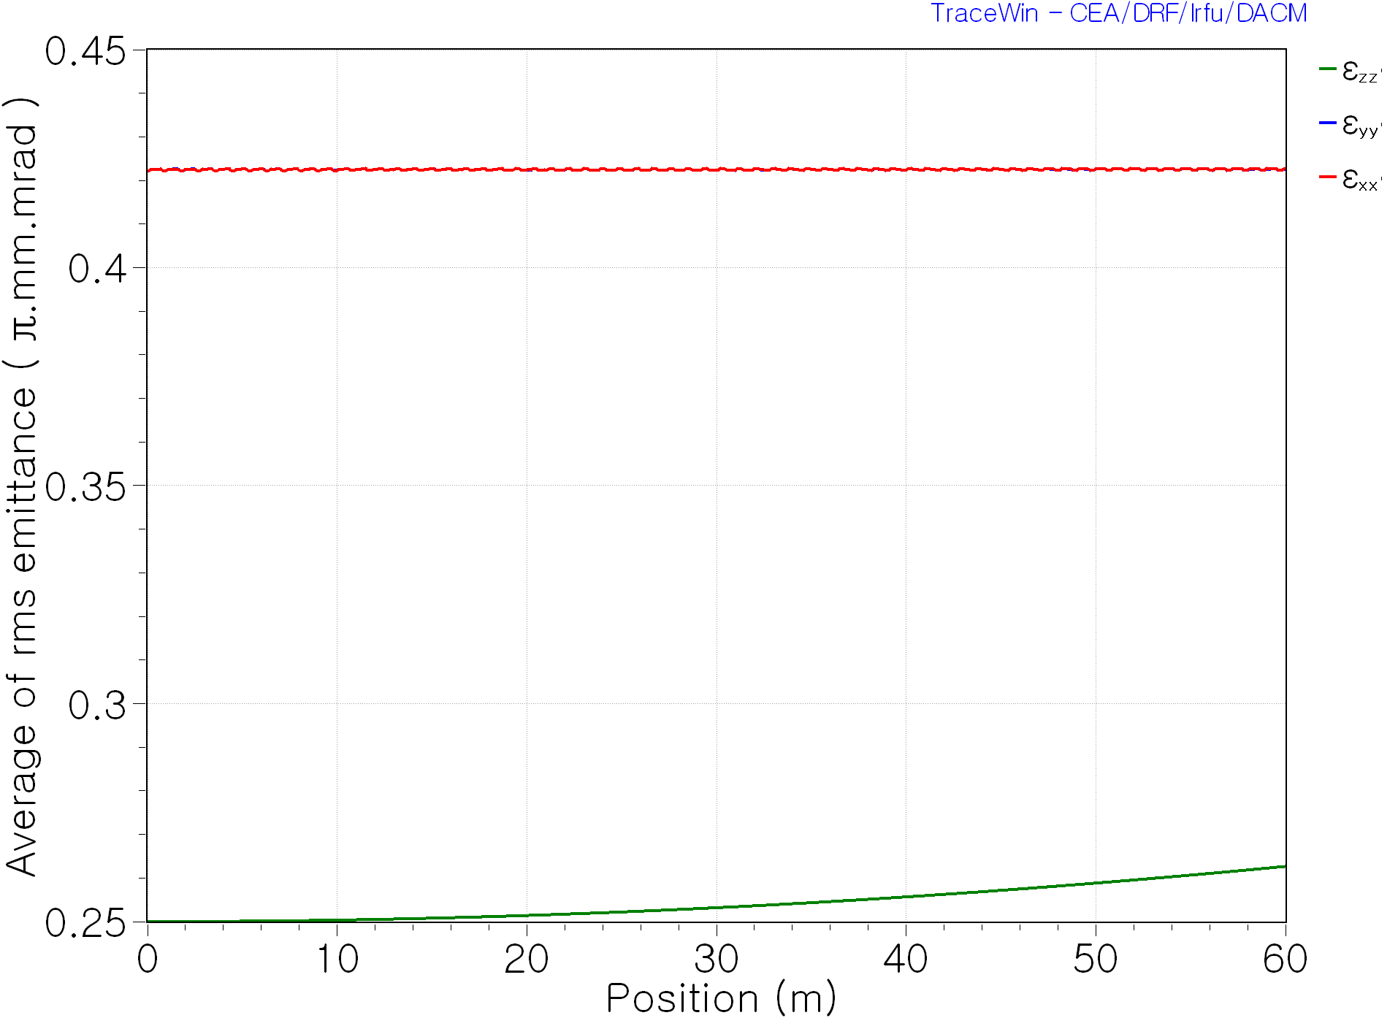
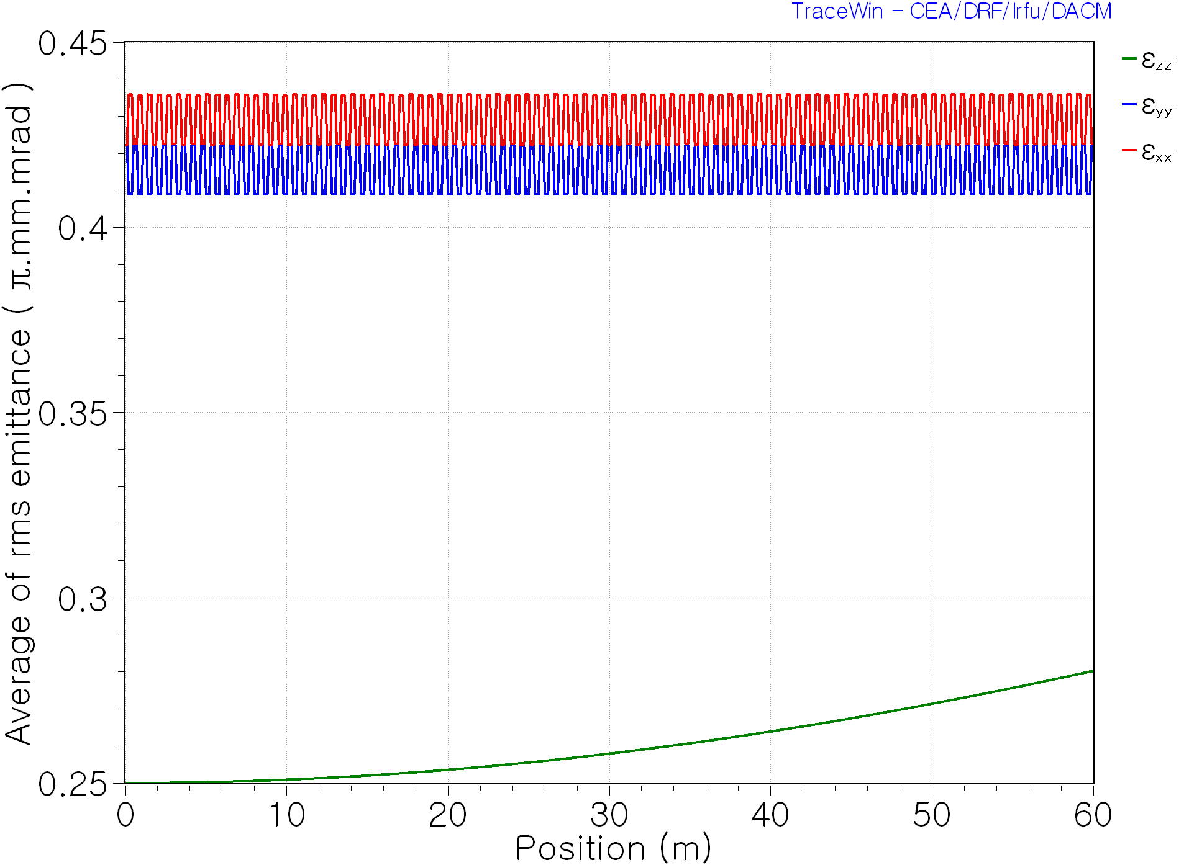
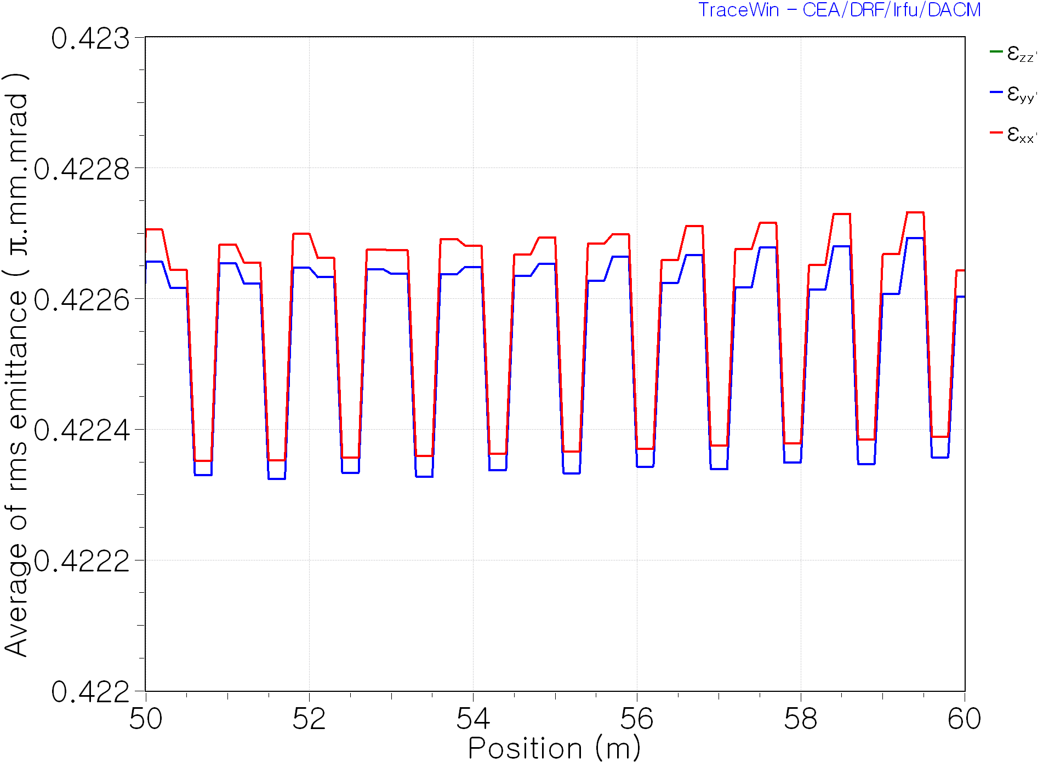
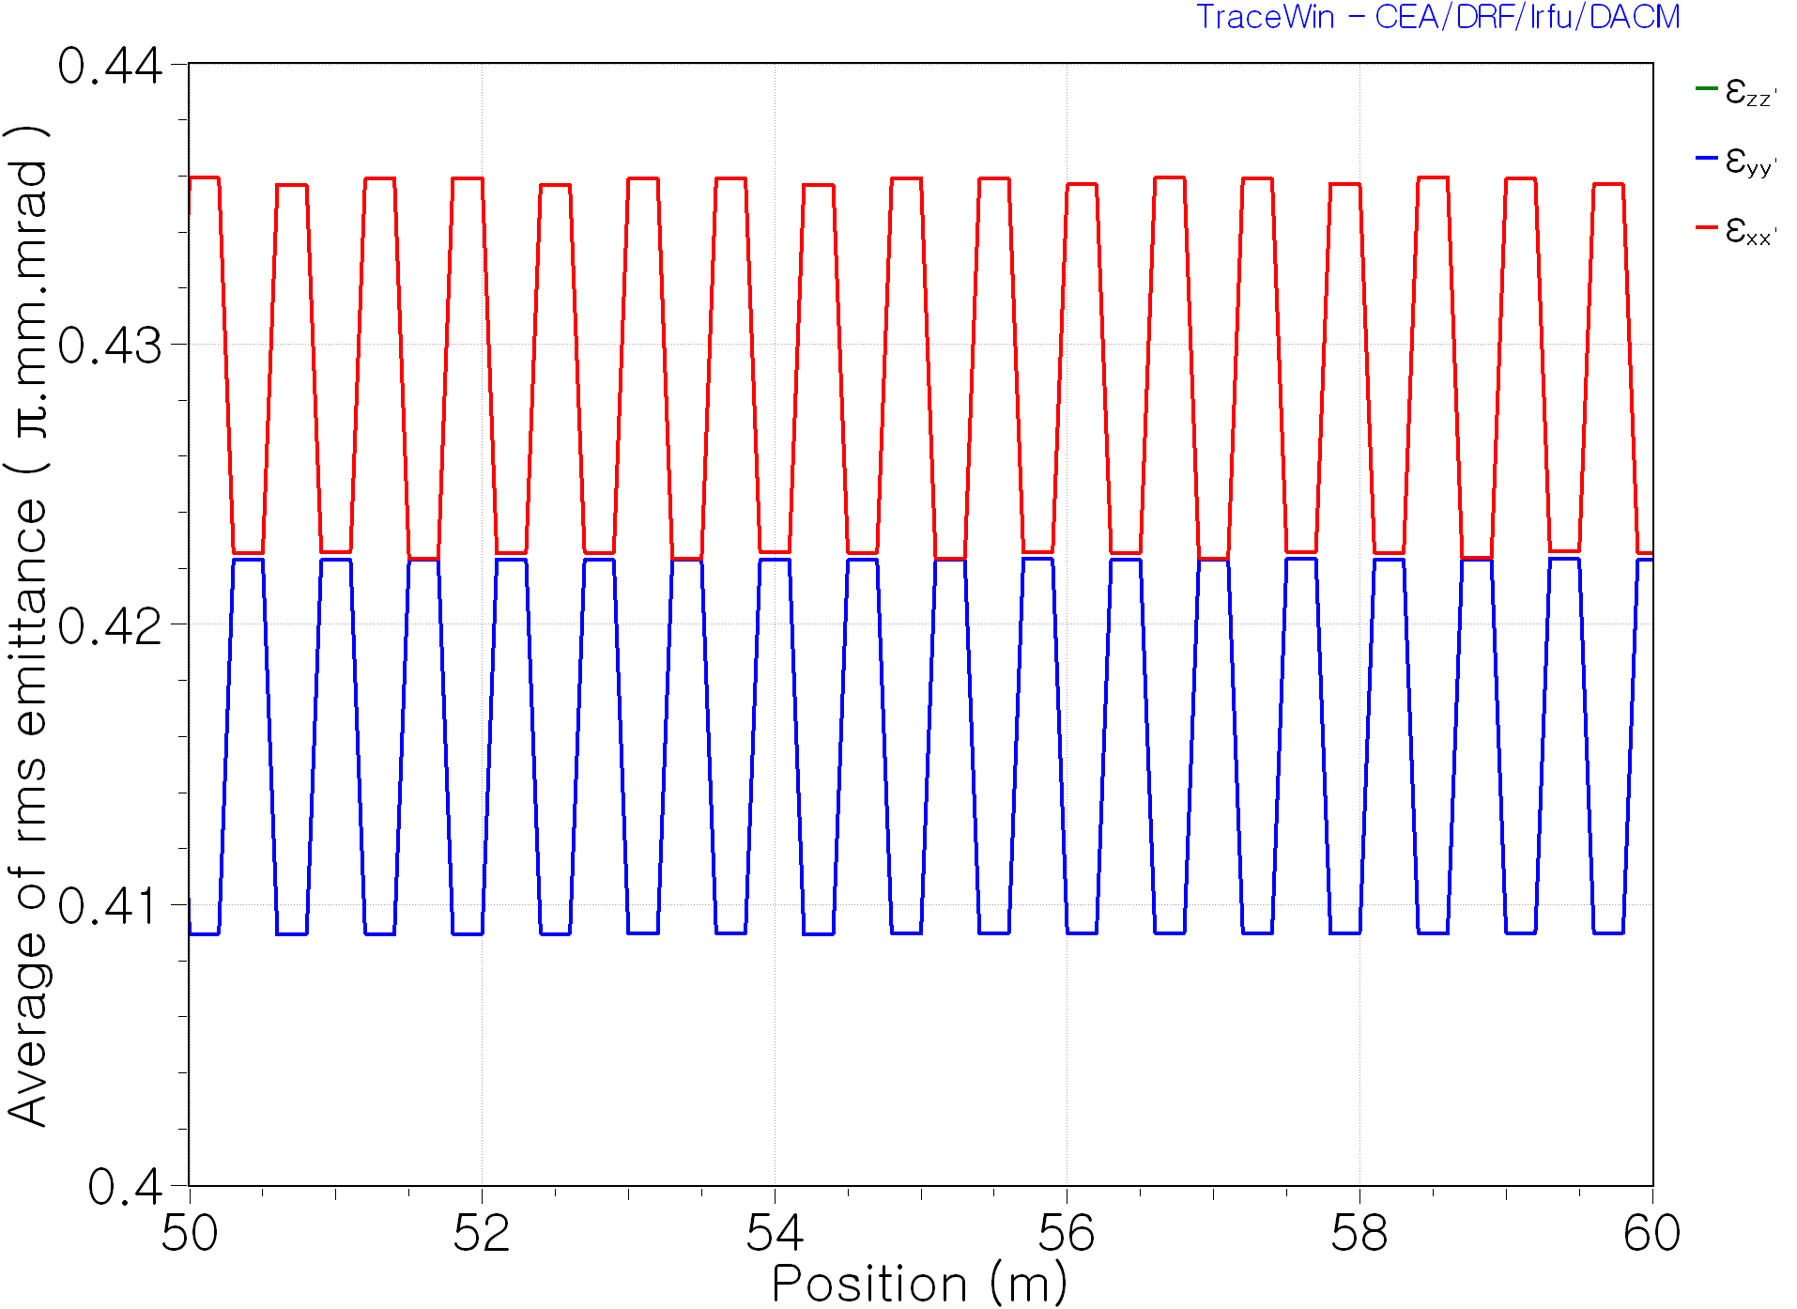
@ Error 100%
No-spin Beam input
Spinning Beam input

Slide 10
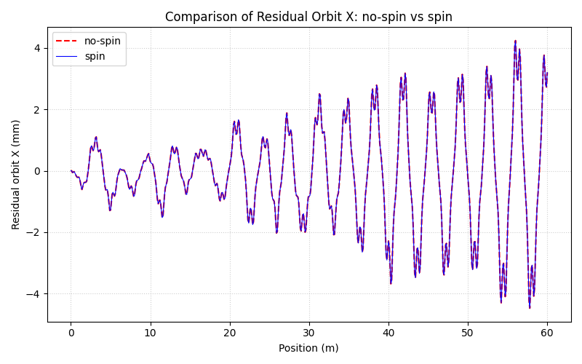
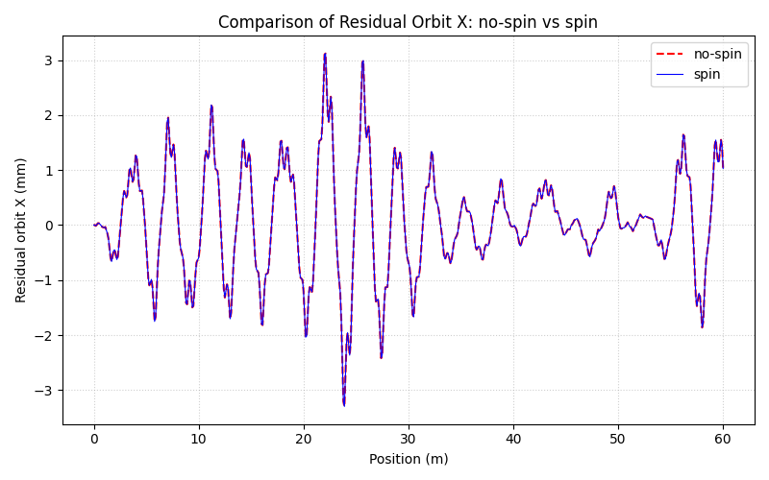
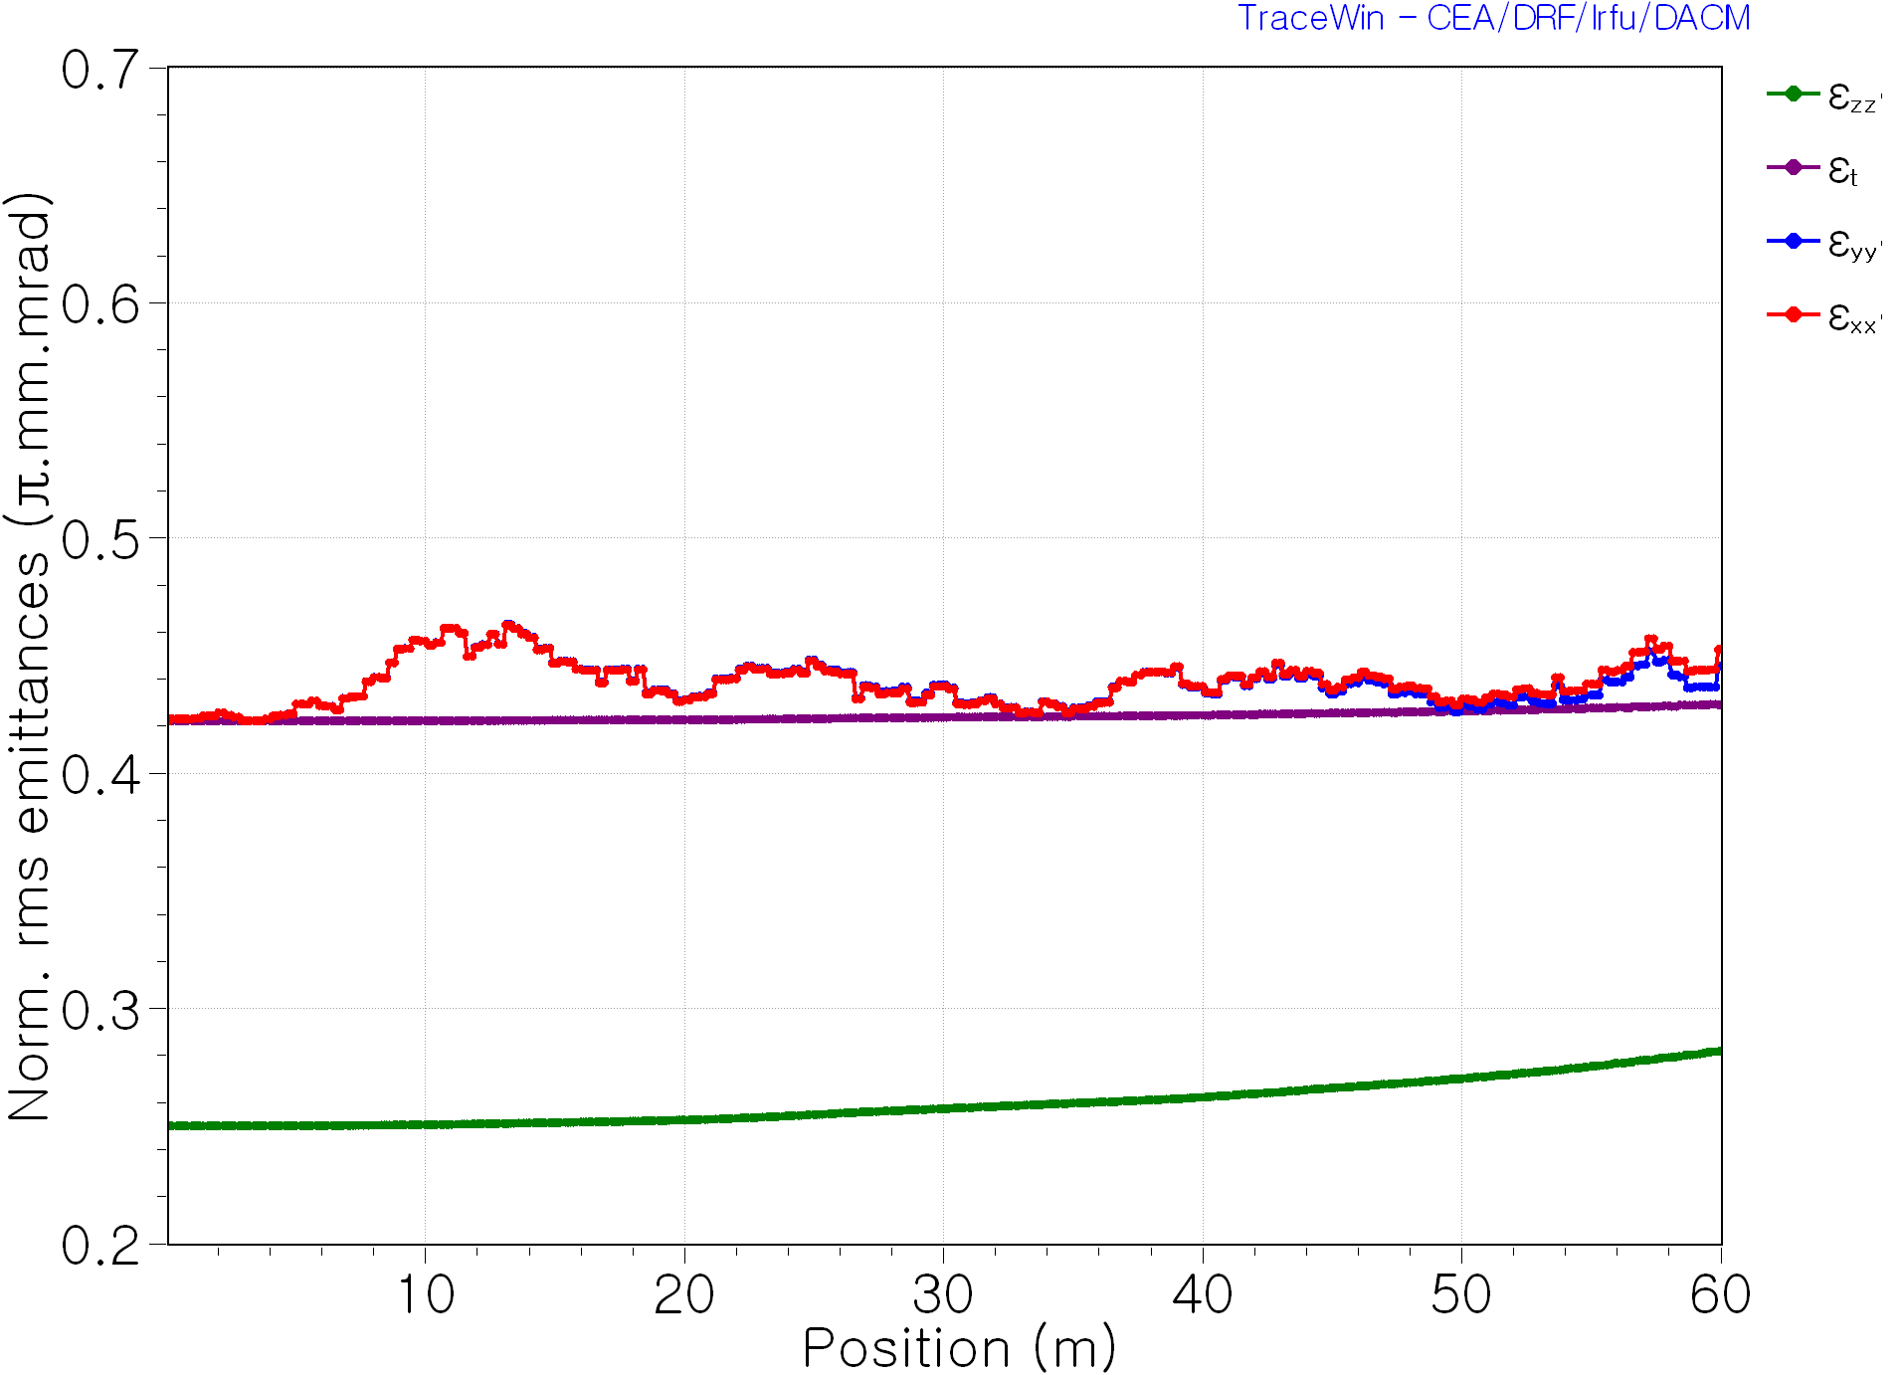
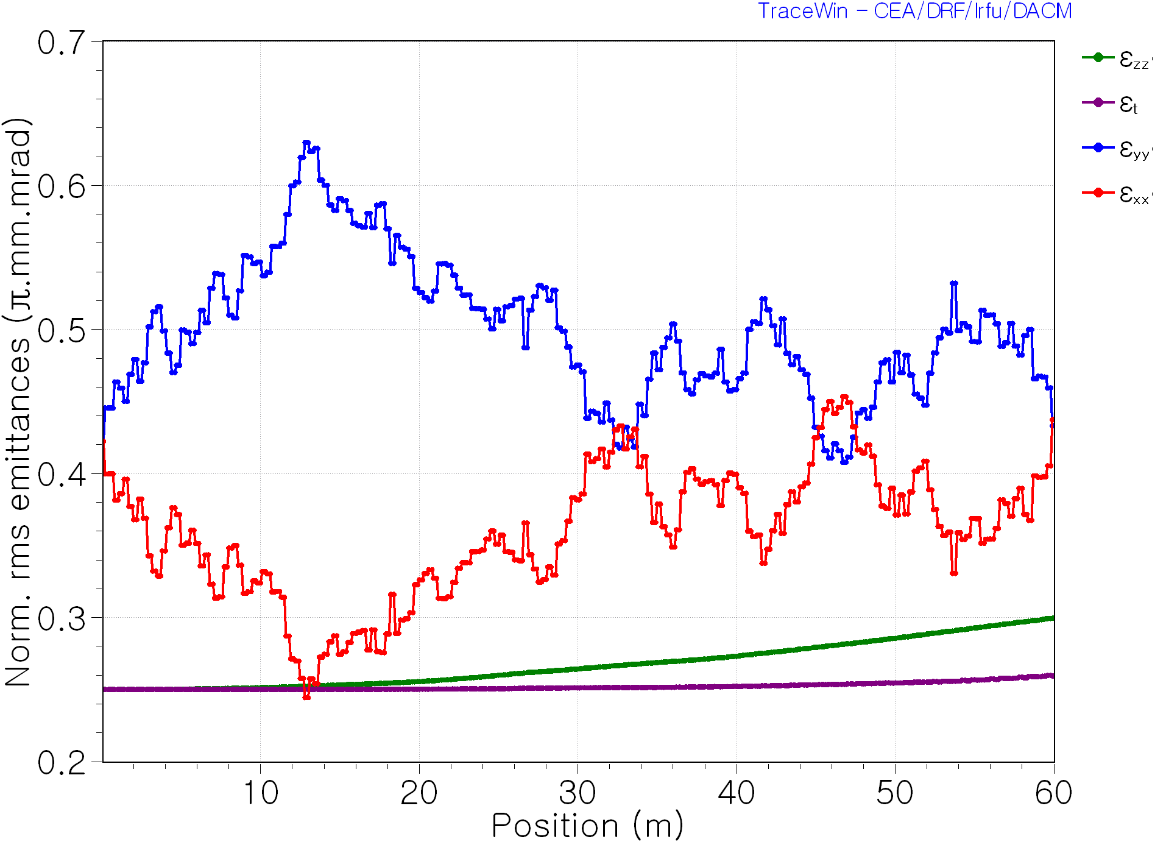





# of Run 1
Error type | Gaussian distribution (RMS value)
Misalignment Error | $$dx, dy:100μm$$
Rotation Error | $$φ_{x}, φ_{y}, φ_{z}:0.5°$$
Gradient Error | $$dG:1\%$$
No-spin Beam input
Spinning Beam input
$$ε_{xx^{′}} growth rate\left(\%\right):7.206\%$$
$$ε_{xx^{′}} growth rate\left(\%\right):3.584\%$$
$$ε_{yy^{′}} growth rate\left(\%\right):5.524\%$$
$$ε_{yy^{′}} growth rate\left(\%\right):2.594\%$$

Slide 11
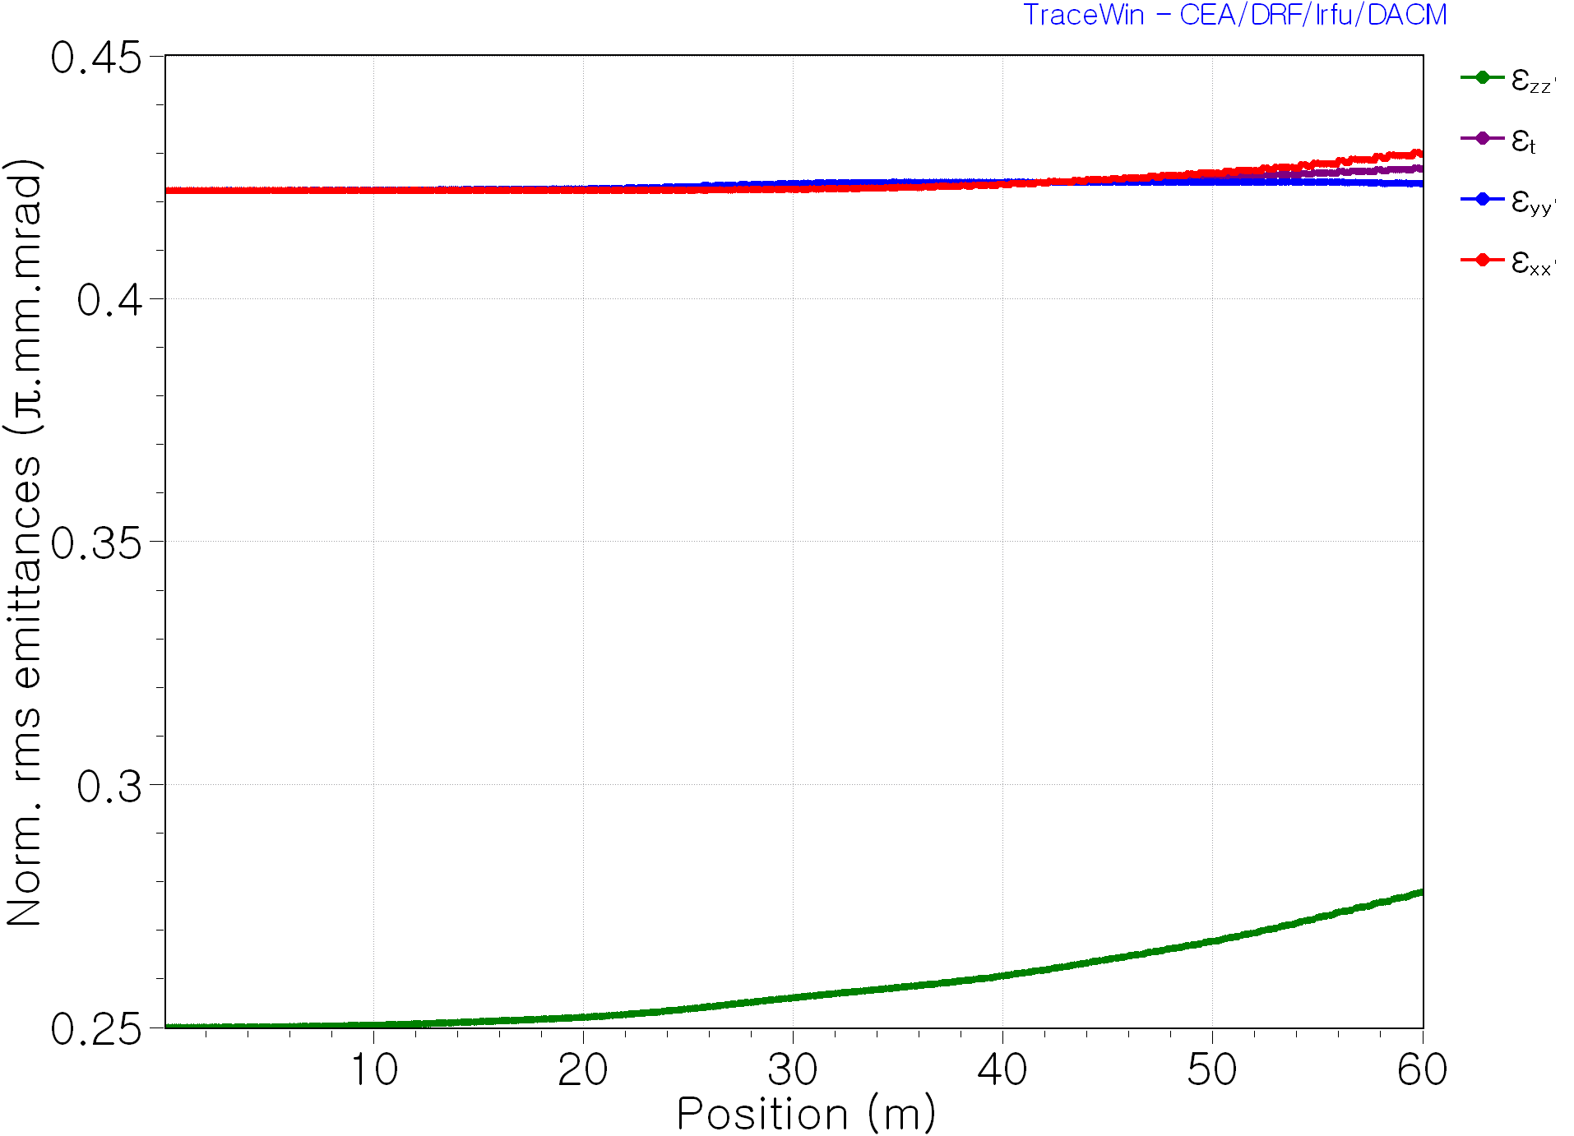
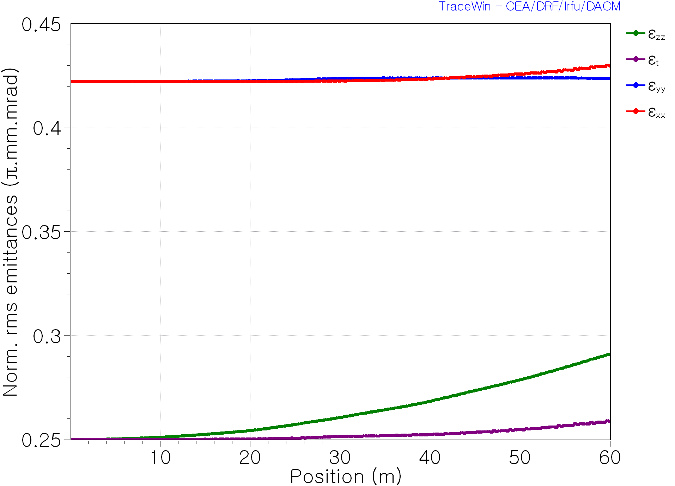
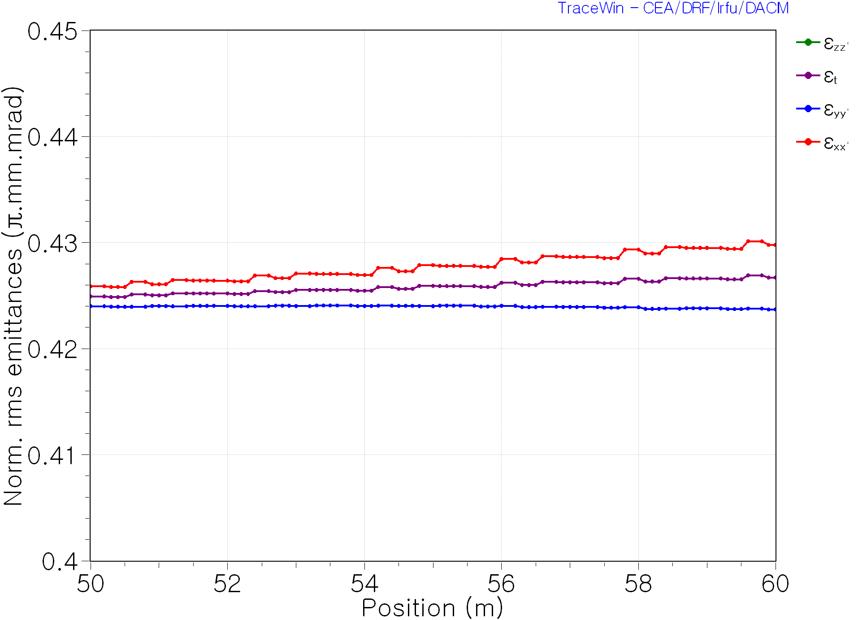
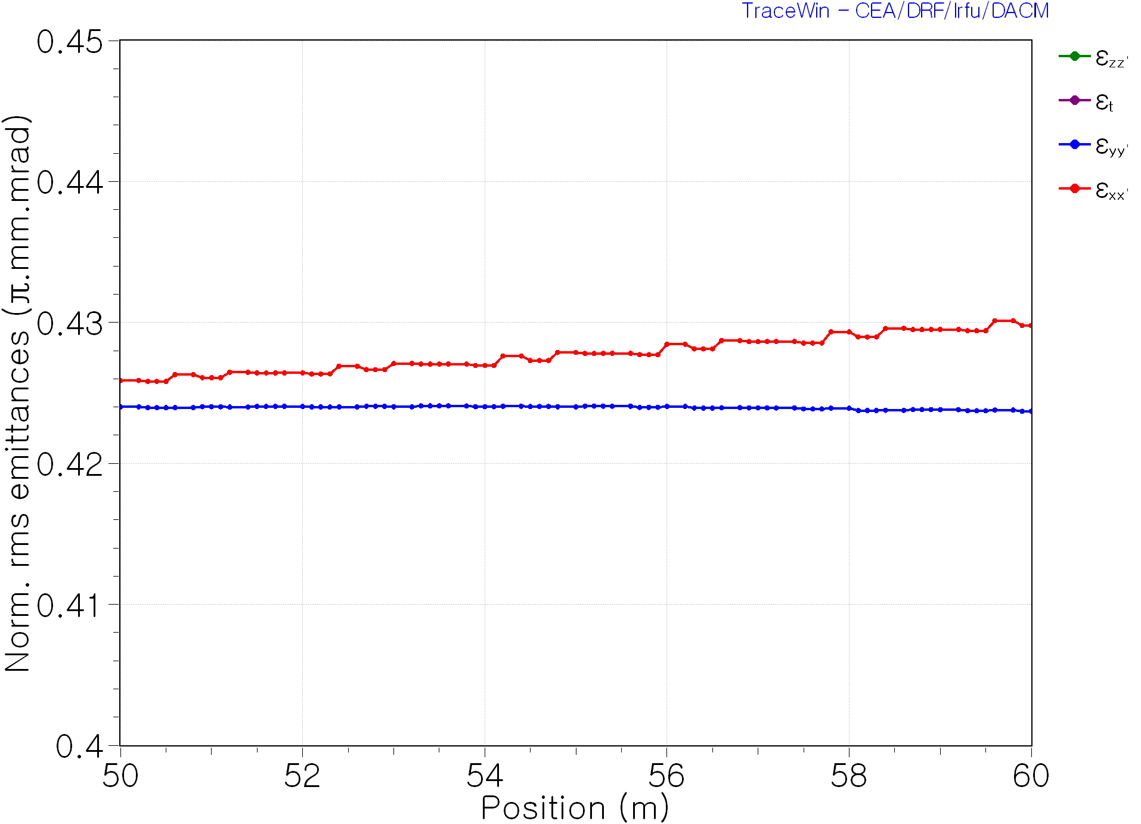
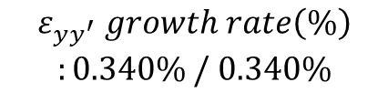
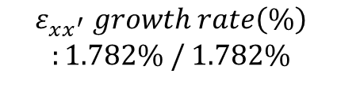
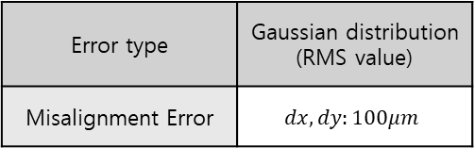
# of Run 1
No-spin Beam input
Spinning Beam input
Error type | Gaussian distribution (RMS value)
Misalignment Error | $$dx, dy:100μm$$
$$ε_{xx^{′}} growth rate\left(\%\right)$$
$$:1.782\% / 1.782\%$$
$$ε_{yy^{′}} growth rate\left(\%\right)$$
$$:0.340\% / 0.340\%$$

Slide 12
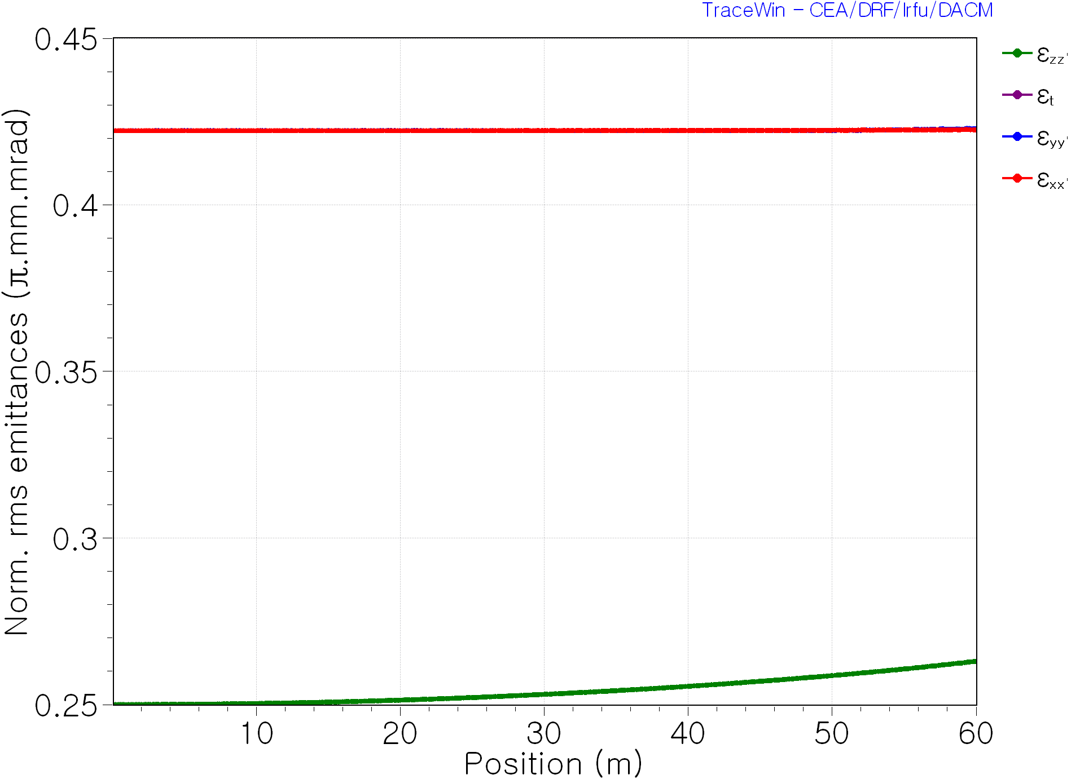






# of Run 1
No-spin Beam input
Spinning Beam input
Error type | Const
Gradient Error | $$dG:1\%$$
$$ε_{xx^{′}} growth rate\left(\%\right)$$
$$:0.067\% / 0.057\%$$
$$ε_{yy^{′}} growth rate\left(\%\right)$$
$$:0.147\% / 0.137\%$$

Slide 13







# of Run 1
Error type | Gaussian distribution (RMS value)
Rotation Error | $$φ_{x}, φ_{y}, φ_{z}:0.5°$$
No-spin Beam input
Spinning Beam input
$$ε_{xx^{′}} growth rate\left(\%\right):6.139\%$$
$$ε_{xx^{′}} growth rate\left(\%\right):5.335\%$$
$$ε_{yy^{′}} growth rate\left(\%\right):6.169\%$$
$$ε_{yy^{′}} growth rate\left(\%\right):−0.266\%$$

Slide 14

Future Plan
Input Beam Setting
Lattice
Error Setting
Error Study
Analyze
No-Spin & Spin
$$\left\langle P_{θ}\right\rangle ≅9mm.mrad$$
FODO Lattice
Gaussian Distribution
# of Run: 1
Centroid
Solenoid Lattice
Statistic Error
Based on Monte Carlo approach
Rotation Error
Another Lattice
X-Y coupling

