Slide 1
Design and Simulation of X-ray tube for Hypersonic Vehicle Data Transmission Studies
나창선
2025. 10. 31

Slide 2
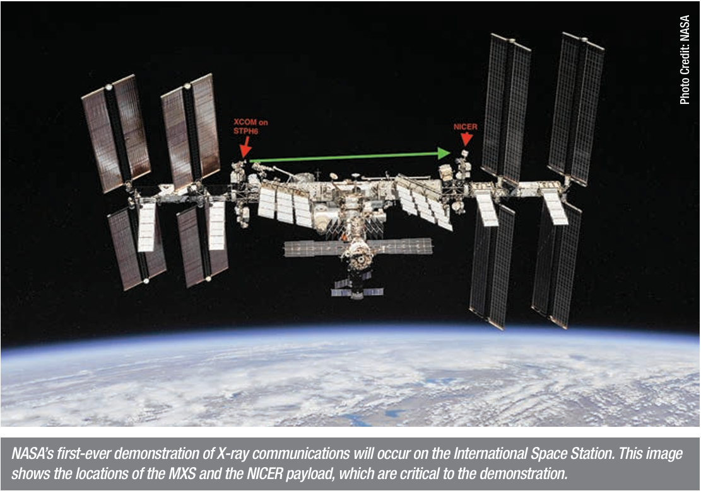
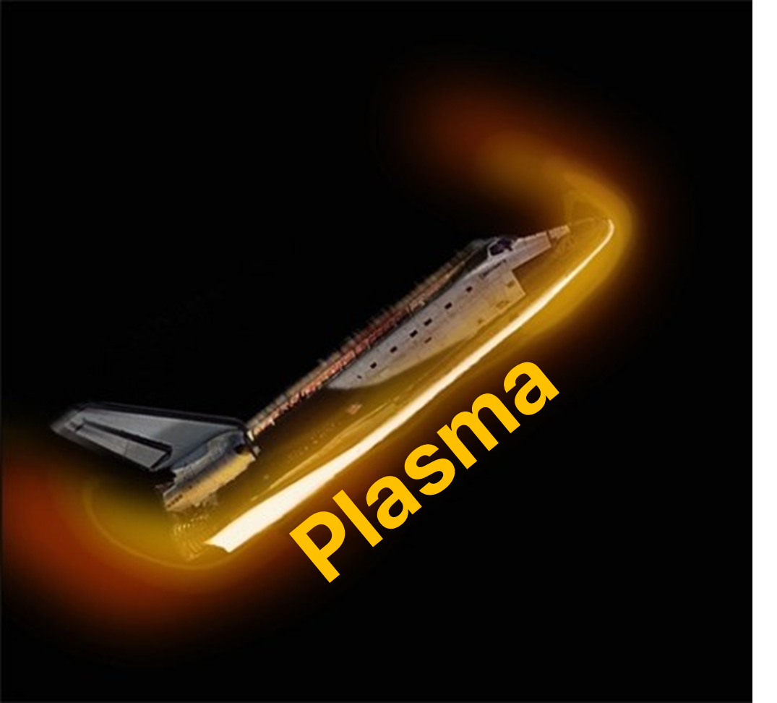





Overview
NASA, 2019
X-ray tube
plasma
communication
signal
Signal
modulation
X-ray
detector

Slide 3
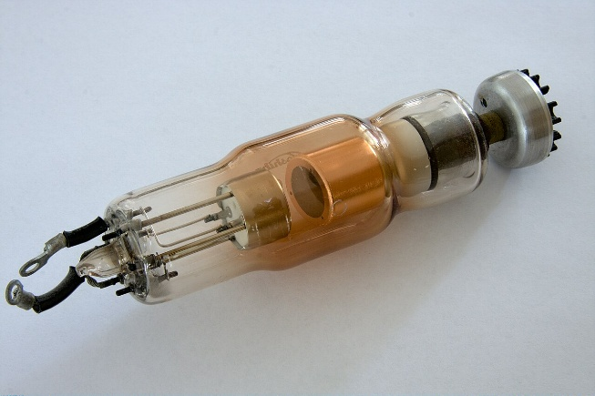
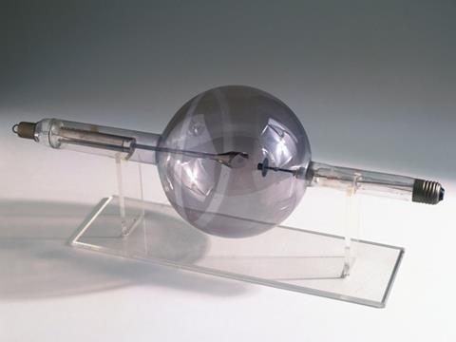
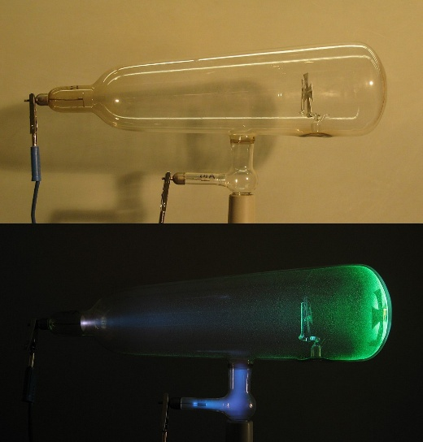
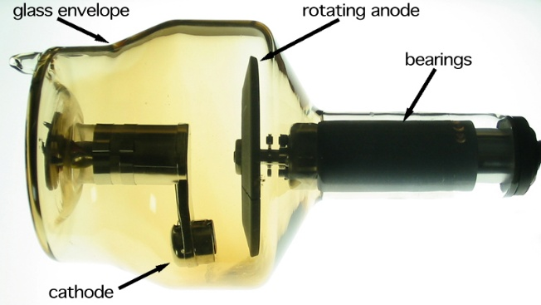
History of the X-ray Tube
1895
1913
Modern X-ray Tubes
Crookes tube
Coolidge tube
Wilhelm Röntgen discovered X-rays using a Crookes tube.
William D. Coolidge developed the X-ray tube based on the thermionic emission principle.
It used a heated filament and a high-vacuum system to emit electrons efficiently.
The Coolidge tube was later improved into various modern types of X-ray tubes,
optimized for medical and industrial applications.

Slide 4
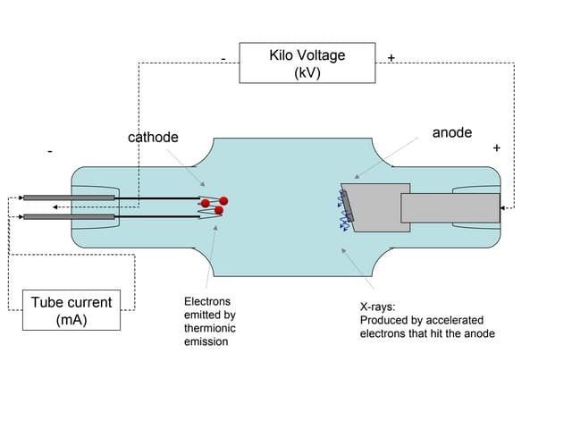
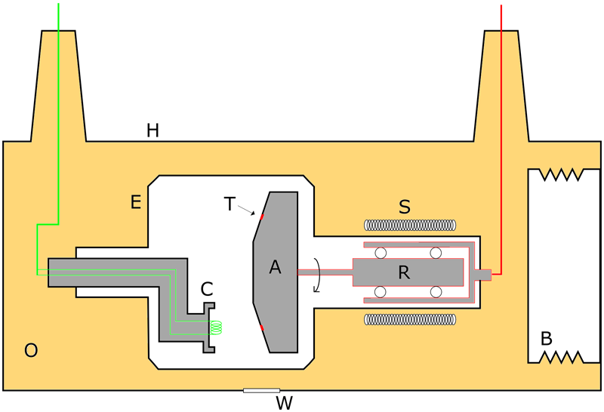
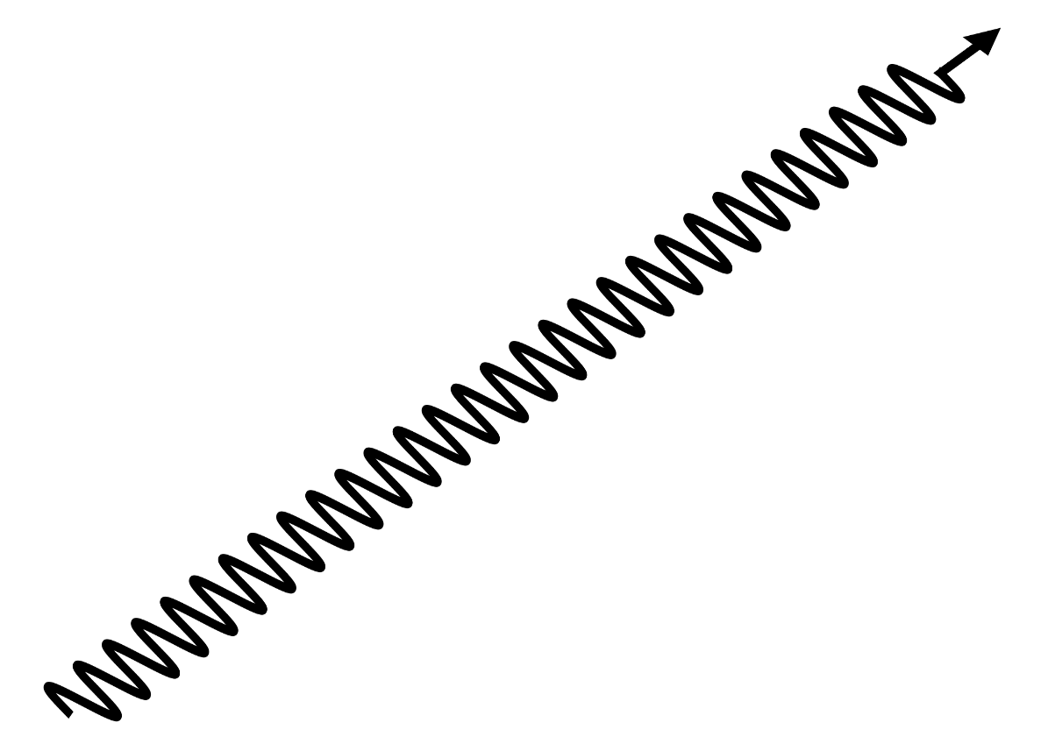
Conventional X-ray Tube Operation
Heated tungsten cathode emits electrons by thermionic emission.
Electrons accelerate toward the anode and hit the target.
Only about 1% of the energy becomes X-rays.
The rest is converted into heat at the anode.
X-rays consist of bremsstrahlung and characteristic radiation.
Rotating anodes improve cooling in medical systems.
Stationary anodes are used for compact designs.

Slide 5
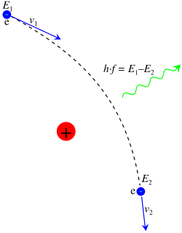
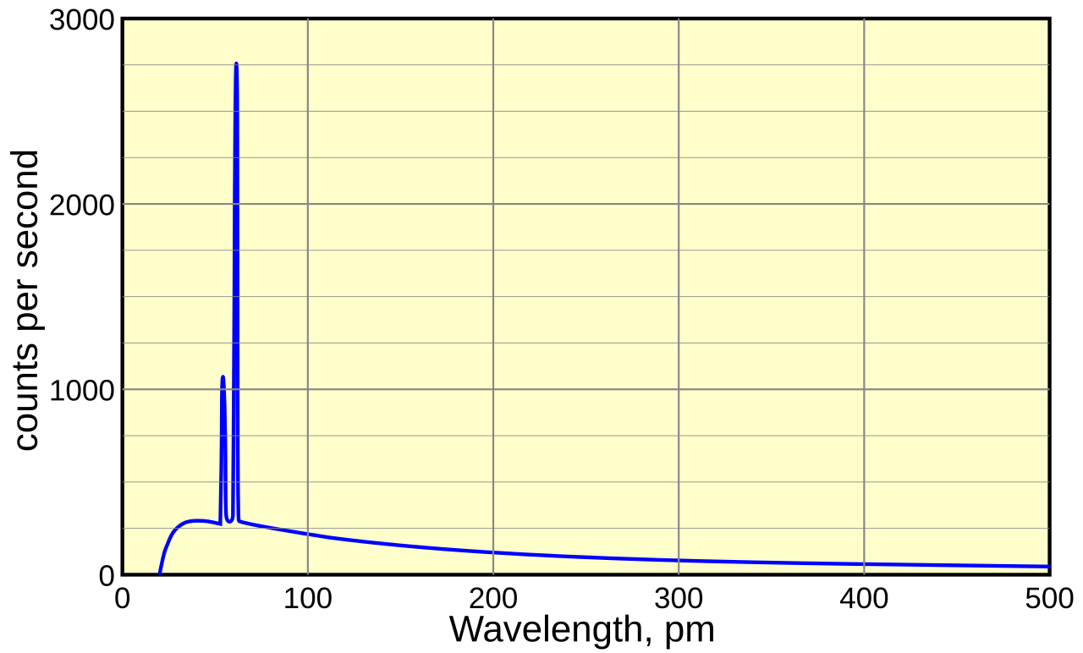
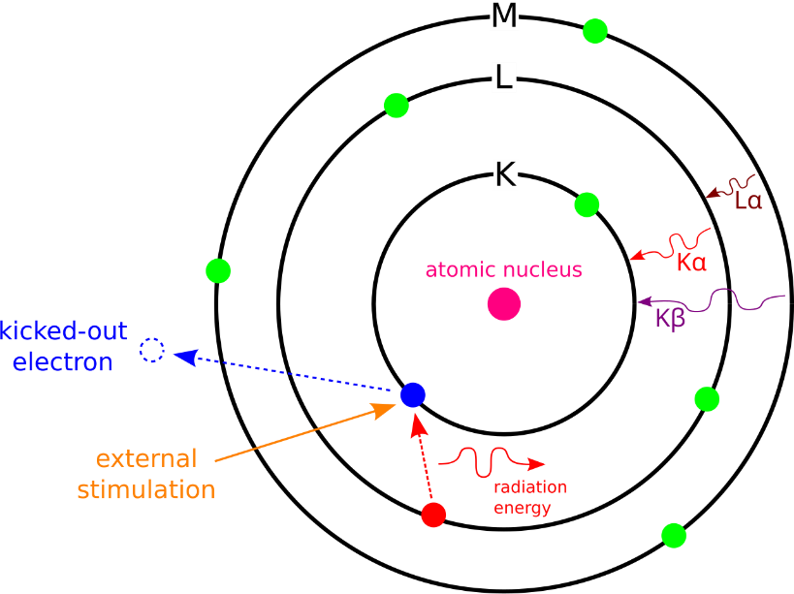
X-ray Spectrum
bremsstrahlung
Continuous radiation: Bremsstrahlung; Sharp peaks: Characteristic lines.
The X-ray spectrum consists of bremsstrahlung and characteristic X-rays.
To enhance bremsstrahlung efficiency, high-Z targets such as W (74), Mo (42), and Cu (29) are used.
characteristic X-ray

Slide 6
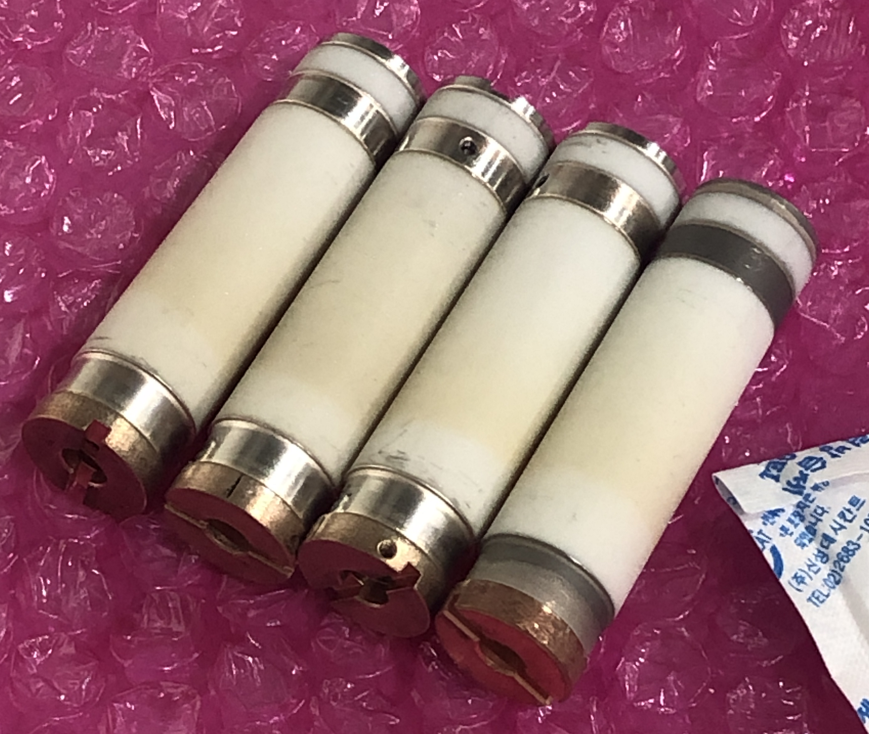
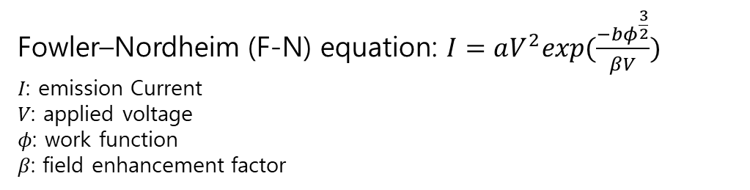
CNT X-ray Tube
Unlike filament-type tubes, CNT emitters require no heating or vacuum filament system, allowing compact and energy-efficient design.
CNT cathodes enable fast on/off switching, making pulsed X-ray emission possible.
CNT-based X-ray tubes have been commercially used in the medical since the mid-2010s.
Fowler–Nordheim (F-N) equation: $I=aV^{2}exp(\frac{−bφ^{\frac{3}{2}}}{βV})$
𝐼: emission Current
𝑉: applied voltage
𝜙: work function
𝛽: field enhancement factor

Slide 7
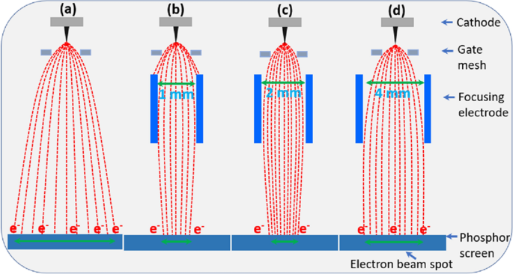
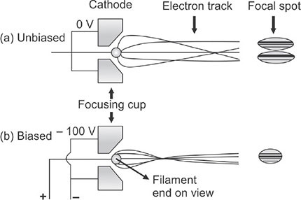
Focusing
Focusing cup
Focusing electrode
A negative bias is applied to the focusing cup or focusing electrode to converge the electron beam onto a small focal spot.

Slide 8
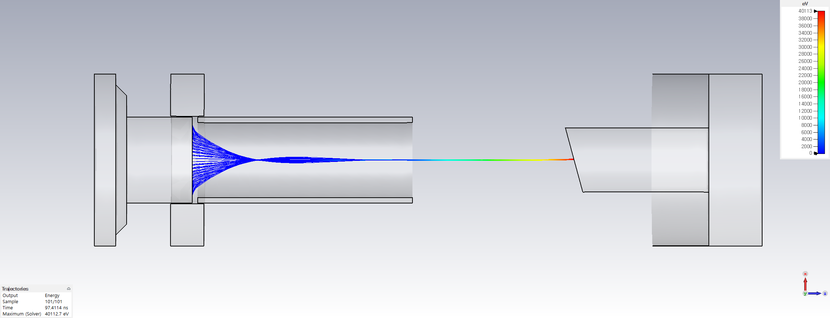
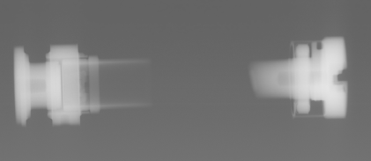
Simulation Setup
(-)
(+)
(-)
anode
cathode
Focusing electrode
The simulation was performed under 40 kV and 2 mA, less than 10 cm conditions.
Electrons emitted from the cathode are focused by the focusing electrode and accelerated toward the anode to generate X-rays.

Slide 9
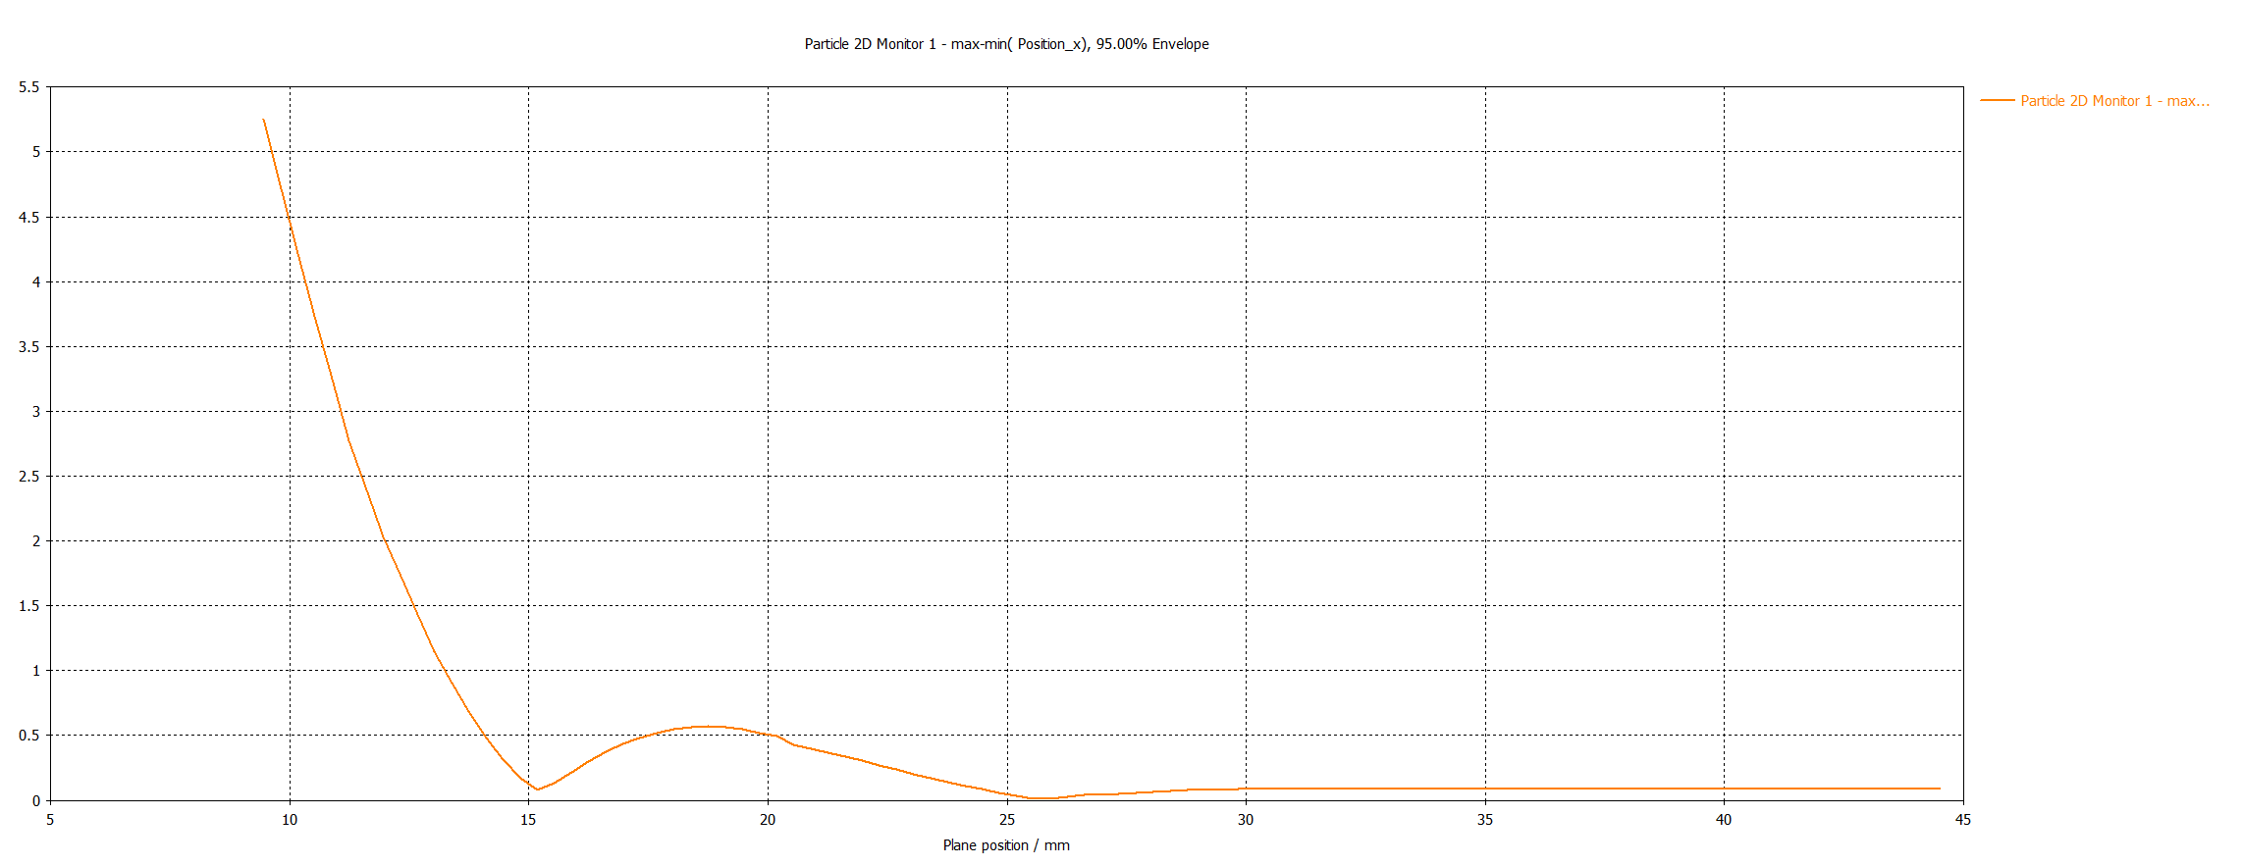
Beam Size by Position
88.4 µm
The simulated beam was successfully focused to 88.4 µm,
achieving the target beam size below 100 µm.

Slide 10
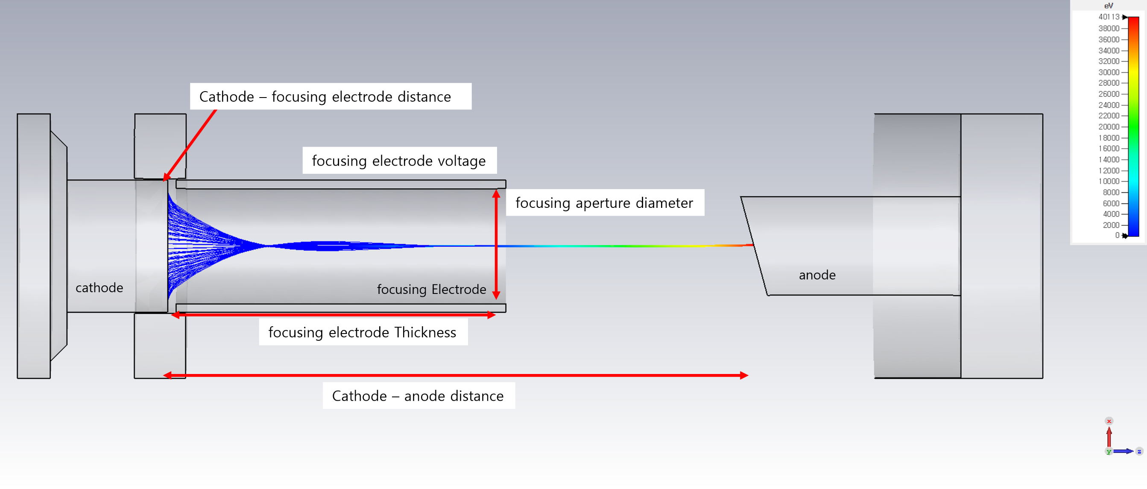
Future Plan
The beam focusing will be optimized
based on the key parameters shown above:
– Cathode–focusing electrode distance (∝focusing)
– Cathode–anode distance (∝defocusing)
– Focusing electrode thickness (∝focusing)
– Focusing aperture diameter (∝defocusing)
– Focusing electrode voltage (∝focusing)

Slide 11
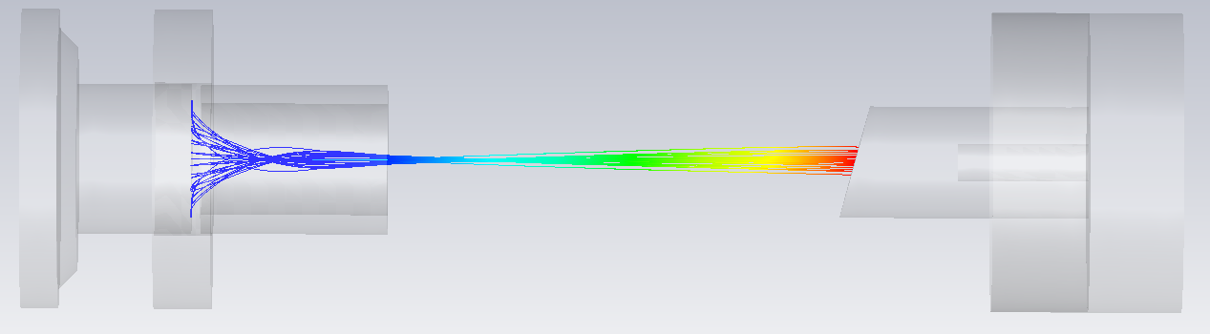
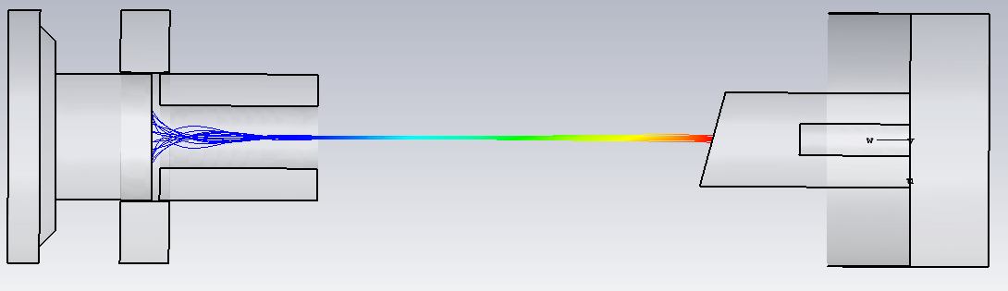
Future Plan
– D_{c-f} fixed
– D_{c-a} fixed
– Th_{f} : 15 (∝focusing)
– d_{f} : 3 (∝defocusing)
– V_{f} fixed
d_{f}
Th_{f}
– D_{c-f} fixed
– D_{c-a} fixed
– Th_{f} : 10 (∝focusing)
– d_{f} : 3 (∝defocusing)
– V_{f} fixed
– D_{c-f} fixed
– D_{c-a} fixed
– Th_{f} : 10 (∝focusing)
– d_{f} : 2 (∝defocusing)
– V_{f} fixed

Slide 12
Summary
This study is an X-ray tube for Data Transmission in plasma environments, where conventional radio transmission fails.
The field-emission CNT cathode enables compact, low-heat, and pulsed X-ray generation,
which is essential for data transmission.
A CNT-based X-ray tube was designed and simulated under 40 kV / 2 mA conditions.
The electron beam was successfully focused to 88.4 µm.
Beam focusing will be optimized by adjusting electrode geometry and bias voltage.

Slide 13
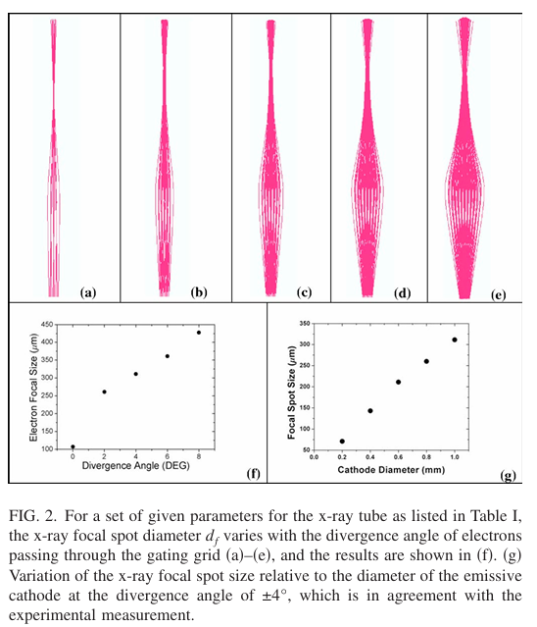
(a)~(f) : 발산각에 따른 집속정도
(g) : Cathode(CNT)의 직경에 따른 집속정도

Slide 14
