Slide 1


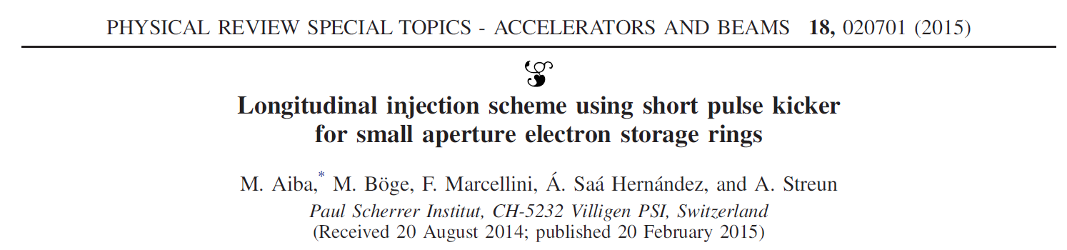
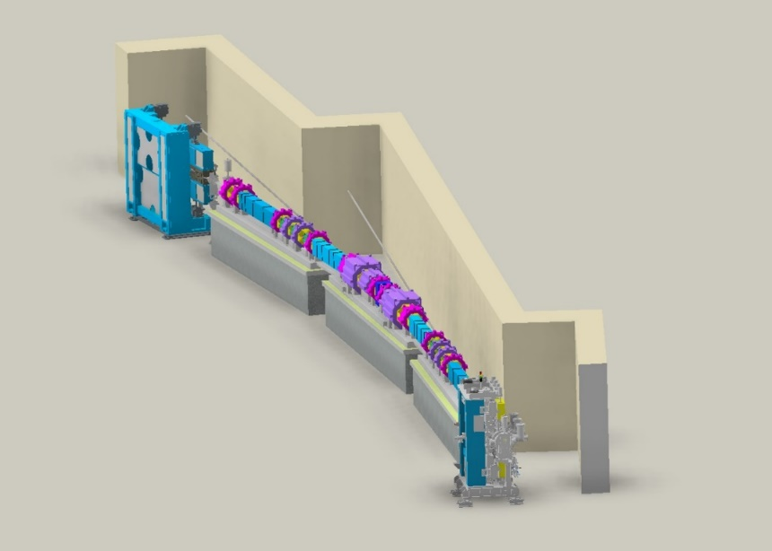

JKPS
Longitudinal injection scheme using short pulse kicker for small aperture electron storage rings
Junha Kim
Oct 17th, 2025

Slide 2
JKPS
Composition of the paper
Introduction
Longitudinal injection
Application to MAX-IV lattice
Short pulse Kicker
Discussion
Conclusion

Slide 3
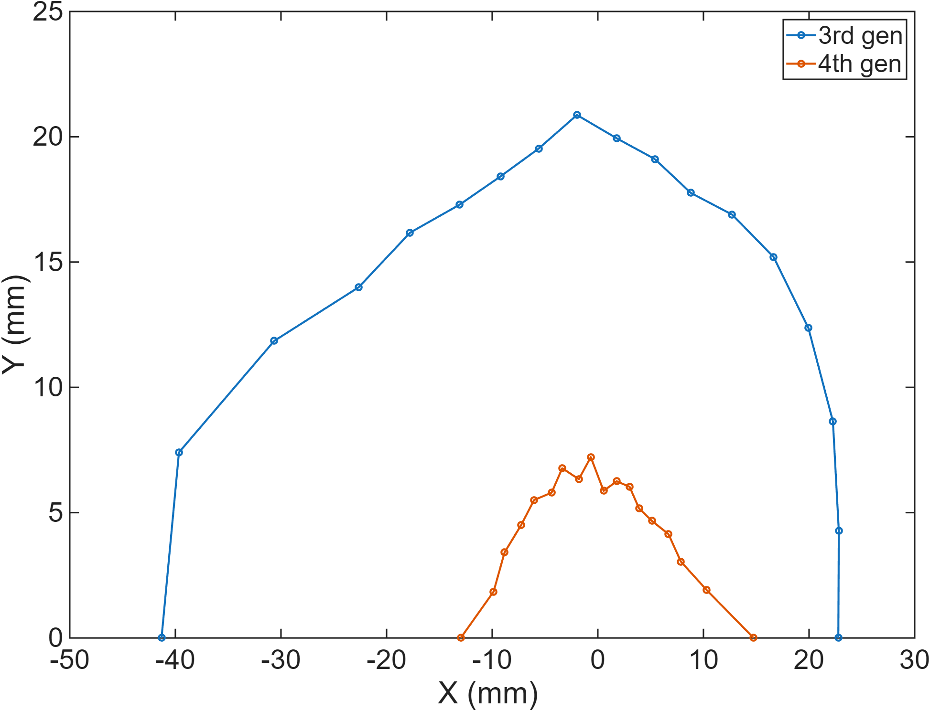
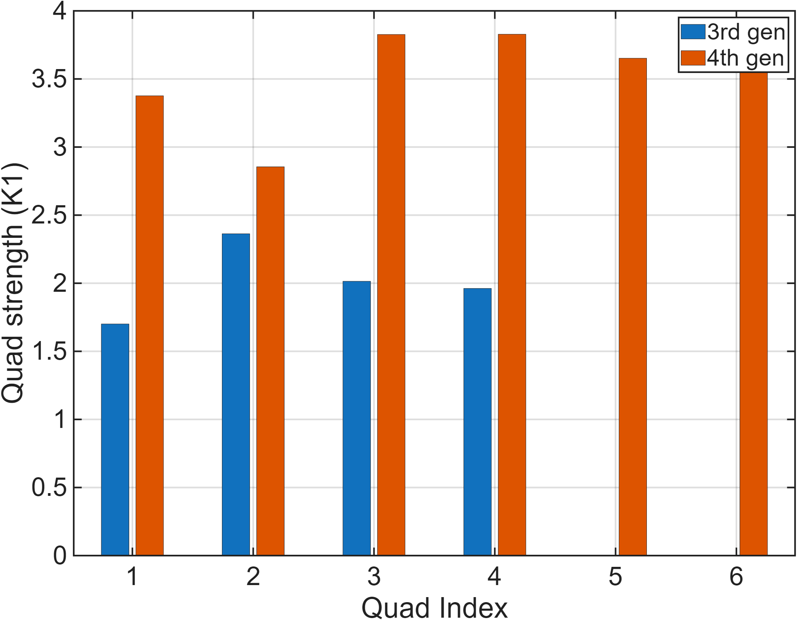
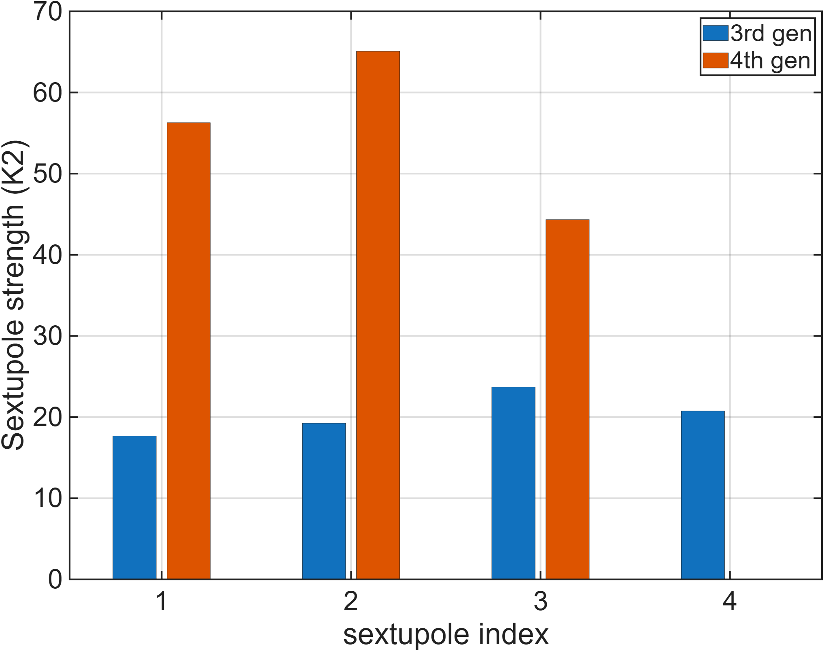
JKPS
I. Introduction
The fundamental approach for this is lowering the transverse electron beam emittance both in the horizontal and vertical planes to the picometer regime.
A storage ring realizing such ultra-low emittance is normally composed of quadrupoles with rater high gradient, and thus the available physical aperture decrease.
In addition the dynamic aperture may become small because of strong sextupoles which are necessary to compensate for the chromatic effect arising from these strong quadrupoles.
Dynamic aperture 비교
자석 세기 비교 (3세대 vs 4세대)
3/20

Slide 4
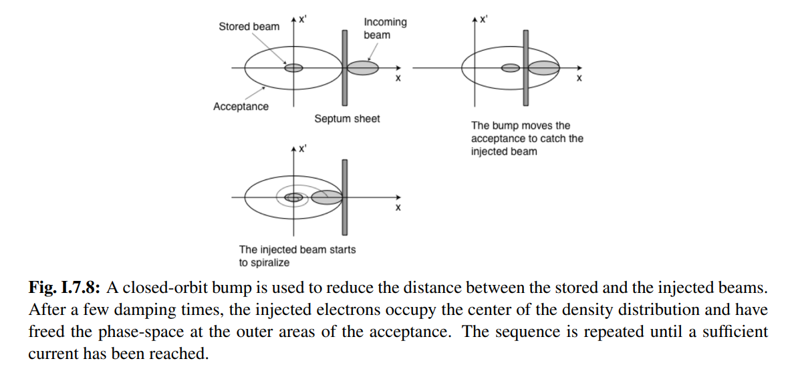
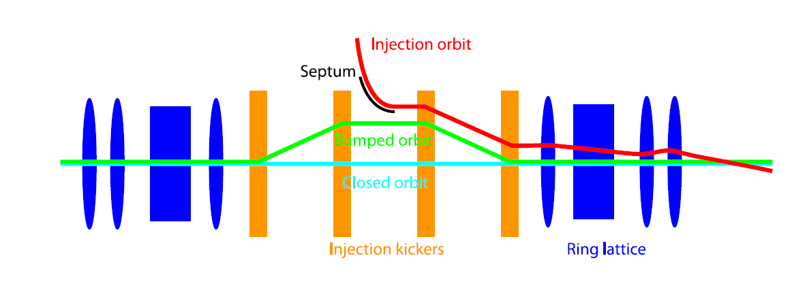
JKPS
I. Introduction
According to Liouville’s theorem, a bunch cannot be injected to the same phase-space volume occupied by the circulating bunches at the time of injection although it will later be merged into a circulating bunch because of synchrotron radiation damping.
Injection scheme
Conventional scheme (off-axis injection)
Multipole kicker (nonlinear kicker)
Swap-out
Conventional scheme :
4/20

Slide 5
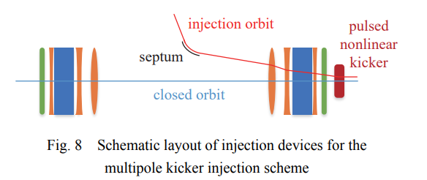
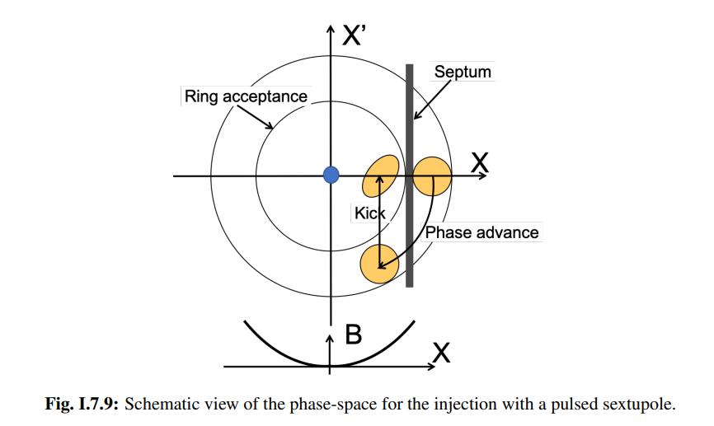
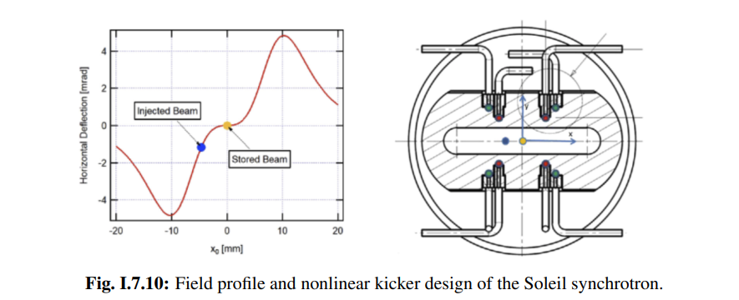
JKPS
I. Introduction
Off-axis injection – multipole kicker :
5/20

Slide 6
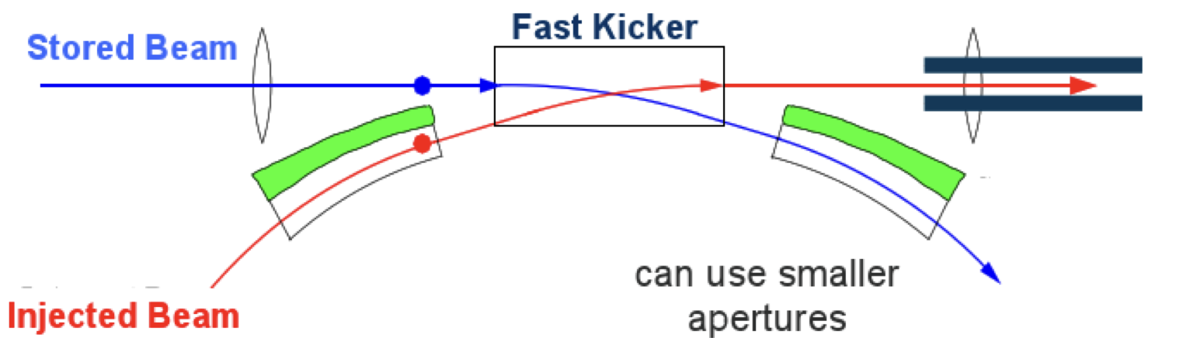
JKPS
I. Introduction
https://youtu.be/_sa4sycxeIg?si=SETq0QQQA9kxH9C6
Swap-out injection :
4th-generation light sources have ultra-low emittance but very small dynamic aperture.
Off-axis injection needs ≥4–5 mm dynamic aperture → often too small in new rings.
→ On-axis (swap-out) injection becomes the only feasible method.
In swap-out, a full-current bunch is injected while the stored bunch is extracted.
Drawbacks:
Injector must accelerate a full-charge bunch (may exceed booster limits).
Might require an accumulator ring.
Needs fast kickers for uniform filling.
6/20

Slide 7
JKPS
I. Introduction
In this paper, they present another transparent injection scheme for reduced-aperture machines- longitudinal injection where the injected bunch is longitudinally separate from the circulating bunches.
The circulating bunches are not disturbed if the kicker pulse strength is shorter than the bunch spacing.
Longitudinal injection was utilized for separation, have already been realized in lepton rings
In LEP, synchrotron phase space injection was applied to realize an on-axis injection.
The bunches were injected with an energy offset and the injection orbit was matched to the off-momentum closed orbit.
But Kicker bump needed
In VEPP-3, the two RF system was employed.
First, an rf system of ~8MHZ was used to realize a relatively long rf bucket at the injection energy.
The bunches were injected with a time offset, damped with the synchrotron radiation and accumulated
Then, an rf system of ~72MHZ was turned on when the beam was accelerated to and/ or kept at high energy
But, this paper based on the separation in the longitudinal phase space but adopted to modern light source : it requires neither a kicker bump nor a multiple rf system.
They applicate to the lattice of the MAX-IV 3GeV storage ring.
7/20

Slide 8
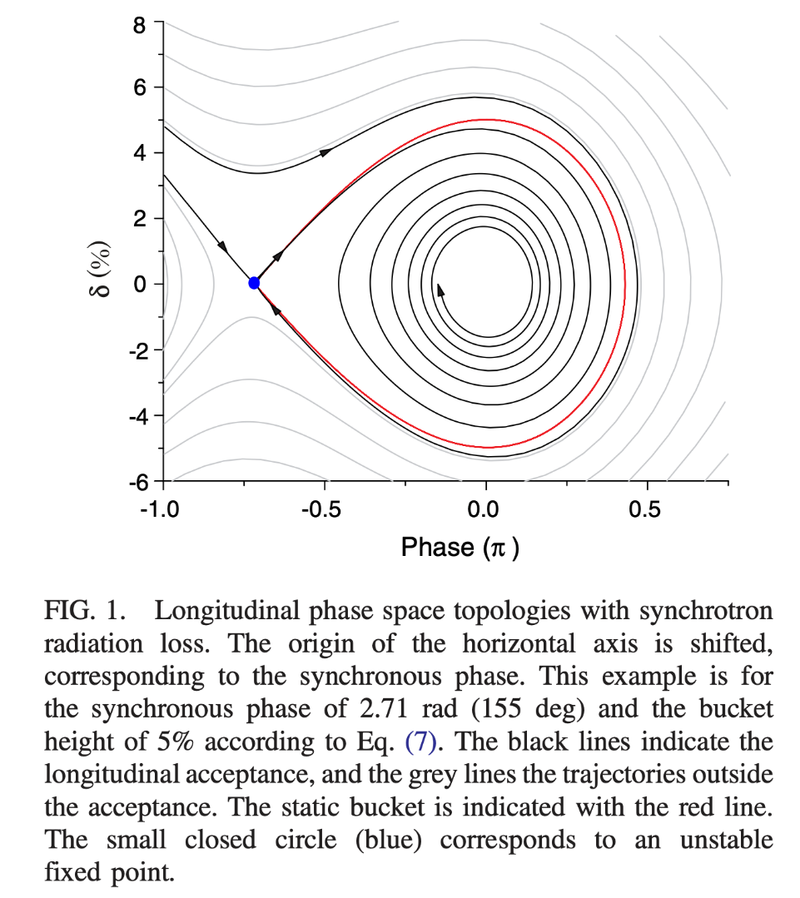
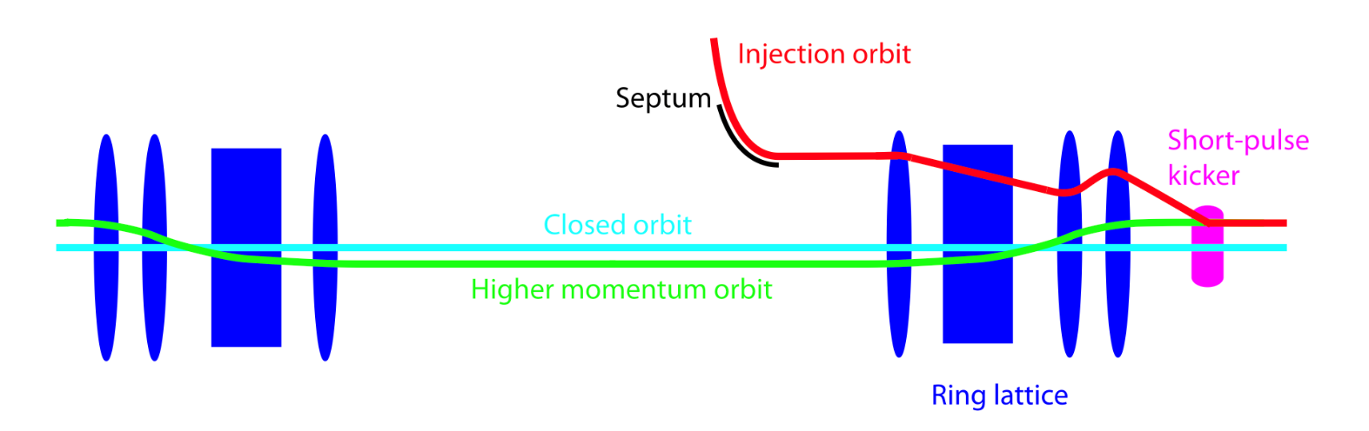
JKPS
Longitudinal injection
On sees in Fig. 1 that the acceptance phase-space plot has the shape of a golf-club with its shaft extending toward the neighboring bucket.
Golf-club shape appears when the rf acceleration is taken into account. It originated from the energy-dependent synchrotron radiation loss and the recovery from the rf field in storage rings.
The particles not only in the static bucket but also in the shaft can finally be trapped. When the height and width of the tilted shaft are sufficient for the energy and time spread of the bunch generated by an injector
Injection point
8/20

Slide 9
JKPS
Longitudinal injection
Since the injected bunch can be longitudinally separate from the circulating bunches, a transverse on-axis injection is realized with a pulsed dipole kicker.
When the pulse length of the kicker is shorter than the bunch spacing, the kicker field is fully transparent to the circulating bunches.
The injection orbit needs to be matched to the off-momentum closed orbit corresponding to the higher injection energy.
Injection point
9/20

Slide 10
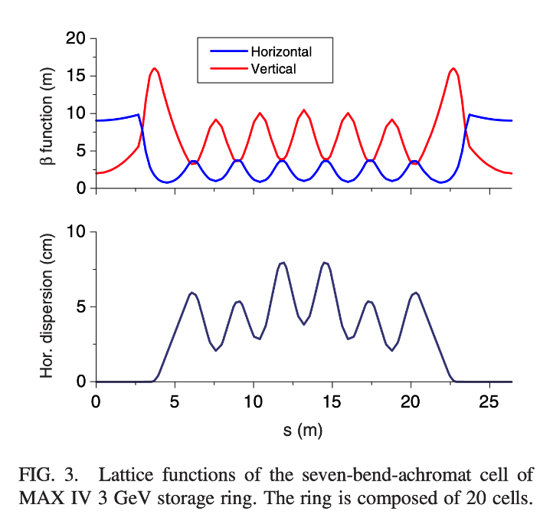
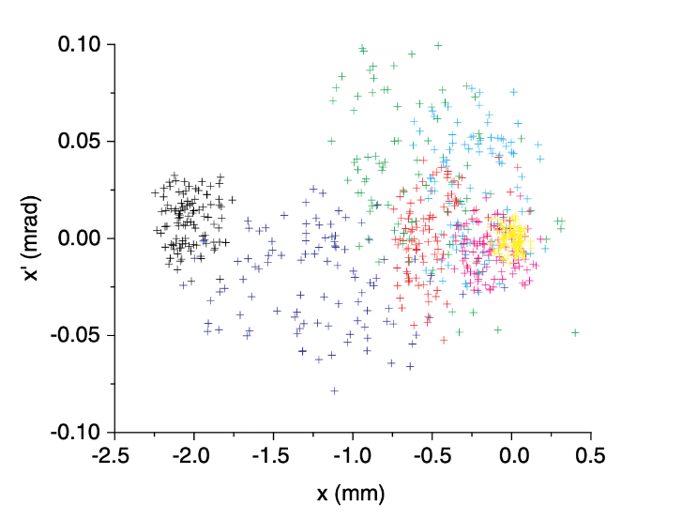
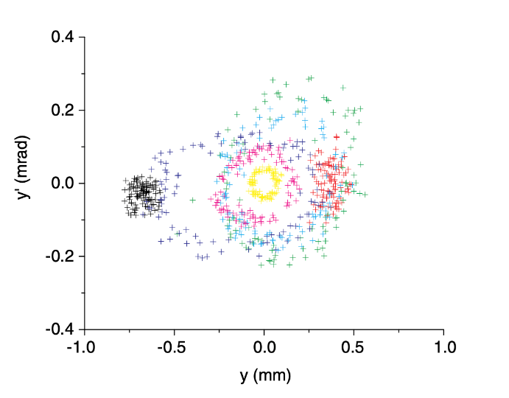
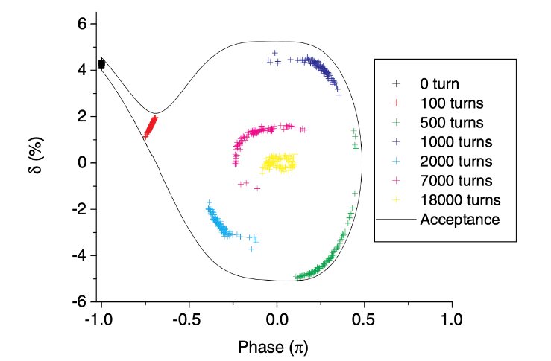
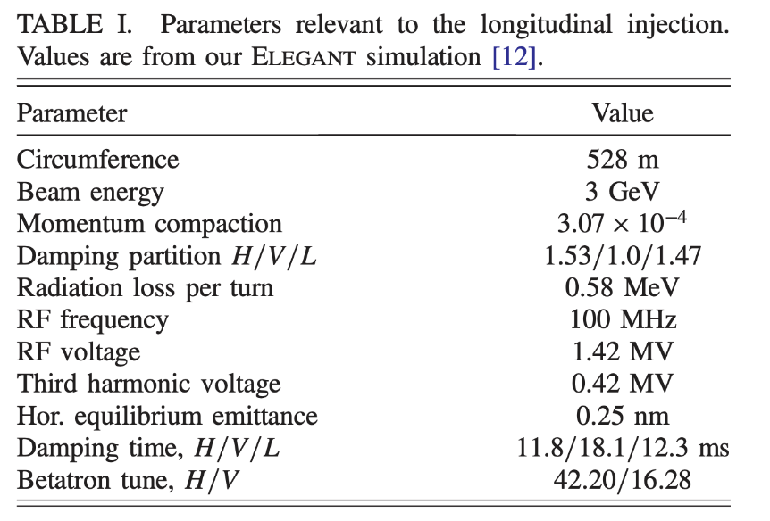
JKPS
Application to MAX-IV lattice
The bunch described above is injected with a time offset of -5ns with respect to a circulating bunch, which corresponds to exactly the point equidistant to two successive circulating bunches and relative energy offset of +4.3%
18000 turns following the injection.
Closed orbit for the off-momentum injected beam is horizontally/vertically shifted by -1.4mm/-0.2mm due to higher order dispersion terms and the introduced machine error.
The bunch injected at x = -1.9mm / y = -0.7mm
10/20

Slide 11
JKPS
Application to MAX-IV lattice
To simulate a realistic machine, the following random machine errors are introduced :
Vertical sextupole misalignments of 50 um rms and quadrupole roll errors of 0.2 mrad rms, exciting linear coupling resonance.
Beta-beating of 3~6% rms through quadrupole gradient errors, exciting normal resonances.
Sextupole and octupole roll errors of 0.2 mrad rms, exciting skew resonances.
In addition, the bunch is injected with a transverse offset of 0.5mm with respect to the off-momentum closed orbit in the middle of the straight section. This corresponds to possible injection errors.
They generated 100 machines with different random seeds and confirmed an injection efficiency of 100% for all but one, which gave an efficiency of 95%. Even for the worst case, an efficiency of 100% was achieved by decreasing the injection error from 0.5mm to 0.2mm.
Figure 4.(Previous slide) shows the particle distributions in the longitudinal and transverse planes for one of the simulation results. It is seen that the injected bunch with the energy offset and time offset is successfully trapped to the rf bucket.
11/20

Slide 12
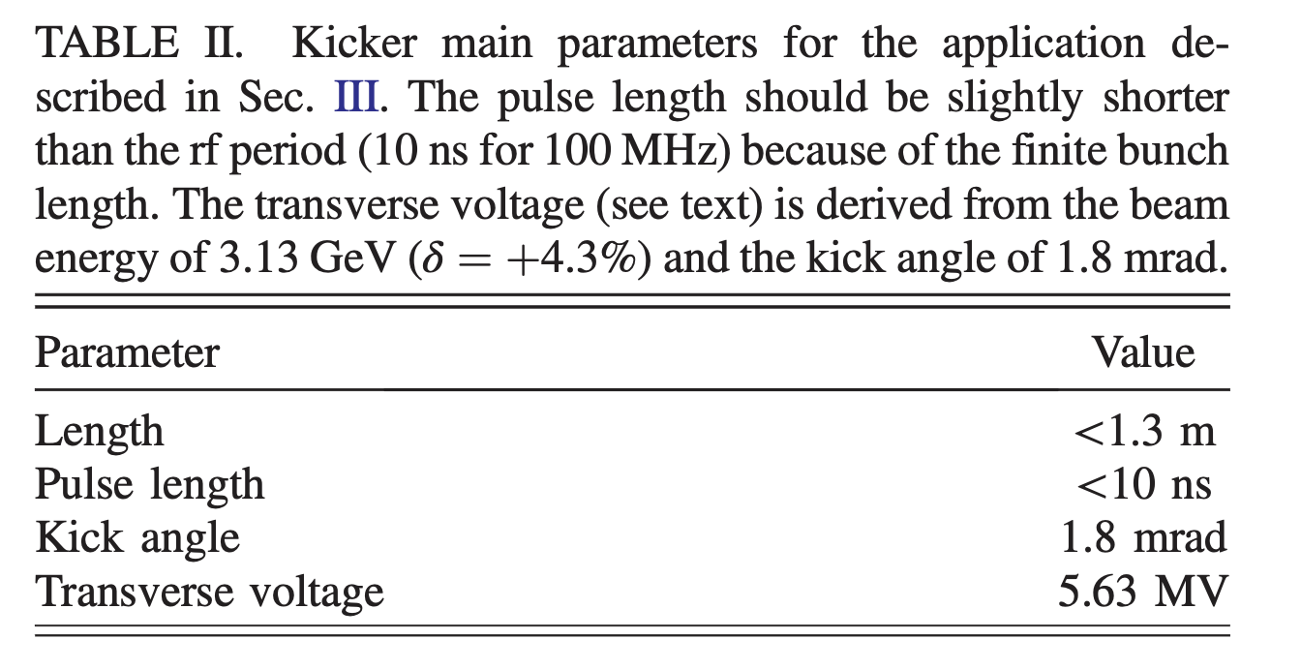
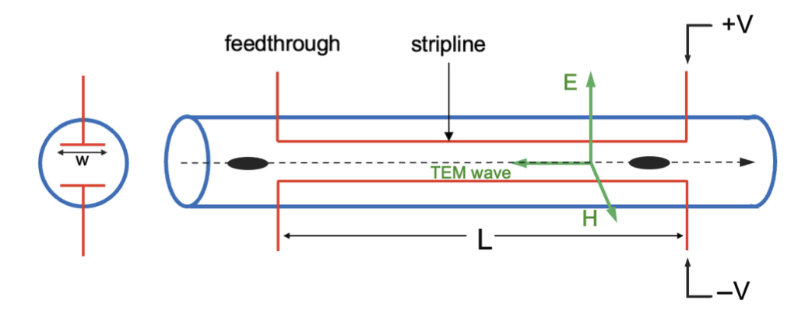
JKPS
Short pulse kicker
One technical challenge in the longitudinal injection scheme would be the short pulse kicker used to situate the injection bunch on-axis.
There are a few strip-line type kickers in operation whose pulse lengths are short enough for the required pulse length of < 10ns.
Strip-line kicker in general consists of a vacuum chamber that accommodates two strip-line electrodes inside.
Strip-line kicker : 전기력과 자기력을 둘다 이용해서 Kick을 줄 수 있음
Strip-line kicker 모식도
12/20

Slide 13
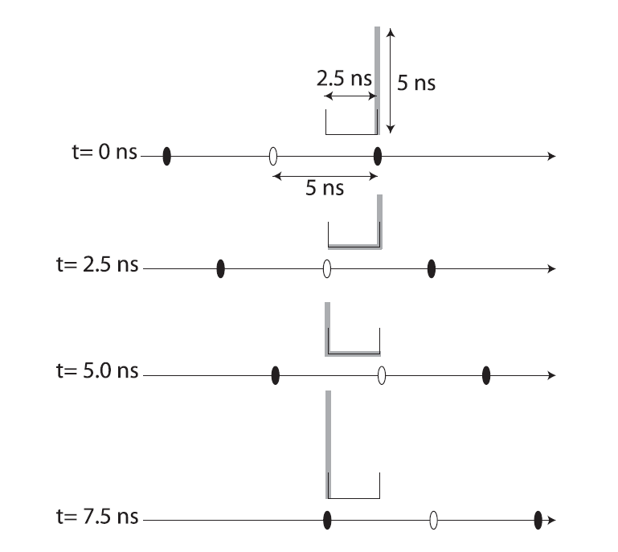
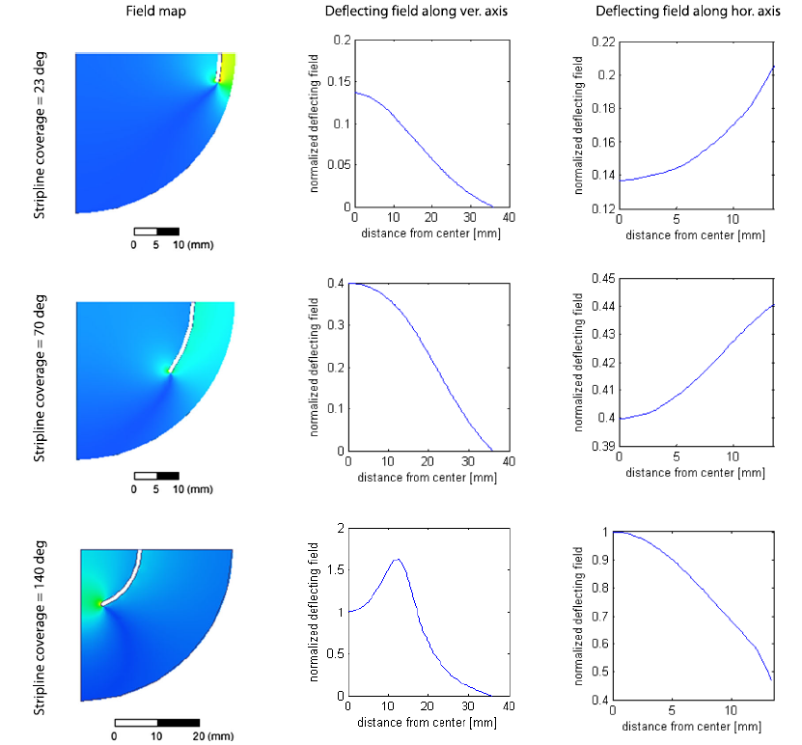
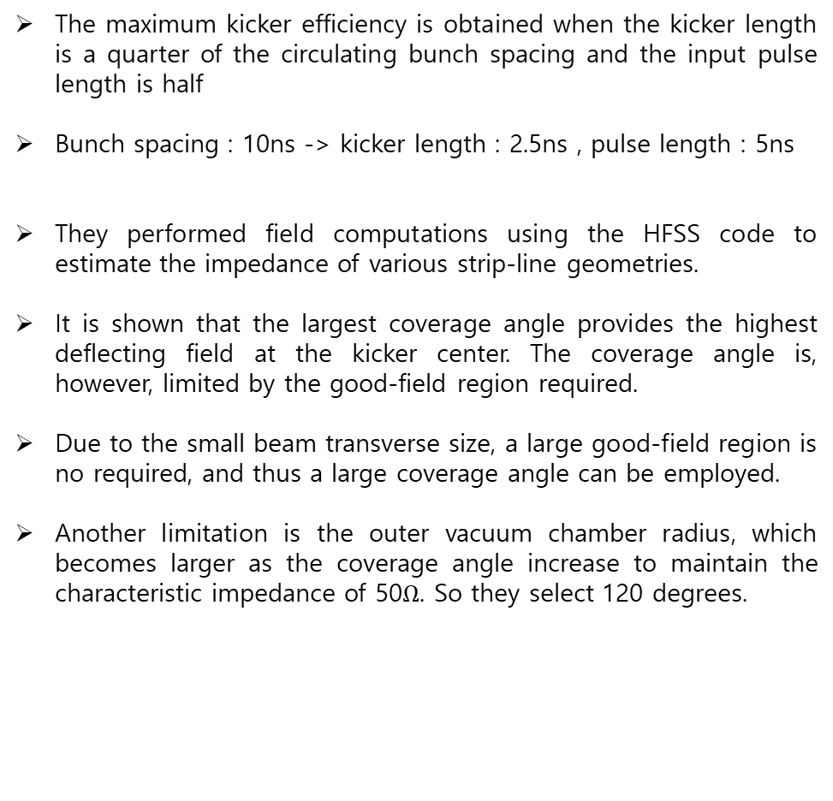
JKPS
Short pulse kicker
The maximum kicker efficiency is obtained when the kicker length is a quarter of the circulating bunch spacing and the input pulse length is half
Bunch spacing : 10ns -> kicker length : 2.5ns , pulse length : 5ns
They performed field computations using the HFSS code to estimate the impedance of various strip-line geometries.
It is shown that the largest coverage angle provides the highest deflecting field at the kicker center. The coverage angle is, however, limited by the good-field region required.
Due to the small beam transverse size, a large good-field region is no required, and thus a large coverage angle can be employed.
Another limitation is the outer vacuum chamber radius, which becomes larger as the coverage angle increase to maintain the characteristic impedance of 50$Ω$. So they select 120 degrees.
13/20

Slide 14
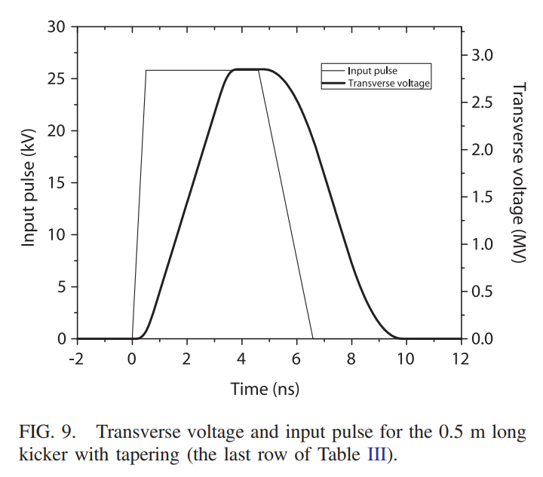
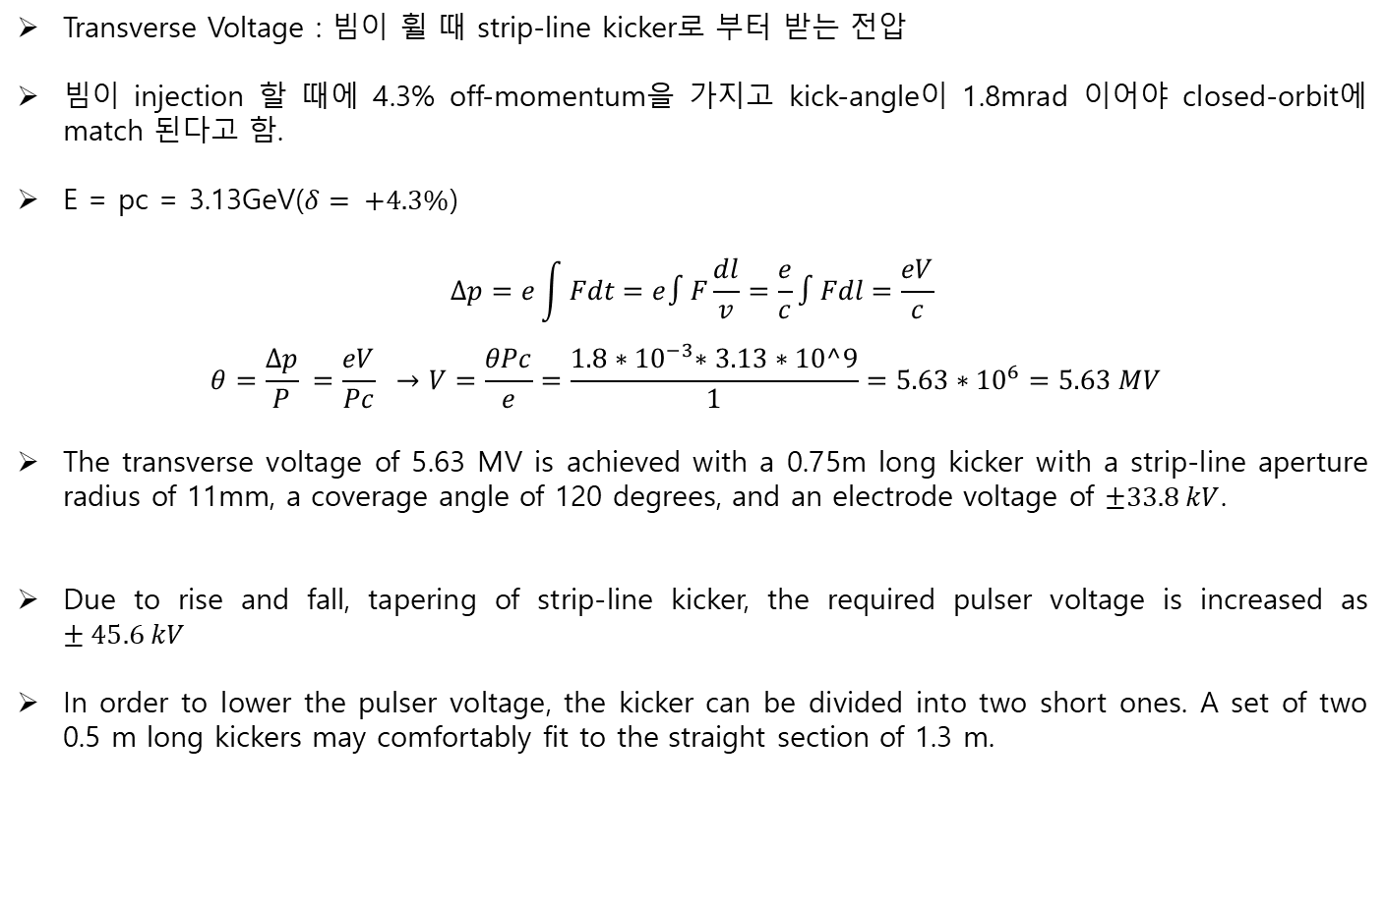
JKPS
Short pulse kicker
Transverse Voltage : 빔이 휠 때 strip-line kicker로 부터 받는 전압
빔이 injection 할 때에 4.3% off-momentum을 가지고 kick-angle이 1.8mrad 이어야 closed-orbit에 match 된다고 함.
E = pc = 3.13GeV($δ= +4.3\%$)
$$Δp=e\int{Fdt=e∫F\frac{dl}{v}=\frac{e}{c}∫Fdl=\frac{eV}{c}}$$
$$θ=\frac{Δp}{P} =\frac{eV}{Pc} →V=\frac{θPc}{e}=\frac{1.8{∗10}^{−3}∗3.13∗10^9}{1}=5.63∗{10}^{6}=5.63 MV$$
The transverse voltage of 5.63 MV is achieved with a 0.75m long kicker with a strip-line aperture radius of 11mm, a coverage angle of 120 degrees, and an electrode voltage of $±33.8 kV$.
Due to rise and fall, tapering of strip-line kicker, the required pulser voltage is increased as $±45.6 kV$
In order to lower the pulser voltage, the kicker can be divided into two short ones. A set of two 0.5 m long kickers may comfortably fit to the straight section of 1.3 m.
14/20

Slide 15
JKPS
Discussion
The 100 MHz rf frequency of the MAX-IV 3GeV ring was selected.
But most light sources are equipped with a 500 MHz rf system. -> rf bucket length 2ns
Research and development of nanosecond-kicker (pulse length of about 1ns) is necessary to adapt the injection scheme to storage rings with a common 500 MHz rf system.
With respect to the longitudinal acceptance, the ‘shaft’ phase space must be of sufficient height and width relative to the energy spread and the bunch length of the injection bunch
15/20

Slide 16
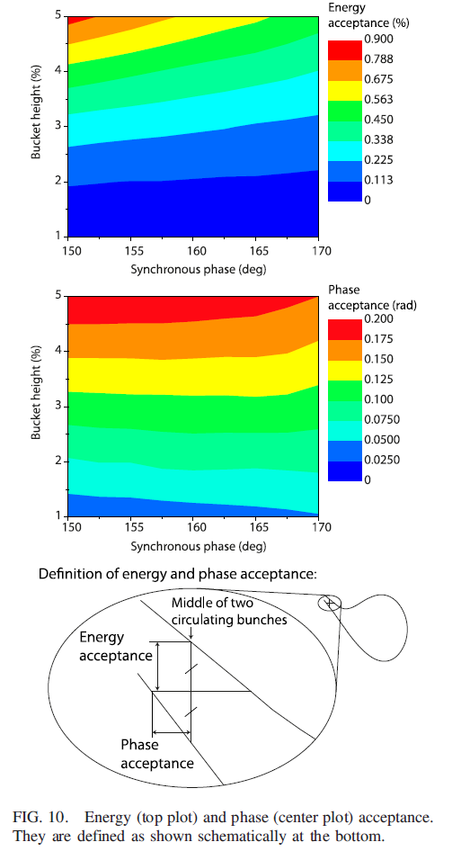
JKPS
Discussion
The phase acceptance of 0.1 rad corresponds to 32 ps (~160 ps) for an rf frequency of 500 MHZ (100 MHz).
Therefore, the energy and phase acceptance would be sufficient when the bucket height is ~3% (corresponding to > 0.2% energy acceptance), at least for a linac injector.
The jitter tolerance on the injection beam energy and timing are then <<0.2% and <<32 ps (160ps), respectively.
A higher bucket height may allow one to employ a booster synchrotron as an injector, which in general generates injection bunches with larger energy spread and longer bunch length compared to linac inejector.
It is noted that the acceptance decrease when the damping partition numbers are shifted by mean of combined function dipole magnets, and longitudinal damping consequently weakens. -> MAX-IV lattice employed
Linac is Okay
16/20

Slide 17
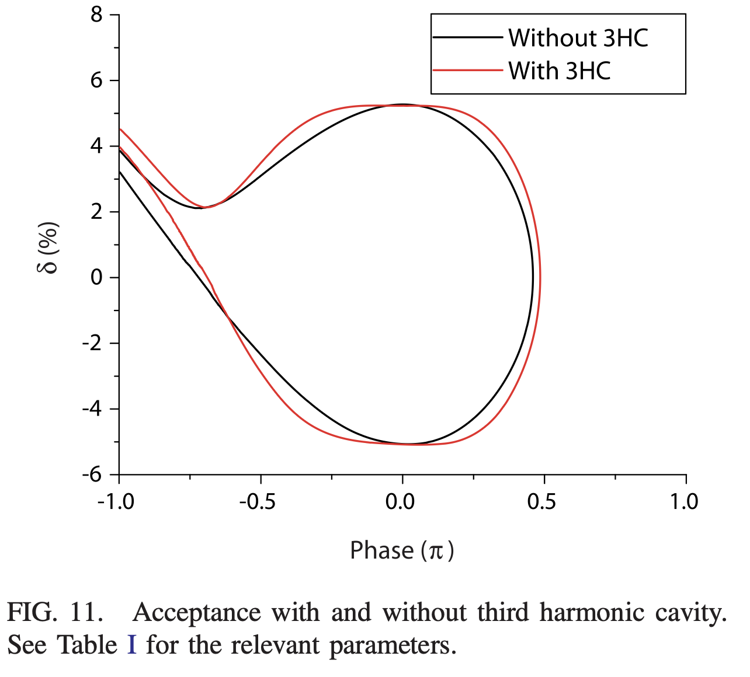
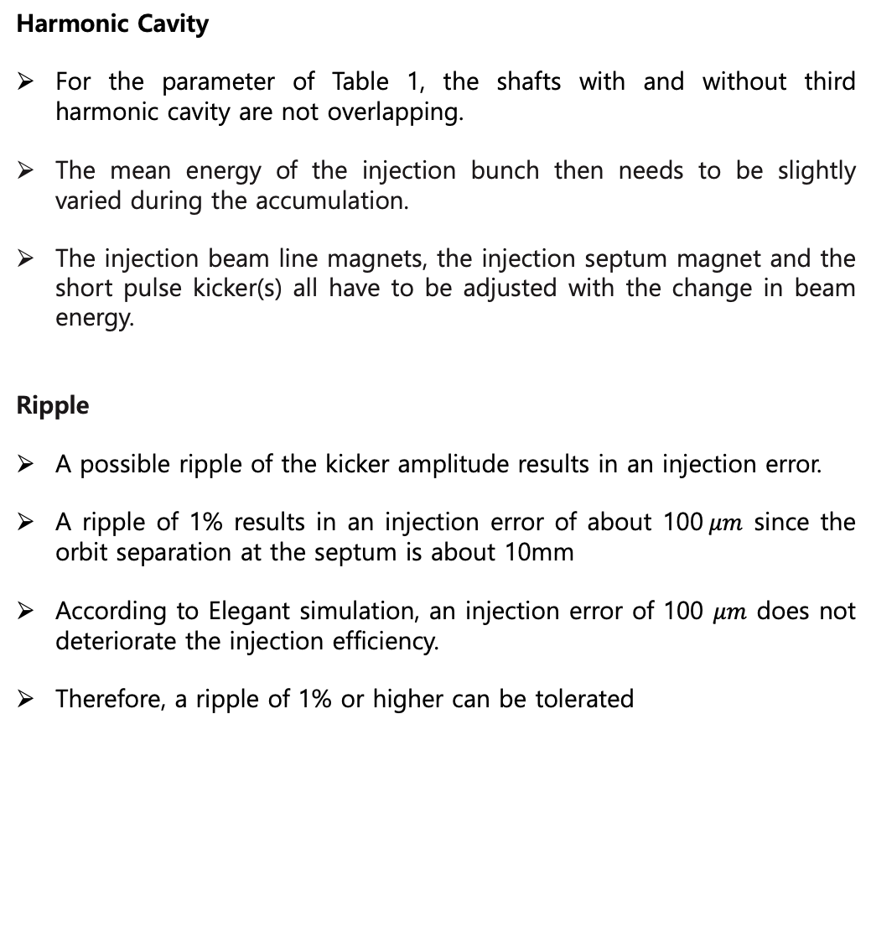
JKPS
Discussion
Harmonic Cavity
For the parameter of Table 1, the shafts with and without third harmonic cavity are not overlapping.
The mean energy of the injection bunch then needs to be slightly varied during the accumulation.
The injection beam line magnets, the injection septum magnet and the short pulse kicker(s) all have to be adjusted with the change in beam energy.
Ripple
A possible ripple of the kicker amplitude results in an injection error.
A ripple of 1% results in an injection error of about 100$μm$ since the orbit separation at the septum is about 10mm
According to Elegant simulation, an injection error of 100 $μm$ does not deteriorate the injection efficiency.
Therefore, a ripple of 1% or higher can be tolerated
17/20

Slide 18
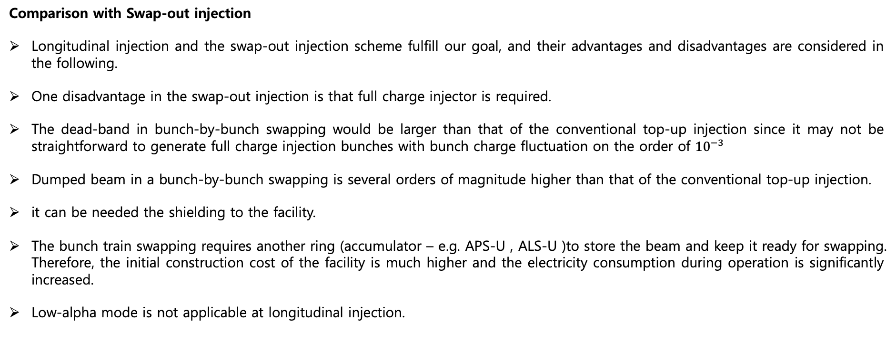
JKPS
Discussion
Comparison with Swap-out injection
Longitudinal injection and the swap-out injection scheme fulfill our goal, and their advantages and disadvantages are considered in the following.
One disadvantage in the swap-out injection is that full charge injector is required.
The dead-band in bunch-by-bunch swapping would be larger than that of the conventional top-up injection since it may not be straightforward to generate full charge injection bunches with bunch charge fluctuation on the order of ${10}^{−3}$
Dumped beam in a bunch-by-bunch swapping is several orders of magnitude higher than that of the conventional top-up injection.
it can be needed the shielding to the facility.
The bunch train swapping requires another ring (accumulator – e.g. APS-U , ALS-U )to store the beam and keep it ready for swapping. Therefore, the initial construction cost of the facility is much higher and the electricity consumption during operation is significantly increased.
Low-alpha mode is not applicable at longitudinal injection.
18/20

Slide 19
JKPS
Conclusion
A new on-axis top-up injection scheme is proposed for small-aperture storage rings.
The longitudinal acceptance forms a “golf-club” shape due to energy-dependent synchrotron radiation loss, not RF acceleration.
The shaft region enables injection between two neighboring bunches using short-pulse dipole kickers.
The injected bunch stays transversely on-axis, ensuring photon beam stability.
Feasibility confirmed for the MAX IV 3 GeV ring via simulations.
Requires ~10 ns kicker for low-frequency (~100 MHz) RF, or ~1 ns kicker for 500 MHz rings.
19/20

Slide 20
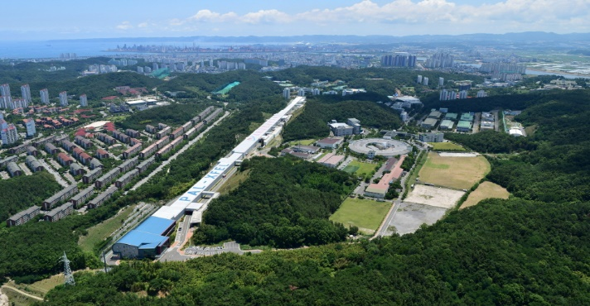
Thank you!

