Slide 1
PLS-II low-alpha mode lattice
2025-10-17
김준하

Slide 2
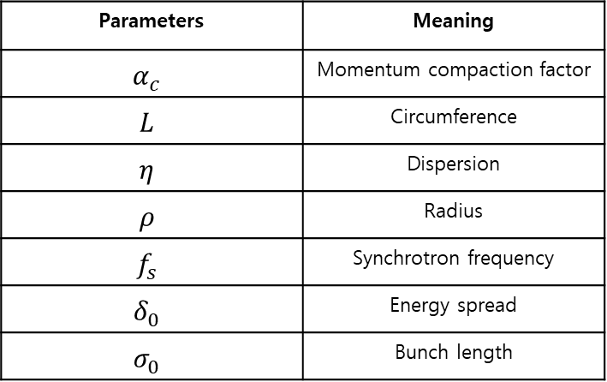
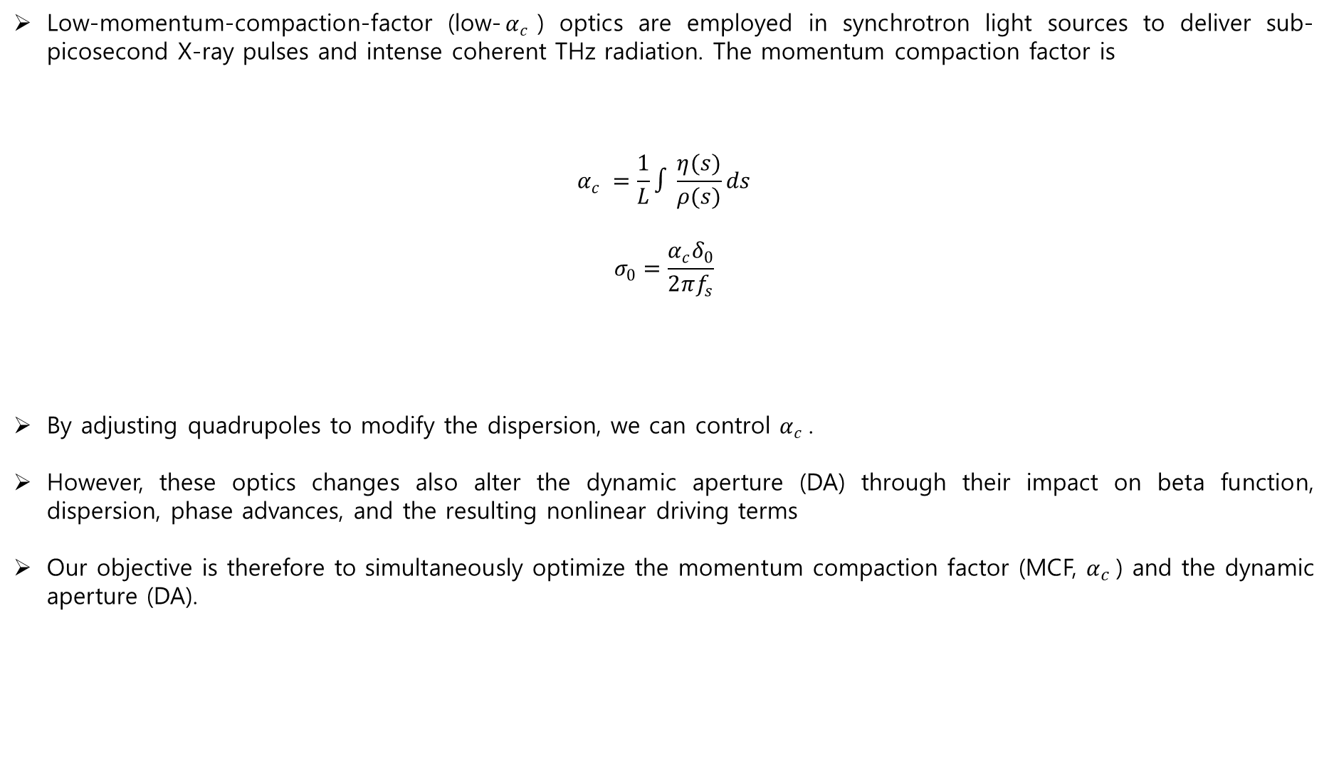
Low alpha lattice?
Low-momentum-compaction-factor (low-$α_{c}$) optics are employed in synchrotron light sources to deliver sub-picosecond X-ray pulses and intense coherent THz radiation. The momentum compaction factor is
$$α_{c} =\frac{1}{L}∫\frac{η(s)}{ρ(s)}ds$$
$$σ_{0}=\frac{α_{c}δ_{0}}{2πf_{s}}$$
By adjusting quadrupoles to modify the dispersion, we can control $α_{c}$.
However, these optics changes also alter the dynamic aperture (DA) through their impact on beta function, dispersion, phase advances, and the resulting nonlinear driving terms
Our objective is therefore to simultaneously optimize the momentum compaction factor (MCF, $α_{c}$​) and the dynamic aperture (DA).
Parameters | Meaning
$$α_{c}$$ | Momentum compaction factor
$$L$$ | Circumference
$$η$$ | Dispersion
$$ρ$$ | Radius
$$f_{s}$$ | Synchrotron frequency
$$δ_{0}$$ | Energy spread
$$σ_{0}$$ | Bunch length

Slide 3
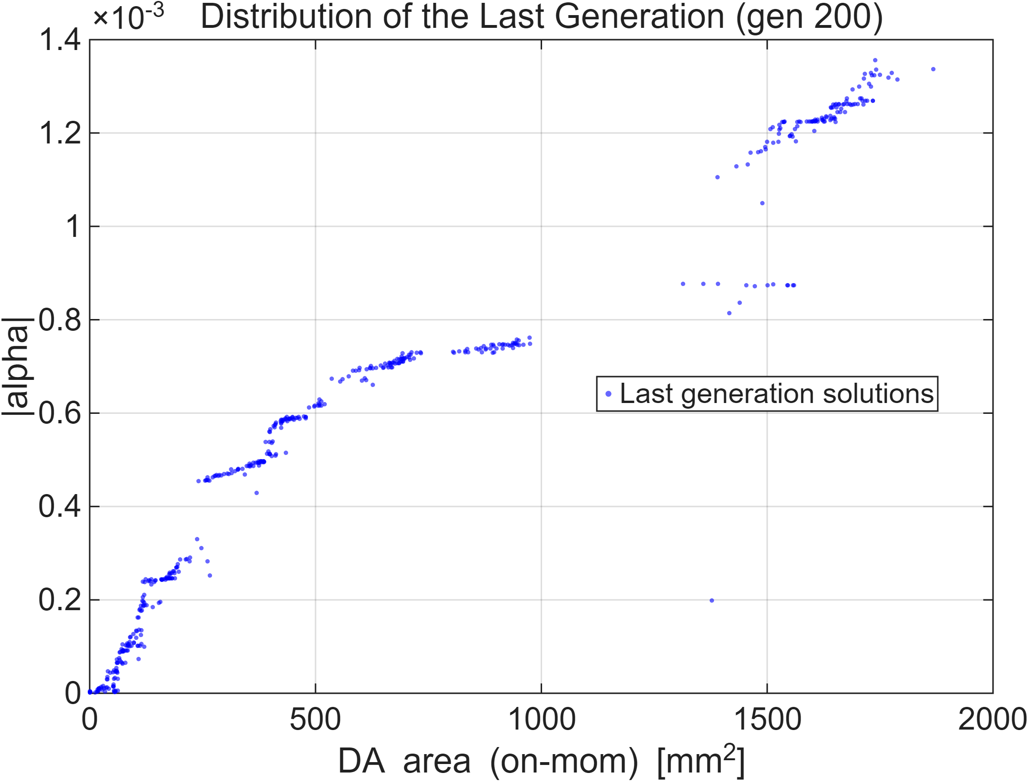
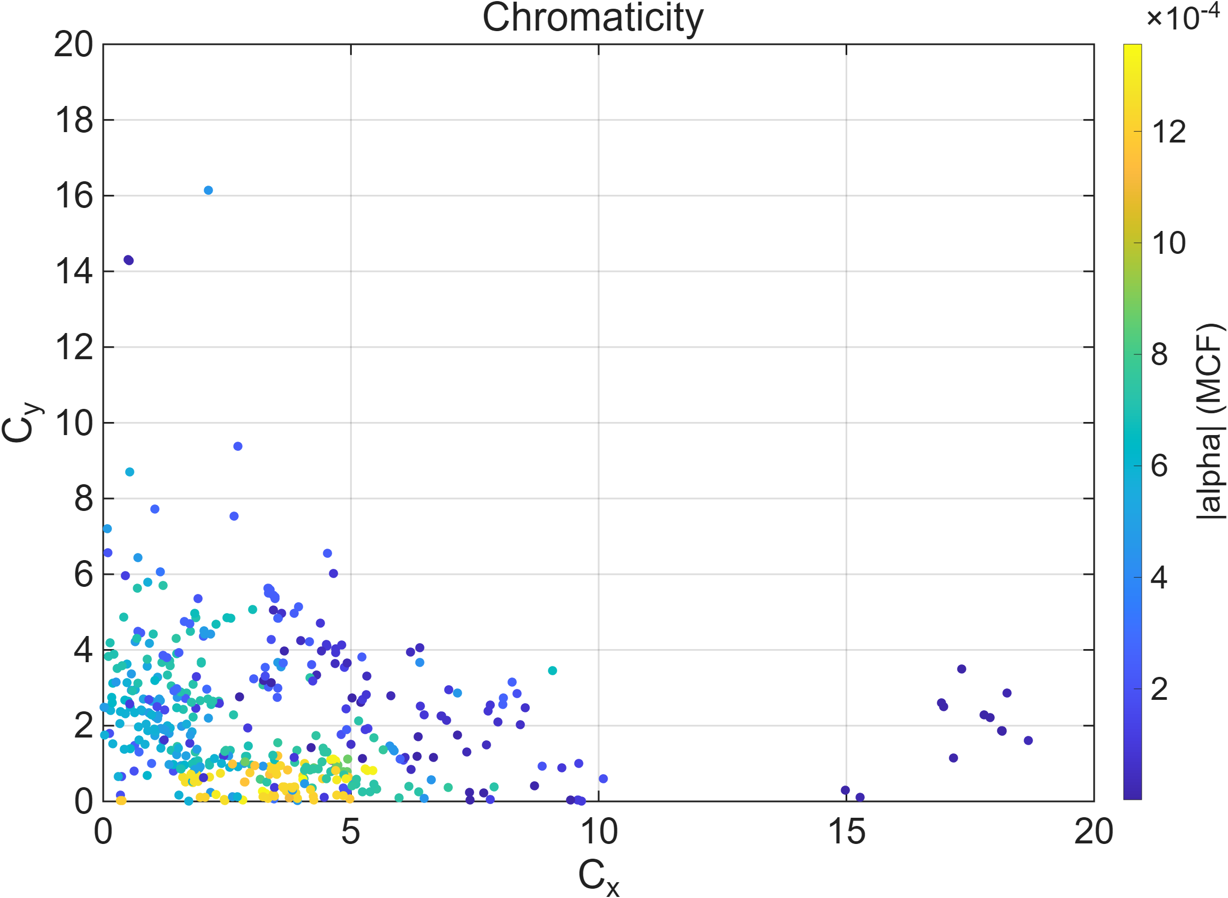
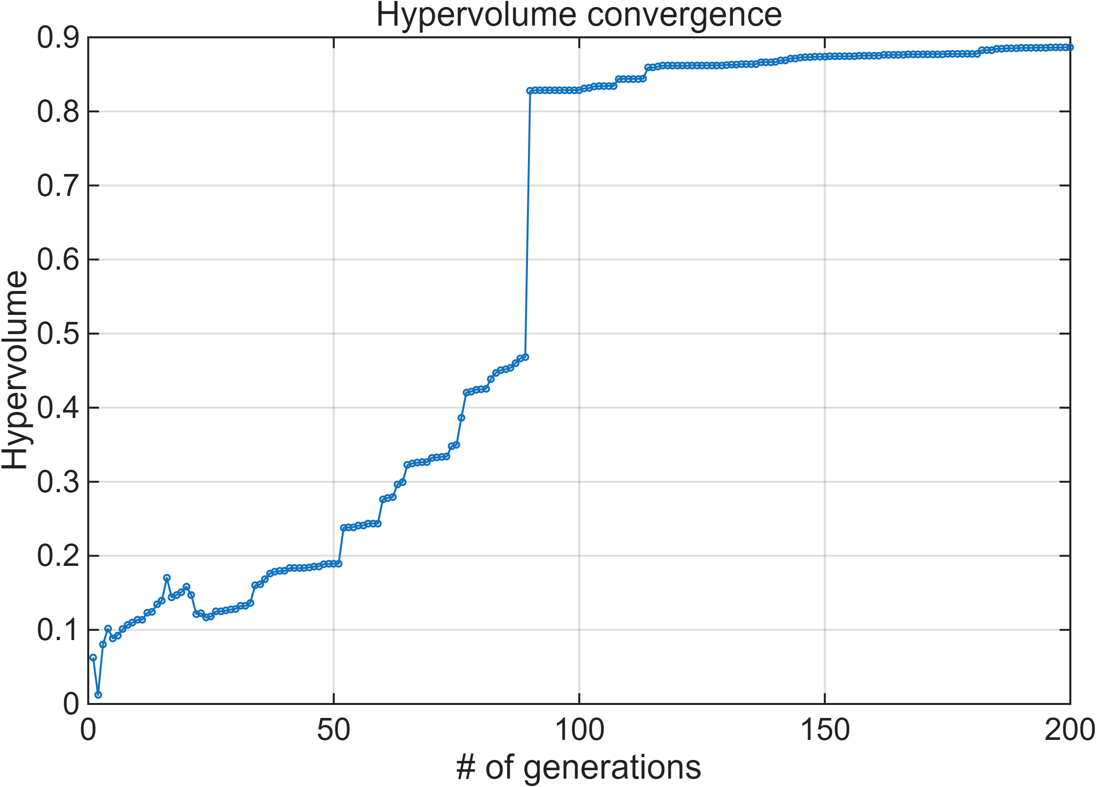
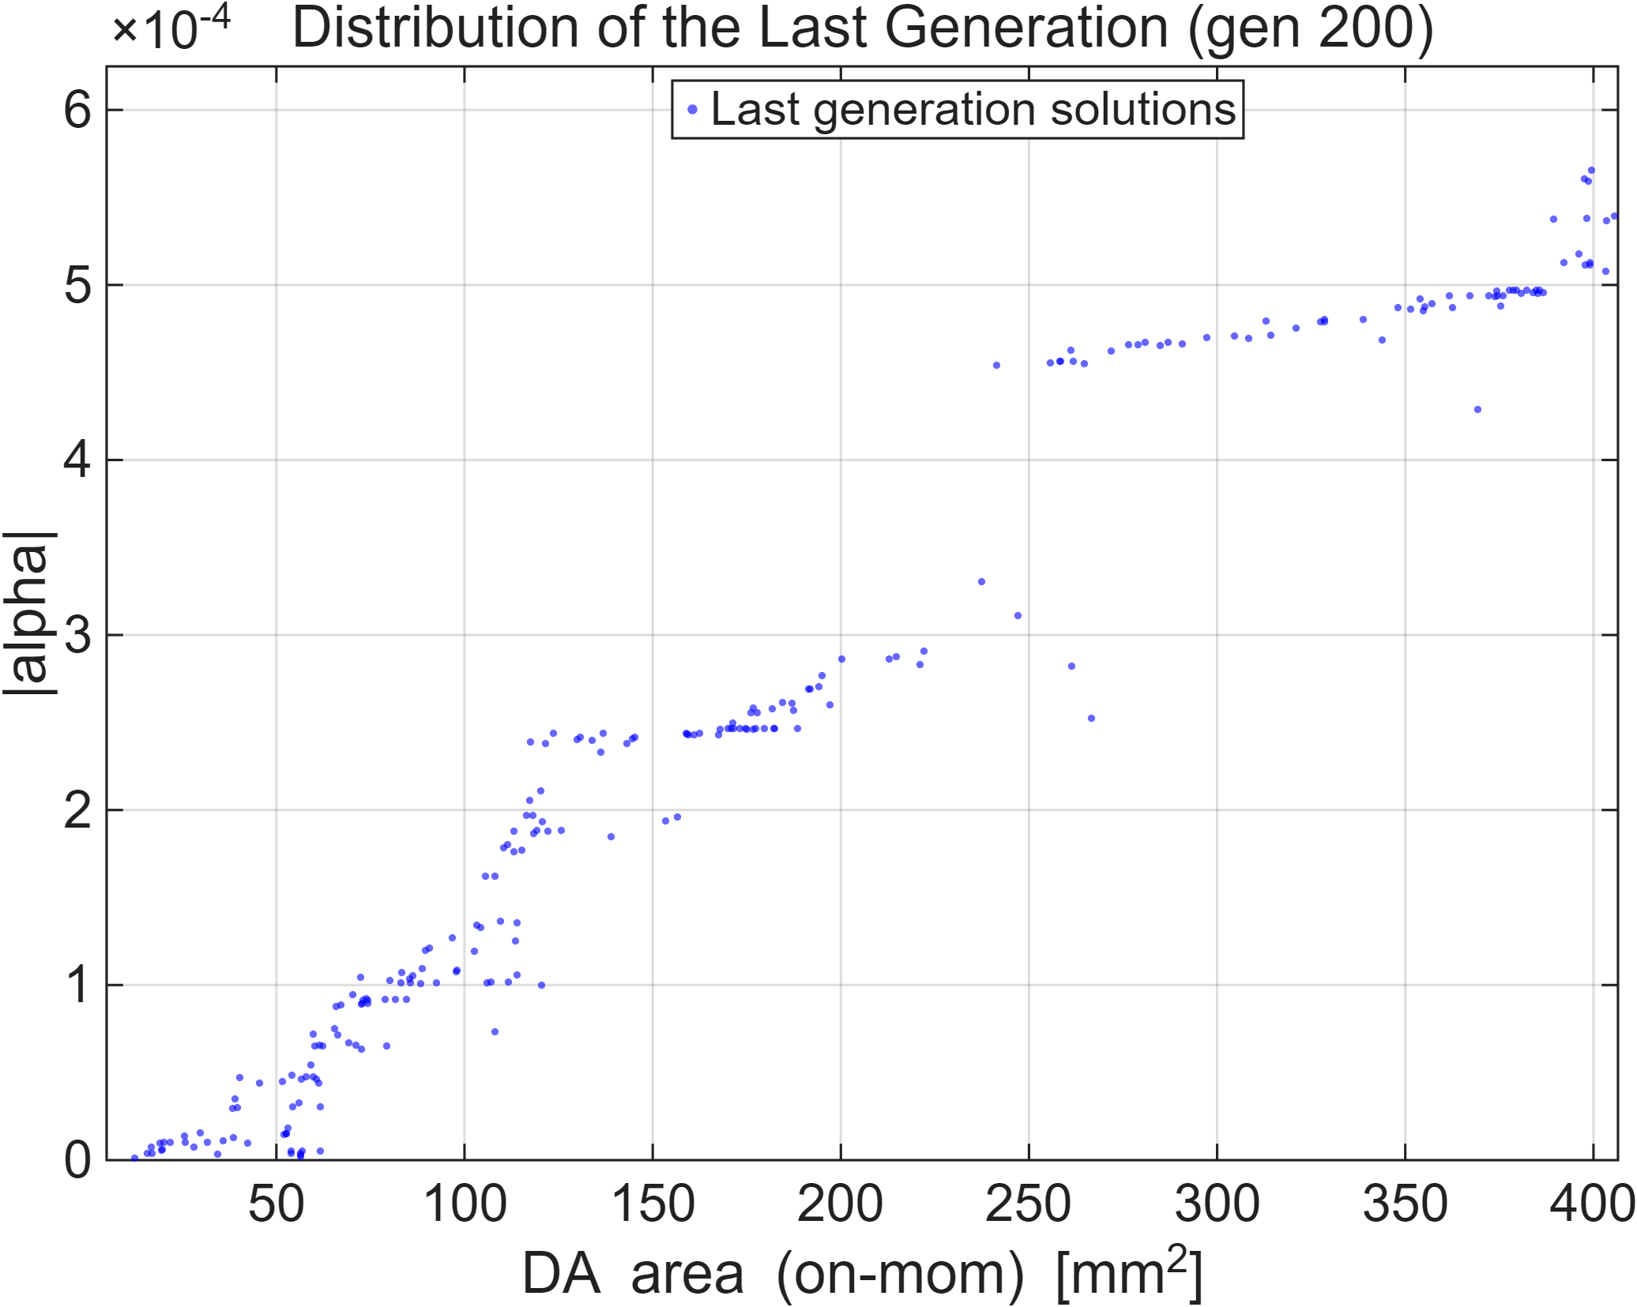

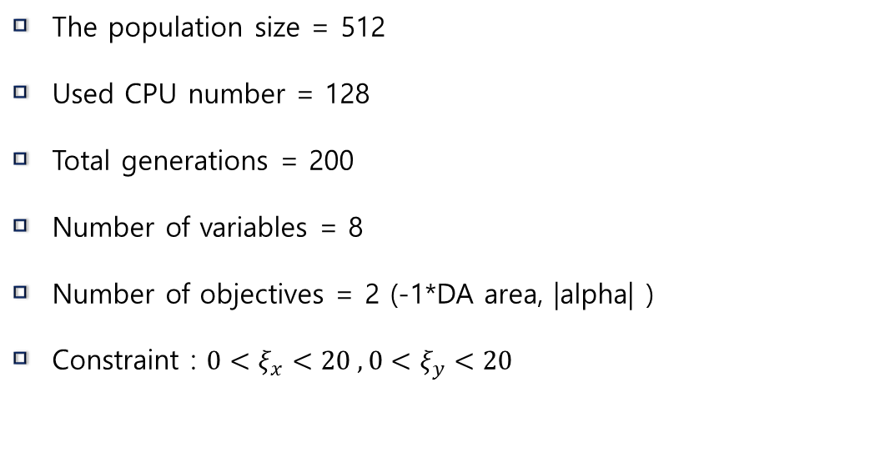
Lattice : PLS-II bare lattice
Storage ring | Circumference (m) | Energy (GeV) | MCF
Soleil | 354 | 2.75 | 1.7e-5
Diamond | 561 | 3 | -3e-6
Bessy-II | 240 | 1.7 | 3.5e-5
SLS | 288 | 2.4 | 5.3e-5
SPEAR3 | 234 | 3 | 5.2e-5
The population size = 512
Used CPU number = 128
Total generations = 200
Number of variables = 8
Number of objectives = 2 (-1*DA area, |alpha| )
Constraint : $0<ξ_{x}<20 , 0<ξ_{y}<20$

Slide 4
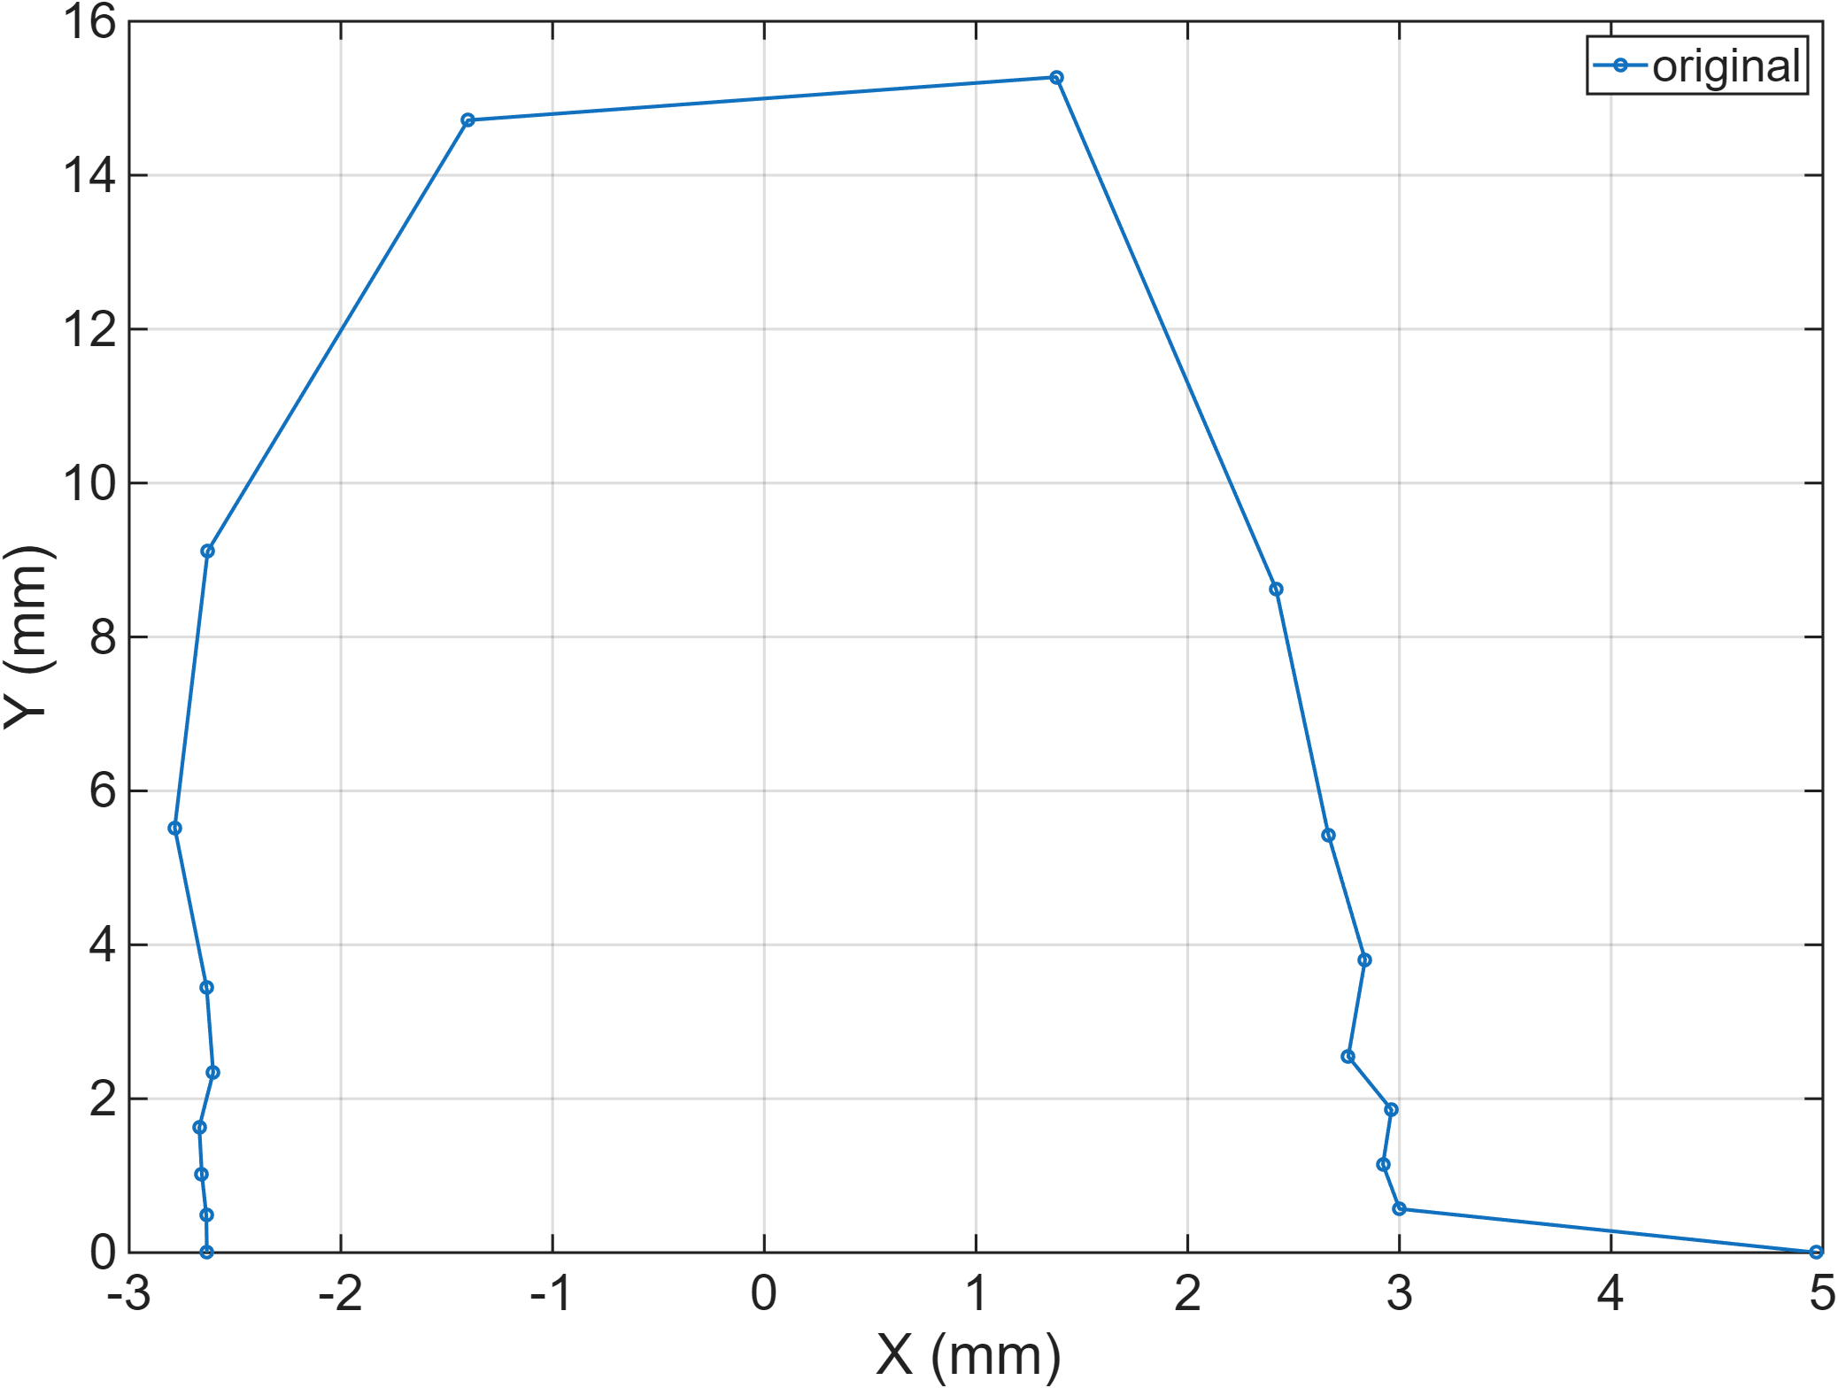
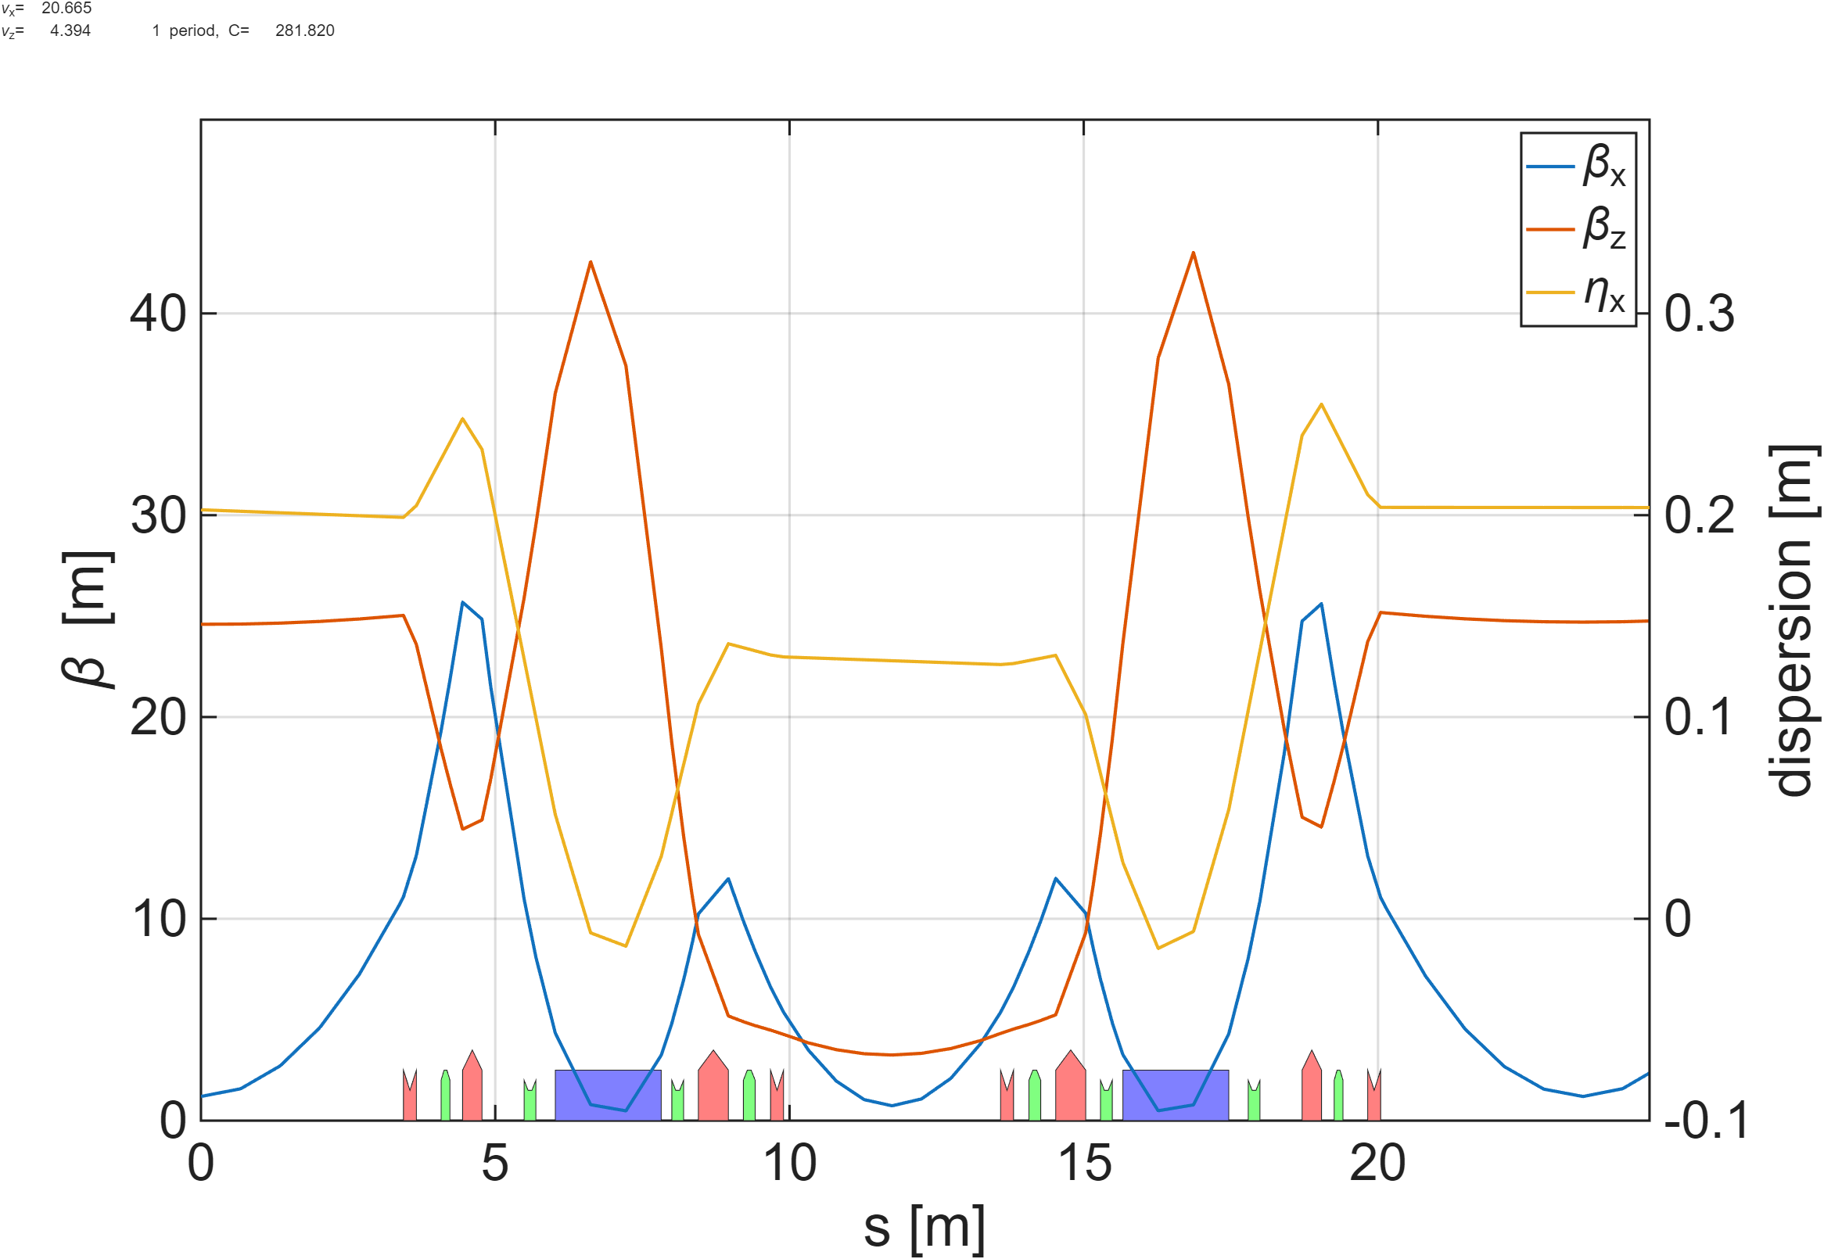
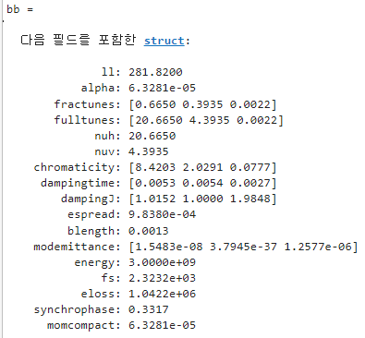
Magnet | Original K | K
Q1 | -1.7008 | -1.2653
Q2 | 2.3633 | 2.4685
Q3 | 2.0142 | 1.9714
Q4 | -1.9618 | -0.2384
S1 | 17.6670 | 25.5233
S2 | -19.2500 | -33.7142
S3 | -23.7000 | -37.0680
S4 | 20.7550 | 35.0051
Dipole에서 dispersion <0
DA x 방향 acceptance -2.63mm
MCF : 6.3281e-5 (원래 값 대비 1/21 수준)
Tune (H/V) : 20.6650 / 4.3935
Chromaticity (H/V) : 8.4203 / 2.0291

Slide 5
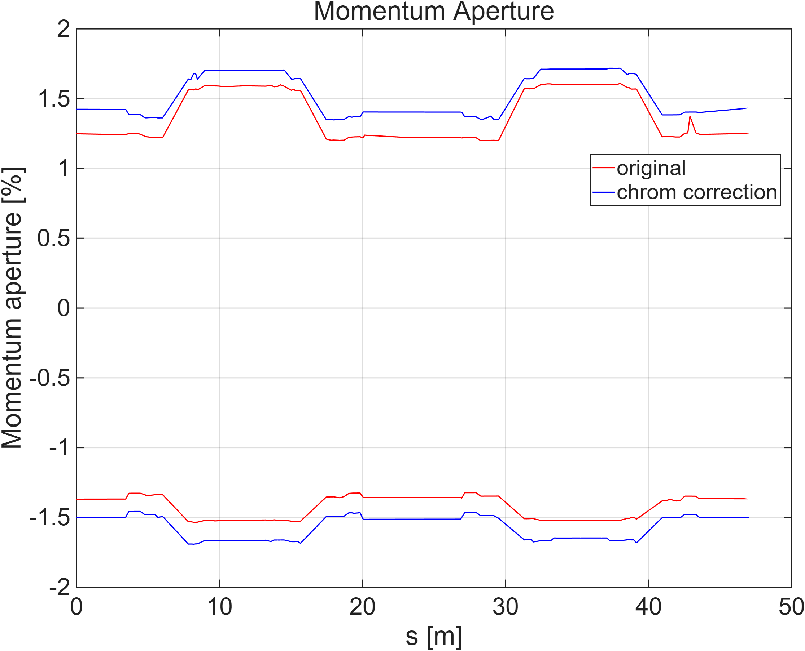
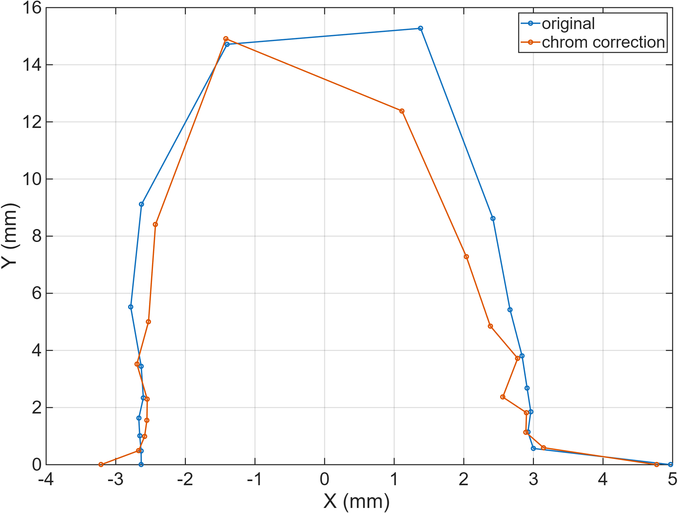
S1,S2 이용하여 chromaticity[H,V] [8.4203, 2.0291]에서 [5,5] 으로 이동
X acceptance -2.63mm 에서 -3.21mm로 바뀜
Magnet | Original K | K | Modified K
Q1 | -1.7008 | -1.2653 | 변동없음
Q2 | 2.3633 | 2.4685
Q3 | 2.0142 | 1.9714
Q4 | -1.9618 | -0.2384
S1 | 17.6670 | 25.5233 | 22.9306
S2 | -19.2500 | -33.7142 | -31.6184
S3 | -23.7000 | -37.0680 | 변동없음
S4 | 20.7550 | 35.0051
scanrange : 2 cell
Emitx : 1.548e-08
Emity : 1.548e-09 / 1.548e-10
Lifetime (hrs) : 16.7115 / 5.2577

Slide 6
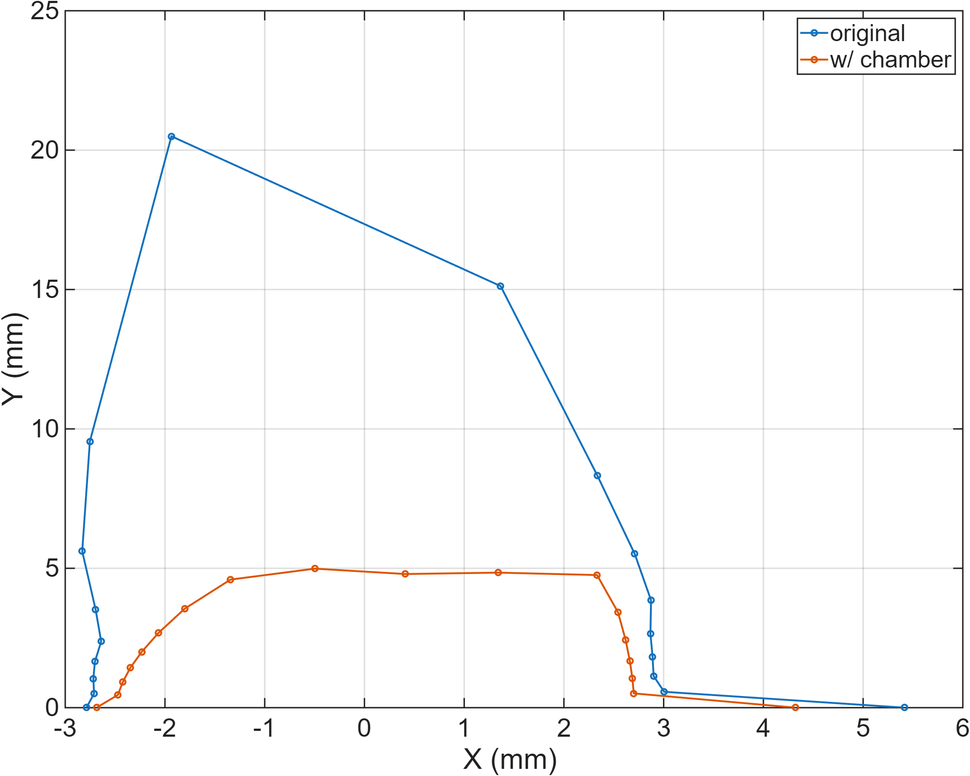
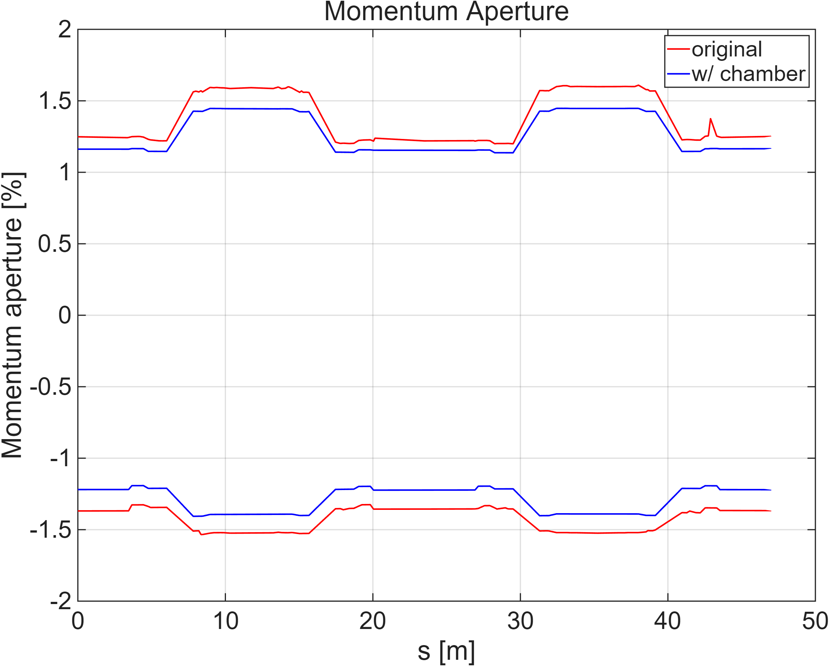
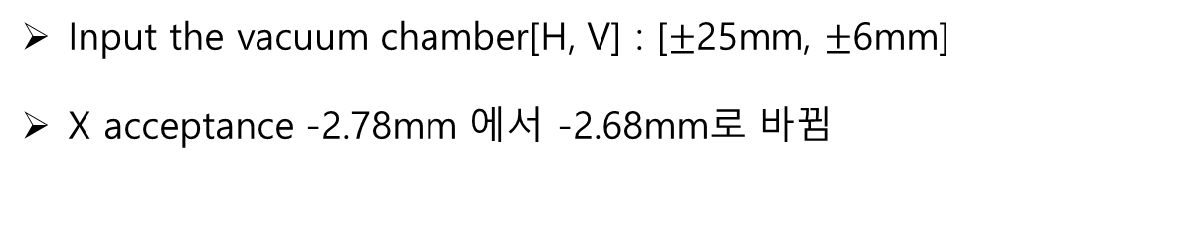
Input the vacuum chamber[H, V] : [$±$25mm, $±$6mm]
X acceptance -2.78mm 에서 -2.68mm로 바뀜
scanrange : 2 cell
Emitx : 1.548e-08
Emity : 1.548e-09 / 1.548e-10
Lifetime (hrs) : 13.3013 / 4.2690

Slide 7
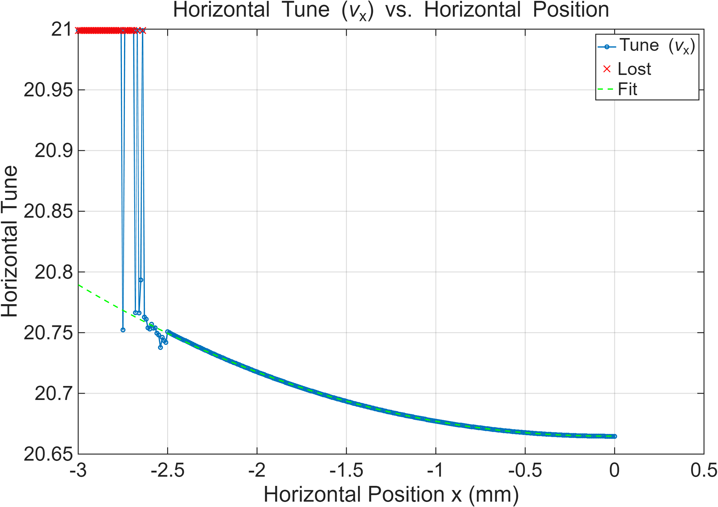
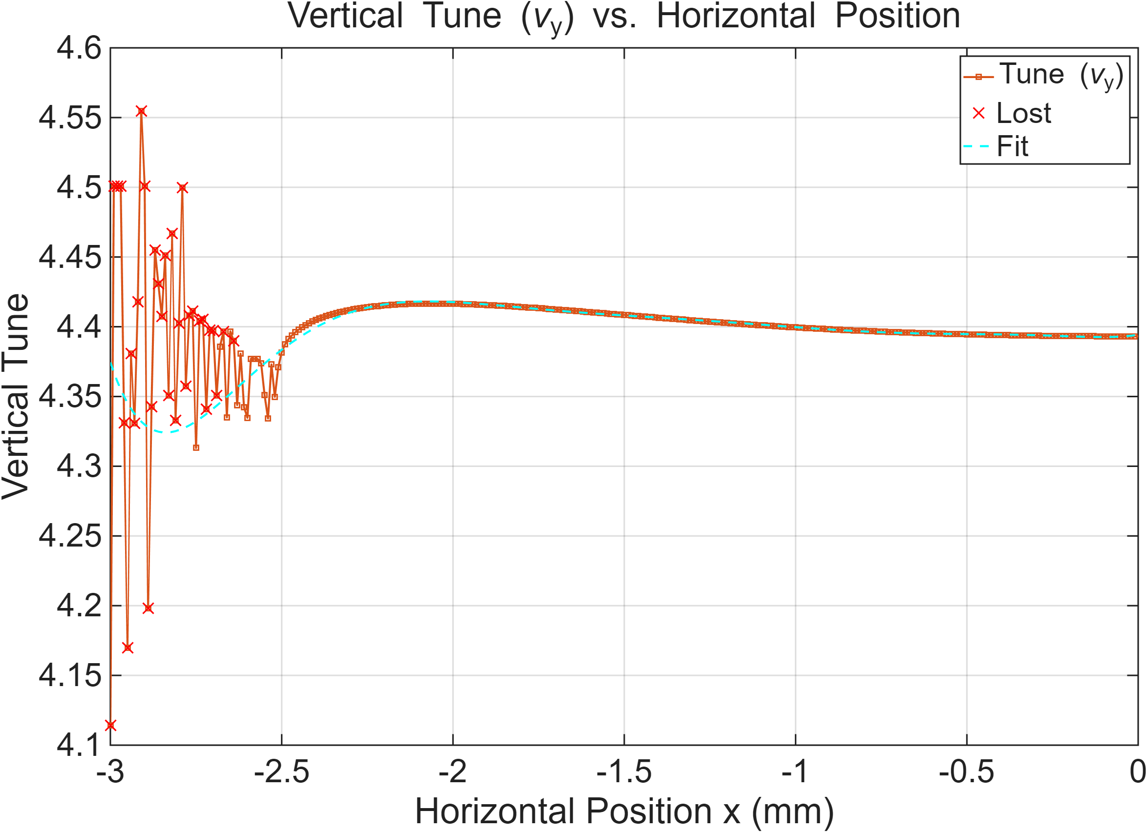


빔이 첫번째로 죽은 지점 : -2.64mm
Hor. Tune = 20.759
Ver. Tune = 4.3561
$ν_{x}−2ν_{y}=12.0468$
Normal sextupole에 의한 3rd order resonance 때문에 빔 손실
$ν_{x}−2ν_{y}=integer 에$ 해당하는 RDT : h10020
PLS-II : 418
PLS-II low-alpha : 3.6865e+03

Slide 8
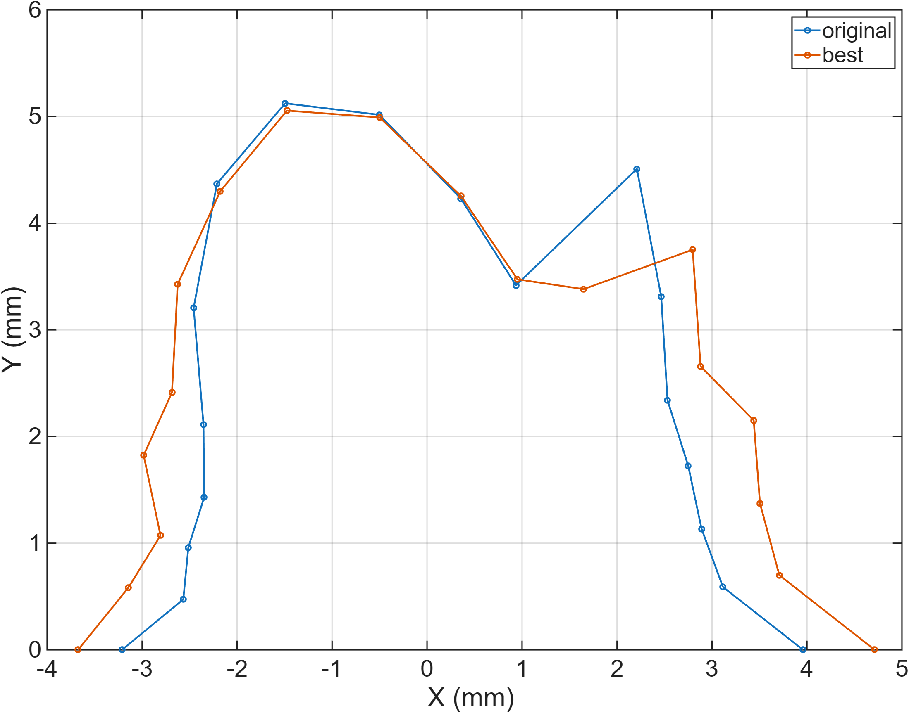
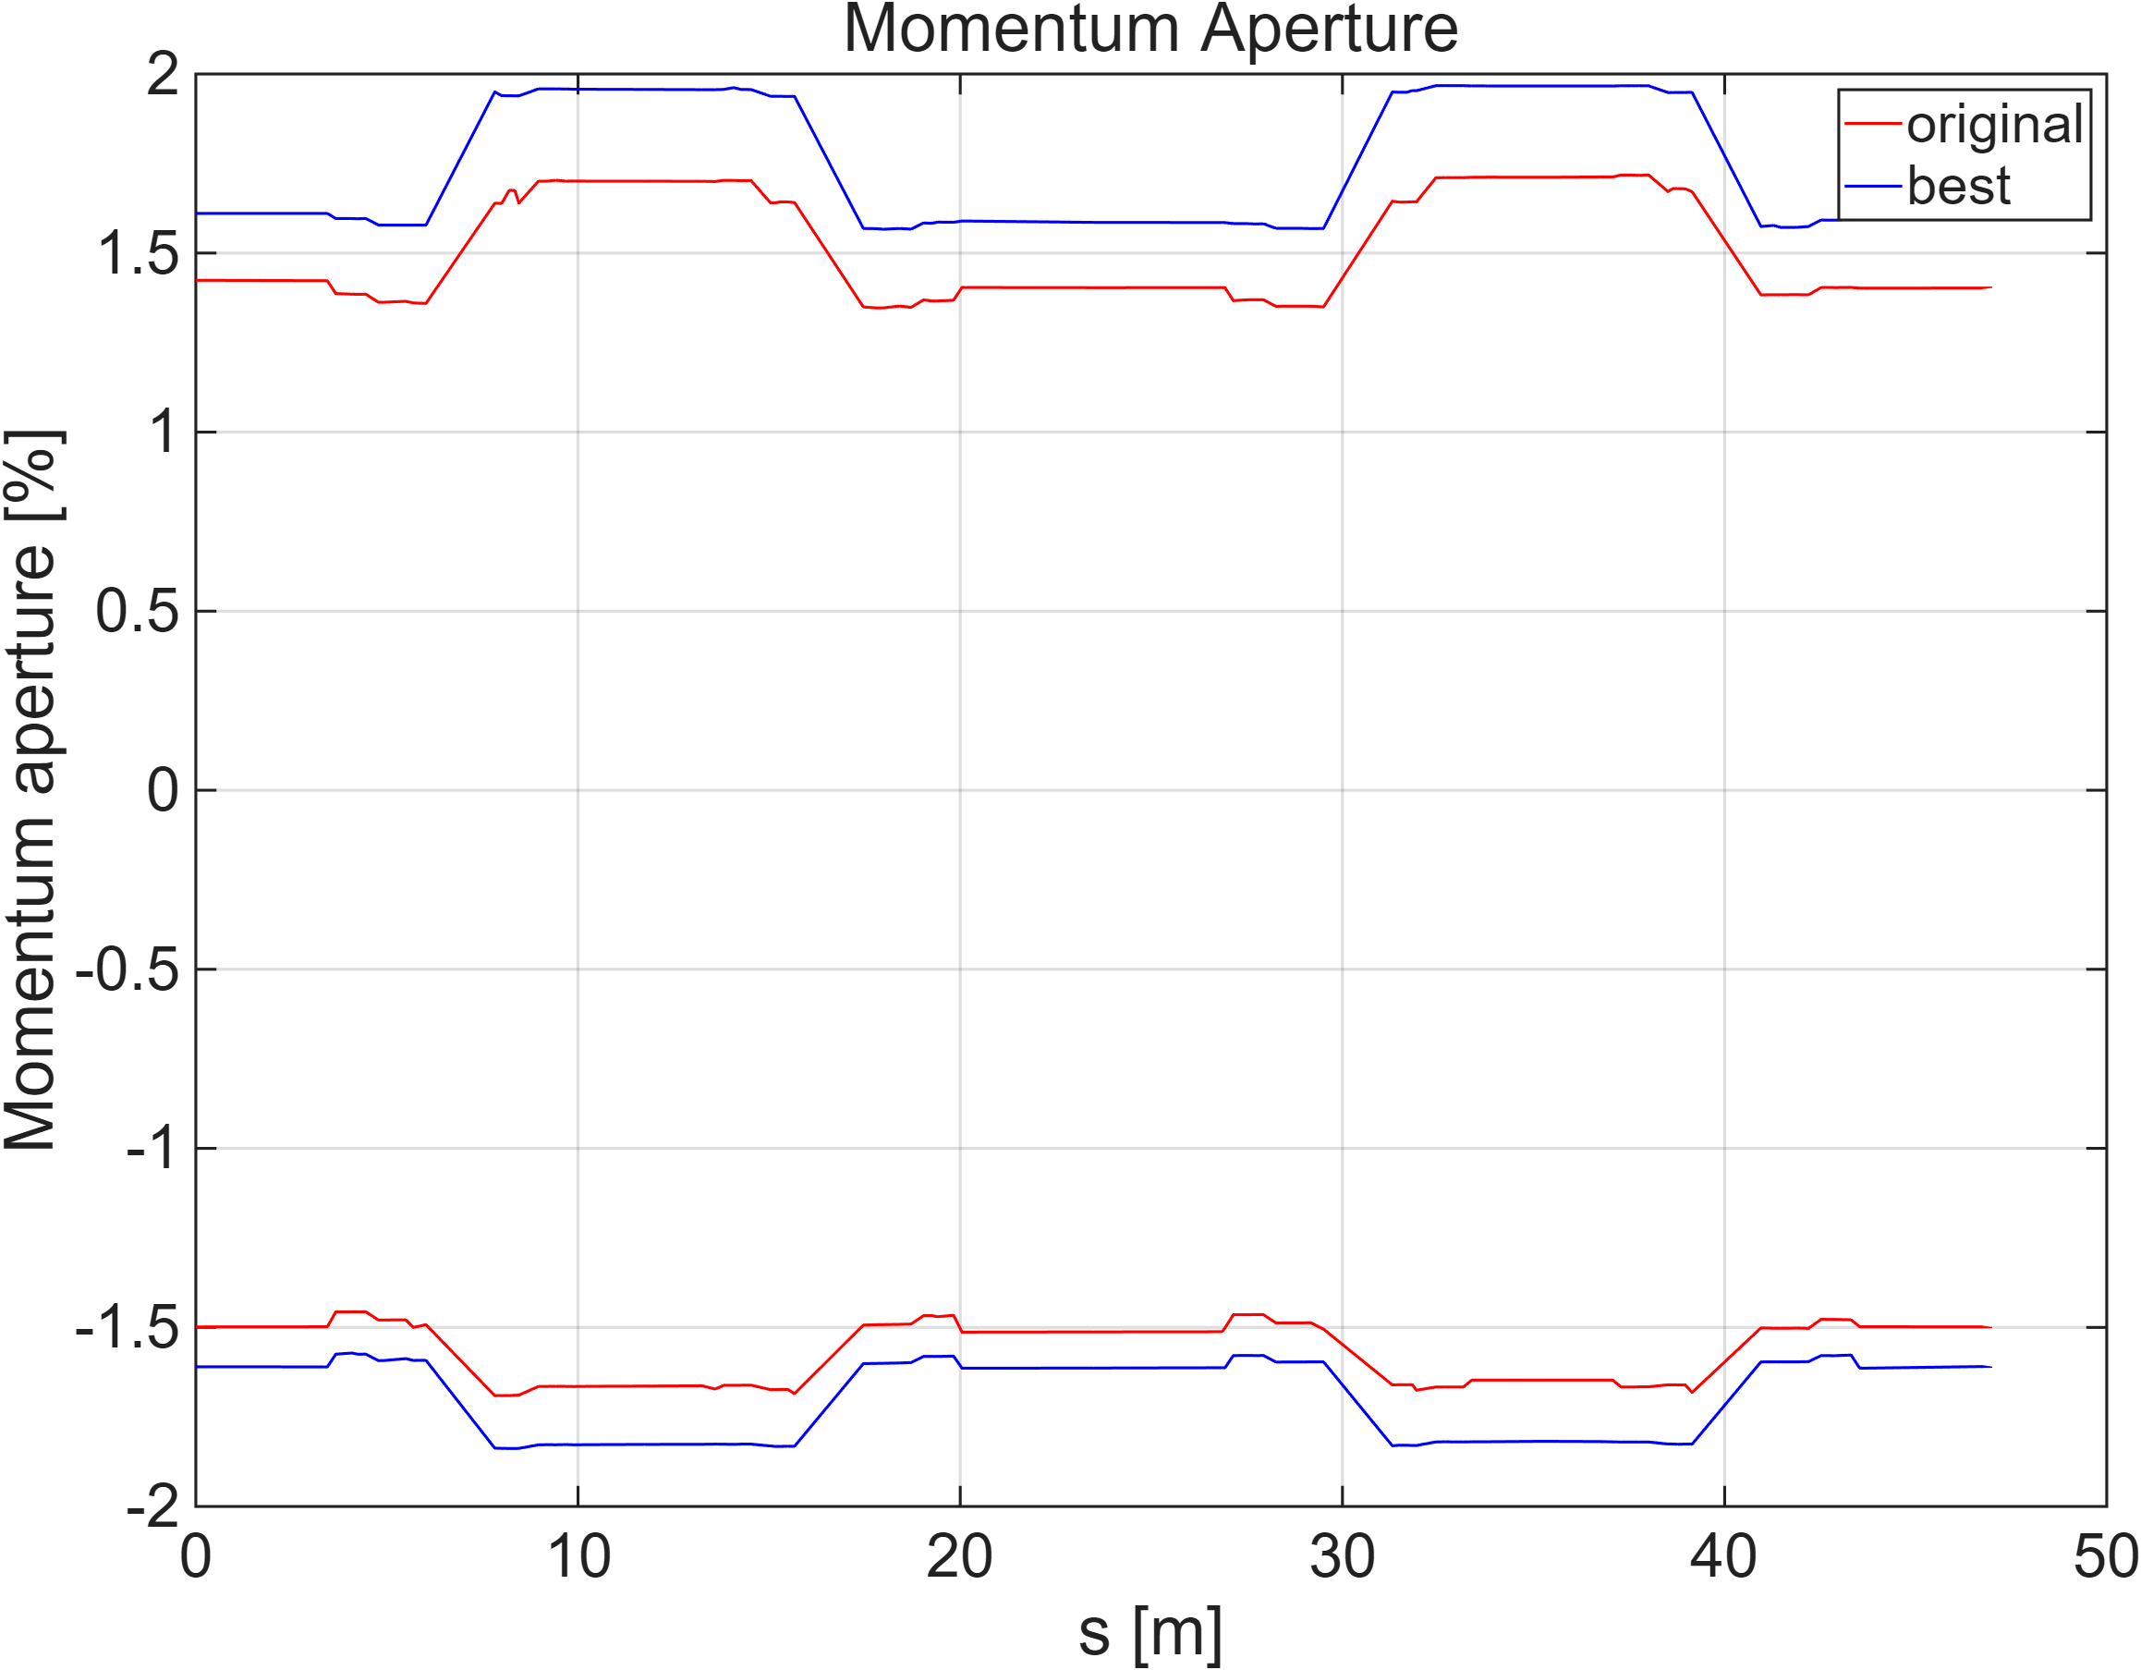
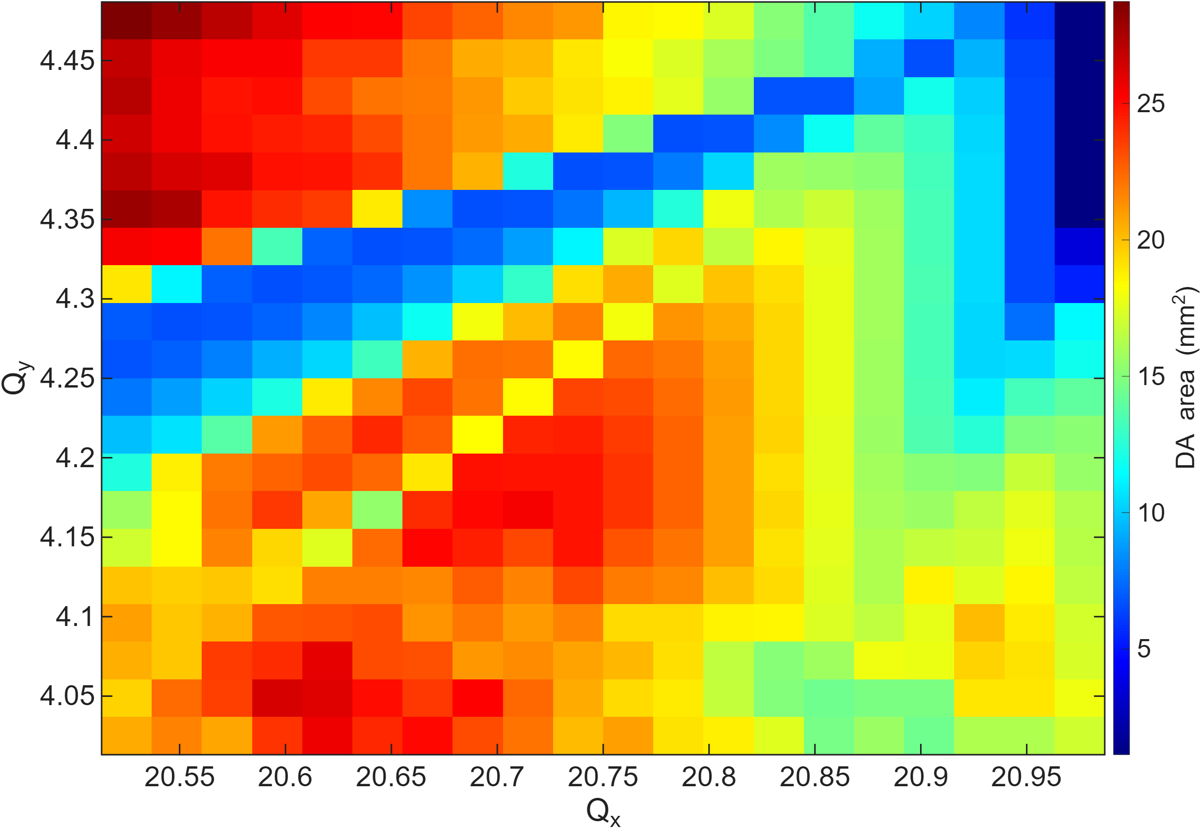
Q1, Q2 이용하여 tune에 따른 DA scan 진행.
  Hor. Tune : 20.525 ~20.975
  Ver. Tune : 4.025 ~ 4.475
그러나 tune을 조정하는 과정에서 Quad세기가 변경되어서 MCF가 커짐 : 6.3281e-5 -> 7.2660e-5
Lifetime 소폭 증가 : 4.2690 hrs -> 5.3866 hrs
Magnet | Original | Best
Q1 | -1.2653 | -1.2522
Q2 | 2.4685 | 2.4575
Q3 | 1.9714 | 변동없음
Q4 | -0.2384
S1 | 22.9306
S2 | -31.6184
S3 | -37.0680
S4 | 35.0051

Slide 9
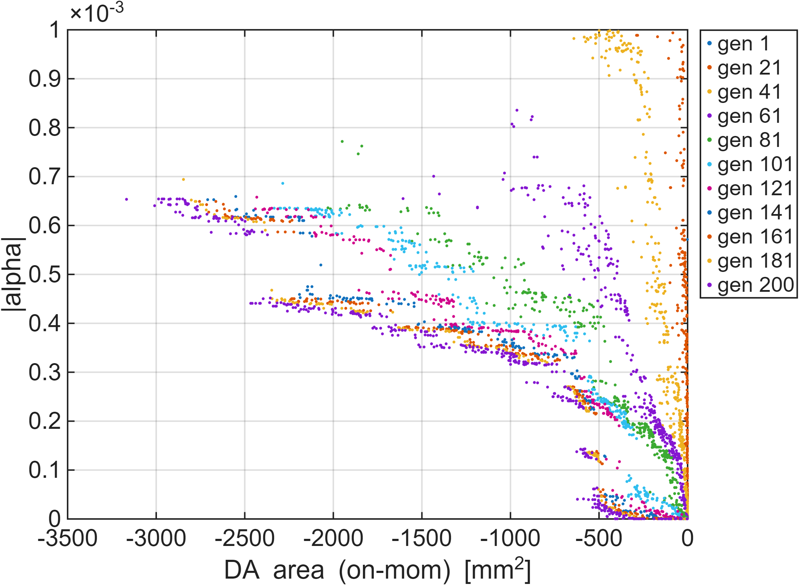
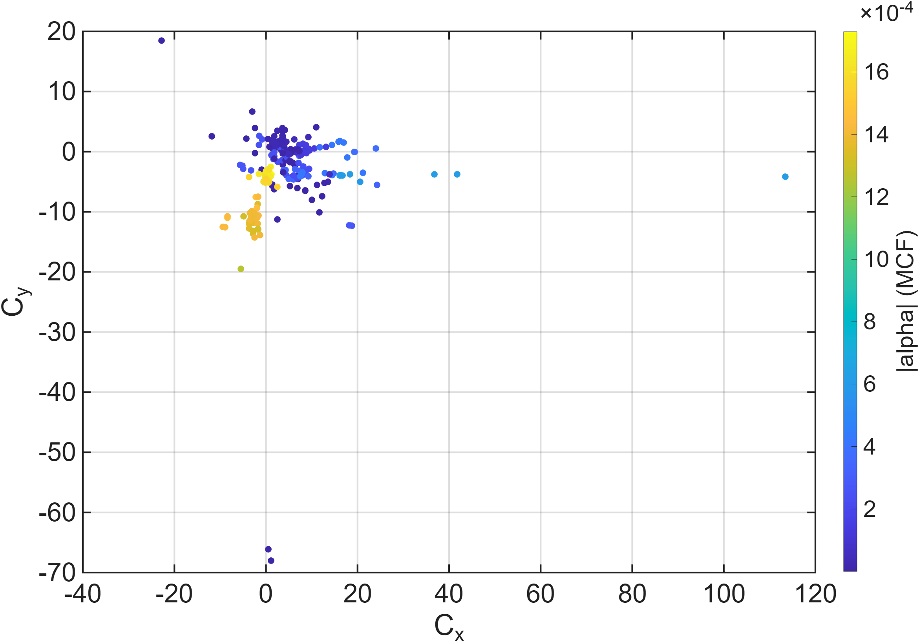
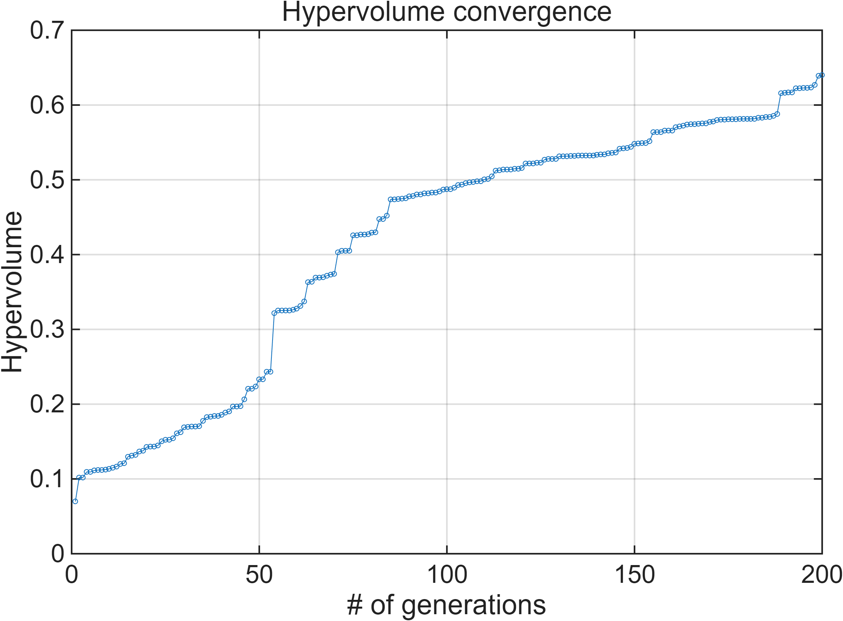
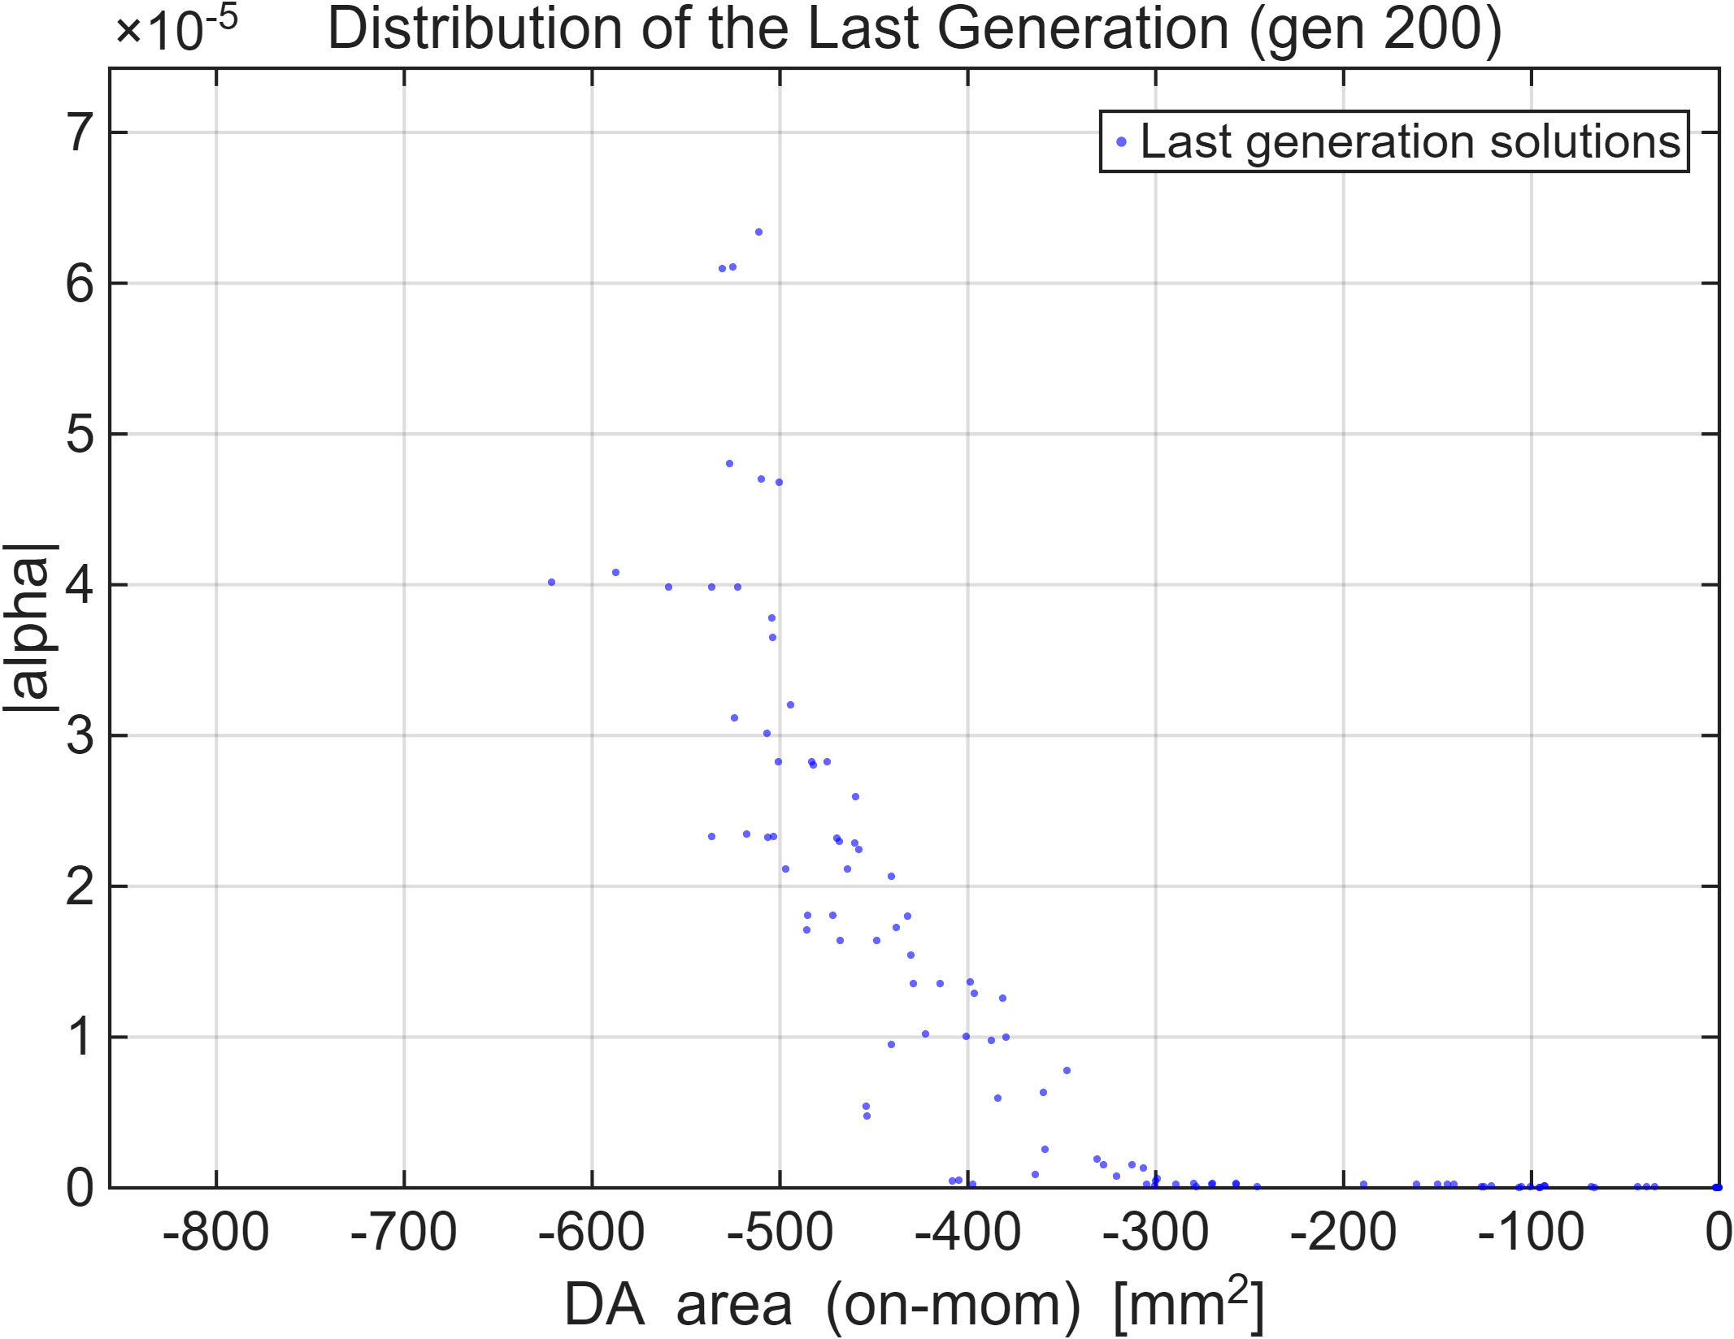
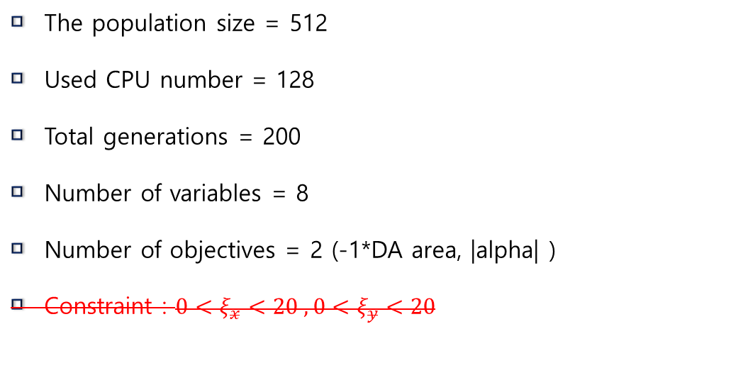
Lattice : PLS-II bare lattice
Storage ring | Circumference (m) | Energy (GeV) | MCF
Soleil | 354 | 2.75 | 1.7e-5
Diamond | 561 | 3 | -3e-6
Bessy-II | 240 | 1.7 | 3.5e-5
SLS | 288 | 2.4 | 5.3e-5
SPEAR3 | 234 | 3 | 5.2e-5
The population size = 512
Used CPU number = 128
Total generations = 200
Number of variables = 8
Number of objectives = 2 (-1*DA area, |alpha| )
Constraint : $0<ξ_{x}<20 , 0<ξ_{y}<20$

Slide 10
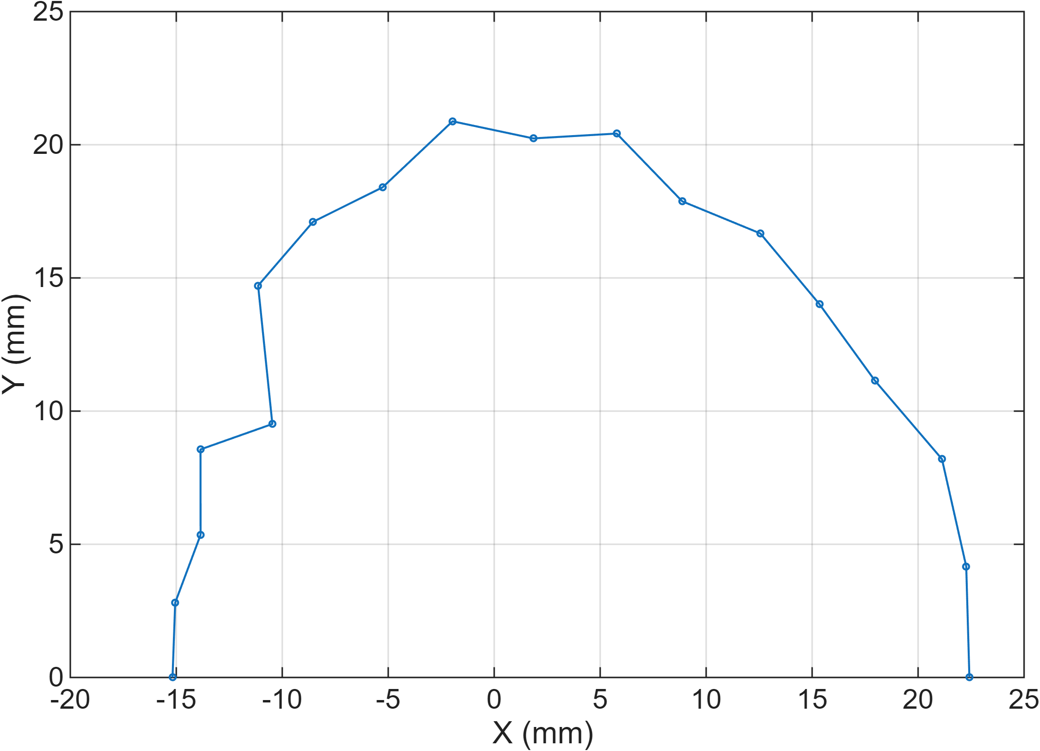
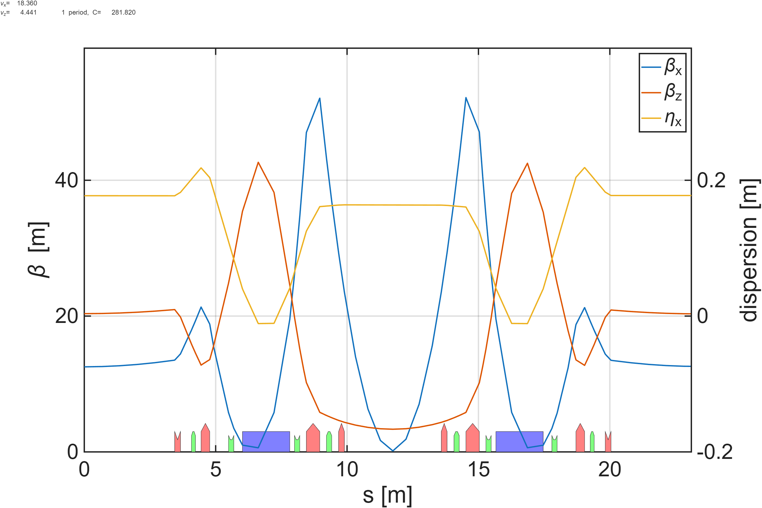
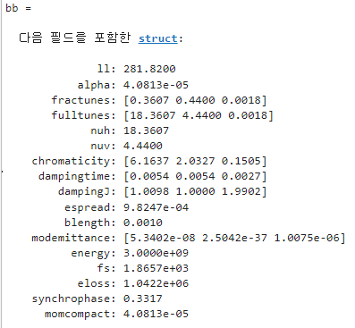
Magnet | Original K | New K
Q1 | -1.7008 | -1.1709
Q2 | 2.3633 | 2.4921
Q3 | 2.0142 | 1.7125
Q4 | -1.9618 | 0.0905
S1 | 17.6670 | 13.3927
S2 | -19.2500 | -27.8180
S3 | -23.7000 | -19.6343
S4 | 20.7550 | 26.5200
Dipole에서 dispersion <0
DA x 방향 acceptance -15.17mm
MCF : 4.0813e-5 (원래 값 대비 1/32 수준)
Tune (H/V) : 18.3607 / 4.4400
Chromaticity (H/V) : 6.1637 / 2.0327

Slide 11
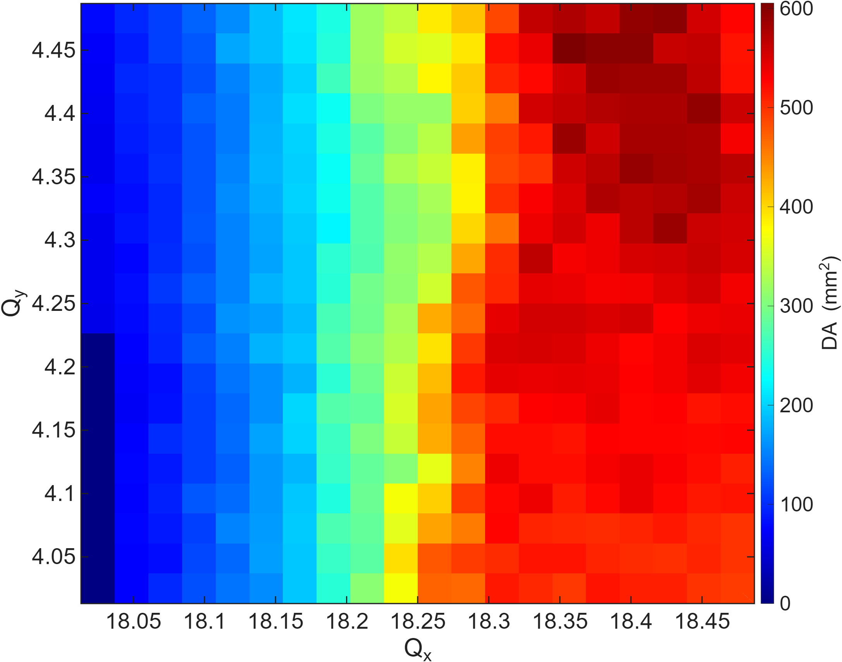
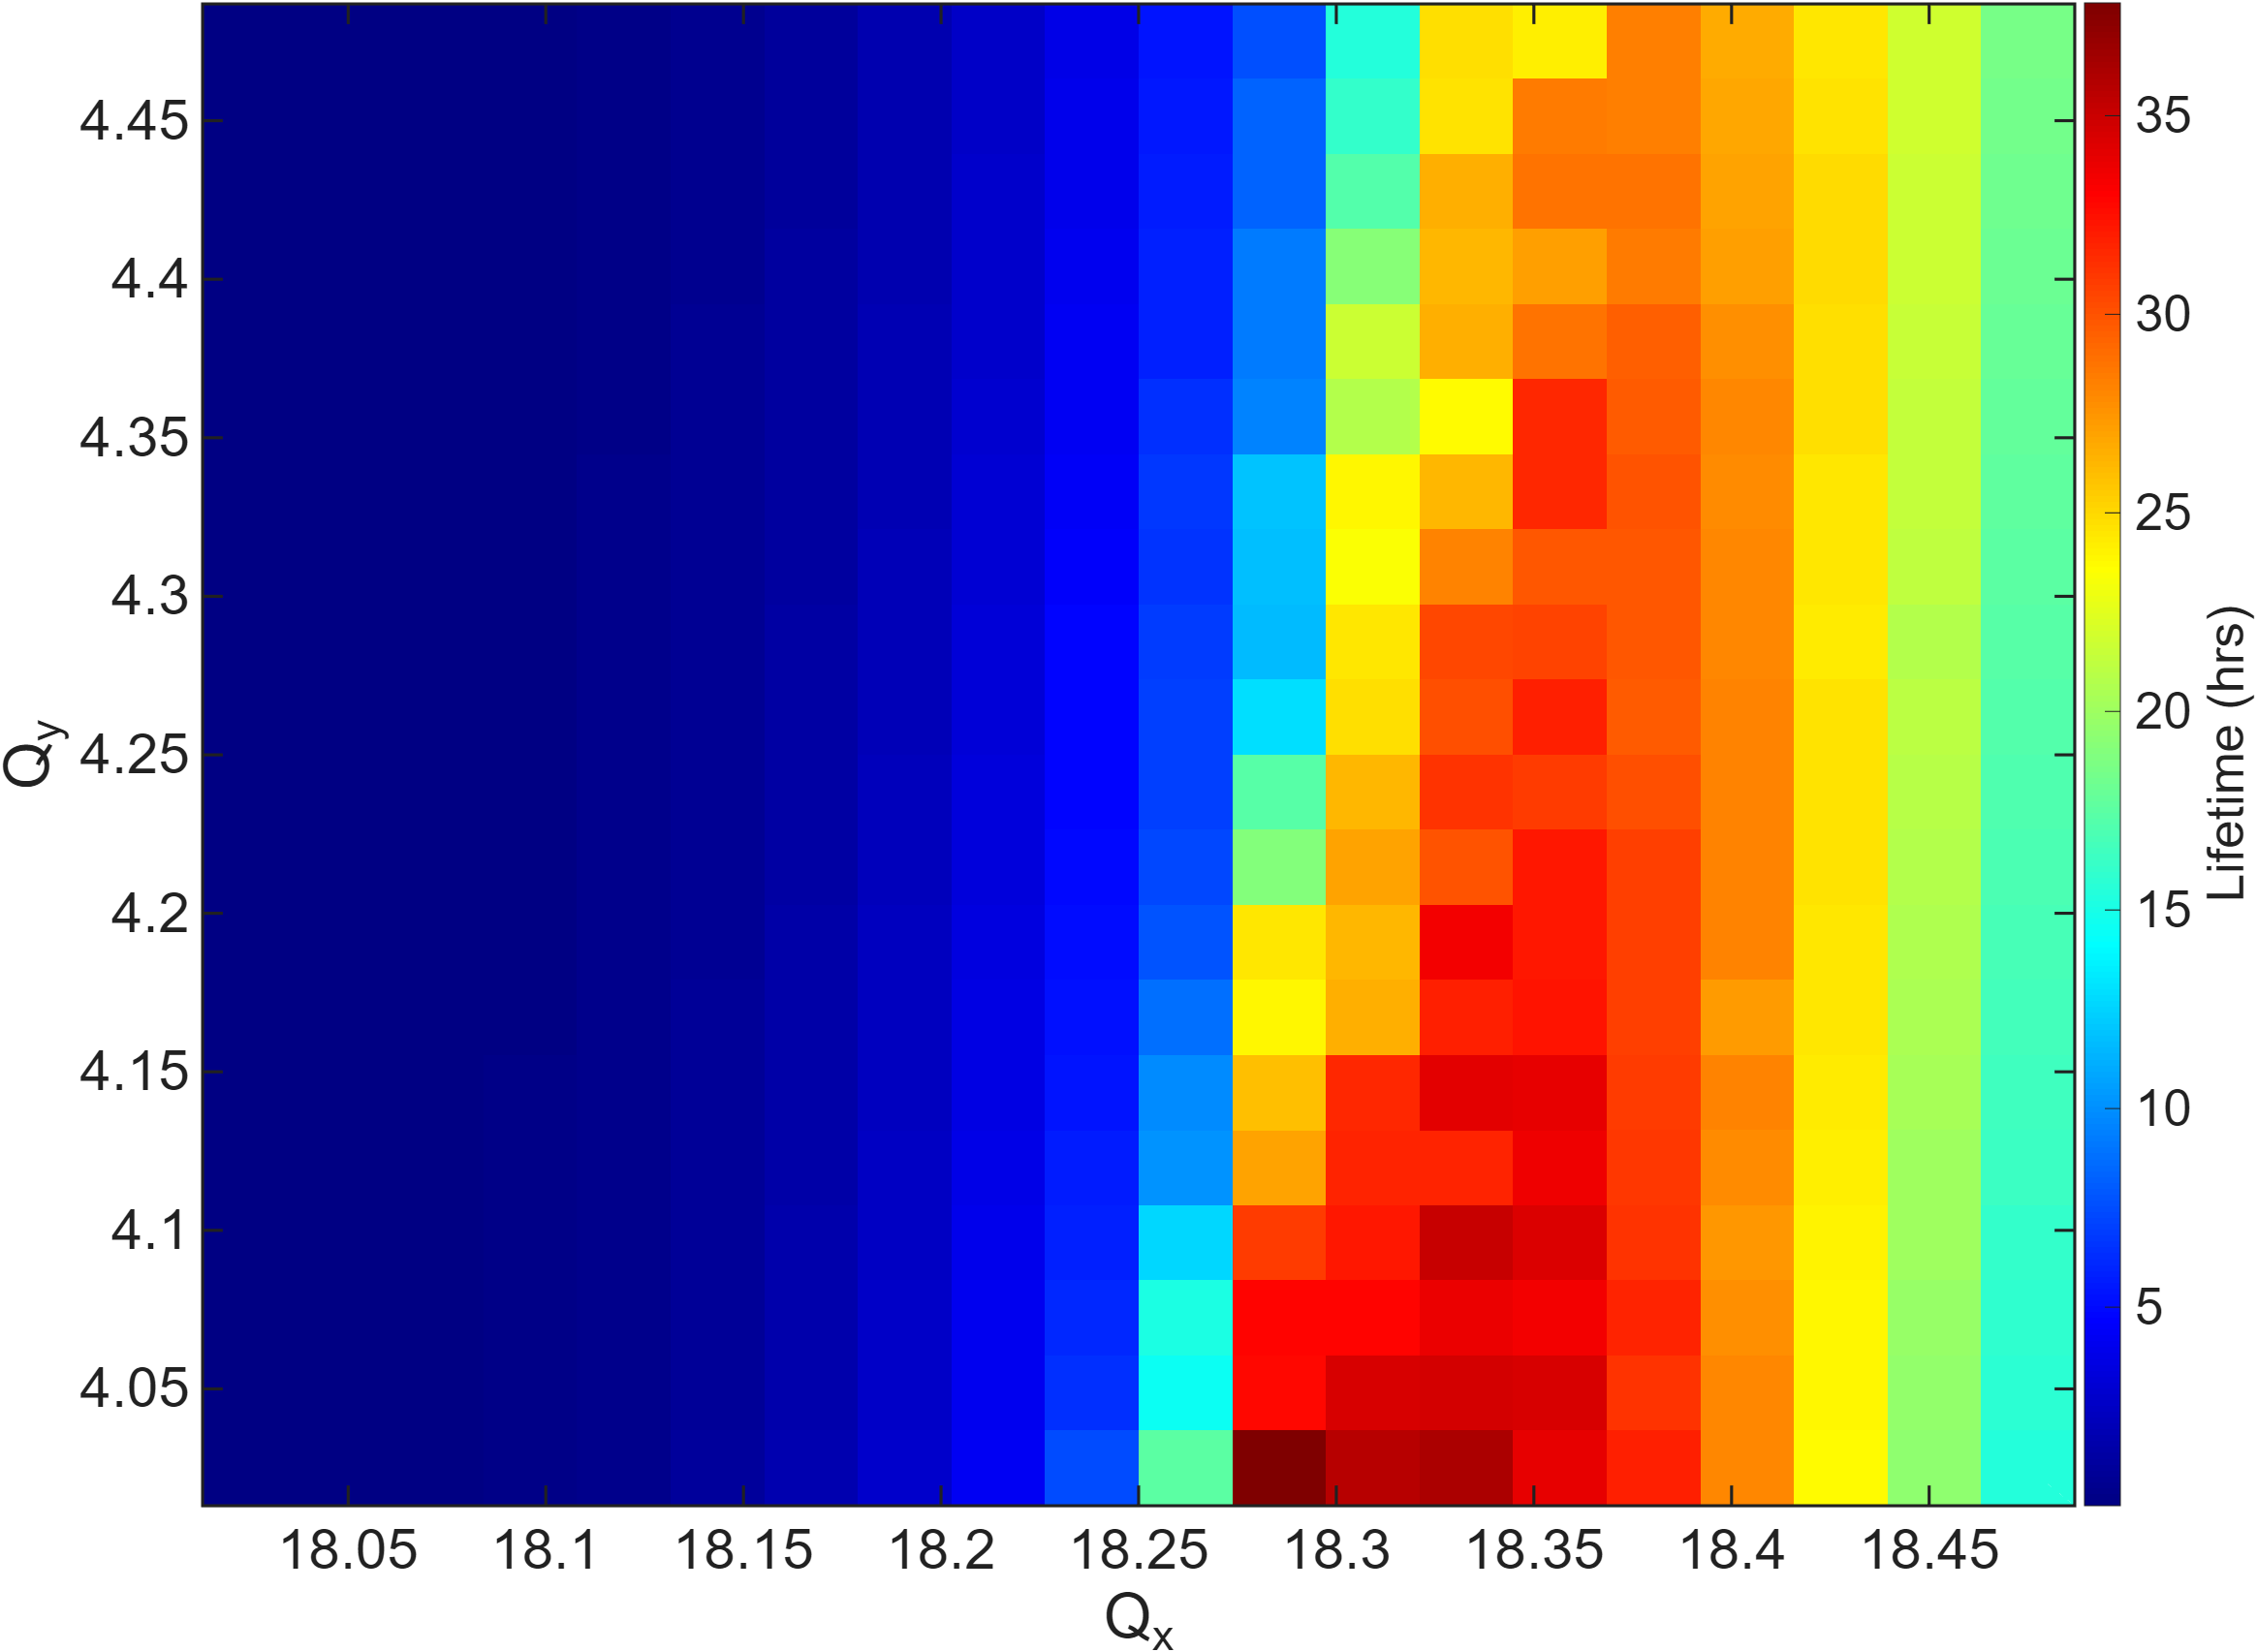
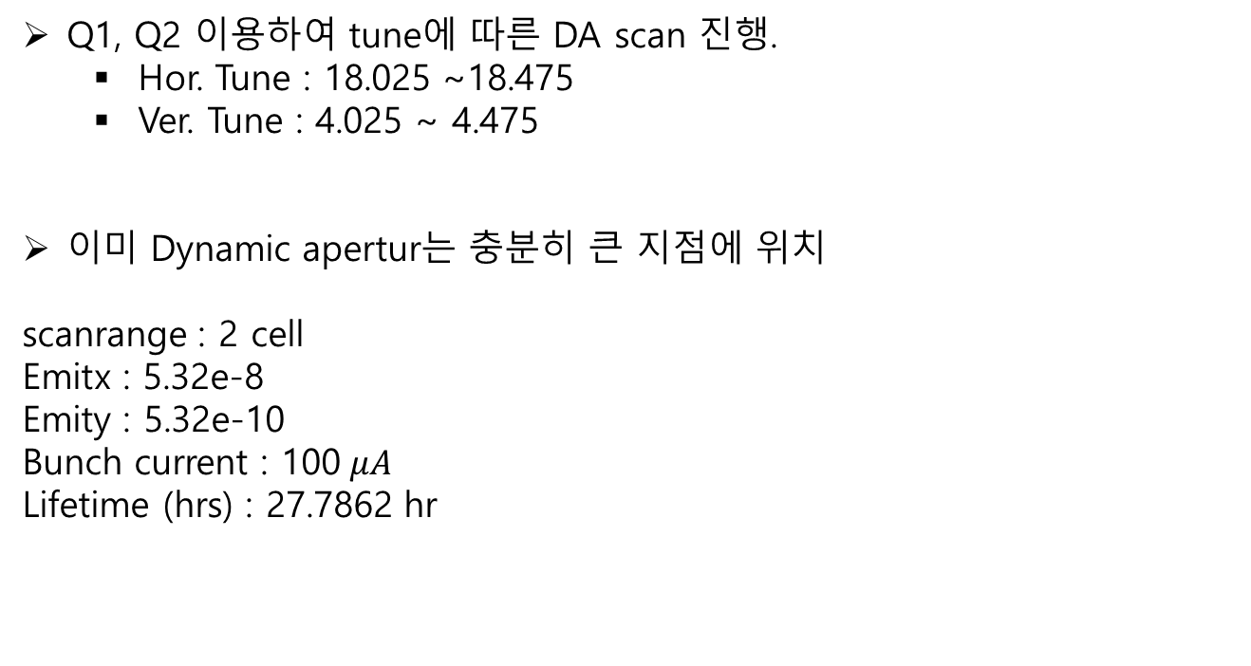
Q1, Q2 이용하여 tune에 따른 DA scan 진행.
  Hor. Tune : 18.025 ~18.475
  Ver. Tune : 4.025 ~ 4.475
이미 Dynamic apertur는 충분히 큰 지점에 위치
scanrange : 2 cell
Emitx : 5.32e-8
Emity : 5.32e-10
Bunch current : 100$μA$
Lifetime (hrs) : 27.7862 hr

Slide 12
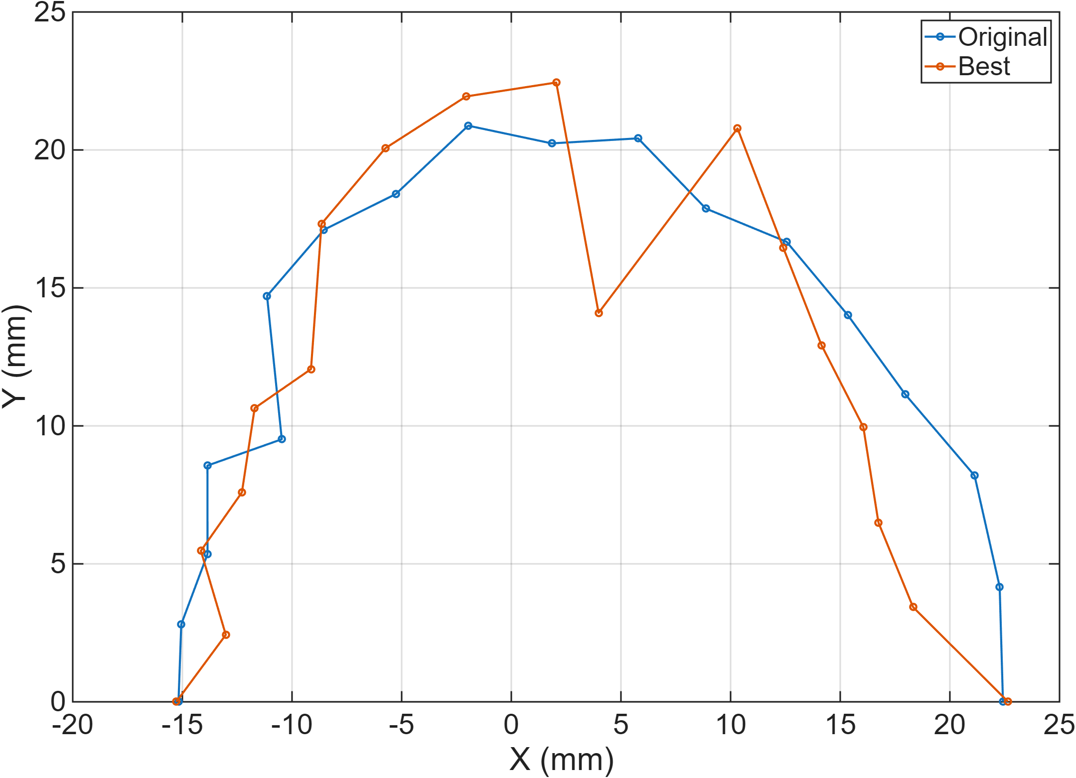
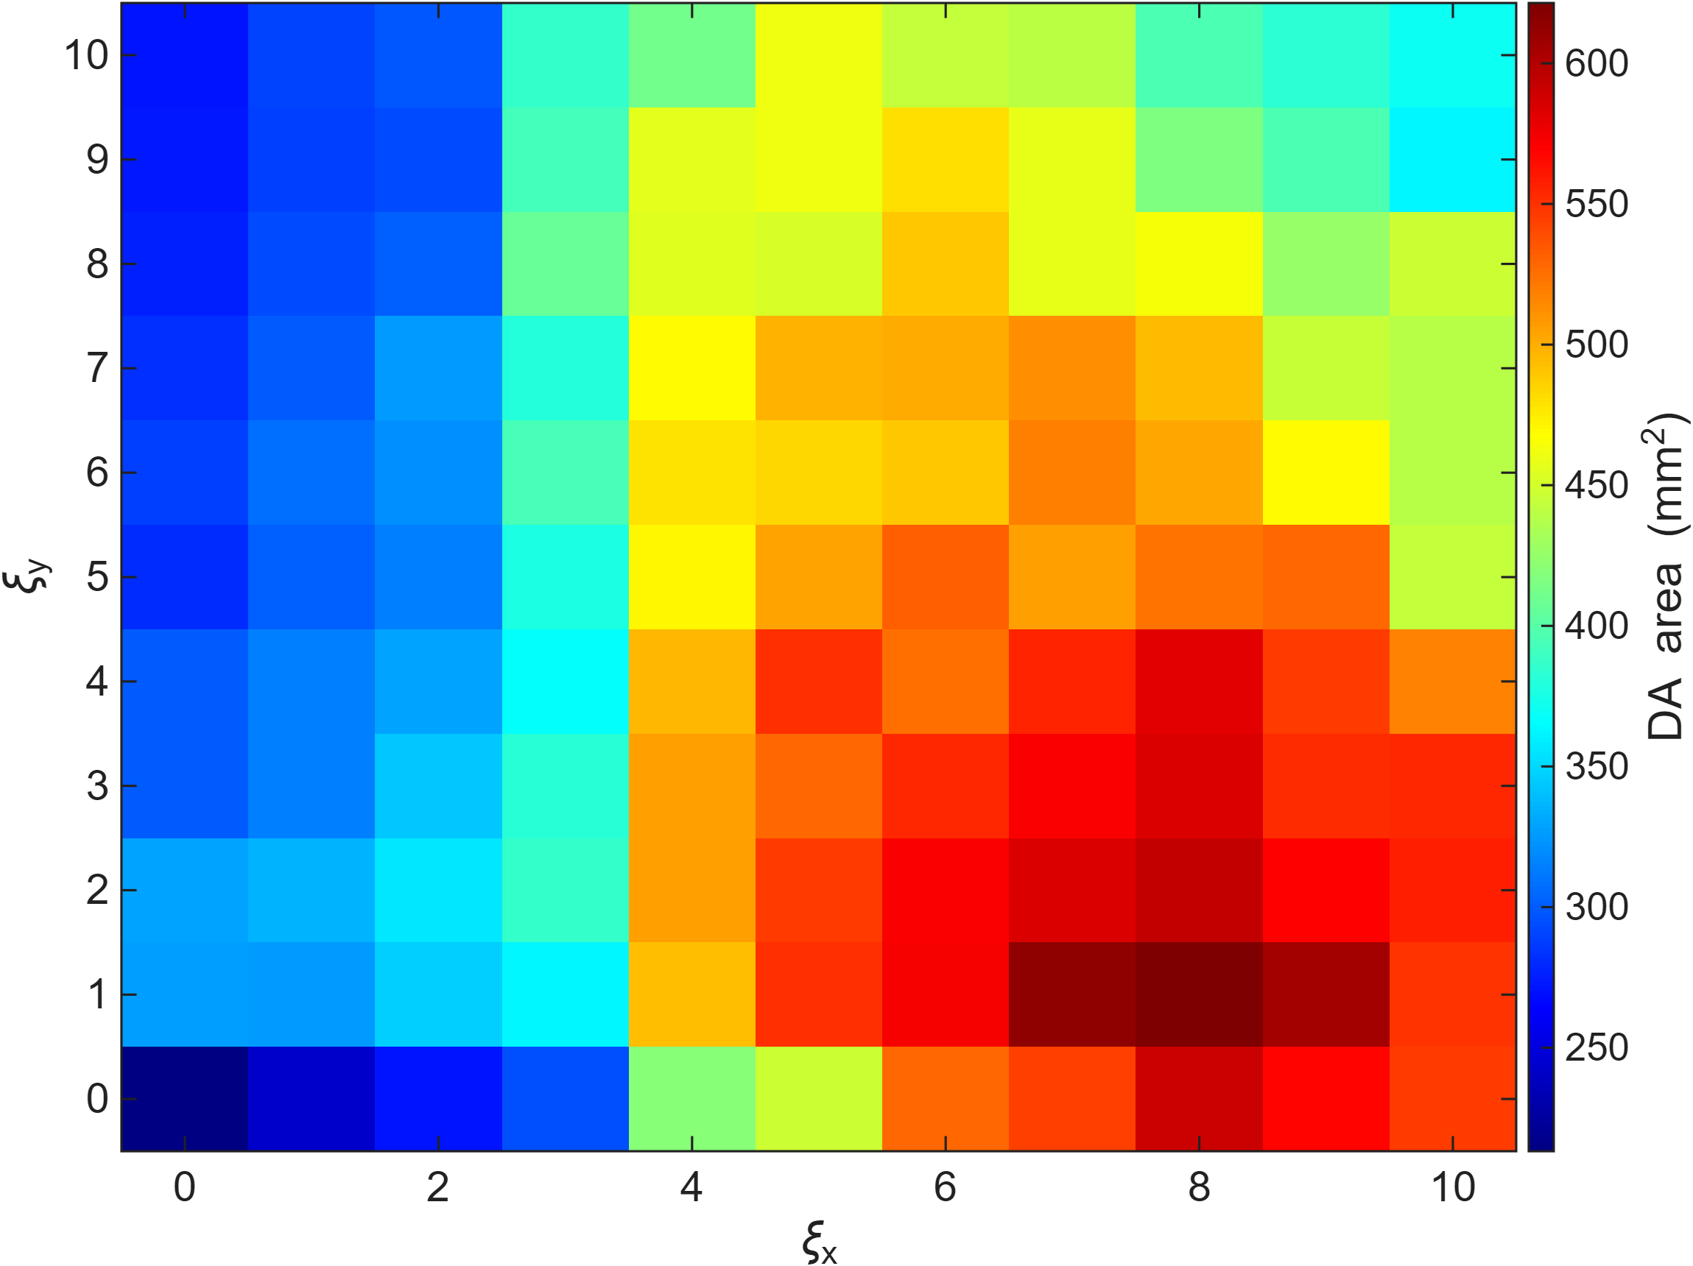
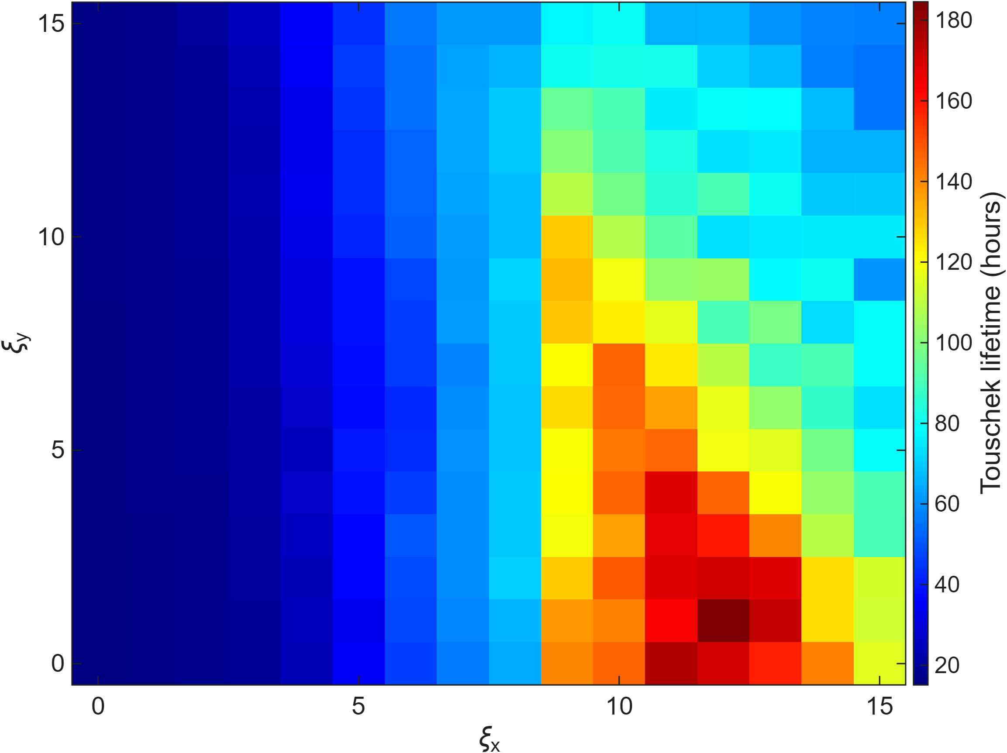
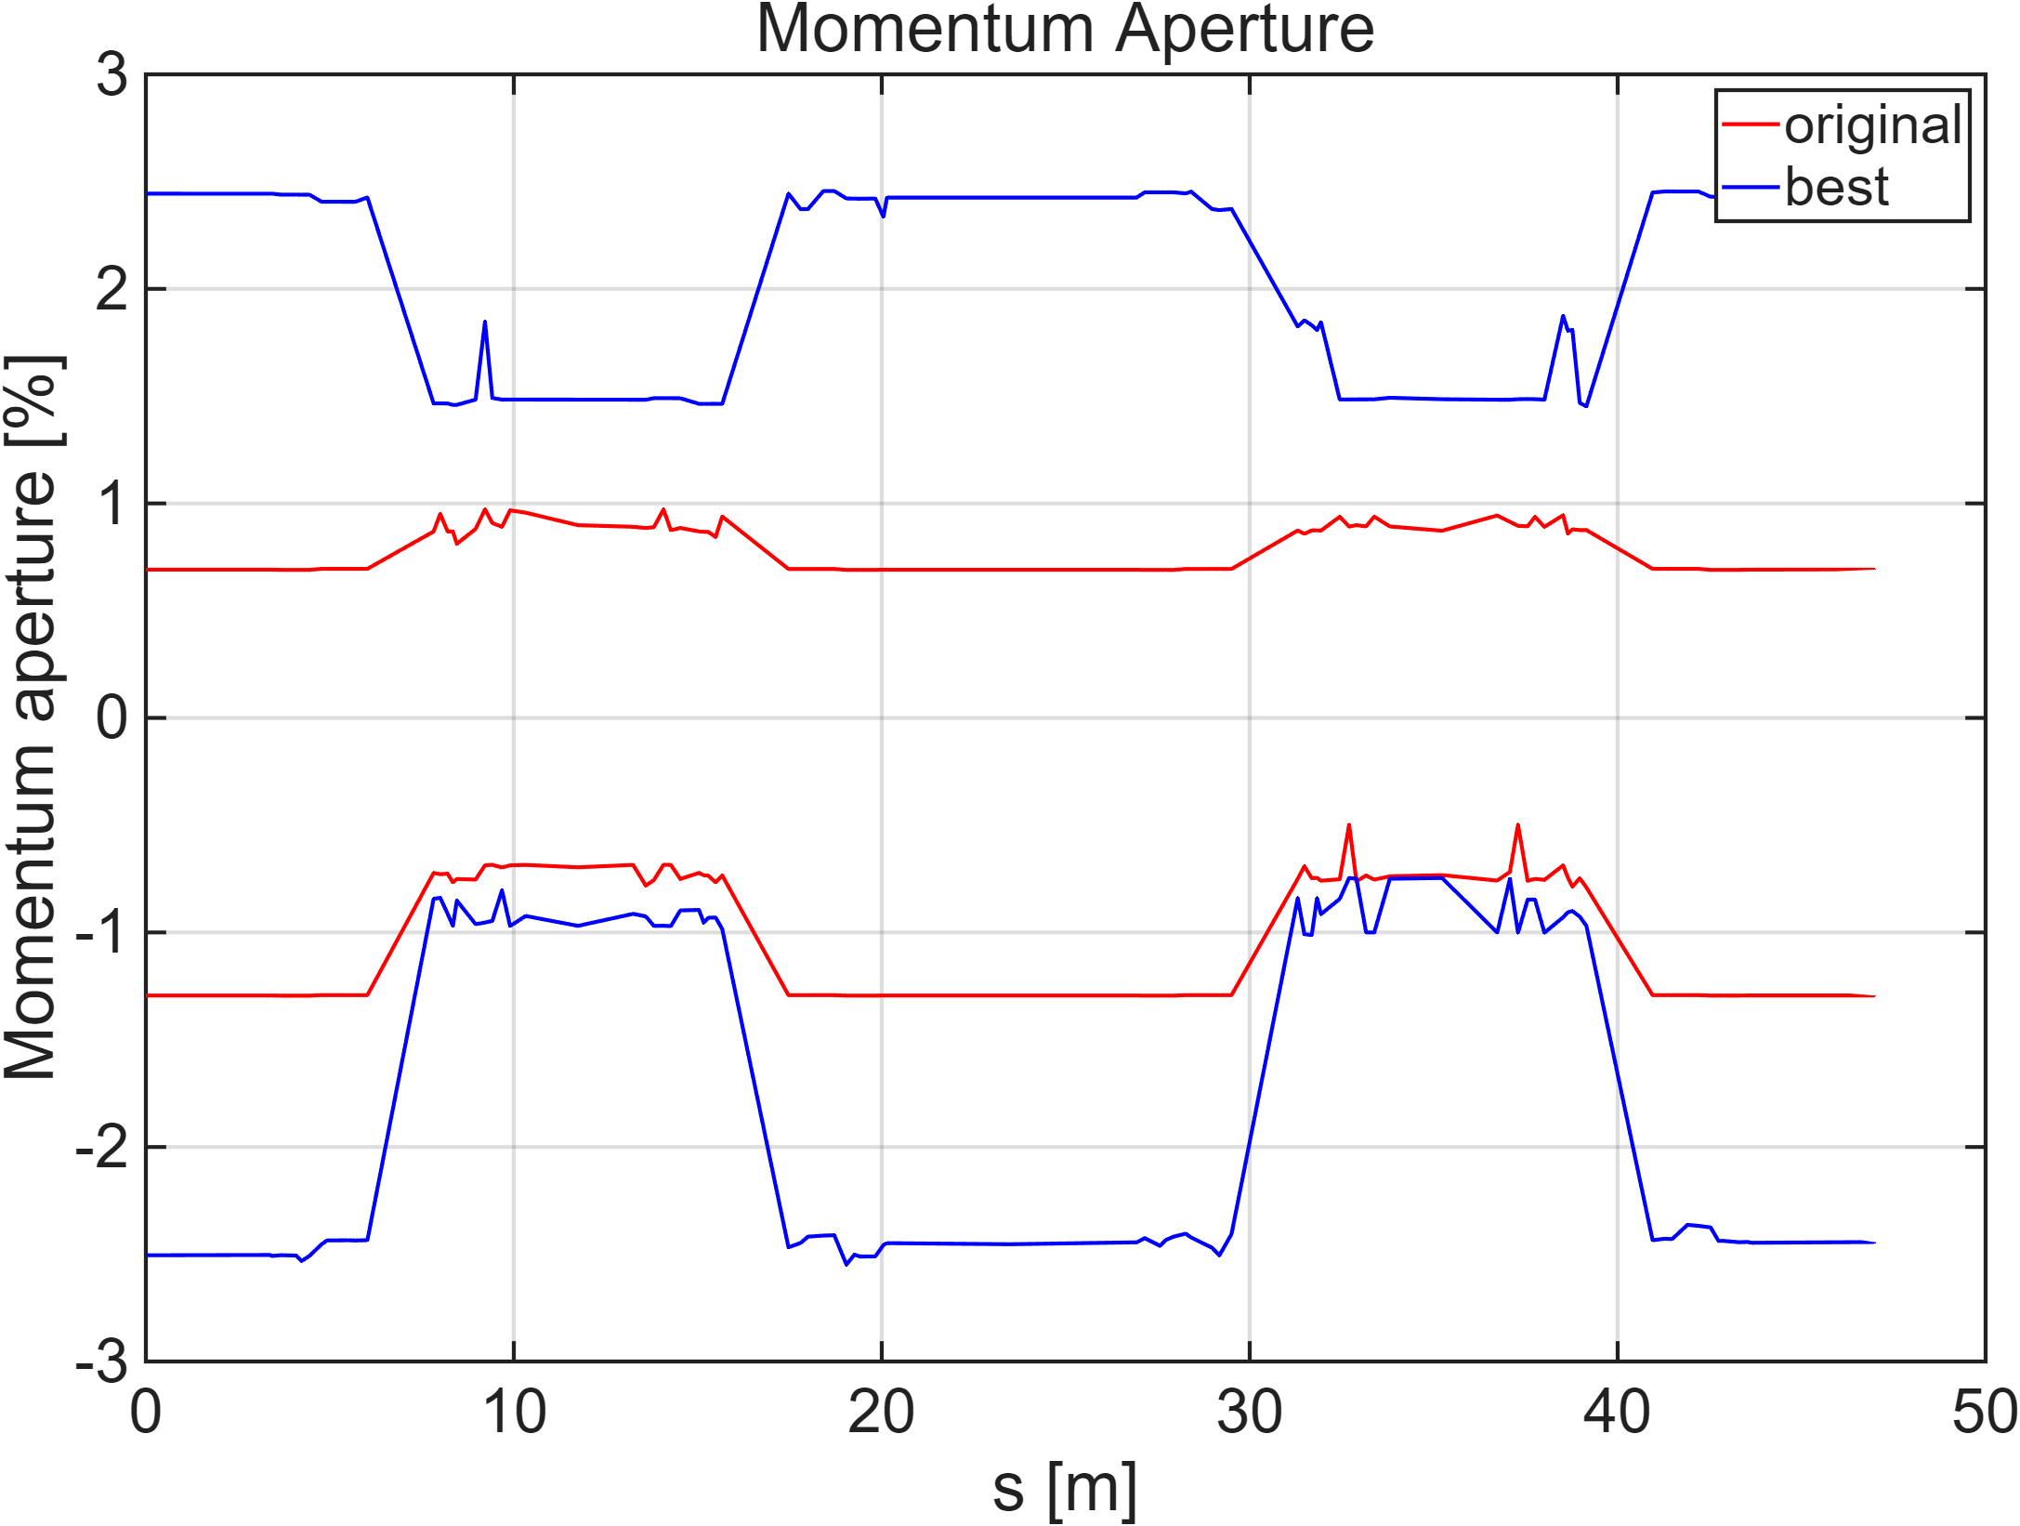
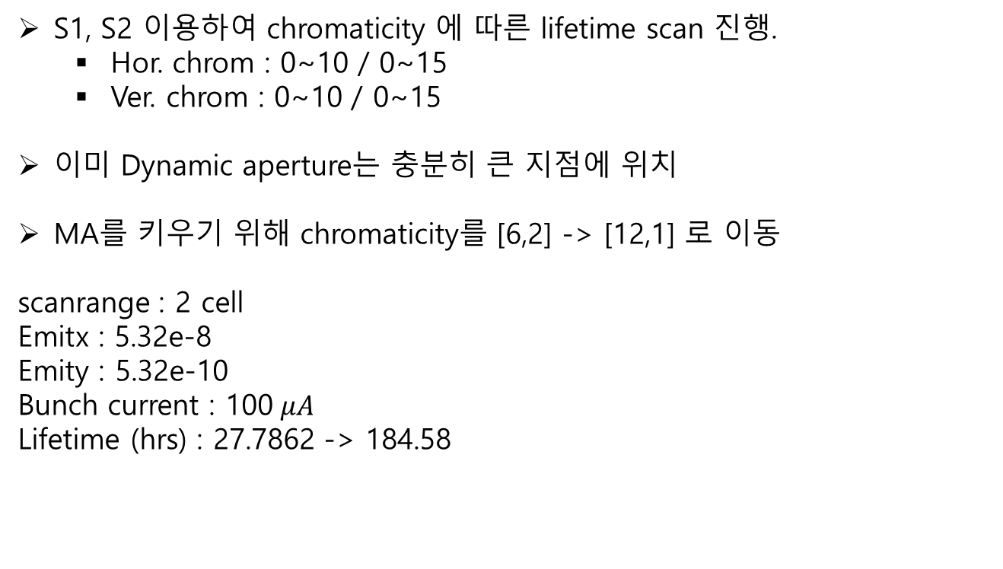
S1, S2 이용하여 chromaticity 에 따른 lifetime scan 진행.
  Hor. chrom : 0~10 / 0~15
  Ver. chrom : 0~10 / 0~15
이미 Dynamic aperture는 충분히 큰 지점에 위치
MA를 키우기 위해 chromaticity를 [6,2] -> [12,1] 로 이동
scanrange : 2 cell
Emitx : 5.32e-8
Emity : 5.32e-10
Bunch current : 100$μA$
Lifetime (hrs) : 27.7862 -> 184.58
Magnet | Original K | K | Modified K
Q1 | -1.7008 | -1.1709 | 변동없음
Q2 | 2.3633 | 2.4921
Q3 | 2.0142 | 1.7125
Q4 | -1.9618 | 0.0905
S1 | 17.6670 | 13.3927 | 16.5069
S2 | -19.2500 | -27.8180 | -30.1235
S3 | -23.7000 | -19.6343 | 변동없음
S4 | 20.7550 | 26.5200

Slide 13
SSMB at PLS-II?

Slide 14
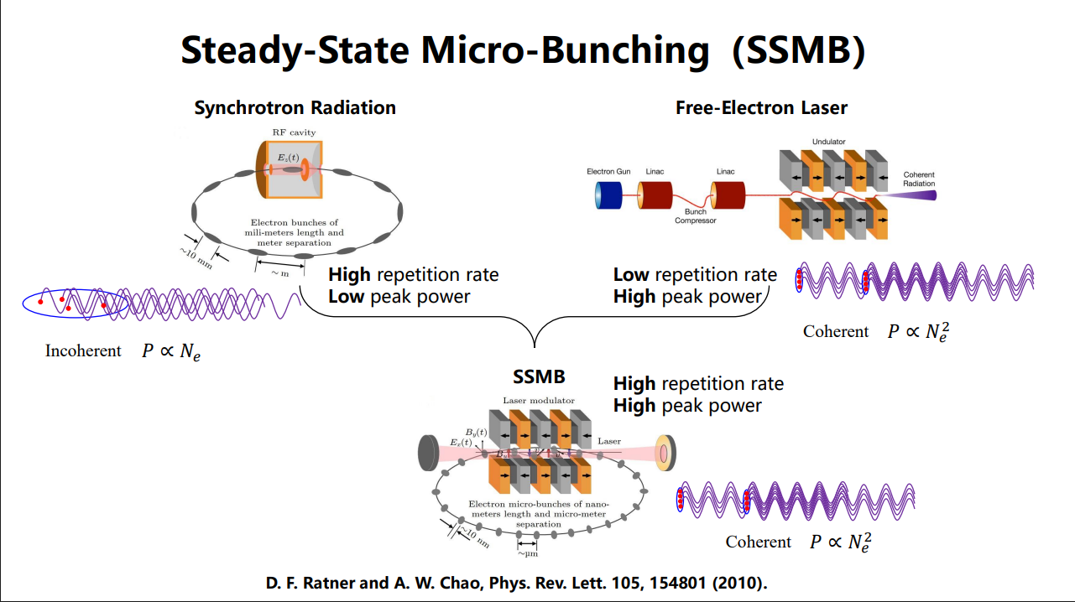
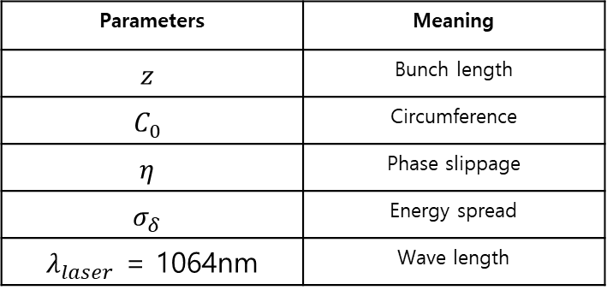


PLS-II SSMB?
Steady state micro bunching (SSMB) in a storage ring to produce coherent radiation at a high repetition rate or in continuous wave mode.
To form and sustain microbunching in a storage ring, the r.m.s spread of z in one turn that arises from the uncorrelated electron energy spread should be adequately smaller than the laser wavelength.
Parameters | Meaning
$$z$$ | Bunch length
$$C_{0}$$ | Circumference
$$η$$ | Phase slippage
$$σ_{δ}$$ | Energy spread
$λ_{laser}$ = 1064nm | Wave length
$$Δz=\left|C_{0}ησ_{δ}\right|≤\frac{λ_{laser}}{2π}$$
For example, MLS storage ring.
$$C_{0}=48m , E=250MeV, bunch charge<1pC , α_{c}<2e−5$$
Adjusting in PLS-II lattice.
$$α_{c} \text{< }\text{5.3454}\text{e}\text{-07}$$

Slide 15
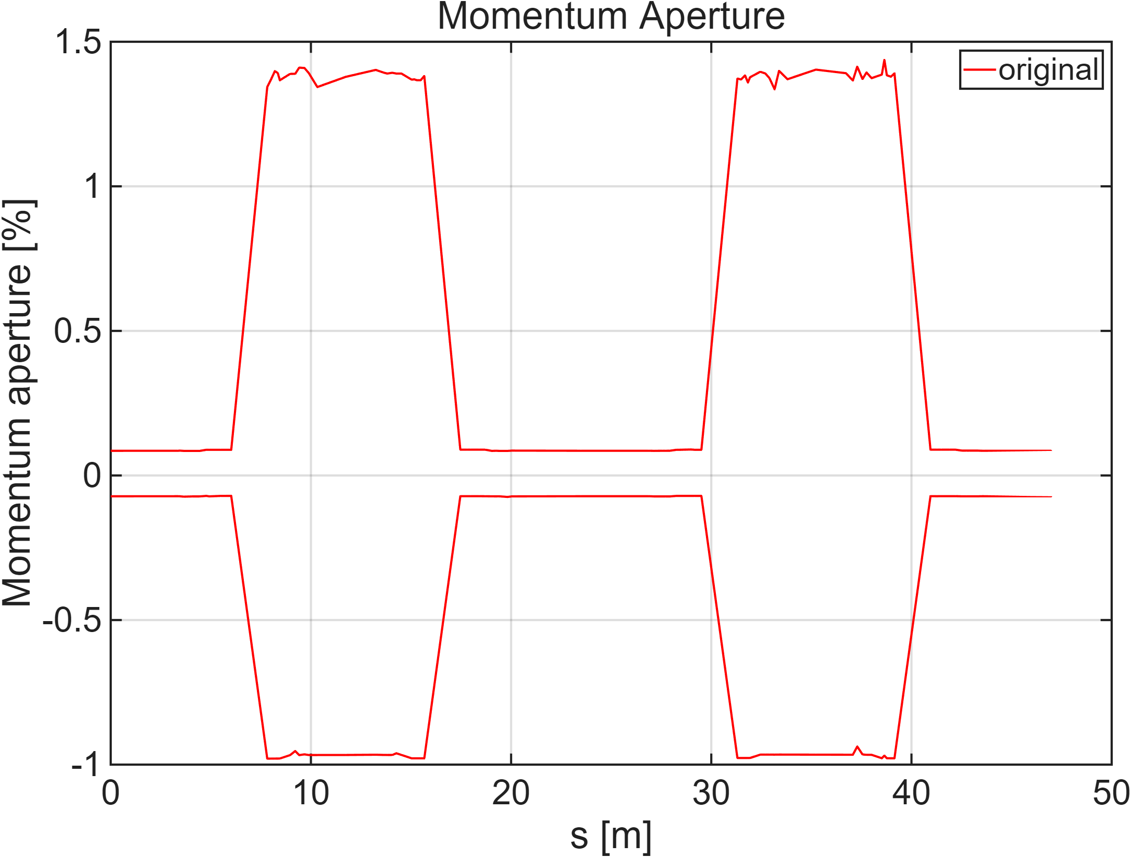
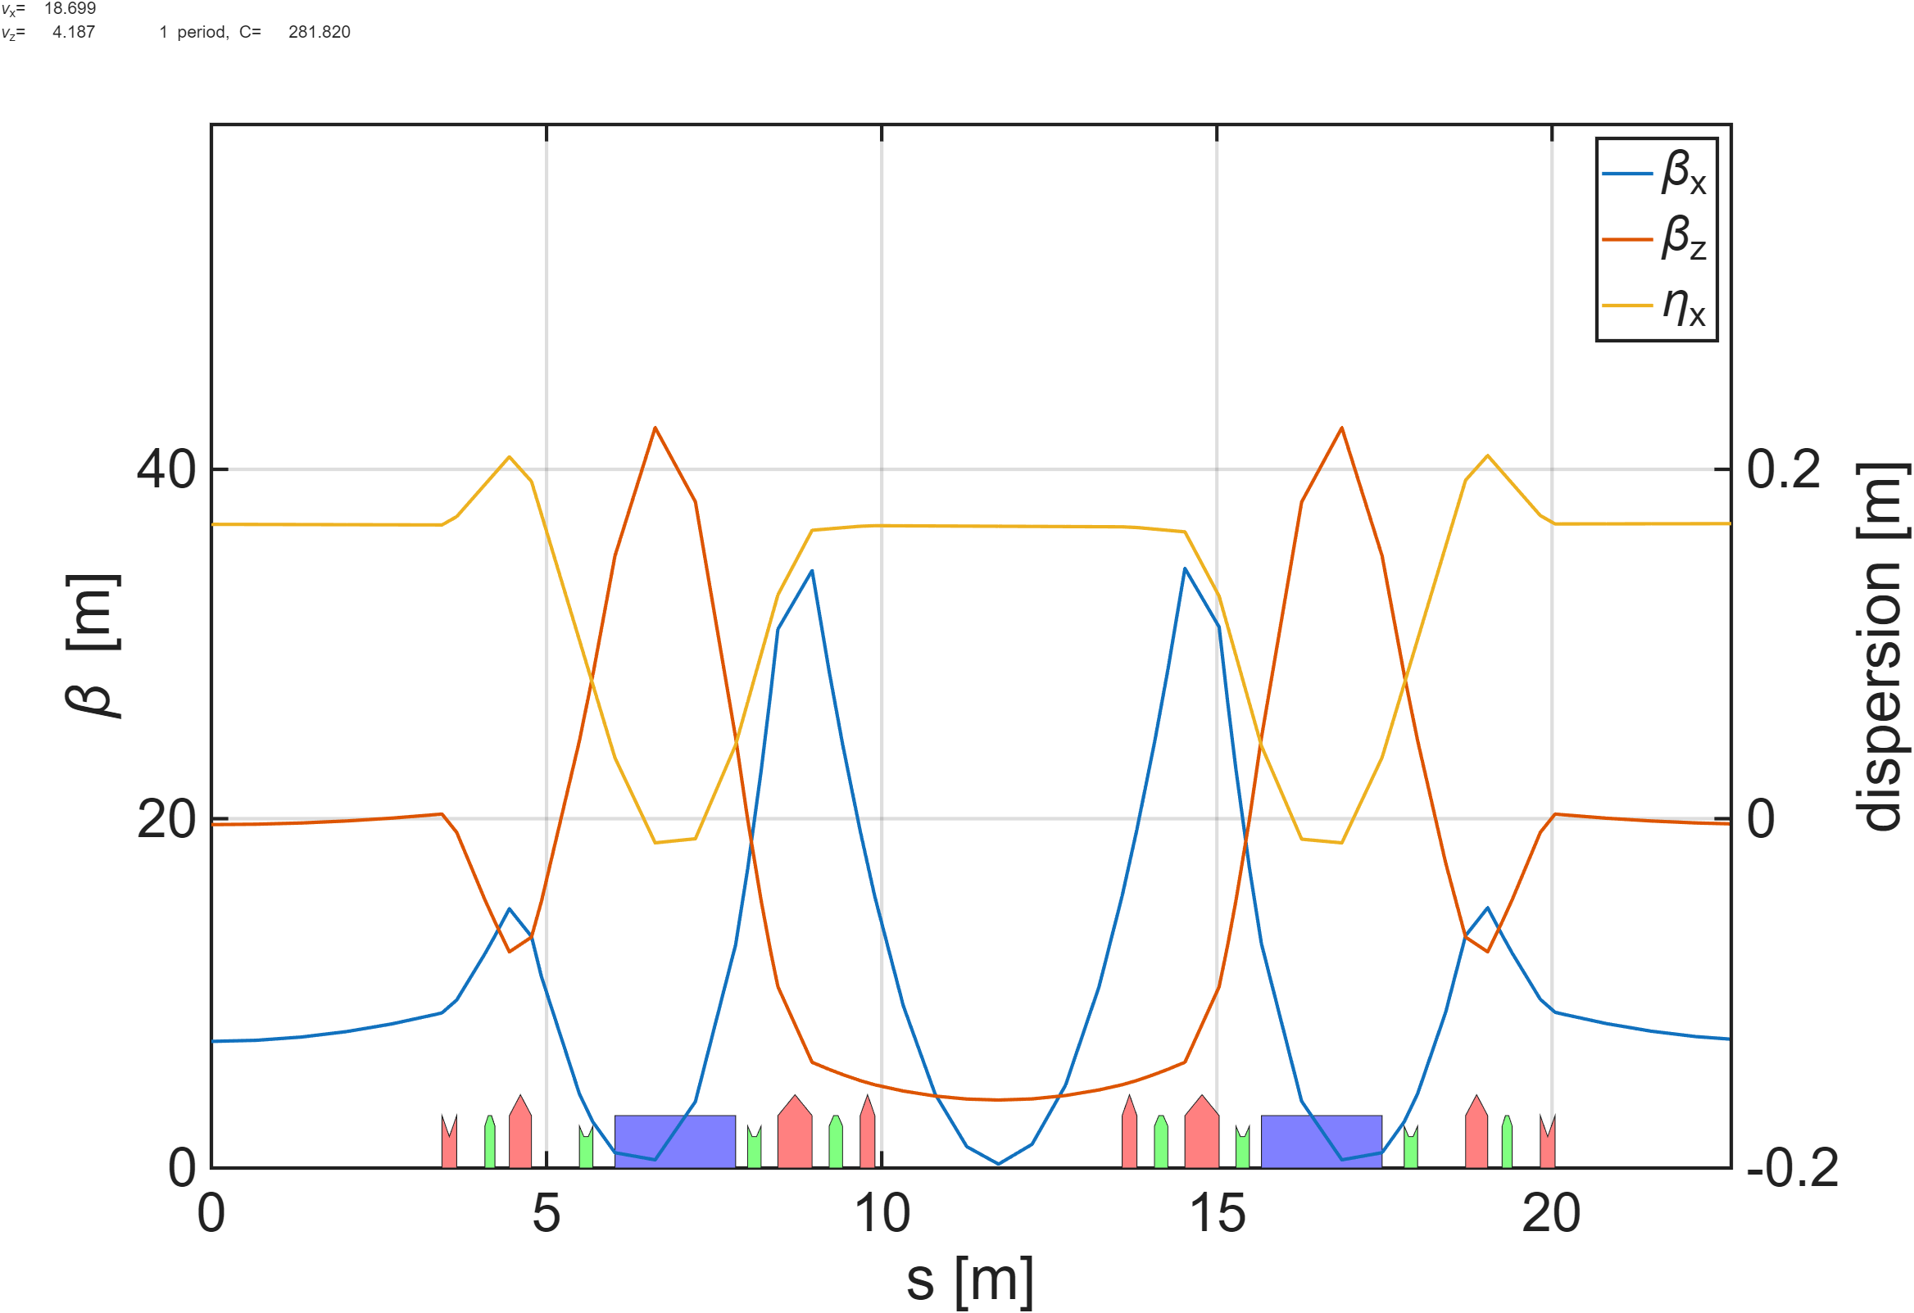
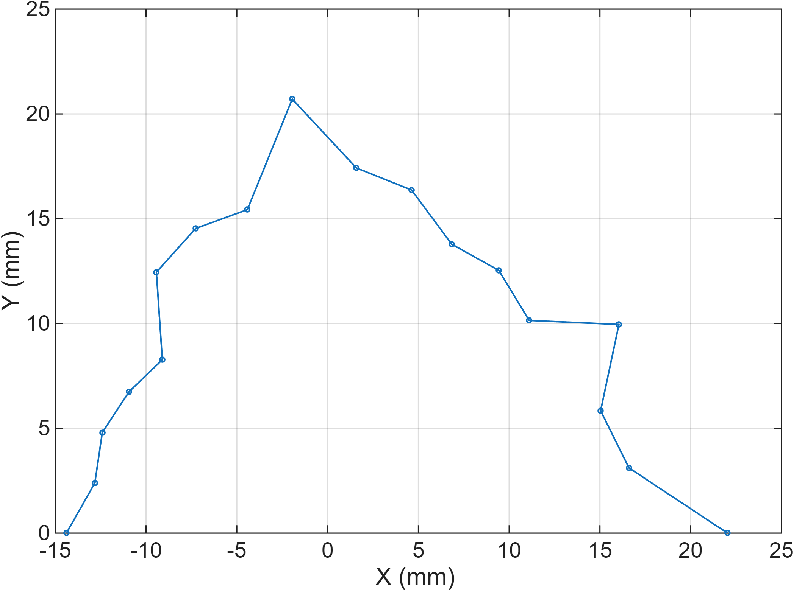
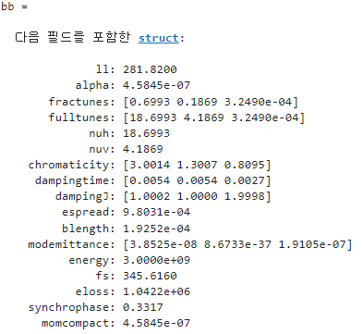
Dipole에서 dispersion <0
DA x 방향 acceptance -15.17mm
MCF : 4.5845e-7 (원래 값 대비 1/2800 수준)
Tune (H/V) : 18.6993 / 4.1869
Chromaticity (H/V) : 3.0014 / 1.3007
MA 가 너무 작아서 lifetime이 매우 작음
LT : 3.7681분
Magnet | Original K | New K
Q1 | -1.7008 | -1.1709
Q2 | 2.3633 | 2.5248
Q3 | 2.0142 | 1.7125
Q4 | -1.9618 | 0.0896
S1 | 17.6670 | 11.8065
S2 | -19.2500 | -28.0293
S3 | -23.7000 | -19.0692
S4 | 20.7550 | 26.8535

Slide 16
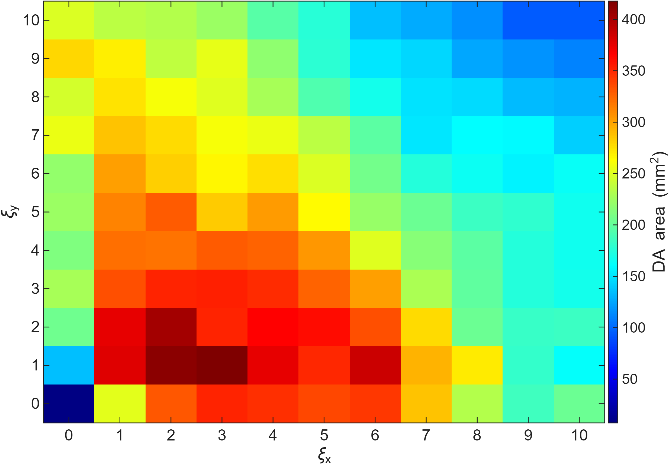
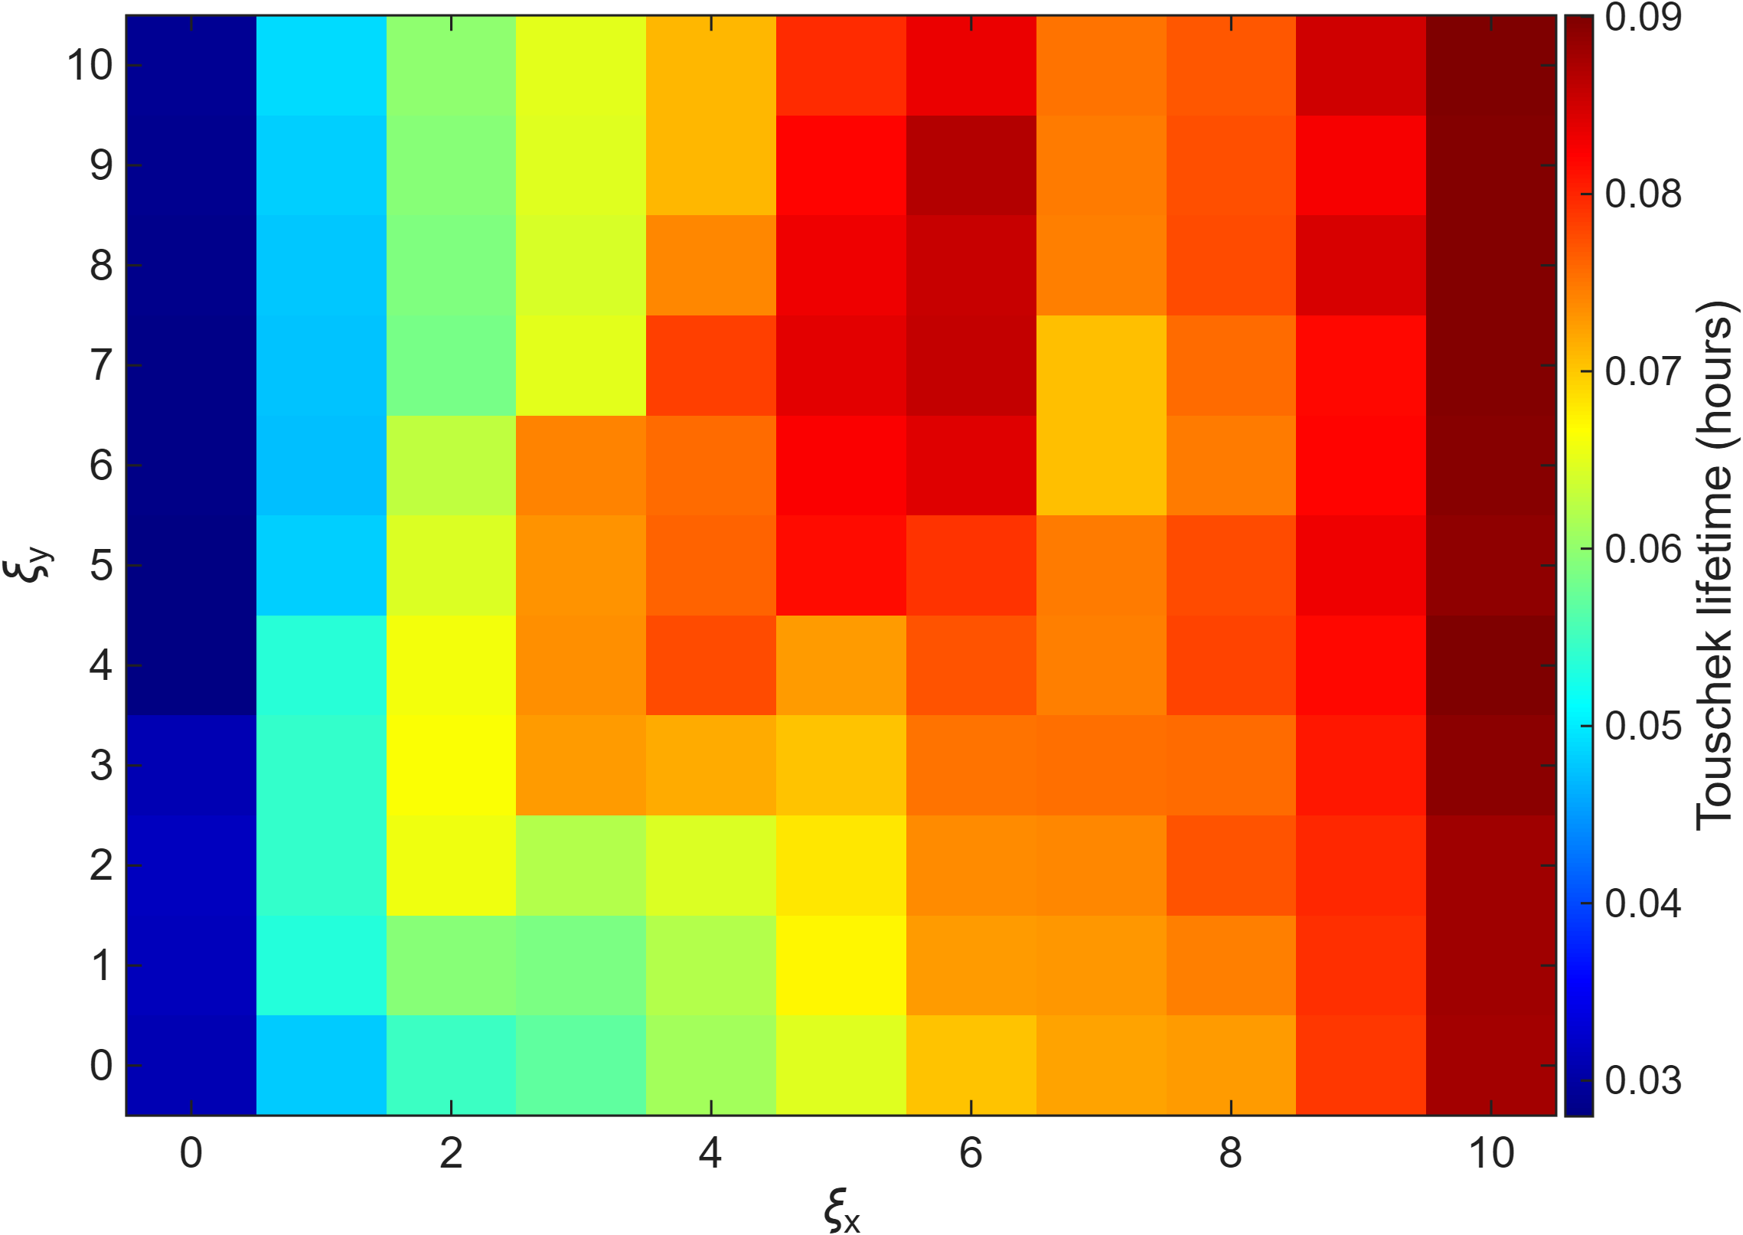
S1, S2 이용하여 chromaticity 에 따른 lifetime scan 진행.
  Hor. chrom : 0~10
  Ver. chrom : 0~10
Dynamic aperture는 충분히 큰 지점에 위치함.
MA는 chromaticity를 바꿔도 큰 이득을 보지 못함.

Slide 17
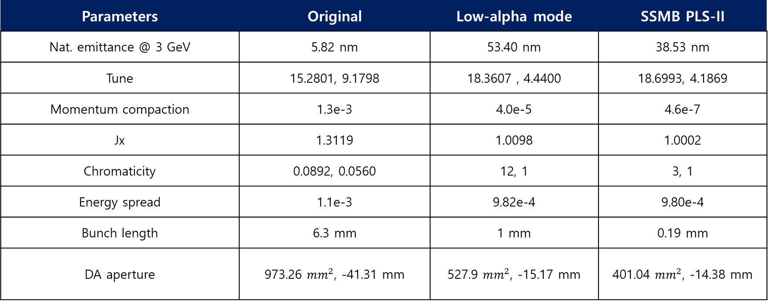
PLS-II storage ring parameter
Parameters | Original | Low-alpha mode | SSMB PLS-II
Nat. emittance @ 3 GeV | 5.82 nm | 53.40 nm | 38.53 nm
Tune | 15.2801, 9.1798 | 18.3607 , 4.4400 | 18.6993, 4.1869
Momentum compaction | 1.3e-3 | 4.0e-5 | 4.6e-7
Jx | 1.3119 | 1.0098 | 1.0002
Chromaticity | 0.0892, 0.0560 | 12, 1 | 3, 1
Energy spread | 1.1e-3 | 9.82e-4 | 9.80e-4
Bunch length | 6.3 mm | 1 mm | 0.19 mm
DA aperture | 973.26 $mm^{2}$, -41.31 mm | 527.9 $mm^{2}$, -15.17 mm | 401.04 $mm^{2}$, -14.38 mm

Slide 18
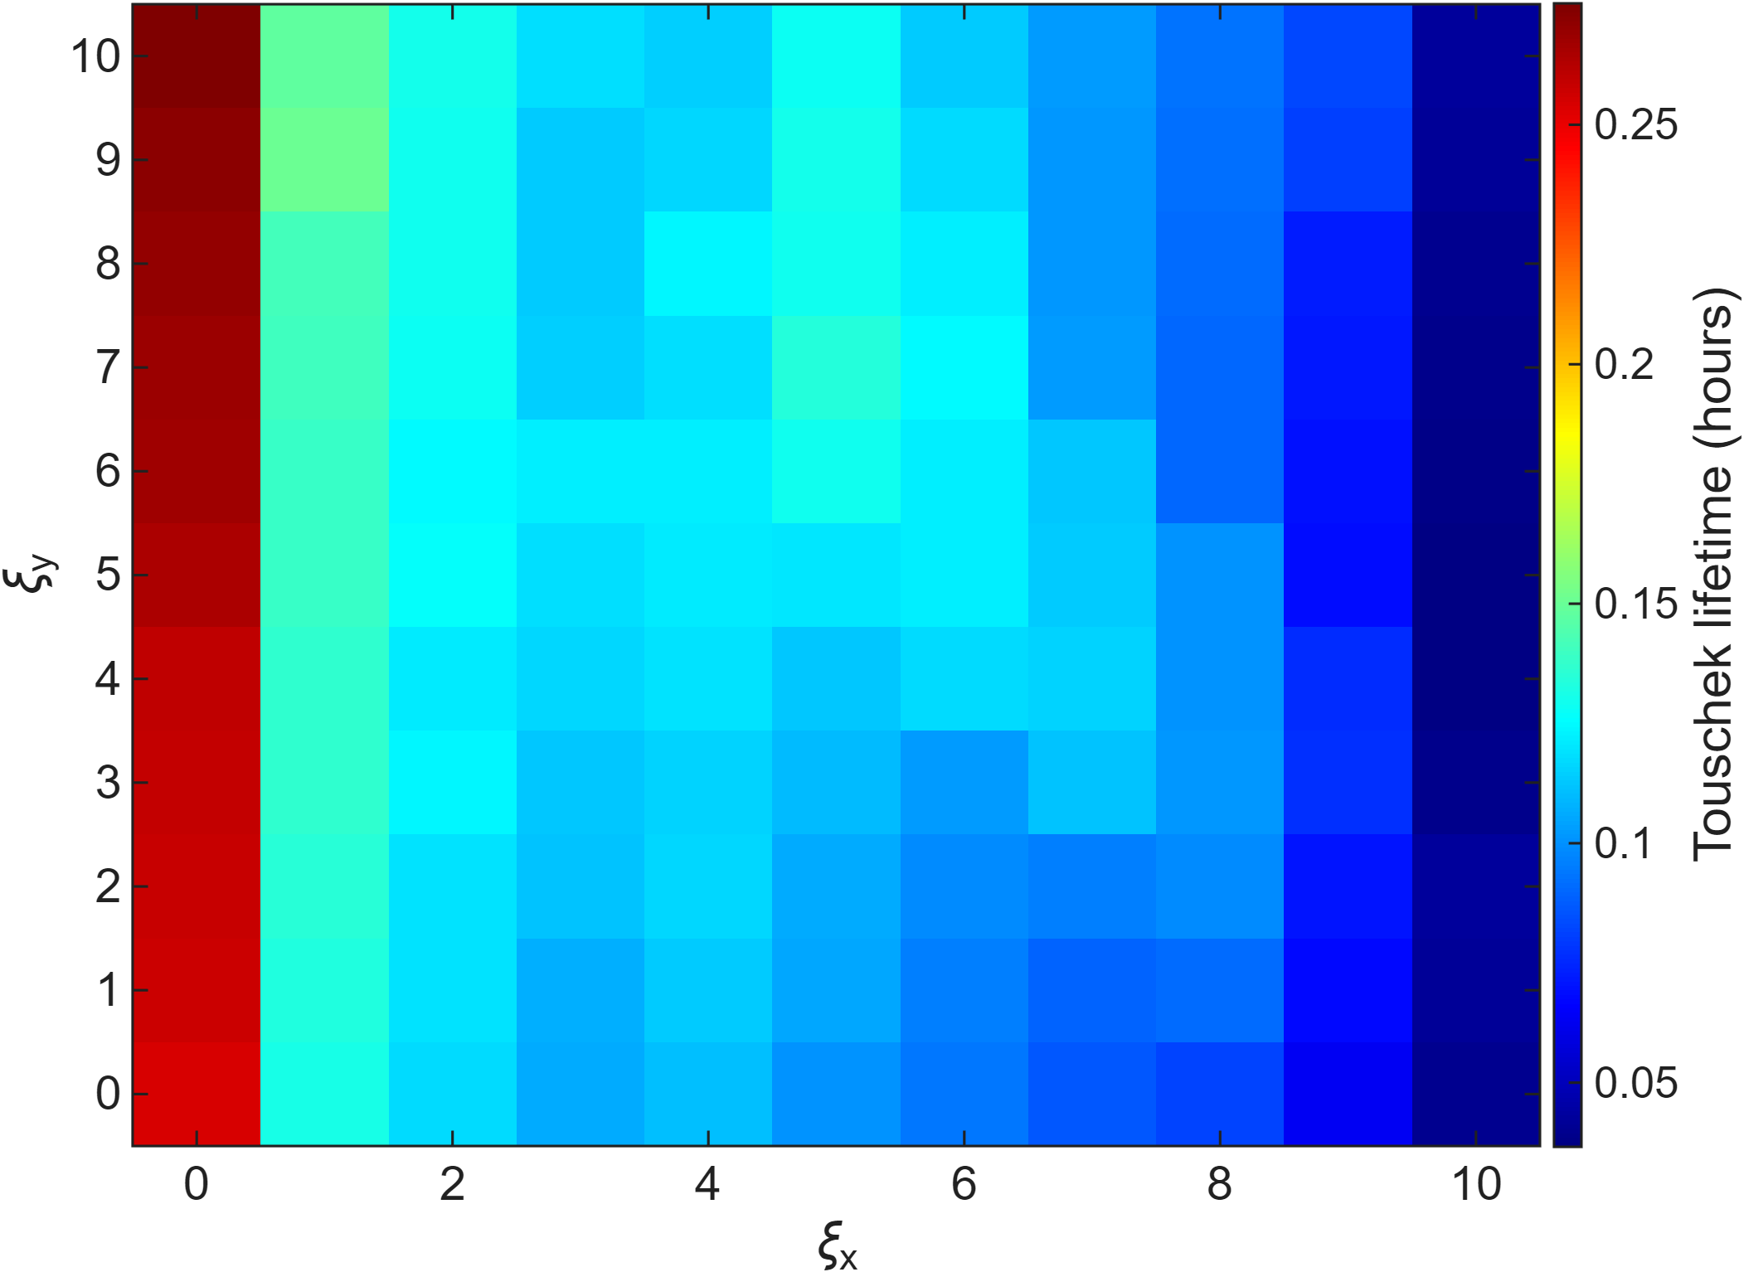

Slide 19
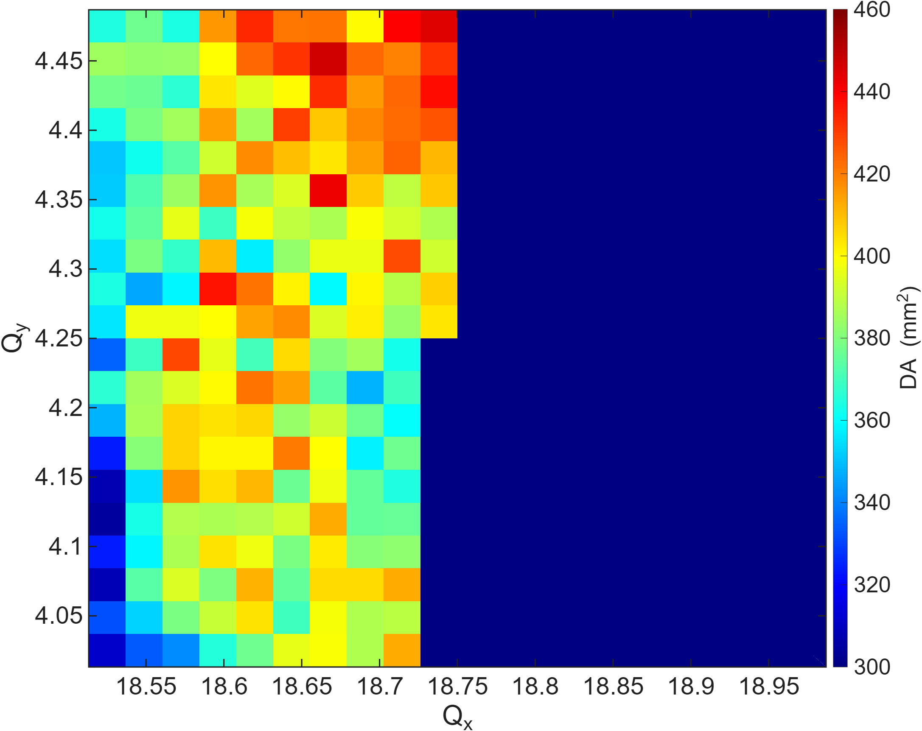



Slide 20
Low-alpha용 4e-5

