Slide 1
WBPM Test Results and Paper Work Status
2025. 10. 17.
송우진

Slide 2
Introduction
Experimental Objective
  To test the performance of the WBPM developed for measuring the white-beam profile at the 4GSR beamline.
  To evaluate the WBPM performance in measuring the beam profile under different gas environments and with varying beam positions and sizes.
Experimental Details
  Measurement of beam profiles under different gas environments.
    Residual gas, Xenon gas (@ 1 X 1 mm pink beam)
  Performance test according to beam size changes
    1.2 x 1.0 mm -> 1.0 x 0.5 mm -> 0.9 x 0.2 mm (@ center)
  Performance test according to beam displacement
    7 steps, beam size 1 x 1 mm

Slide 3
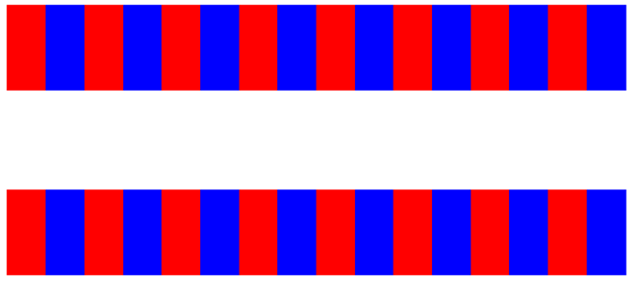
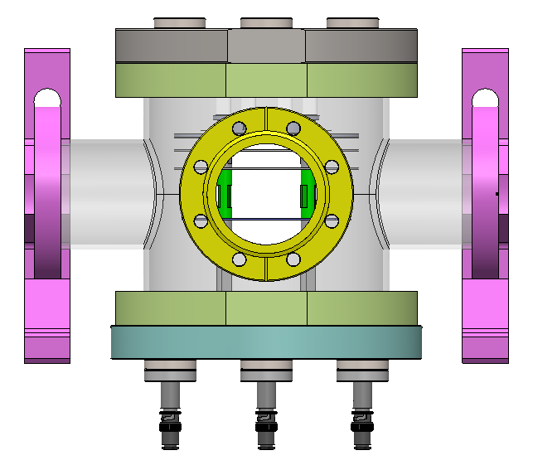
Schematic Diagram
Application scenario at Korea-4GSR
Fixed Mask
Movable Mask
Shielding
wall
White beam Slit
WBPM
DCM
IVU24
(0m)
(14m)
(21m)
(24.5m)
(28m)
(30m)
sCMOS Camera
Pco.Edge 5.5
Hamamatsu Fusion
2x ,4x, 5x, 10x, 20x, 40x
IVU24
2.4 x 2.4 mrad (H x V)
Sigma (H) : 12.9 urad
Power=17.94 kW
Fixed Mask
300 x 300 urad
Power= 8.25 kW
Movable Mask
77 x 77 urad
(1.6 x 1.6 mm)
Power= 699 W
White beam Slit
33 x 33 urad
(1 x 1 mm)
Power= 208 W
PLS-II BL6C test - Pink beam (Total reflection beam by DMM 1st crystal)
36m
Slit
Al window
0.1 mm
Diamond
1.4 mm
LMM
Multi-Pole Wigger
E_{c} = 12 keV
Normal source size
: 500 um x 30um
Total power : 10kW
Double Multilayer
Monochromator
Ru/C, 4.0 nm
: 10 – 20 keV
W/B4C, 2.6 nm
: 20 – 55 keV
DCM 1
Si (220)
: 30 – 50 keV
DCM 2
Si (111)
: 12 – 33 keV
Sample stage
Air bearing rotation stage

Slide 4
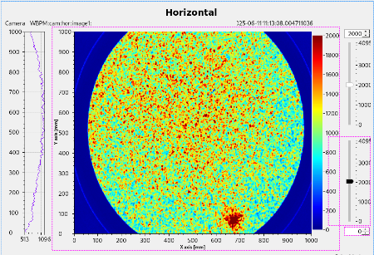
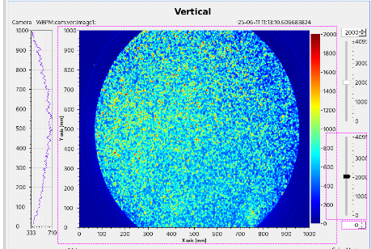
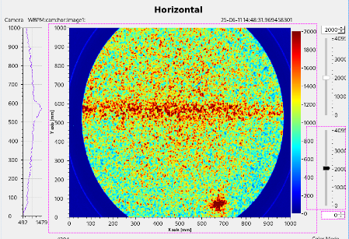
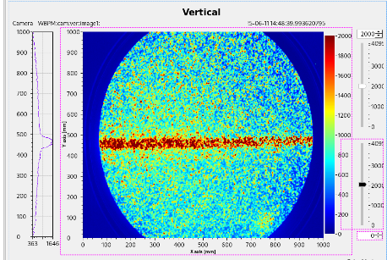
1st Beam Image
Verification of availability in residual gas environments (Hard X-ray)
Residual gas
(middle -7 torr)
Xenon injection
(middle -6 torr)
Exposure time: 0.3 sec

Slide 5
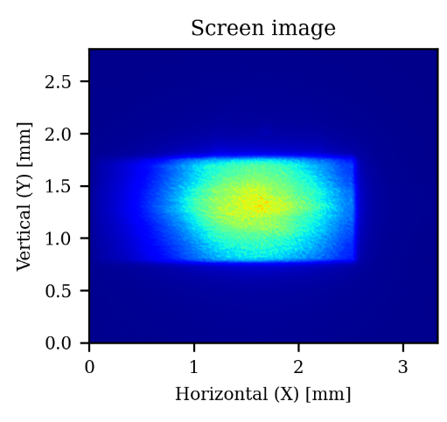
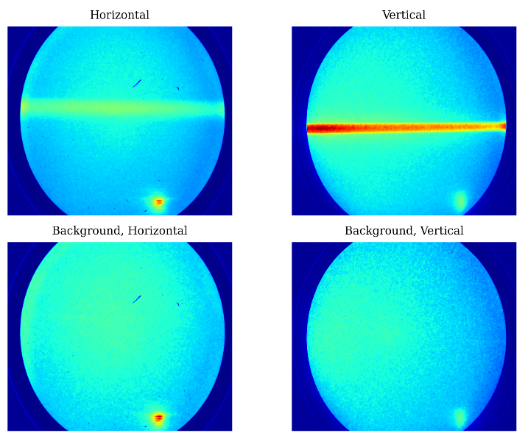
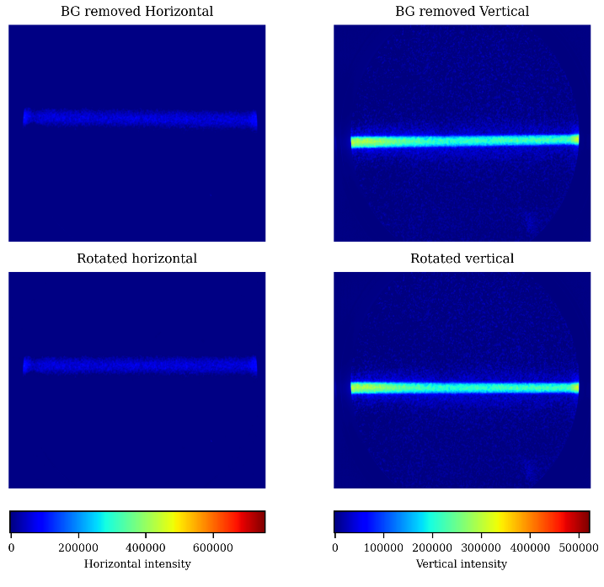
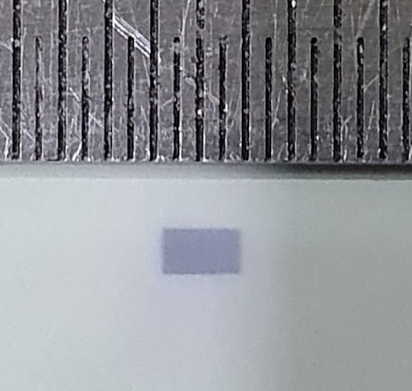
Image Pre-processing
Screen: Use the projection result without additional processing
WBPM: Background image removal and image rotation
Exposure time: 75 sec
Absolute color-bar scale
X-ray burn paper

Slide 6
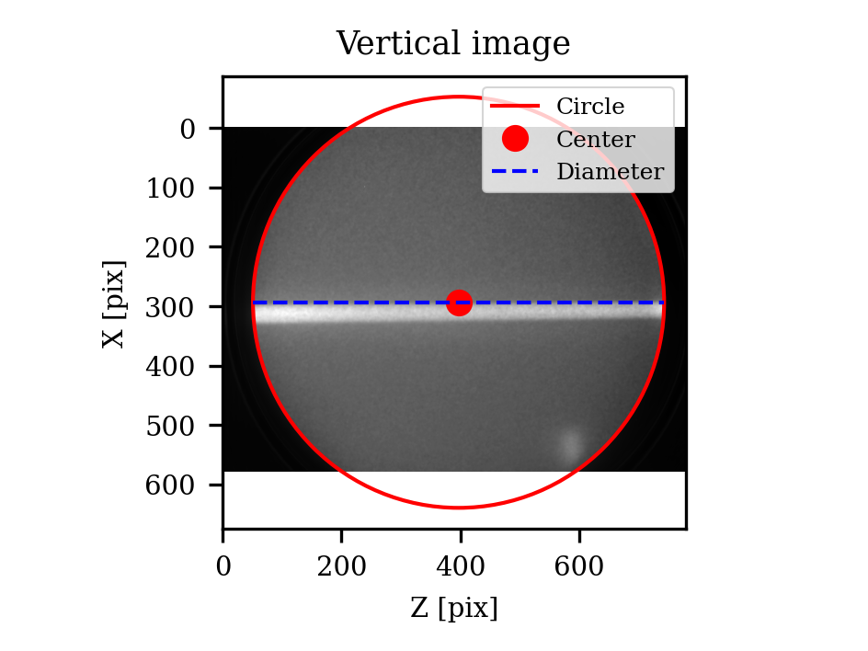
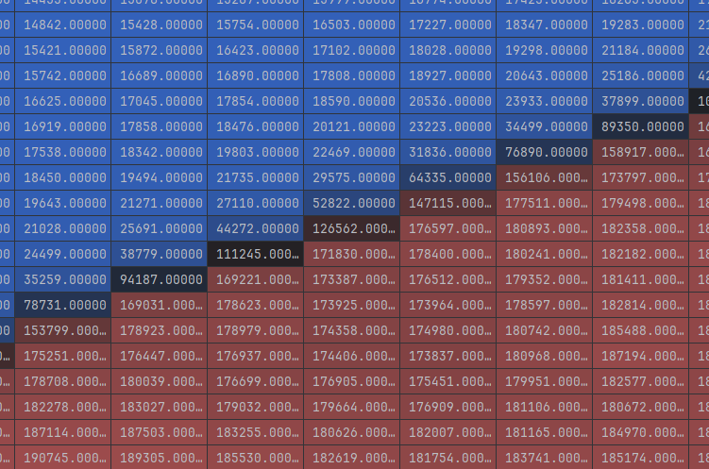
Calculation of pix/mm using the active area
Center: (397.0, 293.5) pixel
Diameter: 692.356 pixels = 24 mm
pix./mm = 34.664 um/pix
Threshold=100000

Slide 7
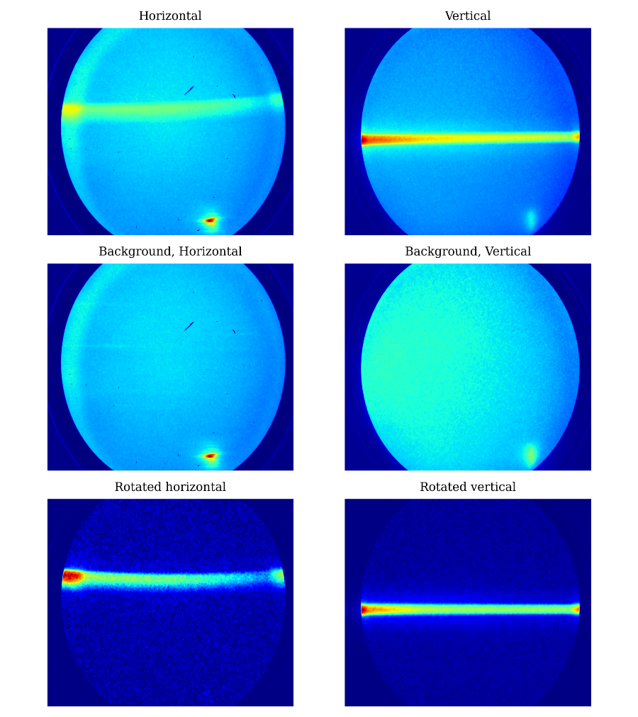
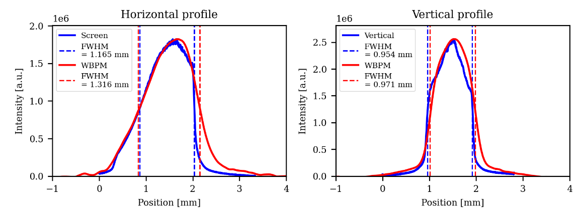
Beam Size Measurement

Slide 8
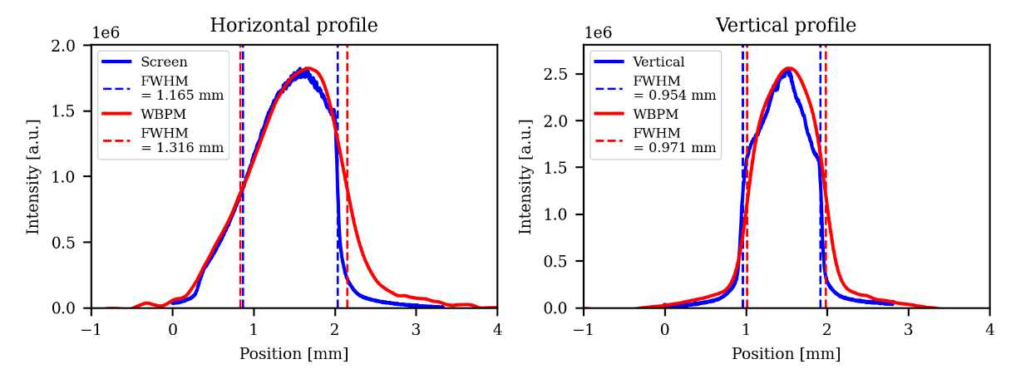
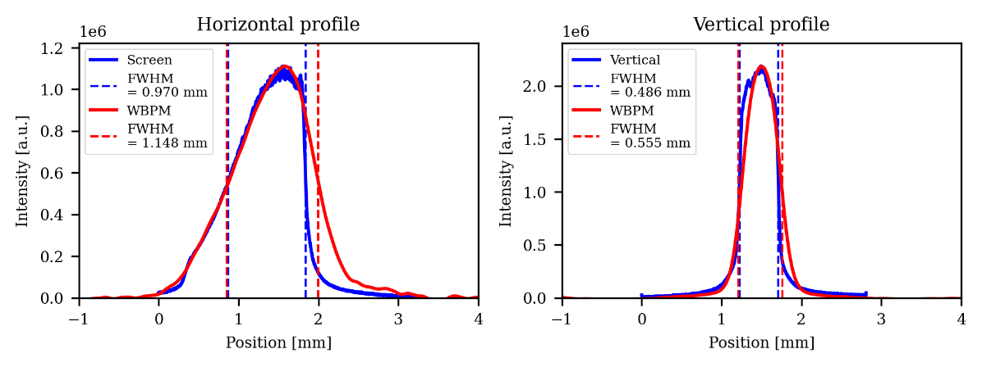
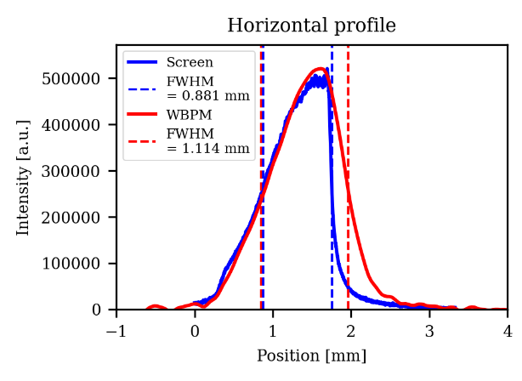
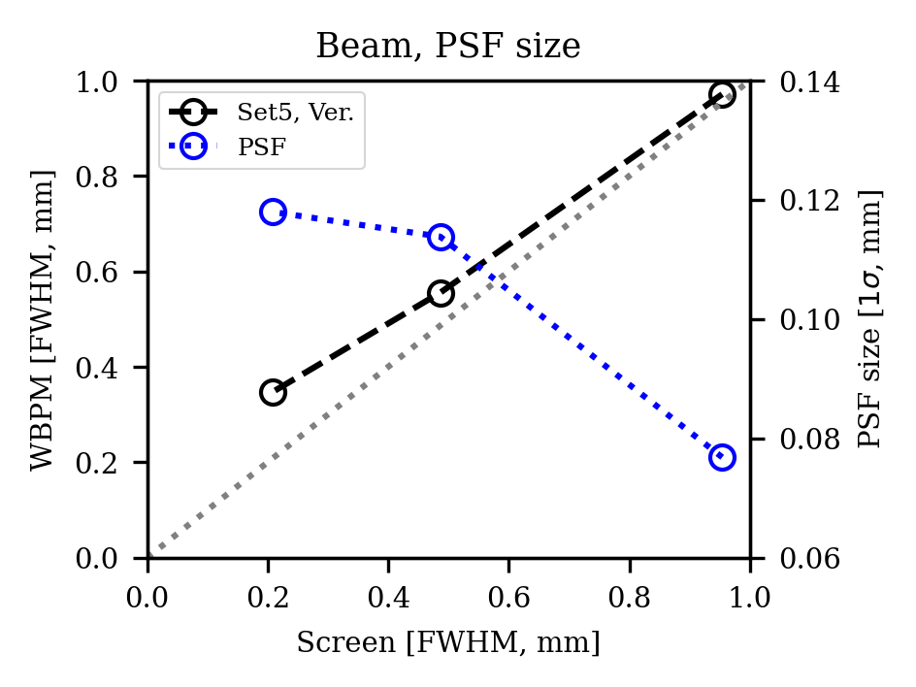
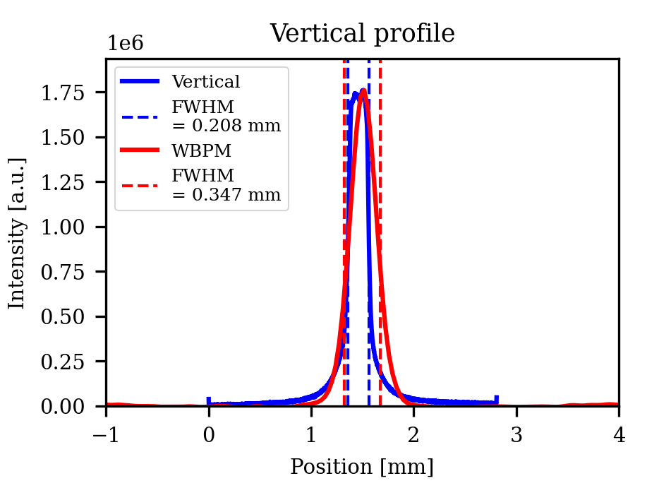
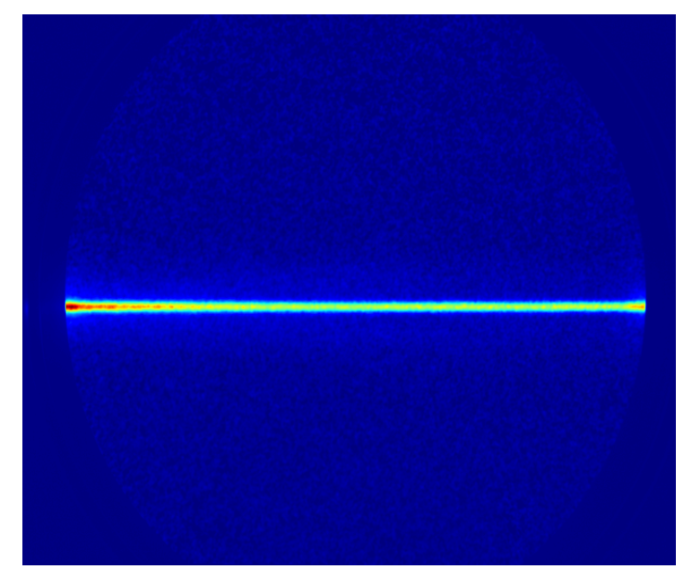
Beam Size Measurement
Beam Size: 1.2 x 1.0 mm, 1.0 x 0.5 mm, 0.9 x 0.2 mm
Horizontal
Vertical
1.2 x 1.0 mm
1.0 x 0.5 mm
0.9 x 0.2 mm

Slide 9
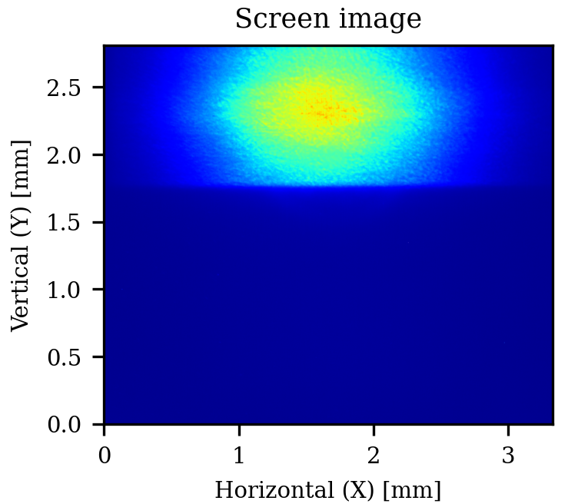
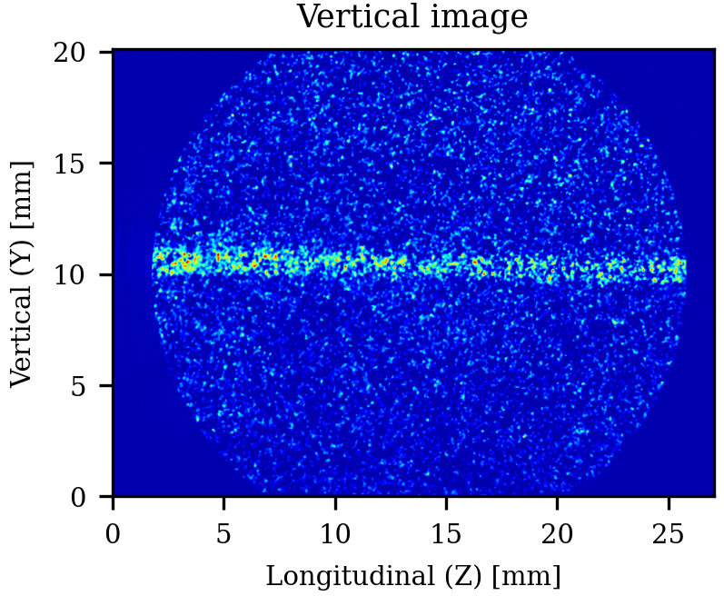
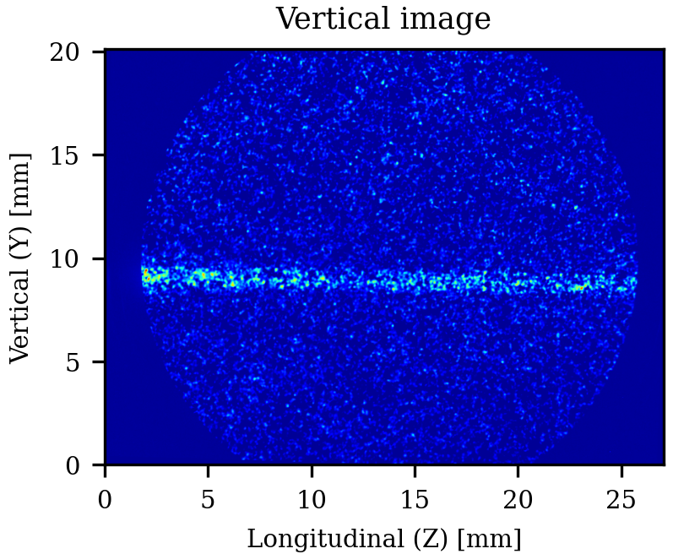
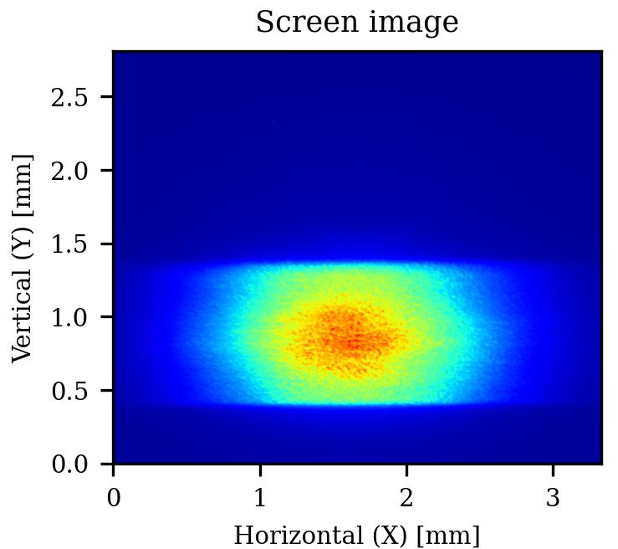
Beam Position Measurement
Position data was analyzed shot by shot
→ 0.3 sec exposure time, total of 600 shots.
The position resolution: Deviation of the 600 image centers & Fitting error → 29.37 µm.
The center position was obtained using Gaussian fitting.

Slide 10
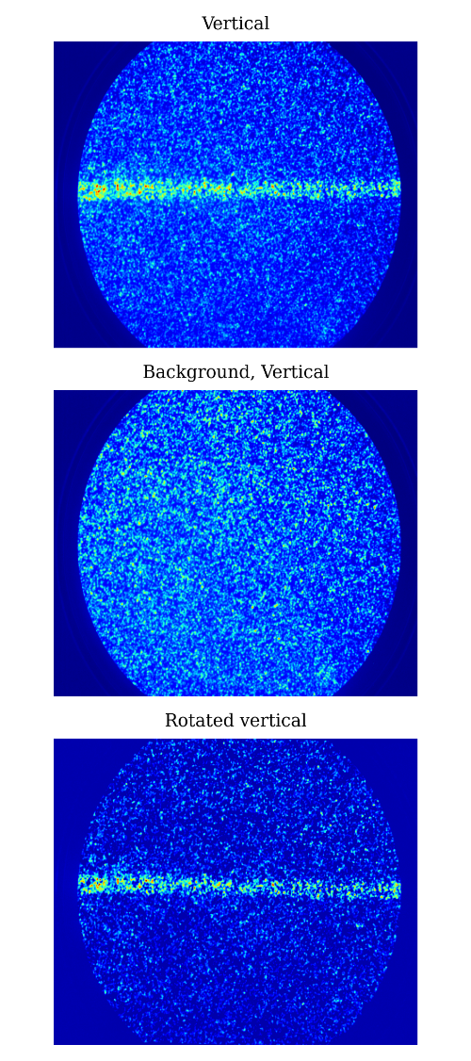
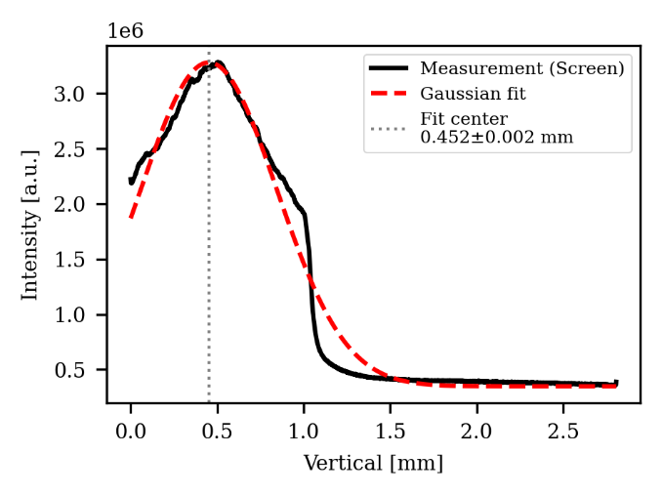
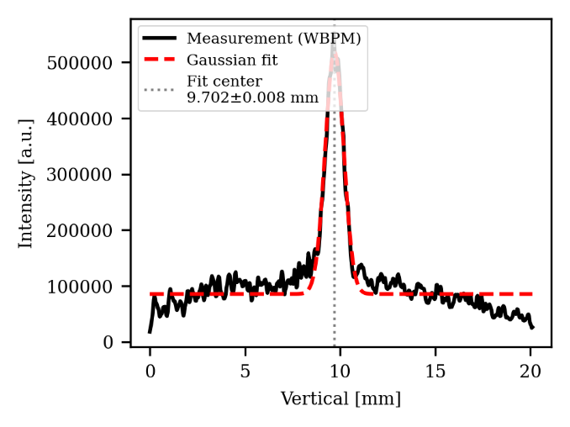
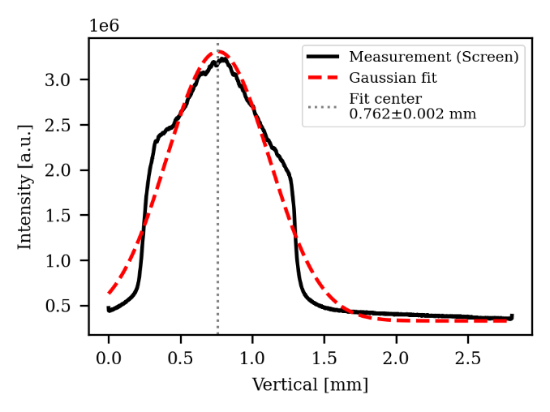
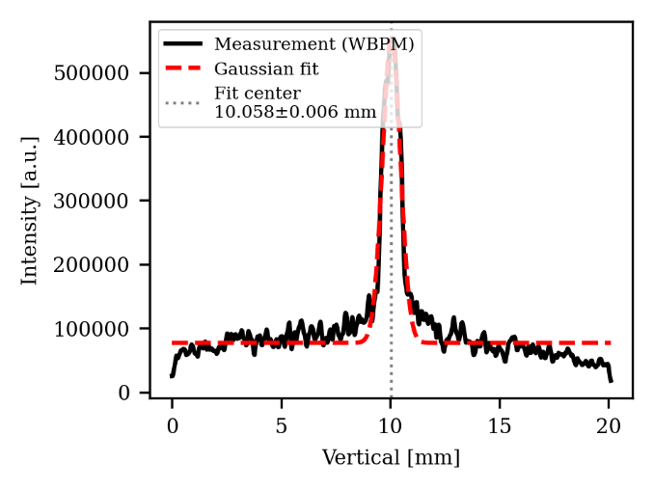
Beam Position Measurement

Slide 11
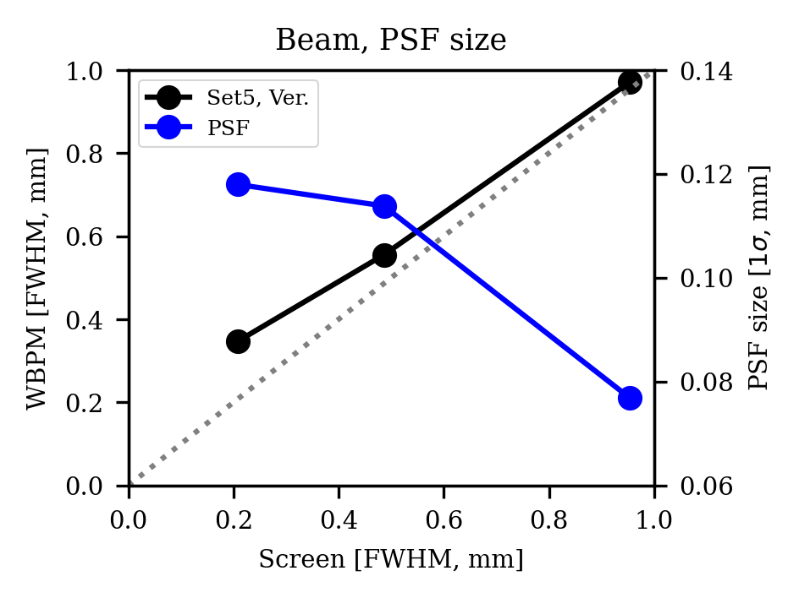
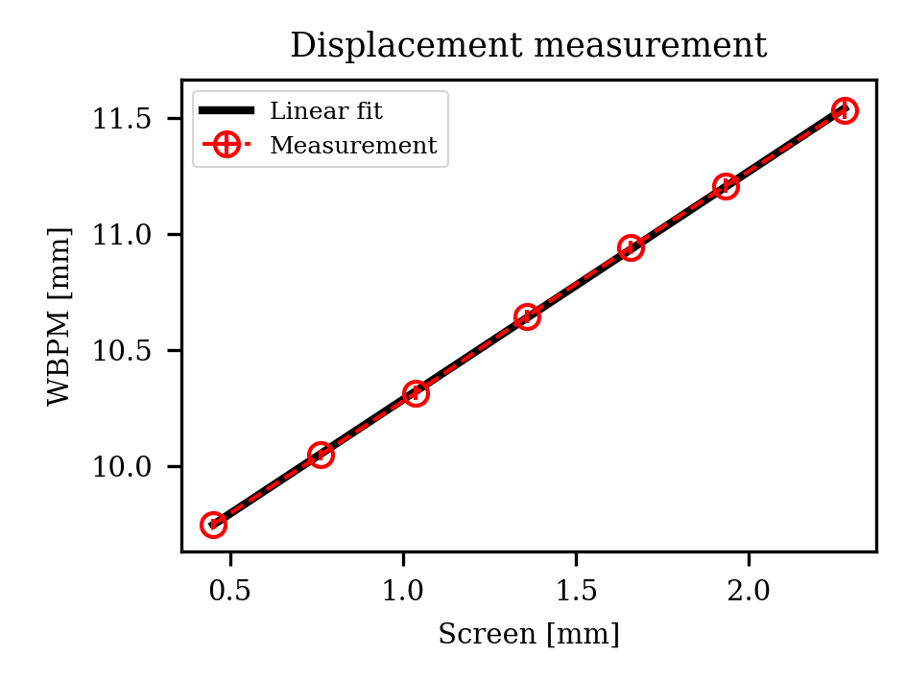
WBPM Test Result
The WBPM test was carried out at PLS-II BL6C.
The PSF is predicted to be 120 μm or less during beam profile measurement
The position measurement resolution is 29 μm based on an exposure time of 0.3 ms.

Slide 12
Paper Preparation
Dissertation: Entire content written
- Excluded: Beam size measurement experiment
- Included: Magnification defocusing field design, experiment, and correction method
IBIC proceeding: Beam size measurement experiment
- Excluded: Design, Result analysis, Magnification
- Included : Photo of the whole equipment, WBPM measurement images
Journal: Resolution calculation and verification (Experimentally)
- Excluded: Magnification, Design detail
- Included: Resolution, result analysis
Internal report (Planned): Technical design, operation method
- Excluded: Theory (Resolution, Principle detail, …)
- Included: Fabrication process, PLS-II experiment details

Slide 13
Paper Preparation
Introduction
Principle and configuration
Monitor resolution
Experimental set-up
Measurement
Conclusions
Logical Structure
Necessity:
DLSR → ε↓
→ Requires high position measurement accuracy.
→ Conventional devices cannot withstand power density.
→ Non-destructive measurement via IPM method.
Central cone at 10 urad level used in undulator beamline.
→ Requires profile measurement to identify the central cone.
→ Requires precise electric field design (resolution).
Features:
1. Resolution determining factor (PSF) analysis via particle tracking simulation.
2. Verified at PLS-II beamline.

Slide 14
Paper Preparation
Introduction
Principle and configuration
Monitor resolution
Experimental set-up
Measurement
Conclusions
Repeller electrode
-
-
-
-
Photo-electrons
Extraction field
-
Photo-ions
-
Beam
+
+
Guiding electrode
+
+
+
+
Readout
Microchannel plate (MCP)
Phosphor screen
Visible light
Camera

Slide 15
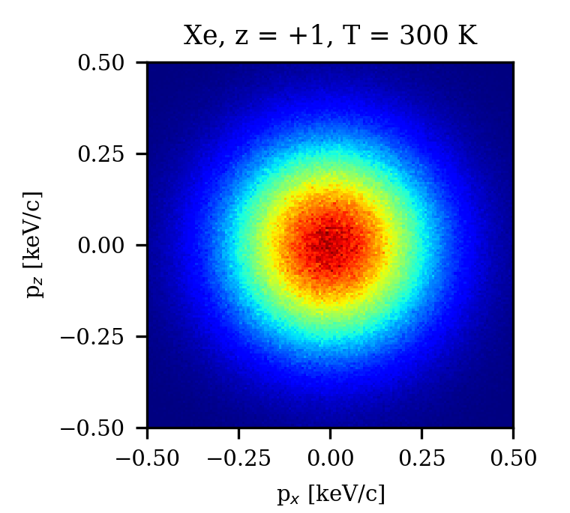
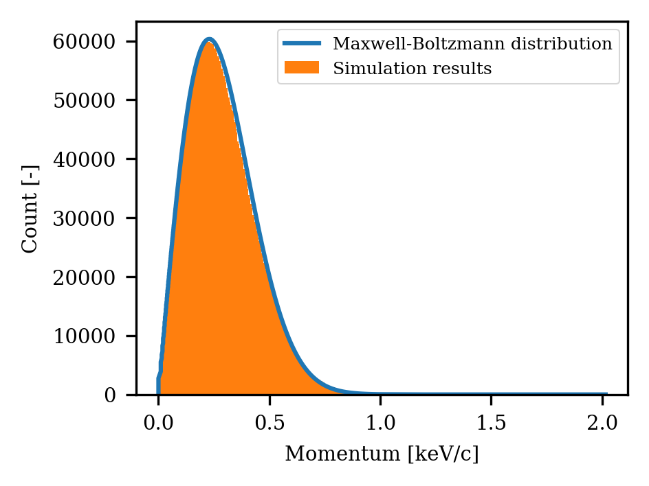
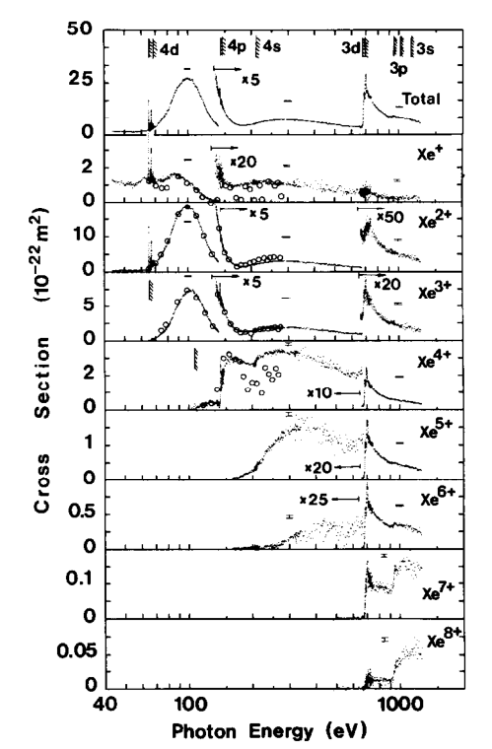
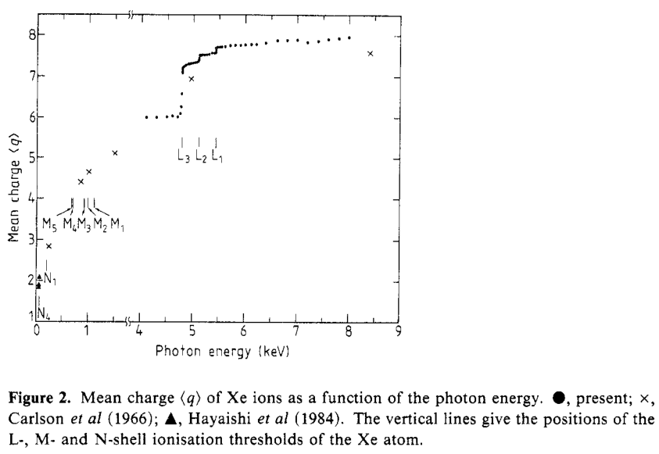
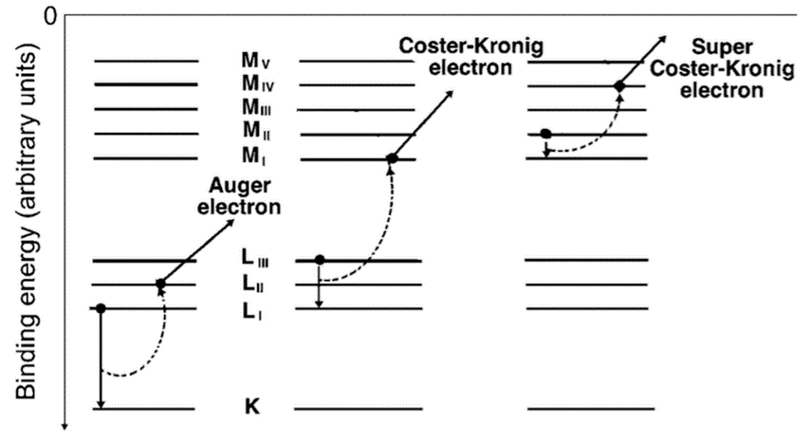
Paper Preparation
Introduction
Principle and configuration
Monitor resolution
Experimental set-up
Measurement
Conclusions

Slide 16
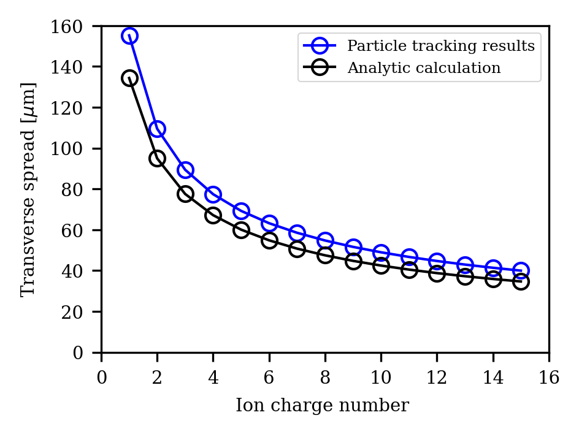
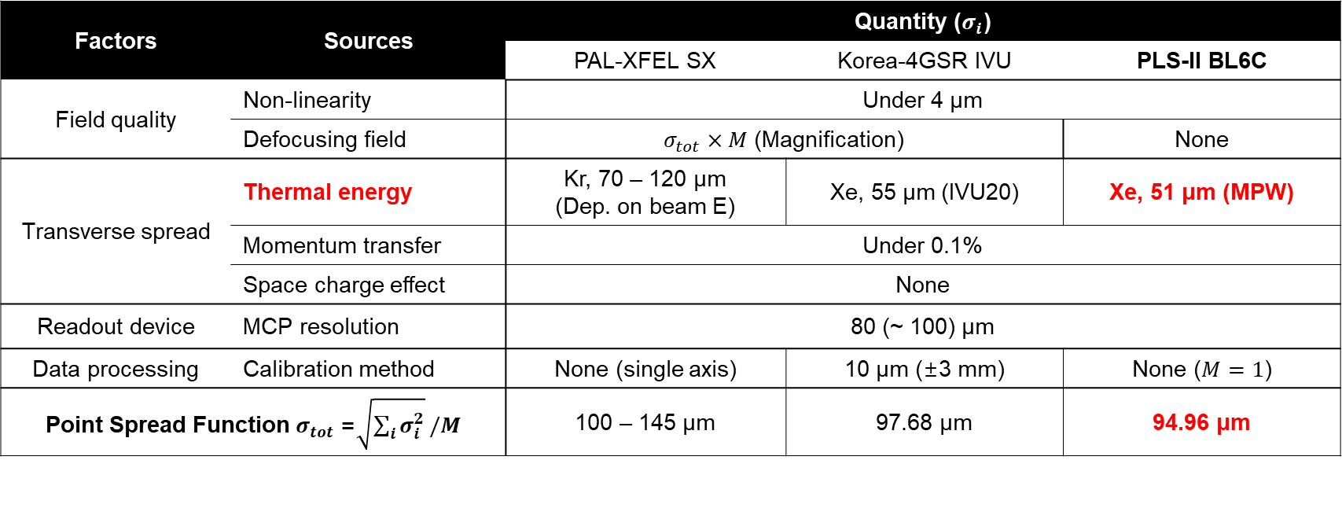
Paper Preparation
Introduction
Principle and configuration
Monitor resolution
Experimental set-up
Measurement
Conclusions
Factors | Sources | Quantity ($σ_{i}$)
 |  | PAL-XFEL SX | Korea-4GSR IVU | PLS-II BL6C
Field quality | Non-linearity | Under 4 μm
 | Defocusing field | $σ_{tot}×M$ (Magnification) |  | None
Transverse spread | Thermal energy | Kr, 70 – 120 μm (Dep. on beam E) | Xe, 55 μm (IVU20) | Xe, 51 μm (MPW)
 | Momentum transfer | Under 0.1%
 | Space charge effect | None
Readout device | MCP resolution | 80 (~ 100) μm
Data processing | Calibration method | None (single axis) | 10 μm (±3 mm) | None ($M=1$)
Point Spread Function $σ_{tot}$=$\sqrt{\sum_{i}{σ_{i}^{2}}}/M$ |  | 100 – 145 μm | 97.68 μm | 94.96 μm

Slide 17
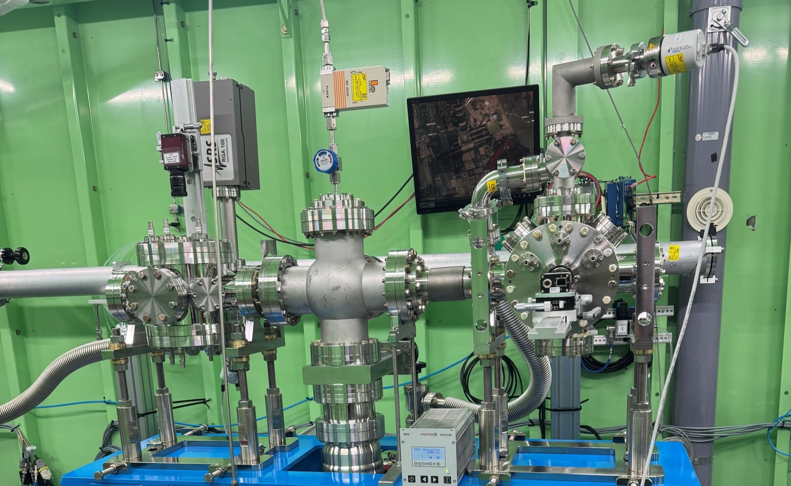
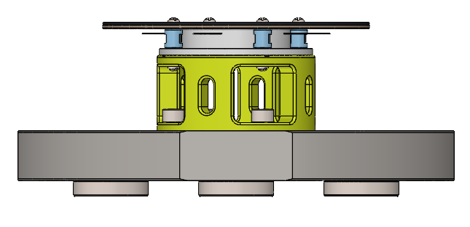
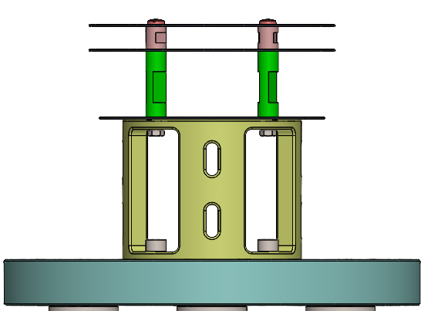
Paper Preparation
Introduction
Principle and configuration
Monitor resolution
Experimental set-up
  Schematic diagram
  PLS-II BL6C, Xenon gas injection
Measurement
Conclusions
36m
Slit
LMM
Diamond
1.4 mm
Al window
0.1 mm

Slide 18
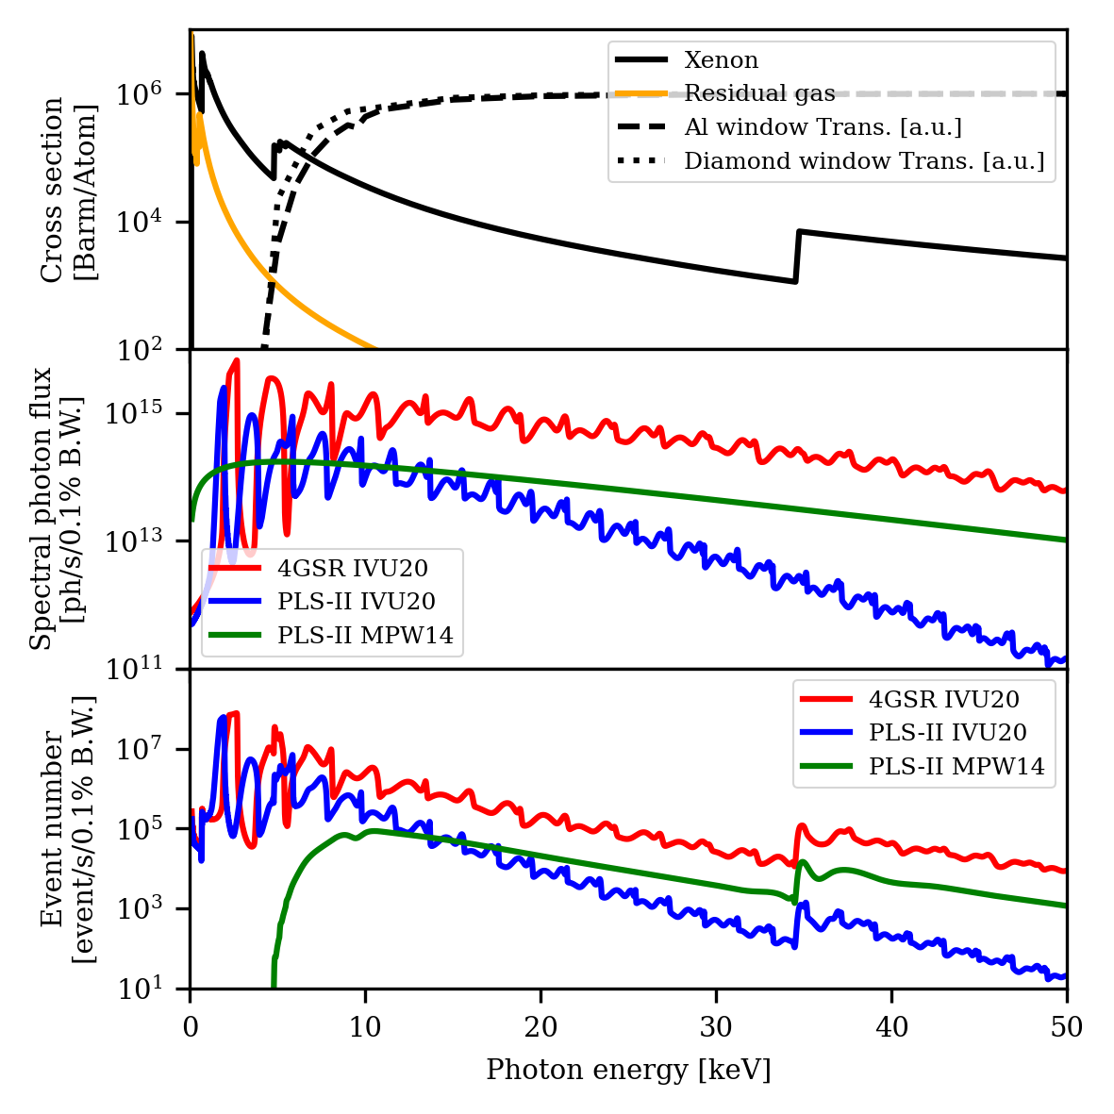
Paper Preparation
Introduction
Principle and configuration
Monitor resolution
Experimental set-up
  Schematic diagram
  PLS-II BL6C, Xenon gas injection
Photon beam | Beamline | Event number (Xe) | Event number (Residual gas)
White beam | 4GSR IVU20 | 7.91e+9 | 1.76e+8
 | PLS-II IVU20 | 3.00e+9 | 9.25e+7
 | PLS-II MPW14 | 2.44e+7 | 7.94e+4
10 keV beam (0.1% bW) | 4GSR IVU20 | 2.50e+6 | 8.19e+3
 | PLS-II IVU20 | 1.85e+5 | 6.07e+2
 | PLS-II MPW14 | 7.76e+4 | 2.55e+2
30 keV beam (0.1% bW) | 4GSR IVU20 | 2.59e+4 | 5.24e+1
 | PLS-II IVU20 | 5.09e+2 | 1.03e+0
 | PLS-II MPW14 | 3.75e+3 | 7.60e+0

Slide 19
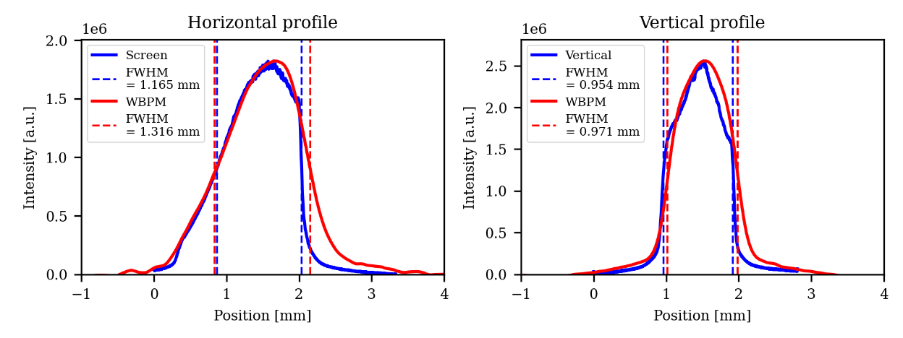
Paper Preparation
Introduction
Principle and configuration
Monitor resolution
Experimental set-up
Measurement
Conclusions

Slide 20
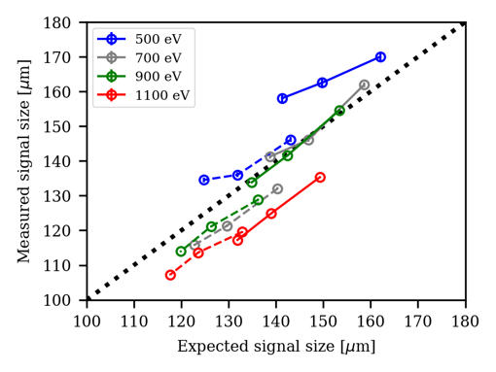
Summary
Analysis of PLS-II BL6C experimental results completed and results sharing meeting concluded.
After completing the logical structure and outline of the paper, currently drafting the content.
Still considering whether to include the PSF measurement experiment conducted at XFEL.

