Slide 1
Development of Zynq SoC-Based EPICS IOC for KOMAC remote control System
류연찬
2025/09/26

Slide 2
목차
The Reason of Choice
What is EPICS
Meaning, Workflow, Example, Application
Development DAQ based on FPGA(Zynq)
Motivation, Component, Sequence

Slide 3
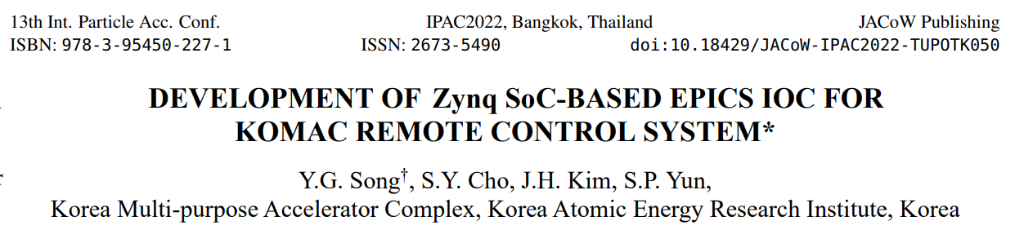
Reason of Choice
Introduce EPICS and Control
FPGA in accelerator
Motivation of use FPGA
Design requirement and Result

Slide 4
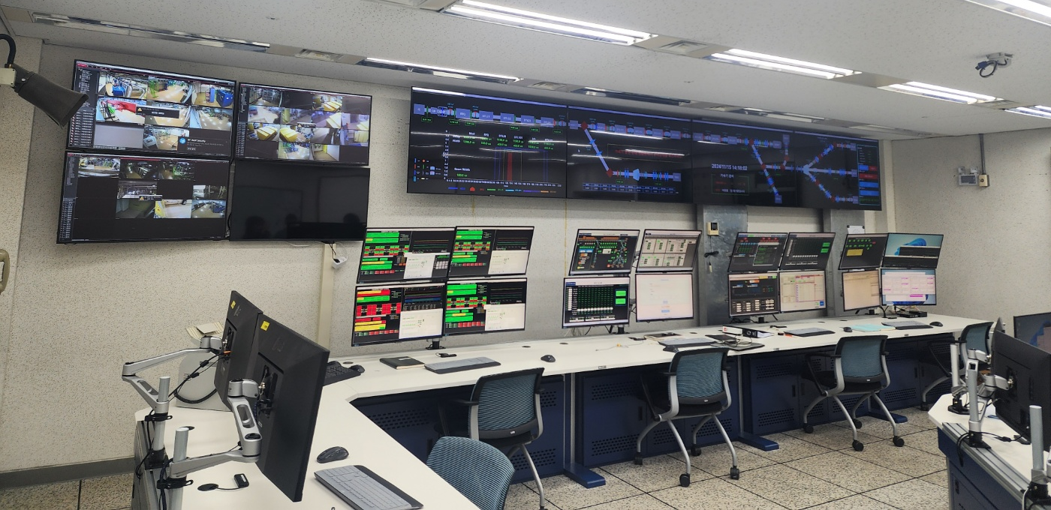
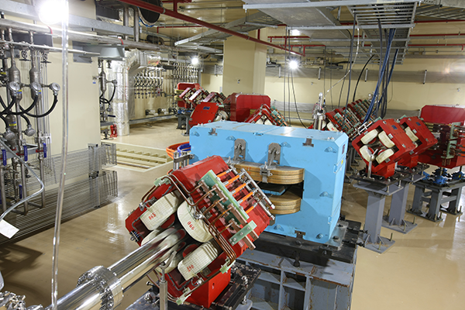

What is EPICS
What is EPICS
Accelerators consist of many devices that must operate in coordination
Operator room is might be far from hardware device
EPICS is the framework that enables such coordinated operation across distributed devices
EPICS
KOMAC Operator Room
KOMAC 100 MeV Beam

Slide 5
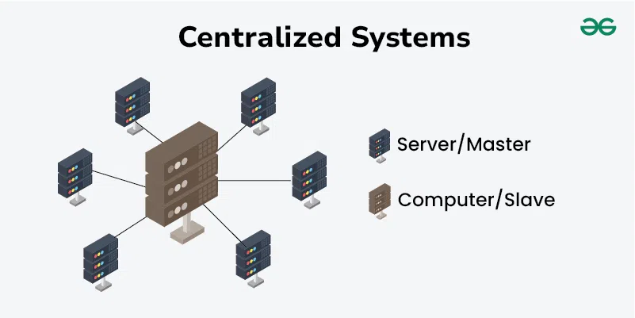
What is EPICS
EPICS : Experimental Physics and Industrial Control System
Toolkit for building distributed control system at large research facilities (such as accelerator)
Client
ask information and use service
Server (IOC)
provide information and service
Channel Access (CA)
network protocol
Process Variable (PV)
a single data unit exposed by a device
Centralized System
EPICS
Client
Channel Access
Server
EPICS Logo and meaning

Slide 6
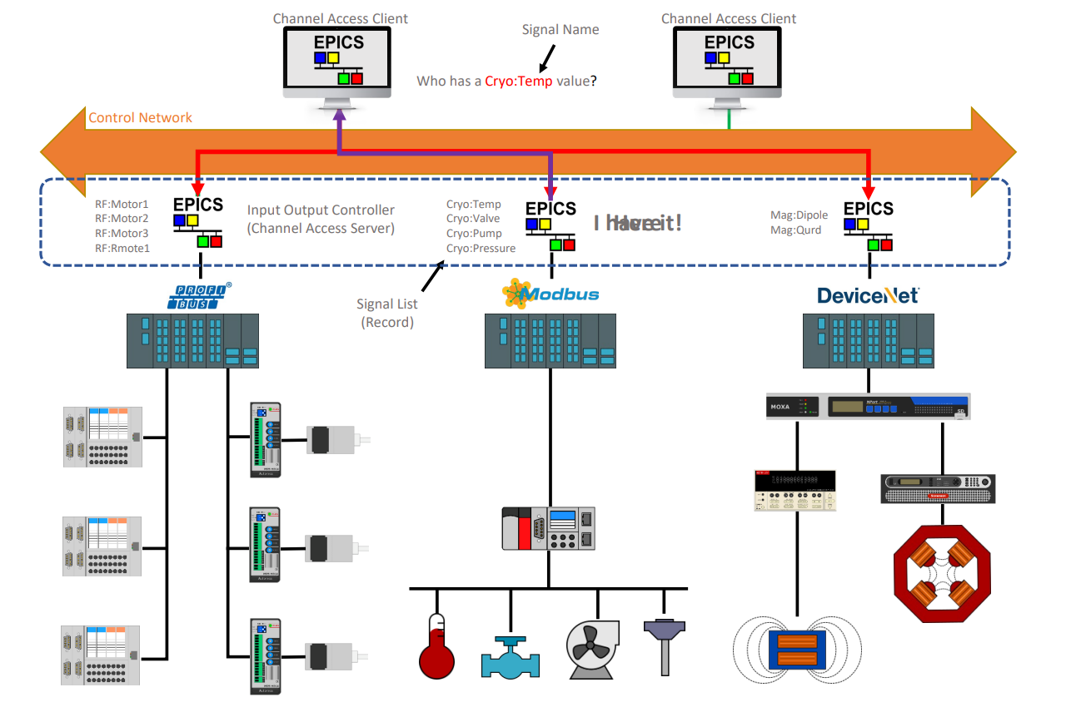
How does EPICS work

Slide 7
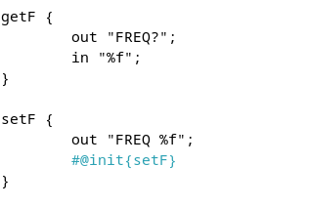
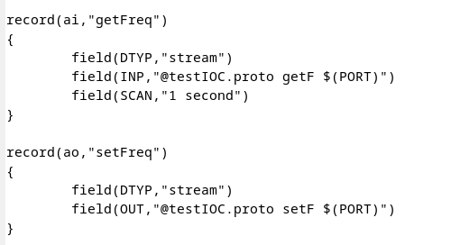
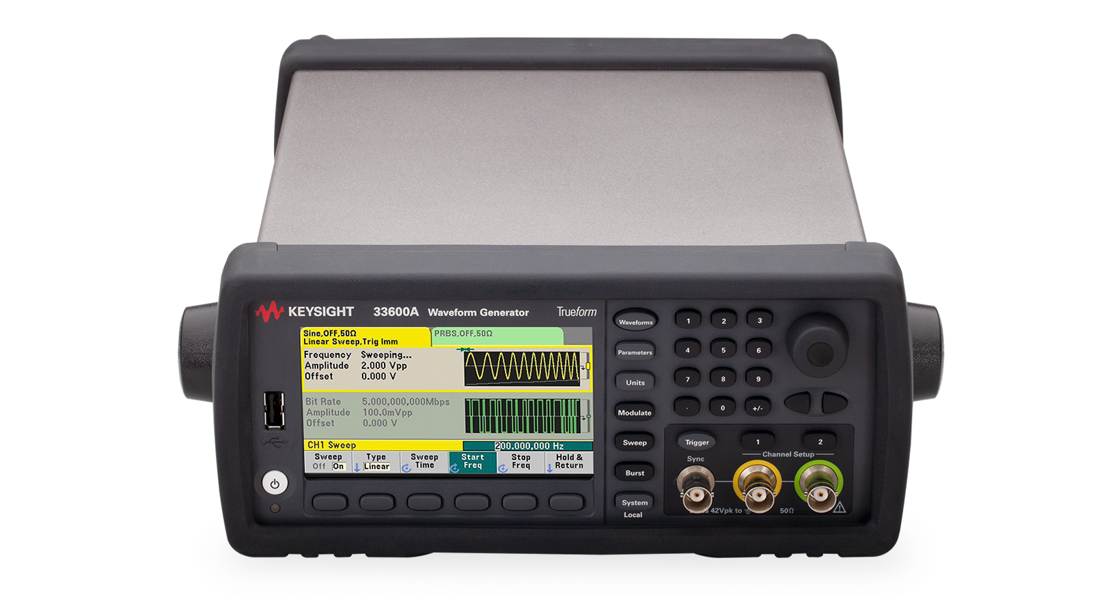

Example of EPICS IOC
EPICS IOC setup (Keysight Waveform Generator)
Proto file
Keysight W.G. speaks SCPI protocol
Map SCPI commands to PVs with Streamdevice (Support Module)
DB file
Records that use the protocol files the IOC exposes PVs
Clients
Access PVs via Channel Access
Proto file
DB file
CA
SCPI
Sever/Client
EPICS Control
Generator

Slide 8
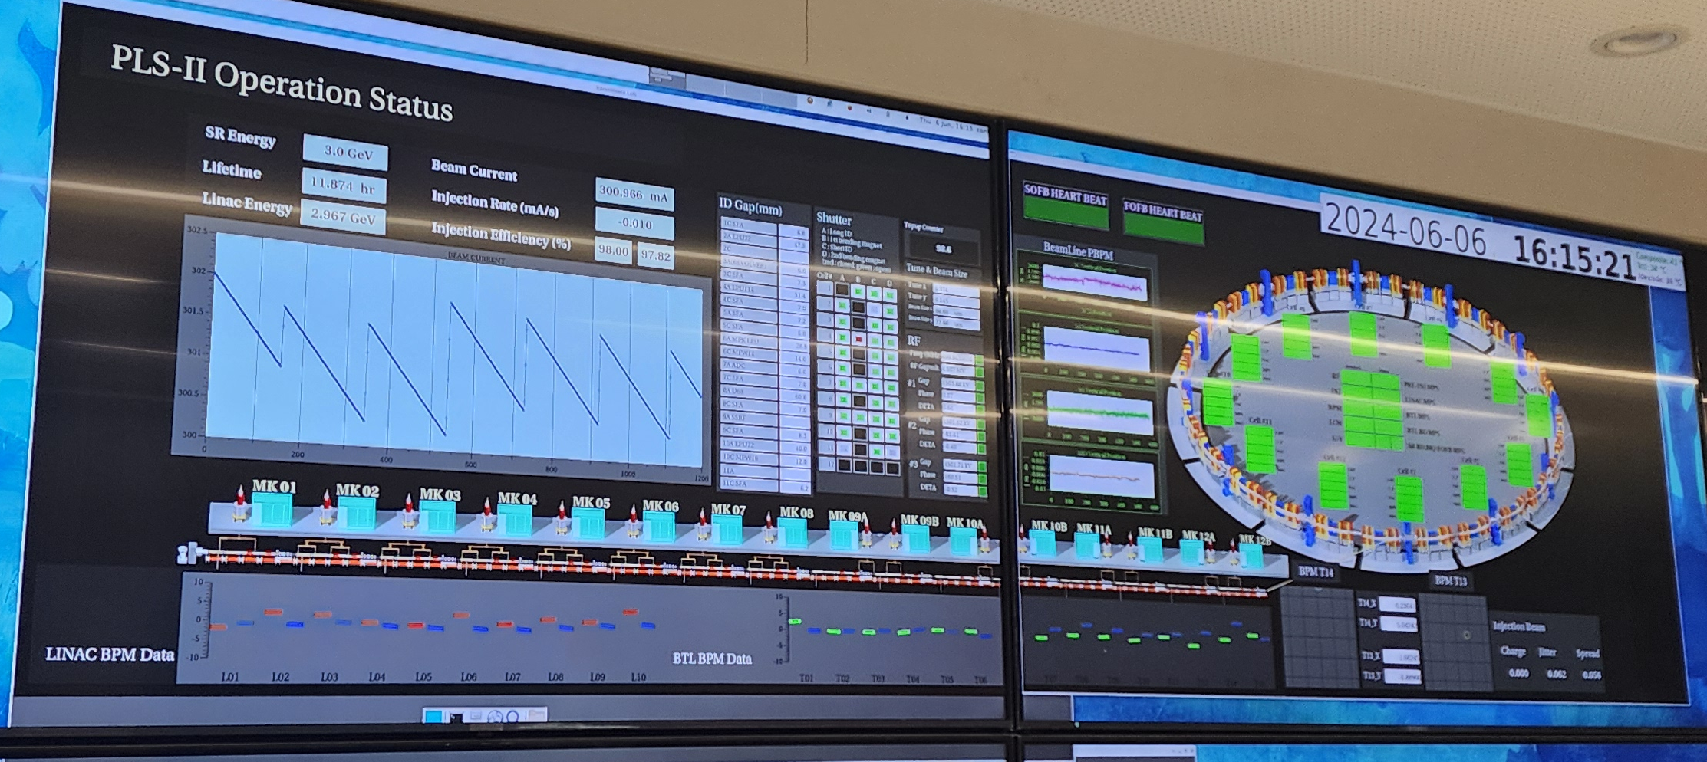
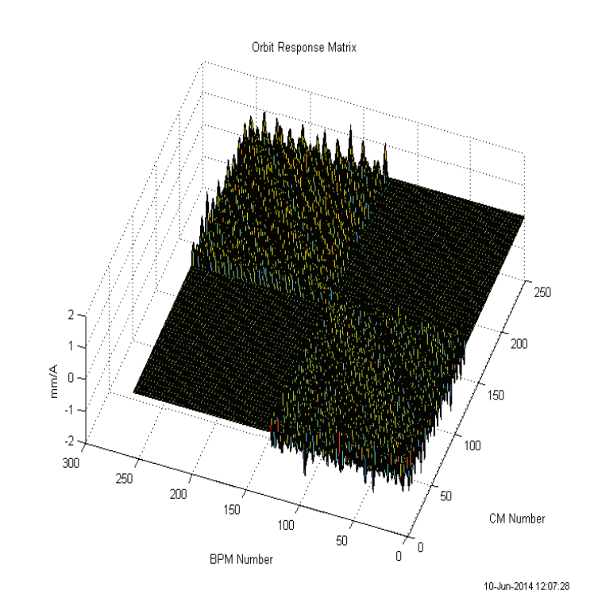
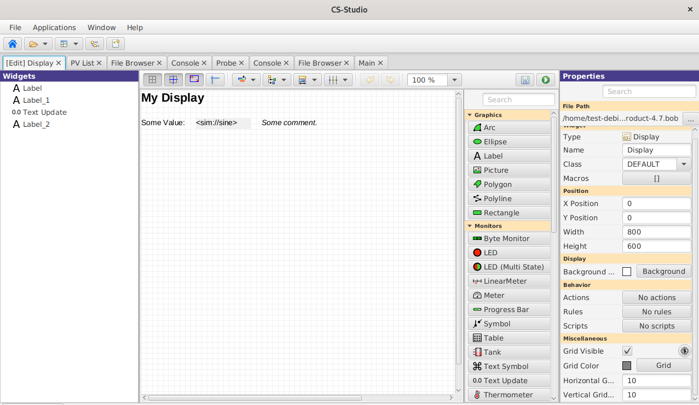
EPICS Application
EPICS UI Tools
Phoebus (CSS)
Check PV status by GUI
Communicate with CA protocol
Matlab Middle Layer
Matlab interface
Middle layer of EPICS PV
Pyepics
via python
PLS-II Operation Status
CSS Tool view
ORM graph in Matlab
(E.Ahmadi, IPM)
Python control

Slide 9

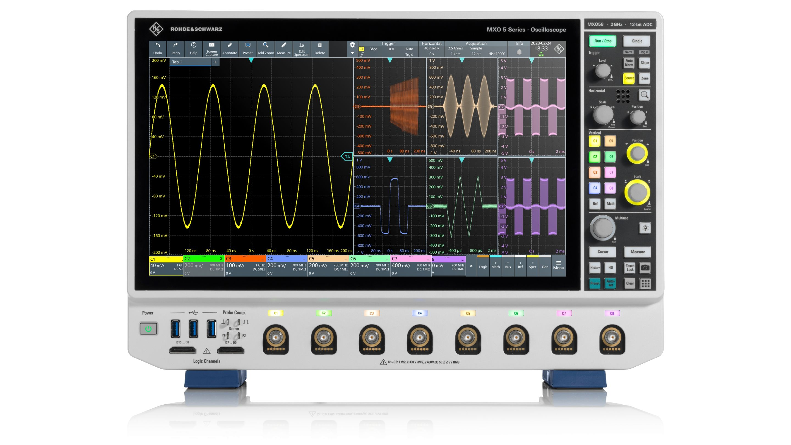
Motivation of Development DAQ
Beam Current Monitor (BCM)
Legacy workflow (problem)
Oscilloscope exported values over Ethernet(SCPI)
Operators viewed waveforms via VNC(Virtual Network Computing)
Polling-based led to latency and data drop at higher repetition rates
Goal
Build shot-synchronous DAQ and PVs to directly to EPICS
If data is over user-set value, send stop signal
DAQ (Data Acquisition)
Acquire the analog signal, digitize it
Deliver snapshots and summaries via EPICS for remote operation
EPICS IOC
BCM
Legacy workflow

Slide 10
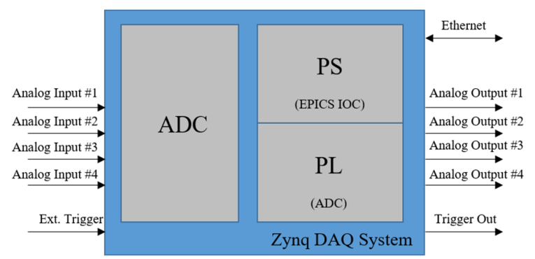
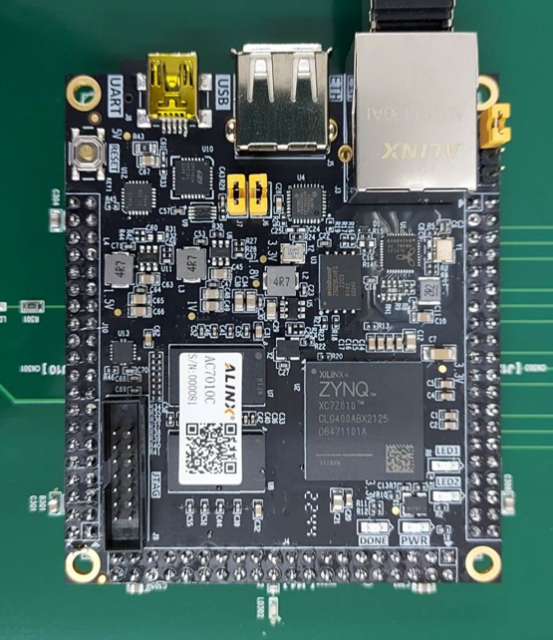
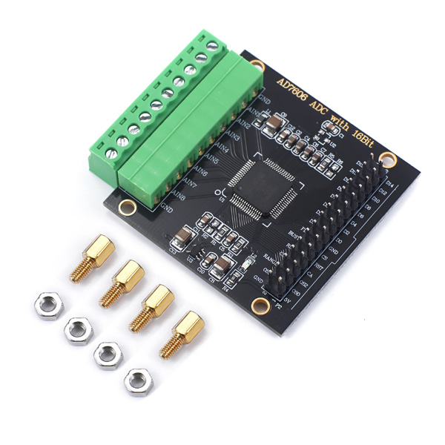
DAQ Components
Xilinx Zynq SoC (System on Chip)
PS(Process System)
Linux OS
Build and run EPICS IOC
Communicates over Ethernet using Channel Access
PL(Programmable Logic)
Logic gate area (AND, OR, NOT)
Connects to the ADC and stores snapshot in BRAM
AXI4 communication
Communication protocol between PL and PS
ADC(Analog to Digital Conver)
Converts the BCM current signal to samples
AXI4
ADC Module
Xilinx Zynq
ADC Module

Slide 11
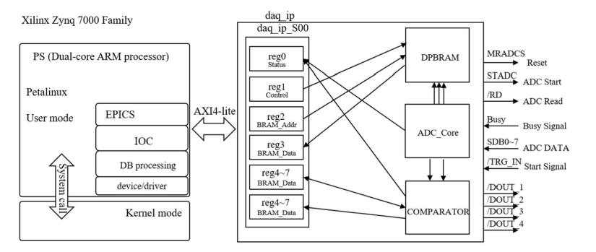
Design of DAQ Sequence
1. The PL continuously samples the ADC.
2. On an external trigger, the PL stores 1.3 ms sequentially in BRAM (buffer)
3. When the required count is reached, the PL asserts an interrupt
4. Interrupt signal is delivered to the PS (kernel)
5. The EPICS IOC reads BRAM and creates a waveform for PV

Slide 12
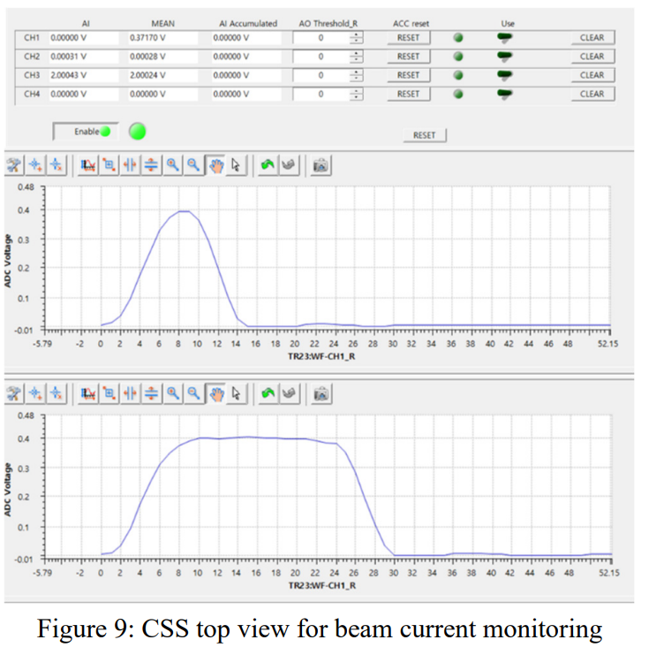
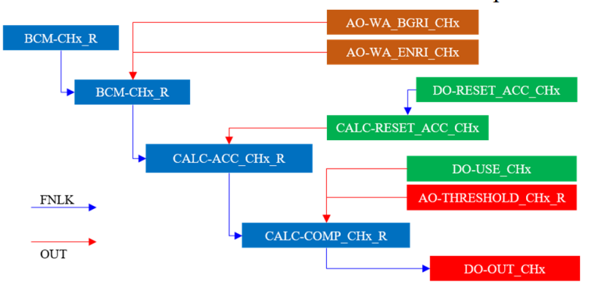
EPICS IOC
Xilinx petalinux compiler (EPICS)
Record chain
Record for 4 ADC channels waveform PV
Accumulation the data
Compared with the threshold value
Action output to hardware
Operation view
Beam current monitoring via CSS

Slide 13
QnA

