Slide 1
Group meeting
2025/09/26
장원

Slide 2
Content
Review - Issue for sapphire crystal
Choose material for target range
Experimental set up
Expected result

Slide 3
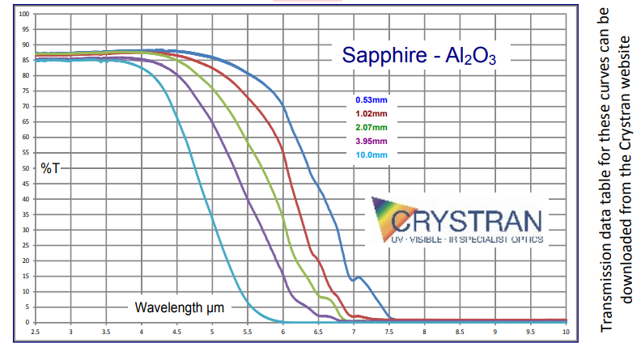
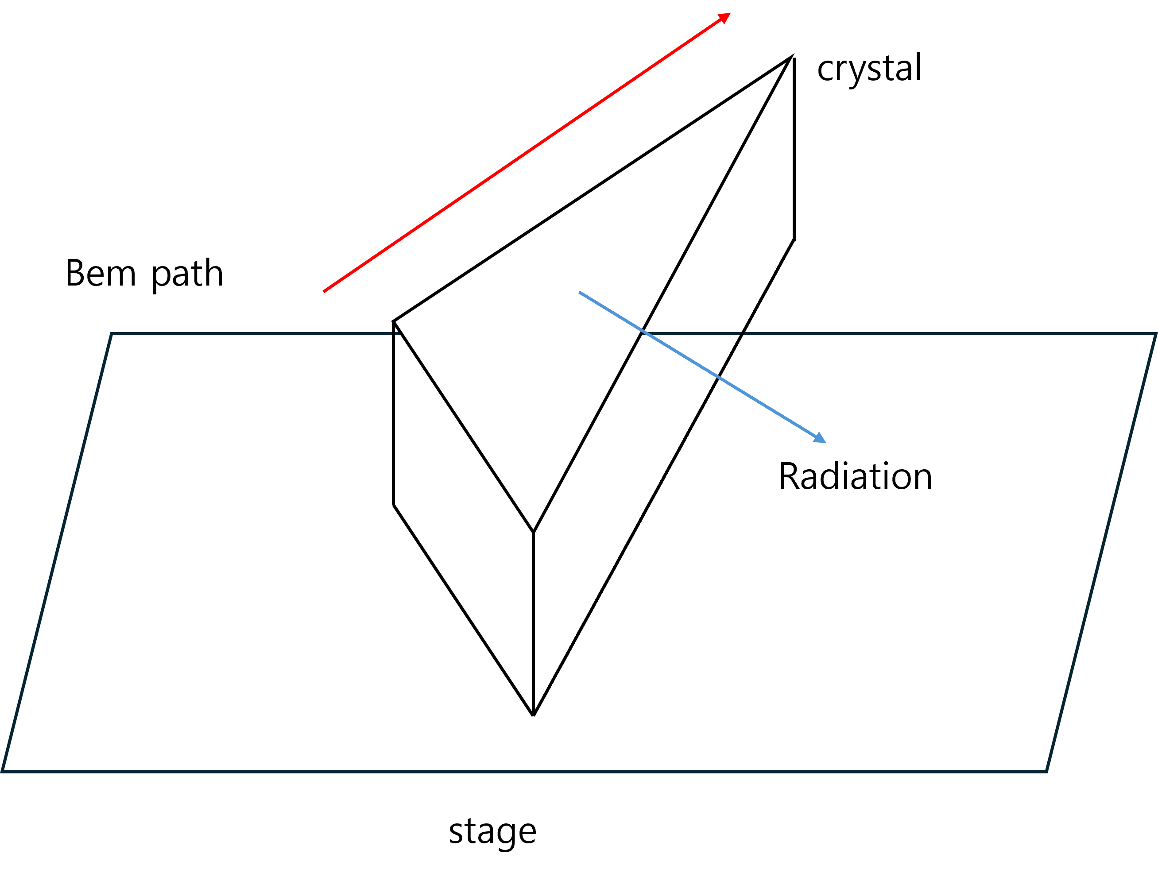
Review-Transmission coefficient issue for Sapphire
  20 THz ~ 80 THz
  15um ~ 3.75um
  https://www.crystran.com/optical-materials/sapphire-al2o3
Radiation intensity can be affected by the crystal properties depending on the wavelength.(It may not be detected at all.)

Slide 4
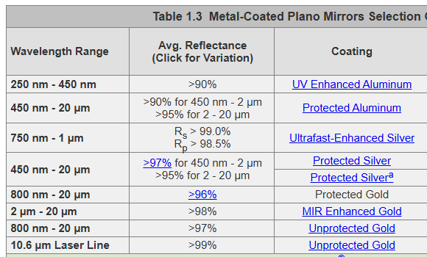
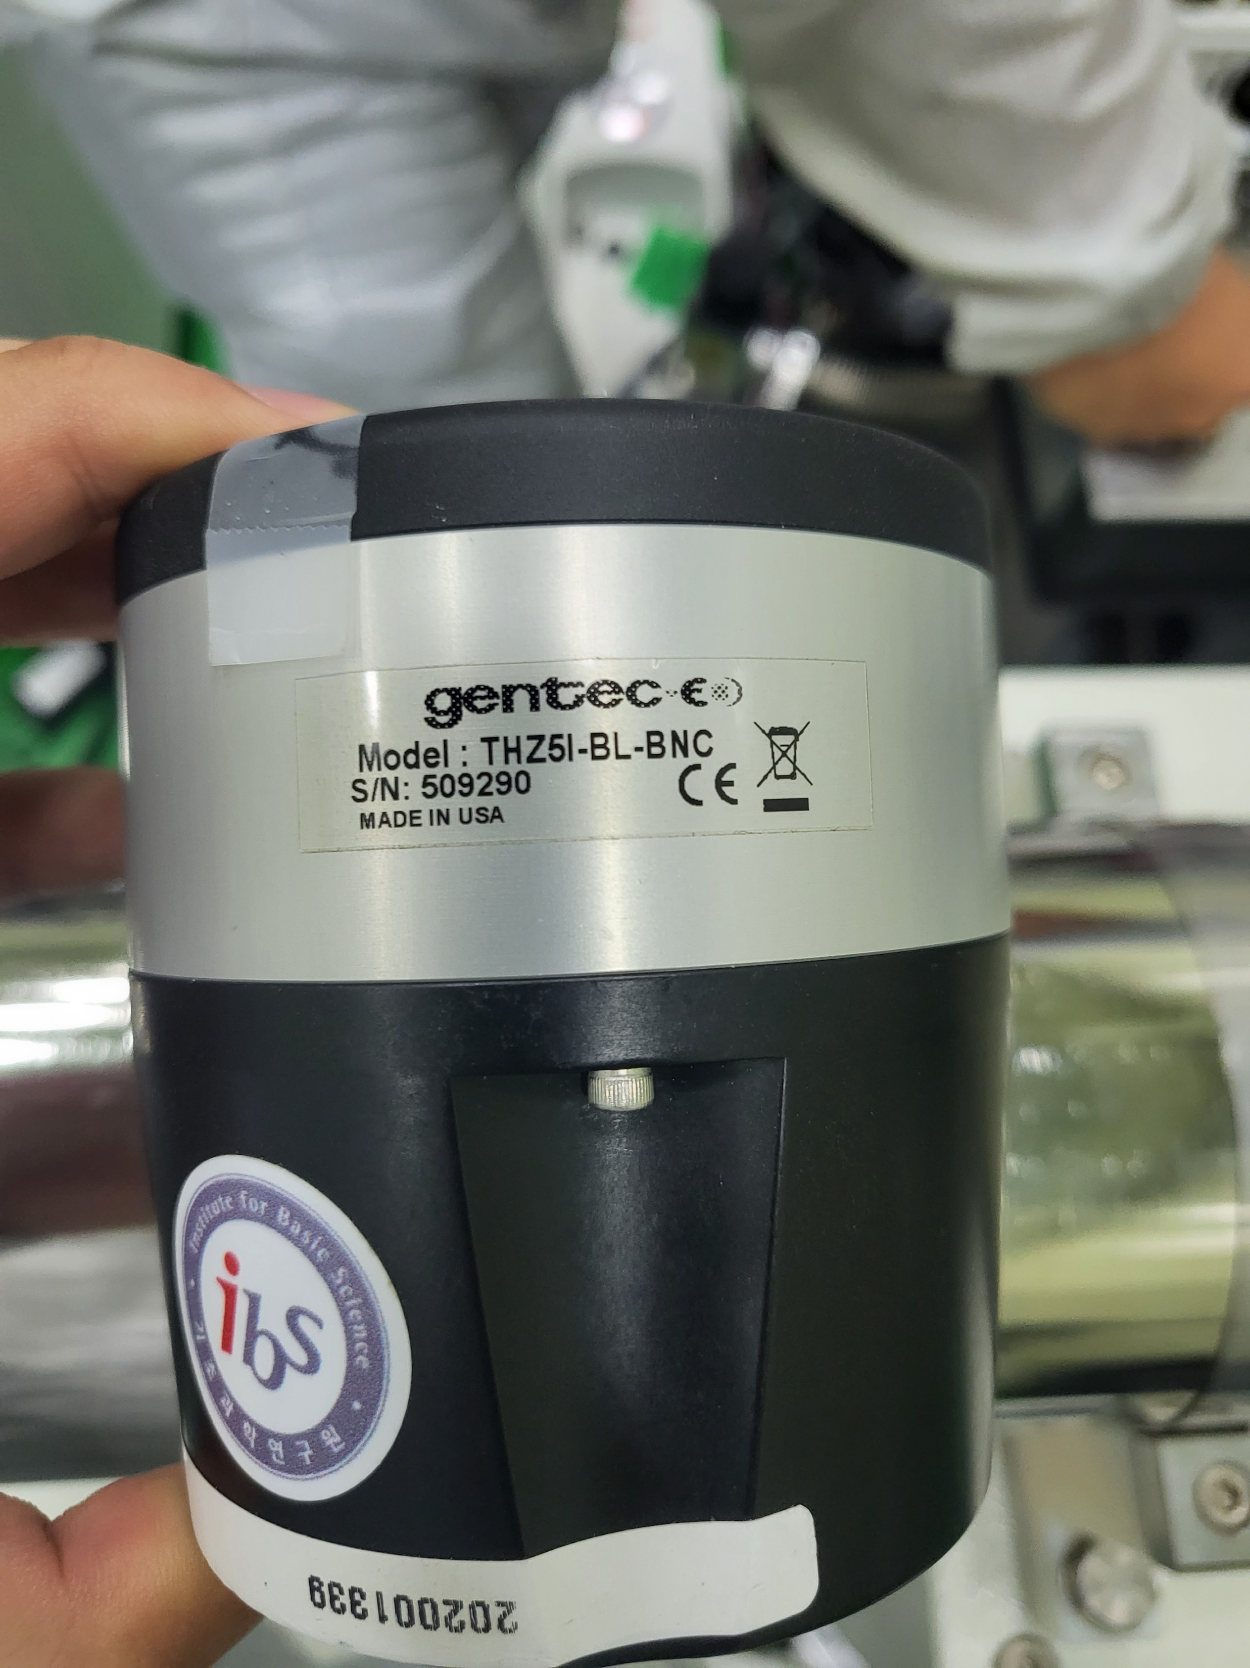
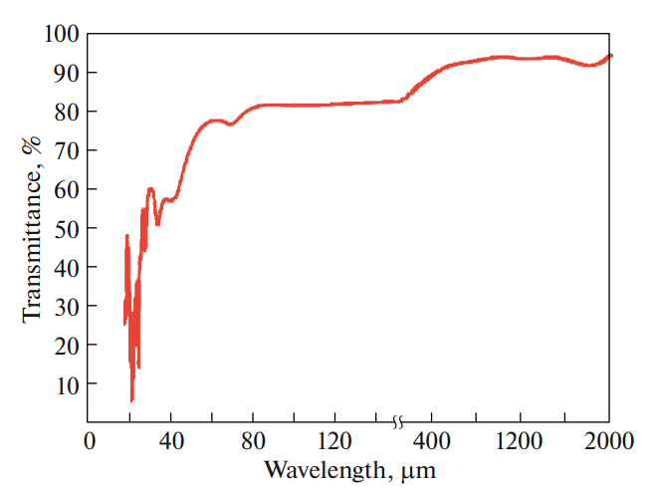
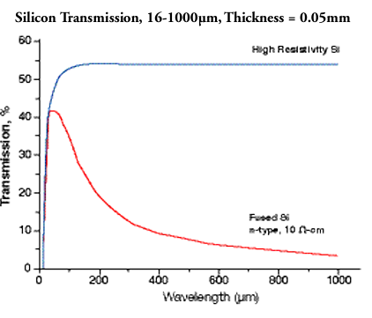
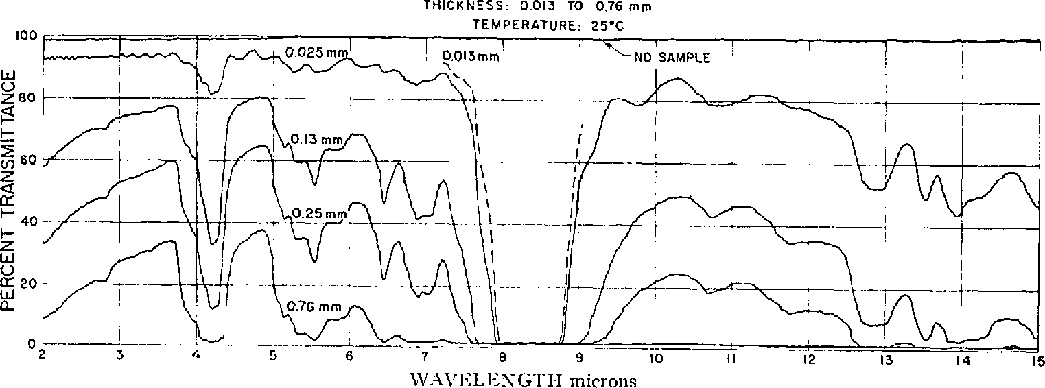
Gold mirror
THz detector
Target: 0.1 – 30 THz (=3000 – 10 um)
THz material option:
– TPX (>30 THz), HRFZ-Si, ZnSe, PTFE (< 20 THz)
TPX (polymethylpentene)
High-resistivity float-zone Silicon (HRFZ-Si)
Polytetrafluoroethylene (PTFE)

Slide 5
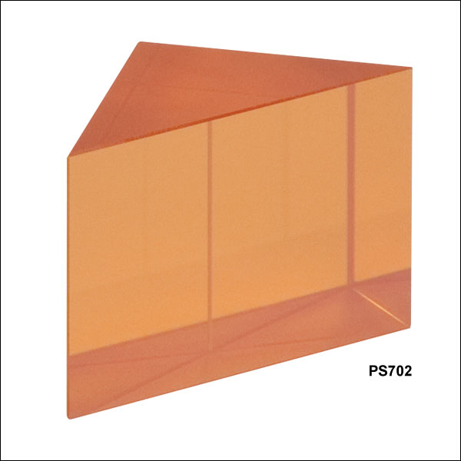
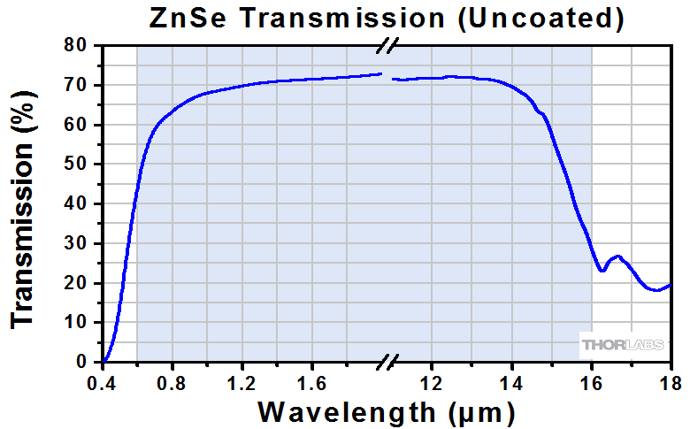

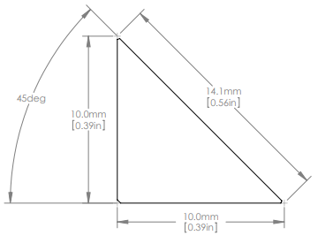
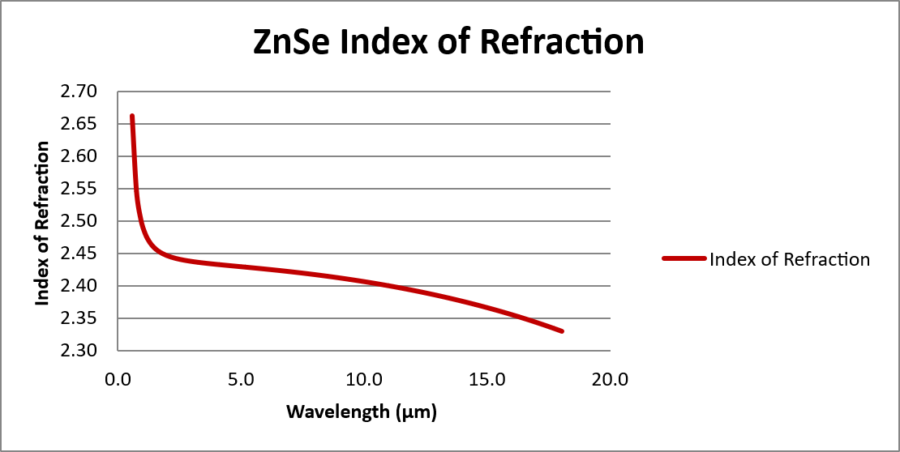
ZnSe Right-Angle Prism(600nm~16um)- Thorlabs

Slide 6
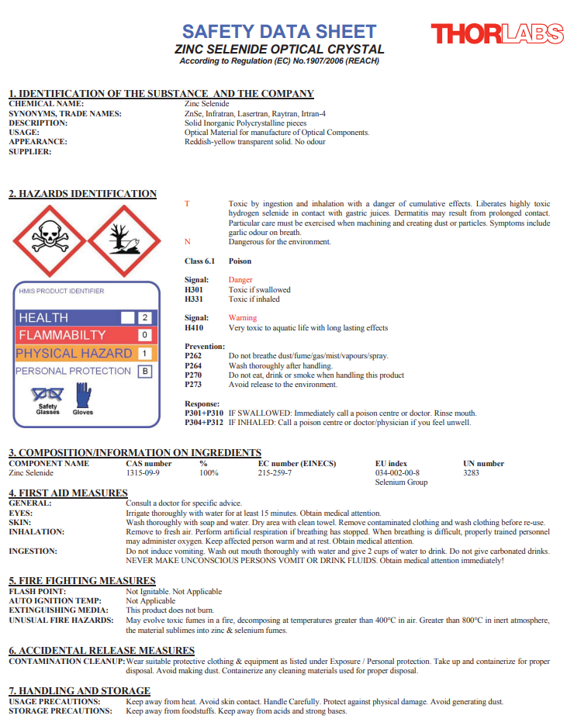
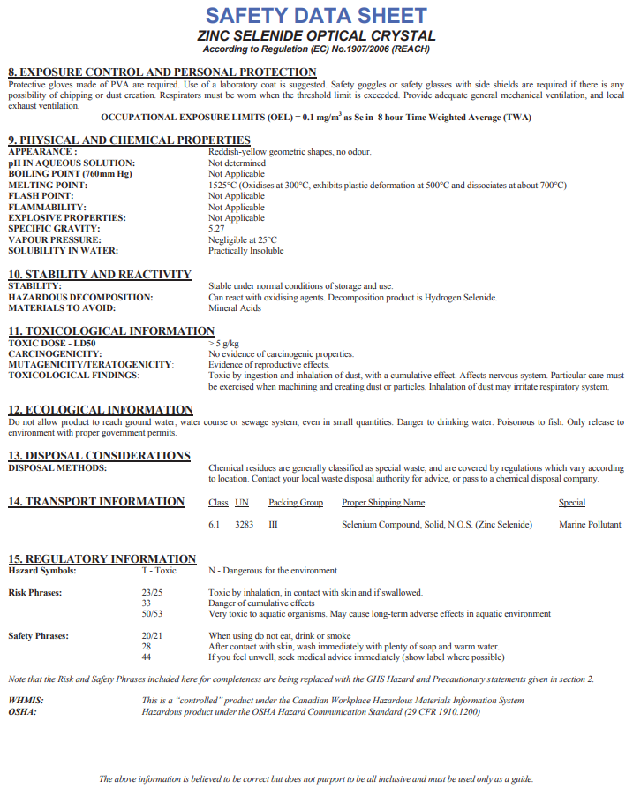

Slide 7
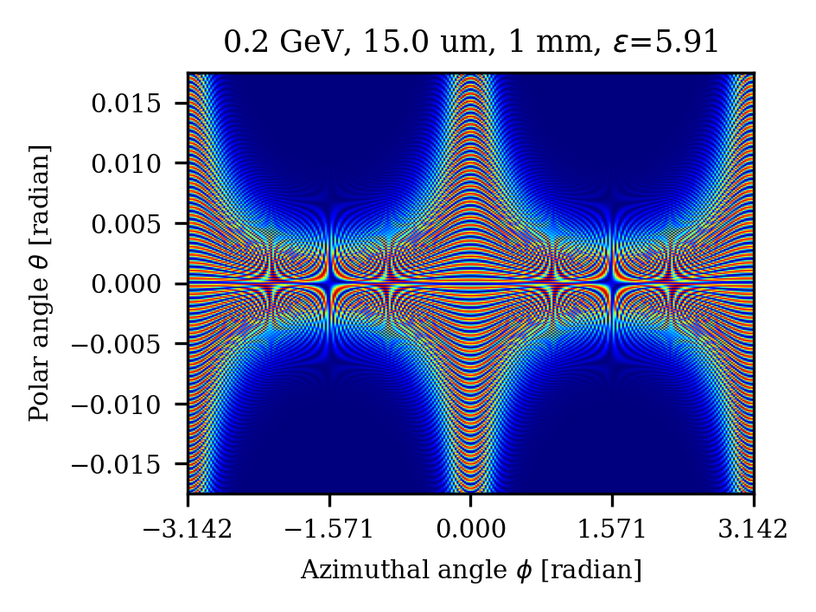
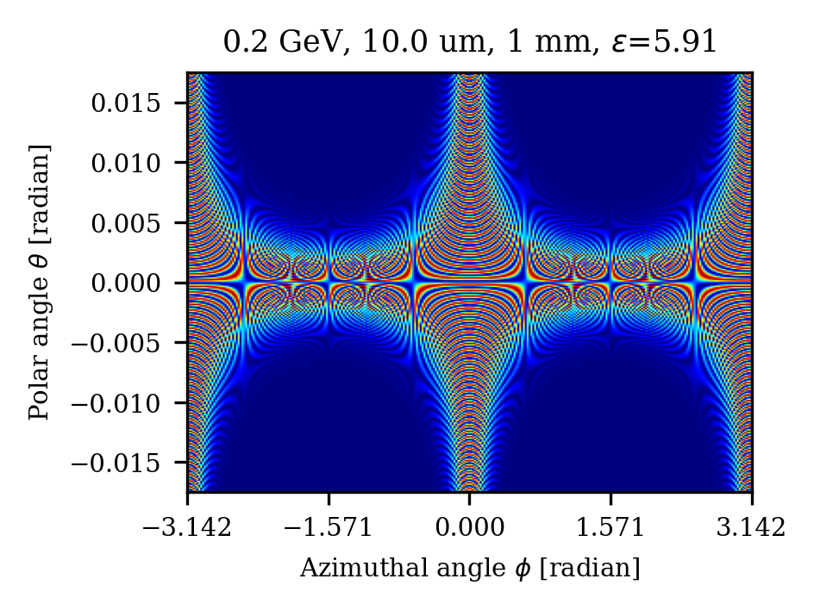


Divergence
$$ϕ$$
ZnSe기준, h=1 mm
$$θ$$
20 THz → 15 um
→ ~ 3 mrad
30 THz → 10 um
→ ~ 2 mrad

Slide 8
crystal
Bem path
Radiation
stage

Slide 9
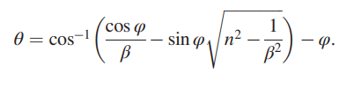
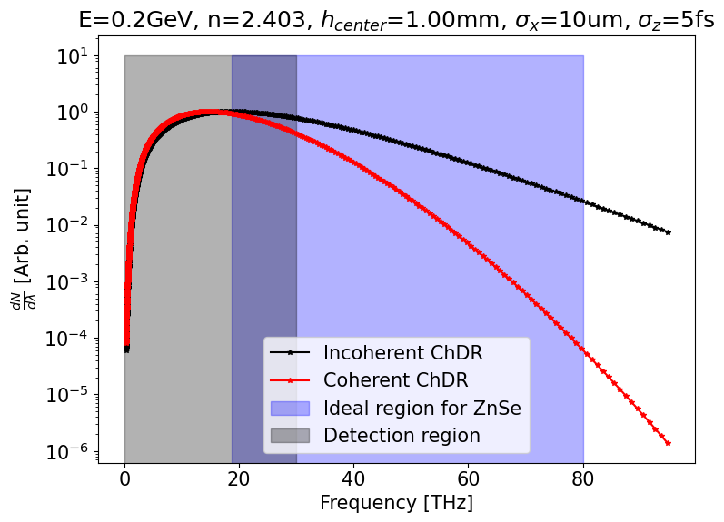
Detecting angle for Commercial product(ZnSe)
5-axis stage
Gold Mirror (4”)
Light path < 1 m (2~3 mm spread)
Detector
ChDR
By Snell’s law
2~3 mrad
Prism
e beam

Slide 10
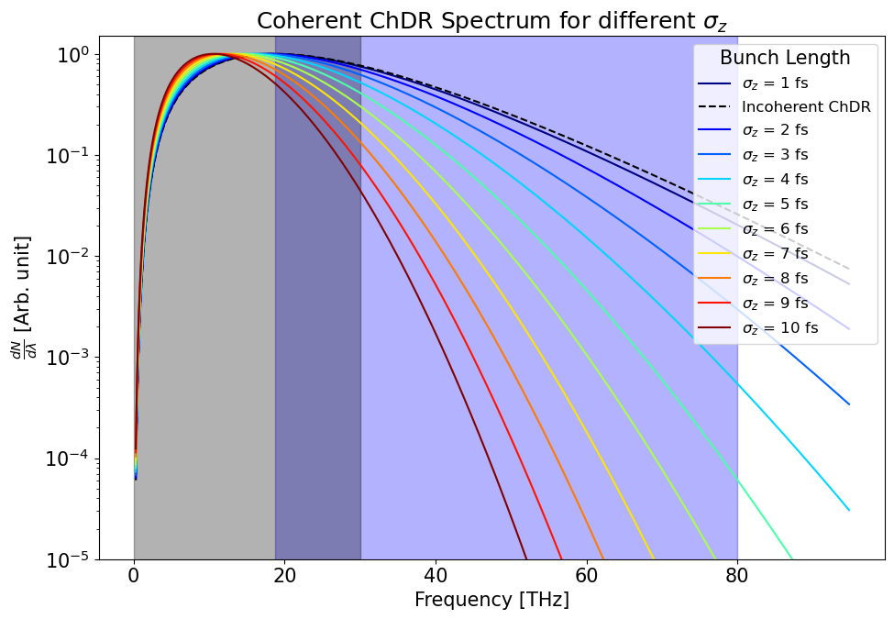
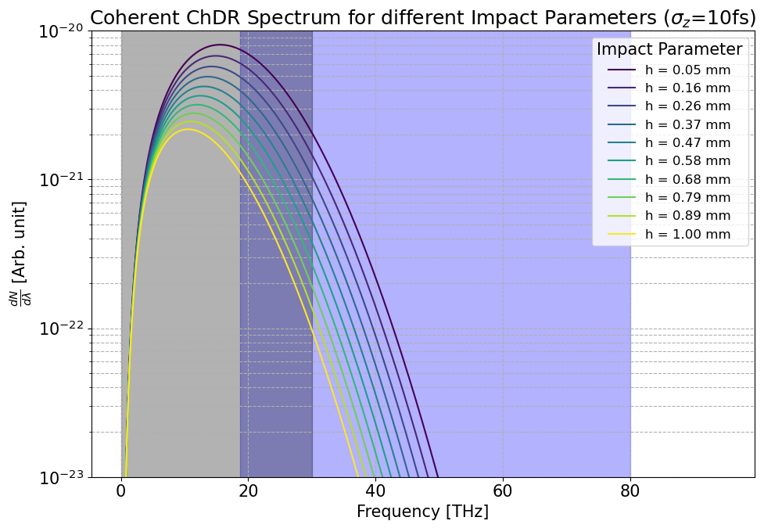
It's slightly off from the peak.
The peak position shifts to a lower frequency for shorter bunch lengths.

Slide 11
Result
ZnSe exhibits a relatively constant transmission rate and refractive index over a region that significantly overlaps with the target range.
Choose material for target range
Modify the setup by moving the gold mirror instead of the radiator.
As the peak region lies slightly outside the detecting region, it remains uncertain whether the length can be reliably measured.
Because of it’s toxicity, it is advisable to obtain practical guidance from experienced users.

