Slide 1
20250926 Group Meeting
Minseo Jeong

Slide 2
UED Experiment(with IBS)
Design of sample chamber for gas sample experiment
(with IBS)
Every required equipment will be stocked by early November

Slide 3
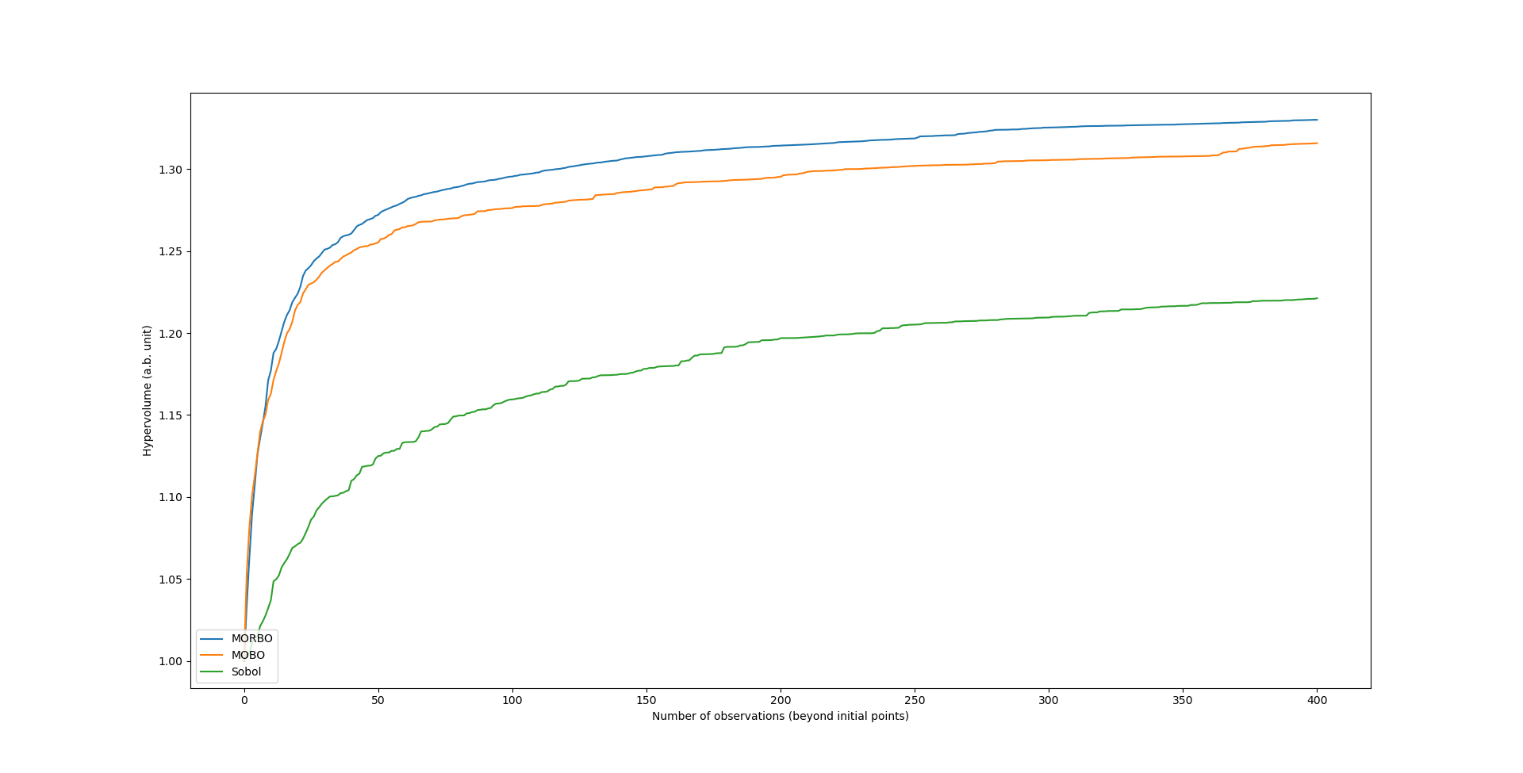
UED Optimization
UED optimization via GPT simulator
- It takes three times shorter time than optimization via ASTRA

Slide 4
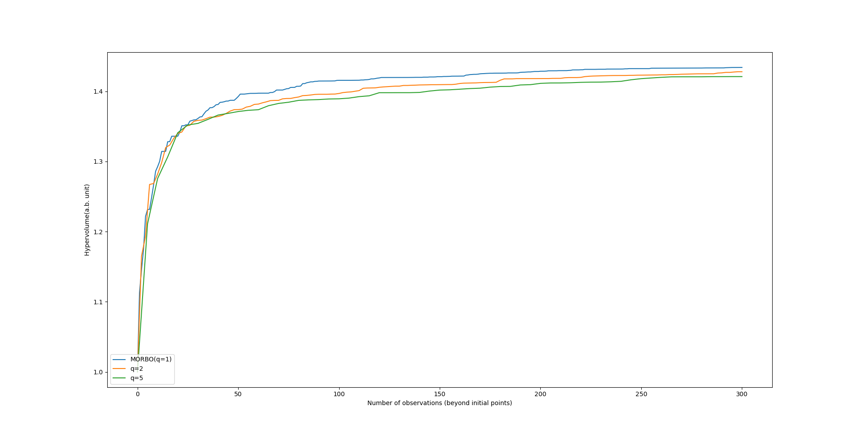
UED Optimization
Batch-mode(the mode which selects multiple solutions concurrently)
Batch-mode took more time for optimization(>10s) than single mode(2~5s)

Slide 5
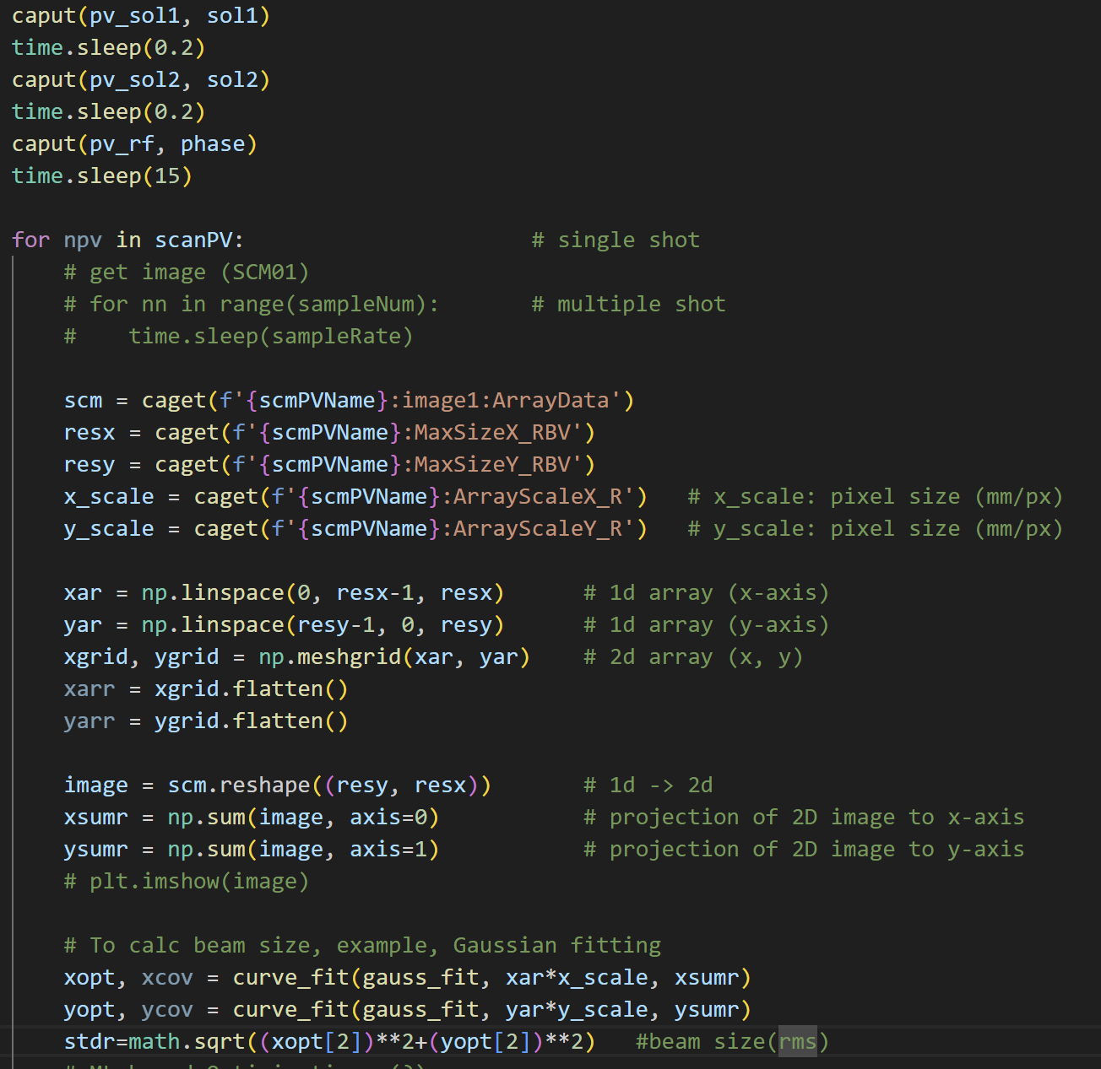
UED Optimization
Optimization of PAL-eLabs MeV-UED machine parameter by extracting data and putting value by EPICS

Slide 6
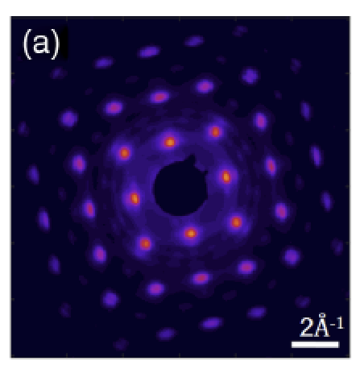
UED Optimization(Planned)
Measurement of q-resolution by fitting of diffraction pattern
Upper limit of q-resolution can be determined by measuring the width of peaks
F. Qi. et al. Phys. Rev. Lett. (2020)

Slide 7
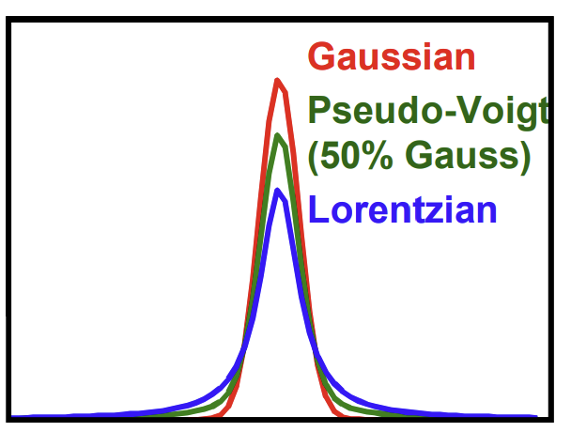
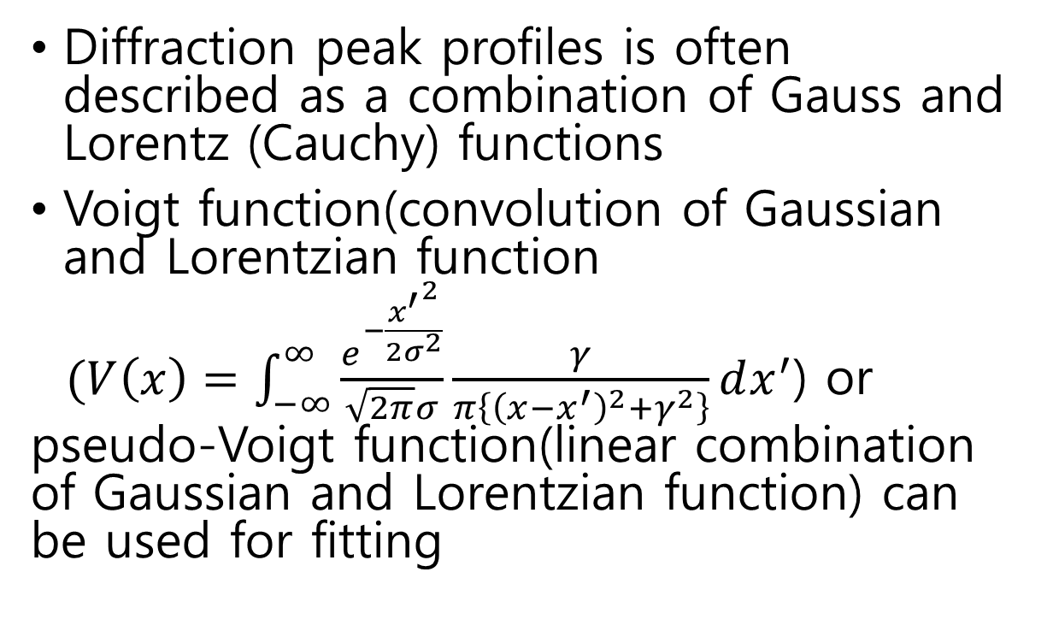
UED Optimization (Planned)
Diffraction peak profiles is often described as a combination of Gauss and Lorentz (Cauchy) functions
Voigt function(convolution of Gaussian and Lorentzian function
$(V\left(x\right)=\int_{−∞}^{∞}{\frac{e^{−\frac{{x^{′}}^{2}}{2σ^{2}}}}{\sqrt{2π}σ}\frac{γ}{π\left\{{\left(x−x^{′}\right)}^{2}+γ^{2}\right\}}dx^{′}}$) or pseudo-Voigt function(linear combination of Gaussian and Lorentzian function) can be used for fitting

Slide 8
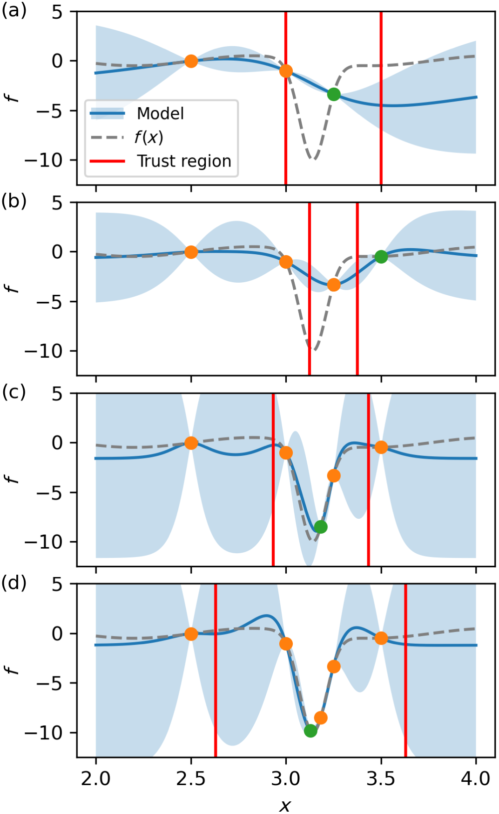
UED Optimization (Planned)
Multi-objective trust region optimization(MORBO) was used to reduce the number of iteration
Since there is only one trust region(TR), the Pareto front was unequally distributed compared to normal MOBO
R. Roussel et al. Phys. Rev. Accel. Beams 27. (2024).

Slide 9
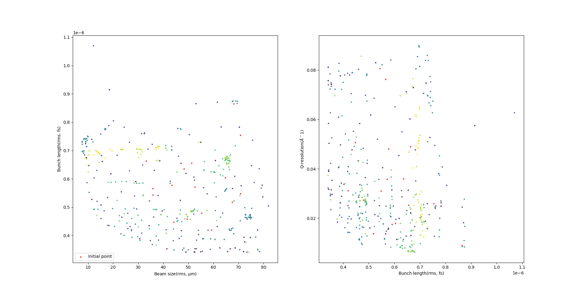
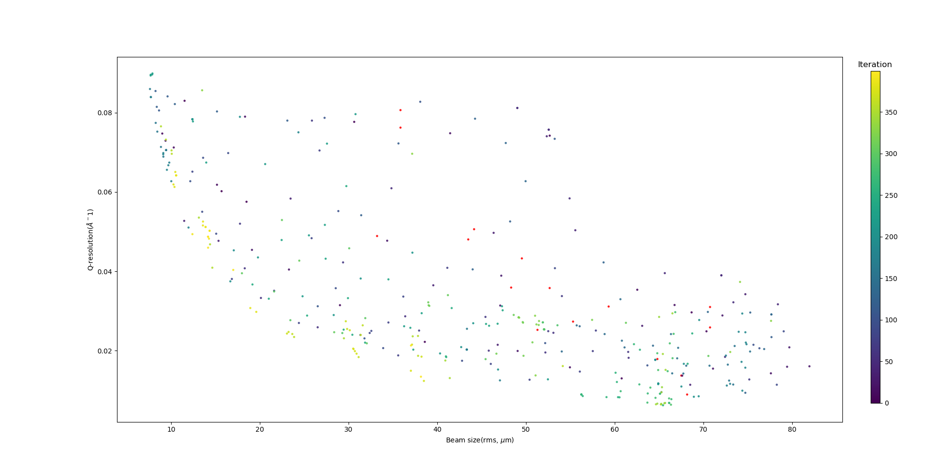
UED Optimization (Planned)

Slide 10
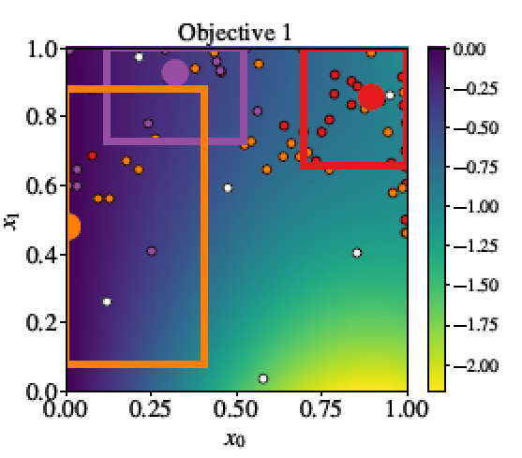
UED Optimization (Planned)
To solve this problem, another TR whose center is not included in the other TR will be introduced
To improve the efficiency, the center of a trust region when it was terminated due to the edge length being too small will be excluded as a candidate for next center of TR

Slide 11
Future Plan
Optimization of PAL-eLabs UED machine parameters
- Measurement of q-resolution by fitting UED diffraction pattern
Participation of gas UED experiment (with IBS)

