Slide 1
Numerical study of LPS
25. 09. 26
Geunwoo Kim

Slide 2
Outline
Introduction
Tomographic Reconstruction of LPS
Results & Discussion
Summary & next plans

Slide 3
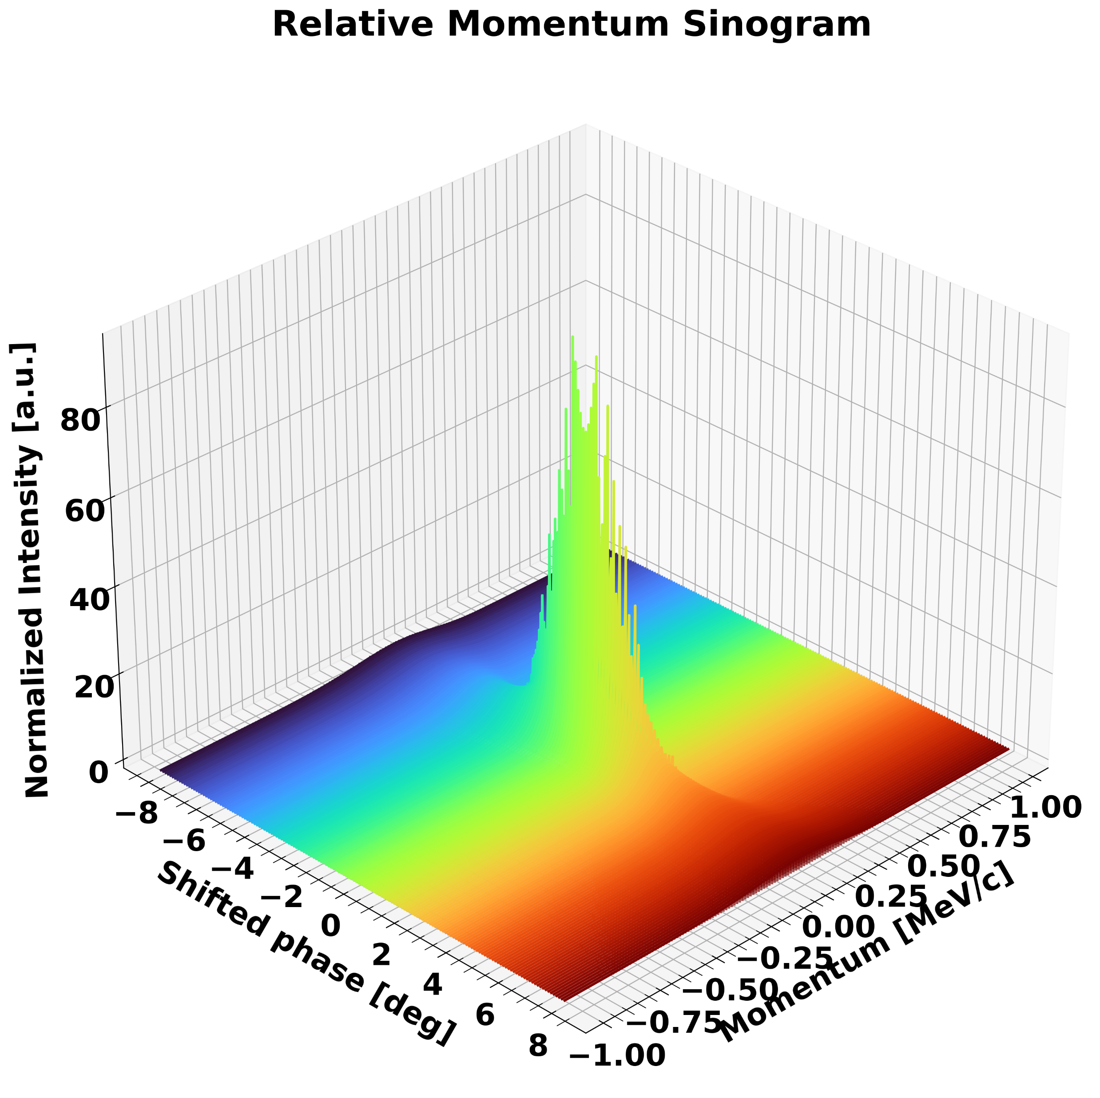
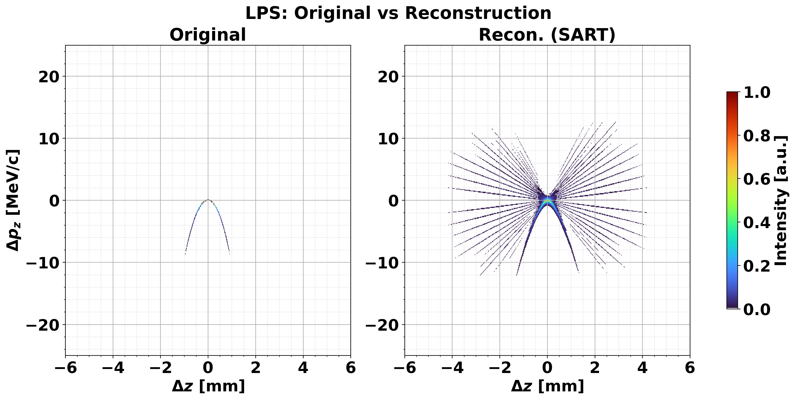
Drawback of previous results
Performed just single iteration for code verification.
No study about initial matrix dependency.

Slide 4
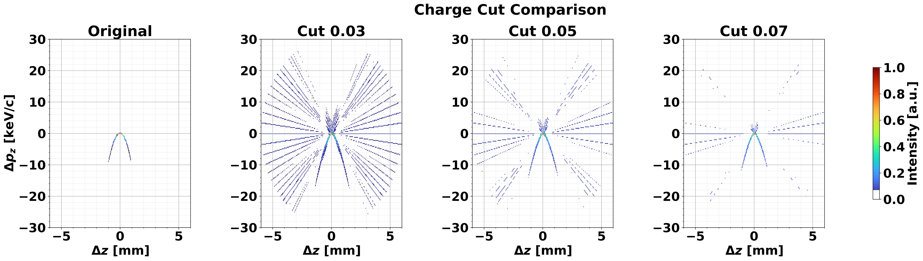
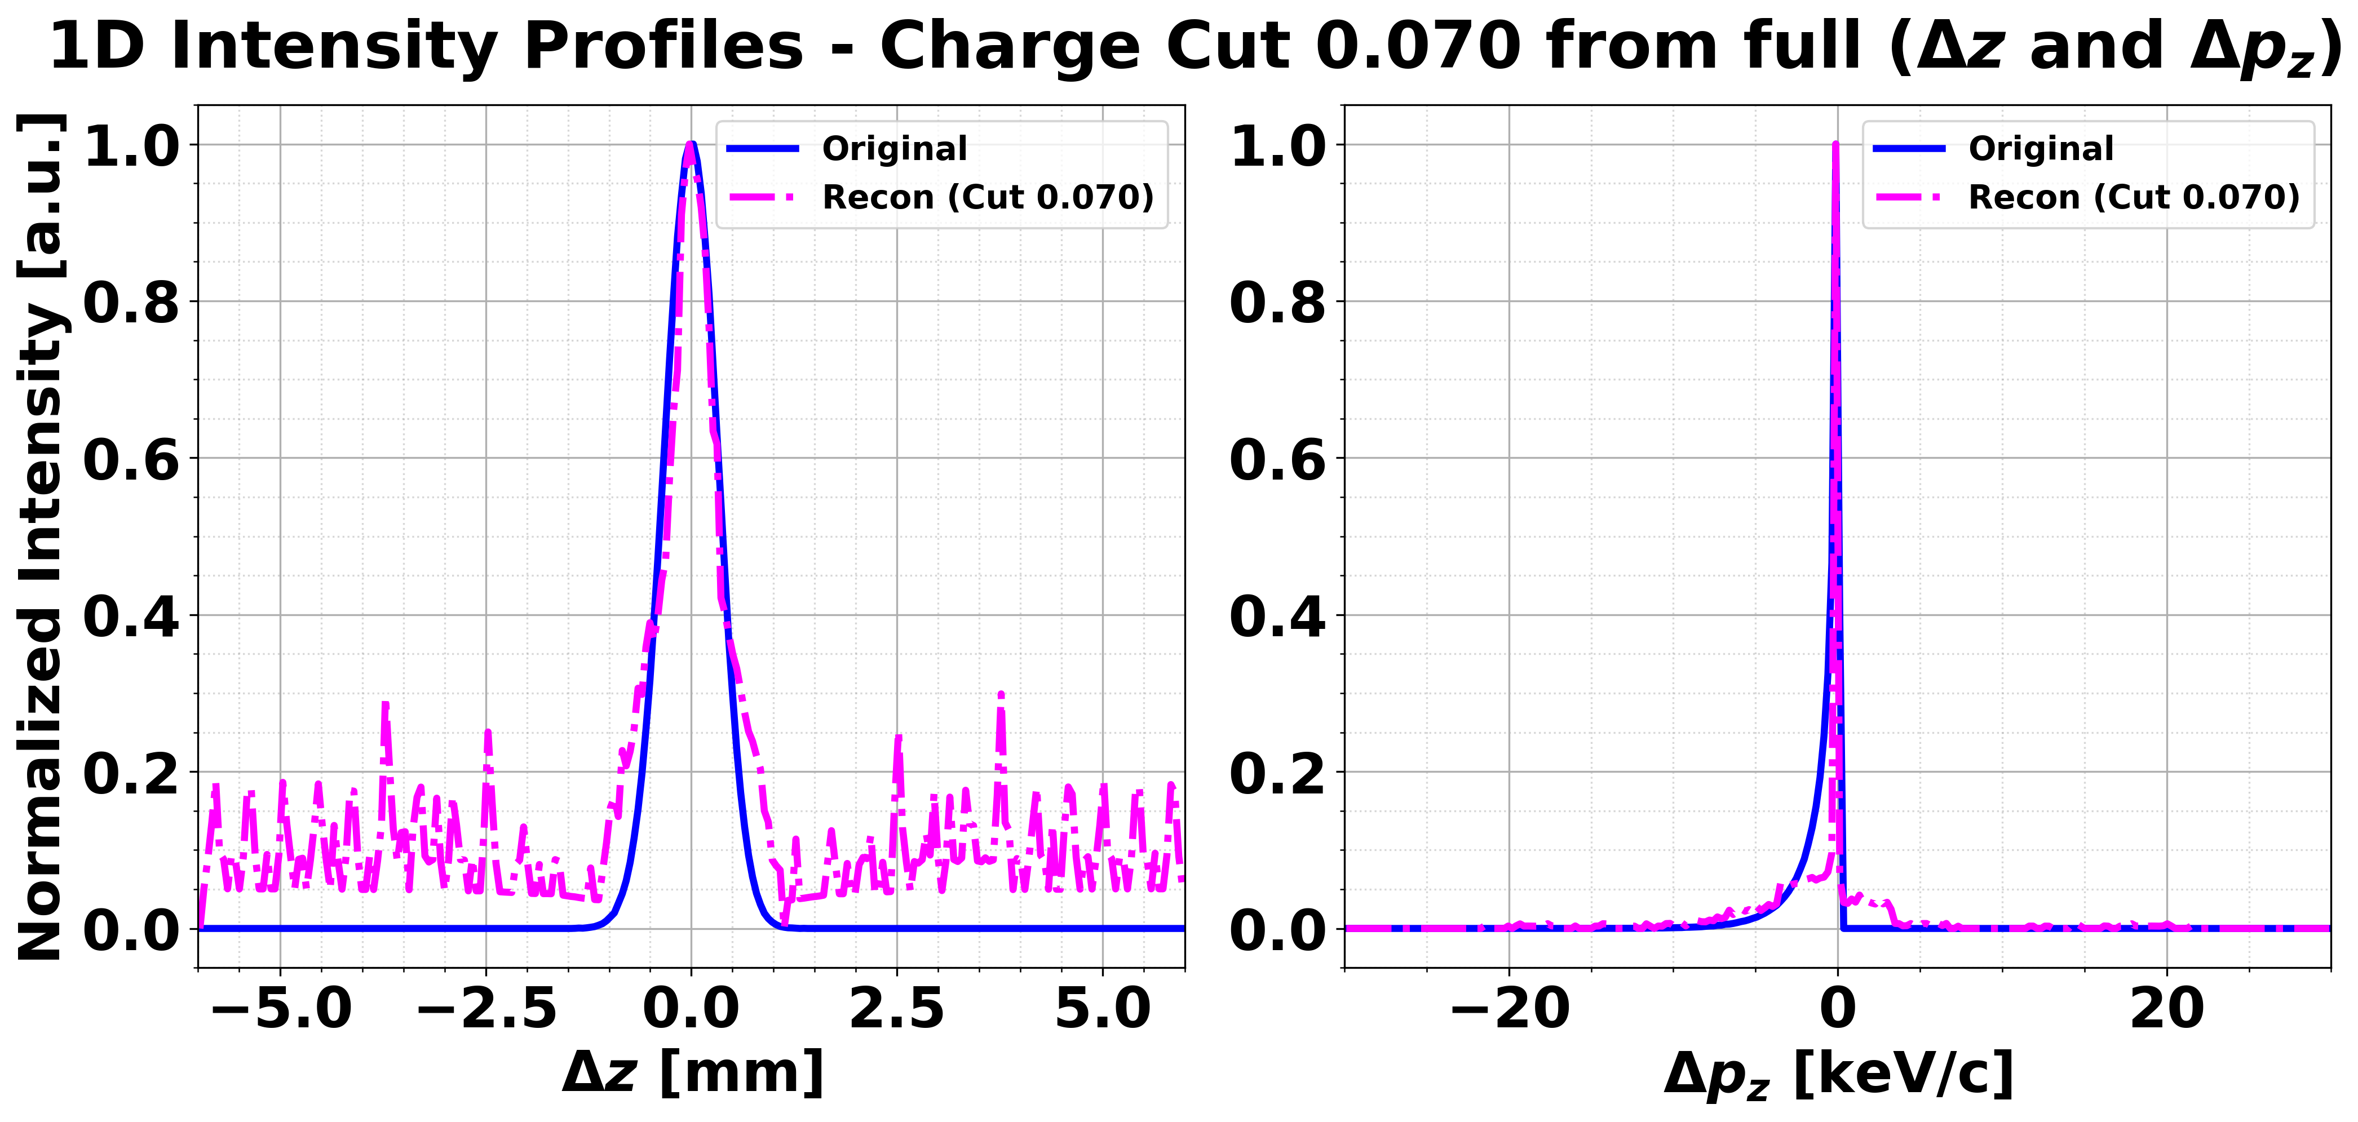
FBP results
45º
0º

Slide 5
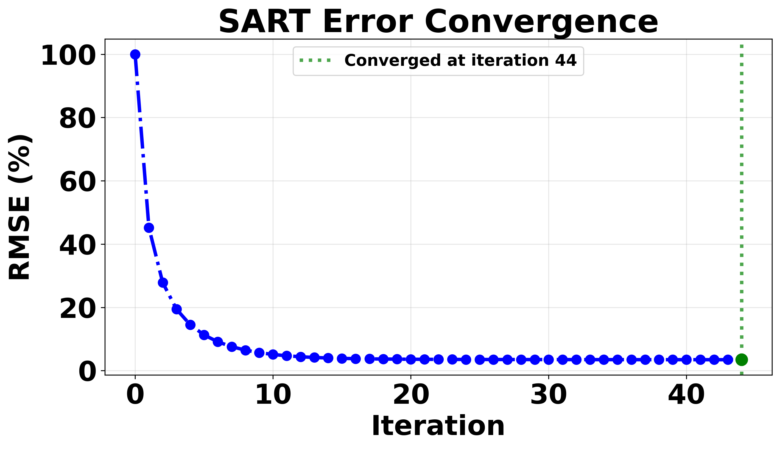
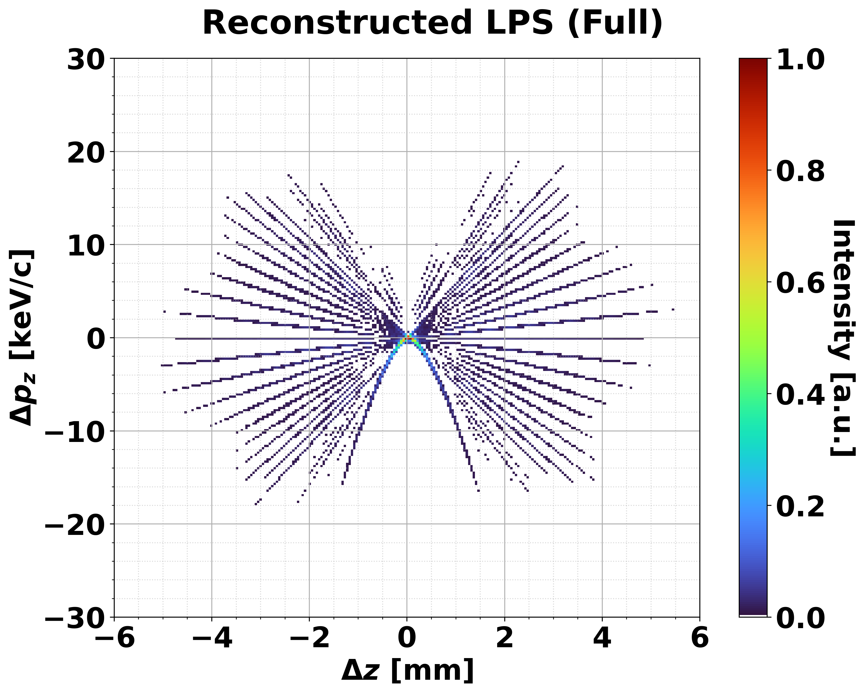
SART results: initial matrix as 0
Convergence condition: < 1e-3 (0.1 %)
Total 44 iteration
250 x 250 (momentum bins x longitudinal bins)

Slide 6
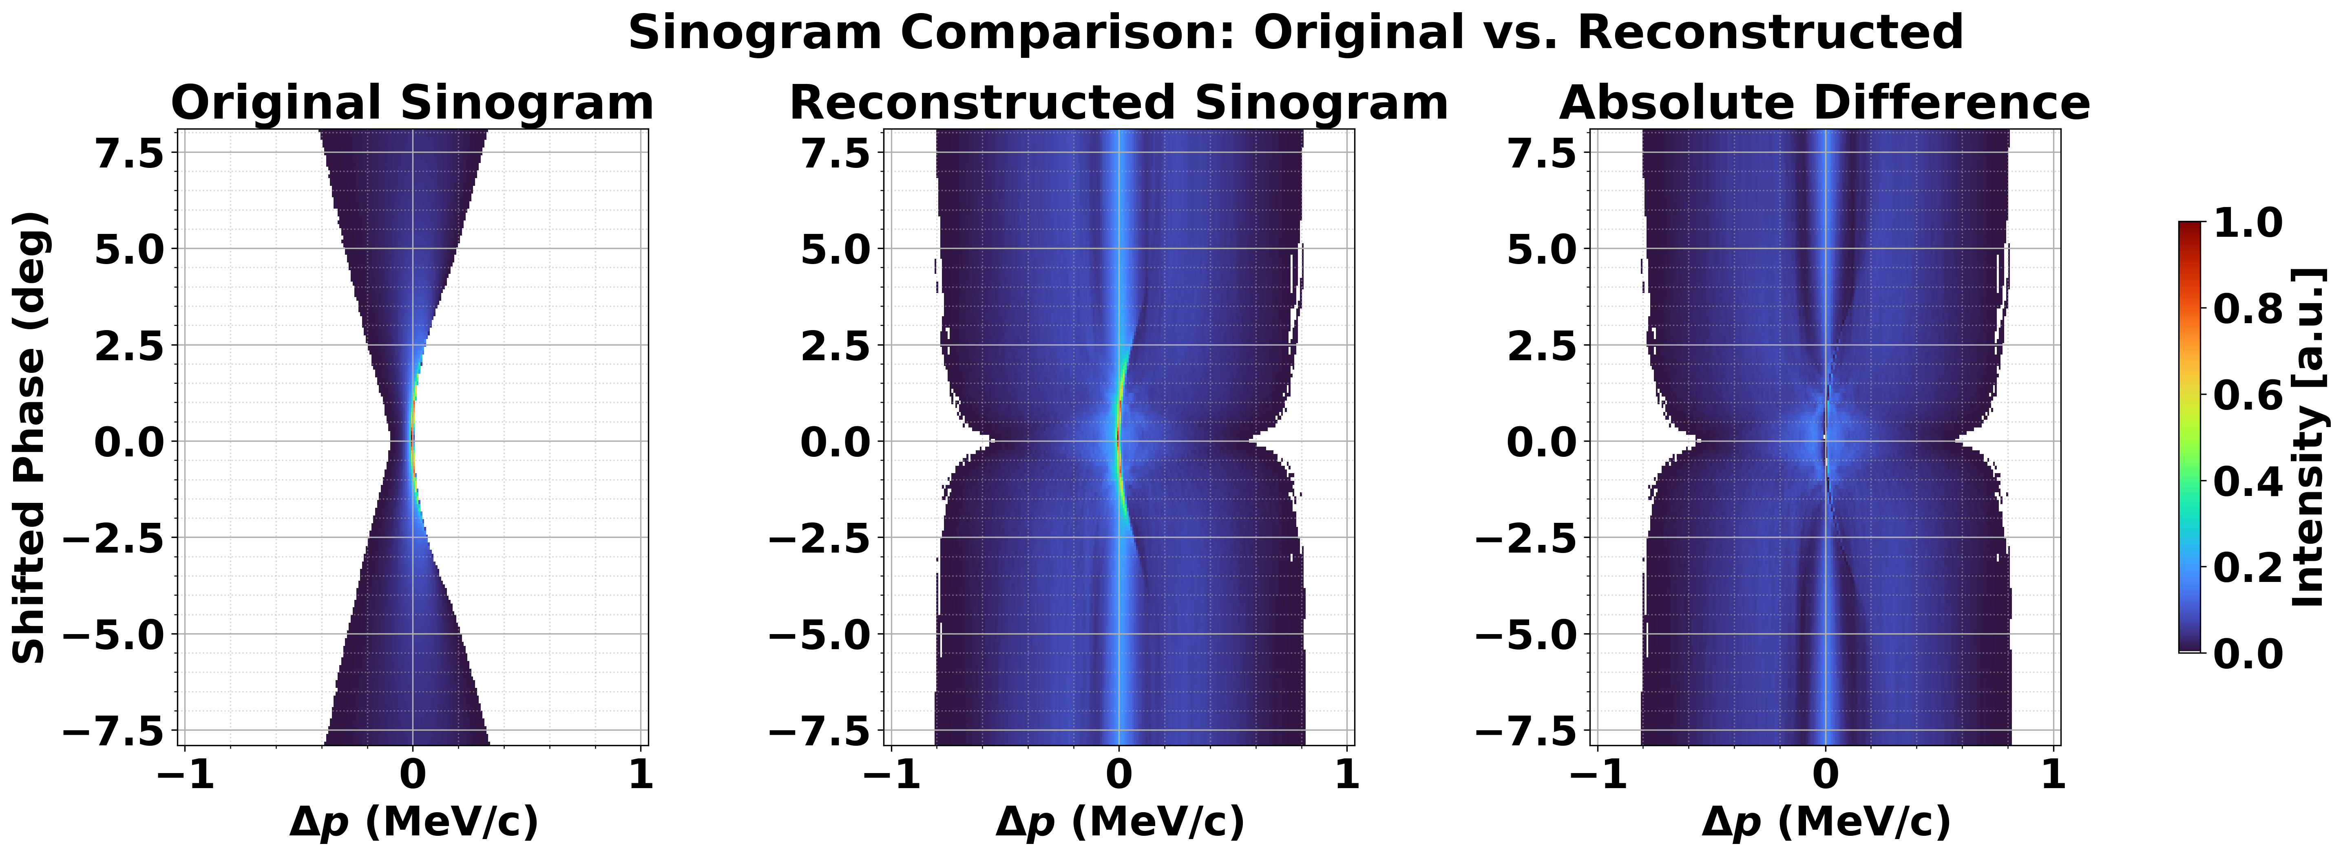
SART results: initial matrix as 0

Slide 7
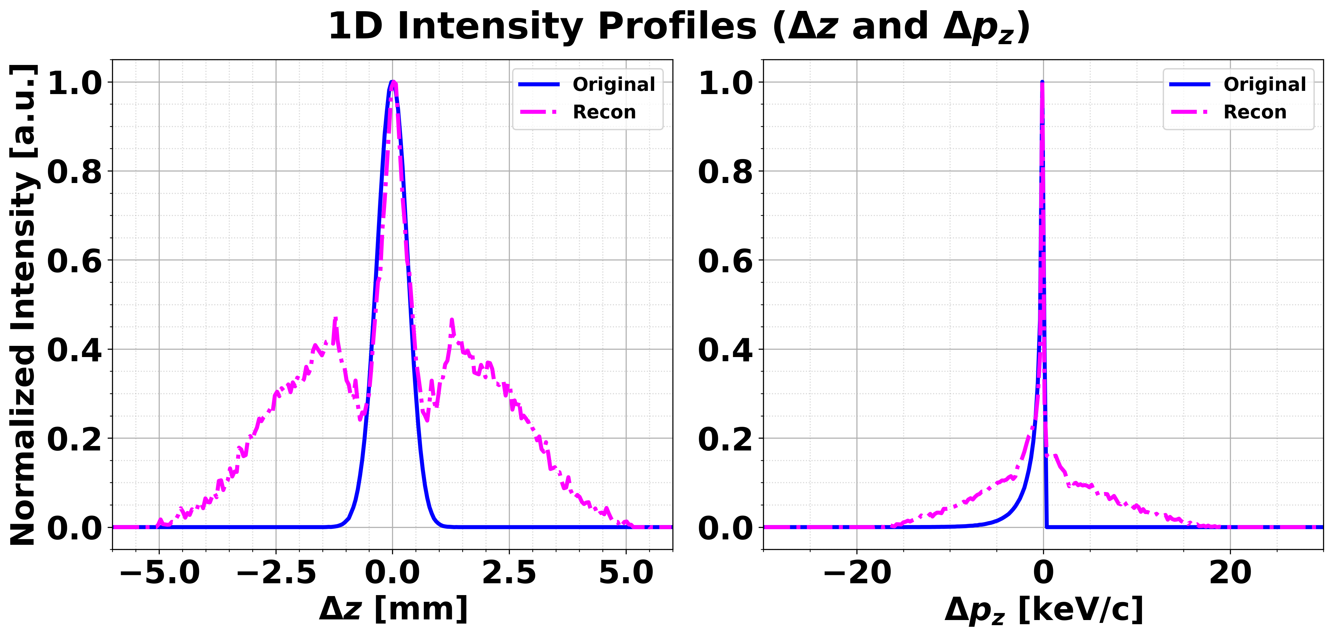
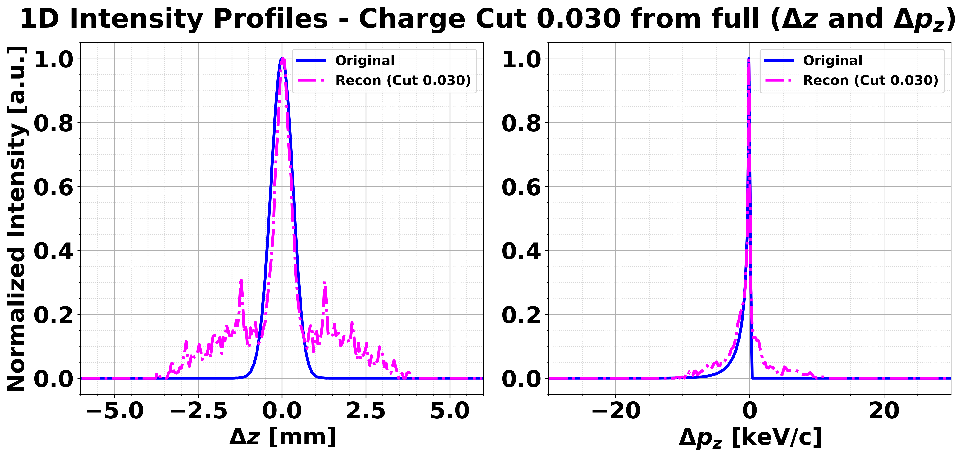
SART results: initial matrix as 0
Before charge cut
After 5% charge cut

Slide 8
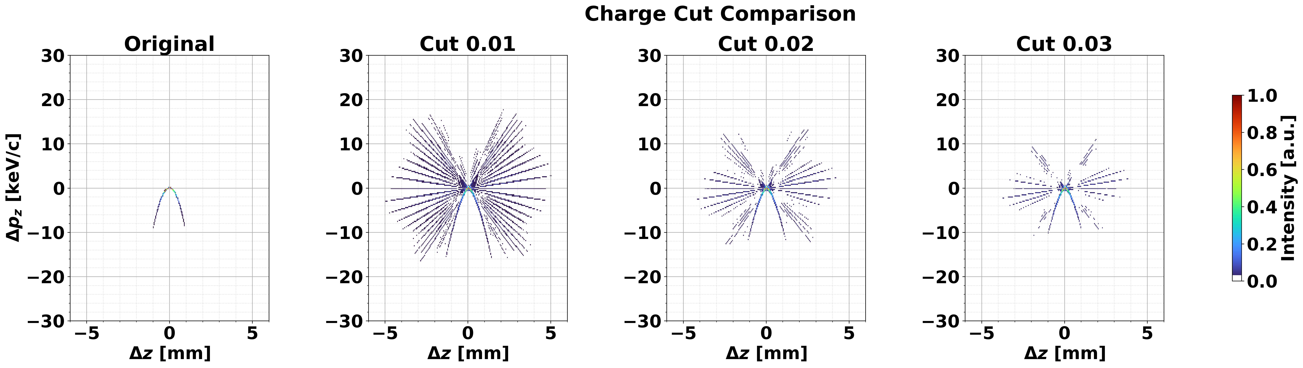
SART results: initial matrix as 0

Slide 9
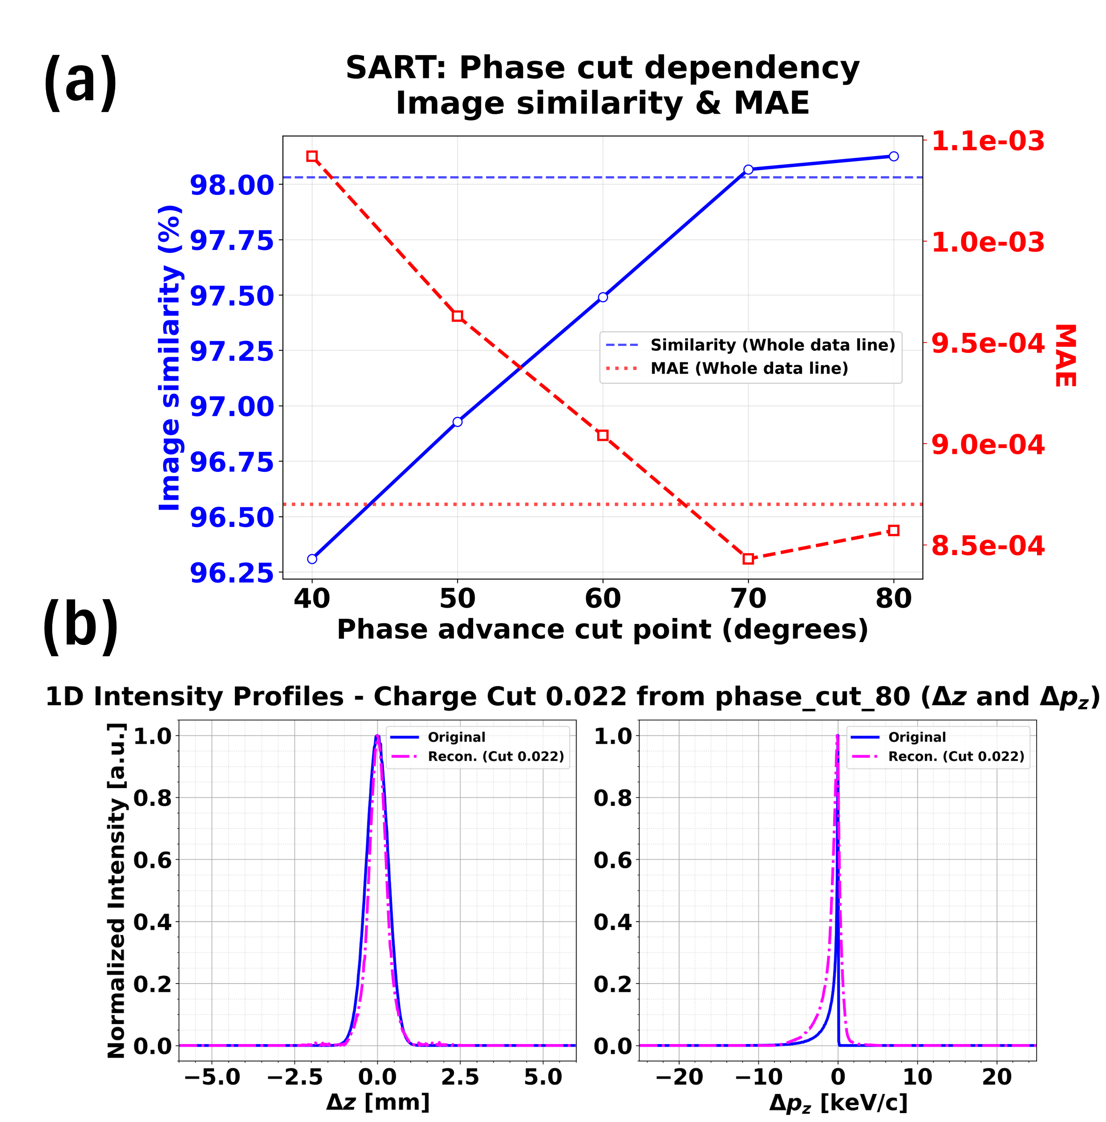
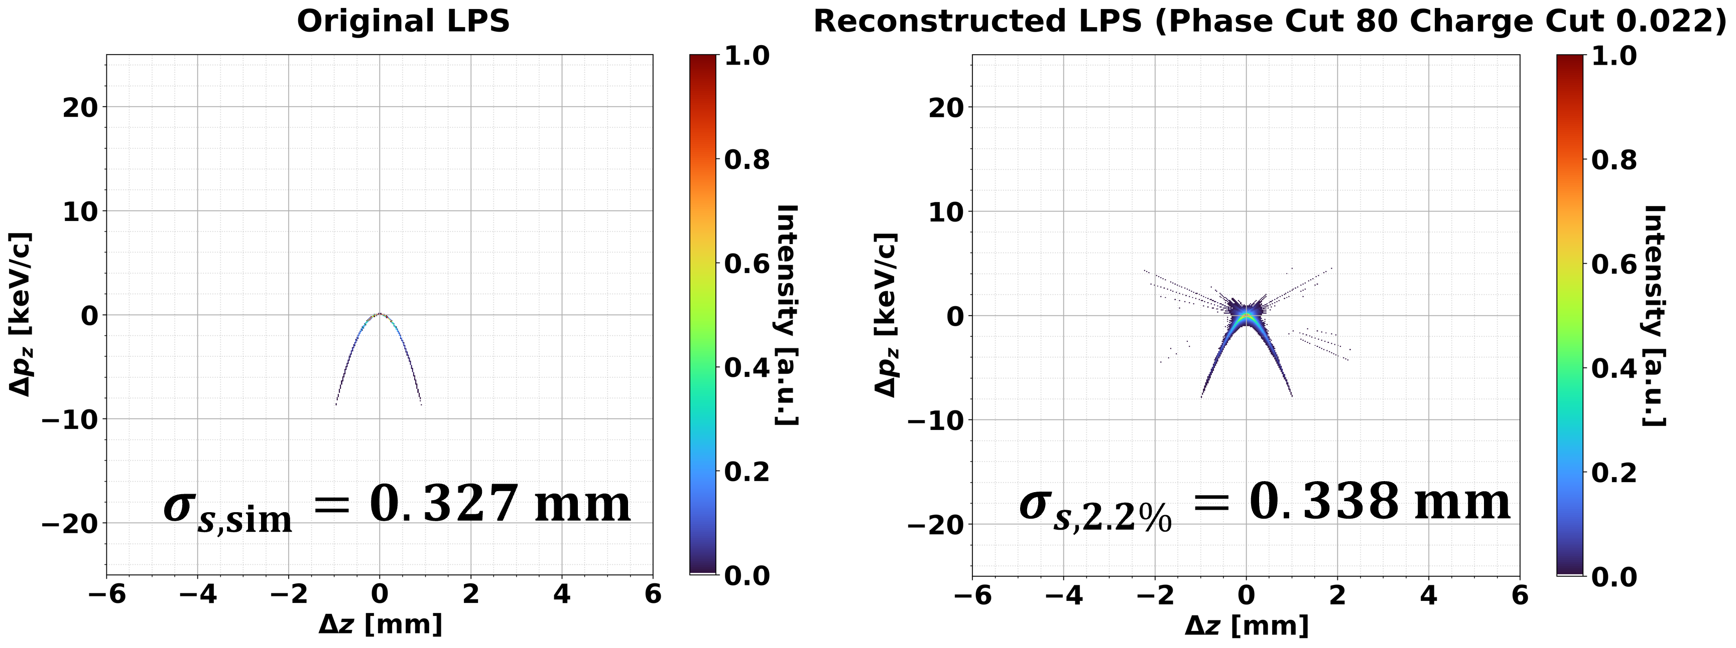
SART results: initial matrix as 0
Single iteration

Slide 10
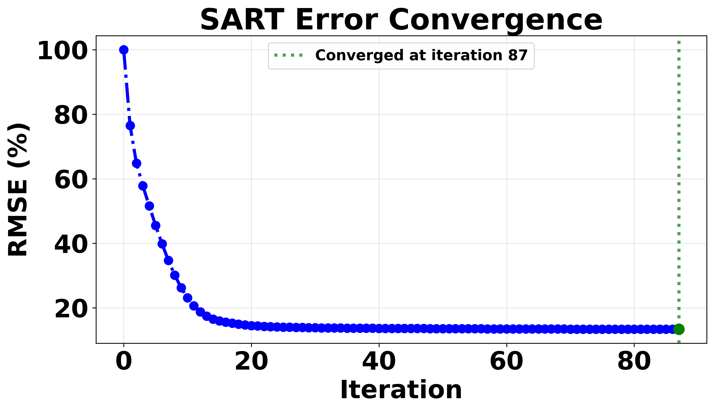
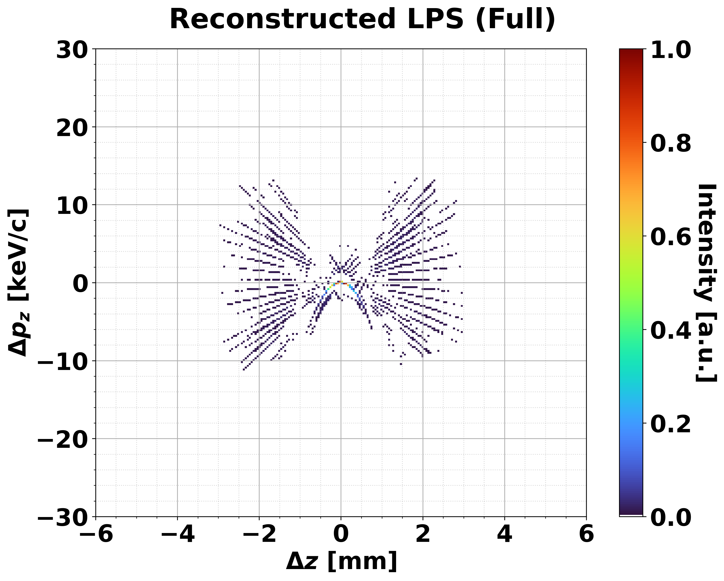
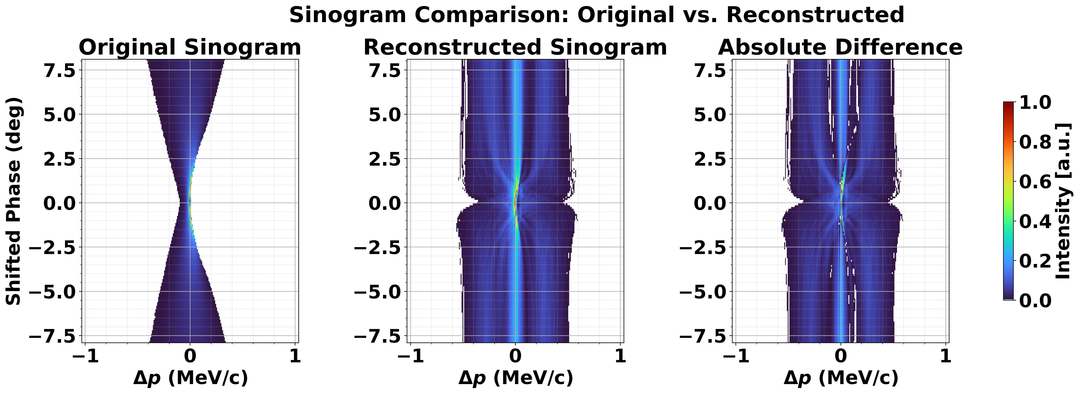
SART results: initial matrix as ground-truth
Total 87 iteration (↔ 47 iteration with 0 matrix).

Slide 11
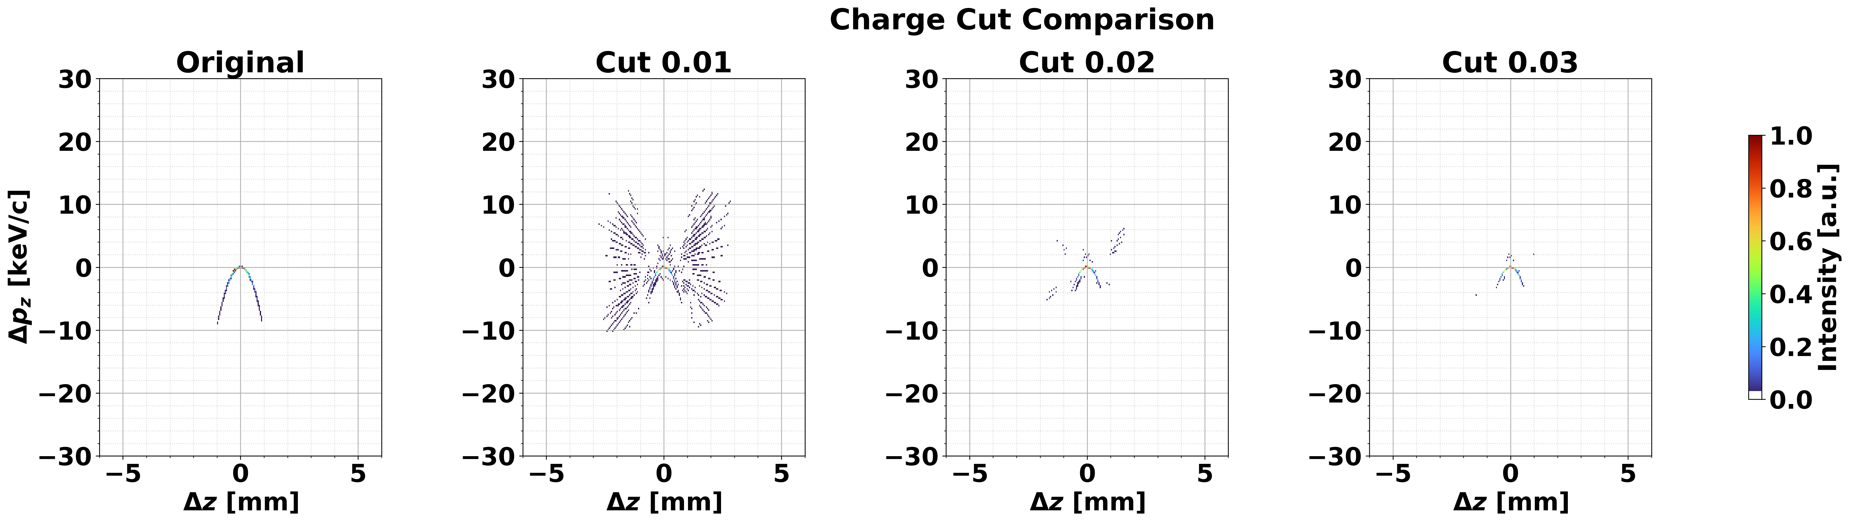
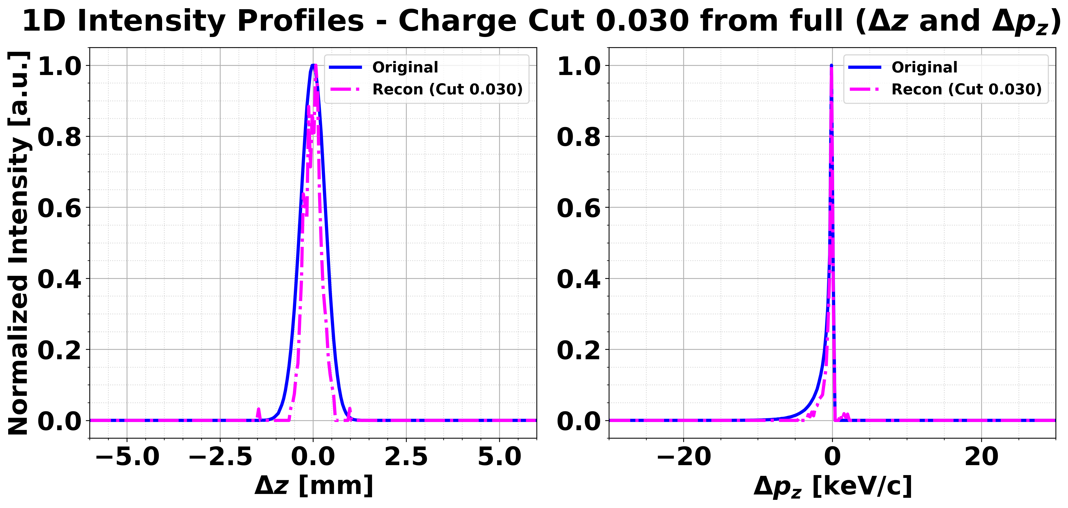
SART results: initial matrix as ground-truth
Overestimate longitudinal profiles lead to less accuracy.

Slide 12
SART results: initial matrix as ground-truth
Overestimate longitudinal profiles lead to less accuracy.

Slide 13
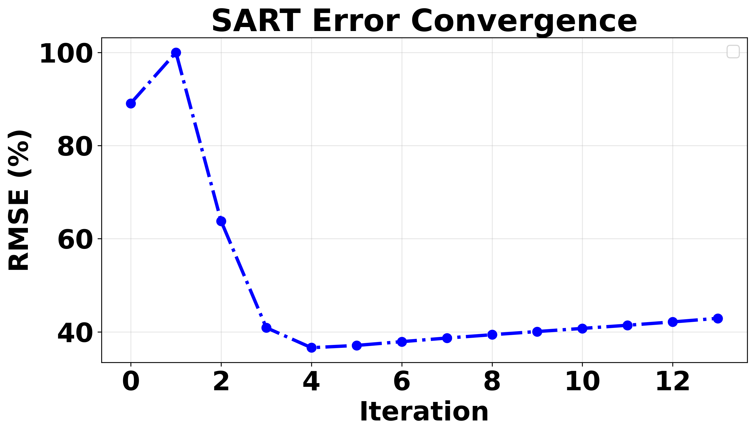
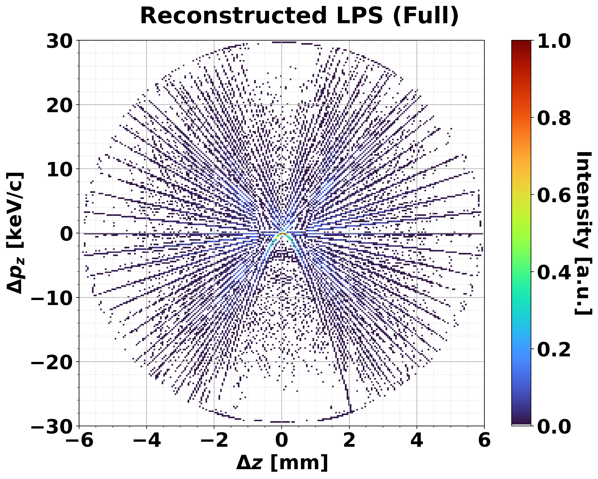
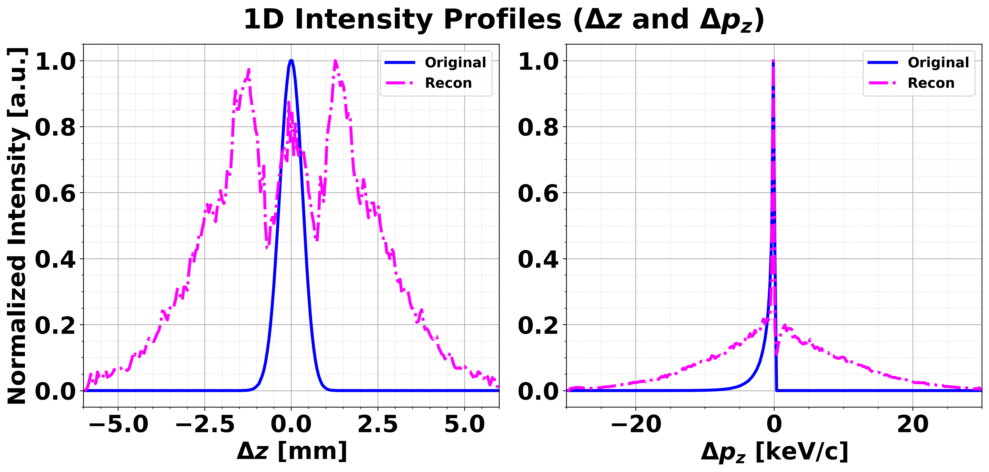
Normalization dependency
Wrong case
Normalization each iteration

Slide 14
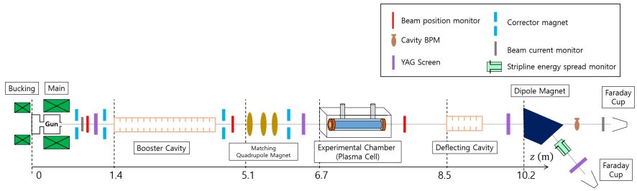
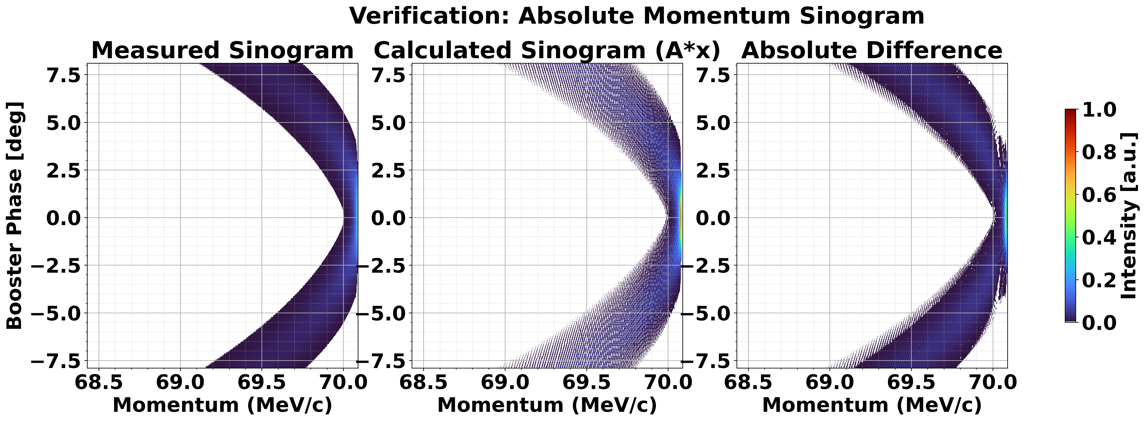




Construction weight matrix manually
$$\vec{x}$$
$$\vec{A}$$
$$Ax$$
$\vec{x}$: Reconstructed image
$\vec{A}$: Weight matrix
$\vec{m}$: Sinogram
${\vec{x}}^{k+1}={\vec{x}}^{k}⋅\frac{{\vec{A}}^{T}\vec{m}}{{\vec{A}}^{T}\vec{A}{\vec{x}}^{k}}$ (ISRA)

Slide 15
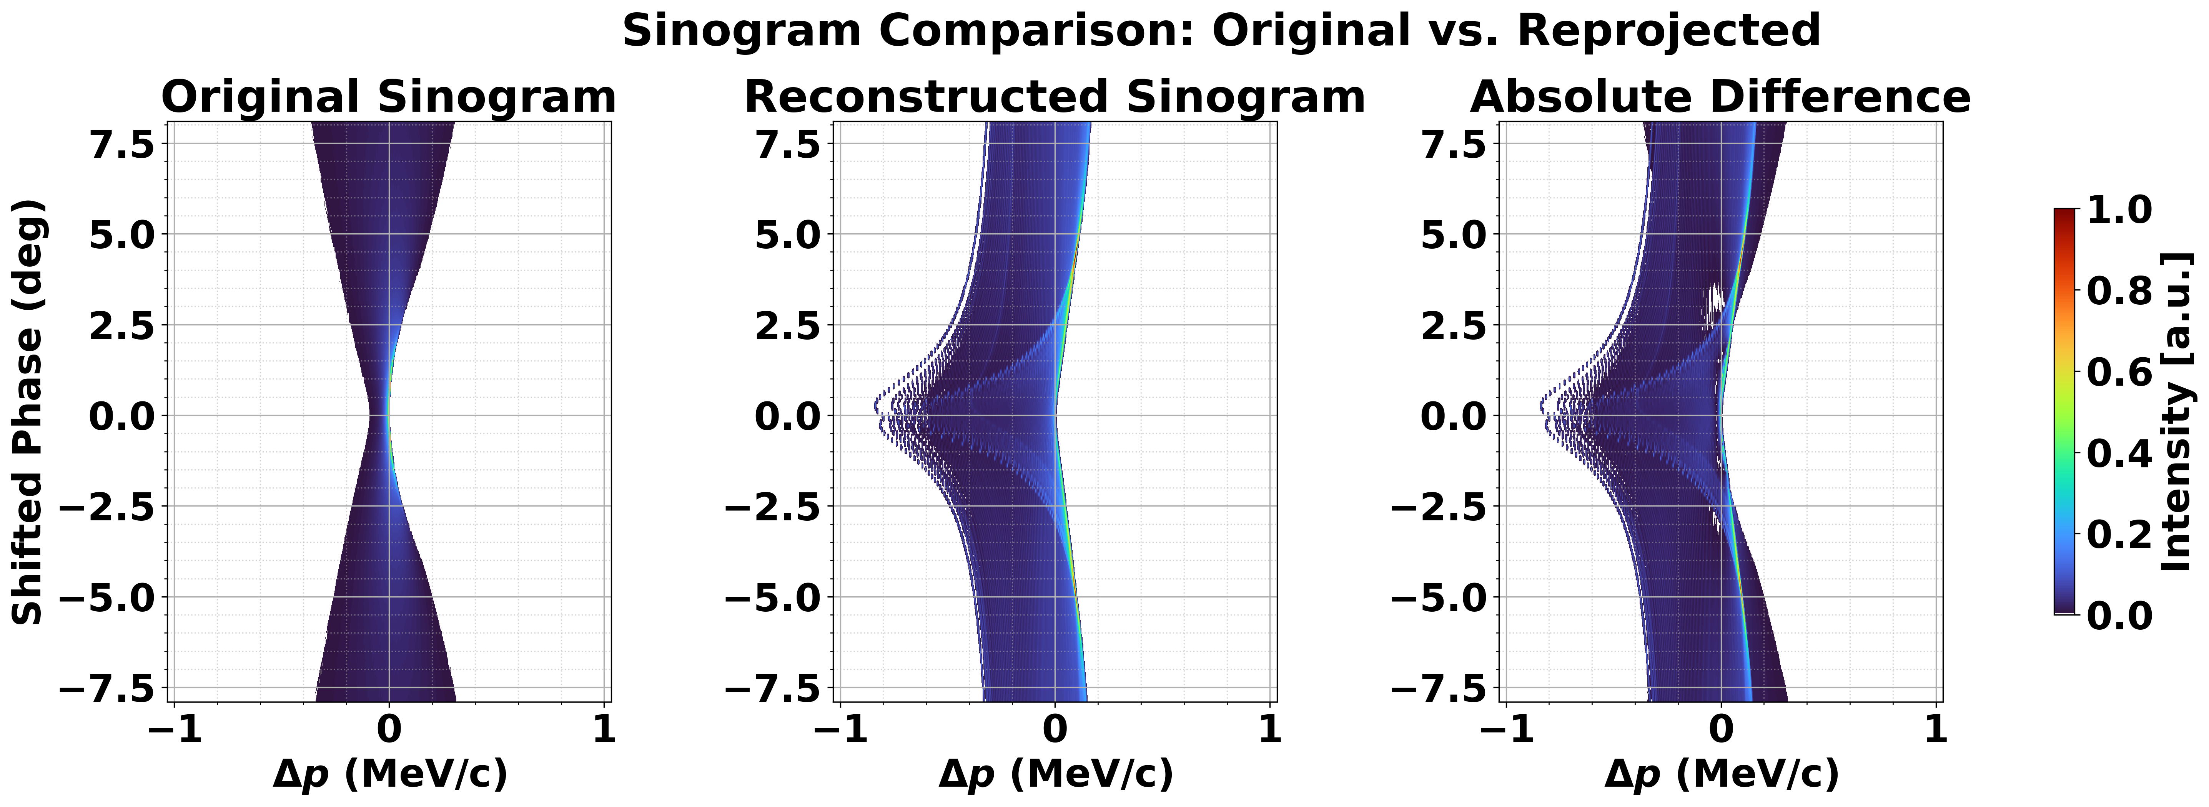
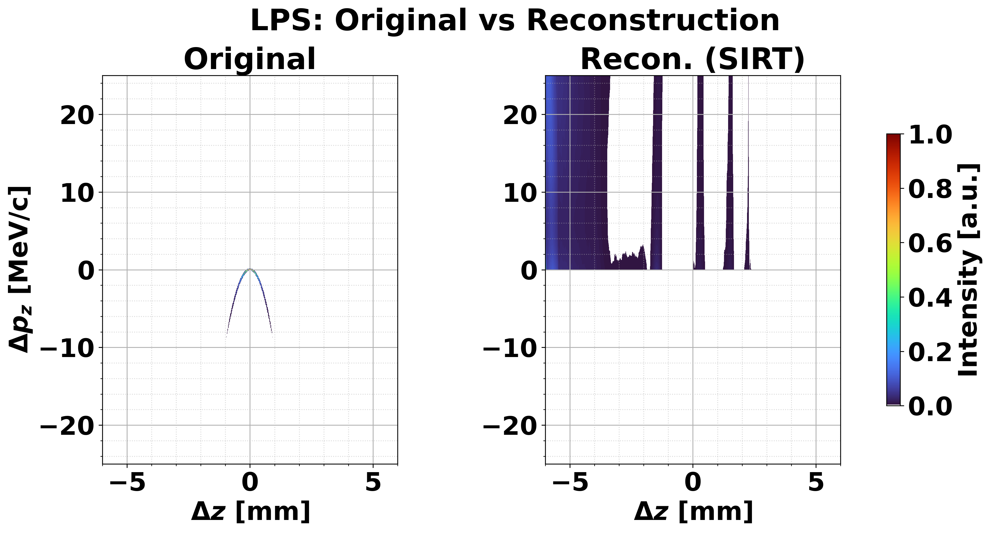
Construction weight matrix manually

Slide 16
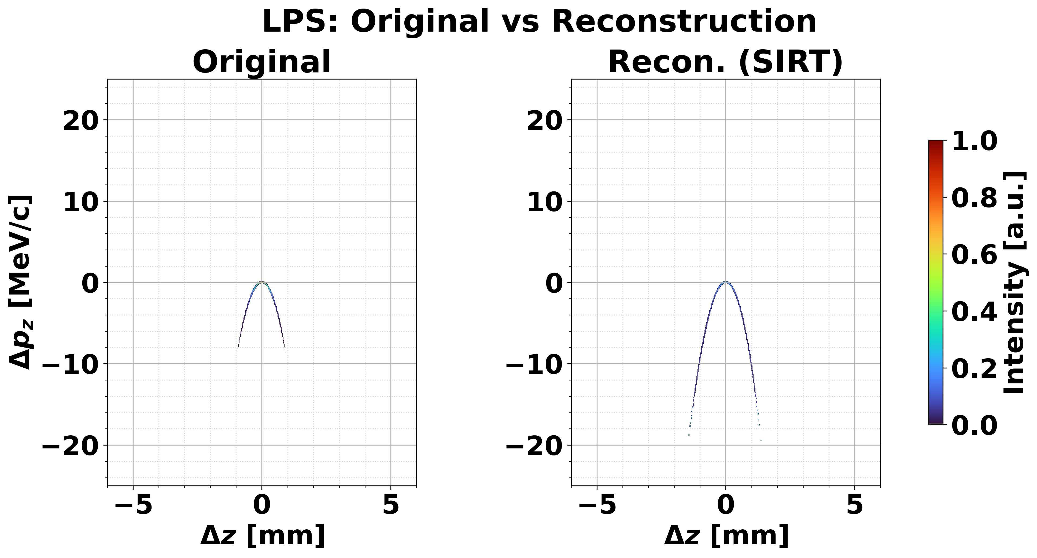
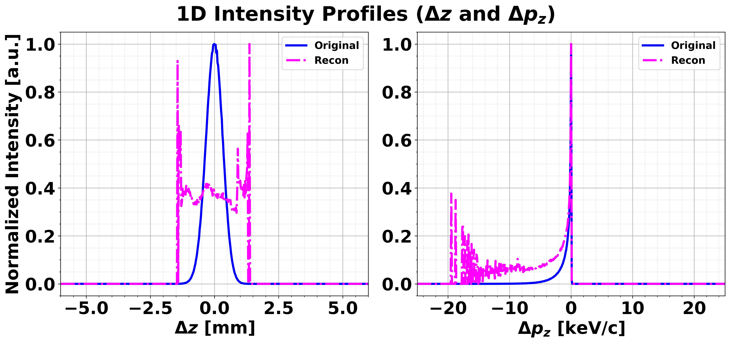
Weight matrix: initial = ground-truth

Slide 17
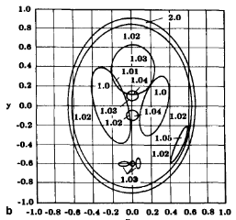
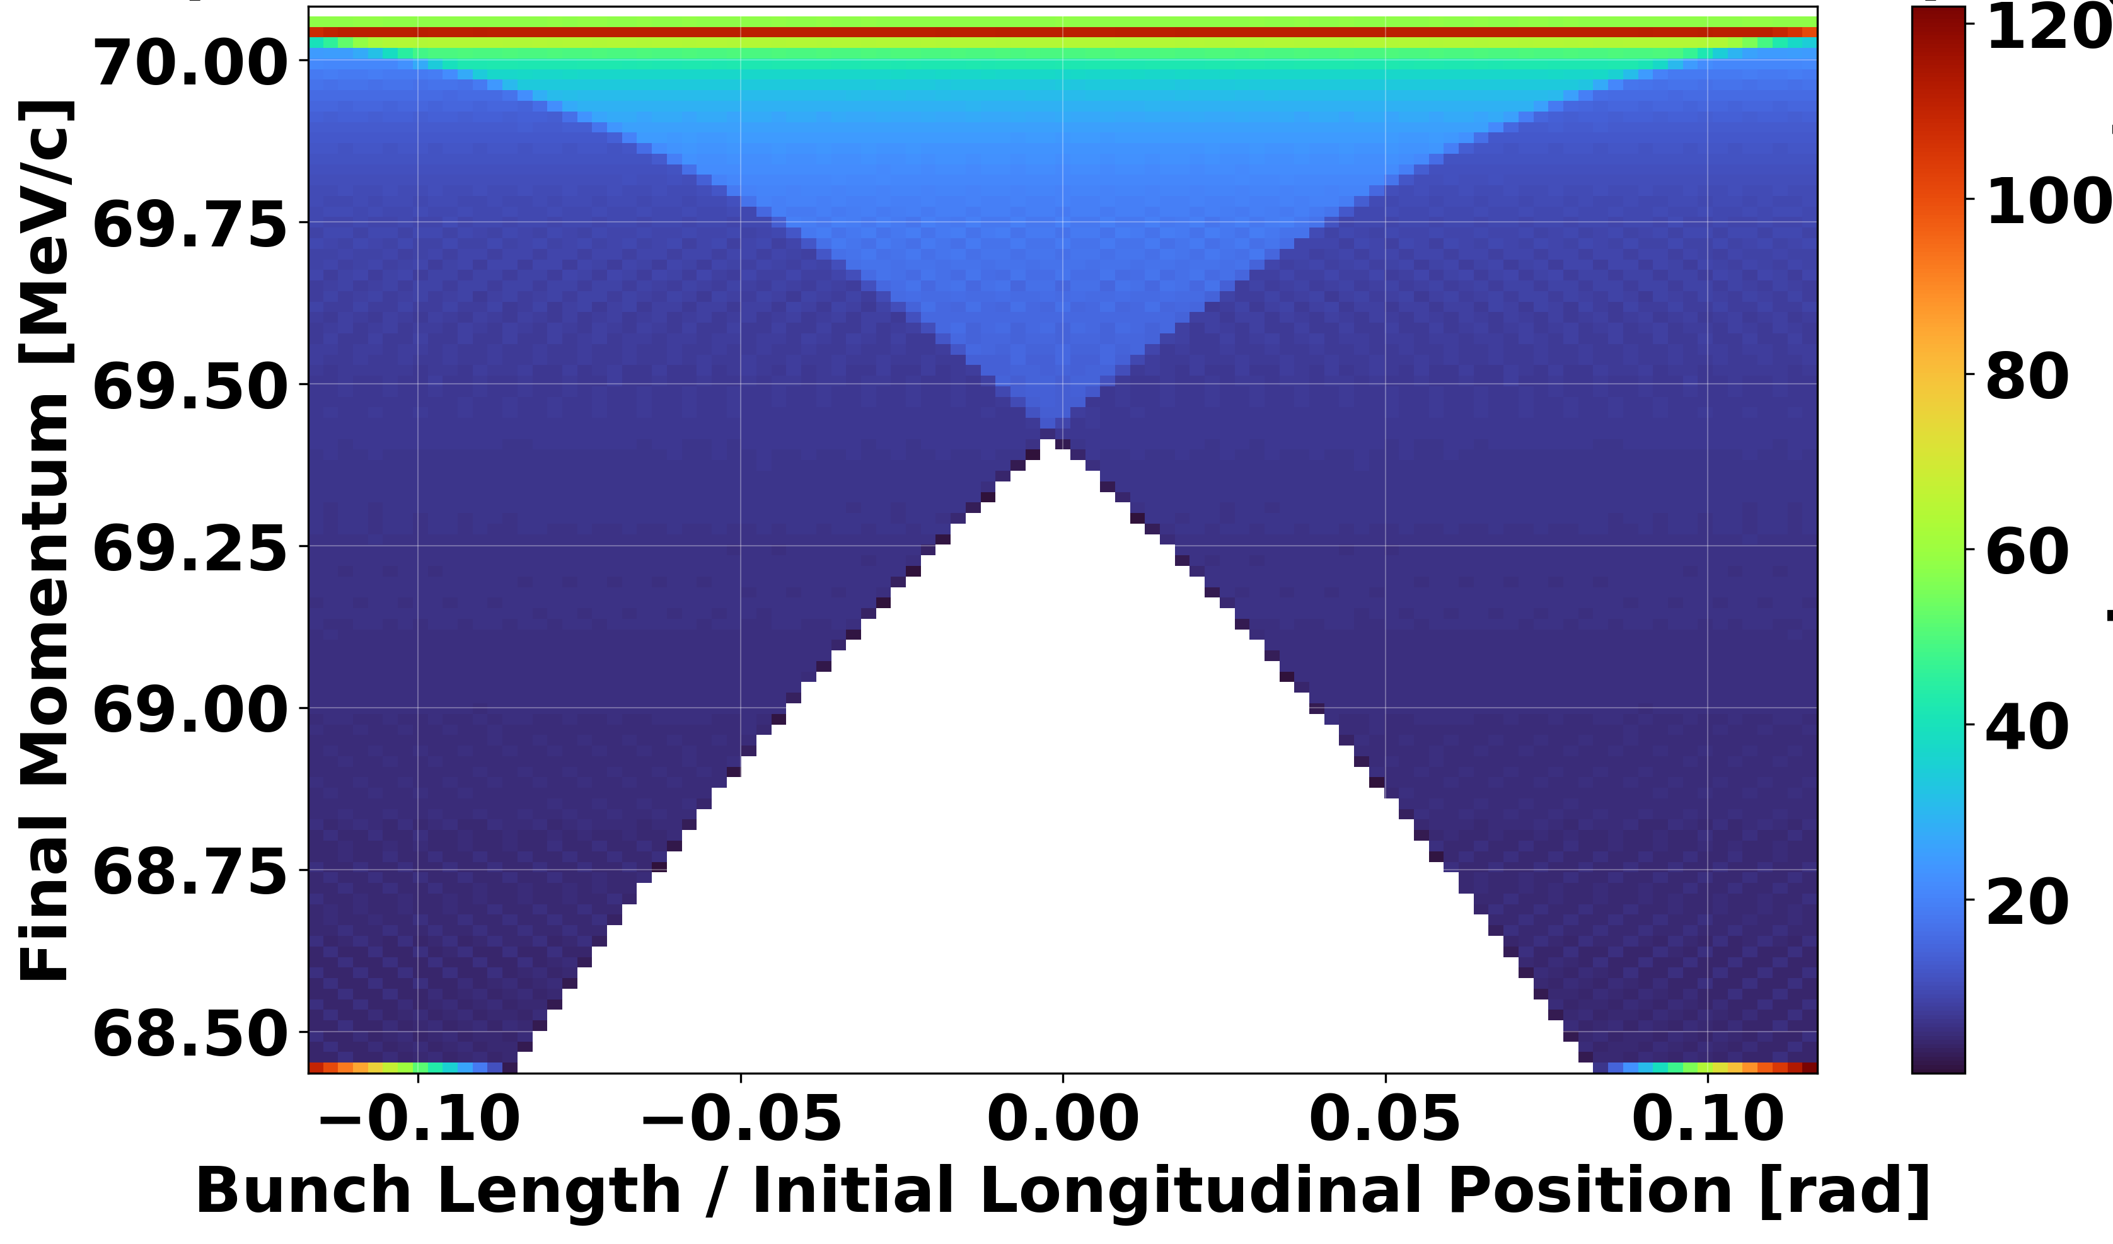
Problem of weight matrix
Weight matrix grid size ≠ Reconstructed image size
Z range: 1σ ~ 6σ (length dependency)
*Plot with all phases overlapped
Weight matrix size
Recon. Image size

Slide 18
Summary & next plans
Data preprocessing was confirmed.
Iteration process was confirmed.
Construction weight matrix is still ongoing.
+) TDC test, scan data obtained from PAL-XFEL by Dr. Sung.

