Slide 1
Comparative Analysis of Active and Passive Higher Harmonic Cavities for Bunch Lengthening in Korea-4GSR
2025-07-25, Pohang, South Korea
Young Min Park
Division of Advanced Nuclear Engineering (DANE), POSTECH

Slide 2
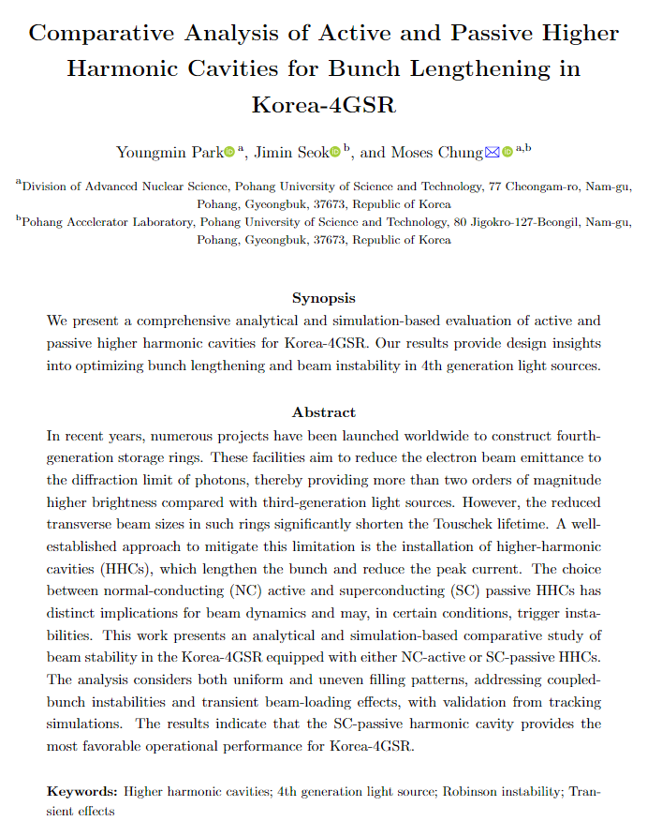
Paper overview
Title & Abstract
Introduction
Basic theory
Bunch lengthening with NC active
Bunch lengthening with SC passive
Simulation result
Conclusion
2

Slide 3
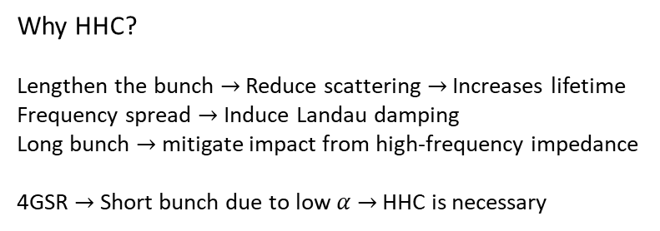
Paper overview
Title & Abstract
Introduction
Basic theory
Bunch lengthening with NC active
Bunch lengthening with SC passive
Simulation result
Conclusion
Why HHC?
Lengthen the bunch $→$ Reduce scattering $→$ Increases lifetime
Frequency spread $→$ Induce Landau damping
Long bunch $→$ mitigate impact from high-frequency impedance
4GSR $→$ Short bunch due to low $α$ $→$ HHC is necessary
Active and passive
Active cavity: Flat potential, LLRF, Generator
Facility : ALBA-II, HEPS, PETRA IV
Passive cavity: Non-flat potential, Transient effects,
Facility : APS-U, ESRF-EBS, MAX-IV
Goal
Determine the HHC options for Korea-4GSR
Instability & Bunch lengthening performance
Analytical models by Venturini, Alves, Bosch
Tracking simulation with pyAT, ELEGANT
3

Slide 4

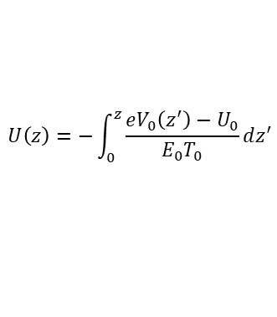

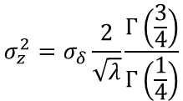

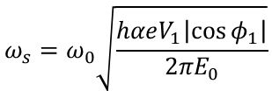


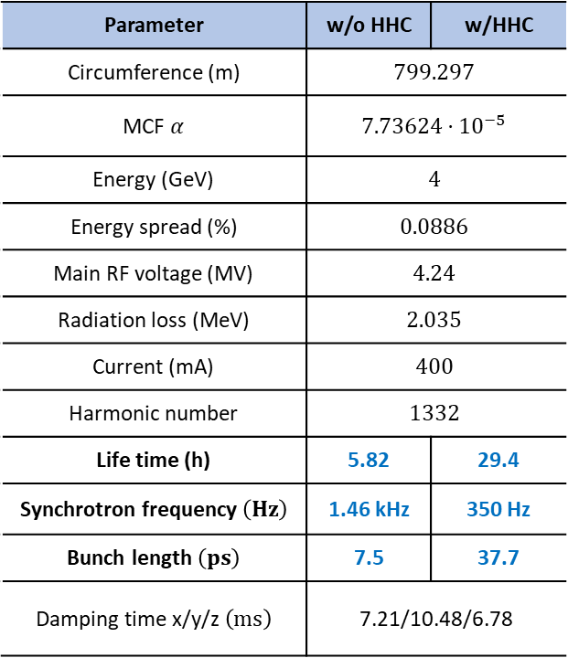


Paper overview
Title & Abstract
Introduction
Basic theory
Bunch lengthening with NC active
Bunch lengthening with SC passive
Simulation result
Conclusion
Total voltage :
Parameter | w/o HHC | w/HHC
Circumference (m) | $$799.297$$
MCF $α$ | $$7.73624⋅{10}^{−5}$$
Energy (GeV) | $$4$$
Energy spread (%) | $$0.0886$$
Main RF voltage (MV) | $$4.24$$
Radiation loss (MeV) | $$2.035$$
Current (mA) | $$400$$
Harmonic number | $$1332$$
Life time (h) | 5.82 | 29.4
Synchrotron frequency $\left(Hz\right)$ | 1.46 kHz | 350 Hz
Bunch length $\left(ps\right)$ | 7.5 | 37.7
Damping time x/y/z $\left(ms\right)$ | 7.21/10.48/6.78
$$V\left(z\right)=V_{m}\sin\left(\frac{ω_{rf}z}{c}+φ_{m}\right)+V_{h}\sin\left(\frac{3ω_{rf}z}{c}+φ_{h}\right)$$
Potential term :
$$U\left(z\right)=−\int_{0}^{z}{\frac{eV_{0}\left(z^{′}\right)−U_{0}}{E_{0}T_{0}}dz^{′}}$$
Equilibrium Hamiltonian :
$$ℋ_{0}\left(z,δ\right)=\frac{αcδ^{2}}{2}+U_{0}\left(z\right)→ℋ_{0}\left(J\right)$$
Synchrotron frequency :
$$ω_{s}\left(J\right)=\frac{∂ℋ_{0}\left(J\right)}{∂J}$$
No HHC
Flat potential
$$U\left(z\right)≈\frac{hω_{0}V_{1}\cos{φ_{1}}}{2E_{0}C_{0}}z^{2}$$
$$U\left(z\right)≈\frac{αcλz^{4}}{4}$$
$$ω_{s}=ω_{0}\sqrt{\frac{hαeV_{1}\left|\cos{φ_{1}}\right|}{{2πE}_{0}}}$$
$$ω_{s}\left(r\right)≈0.846αc\sqrt{λ}r$$
$$σ_{z}^{2}=σ_{δ}\frac{2}{\sqrt{λ}}\frac{Γ\left(\frac{3}{4}\right)}{Γ\left(\frac{1}{4}\right)}$$
$$σ_{z}=\frac{σ_{δ}cα}{ω_{s}}$$
4

Slide 5
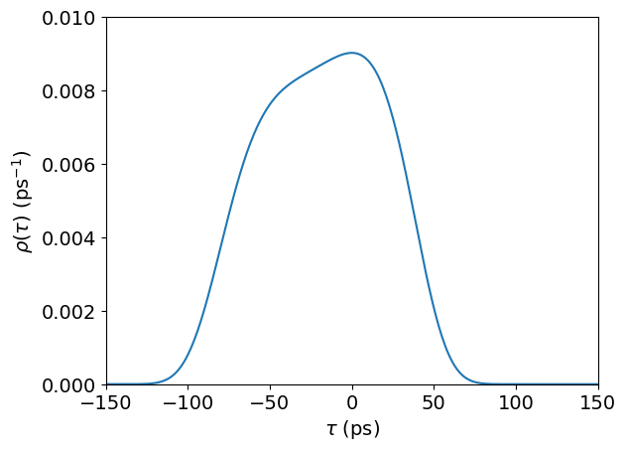
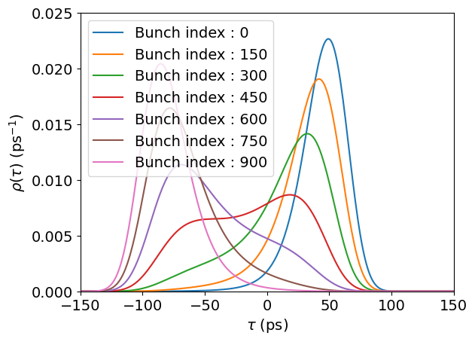
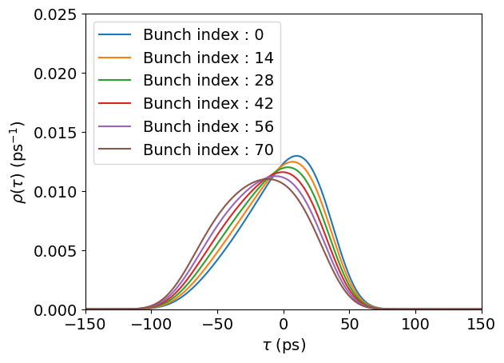







Paper overview
Title & Abstract
Introduction
Basic theory
Bunch lengthening with NC active
Bunch lengthening with SC passive
Simulation result
Conclusion
Gamelin method
[1]
Compute equilibrium bunch density including beam loading of main cavity
$$V_{rf}\left(z\right)=\sum_{i}^{N}{\left[V_{gi}\cos\left(k_{i}z+θ_{gi}\right)−\frac{2I_{avg}R_{s}F_{i}}{1+β_{i}}\cos{ψ_{i}}\int^{z}{\cos\left(k_{i}z^{′}+ψ_{i}−Θ_{i}\right)dz^{′}}\right]}$$
$$U\left(z\right)$$
$$λ\left(z\right)$$
$$F_{i},Θ_{i}$$
[2]
Alves method
Compute equilibrium longitudinal distribution with uneven filling pattern
$$V_{rf}\left(z\right)⇒V_{t,n}\left(z\right)=V_{g,n}\left(z\right)+V_{b,n}\left(λ;z\right)$$
$$U_{n}\left(z\right)$$
$$λ_{n}\left(z\right)$$
$$F_{n,i},Θ_{n,i}$$
In progress
[1] A.Gamelin., “EQUILIBRIUM BUNCH DENSITY DISTRIBUTION WITH MULTIPLE ACTIVE AND PASSIVE RF CAVITIES, IPAC2021, (2021)
[2] M.Alves., “Equilibrium of longitudinal bunch distributions in electron storage rings with arbitrary impedance soures and generic filling patterns”
5

Slide 6
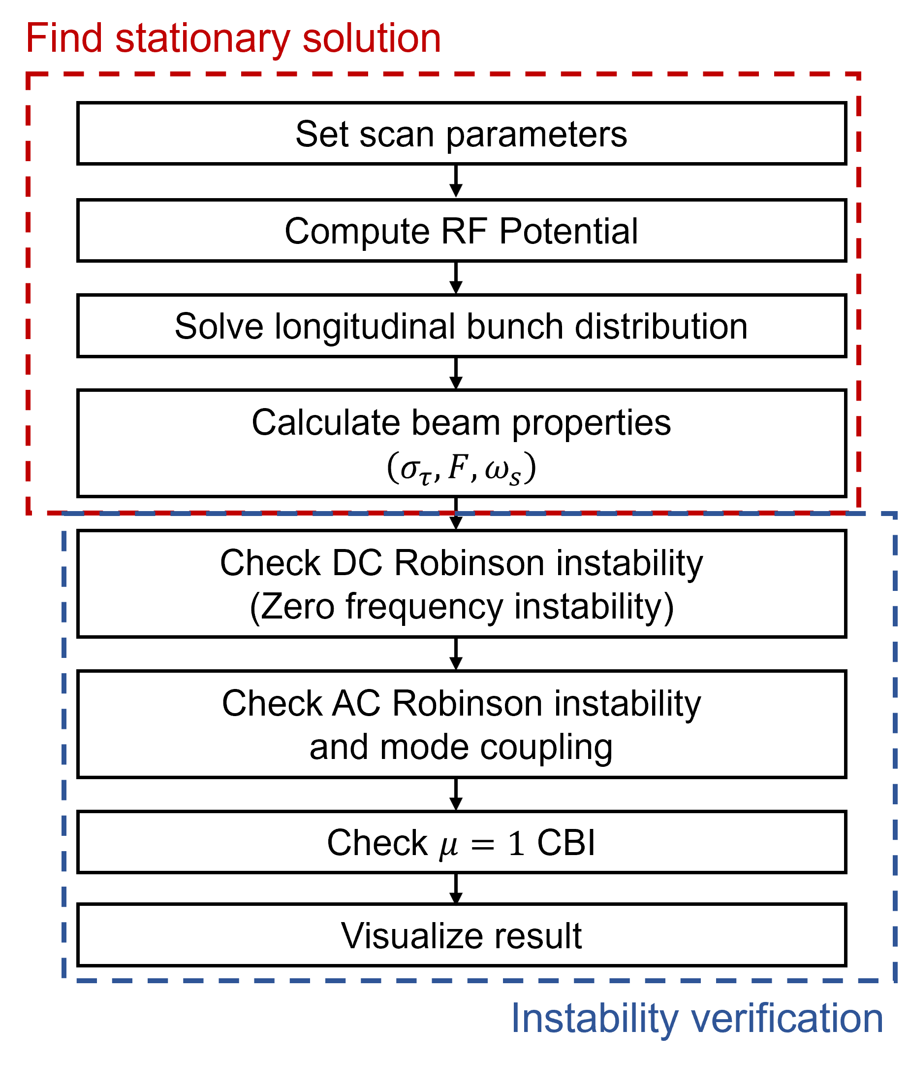
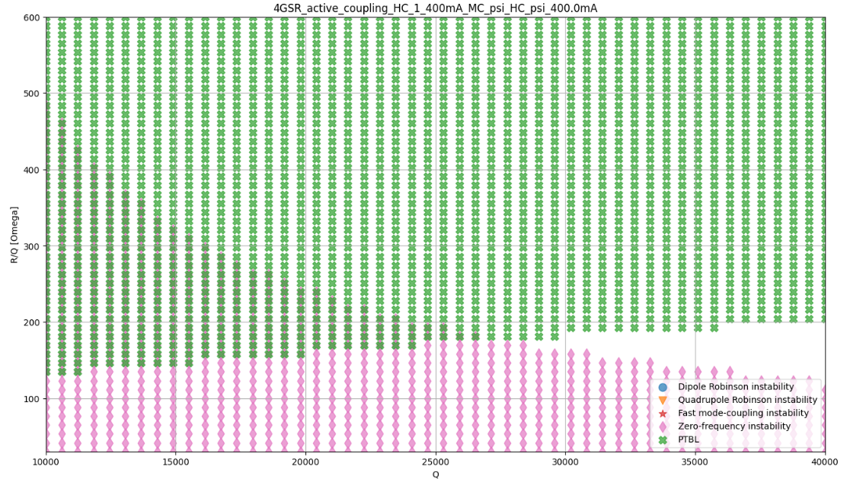

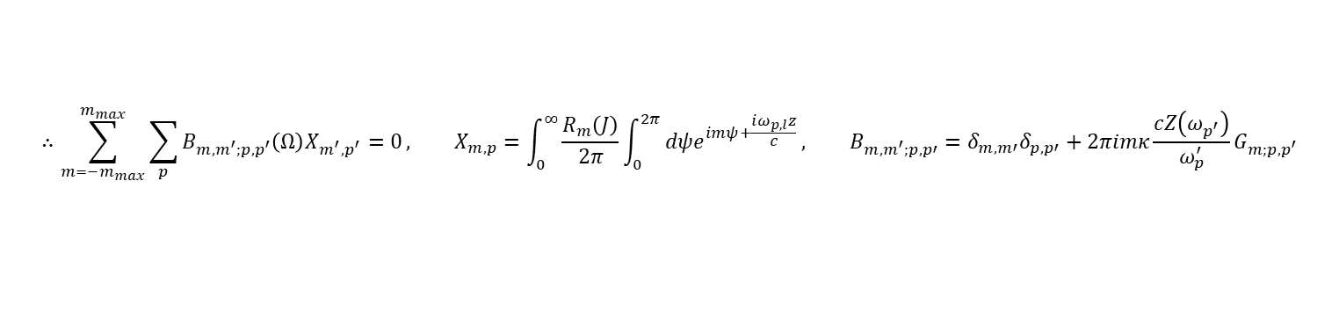
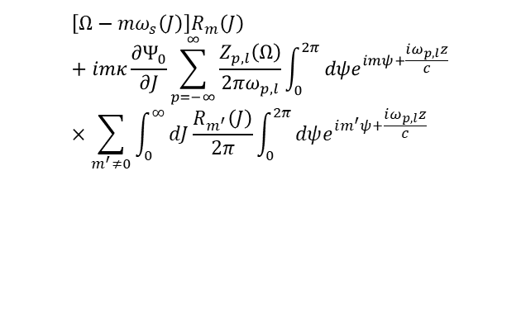

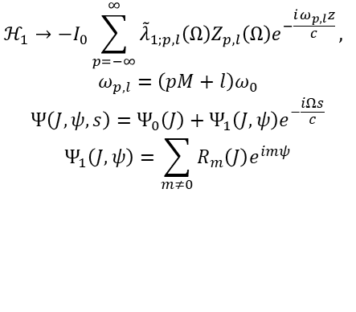
Paper overview
Title & Abstract
Introduction
Basic theory
Bunch lengthening with NC active
Bunch lengthening with SC passive
Simulation result
Conclusion
[1]
[2]
Venturini approach
Gamelin algorithm
Linearized Vlasov equation :
$$−iΩΨ_{1}+ω_{s}\left(J\right)\frac{∂Ψ_{1}}{∂ψ}−cω_{s}\left(J\right)\frac{∂ℋ_{1}}{∂ψ}=0$$
$ℋ_{1}$ and $Ψ_{1}$ :
$$ℋ_{1}→−I_{0}\sum_{p=−∞}^{∞}{{\tilde{λ}}_{1;p,l}\left(Ω\right)Z_{p,l}\left(Ω\right)e^{−\frac{iω_{p,l}z}{c}}},$$
$$ω_{p,l}=\left(pM+l\right)ω_{0}$$
$$Ψ\left(J,ψ,s\right)=Ψ_{0}\left(J\right)+Ψ_{1}\left(J,ψ\right)e^{−\frac{iΩs}{c}}$$
$$Ψ_{1}\left(J,ψ\right)=\sum_{m≠0}{R_{m}\left(J\right)e^{imψ}}$$
Dispersion relation:
$$\left[Ω−mω_{s}\left(J\right)\right]R_{m}\left(J\right)+imκ\frac{∂Ψ_{0}}{∂J}\sum_{p=−∞}^{∞}{\frac{Z_{p,l}\left(Ω\right)}{2πω_{p,l}}\int_{0}^{2π}{dψe^{imψ+\frac{iω_{p,l}z}{c}}}}×\sum_{m^{′}≠0}{\int_{0}^{∞}{dJ\frac{R_{m^{′}}\left(J\right)}{2π}\int_{0}^{2π}{dψe^{im^{′}ψ+\frac{iω_{p,l}z}{c}}}}}$$
$$∴\sum_{m={−m}_{max}}^{m_{max}}{\sum_{p}{B_{m,m^{′};p,p^{′}}\left(Ω\right)X_{m^{′},p^{′}}=0}}, X_{m,p}=\int_{0}^{∞}{\frac{R_{m}\left(J\right)}{2π}\int_{0}^{2π}{dψe^{imψ+\frac{iω_{p,l}z}{c}}}}, B_{m,m^{′};p,p′}=δ_{m,m′}δ_{p,p′}+2πimκ\frac{cZ\left(ω_{p^{′}}\right)}{ω_{p}^{′}}G_{m;p,p^{′}}$$
[1] M.Venturini., “Theoretical models for longitudinal coupled-bunch instabilities driven by harmonic cavities in electron storage rings (2025)
[2] A.Gamelin., “Semianalytical algorithms to study longitudinal beam instabilities in double rf system (2025)”
6

Slide 7
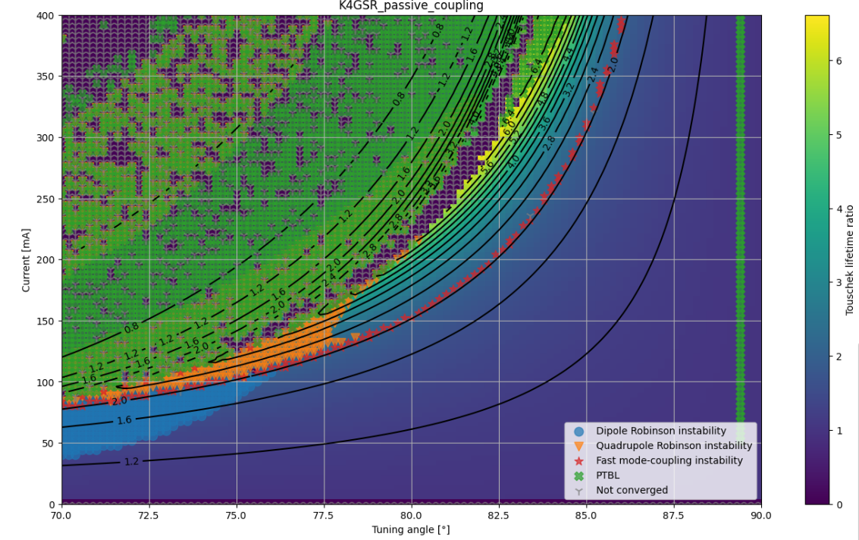
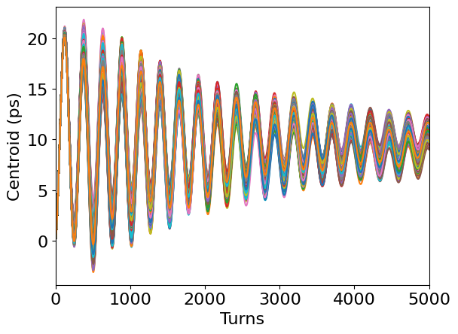
Paper overview
Title & Abstract
Introduction
Basic theory
Bunch lengthening with NC active
Bunch lengthening with SC passive
Simulation result
Conclusion
Similar to NC cases
7

Slide 8
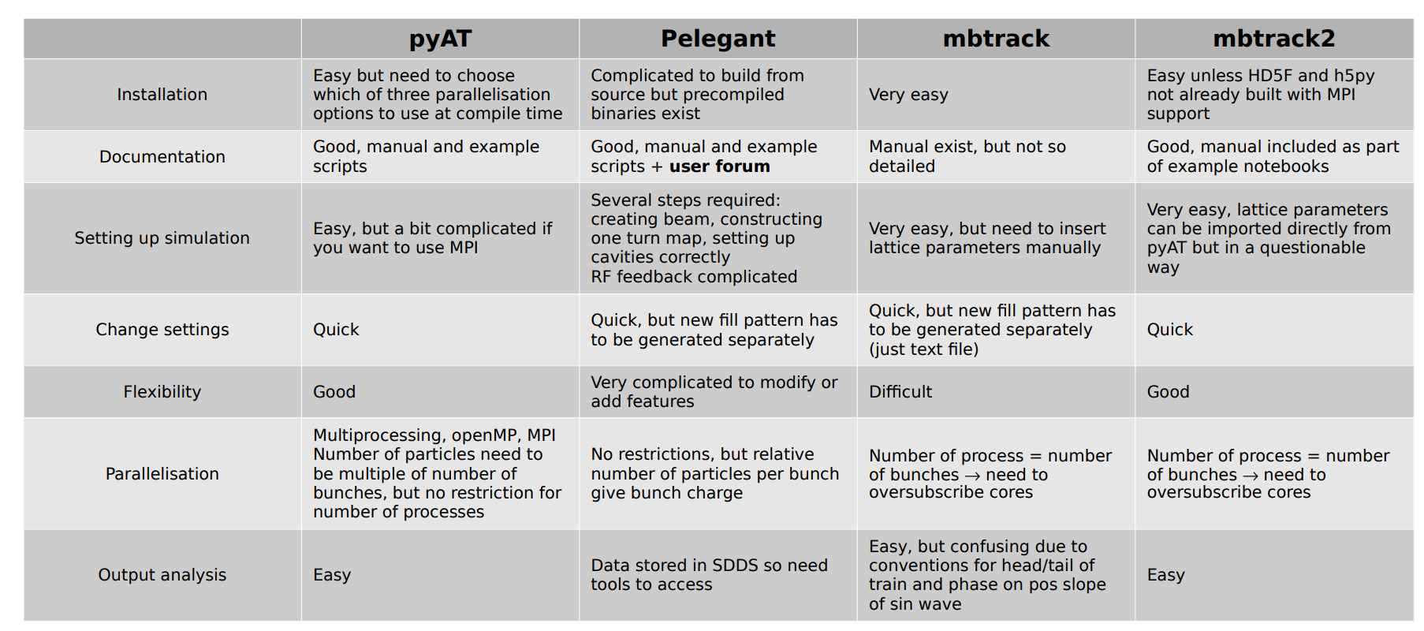
Higher harmonic cavity simulation tools
[1] T.Olsson, “Harmonic Cavity Simulations”, Presentation, AT Workshop, 2023
8

Slide 9


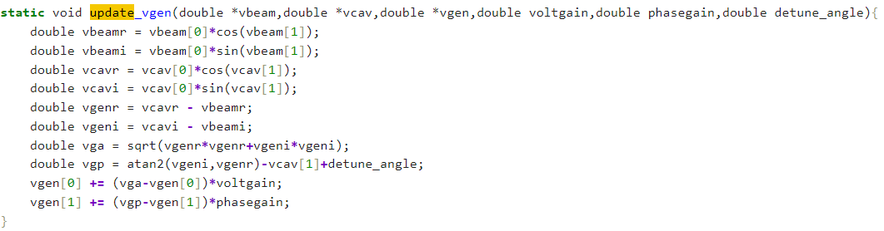
pyAT & ELEGANT
In pyAT, problem is beamloading elements
$V_{b}=2IR_{s}\cos{ψ}\cos\left(ψ+\frac{π}{2}\right)→$ Satisfied only $F=1$ cases (short bunch)
$V_{g,i+1}=\left(V_{g,set}−V_{g,i}\right)⋅e_{volt}, θ_{g,i+1}=\left(θ_{g,set}−θ_{g,i}\right)⋅e_{phase} →$ Simple P controller, differ to actual cavity response.
These effects introduce a static offset of bunch centroid,
resulting in a discrepancy from the analytical results
9

Slide 10
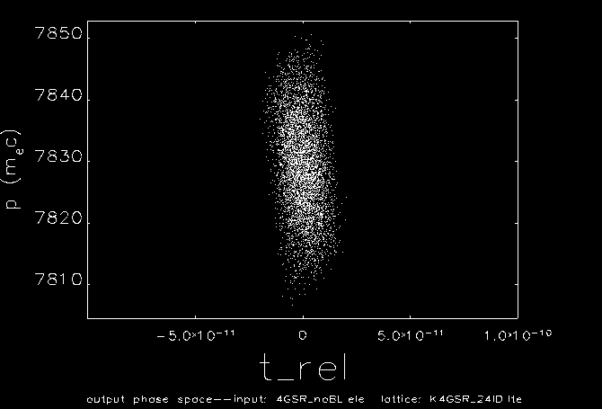
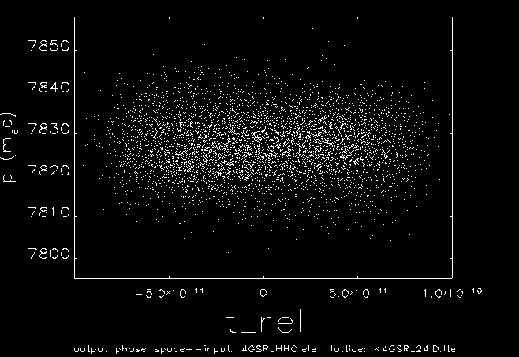
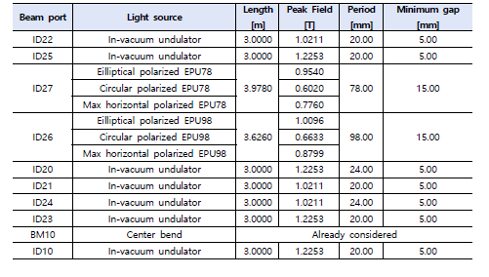
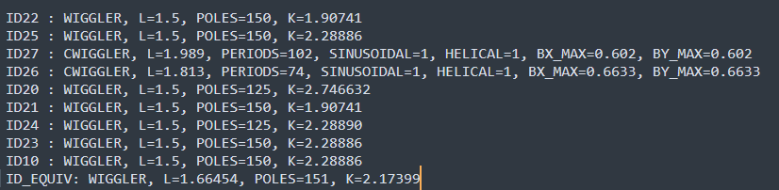

ELEGANT simulation
w/o HHC
w HHC
Lattice setup .lte
RF cavity setting
Generate filling patten
RF mode
$$4.24 MV/151.95$$
Feedback
10

Slide 11
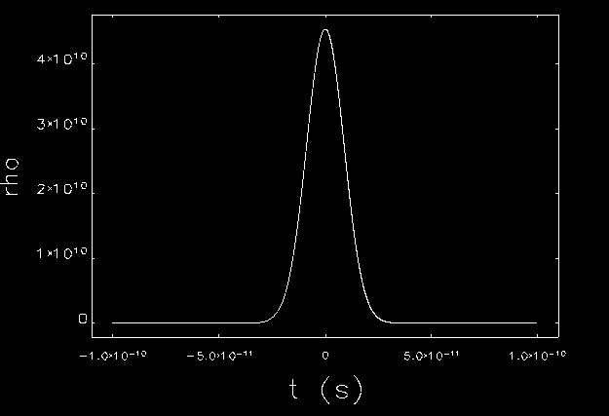
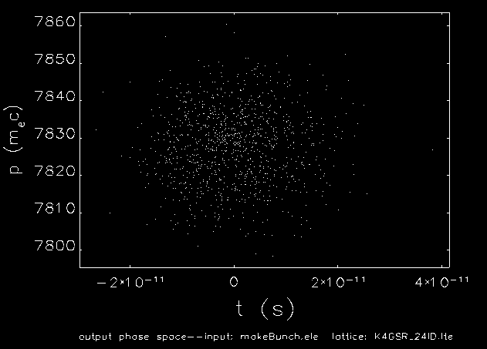
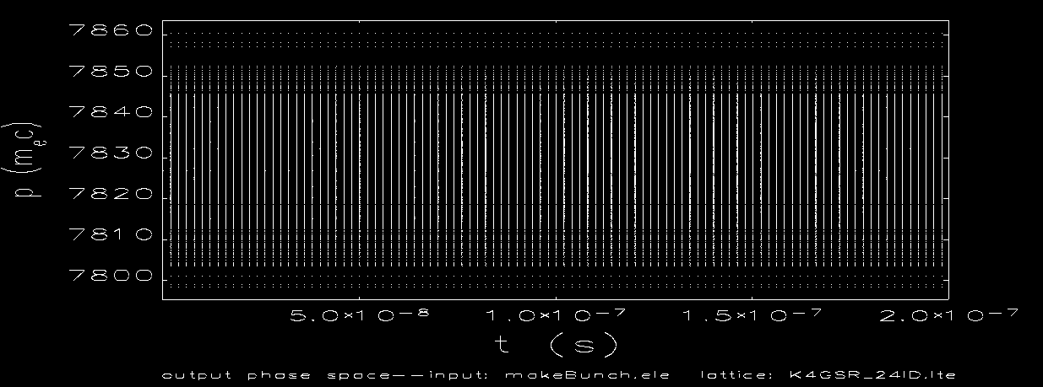

ELEGANT simulation
Lattice setup .lte
Makeprofile
1D longitudinal profile
RF cavity setting
Generate filling patten
Makebunch
6D distribution by using $ε_{x},ε_{y},ε_{τ}$
RF mode
Feedback
generateBunchTrain
Generate bunch train
(200*1*1 200*1*0 100*1*1)
Relative
charge
Bunch
number
gap
11

Slide 12
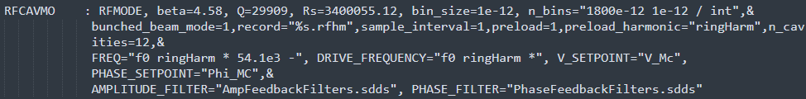
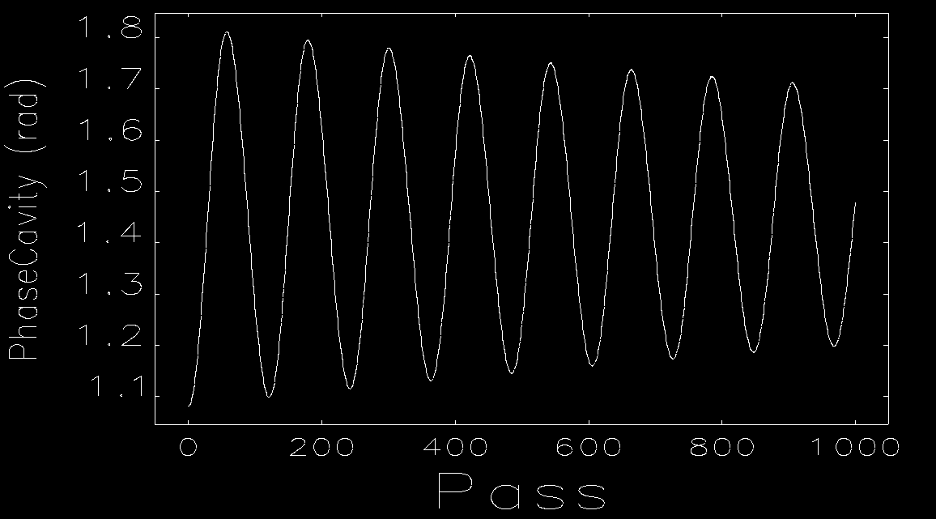
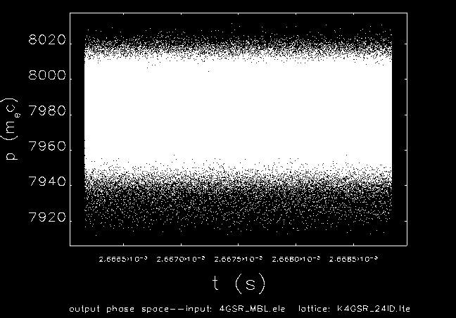
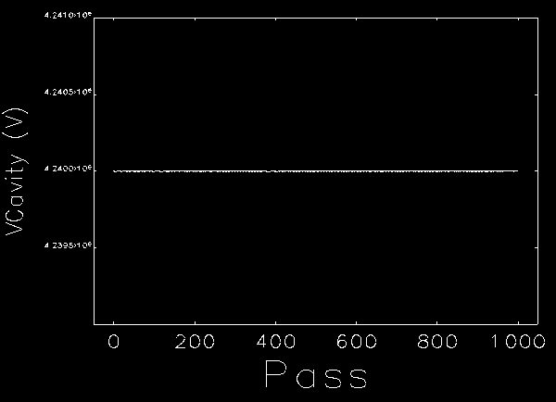
ELEGANT simulation
Lattice setup .lte
RF cavity setting
Generate filling patten
RF mode
Feedback
12

Slide 13
Summary & Future plan
Paper will cover analytic instability results for active vs. passive higher‑harmonic cavities (HHCs) and tracking simulations.
Analytic calculation of instability growths rates for active and passive HHCs is done.
pyAT has some issues about beamloadingelements, I decide to swith tracking tools from pyAT to ELEGANT
Plan:
  Active cavity: compute beam‑loading‑consistent equilibrium bunch distribution
  ELEGANT HHC simulation: lattice + RFMODE/FRFMODE
  compute growth rates
  scan detune/Q/R
  evaluate bunch‑lengthening factor under generic fill patterns.
13
[1] T. Olsson, Self-consistent calculation of transient beam loading in electron storage rings with passive harmonic cavities, Phys. Rev. Accel. Beams 21, (2018).

Slide 14
Thank you for your attention!
14

