Slide 1


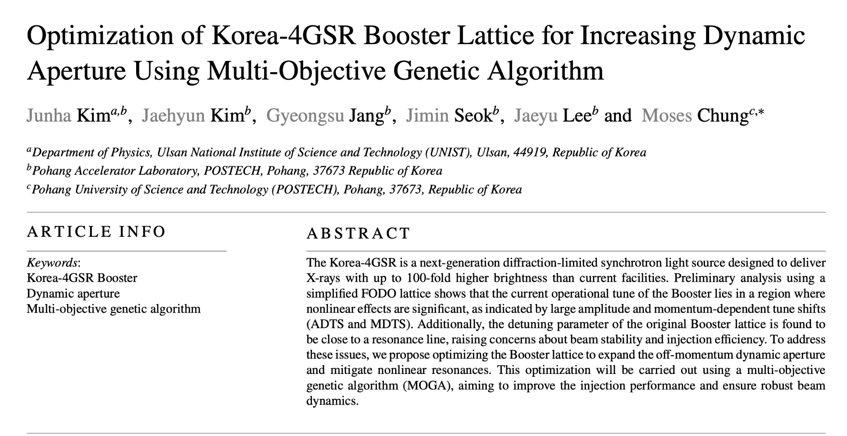
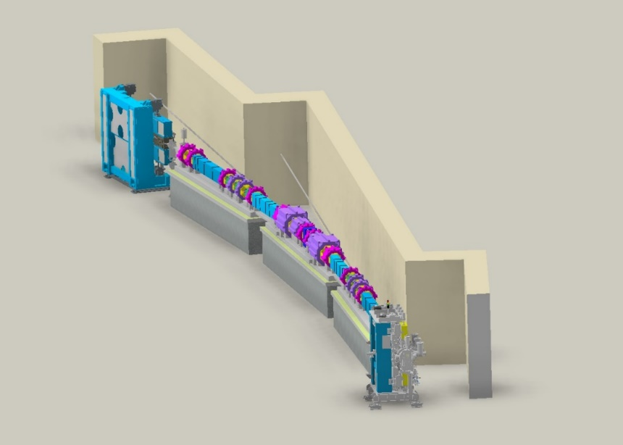

Booster Optimization figure

Slide 2
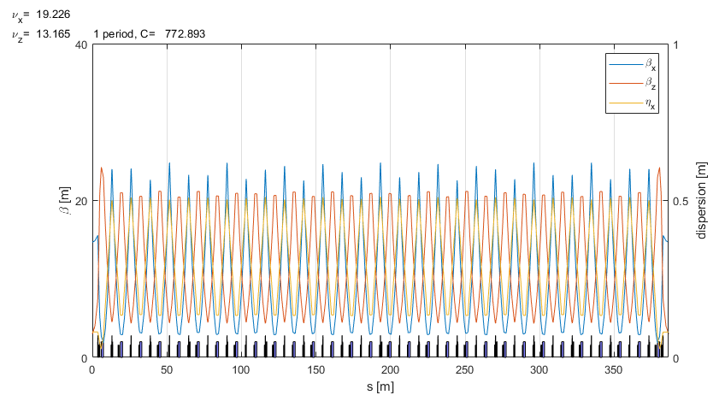
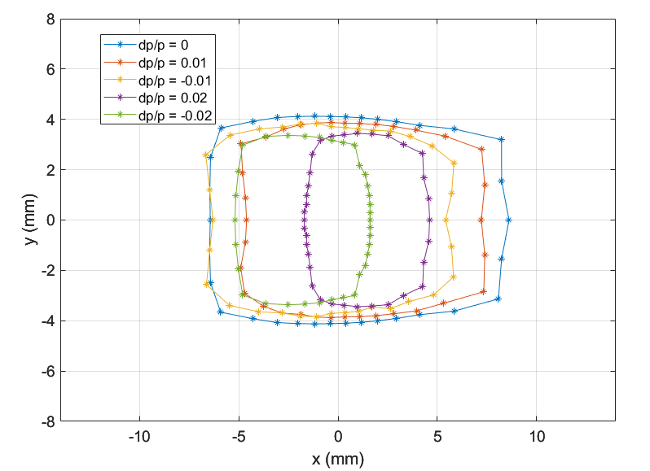
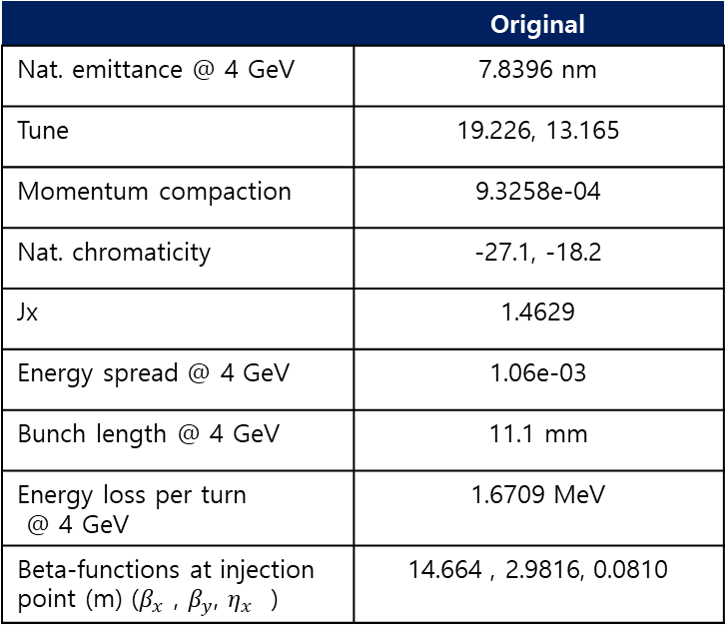
Original booster lattice
Beta-functions for half ring
 | Original
Nat. emittance @ 4 GeV | 7.8396 nm
Tune | 19.226, 13.165
Momentum compaction | 9.3258e-04
Nat. chromaticity | -27.1, -18.2
Jx | 1.4629
Energy spread @ 4 GeV | 1.06e-03
Bunch length @ 4 GeV | 11.1 mm
Energy loss per turn @ 4 GeV | 1.6709 MeV
Beta-functions at injection point (m) ($β_{x}$ , $β_{y}$, $η_{x}$ ) | 14.664 , 2.9816, 0.0810

Slide 3
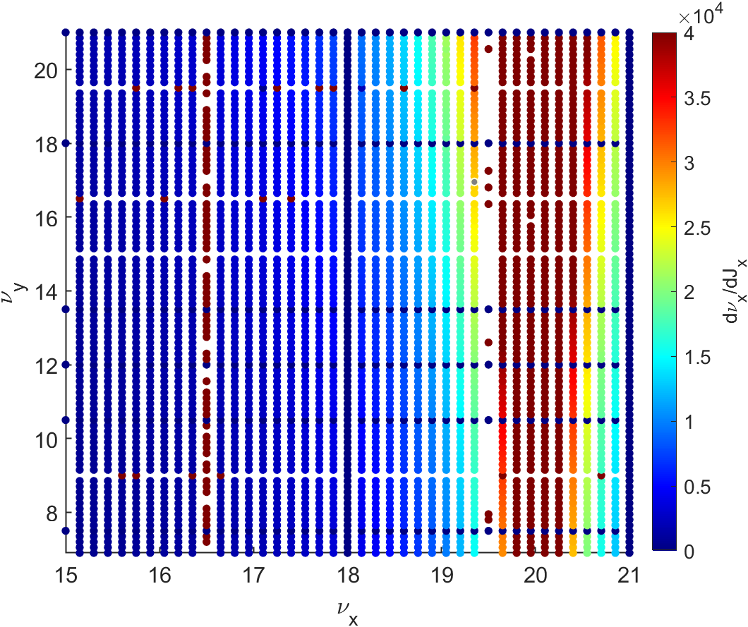
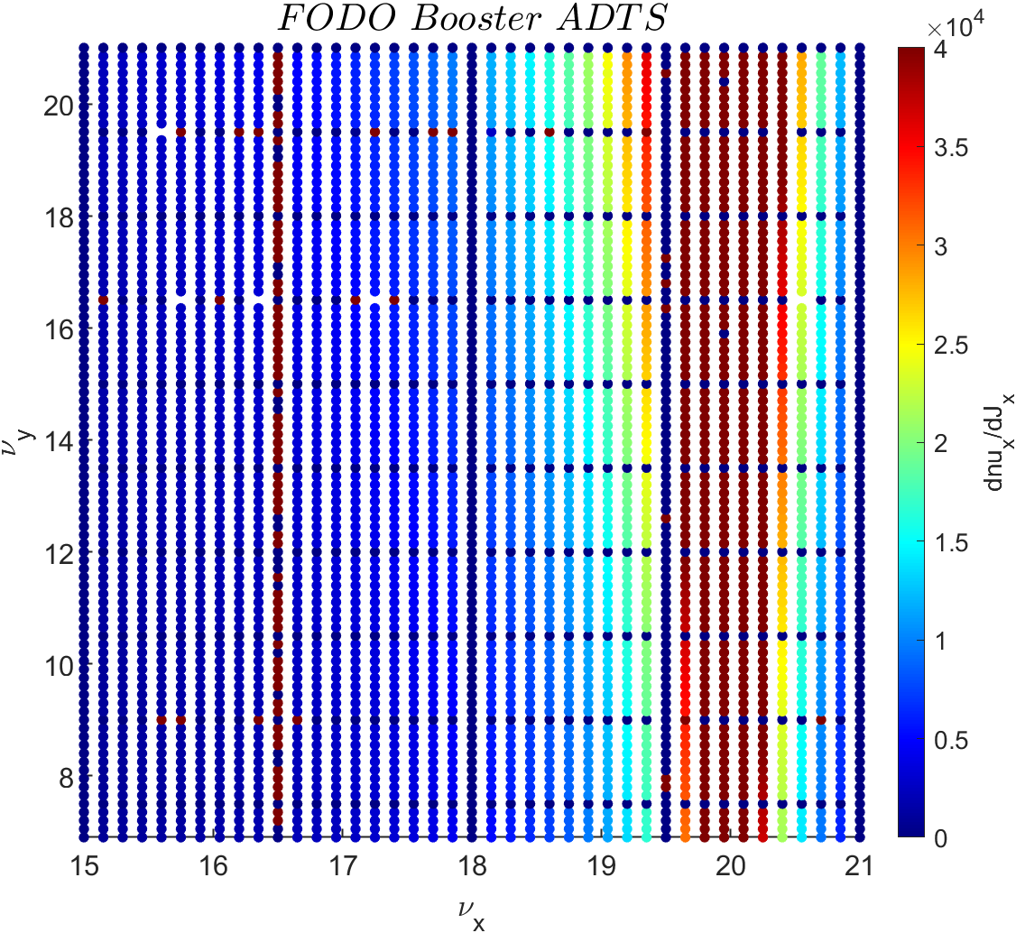
Beam physics group meeting
Horizontal amplitude tuneshift across various tunes
Calculation using Symplectic Approximation
Calculation using AT Function

Slide 4
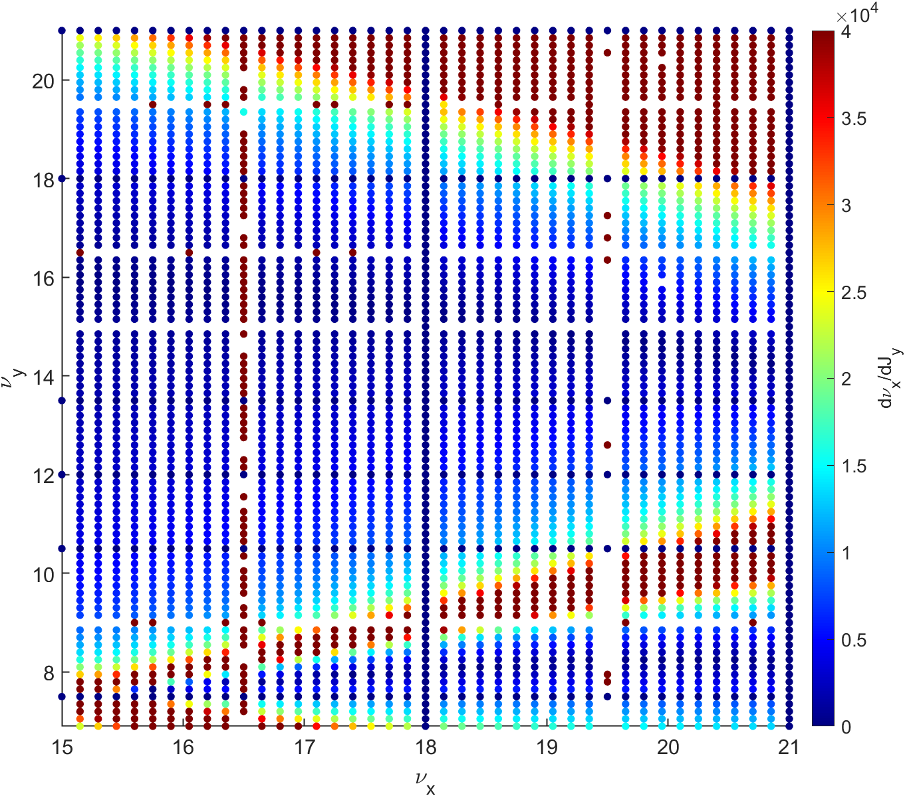
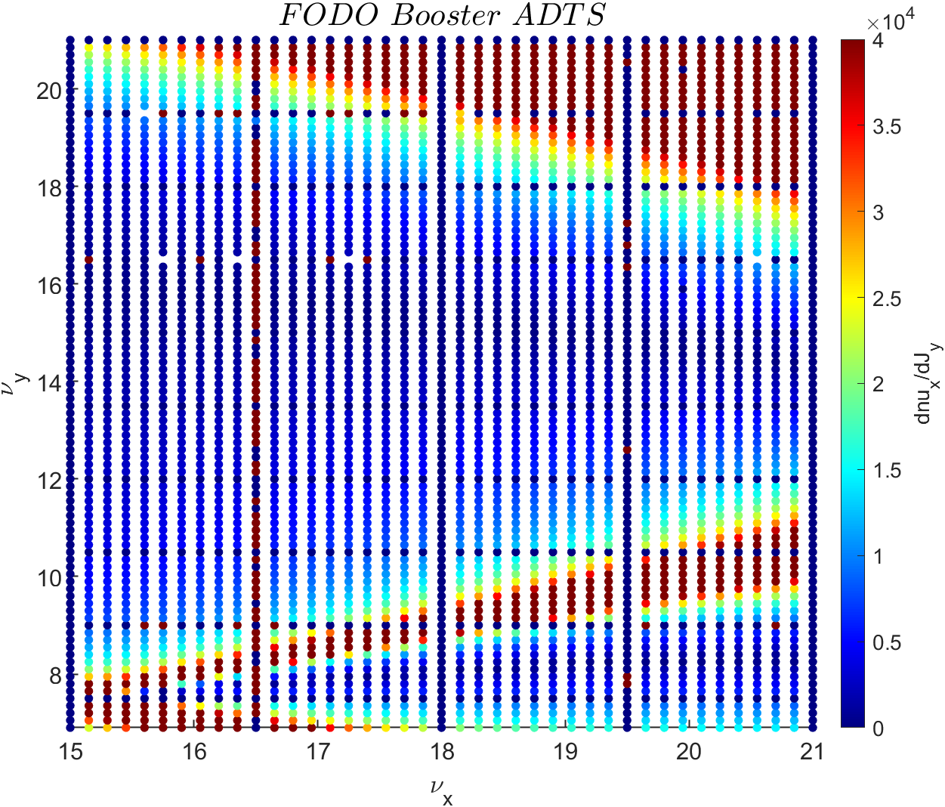
Beam physics group meeting
Horizontal amplitude tuneshift across various tunes
Calculation using Symplectic Approximation
Calculation using AT Function

Slide 5
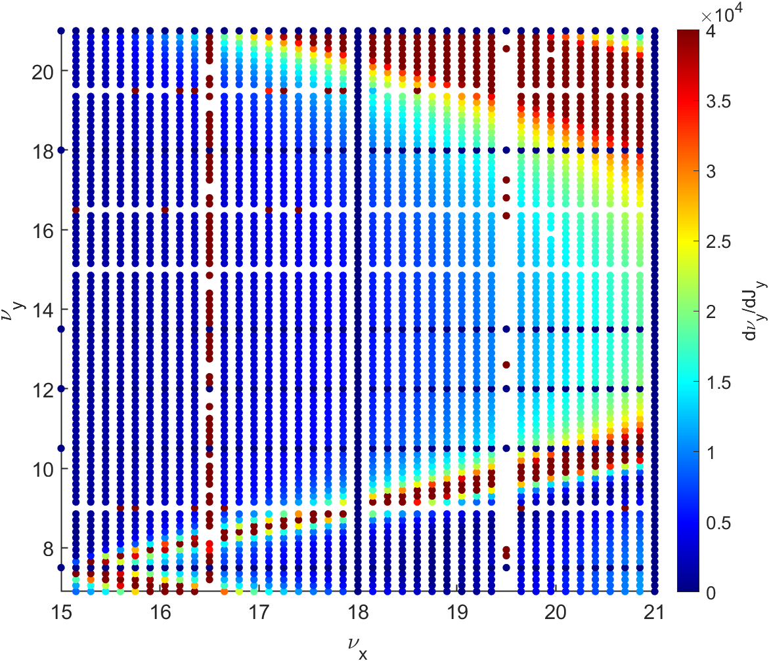
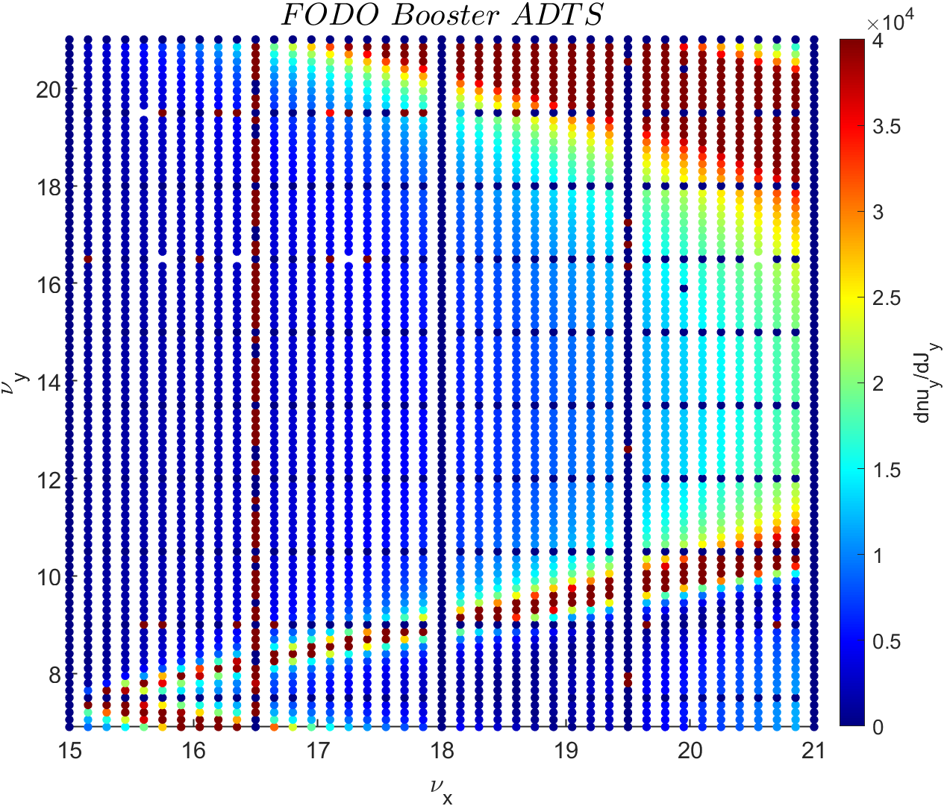
Beam physics group meeting
Horizontal amplitude tuneshift across various tunes
Calculation using Symplectic Approximation
Calculation using AT Function

Slide 6
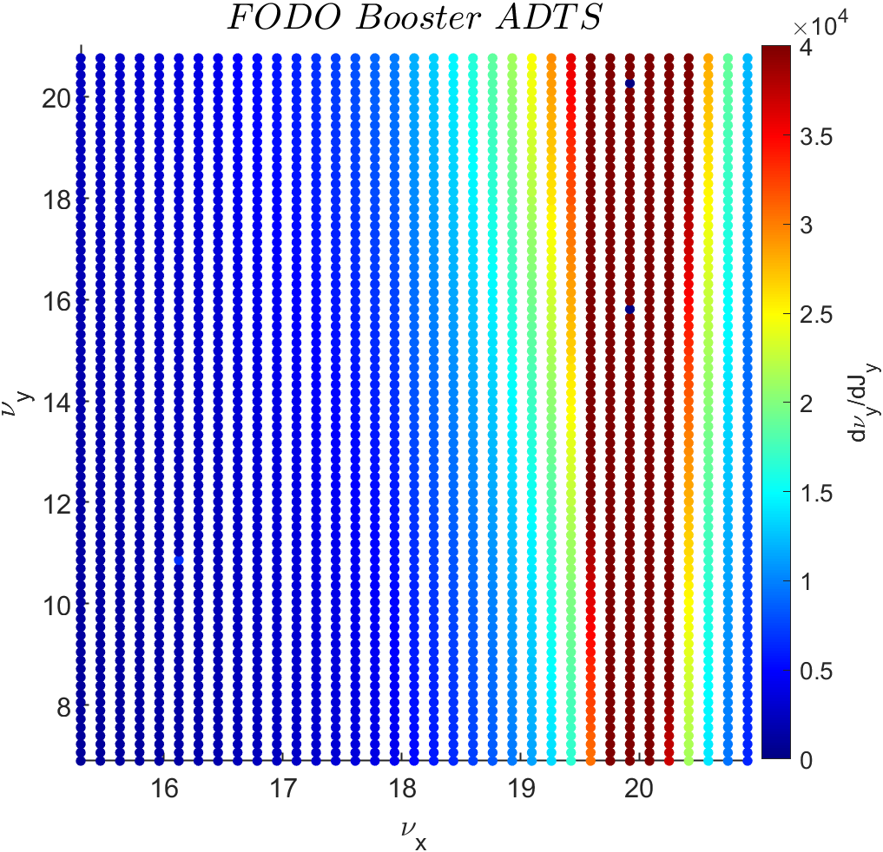
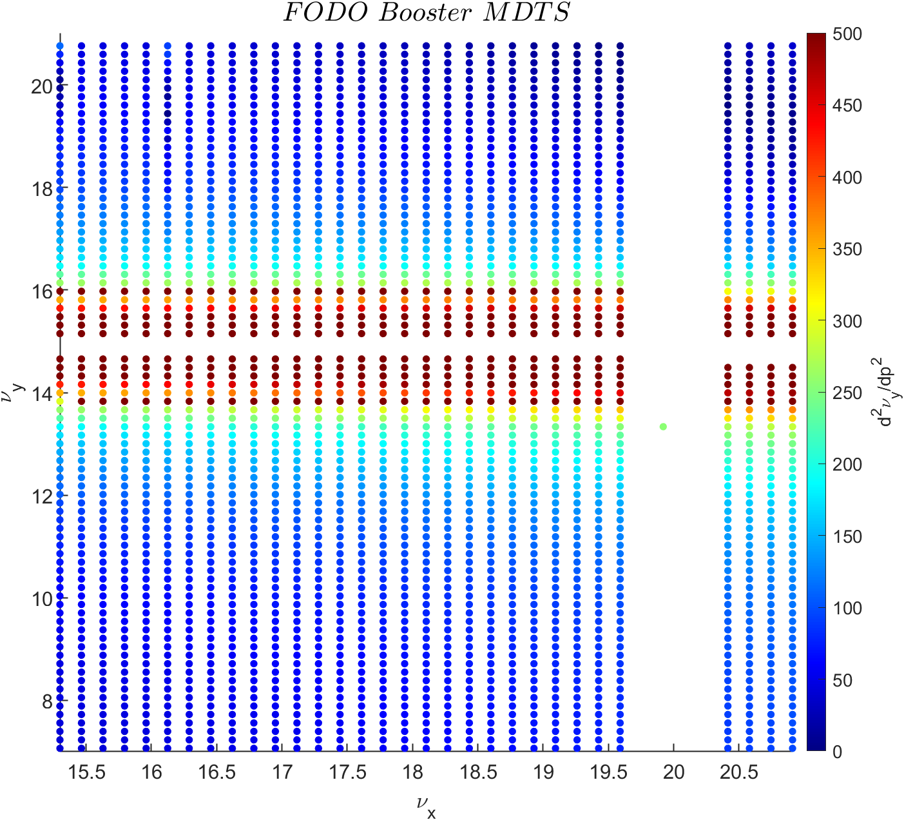
Motivation of MOGA simulation
While a photocathode electron gun was initially chosen based on the operational success of PAL-XFEL, a shift towards a thermionic electron gun is being considered to achieve greater operational stability.
Additionally, the detuning parameter of the original booster is close to the resonance line or region.
To address this issue, we propose optimizing the Booster lattice to expand the off-momentum dynamic aperture and achieve more stable nonlinear effects. This optimization will be performed using a multi-objective genetic algorithm (MOGA).

Slide 7
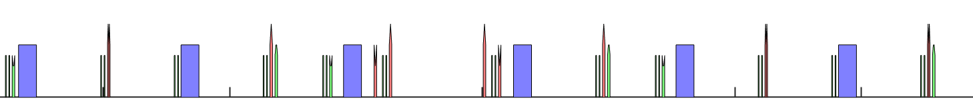
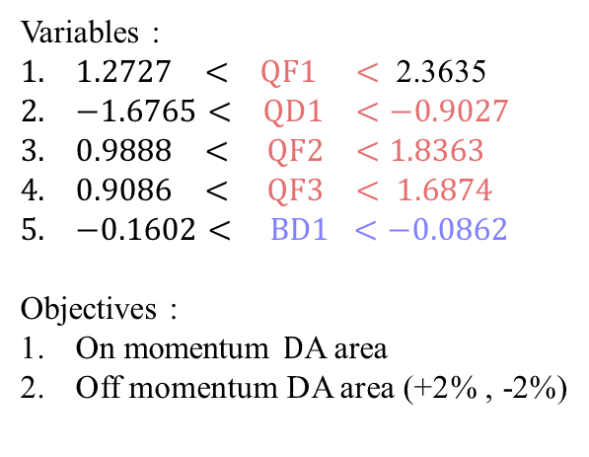
Variables of MOGA simulations
Variables :
$1.2727 < QF1 <$ 2.3635
$−1.6765< QD1 <−0.9027$
$0.9888 < QF2 <1.8363$
$0.9086 < QF3 < 1.6874$
$−0.1602< BD1 <−0.0862$
Objectives :
On momentum $D$A area
Off momentum DA area (+2% , -2%)
Middle of straight section
QF3
QF2
QF1
QF1
QF2
QF3
QF3
BD2
BD2
BD1
BD1
BD2
BD2
QD1
QD1

Slide 8
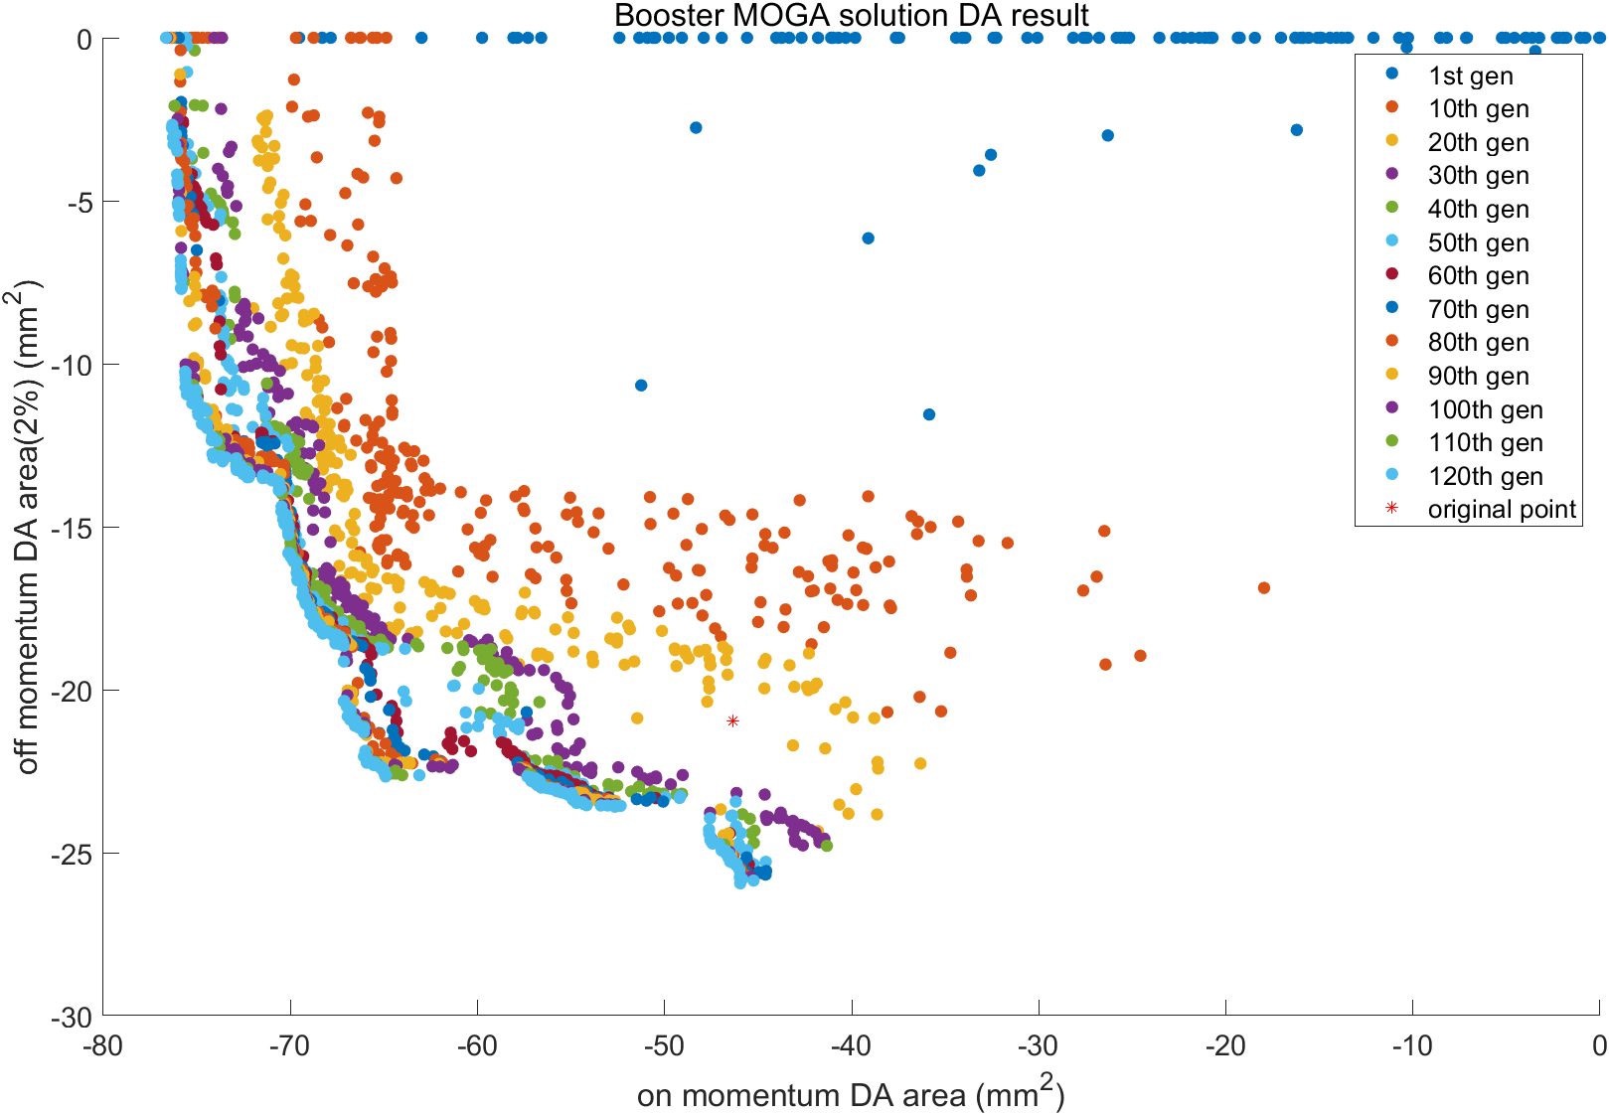
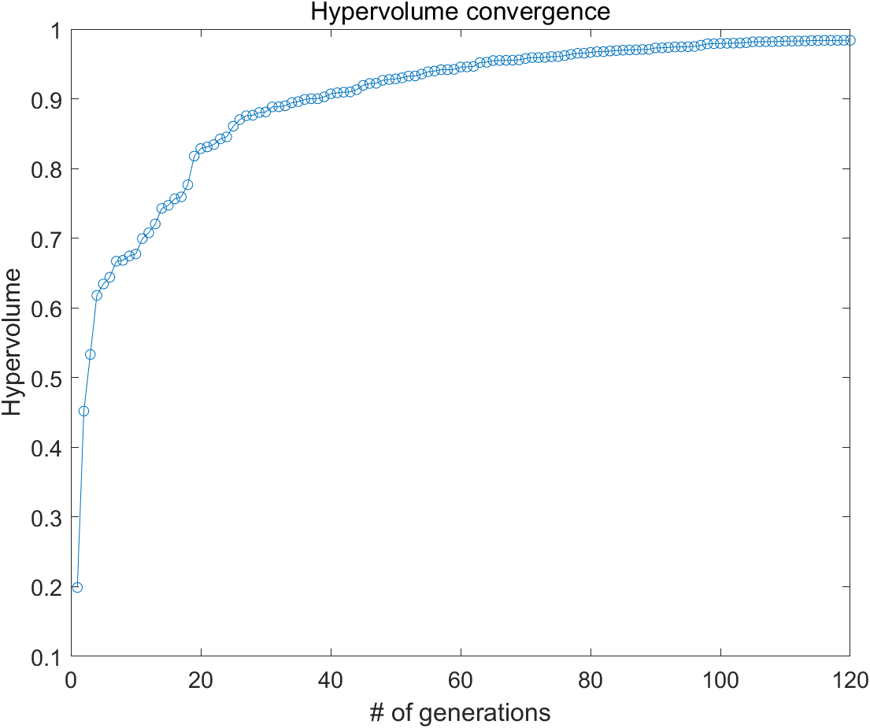
Booster MOGA simulation result

Slide 9
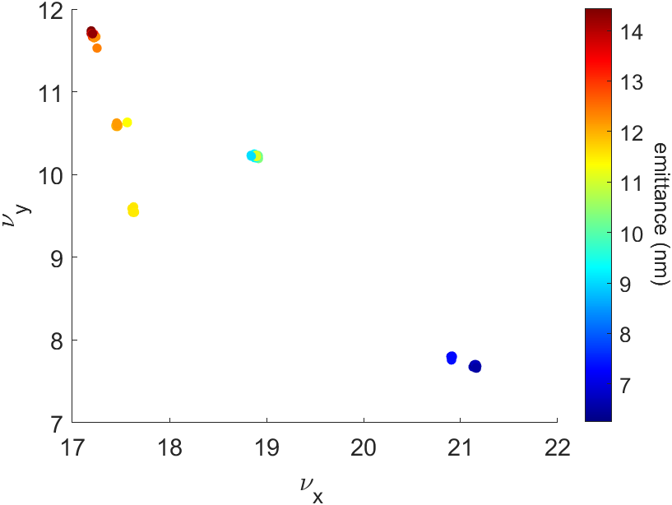
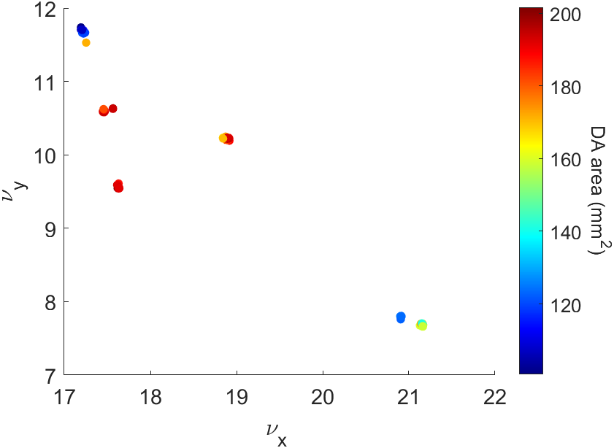
Booster MOGA simulation result (Final generation)
These three figures show the natural emittance and the sum of the On/Off momentum DA area across 256 populations in tune space of the 120th generation.
We can observe six clusters of the 256 populations. Each cluster's populations share similar lattice characteristics.
The populations within the blue box have the largest DA area, while those in the red box have the second-largest DA area.

Slide 10
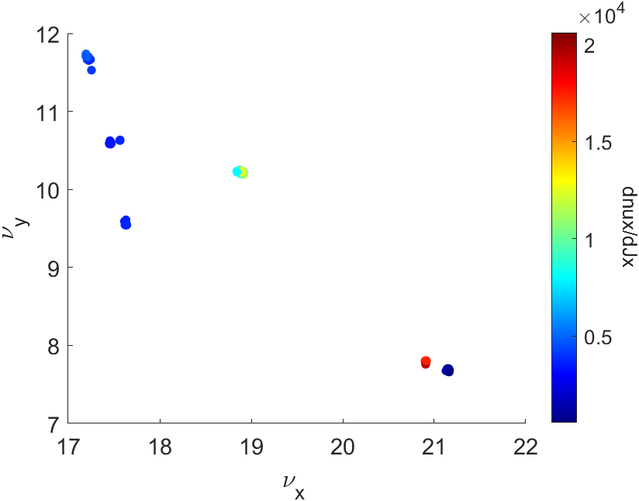
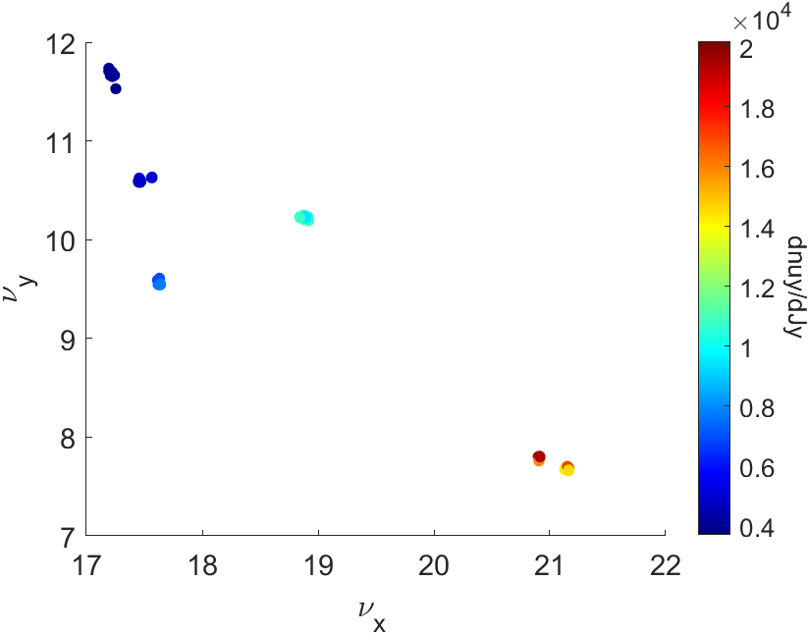
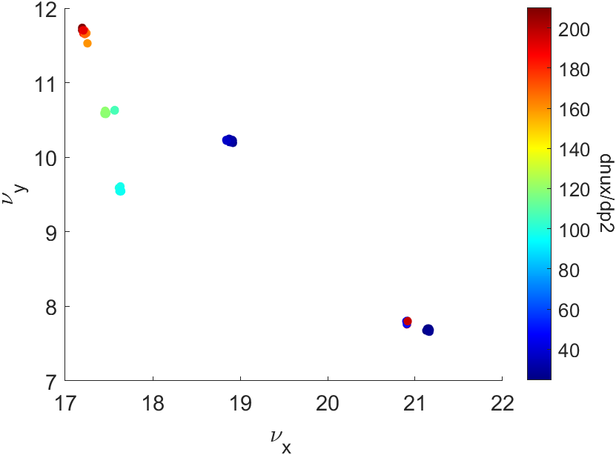
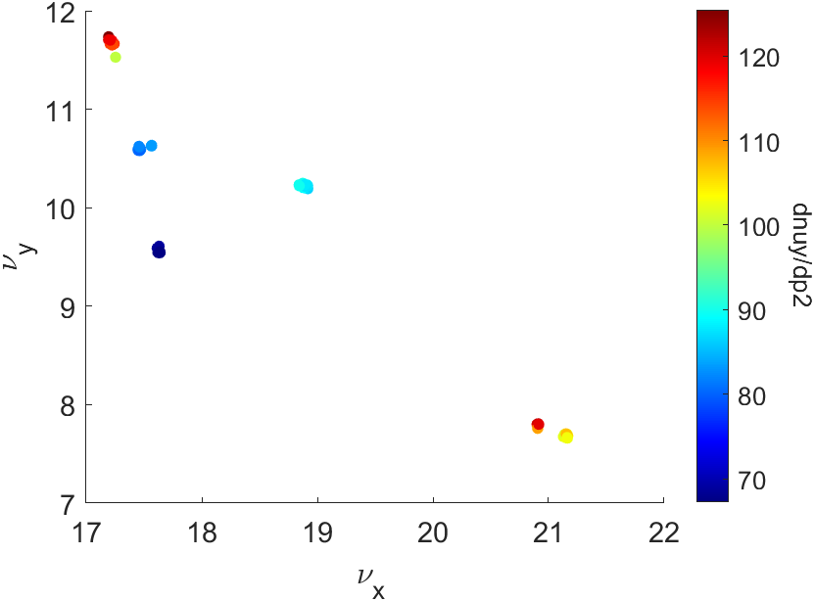
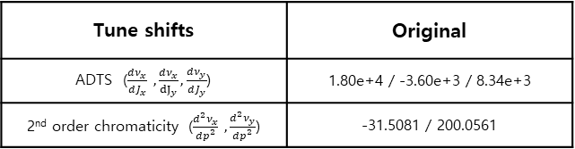
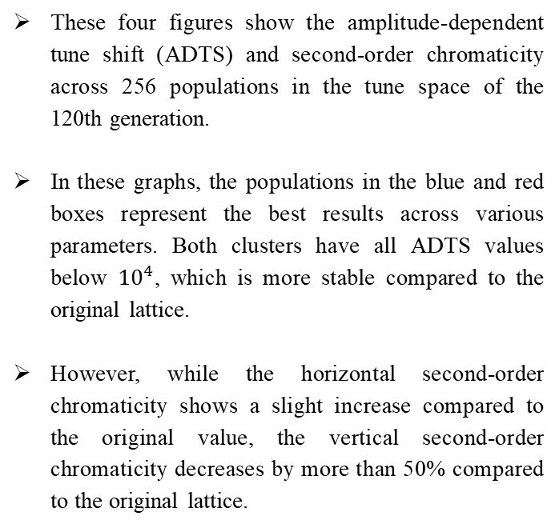
Booster MOGA simulation result(Final generation)
These four figures show the amplitude-dependent tune shift (ADTS) and second-order chromaticity across 256 populations in the tune space of the 120th generation.
In these graphs, the populations in the blue and red boxes represent the best results across various parameters. Both clusters have all ADTS values below ${10}^{4}$, which is more stable compared to the original lattice.
However, while the horizontal second-order chromaticity shows a slight increase compared to the original value, the vertical second-order chromaticity decreases by more than 50% compared to the original lattice.
Tune shifts | Original
ADTS ($\frac{dν_{x}}{dJ_{x}} ,\frac{dν_{x}}{{dJ}_{y}},\frac{dν_{y}}{dJ_{y}}$) | 1.80e+4 / -3.60e+3 / 8.34e+3
2nd order chromaticity ($\frac{d^{2}ν_{x}}{dp^{2}} ,\frac{d^{2}ν_{y}}{dp^{2}}$) | -31.5081 / 200.0561

Slide 11
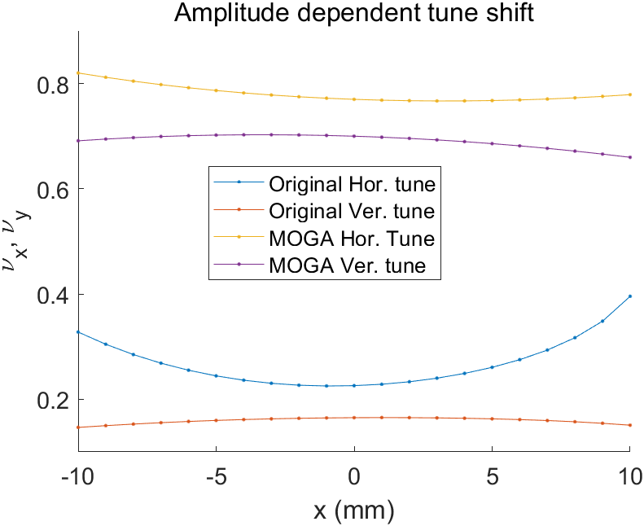
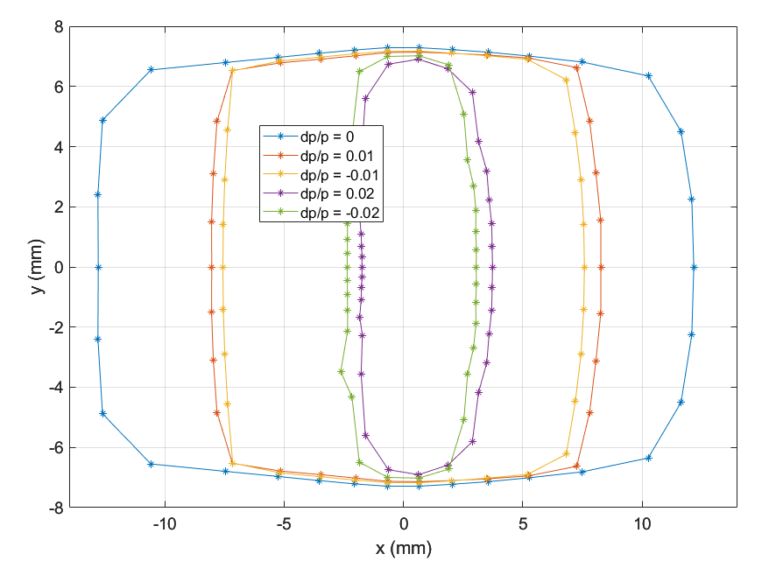
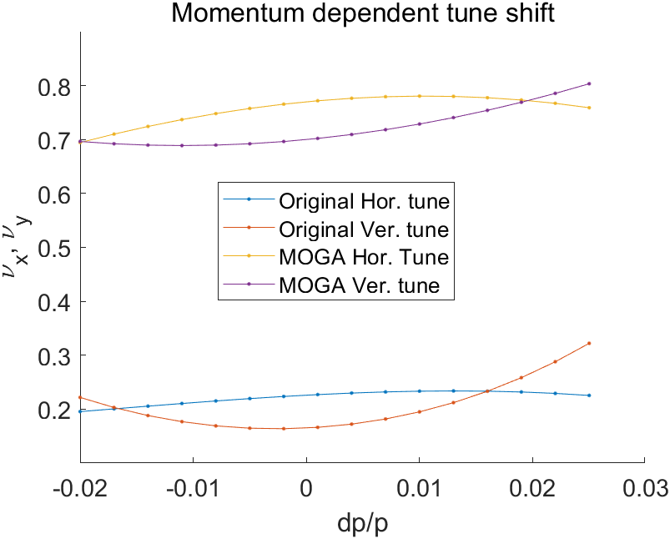
Booster optics update

Slide 12
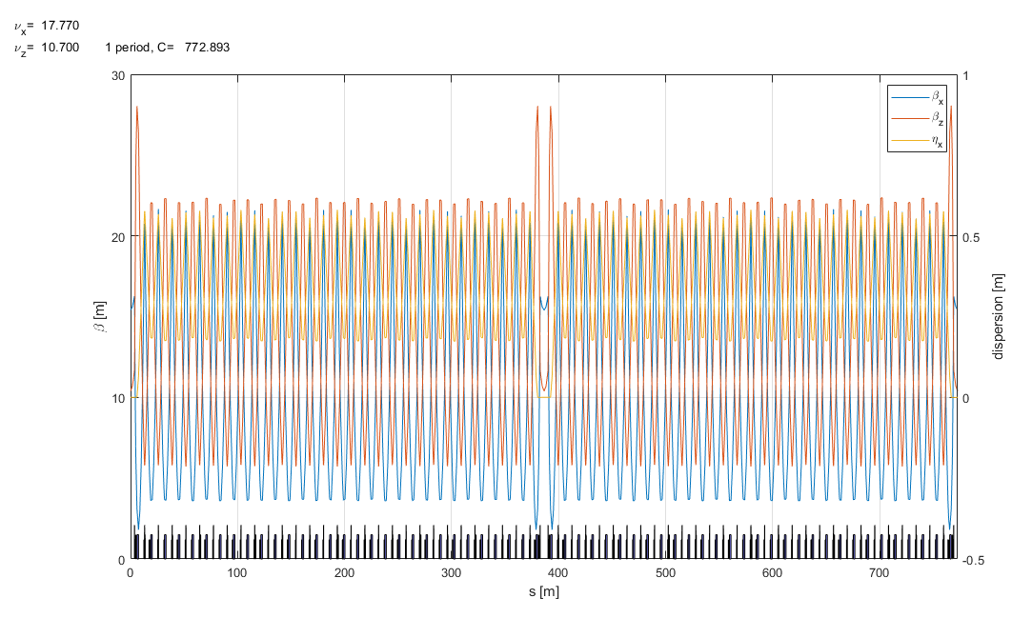
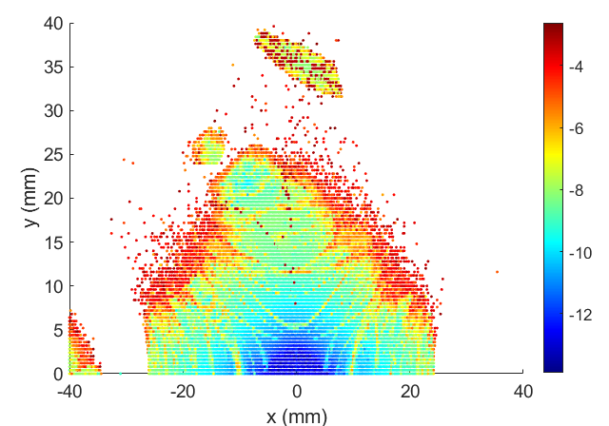
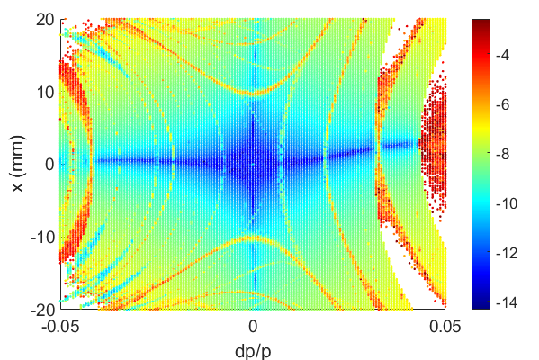
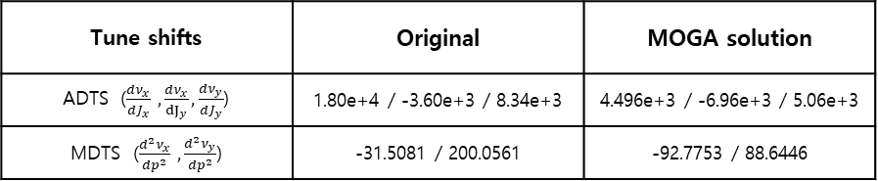
Booster optics update
Frequency map analysis
(w/o aperture)
New parameters
Hor. Tune = 17.770
Ver. Tune = 10.700
Hor. Emitt = 10.89nm @ 4GeV
Twiss function at Injection point
Hor. Beta = 15. 403
Ver. Beta = 10.397
Dispersion = 0.0
Nat. Chrom = (-22.2238, -15.3008)
Tune shifts | Original | MOGA solution
ADTS ($\frac{dν_{x}}{dJ_{x}} ,\frac{dν_{x}}{{dJ}_{y}},\frac{dν_{y}}{dJ_{y}}$) | 1.80e+4 / -3.60e+3 / 8.34e+3 | 4.496e+3 / -6.96e+3 / 5.06e+3
MDTS ($\frac{d^{2}ν_{x}}{dp^{2}} ,\frac{d^{2}ν_{y}}{dp^{2}}$) | -31.5081 / 200.0561 | -92.7753 / 88.6446

Slide 13

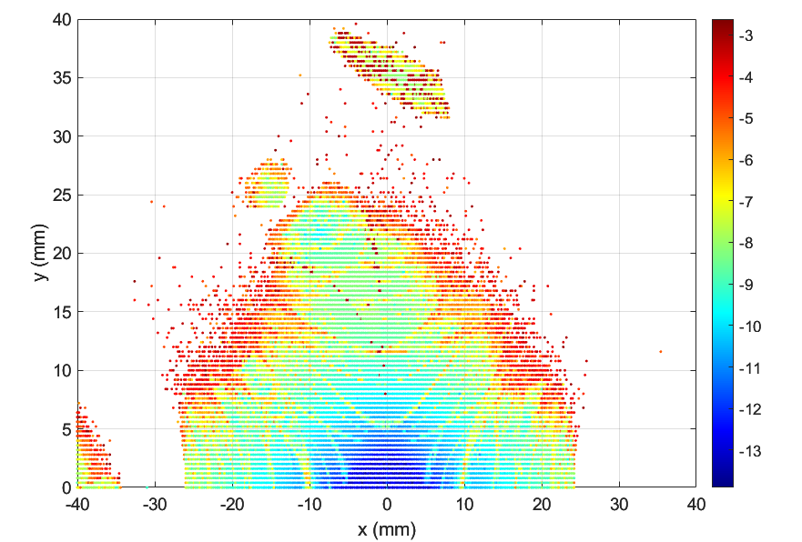
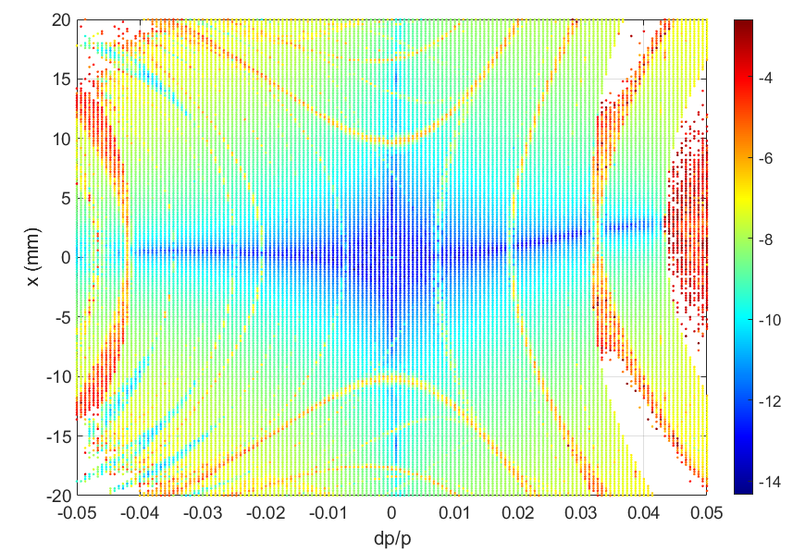
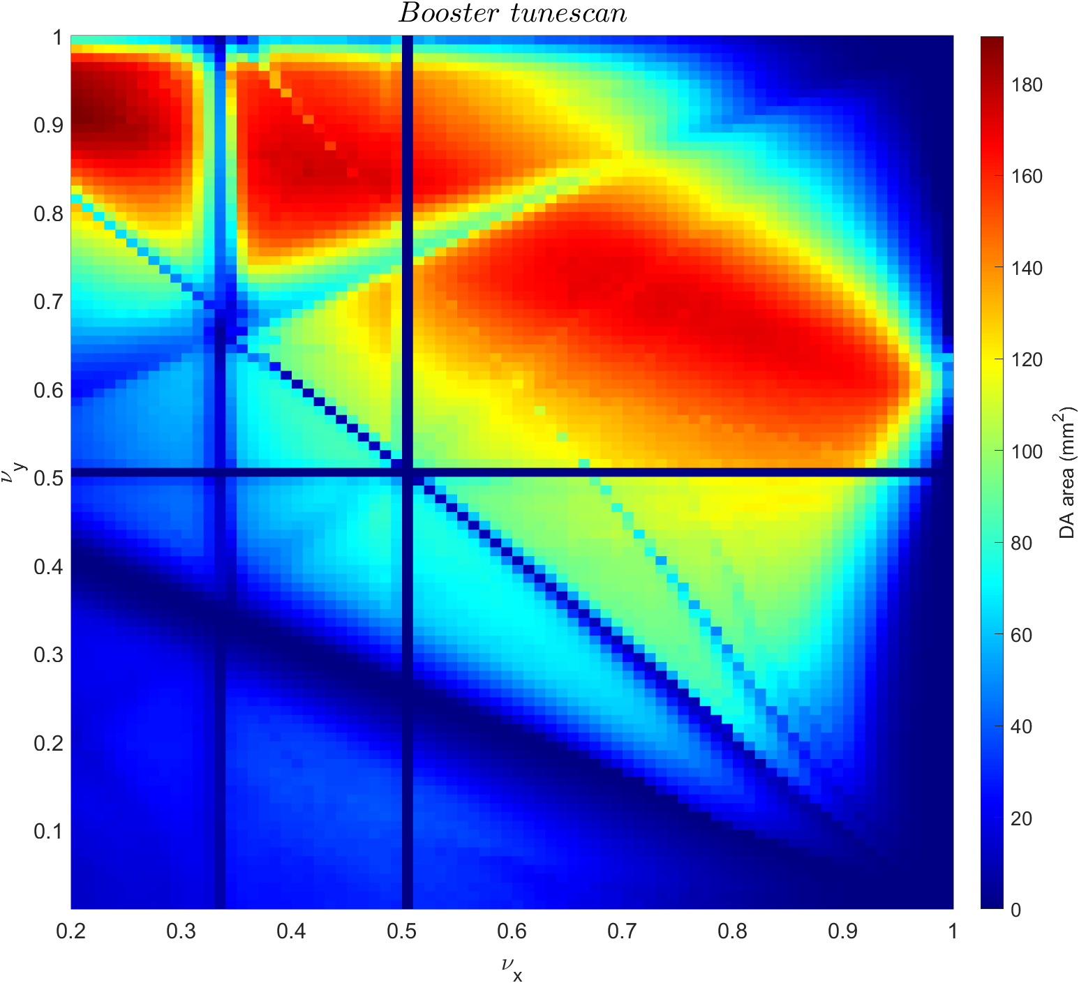
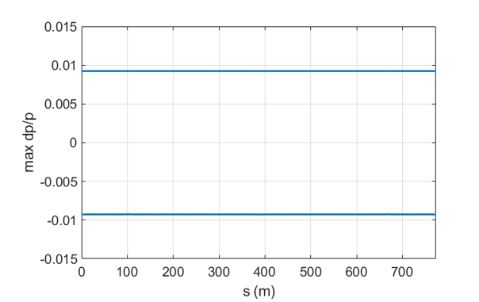
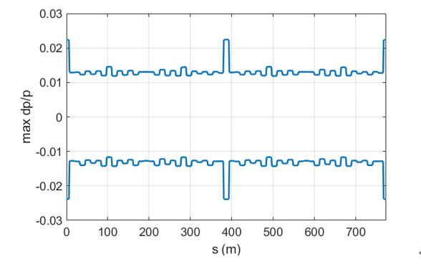
Booster beam dynamics
Tune scan
(color-code: DA area)
*tuning knobs: two quads families in
long straights and one quad family
in unit FODO cell
Frequency map analysis (w/o physical aperture)
Local momentum aperture (w/ physical aperture)
E = 200 MeV
E = 4 GeV

Slide 14
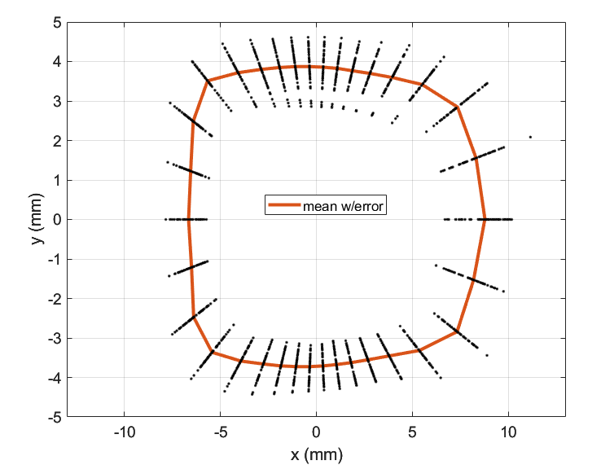
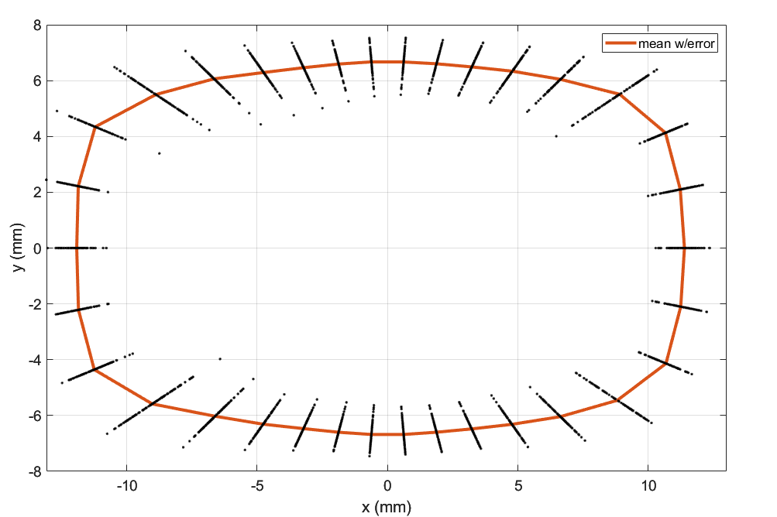


DA w/ magnet alignment error & magnet strength error
DA w/o error
Booster update
Original booster
DA w/ magnet alignment error & magnet strength error
Original booster
Booster update
$\frac{dp}{p}$ = 0
$\frac{dp}{p}$ = 0

Slide 15
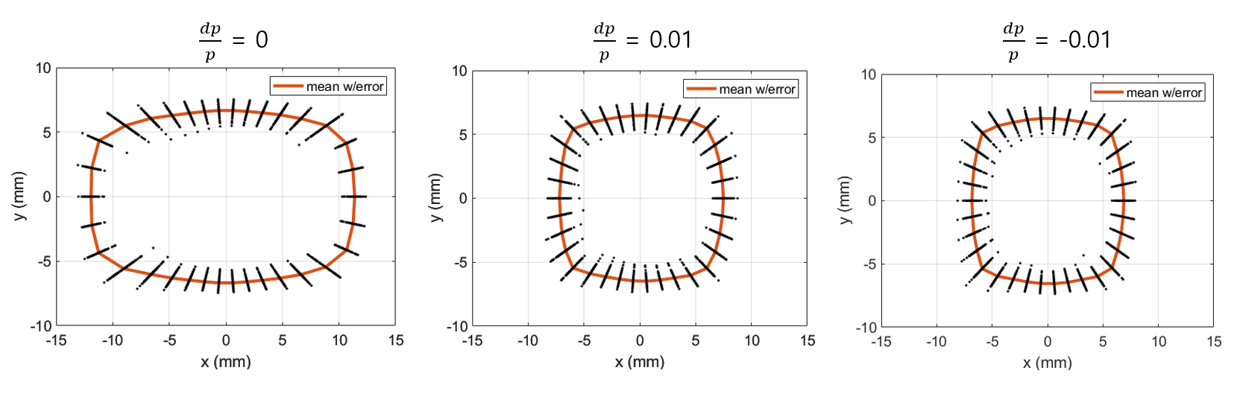
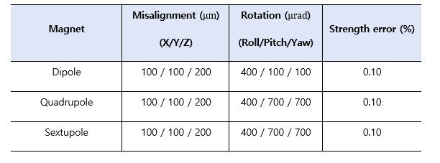
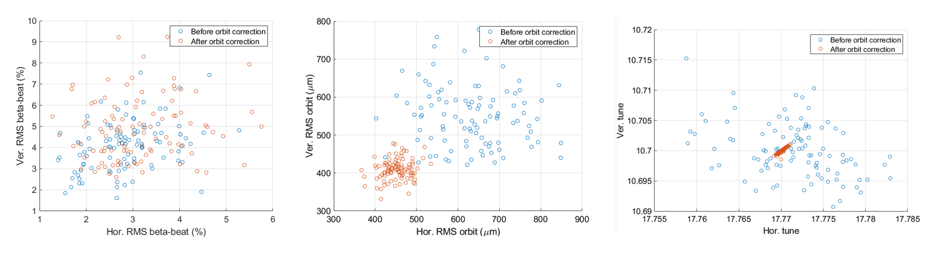
Booster error study
DA with errors
Beta-beat, rms orbit, and tune
Booster correction chain
trajectory correction
rf correction
orbit correction
no BBA and no LOCO assumed

Slide 16
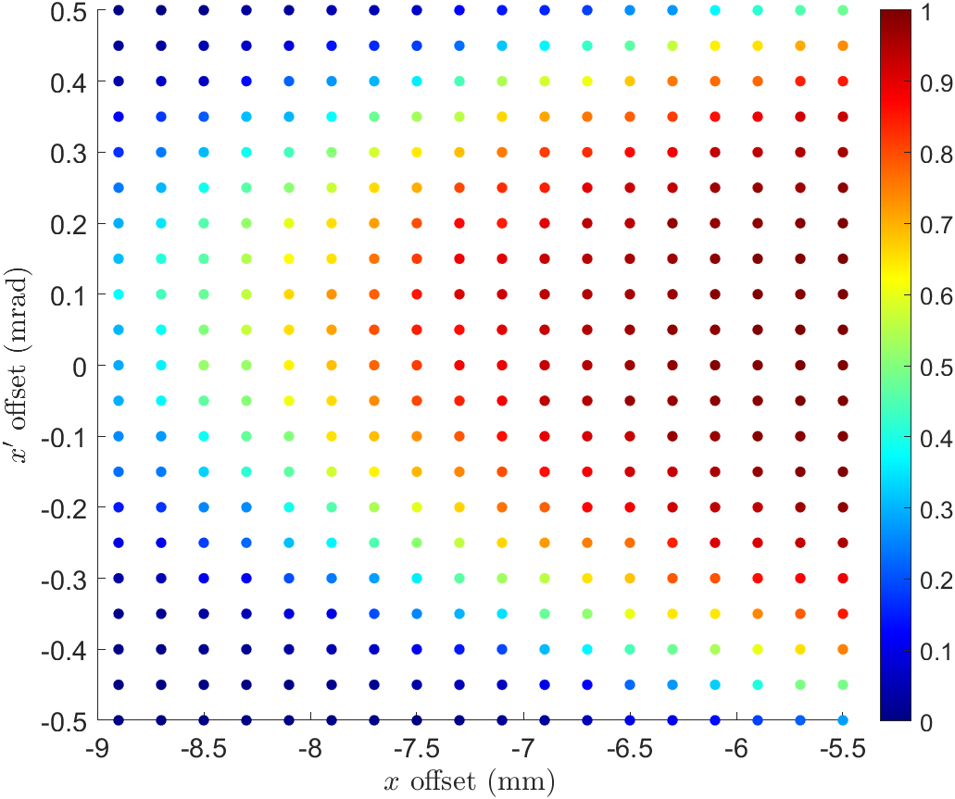
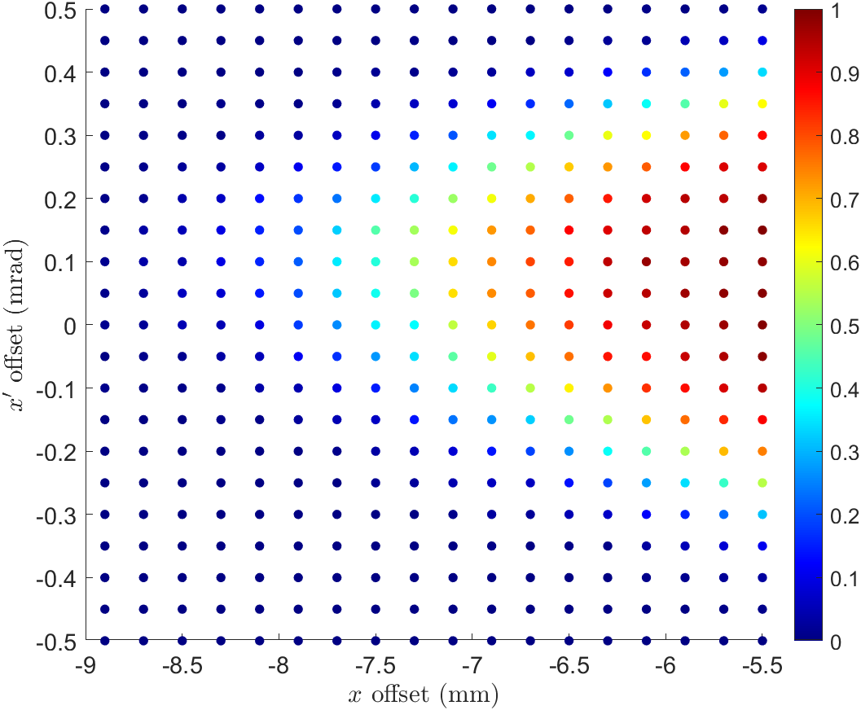
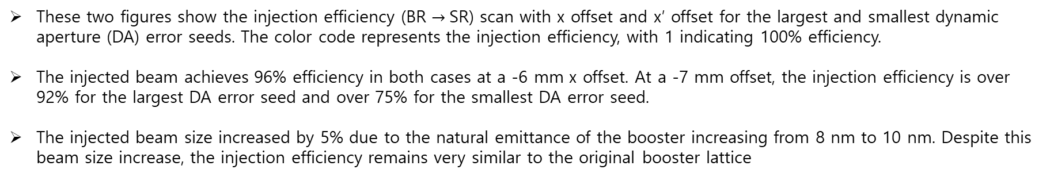
Injection efficiency with new Booster lattice
These two figures show the injection efficiency (BR $→$SR) scan with x offset and x′ offset for the largest and smallest dynamic aperture (DA) error seeds. The color code represents the injection efficiency, with 1 indicating 100% efficiency.
The injected beam achieves 96% efficiency in both cases at a -6 mm x offset. At a -7 mm offset, the injection efficiency is over 92% for the largest DA error seed and over 75% for the smallest DA error seed.
The injected beam size increased by 5% due to the natural emittance of the booster increasing from 8 nm to 10 nm. Despite this beam size increase, the injection efficiency remains very similar to the original booster lattice

Slide 17
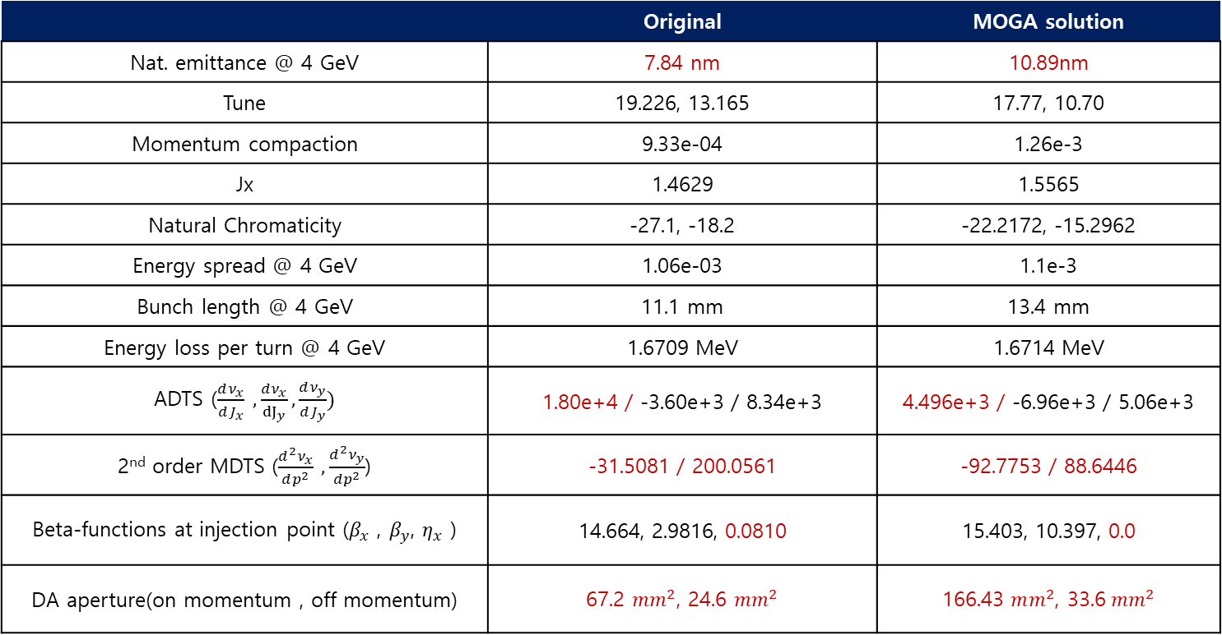
Comparison of the Booster parameter
Booster ring parameter
 | Original | MOGA solution
Nat. emittance @ 4 GeV | 7.84 nm | 10.89nm
Tune | 19.226, 13.165 | 17.77, 10.70
Momentum compaction | 9.33e-04 | 1.26e-3
Jx | 1.4629 | 1.5565
Natural Chromaticity | -27.1, -18.2 | -22.2172, -15.2962
Energy spread @ 4 GeV | 1.06e-03 | 1.1e-3
Bunch length @ 4 GeV | 11.1 mm | 13.4 mm
Energy loss per turn @ 4 GeV | 1.6709 MeV | 1.6714 MeV
ADTS ($\frac{dν_{x}}{dJ_{x}} ,\frac{dν_{x}}{{dJ}_{y}},\frac{dν_{y}}{dJ_{y}})$ | 1.80e+4 / -3.60e+3 / 8.34e+3 | 4.496e+3 / -6.96e+3 / 5.06e+3
2nd order MDTS ($\frac{d^{2}ν_{x}}{dp^{2}} ,\frac{d^{2}ν_{y}}{dp^{2}}$) | -31.5081 / 200.0561 | -92.7753 / 88.6446
Beta-functions at injection point ($β_{x}$ , $β_{y}$, $η_{x}$ ) | 14.664, 2.9816, 0.0810 | 15.403, 10.397, 0.0
DA aperture(on momentum , off momentum) | 67.2 $mm^{2}$, 24.6 $mm^{2}$ | 166.43 $mm^{2}$, 33.6$mm^{2}$

Slide 18
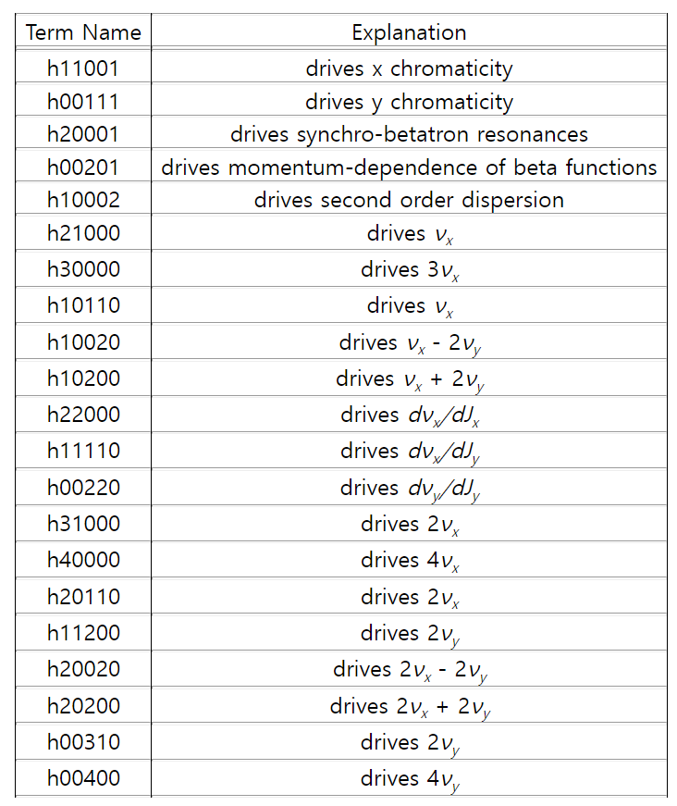
Comparison of one-turn resonance driving terms
 | Orignal | Update | Ratio (update/original)
h11001 | 4.631 | 7.211 | 1.557
h00111 | 9.171 | 11.836 | 1.291
h10100 | 0.000 | 0.000
h10010 | 0.000 | 0.000
h21000 | 5.862 | 7.709 | 1.315
h30000 | 15.965 | 0.972 | 0.061
h10110 | 9.377 | 10.075 | 1.074
h10020 | 3.278 | 3.290 | 1.004
h10200 | 10.824 | 3.482 | 0.322
h20001 | 0.358 | 2.285 | 6.377
h00201 | 0.744 | 0.676 | 0.910
h10002 | 0.090 | 0.298 | 3.317
h22000 | 12822.751 | 3337.164 | 0.260
h11110 | 5464.975 | 11148.126 | 2.040
h00220 | 6637.550 | 3890.082 | 0.586
h31000 | 1271.205 | 93.878 | 0.074
h40000 | 300.149 | 19.461 | 0.065
h20110 | 765.204 | 157.827 | 0.206
h11200 | 615.354 | 141.216 | 0.229
h20020 | 421.407 | 99.437 | 0.236
h20200 | 425.162 | 122.164 | 0.287
h00310 | 359.866 | 74.248 | 0.206
h00400 | 108.448 | 24.771 | 0.228
https://ops.aps.anl.gov/manuals/elegant_latest/elegantsu82.html#x90-890007.71

Slide 19
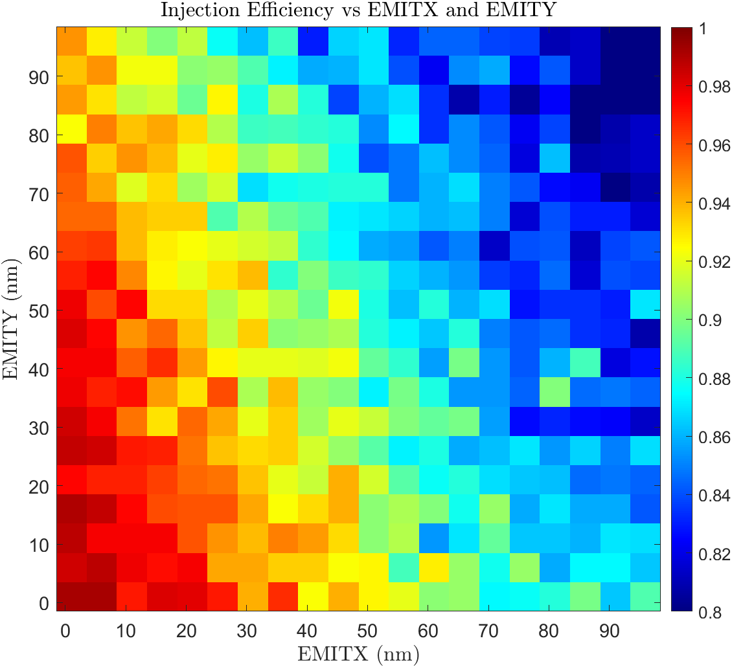
Beam physics group meeting
Injection Efficiency VS Injected Beam Emittance
Choosing average value of DA areas from DAs of 56 error seeds
Injection point is fixed.
  X = -6mm
  X’ = 0.0 rad
The horizontal/vertical (H/V) emittance varies from 0 to 100 nm.
The horizontal and vertical emittance achieves an injection efficiency of over 98% around 10 nm

Slide 20
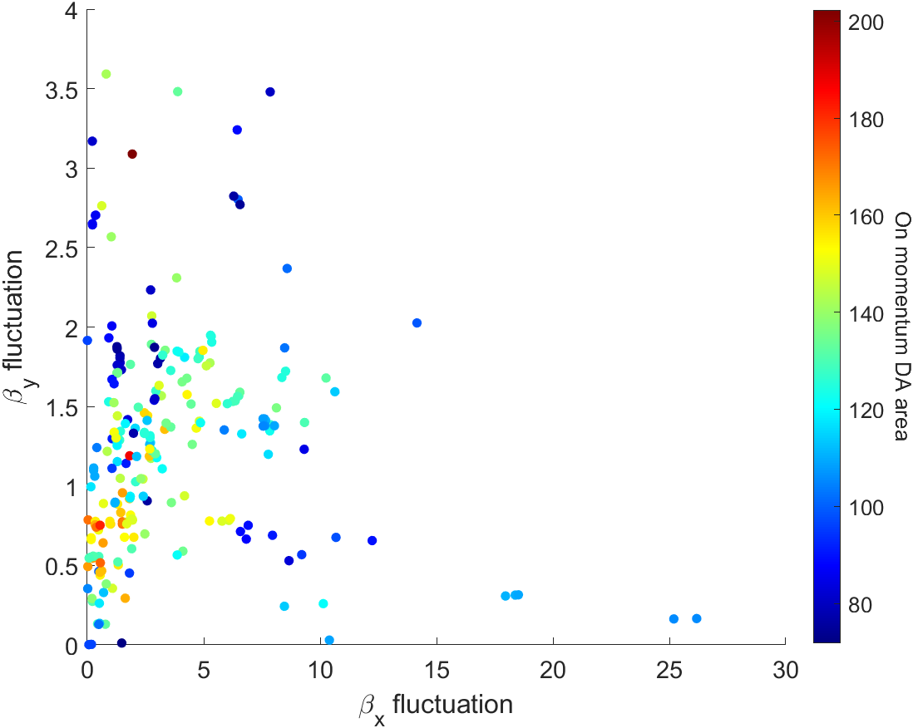
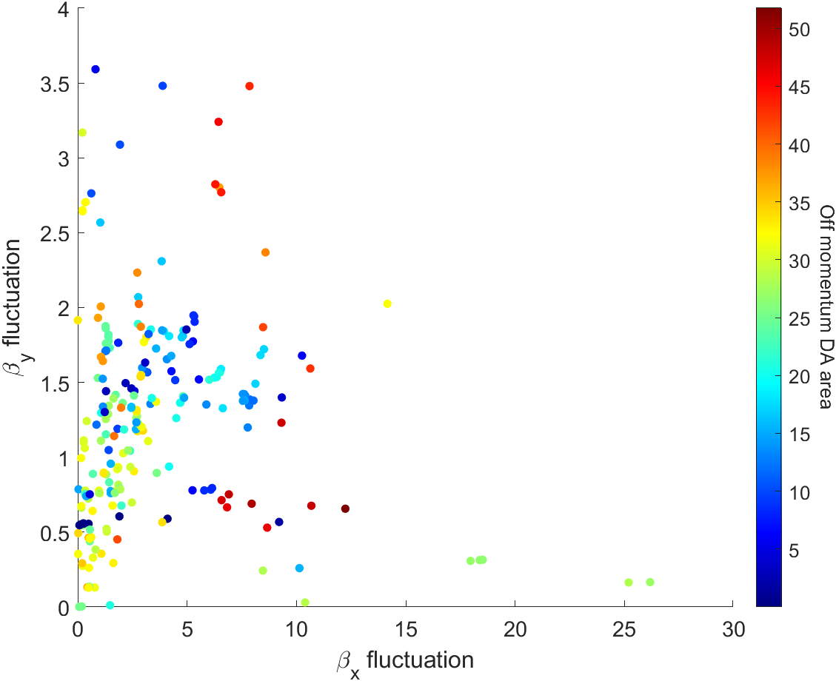
Beam physics group meeting
Booster MOGA simulation result(20th generation)

Slide 21

Thank you!

Slide 22




Booster MOGA simulation result(20th generation)

Slide 23





Booster MOGA simulation result(20th generation)

Slide 24




Booster MOGA simulation result(20th generation)

Slide 25








I want to represent a specific number that shows the fluctuation of the beta functions
$β_{x} and β_{y}$ of QF3_HALF positions in unit cells
Standard deviation of $β$at same phase advance difference
Max fluctuation of $β_{y}$
Min fluctuation of $β_{y}$

