Slide 1




Finding optimal tune and chromaticity of Korea-4GSR storage ring
Junha Kim
PAL, UNIST
Jaehyun Kim, Gyeongsu Jang, Jimin Seok, Jaeyu Lee, Moses Chung*
PAL, POSTECH
Notes:
Hello, I’m Junha Kim, a graduate student at UNIST and working at the Pohang Accelerator Laboratory. In this talk, I will present our progress on optimizing the Korea-4GSR storage ring, focusing on how we improved the dynamic aperture and Touschek lifetime

Slide 2

Tune & Chromaticity scan setting
We aimed to understand how the dynamic aperture (DA) and Touschek lifetime change with tune and chromaticity.
The DA and Touschek lifetime were calculated by averaging results over 2–3 different random error seeds.
Tune scan range :
Horizontal : 68.05 ~ 68.49
Vertical : 23.05 ~ 23.49
Chromaticity scan range :
Horizontal : 0 ~10, step size : 0.5 or 1.0
Vertical : 0 ~10 , step size : 0.5 or 1.0
2
Notes:
The purpose of this study is to understand how DA and Touschek lifetime vary with tune and chromaticity. To make the results more reliable, we averaged over two to three random error seeds.
For the tune scan, the horizontal tune was scanned from 68.05 to 68.49, and the vertical tune from 23.05 to 23.49. For the chromaticity scan, both horizontal and vertical chromaticities were varied from 0 to 10, with step sizes of 0.5 or 1.0.

Slide 3
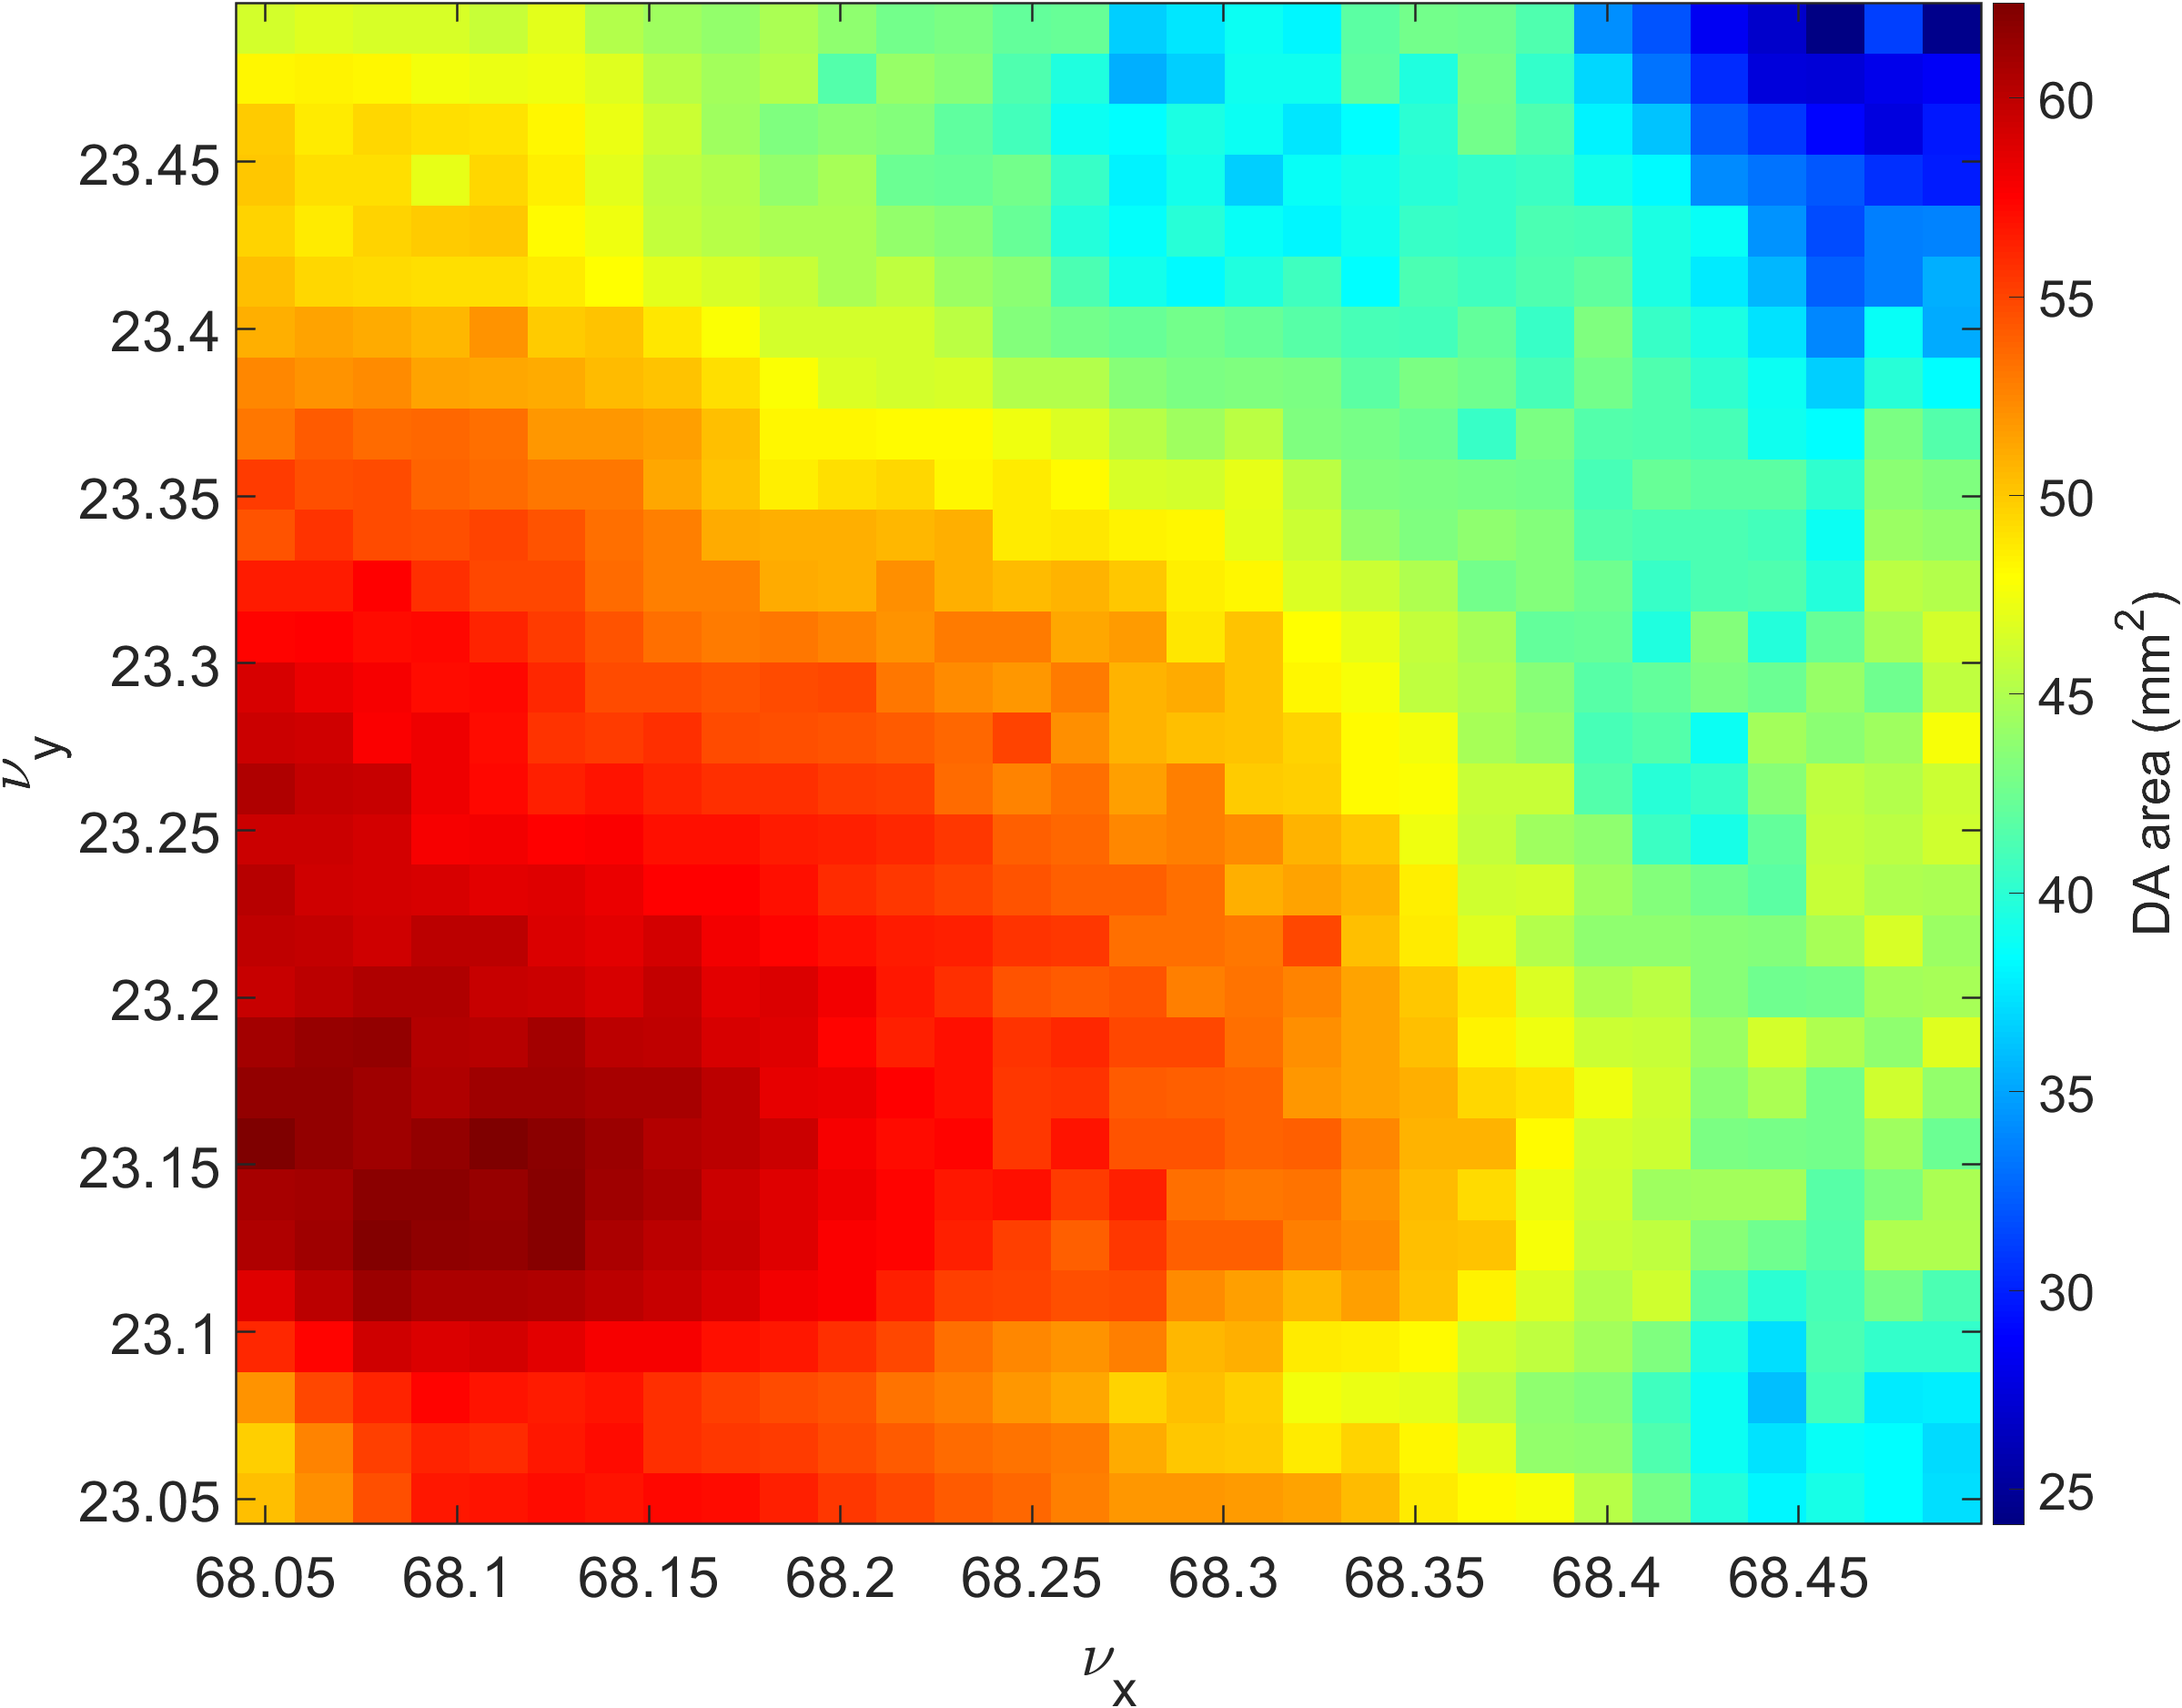
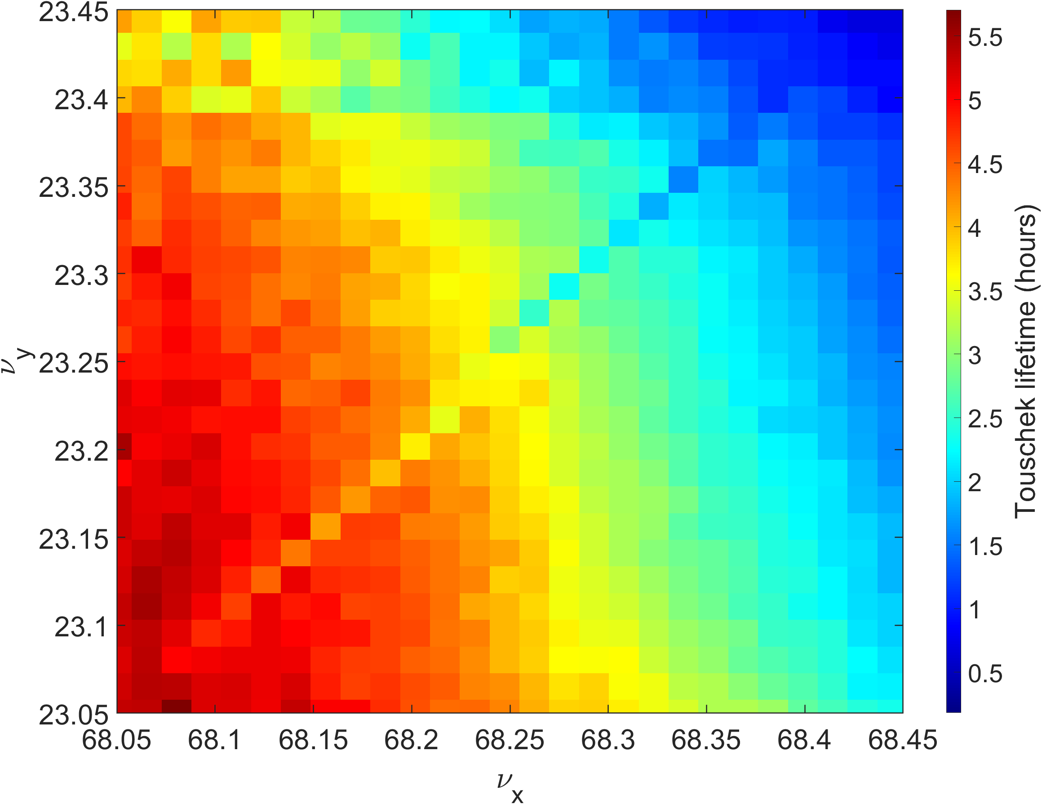
Tune scan results of DA and lifetime
Average of DA area result with 3 error seed
Average of lifetime result with 3 error seed
: Original tune point
3
Notes:
These plots show the results of the tune scan for DA and lifetime, averaged over three error seeds.
The star marks the original working point of the lattice. When both tunes are shifted to smaller values, the DA area becomes larger, and the Touschek lifetime also increases.
This shows that the choice of working point strongly affects performance.

Slide 4
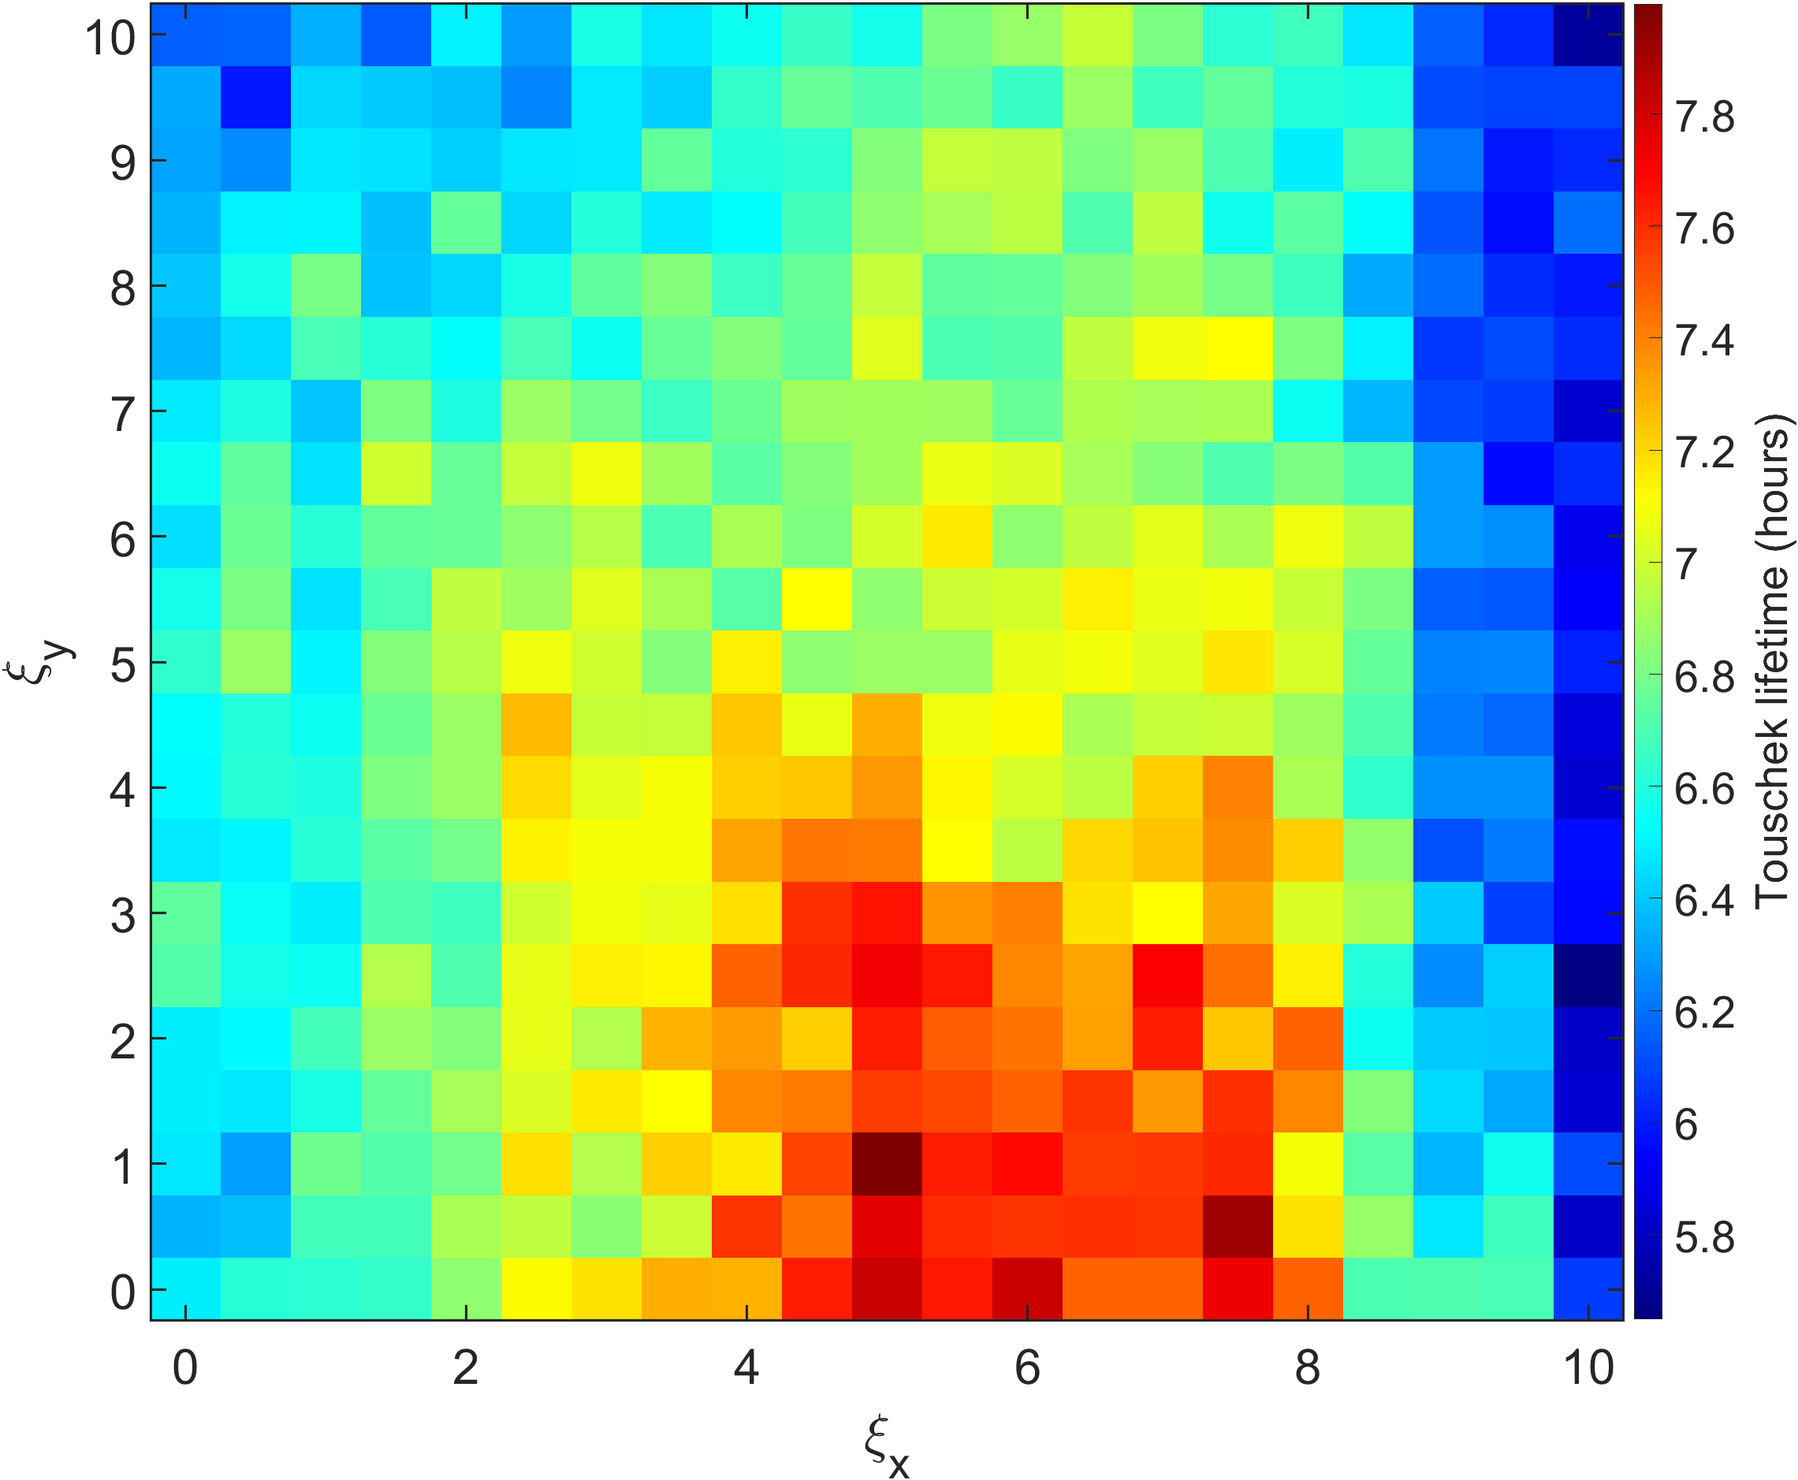
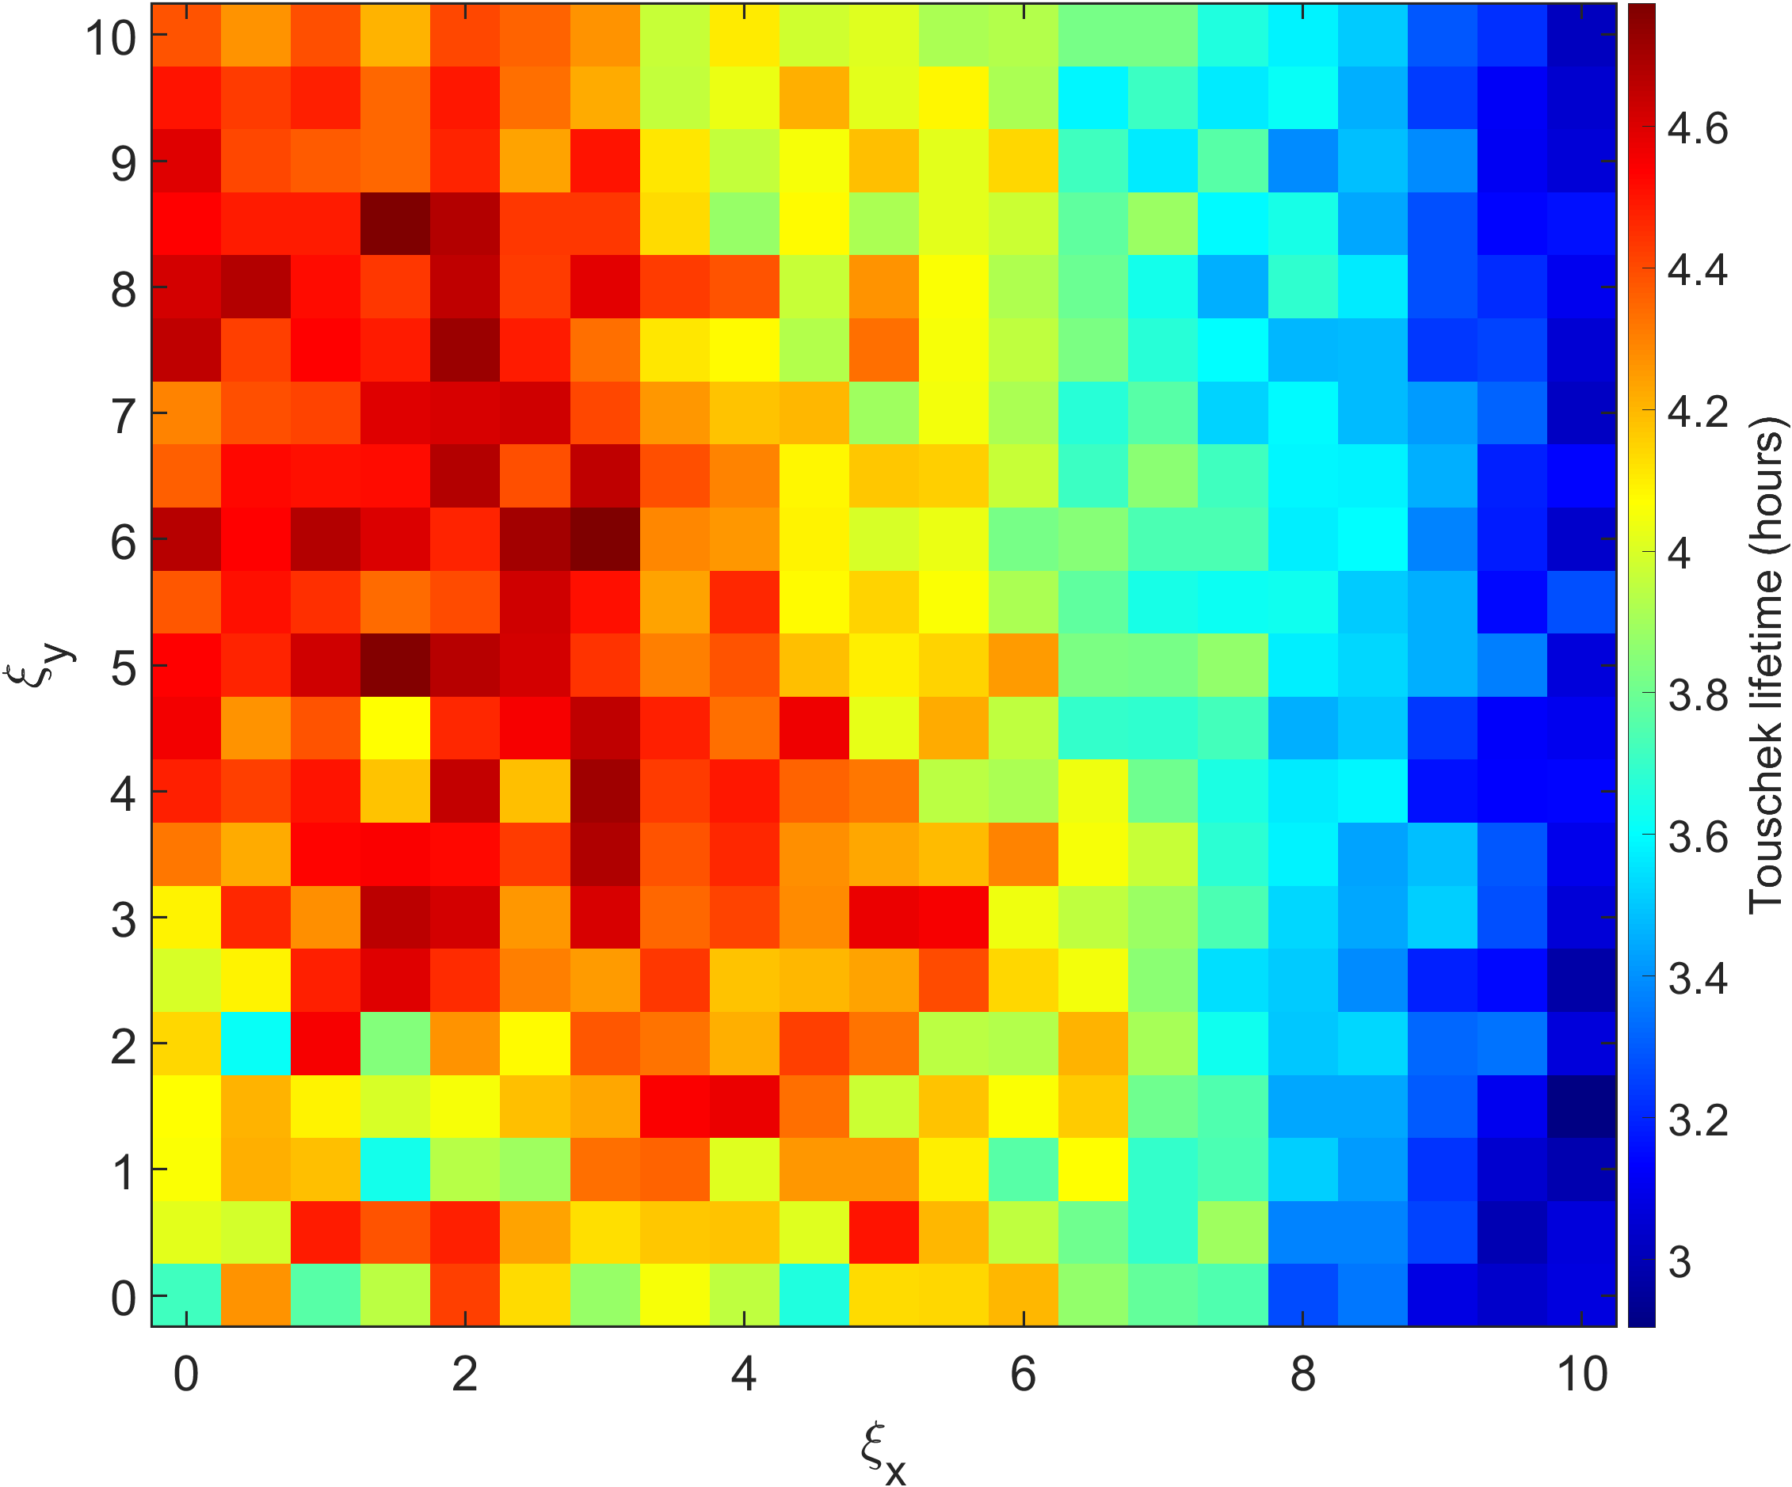
Result of chromaticity scan with error
Lifetime result with bare lattice
Lifetime result with error
: Original chromaticity point
The results of chromaticity scan for DA along with / without error are similar tendency
But results of lifetime are not. The error seed prefer low horizontal chromaticity and high vertical chromaticity
4
Notes:
These plots show the results of the chromaticity scan for Touschek lifetime, both for the bare lattice (left) and error lattice (right).
In the bare lattice case, the lifetime is larger when the horizontal chromaticity is high and the vertical chromaticity is low. So, we expected the error lattice to show the same trend. However, the result is different: with errors, the lattice prefers low horizontal and high vertical chromaticity for longer lifetime.

Slide 5
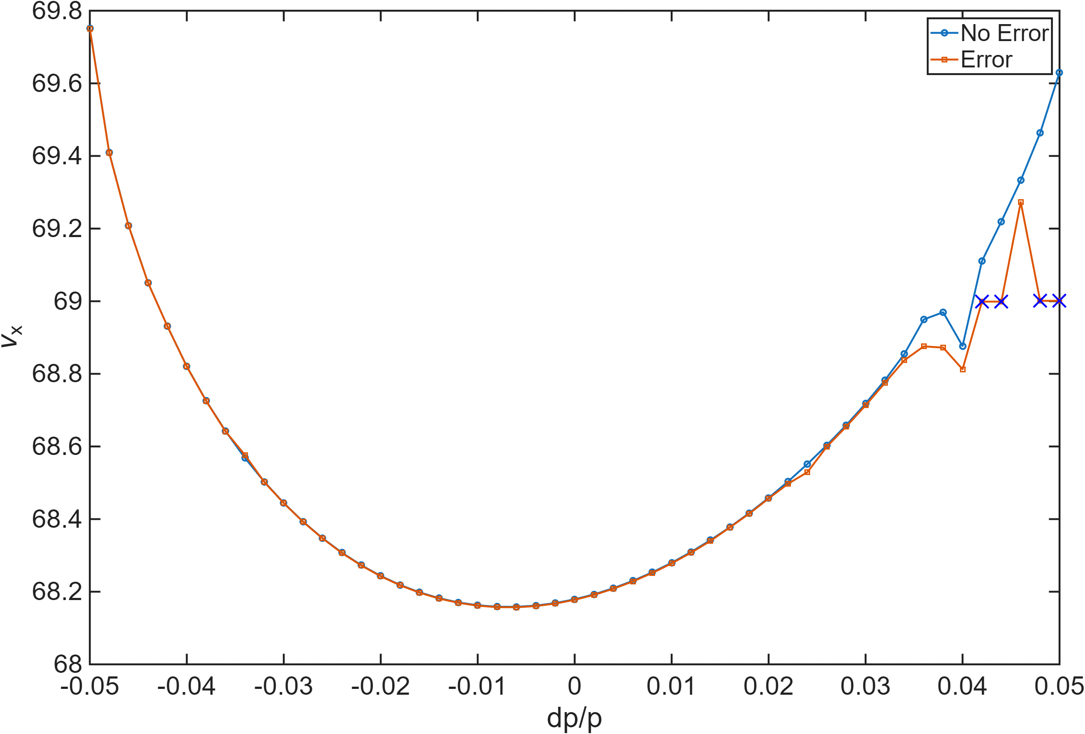
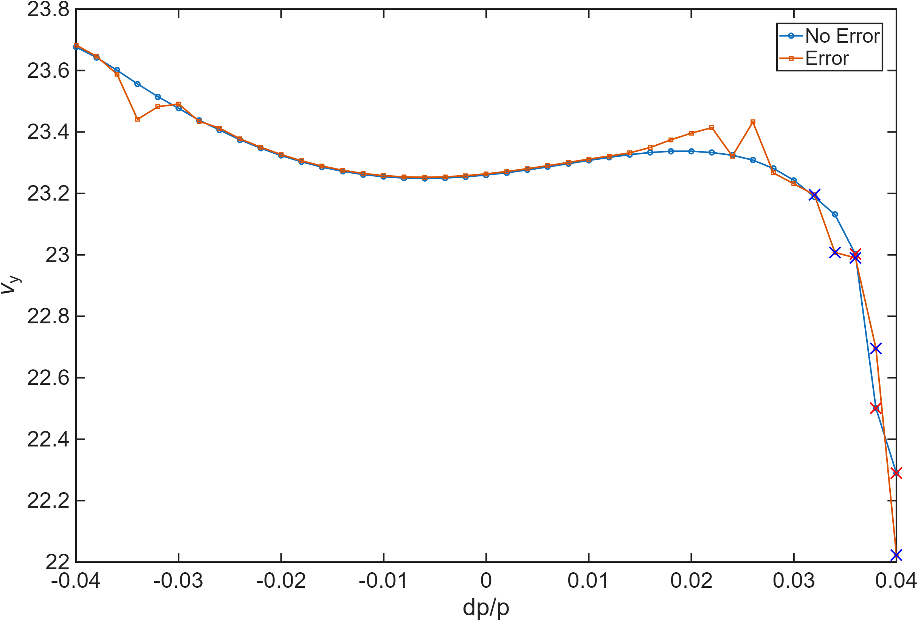

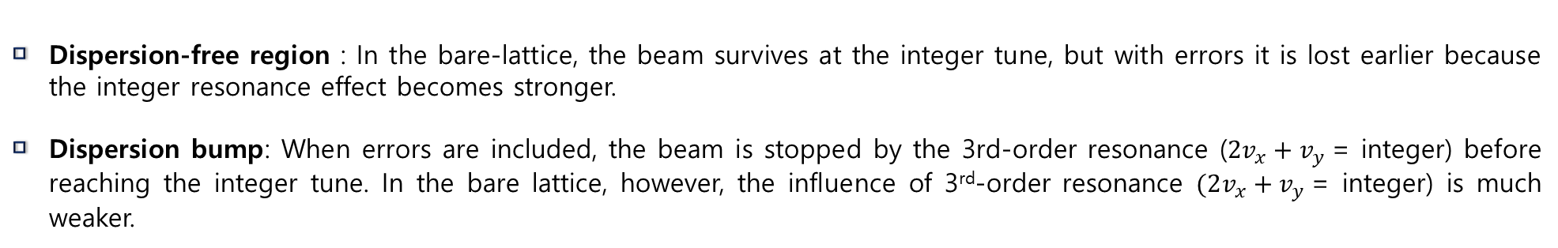
MDTS curves at dispersion free region and dispersion bump
Hor. MDTS @ dispersion free
Ver. MDTS @ dispersion bump
$$2v_{x}+v_{y}=integer$$
Dispersion-free region : In the bare-lattice, the beam survives at the integer tune, but with errors it is lost earlier because the integer resonance effect becomes stronger.
Dispersion bump: When errors are included, the beam is stopped by the 3rd-order resonance ($2v_{x}+v_{y}$= integer) before reaching the integer tune. In the bare lattice, however, the influence of 3rd-order resonance $(2v_{x}+v_{y}$= integer) is much weaker.
5
Notes:
To understand the reason for this difference, we plotted the MDTS curves at two points, with and without errors.
On the dispersion-free region, in the bare lattice the beam survives at the integer tune. But with errors, the beam is lost due to stronger resonance effects.
On the dispersion bump (right), with errors the beam is lost already at the 3rd-order resonance before reaching the integer tune, while in the bare lattice the 3rd-order resonance has little effect. The beam is lost at integer tune. So in the bare lattice case, momentum aperture is established at higher momentum deviation
This explains why the lifetime behavior changes when errors are included.

Slide 6
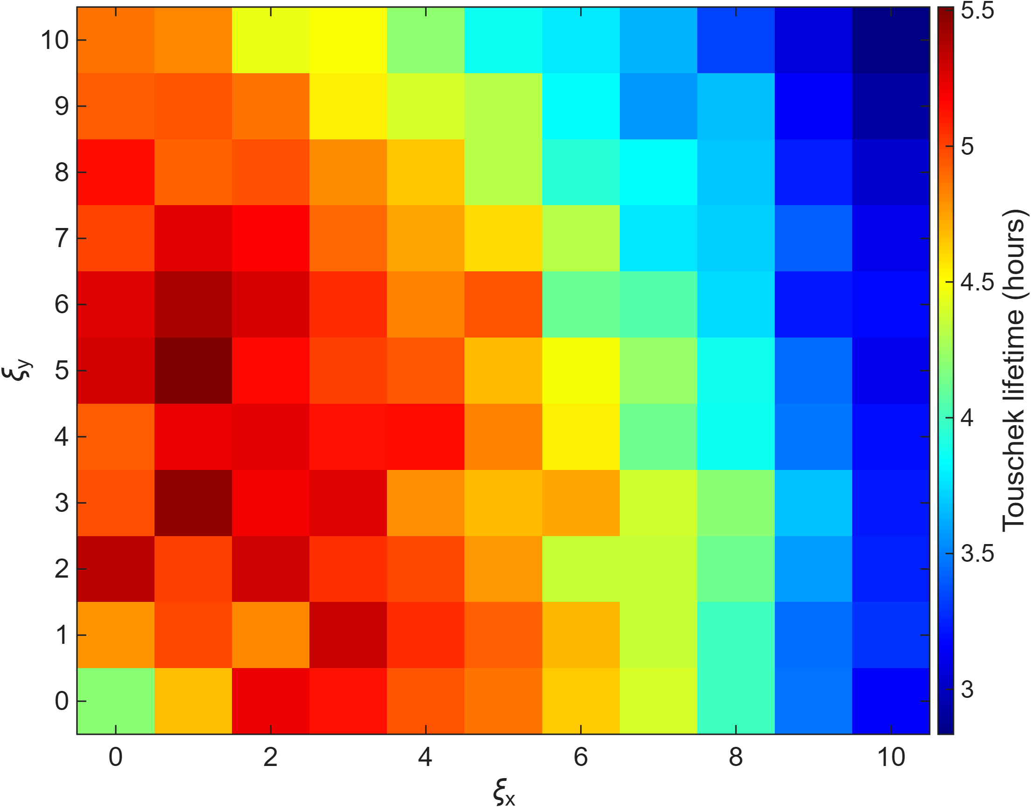
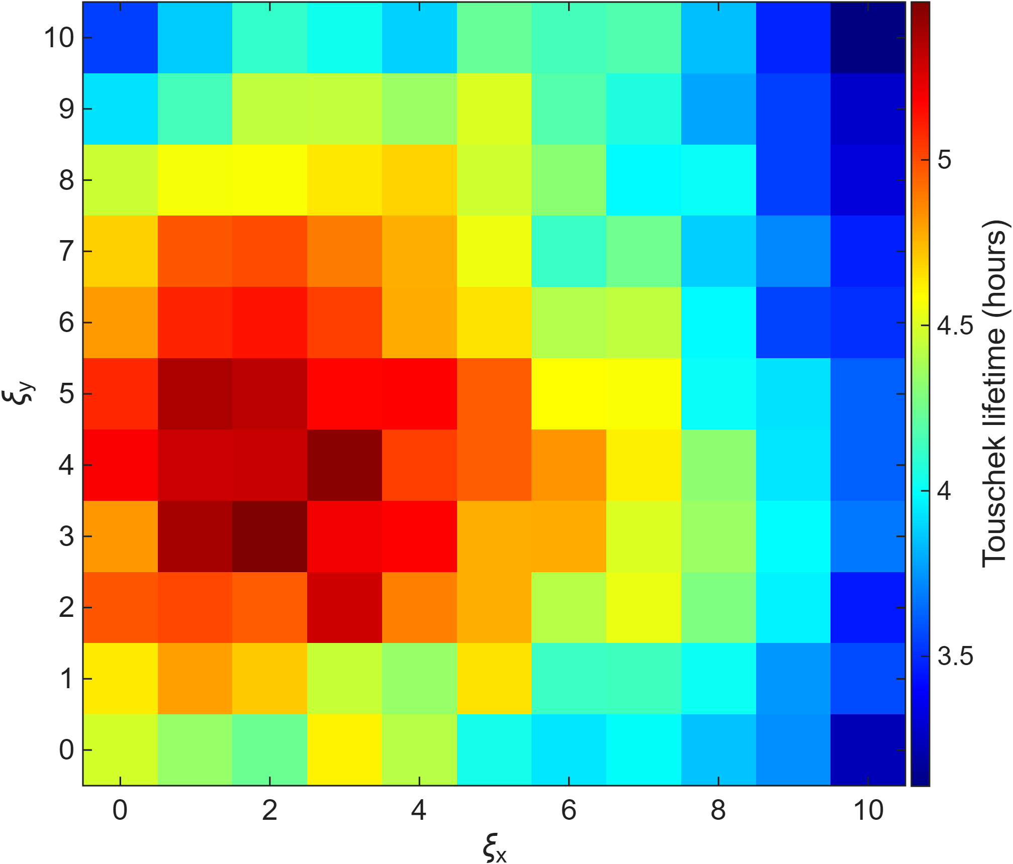
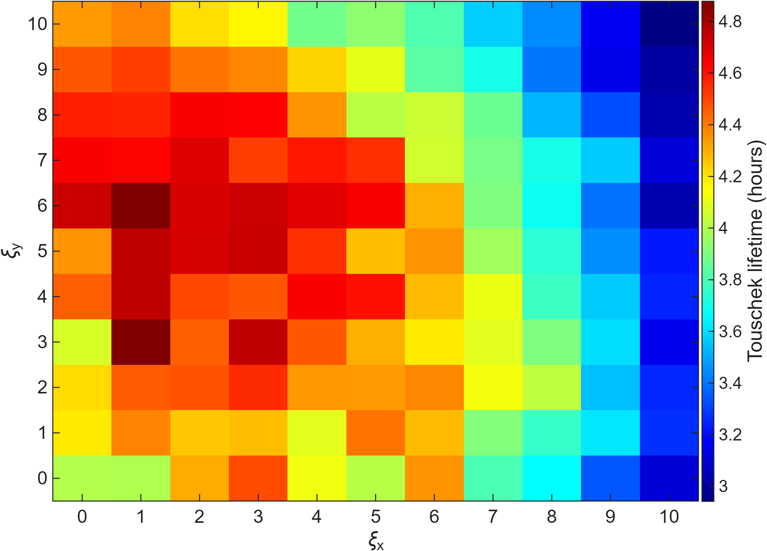
Chromaticity scan with different error seeds
Error RING 1
Error RING 2
Error RING 3
The chromaticity scan for lifetime was performed with three different error seeds.
In all cases, the trend is different from the bare-lattice case.
A common feature is that the lifetime is higher at low horizontal chromaticity and high vertical chromaticity.
6
Notes:
Previously, I showed results only for a single error seed. To check consistency, we generated three different error seeds and performed the same chromaticity scans.
In all three error lattices, the results differ from the bare lattice case. However, there is a common feature: lifetime is always higher with low horizontal and high vertical chromaticity.
This suggests that the preference for low ξx and high ξy is a robust property of error lattices.

Slide 7
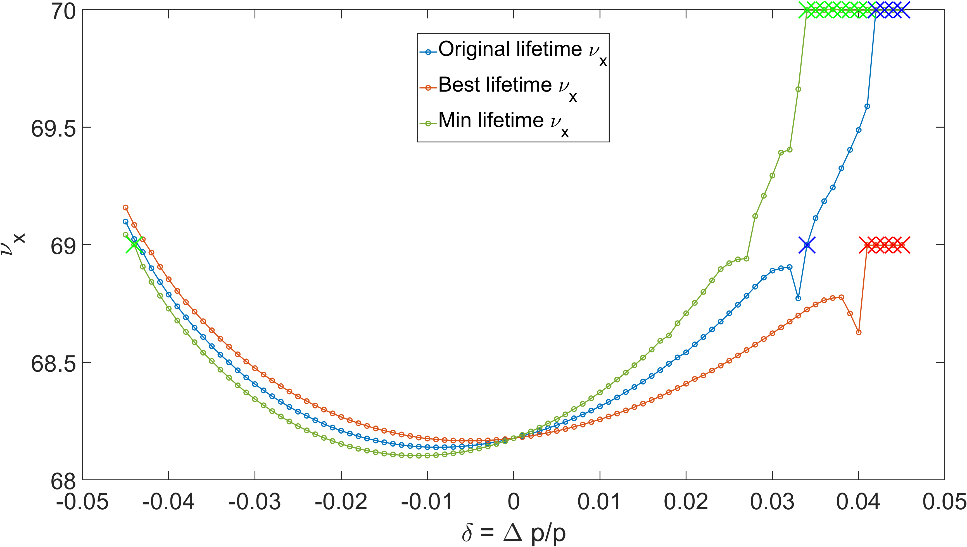
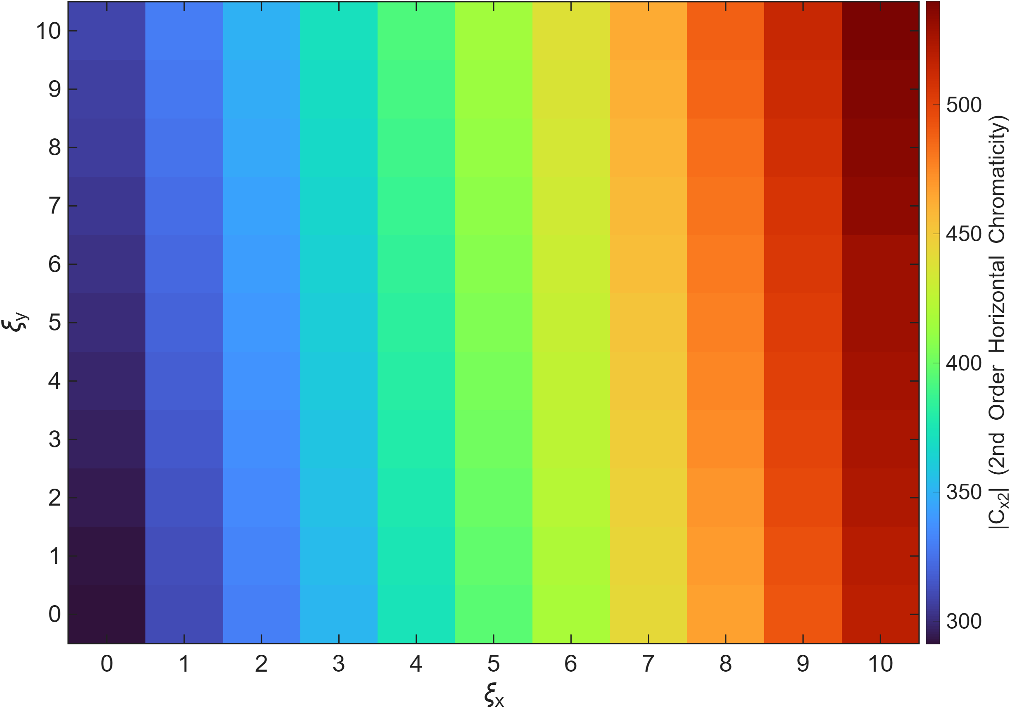
Lifetime trend analysis under varying chromaticity
Best
Original
Min
Best
Low horizontal chromaticity tend to has low 2nd order horizontal chromaticity. It can help reaching integer tune slower
So we can think the error lattices prefer low horizontal chromaticity
Original
Min
7
Notes:
Here, I’ll explain how the Touschek lifetime trend relates to chromaticity. On the left is the chromaticity scan for lifetime, where we marked three points: the best lifetime, the original lattice, and the minimum lifetime. Below that, you can see the corresponding 2nd-order horizontal chromaticity values, and on the right are the MDTS curves for the same three cases. What we find is that lattices with lower horizontal chromaticity also have smaller 2nd-order horizontal chromaticity. Because of this, the MDTS curve reaches the integer tune only at larger momentum deviation, which enlarges the momentum aperture and leads to a longer lifetime. Therefore, error lattices tend to favor low horizontal chromaticity.

Slide 8
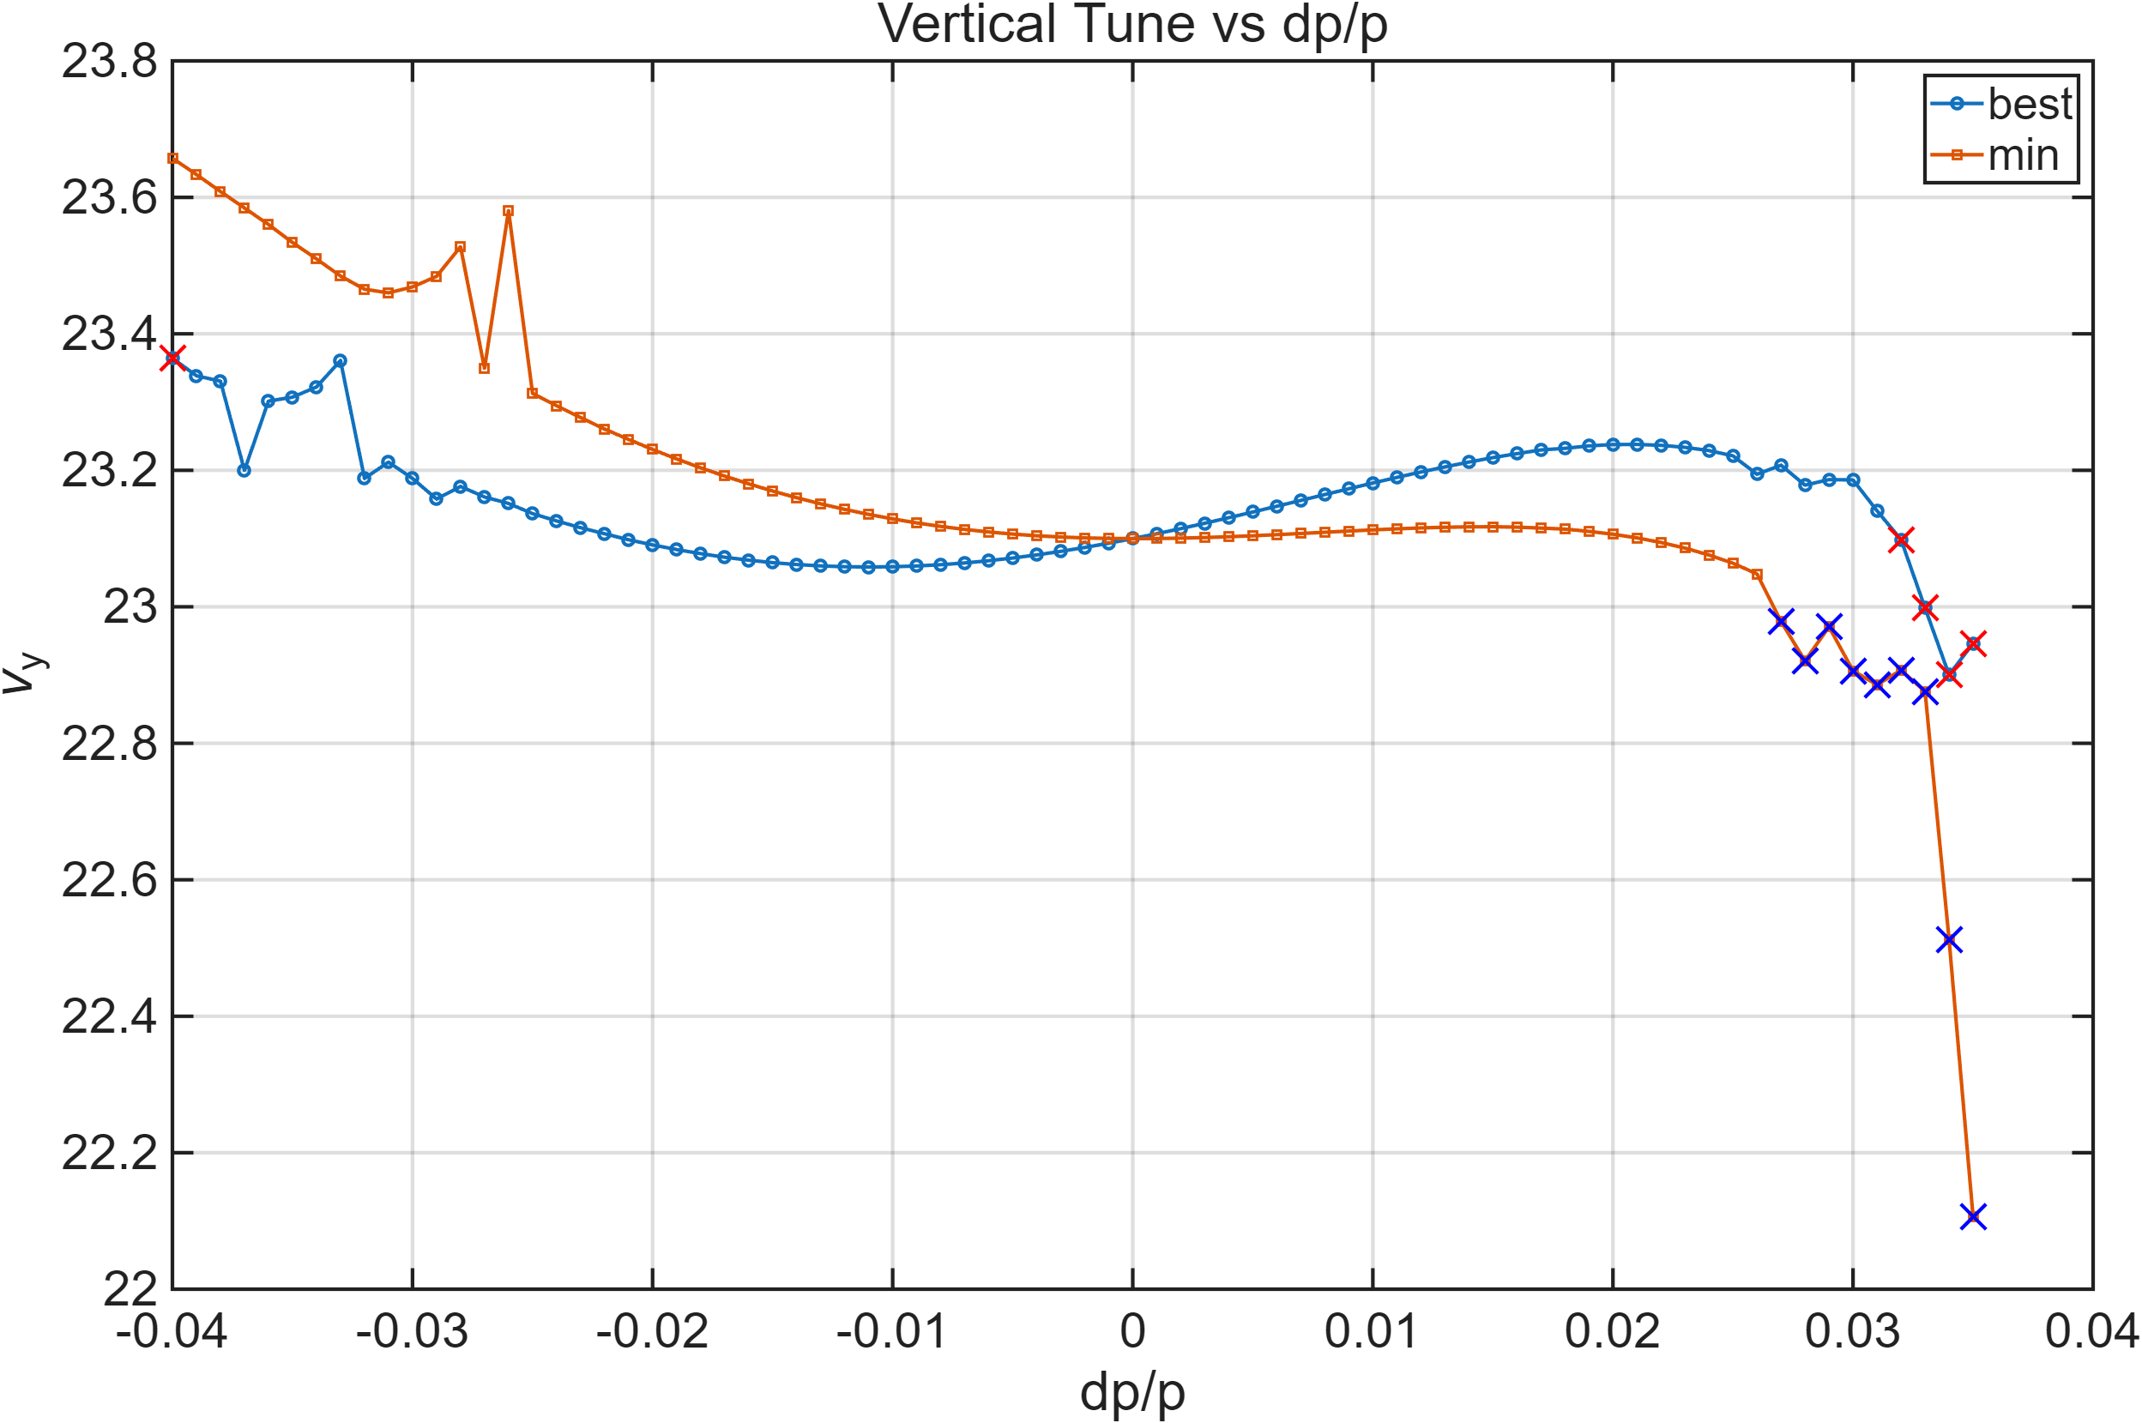
Lifetime trend analysis under varying chromaticity
Best
Min
Higher vertical chromaticity shifts the integer resonance to higher momentum deviation, resulting in a larger momentum aperture and longer lifetime
Therefore, we can conclude that error lattices tend to prefer high vertical chromaticity.
8
Notes:
On this slide, I’ll explain why error lattices prefer high vertical chromaticity.
Here, we fixed the horizontal chromaticity and compared two points: the best and the minimum lifetime cases, marked as stars. The dashed lines show the first momentum offset where the beam is lost, i.e., the momentum aperture limit.
With higher vertical chromaticity, the MDTS curve becomes steeper. This means the integer tune is reached at a larger momentum deviation compared to the lower-chromaticity case.
As a result, the beam can survive further in momentum space, enlarging the momentum aperture and extending the lifetime.
This explains why error lattices prefer higher vertical chromaticity, complementing the earlier result that they also favor lower horizontal chromaticity.

Slide 9
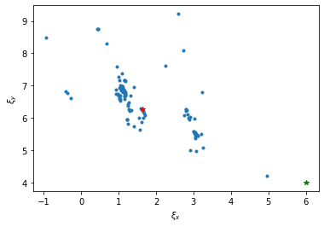
Comparing with MOGA result and scanning result
Best lifetime point
Original point
Populations of last generation of MOGA
Chromaticity scan result for lifetime with error lattice
In the last generation, MOGA populations clustered at low horizontal and high vertical chromaticity, but the reason was not clear at the time.
Our chromaticity scans with error lattices now show that this region corresponds to longer lifetimes.
This indicates that the MOGA result was not a coincidence, but rather a reflection of the underlying lattice behavior.
9
Notes:
On this slide, I’d like to connect the previous MOGA optimization results with the chromaticity scan. On the left, you see the chromaticity distribution of the last-generation populations from the direct MOGA optimization. At that time, we observed that most solutions clustered in the region of low horizontal and high vertical chromaticity, but we could not explain the reason. On the right, you see the lifetime results from chromaticity scans with error lattices. These show a very similar trend: lattices with low horizontal and high vertical chromaticity achieve longer lifetimes. This tells us that the clustering of MOGA solutions in that region was not a coincidence, but rather reflects the underlying preference of error lattices for this chromaticity condition. So this new analysis helps explain why the MOGA with errors showed that trend.

Slide 10
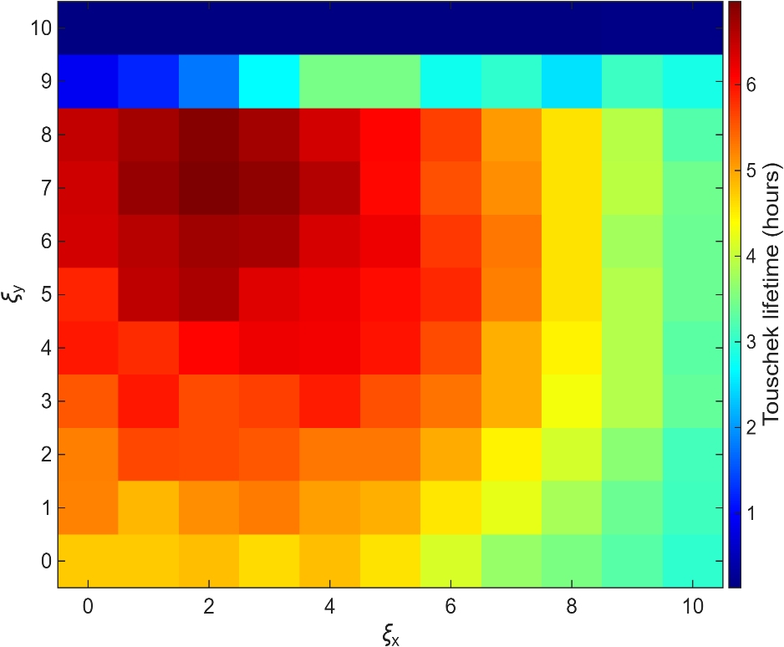
Tune scan
Chrom scan @ fix tune
Tune scan
Chrom scan @ fix tune

Slide 11
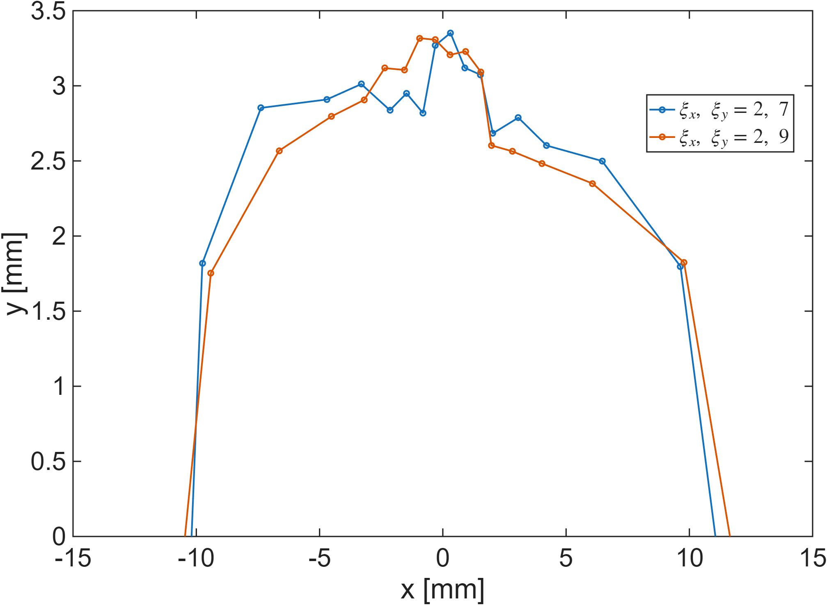
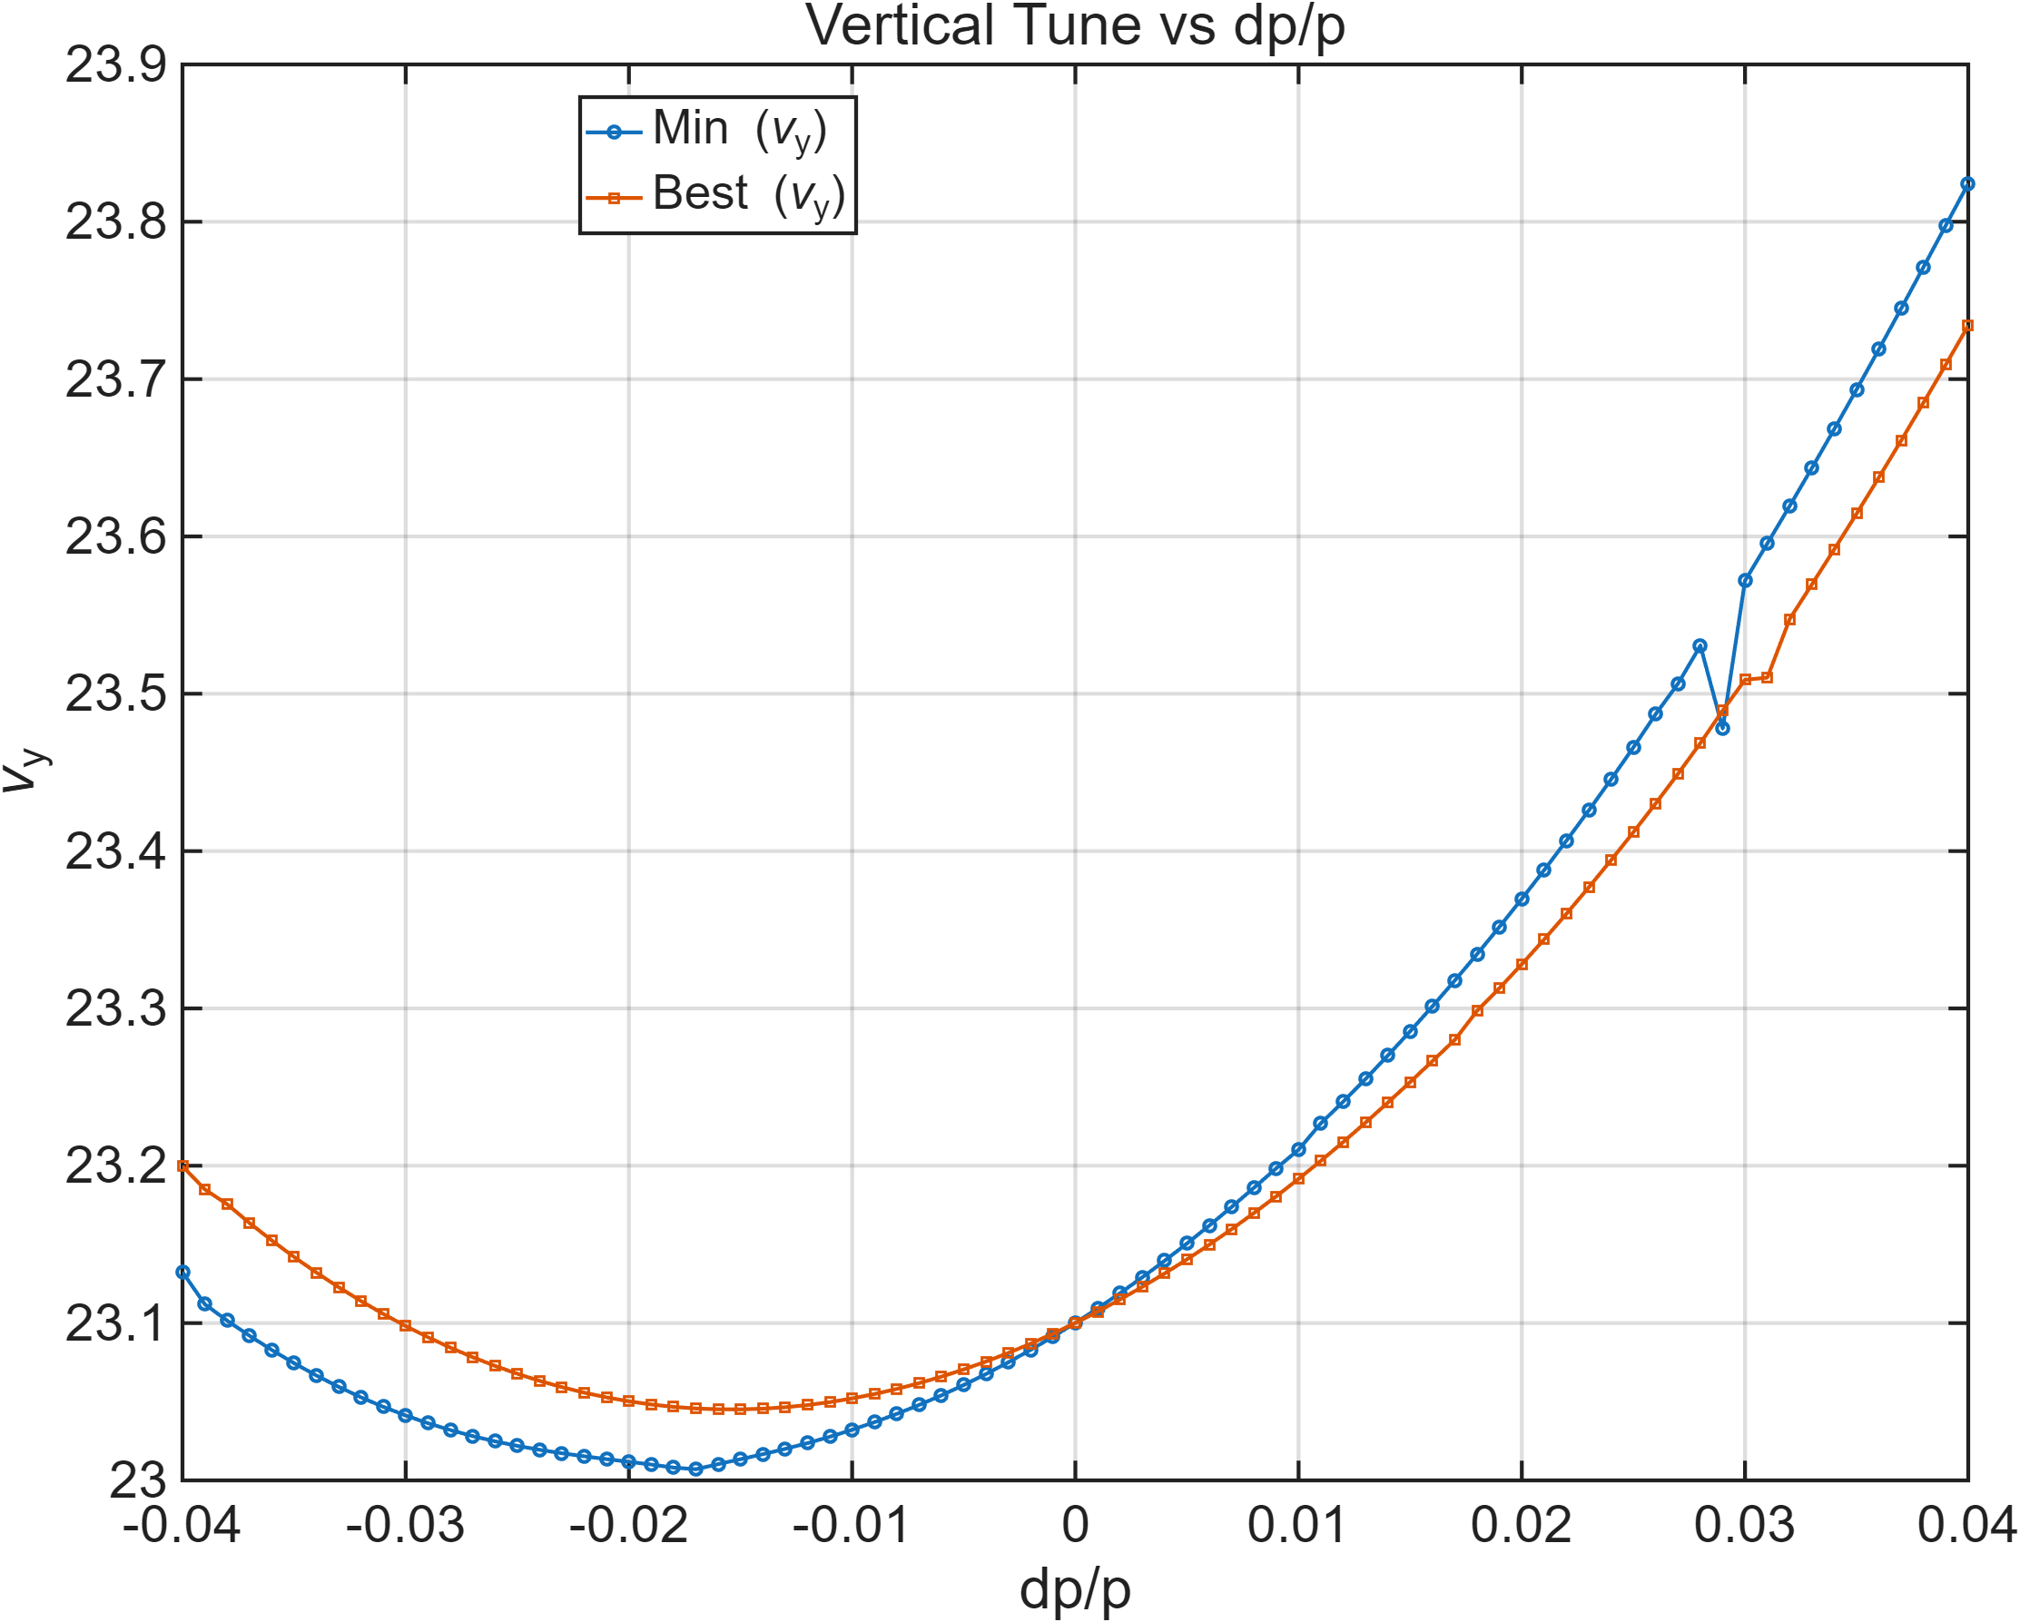
Chrom scan @ fix tune
두 지점 DA, MDTS curve 비교
Vertical chromaticity가 9이상에서 lifetime이 안좋은 이유 :
Vertical tune : 0.26 -> 0.1로 낮아짐
Vertical chrom : 4 -> 7 로 높아짐
으로 인하여 적은 momentum deviation에도 integer tune에 도달함으로 인해서 적은 momentum aperture가 생겨 lifetime이 낮아진것으로 보임

Slide 12
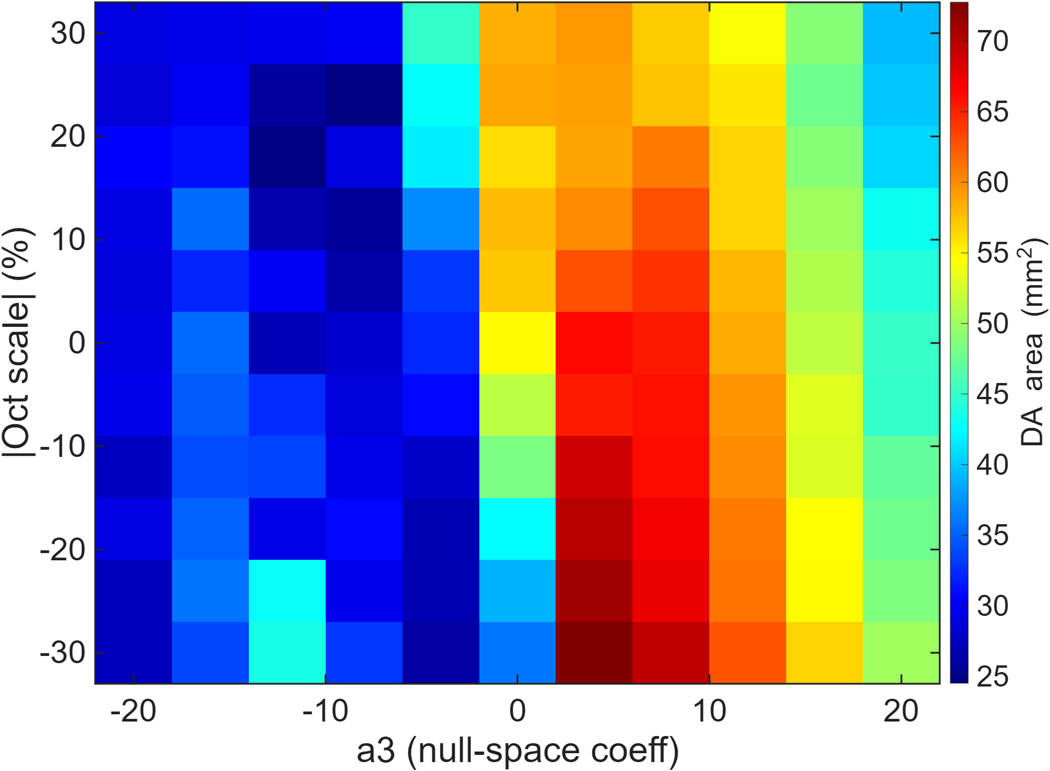
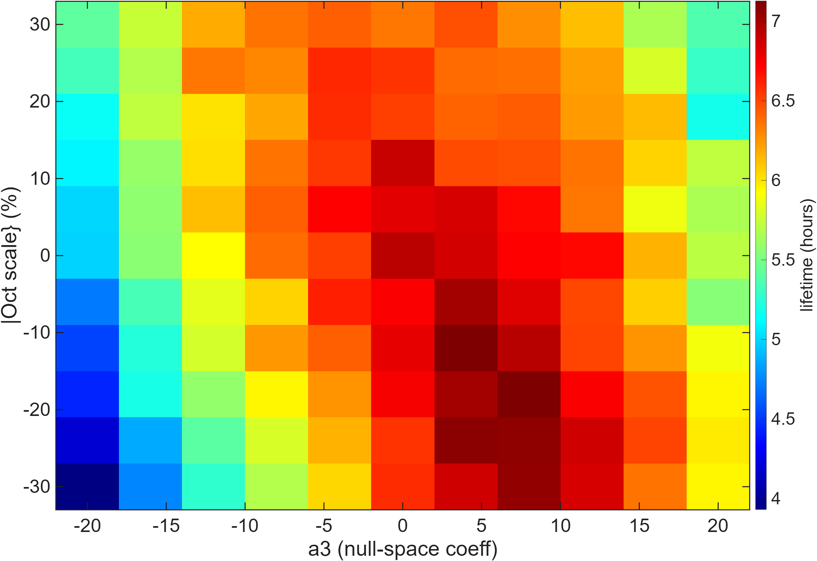
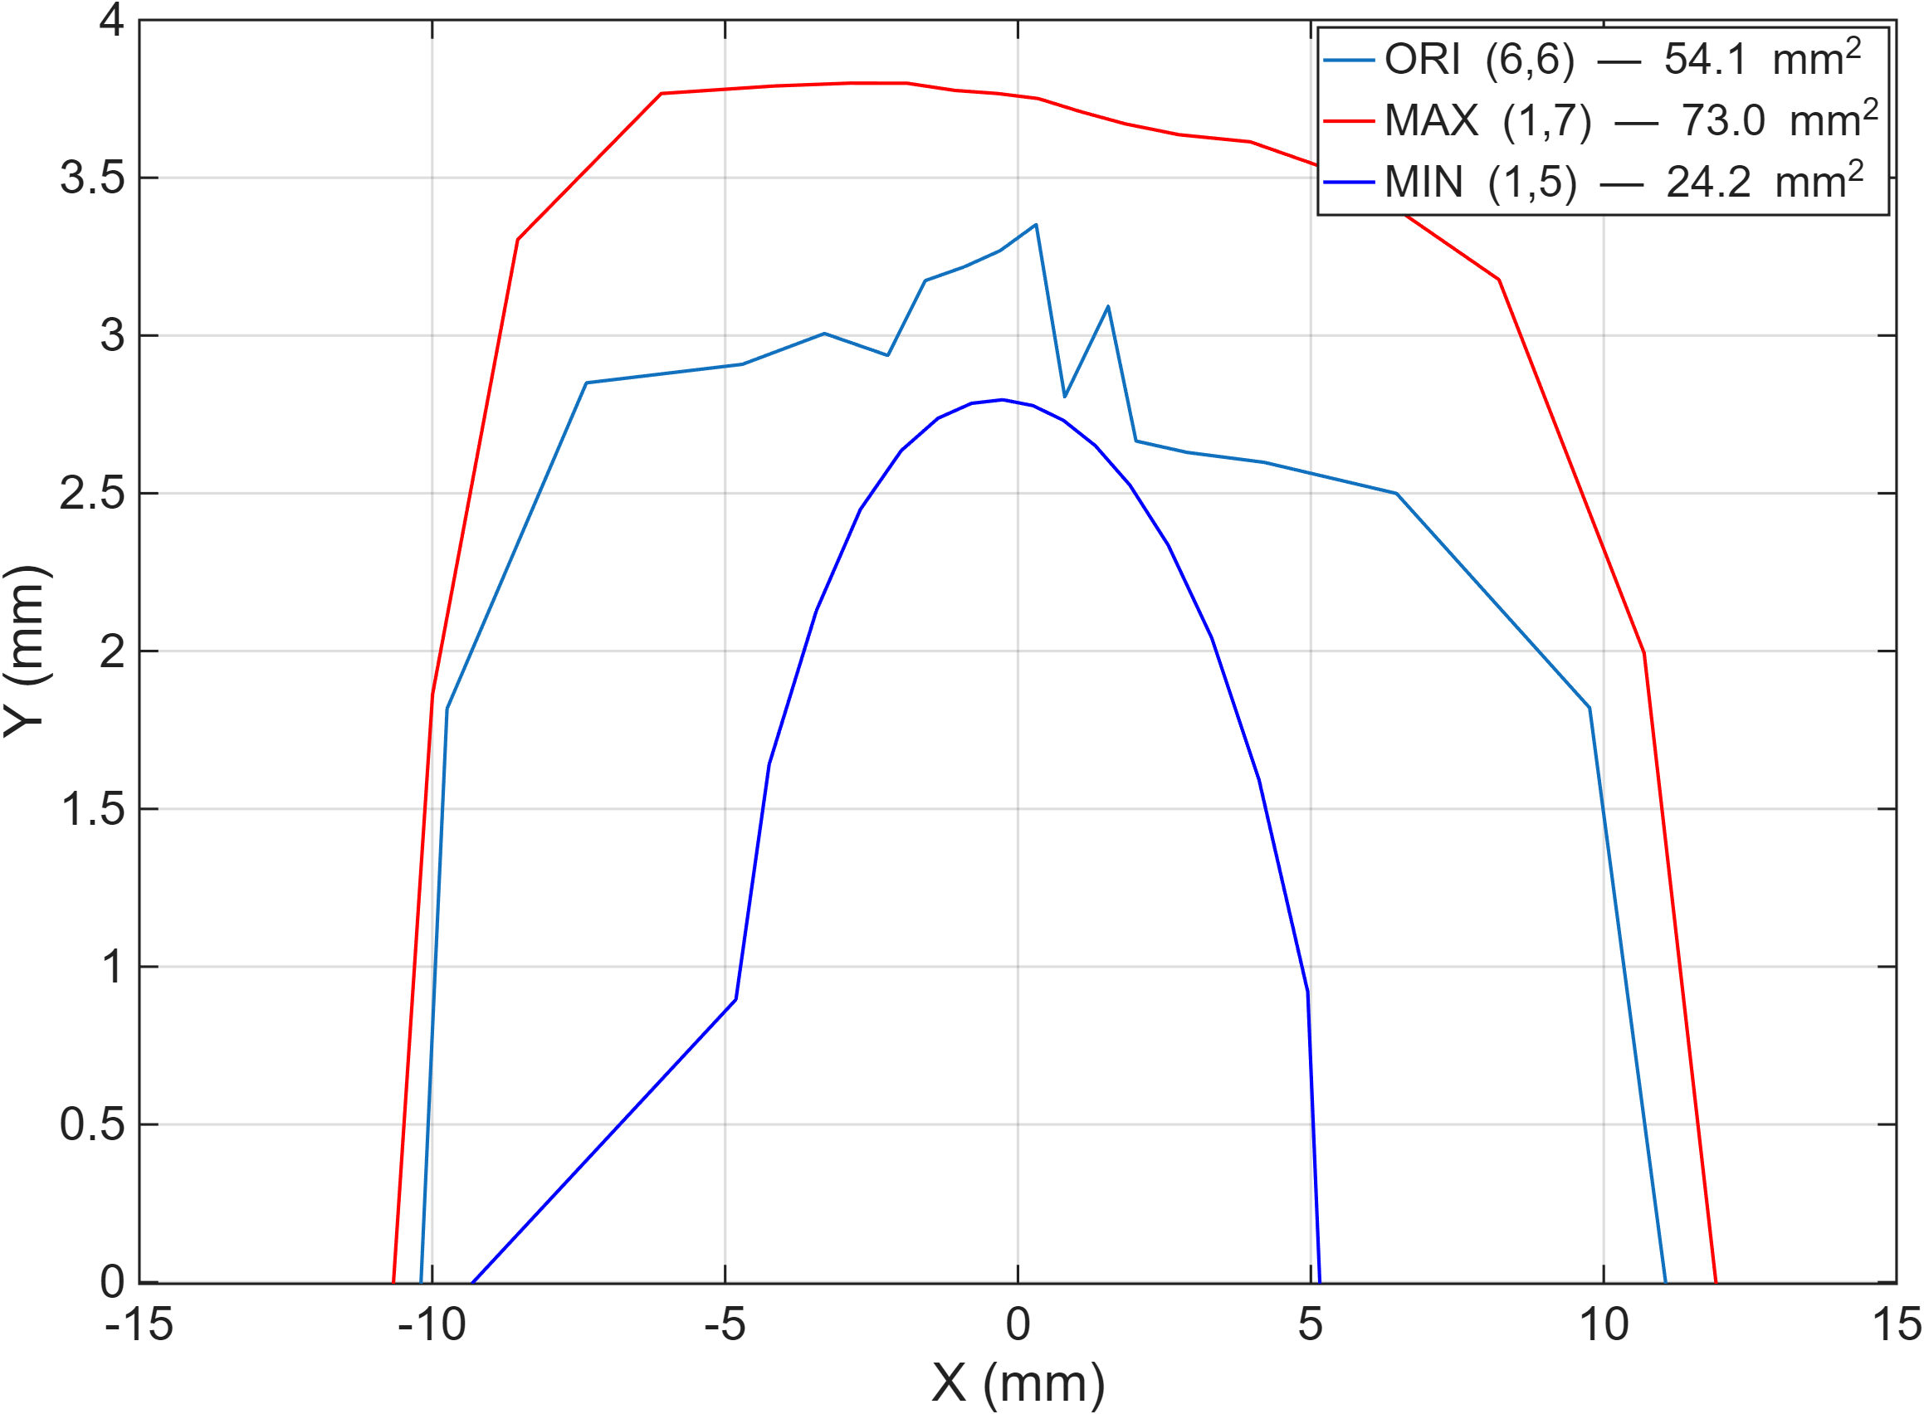
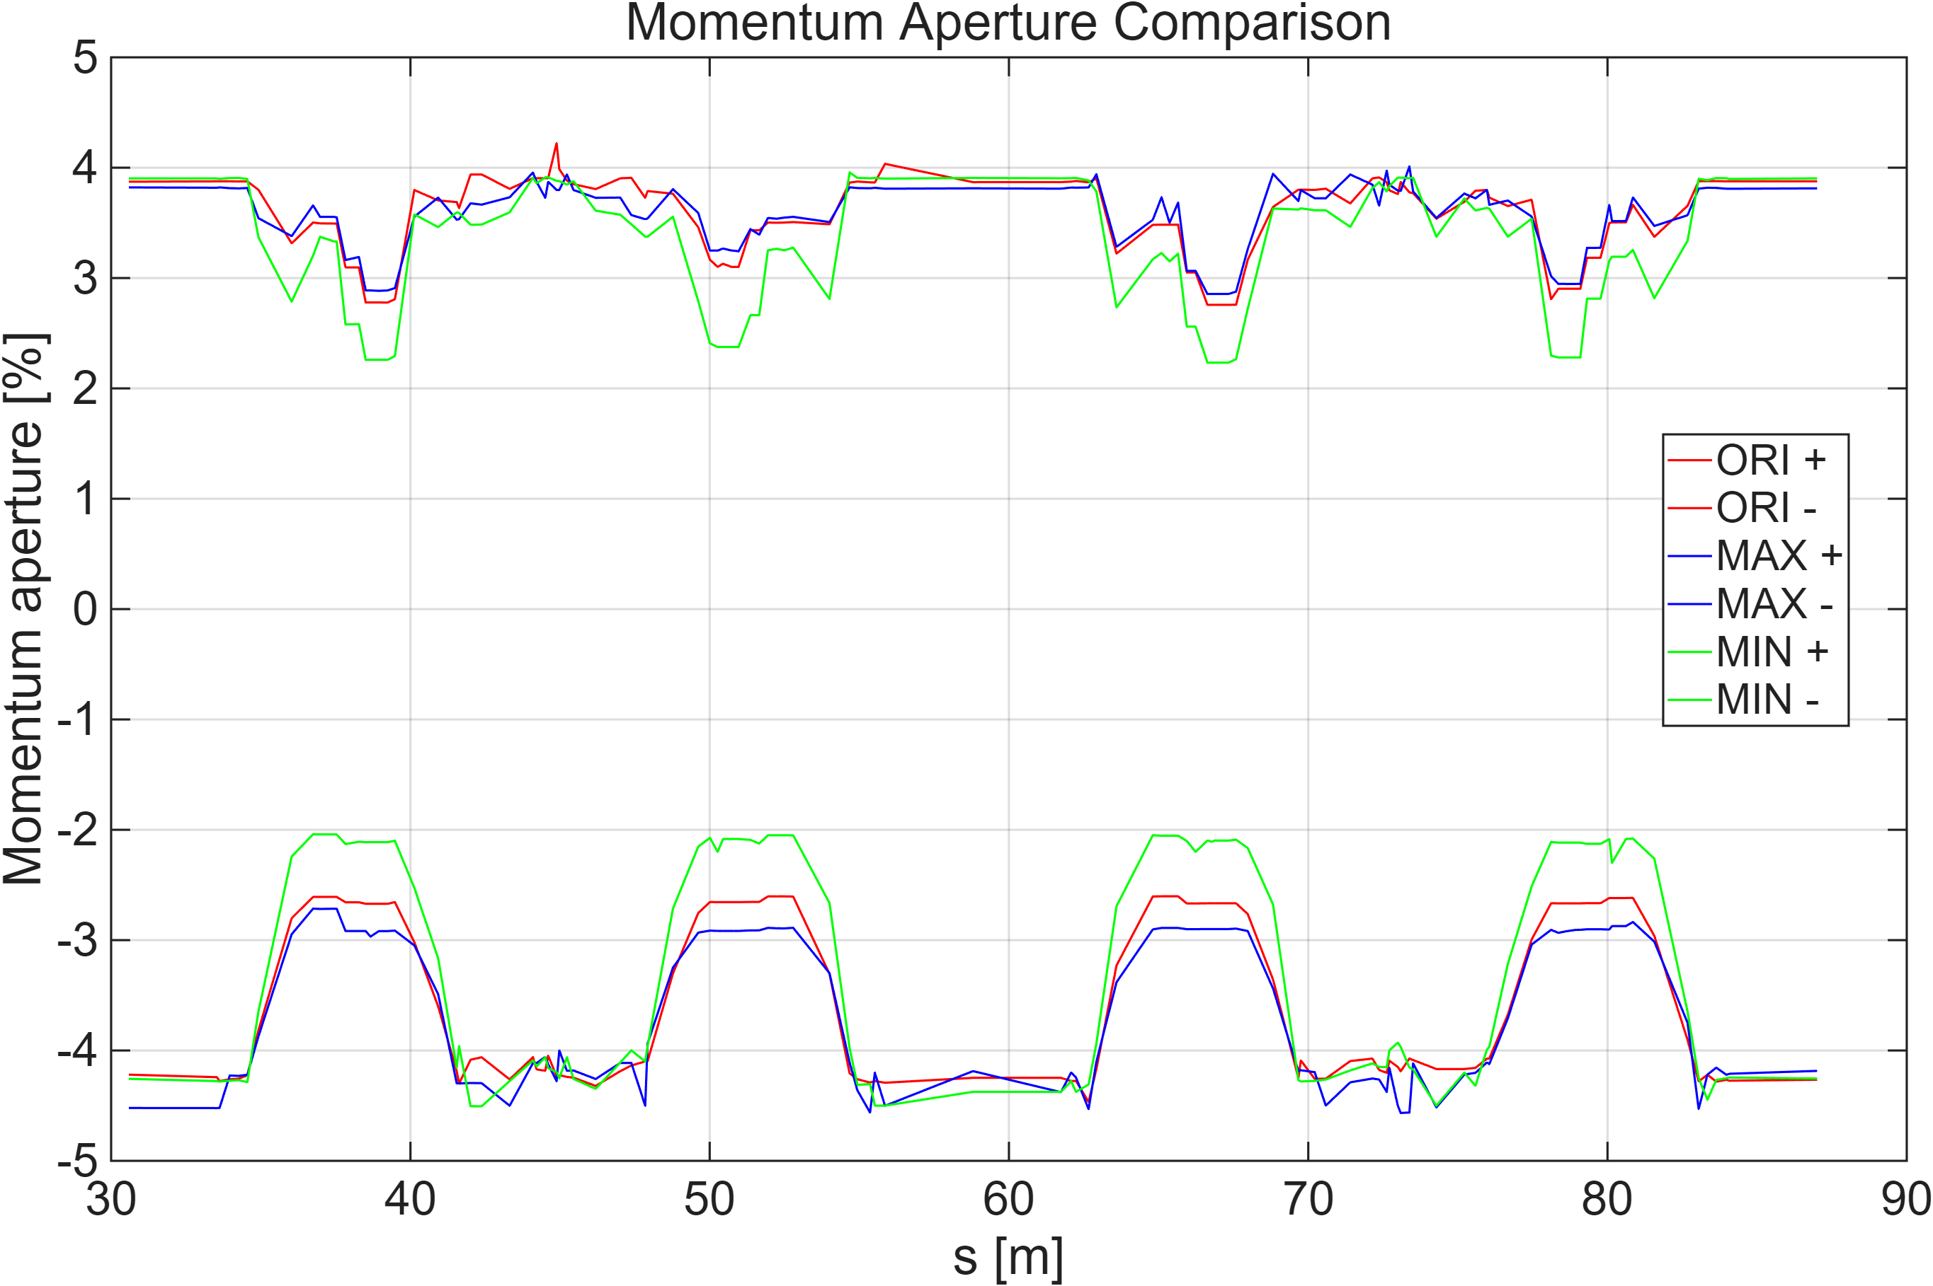
ORI
MAX
Min

Slide 13
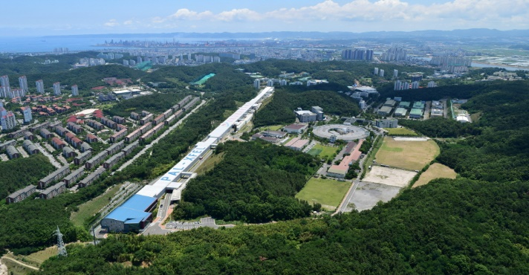

Thank you!

Slide 14
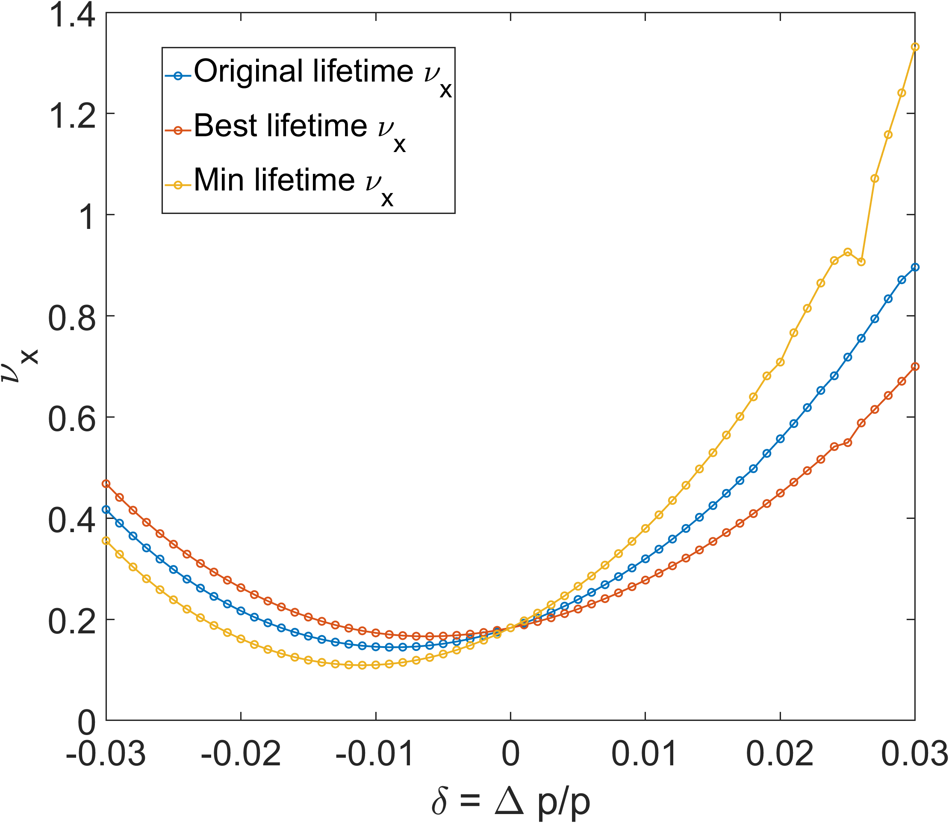
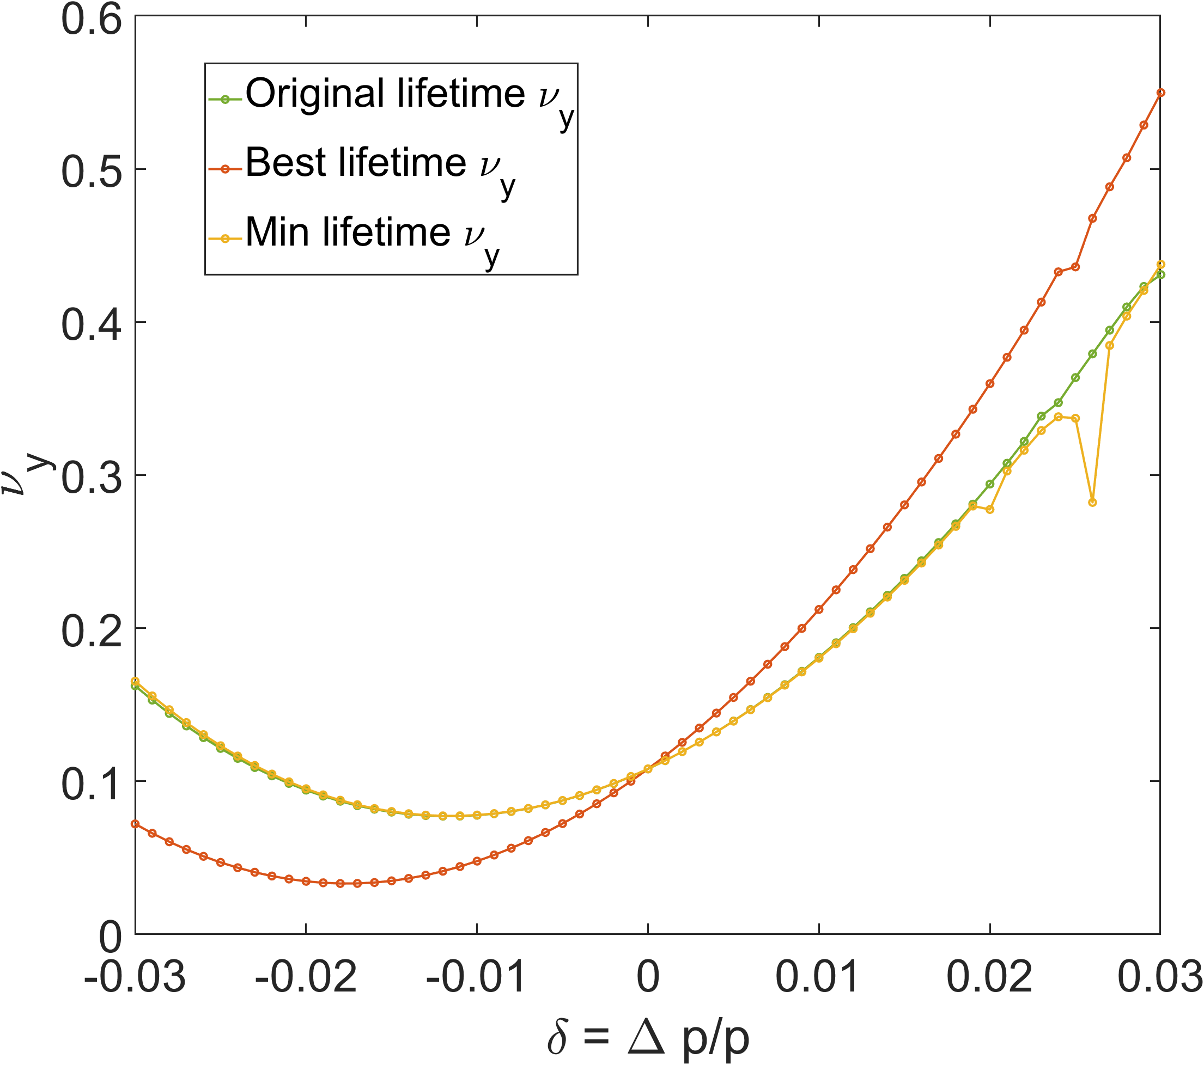
@ middle of HB

Slide 15
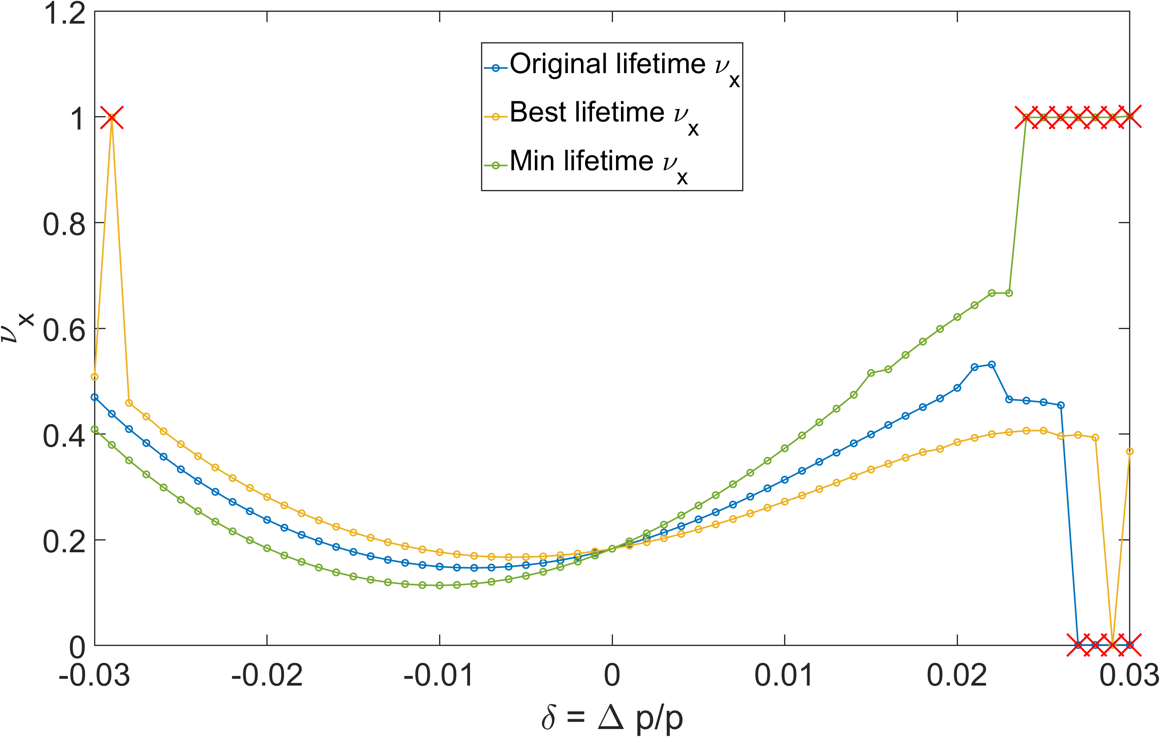
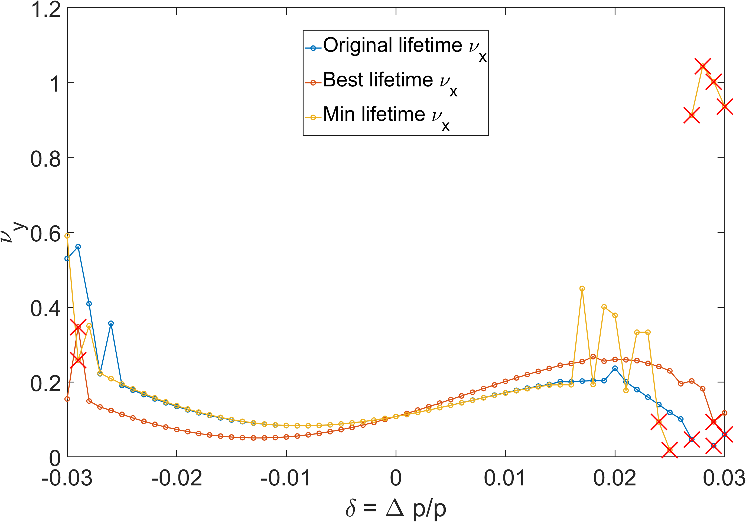
@ Dispersion bump

Slide 16
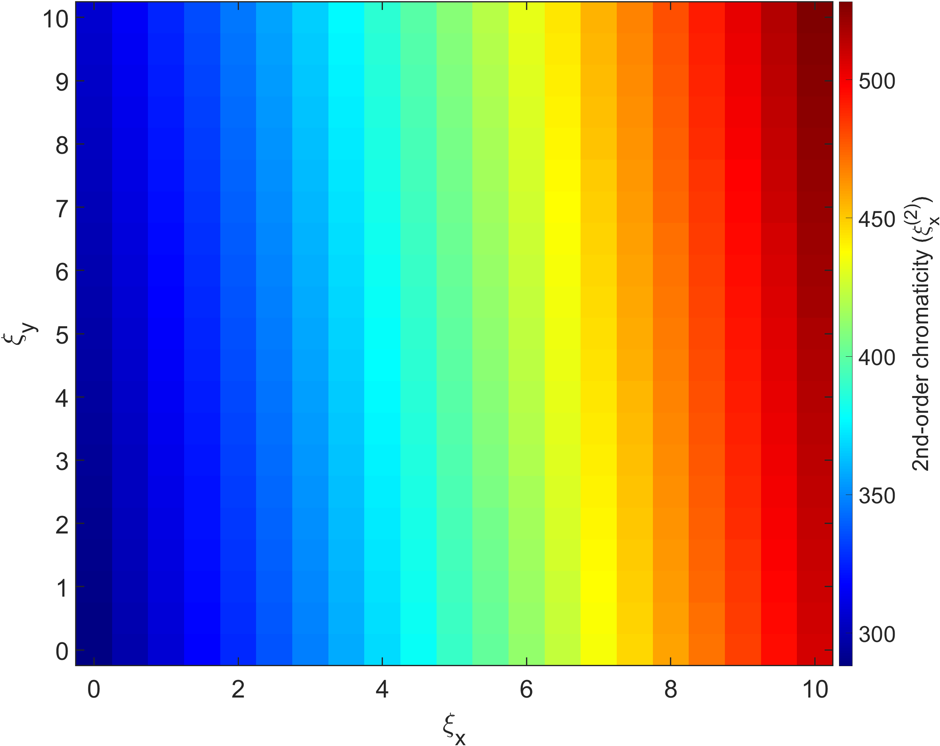
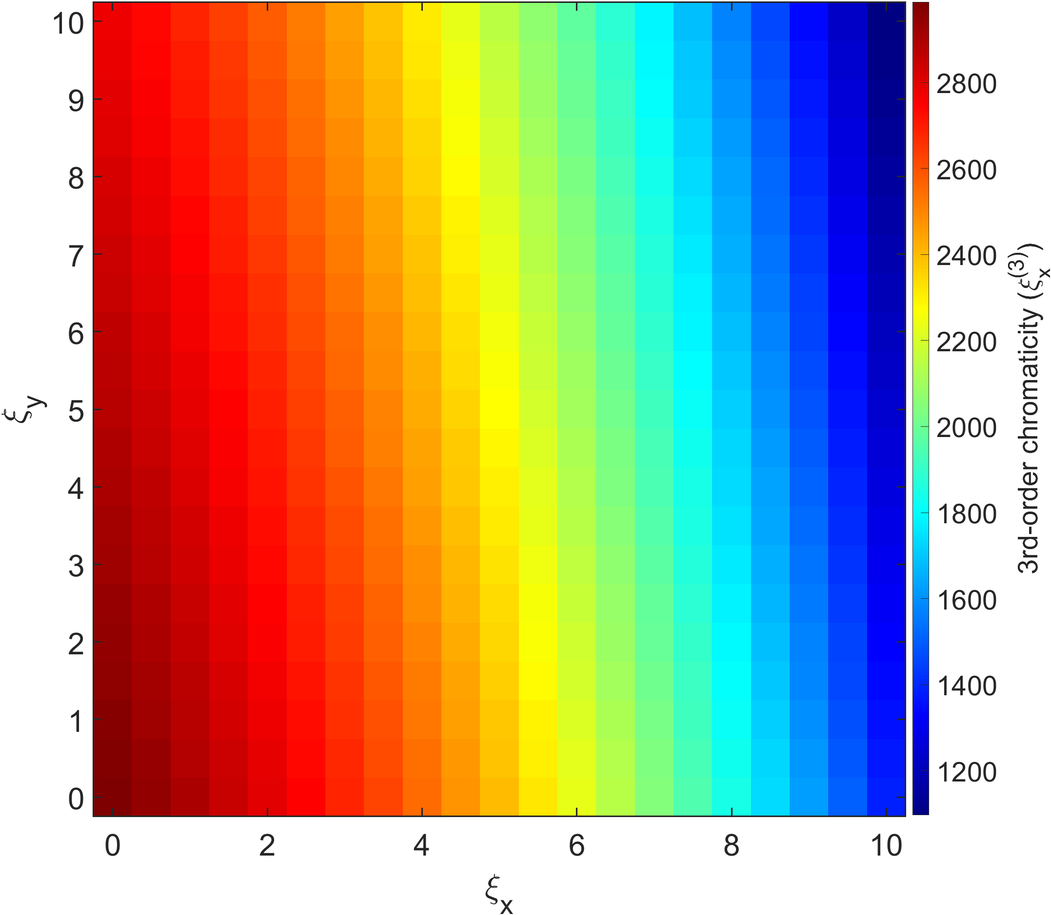
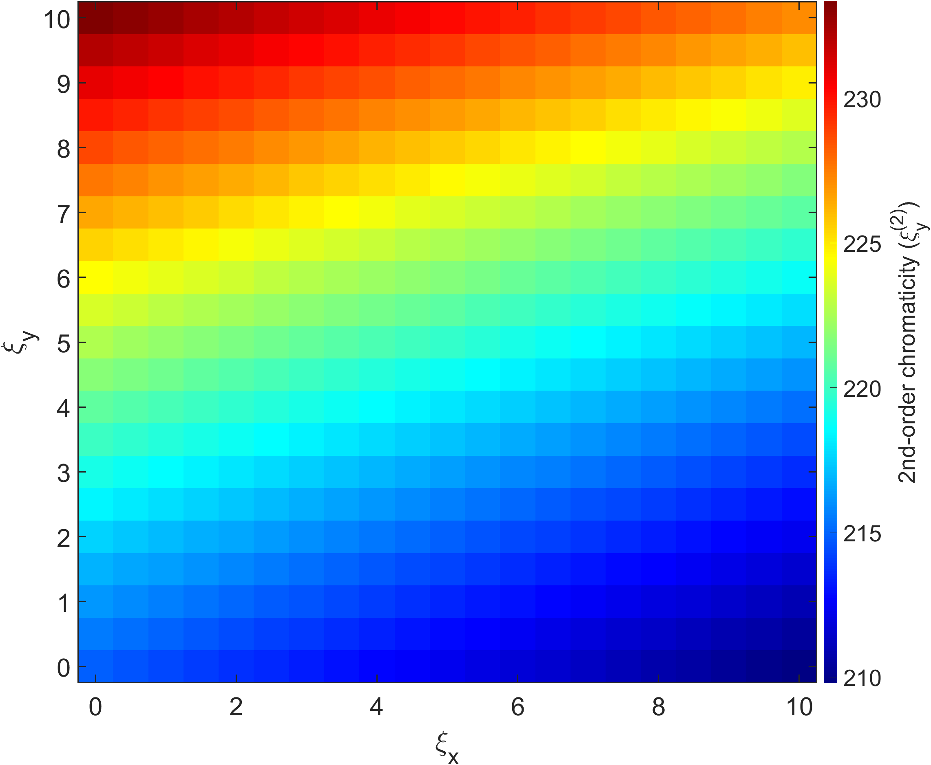
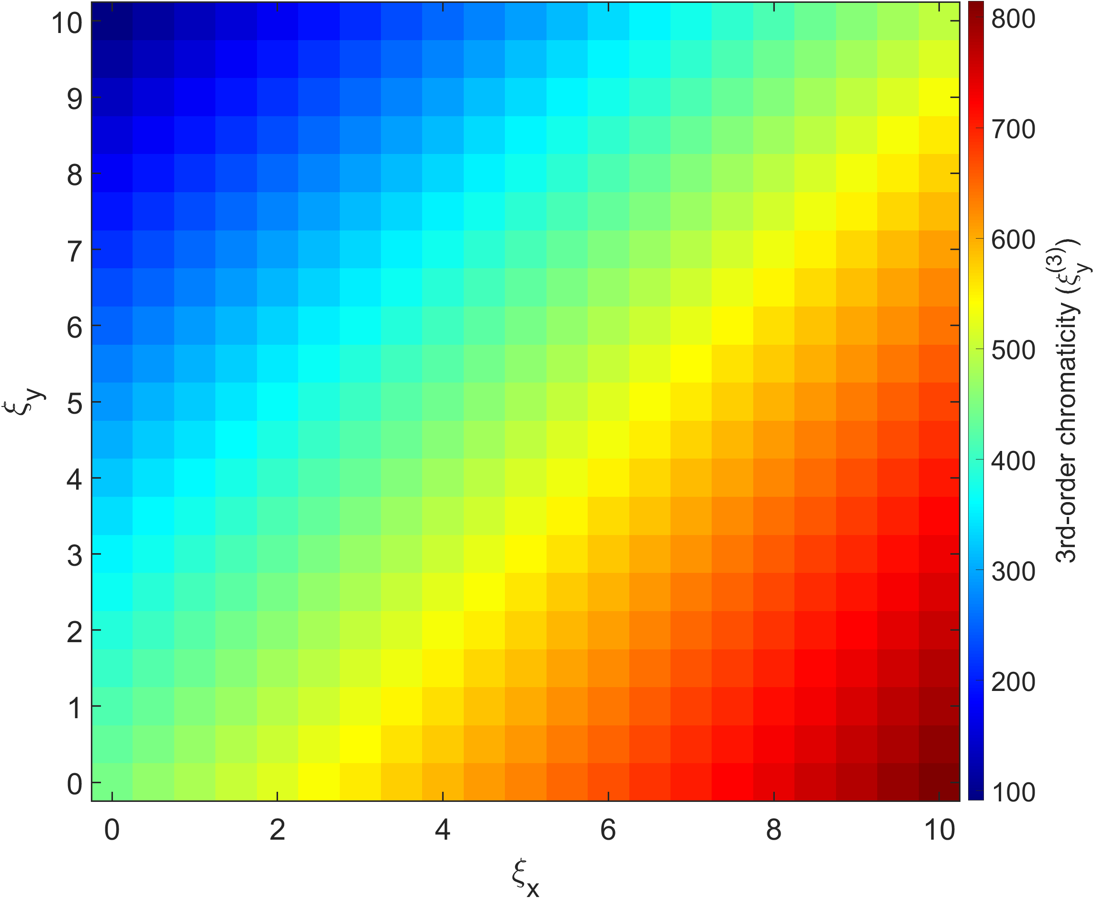
@ middle of HB
(w/o error)

Slide 17

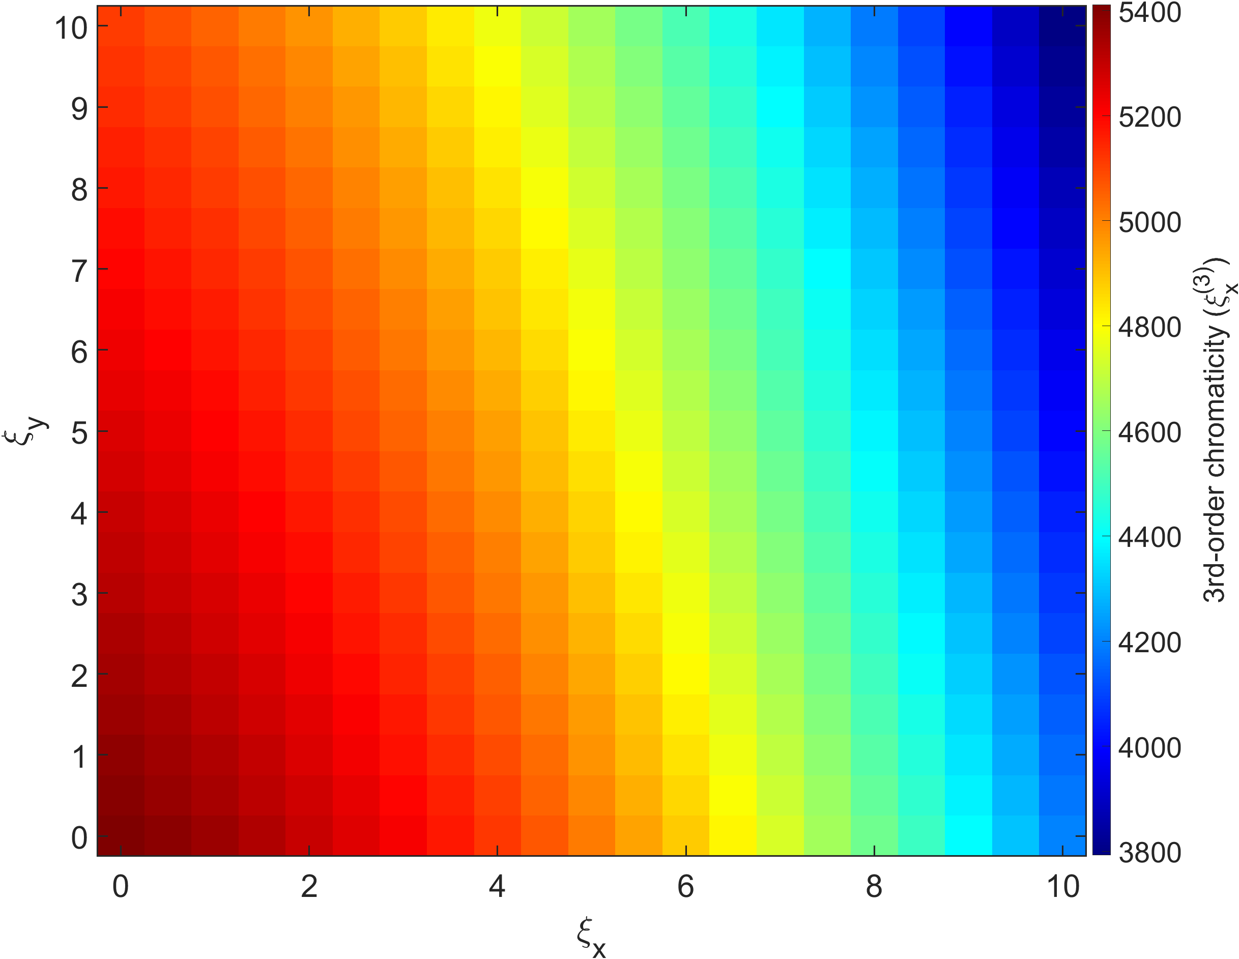
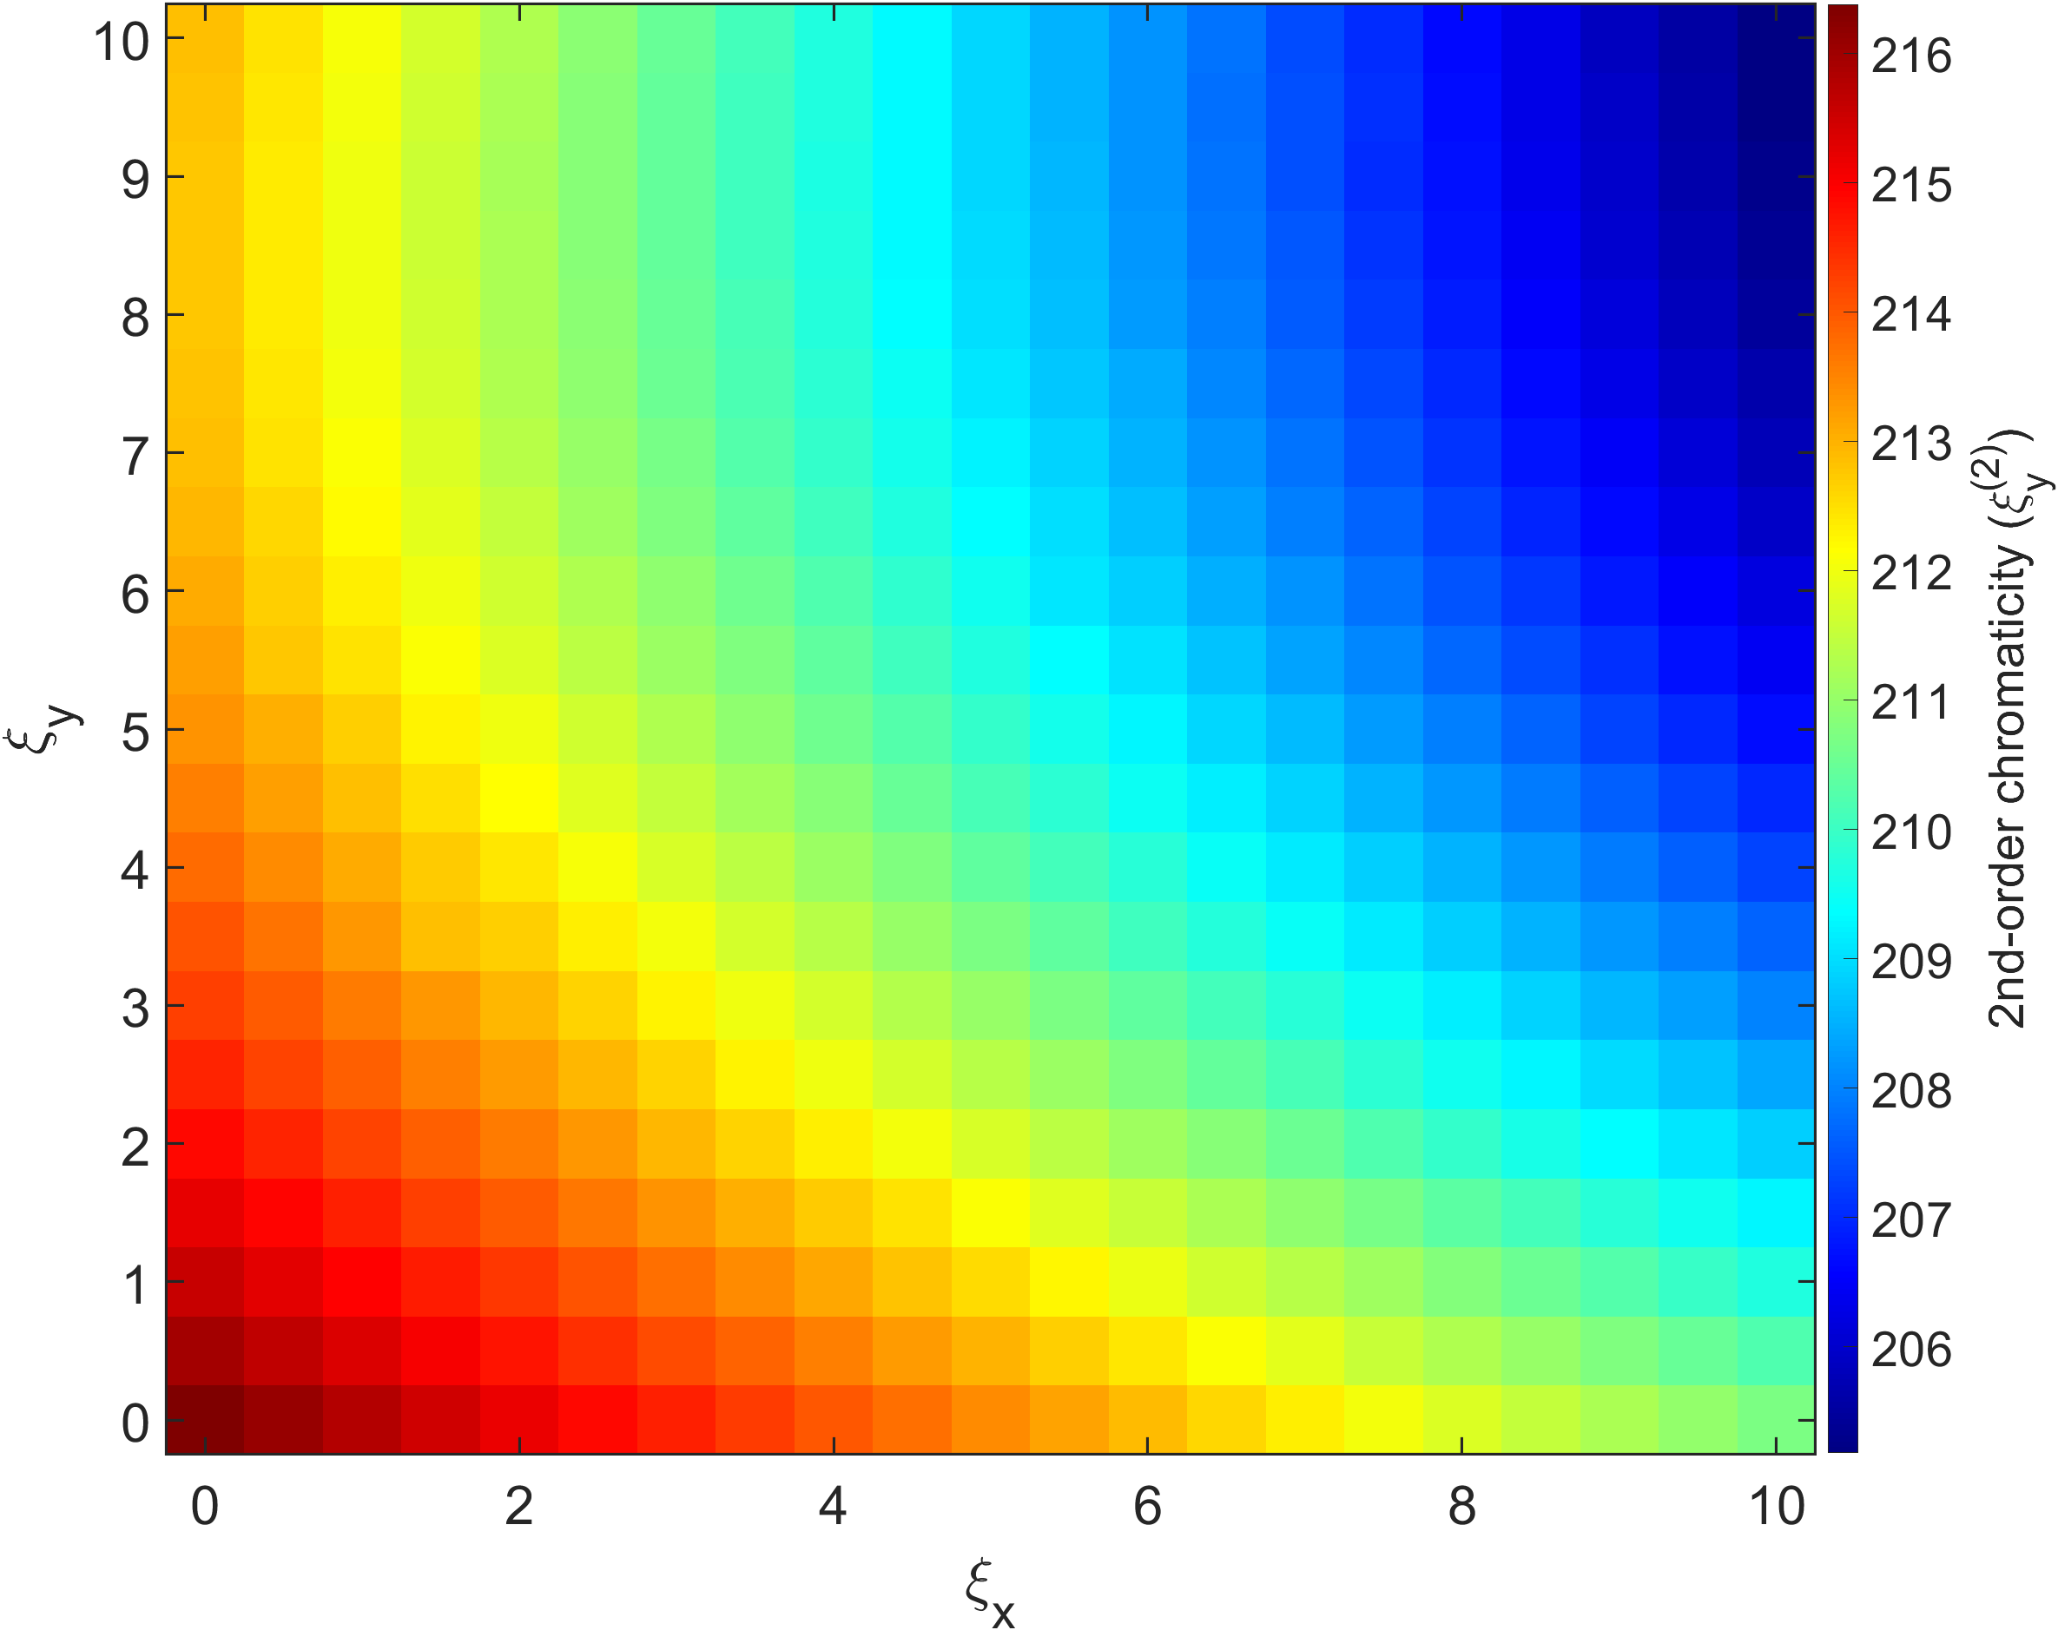
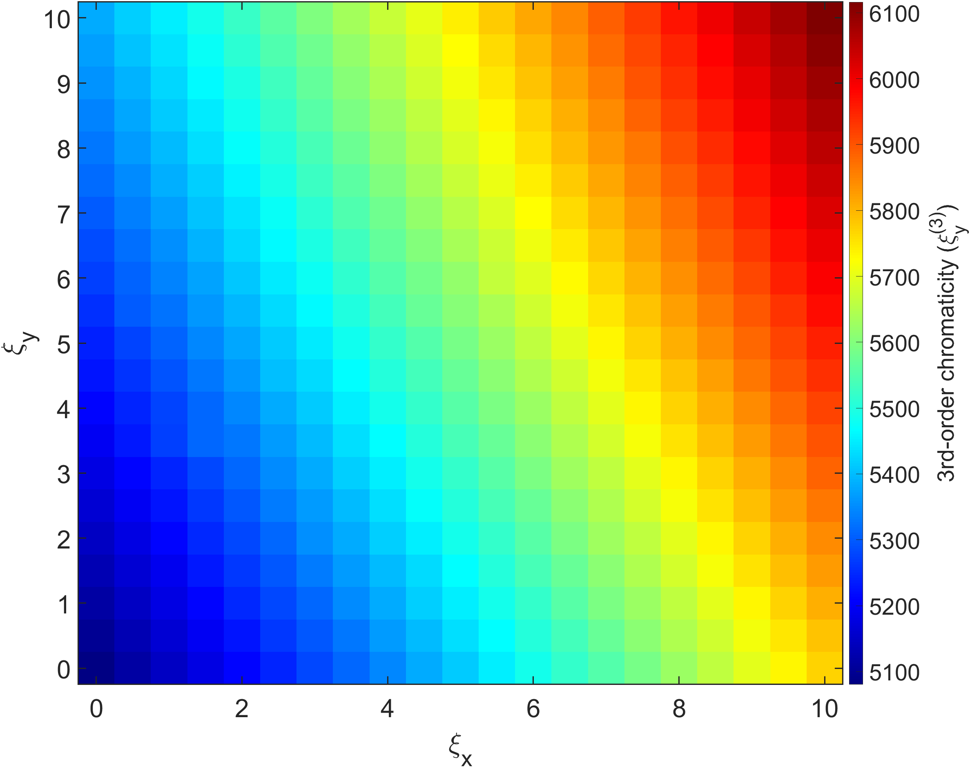
@ Dispersion bump
(w/o error)

Slide 18
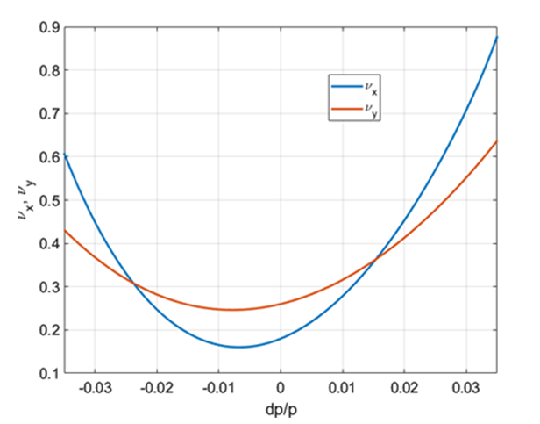
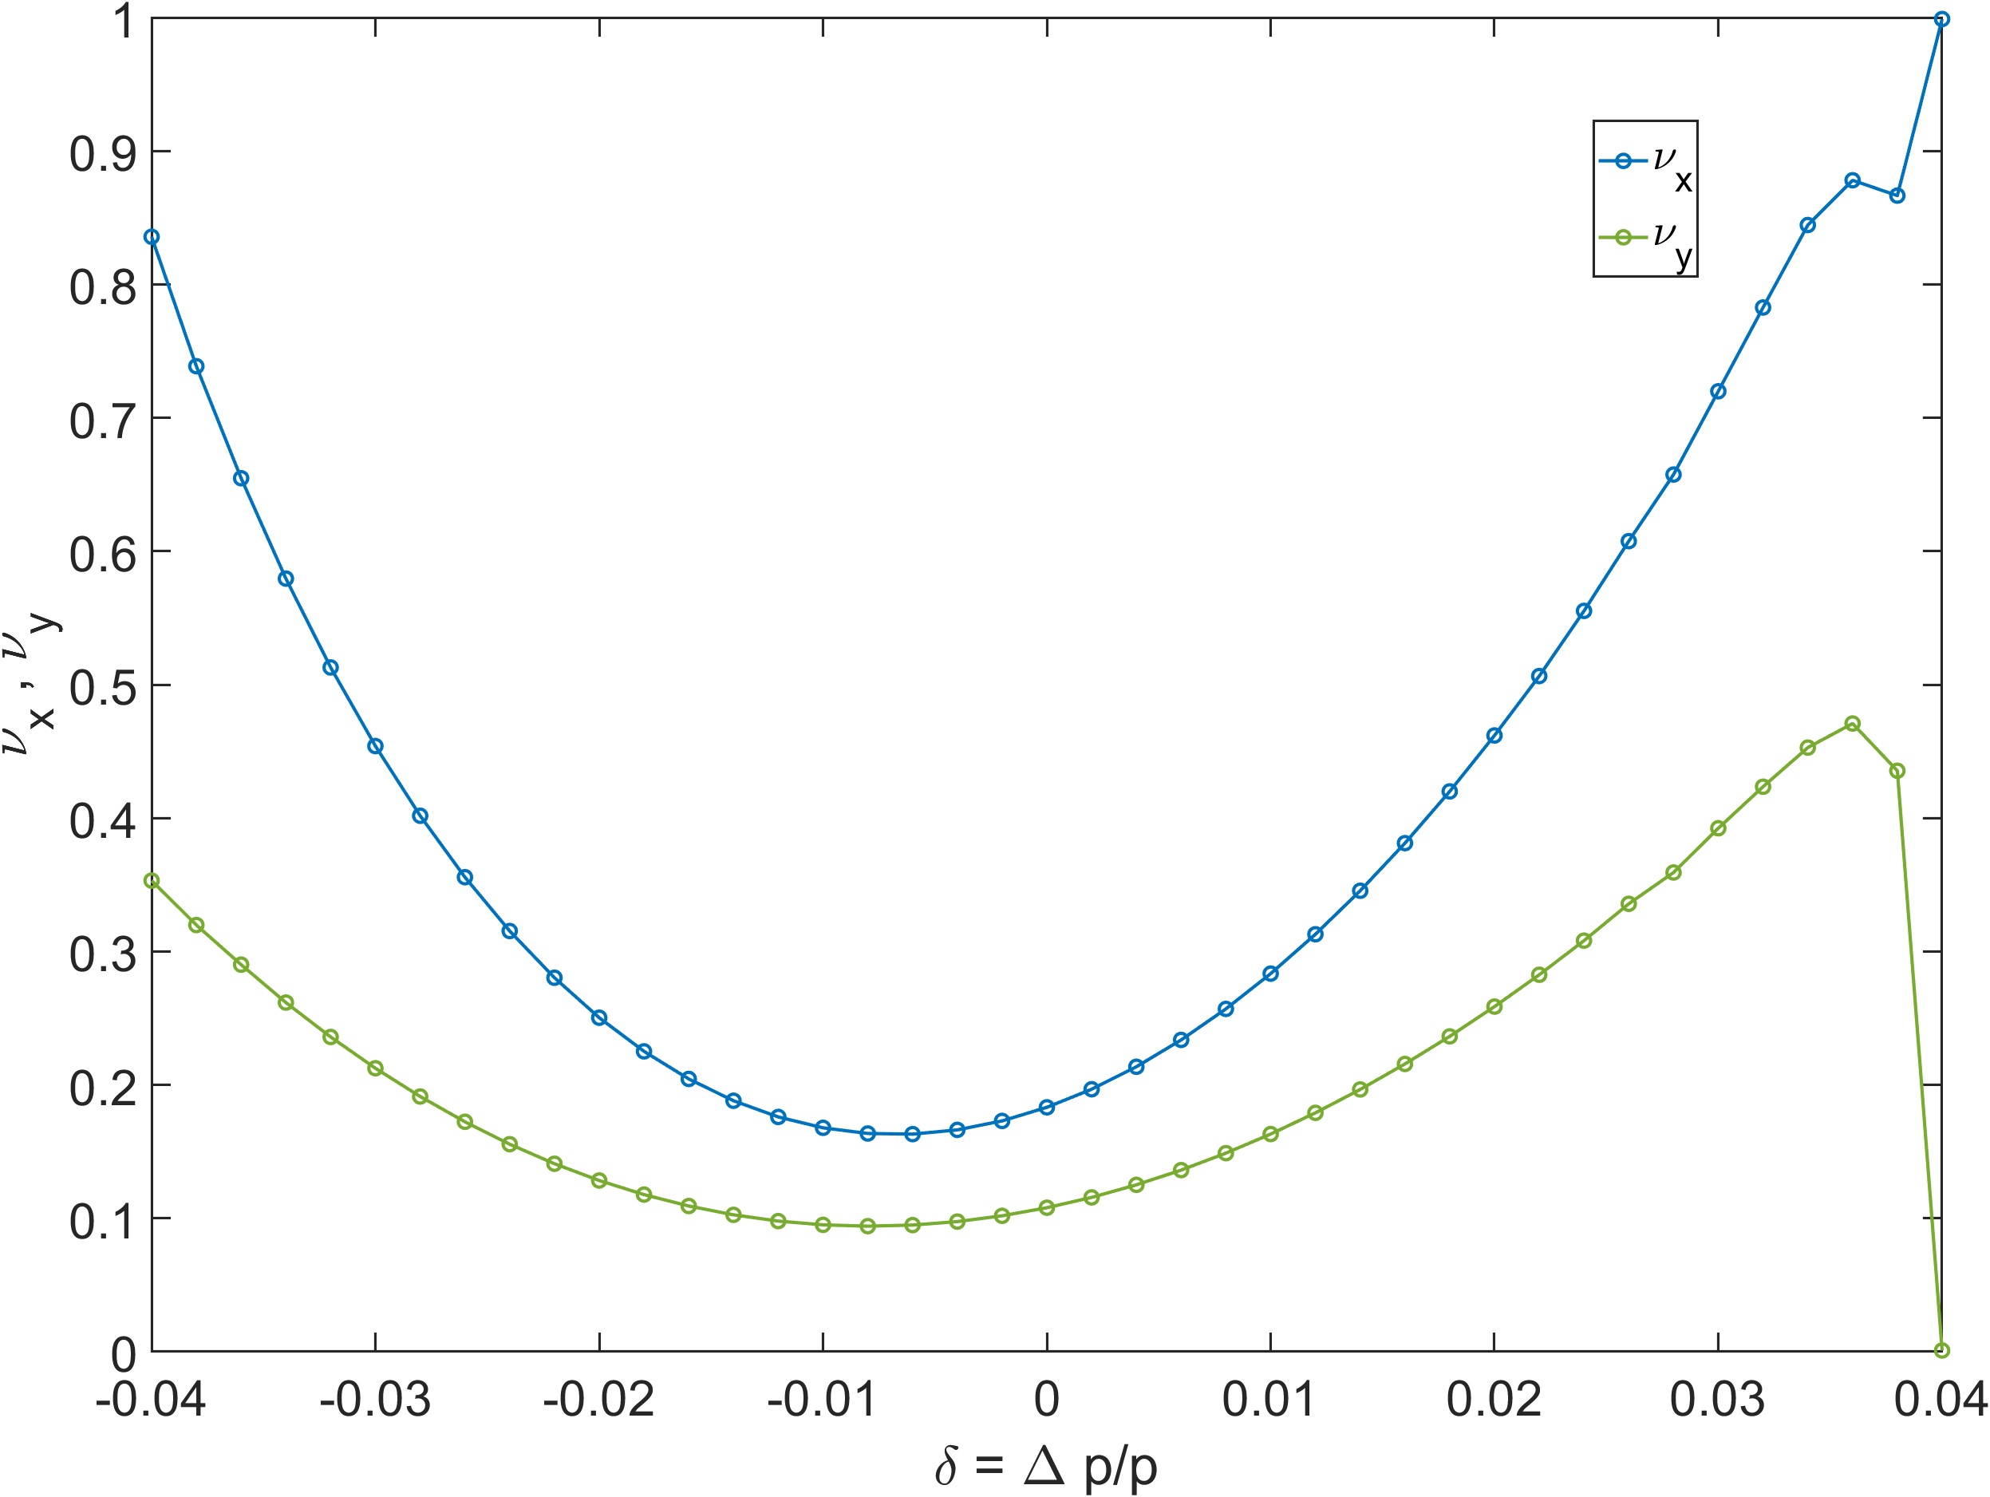


Chromaticity scan – Tune moving
$$ν_{x}=0.18 , ν_{y}=0.26$$
$$ν_{x}=0.18 , ν_{y}=0.10$$

