Slide 1
Group meeting
2025/09/05
장원

Slide 2
Content
Crytal design
Understanding about Coherent/Incoherent Cherenkov diffraction radiation
Issues with refractive index and transmission coefficient
Future work, plan

Slide 3

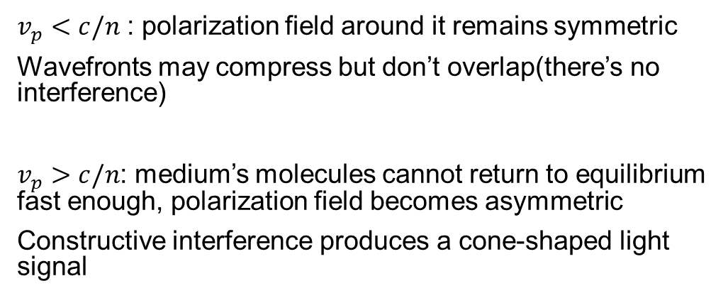
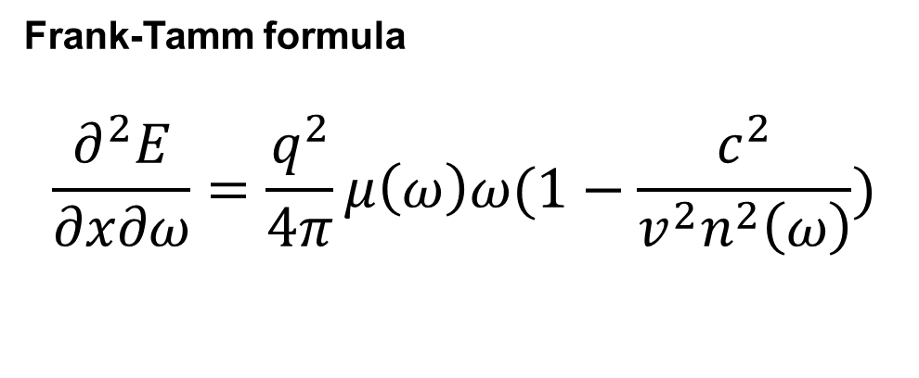
Considering physical phenomena
Frank-Tamm formula
$$\frac{∂^{2}E}{∂x∂ω}=\frac{q^{2}}{4π}μ\left(ω\right)ω(1−\frac{c^{2}}{v^{2}n^{2}\left(ω\right)})$$
Relative intensity of one frequency is approximately proportional to the frequency.
$v_{p}<c/n$ : polarization field around it remains symmetric
Wavefronts may compress but don’t overlap(there’s no interference)
$v_{p}>c/n$: medium’s molecules cannot return to equilibrium fast enough, polarization field becomes asymmetric
Constructive interference produces a cone-shaped light signal

Slide 4
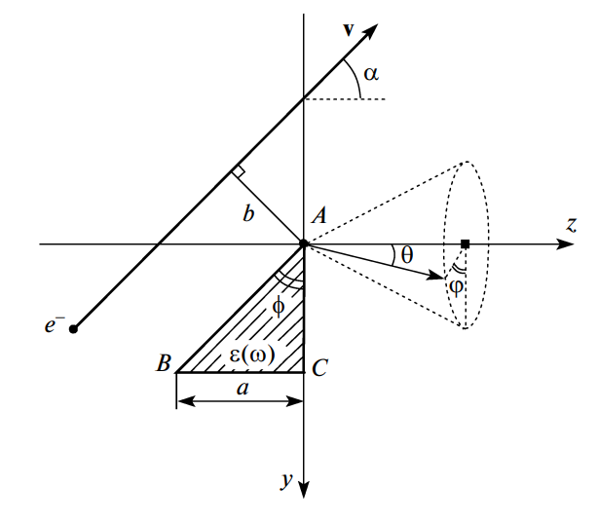
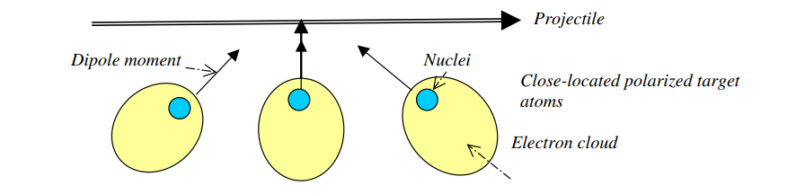
Considering physical phenomena
charge
Polarization radiation(PR)
For a thicker layer, the solution gives Tamm-Frank formula for CR in an unbounded transparent medium.
Total radiation intensity is independent of target thickness.
This because the field strength decreases with distance from the charge trajectory, and VCR is coherent radiation, so constructive interference occurs only within a thin layer of medium.
Only the AB face contributes to the VCR.
(Exact solution can be obtained.)

Slide 5
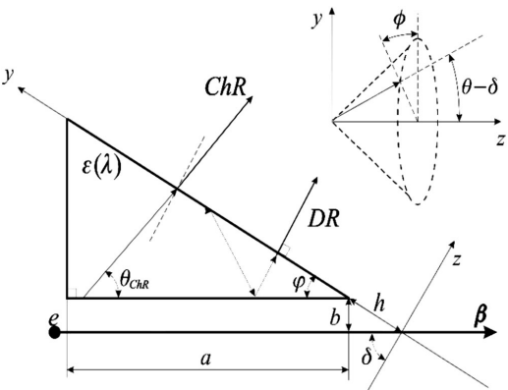
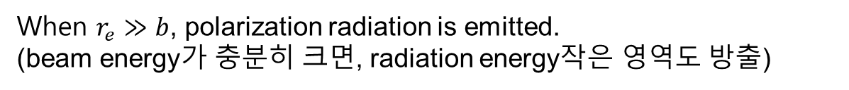
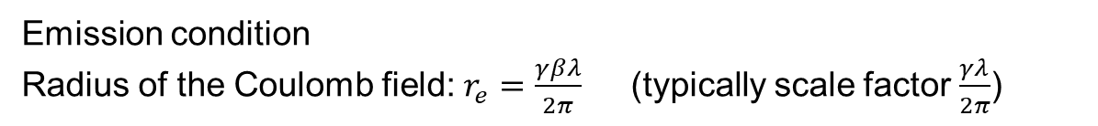
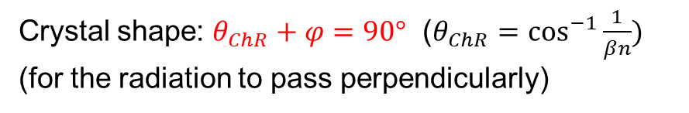
Incoherent Cherenkov Diffraction Radiation
Crystal shape: $θ_{ChR}+φ=90°$ ($θ_{ChR}=\cos^{−1}{\frac{1}{βn}})$
(for the radiation to pass perpendicularly)
Emission condition
Radius of the Coulomb field: $r_{e}=\frac{γβλ}{2π}$ (typically scale factor $\frac{γλ}{2π}$)
When $r_{e}≫b$, polarization radiation is emitted.
(beam energy가 충분히 크면, radiation energy작은 영역도 방출)
200Mev 기준 radiation $20\sim 80THz$ ($3.75\sim 15μm)$
$impact parameter b<0.117mm$

Slide 6
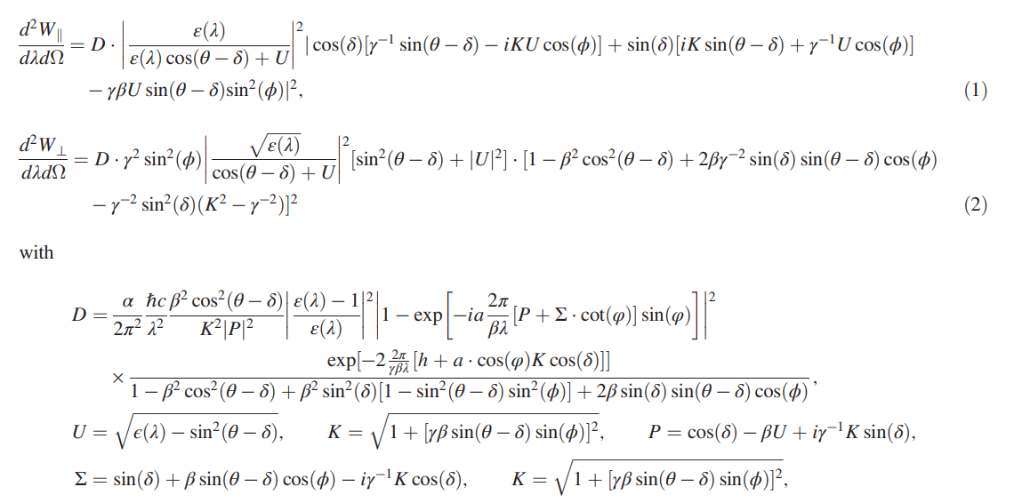

Slide 7
crystal
Bem path
Radiation
stage

Slide 8
Summary
Cherenkov radiation is described by the Frank-Tamm formula for its spectral intensity.
Cherenkov radiation is generated near the surface traversed by the charged particle.
Cherenkov diffraction radiation occurs regardless of the target thickness, as long as it exceeds a sufficient minimum.
Impact parameter must fall within the radius of the Coulomb field. ------ beam size..?
The prism-shaped crystal geometry allows the radiation to exit perpendicularly through the hypotenuse.

Slide 9
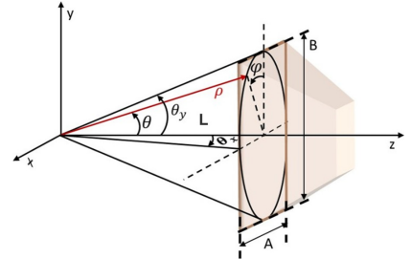
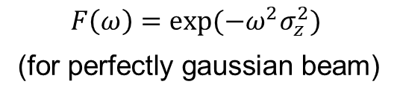

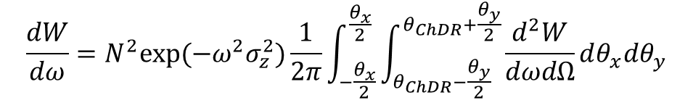
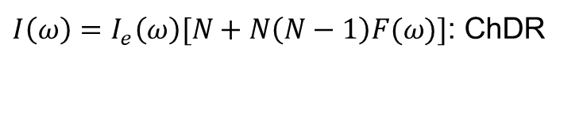


Coherent Cherenkov Diffraction Radiation(ChDR)
$$\frac{dW}{dω}=N^{2}exp⁡(−ω^{2}σ_{z}^{2})\frac{1}{2π}\int_{−\frac{θ_{x}}{2}}^{\frac{θ_{x}}{2}}{\int_{θ_{ChDR}−\frac{θ_{y}}{2}}^{θ_{ChDR}+\frac{θ_{y}}{2}}{\frac{d^{2}W}{dωdΩ}}dθ_{x}dθ_{y}}$$
$$I_{e}$$
$I\left(ω\right)=I_{e}\left(ω\right)[N+N\left(N−1\right)F(ω)]$: ChDR
Bunch form factor
$$F\left(ω\right)=exp⁡(−ω^{2}σ_{z}^{2})$$
(for perfectly gaussian beam)
$$I_{1}\left(ω_{1}\right)=N^{2}I_{e1}\left(ω_{1}\right)exp⁡(−ω_{1}^{2}σ_{z}^{2})$$
$$I_{2}\left(ω_{2}\right)=N^{2}I_{e2}\left(ω_{2}\right)exp⁡(−ω_{2}^{2}σ_{z}^{2})$$
$$σ_{z}=\sqrt{\frac{1}{|ω_{2}^{2}−ω_{1}^{2}|}|\ln{\frac{I_{1}\left(ω_{1}\right)I_{e2}\left(ω_{2}\right)}{I_{2}\left(ω_{2}\right)I_{e1}\left(ω_{1}\right)}}|}$$

Slide 10
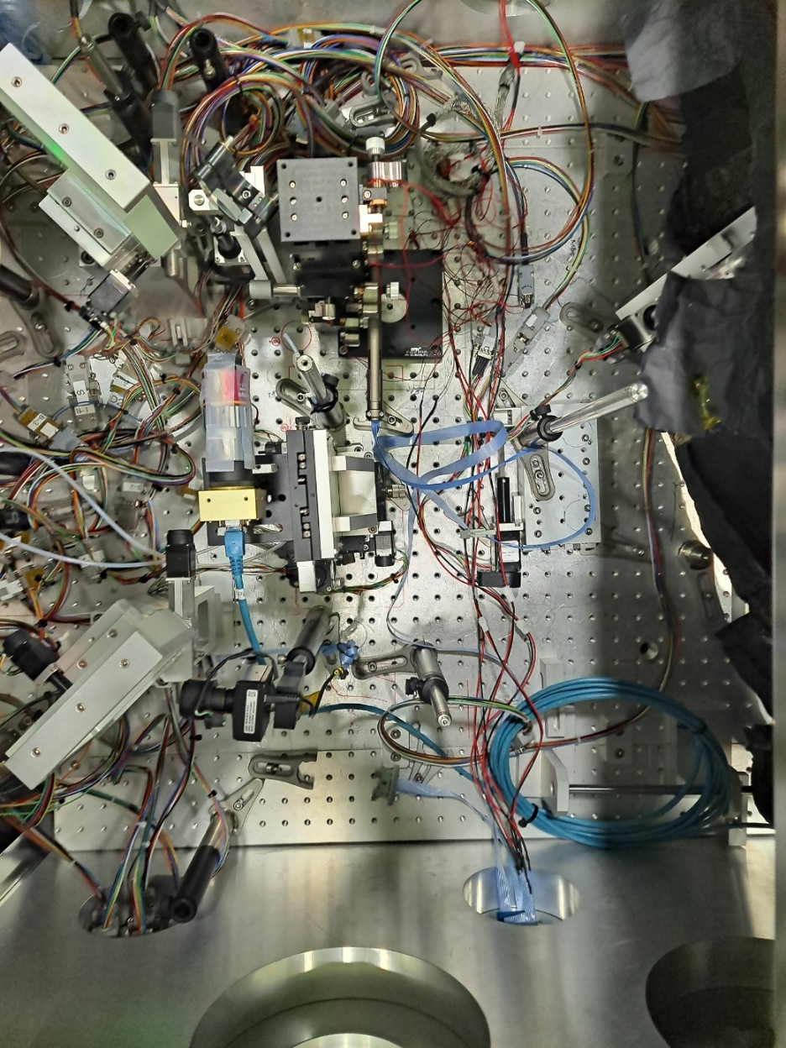
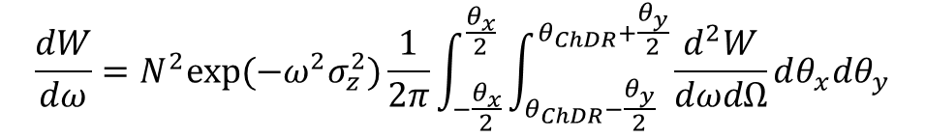
Laser
Capillary
$$\frac{dW}{dω}=N^{2}exp⁡(−ω^{2}σ_{z}^{2})\frac{1}{2π}\int_{−\frac{θ_{x}}{2}}^{\frac{θ_{x}}{2}}{\int_{θ_{ChDR}−\frac{θ_{y}}{2}}^{θ_{ChDR}+\frac{θ_{y}}{2}}{\frac{d^{2}W}{dωdΩ}}dθ_{x}dθ_{y}}$$
ChDR
ChDR
The solid angle integral needs to be evaluated
ChDR
Au Mirror
Au Mirror
ChDR
Window

Slide 11
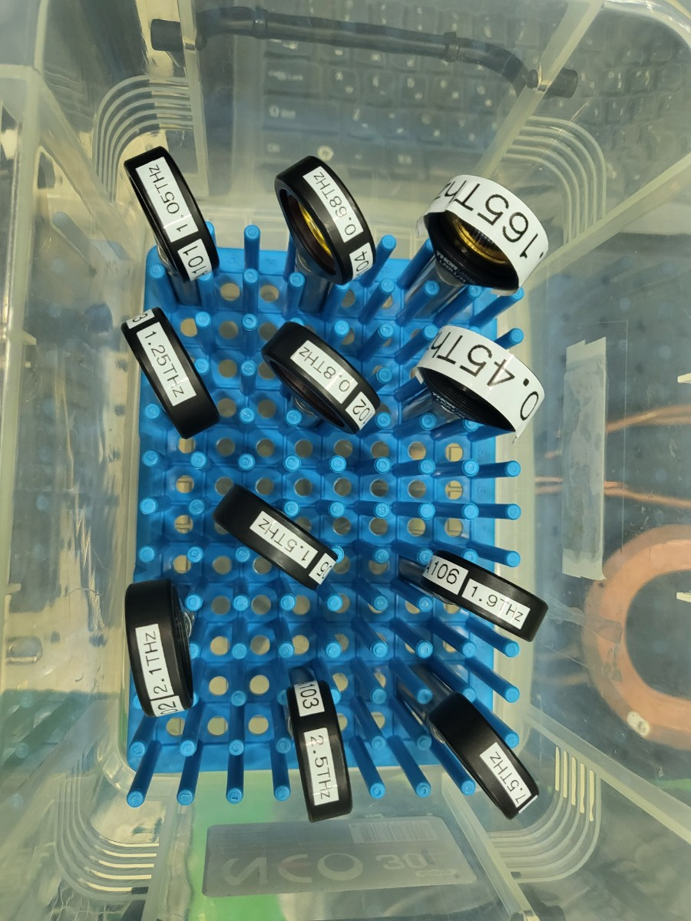
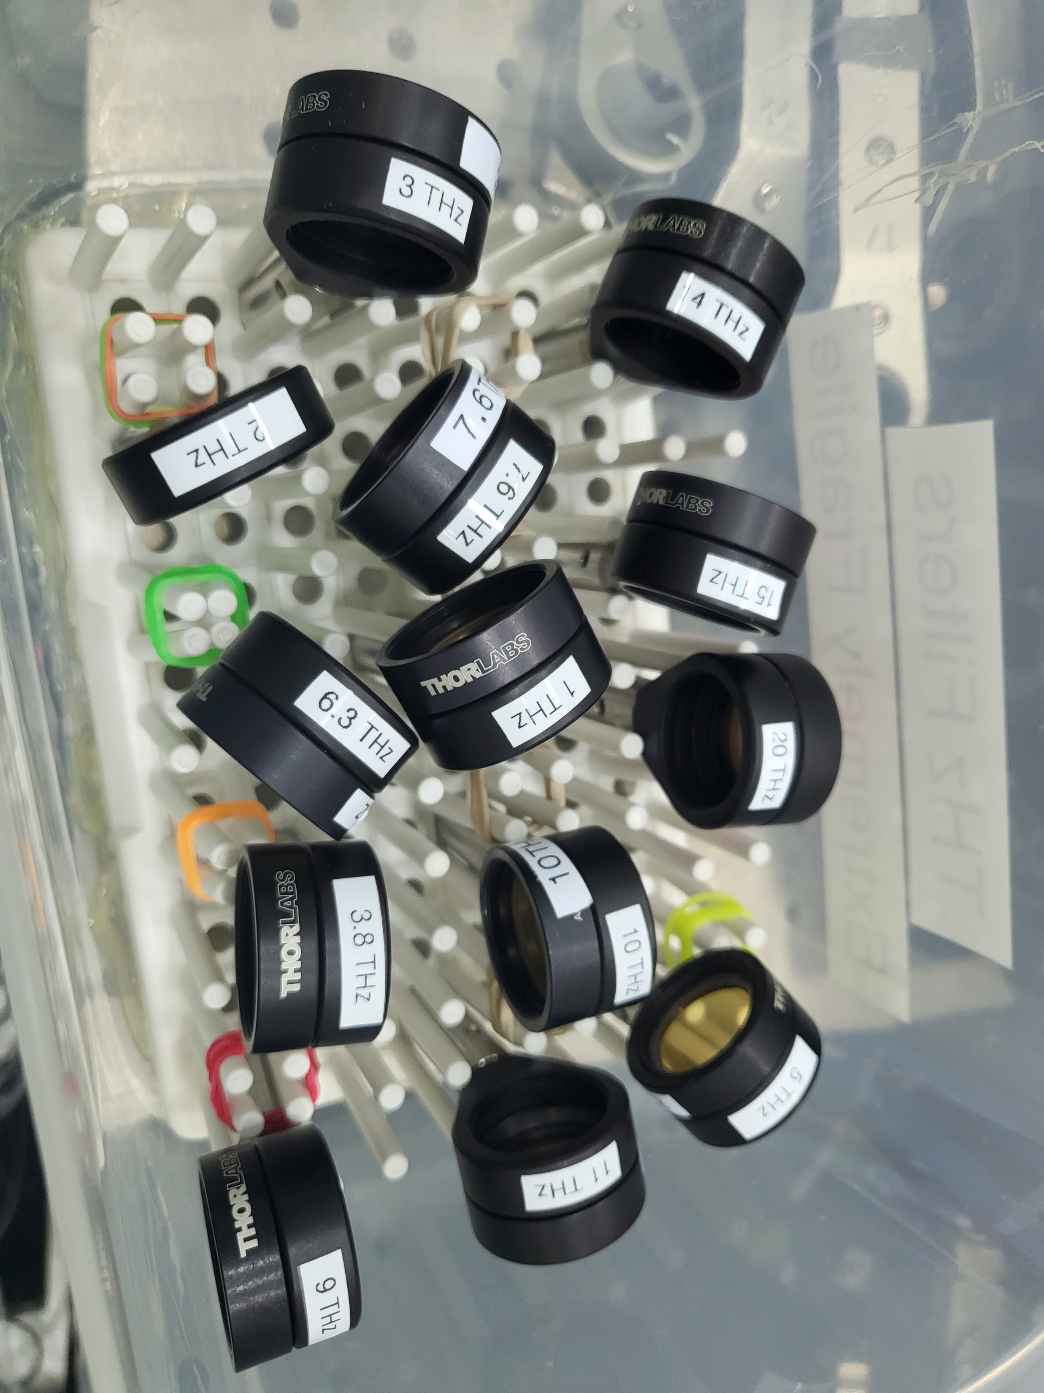
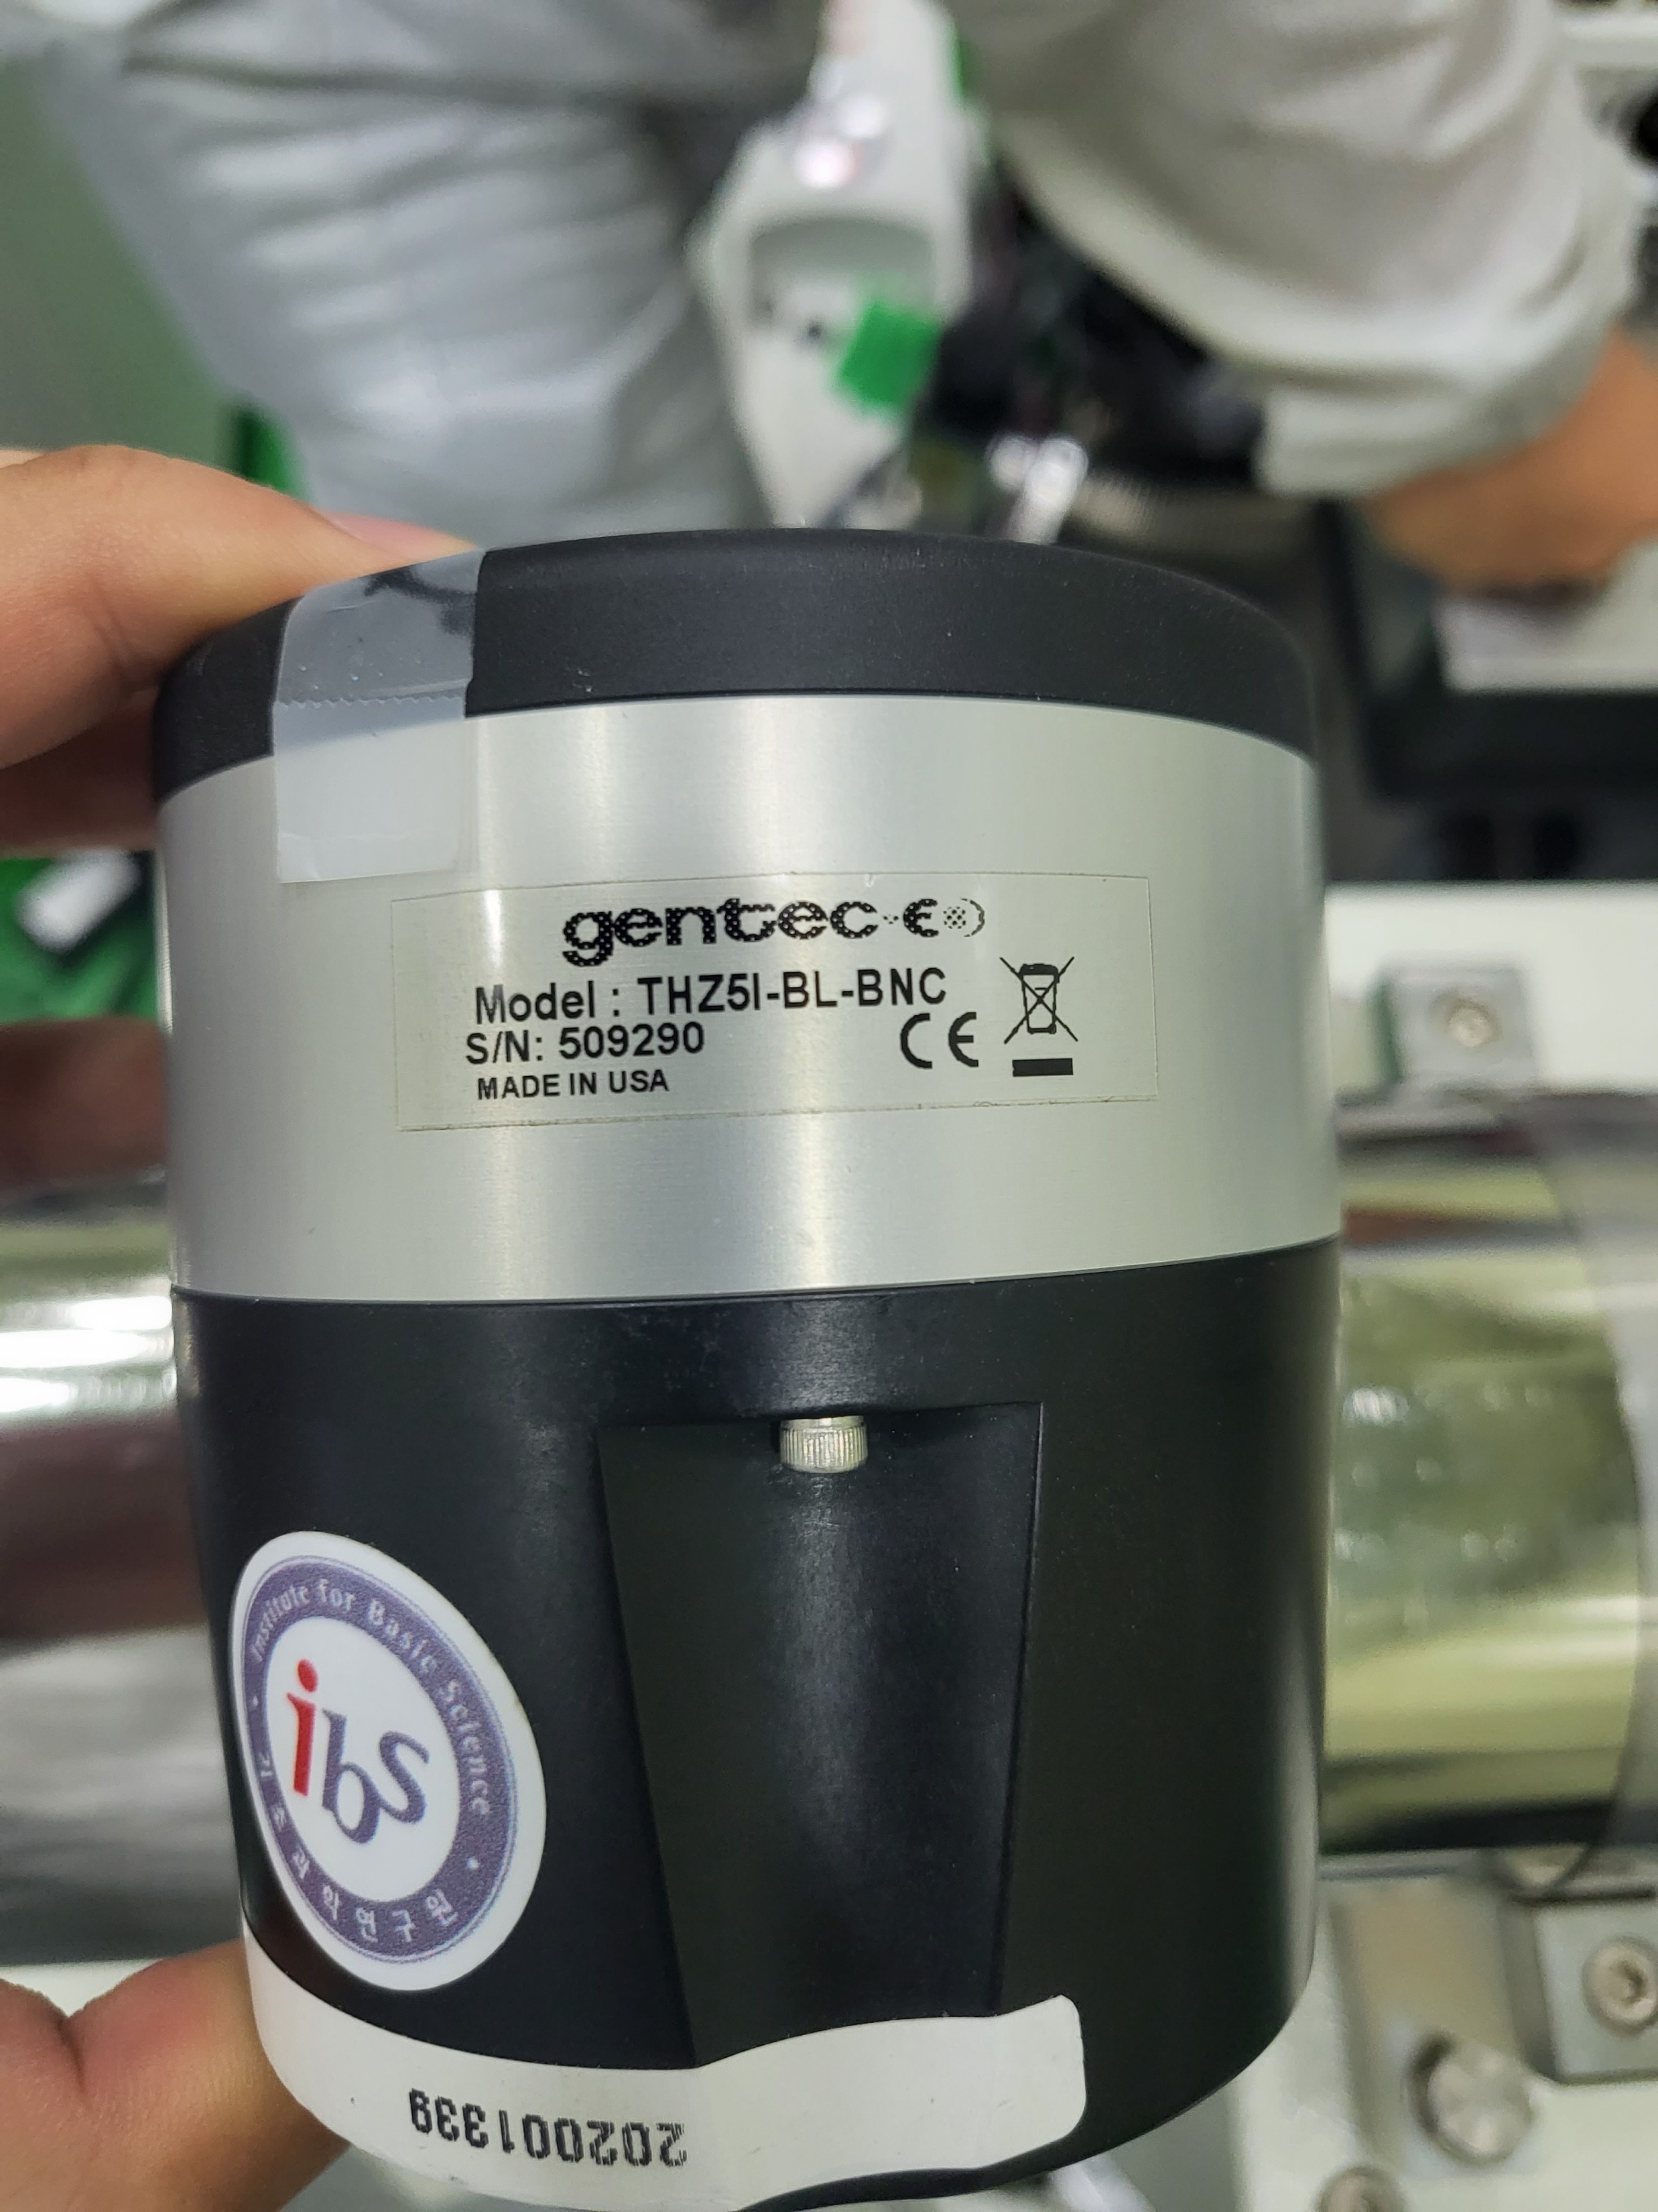
Experimental set-up
THz detector
(power meter, 0.1~30 THz)
THz filter
Measurement Target: Regions where the trends of Incoherent ChDR and Coherent ChDR differ.
  As the bunch length increases, differences appear at lower frequencies.
  (1 fs → ~80 THz(15um), 5 fs → ~ 20 THz(3.75um))

Slide 12
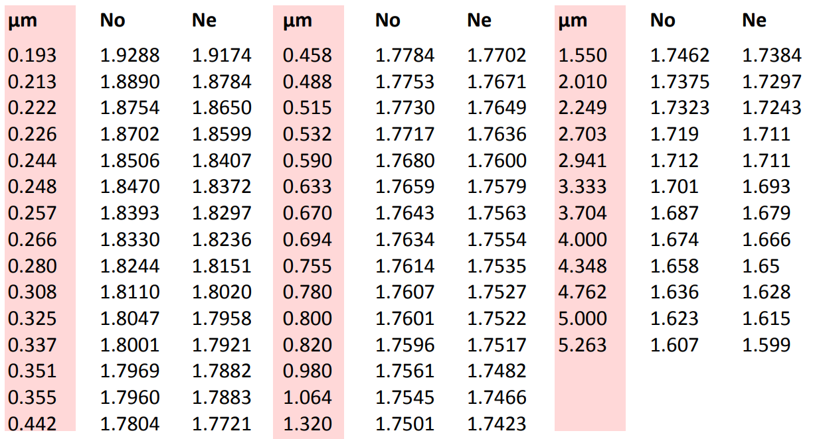
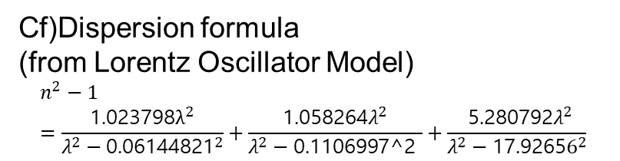
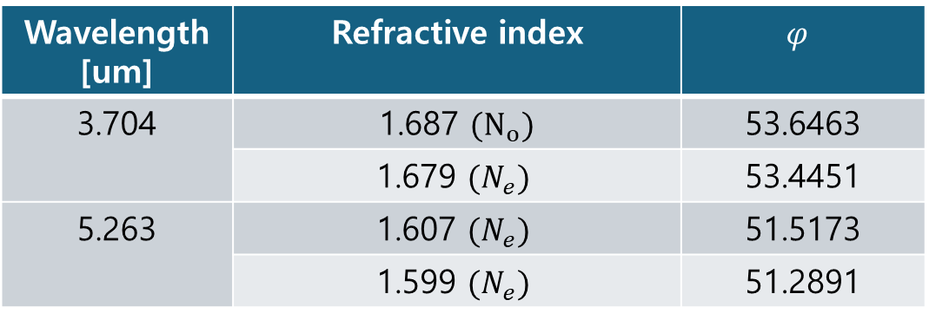
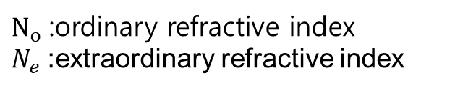

Refractive index issue
  1 fs ~ 5 fs
  80 THz ~ 20 THz
  15um ~ 3.75um
$N_{o}$:ordinary refractive index
$N_{e}$:extraordinary refractive index
Cf)Dispersion formula
(from Lorentz Oscillator Model)
$$n^{2}−1=\frac{\text{1.023798}λ^{2}}{λ^{2}−{\text{0.06144821}}^{2}}+\frac{\text{1.058264}λ^{2}}{λ^{2}−\text{0.1106997}\text{^2 }}+\frac{{ \text{5.280792}λ}^{2}}{λ^{2}−\text{17.9265}6^{2}}$$
  https://www.crystran.com/optical-materials/sapphire-al2o3
Wavelength [um] | Refractive index | $$φ$$
3.704 | 1.687 $(N_{o})$ | 53.6463
 | 1.679 $(N_{e})$ | 53.4451
5.263 | 1.607 $(N_{e})$ | 51.5173
 | 1.599 $(N_{e})$ | 51.2891
$θ_{ChR}+φ=90°$ ($θ_{ChR}=\cos^{−1}{\frac{1}{βn}})$

Slide 13
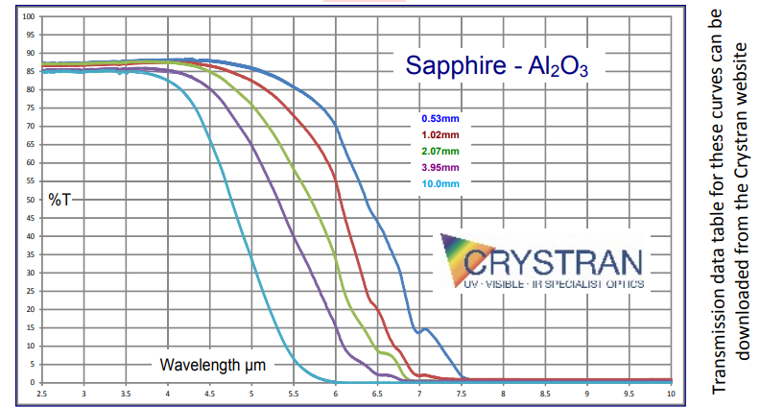
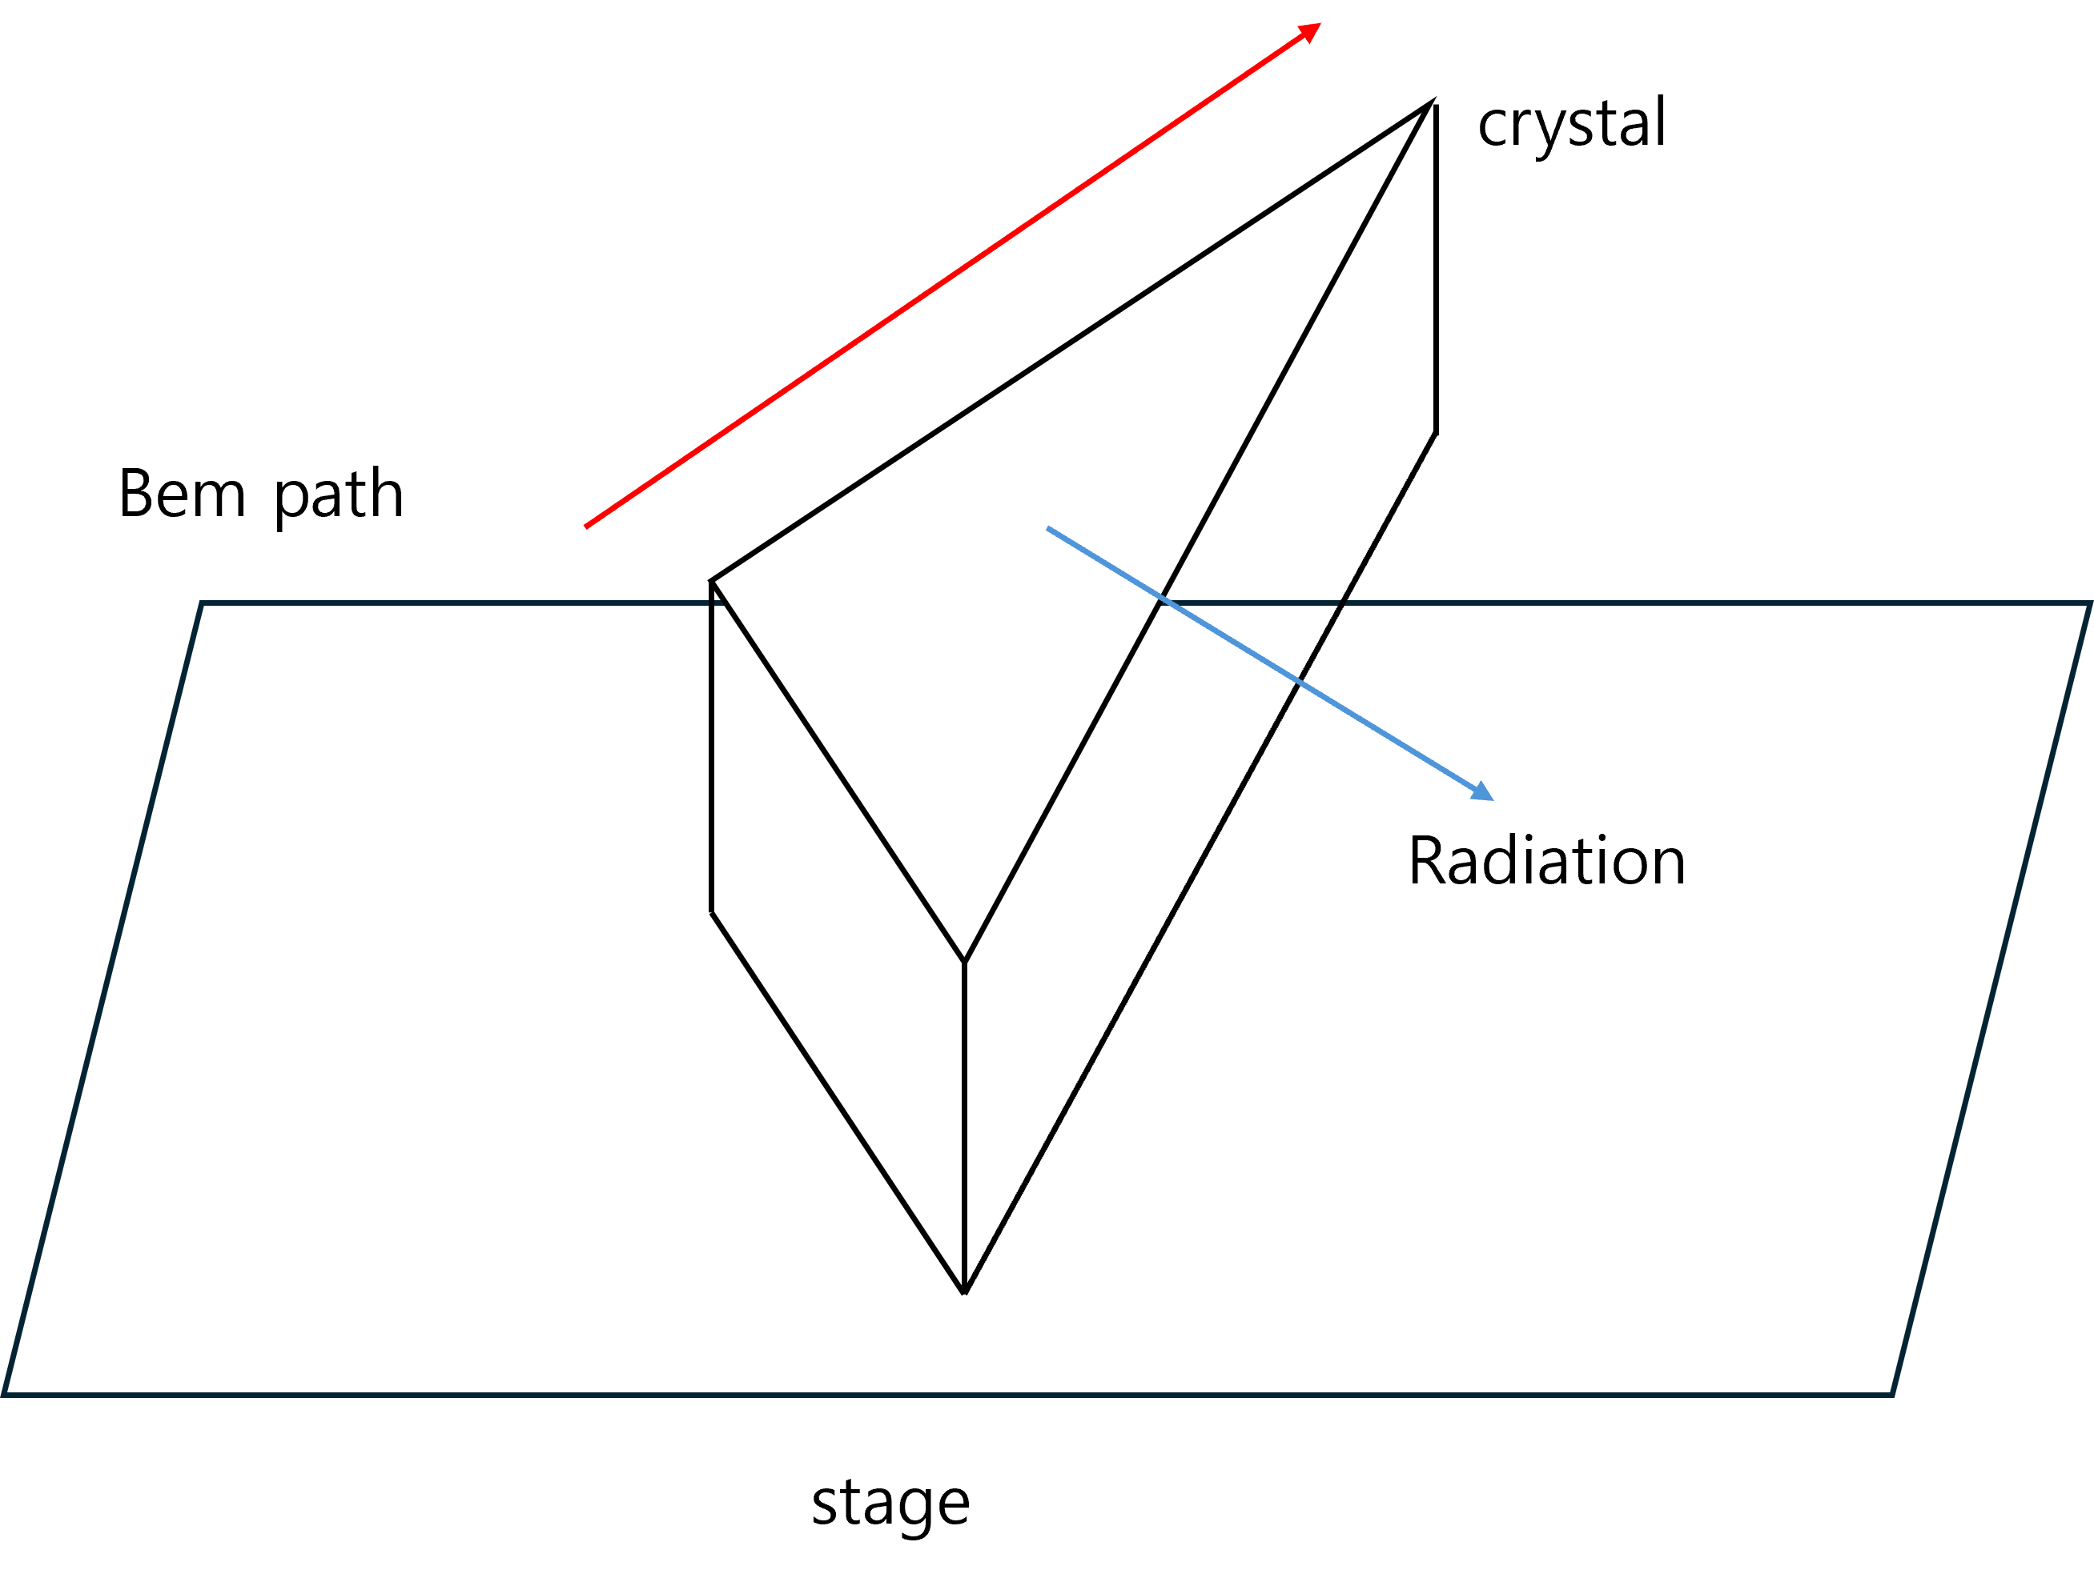
Transmission coefficient issue
  1 fs ~ 5 fs
  80 THz ~ 20 THz
  15um ~ 3.75um
  https://www.crystran.com/optical-materials/sapphire-al2o3
Radiation intensity can be affected by the crystal properties depending on the wavelength.(It may not be detected at all.)
Reststrahlen Peak 13.5µm (Almost of light reflects.)

Slide 14
Future work
To observe 80THz radiation, the impact parameter must be smaller than 0.117mm. (for 200MeV beam)
(With higher electron beam energy, radiation can still be detected at larger impact parameter)
A characteristic study of the crystal in the THz range is also required, including investigation of its refractive index and absorption rate.
In the intensity calculation, it appears necessary to account for the vertical and horizontal refractive indices as well as the absorption rate.
Based on these properties, the resulting solid angle integral should also be computed accordingly.
9월
Crystal fabrication
~10월 27일
Analytic calculation

Slide 15
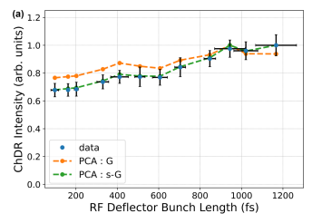
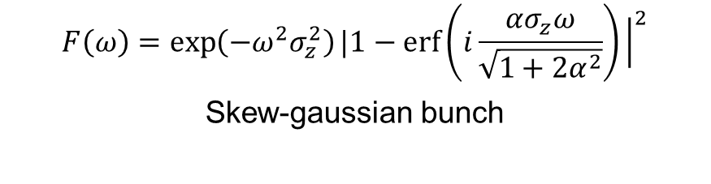
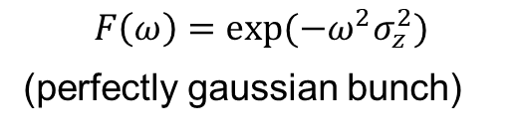
Additionaly Analysis on bunch form factor
Design and experimental verification of a bunch length monitor based on coherent Cherenkov diffraction radiation,” Phys. Rev. Res. 7, 013193 (2025).
At CERN CLEAR(electron linac)
$$F\left(ω\right)=exp⁡(−ω^{2}σ_{z}^{2})$$
(perfectly gaussian bunch)
$$F\left(ω\right)=\exp\left(−ω^{2}σ_{z}^{2}\right)|1−\operatorname{erf}\left(i\frac{ασ_{z}ω}{\sqrt{1+2α^{2}}}\right){\left.​\right|}^{2}$$
Skew-gaussian bunch

