Slide 1
Ultrafast Electron Diffraction Facility in PAL-eLabs
Minseo Jeong

Slide 2
Ultrafast Electron Diffraction
Pump-probe imaging technique based on optical pump-probe spectroscopy and electron diffraction caused by ultrafast electron
D. Filippetto et al. Rev. Mod. Phys. (2022).

Slide 3
UED Facility in PAL-eLabs

Slide 4
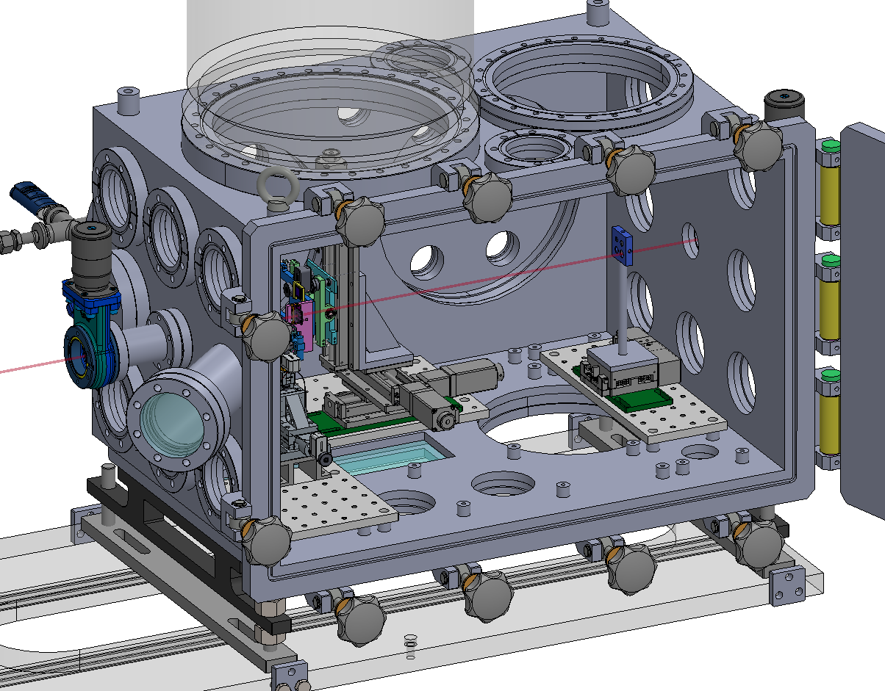
UED Facility in PAL-eLabs
Design of sample chamber for gas sample experiment
(with IBS)

Slide 5
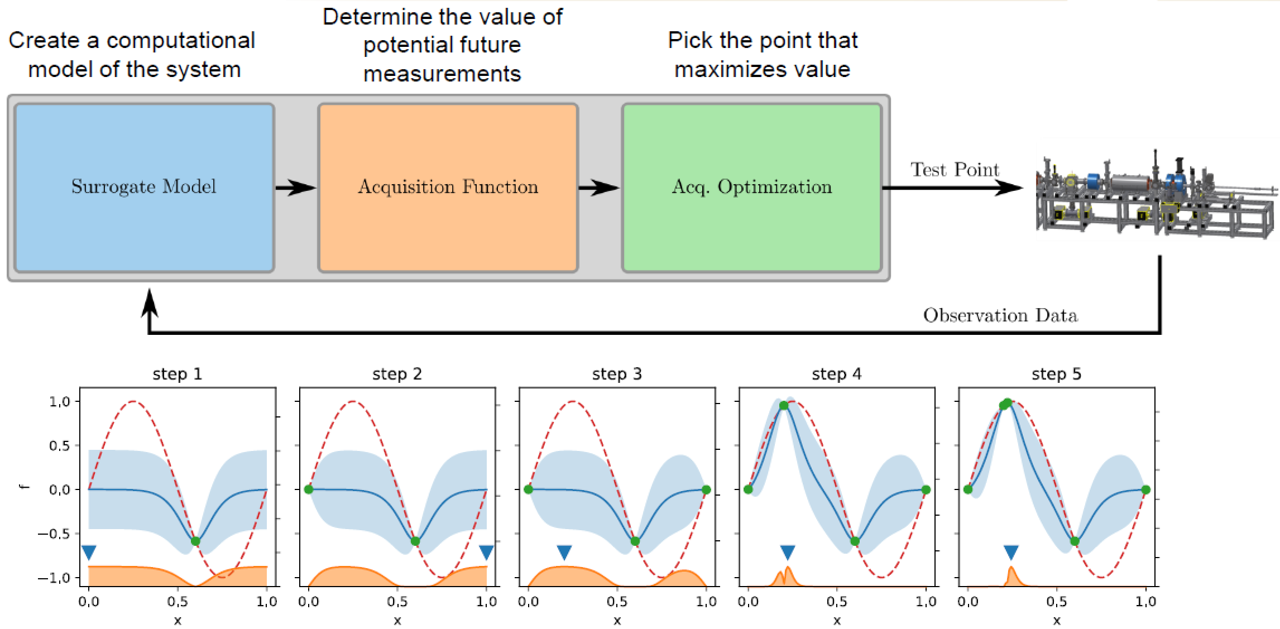
Optimization of UED parameters
Bayesian optimization: Model-based optimization algorithm using probability distribution model based on previous observations

Slide 6
Optimization of UED parameters
Input parameter: Strength of solenoids, RF gun phase, source beam size
Objective parameter: Beam size, bunch length, q-resolution

Slide 7
EPICS Simulator
Goal: Test of optimization algorithm of PAL UED facility by simulator
Running simulation(e.g. BMAD) by modifying process variables(PV) of PAL UED facility(e.g. solenoid current, RF phase)

Slide 8
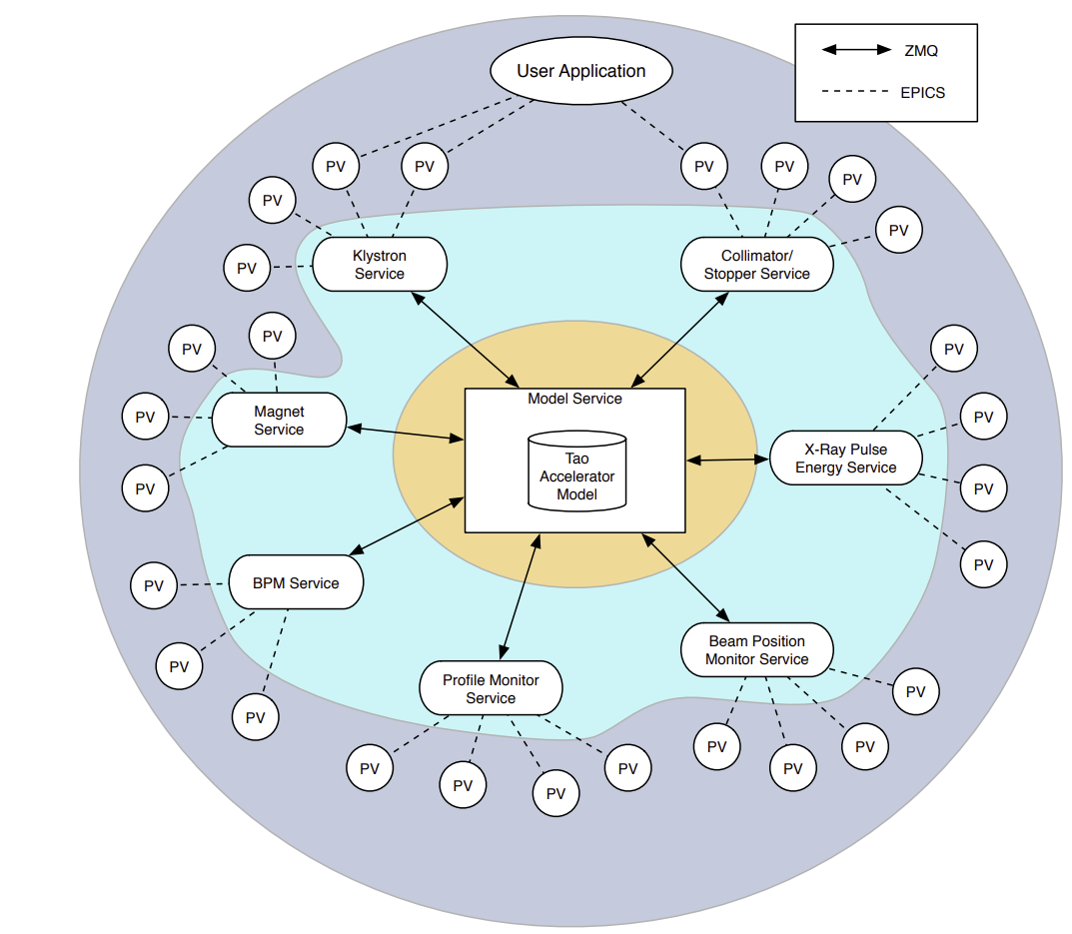
EPICS Simulator
Simulacrum(simulator of LCLS accelerator)

Slide 9
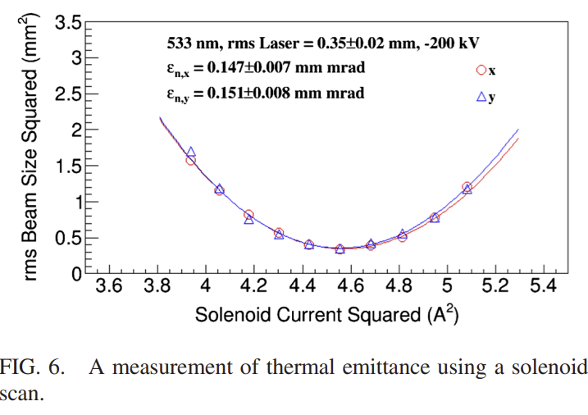
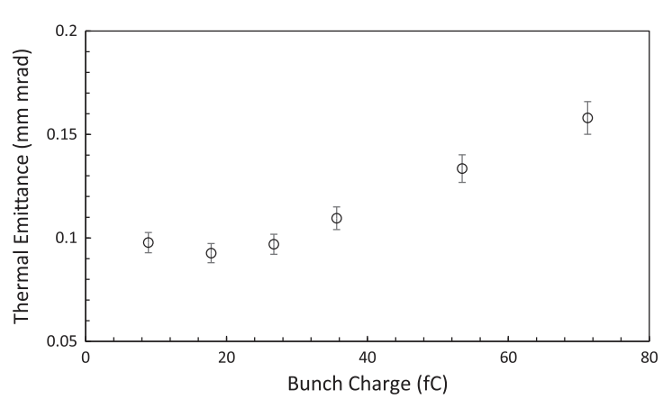
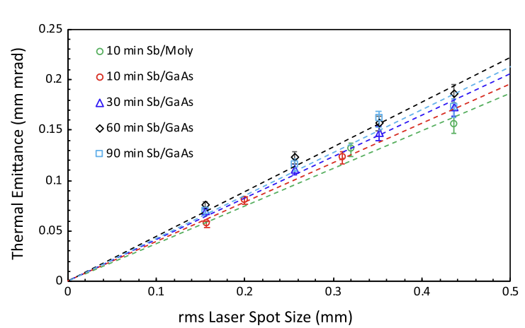

Measurement of Thermal Emittance of Photogun
The normalized emittance at emission: $ε_{n}=σ_{laser}\sqrt{\frac{(ħω−Φ)}{3mc^{2}}}$
($Φ=Φ_{W}−\frac{e}{2}\sqrt{\frac{eE_{0}}{πε_{0}}}, E_{0}:$ electric field at the cathode)
The thermal emittance of photogun can be measured by solenoid scan
Y. WANG et al. PHYS. REV. ACCEL. BEAMS 23, 103401 (2020)

Slide 10
Future Plan
Measurement of thermal emittance of photogun
Optimization of PAL-eLabs UED machine parameters
Participation of UED experiment (with IBS)
- static gas UED
- pump-probe experiment with solid sample

