Slide 1
Tomography results by using python library
25. 09. 05
POSTECH
PhD/MS combined student
Geunwoo Kim

Slide 2
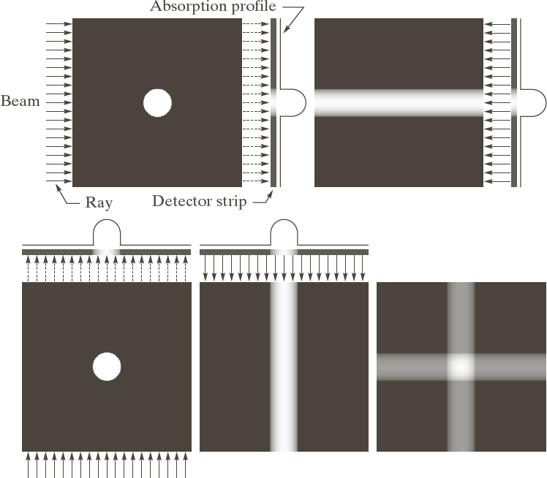
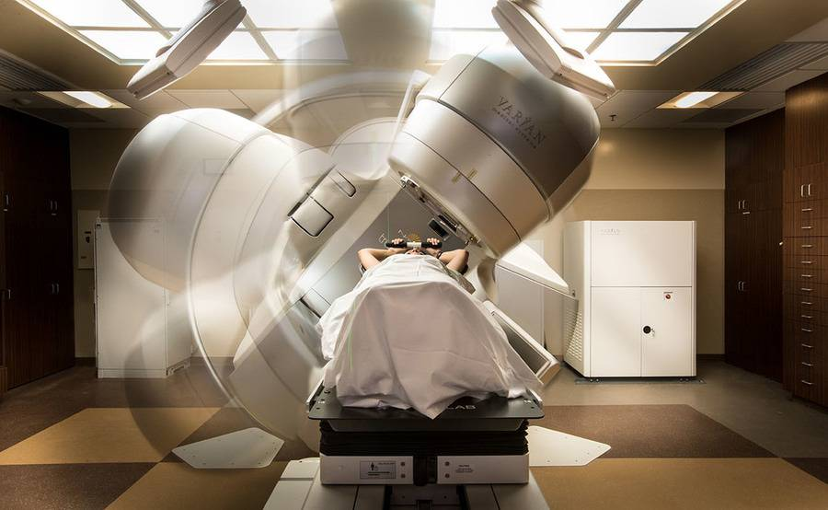
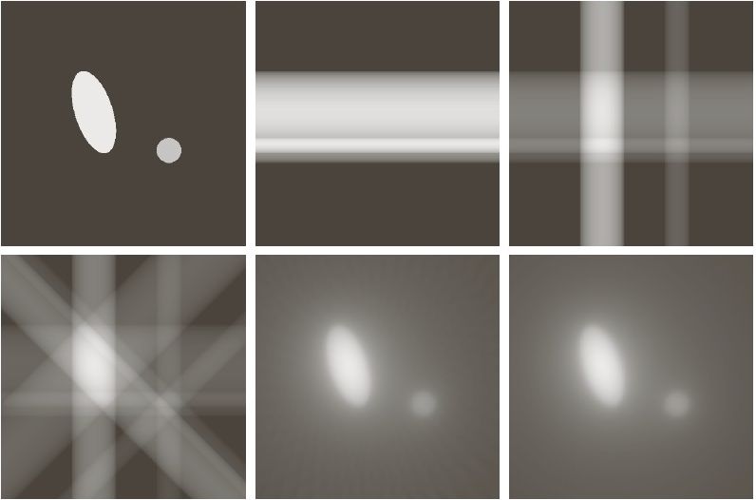
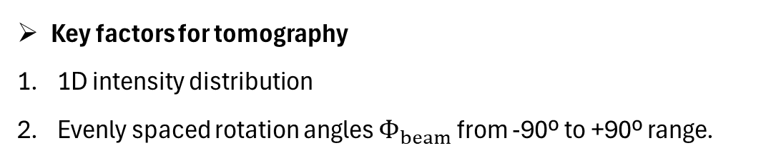
Remind: Principle of tomography
① 1st projection
③ Combine both projection
② 2nd projection
[Original beam image]
What we want to know
Key factors for tomography
1D intensity distribution
Evenly spaced rotation angles $Φ_{beam}$ from -90º to +90º range.
[Reconstructed image]
Notes:
https://watkins.cs.queensu.ca/~jstewart/457/notes/ct/06/06-fbp.html

Slide 3
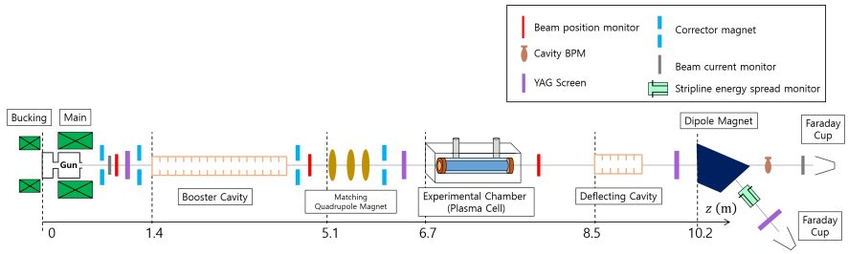
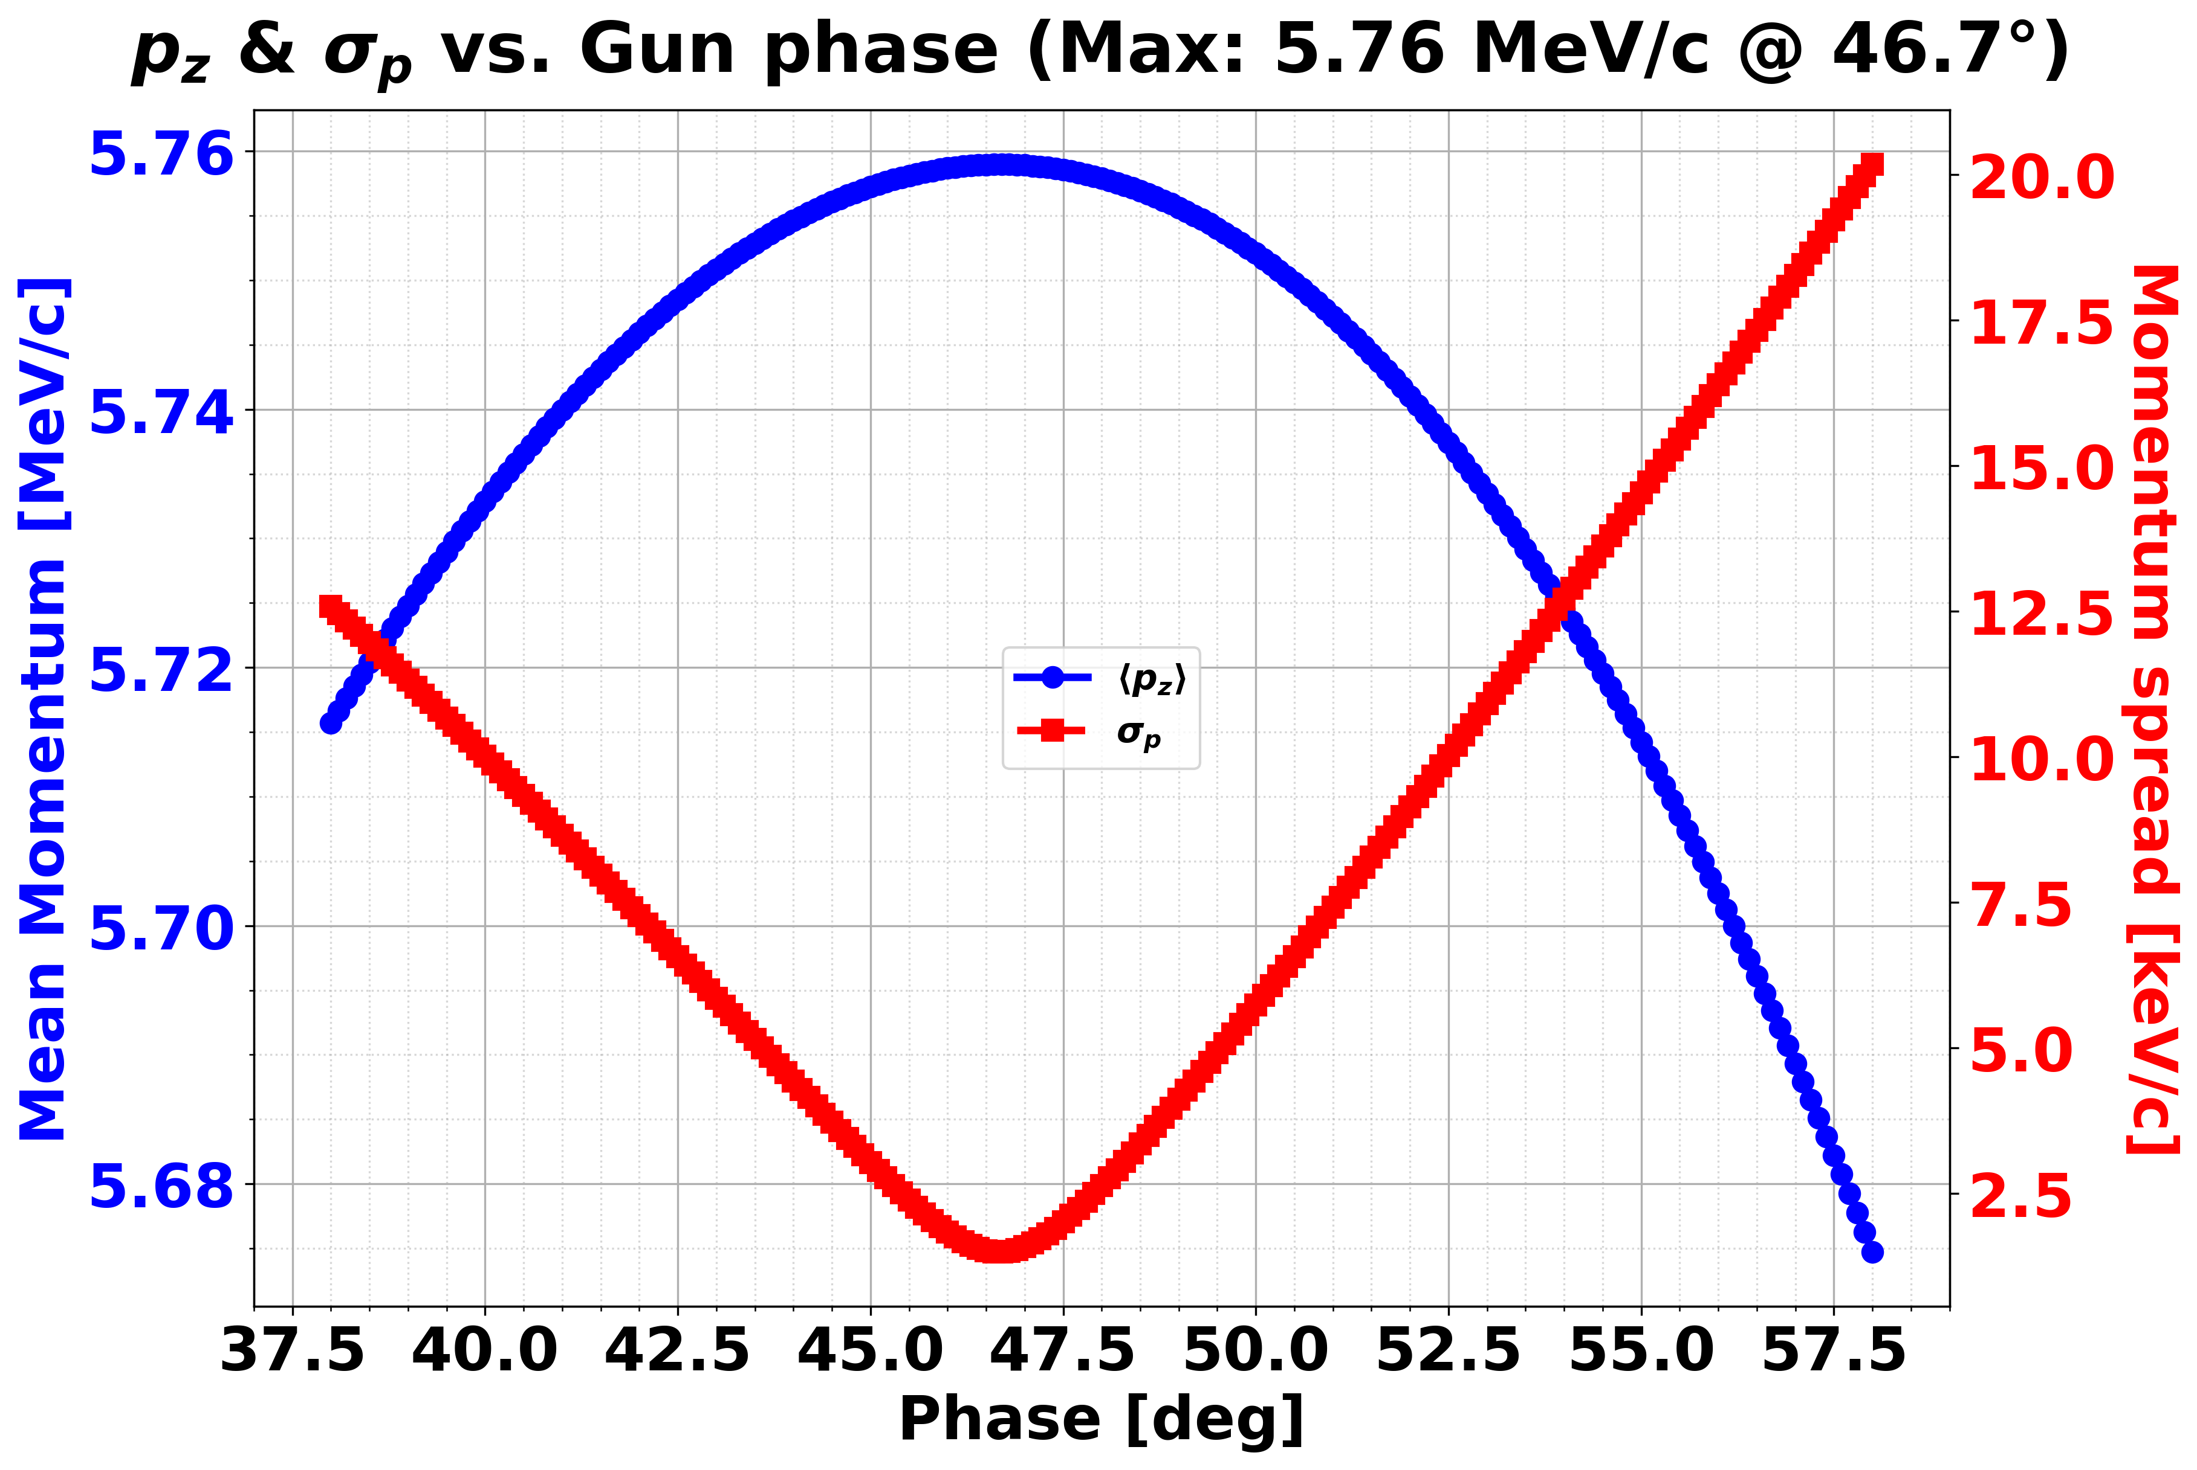
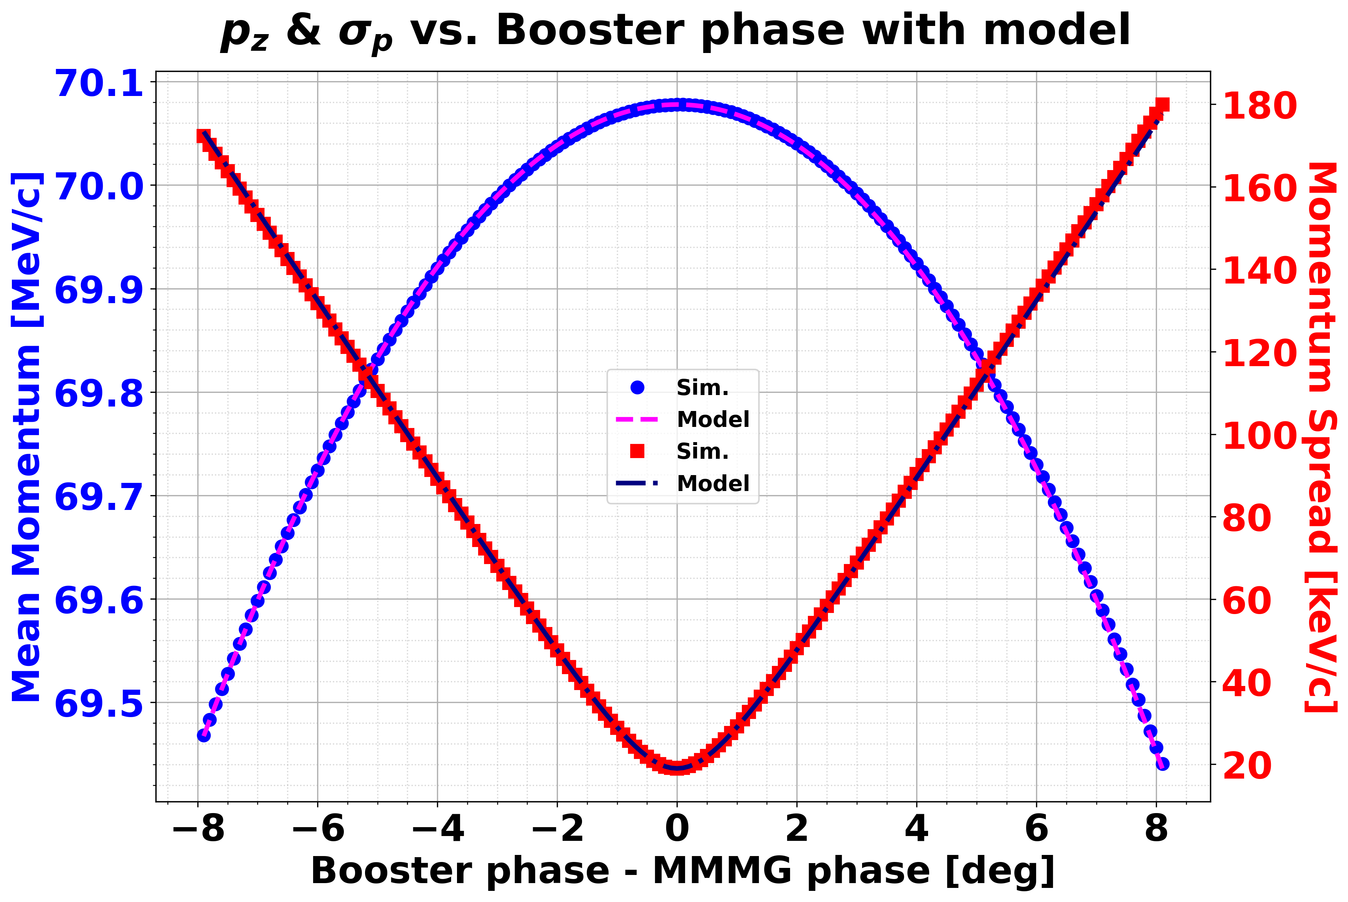


Data preprocessing: $p$ and $σ_{p}$.
Parameters | Specifications
Energy | 70 MeV
Charge | 200 pC
# of particles | 100,000
Space charge | OFF
Bunch length | 1.2739 ps
Phase increment | 0.1 deg
Reconstruction point
Measurement point
$$⟨p_{z}〉$$
$$σ_{p}$$

Slide 4
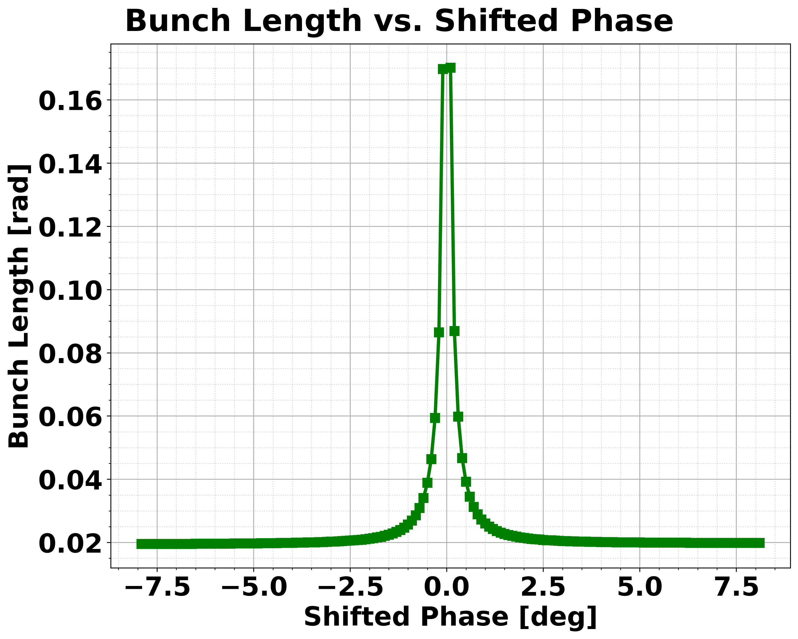
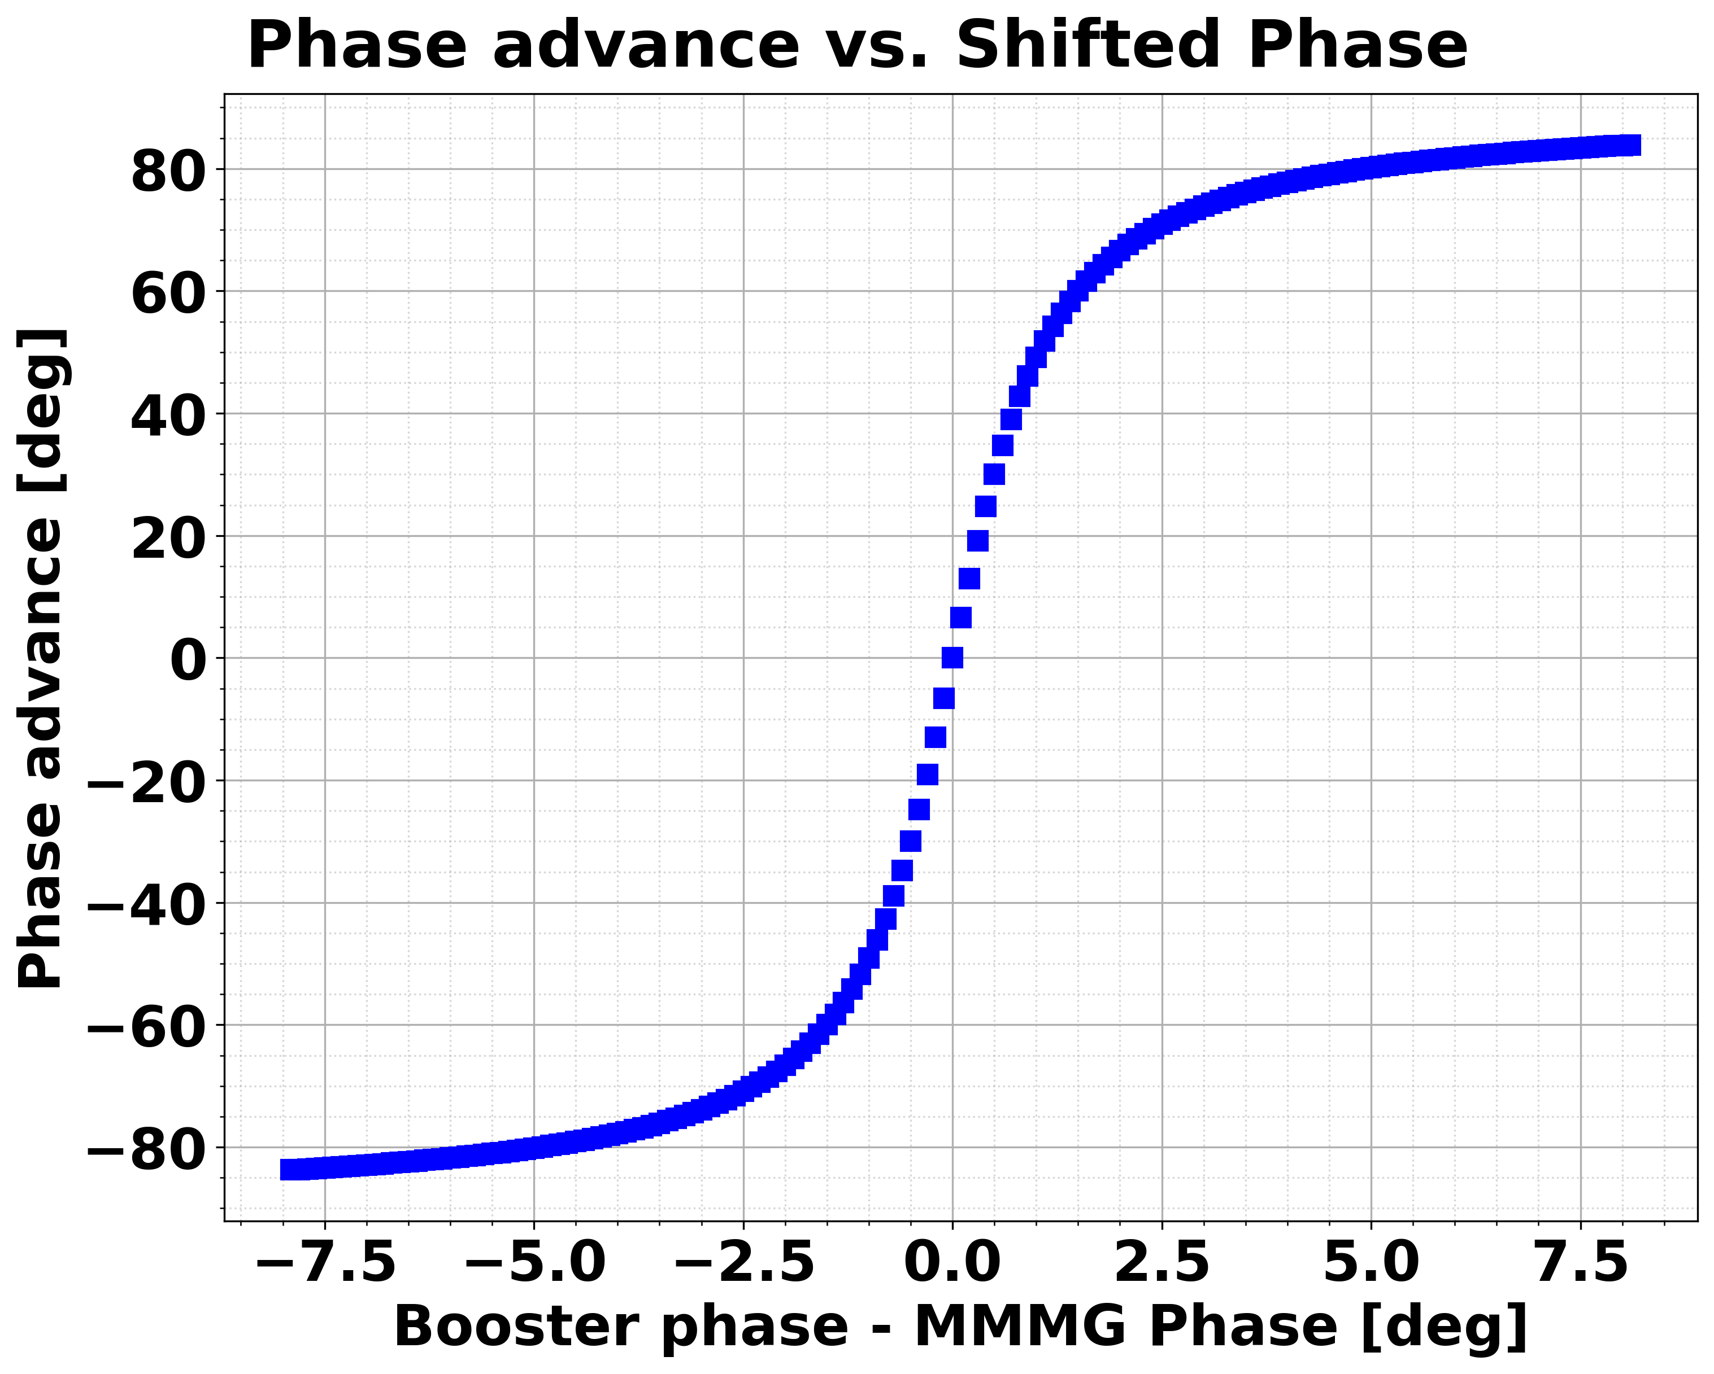
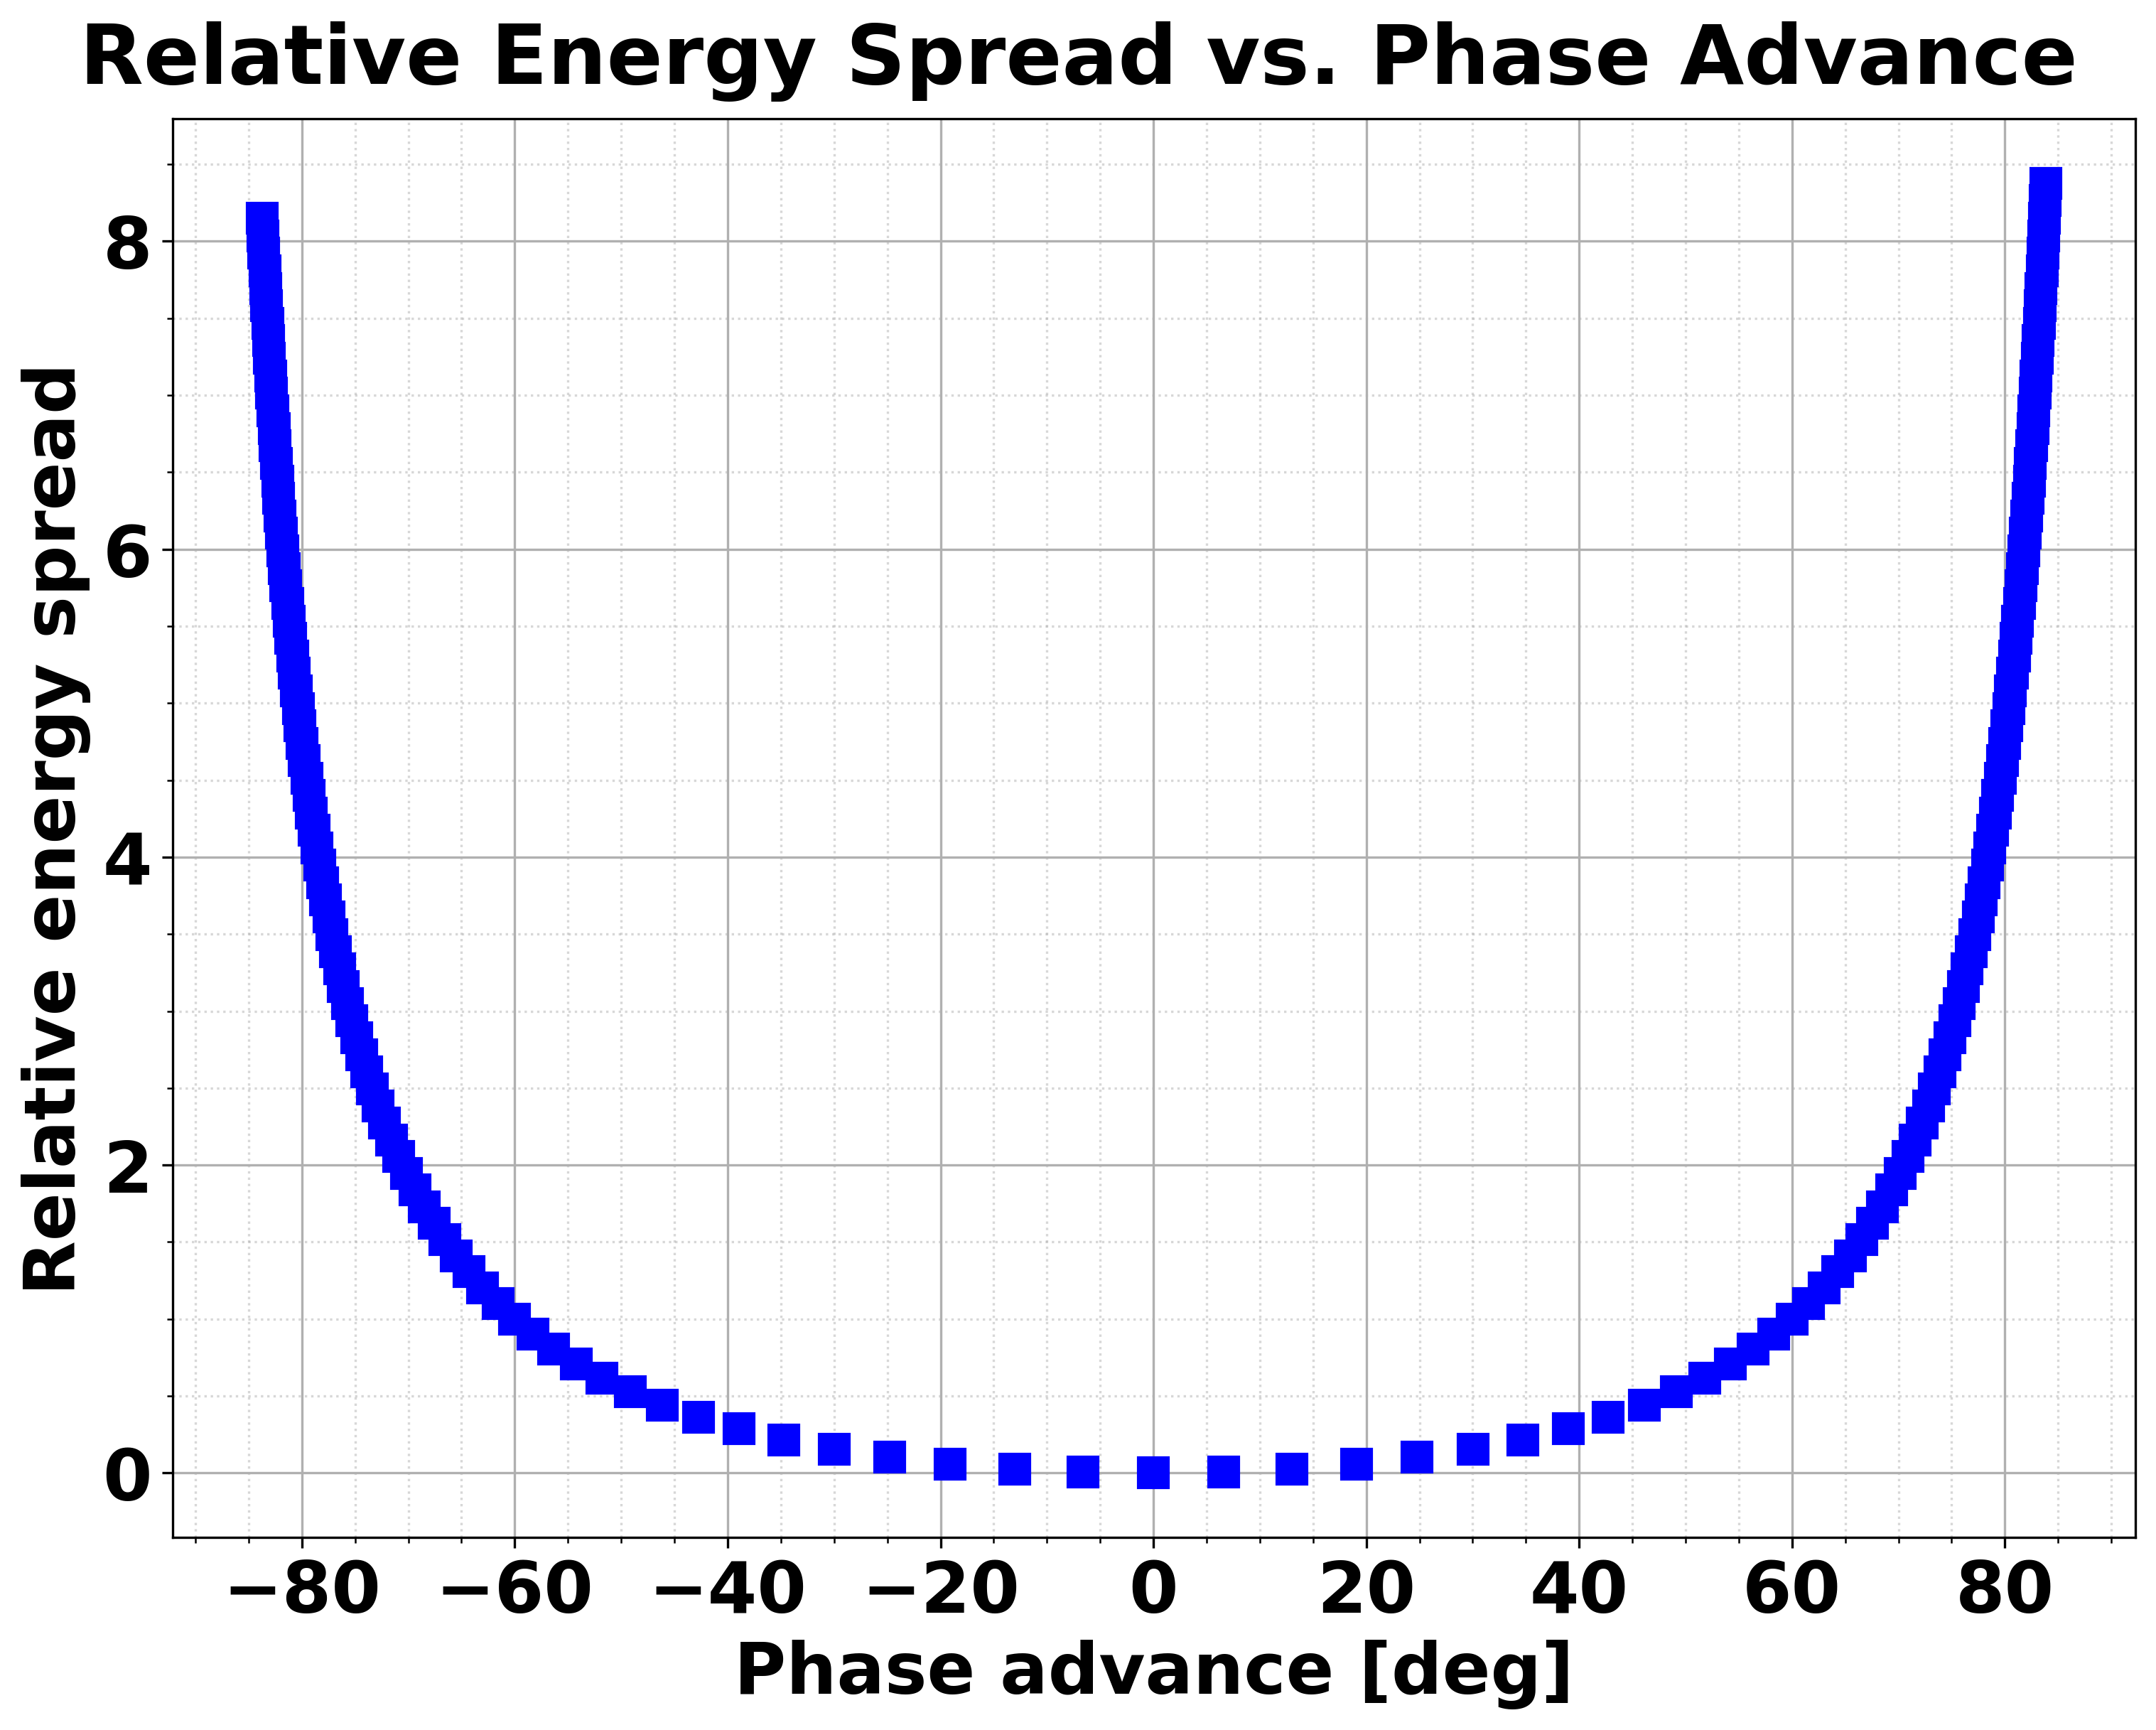



Data preprocessing: $σ_{φ}$, $Φ_{beam}$, and $δσ_{p}$.
We obtained the phase advance from booster cavity phase sweep.
Before move on to apply tomography step, the angle-momentum data, called sinogram, is needed.
$$σ_{φ}$$
$$Φ_{beam}$$
$$δσ_{p}$$

Slide 5
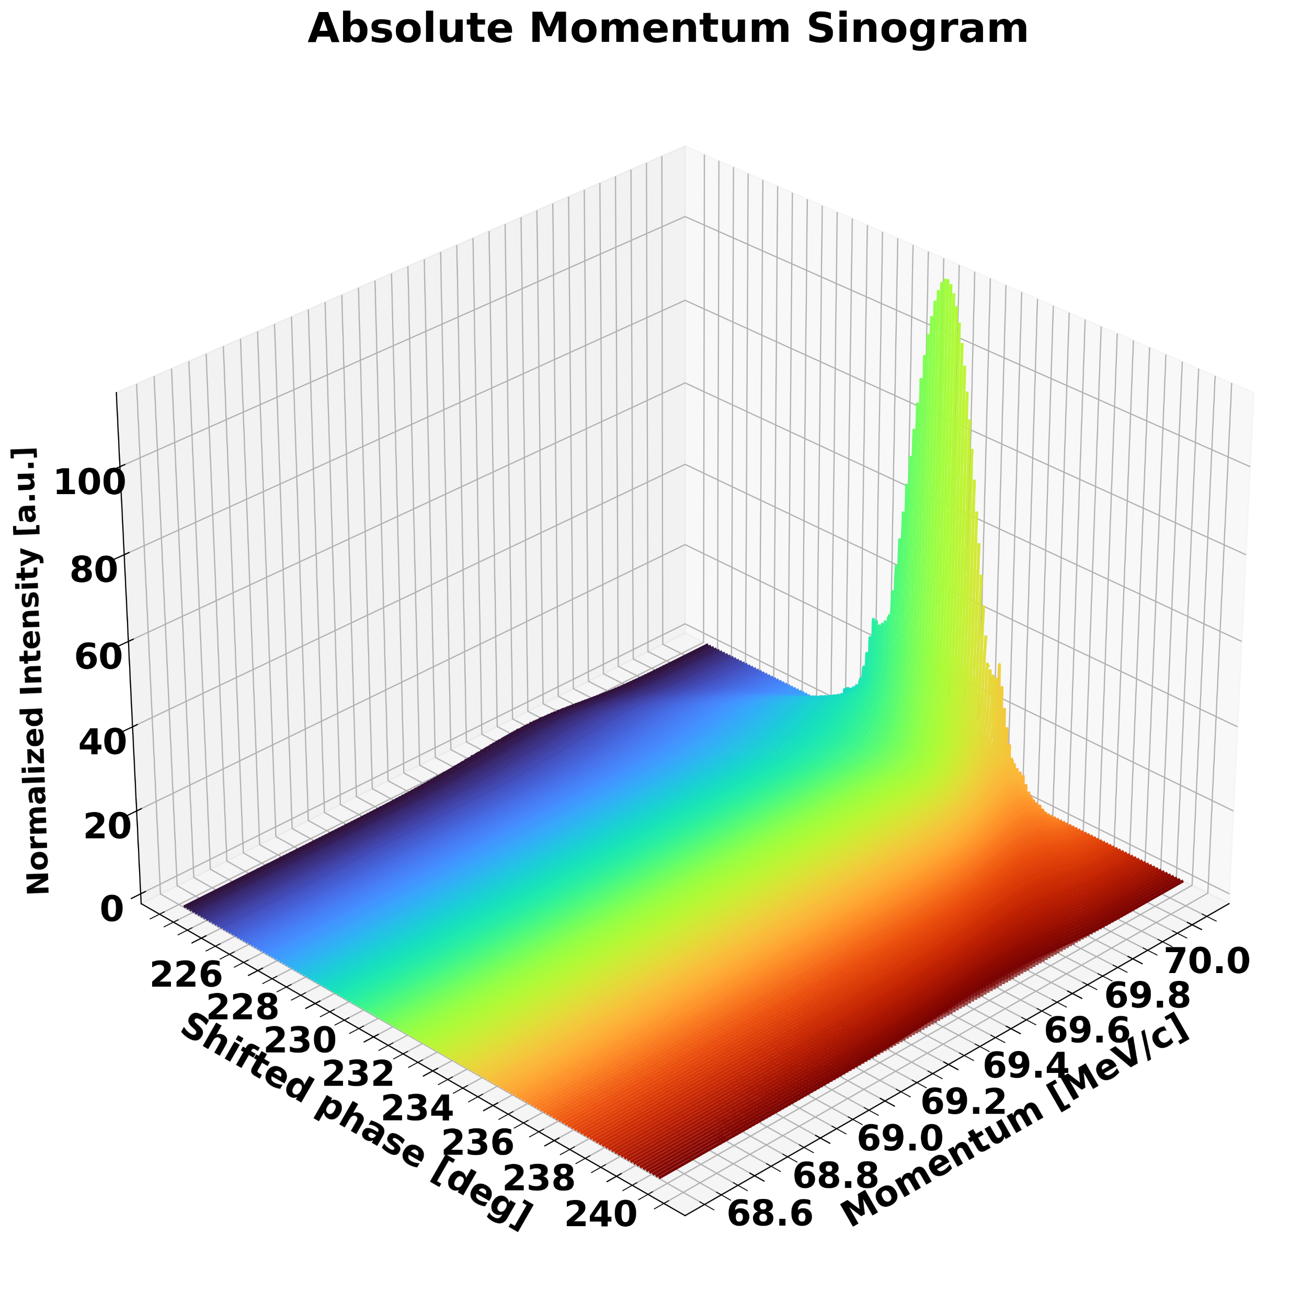
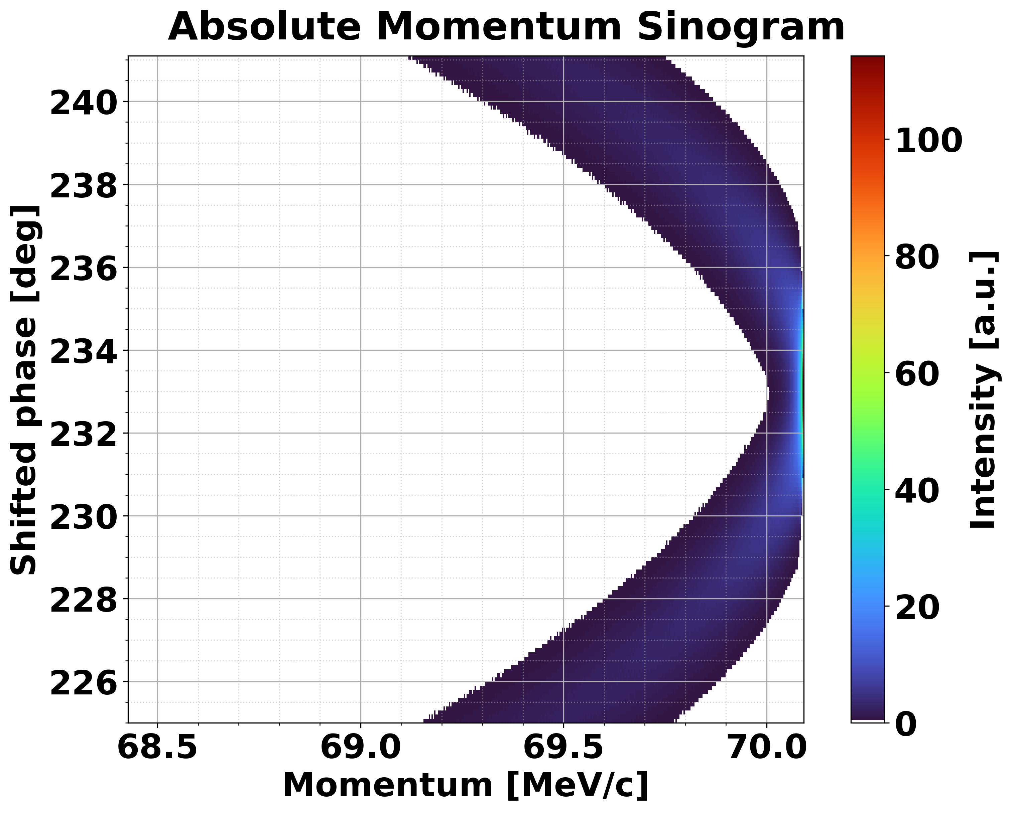
Angle sweep data-taking: Sinogram.
RF cavity phase
A sinogram, which serves as angle sweep data, can be generated based on the measurement of the phase advance.
By utilizing this sinogram data in conjunction with a one-dimensional momentum distribution, LPS can be reconstructed.

Slide 6
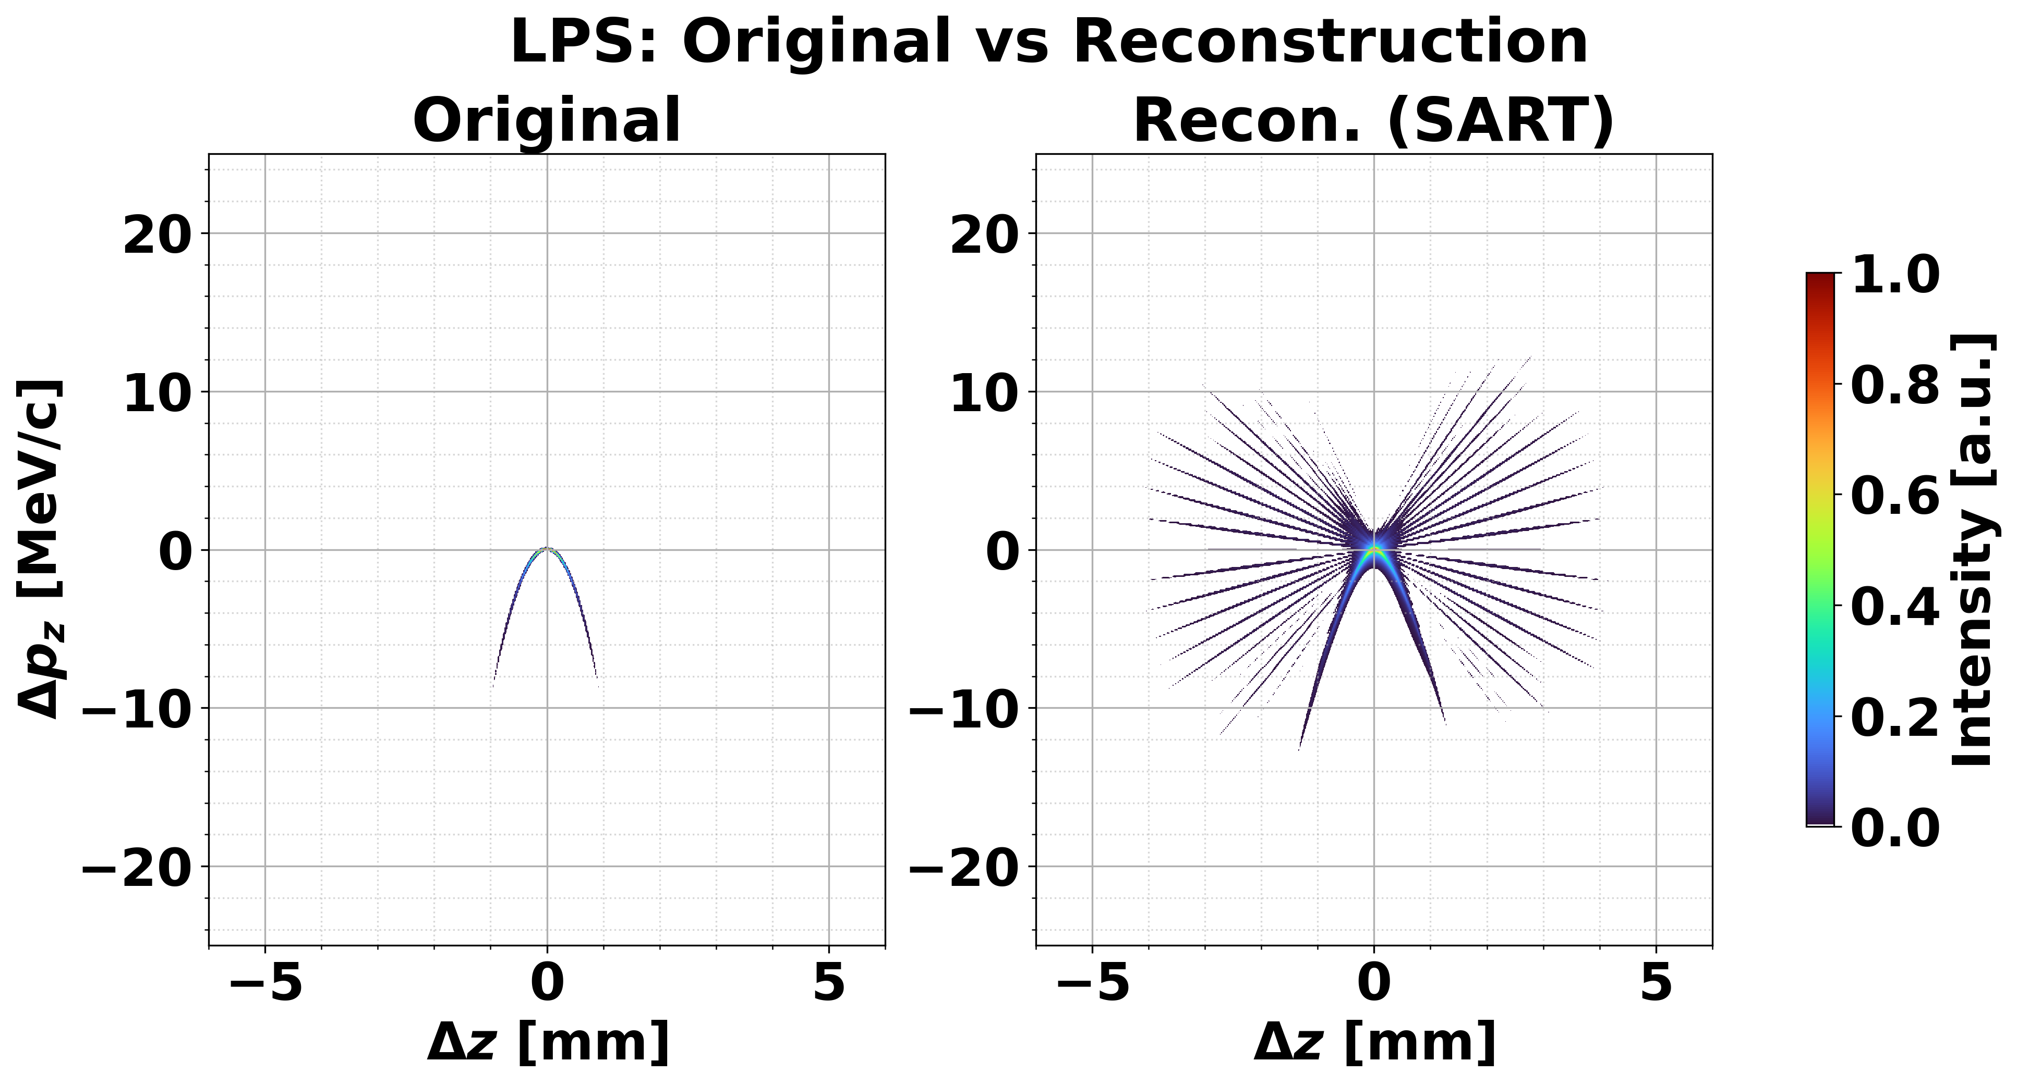
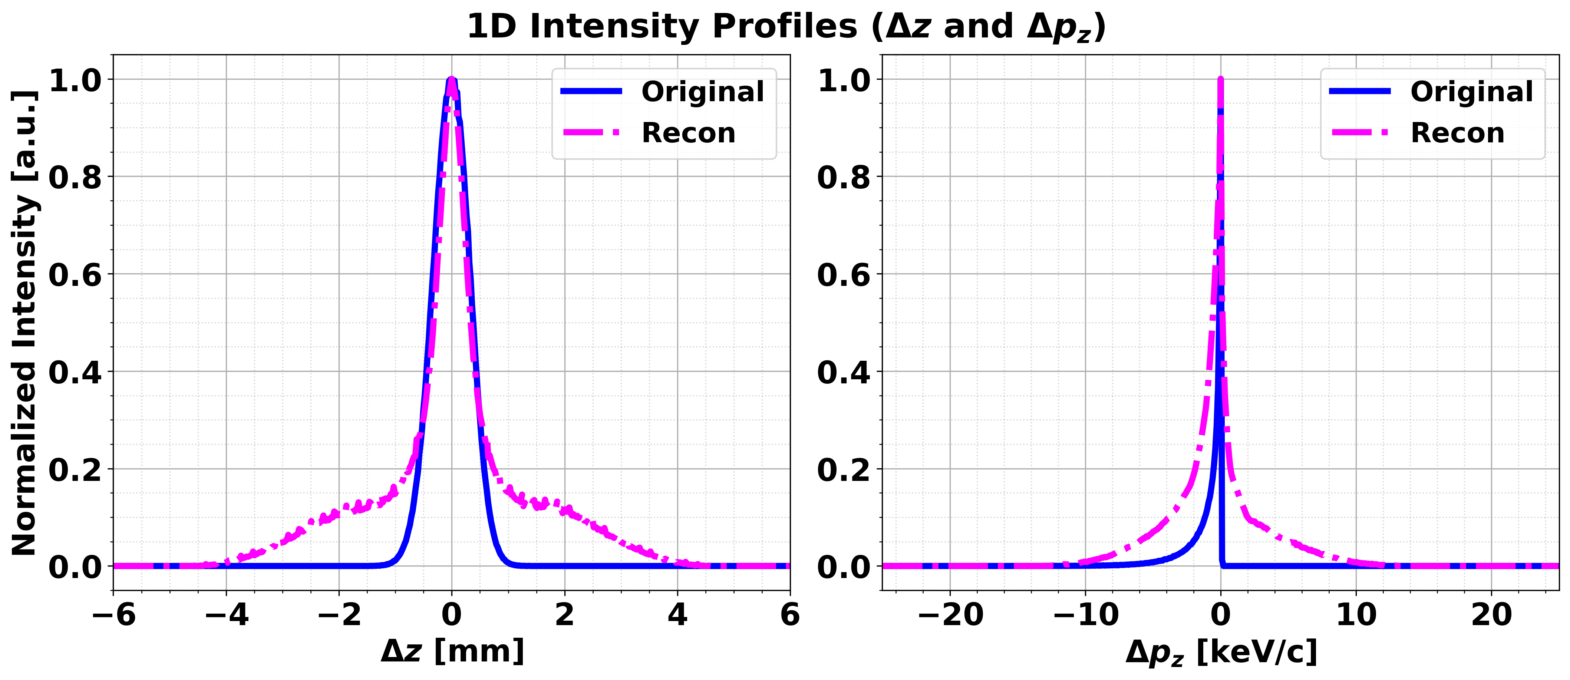
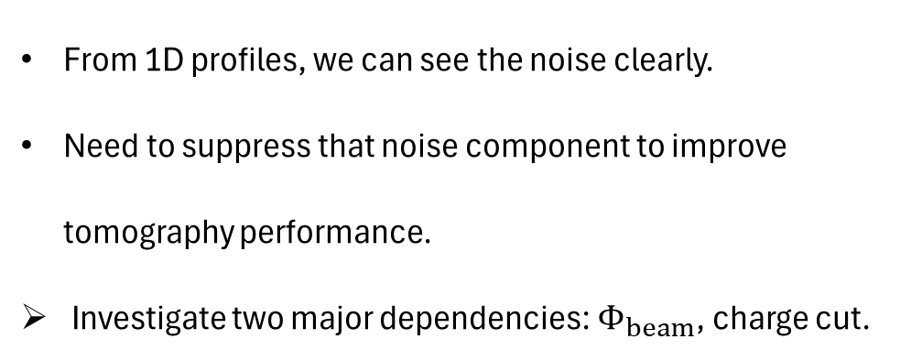
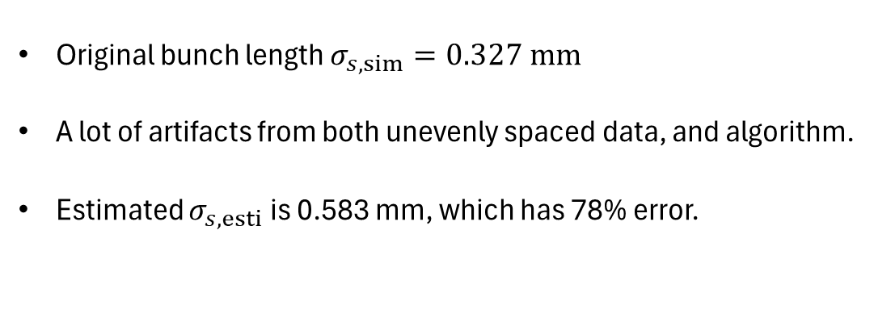


① Tomography result: use the whole data.
Original bunch length $σ_{s,sim}=0.327 mm$
A lot of artifacts from both unevenly spaced data, and algorithm.
Estimated $σ_{s,esti}$is 0.583 mm, which has 78% error.
$$σ_{s,sim}=0.327 mm$$
$$σ_{s,esti}=1.17 mm$$
From 1D profiles, we can see the noise clearly.
Need to suppress that noise component to improve tomography performance.
Investigate two major dependencies: $Φ_{beam}$, charge cut.

Slide 7
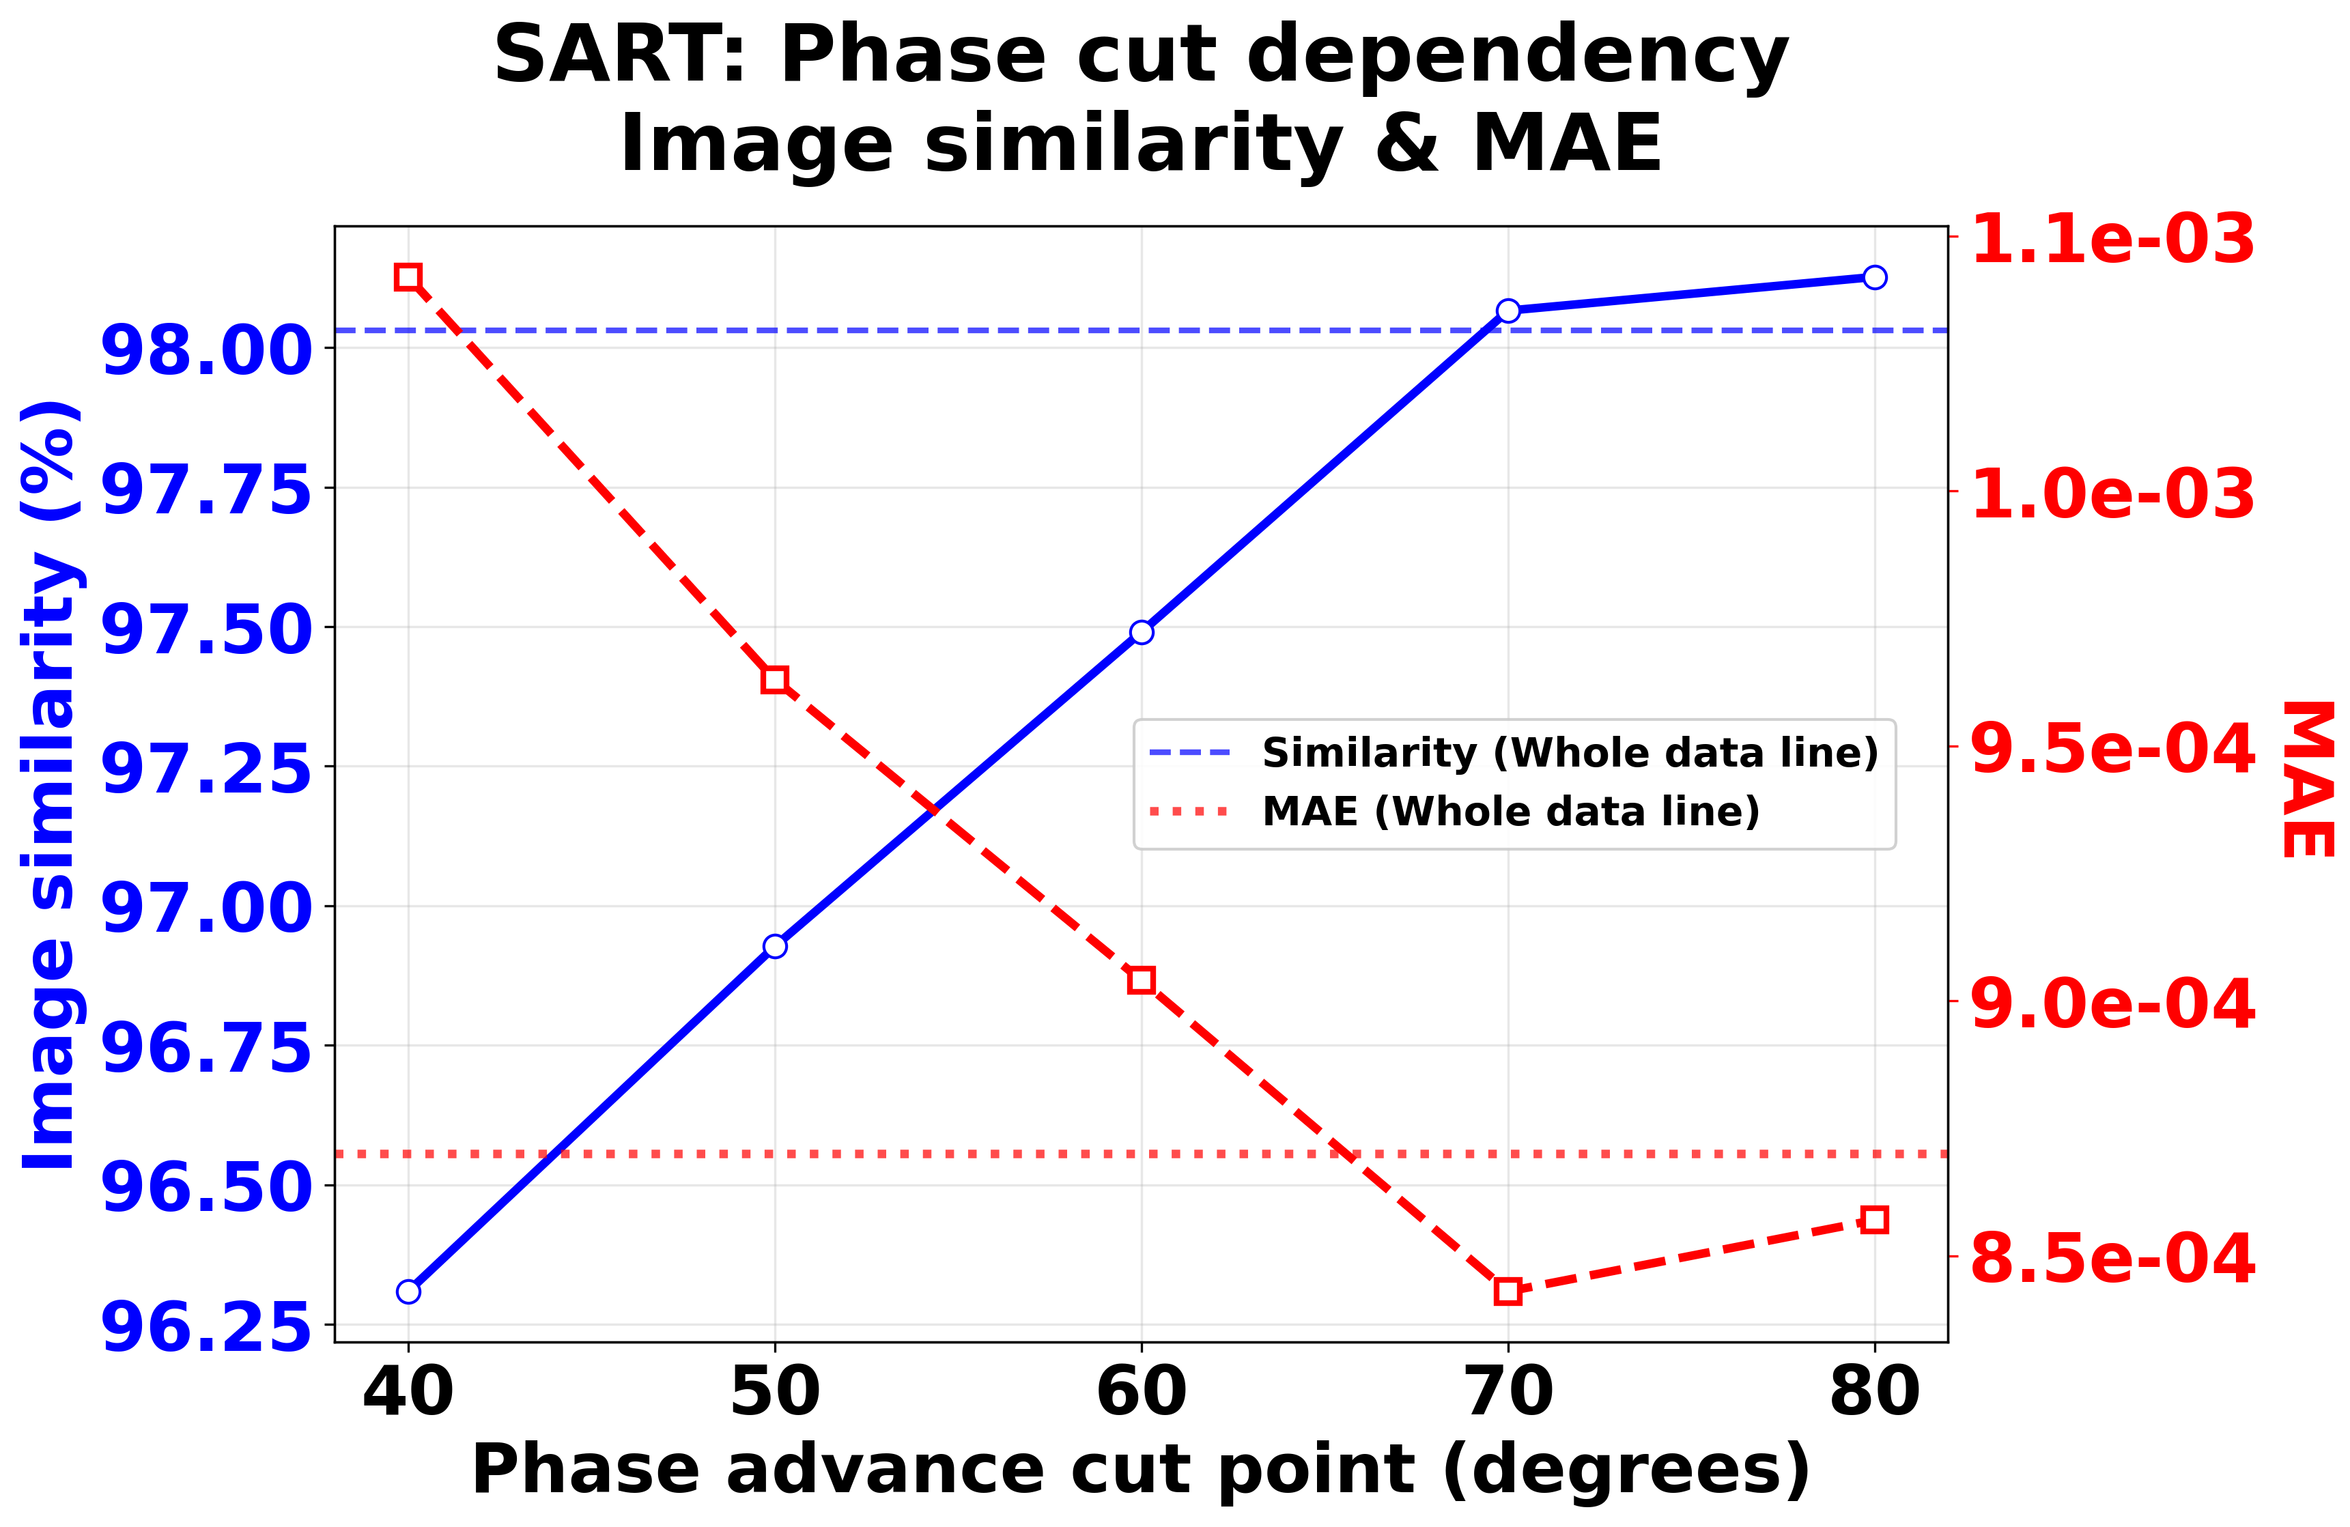
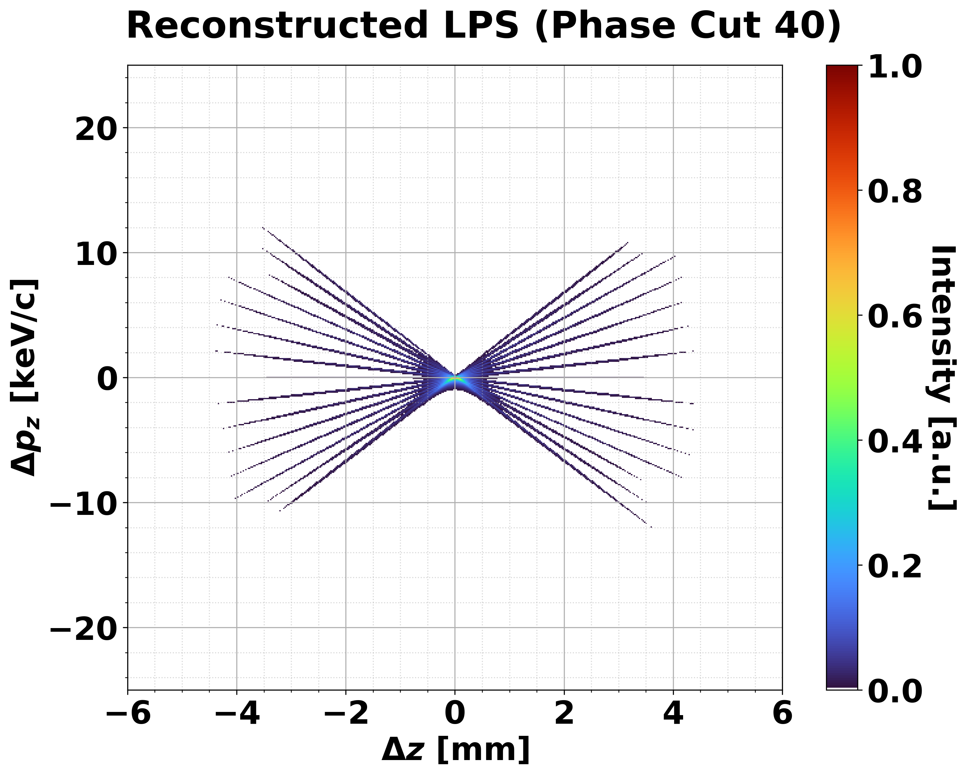
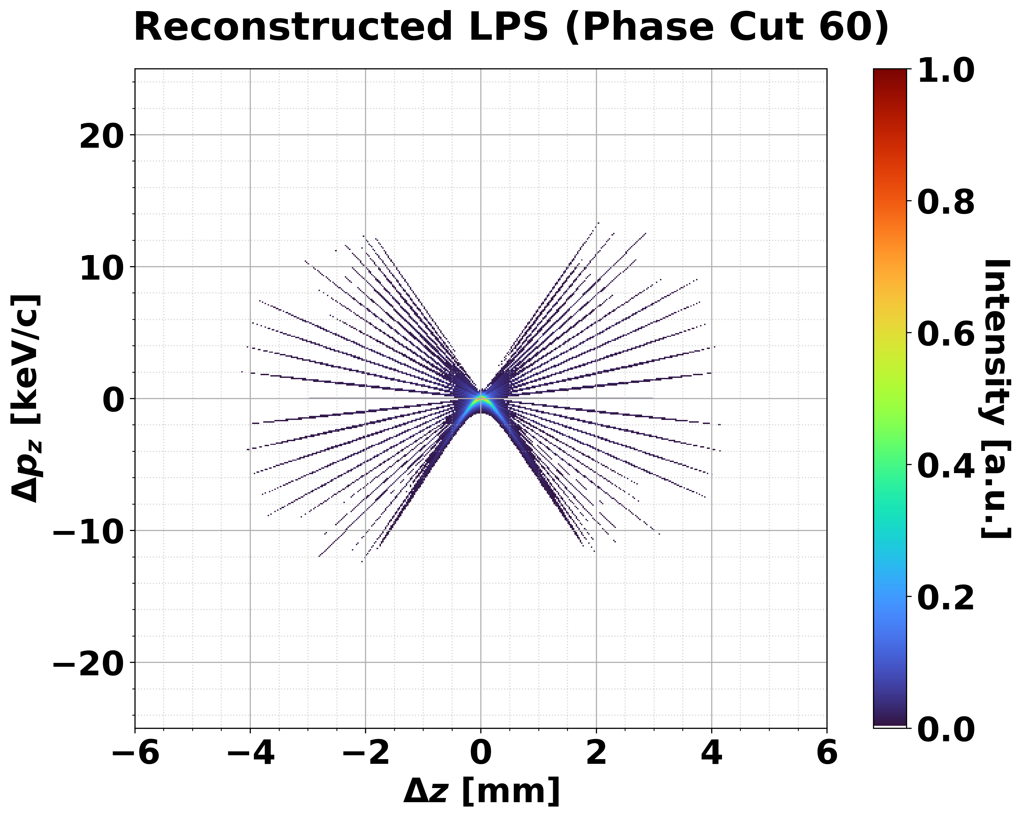
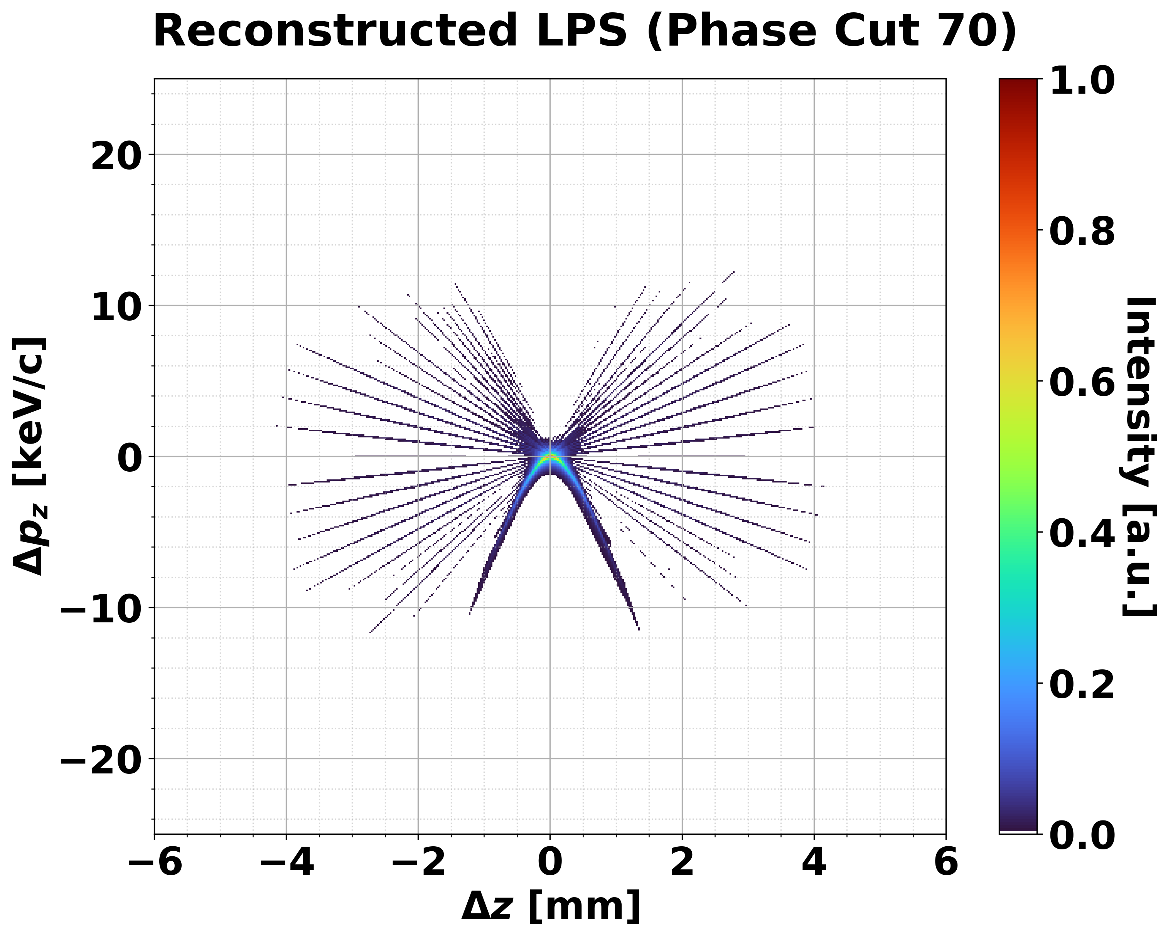
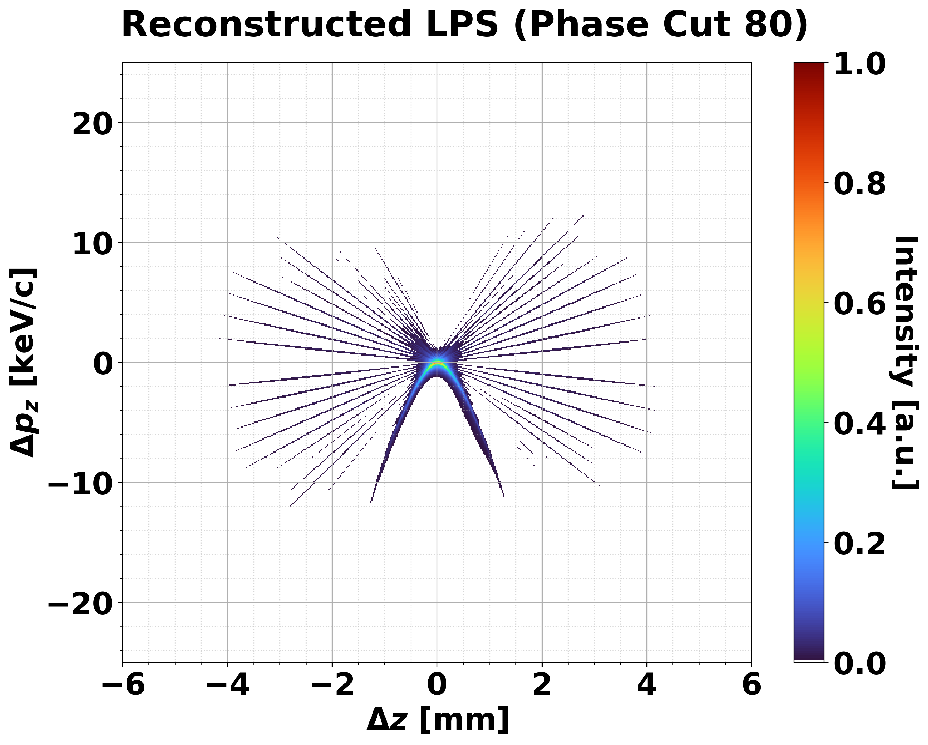
① Tomography results: Investigate $Φ_{beam}$ dependency.
s

Slide 8
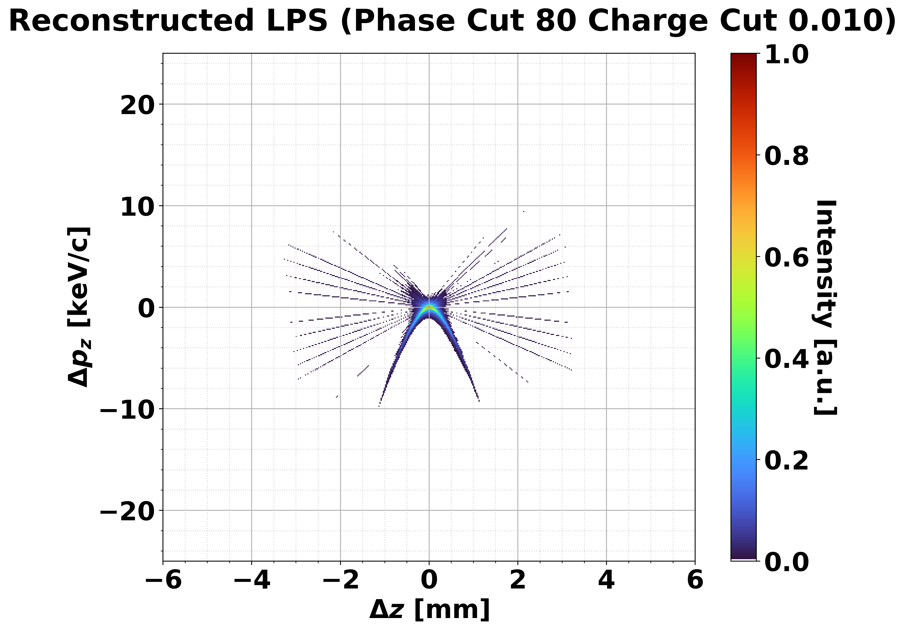
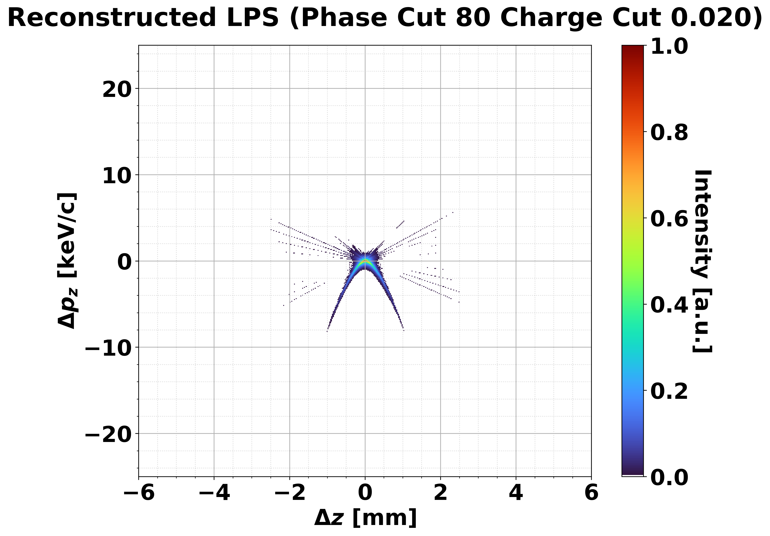
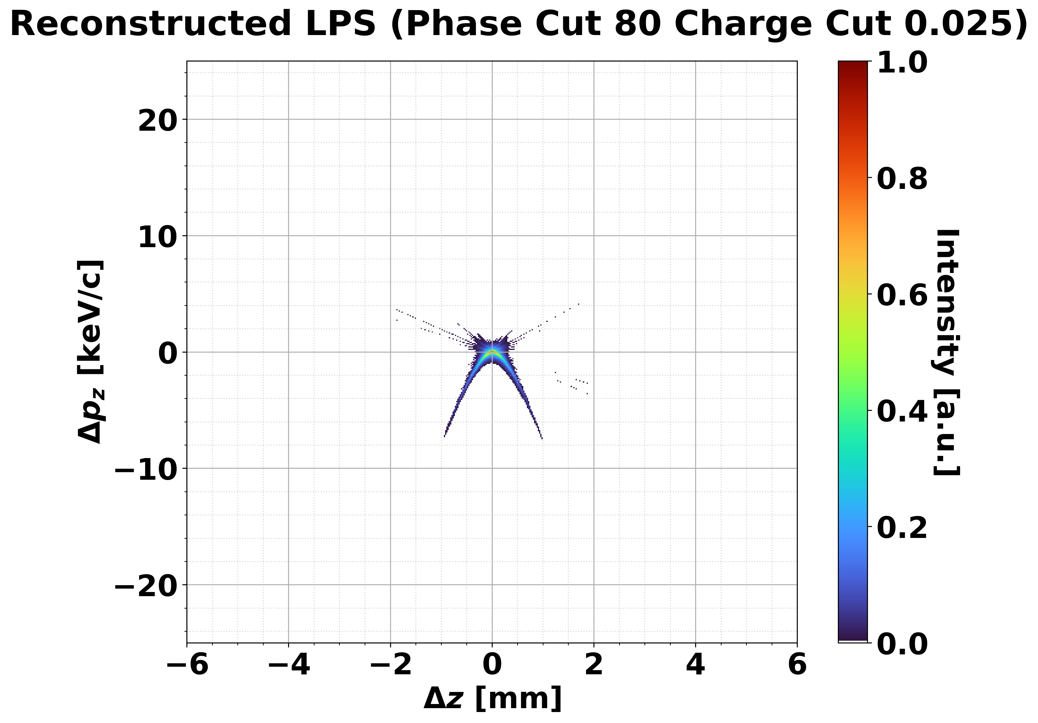
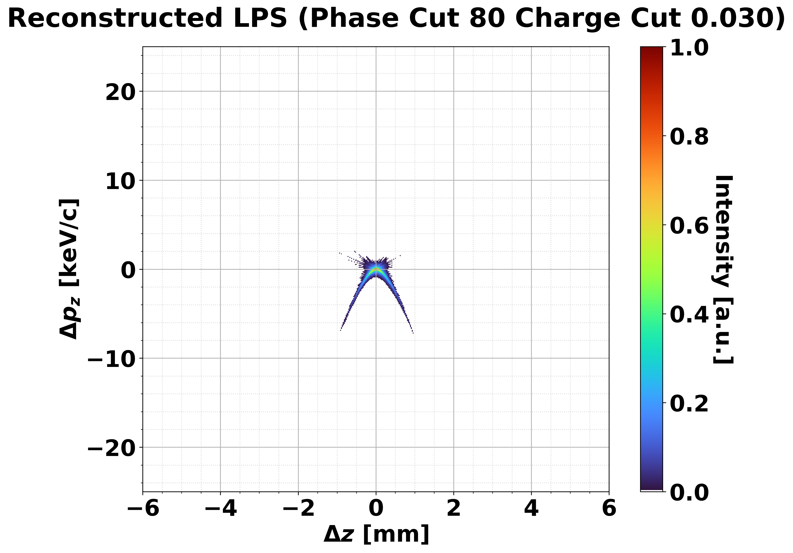
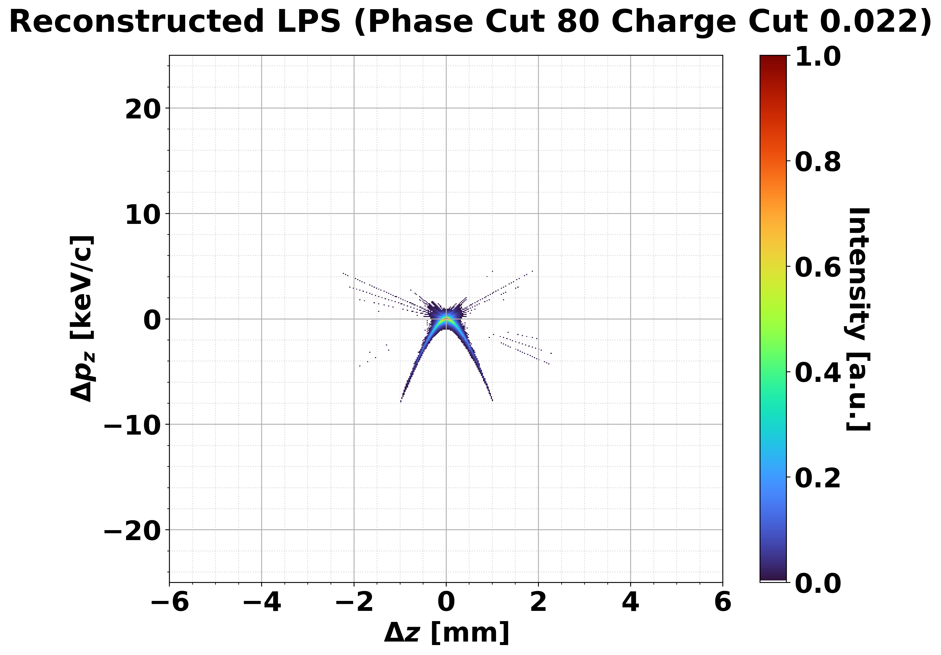
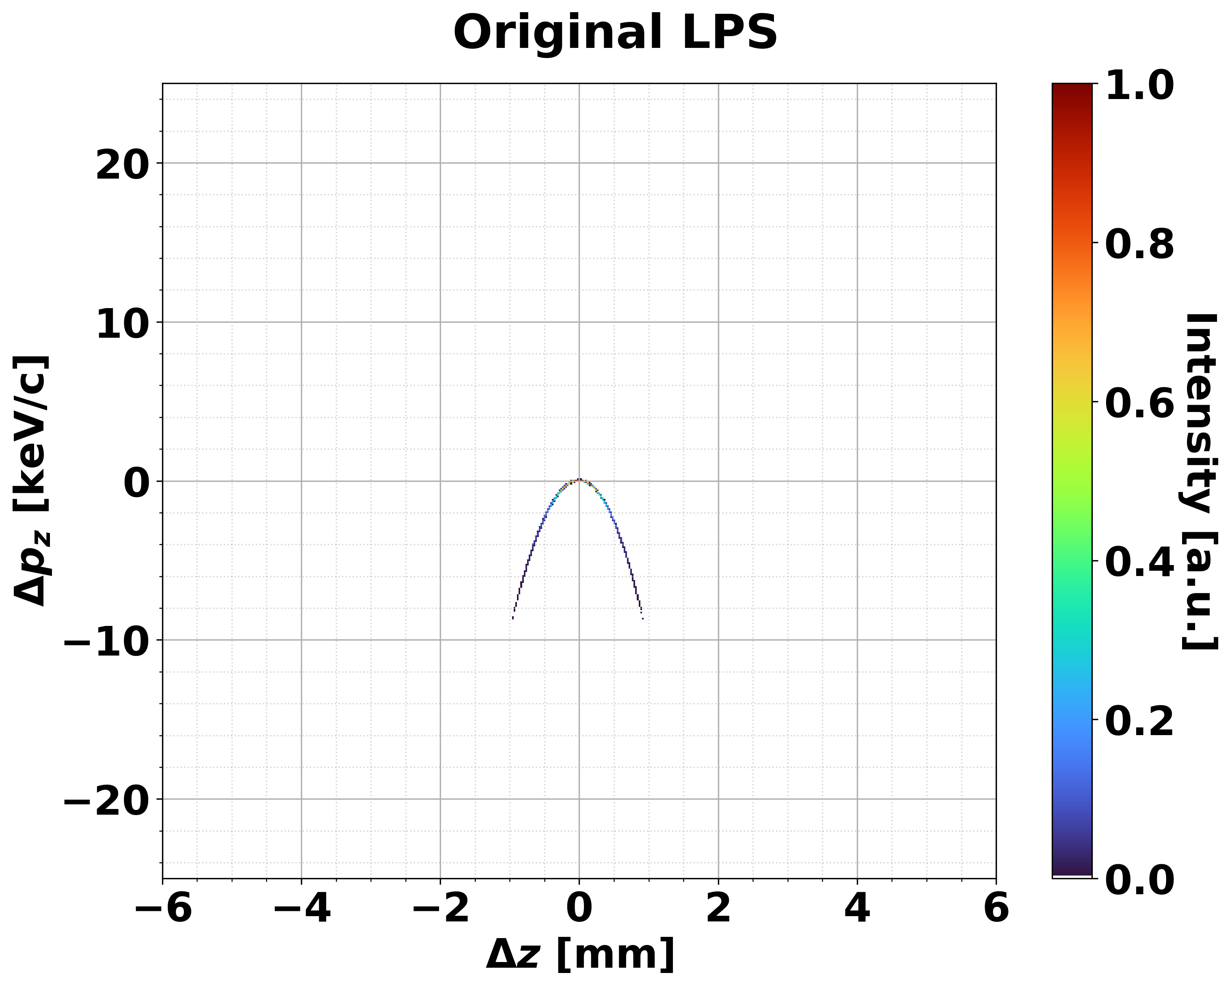






① Tomography results: Investigate charge cut dependency.
10% cut
20% cut
25% cut
30% cut
$$σ_{s, 10\%}=0. 376mm$$
$$σ_{s, 20\%}=0. 301mm$$
$$σ_{s, 25\%}=0. 276mm$$
$$σ_{s, 30\%}=0. 265mm$$
22% Charge cut
$$σ_{s,22\%}=0.338 mm$$
$$σ_{s,sim}=0.327 mm$$

Slide 9
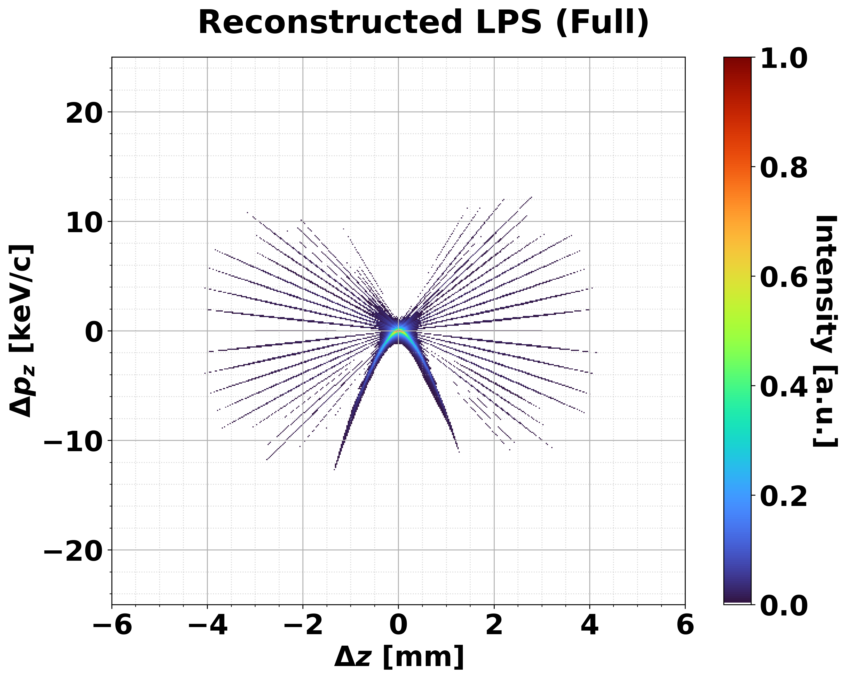
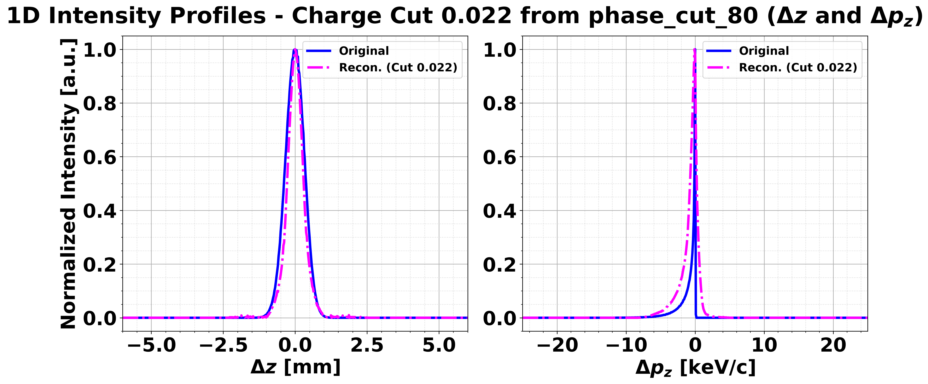


① Tomography results: Compare between initial and cutting
$$σ_{s,esti}=1.17 mm$$
22% cut
$$σ_{s,22\%}=0.338 mm$$

Slide 10
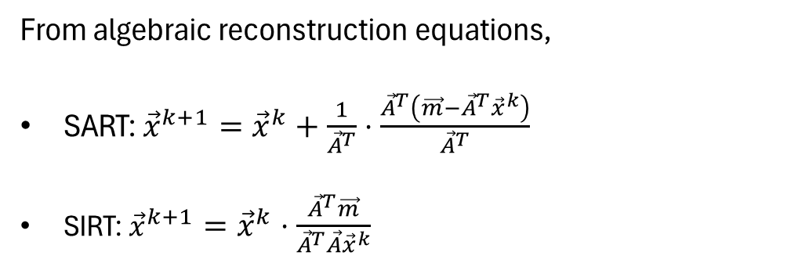

② Weight matrix construction
Reconstruction point
Measurement point
Backward projection
Forward projection
$$\vec{A}⋅{\vec{x}}^{k}$$
From algebraic reconstruction equations,
SART: ${\vec{x}}^{k+1}={\vec{x}}^{k}+\frac{1}{{\vec{A}}^{T}}⋅\frac{{\vec{A}}^{T}\left(\vec{m}−{\vec{A}}^{T}{\vec{x}}^{k}\right)}{{\vec{A}}^{T}}$
SIRT: ${\vec{x}}^{k+1}={\vec{x}}^{k}⋅\frac{{\vec{A}}^{T}\vec{m}}{{\vec{A}}^{T}\vec{A}{\vec{x}}^{k}}$
III. Projection data
II. k^{th} estimated image
I. Weight matrix

Slide 11
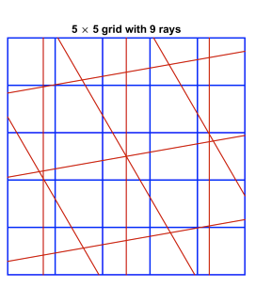
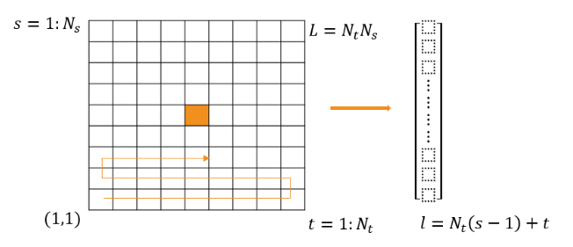


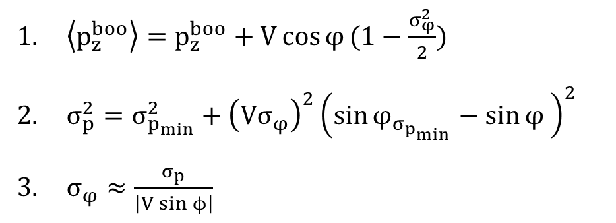
② Weight matrix construction
What is weight matrix?
$$Δp_{z}$$
$$σ_{φ}$$
$\left\langle p_{z}^{boo}\right\rangle =p_{z}^{boo}+V\cos{φ}(1−\frac{σ_{φ}^{2}}{2})$
$σ_{p}^{2}=σ_{p_{min}}^{2}+{\left(Vσ_{φ}\right)}^{2}{\left(\sin{φ_{σ_{p_{min}}}}−\sin{φ} \right)}^{2}$
$σ_{φ}≈\frac{σ_{p}}{\left|V\sin{ϕ}\right|}$

Slide 12
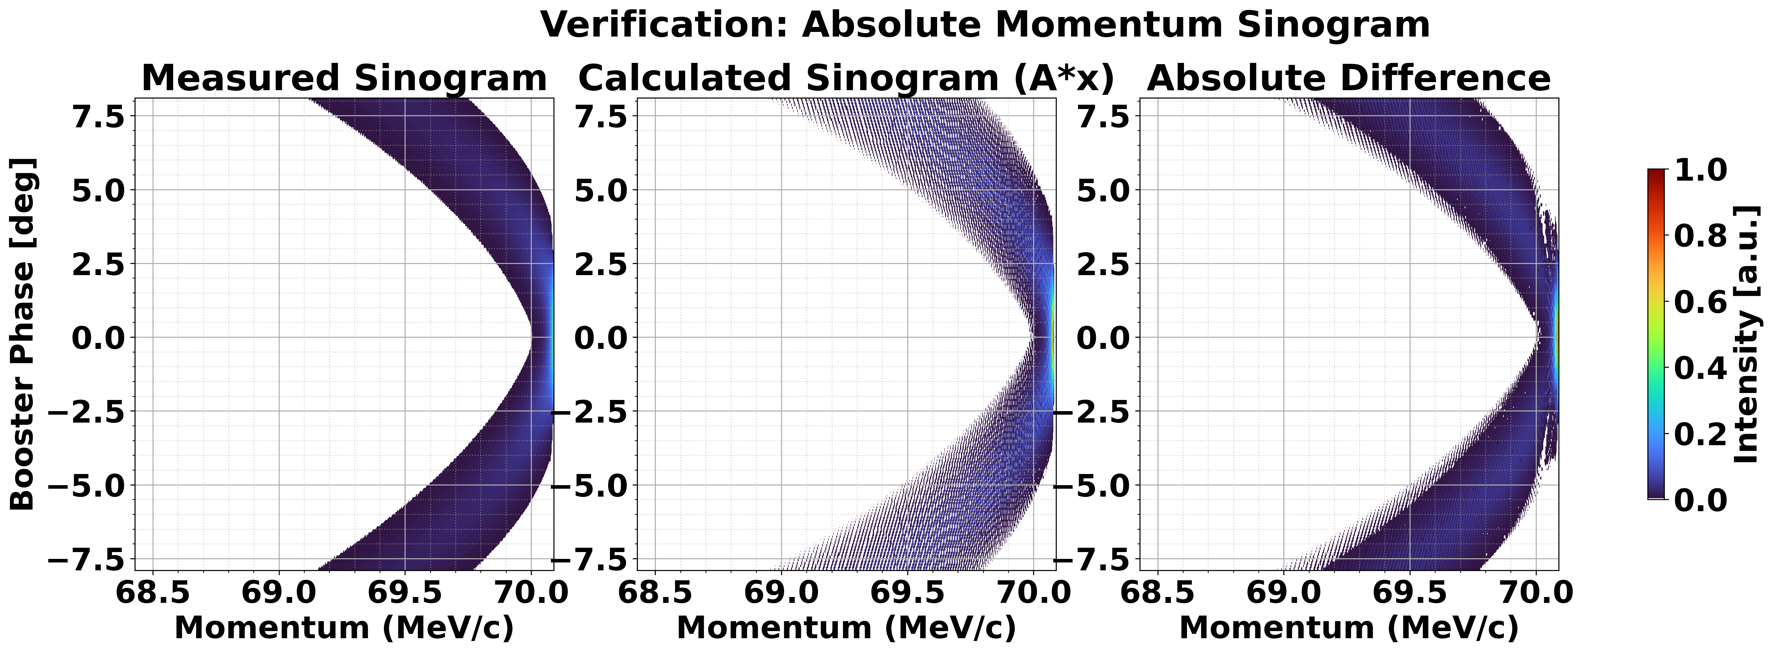
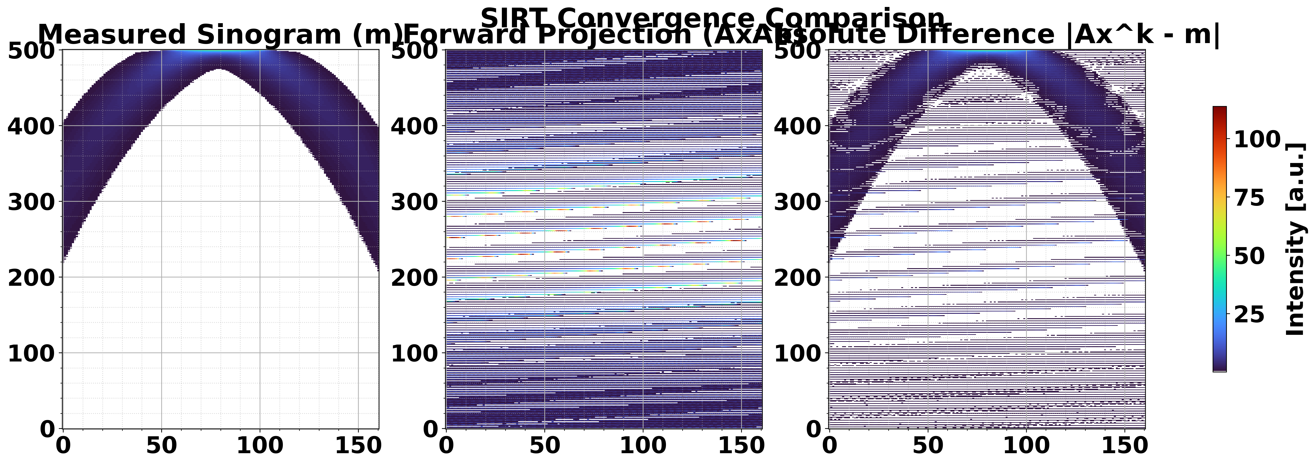
② Weight matrix construction
When we use ground truth image, calculated sinogram looks similar.
But for the uniform estimation, it is not work properly.

Slide 13
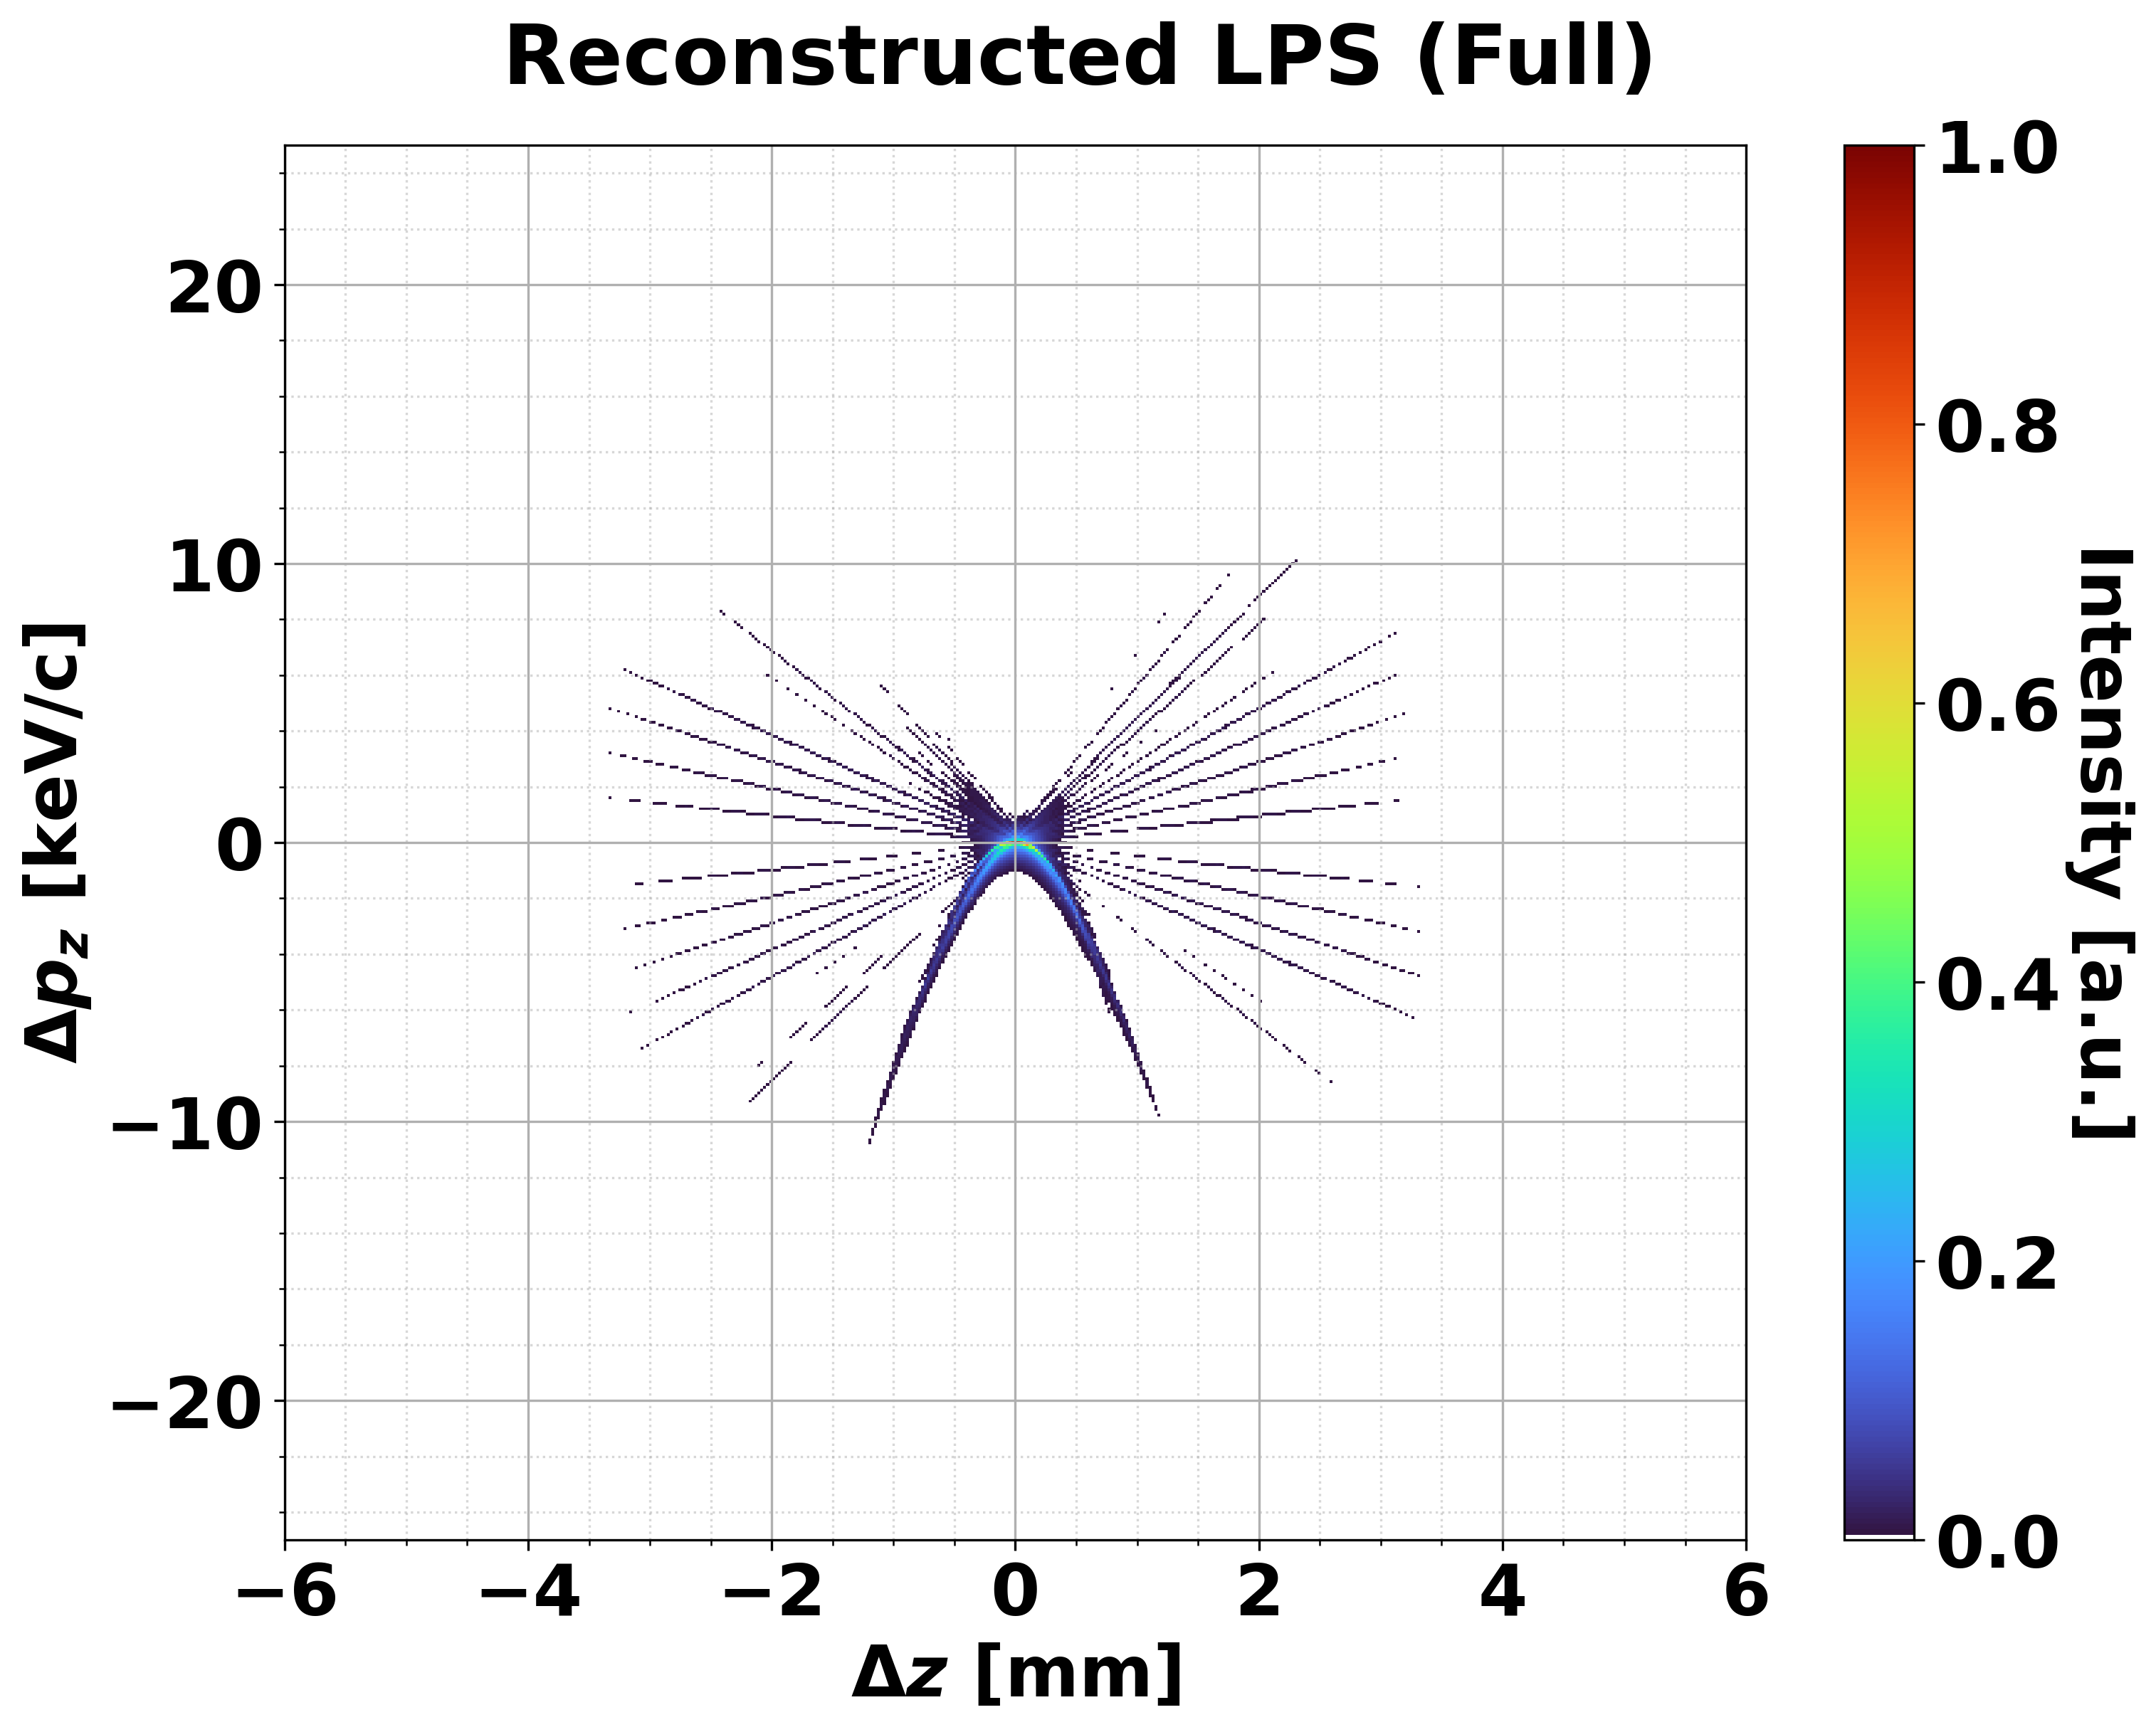
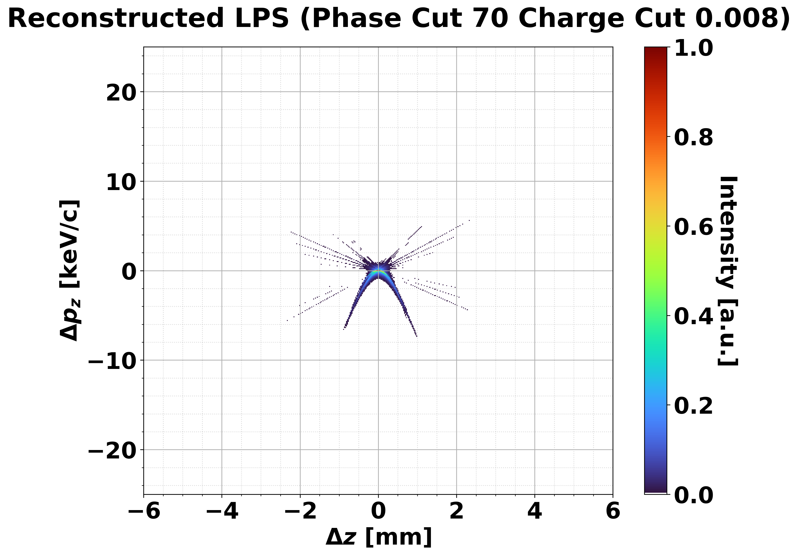
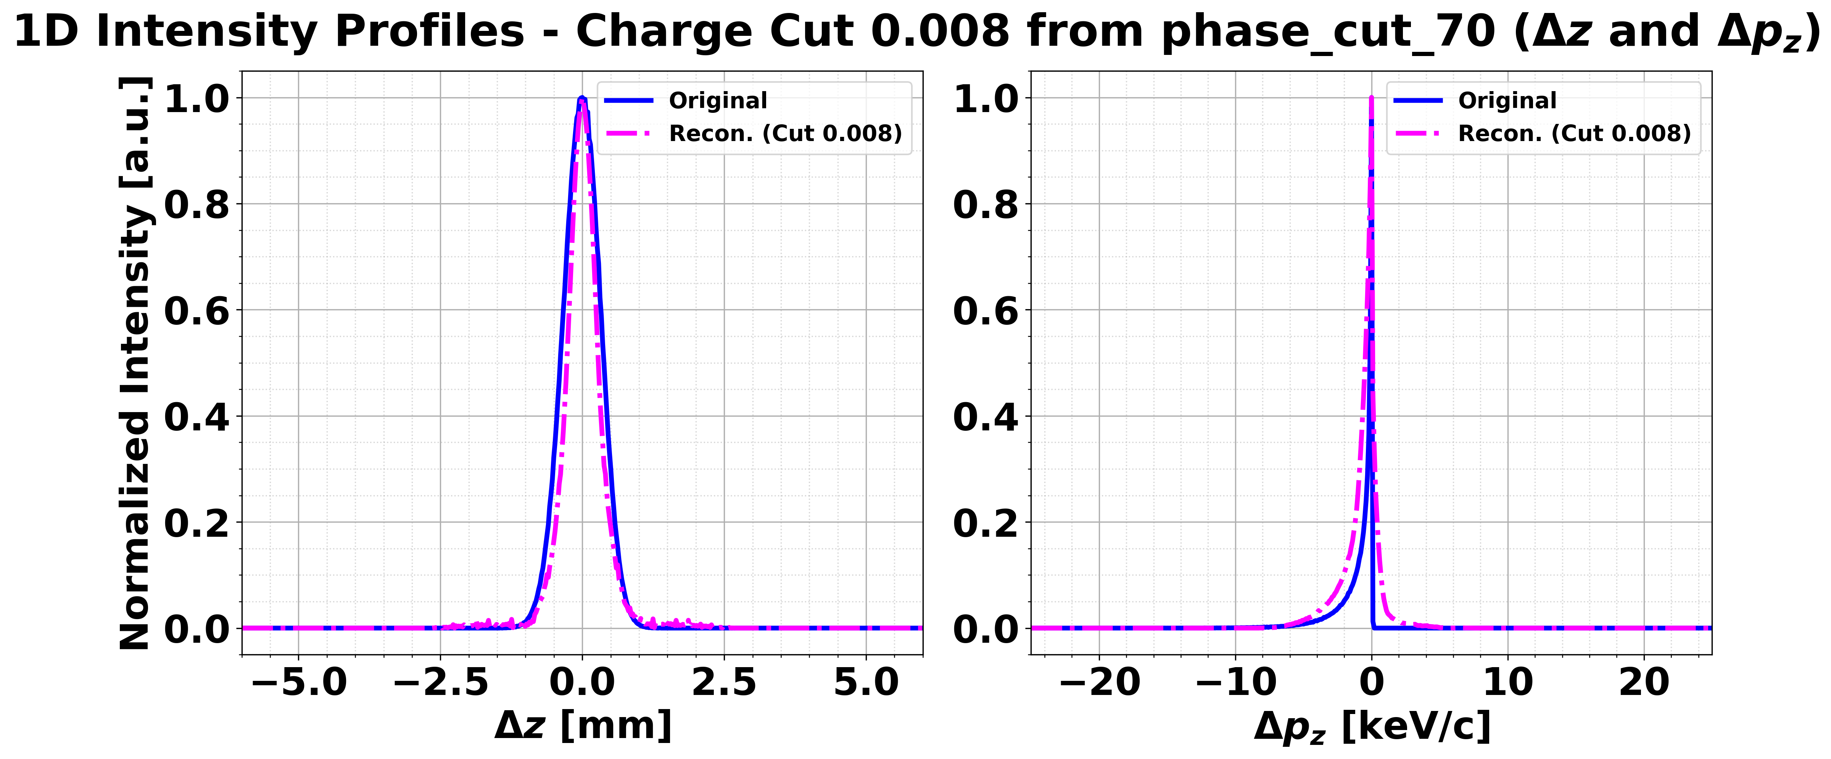


② Initial guess dependency
$$σ_{s,esti}=1.17 mm$$
$$σ_{s,truth}=0.819 mm$$
Phase advance 70º cut
0.8% charge cut

Slide 14
Summary & Next plans
Done
Ongoing
Future works
Procedure of tomography
1. Preprocessing
2. Analytic modeling
3₋₁. Using library
4. Verification
3₋₂. Weight Matrix
4. Apply algorithm
5. Verification

Slide 15

Appendix
Temporal resolution for current simulation set.
$$τ=\frac{1}{ω}⋅\frac{σ_{δ}+σ_{0}}{k_{max}}=548 fs$$
± 8 deg range for MMMG phase
Spectrometer error: σ₀~70 MeV/c
K_{max}=9.036 MeV/c/rad
It can be improved by extension of RF cavity sweep range. Then, K_{max} will be increased.

