Slide 1
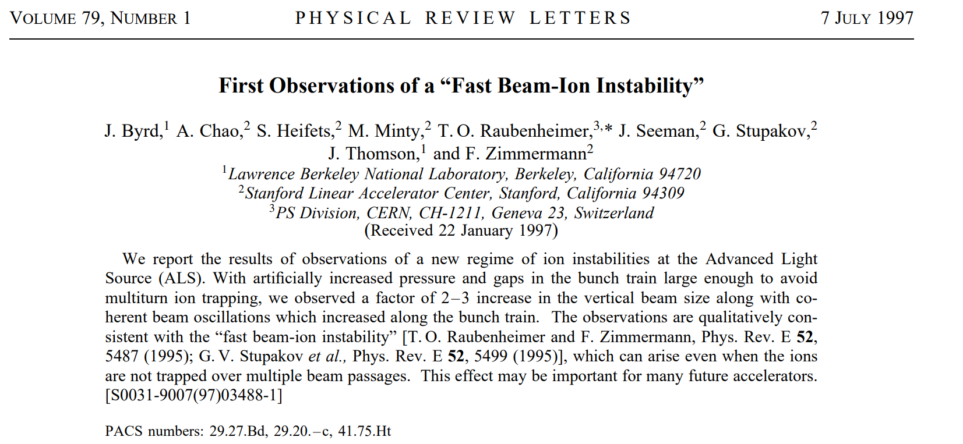
First Observations of a “Fast Beam-Ion Instability”
2025-08-29, Pohang, South Korea
Young Min Park
Division of Advanced Nuclear Engineering (DANE), POSTECH

Slide 2
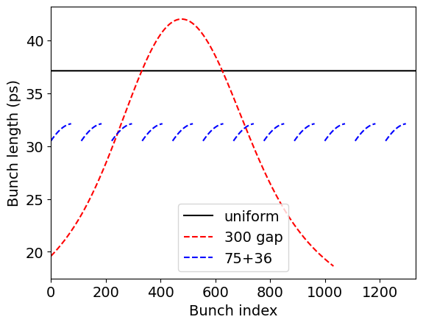
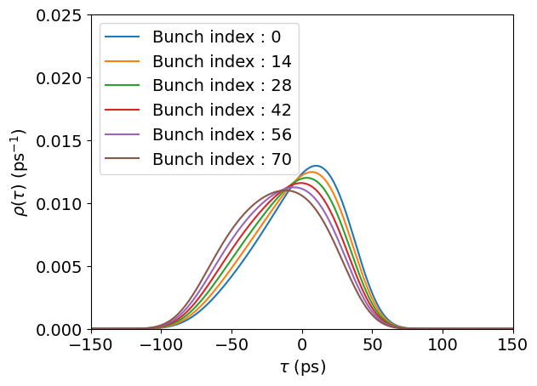
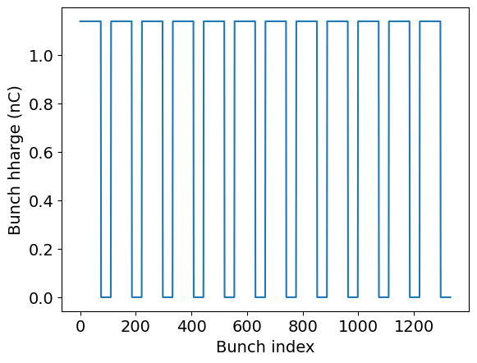

Motivation
My current work: Used HHCs in storage ring to achieve bunch lengthening
Ion clearing gap $→$ Transient effects $→$ Degrade beam stability
“What instabilities can occur inside the bunch train when a clearing gap is present?”
This paper reports the first experimental observation of FBII in a storage ring
2

Slide 3
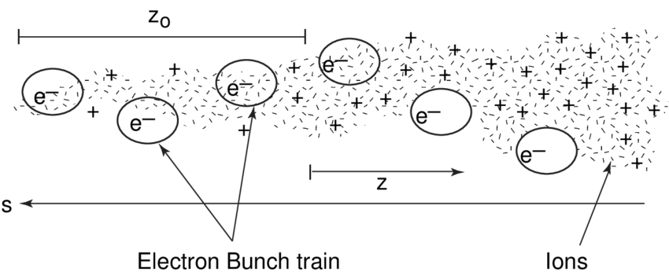
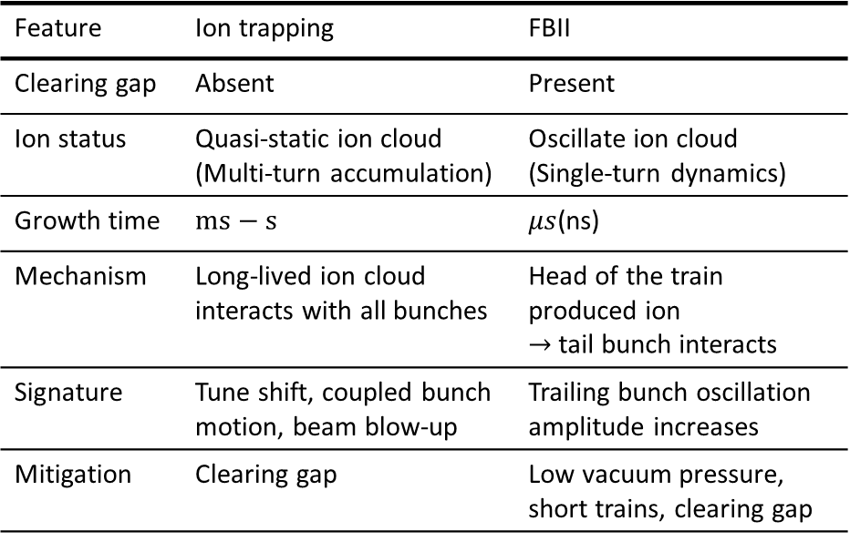
Ion instability
Feature | Ion trapping | FBII
Clearing gap | Absent | Present
Ion status | Quasi-static ion cloud (Multi-turn accumulation) | Oscillate ion cloud (Single-turn dynamics)
Growth time | $$ms−s$$ | $μs$(ns)
Mechanism | Long-lived ion cloud interacts with all bunches | Head of the train produced ion $→$ tail bunch interacts
Signature | Tune shift, coupled bunch motion, beam blow-up | Trailing bunch oscillation amplitude increases
Mitigation | Clearing gap | Low vacuum pressure, short trains, clearing gap
Residual gas
Goal of paper : Demonstrate Fast Beam Ion Instability(FBII) in ALS
Operate ALS with a clearing gap to suppress ion trapping
Increase vacuum pressure to enhance beam-ion interaction
Perform bunch-by-bunch measurements to capture trailing-bunch oscillation growth
Compare multi-bunch and single-bunch operation to rule out beam-gas scattering
Verify agreement with the predicted FBII mechanism
3

Slide 4
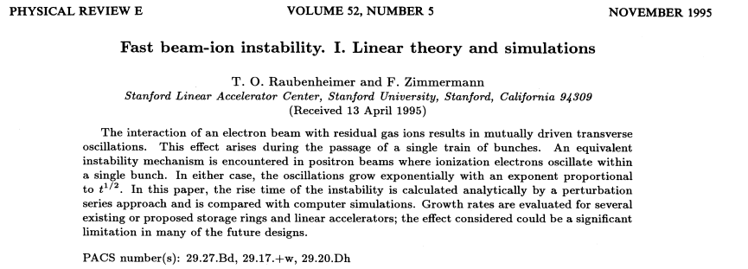
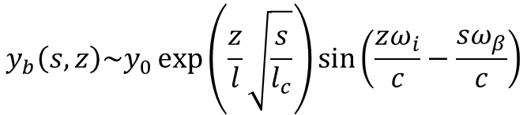

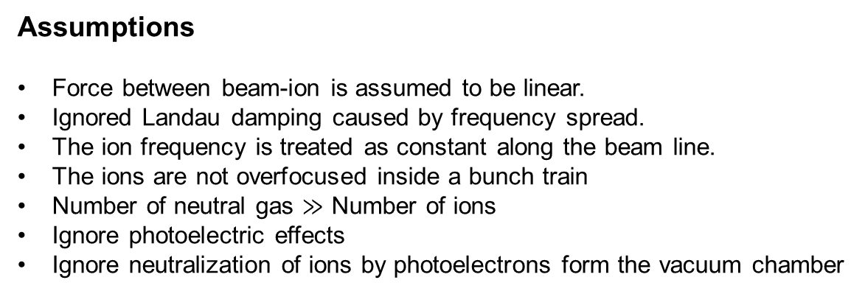
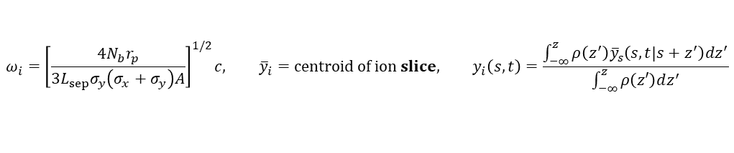
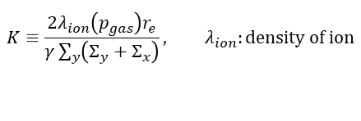

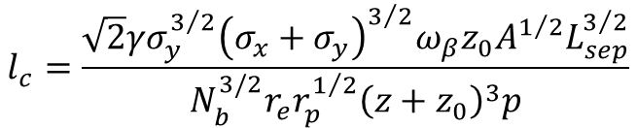
FBII theory
EOM of electron:
$$\frac{d^{2}y_{b}}{ds^{2}}+ω_{β}^{2}y_{b}\left(s,z\right)=K\left[y_{i}\left(s,s+z\right)−y_{b}\left(s,z\right)\right]\int_{−∞}^{z}{ρ\left(z^{′}\right)dz^{′}}$$
$$K≡\frac{2λ_{ion}\left(p_{gas}\right)r_{e}}{γ\sum_{y}{\left(Σ_{y}+Σ_{x}\right)}}, λ_{ion}:density of ion$$
EOM of ion:
$$\frac{d^{2}{\overline{y}}_{i}}{ds^{2}}+ω_{i}^{2}\left(ct−s\right){\overline{y}}_{i}\left(s,t\right)=ω_{i}^{2}\left(z\right)y_{b}\left(s,ct−s\right)$$
$$ω_{i}={\left[\frac{4N_{b}r_{p}}{3L_{sep}σ_{y}\left(σ_{x}+σ_{y}\right)A}\right]}^{1/2}c, {\overline{y}}_{i}=centroid of ion slice, y_{i}\left(s,t\right)=\frac{\int_{−∞}^{z}{ρ\left(z^{′}\right){\overline{y}}_{s}\left(s,t|s+z^{′}\right)dz^{′}}}{\int_{−∞}^{z}{ρ\left(z′\right)dz^{′}}}$$
Assumptions
Force between beam-ion is assumed to be linear.
Ignored Landau damping caused by frequency spread.
The ion frequency is treated as constant along the beam line.
The ions are not overfocused inside a bunch train
Number of neutral gas $≫$ Number of ions
Ignore photoelectric effects
Ignore neutralization of ions by photoelectrons form the vacuum chamber
$$y_{b}\left(s,z\right)\sim y_{0}\exp\left(\frac{z}{l}\sqrt{\frac{s}{l_{c}}}\right)\sin\left(\frac{zω_{i}}{c}−\frac{sω_{β}}{c}\right)$$
$$l_{c}=\frac{\sqrt{2}γσ_{y}^{3/2}{\left(σ_{x}+σ_{y}\right)}^{3/2}ω_{β}z_{0}A^{1/2}L_{sep}^{3/2}}{N_{b}^{3/2}r_{e}r_{p}^{1/2}{\left(z+z_{0}\right)}^{3}p}$$
4

Slide 5
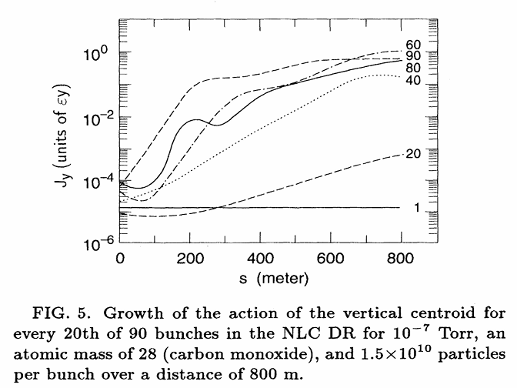
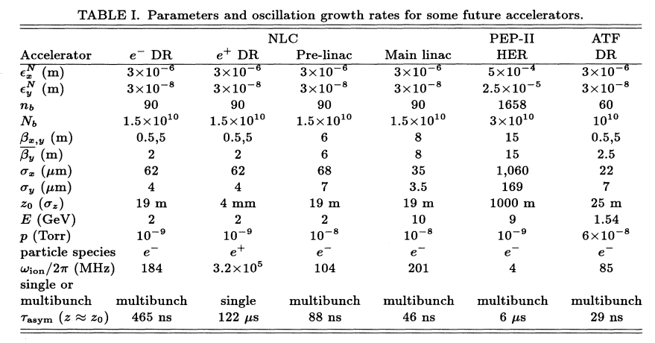
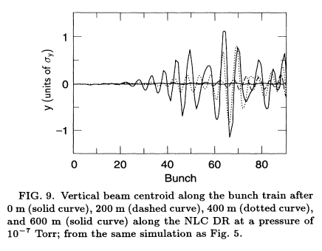
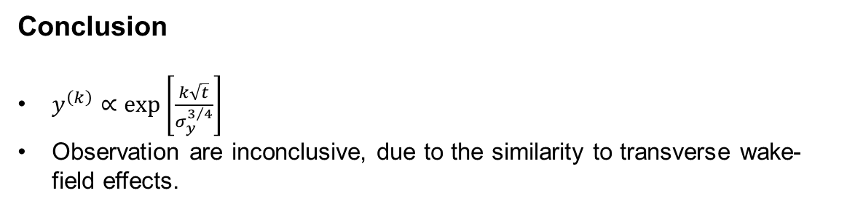
FBII theory
Conclusion
$y^{\left(k\right)}∝\exp\left[\frac{k\sqrt{t}}{σ_{y}^{3/4}}\right]$
Observation are inconclusive, due to the similarity to transverse wake-field effects.
5

Slide 6
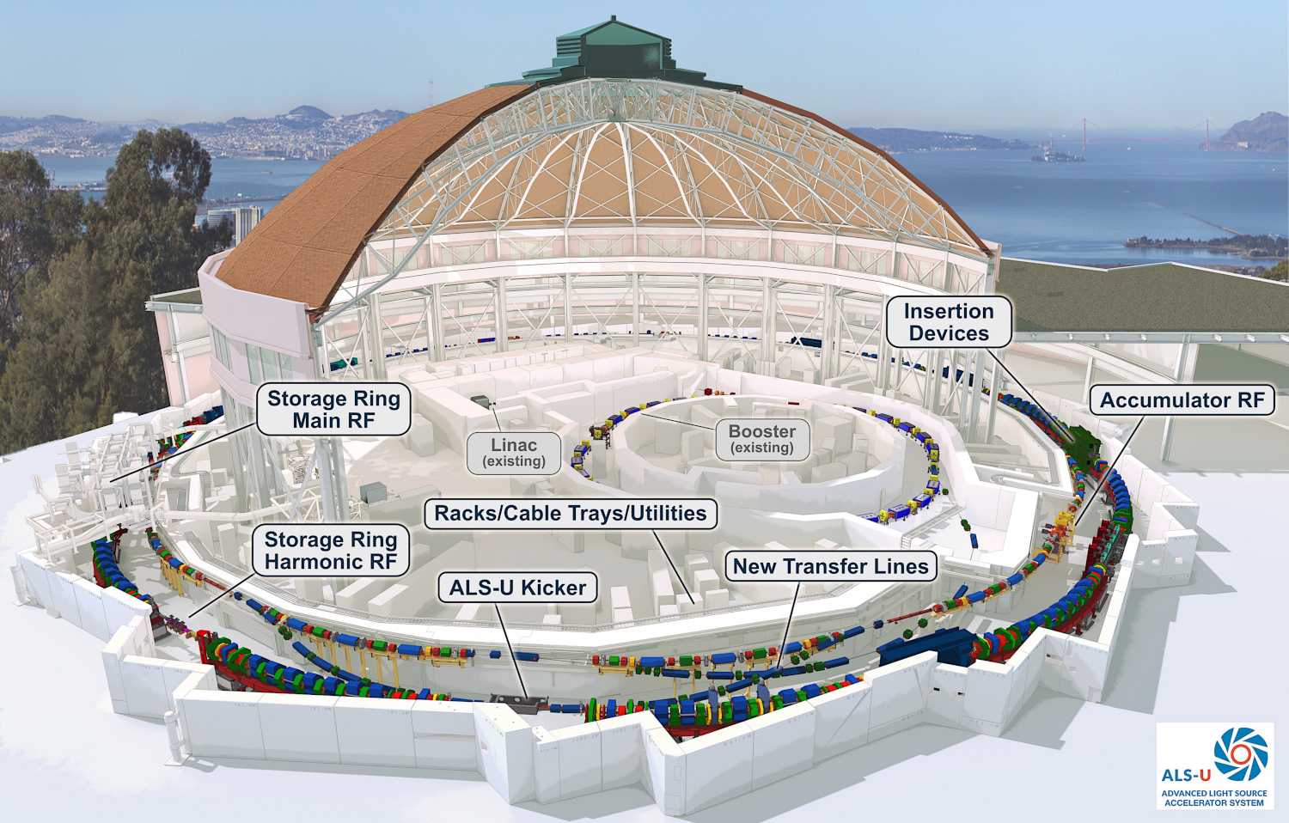
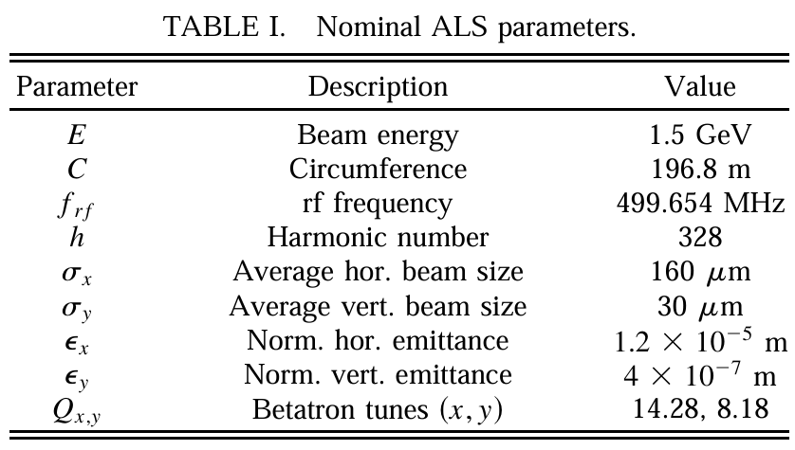
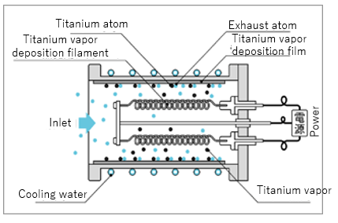
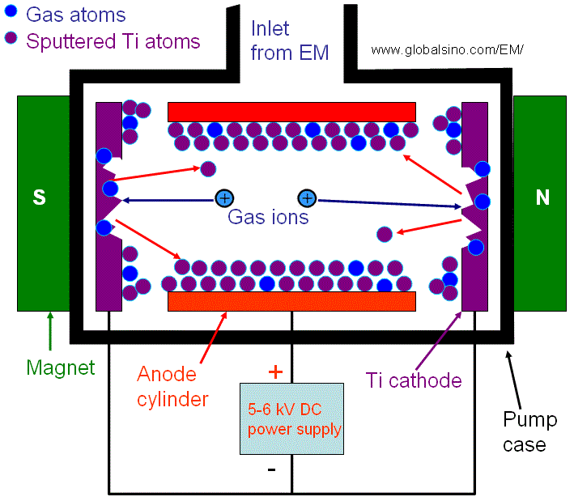
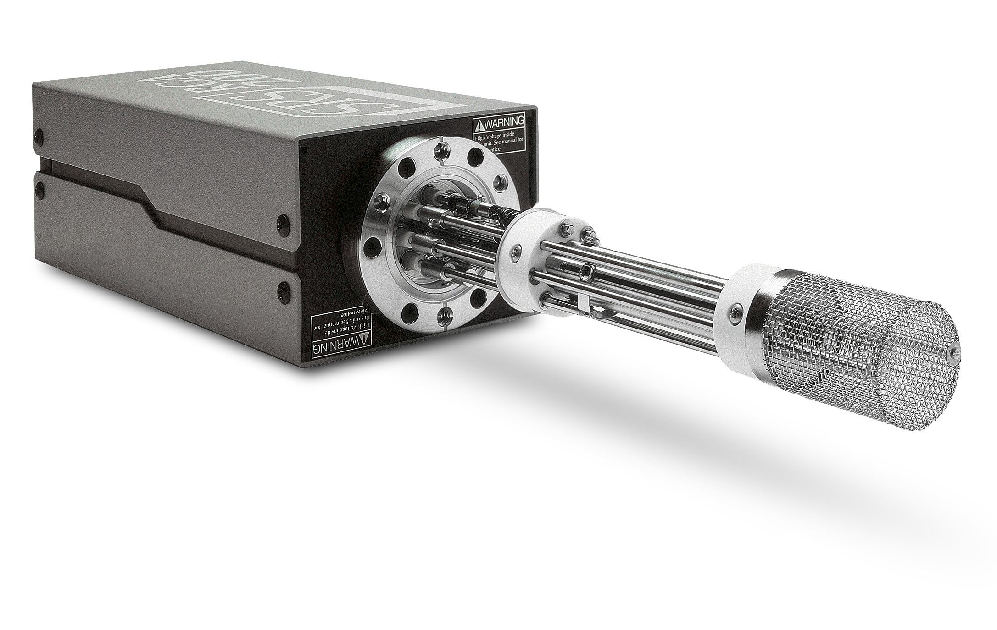
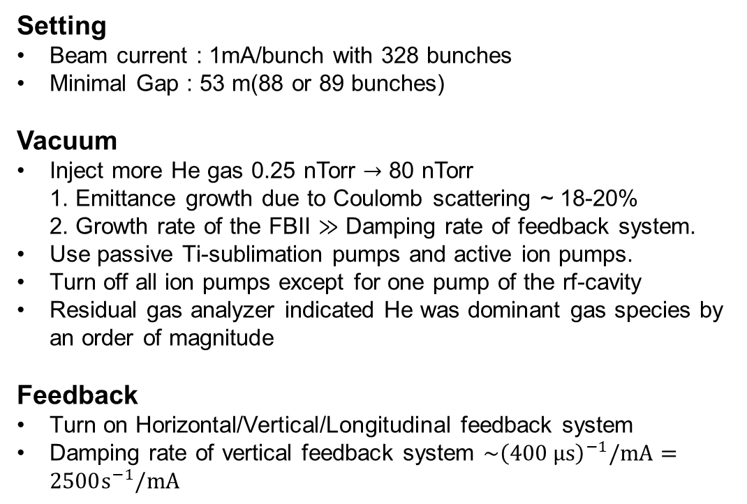
Experiment method
Setting
Beam current : 1mA/bunch with 328 bunches
Minimal Gap : 53 m(88 or 89 bunches)
Vacuum
Inject more He gas 0.25 nTorr $→$ 80 nTorr
1. Emittance growth due to Coulomb scattering ~ 18-20%
2. Growth rate of the FBII $≫$ Damping rate of feedback system.
Use passive Ti-sublimation pumps and active ion pumps.
Turn off all ion pumps except for one pump of the rf-cavity
Residual gas analyzer indicated He was dominant gas species by an order of magnitude
Feedback
Turn on Horizontal/Vertical/Longitudinal feedback system
Damping rate of vertical feedback system $\sim {\left(400 μs\right)}^{−1}/mA=2500s^{−1}/mA$
Detector
Ion source
6

Slide 7
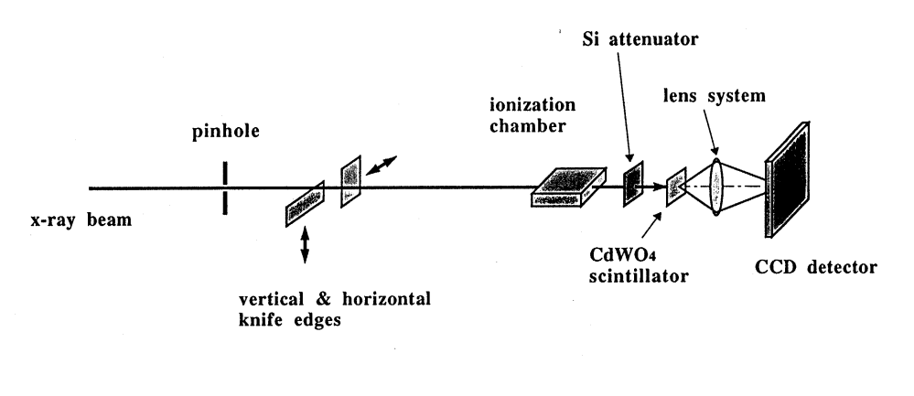
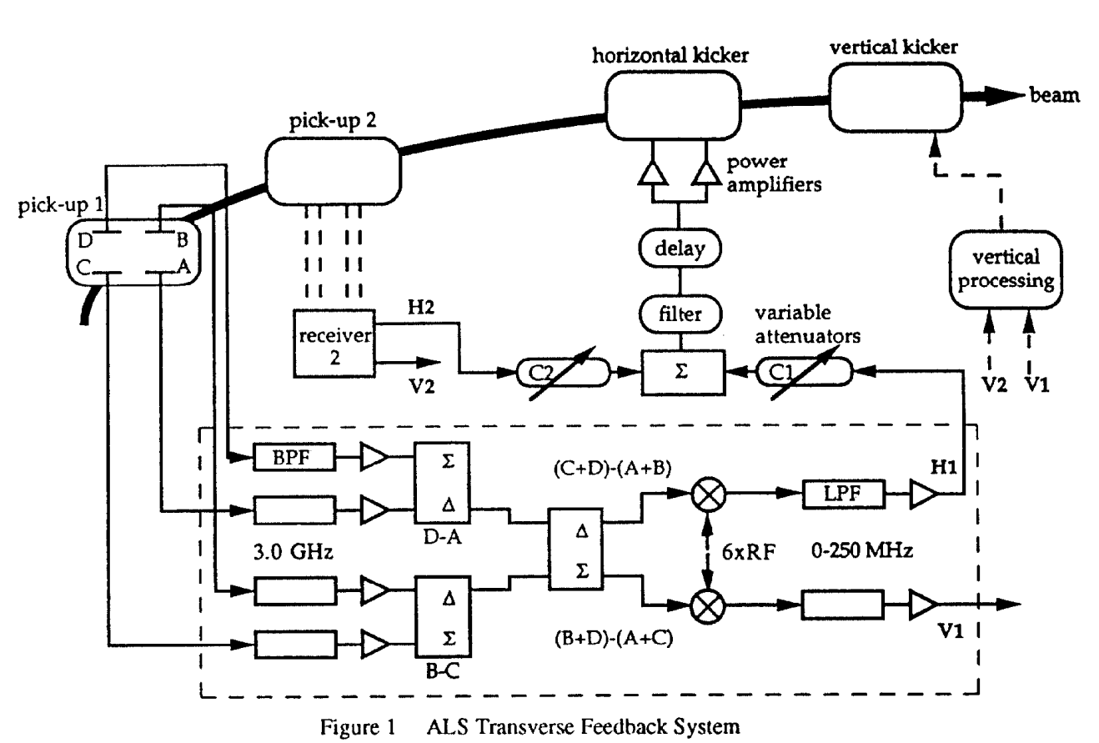
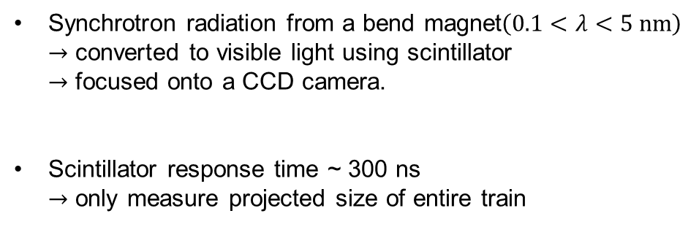
Experiment method
Scintillator + CCD
BPM + Spectrum analyzer
Synchrotron radiation from a bend magnet$\left(0.1<λ<5 nm\right)$
$→$ converted to visible light using scintillator
$→$ focused onto a CCD camera.
Scintillator response time ~ 300 ns
$→$ only measure projected size of entire train
BPM signal $→$ Spectrum analyzer $→$ measure sideband
7

Slide 8
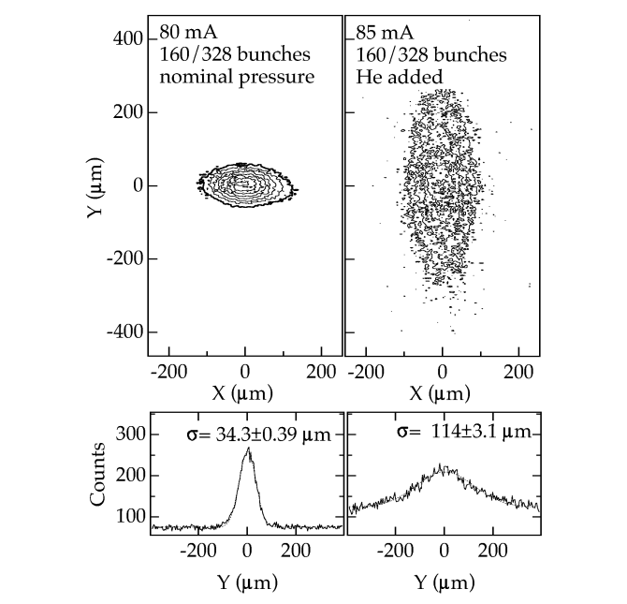
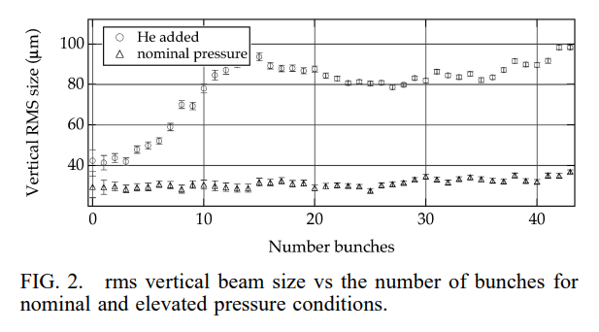
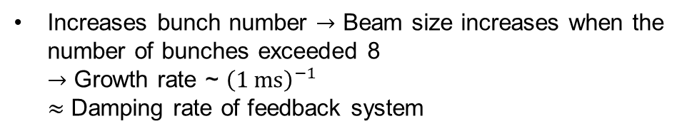
Result
Increases bunch number $→$ Beam size increases when the number of bunches exceeded 8
$→$ Growth rate ~ ${\left(1 ms\right)}^{−1}$
$≈$ Damping rate of feedback system
Beam size of single bunch increase with the order of 15-20%, in agreement with calculations at both nominal and He added cases.
Ion instability effects only y-axis due to small vertical beam size.
8

Slide 9
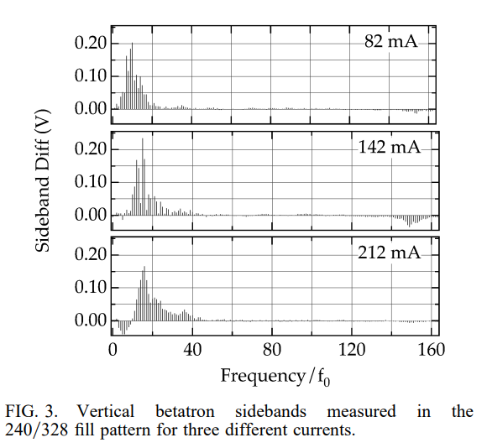
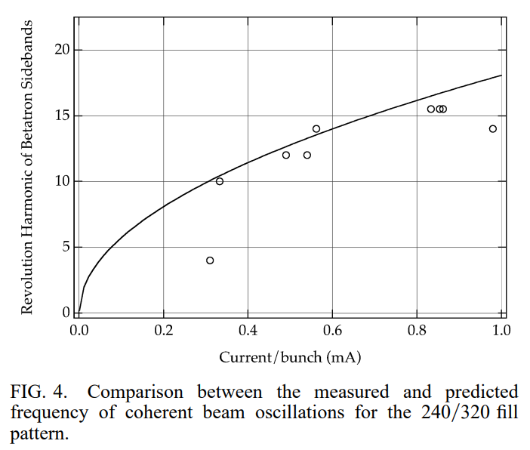
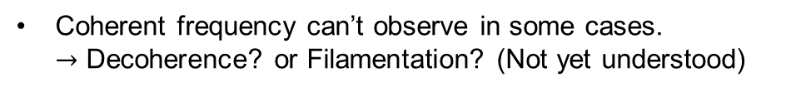
Result
Coherent frequency can’t observe in some cases.
$→$ Decoherence? or Filamentation? (Not yet understood)
Sideband Diff : Upper sideband – Lower sideband
9

Slide 10
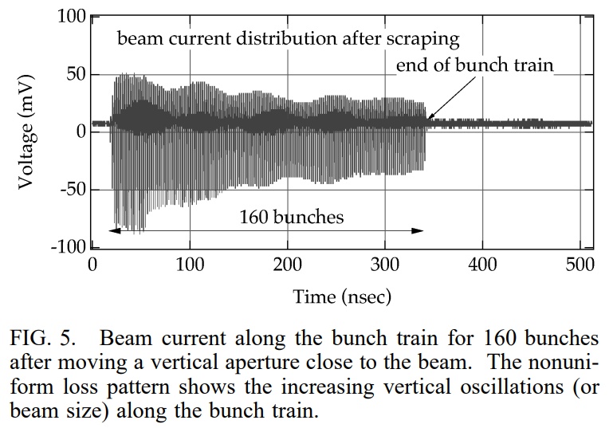

Ion instability theory
Scintillator response time ~ 300 ns
$→$ Can’t observe bunch by bunch signal
Move vertical aperture close to beam can overserve relative amplitude of oscillations.
Gradual loss of current along the bunch trains is one of the main predictions of FBII theory.
Beam loss
BPM
Bunch train
Vertical aperture
10

Slide 11
Conclusion
In an experiment at the ALS, scientists observed that the vertical beam size doubled or tripled when the vacuum pressure was high. This beam swelling was linked to coherent vertical oscillations, a characteristic sign of an ion-induced instability.
They used a scraper to find that the instability increased along the bunch train, a finding that's consistent with the Fast Beam-Ion Instability (FBII) theory.
The instability began when the bunch train reached 8 to 10 bunches, which is a number predicted by FBII theory. This all suggests the observed instability is likely FBII, which could be a significant limitation for many future storage rings.
11

Slide 12
Thank you for your attention!
12

