Slide 1
20250801 Group Meeting
Minseo Jeong

Slide 2
Ultrafast Electron Diffraction
D. Filippetto et al. Rev. Mod. Phys. (2022).

Slide 3
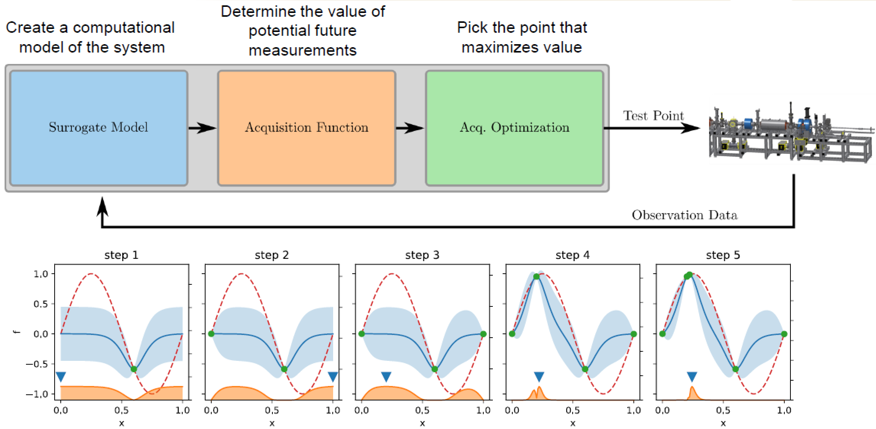
Bayesian Optimization

Slide 4
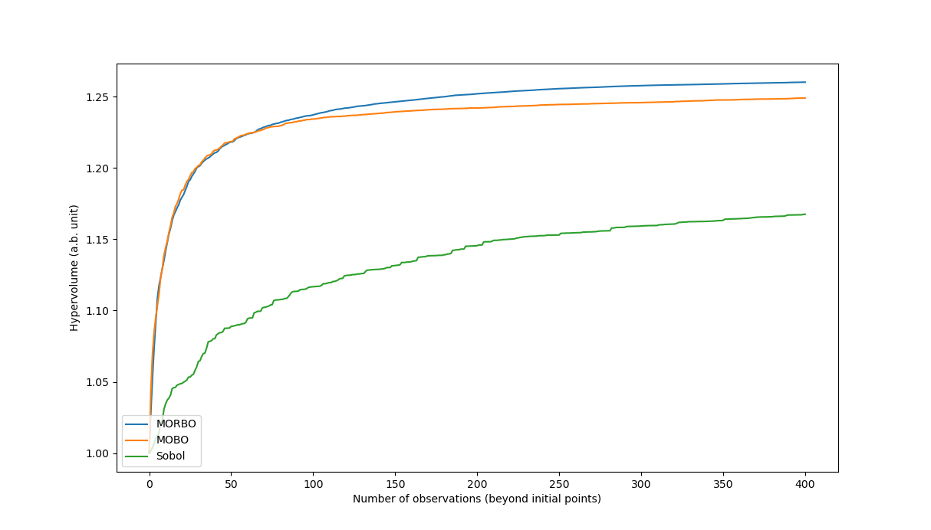
Multi-objective trust region Bayesian optimization(MORBO)
Comparison of MORBO, MOBO, and Sobol(quasi-random process) for optimizing three objectives at once

Slide 5
Multi-objective trust region Bayesian optimization(MORBO)
The computational cost increases exponentially when the number of the objectives P is larger than three
Optimizing upper confidence bound-hypervolume improvement(UCB-HVI) acquisition function without gradient-based method was inefficient

Slide 6
Bayesian Optimization of PAL-eLabs UED Machine
Input parameters: RF phase, initial beam size, currents of solenoids
Objective parameters:
Beam Size(CCD camera)
Q-resolution(Bragg peak width of single crystal diffraction image)
Bunch length(deflector/rising time of pump-probe experiment)

Slide 7
Bayesian Optimization of PAL-eLabs UED Machine
Surrogate model: Gaussian process
Kernel: Matern function with v=5/2
Initial sample point: 10
Acquisition function: Expected hypervolume improvement(EHVI)
Number of iteration: ~200
Limit of consecutive success/failure: 5/5

Slide 8
Bayesian Optimization of PAL-eLabs UED Machine
Modifying the MORBO code for extracting the beam parameters from diagnostics data and entering the candidate point into the eLabs control system(completed)
Test of MORBO code with the beam size the only objective parameter(planned)

Slide 9
Future Plan
Optimization of PAL-eLabs UED machine parameters
- Obtaining solid sample for measuring Bragg peak width
- Diagnostics for measuring bunch length
Participation of gas UED experiment (with IBS)

