Slide 1
Group meeting
2025/07/31
장원

Slide 2
Cherenkov diffraction radiation(ChDR)

Slide 3
Future plan
8월
Crystal design
Analytical calculation
10/24~ 11/14 (3weeks)
Conduct an experiment at GIST
Confirm that the beam has been properly produced
Confirm the proper operation of the plasma lens(~10days)
bunch length measurement, check beam profile)

Slide 4
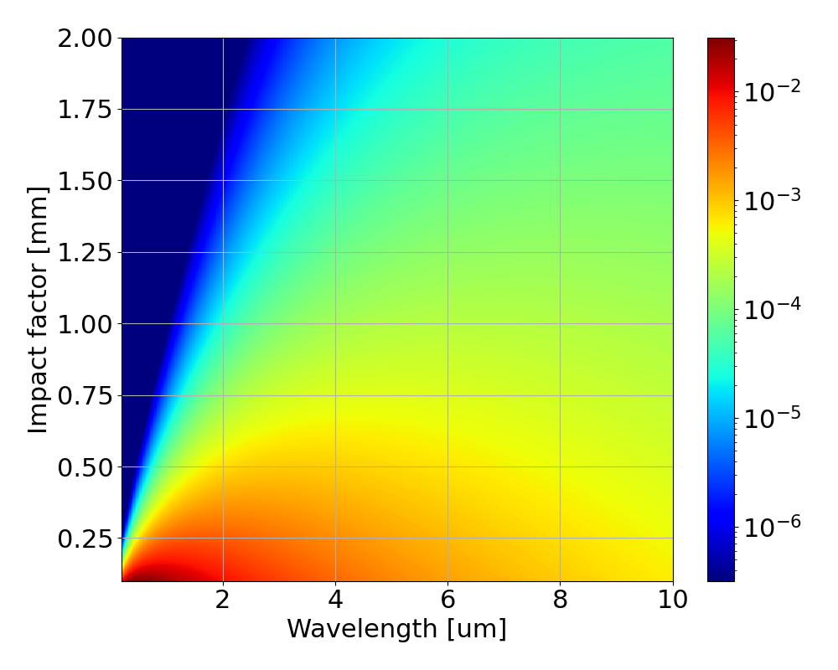
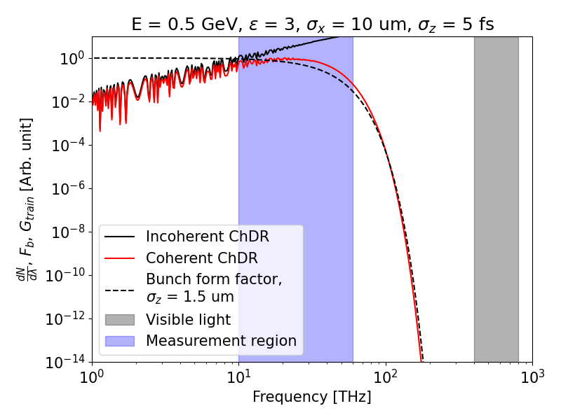
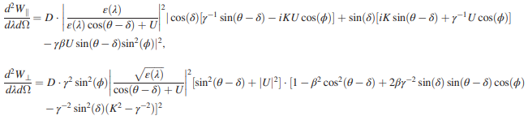
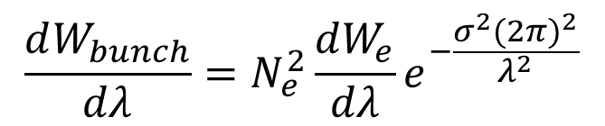

Meeting notes
What we already know
(Incoherent / Single particle ChDR)
$$\frac{dW_{bunch}}{dλ}=N_{e}^{2}\frac{dW_{e}}{dλ}e^{−\frac{σ^{2}{(2π)}^{2}}{λ^{2}}}$$
What we Measure
(Coherent ChDR)
What we want to know
(Bunch length)
IBS 150 TW Laser, LWFA experiment
Expected e-beam parameters:
500 MeV, 1~5 fs(0.3~1.5 um), 10 pC
~200MeV, $ΔE \sim 10\%$, divergency
Notes:
Beam spec바뀐거, dispersion, divergency

Slide 5
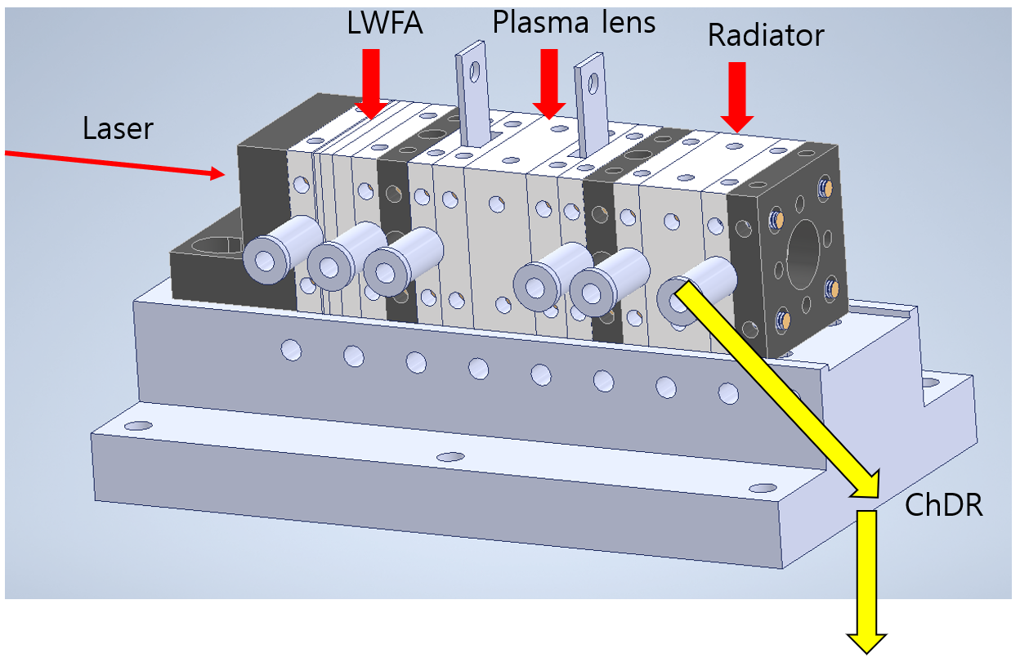

Meeting notes
Laser
LWFA
Plasma lens
Radiator
Should confirm the
beam collimation
Previous overview
Lanex
fluorescent screen
Spectrometer, THz camera
Lens may be required due to beam divergence.
Radiator
Beam($ΔE \sim 10\%)$
Notes:
Radiator 분리해서 설치, THz camer로 beam profil확인, radiator crystal 변경

Slide 6
Summary
Capillary structure change
Beam spec 500MeV => 200MeV
Divergence and energy dispersion of the electron beam may need to be taken into account
3. THz camera
4. Consideration of refractive index variation with wavelength

Slide 7
Ground motion analysis

Slide 8
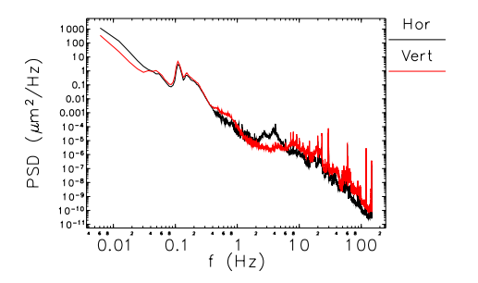
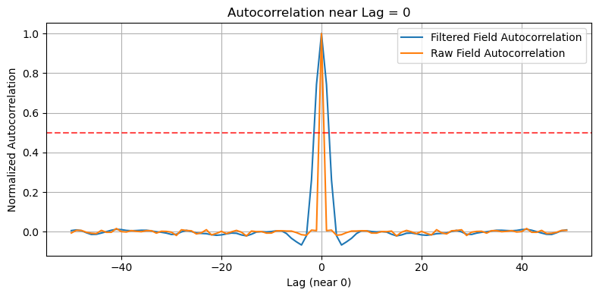
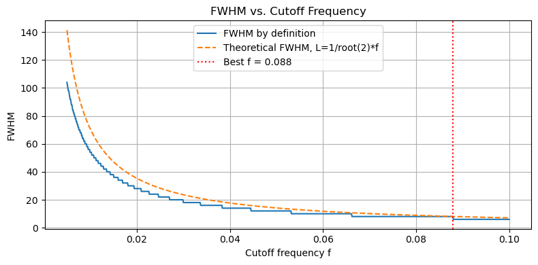


Review
Autocorrelation:
$$R\left(Δx\right)=\frac{1}{N}μ\left(x_{i}\right)μ(x_{i}+Δx)$$
Condition:
FWHM=$L=\frac{1}{\sqrt{2}f_{cut}}$
V. Sajaev and C. Preissner, "Determination of the Ground Motion Orbit Amplification Factors Dependence on the Frequency for the APS Upgrade Storage Ring," in Proc. 9th Int. Particle Accelerator Conf. (IPAC’18), Vancouver, BC, Canada, Apr. 2018, pp. 1272–1275. doi: 10.18429/JACoW-IPAC2018-TUPMF012.

Slide 9
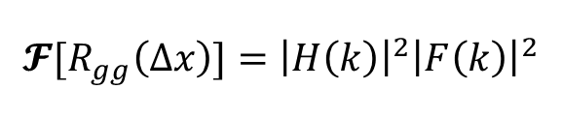
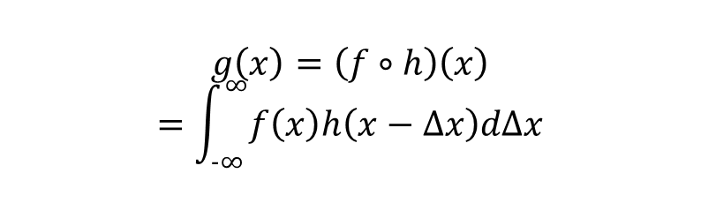

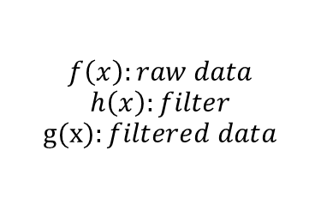
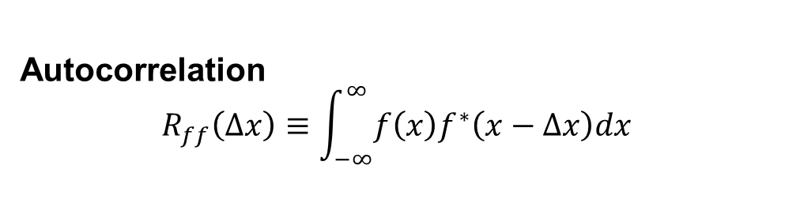
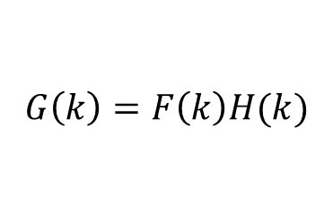

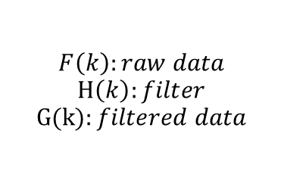
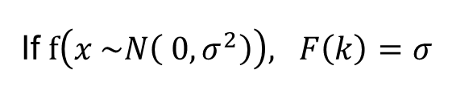
Understanding about Filter and Autocorrelation
Filter
Autocorrelation
$$R_{ff}\left(Δx\right)≡\int_{−∞}^{∞}{f\left(x\right)f^{∗}\left(x−Δx\right)dx}$$
$$f\left(x\right):raw data$$
$$h\left(x\right):filter$$
$$g(x):filtered data$$
$$g\left(x\right)=\left(f∘h\right)\left(x\right)$$
$$=\int_{−∞}^{∞}{f\left(x\right)h\left(x−Δx\right)dΔx}$$
Fourier transform
Fourier transform
$$F\left(k\right):raw data$$
$$H\left(k\right):filter$$
$$G(k):filtered data$$
$$G\left(k\right)=F\left(k\right)H(k)$$
$$\text{𝓕}[R_{ff}\left(u\right)]={\left|F\left(k\right)\right|}^{2}$$
$$\text{𝓕}[R_{gg}\left(Δx\right)]={\left|H\left(k\right)\right|}^{2}{\left|F\left(k\right)\right|}^{2}$$
$$\text{𝓕}\left[R_{gg}\left(Δx\right)\right]={\left|H\left(k\right)\right|}^{2}σ^{2}$$
If $f\left(x \sim N\left( 0,σ^{2}\right)\right), F\left(k\right)=σ$
Autocorrelation can be obtained by taking the Fourier transform of the squared filter.

Slide 10
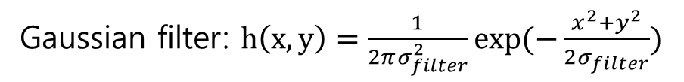

Understanding about Filter and Autocorrelation
Raw data: $f\left(\vec{x} \sim N\left( 0,σ^{2}\right)\right)$
Gaussian filter: $h\left(x,y\right)=\frac{1}{2πσ_{filter}^{2}}\exp{(−\frac{x^{2}+y^{2}}{2σ_{filter}})}$
Filtered data’s autocorrelation: $R_{gg}\left(Δx,Δy\right)=σ^{2}\frac{1}{4πσ_{g}^{2}}exp⁡(−\frac{Δx^{2}+Δy^{2}}{4σ_{g}^{2}})$
Full width half maximum, $R_{fwhm}^{2}=4σ_{g}^{2}ln2$

Slide 11
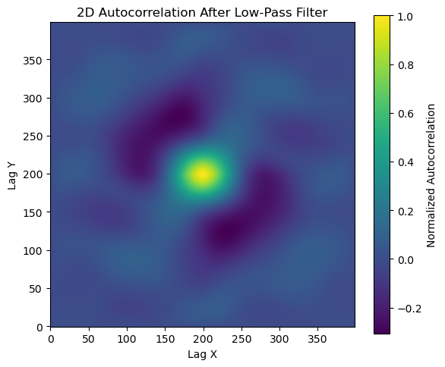
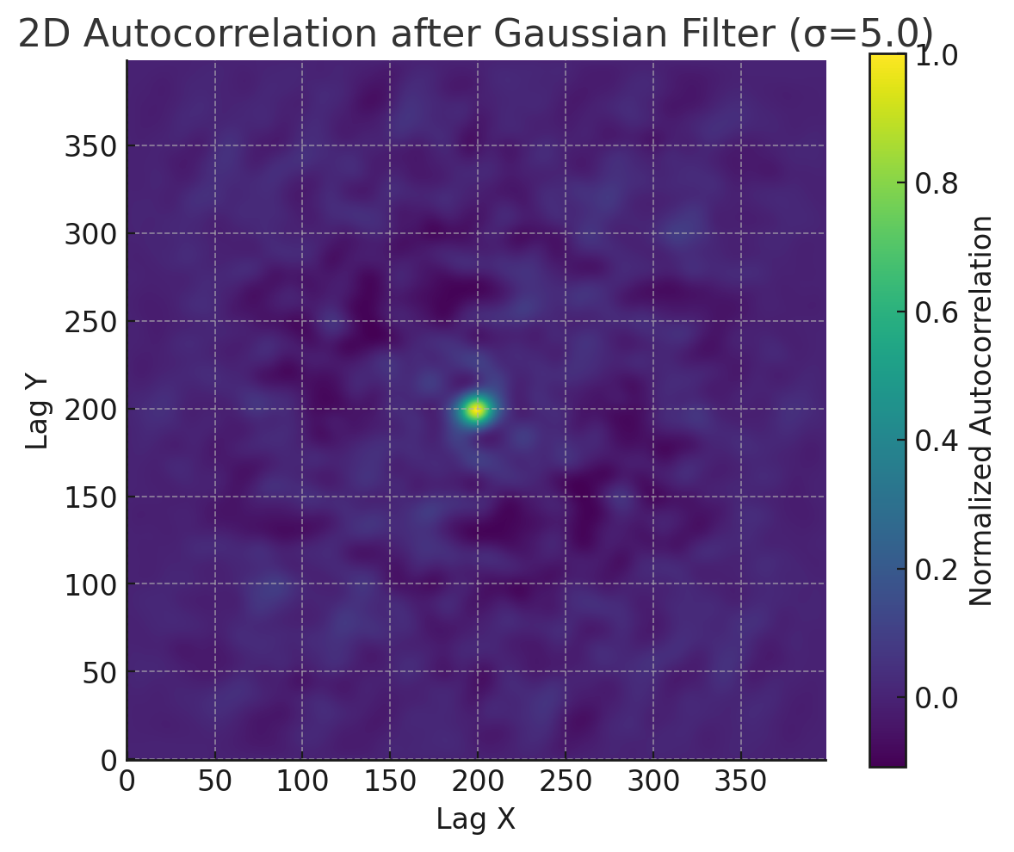
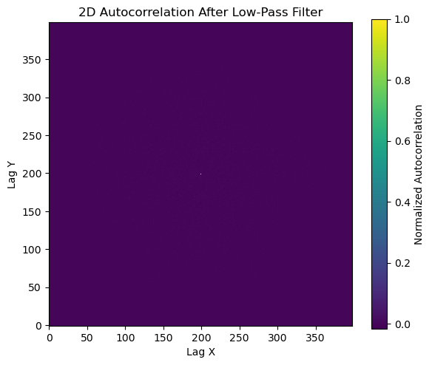
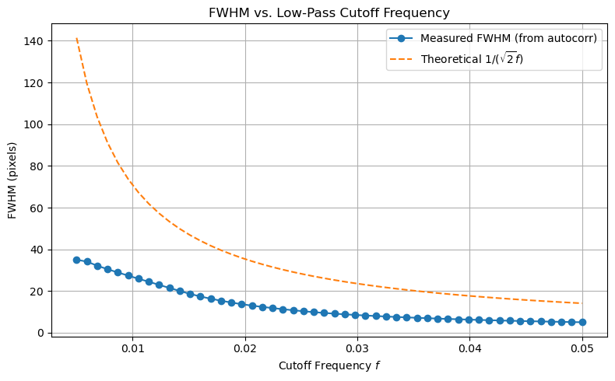
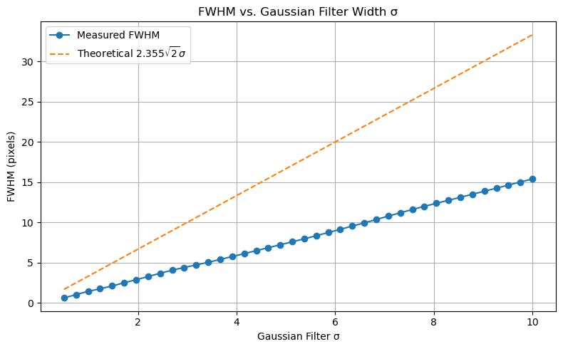

200x200 grid
$$σ_{g}=5$$
Need to increase the grid size or reduce the FFT spacing.

Slide 12
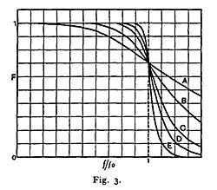
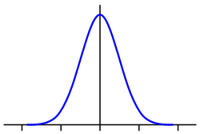

Butterworth filter
Butterworth filter: $G\left(ω\right)=\frac{1}{\sqrt{1+ω^{2n}} }$
Gaussian filter: $G\left(ω\right)=\frac{1}{\sqrt{1+ω^{2n}} }$

