Slide 1
Design and first operation of a supersonic gas jet based beam profile monitor
Aug. 01, 2025
Woojin Song

Slide 2
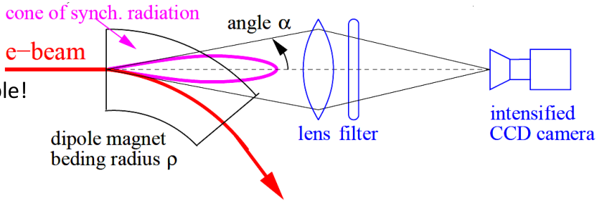
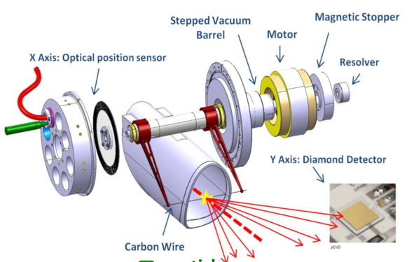
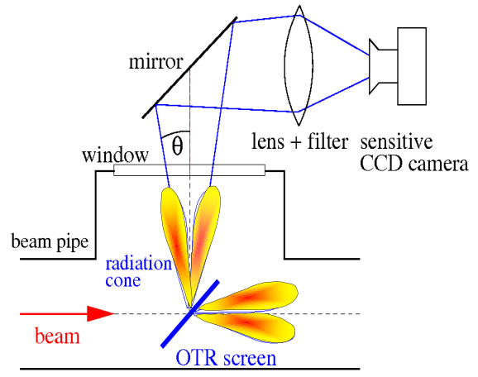
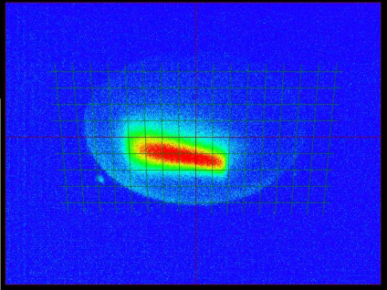
Beam profile measurement
Destructive ways
Scintillation screen monitor
Optical transition radiation
Wire scanner
Non-destructive ways
Synchrotron light monitor
X-ray pin-hole, zone plate
Ionization profile monitor

Slide 3
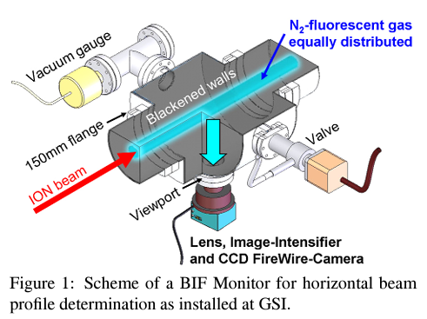
Ionization profile monitor (IPM)
X-rays or charged particles ionize the residual gas within the chamber.
→ Creating ion–electron pairs.
These pairs are extracted before recombination occurs.
Ion distribution at the readout is used to measure the beam profile.
Repeller electrode
Photo-electron
X-ray
-
Gas
-
Photo-ion
+
+
+
+
+
+
+
+
+
+
+
+
+
e-
Microchannel plate
(MCP)
+
E field
Photo-ion
Phosphor screen
Visible light
MCP
Readout (Camera)
Screen

Slide 4
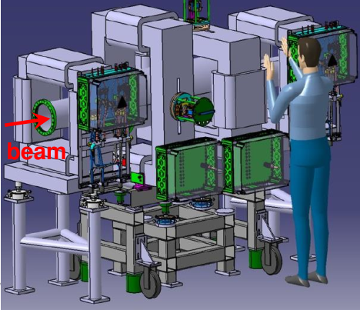
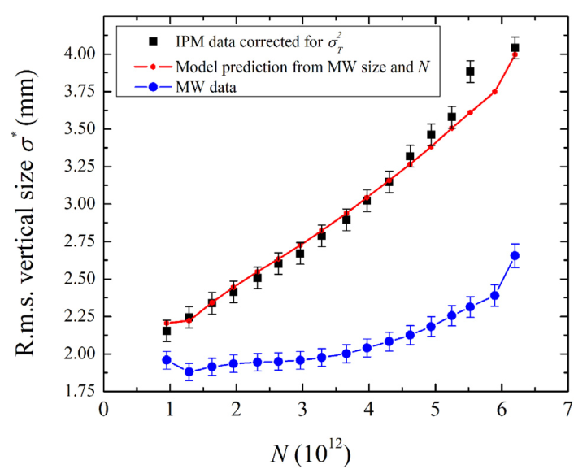
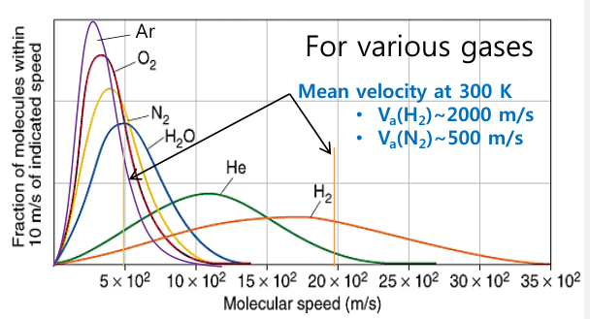
Limitation of residual gas IPM
Image broadening due to the transverse spread
Transverse spread occurs during the drift of ions due to space charge and initial ion energy.
Typically, magnets are installed to compensate for beam broadening.
The difficulty of measuring low-current beams
In UHV, gas density is sparse, resulting in very few events occurring.
Broadening due to the space charge
effect of non-relativistic ions
Transverse spread due to thermal energy
Space charge

Slide 5
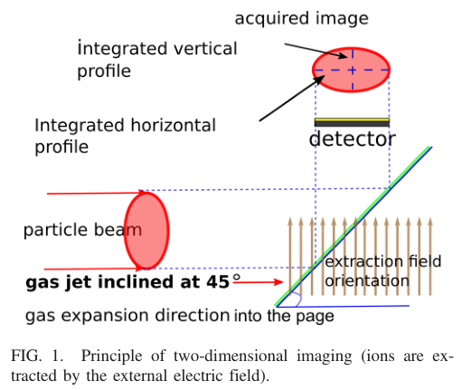
Cold supersonic gas jet based beam profile monitor
Ionization by introducing a gas jet instead of residual gas.
Already in use at HIMAC, J-PARC, RHIC, etc.
The gas jet has a high density, significantly increasing the event number.
It also has directionality, maintaining the surrounding UHV environment.
Simultaneous measurement in the X and Y directions is possible in a single chamber.
In this paper: The goal is to create a well-controlled environment using a supersonic gas jet and to accurately analyze the resolution.

Slide 6
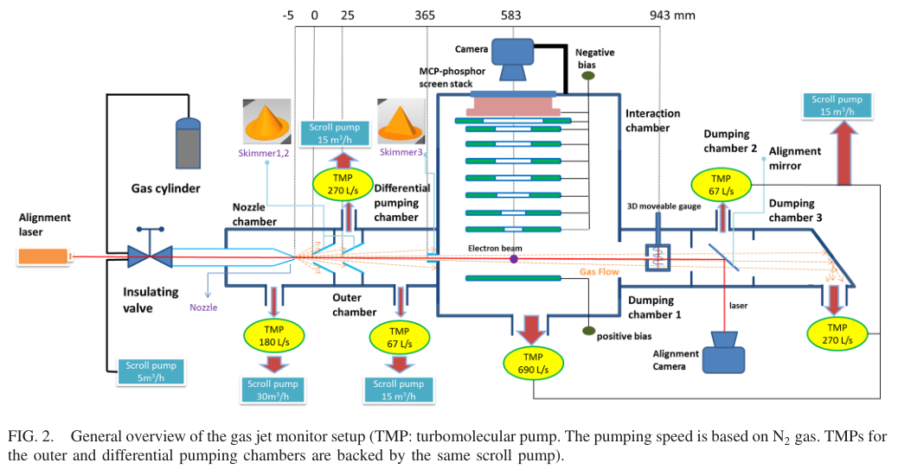
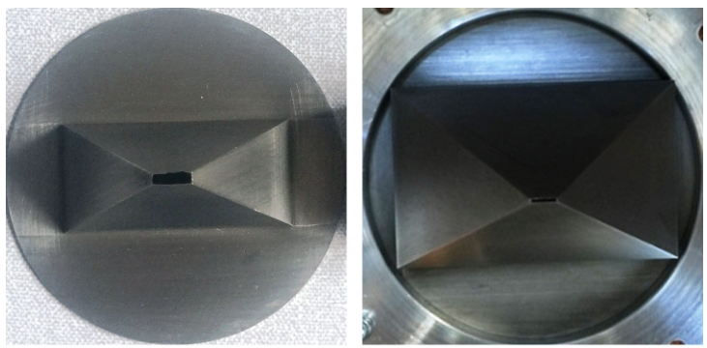
Hardware description

Slide 7
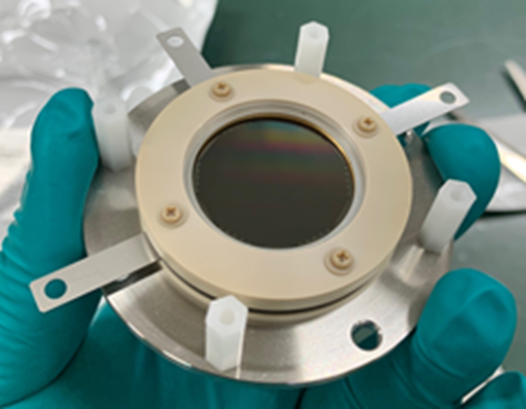
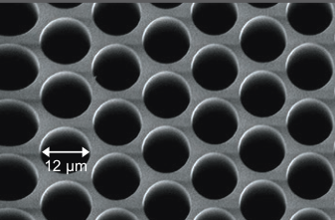
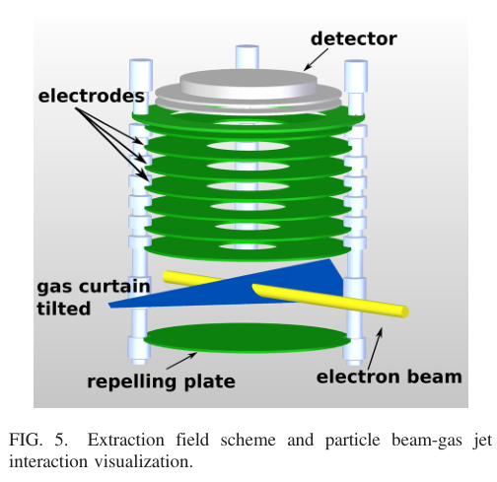
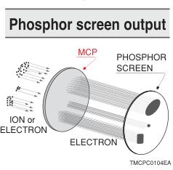
Working principle
The gas jet is injected perpendicular to the electron beam.

Slide 8
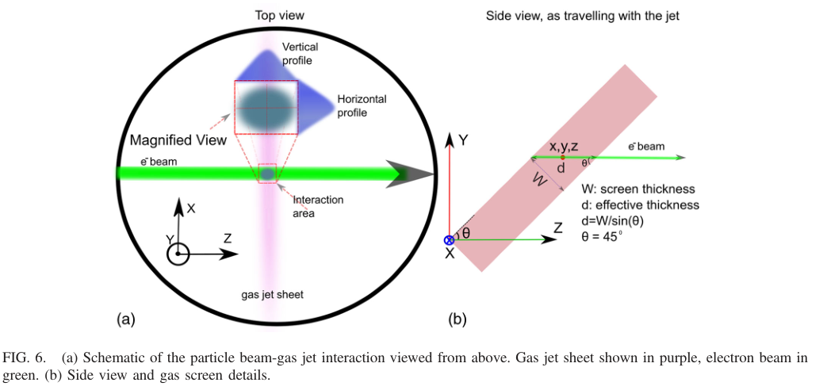
Jet curtain
Beam Dist.
Gas jet
Proj. Dist.

Slide 9
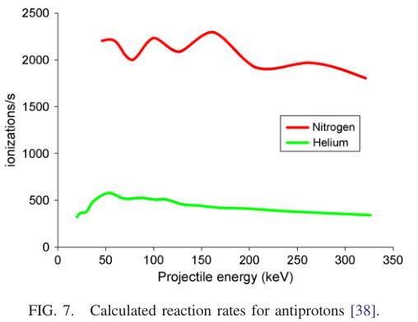
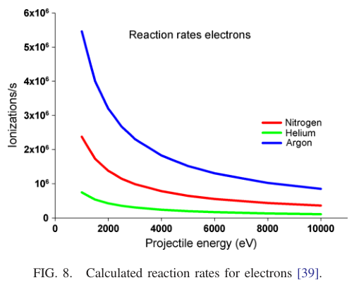
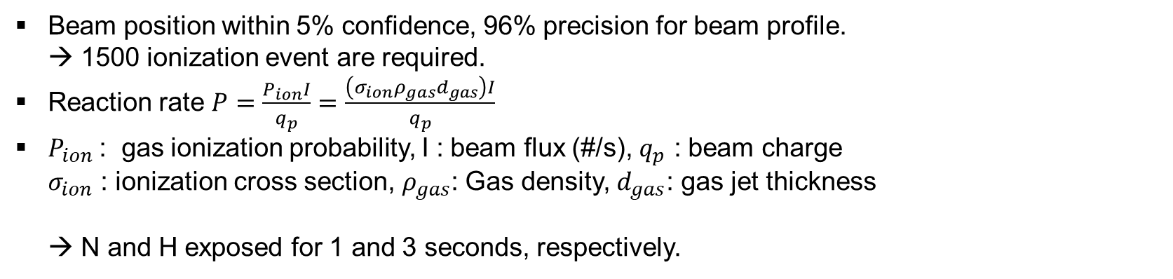
Acquisition time estimation
Beam position within 5% confidence, 96% precision for beam profile.
→ 1500 ionization event are required.
Reaction rate $P=\frac{P_{ion}I}{q_{p}}=\frac{\left(σ_{ion}ρ_{gas}d_{gas}\right)I}{q_{p}}$
$P_{ion}$: gas ionization probability, I : beam flux (#/s), $q_{p}$ : beam charge
$σ_{ion}$ : ionization cross section, $ρ_{gas}$: Gas density, $d_{gas}$: gas jet thickness
→ N and H exposed for 1 and 3 seconds, respectively.

Slide 10
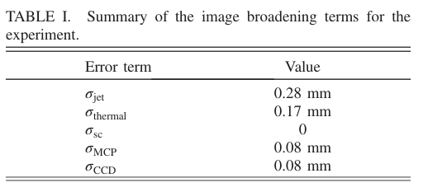
Monitor resolution
Major factors of the resolution
Optics (camera) resolution
MPC Resolution → Determined by channel pitch
Broadening due to gas jet thickness
Gas incidence at 45 degrees → effective thickness = W/sin(45), where W is measured by a gas probe.
Space charge effect
Nonlinear external field

Slide 11
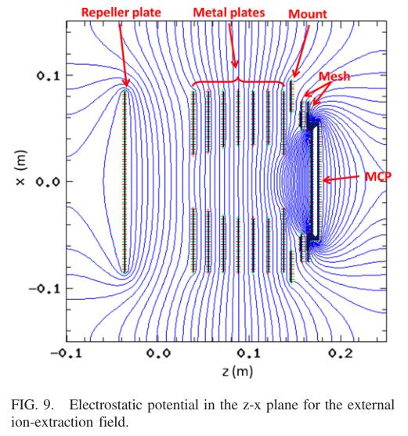
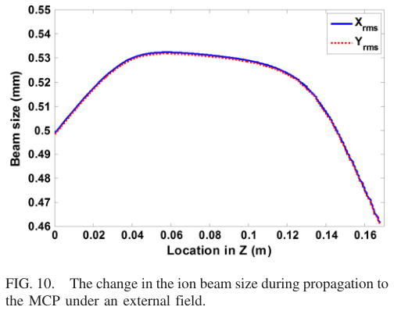
Monitor resolution
Nonlinear external field
Simulation conducted for N2+
Z=0.0 vicinity is dominated by thermal spread and therefore not considered (ion velocity is slow).
Focusing field at Z=0.04~0.12,
→ focusing field to offset thermal spread in the last electrode-MCP section.

Slide 12
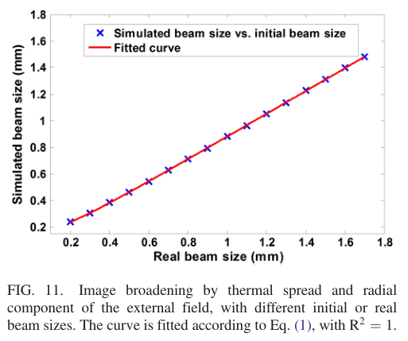

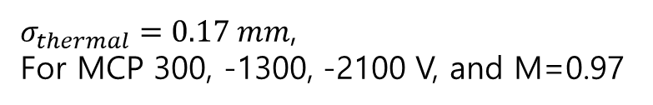
Monitor resolution
Thermal spead
M: magnification factor for cases without thermal spread or space charge
$σ_{thermal}=0.17 mm$,
For MCP 300, -1300, -2100 V, and M=0.97

Slide 13
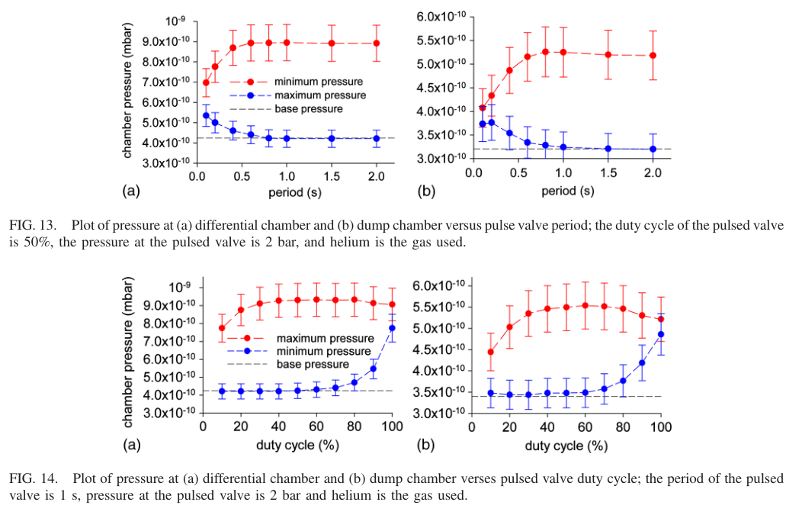
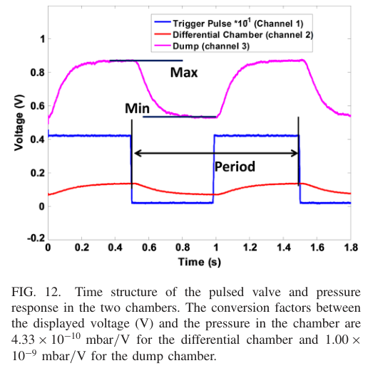
Gas jet working in pulse mode

Slide 14
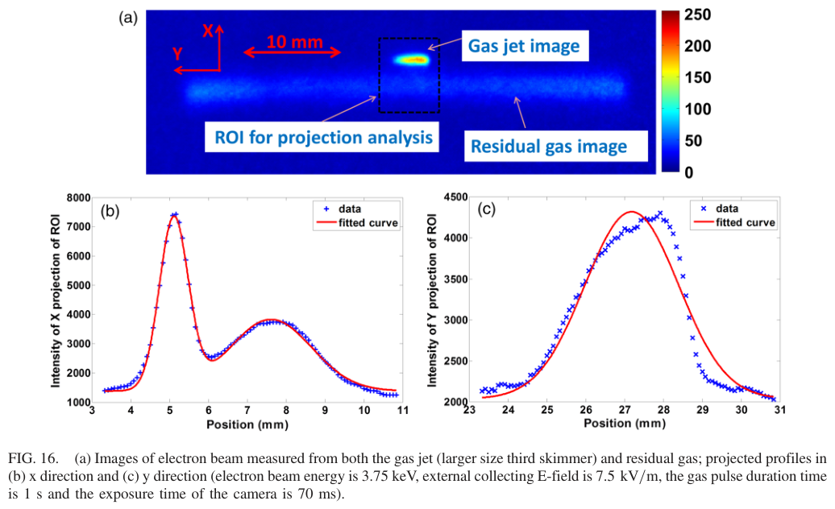
Profile measurements
Large skimmer

Slide 15
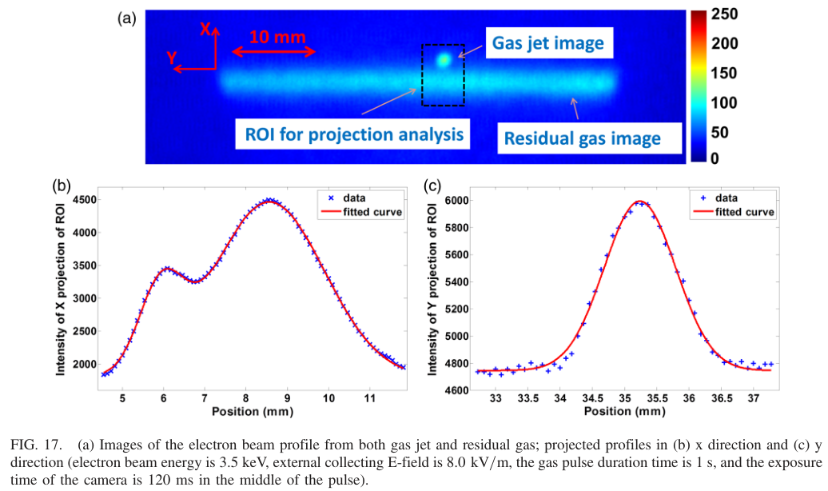
Profile measurements
Small skimmer

Slide 16
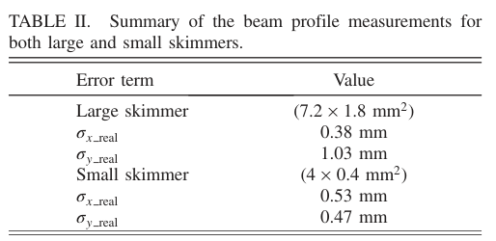
Profile measurements
When the gas jet thickness is thick, the ionization position of the beam is formed over a wide range.
As a result, the measured beam profile appears larger than it actually is, which reduces the resolution.
 | Orientation angle | Gas jet thickness
Larger skimmer | 45’ | 2.55 mm
Small skimmer | 32’ | 0.75 mm

Slide 17
Conclusion
Verified the operating principle and design of the supersonic gas jet beam profile monitor, and demonstrated its performance through the first experiment.
Confirmed the possibility of improving vacuum conditions through pulse mode operation.
Future improvement directions:
- Develop technology to form a thinner and more uniform supersonic gas jet.
- Consider introducing a magnetic field to compensate for the space charge effect.
- Collaborate with CERN, GSI, etc. to promote application to High Luminosity LHC upgrade.

