Slide 1


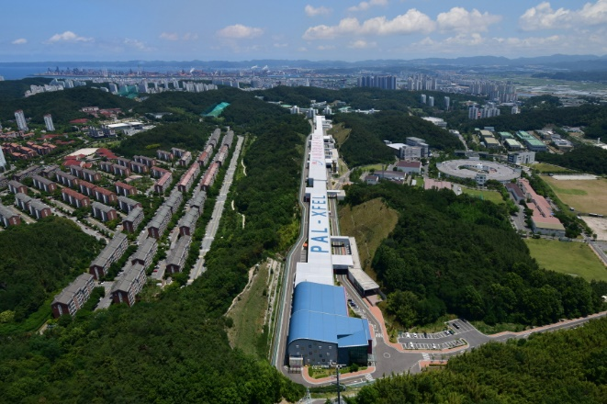

Generation and Measurement of Relativistic Electron Bunches Characterized by a Linearly Ramped Current profile
Generation and Measurement of Relativistic Electron Bunches Characterized by a Linearly Ramped Current profile
Jimin Seok
4GSR Beam Dynamics Group
Pohang Accelerator Laboratory, POSTECH
2025.7.25

Slide 2
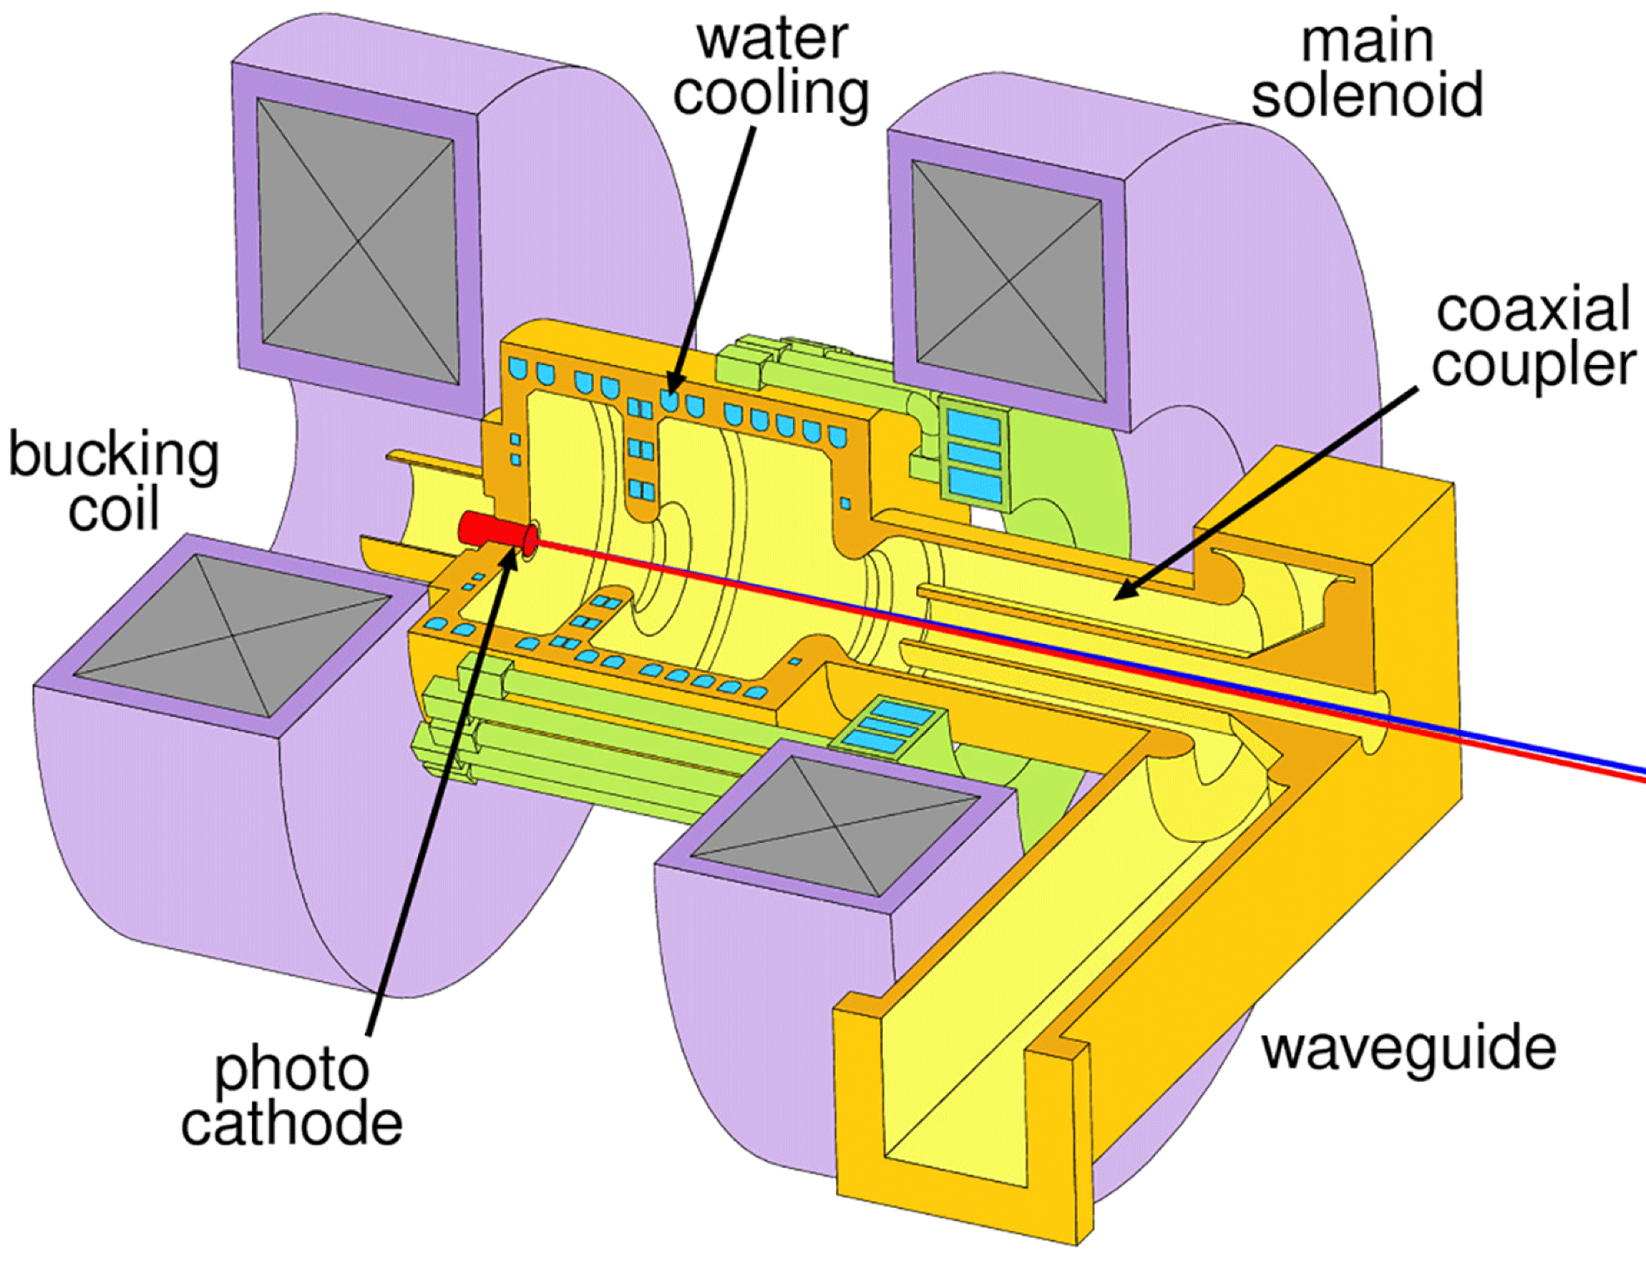
Generation and Measurement of Relativistic Electron Bunches Characterized by a Linearly Ramped Current profile
Beam manipulation
Photocathode gun
Manipulation
TPS
LPS
Magnets
O (Very efficiency)
X
EM field
O (not common)
O (Neutral?, limitations)
Required electron beam energy for ultra-relativistic condition is 0.511 MeV
Generally, electron beam energy after the gun is > 4 MeV

Slide 3


















Generation and Measurement of Relativistic Electron Bunches Characterized by a Linearly Ramped Current profile
Transverse beam manipulation
Quad
Drift
$$x′$$
$$x′$$
$$x′$$
$$x$$
$$x$$
$$x$$
Sext
$$x′$$
$$x′$$
Drift
$$x′$$
$$x$$
$$x$$
$$x$$
Drift
$$x′$$
Oct
$$x′$$
$$x′$$
$$x$$
$$x$$
$$x$$

Slide 4
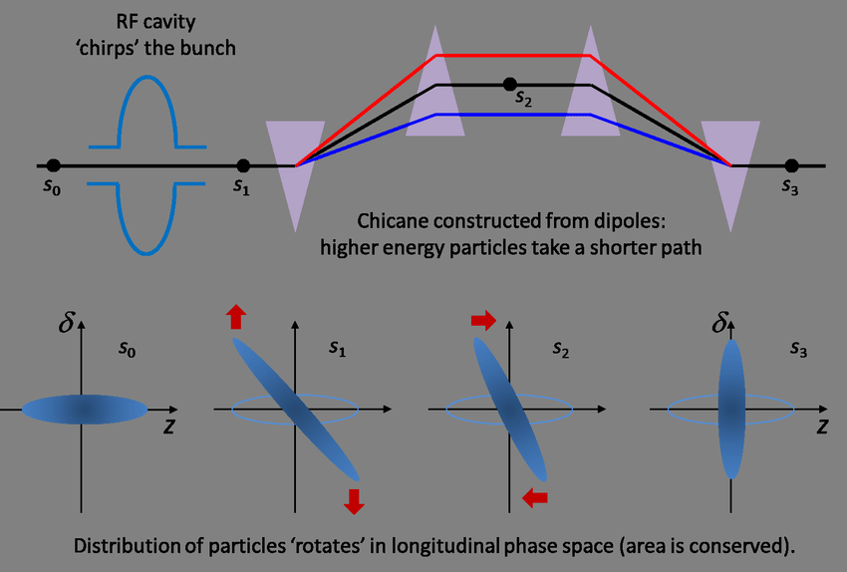
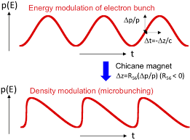
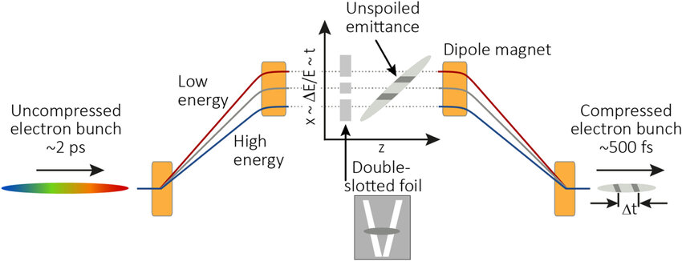










Generation and Measurement of Relativistic Electron Bunches Characterized by a Linearly Ramped Current profile
Longitudinal manipulation???
Chicane bunch compressor
Dispersion + mask or magnets
Modulation + compressor
Velocity bunch compression
Questions
Q1. Who requires longitudinal phase space manipulation?
A1. Usually Linac for high current, wakefield acceleration or double-horn suppression, etc... Some storage rings (like SSMB) need it.
Q2. How to manipulate longitudinal phase space?
A2. Direct longitudinal manipulation has lots of limitations (EM field). So we make coupling in between transverse and longitudinal phase space, and it allow sophisticate manipulations.
$$δ$$
$$E_{z}$$
$$δ$$
$$δ$$
$$z$$
$$z$$
$$z$$
$$δ$$
$$Acceleration$$
$$z$$

Slide 5
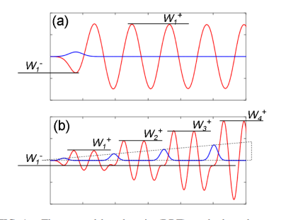
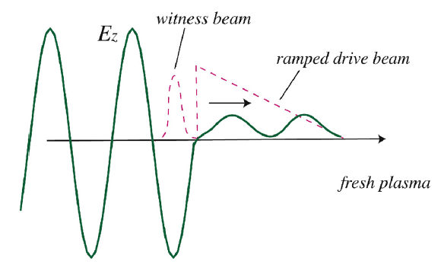
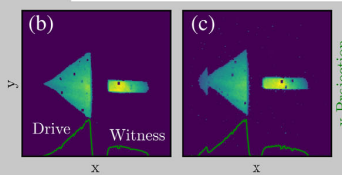
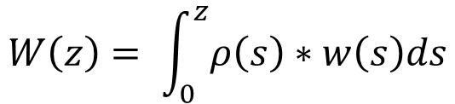
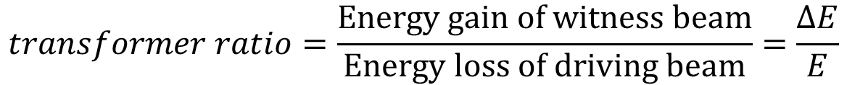
Generation and Measurement of Relativistic Electron Bunches Characterized by a Linearly Ramped Current profile
Wakefield acceleration and transformer ratio
Beam stacking
$$W\left(z\right)= \int_{0}^{z}{ρ\left(s\right)∗w\left(s\right)ds}$$
Triangle / door step
$$transformer ratio=\frac{Energy gain of witness beam}{Energy loss of driving beam}=\frac{ΔE}{E}$$
Large transformer ratio = Efficient wakefield acceleration

Slide 6
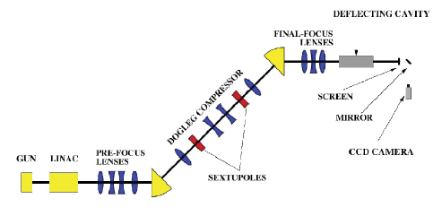
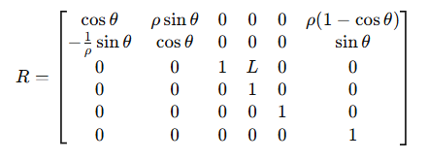

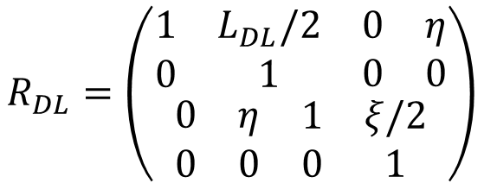
Generation and Measurement of Relativistic Electron Bunches Characterized by a Linearly Ramped Current profile
UCLA Neptune laboratory beamline
Dipole
High E
Low E
Dipole
$$R_{DL}=\left(\begin{matrix}\begin{matrix}\begin{matrix}1 & L_{DL}/2 \\ 0 & 1\end{matrix} & \begin{matrix}0 & η \\ 0 & 0\end{matrix}\end{matrix} \\ \begin{matrix}\begin{matrix}0 & η \\ 0 & 0\end{matrix} & \begin{matrix}1 & ξ/2 \\ 0 & 1\end{matrix}\end{matrix}\end{matrix}\right)$$
Dogleg or achromat
Dipole
R56
T566
Low E
Knob: Quad.
Knob: Sext.
Dipole

Slide 7
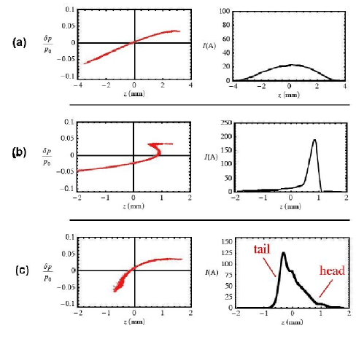
Generation and Measurement of Relativistic Electron Bunches Characterized by a Linearly Ramped Current profile
UCLA Neptune laboratory beamline
Before Dogleg
Quadratic momentum error
Dogleg or achromat
Linear momentum error
R56
T566
Knob: Quad.
Knob: Sext.

Slide 8
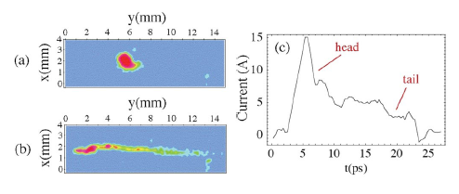

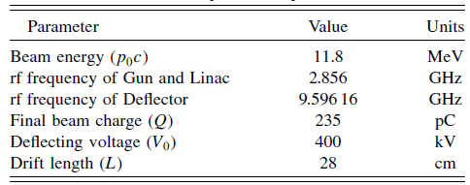
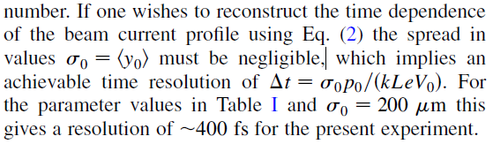



Generation and Measurement of Relativistic Electron Bunches Characterized by a Linearly Ramped Current profile
Experimental setup
9.6 GHz (X-band), maximum 500 kV, resolution ~50 fs
Q: 300 to 600 pC
4 MeV
13 MeV
Phase: 20 degree -> produce linear energy chirp
$$z_{0}=hδ$$
$$z_{f}=z_{0}+η_{z}δ=\left(h+η_{z}\right)δ=0$$
$$if h=−1/η_{z}$$
Critical compression condition

Slide 9
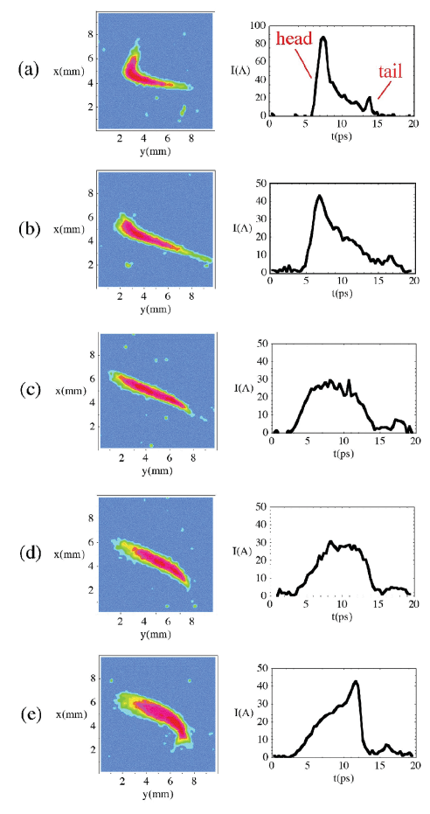
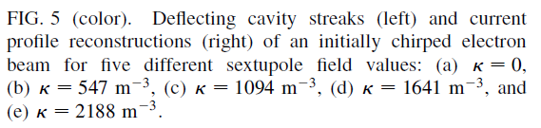
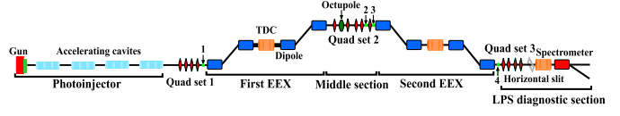
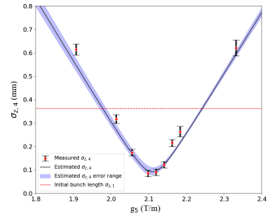
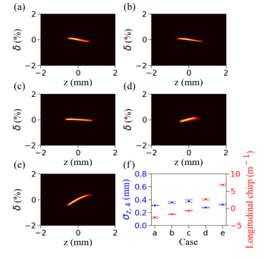
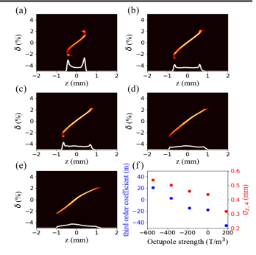
Generation and Measurement of Relativistic Electron Bunches Characterized by a Linearly Ramped Current profile
Experimental results
Are they LPSs??
No linearity control, only second order correction
EXTRA

