Slide 1
0725 Passive Superconducting HHC
2025-07-25, Pohang, South Korea
Young Min Park
Division of Advanced Nuclear Engineering (DANE), POSTECH

Slide 2
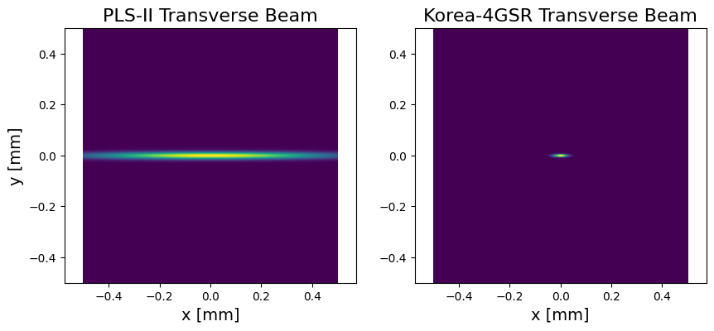
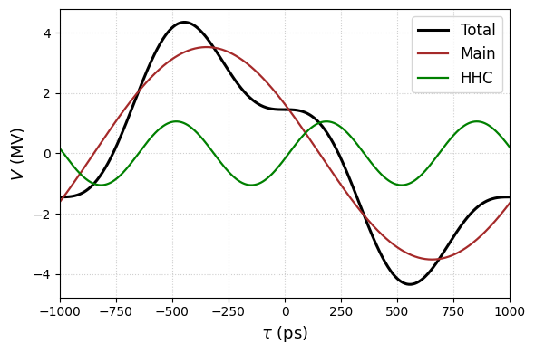
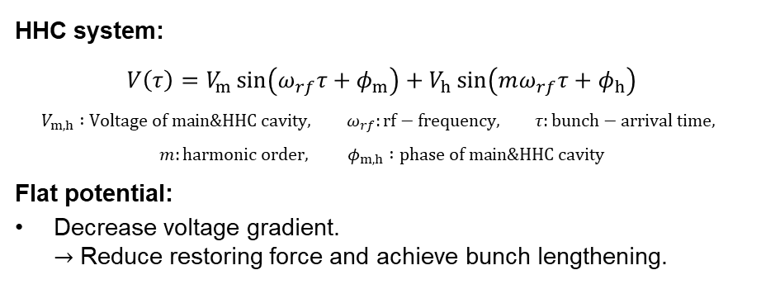
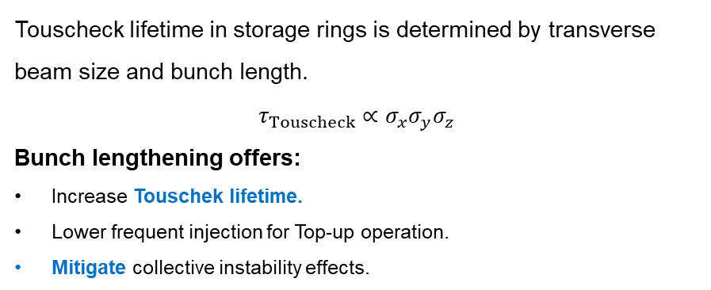
Storage ring with HHC
Touscheck lifetime in storage rings is determined by transverse beam size and bunch length.
$$τ_{Touscheck}∝σ_{x}σ_{y}σ_{z}$$
Bunch lengthening offers:
Increase Touschek lifetime.
Lower frequent injection for Top-up operation.
Mitigate collective instability effects.
HHC system:
$$V\left(τ\right)=V_{m}\sin\left(ω_{rf}τ+φ_{m}\right)+V_{h}\sin\left(mω_{rf}τ+φ_{h}\right)$$
$$V_{m,h} :Voltage of main\&HHC cavity, ω_{rf}:rf−frequency, τ:bunch−arrival time,$$
$$m:harmonic order, φ_{m,h} :phase of main\&HHC cavity$$
Flat potential:
Decrease voltage gradient.
$→$ Reduce restoring force and achieve bunch lengthening.
2
[1] Pedro F. Tavares et al., Equilibrium bunch density distribution with passive harmonic cavities in a storage ring, Phys. Rev. ST Accel. Beams 17, (2014).

Slide 3
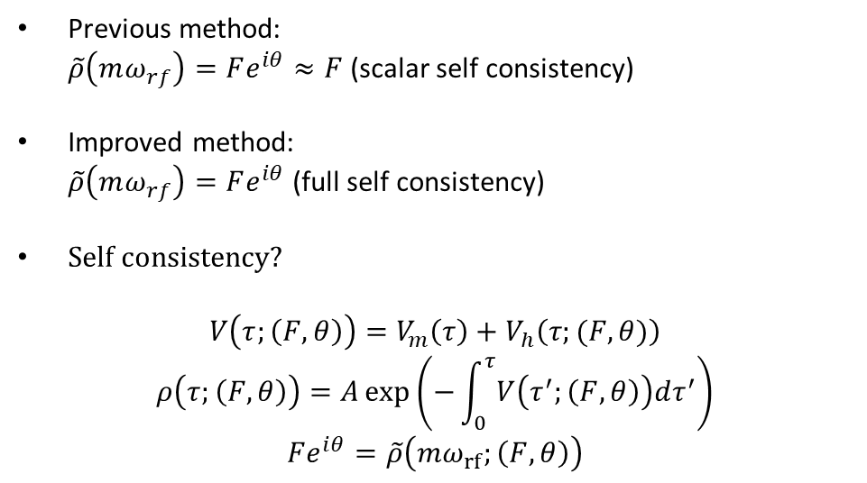
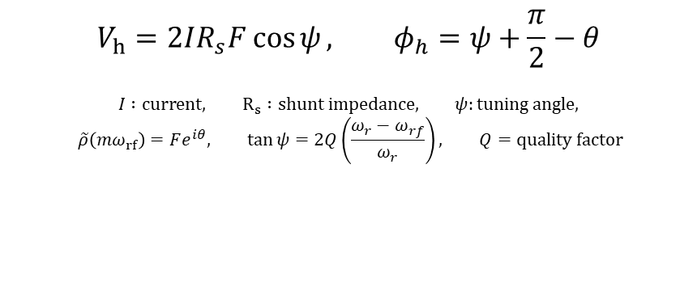

Passive SC HHC
$$V_{h}\sin\left(mω_{rf}τ+φ_{h}\right)$$
$$V_{h}=2IR_{s}F\cos{ψ}, φ_{h}=ψ+\frac{π}{2}−θ$$
$$I :current, R_{s} :shunt impedance, ψ:tuning angle,$$
$$\tilde{ρ}\left(mω_{rf}\right)=Fe^{iθ}, \tan{ψ}=2Q\left(\frac{ω_{r}−ω_{rf}}{ω_{r}}\right), Q=quality factor$$
Previous method:
$\tilde{ρ}\left(mω_{rf}\right)=Fe^{iθ}≈F$ (scalar self consistency)
Improved method:
$\tilde{ρ}\left(mω_{rf}\right)=Fe^{iθ}$ (full self consistency)
Self consistency?
$$V\left(τ;\left(F,θ\right)\right)=V_{m}\left(τ\right)+V_{h}\left(τ;(F,θ)\right)$$
$$ρ\left(τ;\left(F,θ\right)\right)=A\exp\left(−\int_{0}^{τ}{V\left(τ^{′};\left(F,θ\right)\right)dτ^{′}}\right)$$
$$Fe^{iθ}=\tilde{ρ}\left(mω_{rf};\left(F,θ\right)\right)$$
SSRF
NSLS-II
K-4GSR (design)
APS-U
[1]
3
[1] Pedro F. Tavares et al., Equilibrium bunch density distribution with passive harmonic cavities in a storage ring, Phys. Rev. ST Accel. Beams 17, (2014).

Slide 4
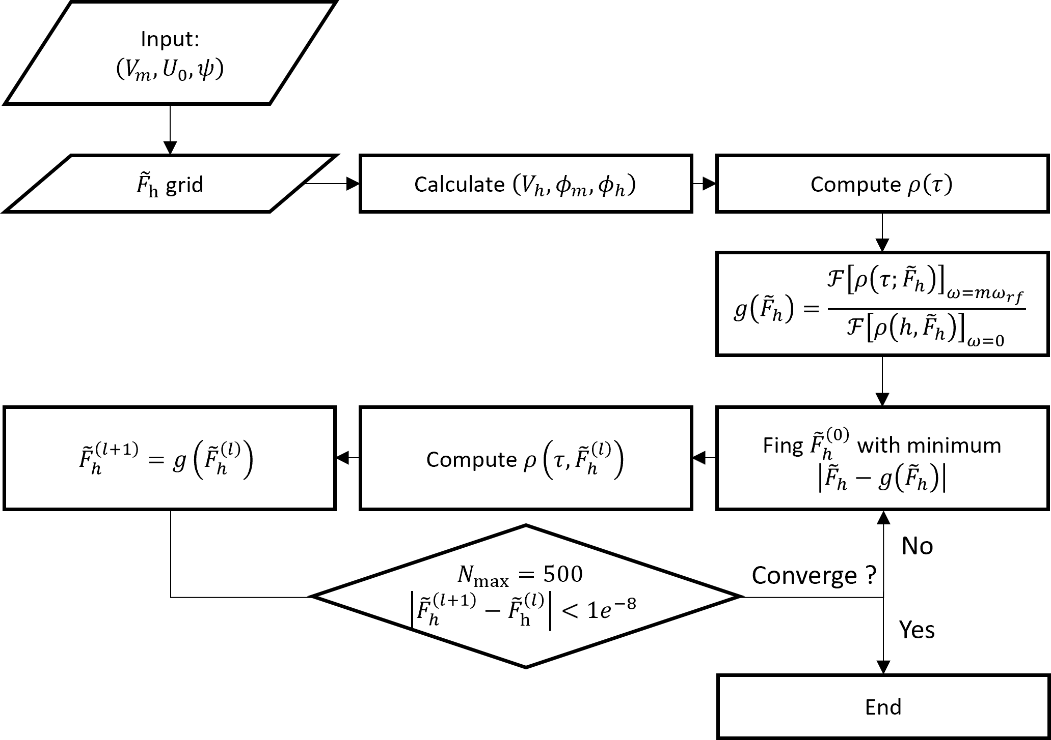
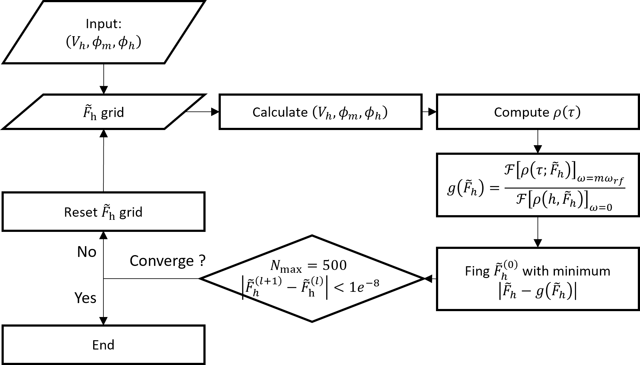
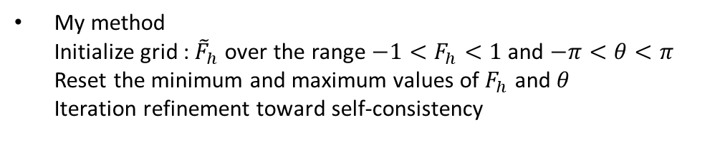
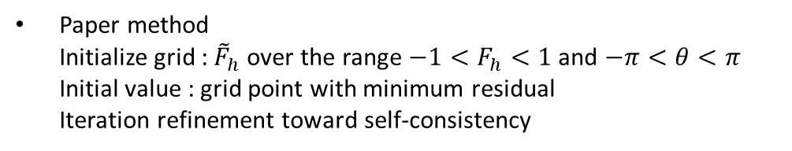
Passive cavity self consistency
Paper method
Initialize grid : ${\tilde{F}}_{h}$ over the range $−1<F_{h}<1$ and $−π<θ<π$
Initial value : grid point with minimum residual
Iteration refinement toward self-consistency
My method
Initialize grid : ${\tilde{F}}_{h}$ over the range $−1<F_{h}<1$ and $−π<θ<π$
Reset the minimum and maximum values of $F_{h}$ and $θ$
Iteration refinement toward self-consistency
4

Slide 5
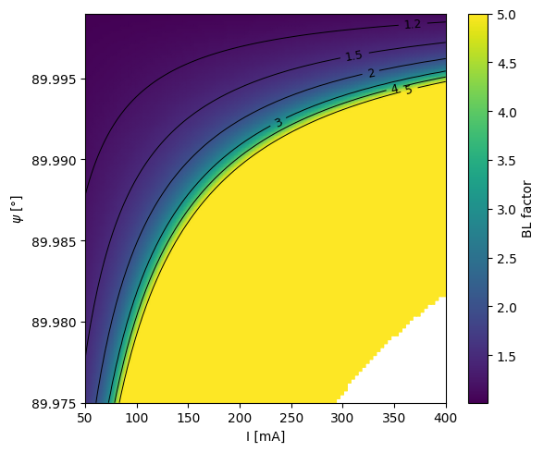
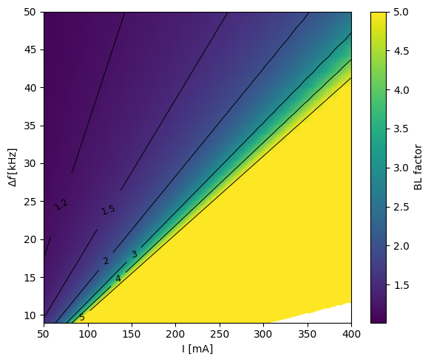
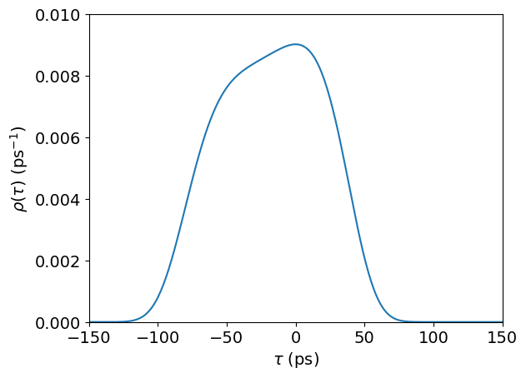
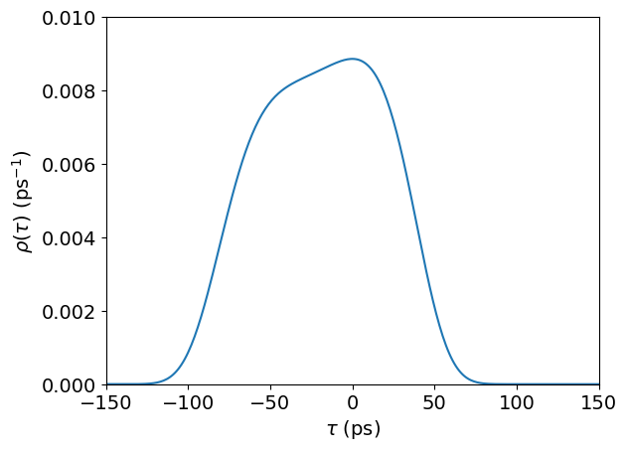



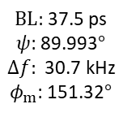
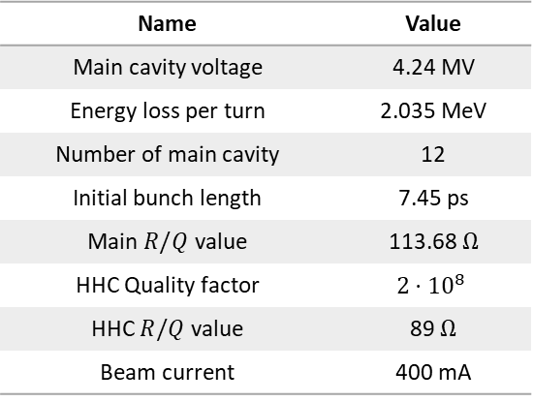

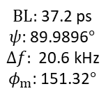
Passive cavity self consistency
Name | Value
Main cavity voltage | 4.24 MV
Energy loss per turn | 2.035 MeV
Number of main cavity | 12
Initial bunch length | 7.45 ps
Main $R/Q$ value | 113.68 $Ω$
HHC Quality factor | $$2⋅{10}^{8}$$
HHC $R/Q$ value | 89 $Ω$
Beam current | 400 mA
$BL:$ 37.2 ps
$ψ$: 89.9948$°$
$Δf:$ 41.3 kHz
$φ_{m}$: 151.33$°$
$BL:$ 37.5 ps
$ψ$: 89.993$°$
$$Δf: \text{30.7} \text{kHz}$$
$φ_{m}$: 151.32$°$
$BL:$ 37.2 ps
$ψ$: 89.9896$°$
$$Δf: \text{20}\text{.}\text{6} \text{kHz}$$
$φ_{m}$: 151.32$°$
$BL:$ 37.13 ps
$ψ$: 89.9792$°$
$$Δf: \text{10.3} \text{kHz}$$
$φ_{m}$: 151.32$°$
400 mA
300 mA
200 mA
100 mA
5

Slide 6
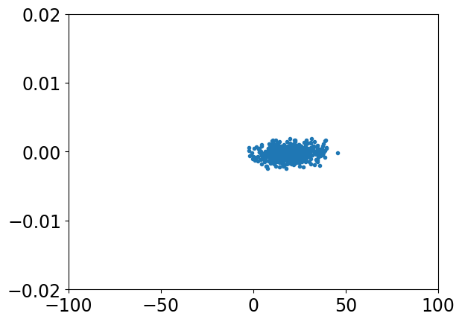
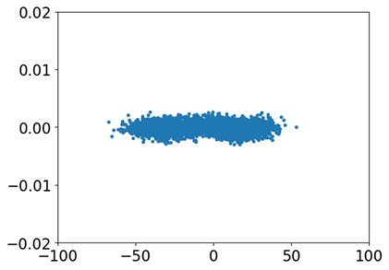
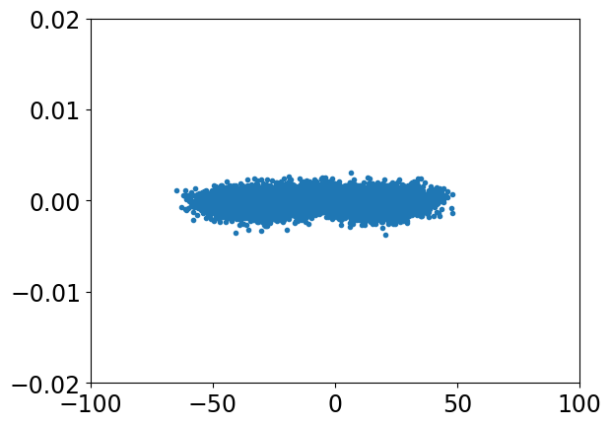
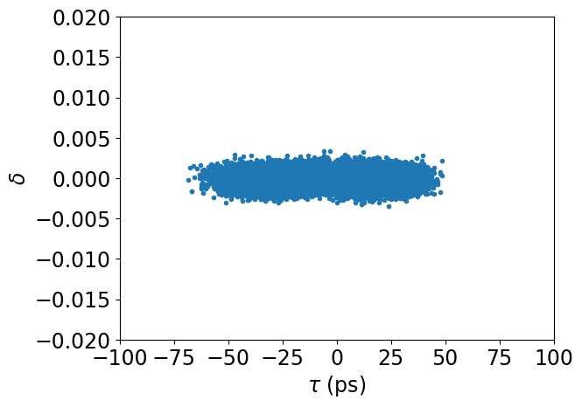
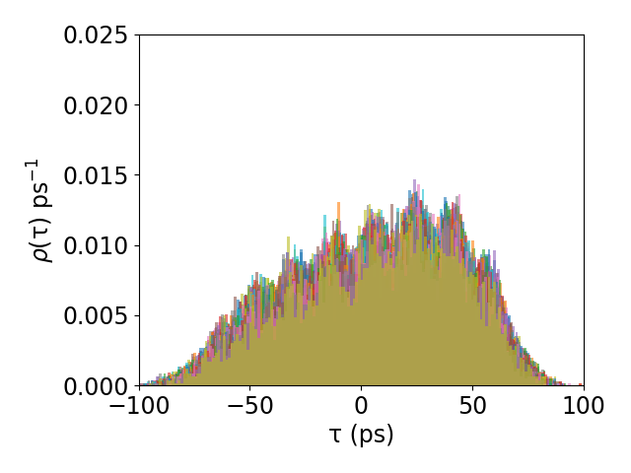
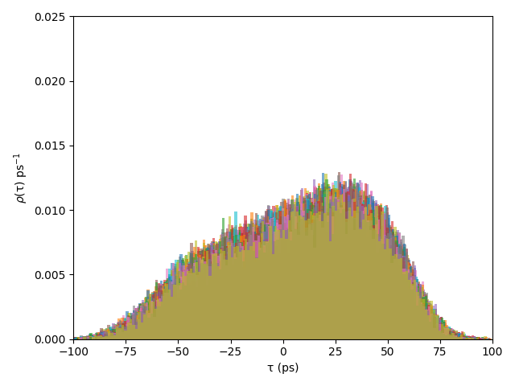

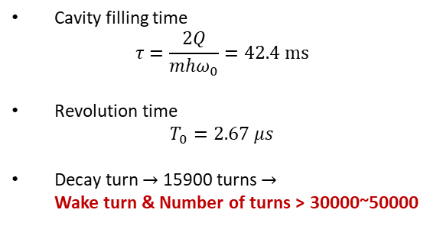
Simulation convergence test
Number of
macroparticles
Macroparticle: 500
BL: 7.76 ps
Macroparticle: 5000
BL: 19.09 ps
Macroparticle: 10000
BL: 24.25 ps
Macroparticle: 30000
BL: 24.13 ps
Nslice
Nslice : 10
BL: 35.8 ps
Nslice : 20
BL: 36.2 ps
Nslice : 30
BL: 35.9 ps
Nturns
Cavity filling time
$$τ=\frac{2Q}{mhω_{0}}=42.4 ms$$
Revolution time
$$T_{0}=2.67 μs$$
Decay turn $→$ 15900 turns $→$
Wake turn & Number of turns > 30000~50000
The convergence test is in progress.
6

Slide 7
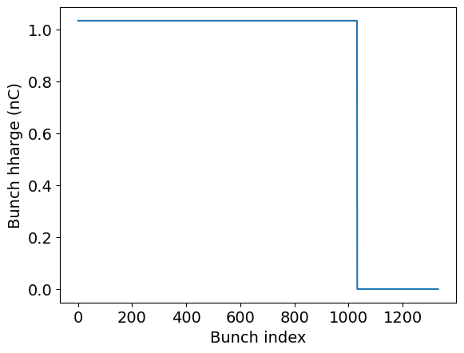
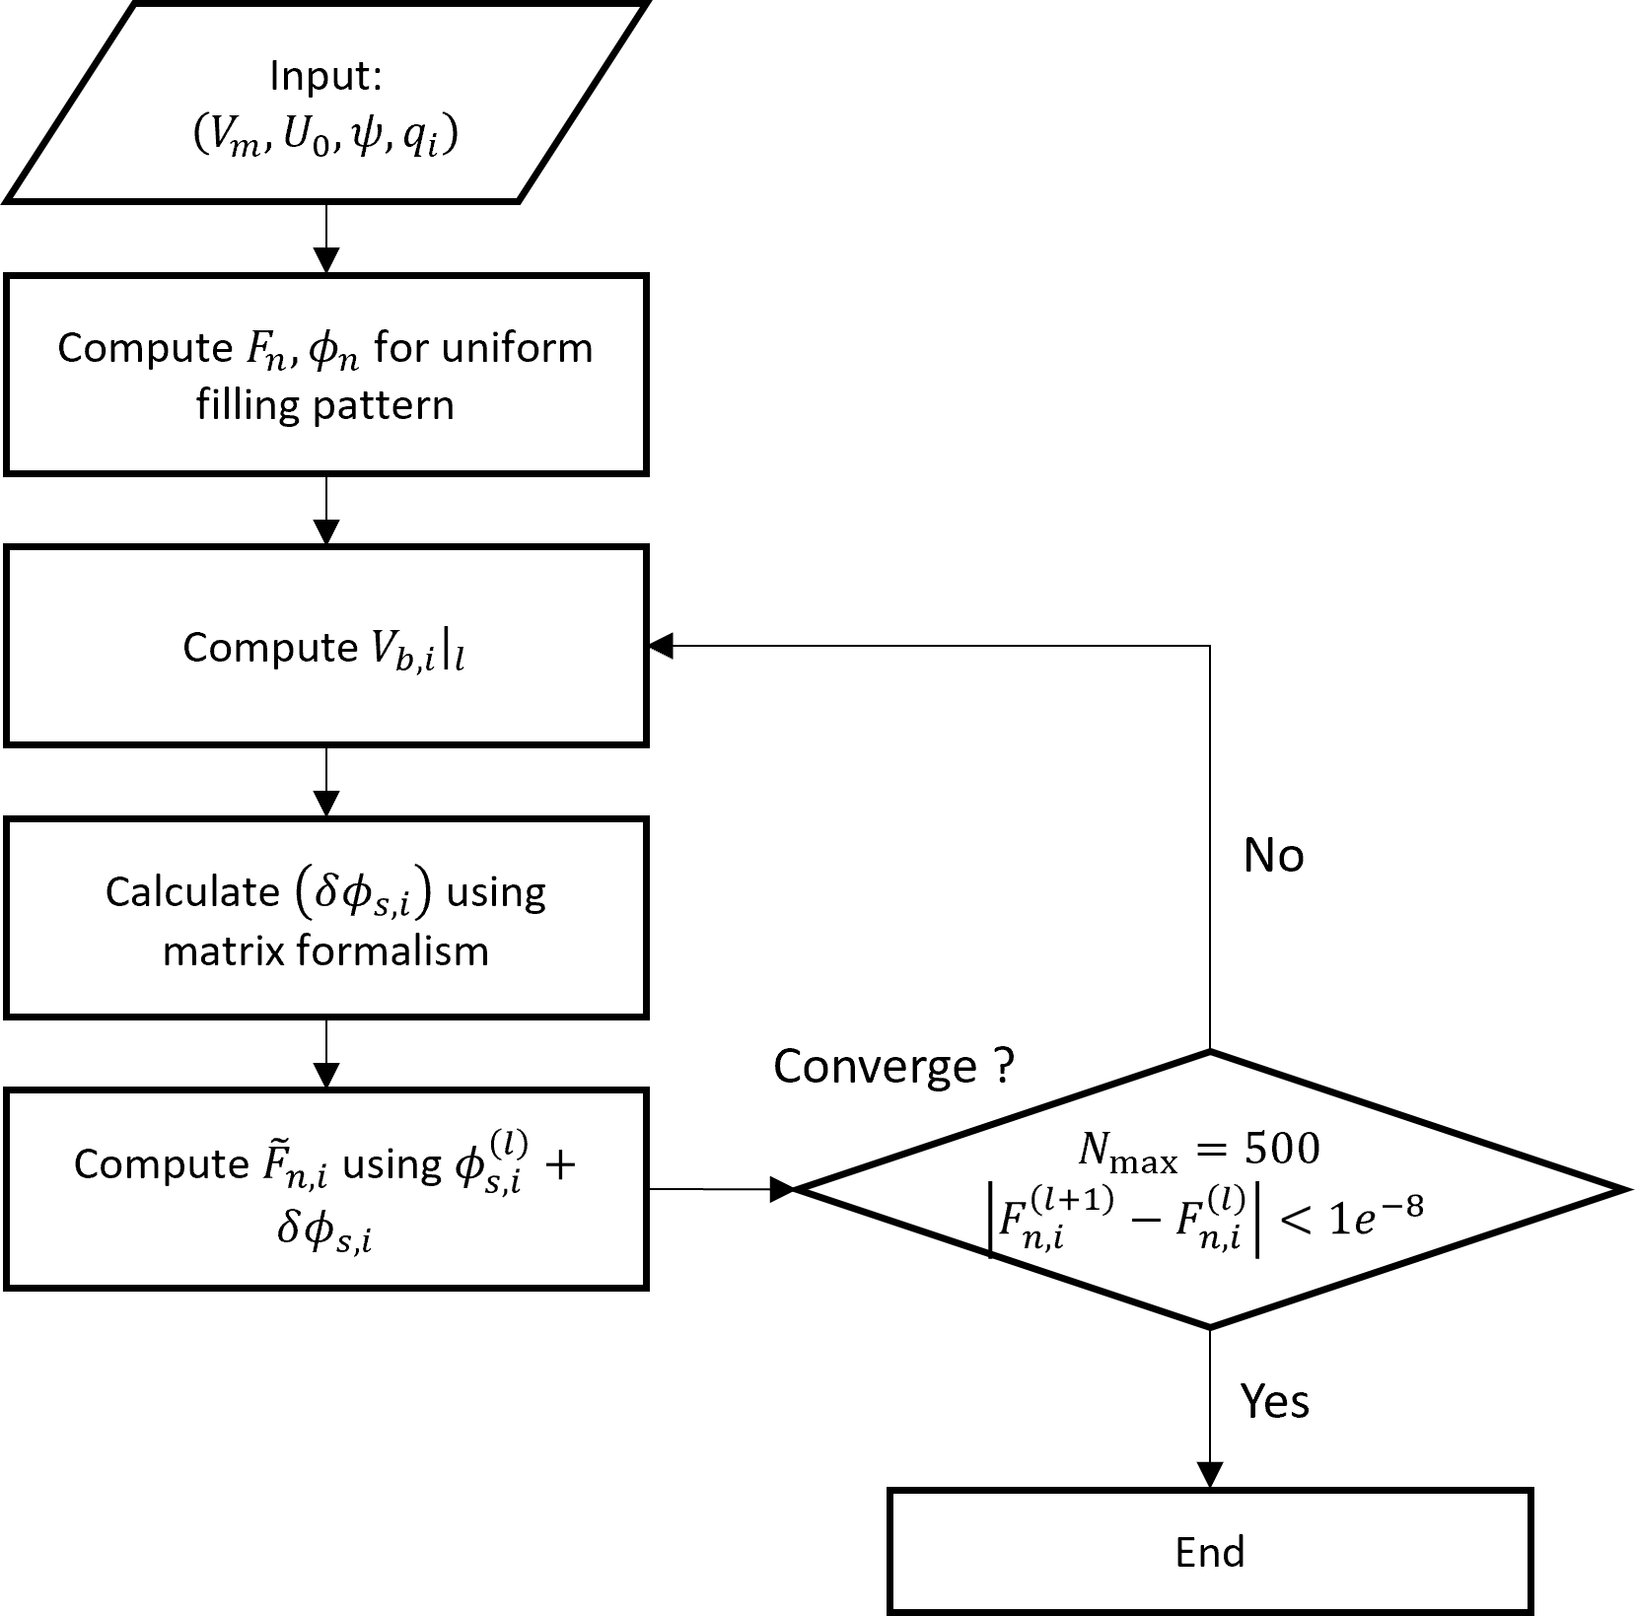
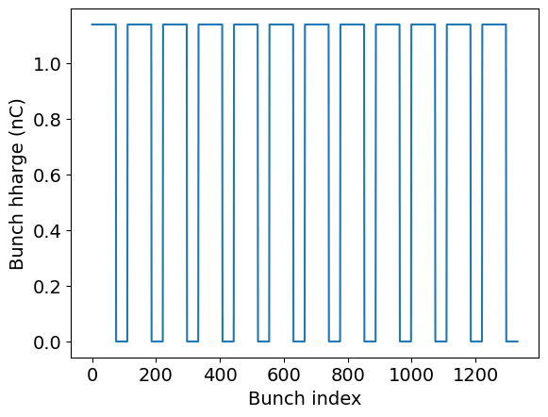
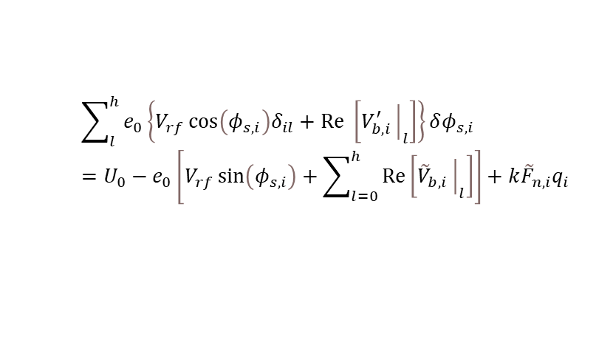
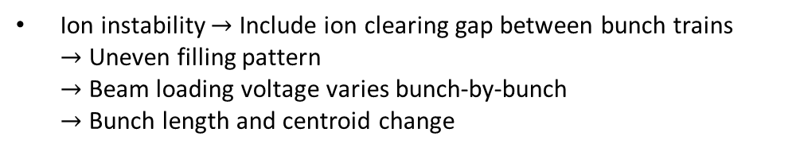
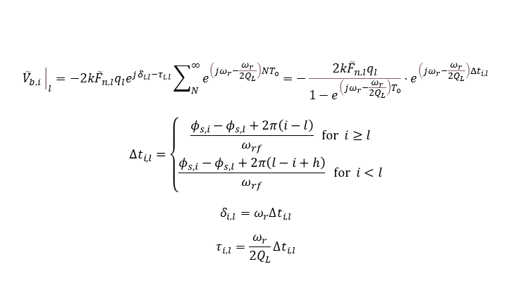

Transient effects
Transient effects
Ion instability $→$ Include ion clearing gap between bunch trains
$→$ Uneven filling pattern
$→$ Beam loading voltage varies bunch-by-bunch
$→$ Bunch length and centroid change
Semi analytic method
$${\tilde{V}}_{b,i}{\left.​\right|}_{l}=−2k{\tilde{F}}_{n,l}q_{l}e^{jδ_{i,l}−τ_{i,l}}\sum_{N}^{∞}{e^{\left(jω_{r}−\frac{ω_{r}}{2Q_{L}}\right)NT_{0}}}=−\frac{2k{\tilde{F}}_{n,l}q_{l}}{1−e^{\left(jω_{r}−\frac{ω_{r}}{2Q_{L}}\right)T_{0}}}⋅e^{\left(jω_{r}−\frac{ω_{r}}{2Q_{L}}\right){Δt}_{i,l}}$$
$$Δt_{i,l}=\left\{\begin{aligned}\frac{φ_{s,i}−φ_{s,l}+2π\left(i−l\right)}{ω_{rf}} for i≥l \\ \frac{φ_{s,i}−φ_{s,l}+2π\left(l−i+h\right)}{ω_{rf}} for i<l\end{aligned}\right.$$
$$δ_{i,l}=ω_{r}Δt_{i,l}$$
$$τ_{i,l}=\frac{ω_{r}}{2Q_{L}}Δt_{i,l}$$
Gap: 300
$$\sum_{l}^{h}{e_{0}\left\{V_{rf}\cos\left(φ_{s,i}\right)δ_{il}+Re \left[V_{b,i}^{′}{\left.​\right|}_{l}\right]\right\}}δφ_{s,i} \\ =U_{0}−e_{0}\left[V_{rf}\sin\left(φ_{s,i}\right)+\sum_{l=0}^{h}{Re\left[{\tilde{V}}_{b,i}{\left.​\right|}_{l}\right]}\right]+k{\tilde{F}}_{n,i}q_{i}$$
[1]
$$\left(75+36\right)×12$$
7
[1] T. Olsson, Self-consistent calculation of transient beam loading in electron storage rings with passive harmonic cavities, Phys. Rev. Accel. Beams 21, (2018).

Slide 8
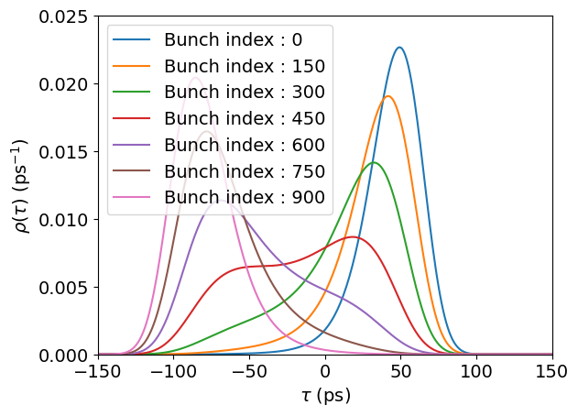
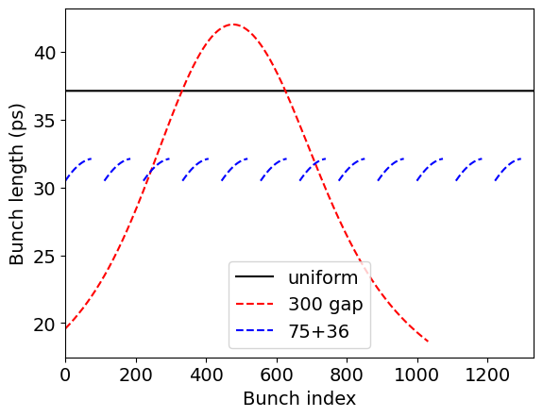
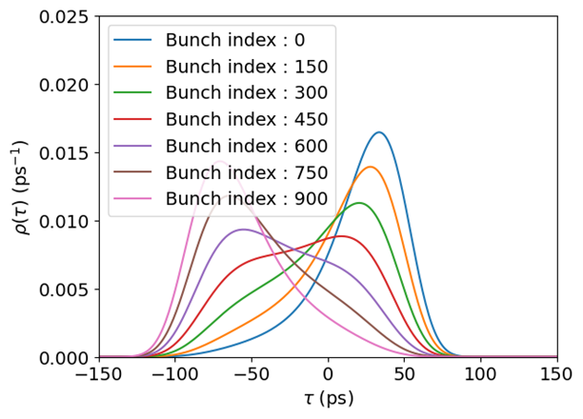
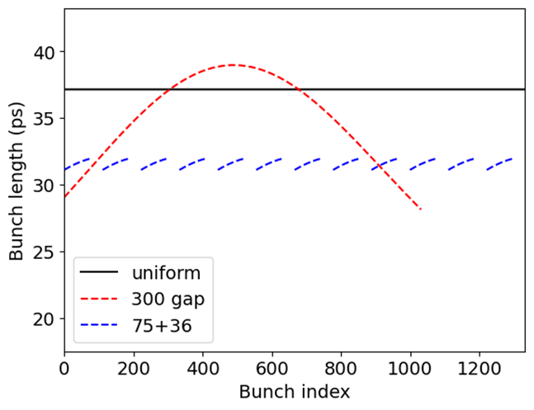
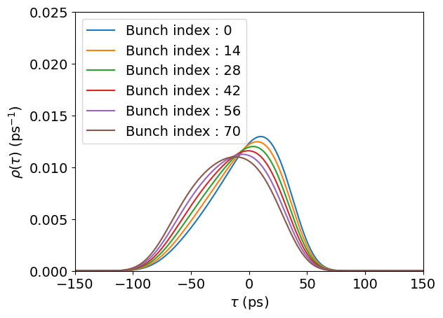
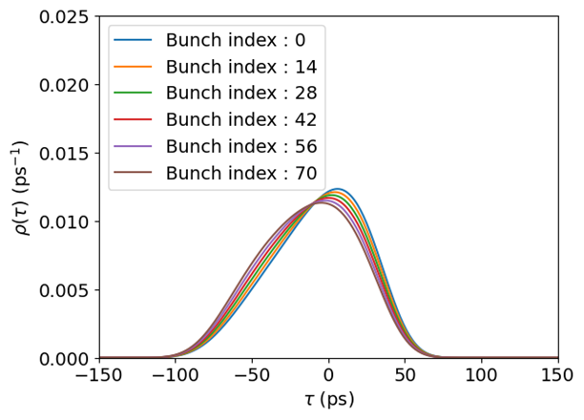

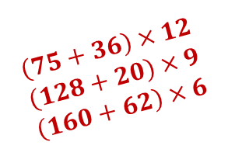
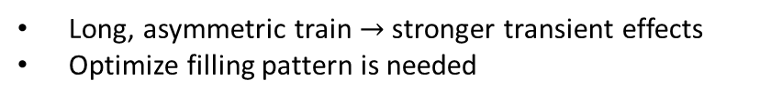



Transient effects
Analytic result
400 mA, $ψ=89.9948, Δf=41.3 kHz$
200 mA, $ψ=89.9896, Δf=20.6 kHz$
Gap: 300
Gap: 300
$$\left(75+36\right)×12$$
$$\left(75+36\right)×12$$
Long, asymmetric train $→$ stronger transient effects
Optimize filling pattern is needed
Number of Gap(determined by ion-clearing & hardware limits) > 25
Number of continuous bunch (determined by hardware) > 64
Number of bunch (Single bunch instability) ~ 1000
$$\left(75+36\right)×12$$
$$\left(128+20\right)×9$$
$$\left(160+62\right)×6$$
8
[1] T. Olsson, Self-consistent calculation of transient beam loading in electron storage rings with passive harmonic cavities, Phys. Rev. Accel. Beams 21, (2018).

Slide 9
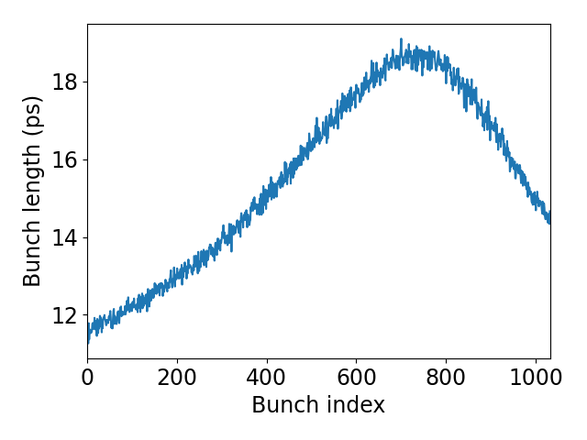
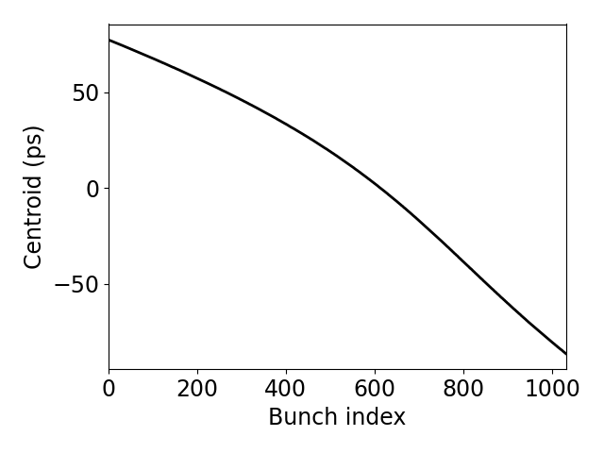
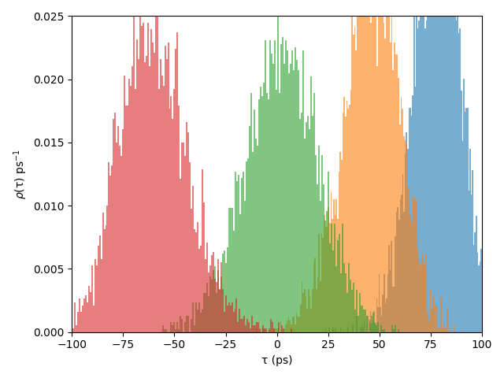
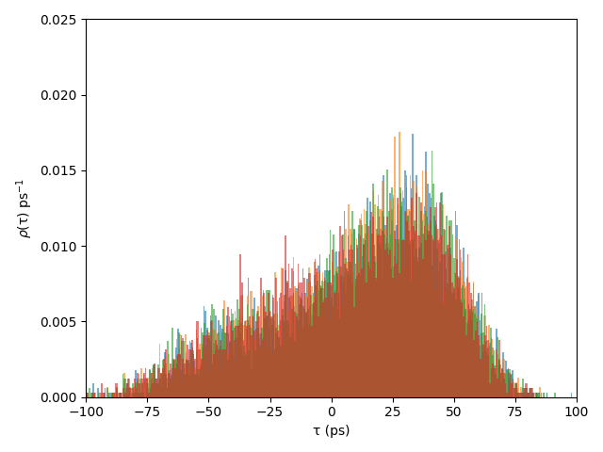
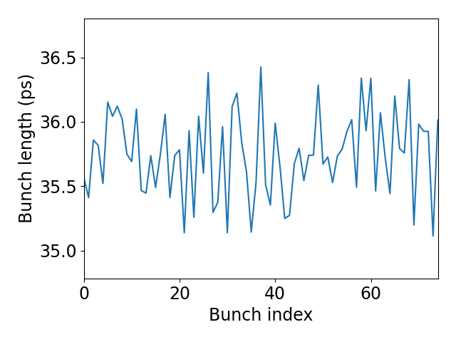
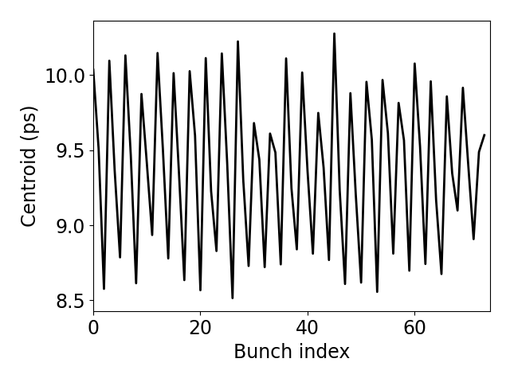


Transient effects
Simulation result
400 mA, $ψ=89.9948, Δf=41.3 kHz$
Gap: 300
Simulation vs analytic mismatch
(Further studies need)
$$\left(75+36\right)×11$$
9
[1] T. Olsson, Self-consistent calculation of transient beam loading in electron storage rings with passive harmonic cavities, Phys. Rev. Accel. Beams 21, (2018).

Slide 10
Summary & Future plan
No instability observed when applying SC passive cavities for bunch lengthening
Conducted semi-analytic, self-consistent methods to compute bunch distributions under both uniform and uneven filling patterns
Convergence tests (especially with respect to turn count and transient effects) remain to be completed due to long runtimes
Plan:
  Incorporate transient-effect analysis and begin drafting manuscript on 4GSR bunch-lengthening studies
  Arrival of new server will significantly improve simulation throughput and enable accelerated convergence testing
10
[1] T. Olsson, Self-consistent calculation of transient beam loading in electron storage rings with passive harmonic cavities, Phys. Rev. Accel. Beams 21, (2018).

Slide 11
Thank you for your attention!
11

