Slide 1
Current progress of LPS reconstruction
25. 07. 25
POSTECH
PhD/MS combined student
Geunwoo Kim

Slide 2
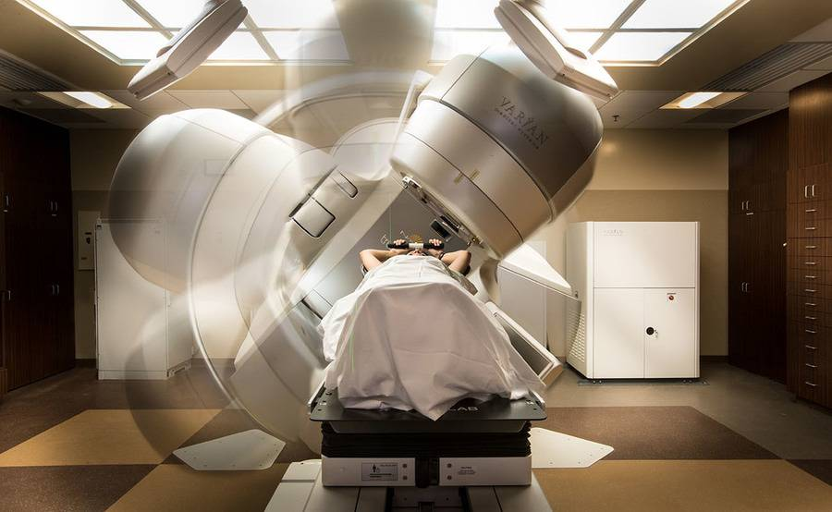
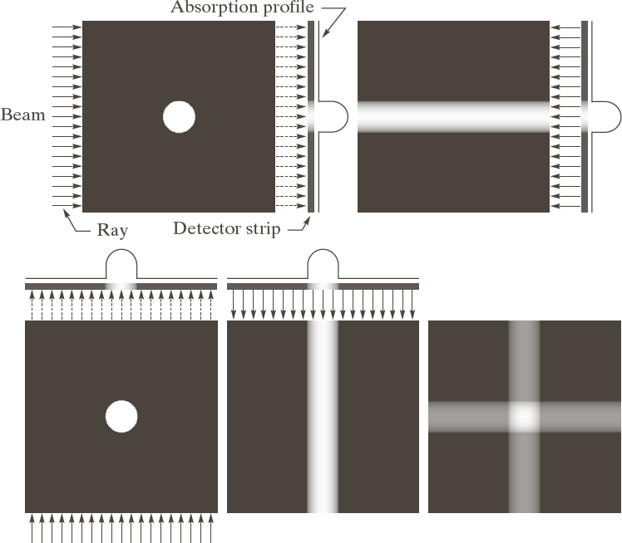
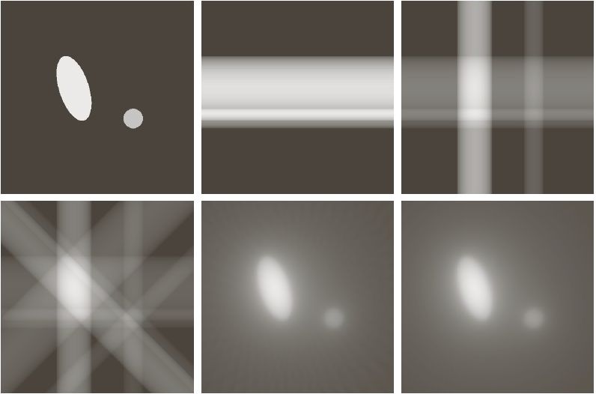
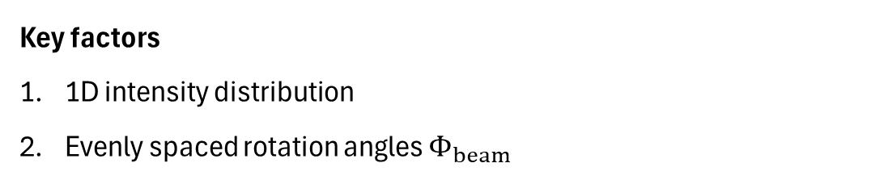
Overview of LPS
Key factors
1D intensity distribution
Evenly spaced rotation angles $Φ_{beam}$
[Original beam image]
What we want to know
[Reconstructed image]
Notes:
https://watkins.cs.queensu.ca/~jstewart/457/notes/ct/06/06-fbp.html

Slide 3
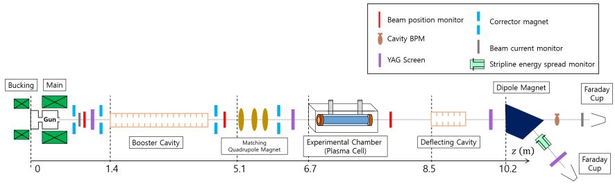
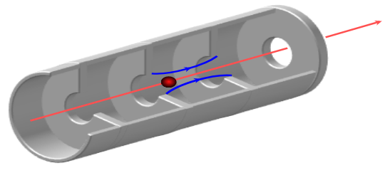
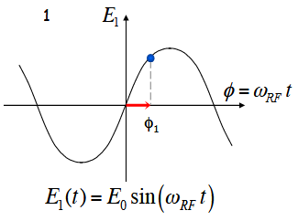
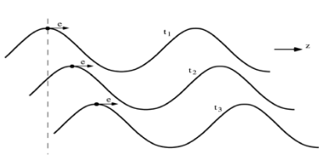


Overview of LPS
How can we rotate the beam in longitudinal direction (z, p_{z}) ?
Varying the booster cavity phase can adjust both $p_{z}$ and $σ_{p}$.
$$φ_{1,boo}→p, σ_{p}→S,σ_{φ}→Φ_{beam}$$
Parameters | Specifications
Energy | 70 MeV
Charge | 200 pC
# of particles | 100,000
Space charge | OFF
Bunch length | 1.2739 ps
Reconstruction point
$$z_{0}=z_{1}$$
Measurement point
 | Phase range [deg] | Increment [deg] | # of data
Booster phase Φ | 225 - 241 | 0.1 | 161

Slide 4
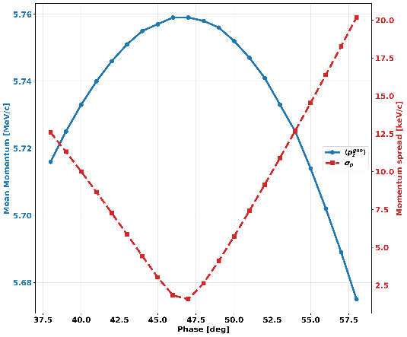
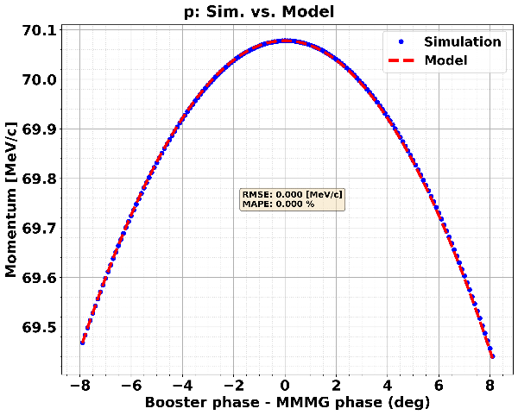
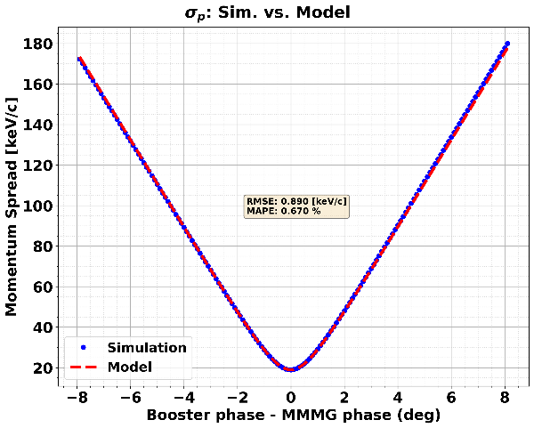
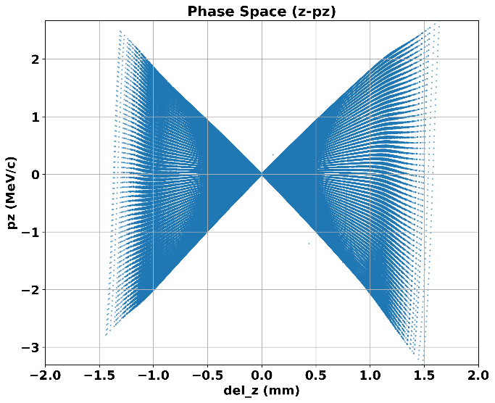


Model vs Simulation
Find the gun phase at the maximum $p$ point (MMMG phase).
Compare equation vs simulation (obtained < 1 % error)
We can know the slope S from $σ_{p}$

Slide 5
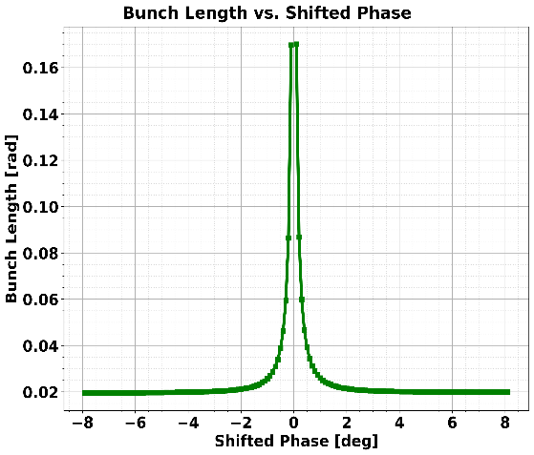
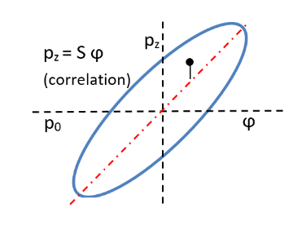
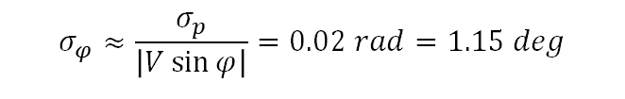





Model vs Simulation
$$σ_{φ}$$
Investigation both slope S and bunch length.
$$φ_{1,boo}→p, σ_{p}→S,σ_{φ}→Φ_{beam}$$
$$Φ_{beam}=\arctan{(Sσ_{φ}/σ_{p_{min}})}$$
$$σ_{φ}≈\frac{σ_{p}}{\left|V\sin{φ}\right|}=0.02 rad=1.15 deg$$
$$Sσ_{φ}$$
$$Φ$$
$$σ_{p_{min} }$$
RMSE = 0.132 MeV/c/rad
MAPE = 2.94 %

Slide 6
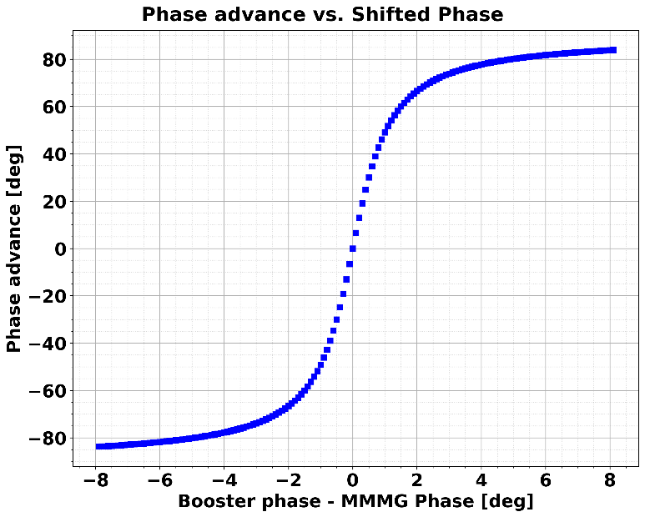
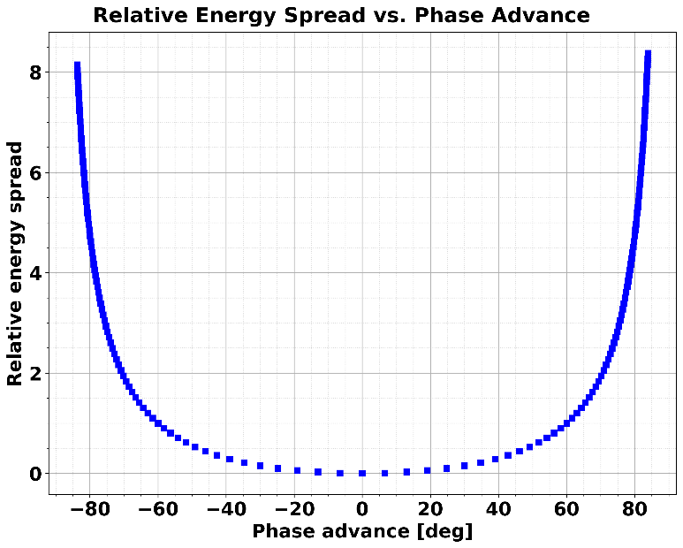



Model vs simulation
Now, we can analysis phase advance
$Φ_{beam}=\arctan{(Sσ_{φ}/σ_{p_{min}})}$
Complete preparing phase space angle data w.r.t booster phase.
$$Φ_{beam}$$
$$δσ_{p}$$

Slide 7
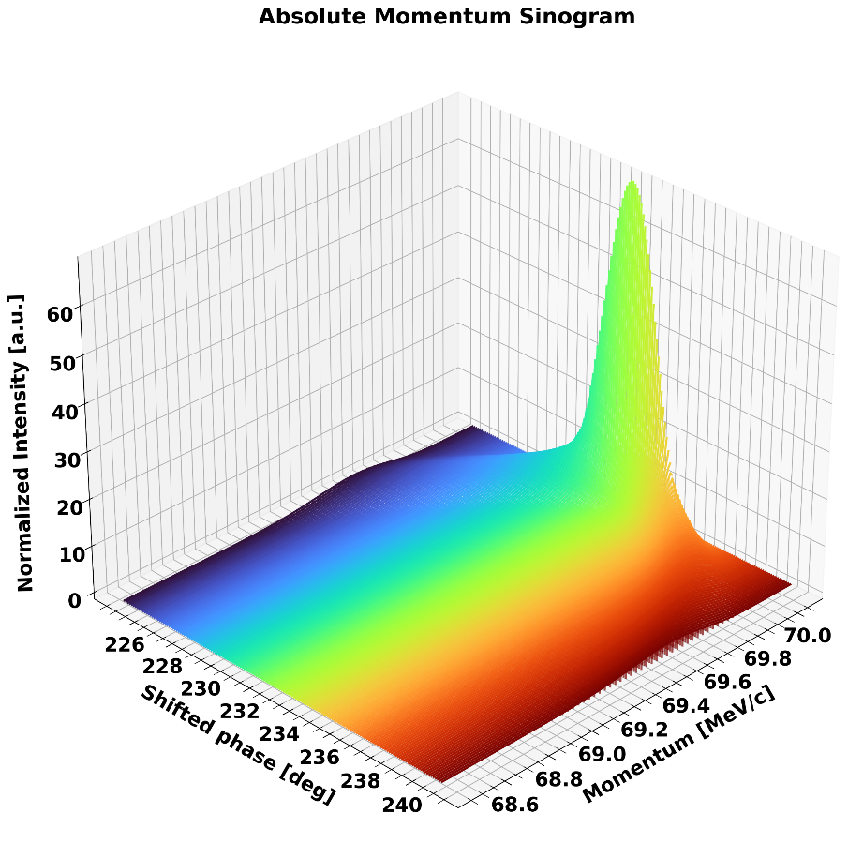
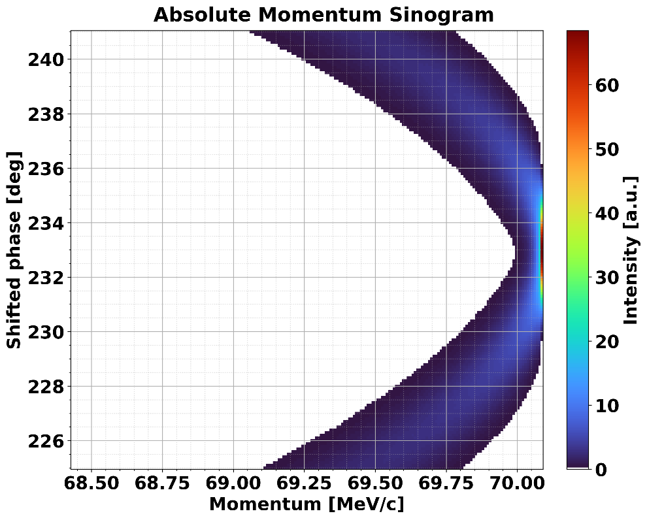
Sinogram (angle data w.r.t momentum)
Only p_{z} distribution can be measured from the beamline.
  X can be converted to p_{z} using a dipole.
  p_{z} distribution in (z,p_{z}) = p_{z} distribution in (p_{z},y)

Slide 8

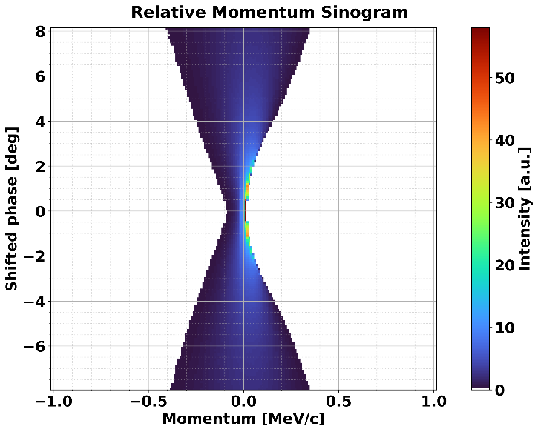

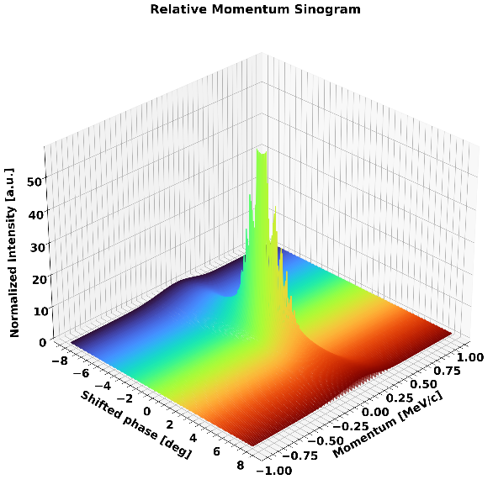
Sinogram (angle data w.r.t momentum)
Prepared center-shifted $p$ distribution for reconstruction (give same weight).

Slide 9
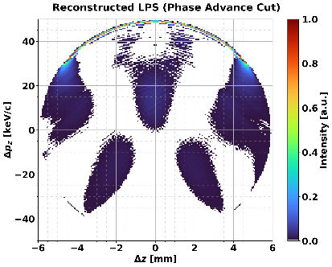
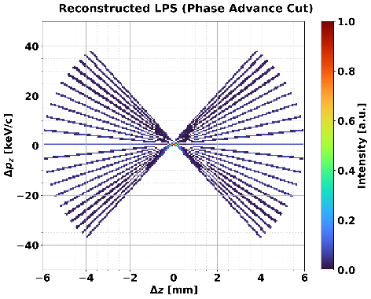
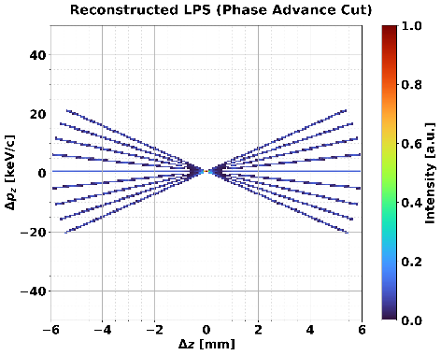
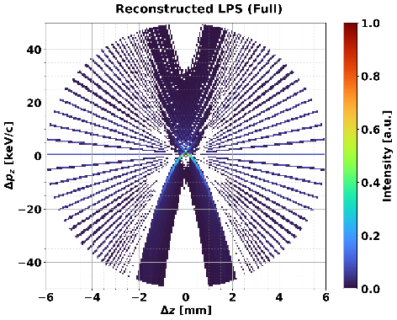
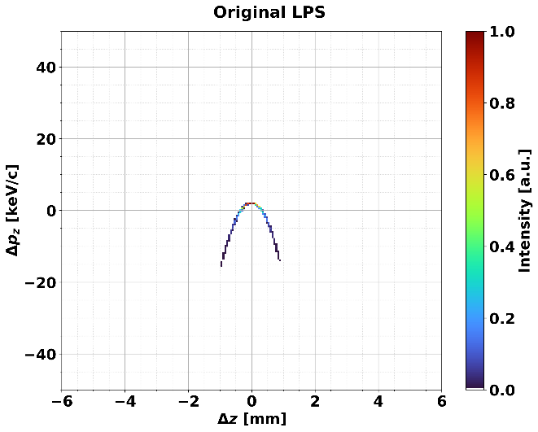
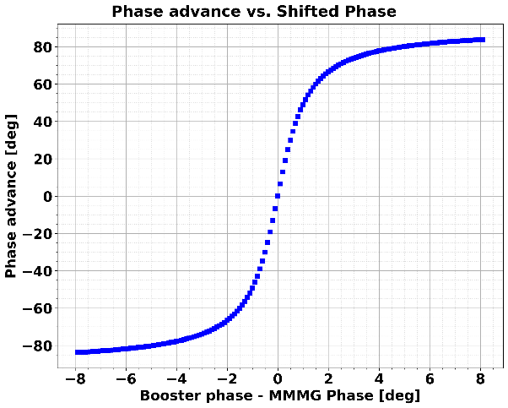
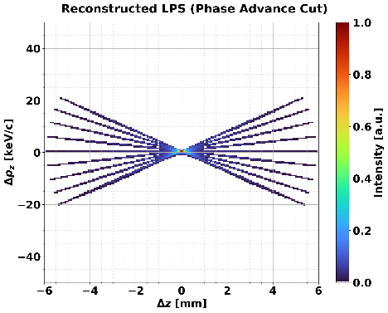
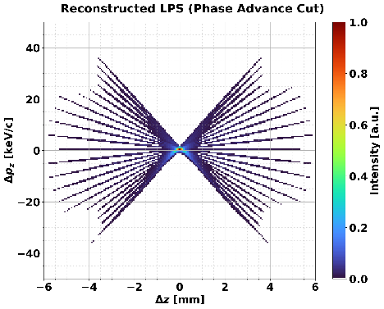
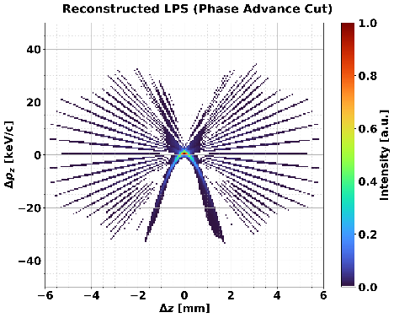
Reconstruction results
Comparison original vs reconstruction
FBP
SART
No center shift case
±30 deg Φ
±50 deg Φ
±30 deg Φ
±50 deg Φ
Phase advance cut

Slide 10
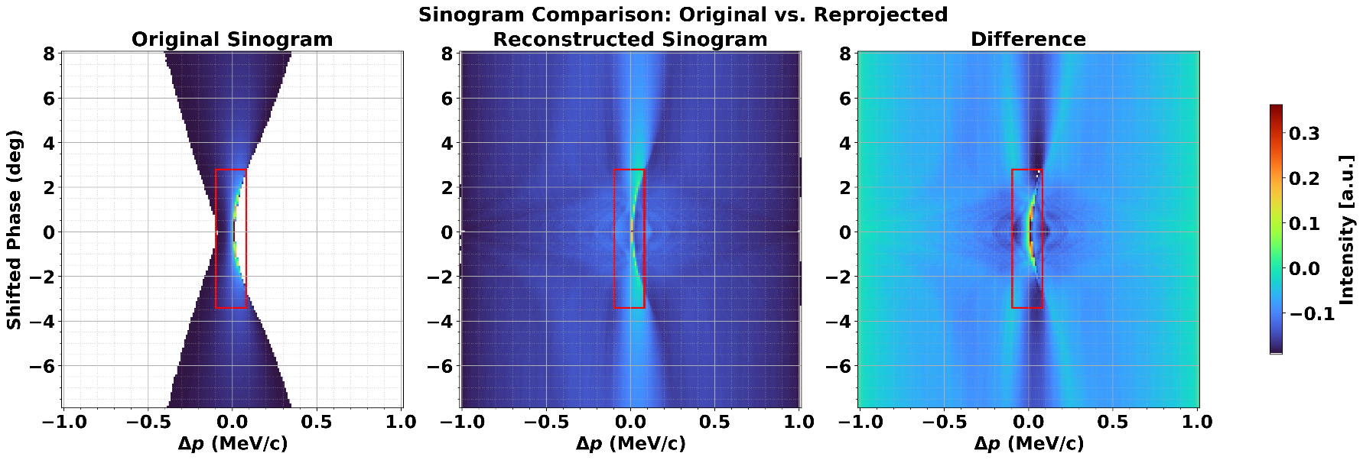
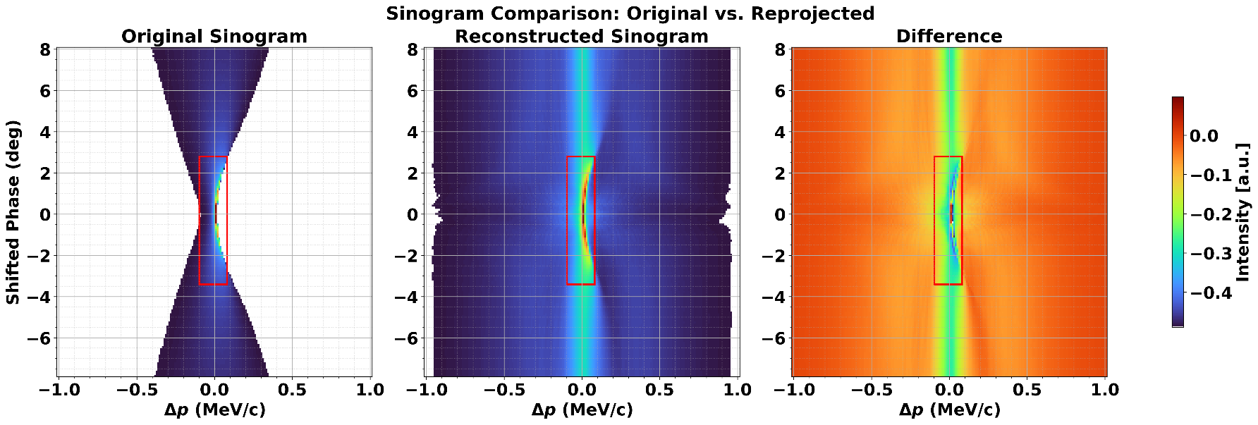
Image analysis
FBP
  MSE: 0.0055
  Similarity for whole region: 12.39 %
  Similarity for ROI: 75.10%
SART
  MSE: 0.0060
  Similarity for whole region: 25.72 %
  Similarity for ROI: 65.46%

Slide 11
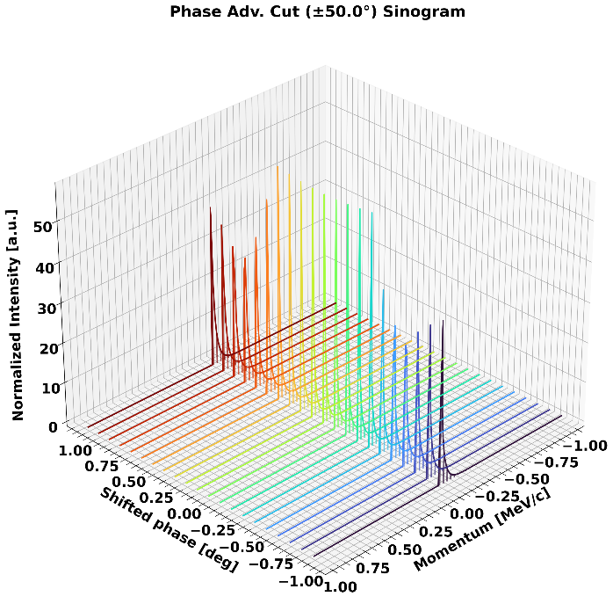

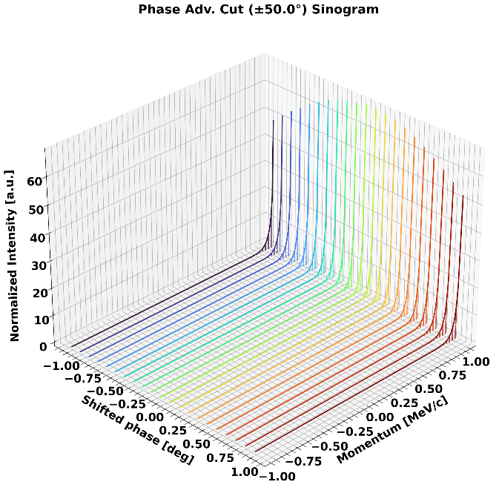
Issues
??

Slide 12
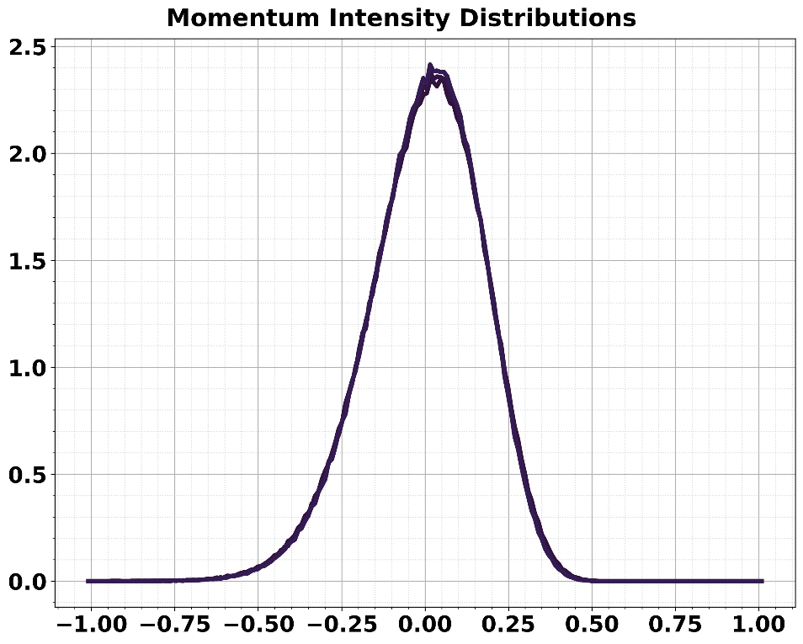
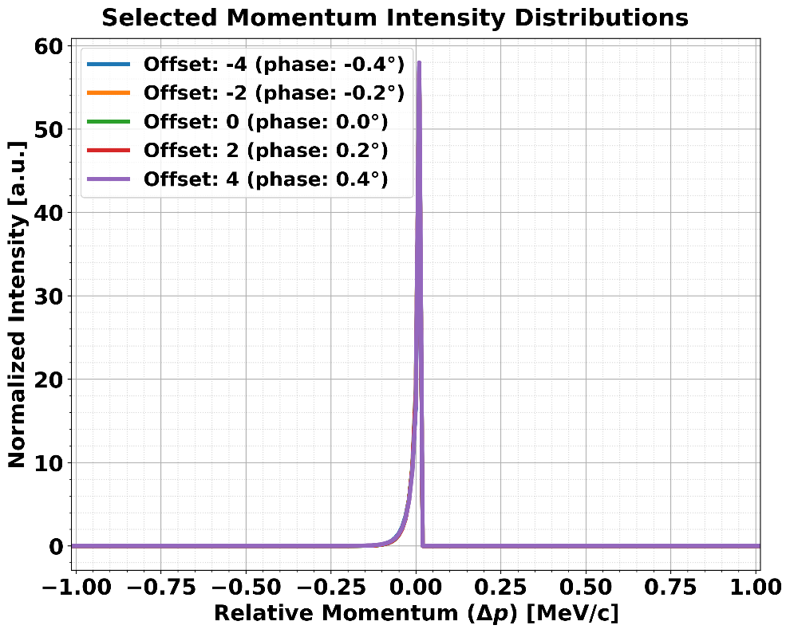
Issues

Slide 13
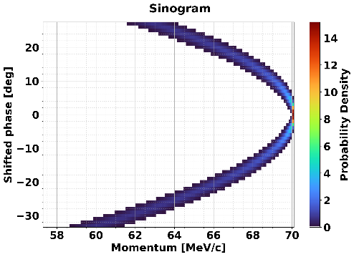
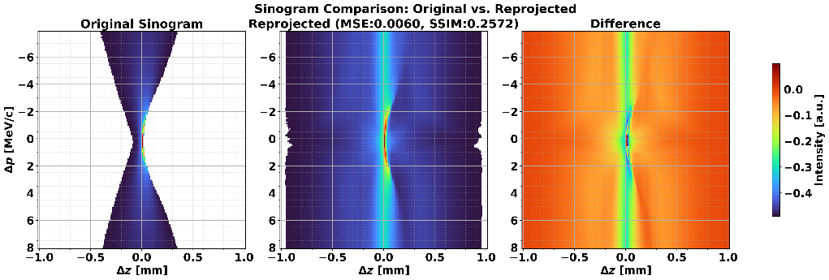
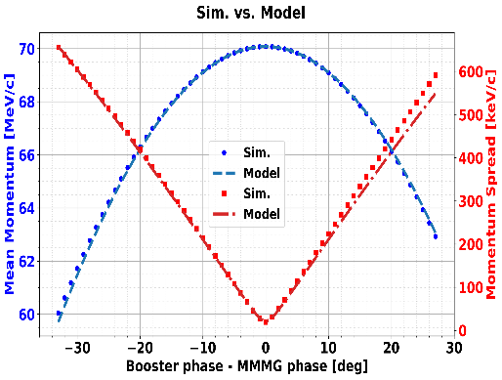
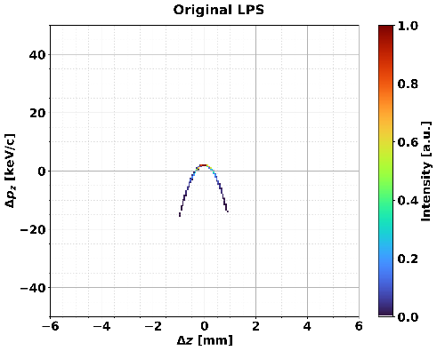
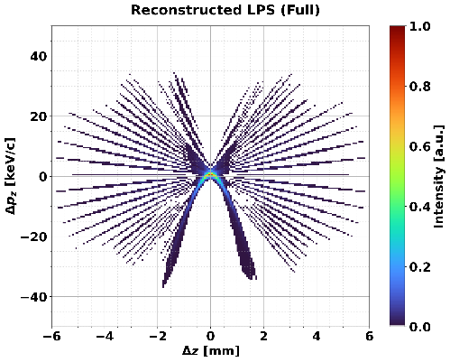
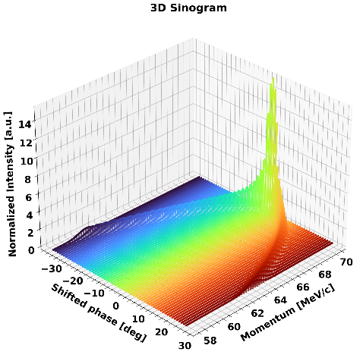
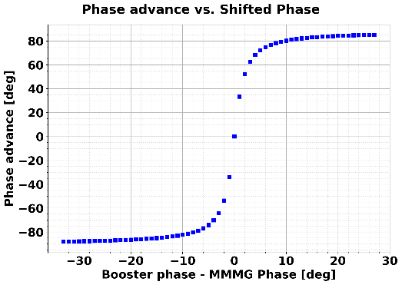
Completed Stages and Next Steps
Done
Ongoing
Next plans
Procedure of tomography
1. Preprocessing
2. Analytic modeling
3₋₁. Using library
4. Verification
3₋₂. Weight Matrix
4. Apply algorithm
5. Verification

