Slide 1
Research proposal(M.S.)
X-ray Photoelectron spectroscopy (XPS)
X-ray communication (XCOM)
2025. 07 .25
나창선

Slide 2
Contents
Introduction
What is XPS?
Applications of XPS
Future plan (XCOM)

Slide 3
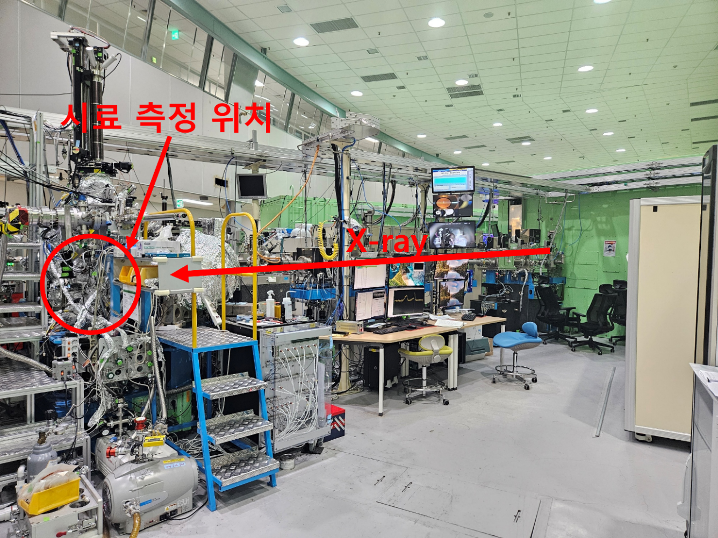
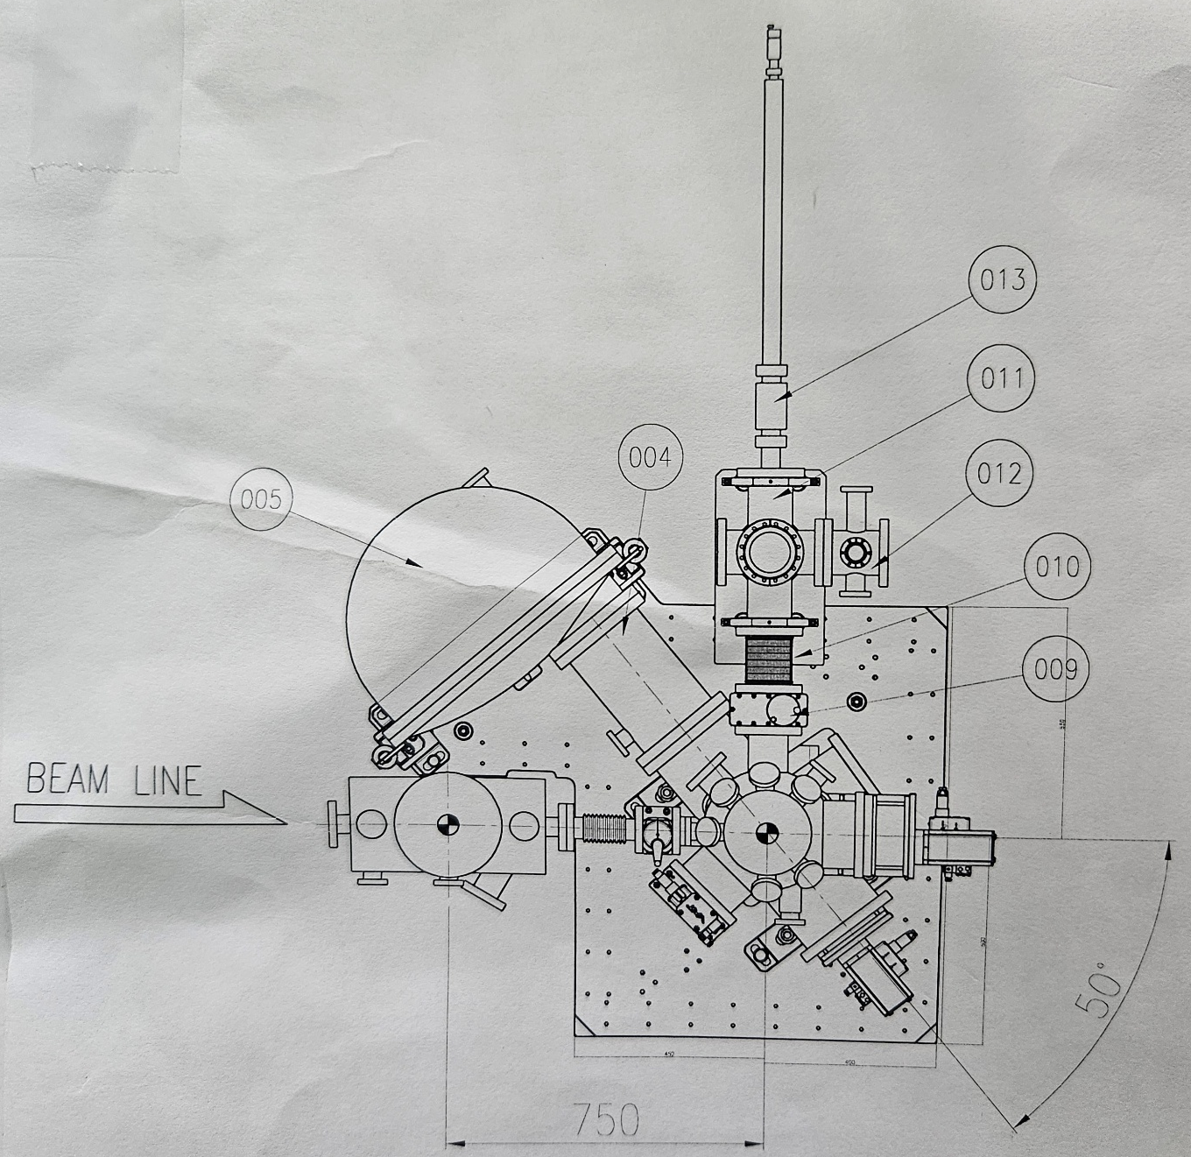
10A2
Spectrometer
e⁻
X-ray
10A2 Beamline spec
Lightsource | Undulator
Photon energy range | 100-1500 eV
Photon Flux | ~ 10¹³ Photons / s
Photon Beam size | 10 μm (H) x 30 μm (V)
Sample

Slide 4
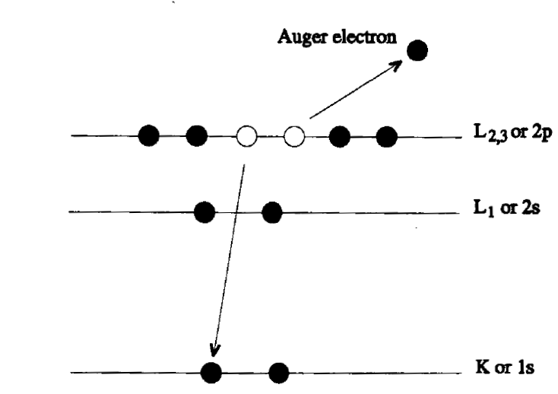
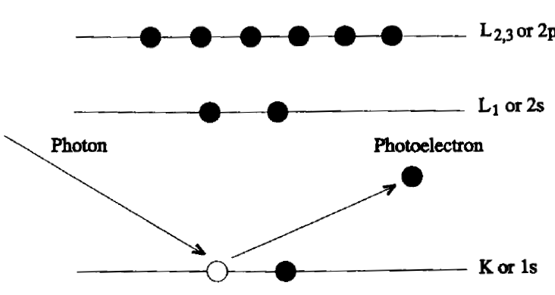




X-ray Photoelectron Spectroscopy (XPS)?
$$(hν)$$
$$Ek$$
Characteristic x-ray
$$Eb$$
hν = E_{k} + E_{b} + ф_{s}
The sample emits Photoelectron with kinetic energy(E_{k}).
Spectrometer measures E_{k} and calculates the binding energy(E_{b})
The process can produce Characteristic x-rays and Auger electrons
These are measured using X-ray Absorption Spectroscopy (XAS)

Slide 5
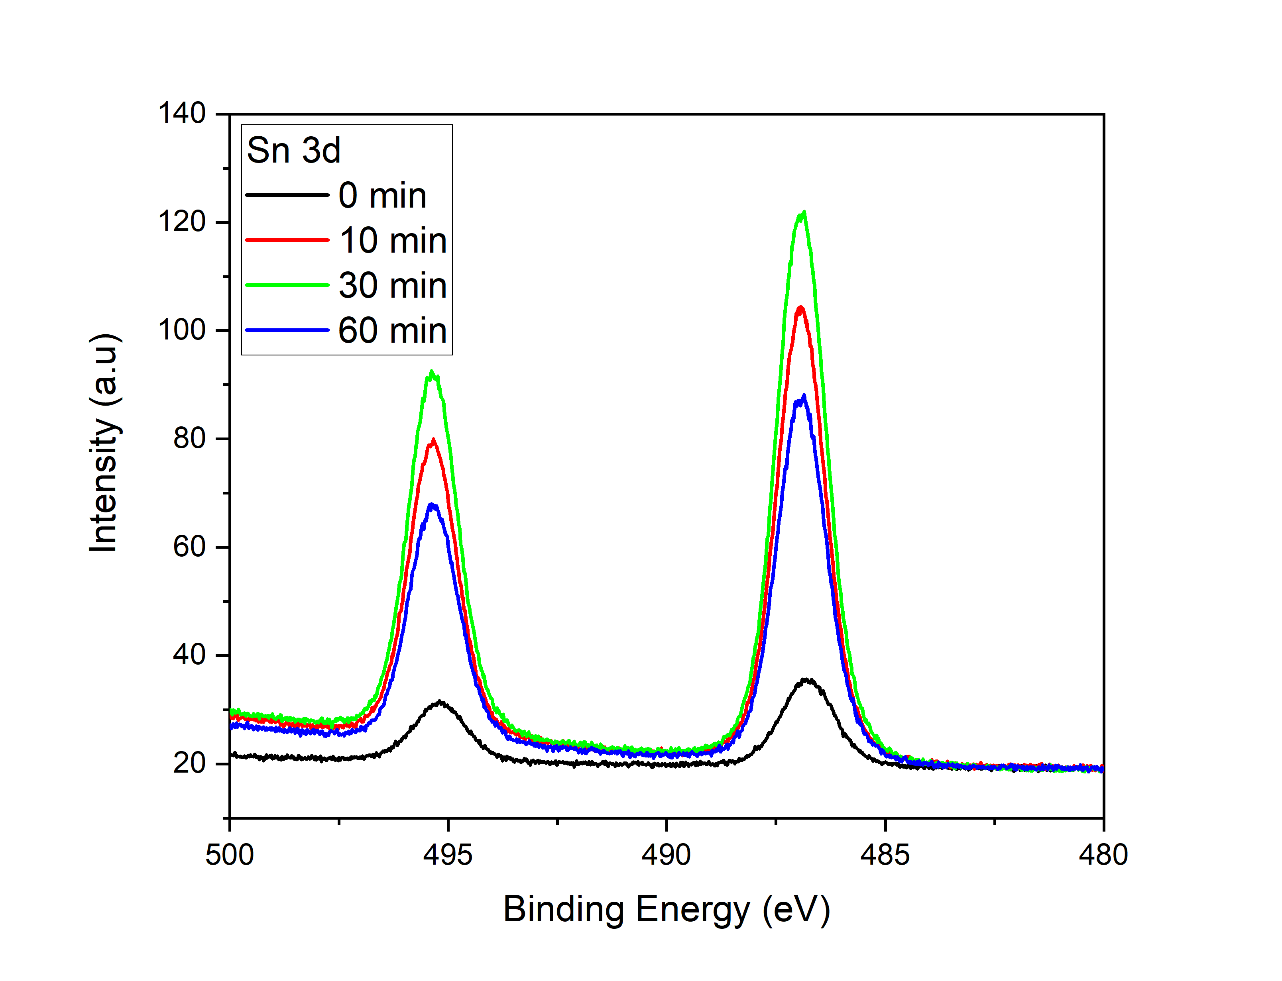
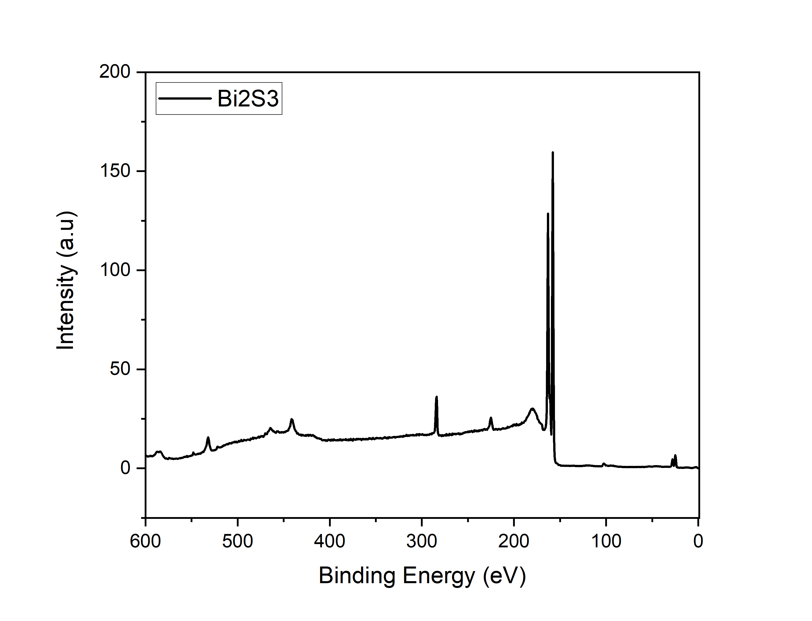
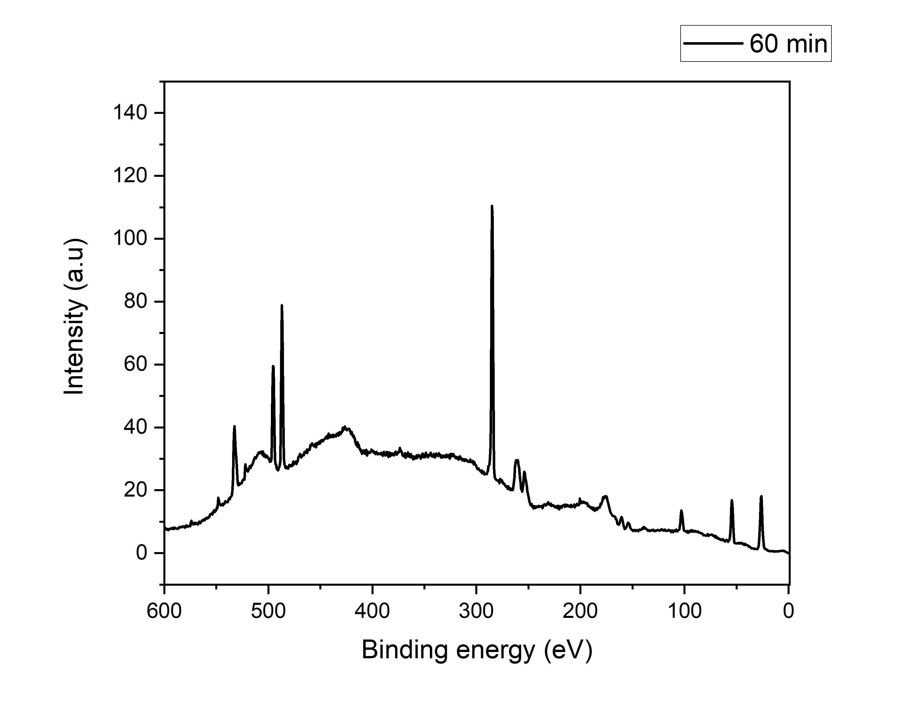
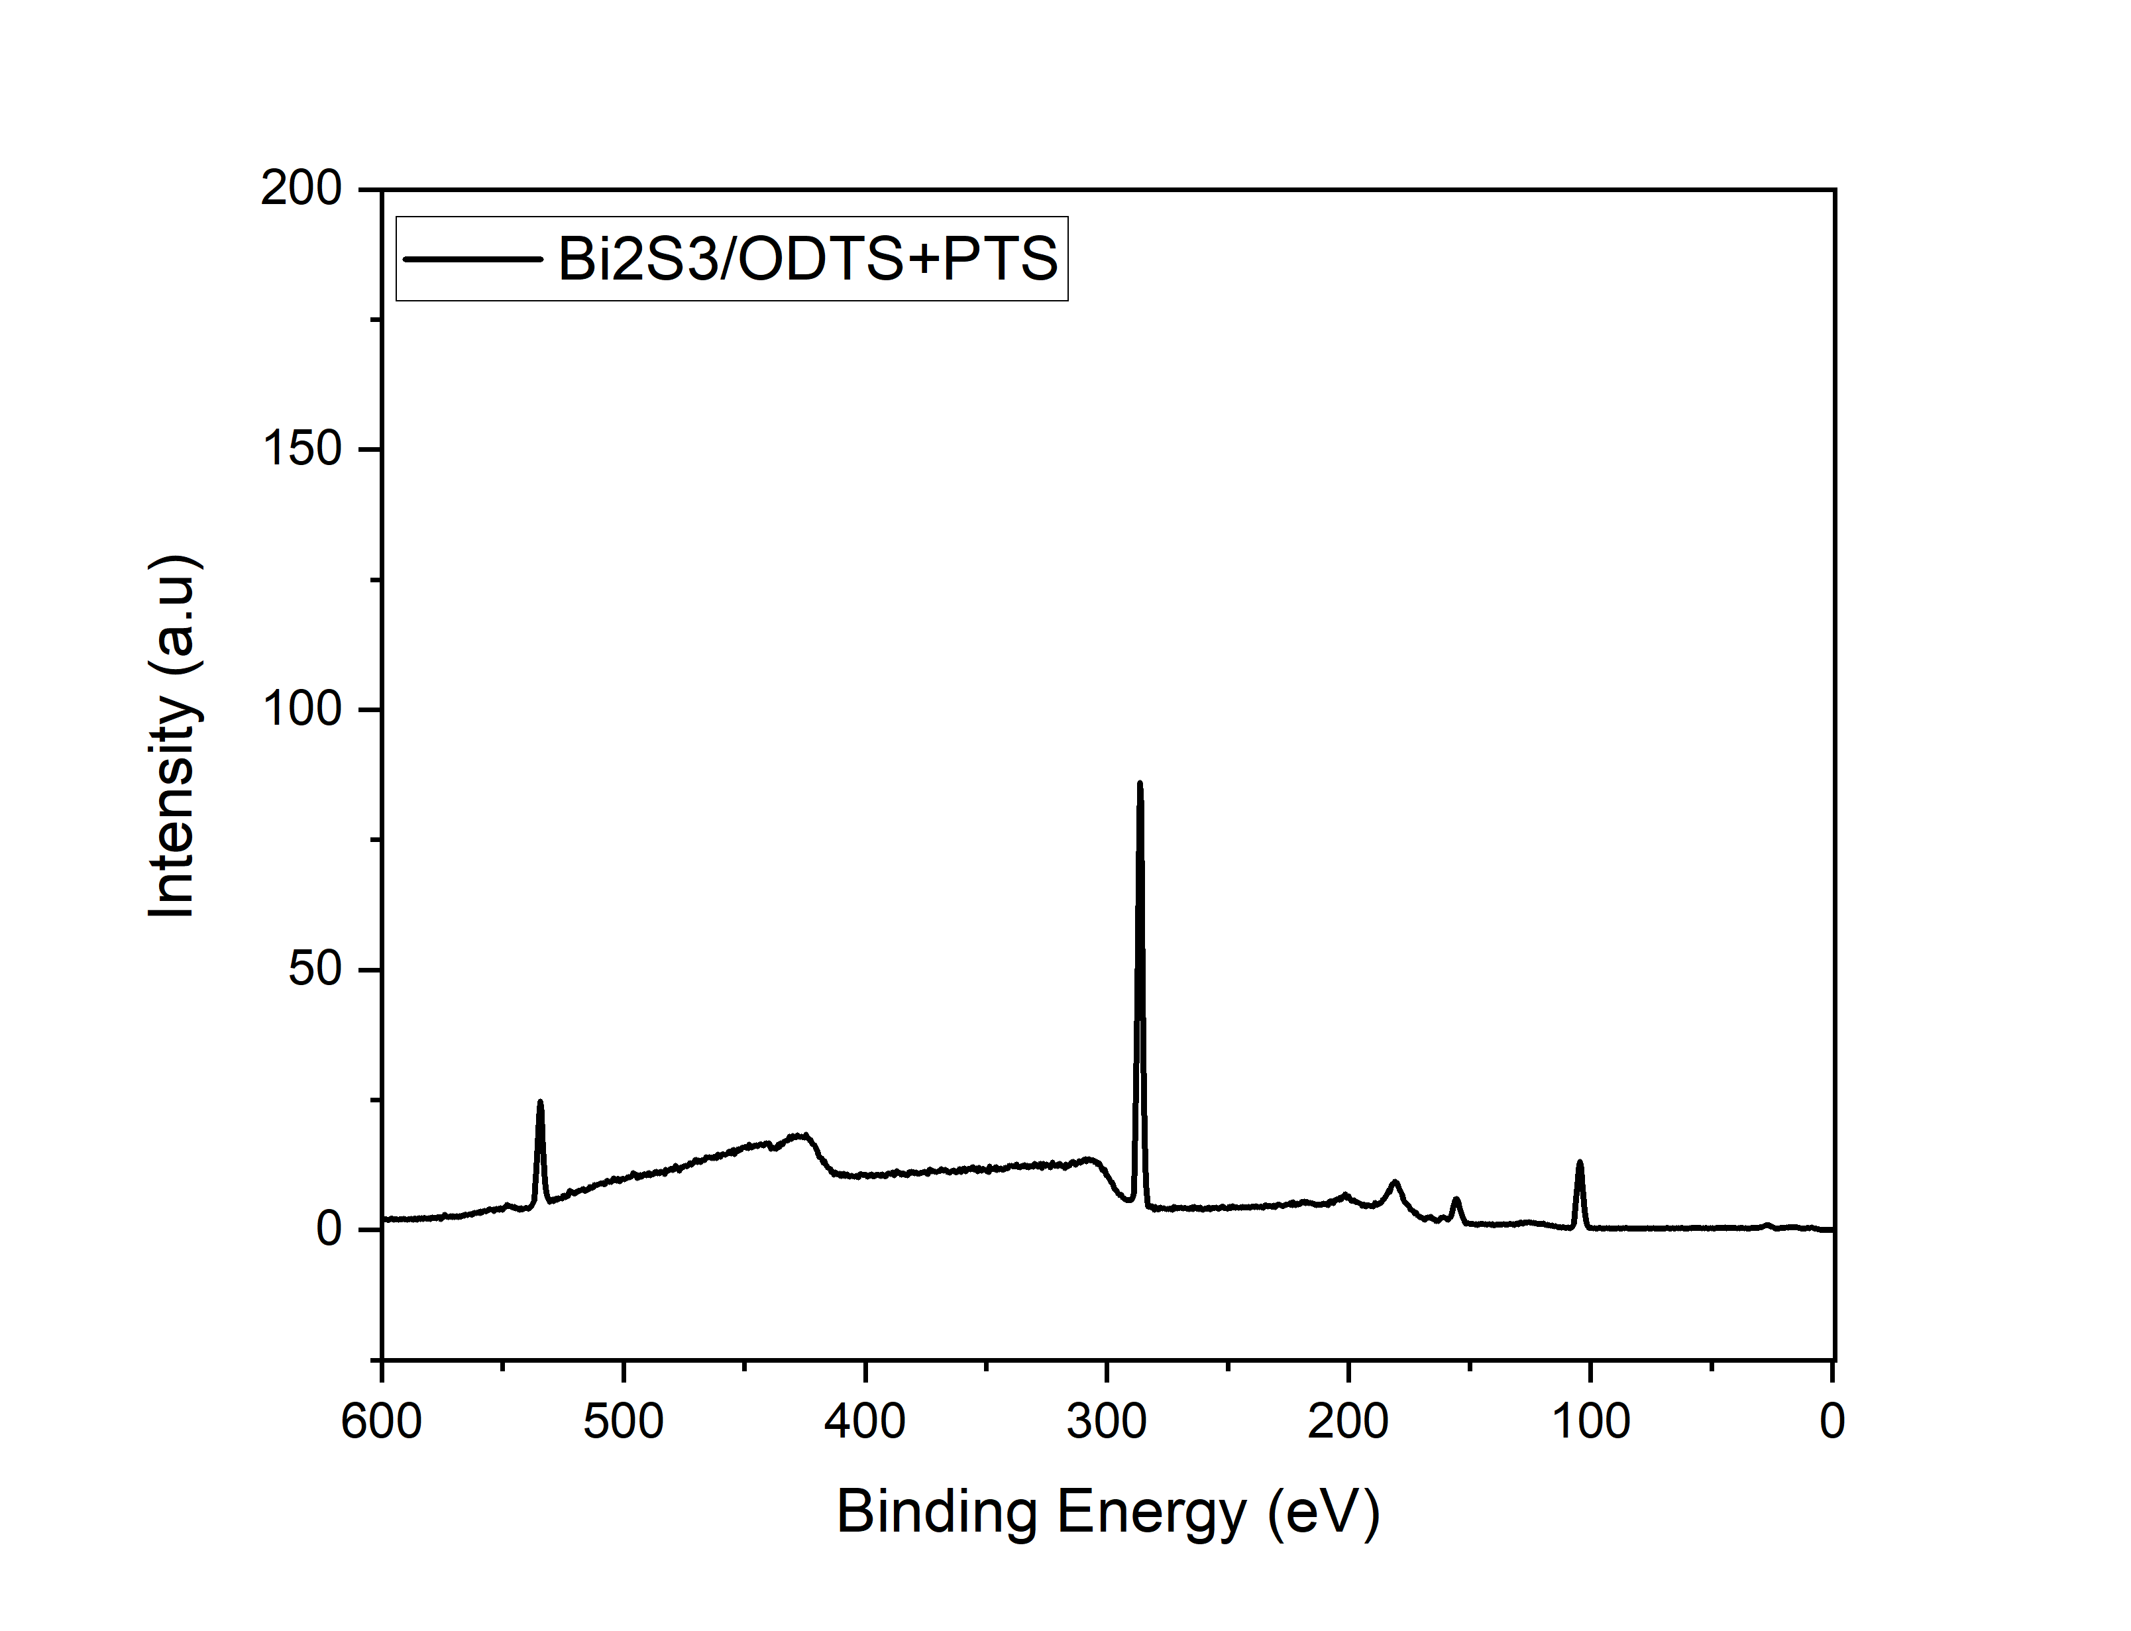
Applications of XPS

Slide 6





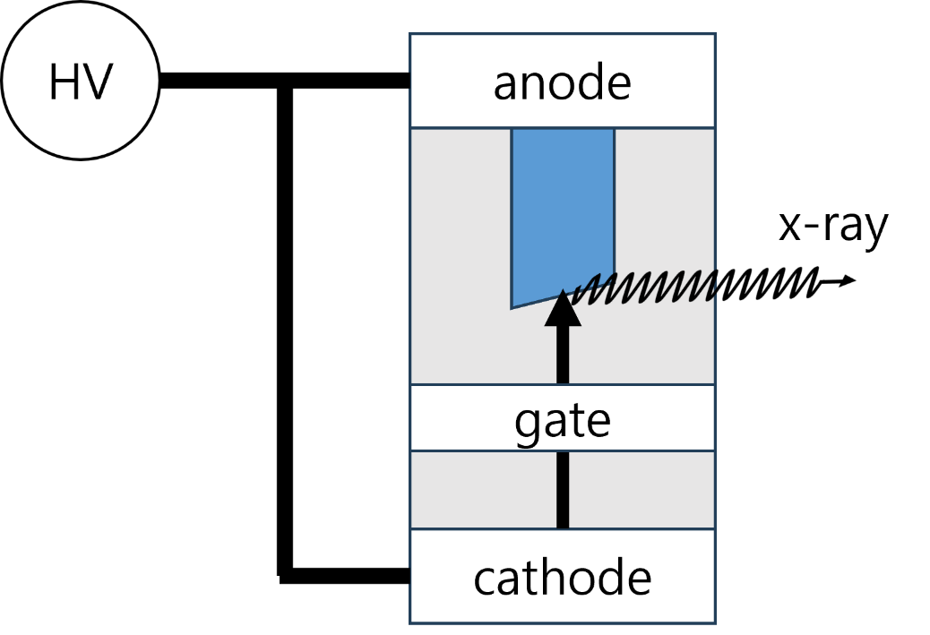
XCOM
X-ray tube
plasma
communication
signal
Signal
modulation
X-ray
detector
X-ray tube (CST simulation)
Plasma chamber
A plasma chamber will be developed to investigate the transmission of X-ray signals through plasma.
X-ray detector
using LYSO etc..
X-ray tube

Slide 7
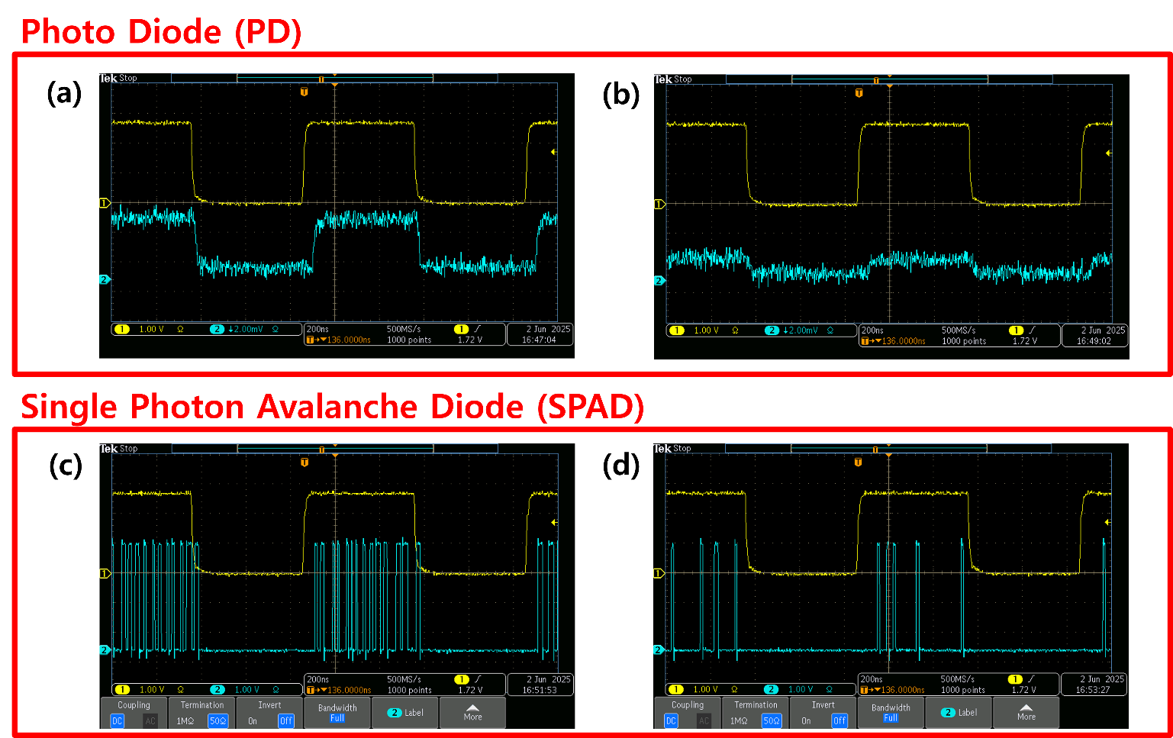
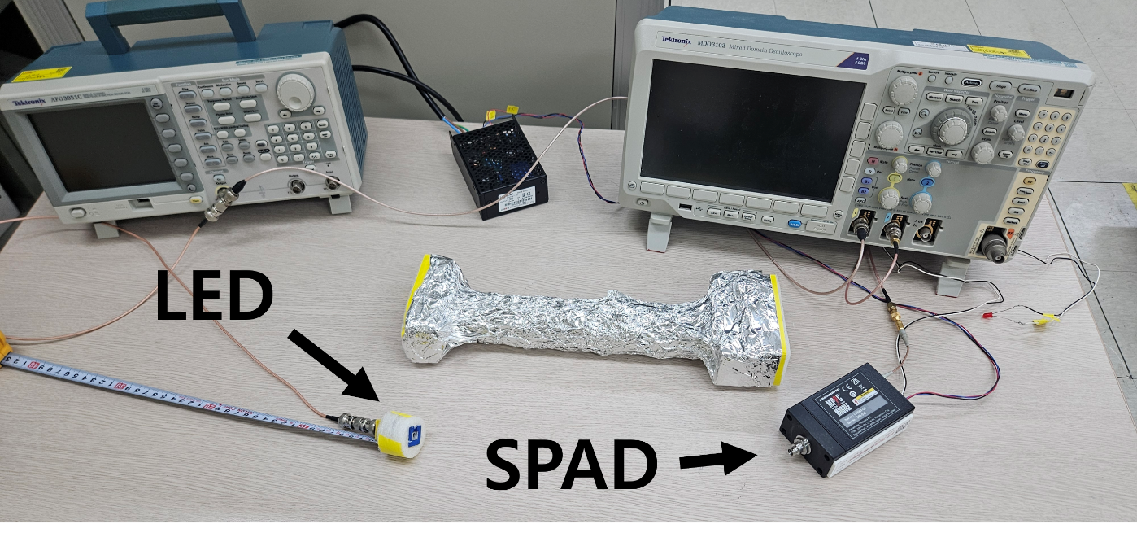
XCOM
Detector test
Pre-tests using an LED light source were conducted to evaluate the detector performance prior to X-ray application.
Further experiments are scheduled.
Figures (a) and (b) show the received signals using a photodiode (PD) under different light intensities.
Figures (c) and (d) present the results using a Single Photon Avalanche Diode (SPAD) under different light intensities.

Slide 8
8
Conclusion
XAS/XPS at 10A2 will be conducted as secondary studies.
The core research will focus on XCOM.
The initial phase of XCOM will involve studying the X-ray tube and detector, followed by the development of the plasma chamber.

Slide 9
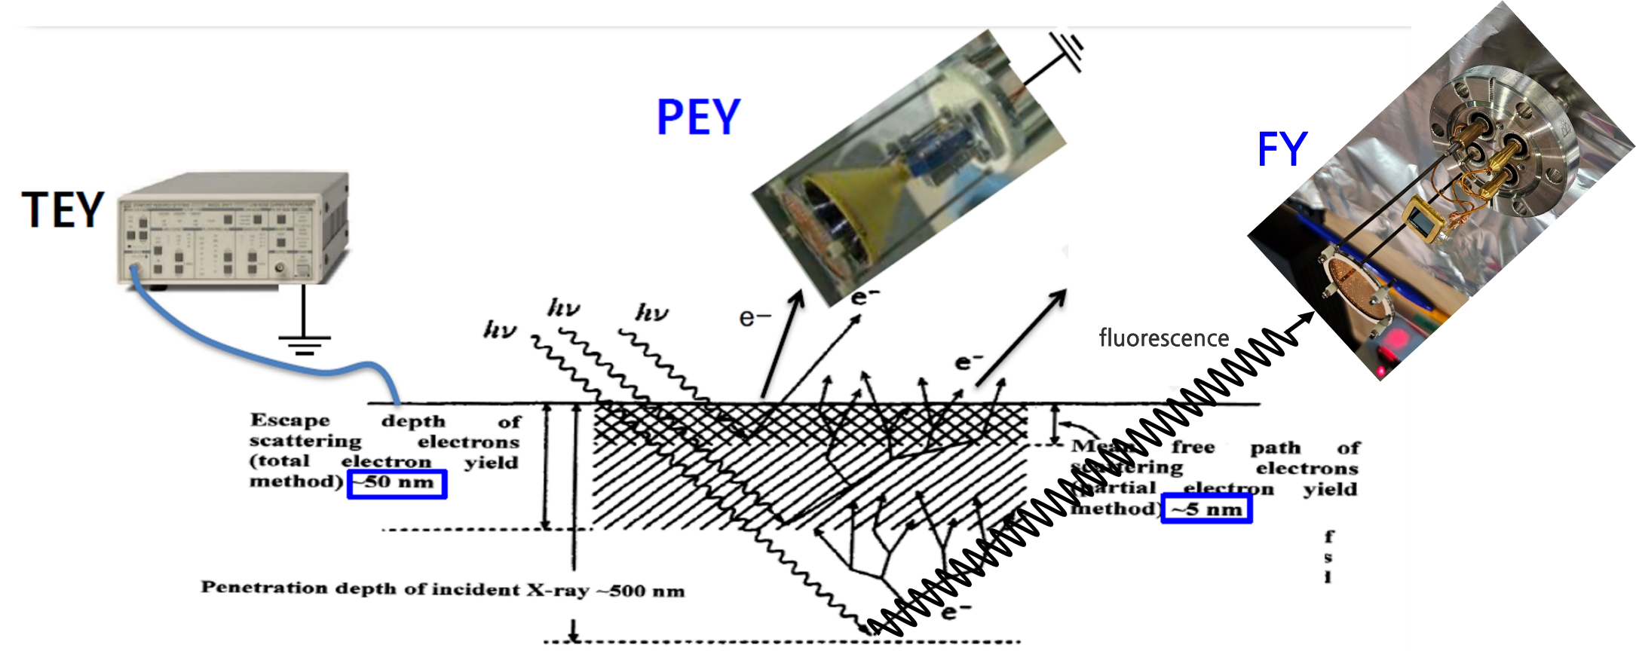
Appendix _ XAS

Slide 10
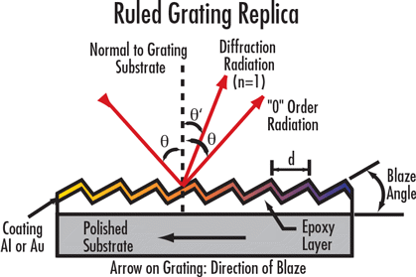
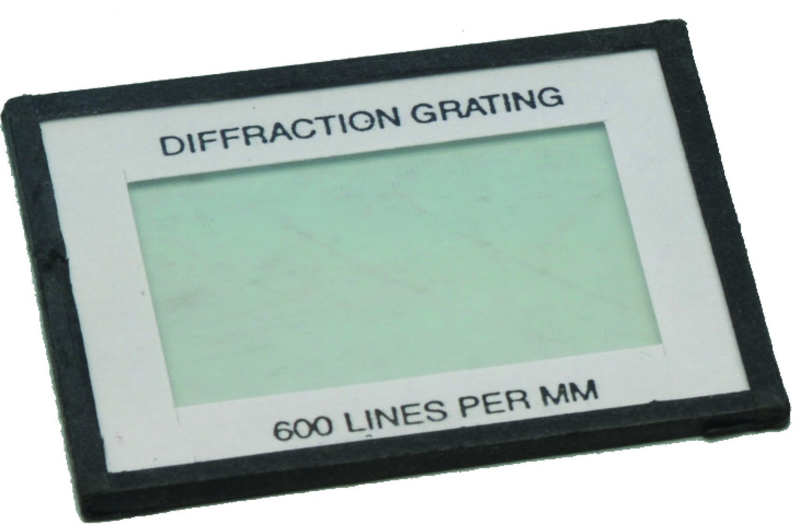
Appendix _ Grating

