Slide 1
Contents
WBPM experiment results paper work plan
  Introduction
  Image analysis
  Beam size calculation
  Beam profile comparison
Ultra-short bunch length measurement using ChDR
  Experimental target
  Bunch length measurement
  Radiator design
  Experimental set-up
Python + EPICS based DAQ monitoring system implementation
  Introduction
  EPICS
  Configuration
  Manual
  HDF5
  Summary

Slide 2
WBPM experiment results paper work plan
2025. 07. 18.
송우진

Slide 3
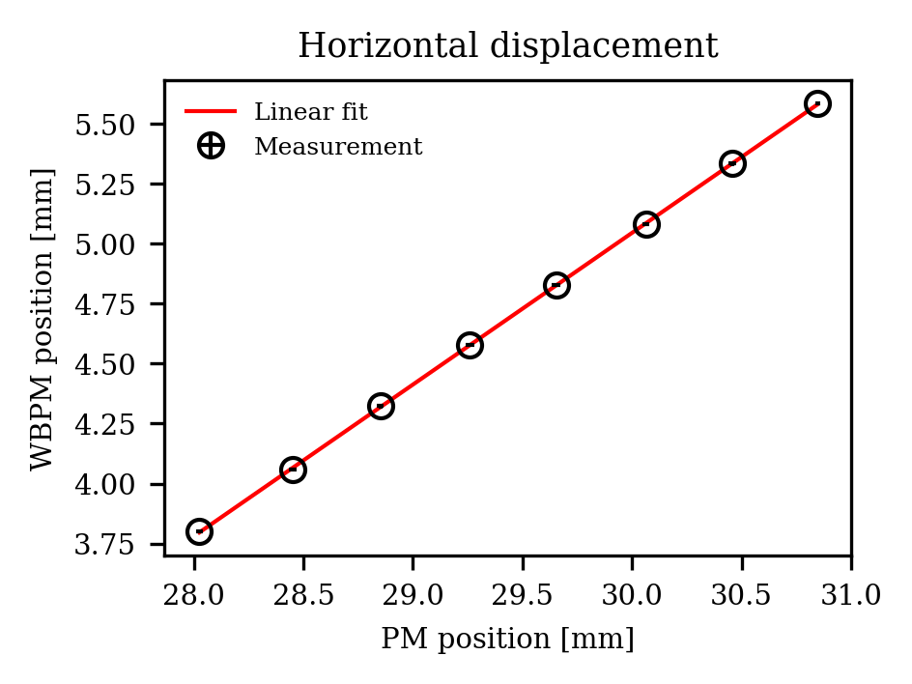
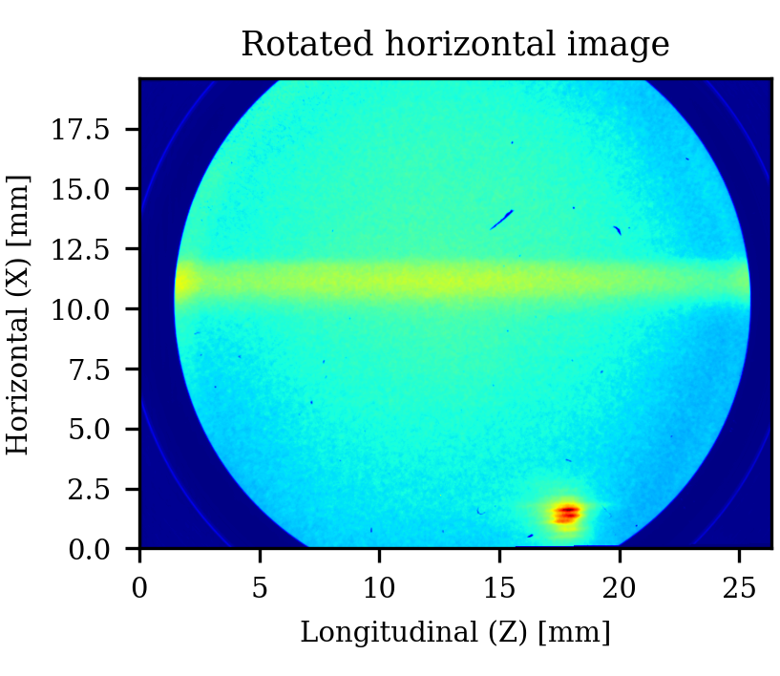
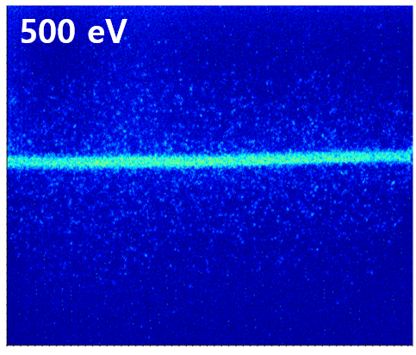
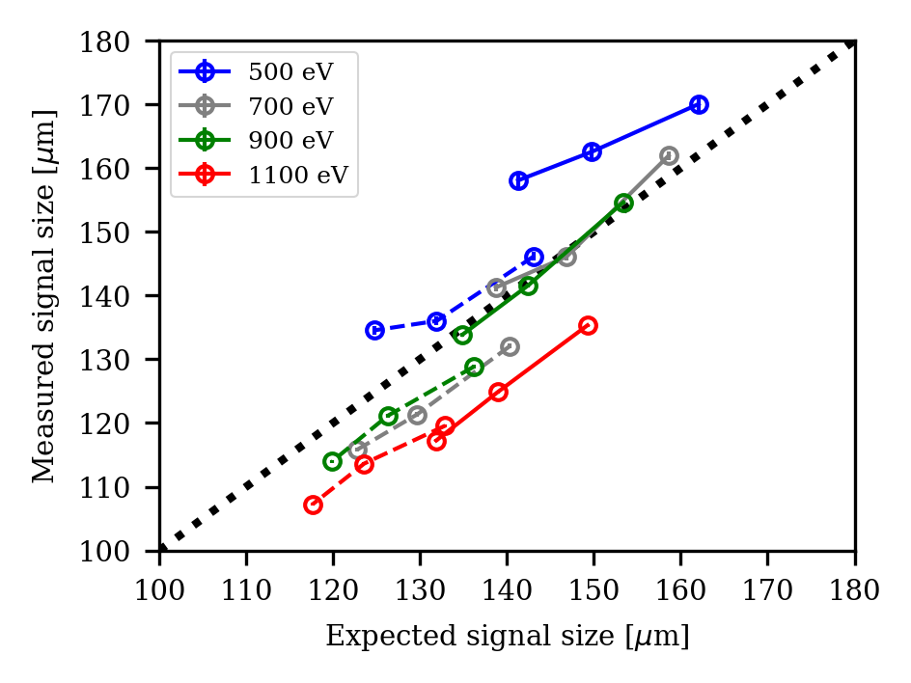
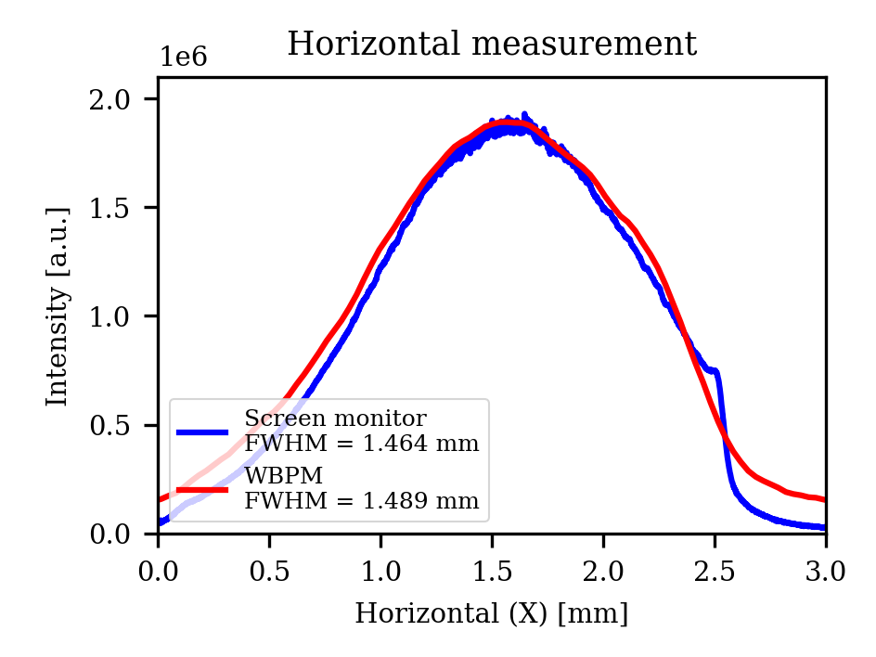
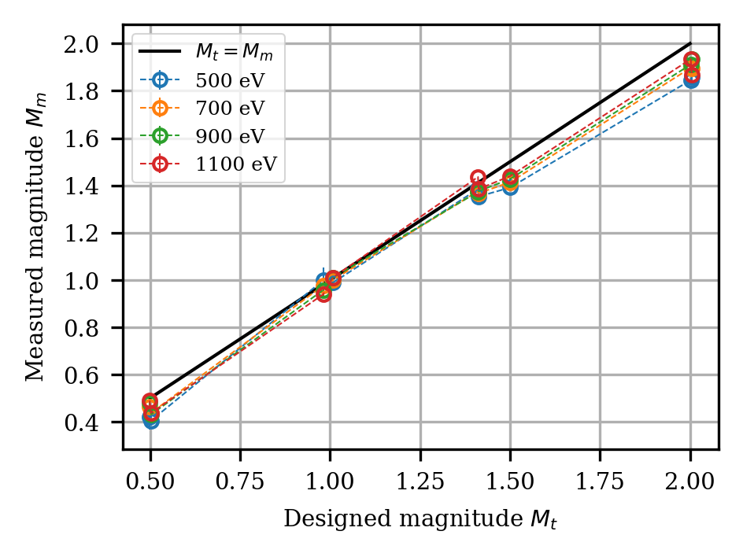
Introduction
Beam position monitor
PAL-XFEL SX beamline
Beam profile monitor
PLS-II BL6C
?

Slide 4
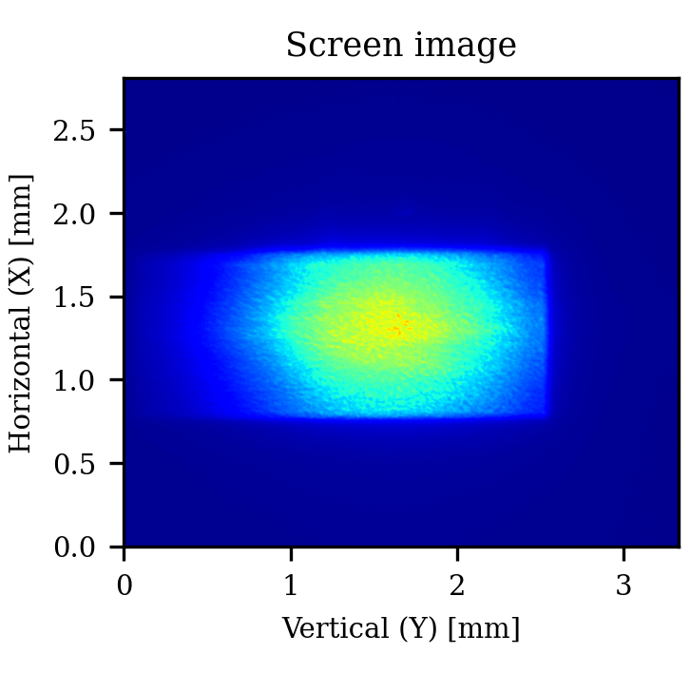
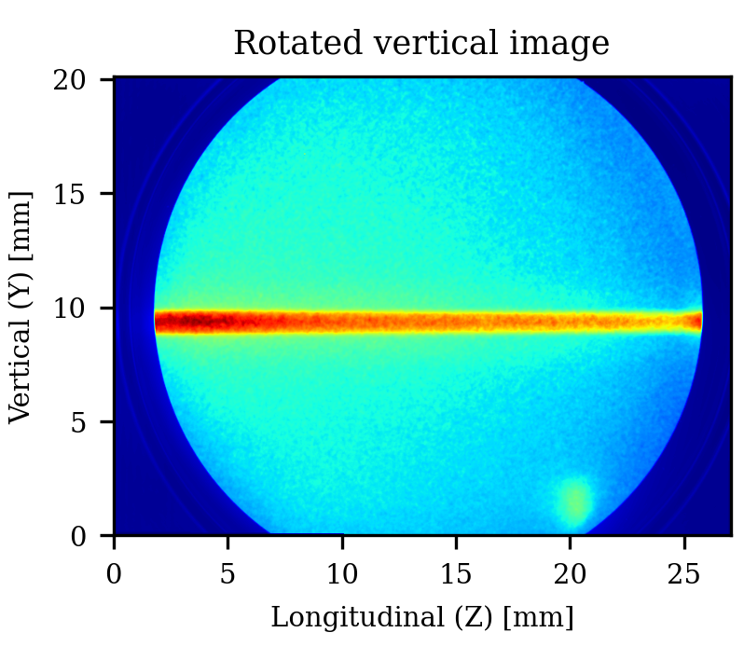
Image analysis
250611_WBPM_Xe_test (Background data X)
- Exposure time 0.3 ms, 250 accumulative (75 sec), ROI: 10-15 mm (Z)

Slide 5
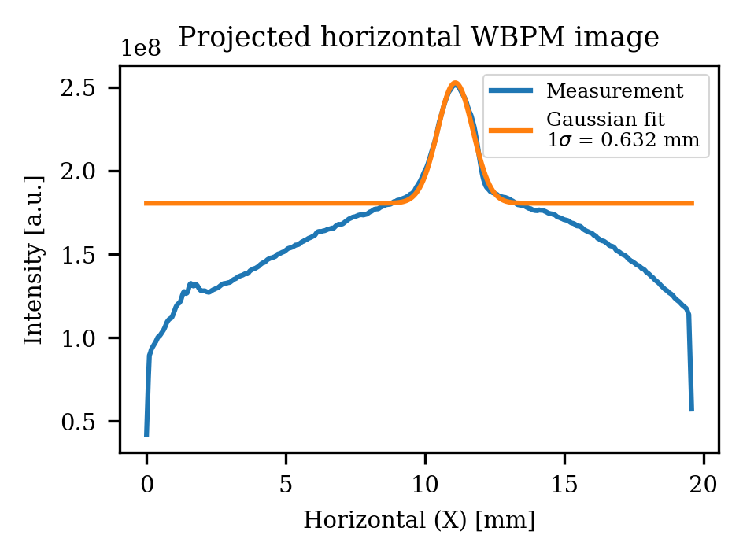
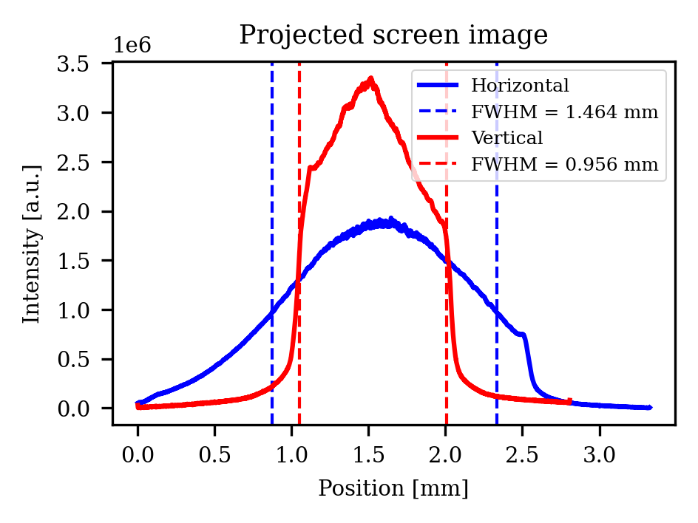
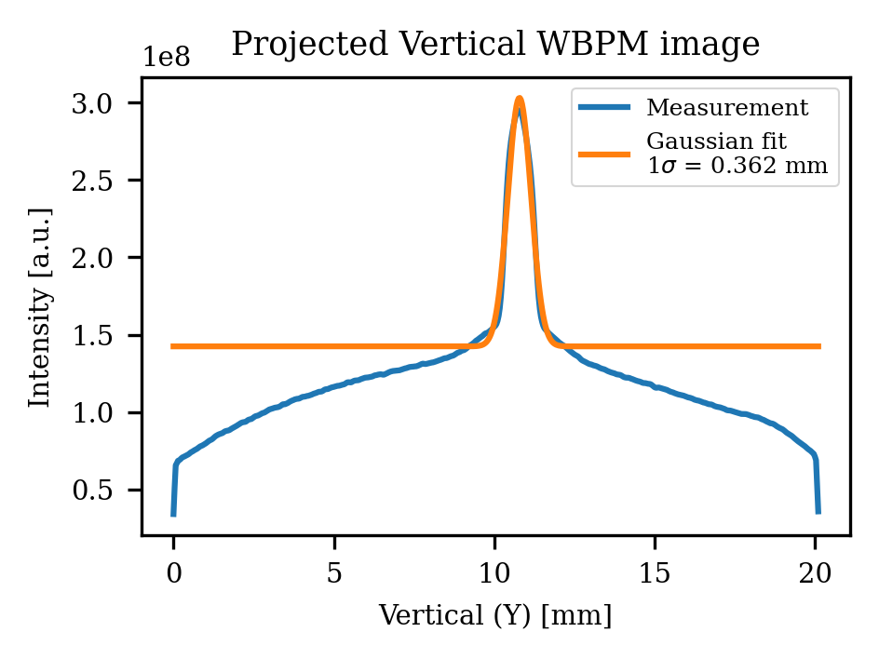
Beam size calculation
Screen monitor → FHWM
WBPM → Gaussian fit
(FWHM = 1sigma * 2.355)

Slide 6
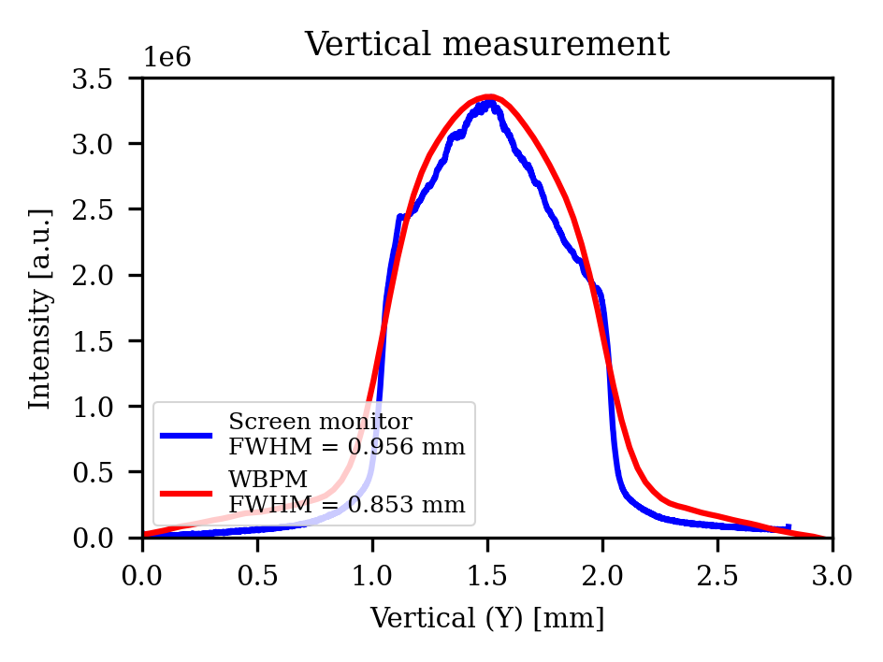
Beam profile comparison

Slide 7
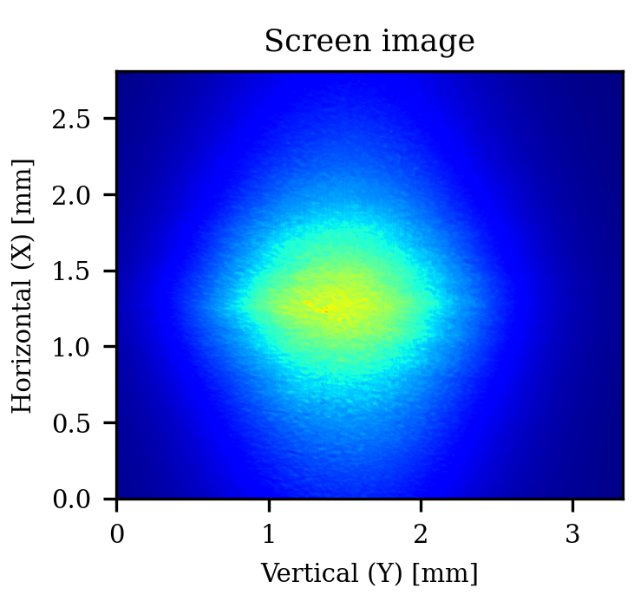
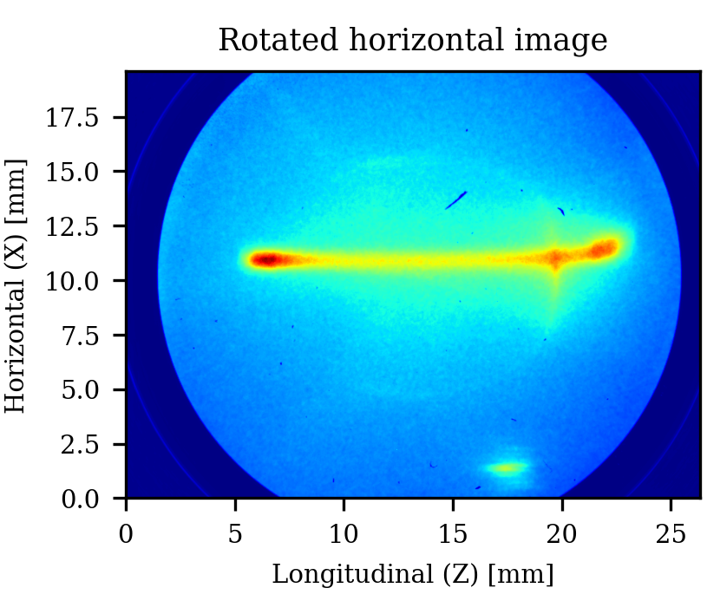
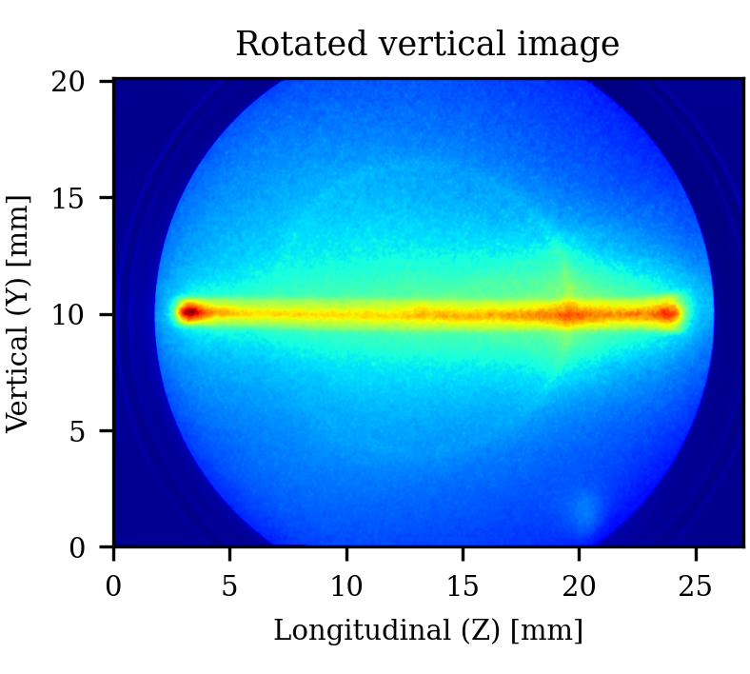
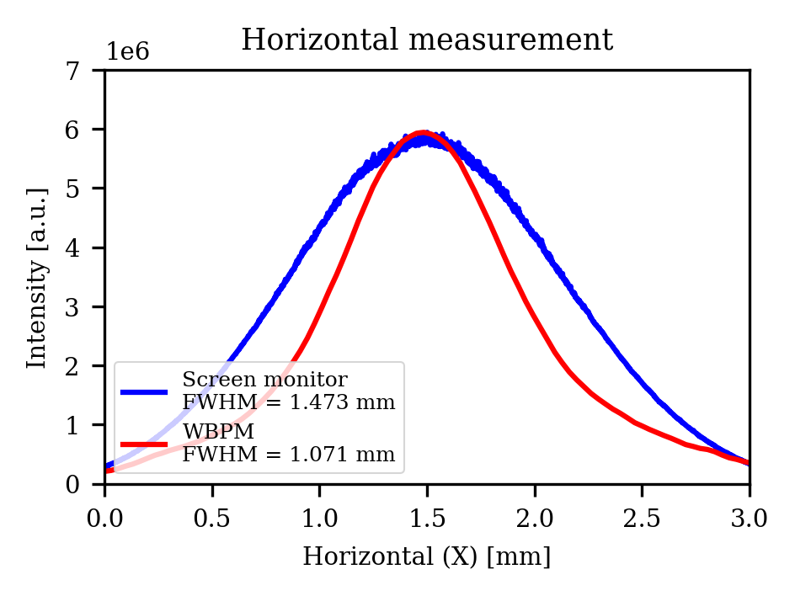
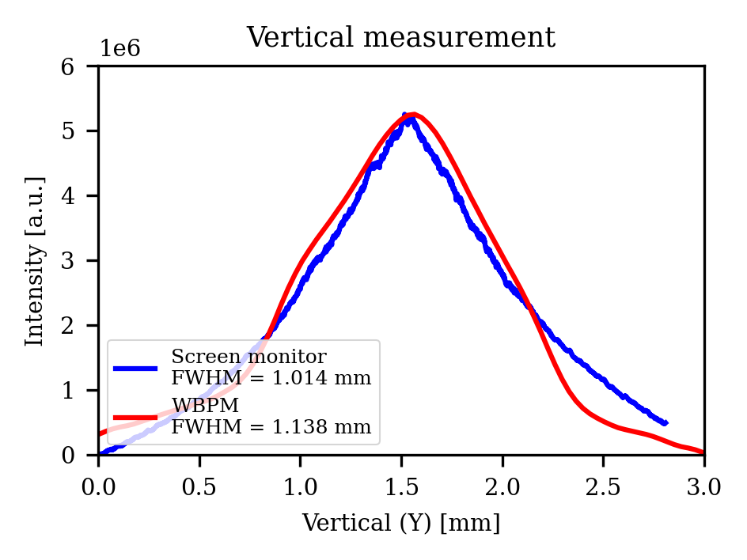

Slide 8
Ultra-short bunch length measurement using ChDR
2025. 07. 18.
송우진

Slide 9
Experimental target
Beam profile monitor
Linac (e-Labs)
Bunch length measurement
LWFA (IBS 150TW laser)
Before installation
Radiator design and manufacture
Set-up
Data acquisition system
Alignment test
Future plan
Installation
Alignment at e-Labs
Experiment
Radiator fabrication
Securing test facilities
Calculation of the target range
Detector (Spectrometer or power meter)
Experiment (1st test at IBS, 23.08)
Future plan
Crystal radiator modification
Experiment (2nd test at IBS, 25.08)

Slide 10
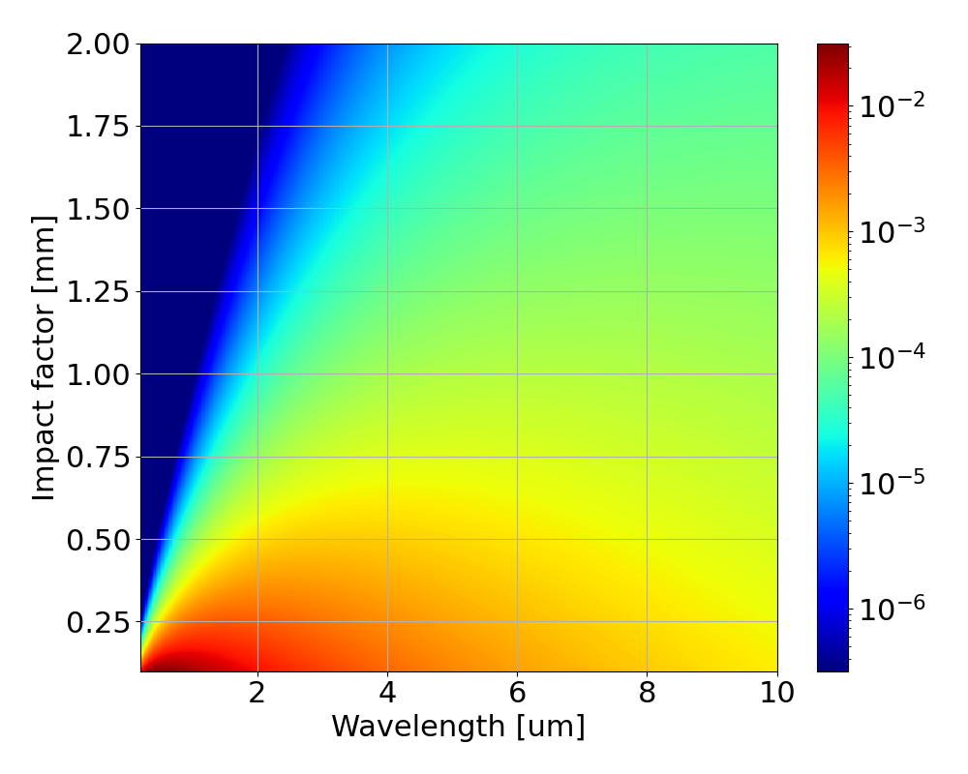
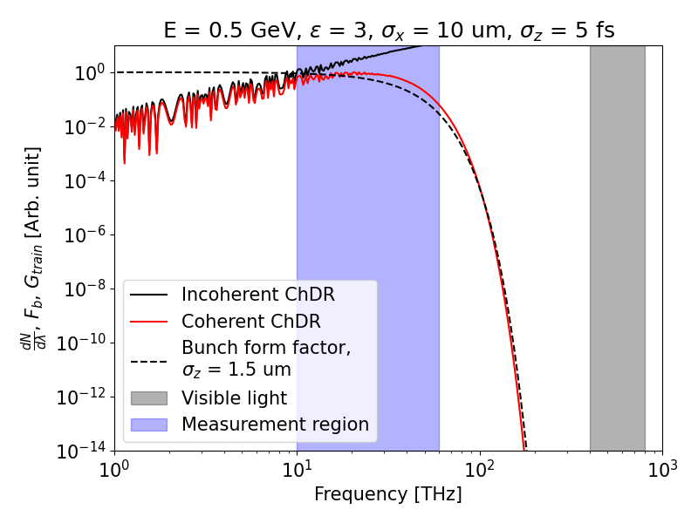
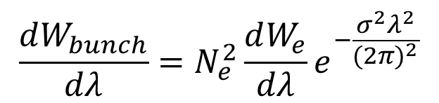
Bunch length measurement
What we already know
(Incoherent / Single particle ChDR)
$$\frac{dW_{bunch}}{dλ}=N_{e}^{2}\frac{dW_{e}}{dλ}e^{−\frac{σ^{2}λ^{2}}{{(2π)}^{2}}}$$
What we Measure
(Coherent ChDR)
What we want to know
(Bunch length)
IBS 150 TW Laser, LWFA experiment
Expected e-beam parameters:
500 MeV, 1~5 fs(0.3~1.5 um), 10 pc

Slide 11
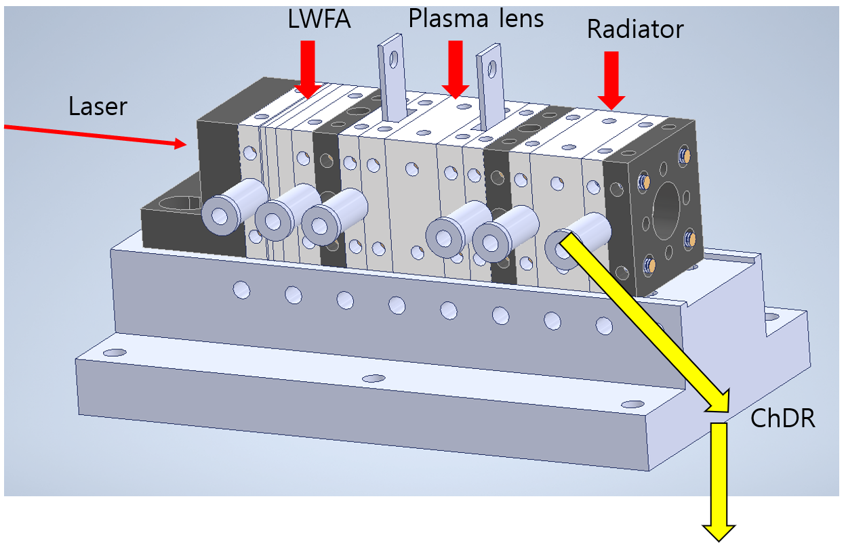


Radiator (with capillary) design
Beam
ChDR
$$θ_{ChDR}$$
$$θ_{critical}$$
Spectrometer

Slide 12
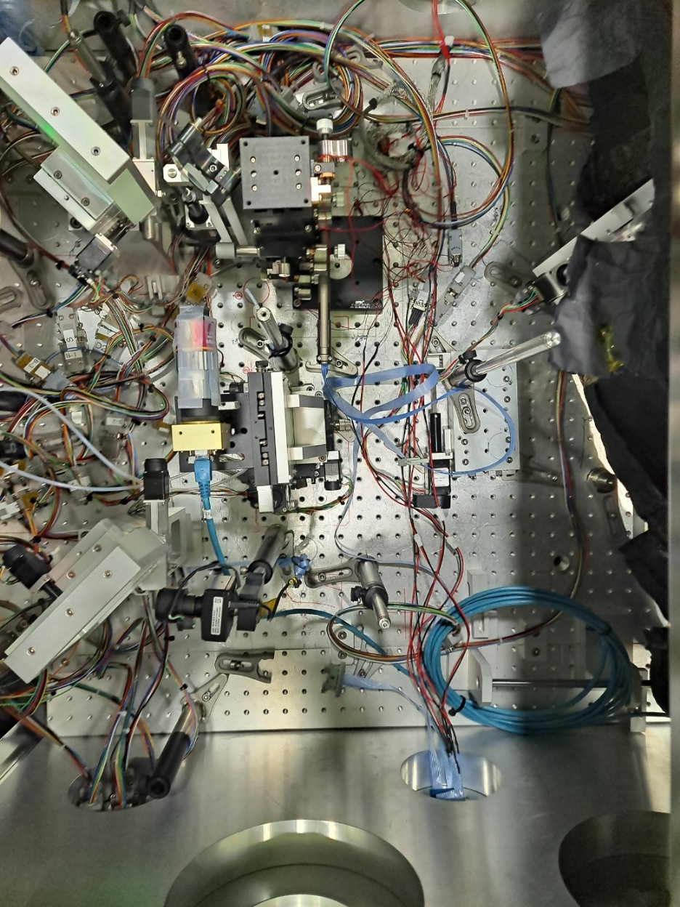
Experimental set-up
LWFA Experiment with IBS 150 TW Laser
The goal was to measure the length of the electron beam. (500 MeV, a few fs, 10 pC)
Measuring ChDR coming off the edge of a capillary.
Beam transported using a 3’ Au mirror.
Outside the chamber, only passes through the filter and directly into the detector.
Capillary
Laser
ChDR
ChDR
Capillary
Detector
ChDR
Au Mirror
Au Mirror
ChDR
Filtered signal
ChDR
Window
ChDR
THz filter
Window

Slide 13
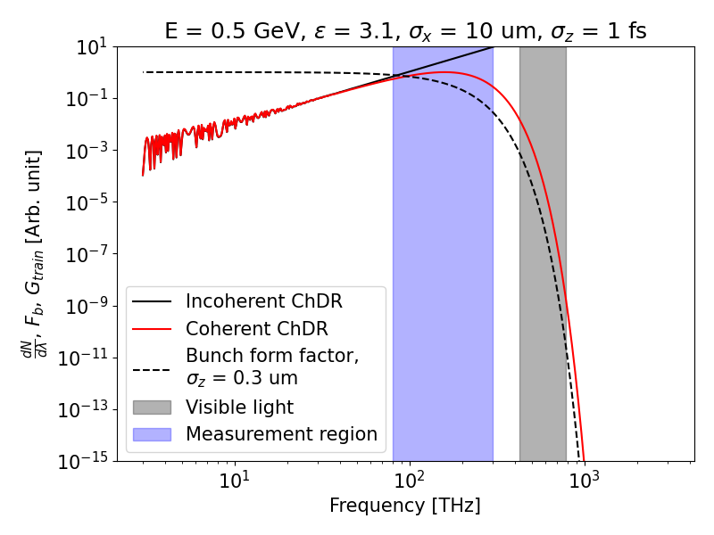
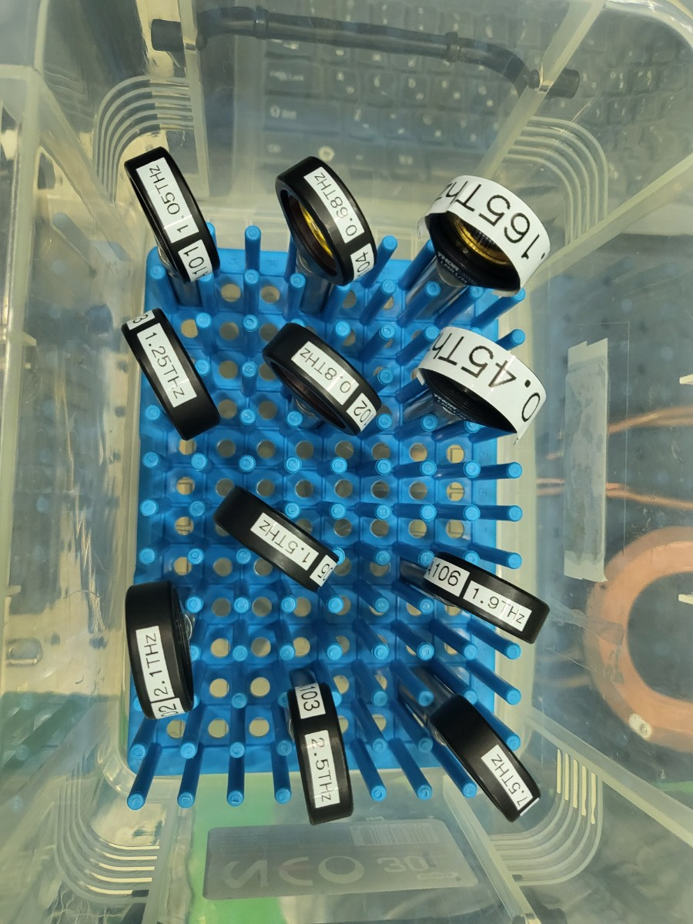
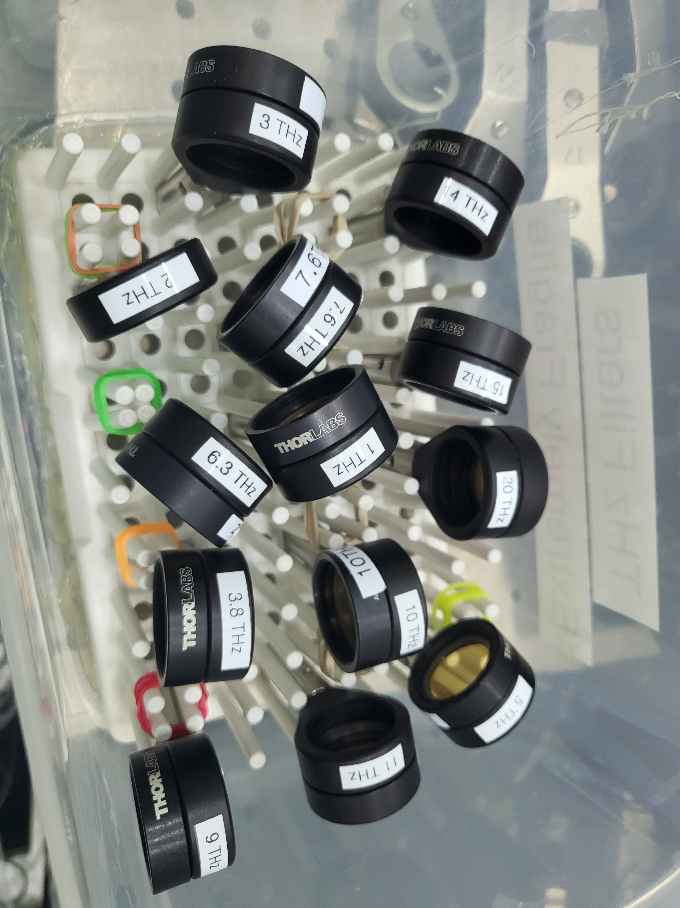
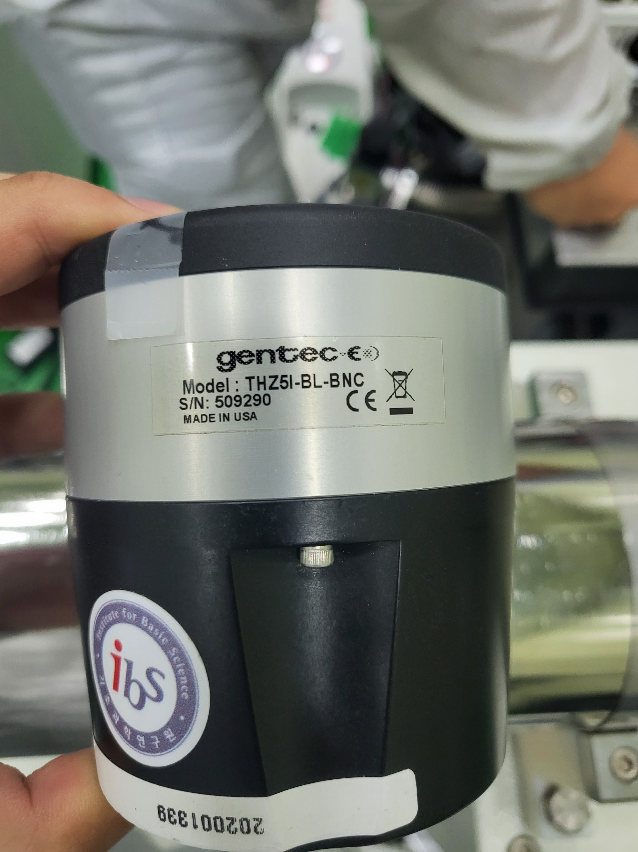
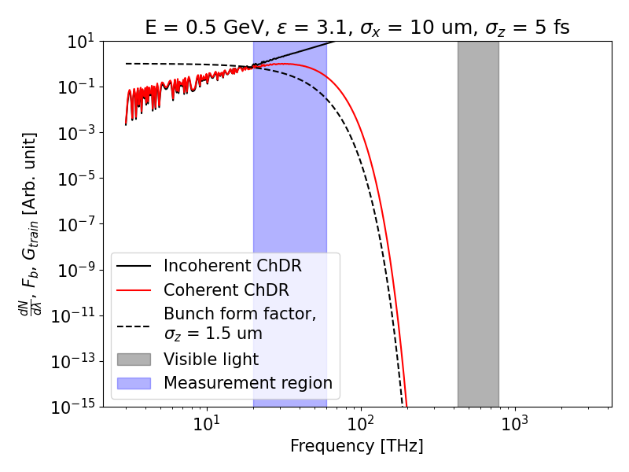
Experimental set-up
THz detector
(power meter, 0.1~30 THz)
THz filter
Measurement Target: Regions where the trends of Incoherent ChDR and Coherent ChDR differ.
  As the bunch length increases, differences appear at lower frequencies.(1 fs → ~80 THz, 5 fs → ~ 20 THz)
Measurement Plan: Use filters up to 20 THz and replace 5 filters sequentially from the highest frequency.
  Record beam energy and, if possible, beam size for each measurement.

Slide 14
Python + EPICS based DAQ monitoring system implementation
2025. 07. 18.
송우진

Slide 15
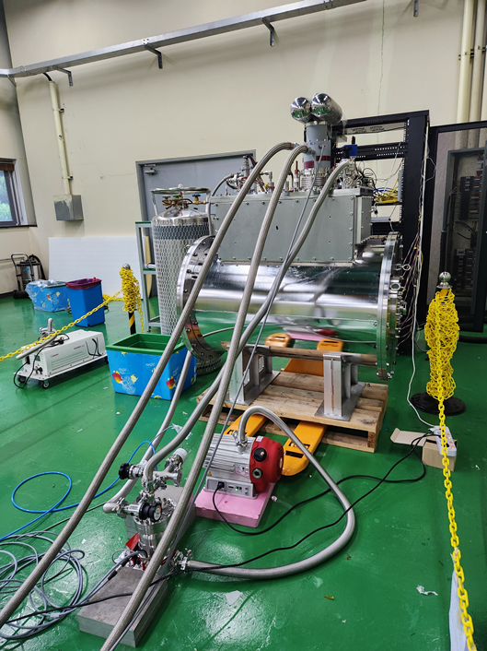
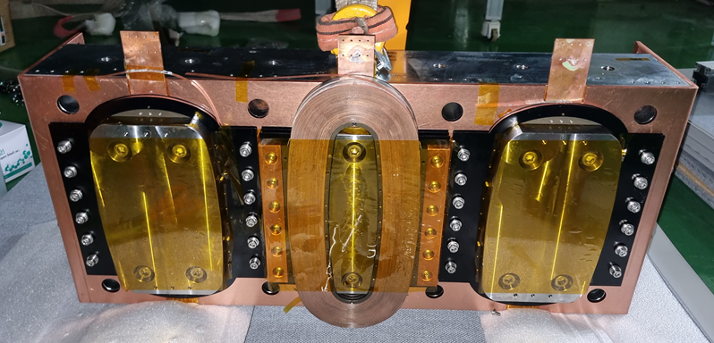
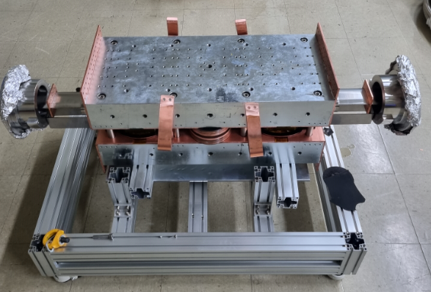
Introduction
High-temperature superconducting (HTS) magnet wavelength shifter (WLS)
  The world's first application using HTS
  Basic testing has been completed, and we plan to install it in the PLS-II storage ring tunnel for experimentation.
  Data such as magnet temperature, voltage, and current must be measured to ensure stable operation.

Slide 16
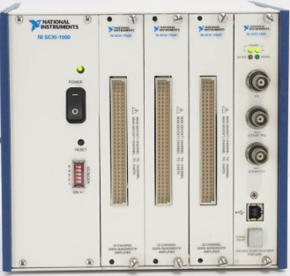
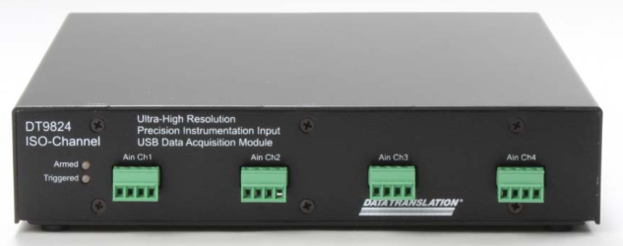
Introduction
The DAQ used in the HTS experiment was SCXI-1125
→ However, it has been discontinued.
A new DAQ that satisfies the required performance must be selected, tested, and built into the system.
SCXI-1125
DT9824

Slide 17
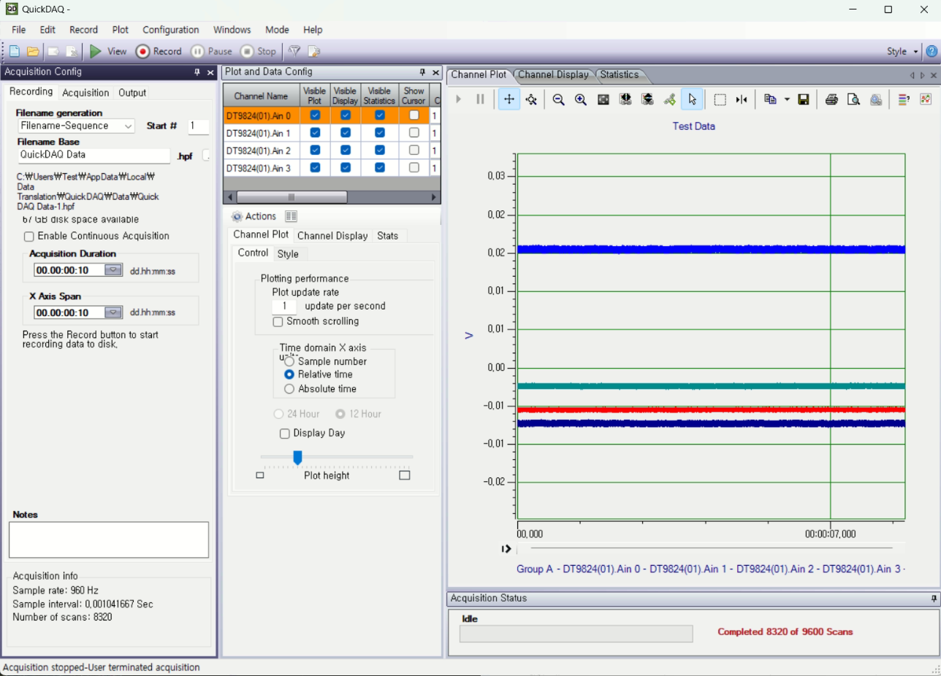
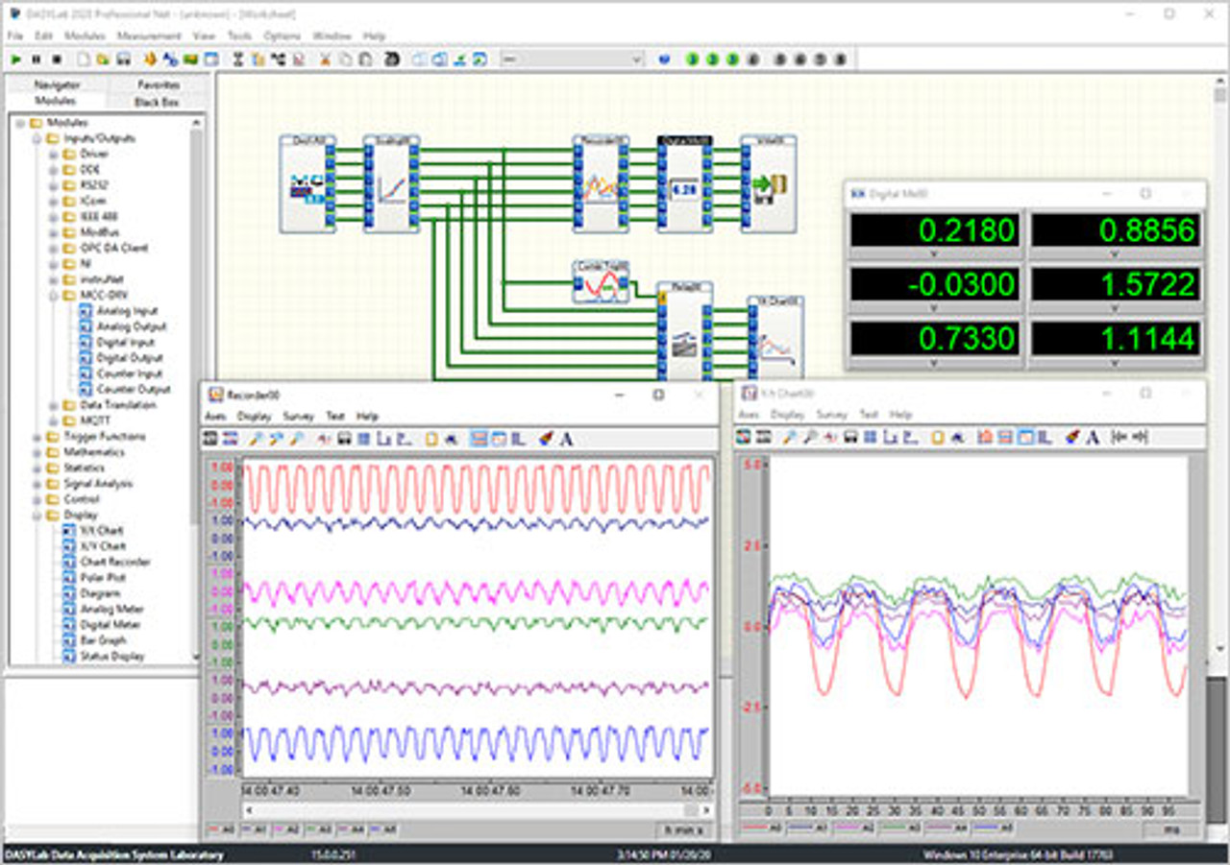
Introduction
Previously, QuickDAQ or DESYLab was used when operating DAQ (DT9824).
  Difficulties in setup and automation each time, suitable for intermittent experiments.
Python + EPICS utilization
  Stable monitoring service, automation and continuous measurement, log data DB conversion, suitable for continuous experiments and services.
QuickDAQ
DESYLab

Slide 18
EPICS
Experimental Physics and Industrial Control System (EPICS)
Open source software framework → Large facility control system, data acquisition.
Input/Output Controller (IOC): A control process that communicates directly with device hardware.
Process Variable (PV): The basic unit of data handled by EPICS.
  Each PV represents the status of equipment (e.g., temperature, current, vacuum, etc.).
  Clients can access PVs to read, write, and monitor them.
Channel Access (CA): EPICS communication protocol (TCP-based)
  Connects clients and IOCs using PV names.
CS-Studio (Control System Studio), Phoebus, caget / caput / camonitor (terminal-based utilities)

Slide 19
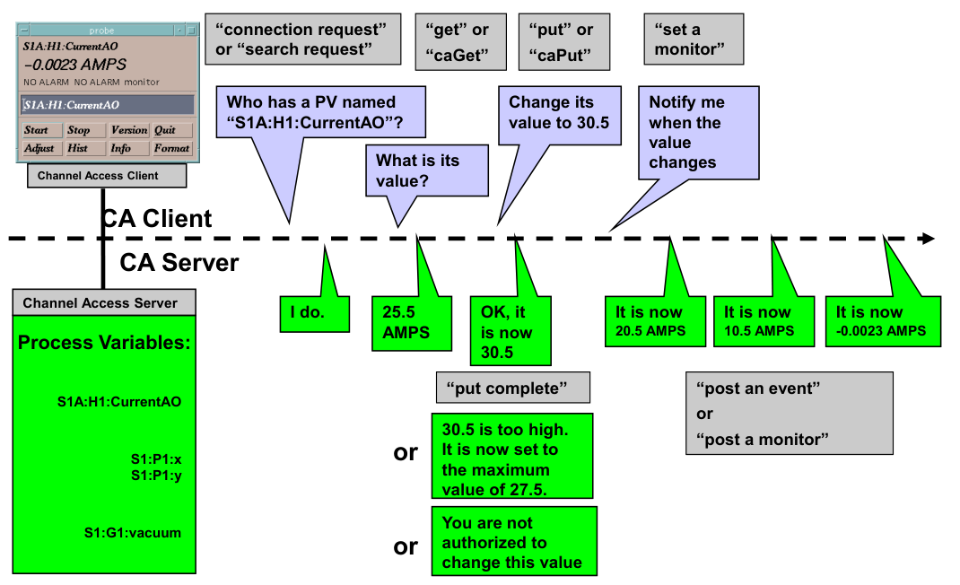
EPICS
CA Client vs Server (From Ziga Oven, COSYLAB)

Slide 20
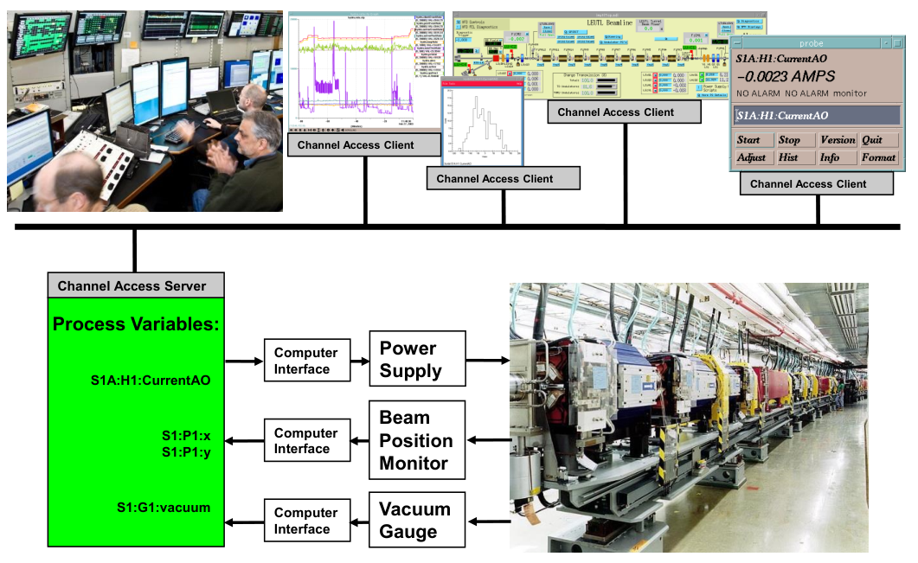
EPICS

Slide 21
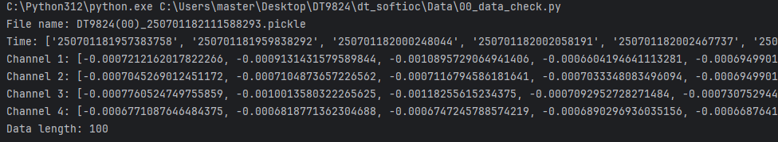
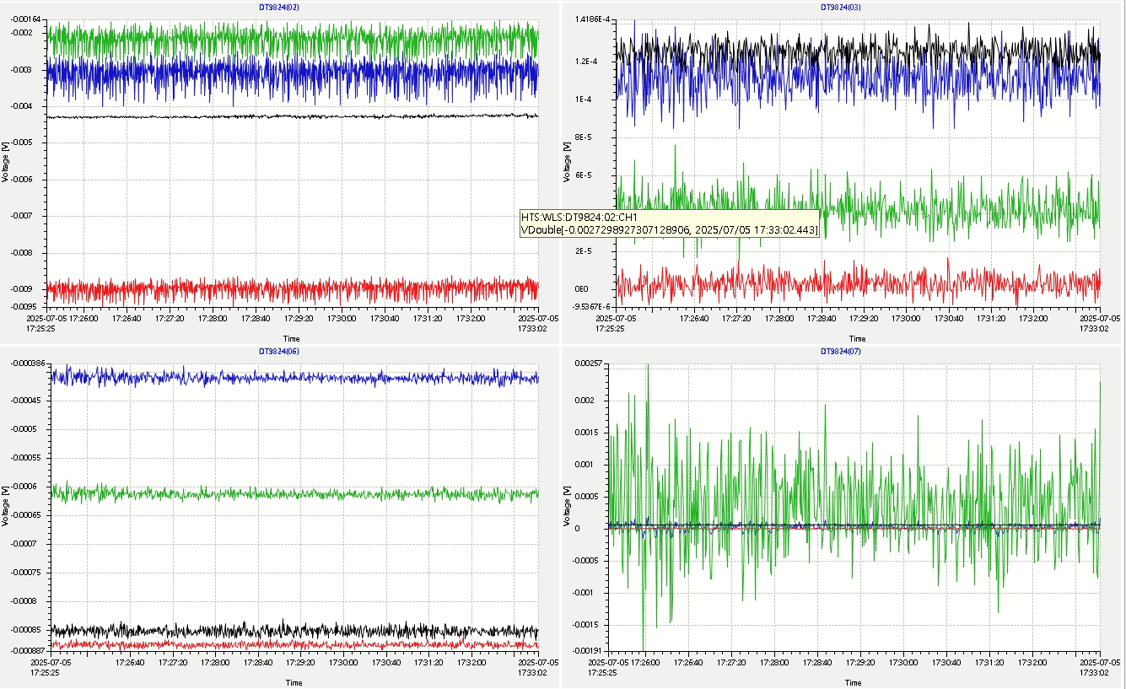
Configuration
Python: DAQ data acquisition, storage, and PV updates
CS-Studio: Visualization of updated measurements in Python (real-time updates)

Slide 22
Configuration
H/W
PC
PV update
(TCP/IP, local host)
Python (IOC)
Epics (Server)
USB
Save file (HDF5)
(Local PC)
Database (dt_data.db)
SoftIoc (dt_softioc.bat)
SN23289013
Thread1
Buffer
SN42949672
Thread2
Buffer
SN31784952
TCP/IP
Visualization
Thread3
Buffer
…...
Multiprocessing
CS-Studio
DT_monitor.opi
(Client)
Flush

Slide 23
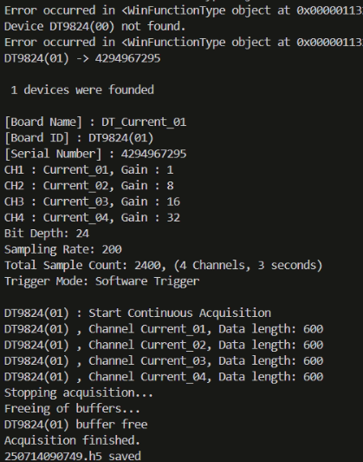
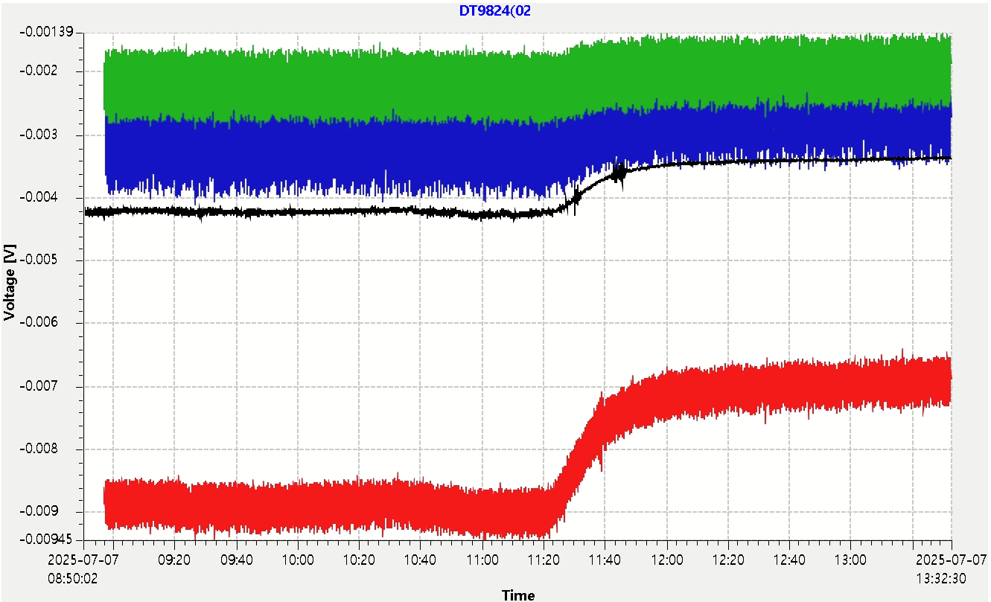
Manual
Run dt_softioc.bat (epics)
Run dt_softioc.py
- If DT9824 operates without problems, automatic measurement starts.
- Data is automatically saved in the Data folder in HDF5 format.
Run CS-Studio
DT_monitor.opi → Monitoring

Slide 24
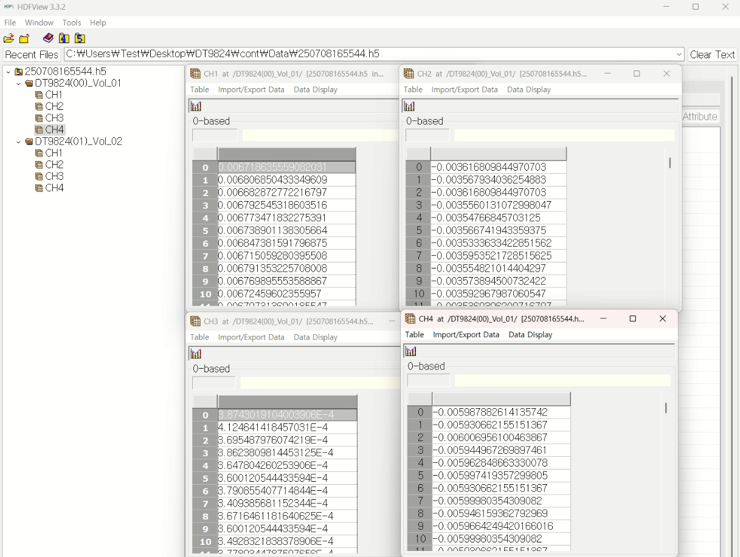
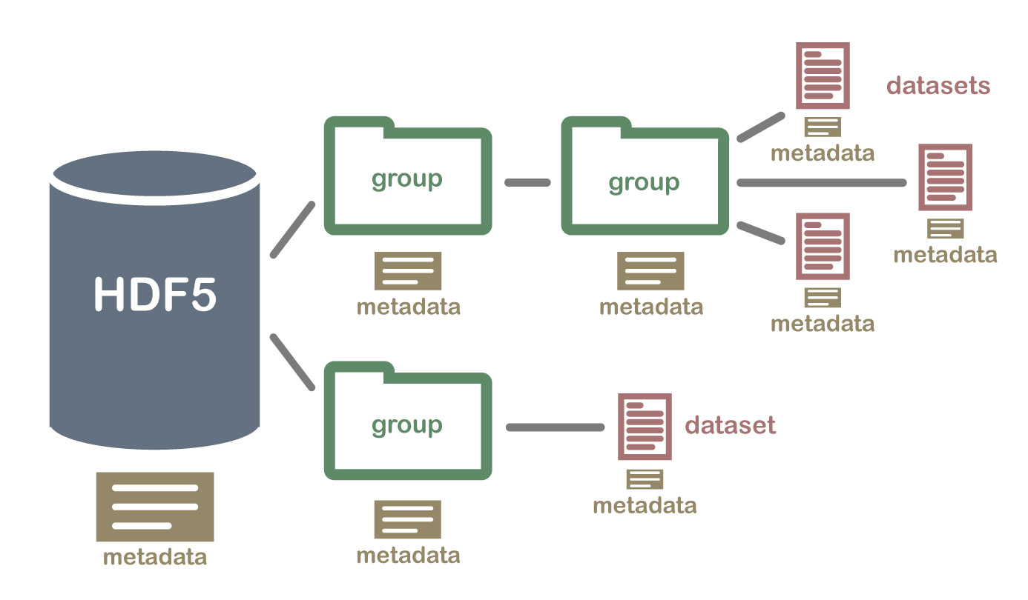
HDF5 Data Access
The measured results are always saved in HDF5 format.
계층적 데이터 형식 (Hierarchical Data Format)
- A file format for storing large amounts of data.
- Small file size, indexing, and fast access speed.
- Can be easily used by installing HDF viewer.

Slide 25
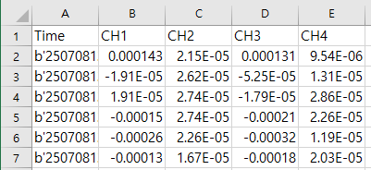
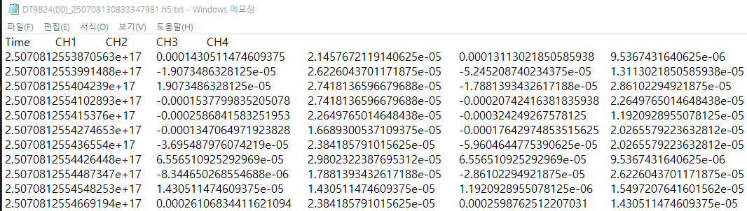
HDF5 Data Access
  HDF5 to CSV/Excel Convert
import h5py
import pandas as pd
h5_file = 'DT9824(00)_250708130833347981.h5' # 변환하고자 하는 HDF5 파일
with h5py.File(h5_file, 'r') as f:
data = {'Time': f['Time'][:],
'CH1': f['CH1'][:],
'CH2': f['CH2'][:],
'CH3': f['CH3'][:],
'CH4': f['CH4'][:]}
df = pd.DataFrame(data) # Pandas DataFrame 생성
df.to_csv(f'{h5_file}.csv', index=False) # CSV 저장
df.to_excel(f'{h5_file}.xlsx', index=False, engine='openpyxl’) # Excel 저장
  HDF5 to ASCII Convert
import h5py
import numpy as np
h5_file = 'DT9824(00)_250708130833347981.h5'
with h5py.File(h5_file, 'r') as f:
time = f['Time'][:]
ch1 = f['CH1'][:]
ch2 = f['CH2'][:]
ch3 = f['CH3'][:]
ch4 = f['CH4'][:]
combined = np.column_stack((time, ch1, ch2, ch3, ch4)).astype(np.float64)
np.savetxt(f'{h5_file}.txt', combined, fmt='%s', delimiter='\t', header='Time\tCH1\tCH2\tCH3\tCH4', comments='')

Slide 26
Summary
Build an automation and monitoring system for multiple DT9824s using Python + epics.
Enable continuous measurement and logging of data to a database, as well as internal/external triggers, and utilize the maximum sampling rate.
Long-term stability testing required.

Slide 27
Measurement of frequency response of DAQ

Slide 28
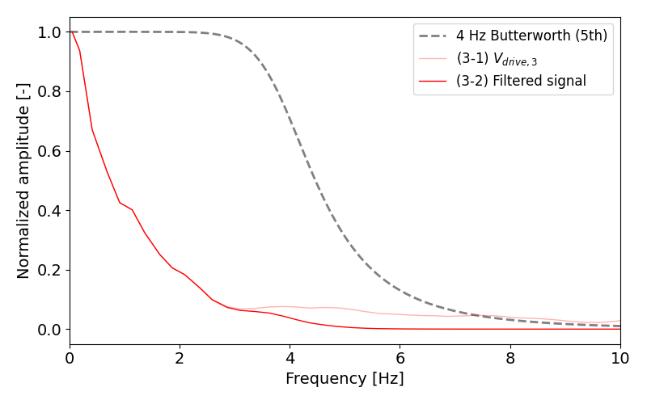
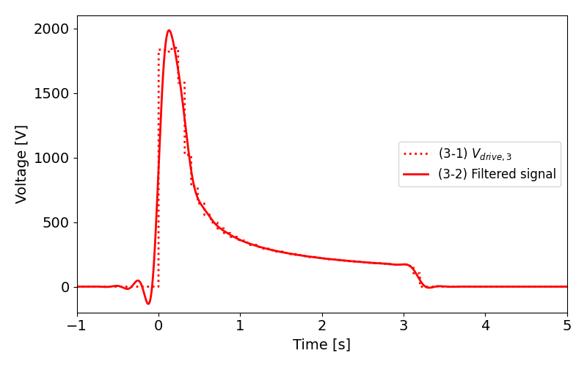
Introduction
Signal distortion due to attenuation in frequency domain. (example)
- Changes in voltage signal waveform with 4 Hz filter applied.
FFT
Signal distortion
iFFT
Removal of high-frequency components with a 4 Hz LPF.
Signal distortion occurs in sections where the slope changes rapidly.
- Attenuation due to the bandwidth of the equipment can cause measurement errors.

Slide 29
Introduction
Bandwidth measurement experiment
  - Data : 2023.10.18-19 PAL
  - SCXI-1125, DT9824 bandwidth measurement
  - Results
Simulation of measurable signal length
- Signal distortion in special situations where short signals occur.
 | Sampling rate | Specification | Measurement
SCXI-1125 | 100 kSa/s | 10 kHz | 11.5 kHz
DT9824 | 4.8 kSa/s | 1.104 kHz | 1.105 kHz

Slide 30
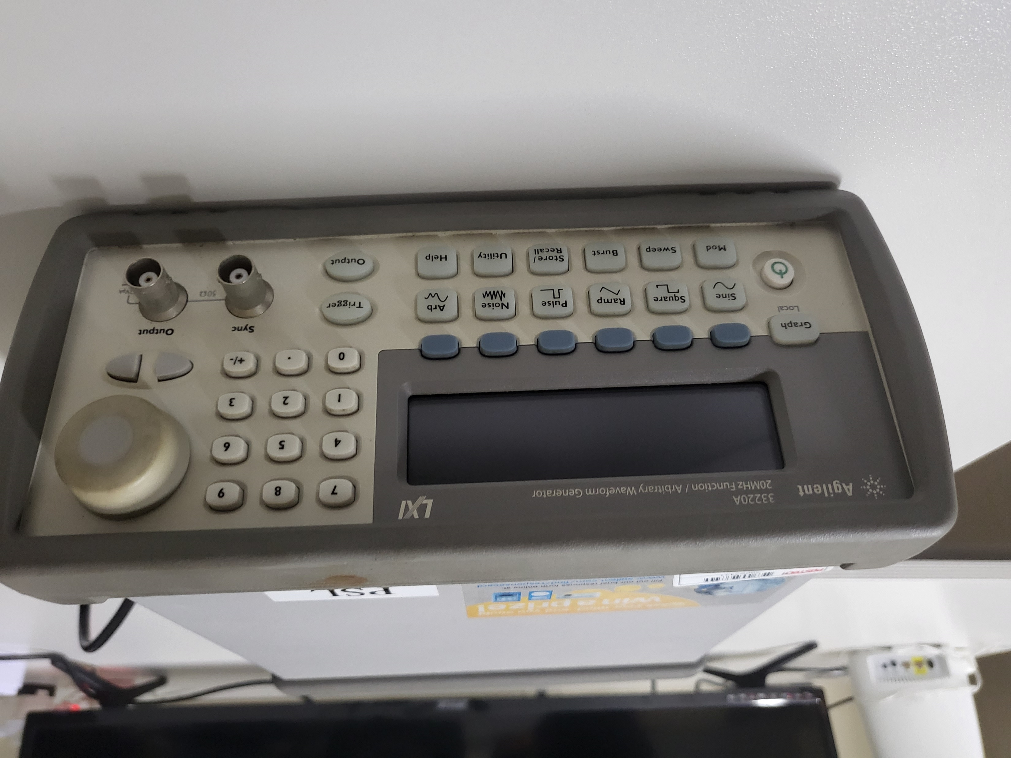
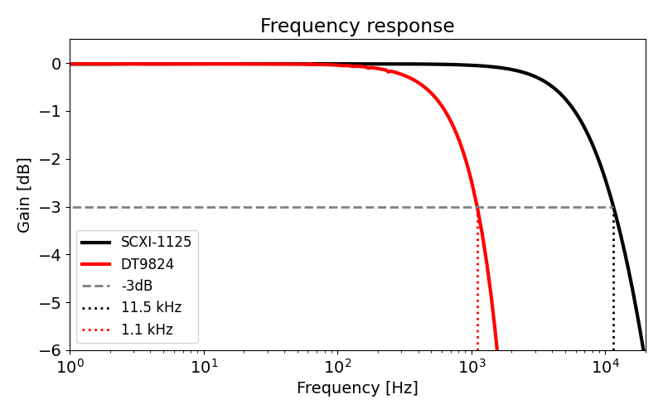
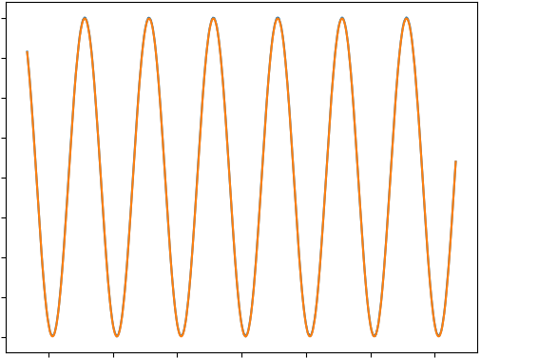
Set-up
Function generator
(Agilent 33220A)
1 uHz ~ 20 MHz
10 mV ~ 10 V (p-p)
Control PC
(Labview)
Set frequency
measurement
Frequency response measurement results
Sine signal
1 Hz ~ 20 kHz (SCXI)
1 Hz ~ 10 kHz (DT)
1 V (p-p)
SCXI-1125
(1ch)
 | Sampling rate | Specification | Measurement
SCXI-1125 | 100 kSa/s | 10 kHz | 11.5 kHz
DT9824 | 4.8 kSa/s | 1.104 kHz | 1.105 kHz
DT9824

Slide 31
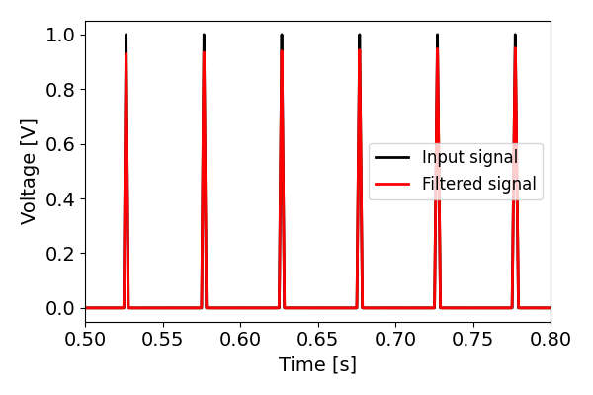




Simulation: Short rise time signal measurement
$t_{r}$ = 0.1~10 ms (0.1 ms step)
90%
Amplitude, $A_{i}=1$
Δt = 5 μs
10%
……
원본 신호 Rise time = $t_{r}$
Time domain signal
Generate a virtual signal with a rise time of 0.1 ms to 10 ms (original signal).
→ Signal distortion occurs due to the frequency response characteristics of DT9824 (measured signal).
→ Calculate how much the amplitude and length of the measured signal have changed compared to the original input signal.
Frequency response and signal spectrum

Slide 32












Simulation: Short rise time signal measurement
Intensity and length changes depending on signal length
Signal with Freq. Resp.
(DT9824 - 1.1 kHz BW)
$$t_{r}=0.1 ms$$
$$A_{i}=1$$
Length variation= $\frac{Original signal length}{Distorted signal length}$
$${FWHM}_{i}$$
$${FWHM}_{f}$$
$$A_{f}$$
Intensity variation= $\frac{Original signal amplitude}{Distorted signal amplitude}$
$$t_{r}=1 ms$$
$$t_{r}=1 ms$$ | $$A_{f} /A_{i}$$ | $${FWHM}_{f}/FWHM_{i}$$
SCXI-1125 | 0.99 | 1.01
DT9824 | 0.92 | 1.08

Slide 33
Summary
Signal distortion caused by bandwidth
Frequency response
Bandwidth measurement experiment conducted with SCXI-1125 and DT9824
SCXI-1125 → DT9824
  Has sufficient bandwidth for high-speed charge/discharge measurement experiments (~ tens of Hz).
  However, in situations where short pulses (~ 1 ms) occur, attenuation correction must be applied.
Measurable range → Additional research considering resolution is necessary (noise, bit depth, …).

