Slide 1
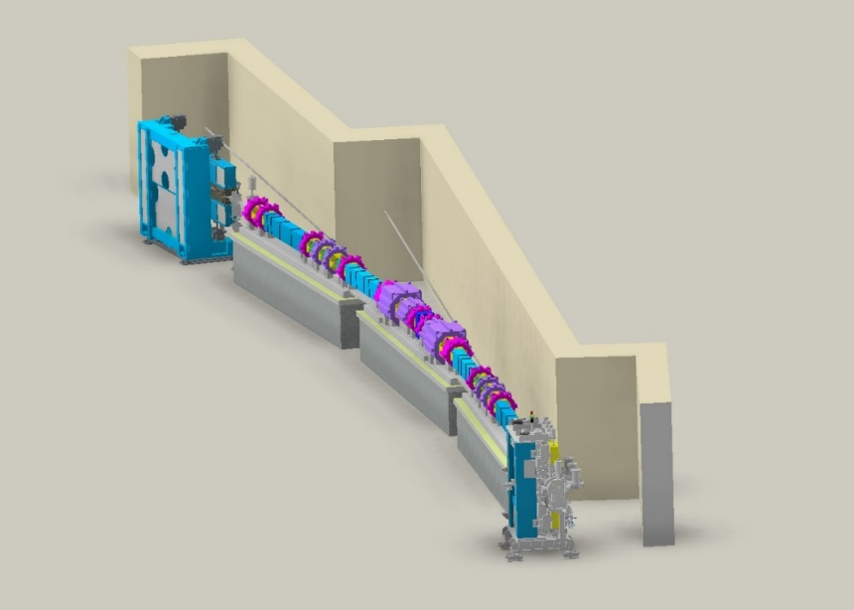
Storage ring lifetime & tune, chromaticity scan
Junha Kim
July 11 2025

Slide 2
High Beta straight cell 도입 배경
Fully symmetric
Race track shape
Beta functions at the center of High-beta SS: ($β_{x}$, $β_{y}$) = (15.90 m, 4.45 m)

Slide 3
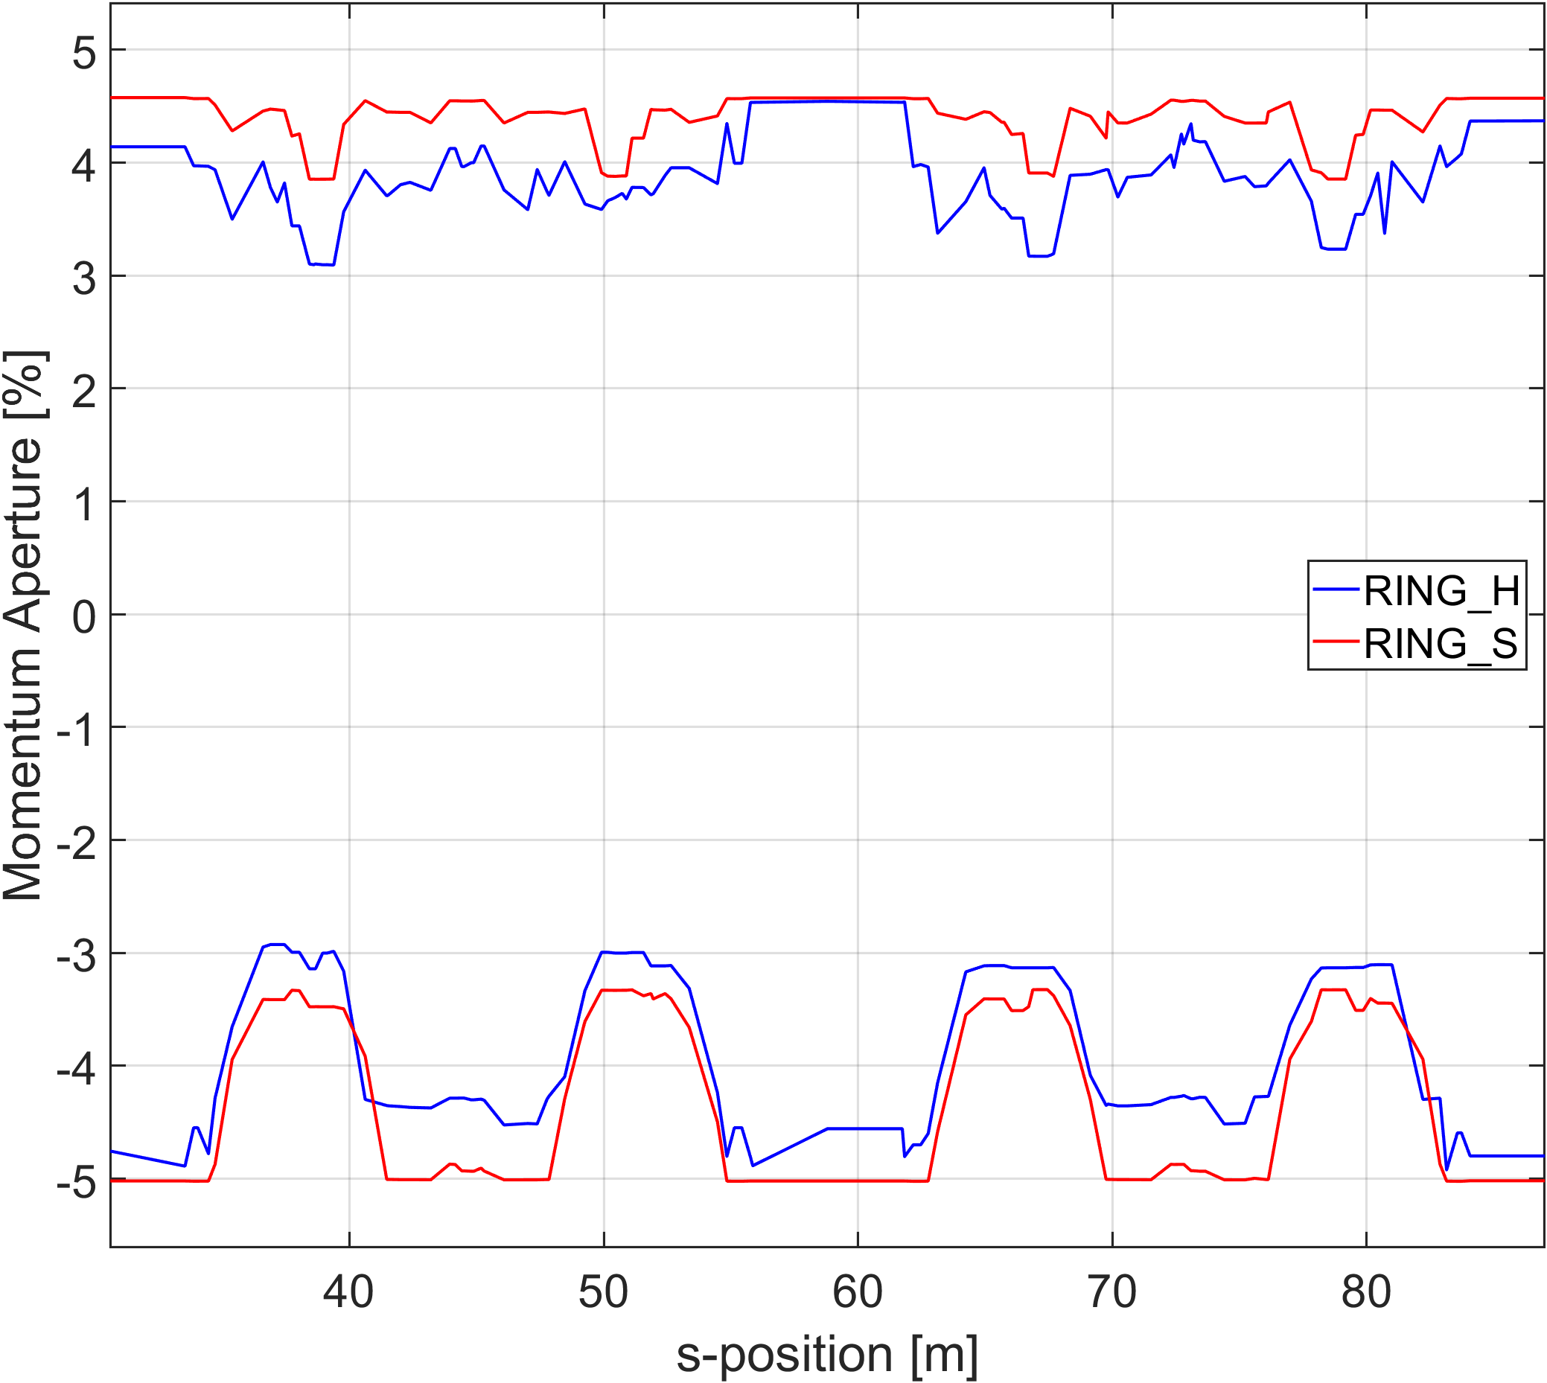
High Beta straight cell 도입 배경
Beta functions at the center of High-beta SS: ($β_{x}$, $β_{y}$) = (15.90 m, 4.45 m)
The original lattice consists of 28 unit cells.
With errors, injection efficiency sometimes drops below 100%.
To avoid relying on probabilistic injection success, we introduced an HB (High-beta) section.
By increasing the beta function at the HB section, we can reduce the beta function at the center bend, which helps to improve photon beam brightness without increasing the number of unit cells.
The momentum aperture decreases, resulting in a ~30% reduction in Touschek lifetime.
However, with the HHC (harmonic cavity), we still maintain over 10 hours of lifetime, which is acceptable.

Slide 4
Tune scan setting
Tune scan range :
Horizontal : 68.05 ~ 68.49
Vertical : 23.05 ~ 23.49
The tune space was discretized into a 30×30 grid for scanning.
Tune correction was performed using two quadrupole families, Q11 and Q12 in the entire ring.
A small error was introduced in one sextupole family (S31), resulting in a beta-beat of approximately 1–3%.
The dynamic aperture (DA) and Touschek lifetime were calculated by averaging results over 2–3 different random error seeds.
Chromaticity correction was not performed.
Q11
Q11
Q11
Q11
Q11
Q11
Q12
Q12
Q12
Q12
Q12
Q12

Slide 5
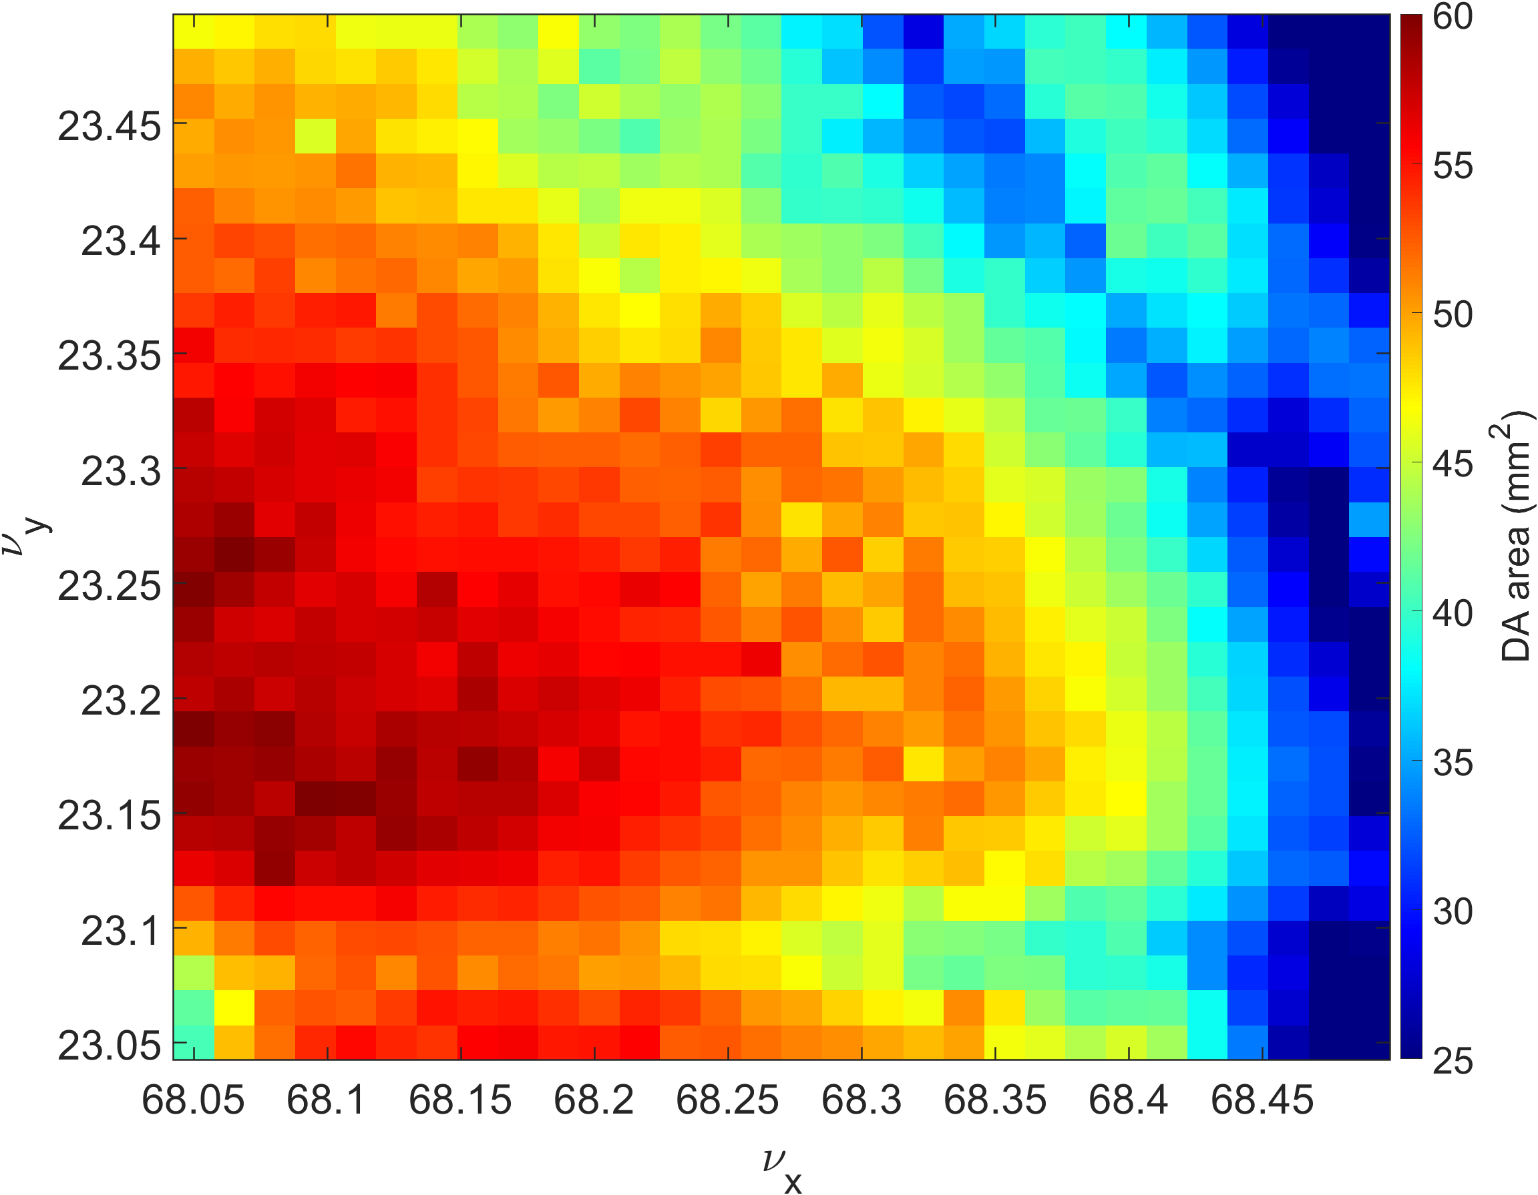
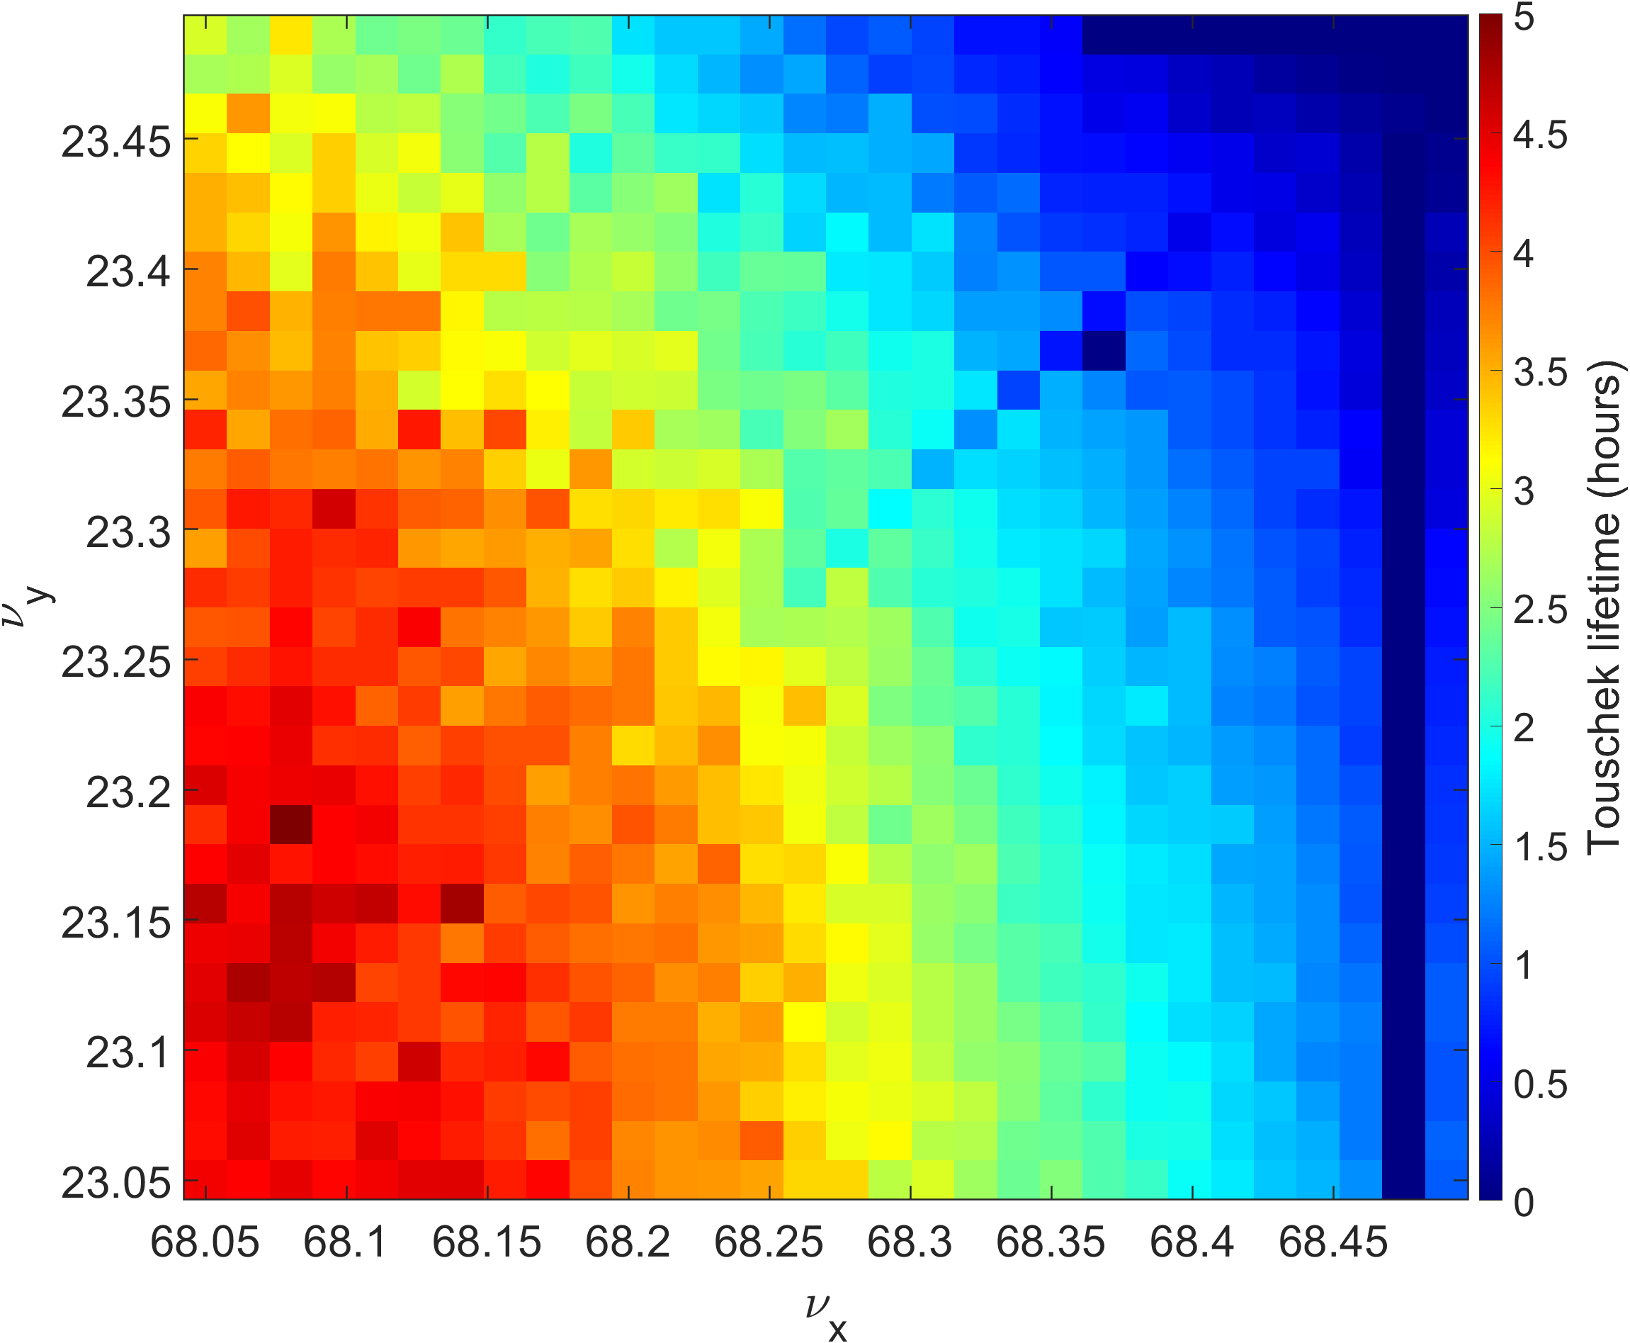
Error seed 1
Beta_beat : 1.9% / 2.4% Nat. emittance : 61.23pm / 0.54pm Closed orbit $δ=−0.26\%$
Tracking turns : 2000 turns

Slide 6
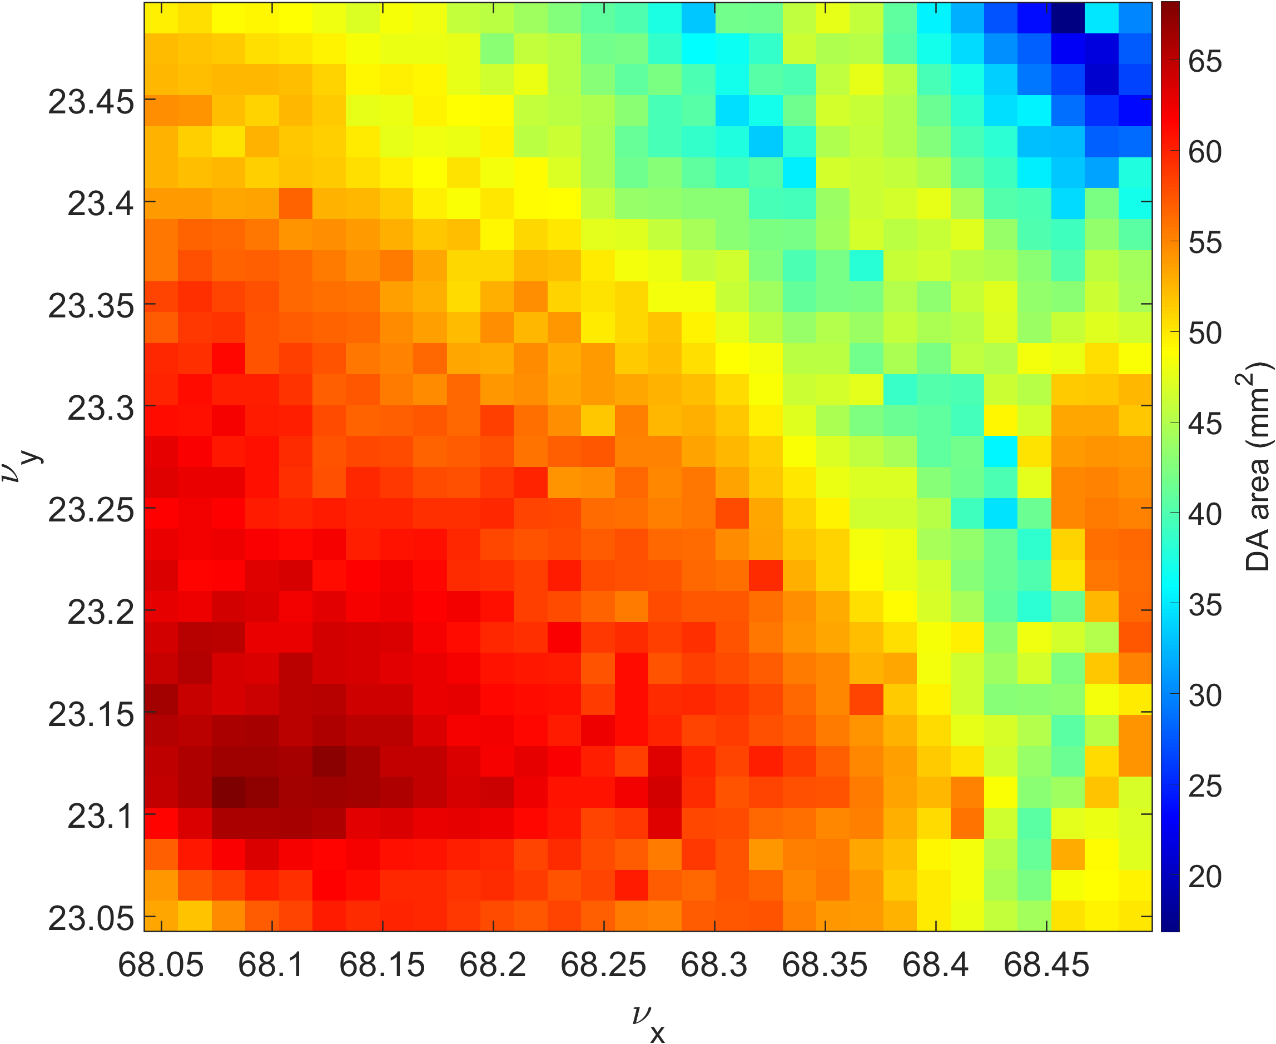
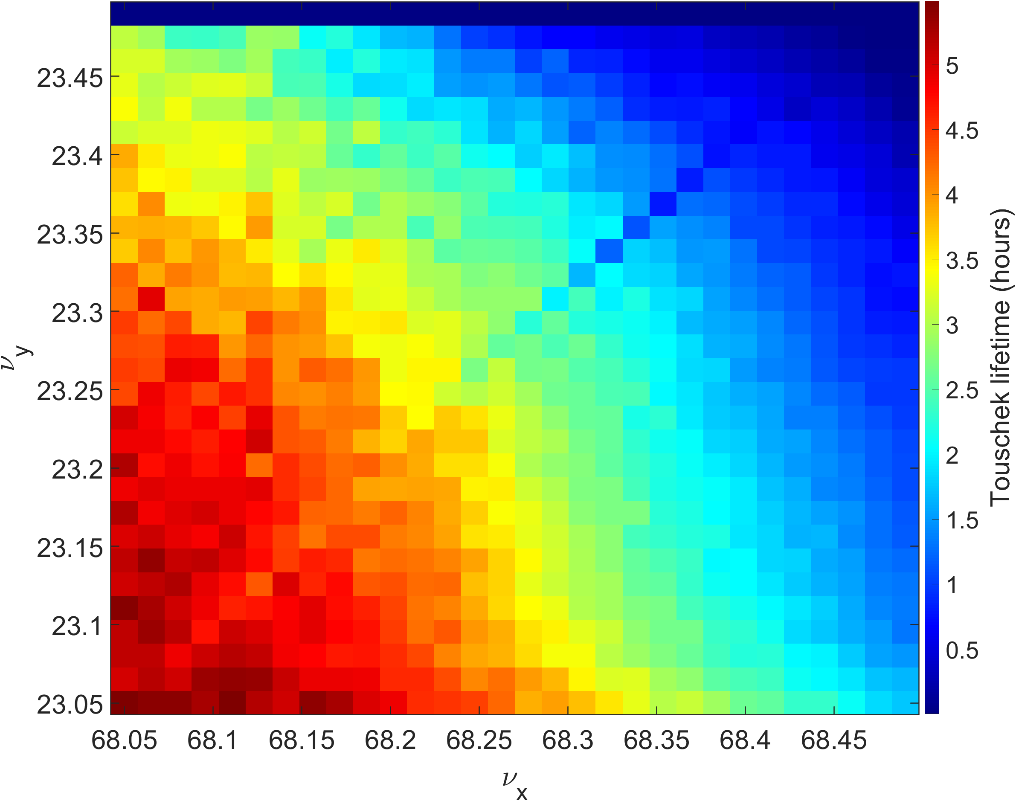
Error seed 2
Beta_beat : 1.1% / 2.2% Nat. emittance : 61.47pm / 2.15pm Closed orbit $δ=−0.28\%$
Tracking turns : 2000 turns

Slide 7
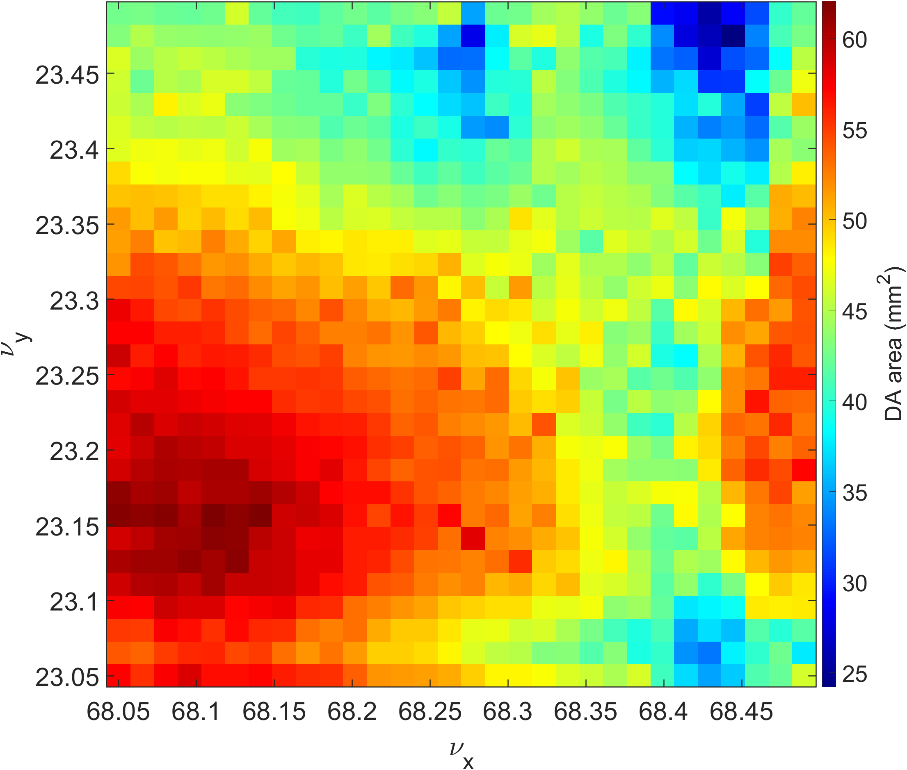
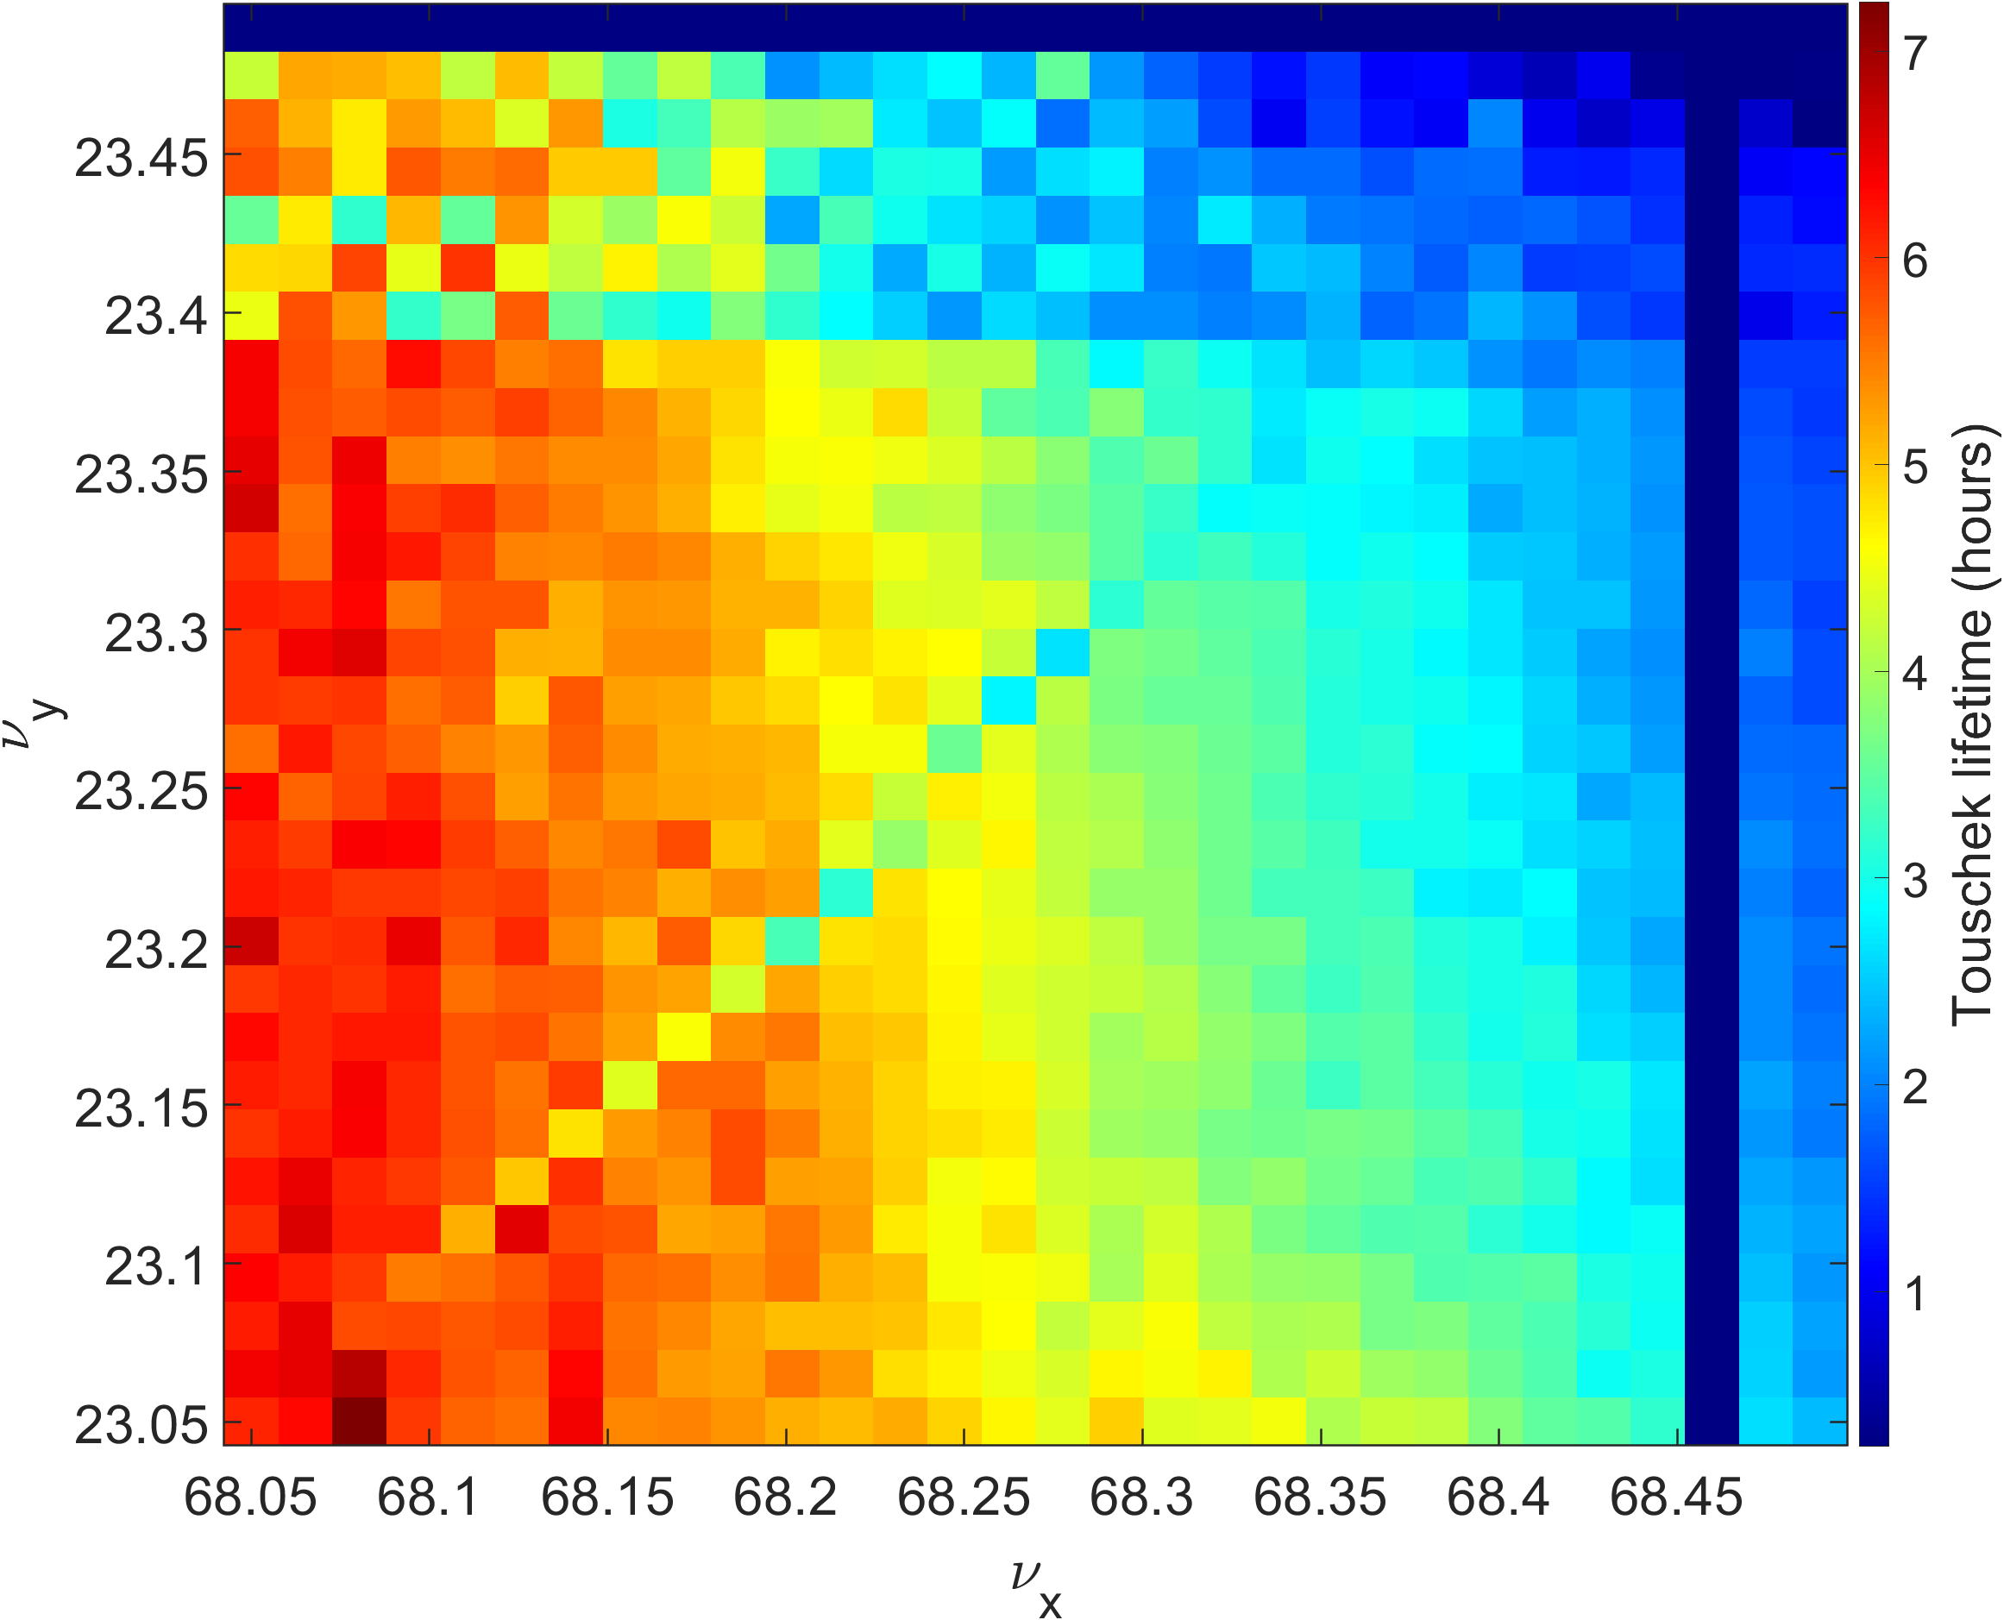
Error seed 3
Beta_beat : 1.1% / 3.0% Nat. emittance : 60.67pm / 3.98pm Closed orbit $δ=−0.43\%$
Tracking turns : 2000 turns

Slide 8
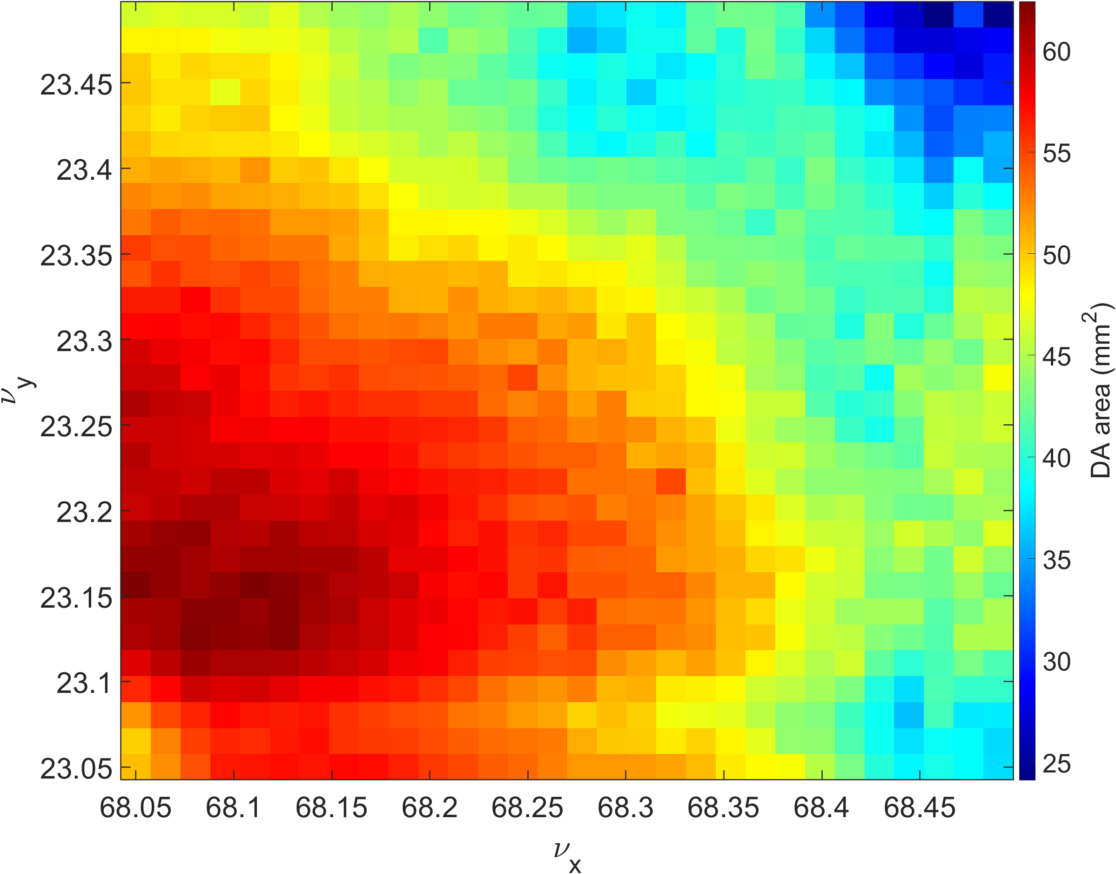
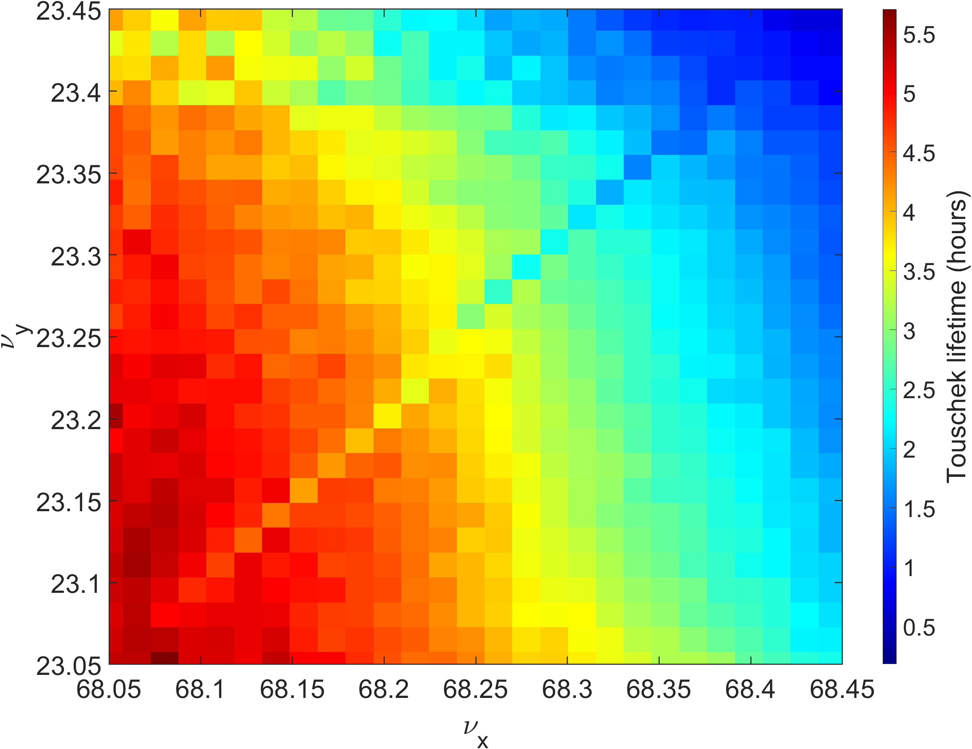
Average result
Average of DA area result with 3 error seed
Average of lifetime result with 3 error seed

Slide 9
Chromaticity scan
Chromaticity scanrange :
Horizontal : 0 ~10, step size : 0.5
Vertical : 0 ~10 , step size : 0.5
Sextupole strengths were determined using the Chromaticity Response Matrix (CRM).
Dynamic Aperture Calculation :
Number of turns : 2048
MA calculation:
2 cell considered
2048 turns tracked
Touschek lifetime is calculated using the Piwinski formula, after the MA calculation.
$$R_{CRM }=\left(\begin{matrix}dξ_{x}/dK2_{s31} & dξ_{y}/dK2_{s31} \\ \begin{matrix}dξ_{x}/dK2_{s32} \\ dξ_{x}/dK2_{s33}\end{matrix} & \begin{matrix}dξ_{y}/dK2_{s31} \\ dξ_{y}/dK2_{s31}\end{matrix}\end{matrix}\right)$$
. . .
S32
S32
S32
S32
S32
S32
. . .
S31
S33
S33
S31
S31
S33
S33
S31
S31
S33
S33
S31

Slide 10
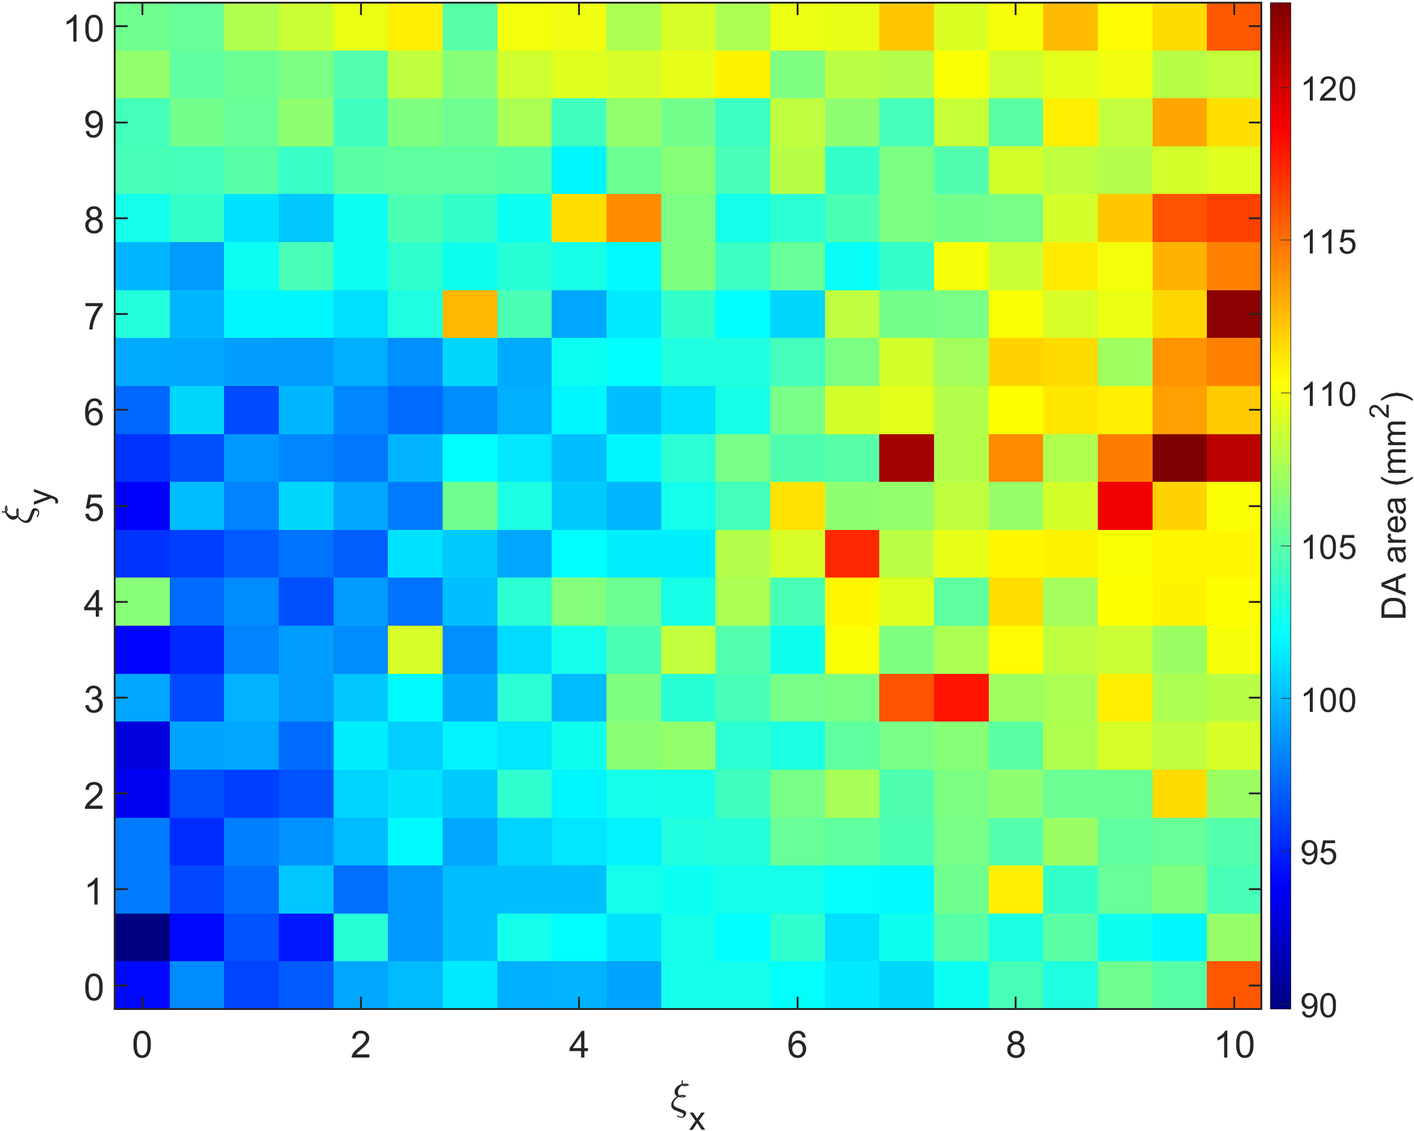
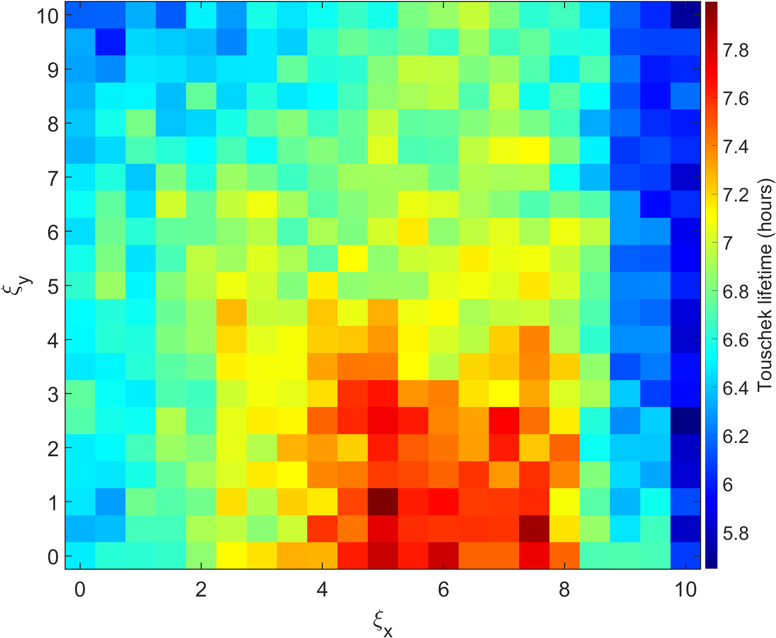
Chromaticity scan – without error
Chromaticity scanrange :
Horizontal : 0 ~10, step size : 0.5
Vertical : 0 ~10 , step size : 0.5
DA result
TL result

Slide 11
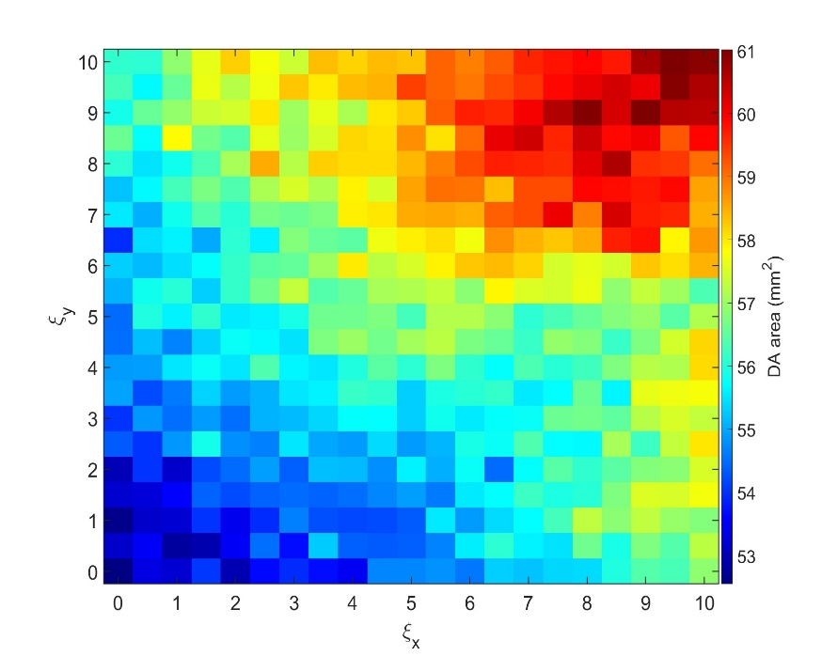
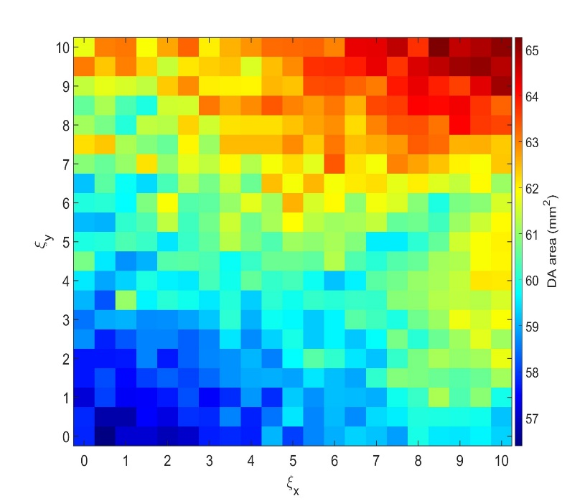
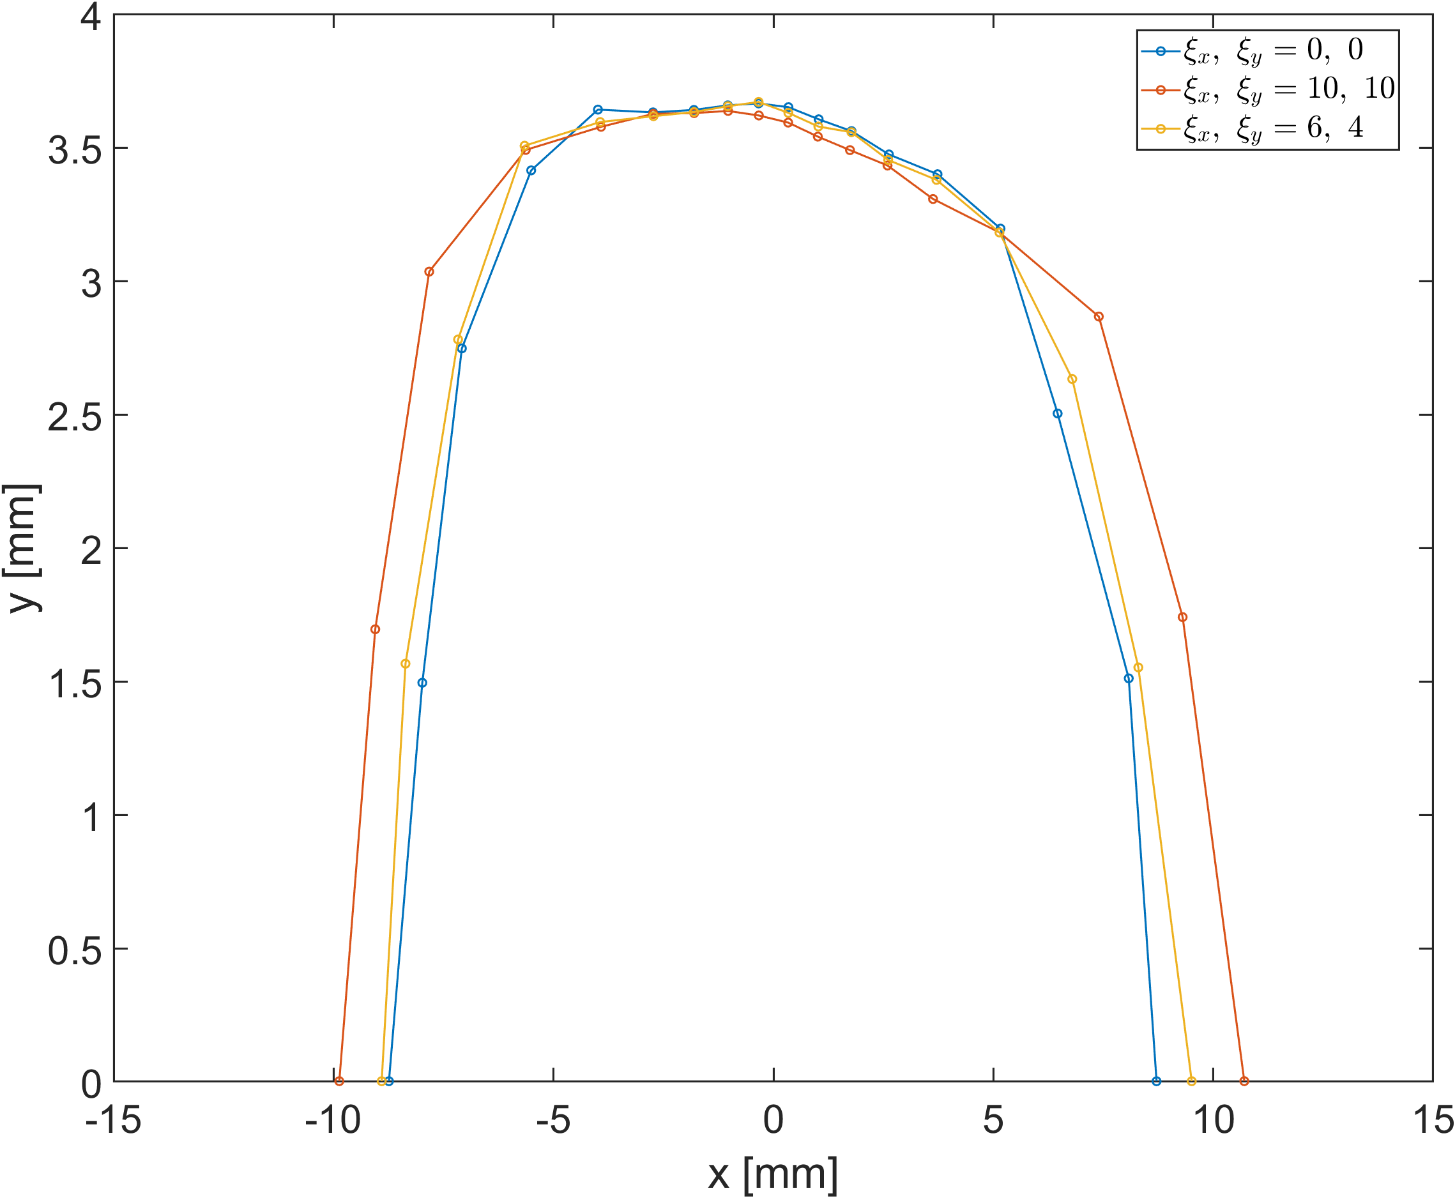
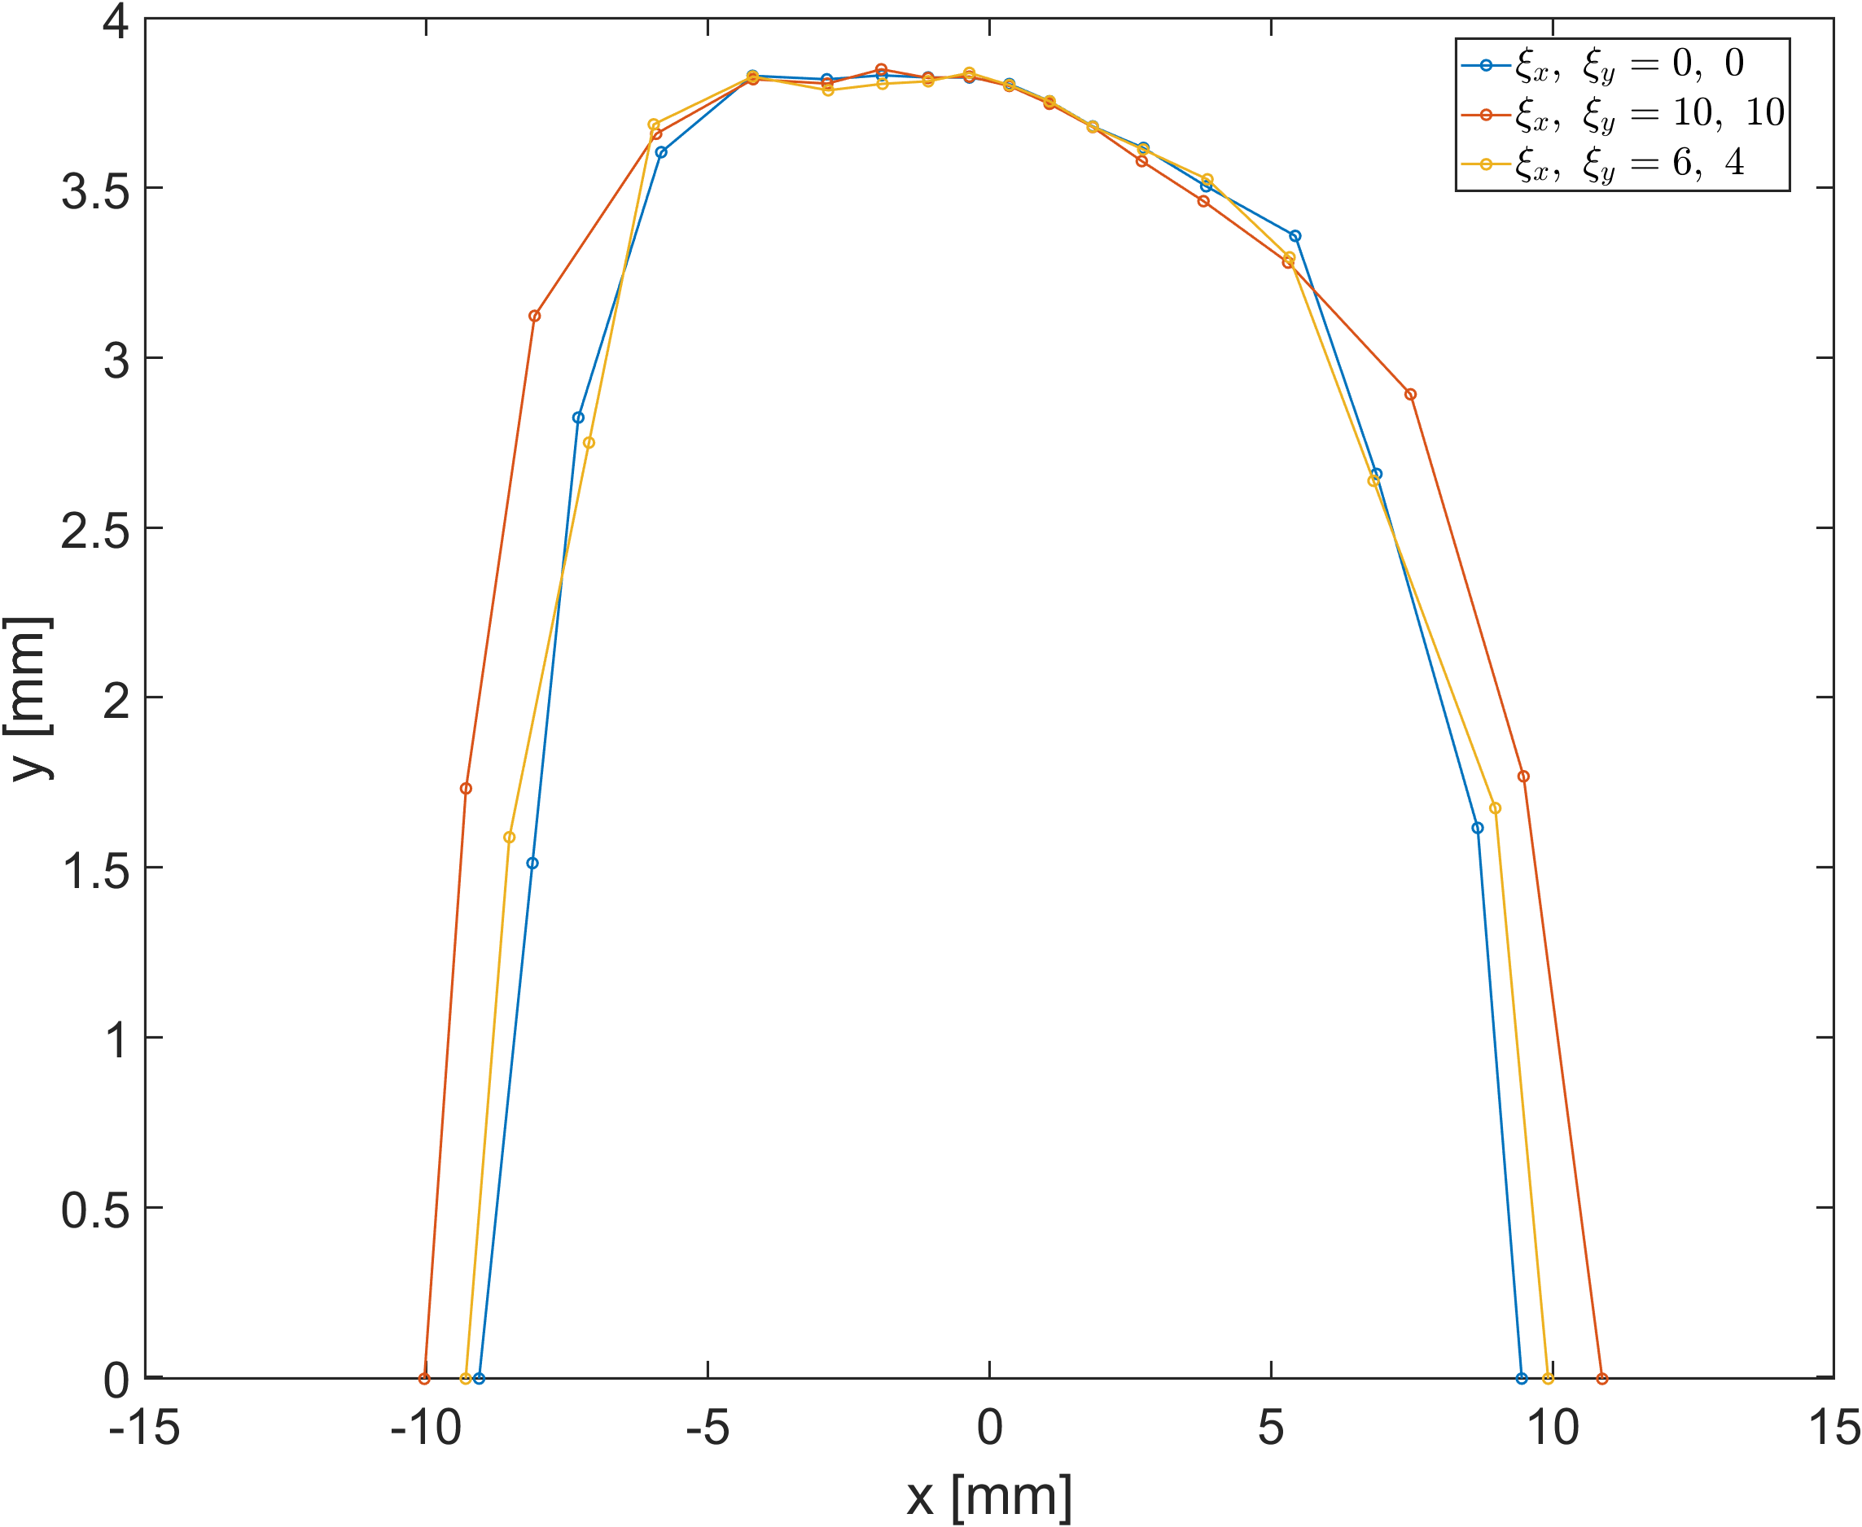
Chromaticity scan DA result – with 3 error seeds
DA calculation for Error2 is in progress..

Slide 12
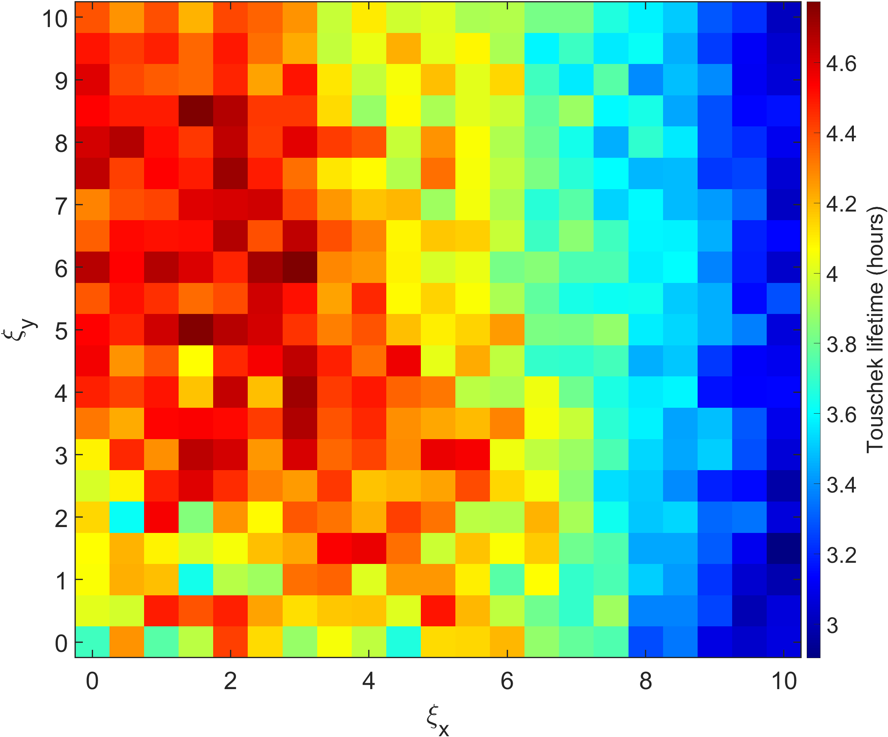
Chromaticity scan – Lifetime difference between with and without error

Slide 13
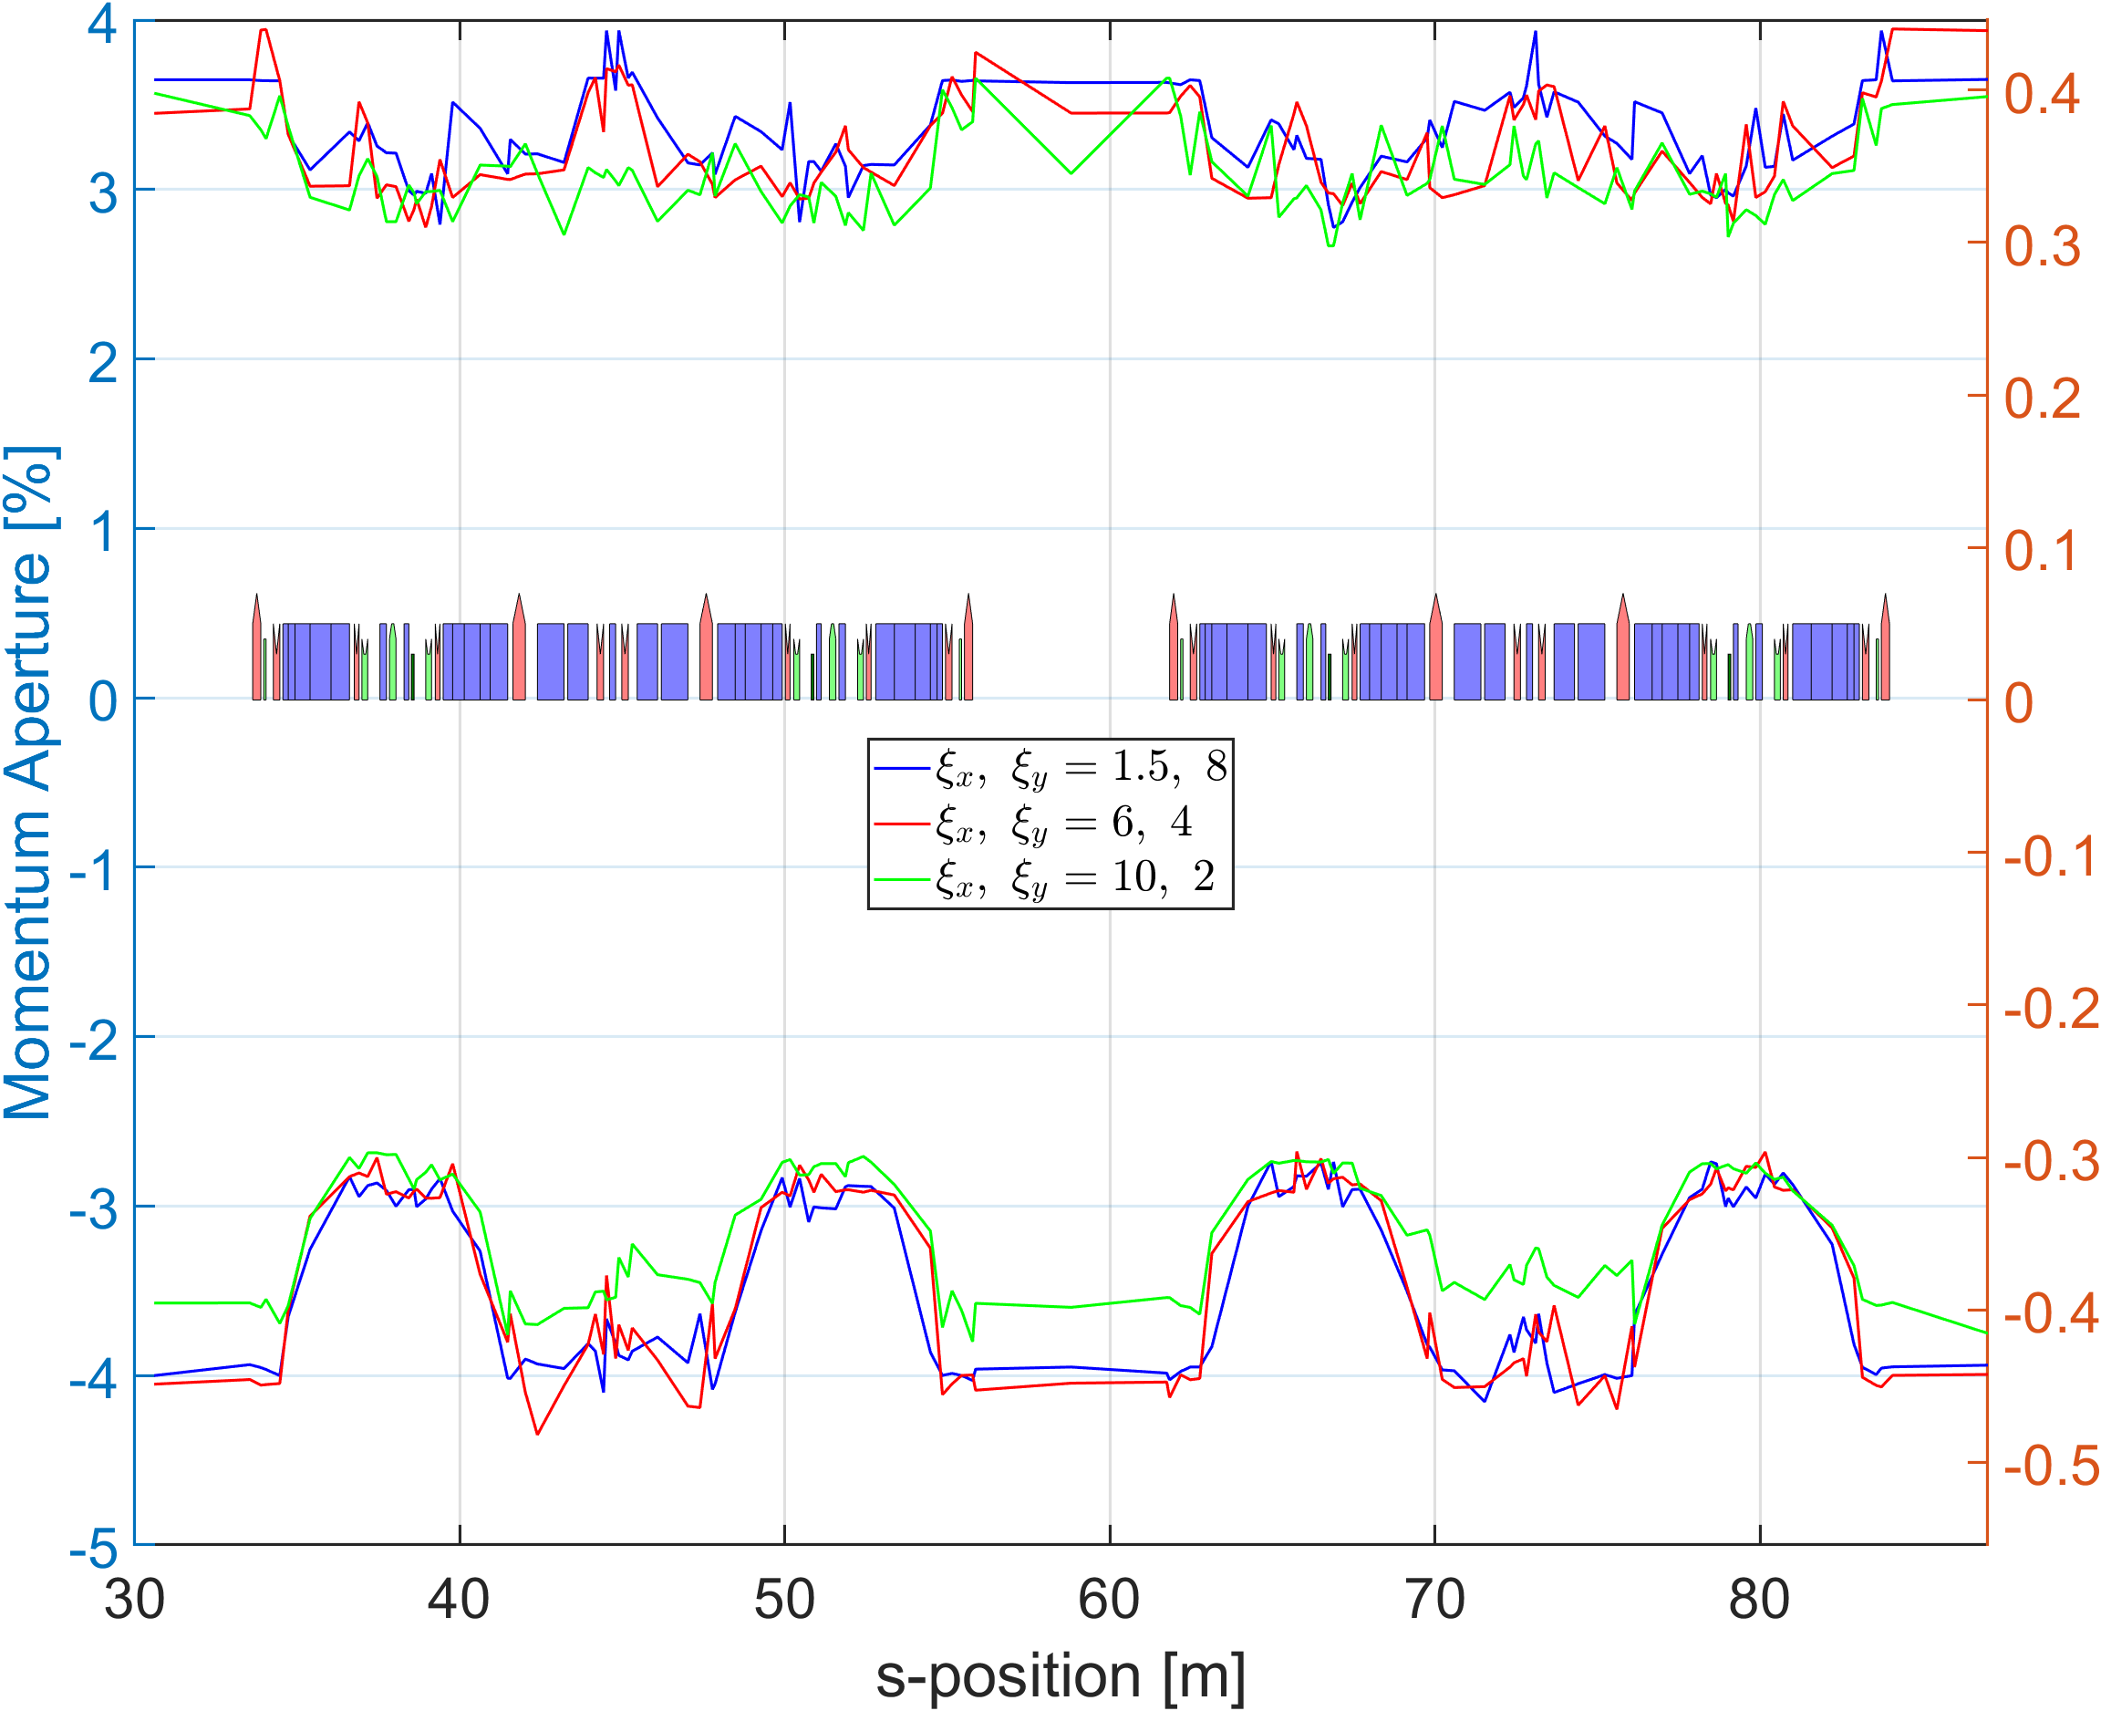
Chromaticity scan – MA calculation about error seed @ 2 unit cells

Slide 14
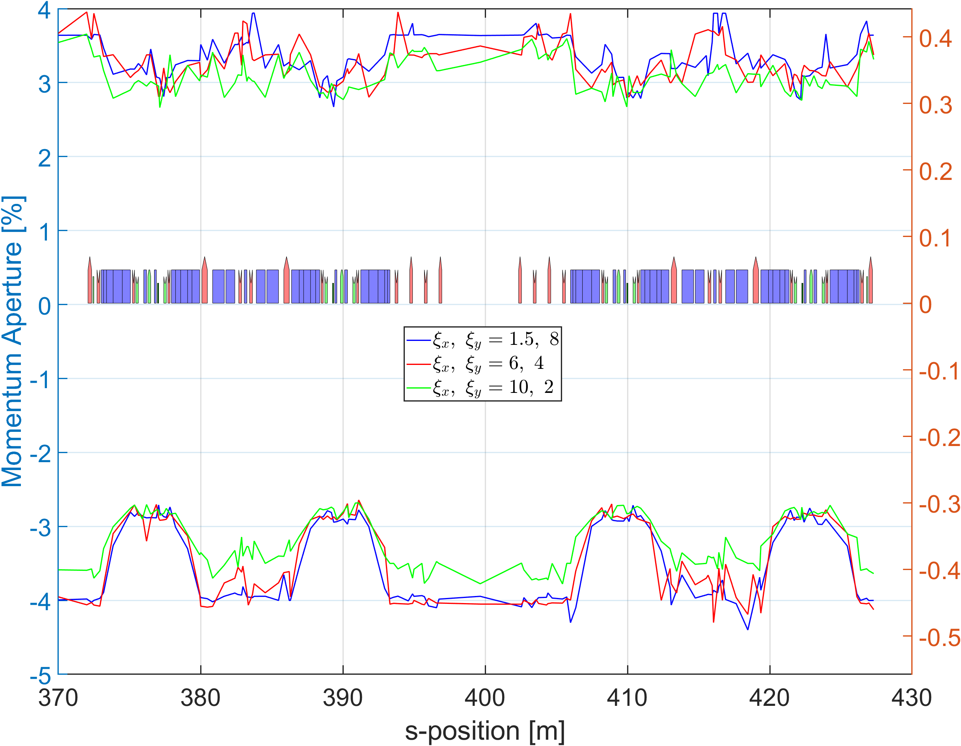
Chromaticity scan – MA calculation about error seed @ HB section
4.84 hrs
4.33 hrs
3.07 hrs

Slide 15
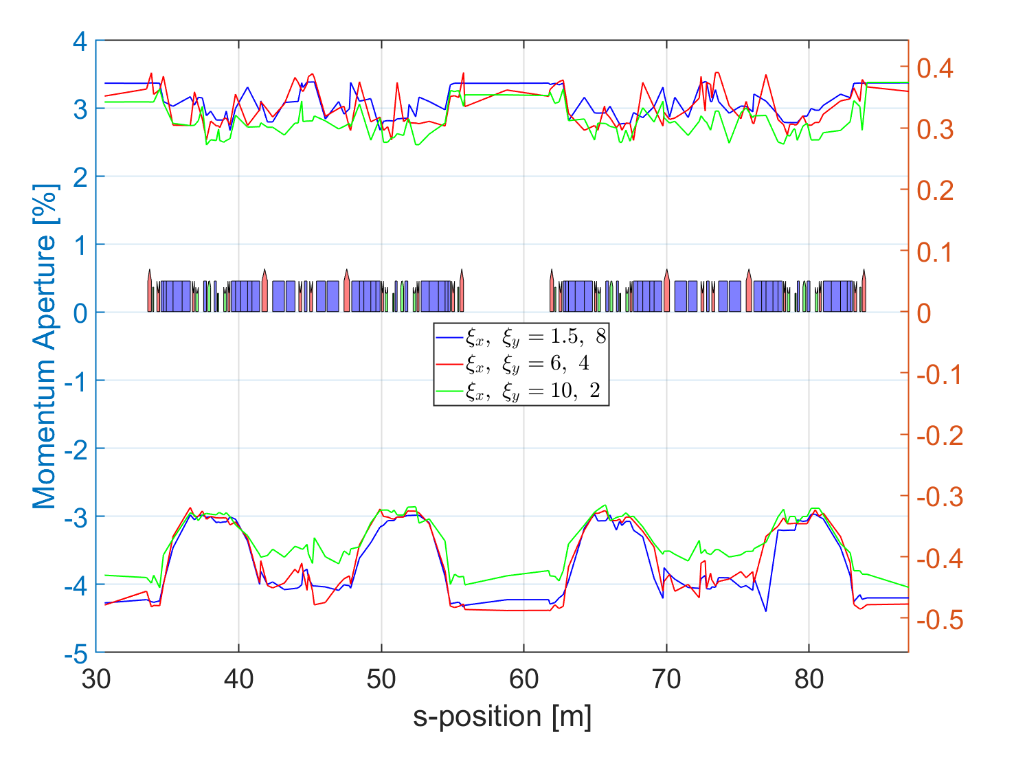
Chromaticity scan – MA calculation about error seed @ 2 unit cells

Slide 16
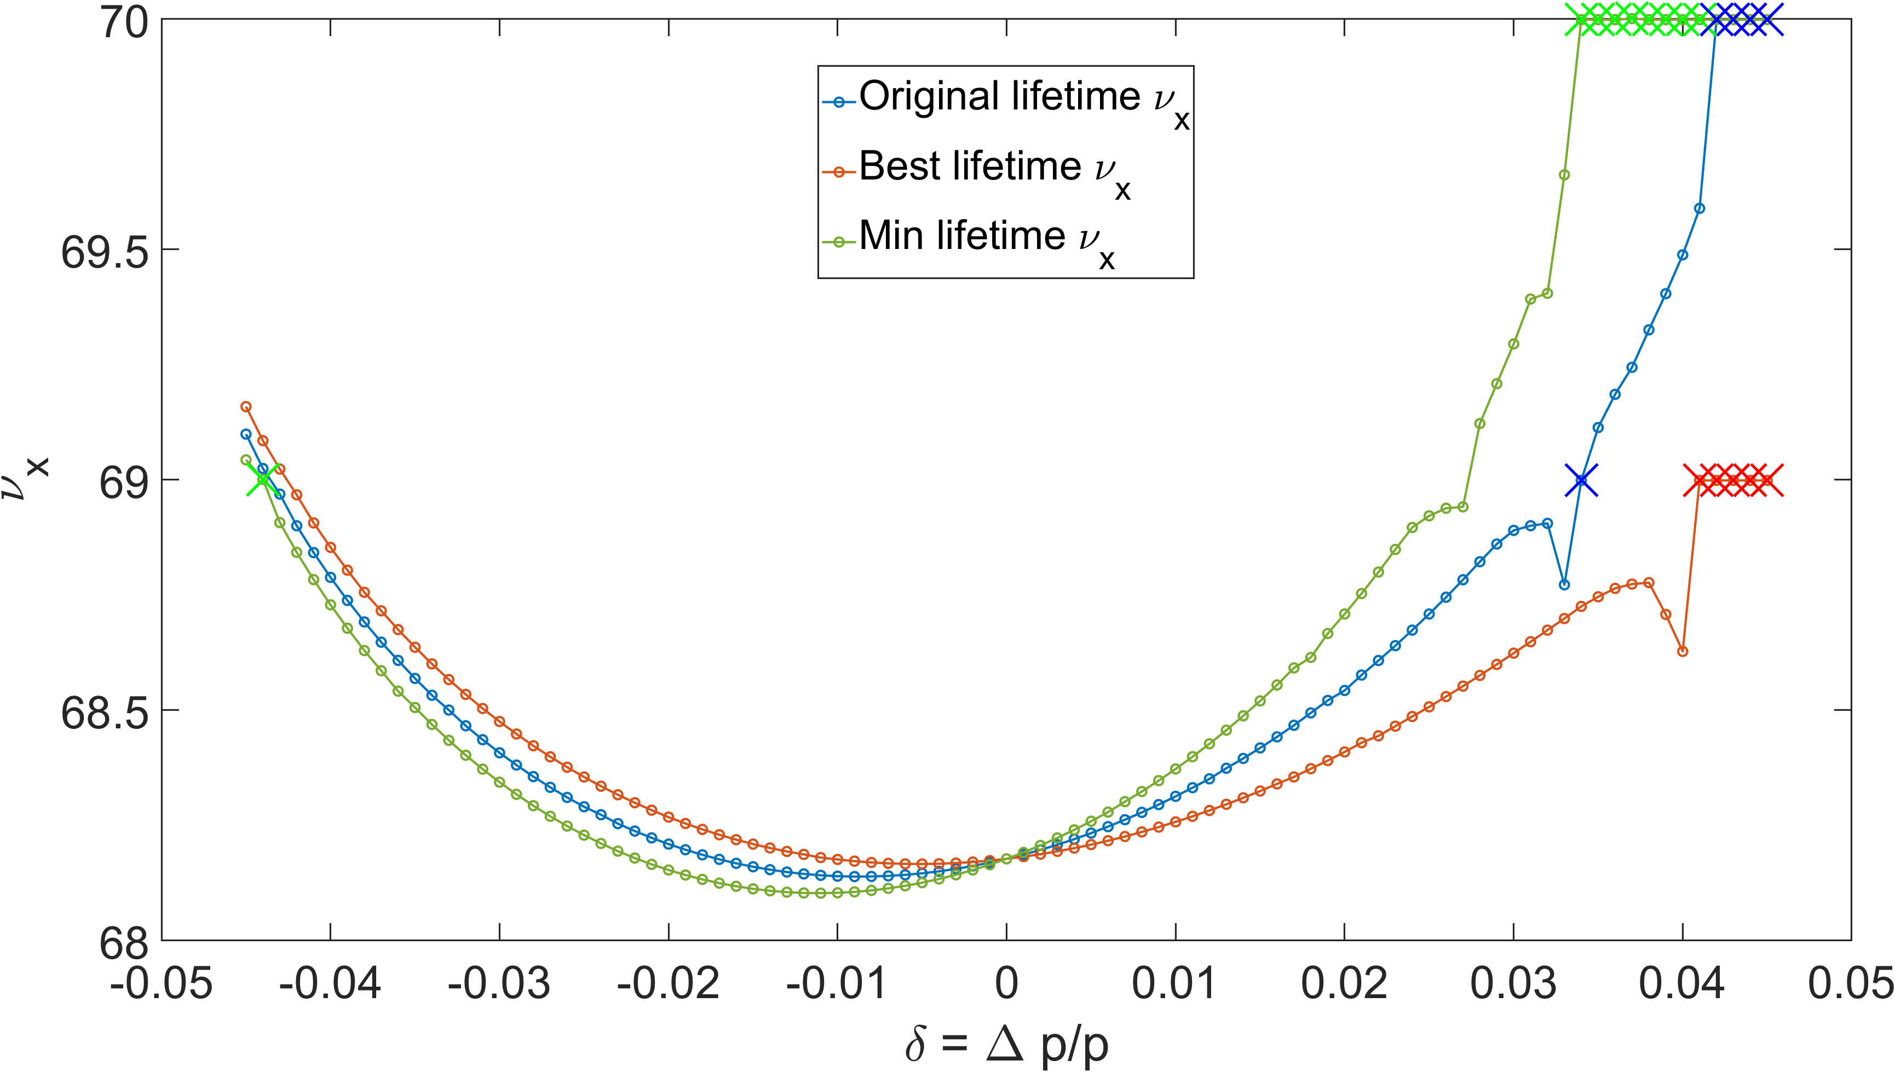
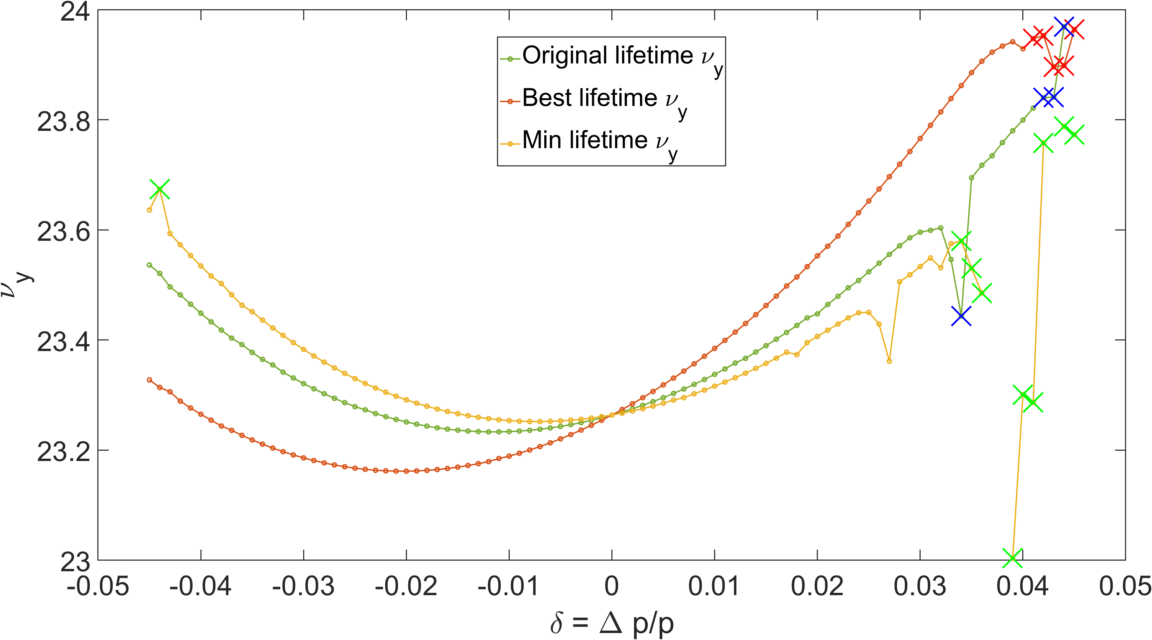
Chromaticity scan – MDTS curve in High beta section

Slide 17
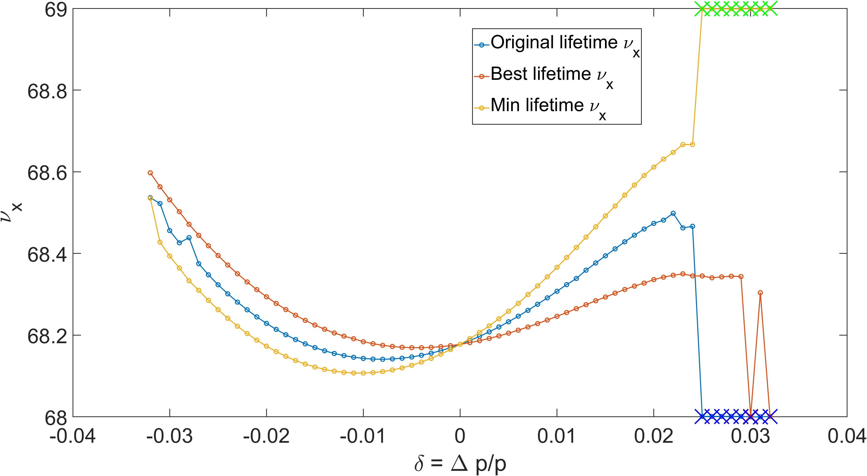
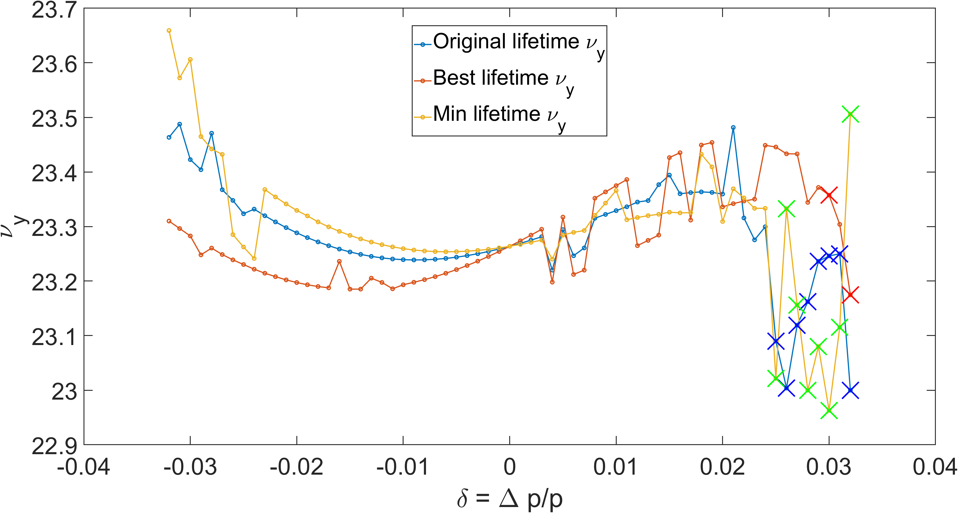
Chromaticity scan – MDTS curve in dispersion bump (S32)

Slide 18
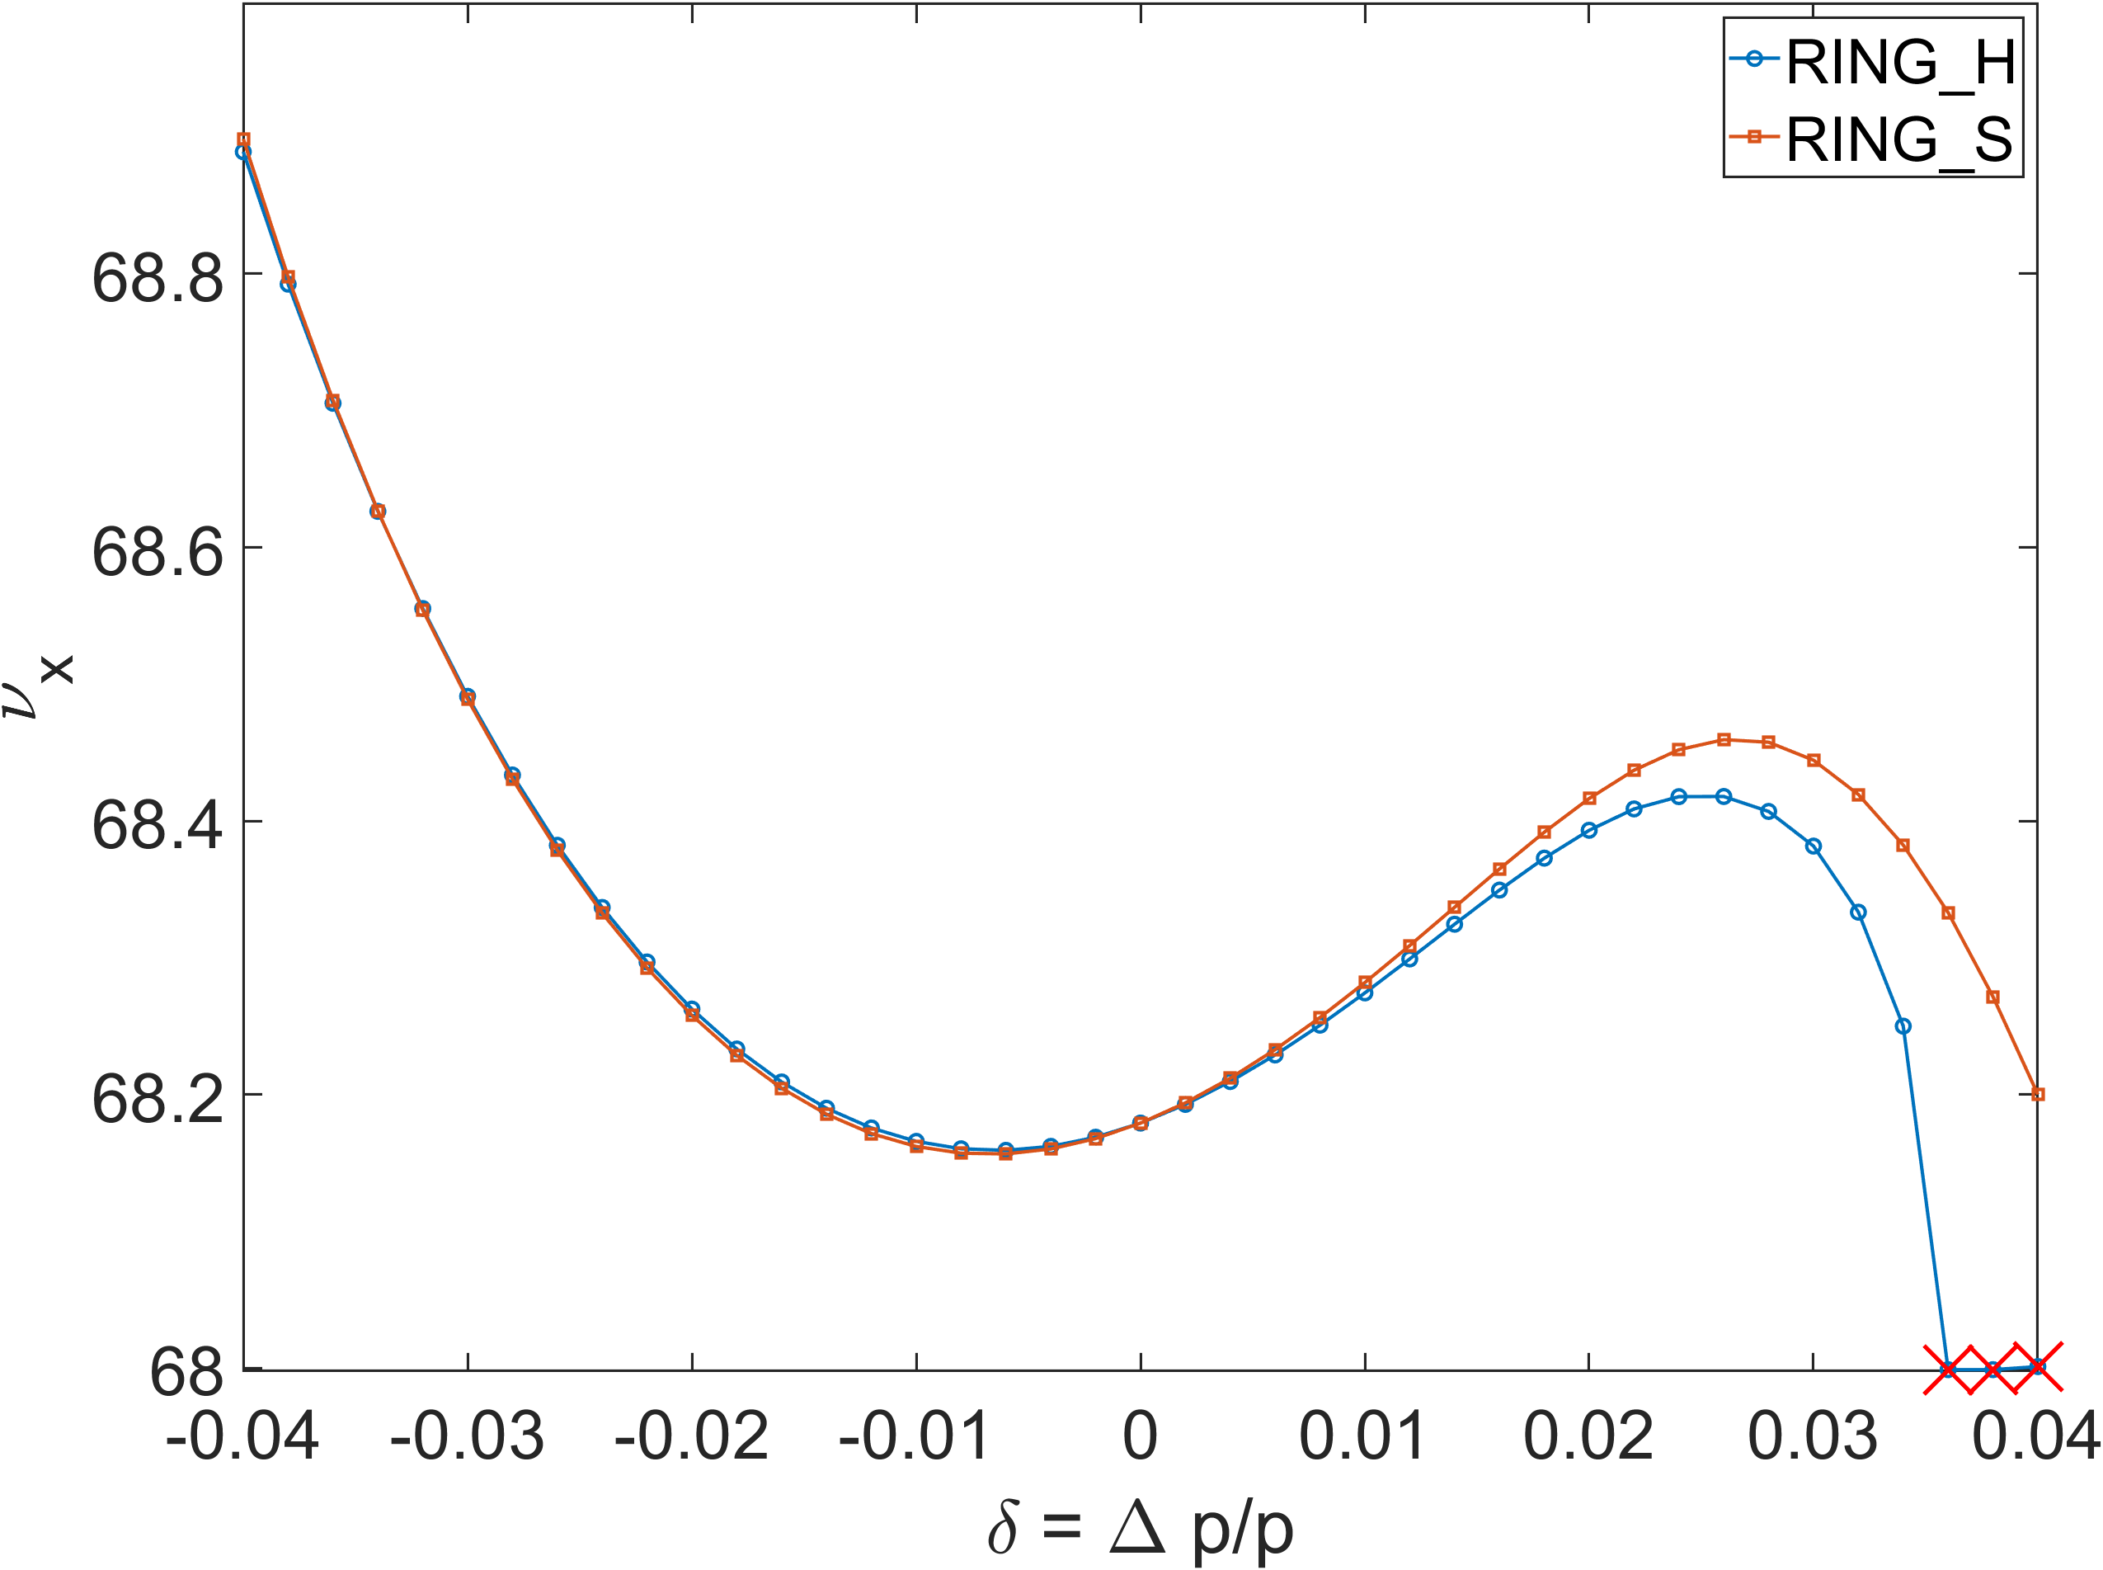
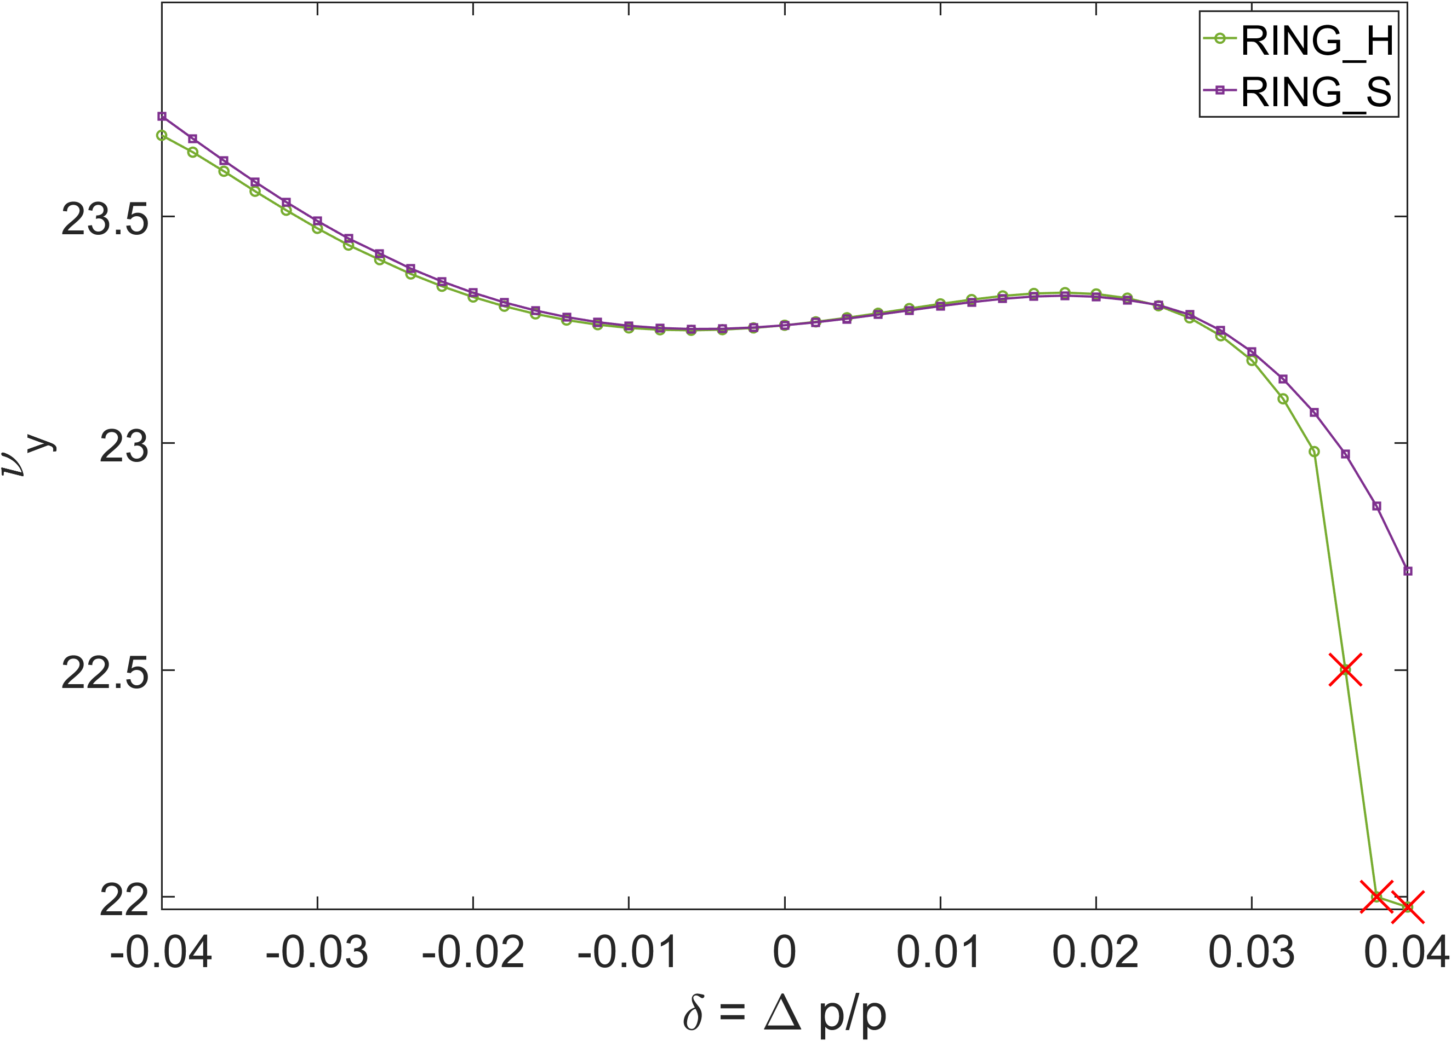
Chromaticity scan – MA calculation about error seed
Survive @ integer tune

Slide 19
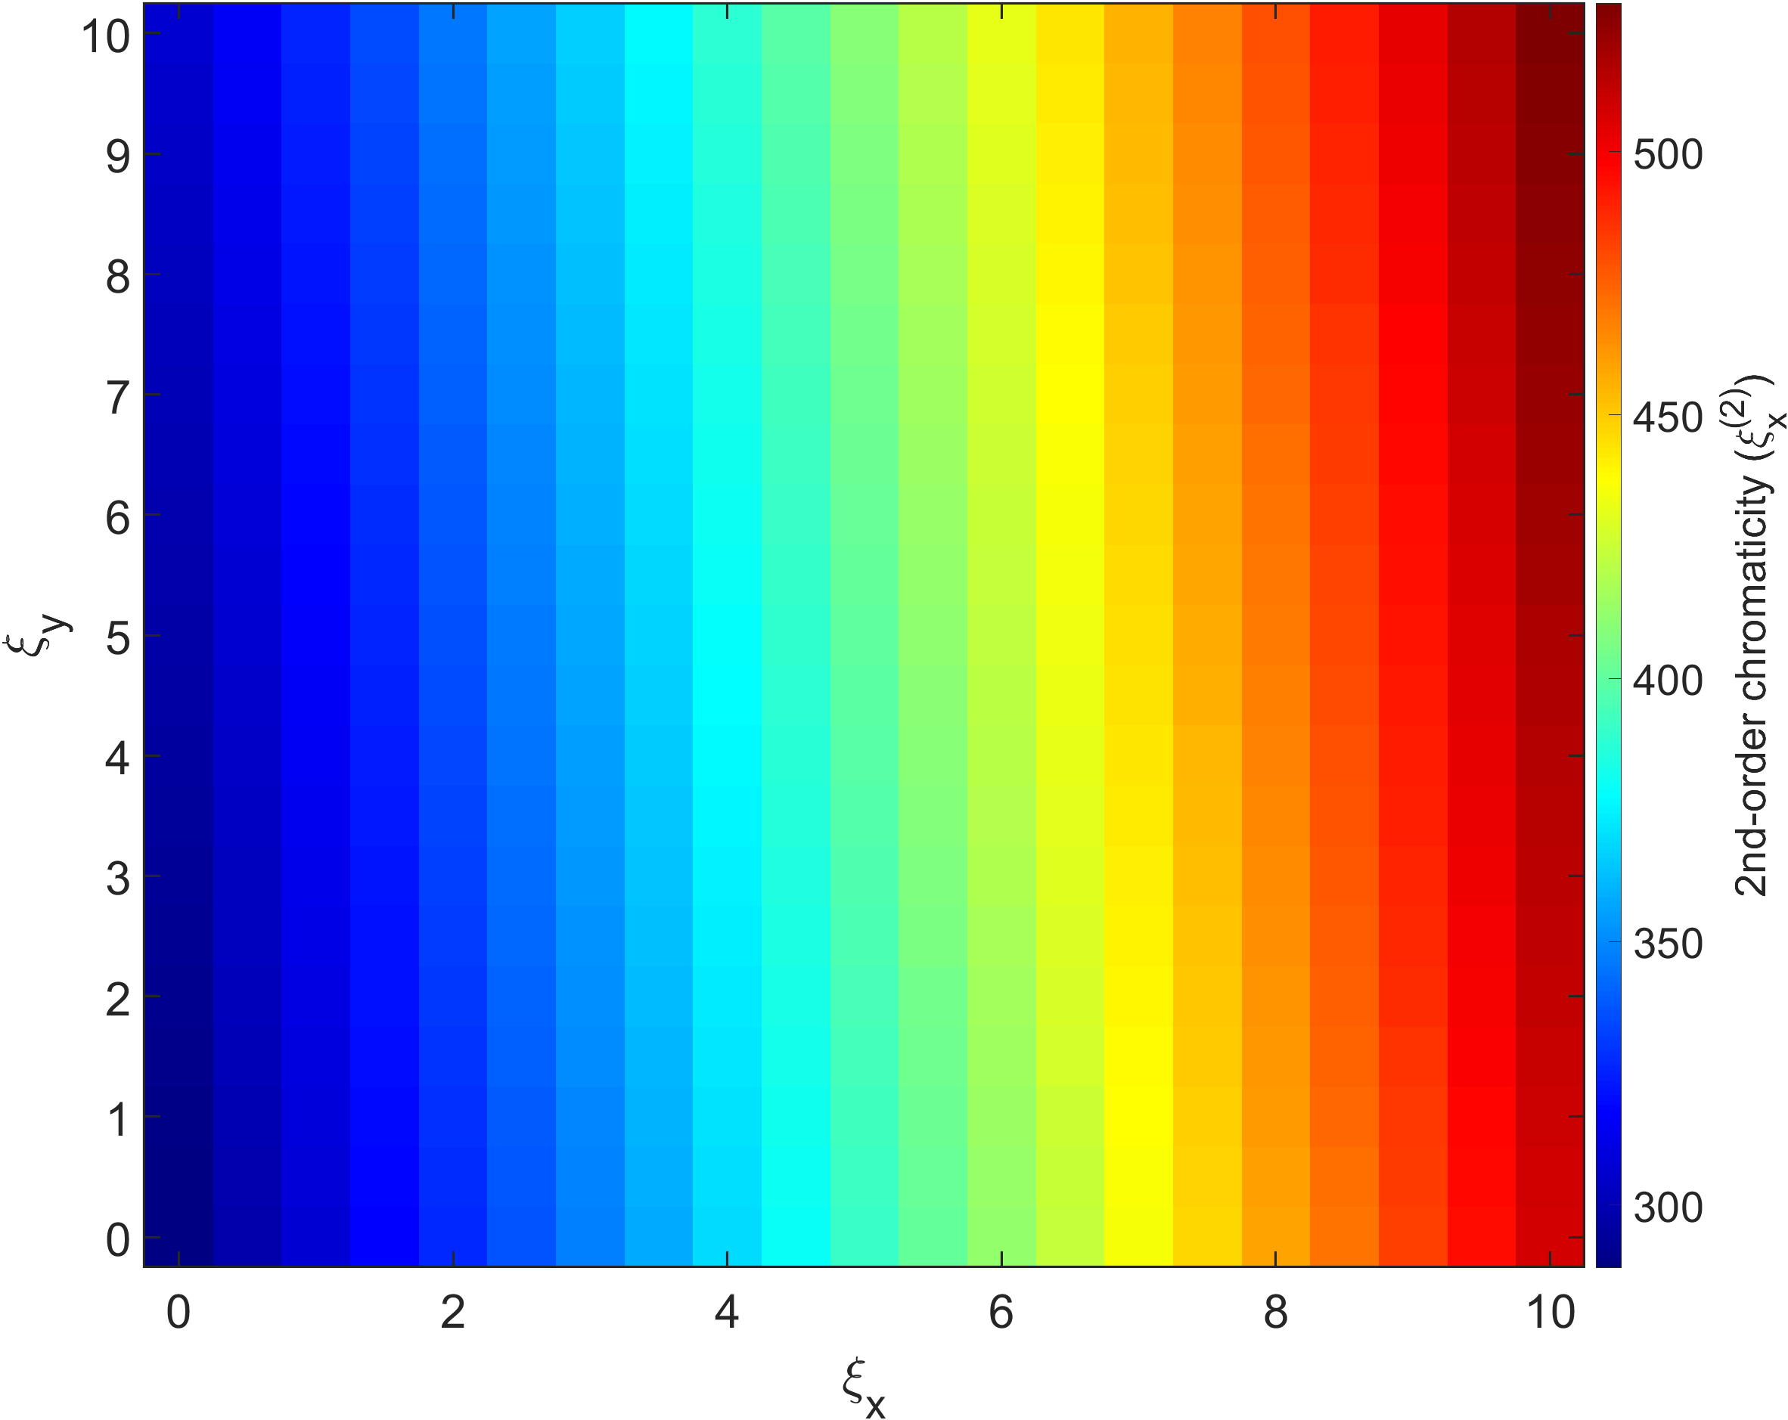
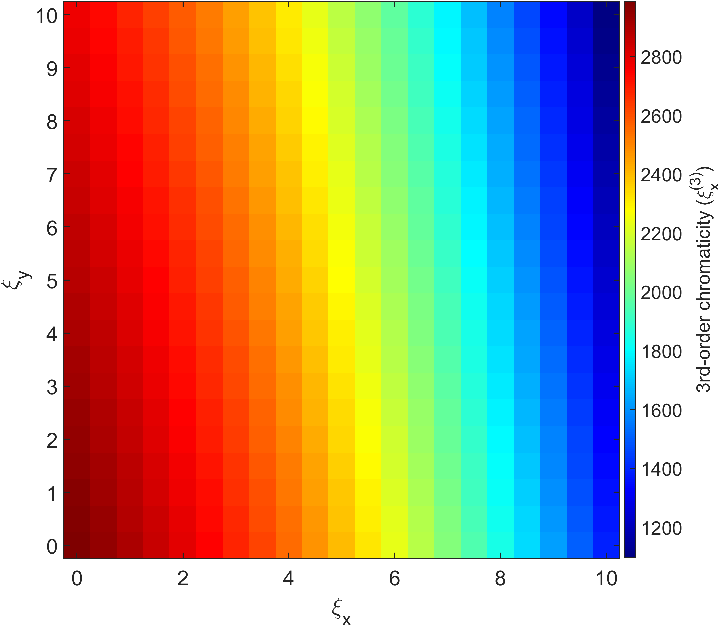
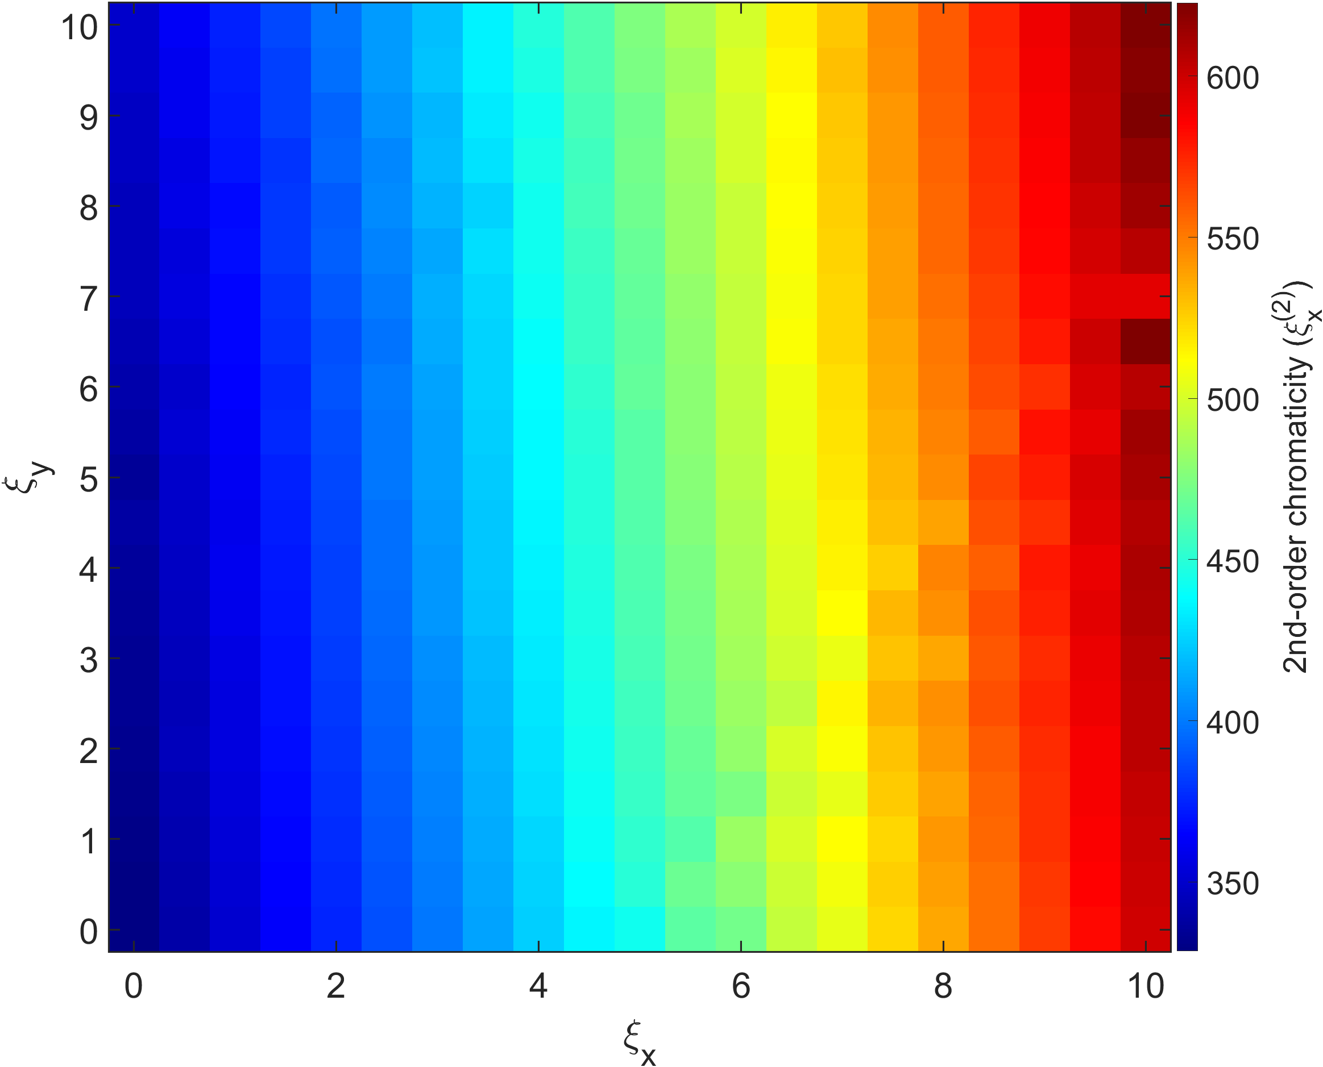
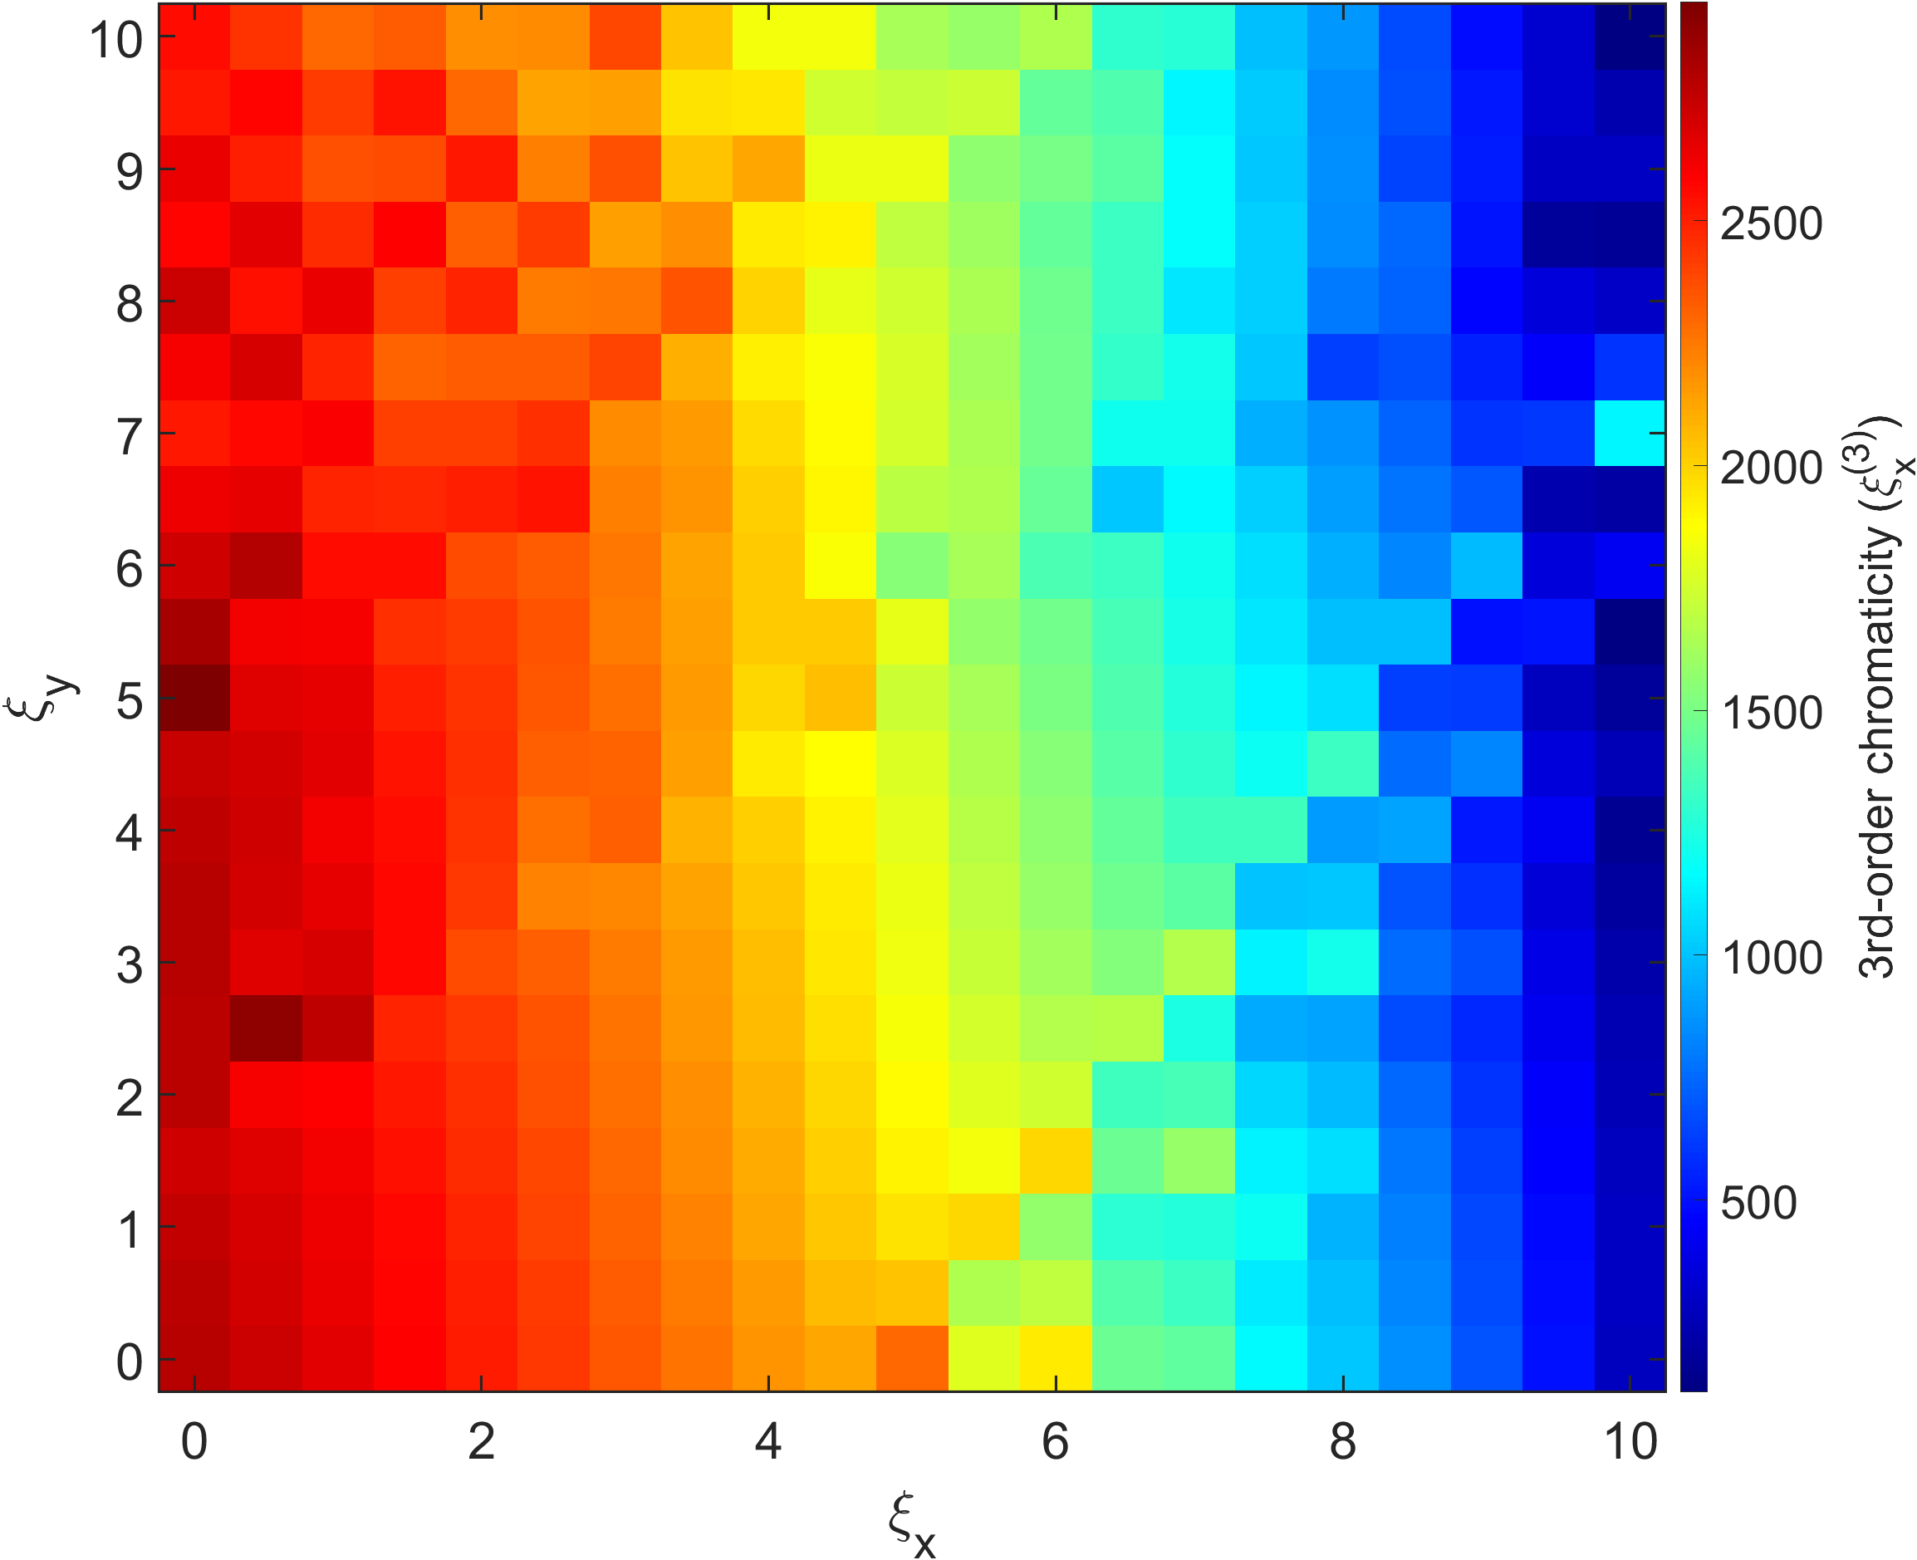
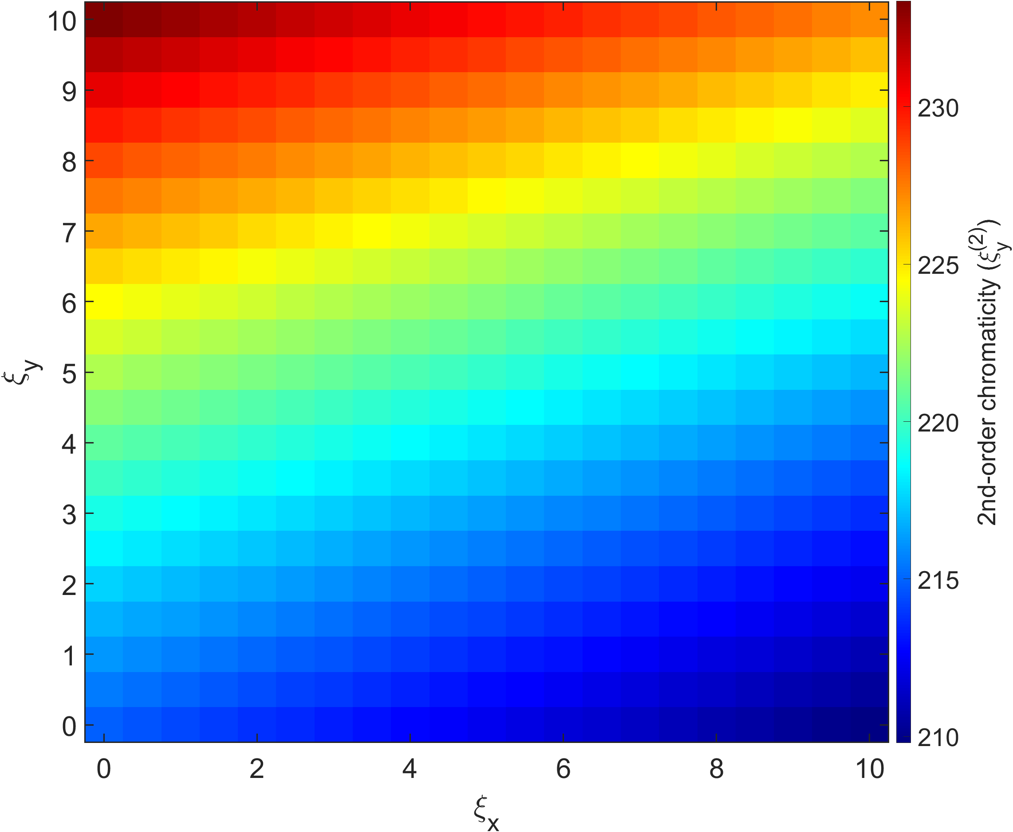
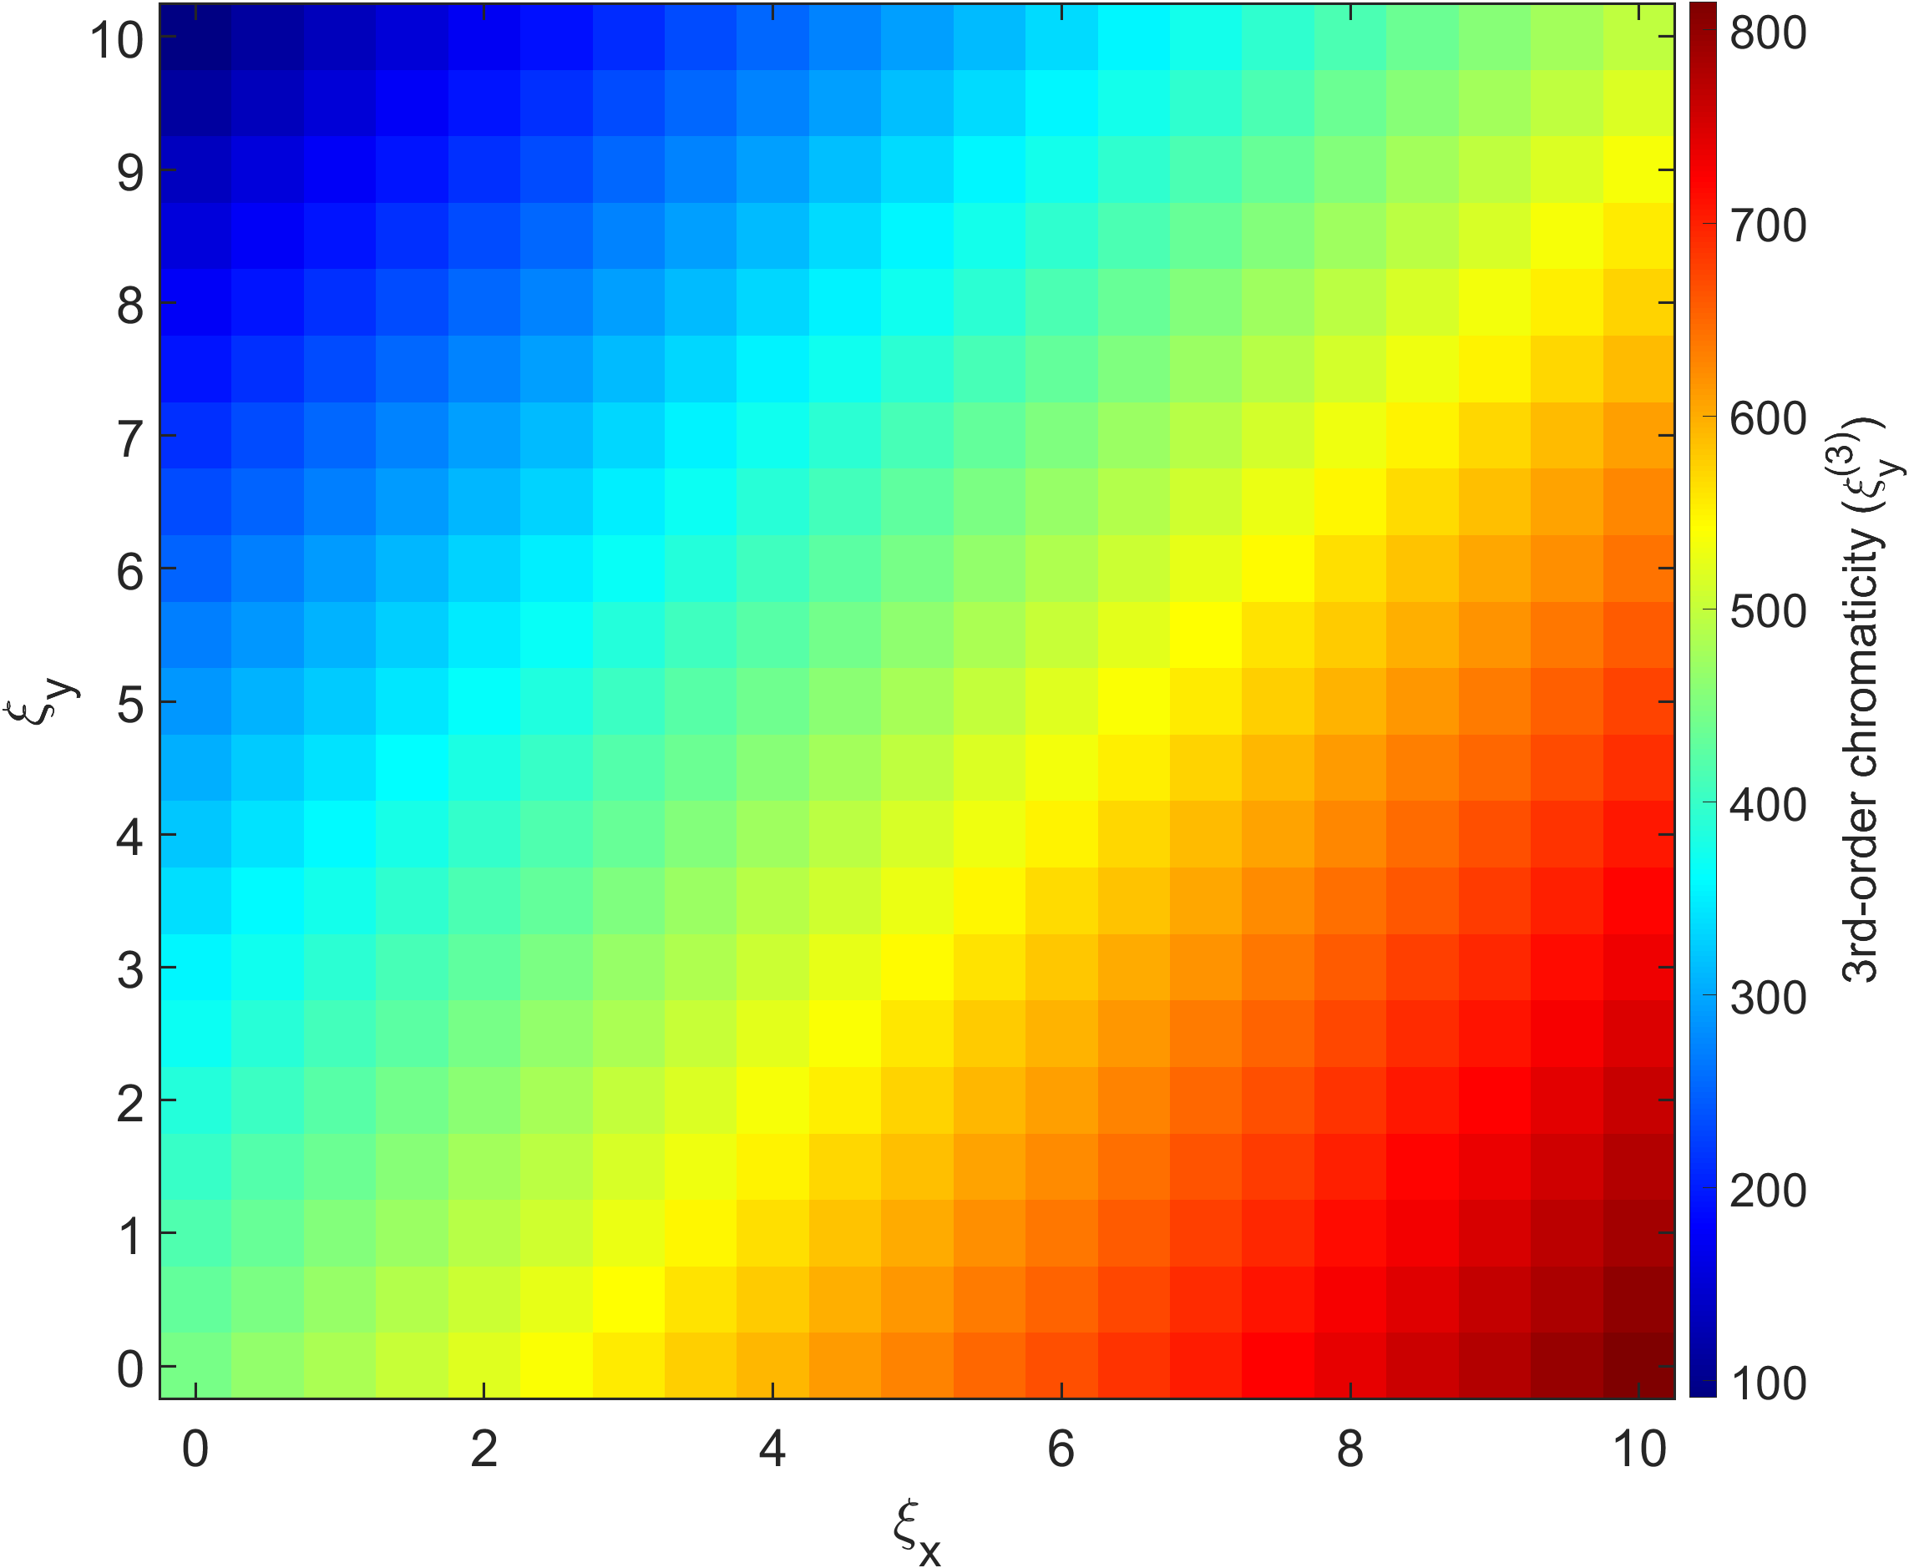
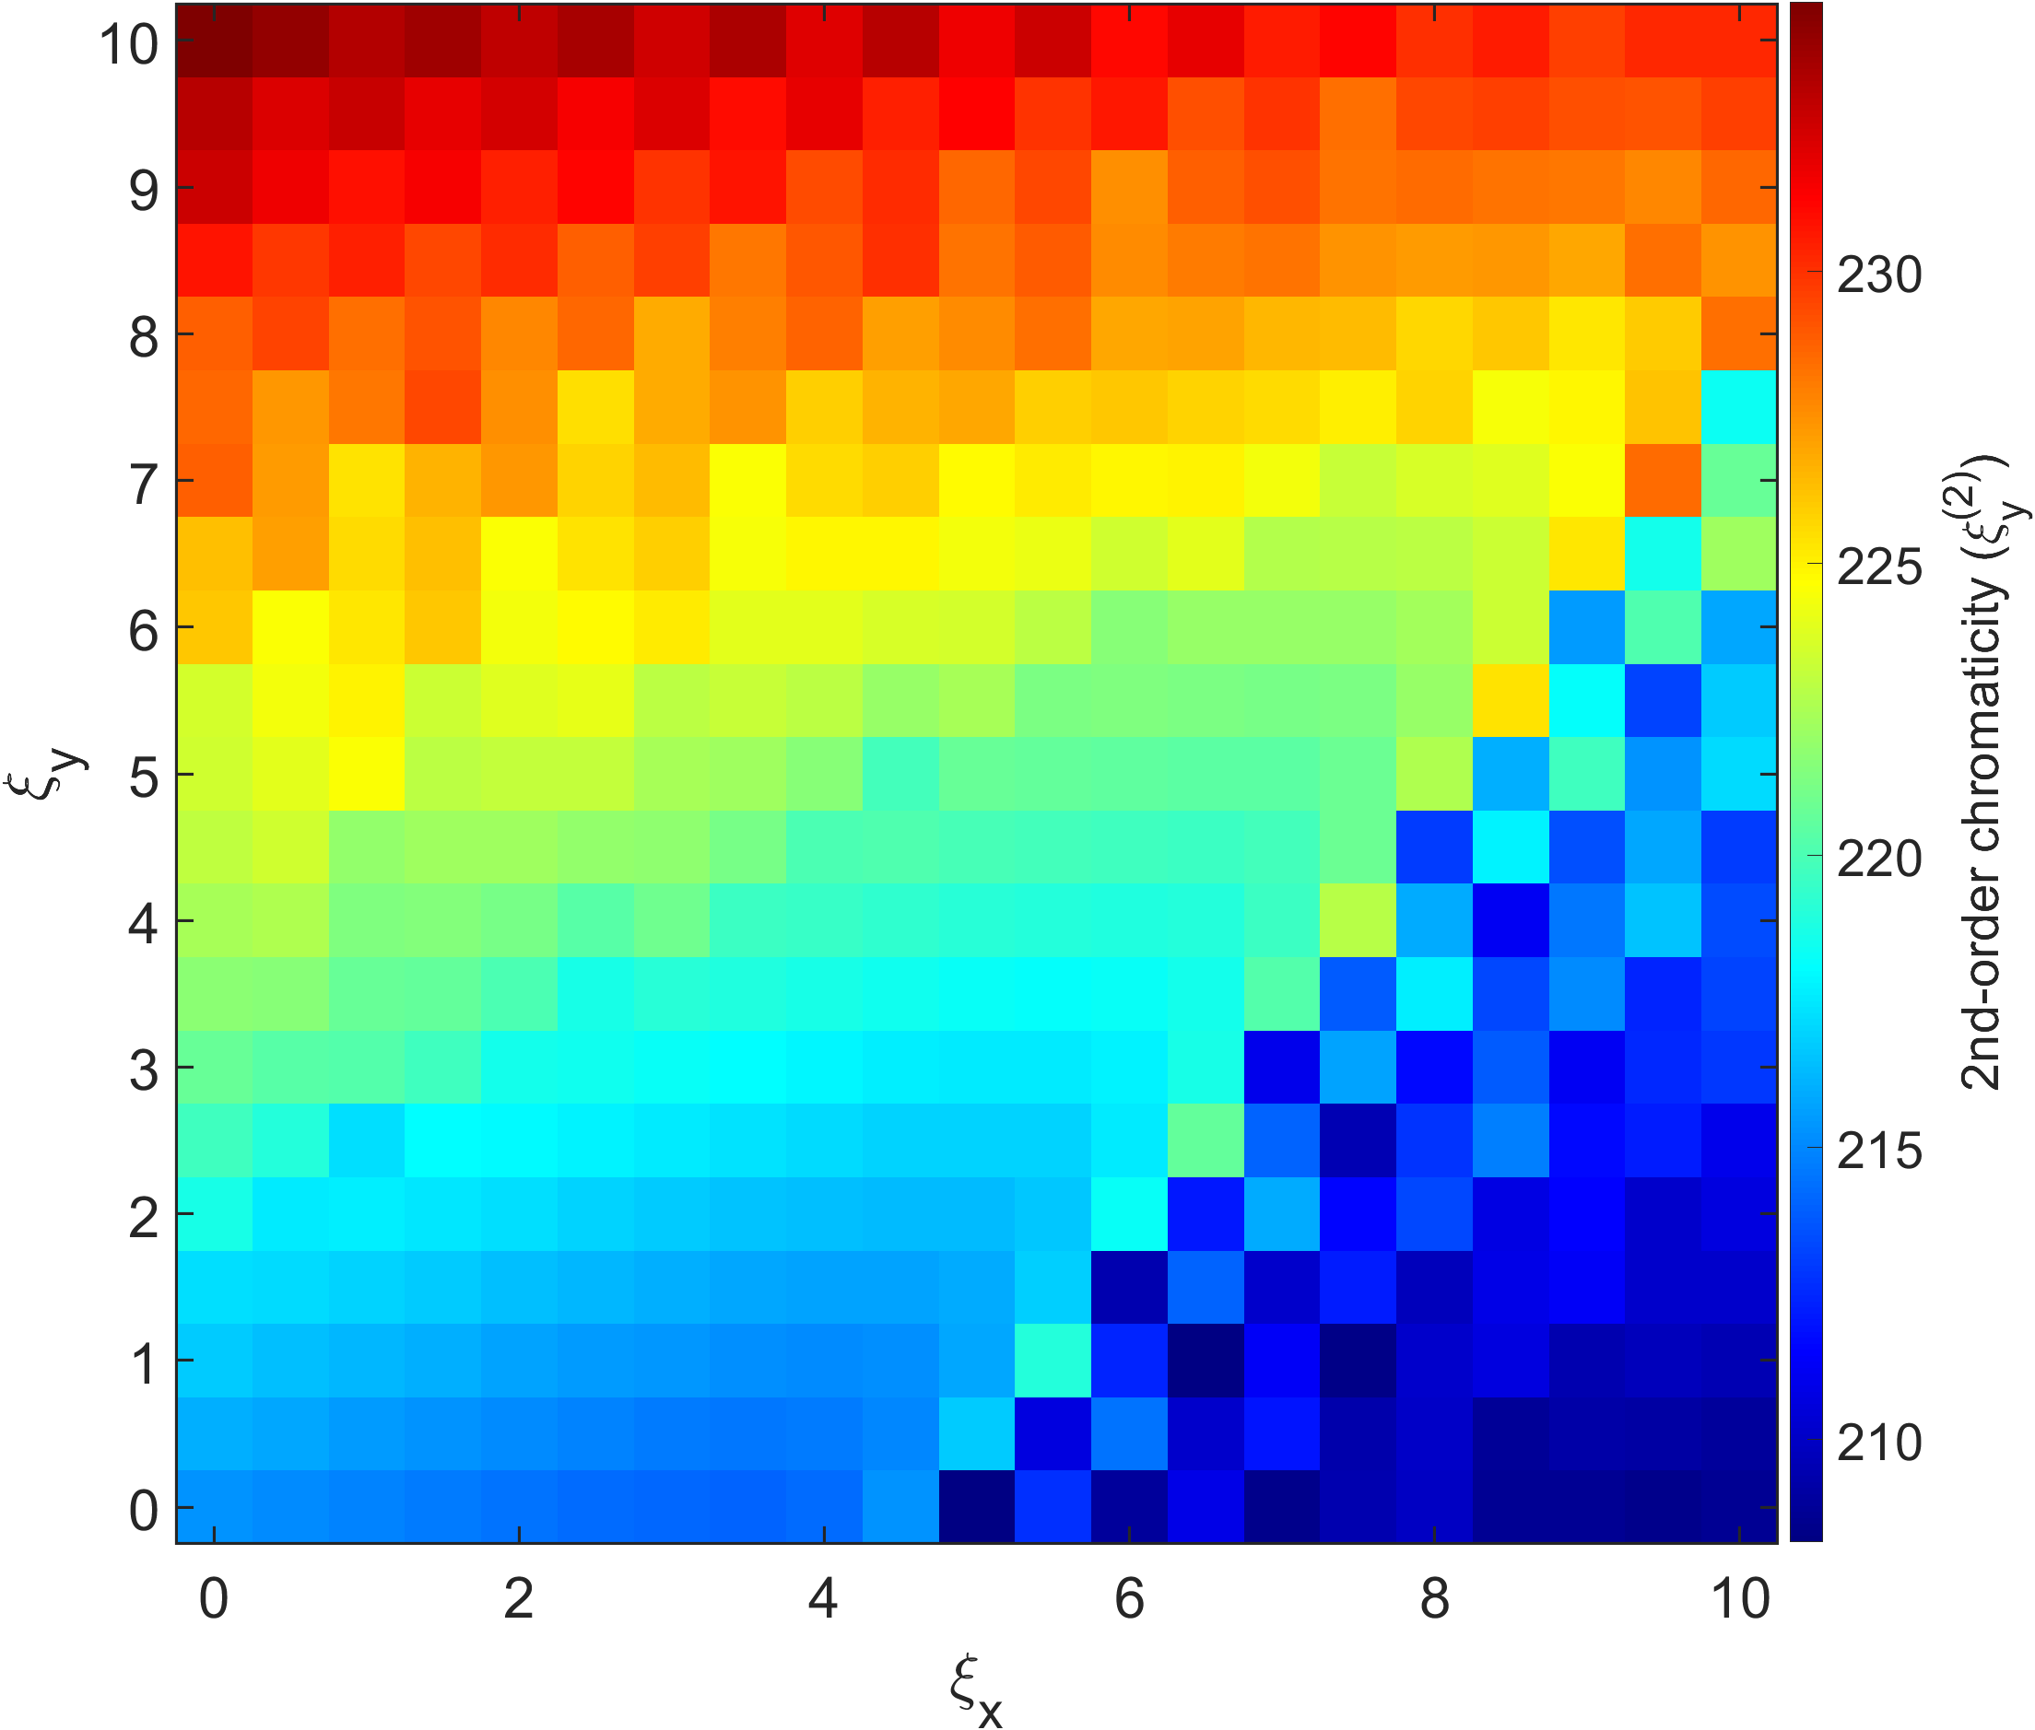
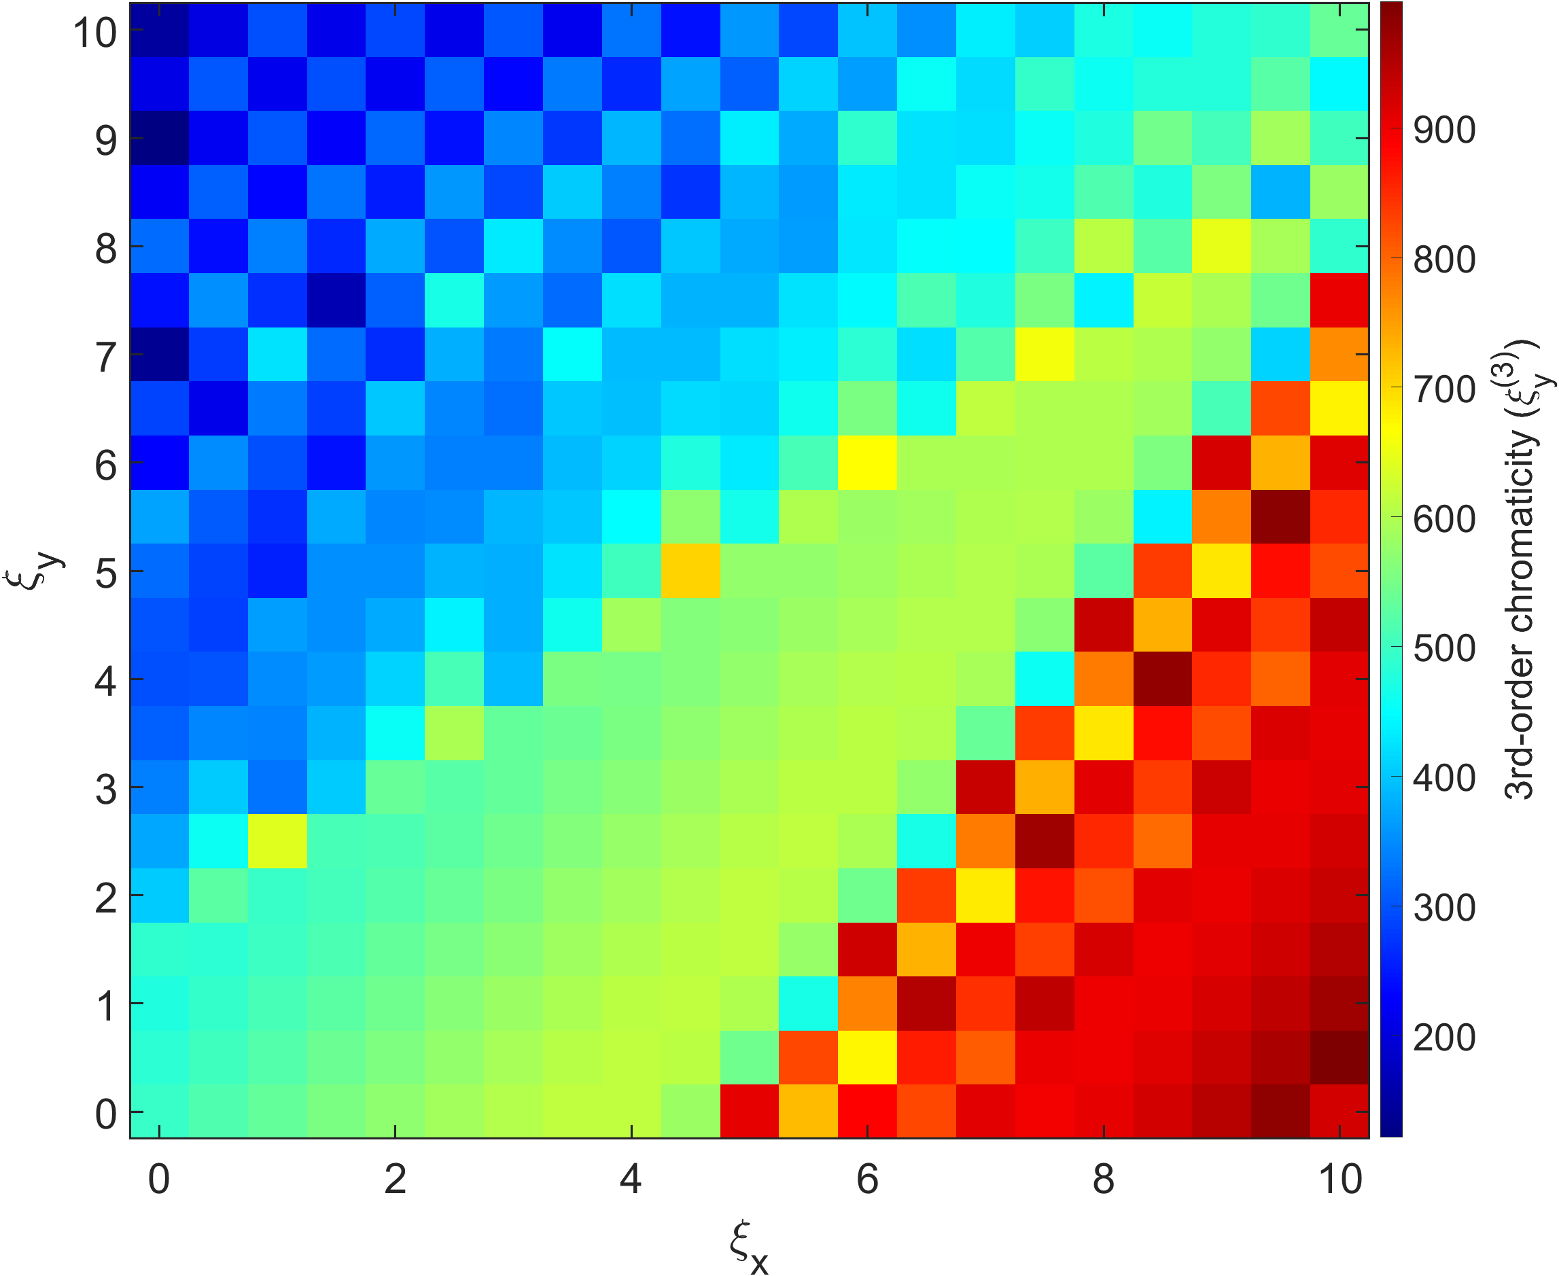
2nd order chromaticity and 3rd order chromaticity without error @ HB section
w/ error
w/o error

Slide 20
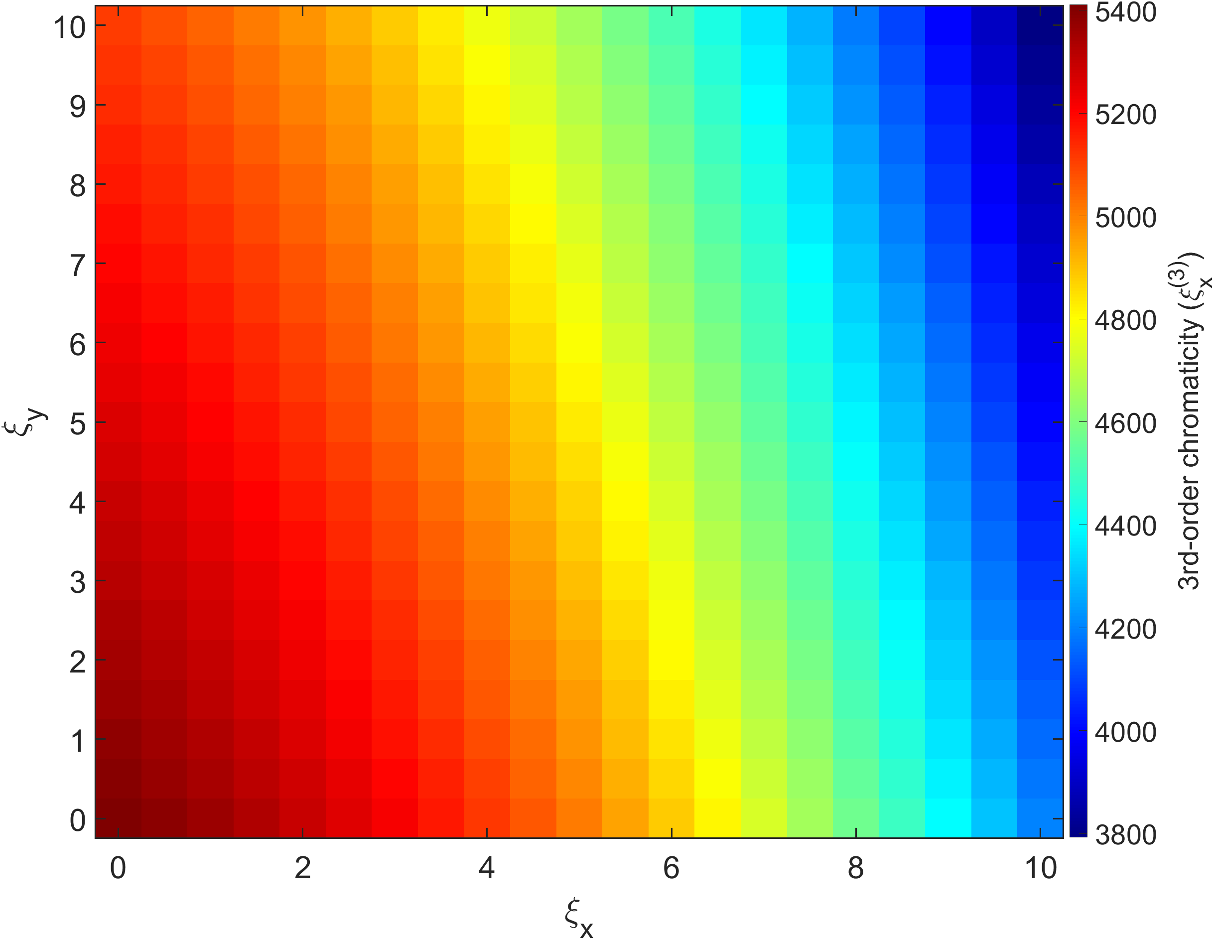
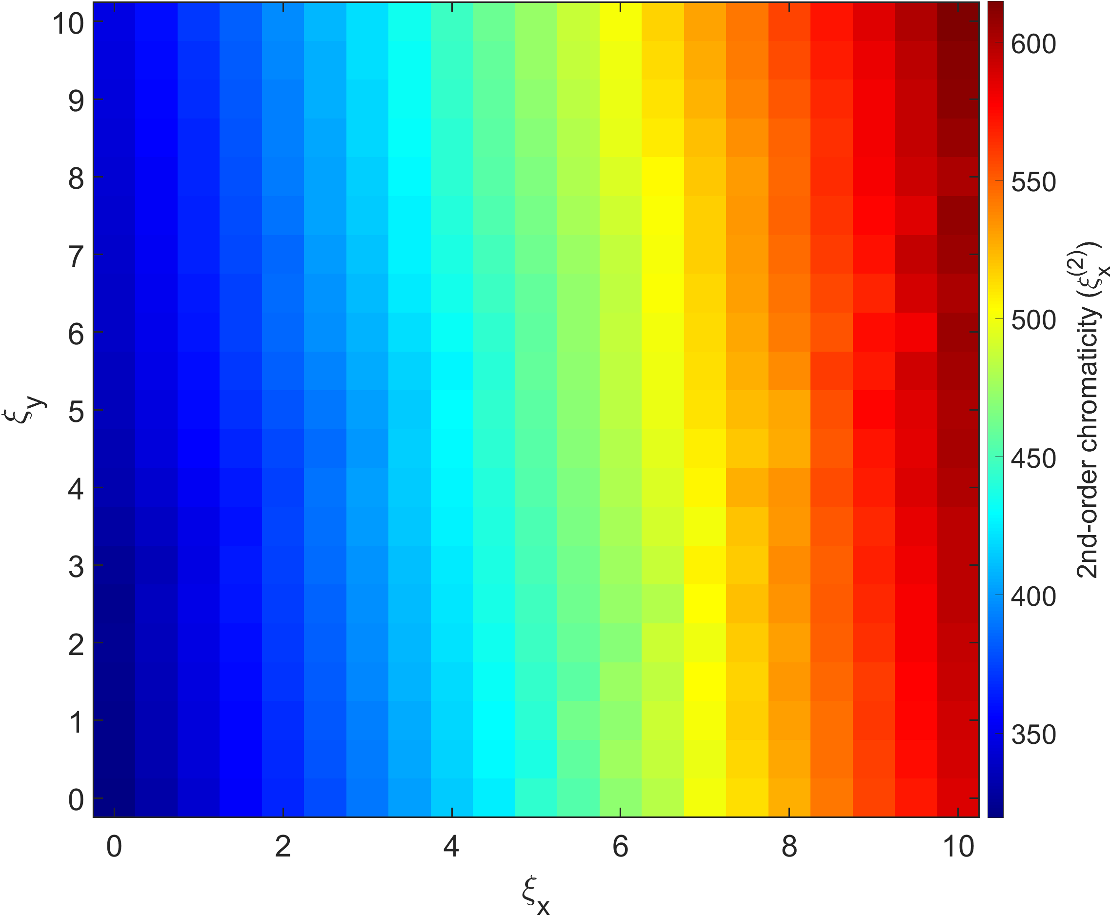
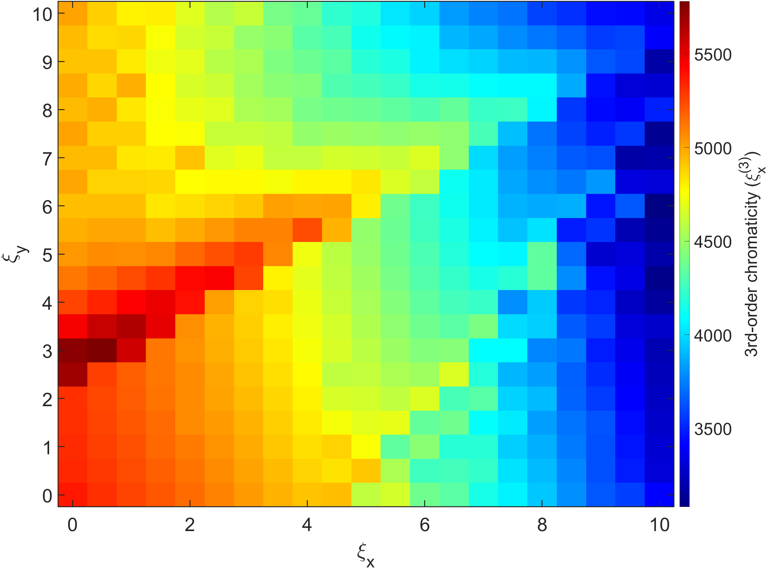
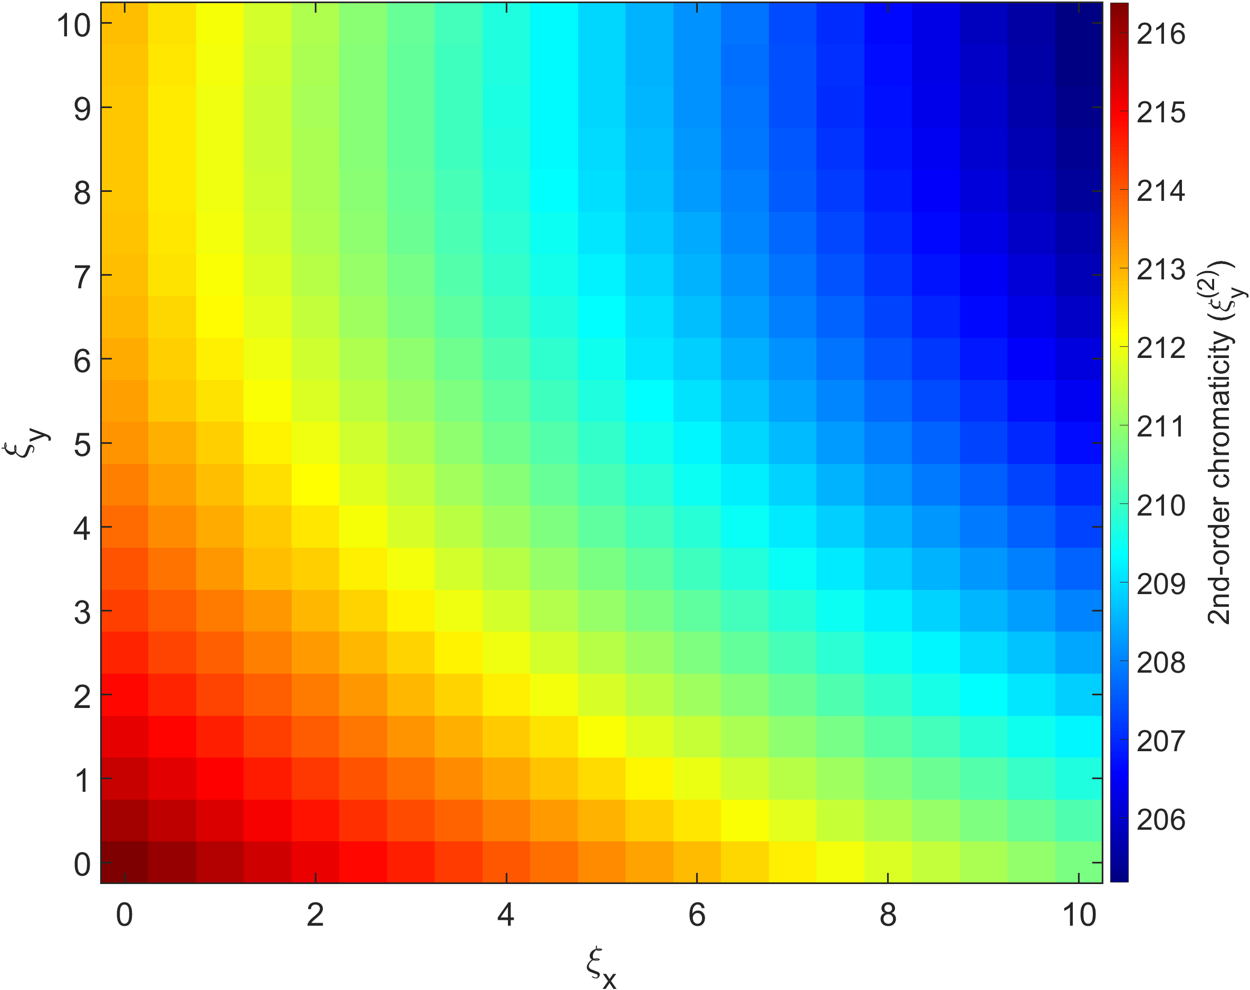
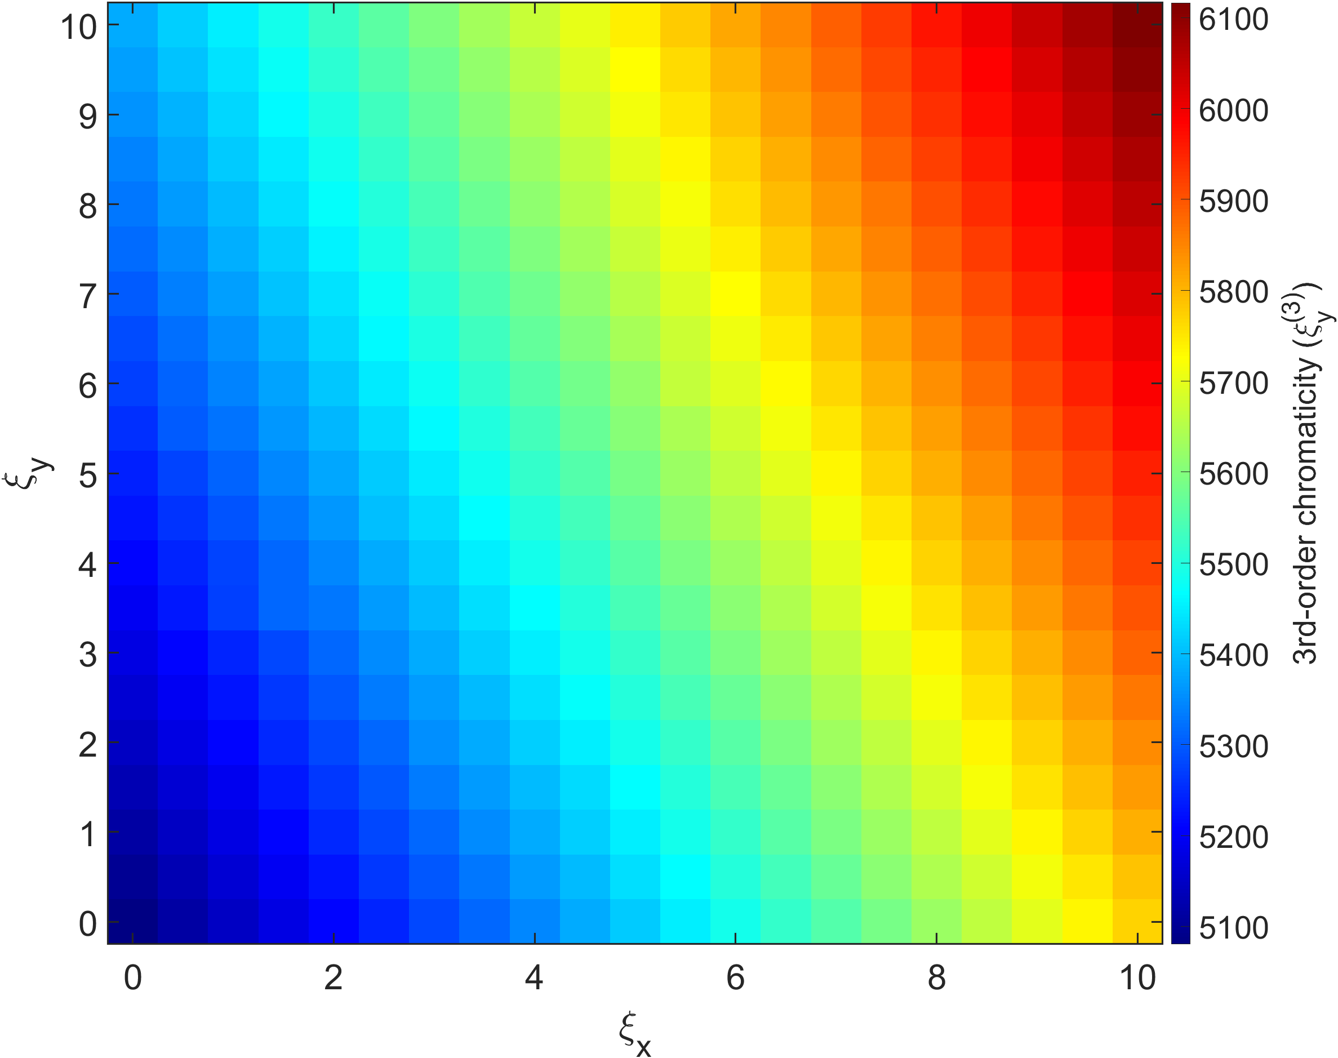
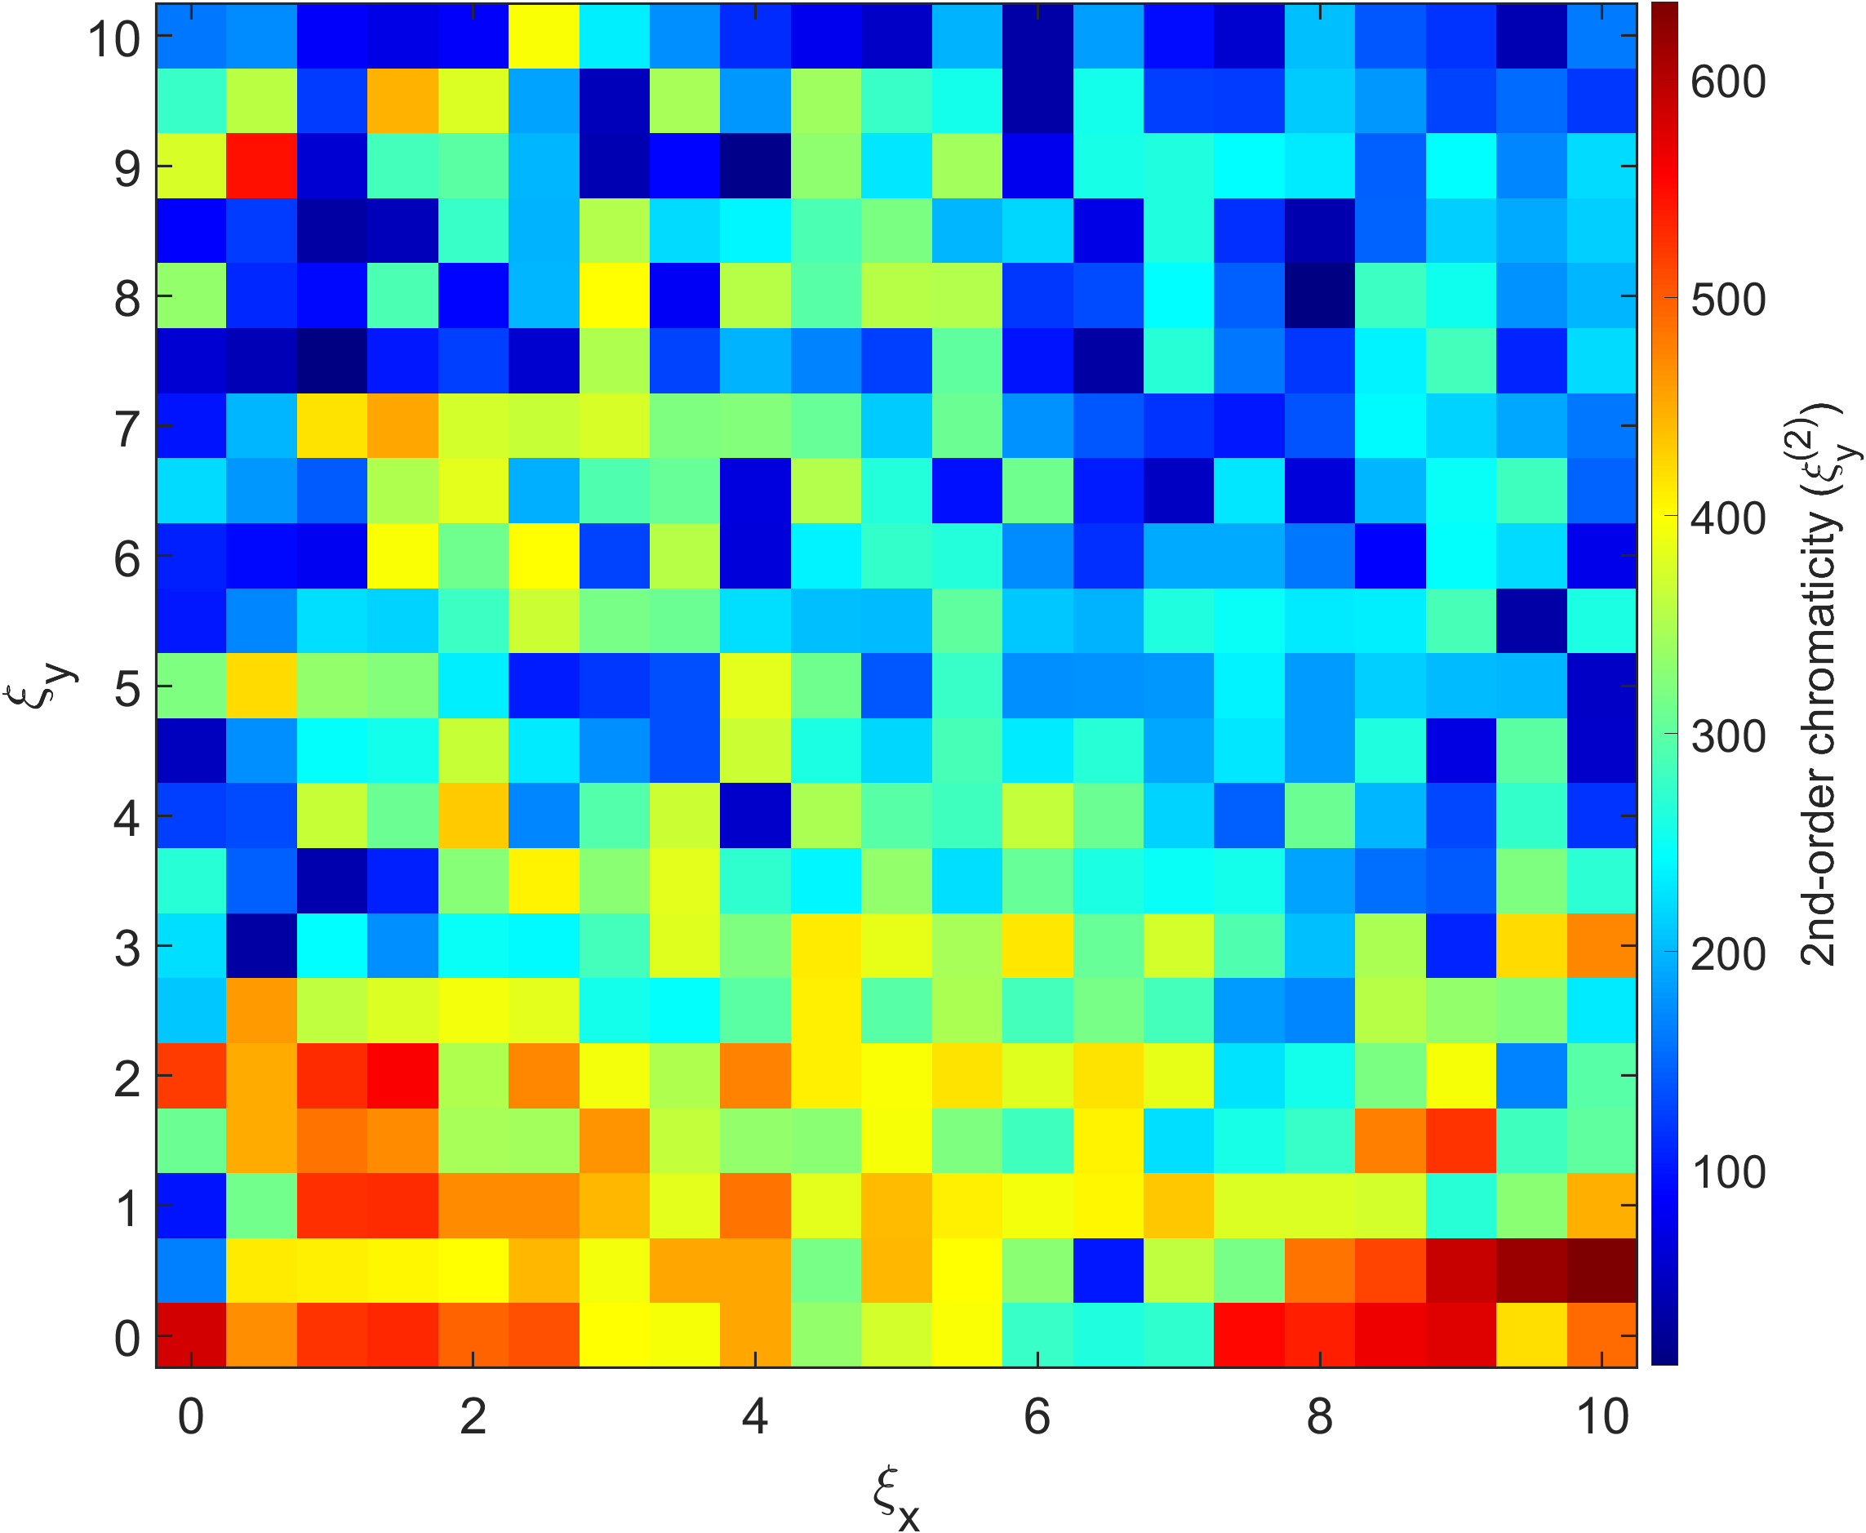
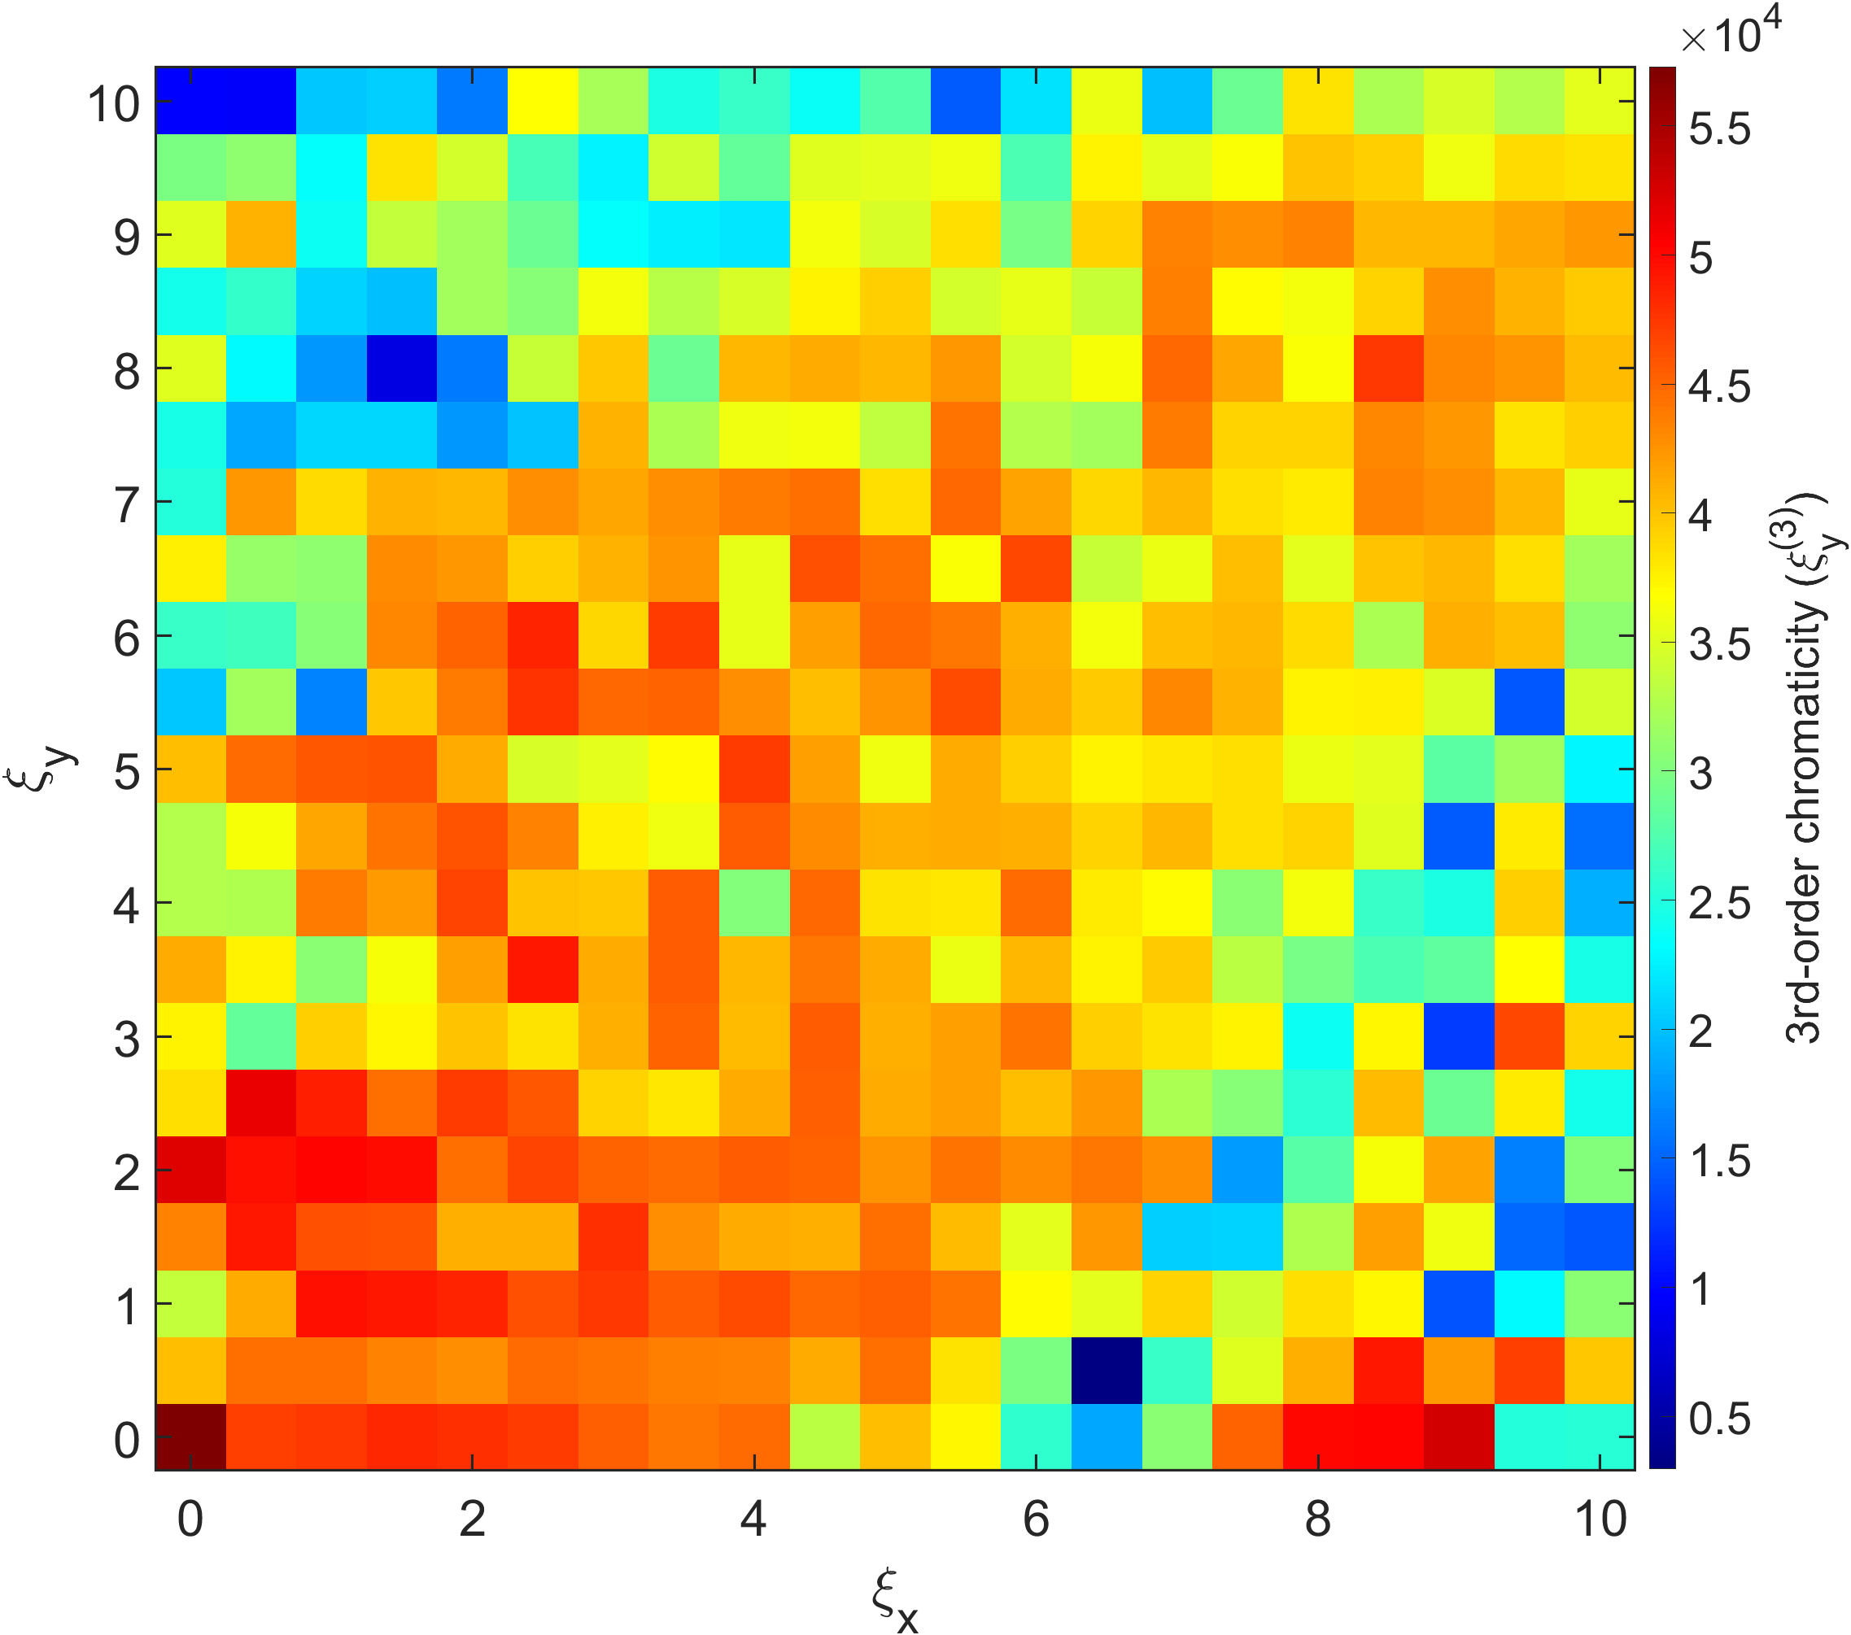
2nd order chromaticity and 3rd order chromaticity without error @ dispersion bump
w/ error
w/o error

Slide 21
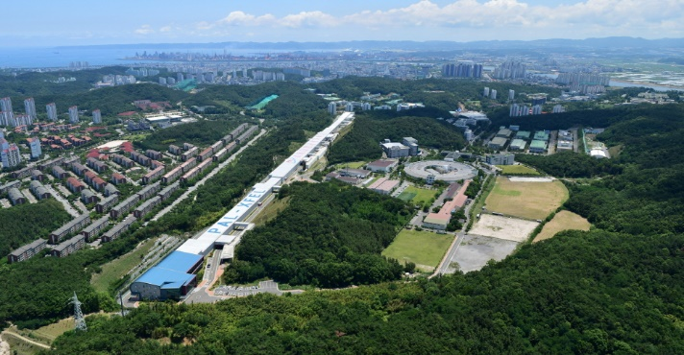
Thank you!

Slide 22
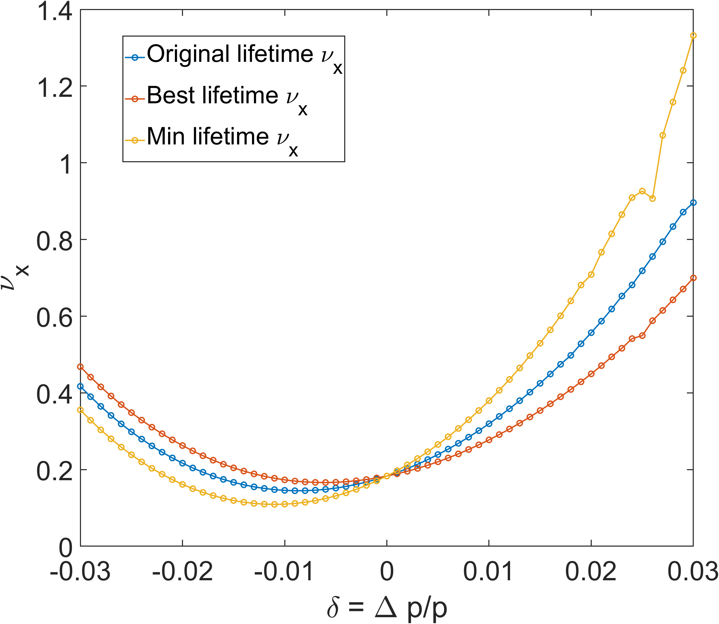
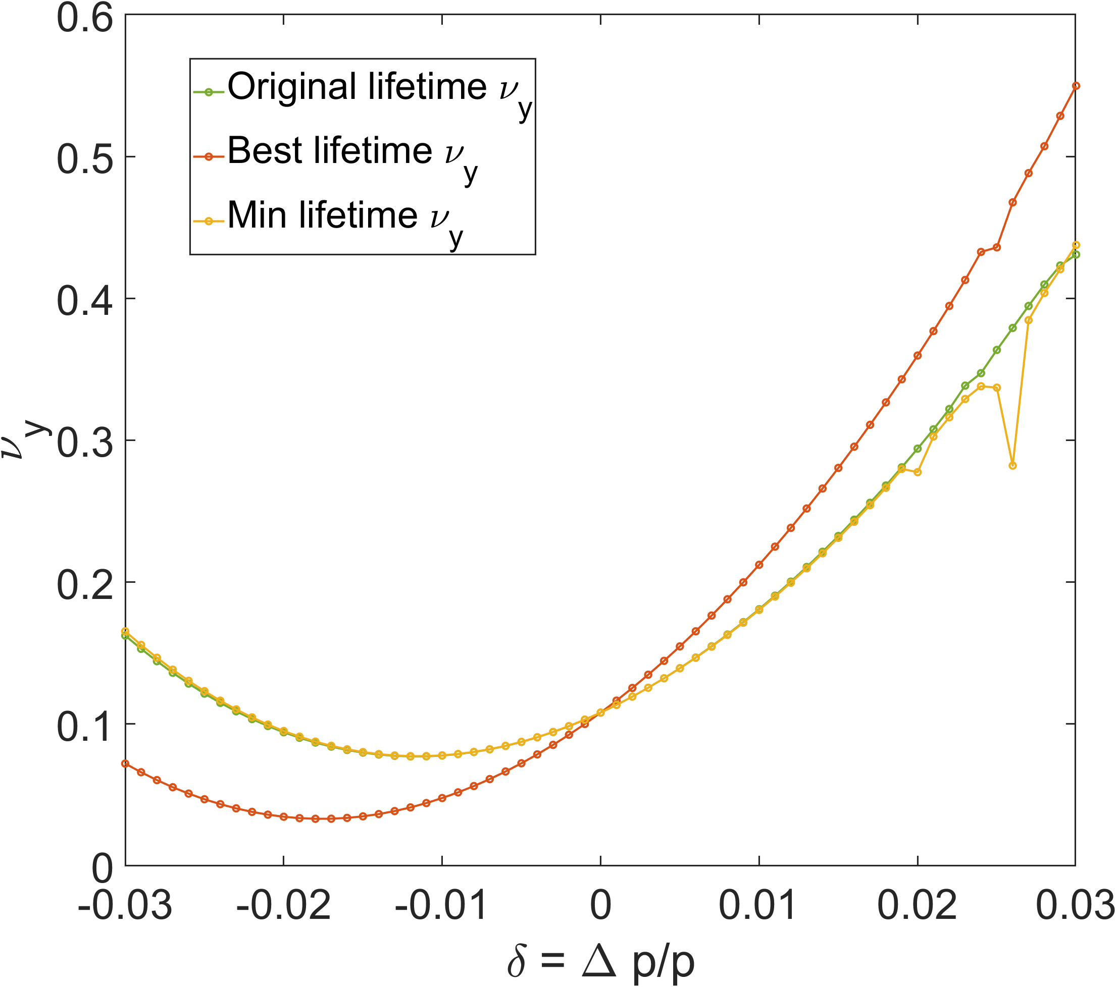
@ middle of HB

Slide 23
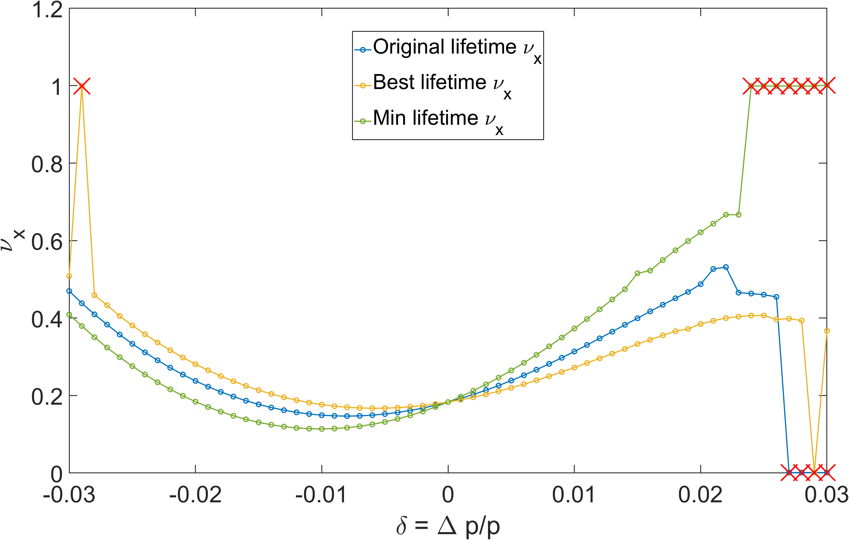
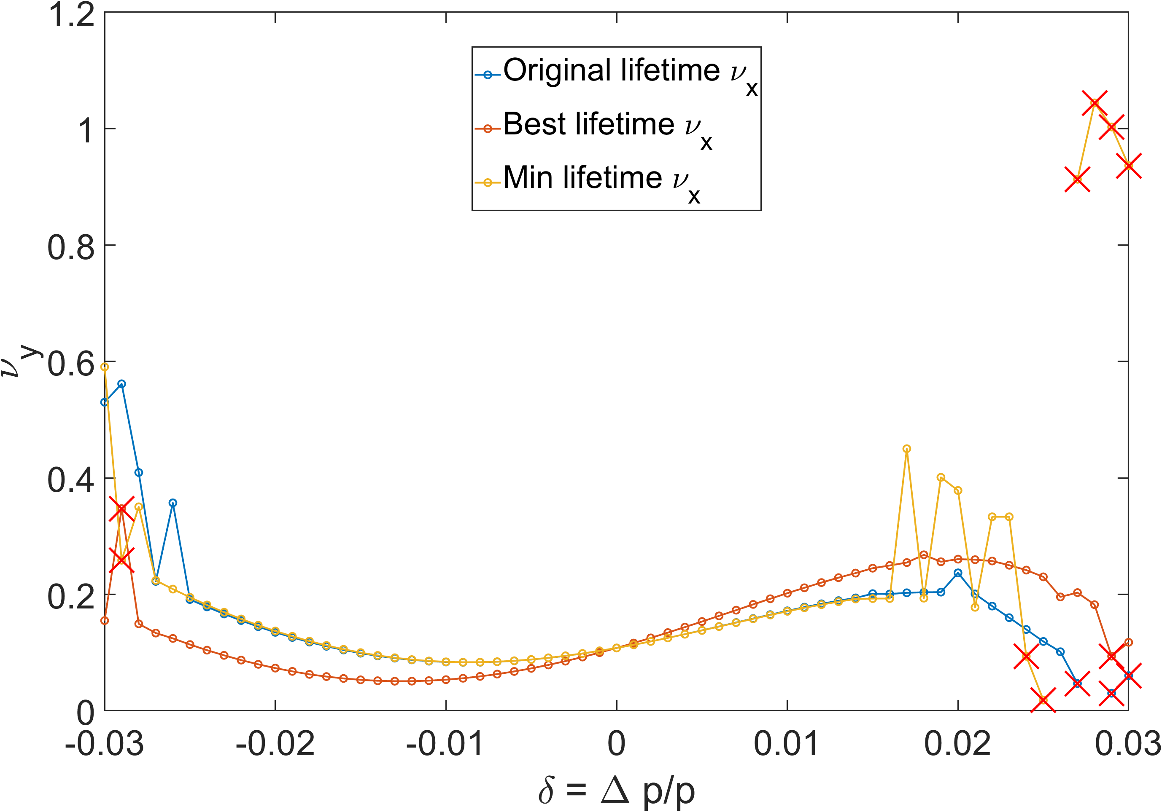
@ Dispersion bump

Slide 24
@ middle of HB
(w/o error)

Slide 25
@ Dispersion bump
(w/o error)

Slide 26
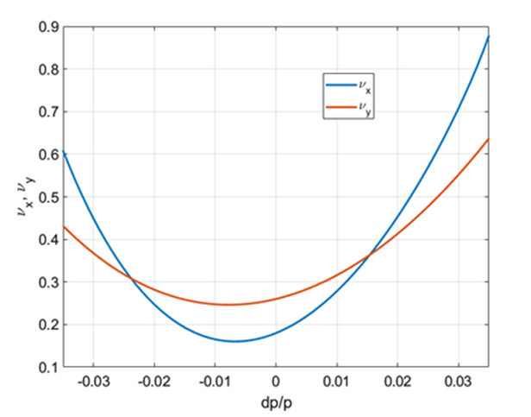
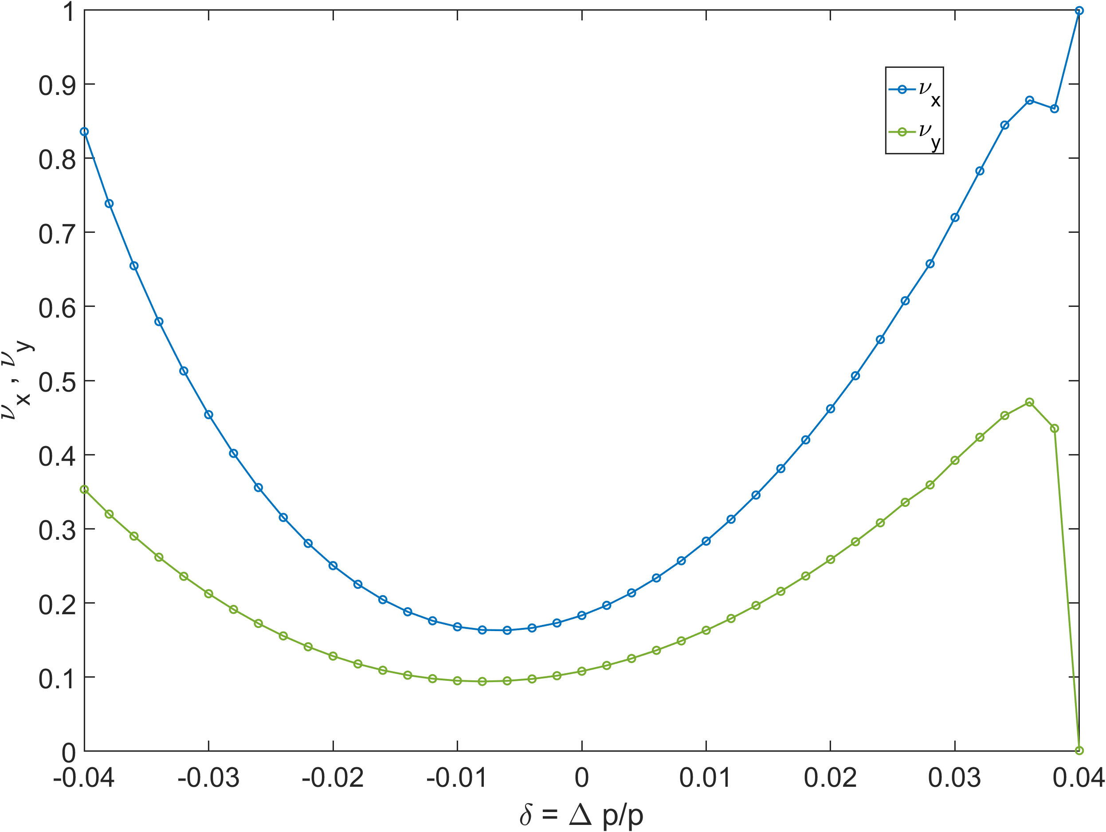
Chromaticity scan – Tune moving
$$ν_{x}=0.18 , ν_{y}=0.26$$
$$ν_{x}=0.18 , ν_{y}=0.10$$

