Slide 1
Influence of ground motion on the time evolution of beams in linear colliders
2025. 07. 11
Jang Won

Slide 2
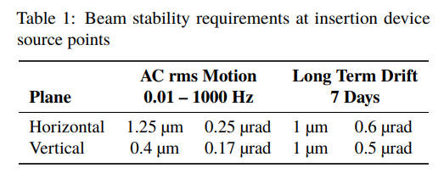
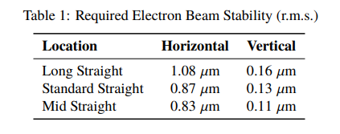
Introduction
Importance of considering ground motion
APS upgrade storage ring
Diamond-2 storage ring
V. Sajaev, C. Preissner, “Determination of the Ground Motion Orbit Amplification Factors Dependence on the Frequency for the APS Upgrade Storage Ring,” Proc. IPAC'18, Vancouver, Canada, 2018
I.P.S. Martin et al., “Orbit Stability Studies for the Diamond-II Storage Ring,” in Proc. IPAC'22, Bangkok, Thailand, 2022

Slide 3
Ground motion description-Absolute measurements
Time-dependent signal: $x(t)$
Variance: $σ^{2}≡<x^{2}(t)> =\lim_{T→∞}{\frac{1}{T}\int_{−\frac{T}{2}}^{\frac{T}{2}}{x^{2}\left(t\right)dt}}$
Different vibration frequencies cause different effects on the linear collider
Power spectral density is useful.
$$p\left(ω\right)={\lim_{T→∞}{\frac{1}{T}\left|\int_{−\frac{T}{2}}^{\frac{T}{2}}{x\left(t\right)e^{−iωt}dt}\right|}}^{2}=\lim_{T→∞}{\frac{1}{T}{\left|\tilde{x} \left(ω\right)\right|}^{2}}$$
$$\int_{−∞}^{∞}{p\left(ω\right)\frac{dω}{2π}=σ^{2}}$$
$$σ^{2}\left(f_{0}<f<f1\right)=\int_{f_{0}}^{f_{1}}{p\left(f\right)df}$$

Slide 4
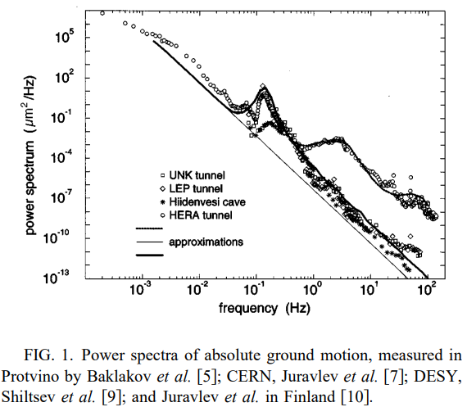
Ground motion description-Absolute measurements
$$p\left(ω\right)\sim \frac{1}{f^{4}}$$
f<1Hz: atmospheric activity
Ex) 0.1~0.2Hz: water motion
f>1Hz: noises produced by human

Slide 5
Ground motion description-Correlation measurements
Measurements, performed by two sensors: $x_{1}, x_{2}$
Mutual power spectrum $p_{12}$:
$$p_{12}\left(ω\right)≡\lim_{T→∞}{\frac{1}{T}}\int_{−\frac{T}{2}}^{\frac{T}{2}}{x_{1}\left(t\right)e^{−iωt}dt\int_{−\frac{T}{2}}^{\frac{T}{2}}{x_{2}^{∗}\left(t′\right)e^{−iωt′}dt}′}$$
If ground motion do not depend on the location,
$${p_{1}=p_{2}, p}_{12}=p_{21}$$
Normalized mutual power spectrum, correlation:
$$N_{12}=\frac{p_{12}}{\sqrt{p_{1}p_{2}}} (−1<N_{12}<1)$$

Slide 6
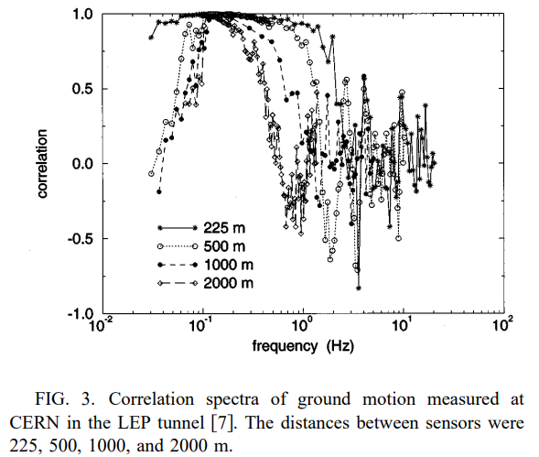
Ground motion description-Correlation measurements
At high frequency:
no correlation
At low frequency(f>0.1Hz):
good correlation
f<0.1Hz:
decreasing correlation has been observed, resulting in non-wave like motion
Or
Because of small SNR
Need to use cross-checks by relative measurements

Slide 7
Ground motion description-Relative measurements
Power spectrum of relative motion:
$$ρ\left(ω,L\right)={\lim_{T→∞}{\frac{1}{T}\left|\int_{−\frac{T}{2}}^{\frac{T}{2}}{[x_{1}\left(t\right)−x_{2}\left(t\right)]e^{−iωt}dt}\right|}}^{2}$$
$$\int_{−∞}^{∞}{ρ\left(ω,L\right)\frac{dω}{2π}=<{\left[x\left(t,s+L\right)−x\left(t,s\right)\right]}^{2}>}$$
For the stability of linear colliders is only interested in relative displacements between two elements.

Slide 8
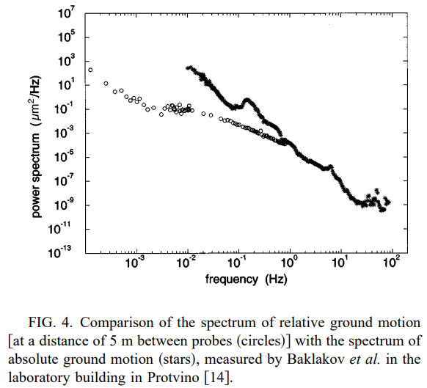
Ground motion description-Relative measurements
At low frequency:
relative motion are much smaller than absolute motion
At high frequency:
Similar each other(there’s no correlation)

Slide 9
Ground motion description-Absolute motion, relative motion, correlation
Power spectrum of relative motion $ρ(ω,L)$:
$$ρ\left(ω,L\right)≡{\lim_{T→∞}{\frac{1}{T}\left|\int_{−\frac{T}{2}}^{\frac{T}{2}}{[x_{1}\left(t\right)−x_{2}\left(t\right)]e^{−iωt}dt}\right|}}^{2}$$
$$=p_{1}+p_{2}−p_{12}−p_{21}$$
$$=2p\left(ω\right)\{1−Re[N_{12}(ω,L)]\}$$

Slide 10
Ground motion description
Power spectrum of relative motion $ρ(ω,L)$:
$$ρ\left(ω,L\right)=2p\left(ω\right)\{1−Re[N_{12}(ω,L)]\}$$
Relative motion
Absolute motion
Correlation
Issue | Absolute motion | Correlation | Relative motion
Low frequency |  | Correlated part is much larger than uncorrelated part. | Can’t see
0.1<f<100Hz |  |  | o
High frequency | Small SNR |  | Can’t see

Slide 11
Measure relative motion?
Power spectrum of relative motion $ρ$:
$$ρ\left(ω,L\right)=2p\left(ω\right)\{1−Re[N_{12}(ω,L)]\}$$
Relative motion
Absolute motion
Correlation
Water level system: for slow motion
Strained wire: fast vibration, limited distance
Optical system: low accuracy for long distance

Slide 12
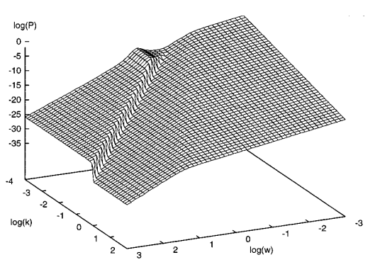

Slide 13
Ground motion description-Modeling Power Spectral Density(by ATL law)
There is a simple expression for describing slow motion.
$$<ΔX^{2}> =ATL$$
$ΔX$ is the relative displacement after a time T
of the two points separated by a distance L
This shows that slow relative motion has random diffusion-like, not wave-like.
B. A. Baklakov, P. K. Lebedev, V. V. Parkhomchuk, A. A. Sery, A. I. Sleptsov, and V. D. Shiltsev, INP Report 91-15, 1991 (unpublished)
V. A. Lebedev, P. K. Lebedev, V. V. Parkhomchuk, and V. D. Shiltsev, INP Report 92-39, 1992 (unpublished)

Slide 14
Ground motion description-Generalized motion
Power spectrum of absolute motion $P(ω,k)$:
$$P\left(ω,k\right)=\lim_{T→∞}{{\lim_{L→∞}\frac{1}{T}\frac{1}{L}\left|\int_{−\frac{T}{2}}^{\frac{T}{2}}{\int_{−\frac{L}{2}}^{\frac{L}{2}}{x\left(t,s\right)e^{−iωt}e^{−iks}dtds}}\right|}^{2}}$$
$$p\left(ω\right)=\frac{1}{2π}\int_{−∞}^{∞}{P\left(ω,k\right)\frac{dk}{2π}}$$
$$σ^{2}=\int_{−∞}^{∞}{\int_{−∞ }^{∞}{P\left(ω,k\right)\frac{dωdk}{{\left(2π\right)}^{2}}}} \left( for x\left(t,s\right) \right)$$

Slide 15
Ground motion description-Generalized motion
Power spectrum of absolute motion $P(ω,k)$:
$$σ^{2}\left(T,L\right)≡<\left[X\left(T,s+L\right)−X{\left(T,s\right)}^{2} \right]> \left(X\left(T,s\right)=x\left(T,s\right)−\left(0,s\right)\right)$$
$$=4\int_{−∞}^{∞}{\int_{−∞ }^{∞}{P\left(ω,k\right)(1−cosωT)(1−coskL)\frac{dωdk}{{\left(2π\right)}^{2}}}}$$

Slide 16
Ground motion description-Generalized motion
Unlike, absolute PSD $p\left(ω\right)$ and relative PSD $ρ\left(ω,L\right)$, the 2D PSD $P\left(ω,k\right)$ is not directly measured in an experiment.
But, it can determine through the PSD identities.
$$ρ\left(ω,L\right)=\int_{−∞}^{∞}{P\left(ω,k\right)2[1−coskL]\frac{dk}{2π}}$$
$$P\left(ω,k\right)=\int_{0}^{∞}{coskL\left[ρ\left(ω,L=∞\right)−ρ\left(ω,L\right)\right]dL }$$
$ρ\left(ω,L\right)=2p\left(ω\right)\left\{1−Re\left[N_{12}\left(ω,L\right)\right]\right\}$ 에서 $L→∞$ 일 때, $N_{12}=0$
$$ρ\left(ω,L=∞\right)=2p(ω)$$

Slide 17
Ground motion description-Corrected ATL law
Approximation for $ρ\left(ω,L\right)$,
Assumption:
Low frequency part of motion is described by the ATL law.
High frequency part is produced mainly by waves but a small, poorly correlated high frequency tail of the ATL law.
$<ΔX^{2}> =ATL=$ $σ^{2}\left(T,L\right)$ $=4\int_{−∞}^{∞}{\int_{−∞ }^{∞}{P\left(ω,k\right)(1−cosωT)(1−coskL)\frac{dωdk}{{\left(2π\right)}^{2}}}}$
By these formula, 2D PSD can be written as
$$P\left(ω,k\right)=\frac{A}{ω^{2}k^{2}}$$
$$ρ\left(ω,L\right)=\frac{AL}{ω^{2}}$$

Slide 18
Ground motion description-Corrected ATL law
$ρ\left(ω,L\right)=\frac{AL}{ω^{2}}$: It can be used as an approximation of relative PSD in the region of parameters where it does not contradict measured data.
ATL law should be corrected at high frequency.
To find, upper limit of the effects one can make the conservative assumption: All motion below the resolution of the probes is uncorrelated.
$→ρ\left(ω,L\right)≤2p(ω)$ (condition for realistic motion)
$$p\left(ω\right)\sim \frac{1}{f^{4}}$$
$$ρ\left(ω,L\right)=2p\left(ω\right)\left\{1−Re\left[N_{12}\left(ω,L\right)\right]\right\}\sim \frac{1}{ω^{4}}$$

Slide 19
Ground motion description-Corrected ATL law
$ρ\left(ω,L\right)≤2p(ω)$ (condition for realistic motion)
Low frequency: $ρ\left(ω\right)=\frac{AL}{ω^{2}} ( 0<ω<ω_{0})$
High frequency: $ρ\left(ω\right)=\frac{B}{ω^{4}} ( ω_{0}<ω<∞)$
$$ω_{0}={\left(B/AL\right)}^{1/2}$$
$$P\left(ω,k\right)=\int_{0}^{∞}{coskL\left[ρ\left(ω,L=∞\right)−ρ\left(ω,L\right)\right]dL }$$
$$=\frac{A}{ω^{2}k^{2}}\left[1−\cos\left(L_{0}k\right)\right] \left(L_{0}=\frac{B}{Aω^{2}}\right)$$

Slide 20
Ground motion description-Corrected ATL law
Misalignment(relative motion) between two points
$$<ΔX^{2}> =σ^{2}\left(T,L\right)=4\int_{−∞}^{∞}{\int_{−∞ }^{∞}{P\left(ω,k\right)(1−cosωT)(1−coskL)\frac{dωdk}{{\left(2π\right)}^{2}}}}$$
$$⋯$$
$$<ΔX^{2}> =ATL \left(T≫T_{0}\right)$$
$$<ΔX^{2}> =\frac{AT^{2}L}{T_{0}} \left(T≪T_{0}\right)$$
$$<ΔX^{2}> ≈\frac{AT^{2}L}{T+T_{0}}$$

Slide 21
Ground motion description-Corrected ATL law
Add elastic waves (like ocean wave),
propagating at the surface of the ground with a uniform distribution over the azimuthal angle, with $k_{max}\left(ω\right)=\frac{ω}{v_{i}}$ and $v_{i}$ the velocity of wave propagation
$$P\left(ω,k\right)=\frac{A}{ω^{2}k^{2}}\left[1−\cos\left(L_{0}k\right)\right]+D\left(ω\right)U\left(ω,k\right)$$
$U\left(ω,k\right)$: wave number distribution of the waves with frequency $ω$
$$U\left(ω,k\right)=\frac{2}{\sqrt{k_{max}^{2}−k^{2}}} \left(if\left|k\right|≤k_{max}\right)$$
$$=0 \left(if\left|k\right|>k_{max}\right)$$
$$(\int_{−k_{max}}^{k_{max}}{U\left(ω,k\right)\frac{dk}{2π}=1)}$$
$D\left(ω\right)$: contribution
$$D\left(ω\right)=\frac{a_{i}}{1+{\left[d_{i}\frac{ω−ω_{i}}{ω_{i} }\right]}^{4}}$$
Effective wave
$${k=k}_{max}cosθ$$
collider
$$k_{max}$$
Wave front

Slide 22
Thin line: $p\left(ω\right)\sim \frac{1}{ω^{4}}$
Thick solid line: quite place(model 1)
$$A={10}^{−4}μm^{2}⋅s^{−1}m^{−1}$$
$$B={10}^{−3}μm^{2}⋅s^{−3}$$
$$ω_{1}=2π⋅0.14Hz$$
Dashed line: cultural noise(model 4)
$$A={10}^{−5}μm^{2}⋅s^{−1}m^{−1}$$
$$B={10}^{−3}μm^{2}⋅s^{−3}$$
$$ω_{1}=2π⋅0.14Hz$$
$$ω_{2}=2π⋅2.5Hz$$
$$ω_{3}=2π⋅50Hz$$

Slide 23
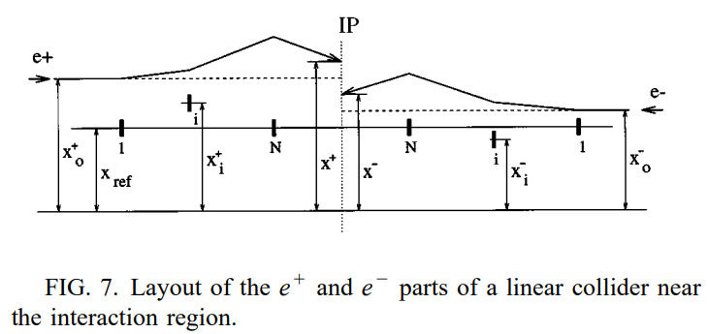
Beam offset at the interaction point(IP)
$$L=\frac{f_{rep}N^{2}}{4πσ_{x}σ_{y}}$$
$$<x_{i}\left(T\right)−x_{j}\left(T\right)> = 4\int_{−∞}^{∞}{\int_{−∞ }^{∞}{P\left(ω,k\right)(1−cosωT)(1−cosk\left(s_{i}−s_{j}\right))\frac{dωdk}{{\left(2π\right)}^{2}}}}$$
$$x^{±}−x_{ref}=R_{11}\left(x_{0}^{±}−x_{ref}\right)+\sum_{i=1}^{N}{a_{i}\left(x_{i}^{±}−x_{ref}\right)}$$
$$a_{i}=k_{1}r_{12}$$
R: transfer matrix between $x_{0}^{±}$and $x_{IP}$
r: transfer matrix between ith quadrupole and $x_{IP}$

Slide 24
Beam offset at the interaction point(IP)
$$<{\left(x^{+}−x^{−}\right)}^{2}>= 4\int_{−∞}^{∞}{\int_{−∞ }^{∞}{P\left(ω,k\right)\left(1−cosωT\right)G\left(k\right)\frac{dωdk}{{\left(2π\right)}^{2}}}}$$
$$G\left(k\right)=\sum_{i=0}^{N}{\sum_{j=0}^{N}{a_{i}a_{j}}}\{cosk\left(s_{i}^{+}−s_{i}^{−}\right)−cosk\left(s_{i}^{+}−s_{j}^{−}\right)\}$$
$$\left(s_{i}^{+}=−s_{j}^{−}\right)$$
$$G\left(k\right)=4{\left(\sum_{i=0}^{N}{a_{i}\sin\left(ks_{i}^{+}\right)}\right)}^{2}$$
$$\sum_{i=0}^{N}{a_{i}s_{i}+R_{12}=S_{IP}}=0,G\left(k\right)=4{\left[kR_{12}+O\left(k^{3}\right)\right]}^{2} (for small k)$$

Slide 25
Beam spot size at the IP
R: transfer matrix between $x_{0}^{±}$and $x_{IP}$
Normalized transfer matrix error at the IP:
$$δQ=δR R^{−1}$$
Vertical spot size growth is given by
$$\frac{δσ_{y}}{σ_{y}}=\frac{1}{2}\left[{\left(\frac{δQ_{34}}{β_{y}}\right)}^{2}+{\left(\frac{δQ_{31}σ_{x}}{σ_{y}}\right)}^{2}+{\left(\frac{δQ_{32}σ_{x}}{σ_{y}β_{y}}\right)}^{2}+{\left(\frac{δQ_{36}σ_{δ}}{σ_{y}}\right)}^{2}\right]$$
1st term:$β_{y}$ waist shift generated by quadrupole and sextupole horizontal displacement
2nd and 3rd term: xy and x’y couplings
4th term: vertical dispersion generated by quadrupole and sextupole vertical displacements
Each term contributes on spectral response function, $G\left(k\right)$
$$ex) <{\left(δQ_{36}\right)}^{2}> =\frac{1}{2}\sum_{i=1}^{N}{\sum_{i=1}^{N}{b_{i}b_{j}[<{\left(y_{i}−y_{0}\right)}^{2}>+<{\left(y_{j}−y_{0}\right)}^{2}>+<{\left(y_{i}−y_{j}\right)}^{2}>]}}$$
$$G_{η}\left(k\right)=\sum_{i=i}^{N}{\sum_{j=i}^{N}{b_{i}b_{j}}}\{1−2cosk\left(s_{i}−s_{0}\right)+cosk\left(s_{i}−s_{j}\right)\}$$

Slide 26
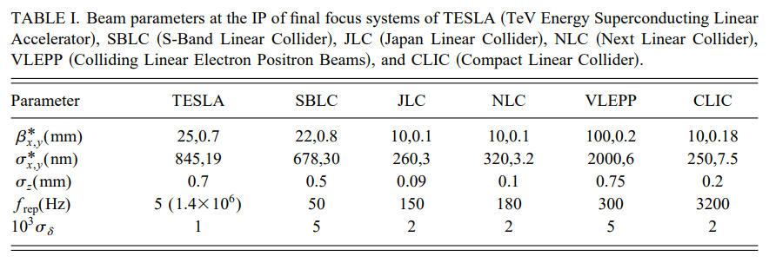
Application for Final Focus System(FFS)
Strong focusing system
The tightest tolerances to transverse magnet displacements are found in the FFS.
Vertical beam sizes at the IP are much smaller than the horizontal ones. It is important to concentrate on the time stability of the vertical offset and spot size.

Slide 27
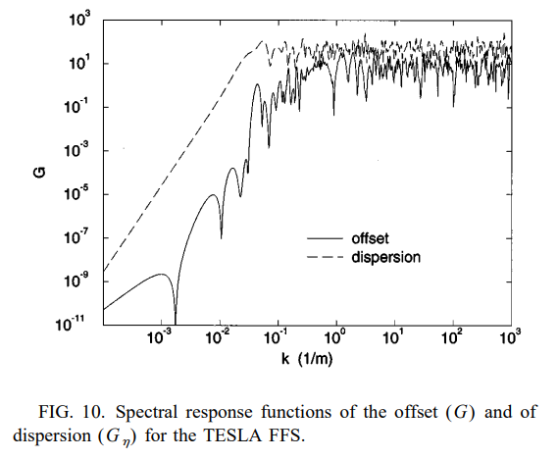
Beam stability in different conditions
$$G\left(k\right)=4{\left[kR_{12}+O\left(k^{3}\right)\right]}^{2}\sim k^{6}$$

Slide 28
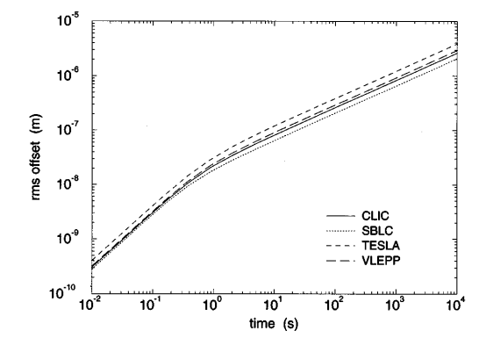
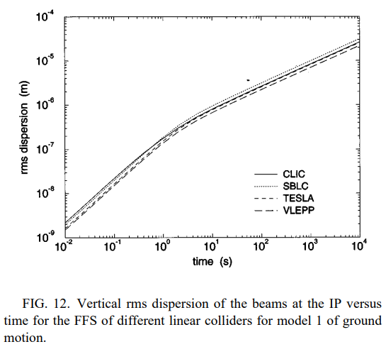
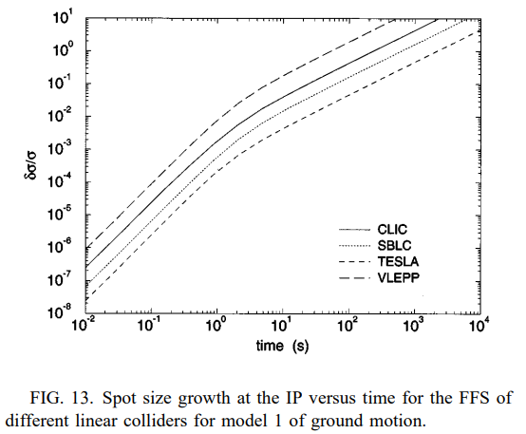
They are calculated as 2D power spectrum $P\left(ω, k\right)$corresponding to model 1.
The offset and dispersion curves of different colliders behave almost identically because of the similarity of the FFS designs.

Slide 29
$σ_{y}^{∗}:$ VLEPP<CLIC<TESLA<SBLC
$σ_{δ}$: SBLC,VLEPP >>CLIC>TESLA
Spot size growth:
$\frac{δσ}{σ}:$ VLEPP>CLIC>SBLC>TESLA
The spot size growth at the IP results mainly from the position dispersion (also from waist shift and x’y coupling for colliders with small energy spread), therefore the size growth $\frac{δσ}{σ}$ is smaller for the project with large $σ_{y}^{∗}$ and small $σ_{δ}$

Slide 30
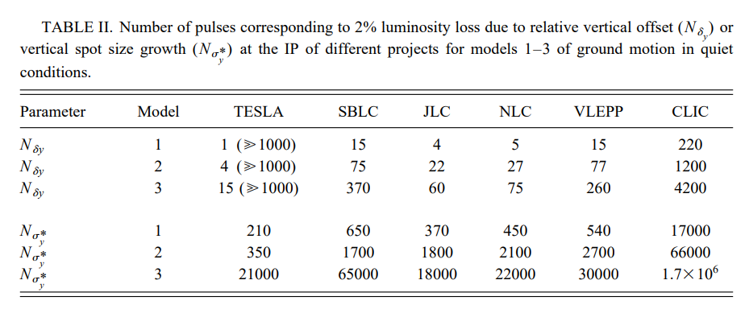
The number of pulses causing 2% luminosity loss from beam offset is very small, requiring fast feedback. If offset is corrected, spot size growth becomes dominant, needing slower orbit correction.
Notes:
빔 오프셋으로 인한 2% luminosity 손실이 발생하기 까지 펄수 수는 매우 적으므로 fast feeback 요구.
Offset이 보정되면, spot size가 지배적인 요인이 되기 떄문에 slower orbit correction이 필요하다.

Slide 31
Conclusion
The influence of ground motion is expected to be very important for future TeV linear colliders.
To describe this influence quantitatively in terms of beam properties and luminosity at the IP, we propose to use the power spectrum $P\left(ω,k\right)$
This paper has derived four such models to account for typical low or high cultural noise conditions.
Then paper described the formalism, which allows one to express the time evolution of typical beam properties.

Slide 32
$$ρ\left(ω,L\right)≡{\lim_{T→∞}{\frac{1}{T}\left|\int_{−\frac{T}{2}}^{\frac{T}{2}}{[x_{1}\left(t\right)−x_{2}\left(t\right)]e^{−iωt}dt}\right|}}^{2}=\lim_{T→∞}{\frac{1}{T}}\left[{\left|\int_{−\frac{T}{2}}^{\frac{T}{2}}{x_{1}\left(t\right)e^{−iωt}dt }\right|}^{2}+{\left|\int_{−\frac{T}{2}}^{\frac{T}{2}}{x_{2}\left(t\right)e^{−iωt}dt }\right|}^{2}−{{\left(\int_{−\frac{T}{2}}^{\frac{T}{2}}{x_{1}\left(t\right)e^{−iωt}dt }\right)}^{}\left(\int_{−\frac{T}{2}}^{\frac{T}{2}}{x_{2}\left(t\right)e^{−iωt}dt }\right)}^{∗}−{\left(\int_{−\frac{T}{2}}^{\frac{T}{2}}{x_{1}\left(t\right)e^{−iωt}dt }\right)}^{∗}{\left(\int_{−\frac{T}{2}}^{\frac{T}{2}}{x_{2}\left(t\right)e^{−iωt}dt }\right)}^{}\right]$$
$$=p_{1}+p_{2}−p_{12}−p_{21}$$
$$=2p\left(ω\right)\{1−Re[N_{12}(ω,L)]\}$$

Slide 33
$$\int_{−∞}^{∞}{P(ω,k)}\frac{dk}{2π}=\int_{−∞}^{∞}{\lim_{T→∞}{{\lim_{L→∞}\frac{1}{T}\frac{1}{L}\left|\int_{−\frac{T}{2}}^{\frac{T}{2}}{\int_{−\frac{L}{2}}^{\frac{L}{2}}{x\left(t,s\right)e^{−iωt}e^{−iks}dtds}}\right|}^{2}}\frac{dk}{2π}}=\int_{−∞}^{∞}{\lim_{T→∞}{{\lim_{L→∞}\frac{1}{T}\frac{1}{L}\left|\tilde{x}(ω,k)\right|}^{2}}\frac{dk}{2π}}=\lim_{T,L→∞}{\frac{1}{TL}\int_{−∞}^{∞}{{\left|X\left(ω,s\right)\right|}^{2}ds}}=\lim_{T→∞}{\frac{1}{T}{<\left|X\left(ω,s\right)\right|}^{2}>_{s}=\lim_{T→∞}{\frac{1}{T}{\left|X\left(ω,s\right)\right|}^{2}=}}p(ω)$$

Slide 34
$$σ^{2}\left(T,L\right)=4\int_{−∞}^{∞}{\frac{A}{ω^{2}k^{2}}\left[1−cos\left(L_{0}k\right)\right]}\left(1−cosωT\right)\left(1−coskL\right)\frac{dωdk}{{\left(2π\right)}^{2}}=\frac{A}{π^{2}}\int_{−∞}^{∞}{\frac{1−cosωT}{ω^{2}}}dω\int_{−∞}^{∞}{\frac{(1−cosL_{0}k)(1−coskL)}{k^{2}}}dk=\frac{A}{π^{2}} πT$$

