Slide 1
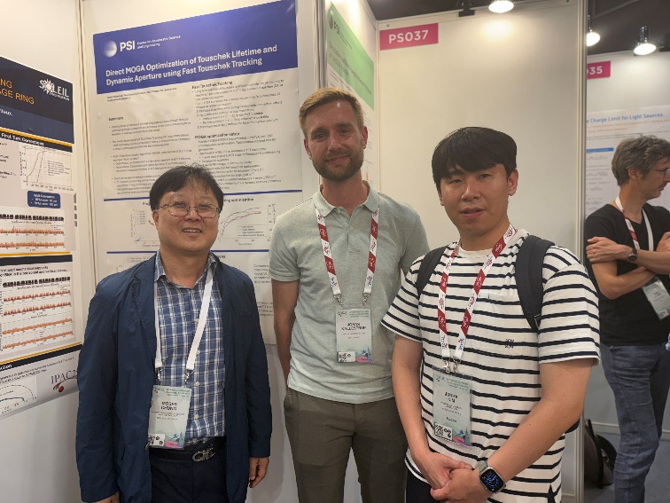


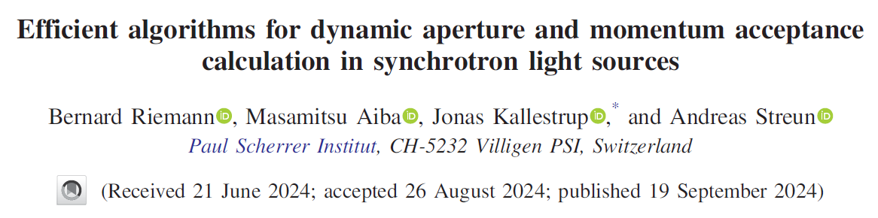
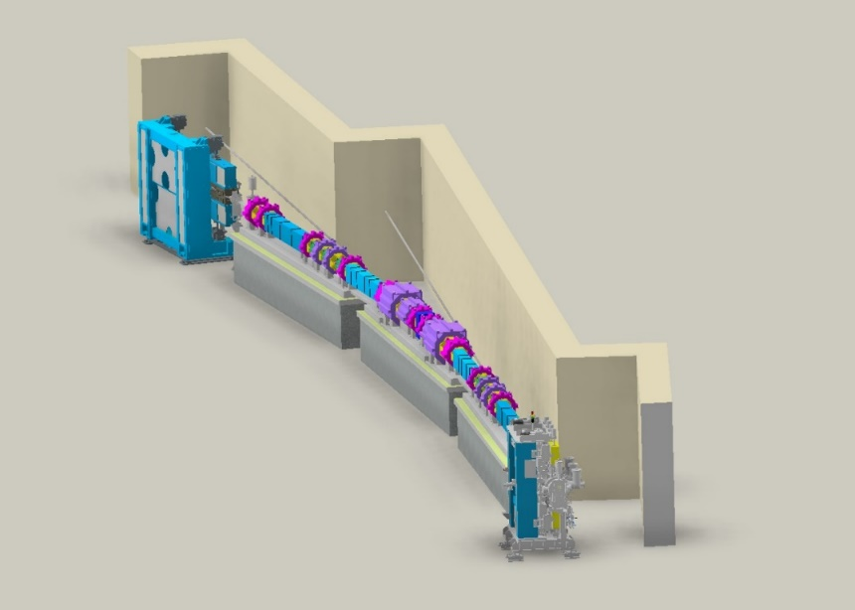

JKPS
Efficient algorithms for dynamic aperture and momentum acceptance calculation in synchrotron light source
Junha Kim
교수님, Jonas Kallestrup, 본인 @ IPAC’25
June 27th, 2025

Slide 2
JKPS
Composition of the paper
Introduction
Dynamic aperture
  Standard approaches
  Flood fill
  Reverse scan
  Performance comparison in OPA
Touschek lifetime
  Standard approaches
  Fast Touschek Tracking (FTT)
  Summary of Fast Touschek Tracking algorithm
    FTT precomputation
    FTT tracking subroutine

Slide 3
JKPS
Composition of the paper
4. FTT implementation into accelerator codes
  OPA
  Accelerator Toolbox
  Lattices with errors
  Fully coupled lattices
Conclusion
Outlook

Slide 4
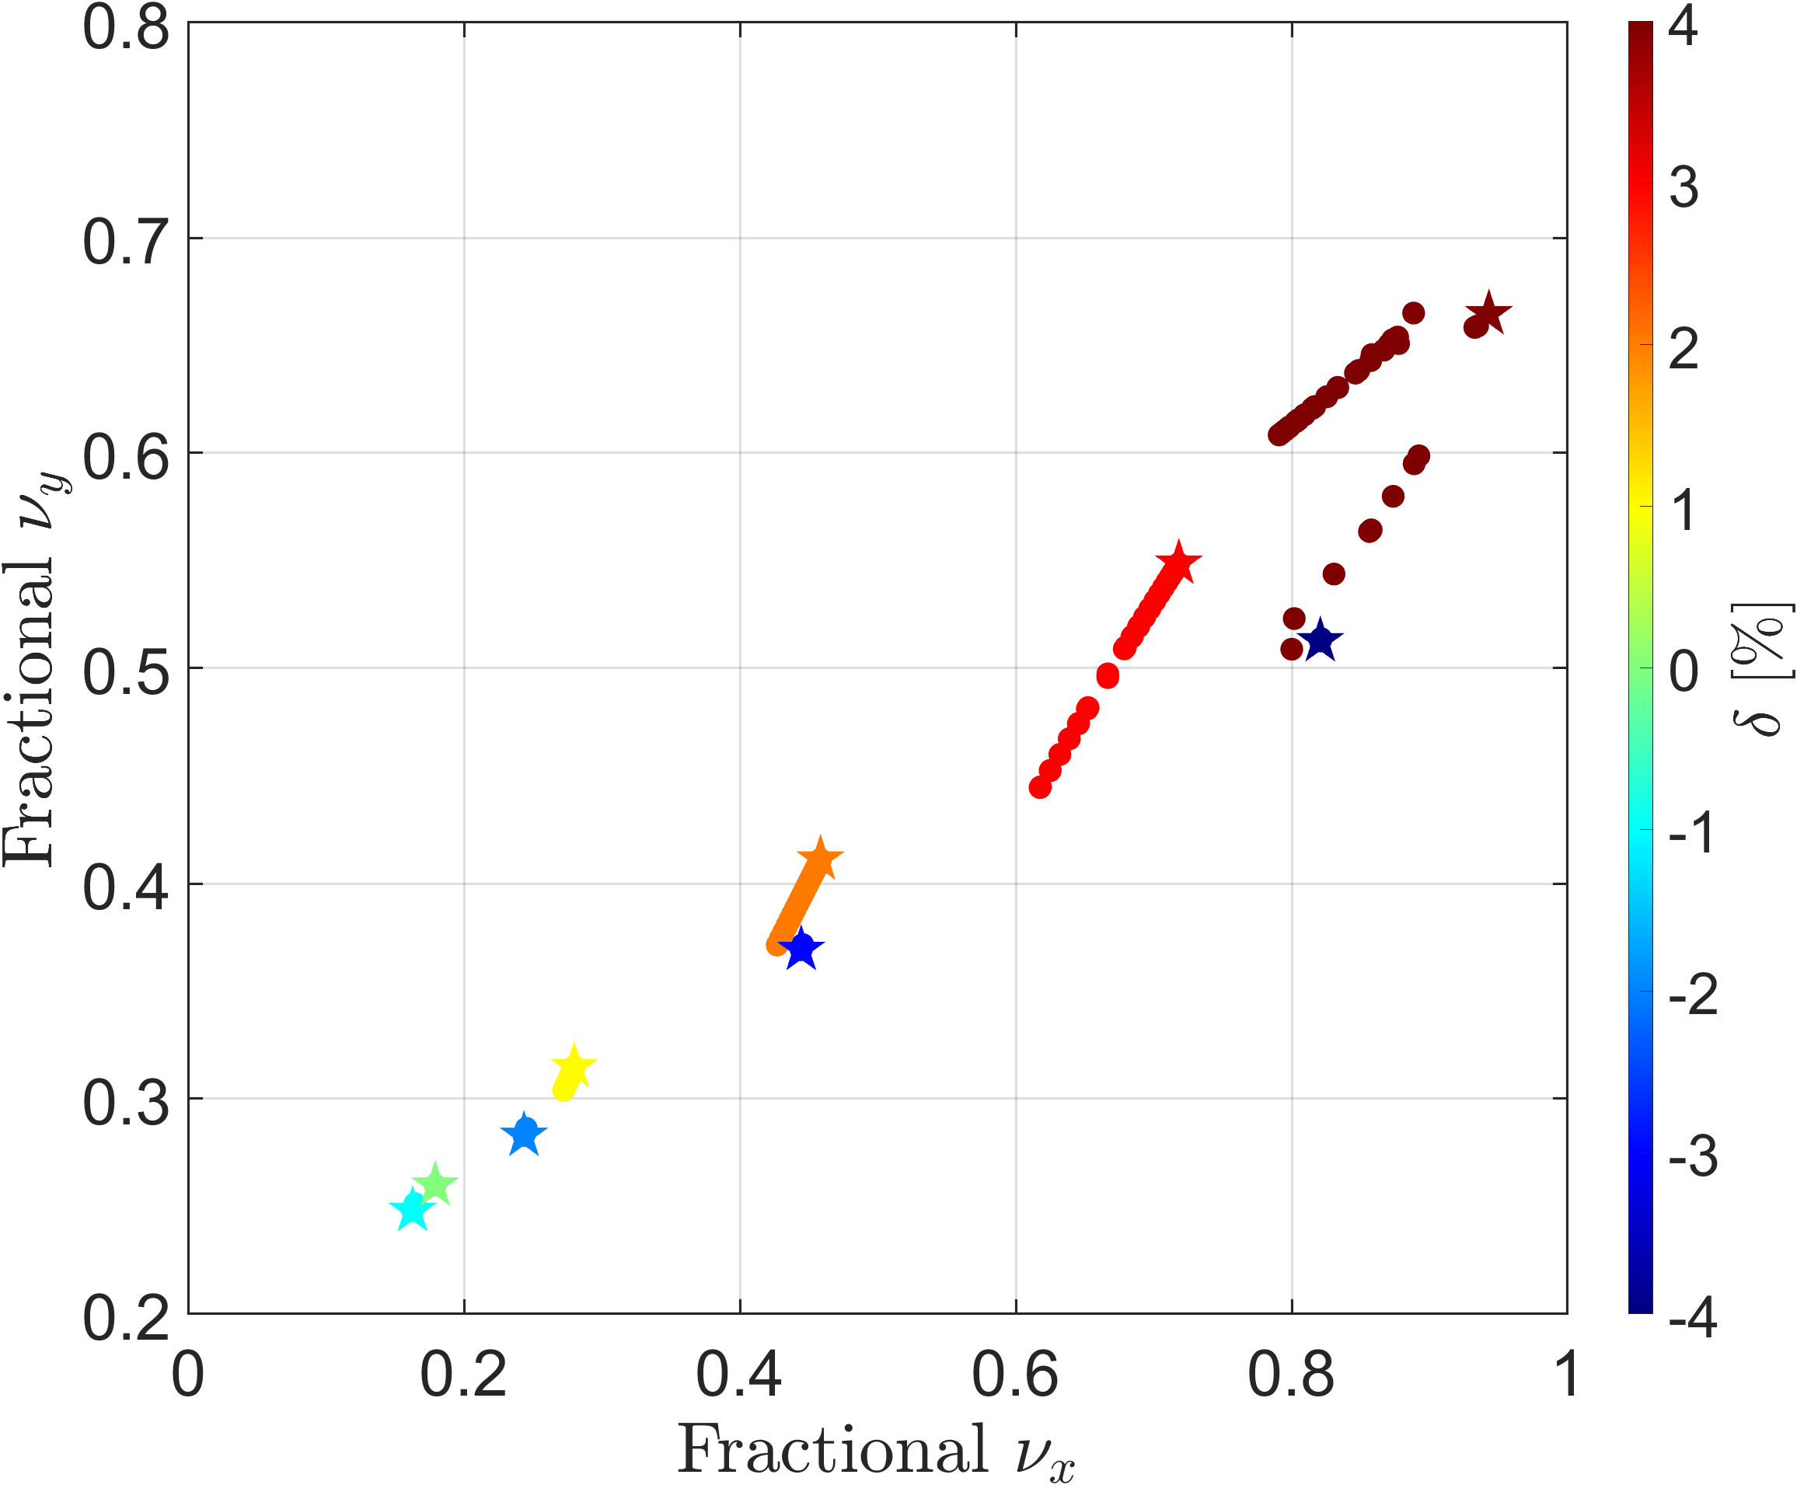
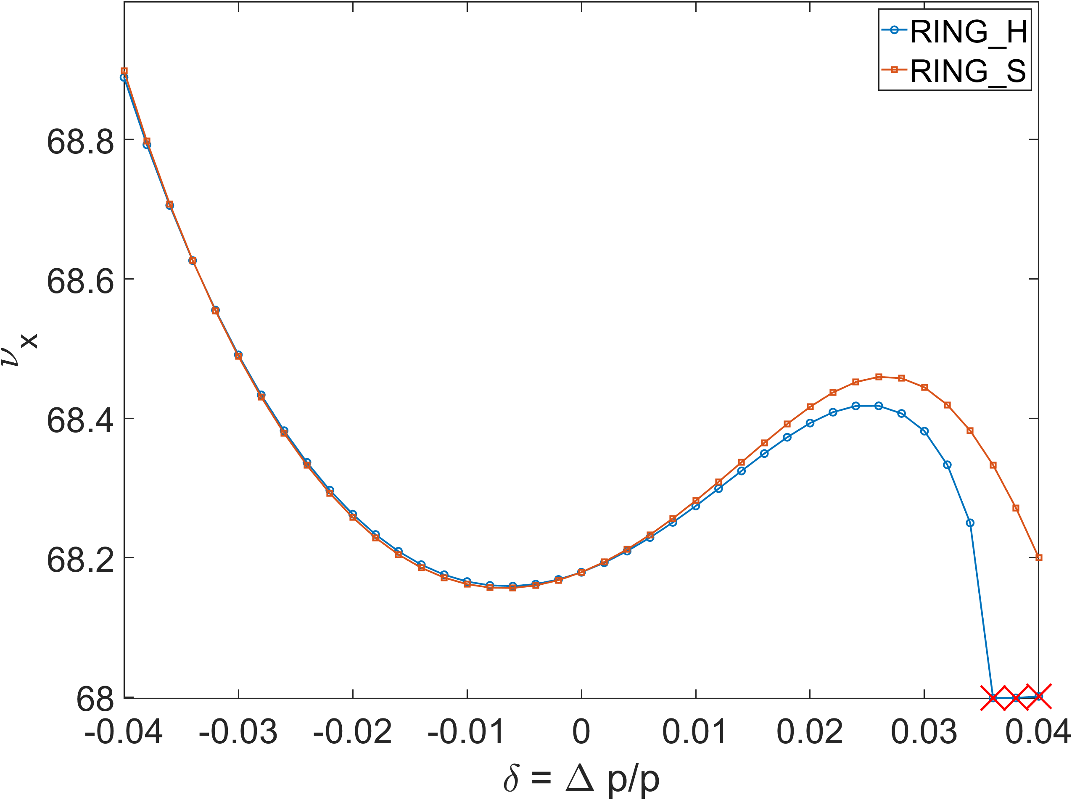
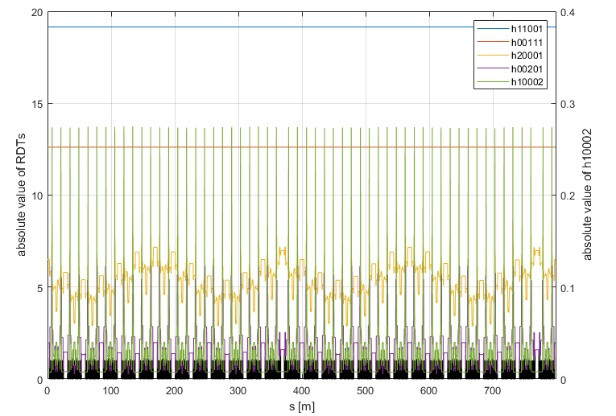

JKPS
I. Introduction
The next generation light sources (NGLS) achieve low natural emittance based on multi-bend achromat (MBA) lattices, thereby improving the photon beam performance drastically.
Low natural emittance within a given circumference requires strong horizontal focusing to suppress dispersion in the bending magnets.
Strong sextupoles and higher-order multipoles are essential for chromaticity correction, but their nonlinearities limit the stable motion of stored electrons, i.e., the dynamic aperture (DA).
Sextupoles are phase-optimized to cancel nonlinear effects while correcting chromaticity, and additional multipoles may be used to suppress RDTs and control CTS and ADTS.
Chromatic RDT
Hor. MDTS
RING_H
4/34

Slide 5
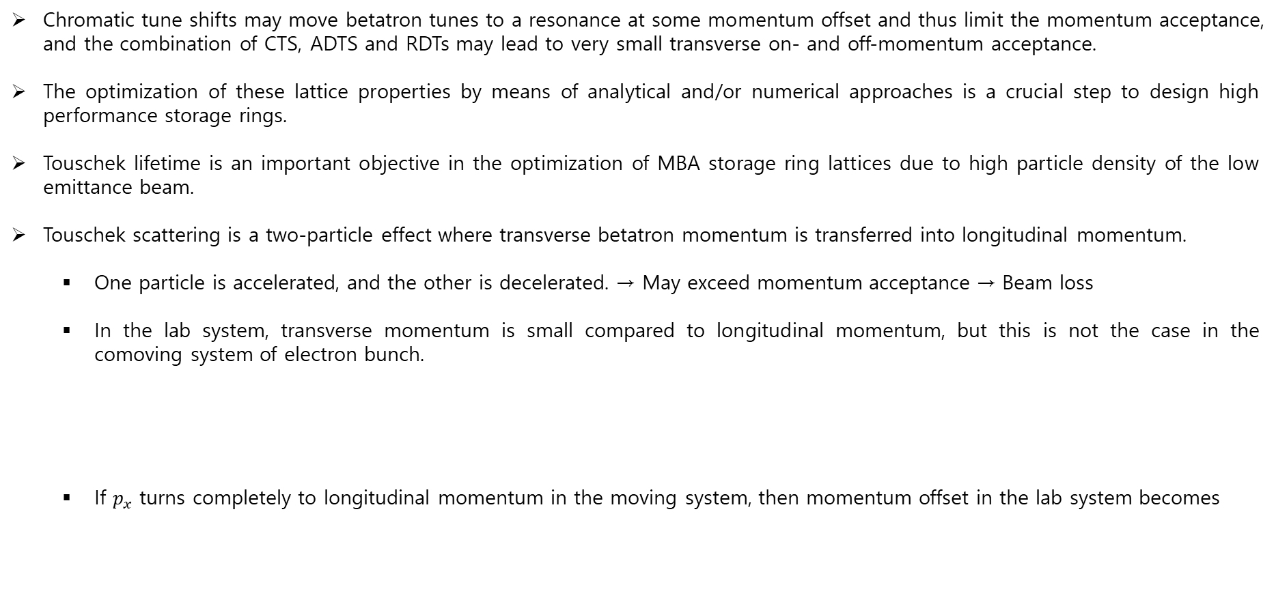
JKPS
I. Introduction
Chromatic tune shifts may move betatron tunes to a resonance at some momentum offset and thus limit the momentum acceptance, and the combination of CTS, ADTS and RDTs may lead to very small transverse on- and off-momentum acceptance.
The optimization of these lattice properties by means of analytical and/or numerical approaches is a crucial step to design high performance storage rings.
Touschek lifetime is an important objective in the optimization of MBA storage ring lattices due to high particle density of the low emittance beam.
Touschek scattering is a two-particle effect where transverse betatron momentum is transferred into longitudinal momentum.
  One particle is accelerated, and the other is decelerated. → May exceed momentum acceptance → Beam loss
  In the lab system, transverse momentum is small compared to longitudinal momentum, but this is not the case in the comoving system of electron bunch.
  If $p_{x}$ turns completely to longitudinal momentum in the moving system, then momentum offset in the lab system becomes
$p_{x}=p_{0}\sqrt{ε_{x}/β_{x}}$ with $p_{0}c=E_{0} {, ε}_{x} :$its horizontal emittance ,$β_{x}$ the local beta function
$\frac{Δp}{p_{0}}=γ\sqrt{ε_{x}/β_{x}}$ with $γ$ the Lorentz factor -> Example : $E_{0}=3GeV, ε_{x}=100pm∙rad$ and $β_{x}=1m ⇒\frac{Δp}{p_{0}}≈6\%$
5/34

Slide 6
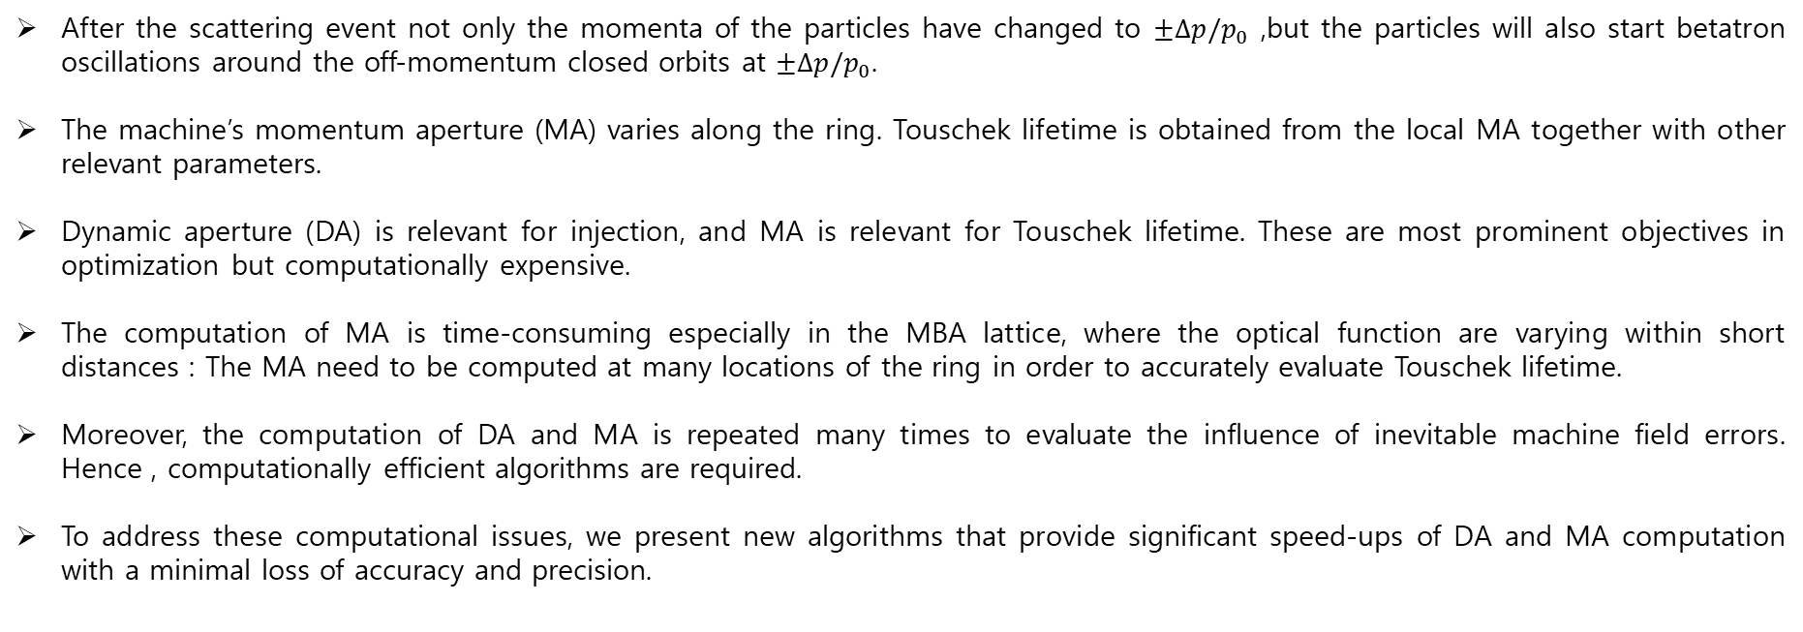
JKPS
I. Introduction
After the scattering event not only the momenta of the particles have changed to $±Δp/p_{0}$ ,but the particles will also start betatron oscillations around the off-momentum closed orbits at $±Δp/p_{0}$.
The machine’s momentum aperture (MA) varies along the ring. Touschek lifetime is obtained from the local MA together with other relevant parameters.
Dynamic aperture (DA) is relevant for injection, and MA is relevant for Touschek lifetime. These are most prominent objectives in optimization but computationally expensive.
The computation of MA is time-consuming especially in the MBA lattice, where the optical function are varying within short distances : The MA need to be computed at many locations of the ring in order to accurately evaluate Touschek lifetime.
Moreover, the computation of DA and MA is repeated many times to evaluate the influence of inevitable machine field errors. Hence , computationally efficient algorithms are required.
To address these computational issues, we present new algorithms that provide significant speed-ups of DA and MA computation with a minimal loss of accuracy and precision.
6/34

Slide 7
JKPS
Dynamic aperture
The maximum stable betatron oscillation amplitude in a ring is limited by either the physical aperture or the dynamic aperture.
  Physical aperture : determined by physical object, such as vacuum chambers or collimators
  Dynamic aperture : limited by the nonlinear particle motion arising from mainly higher multipoles (sextupole and octupoles)
The DA is computed by tracking a particle for various initial conditions, i.e., scanning over the horizontal and vertical coordinates (x and y) typically at a fixed longitudinal location of the ring.
7/34

Slide 8
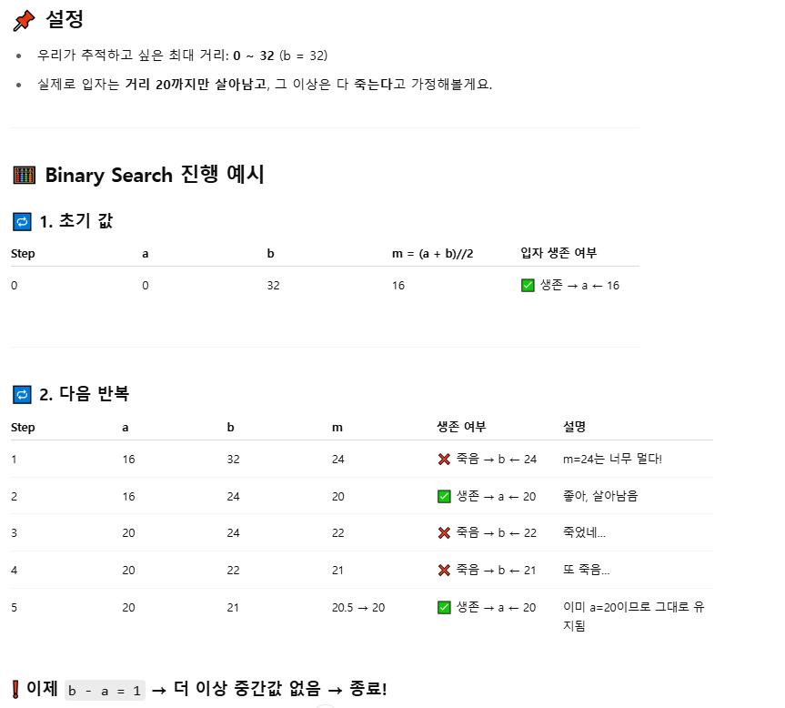
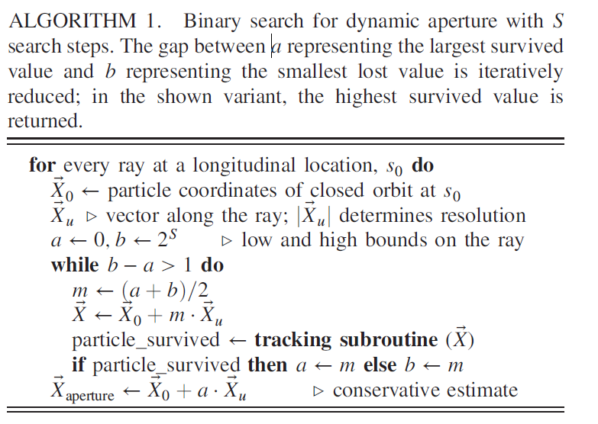
JKPS
Dynamic aperture – Standard approaches
The dynamic aperture is usually estimated via binary search (BS) that finds the boundary between unstable initial coordinate on a line.
It is repeated for several lines to visualize the DA in the two-dimensional plane, x-y.
8/34

Slide 9
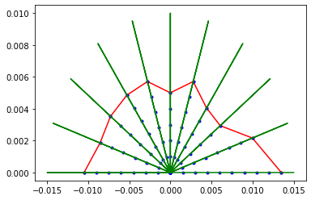
JKPS
Dynamic aperture – Standard approaches
The dynamic aperture is usually estimated via binary search (BS) that finds the boundary between unstable initial coordinate on a line.
It is repeated for several lines to visualize the DA in the two-dimensional plane, x-y.
at.get_acceptance(ring, ('x','y'), (11,11), (15e-3,10e-3), nturns=2000)
9/34

Slide 10
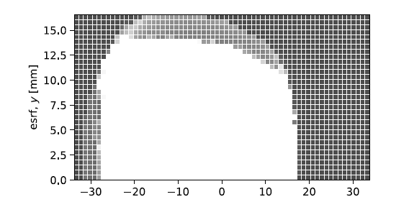
JKPS
Dynamic aperture – Standard approaches
Another approach to compute DA is grid probing (GP), where the x-y plane is discretized into pixels.
To perform an analysis of DA, one may perform tracking taking the center of each pixel as the initial coordinate, and then label is as ‘captured’ or ‘lost’.
10/34

Slide 11
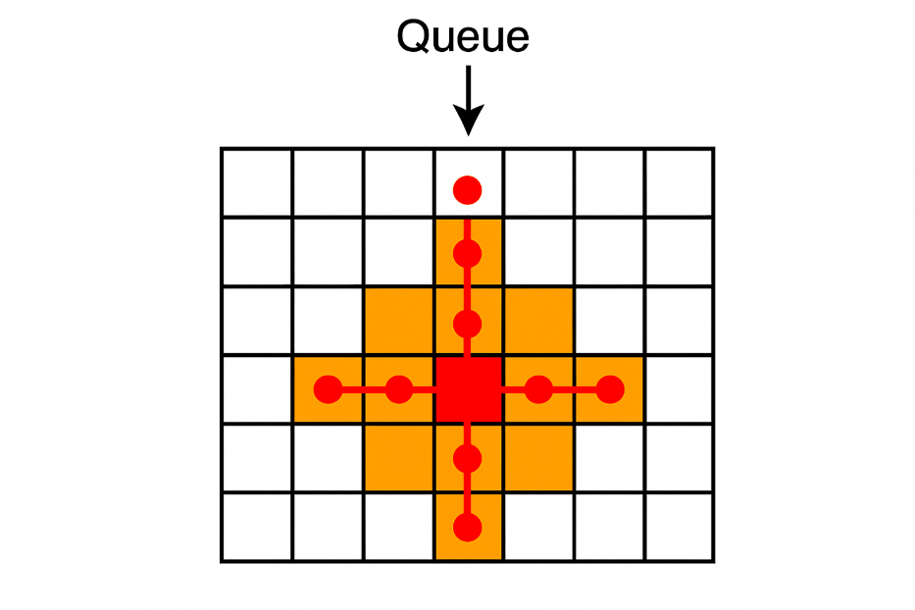
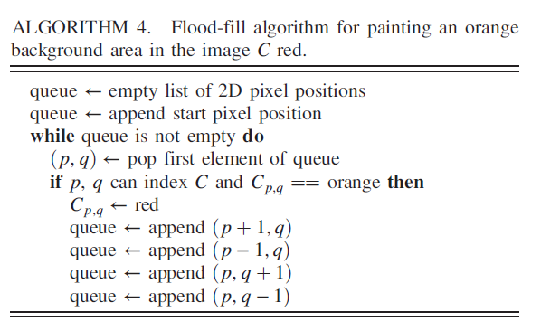
JKPS
Dynamic aperture – Flood fill
Grid probing is computationally expensive due to many captured pixels in the DA interior.
These pixels require the maximum number of turns to be evaluated, while lost pixels typically often terminate within very few turns.
This asymmetry was the inspiration for applying the flood-fill tool, commonly used in raster graphics programs (그림판), in the context of DA computation.
Image from Chat-GPT
11/34

Slide 12

JKPS
Dynamic aperture – Flood fill
Grid probing is computationally expensive due to many captured pixels in the DA interior.
These pixels require the maximum number of turns to be evaluated, while lost pixels typically often terminate within very few turns.
This asymmetry was the inspiration for applying the flood-fill tool, commonly used in raster graphics programs (그림판), in the context of DA computation.
12/34

Slide 13
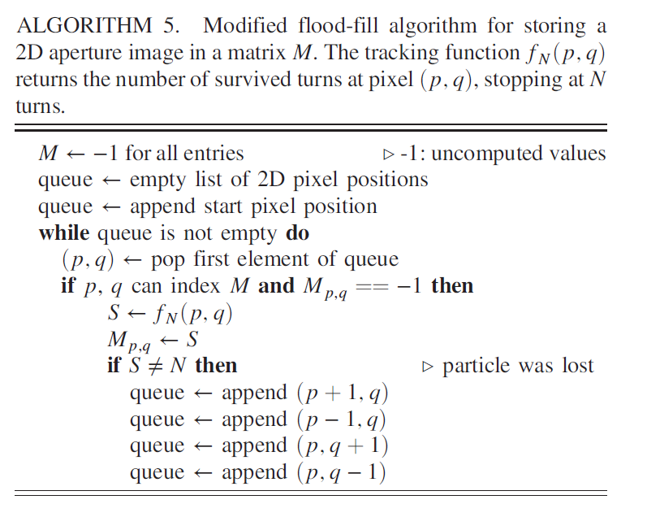
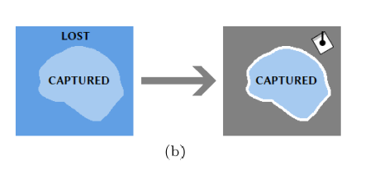
JKPS
Dynamic aperture – Flood fill
For DA computation, the aforementioned criterion is replaced with the outcome of a tracking compution 'particle is lost’ that is performed when the algorithm queries the pixel state.
The algorithm will only query the region with lost particles and the border of the captured region before breaking the search, but not the captured region, which would be computationally expensive
13/34

Slide 14
JKPS
Dynamic aperture – Reverse scan
The binary search can be replaced by a reverse scan (RS) that is based on a concept similar to flood fill algorithm applied to the DA computation.
: Binary Search
: Reverse Search
at.get_acceptance(ring, ('x','y'), (11,11), (15e-3,10e-3), nturns=2000)
14/34

Slide 15
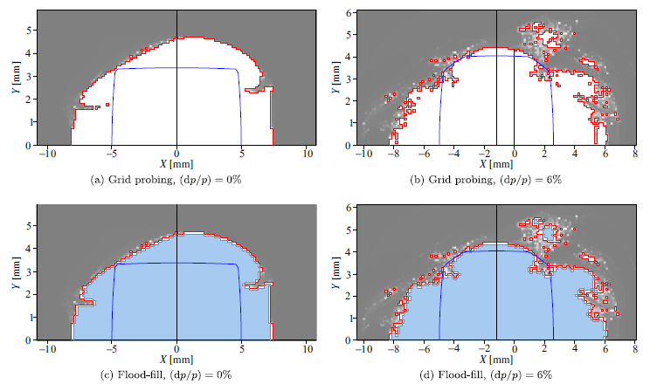
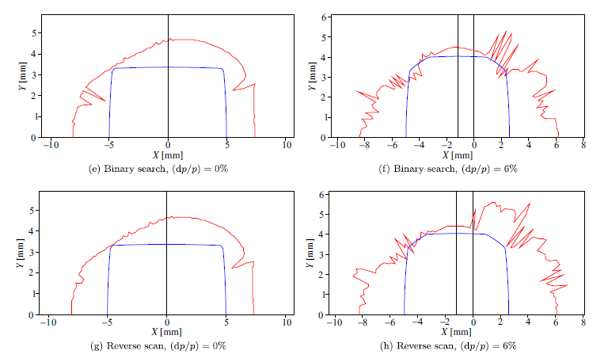
JKPS
Dynamic aperture – Performance comparison
The existing and proposed algorithms are benchmarked to compare their performance.
Flood fill algorithm is compared with grid probing, while reverse scan algorithm is compared with binary search.
All algorithms were implemented in OPA.
Figure 2 shows, OPA screenshots for the four methods of DA calculations for two cases of a relatively smooth DA for dp/p = 0% and a more complex DA for dp/p = 6% in SLS 2.0 lattice
15/34

Slide 16
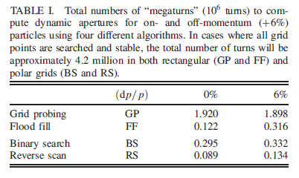
JKPS
Dynamic aperture – Performance comparison
16배 차이
6배 차이
3.3배 차이
2.5배 차이
16/34

Slide 17
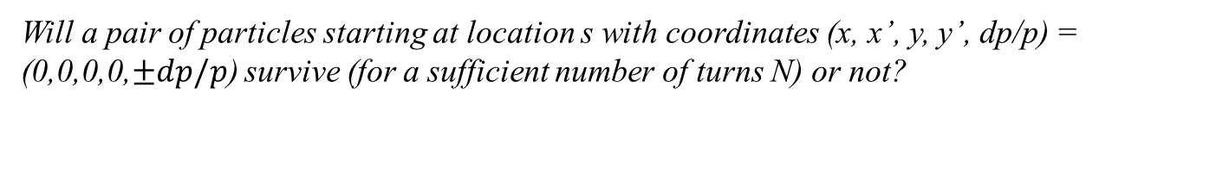
JKPS
Touschek lifetime – Standard approach
The straightforward approach to compute local MA by tracking is the following
Will a pair of particles starting at location s with coordinates (x, x’, y, y’, dp/p) = (0,0,0,0,$±dp/p$) survive (for a sufficient number of turns N) or not?
Here an ideal lattice is assumed where the on-momentum closed-orbit and the coordinate system coincide, and the initial transverse coordinates, x, x’, y, y’ are all zero.
The number of turns N should be on the order of the synchrotron oscillation period or the damping time, which is usually about 1000 turns or more.
Thus Touschek lifetime calculations are computationally expensive in a large part due to the required retrieval of local momentum acceptances.
In SLS 2.0 lattice, computation of the MA takes up about 90% of the total computation time.
17/34

Slide 18


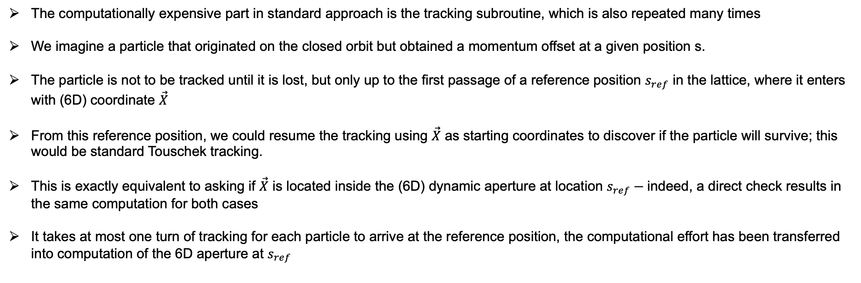
JKPS
Touschek lifetime – Fast Touschek Tracking
The computationally expensive part in standard approach is the tracking subroutine, which is also repeated many times
We imagine a particle that originated on the closed orbit but obtained a momentum offset at a given position s.
The particle is not to be tracked until it is lost, but only up to the first passage of a reference position $s_{ref}$ in the lattice, where it enters with (6D) coordinate $\vec{X}$
From this reference position, we could resume the tracking using $\vec{X}$ as starting coordinates to discover if the particle will survive; this would be standard Touschek tracking.
This is exactly equivalent to asking if $\vec{X}$ is located inside the (6D) dynamic aperture at location $s_{ref}−$indeed, a direct check results in the same computation for both cases
It takes at most one turn of tracking for each particle to arrive at the reference position, the computational effort has been transferred into computation of the 6D aperture at $s_{ref}$
$$DA$$
Touschek scattering occur at s
18/34
$s_{ref}$

Slide 19
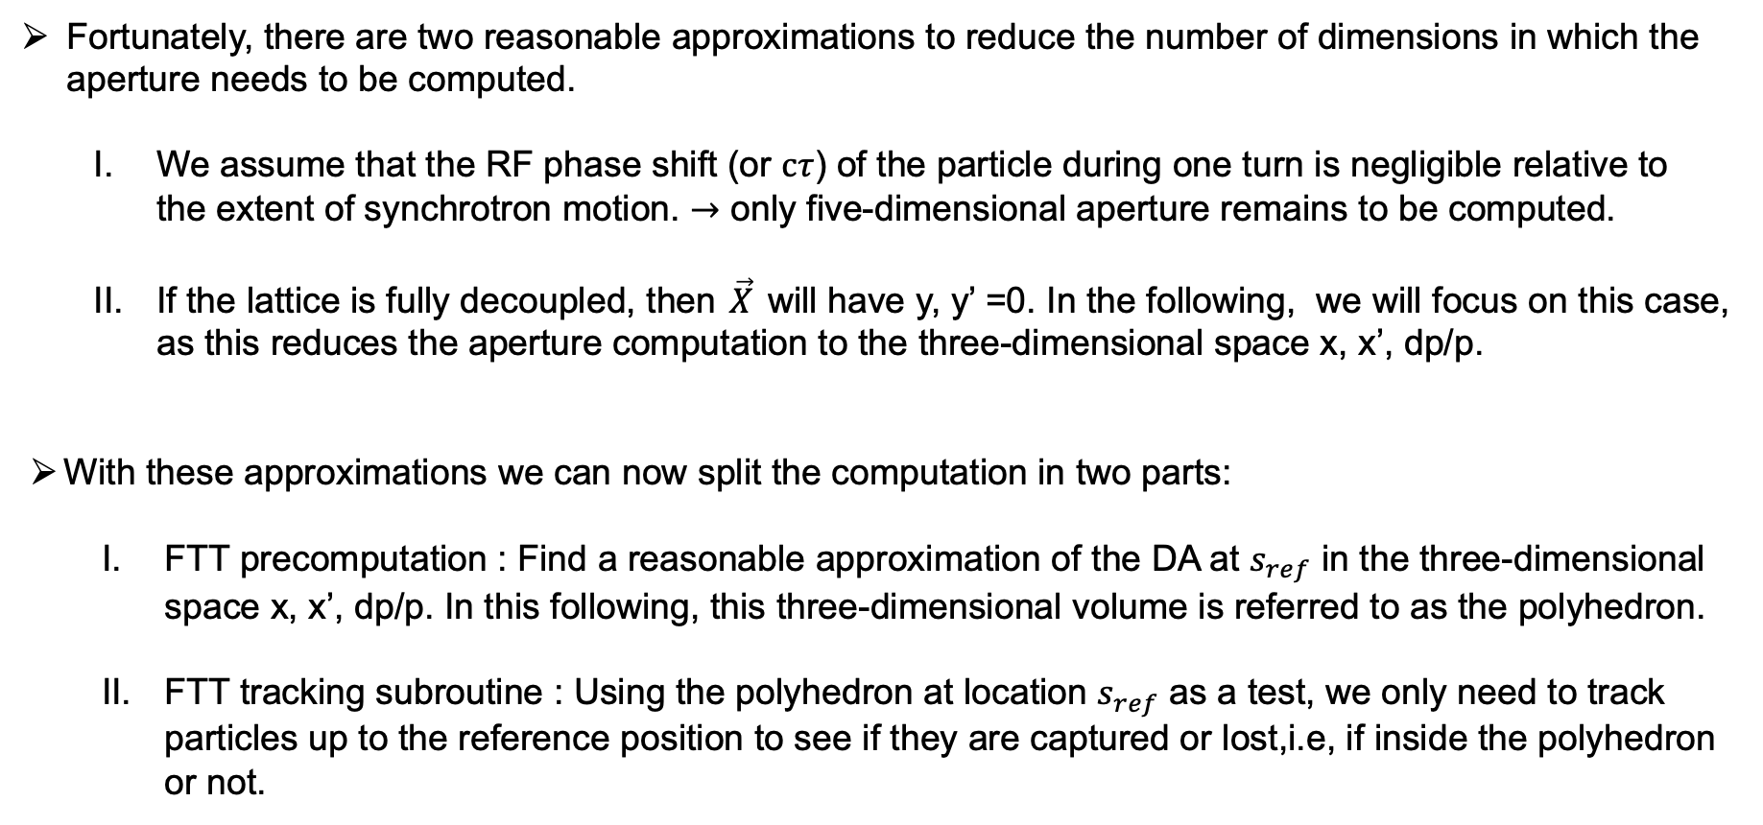
JKPS
Touschek lifetime – Fast Touschek Tracking
Fortunately, there are two reasonable approximations to reduce the number of dimensions in which the aperture needs to be computed.
  We assume that the RF phase shift (or $cτ$) of the particle during one turn is negligible relative to the extent of synchrotron motion. $→$ only five-dimensional aperture remains to be computed.
  If the lattice is fully decoupled, then $\vec{X}$ will have y, y’ =0. In the following, we will focus on this case, as this reduces the aperture computation to the three-dimensional space x, x’, dp/p.
  With these approximations we can now split the computation in two parts:
    FTT precomputation : Find a reasonable approximation of the DA at $s_{ref}$ in the three-dimensional space x, x’, dp/p. In this following, this three-dimensional volume is referred to as the polyhedron.
    FTT tracking subroutine : Using the polyhedron at location $s_{ref}$ as a test, we only need to track particles up to the reference position to see if they are captured or lost,i.e, if inside the polyhedron or not.
19/34

Slide 20
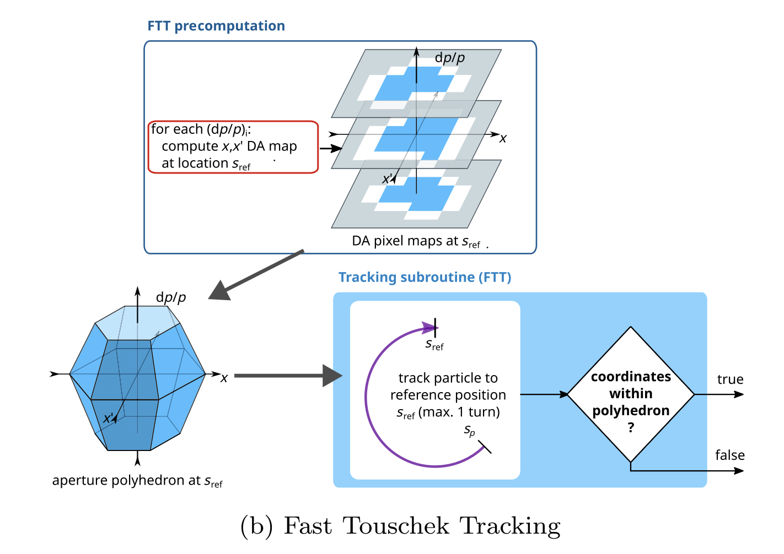
JKPS
Touschek lifetime – Fast Touschek Tracking
20/34

Slide 21
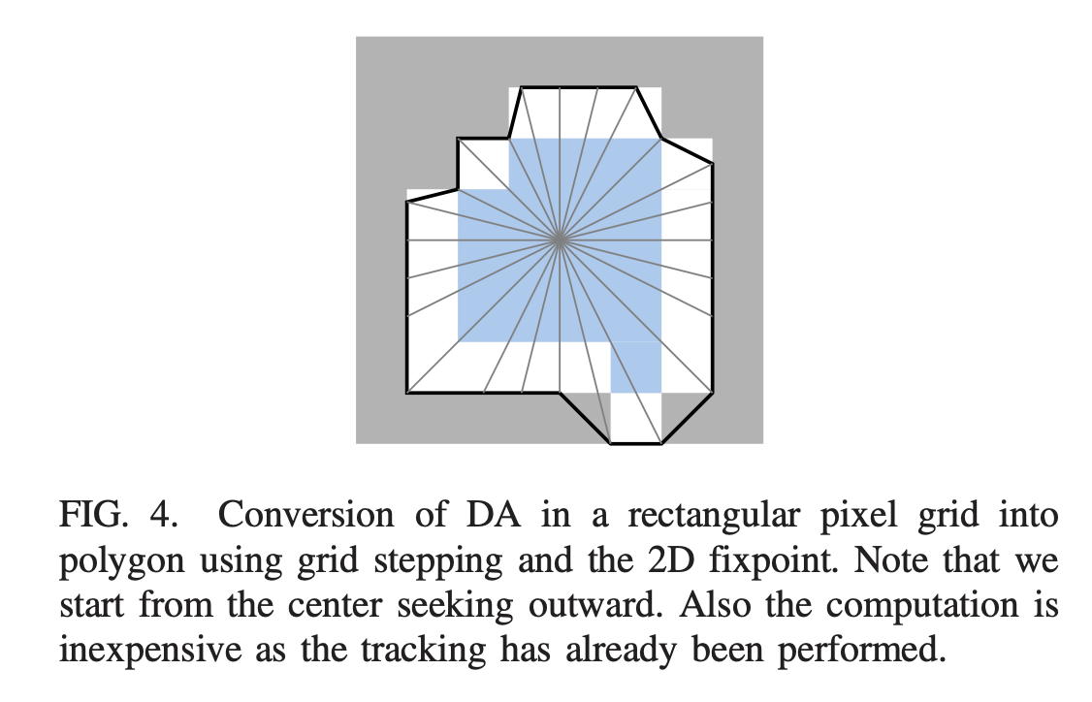
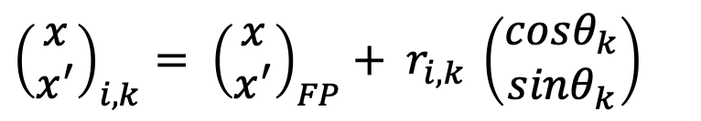
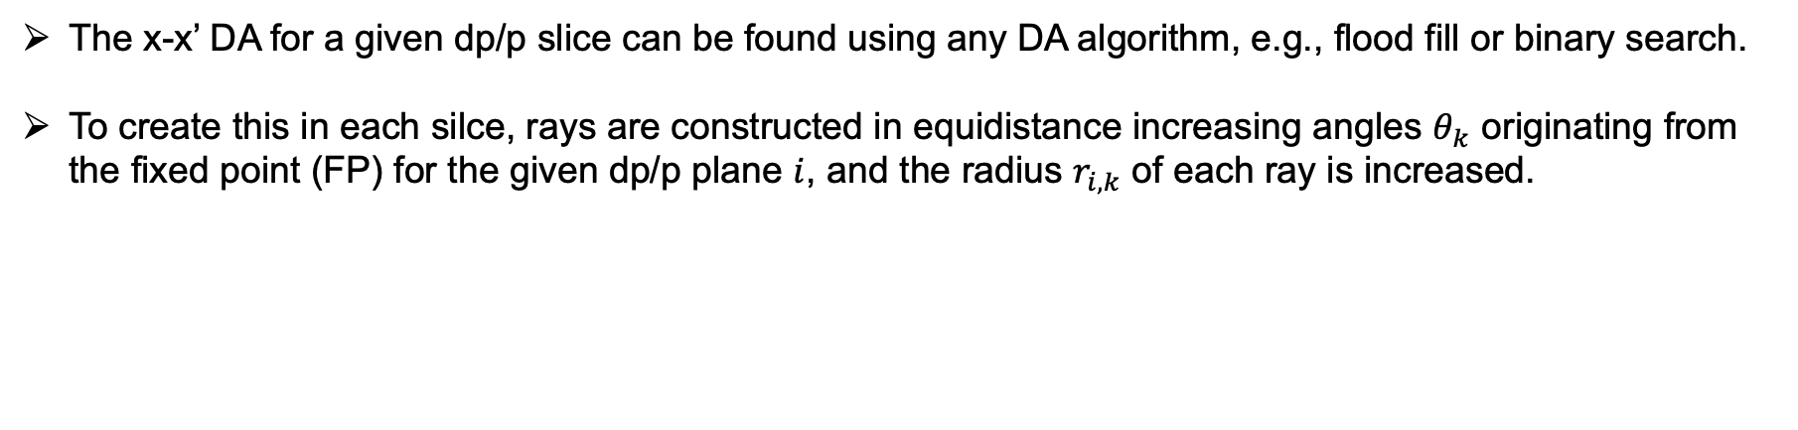
JKPS
Fast Touschek Tracking – FTT precomputation
The x-x’ DA for a given dp/p slice can be found using any DA algorithm, e.g., flood fill or binary search.
To create this in each silce, rays are constructed in equidistance increasing angles $θ_{k}$ originating from the fixed point (FP) for the given dp/p plane $i$, and the radius $r_{i,k}$ of each ray is increased.
${\left(\begin{matrix}x \\ x^{′}\end{matrix}\right)}_{i,k}= {\left(\begin{matrix}x \\ x^{′}\end{matrix}\right)}_{FP}+ r_{i,k}$ $\left(\begin{matrix}cosθ_{k} \\ {sinθ}_{k}\end{matrix}\right)$
21/34

Slide 22
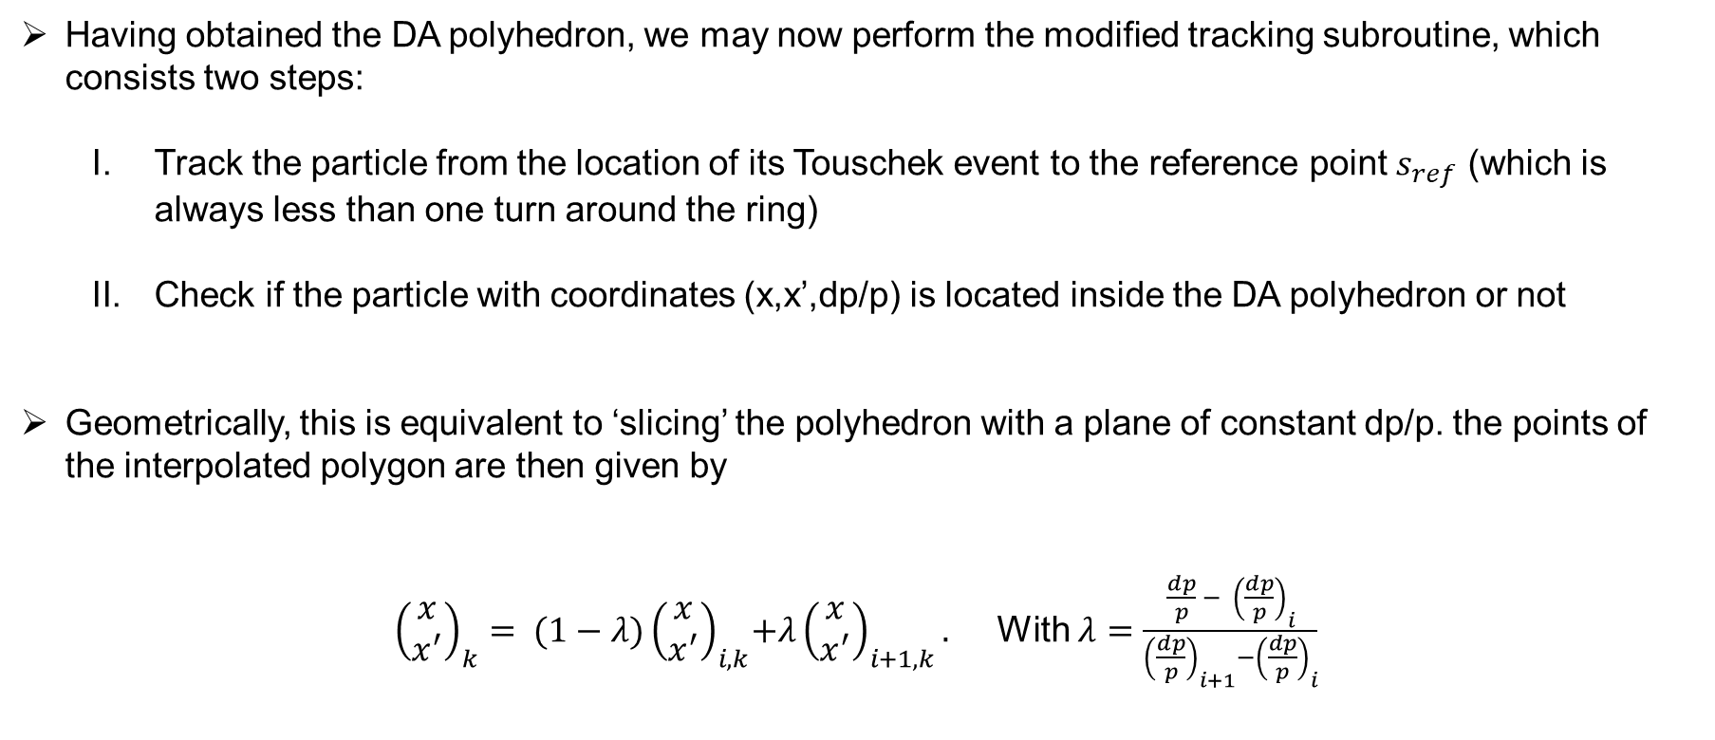
JKPS
Fast Touschek Tracking – FTT tracking subroutine
Having obtained the DA polyhedron, we may now perform the modified tracking subroutine, which consists two steps:
  Track the particle from the location of its Touschek event to the reference point $s_{ref}$ (which is always less than one turn around the ring)
  Check if the particle with coordinates (x,x’,dp/p) is located inside the DA polyhedron or not
Geometrically, this is equivalent to ‘slicing’ the polyhedron with a plane of constant dp/p. the points of the interpolated polygon are then given by
${\left(\begin{matrix}x \\ x^{′}\end{matrix}\right)}_{k}= {(1−λ)\left(\begin{matrix}x \\ x^{′}\end{matrix}\right)}_{i,k}+λ{\left(\begin{matrix}x \\ x^{′}\end{matrix}\right)}_{i+1,k}.$ With $λ=\frac{\frac{dp}{p} −{ \left(\frac{dp}{p}\right)}_{i}}{{\left(\frac{dp}{p}\right)}_{i+1}−{\left(\frac{dp}{p}\right)}_{i}}$
22/34

Slide 23






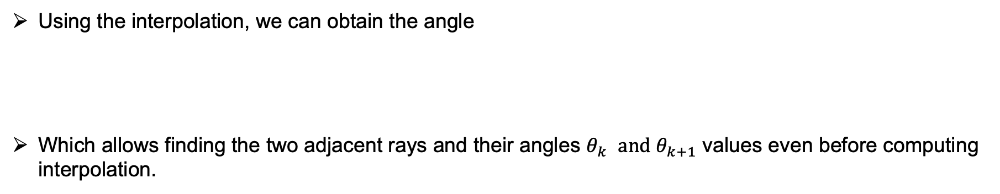


JKPS
Fast Touschek Tracking – FTT tracking subroutine
Using the interpolation, we can obtain the angle
Which allows finding the two adjacent rays and their angles $θ_{k}$ $and θ_{k+1}$ values even before computing interpolation.
$$φ=atan2(x^{′}−x_{FP}^{′}, x−x_{FP})$$
$$x′$$
$${(x,x}^{′})$$
$${\left(\begin{matrix}x \\ x^{′}\end{matrix}\right)}_{i+1,k}$$
$${(1−λ)\left(\begin{matrix}x \\ x^{′}\end{matrix}\right)}_{i,k}+λ{\left(\begin{matrix}x \\ x^{′}\end{matrix}\right)}_{i+1,k}$$
$${\left(\begin{matrix}x \\ x^{′}\end{matrix}\right)}_{i,k}$$
$$φ$$
$$x$$
dp/p
23/34

Slide 24


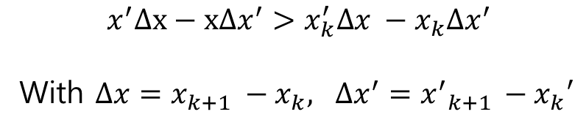



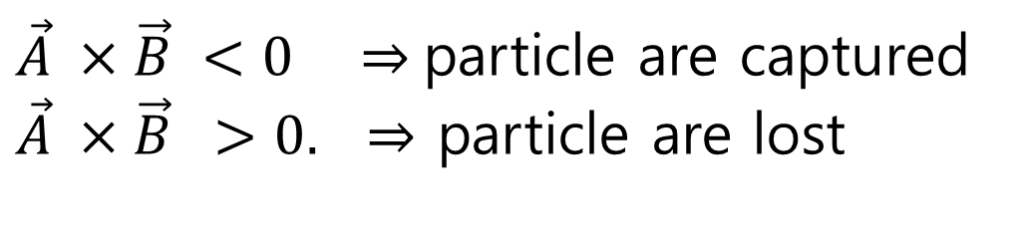

JKPS
Fast Touschek Tracking – FTT tracking subroutine
The condition for acceptance, meaning that the particle is captured, follows from the formula
$$x^{′}Δx−xΔx^{′}>x_{k}^{′}Δx −x_{k}Δx^{′}$$
With $Δx=x_{k+1} −x_{k}, Δx^{′}={x^{′}}_{k+1 }−x_{k}′$
$${(θ}_{k}<φ<θ_{k+1})$$
$$x′$$
($x_{k+1},{x′}_{k+1})$
B
$${(x,x}^{′})$$
($x_{k},{x′}_{k})$
A
$\vec{A} ×\vec{B} <0 ⇒$particle are captured
$\vec{A} ×\vec{B} >0. ⇒$ particle are lost
$$φ$$
$$x$$
24/34

Slide 25
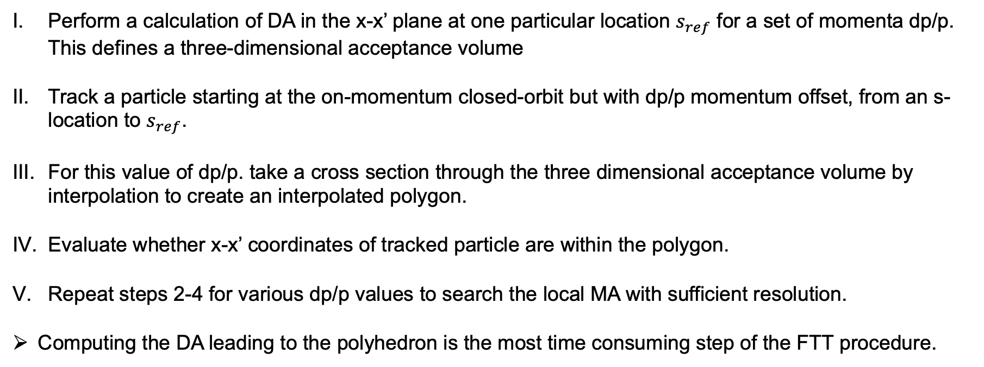
JKPS
Summary of Fast Touschek Tracking algorithm
Perform a calculation of DA in the x-x’ plane at one particular location $s_{ref}$ for a set of momenta dp/p. This defines a three-dimensional acceptance volume
Track a particle starting at the on-momentum closed-orbit but with dp/p momentum offset, from an s-location to $s_{ref}$.
For this value of dp/p. take a cross section through the three dimensional acceptance volume by interpolation to create an interpolated polygon.
Evaluate whether x-x’ coordinates of tracked particle are within the polygon.
Repeat steps 2-4 for various dp/p values to search the local MA with sufficient resolution.
Computing the DA leading to the polyhedron is the most time consuming step of the FTT procedure.
25/34

Slide 26
JKPS
FTT implementation into accelerator codes
The FTT procedure has been implemented into two common tracking codes:
  OPA
  Accelerator Toolbox (AT-MATLAB)
The tracking in OPA is four-dimensional with dp/p being finite but constant, while AT offers six-dimension damping.
In the following, we will present results from the two implementations, while increasing the complexity of the lattices to be evaluated using FTT.
26/34

Slide 27
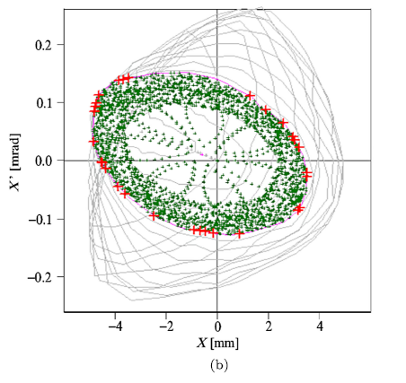
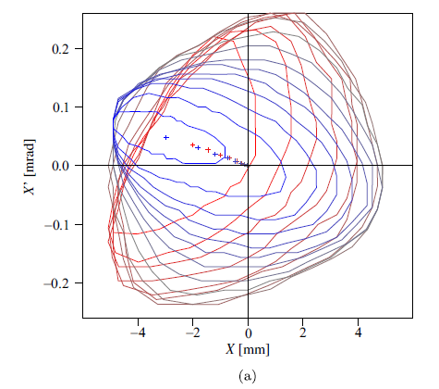
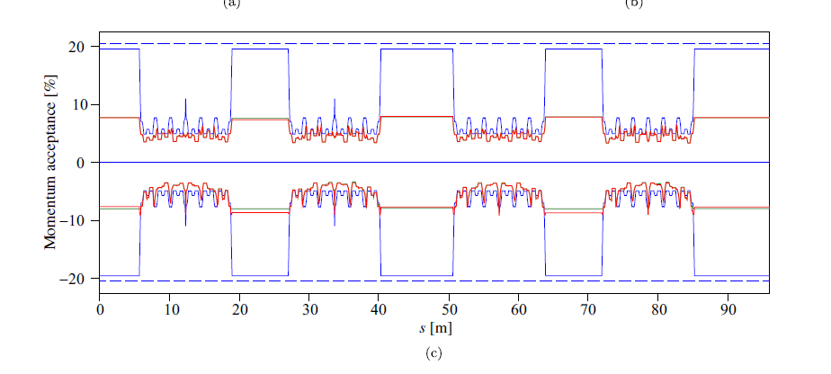
JKPS
FTT implementation into accelerator codes -OPA
The flood-fill algorithm is used to find the dynamic apertures for each dp/p slice at the reference point.
x-x’-dp/p DA polyhedron projected on the x-x’-dp/p plane.
Blue to red (negative dp -> positive dp).
Each dot represent the closed-orbit center
Red : standard tracking (3.45h)
Green : FTT procedure (3.31h)
Blue line : physical aperture
Blue dashed line : RF acceptance
27/34

Slide 28
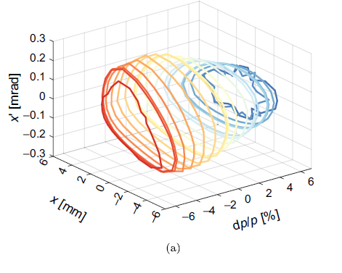
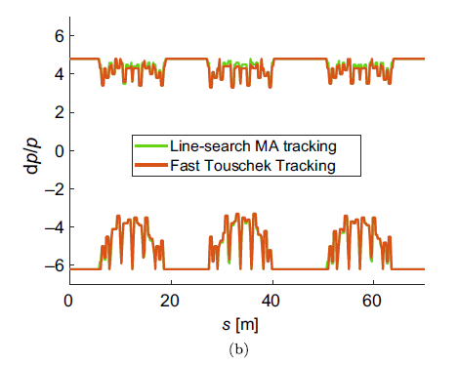
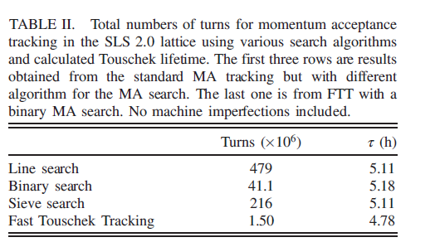
JKPS
FTT implementation into accelerator codes - AT
FTT method requires almost 400 times fewer turns than the standard MA tracking with line search while providing very similar result.
The shorter lifetime from FTT is, therefore, mainly related to the DA polyhedron. The lifetime from the FTT may tend to be underestimated because the surfaces or the polyhedron are mostly convex, and the polyhedron is confined by these surfaces
The accuracy of the FTT lifetime for the ideal lattice is about 93%, which is satisfactory for our lattice characterization.
28/34

Slide 29
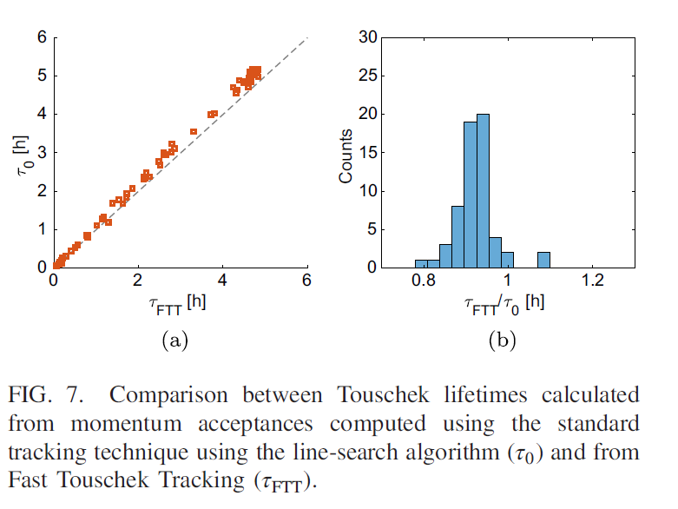
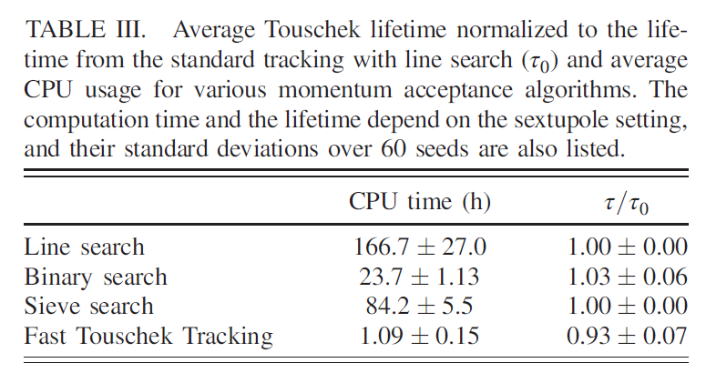
JKPS
FTT implementation into accelerator codes - AT
Sixty samples of sextupole errors are created, and the resulting lifetimes are evaluated.
29/34

Slide 30
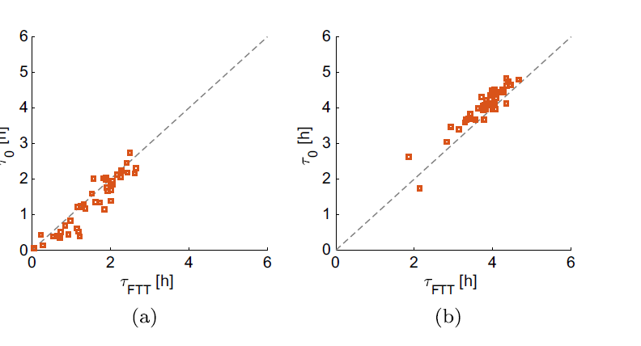
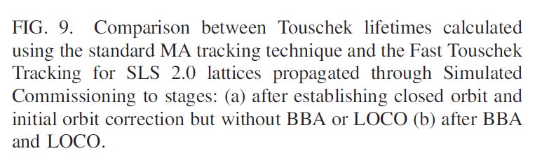
JKPS
Lattices with errors
The Simulated Commissioning toolkit of the Accelerator Toolbox has been used to generate 40 seeds with these errors and propagate them through the realistic commissioning process.
The evaluation is done at two points of the commissioning process
  After closed orbit has been established with orbit correction, but no beam-based alignment (BBA) nor optics correction applied
  After BBA optics correction using Linear Optics from Closed Orbits (LOCO)
30/34

Slide 31
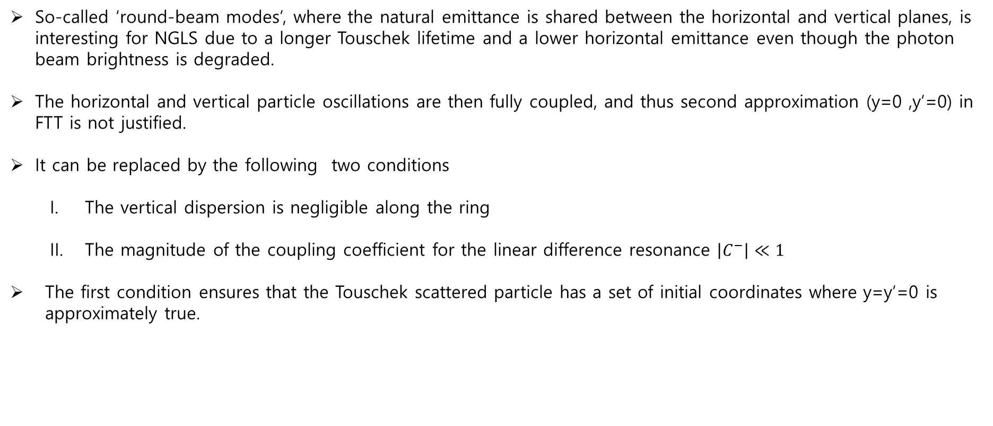
JKPS
Fully coupled lattices
So-called ‘round-beam modes’, where the natural emittance is shared between the horizontal and vertical planes, is interesting for NGLS due to a longer Touschek lifetime and a lower horizontal emittance even though the photon beam brightness is degraded.
The horizontal and vertical particle oscillations are then fully coupled, and thus second approximation (y=0 ,y’=0) in FTT is not justified.
It can be replaced by the following two conditions
  The vertical dispersion is negligible along the ring
  The magnitude of the coupling coefficient for the linear difference resonance $\left|C^{−}\right|≪1$
The first condition ensures that the Touschek scattered particle has a set of initial coordinates where y=y’=0 is approximately true.
$$Given y_{0}= 0, {y′}_{0}= 0, and D_{y}=D_{y}′= 0, the y =y^{′}=0 after scattering.$$
31/34

Slide 32
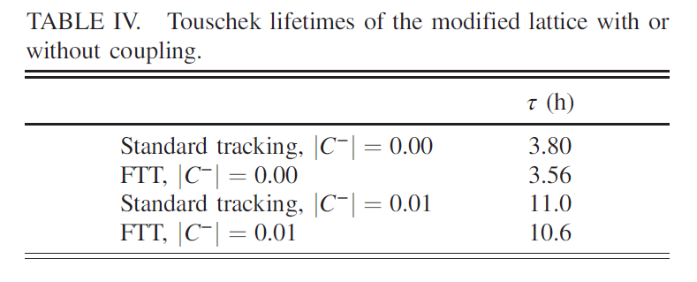
JKPS
Fully coupled lattices
Again, we observe a good agreement between standard MA tracking and FTT both with and without coupling.
32/34

Slide 33
Beam physics group meeting
Conclusion
We have developed new methods for efficient computation of circular accelerator lattices characteristics, with a focus on the NGLS storage ring lattice.
A new algorithm for fast dynamic aperture calculations , flood fill, was introduced
Furthermore, the Fast Touschek Tracking (FTT) algorithm has been developed aiming at significantly speeding up the calculation of momentum acceptance.
FTT was implemented in two accelerator codes, OPA and AT. We examined the lattices with errors and a fully coupled lattice.
During the benchmarking, it was found that the accuracy of the computed lifetime can depend on the algorithm used for the DA computation, particularly when the border of the Das used to construct the polyhedron is not completely smooth
The largest discrepancy between standard tracking and FTT that we observed was about 25% while it was about 7% on average over many machines with random errors.
33/34

Slide 34
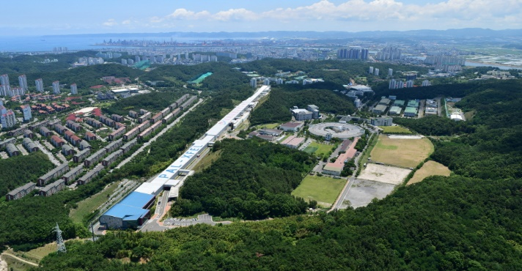
Thank you!

