Slide 1
Group meeting
2025/06/27
장원

Slide 2
일 | 월 | 화 | 수 | 목 | 금 | 토
29 | 30 | 1 | 2 | 3 | 4 | 5
6 | 7 | 8 | 9 | 10 | 11 | 12
13 | 14 | 15 | 16 | 17 | 18 | 19
20 | 21 | 22 | 23 | 24 | 25 | 26
27 | 28 | 29 | 30 | 31 | 1 | 2
3 | 4 | 5 | 6 | 7 | 8 | 9
10 | 11 | 12 | 13 | 14 | 15 | 16
17 | 18 | 19 | 20 | 21 | 22 | 23
24 | 25 | 26 | 27 | 28 | 29 | 30
7월
XFEL-이용자 학회
Ground motion:
Gaussian filter Cut off frequency,
Variance 결정
Cherenkov radiation: 이론 공부
방사광가속기 활용연구과제 Summer School
8월
KoPAS 2025
Ground motion:
Ground motion을 적용한 Elegant simulation practicing
Cherenkov radiation: 이론 공부+인수 인계, 중간 보고서 준비(9월)

Slide 3
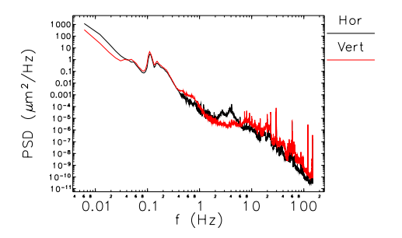
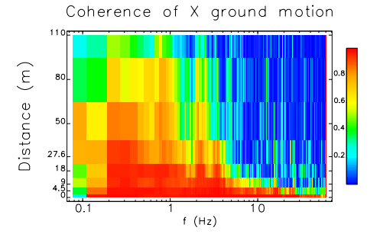
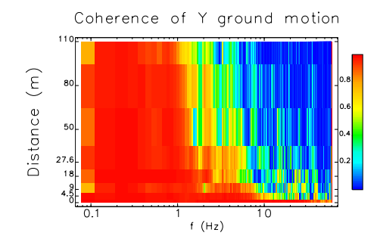
At The Advanced Photon Source(APS)…
$$C_{12}\left(ω\right)=\frac{{\left|P_{12}\left(ω\right)\right|}^{2}}{P_{11}\left(ω\right)P_{22}(ω)}$$
$C_{12}\left(ω\right)>0.8$: coherent
$C_{12}\left(ω\right)<0.8$: incoherent
V. Sajaev and C. Preissner, "Determination of the Ground Motion Orbit Amplification Factors Dependence on the Frequency for the APS Upgrade Storage Ring," in Proc. 9th Int. Particle Accelerator Conf. (IPAC’18), Vancouver, BC, Canada, Apr. 2018, pp. 1272–1275. doi: 10.18429/JACoW-IPAC2018-TUPMF012.

Slide 4
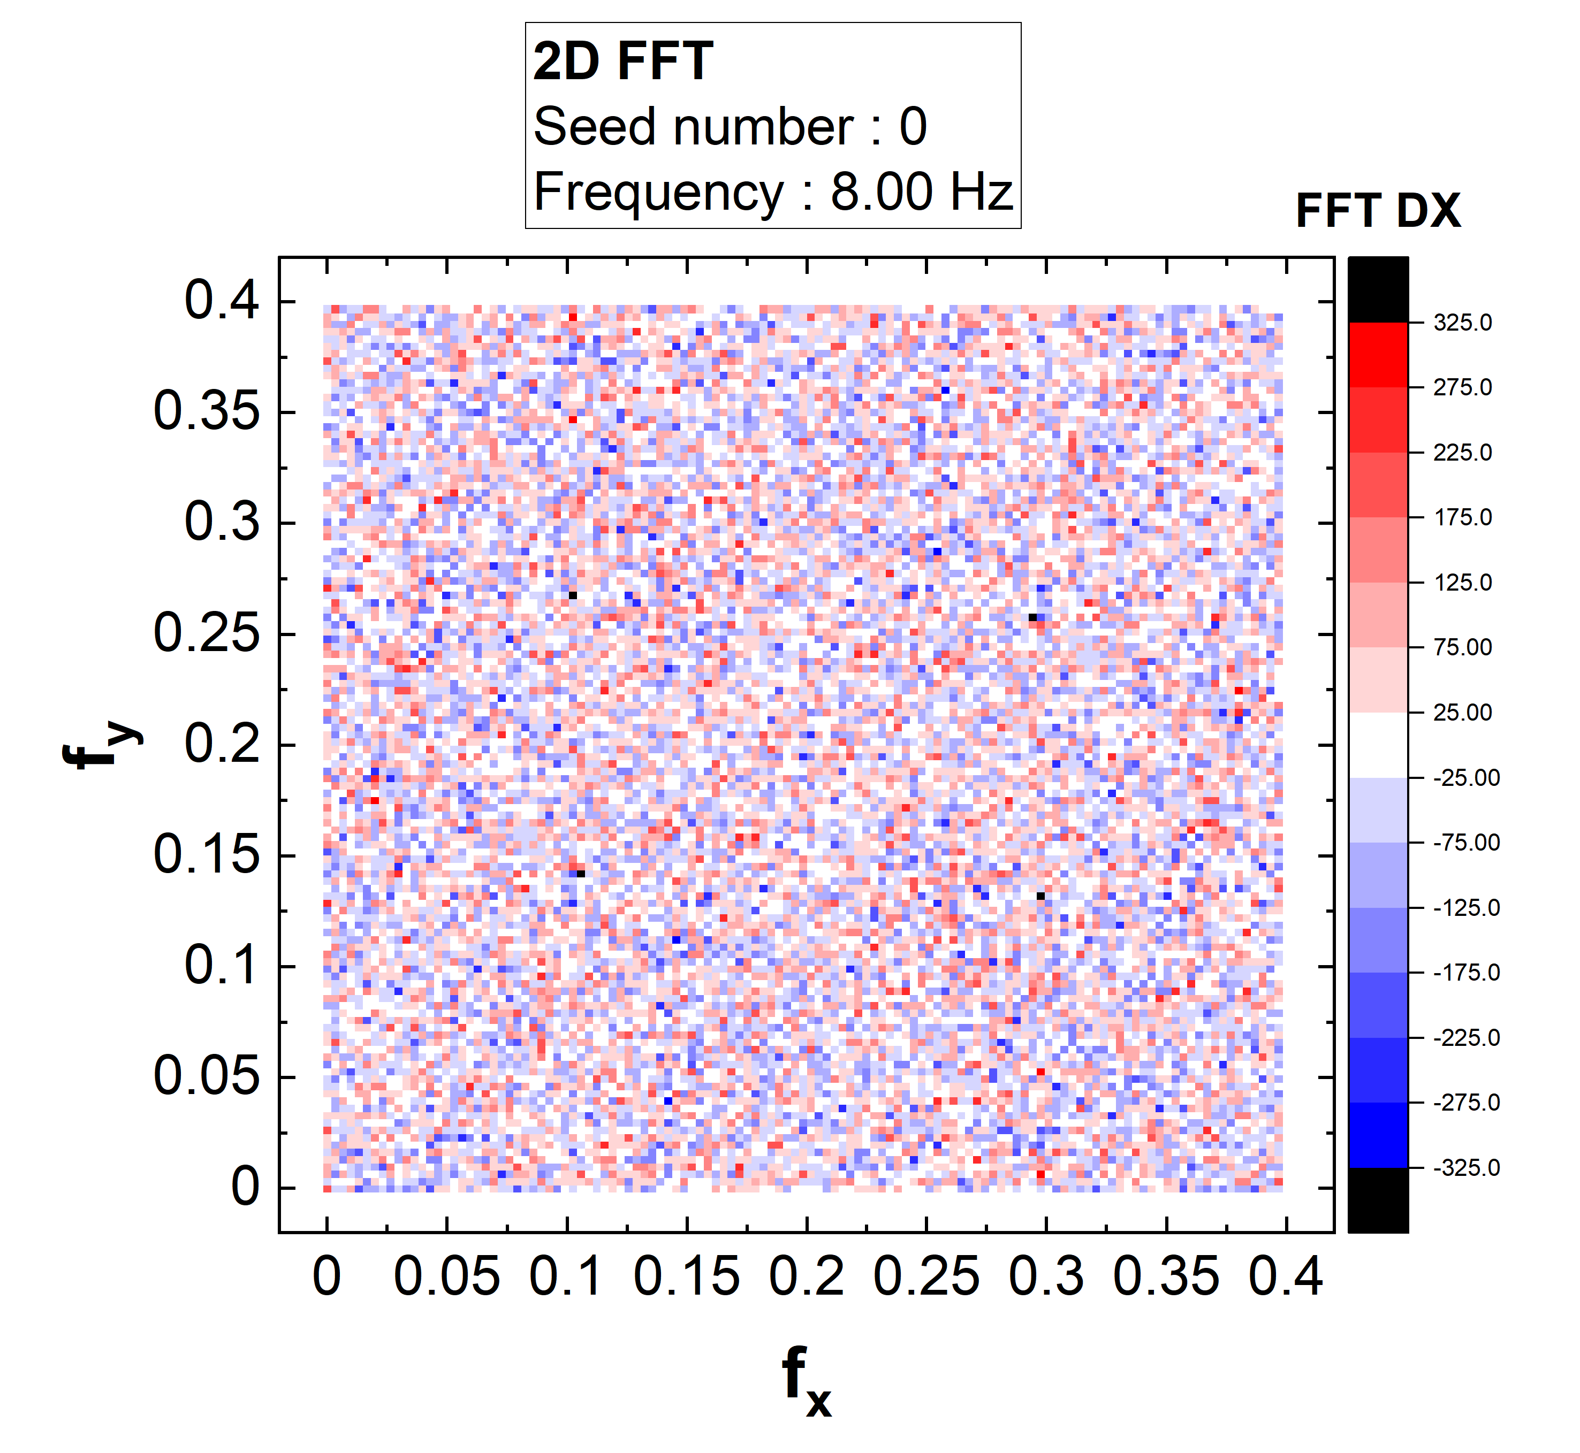
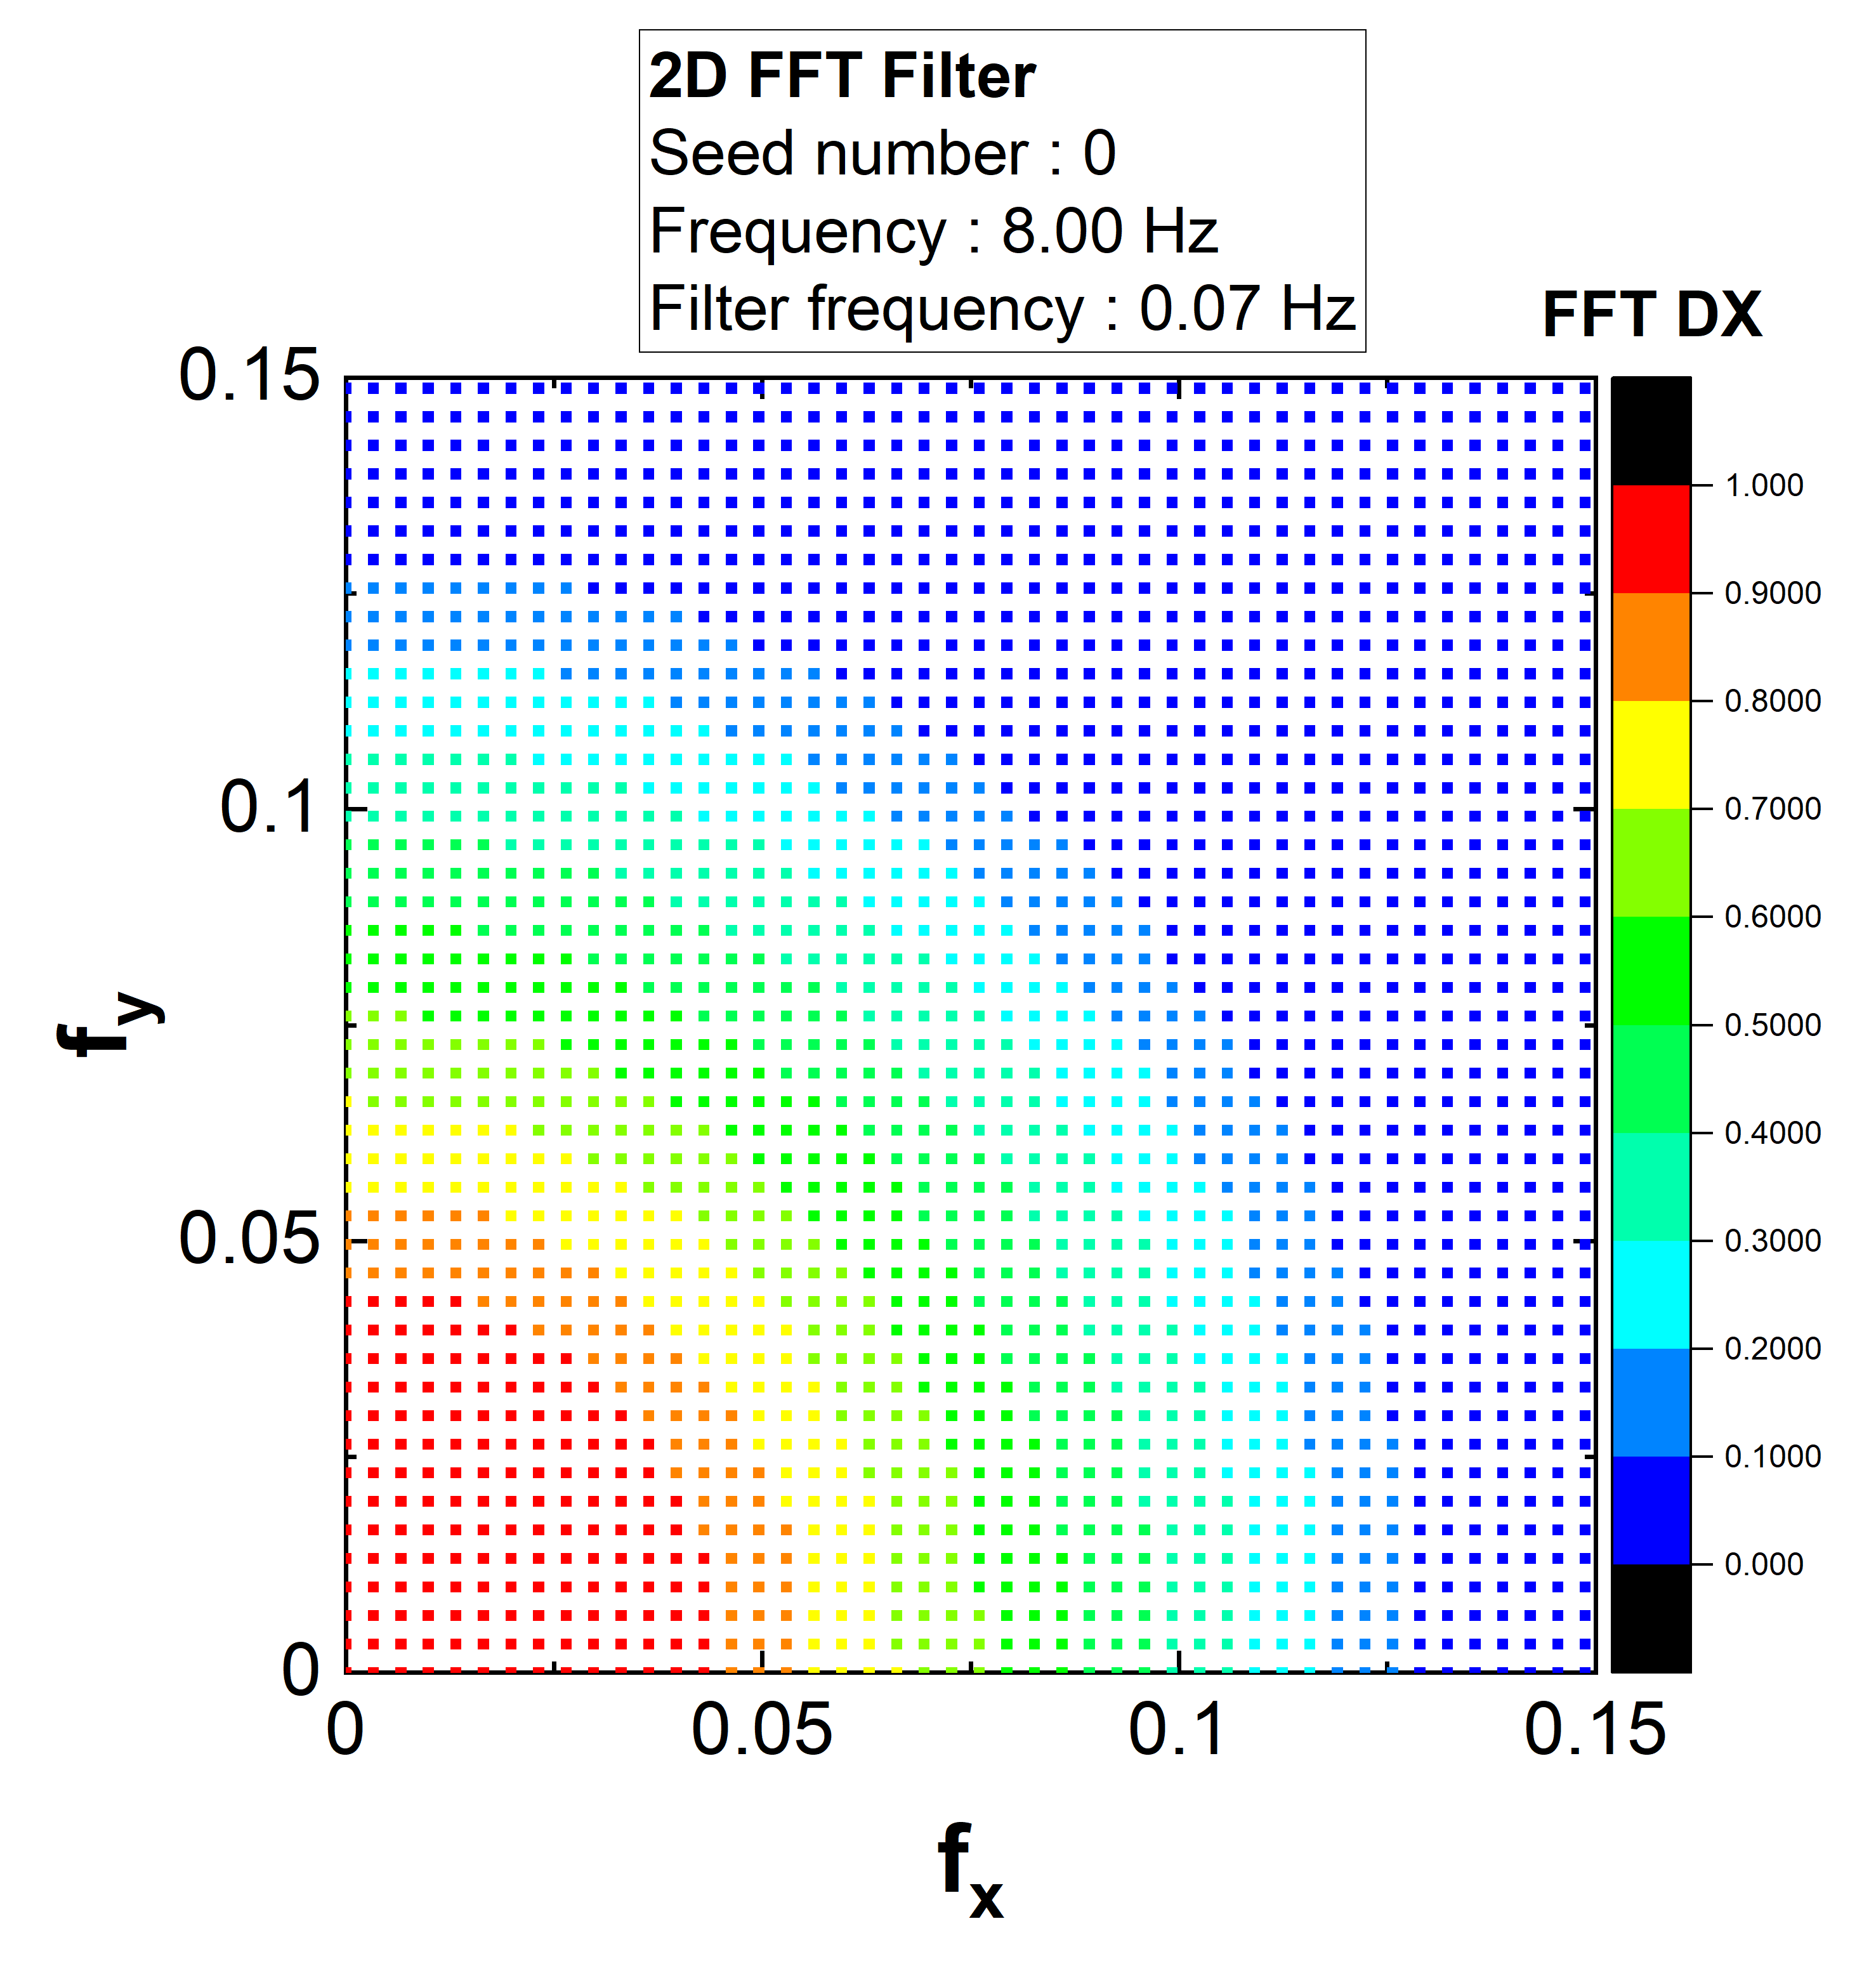
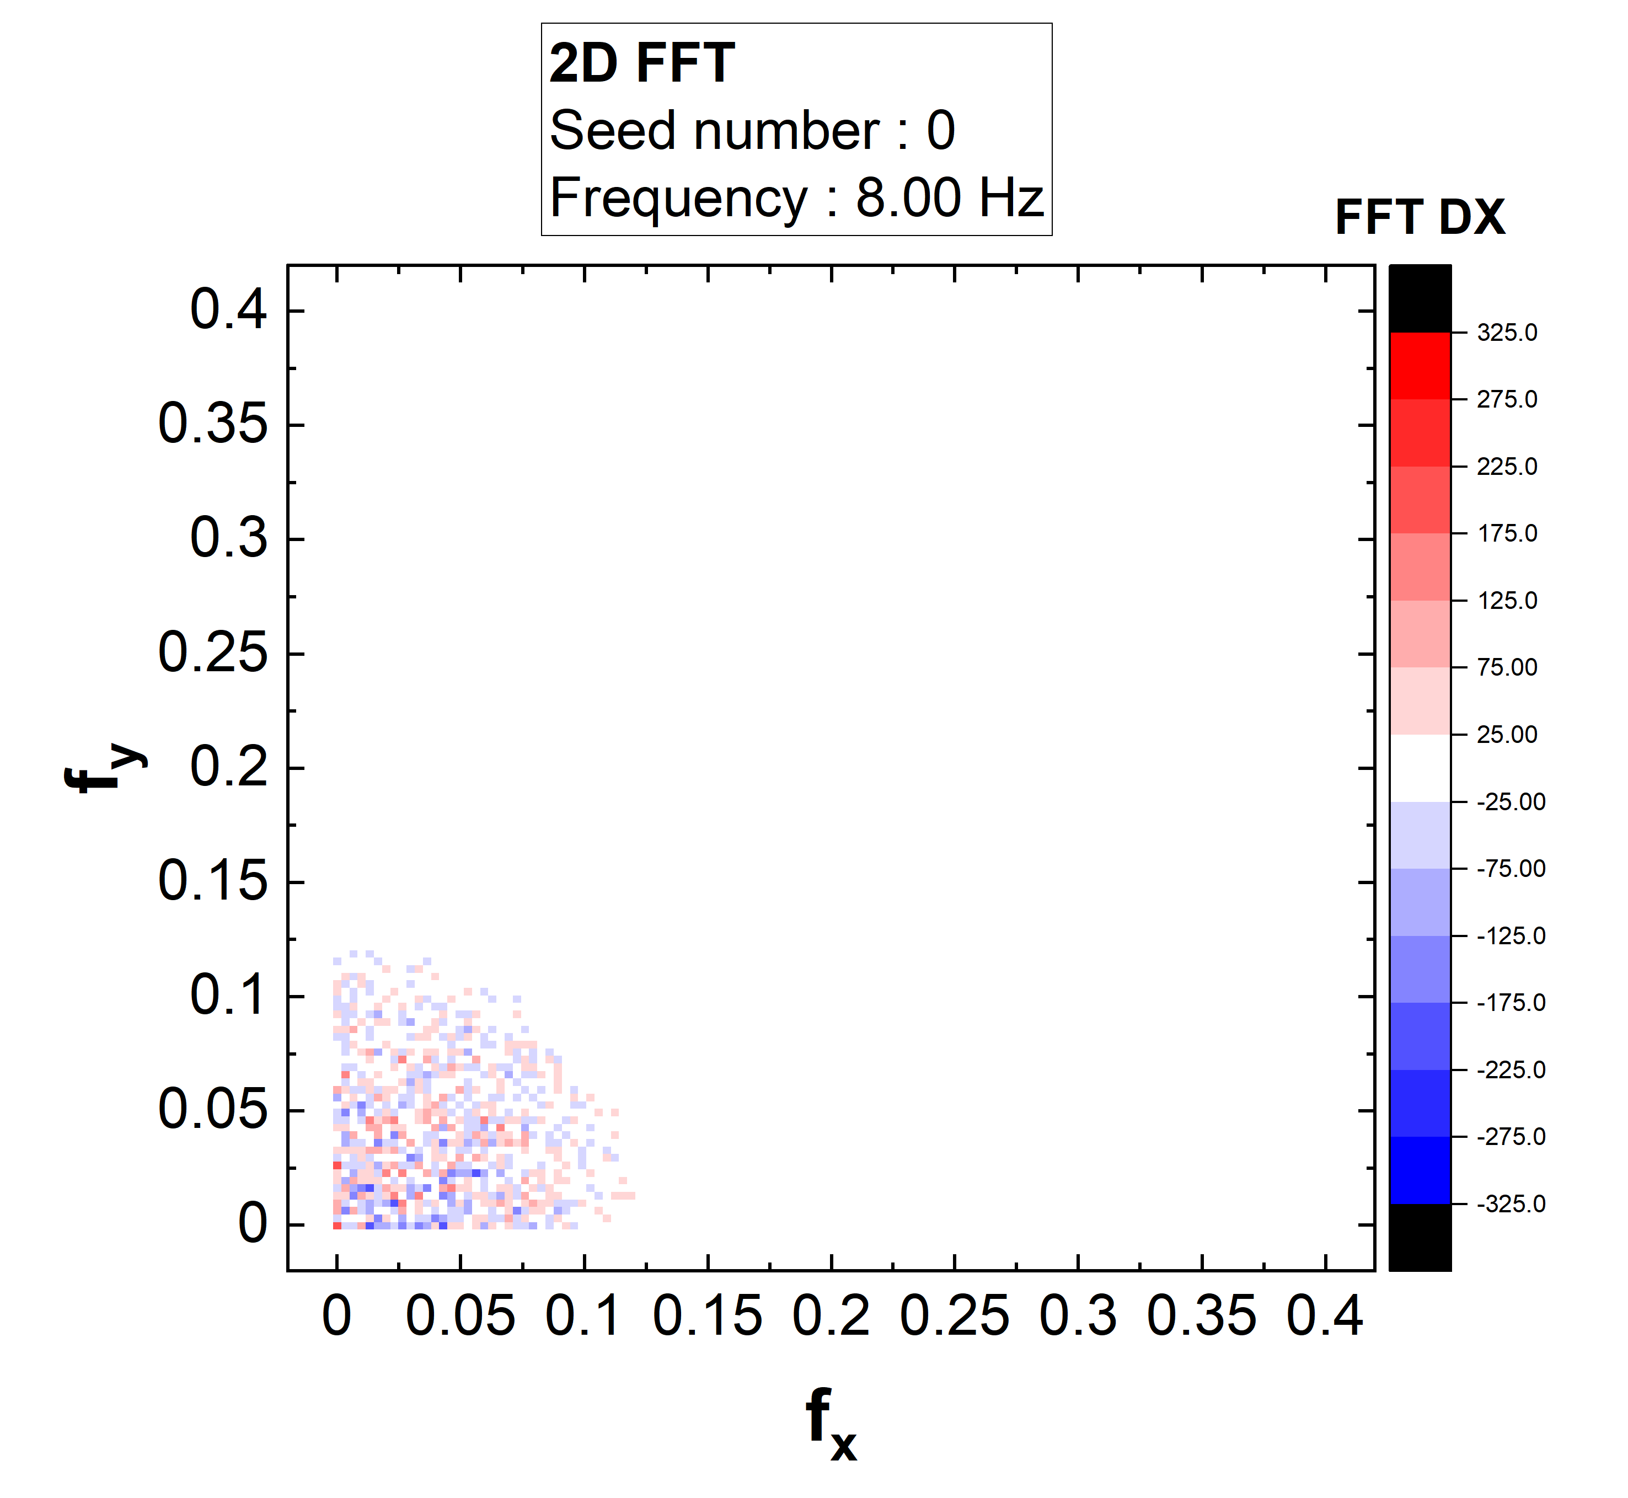
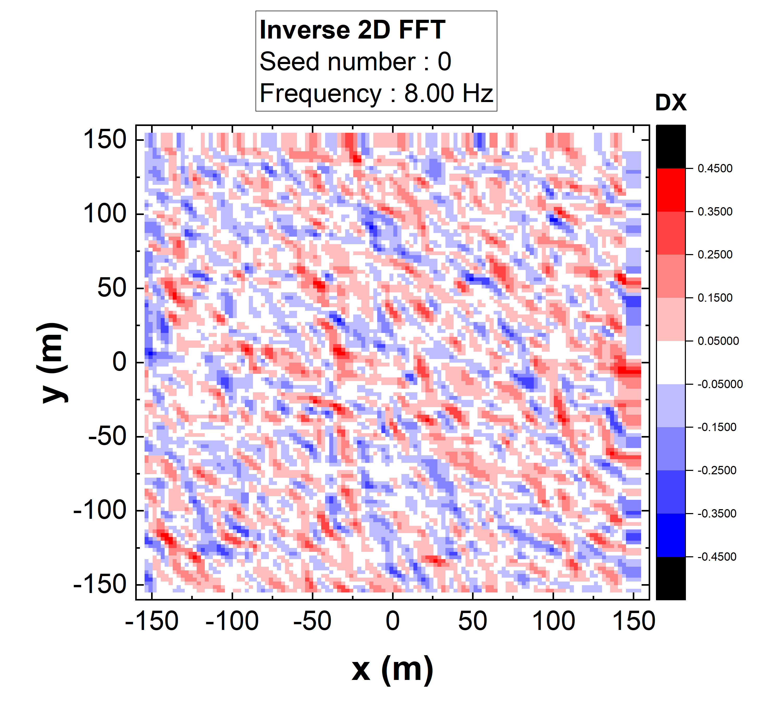
Lowpass filter
Random Seed
(incoherent)
Lowpass filter
Filtered-data
(correlated-data)
Inverse Fourier transform (Ground displacement)
f<f1: 1
f>f2: 0
f1<f<f2: changes linearly
In thins paper, 2f1=f2/2=f (for smooth random variation)

Slide 5
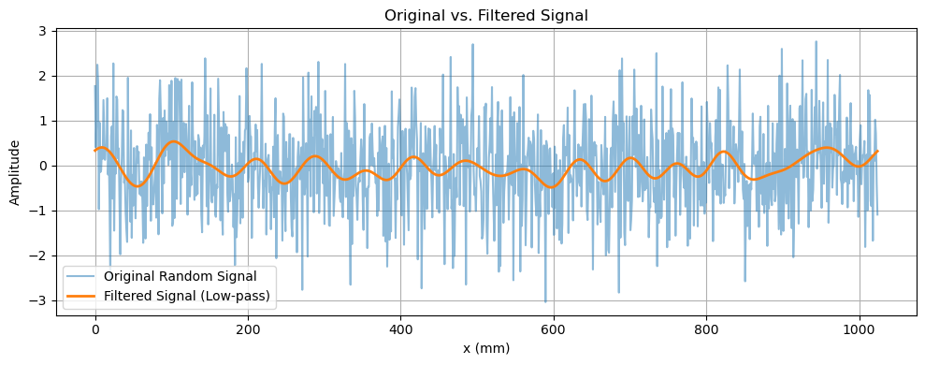
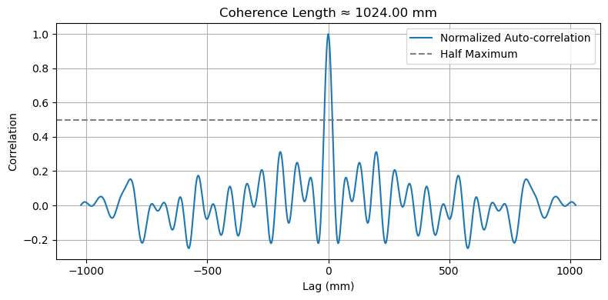
Auto Correlation-Coherence length
Autocorrelation:
$$R\left(Δx\right)=\frac{1}{N}μ\left(x_{i}\right)μ(x_{i}+Δx)$$
Correlation length from FWHM,
And determine the cutoff frequency
Condition:
FWHM=$L=\frac{1}{\sqrt{2}f_{cut}}$

Slide 6
Misunderstand
$$u(x=a,y=b,t)$$
Fourier Transform
Filtering
Random Seed
(incoherent)
Inverse Fourier Transform,
Applying all other points

Slide 7
Misunderstand
$$k_{y}$$
$$u(x,y)$$
$$k_{y}$$
$$k_{x}$$
$$u(x=a,y=b,t)$$
Fourier Transform
Filtering
Random Seed
(incoherent)
(for x and y)
$$k_{x}$$
Inverse Fourier Transform,
Applying all other points
$$k_{y}$$
$$k_{x}$$

Slide 8
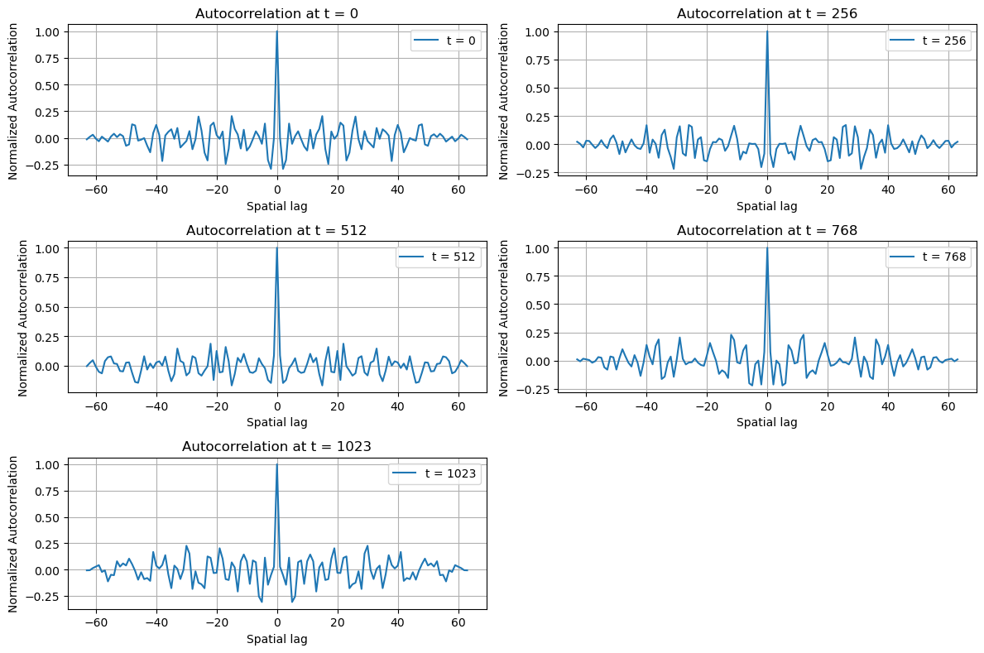
Research progress- for 1D signal
There’s no correlation for random signal.

Slide 9
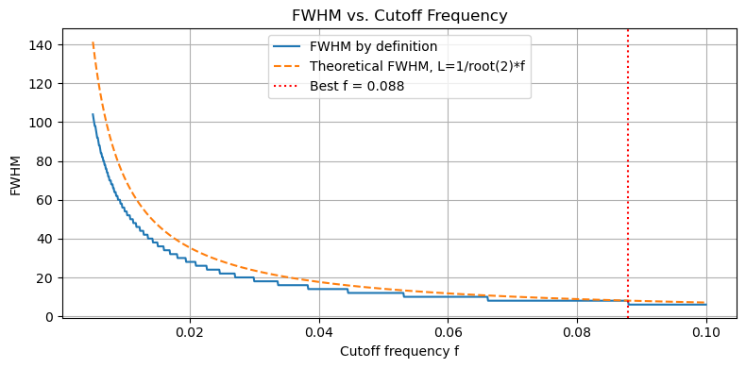
Research progress- for 1D signal
$$f_{cut}=0.0879$$
It seems that we need a better method to determine the appropriate cutoff frequency."
Scan range
0.005<f<0.1
Ground size nx=100000
spacing
0.000095

