Slide 1
20250627 Group Meeting
Minseo Jeong

Slide 2
Index
Status of UED experiment
KAPRA conference preparation

Slide 3
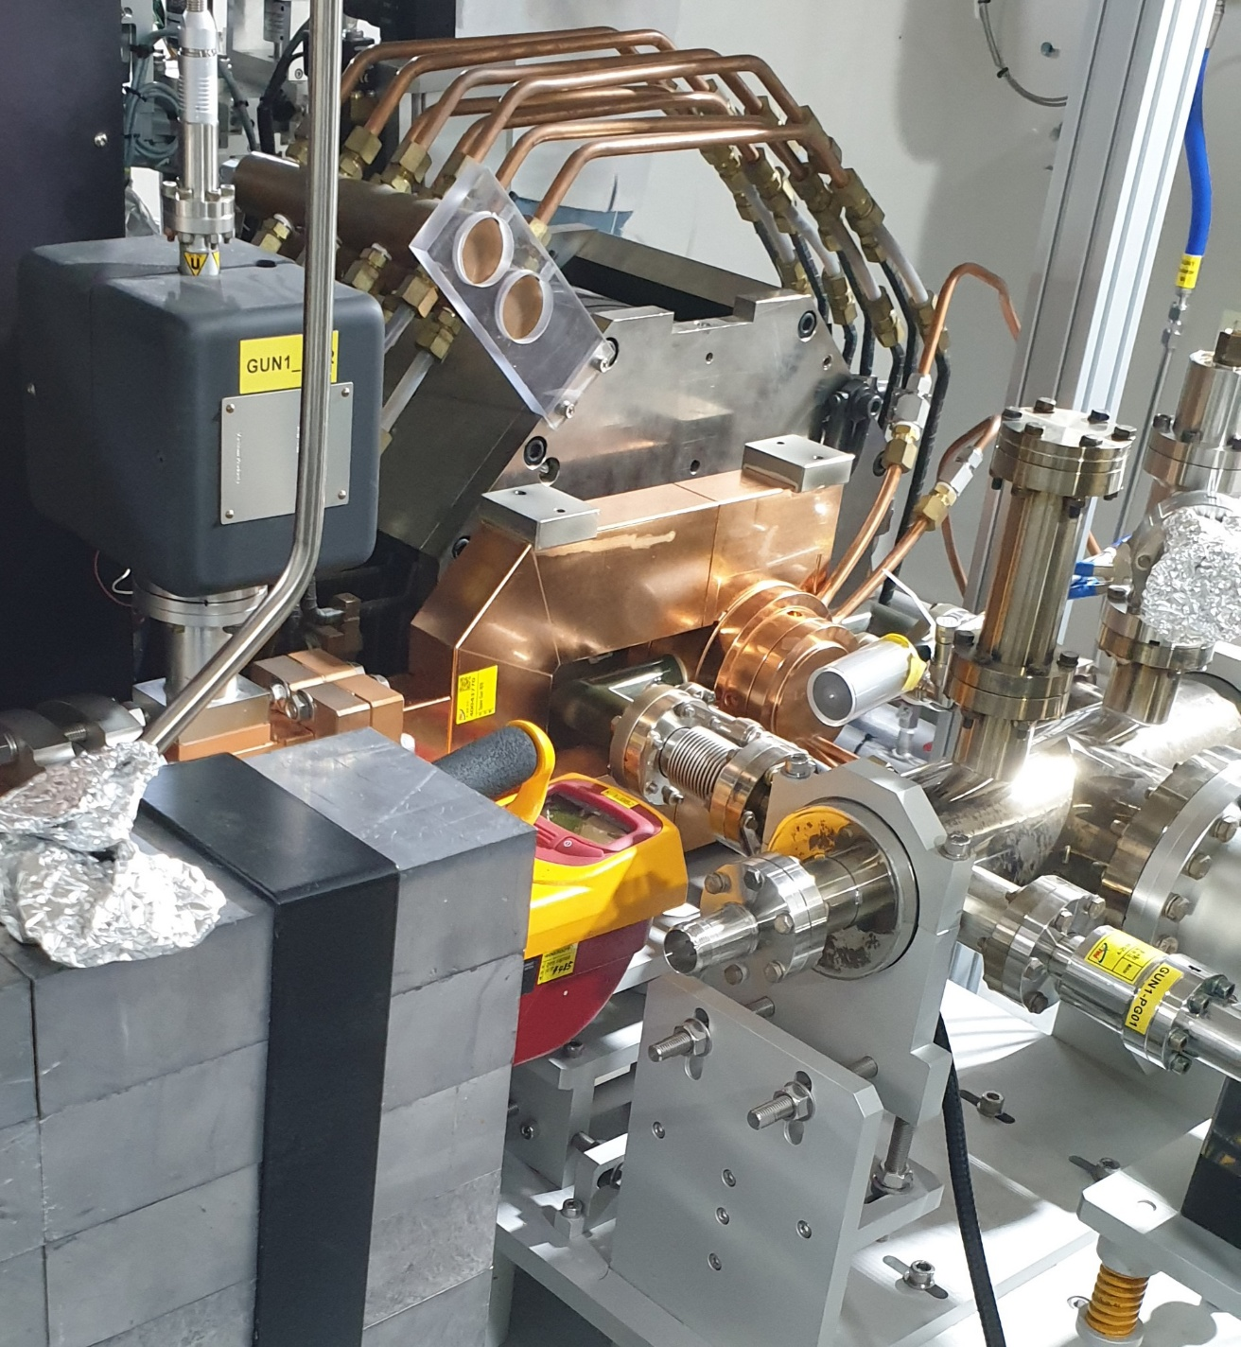
Status of UED experiment
Conditioning of new photogun was completed

Slide 4
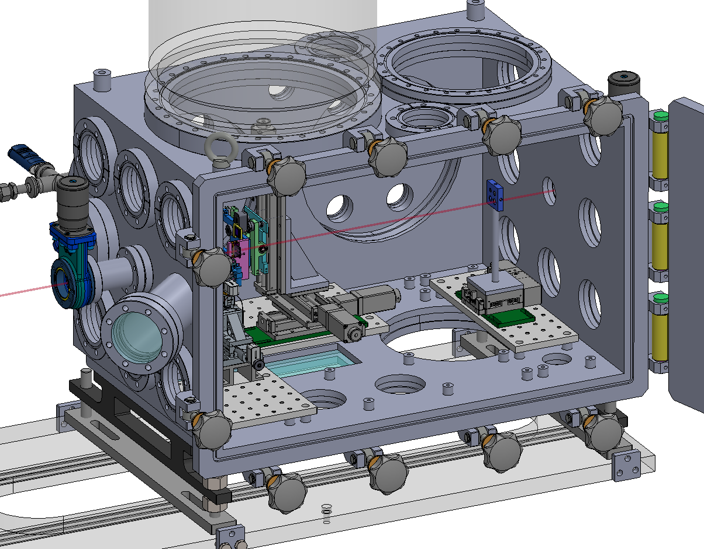
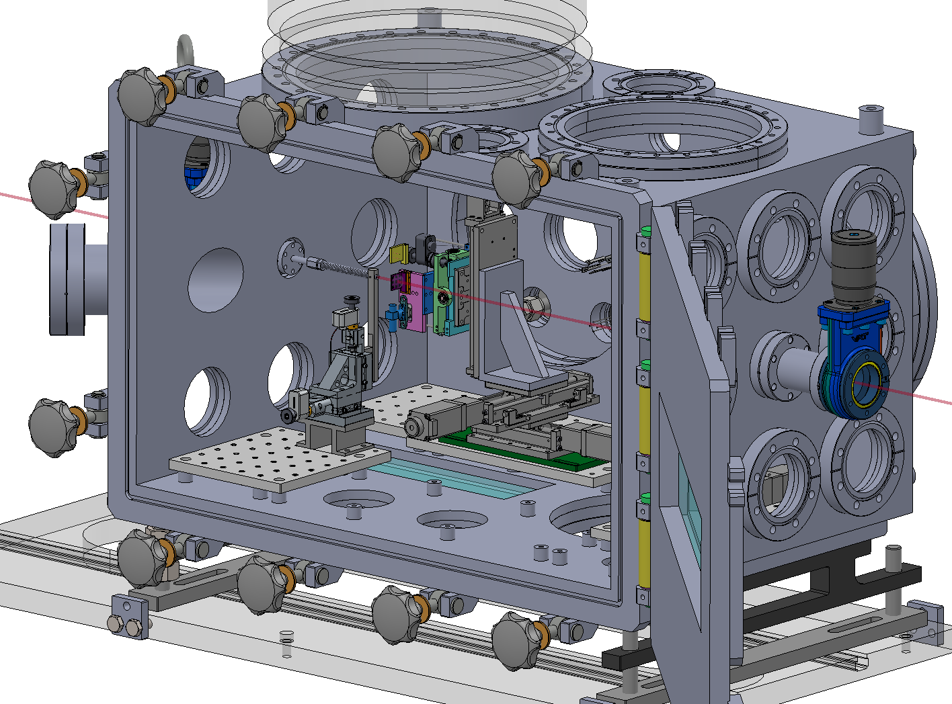
Status of UED experiment -Design of sample chamber
The load capacity of stage issue and discrepancy of size of the parts issue exist

Slide 5
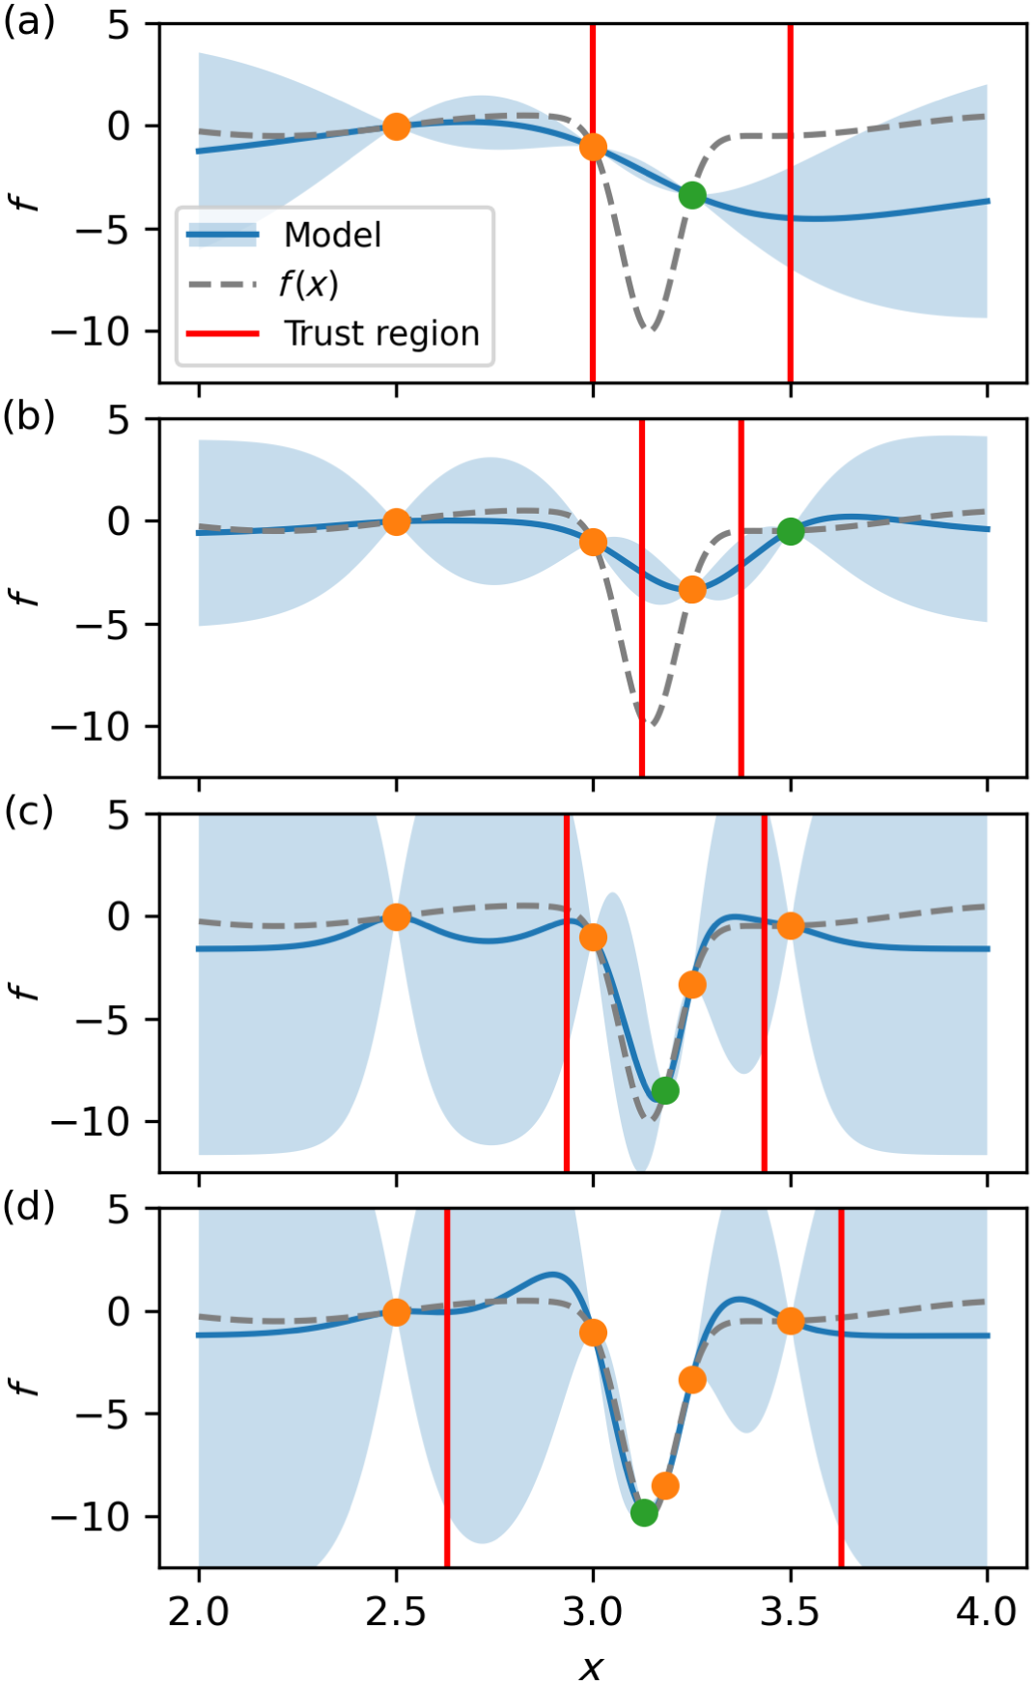
Multi-objective trust region Bayesian optimization(MORBO)
Due to the relatively large posterior uncertainties of GP models, common acquisition functions tend to overprioritize exploration over exploitation in high-dimensional parameter spaces
Trust region Bayesian optimization(TuRBO): An algorithm that restricts optimization of the acquisition function to within a so-called trust region
R. Roussel et al. Phys. Rev. Accel. Beams 27. (2024).

Slide 6
Multi-objective trust region Bayesian optimization(MORBO)
Trust region is centered at the best previously observed measurement so far during optimization
In MOBO, the center of the trust region is at the measured point whose hypervolume contribution is the largest
As optimization progresses, the size of the trust region changes based on the number of consecutive successes or failure
R. Roussel et al. Phys. Rev. Accel. Beams 27. (2024).

Slide 7
Multi-objective trust region Bayesian optimization(MORBO)
Surrogate model: Gaussian process
Kernel: Matern function with v=5/2
Initial sample point: 16
Acquisition function: Expected hypervolume improvement(EHVI)
Number of iteration: 400
Limit of consecutive success/failure: 5/5

Slide 8
Multi-objective trust region Bayesian optimization(MORBO)
Input parameter: Strength of solenoids, bunch charge, RF gun phase, source beam size
Objective parameter: Beam size, bunch length, q-resolution
Parameter | Range
Charge | [50fC, 100fC]
Source beam size | [20μm, 100μm]
RF gun phase | [-75°, -35°]
Solenoid 1 strength | [0.144T, 0.18T]
Solenoid 2 strength | [0.07664T, 0.0958T]

Slide 9
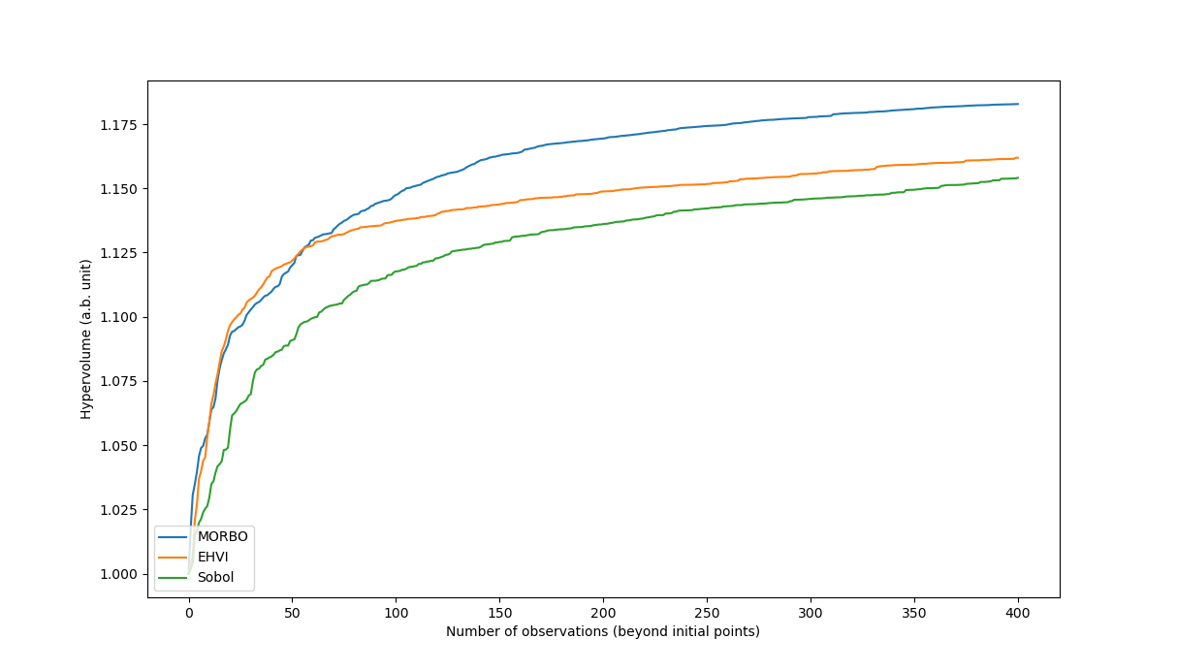
Multi-objective trust region Bayesian optimization(MORBO)
Comparison of MORBO, MOBO, and Sobol(quasi-random process)

Slide 10
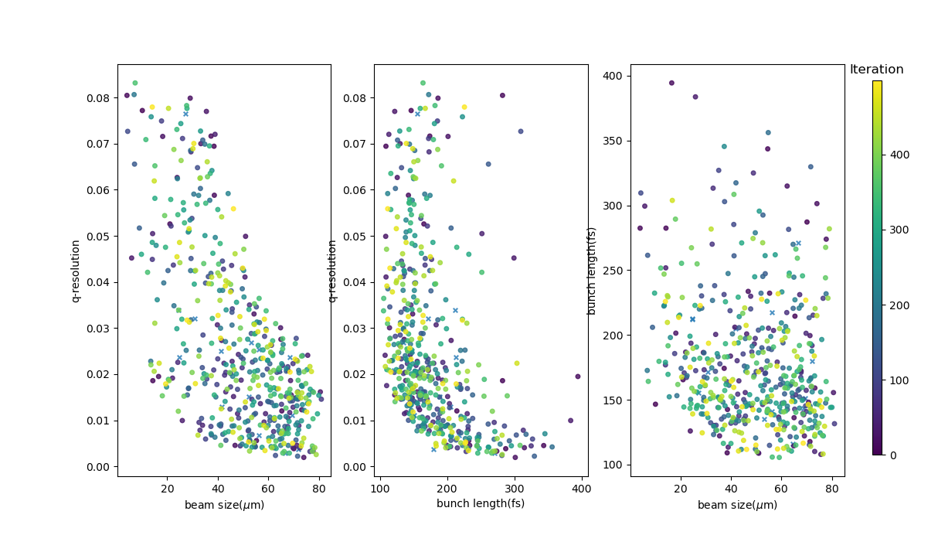
Multi-objective trust region Bayesian optimization(MORBO)
Optimization result of MOBO

Slide 11
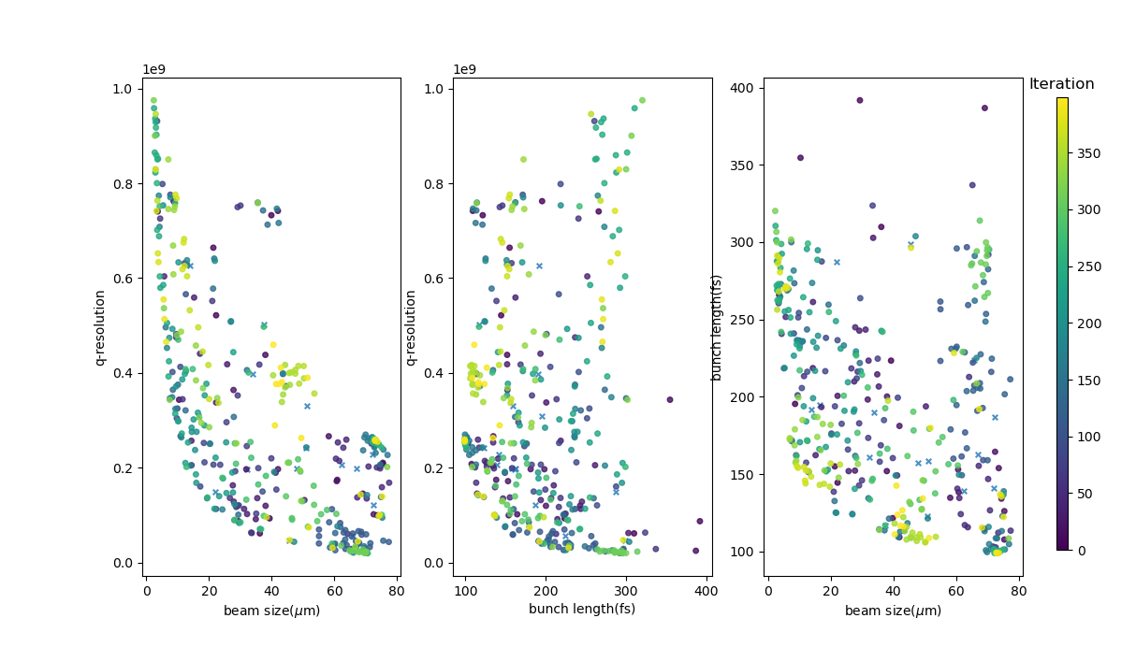
Multi-objective trust region Bayesian optimization(MORBO)
Optimization result of MORBO

Slide 12
Acquisition function issue
Acquisition function determines value of potential future measurements
Pytorch/Botorch finds the maximum of acquisition function by gradient-based algorithm
However, custom made upper confidence bound-hypervolume improvement(UCB-HVI) algorithm does not have gradient

Slide 13
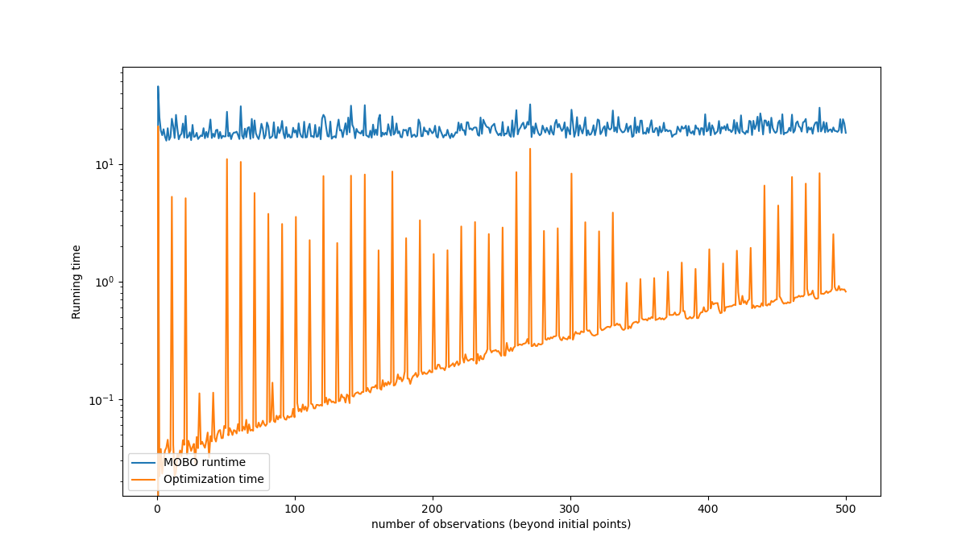
Acquisition function issue
Runtime of Bayesian optimization with EHVI acquisition function when the dimension of objective space m=6

Slide 14
Future plan
Simulation
- Setting energy as a constraint
- Testing EHVI when m=6
- Finding the way to optimize the acquisition function without requiring gradient of acquisition function(e.g. random process)
Experiment
- Measuring objective parameters(e.g. bunch length, emittance)
- Making code for analyzing measured data and automatically entering the value of test point

Slide 15
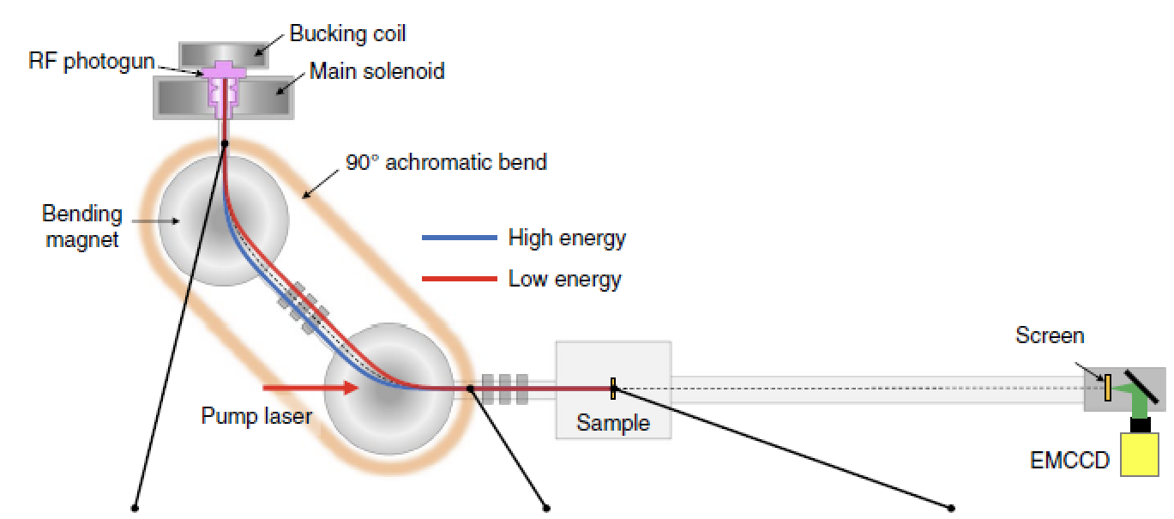
Appendix: MeV-UED in KAERI
Notes:
Temporal resolution: 73fs(FWHM, with 45fs pump)

