Slide 1
Gantry angle dependent beam control optimization of a traveling wave linear accelerator to improve VMAT delivery
류연찬

Slide 2
Contest
Medical linear accelerator
Ion Chamber for monitor
Introduction
Material and Methods
Result
Summary

Slide 3
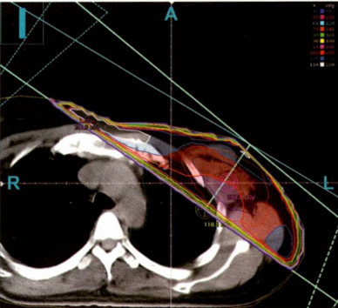
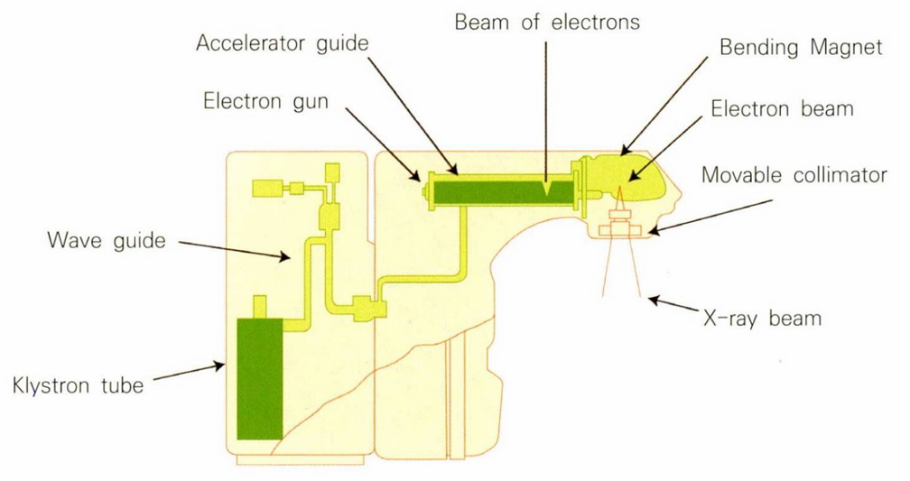
Purpose of Clinical Linear Accelerators (LINAC)
Introduction to Clinical Linear Accelerators
High energy X-rays are generated by a medical LINAC
Accelerated electrons strike a metal target (Tungsten) to produce high energy
Deliver high dose to tumor tissue, while low dose to normal tissue
Asymmetry X-ray delivery can unintentionally expose normal tissue
medical LINAC diagram
Treatment plan about breast cancer nearby lung

Slide 4
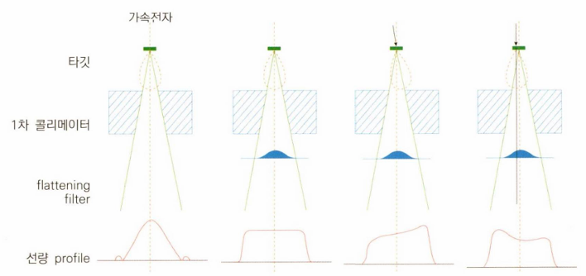
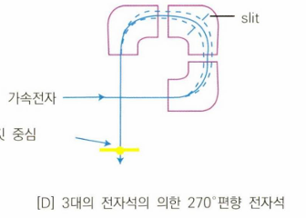
Importance of Symmetric X-ray Beam Emission
Why beam symmetry matters
Dose distribution varies depending on the electron’s incident angle on the target
Radiation therapy treatment plans assume ideal, uniform X-ray beam
Continuous beam monitoring is essential
Accurate beam position and angle correction are required to maintain the planned and consistent dose profile
진리표
Dose profile by incident angle

Slide 5
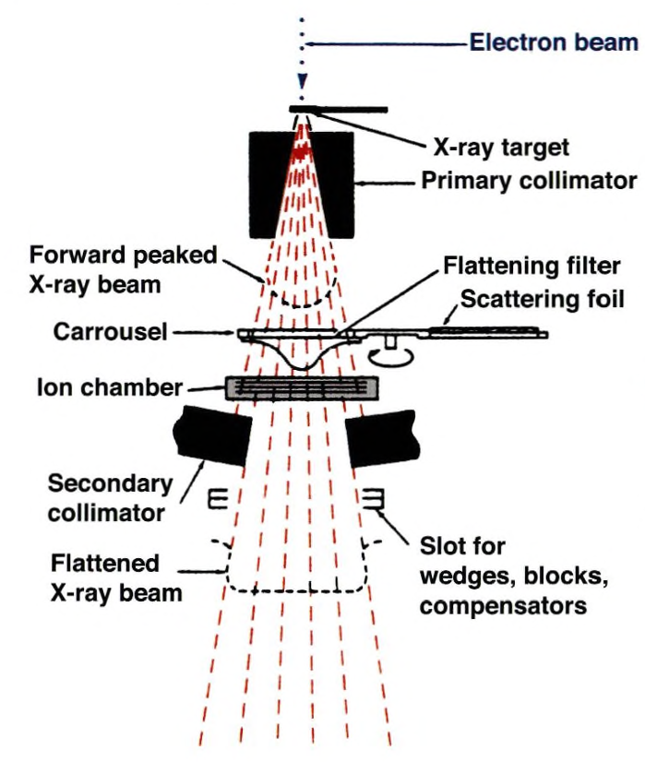
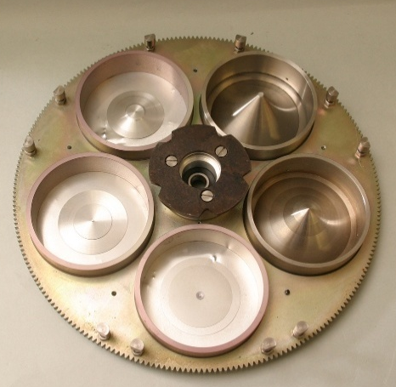
Architecture of medical LINAC
Gantry head
Accelerated electron pass through magnets and hit a target to generate X-rays
High-energy X-rays require precise control and monitoring
Several components ensure accurate delivery and detect error
Ion chamber monitors the dose in real time and interrupts the beam upon error detection
Flattening filter with carrrousel
Structure of gantry head

Slide 6
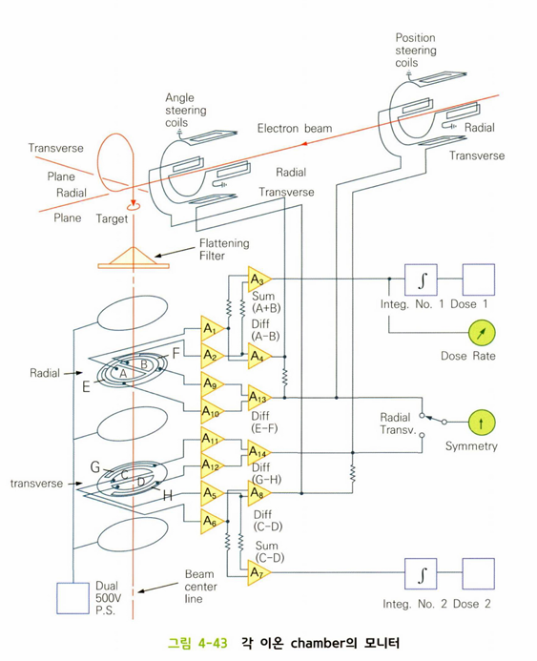
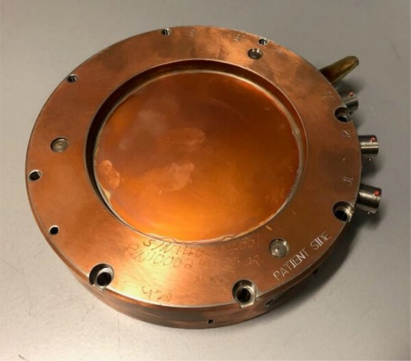
Ion Chamber
Dosimetry X-ray
Measure the delivered dose, dose rate, and beam symmetry
Located below the flattening filter (carrousel) in the gantry head
If the electron beam deviates, feedback is applied via steering coil
to correct the trajectory
When error condition (overdose or asymmetry) is detected,
the beam automatically interrupted for patient safety
Ion chamber
Medical LINAC’s Ion chamber
Monitor at each ion chamber

Slide 7
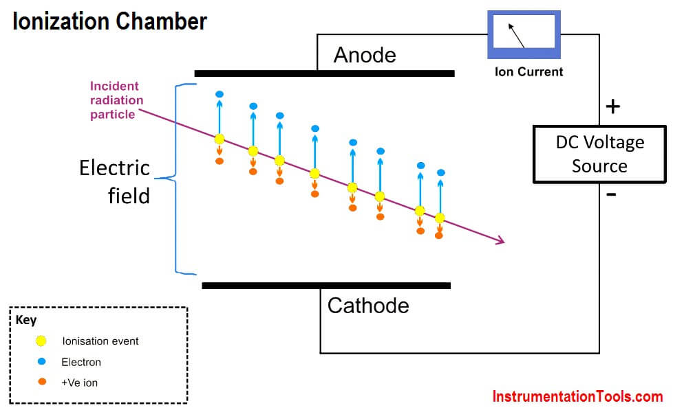
Basic Structure of Ion Chamber
Structure
Consist of two electrodes : anode and cathode
DC voltage source creates an electric field across the electrodes
Working Principle
Incident radiation enters chamber and interacts with the gas
Ionization generate electron-ion pairs
Electric field drives electrons toward the anode and positive ions toward the cathode
Movement of these charges produces an ion current
proportional to the amount of radiation
Basic structure about ion chamber
Notes:
해당 슬라이드는 진리표를 조금더 자세히 들여다보기 위한 내용입니다.
진리표에서 회로도가 1대1 대응으로 만들어지고, 해당내용을 Canonical form형태로 그대로 설계할수 있다는 내용을 설명하려 했습니다.

Slide 8
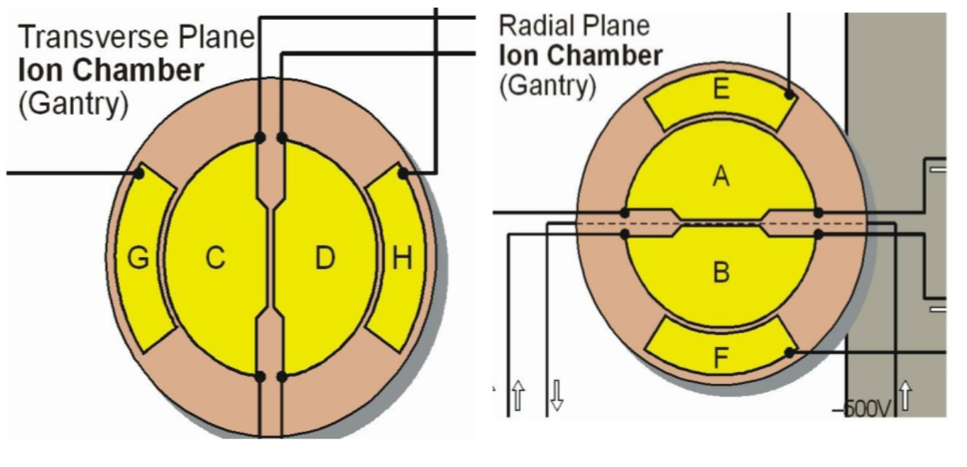
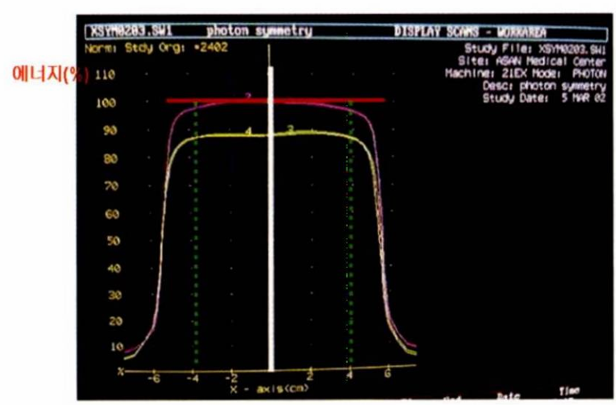

Detailed Structure of the Ion Chamber
Ion chamber consist of two independent planes (Transverse and Radial)
Inner plates (A and B)
Sum of currents is proportional to the dose rate
Difference in current reflects beam symmetry error (angular misalignment)
Measure beam tilt as percentage of central axis dose
Outer plates (E and F)
Evaluate beam position
Unequal current values indicate a positioning error
$$T=\frac{D\left(12cm\right)−D(−12cm)}{D(0cm)}$$
Detailed Structure of the Ion Chamber
Symmetry evaluate by external device

Slide 9
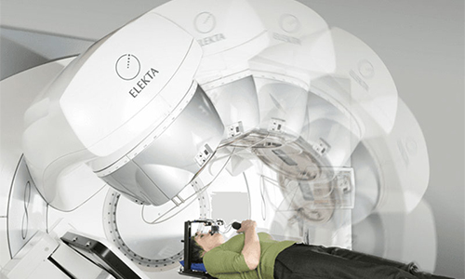
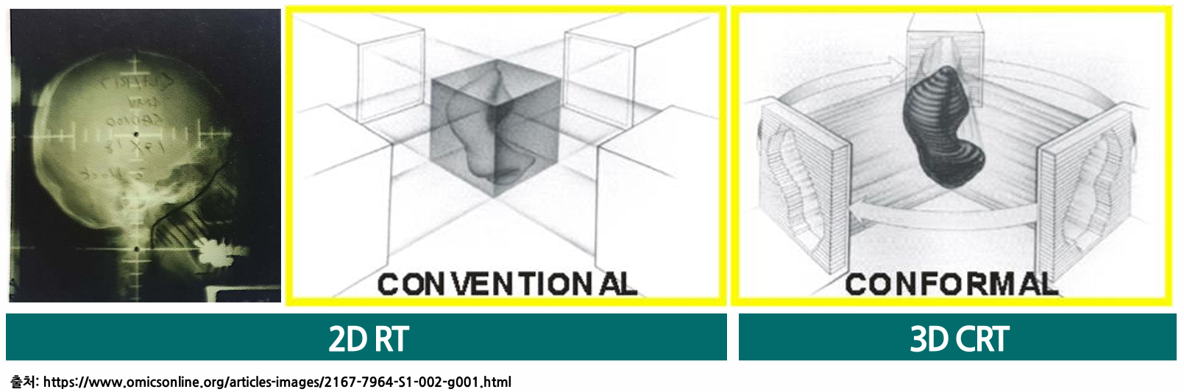
VMAT
Conventional RT(Radiation Therapy) : fixed directions beam
VMAT(Volumetric Modulated Arc Therapy)
Delivers radiation while the gantry rotates continuously around the patient
To ensure treatment accuracy, beam symmetry and flatness must be maintained
External magnetic field(nearby MRI system) and internal components (hysteresis effect)
affect beam stability
Conventional RT
VMAT treatment

Slide 10
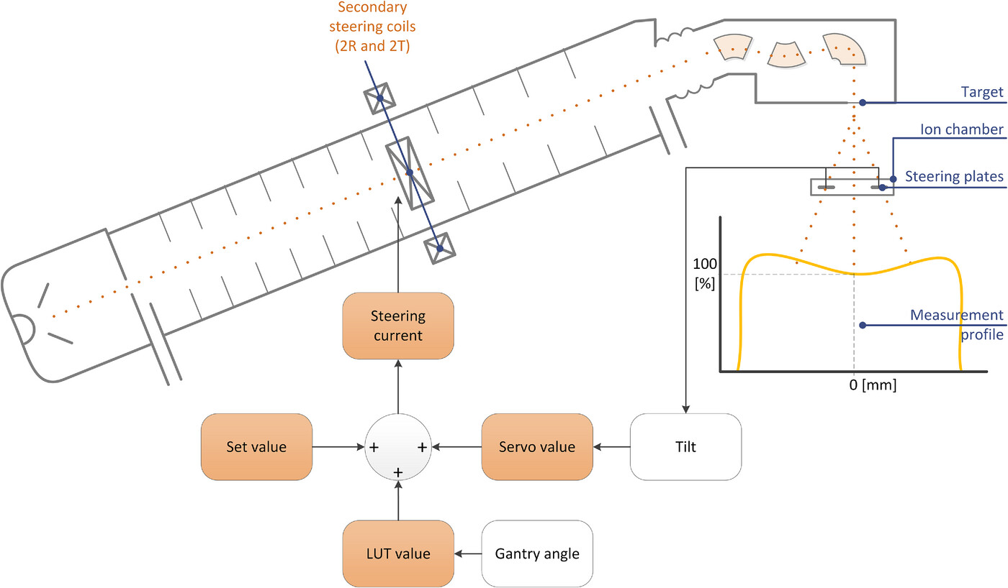
Beam Steering Feedback Overview
Beam tilt is measured by the ion chamber (inner plates)
Detected tilt is corrected using secondary steering coils
Steering current consists of
Set Value (static baseline)
LUT Value (gantry angle dependent)
Servo Value (dynamic error correction)
This feedback loop is essential for beam symmetry
during VMAT
LINAC diagram

Slide 11
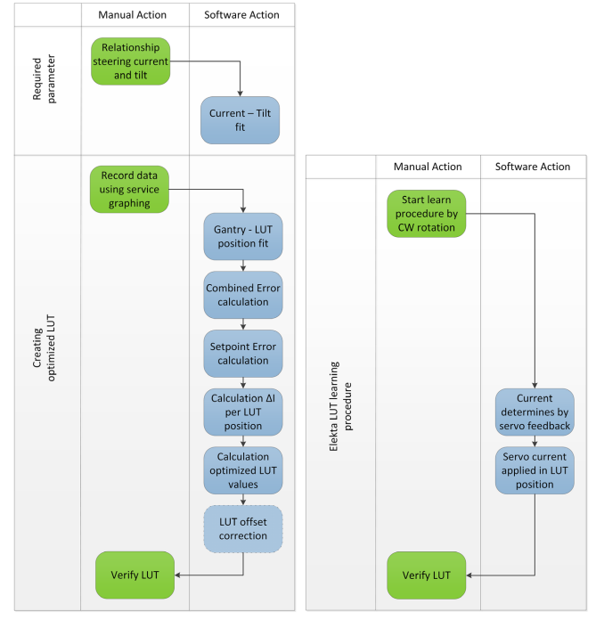
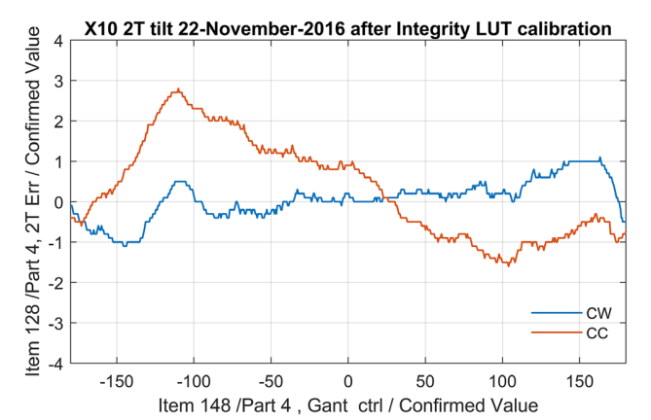
Limitation of the Traditional LUT Method
Hysteresis effect
Hysteresis cause LUT to behave differently in CW vs CC
LUT values are generated using last servo outputs during gantry CW rotation
Noise in ion chamber can be embedded in LUT
-> Lager Error at CC

Slide 12
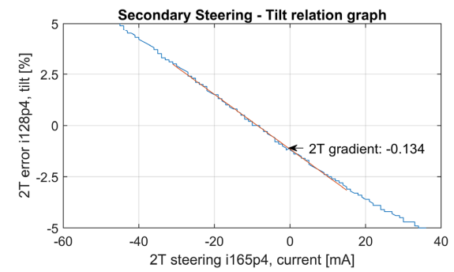
New method for LUT Optimization
Relation between Steering current and beam tilt
Measure how much steering current changes the beam tilt
Fit a linear slope to represent the tilt-to-current relationship
Gathering data for LUT calculation
Measure tilt while rotating the gantry in both CW & CC
Use slow gantry speed and keep servo off

Slide 13
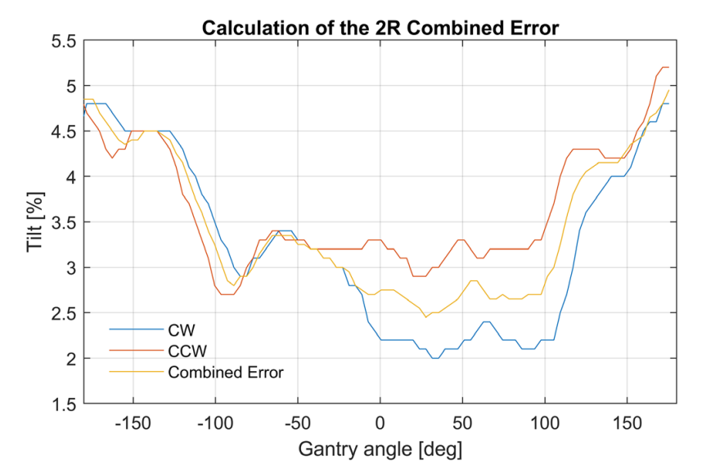
New method for LUT Optimization
Mapping LUT position to gantry angles
Use linear fitting to map each LUT index to a gantry angle
Creating a combined error curve
CW and CC tilt curves differ due to hysteresis and delay
Average the aligned CW and CC to combined error

Slide 14
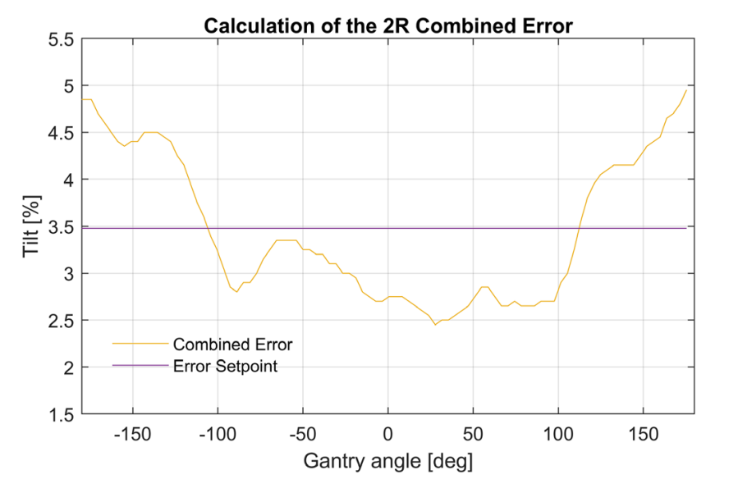
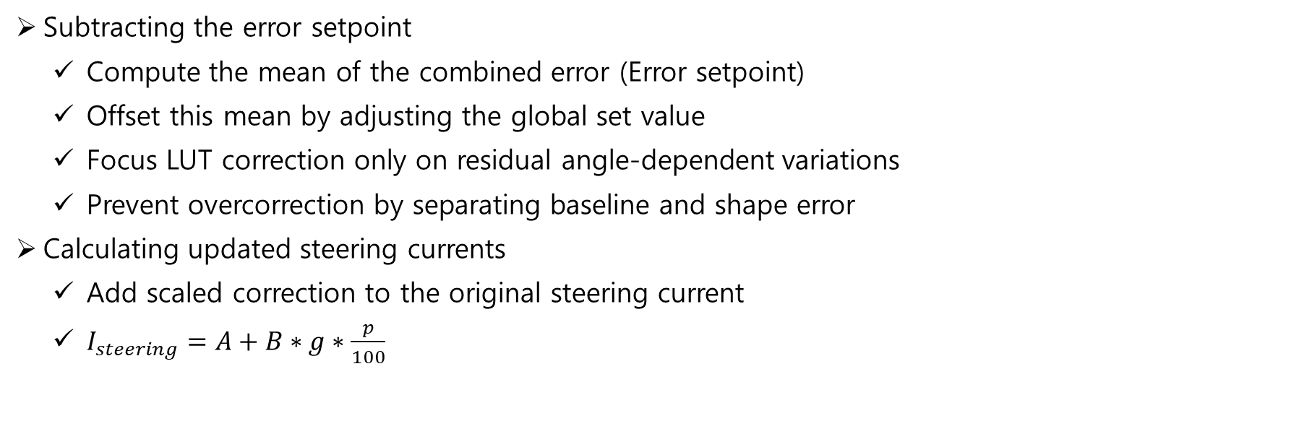
New method for LUT Optimization
Subtracting the error setpoint
Compute the mean of the combined error (Error setpoint)
Offset this mean by adjusting the global set value
Focus LUT correction only on residual angle-dependent variations
Prevent overcorrection by separating baseline and shape error
Calculating updated steering currents
Add scaled correction to the original steering current
$I_{steering}=A+B∗g∗\frac{p}{100}$

Slide 15
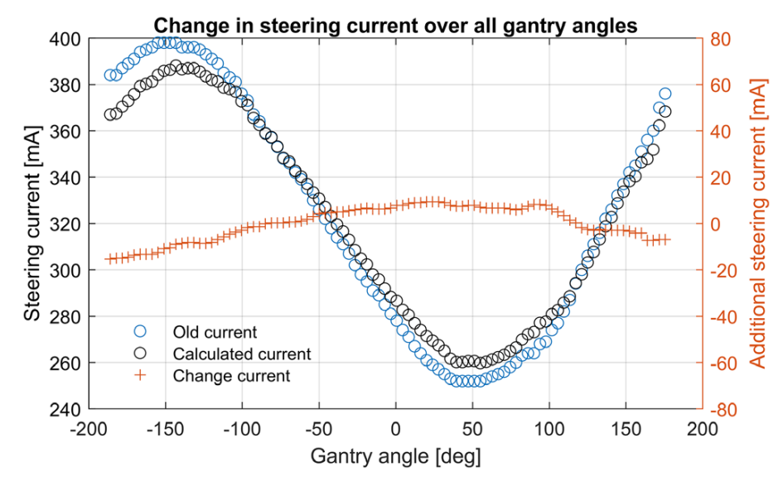
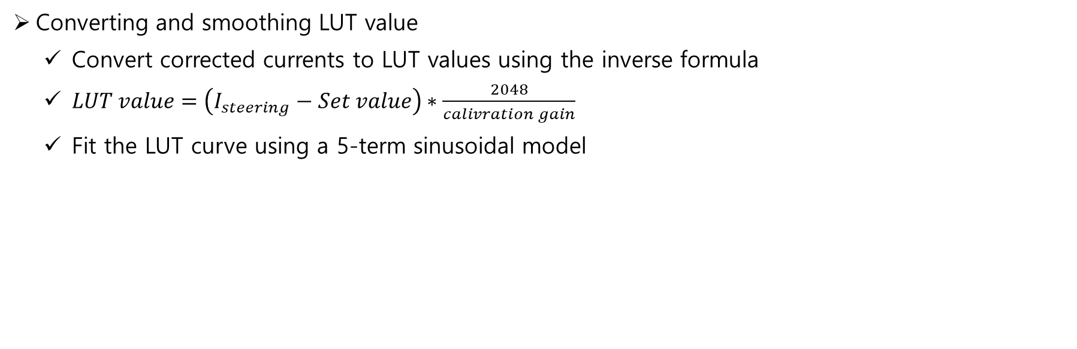
New method for LUT Optimization
Converting and smoothing LUT value
Convert corrected currents to LUT values using the inverse formula
$LUT value=\left(I_{steering}−Set value\right)∗\frac{2048}{calivration gain}$
Fit the LUT curve using a 5-term sinusoidal model

Slide 16
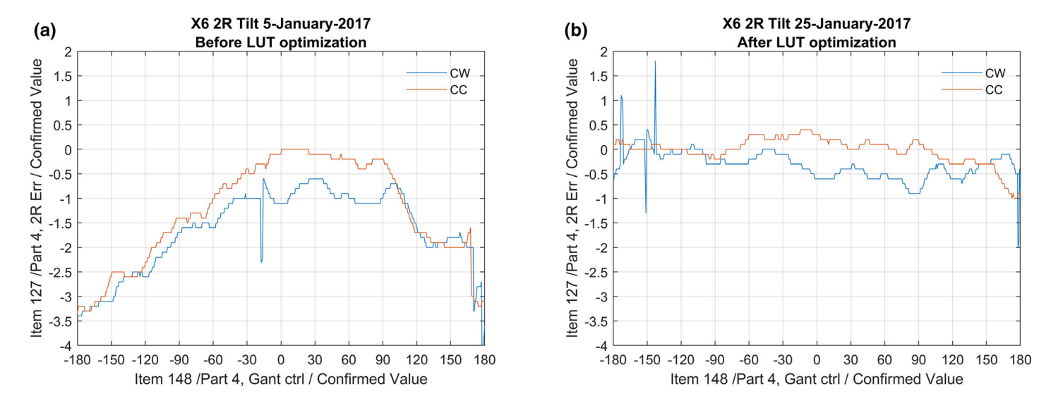
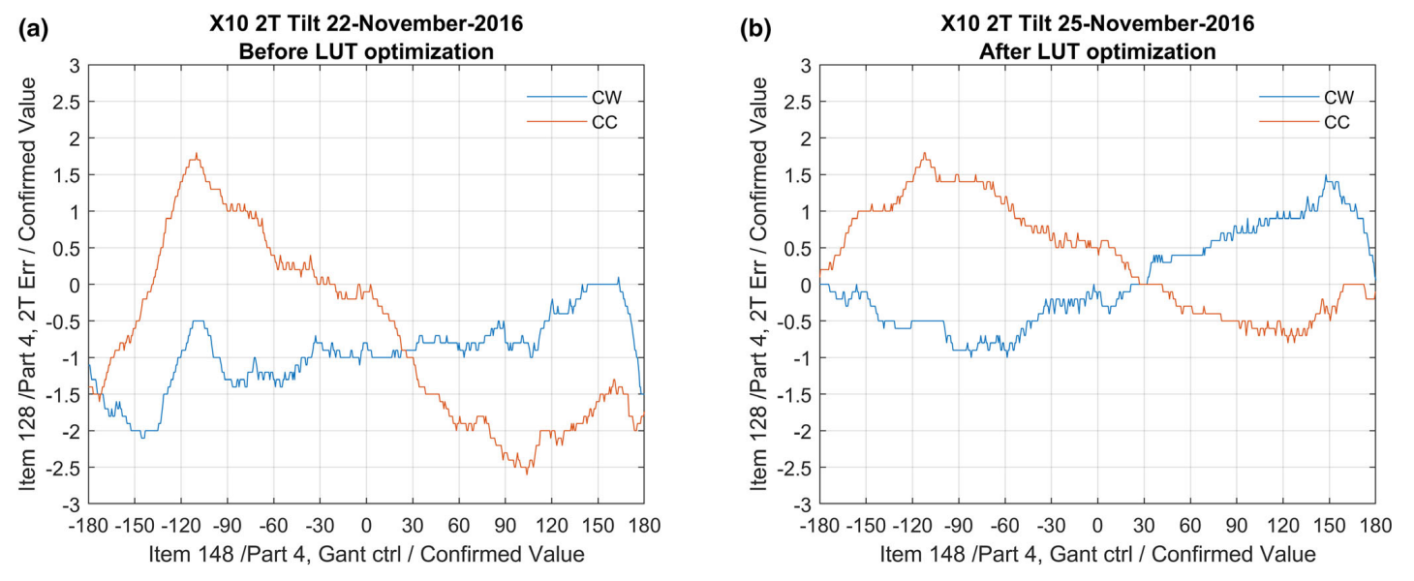
Result
Error values are reduced
both Radial and Transverse

Slide 17
Summary
Symmetric X-ray delivery is essential for accurate and safe radiotherapy.
During VMAT, the gantry rotates continuously, increasing demands on beam stability.
Beam symmetry must be maintained in real time, despite magnetic field effects and hysteresis.
The traditional LUT method suffers from noise and directional bias (CW vs CC).
The proposed optimized LUT reduces steering errors and minimizes treatment interruptions.

