Slide 1



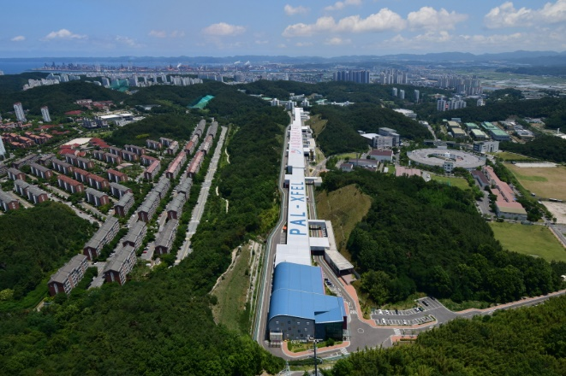


16th International Particle Accelerator Conference, Taipei
Comprehensive Study of Robinson Instability in Active and Passive Higher Harmonic Cavities for Bunch Lengthening
Youngmin Park, Moses Chung
POSTECH
Jimin Seok, Jaeyu Lee, Jaehyun Kim, Gyeong Su Jang
Pohang Accelerator Laboratory(PAL), POSTECH
June.2.2025

Slide 2
16th International Particle Accelerator Conference, Taipei
Outline
Higher harmonic cavities(HHCs) in storage ring
Robinson instability derived by NC active HHCs in Korea-4GSR
Robinson instability derived by SC passive HHCs in PLS-II
Conclusion
Notes:
In this talk, I will first explain the reason why we use higher harmonic cavities (HHCs) in storage rings.
Then, I will briefly introduce the basic theory of Robinson instabilities.
After that, I will present a comparative analysis of Robinson instabilities that occur when using:
a normal-conducting active harmonic cavity in Korea-4GSR, and
a superconducting passive harmonic cavity in PLS-II.

Slide 3
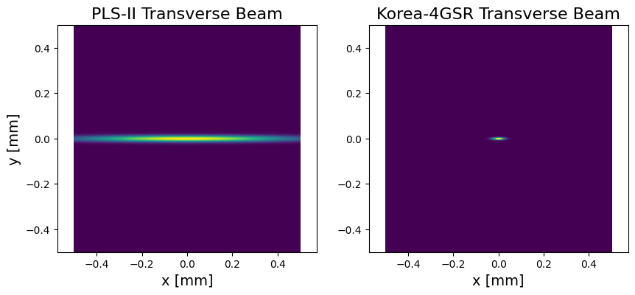
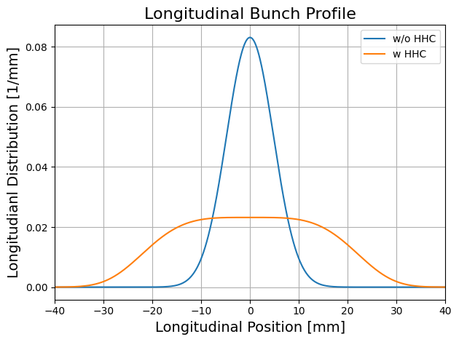
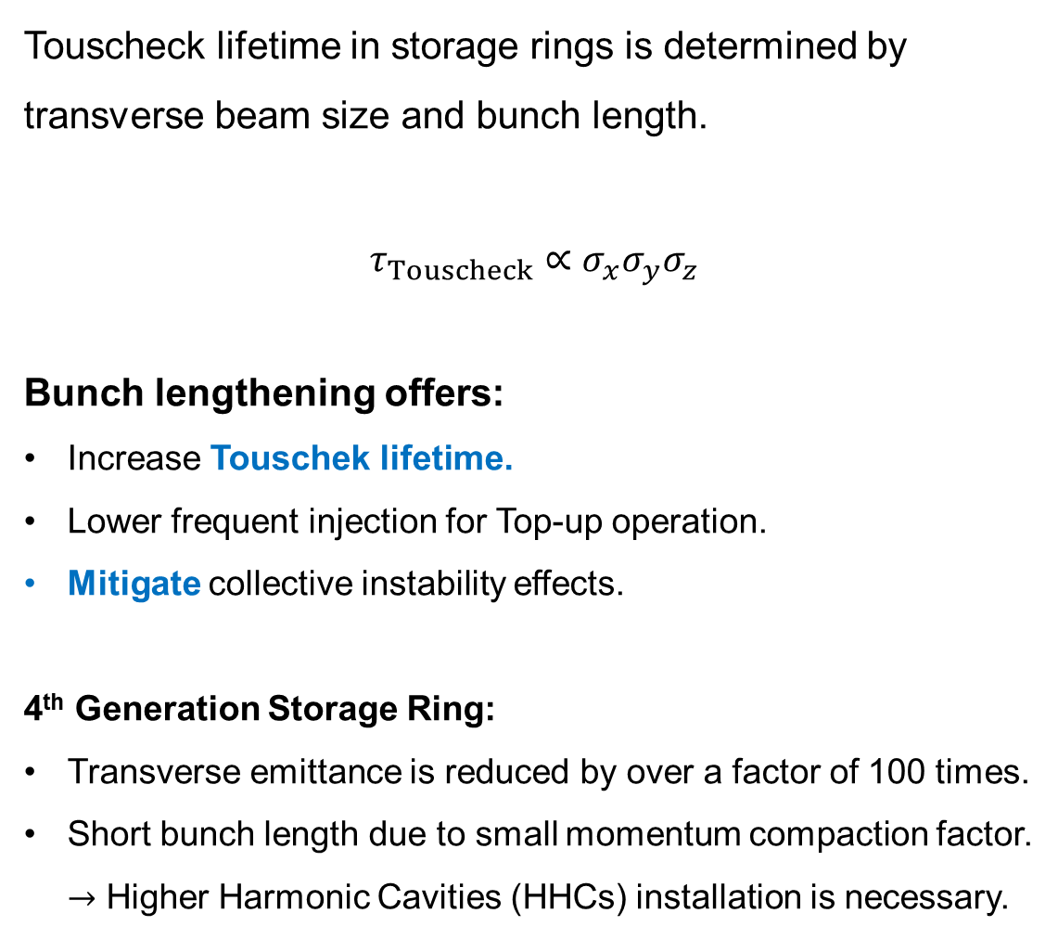


16th International Particle Accelerator Conference, Taipei
Why higher harmonic cavity?
Touscheck lifetime in storage rings is determined by transverse beam size and bunch length.
$$τ_{Touscheck}∝σ_{x}σ_{y}σ_{z}$$
Bunch lengthening offers:
Increase Touschek lifetime.
Lower frequent injection for Top-up operation.
Mitigate collective instability effects.
4th Generation Storage Ring:
Transverse emittance is reduced by over a factor of 100 times.
Short bunch length due to small momentum compaction factor.
$→$ Higher Harmonic Cavities (HHCs) installation is necessary.
Lifetime $\sim 20 h$
Lifetime $\sim 6 h$
Notes:
Let me begin by explaining why higher harmonic cavities are essential.
In storage rings, maintaining a stable beam requires a sufficiently long Touschek lifetime, which is determined by the transverse beam size and the bunch length.
Higher harmonic cavities are used to increase the bunch length, which in turn extends the Touschek lifetime, allowing for less frequent top-up injections.
They also help mitigate several types of collective instabilities.
Especially in 4GSR, the beam emittance is reduced by more than two orders of magnitude.
Combined with a smaller momentum compaction factor, this results in much shorter bunches, making the installation of HHCs indispensable.

Slide 4
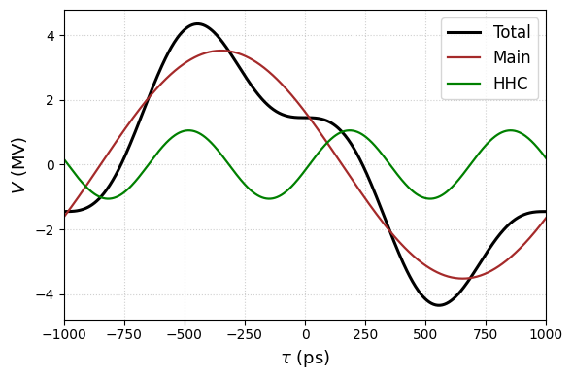

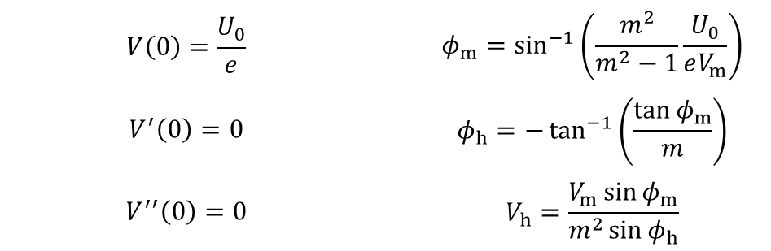
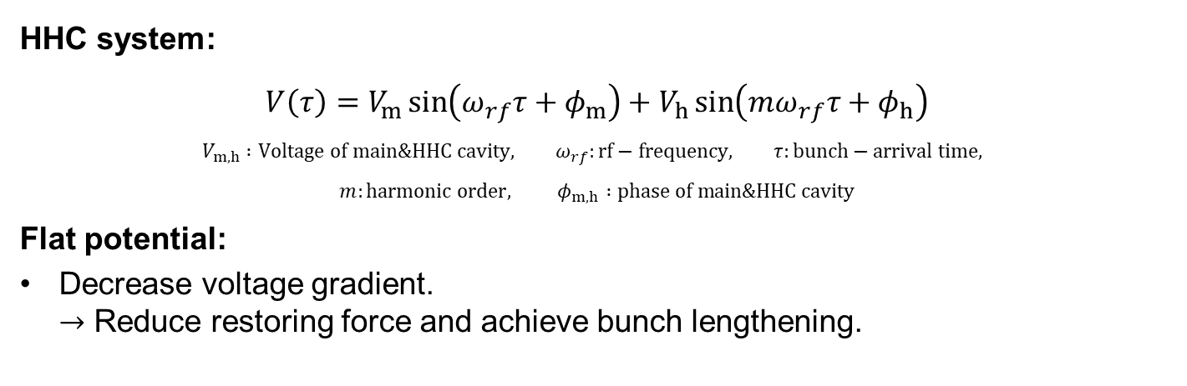
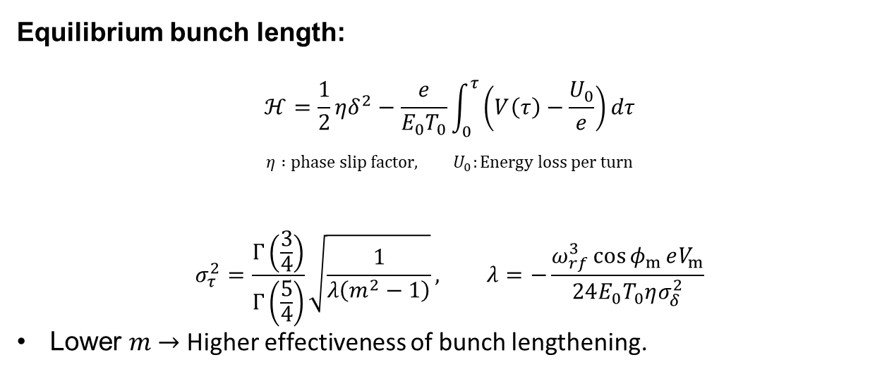
16th International Particle Accelerator Conference, Taipei
Bunch lengthening for HHC
HHC system:
$$V\left(τ\right)=V_{m}\sin\left(ω_{rf}τ+φ_{m}\right)+V_{h}\sin\left(mω_{rf}τ+φ_{h}\right)$$
$$V_{m,h} :Voltage of main\&HHC cavity, ω_{rf}:rf−frequency, τ:bunch−arrival time,$$
$$m:harmonic order, φ_{m,h} :phase of main\&HHC cavity$$
Flat potential:
Decrease voltage gradient.
$→$ Reduce restoring force and achieve bunch lengthening.
Conditions for flat potential:
Energy balance term : $V\left(0\right)={U_{0}}/e$
Flat potential term : $V^{′}\left(0\right)=0,V^{′′}\left(0\right)=0$
Adjustable variable : $φ_{m}, φ_{h}, V_{h}$
Equilibrium bunch length:
$$ℋ=\frac{1}{2}ηδ^{2}−\frac{e}{E_{0}T_{0}}\int_{0}^{τ}{\left(V\left(τ\right)−\frac{U_{0}}{e}\right)dτ}$$
$$η :phase slip factor, U_{0}:Energy loss per turn$$
$$σ_{τ}^{2}=\frac{Γ\left(\frac{3}{4}\right)}{Γ\left(\frac{5}{4}\right)}\sqrt{\frac{1}{λ\left(m^{2}−1\right)}}, λ=−\frac{ω_{rf}^{3}\cos{φ_{m}}eV_{m}}{24E_{0}T_{0}ησ_{δ}^{2}}$$
Lower $m$ $→$ Higher effectiveness of bunch lengthening.
$$V\left(0\right)=\frac{U_{0}}{e}$$ |  | $$φ_{m}=\sin^{−1}\left(\frac{m^{2}}{m^{2}−1}\frac{U_{0}}{eV_{m}}\right)$$
$$V^{′}\left(0\right)=0$$ |  | $$φ_{h}=−\tan^{−1}\left(\frac{\tan{φ_{m}}}{m}\right)$$
$$V^{′′}\left(0\right)=0$$ |  | $$V_{h}=\frac{V_{m}\sin{φ_{m}}}{m^{2}\sin{φ_{h}}}$$
Notes:
Now, I’ll explain how HHCs are used to achieve bunch lengthening.
Before installing an HHC, the bunch experiences a restoring force due to the voltage gradient at the bunch center (around τ=0\tau = 0τ=0).
The goal of a flat potential is to reduce this gradient, thereby weakening the restoring force and allowing the bunch to lengthen.
This condition is achieved by adjusting the relative phase and voltage ratio between the main cavity and the harmonic cavity.
The equilibrium bunch length can be derived from the Hamiltonian or by solving the Vlasov equation.
In general, a lower harmonic order leads to a longer bunch.

Slide 5

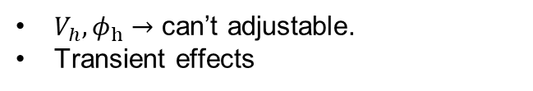
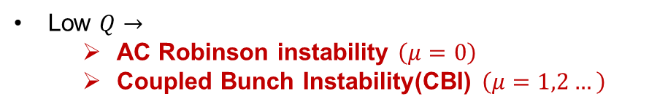


16th International Particle Accelerator Conference, Taipei
Types of higher harmonic cavity
Korea-4GSR
PLS-II
NC-Active
Pros:
Freely adjust $V_{h}$ and $φ_{h}$ for any currents.
LLRF feedback suppress transient effects.
No cryogenic system.
Cons:
External RF source(Generator) is required.
Generator $→$
  DC Robinson instability
NC-Passive
Pros:
Simple design
No DC Robinson instability.
No cryogenic system.
Cons:
Low $R_{s}→$
Can’t operate at low current.
Need many cavity.
SC-Passive
Pros:
Simple design
No DC Robinson instability.
High $Q→$
Low AC Robinson instability.
Low CBI.
High $R_{s}→$
Can operate at low current.
Cons:
Cryogenic system
High $Q→$
  Cavity mode instability (D-mode)
AC/CBI
Low $Q→$
  AC Robinson instability $\left(μ=0\right)$
  Coupled Bunch Instability(CBI) $\left(μ=1,2…\right)$
AC/CBI
$V_{h},φ_{h}→$ can’t adjustable.
Transient effects
Notes:
HHCs can be categorized into:
NC-active (Normal Conducting, powered),
NC-passive (Normal Conducting, beam-driven), and
SC-passive (Superconducting, beam-driven).
While each type has its own pros and cons, I will focus specifically on the instabilities that can arise with each configuration.
In active cavities, due to the presence of an RF generator, DC Robinson instability may occur.
For normal conducting cavities, the low quality factor can also lead to AC Robinson instability and coupled-bunch instabilities (CBIs), which I will discuss next.
On the other hand, superconducting passive cavities have much higher Q values, so AC Robinson and CBI are generally suppressed.
However, a different instability called the cavity mode instability, or D-mode instability, can appear. I’ll return to this later.
In this study, we analyzed two cases:
NC-active HHCs used in Korea-4GSR, and
SC-passive HHCs implemented at PLS-II.

Slide 6
Robinson instability derived by NC active HHCs in Korea-4GSR

Slide 7


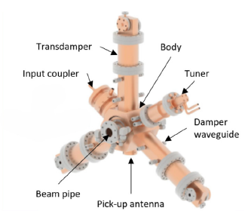
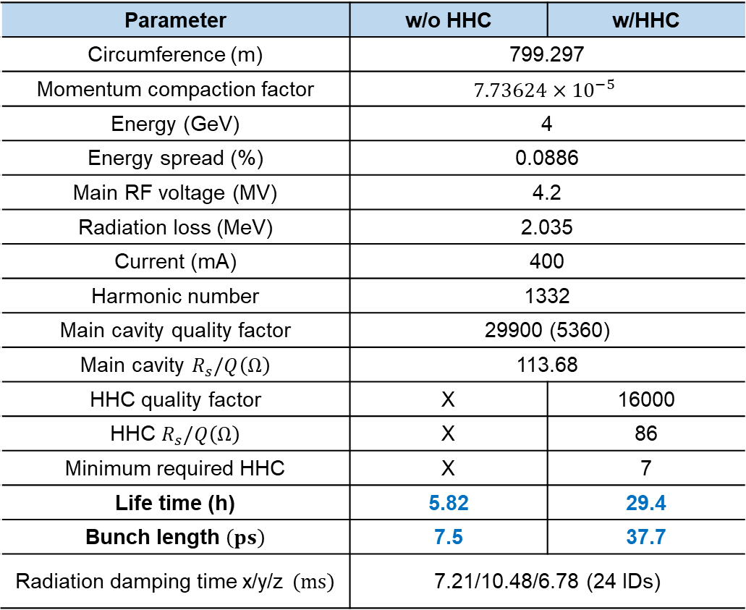
16th International Particle Accelerator Conference, Taipei
Korea-4GSR
Korea-4GSR is a 4th generation electron storage ring currently under construction.
Phase 1: 200 mA with 9 Insertion Devices (IDs)
Final operation : 400 mA with 24 IDs
Parameter | w/o HHC | w/HHC
Circumference (m) | 799.297
Momentum compaction factor | $$7.73624×{10}^{−5}$$
Energy (GeV) | 4
Energy spread (%) | 0.0886
Main RF voltage (MV) | 4.2
Radiation loss (MeV) | 2.035
Current (mA) | 400
Harmonic number | 1332
Main cavity quality factor | 29900 (5360)
Main cavity $R_{s}/Q\left(Ω\right)$ | 113.68
HHC quality factor | X | 16000
HHC $R_{s}/Q\left(Ω\right)$ | X | 86
Minimum required HHC | X | 7
Life time (h) | 5.82 | 29.4
Bunch length $\left(ps\right)$ | 7.5 | 37.7
Radiation damping time x/y/z $\left(ms\right)$ | 7.21/10.48/6.78 (24 IDs)
Located in Ochang
ALBA-type NC active HHC is under consideration
Notes:
Next, I will explain the case of using a normal-conducting active cavity in Korea-4GSR.
Korea-4GSR is a fourth-generation electron storage ring currently under construction and located in Ochang.
The Phase 1 goal is to operate at 200 mA with 9 insertion devices, while the final target is 400 mA with 24 IDs.
In this study, we focus on the final operating condition.
Since Korea-4GSR will install normal-conducting main RF cavities, the plan is to also use normal-conducting harmonic cavities, rather than superconducting ones.
Specifically, an ALBA-type NC-active cavity is being considered.
To achieve a flat potential, at least 7 HHCs are required, which allows us to reach a bunch length of 37.7 ps.

Slide 8
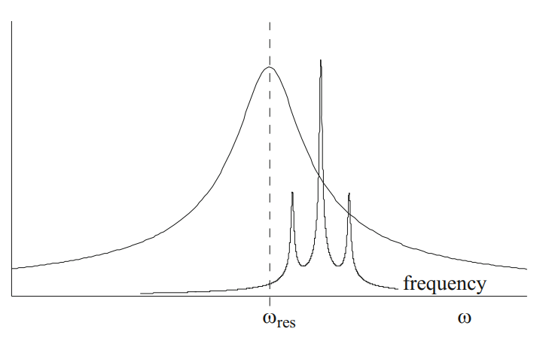
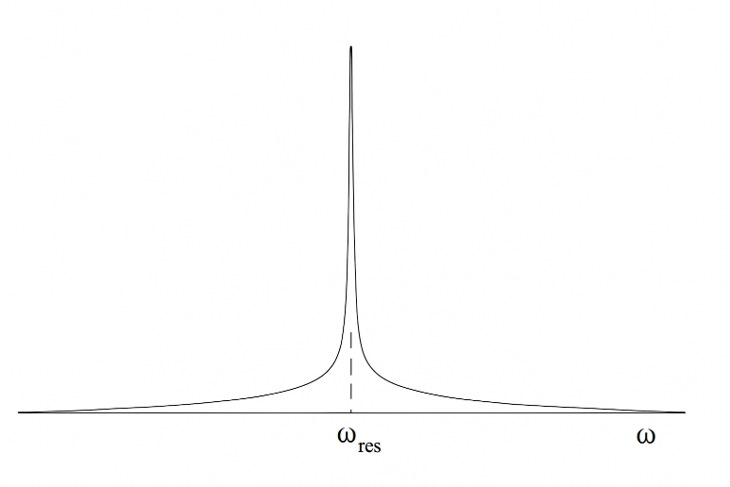













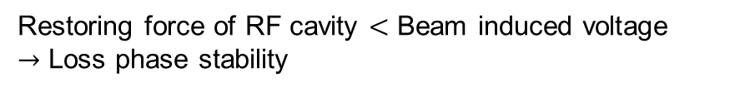










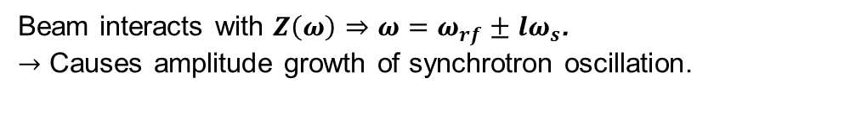

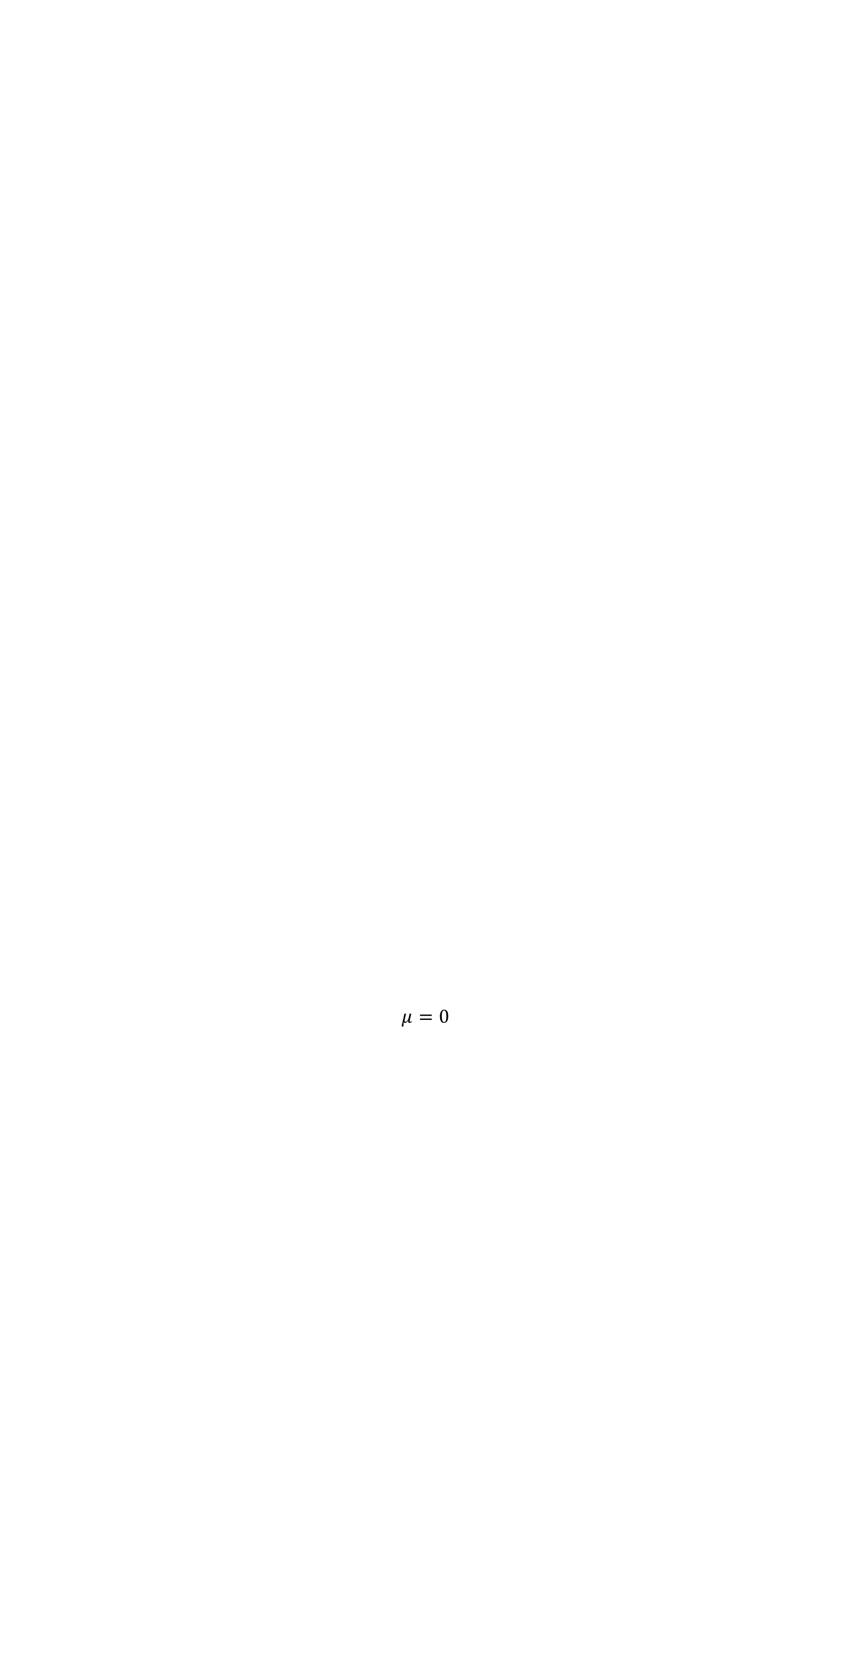


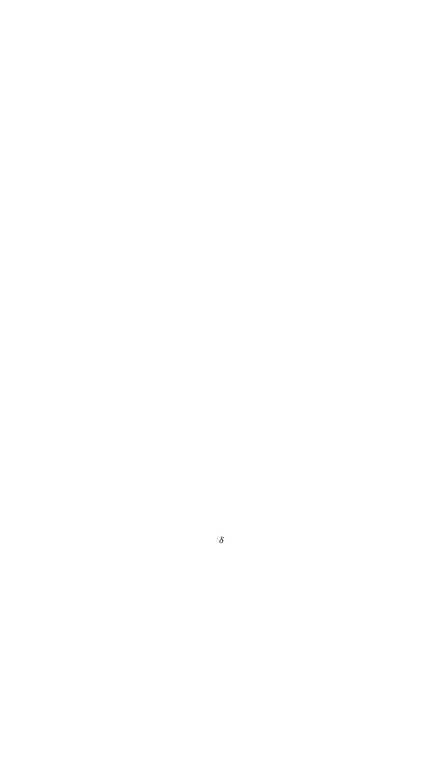





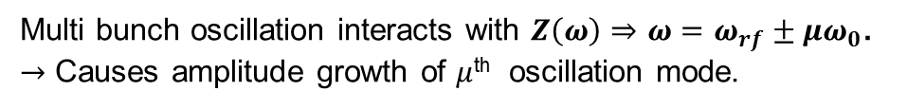



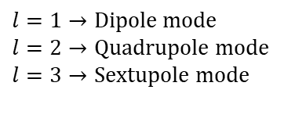
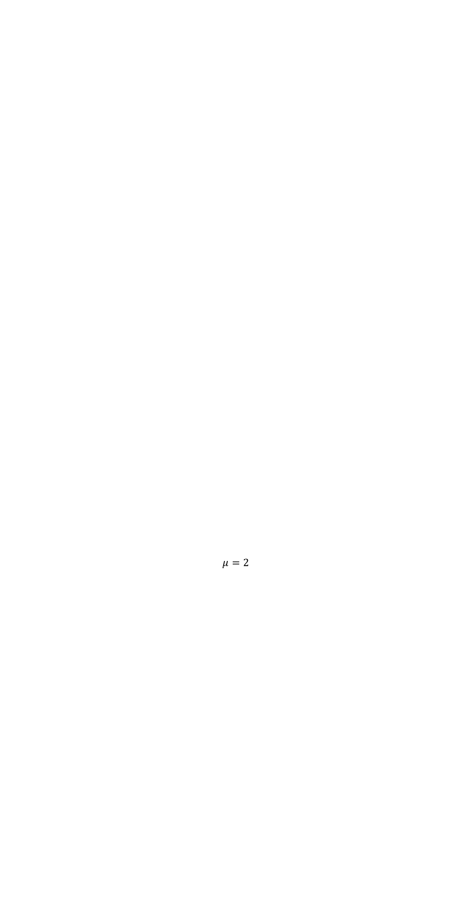
16th International Particle Accelerator Conference, Taipei
AC/CBI
AC/CBI
$$K^{′}=−V_{m}\cos{φ_{m}}−mV_{h}\cos\left(φ_{h}\right)+IR_{m}F_{m}\sin{2ψ_{m}}+mIR_{m}F_{m}\sin{2ψ_{h}}<0$$
Instability in NC active cavity
Restoring force term
Beam loading term
$$Im$$
$$Im$$
DC Robinson instability
$${\tilde{i}}_{b}$$
Restoring force of RF cavity $<$ Beam induced voltage
$→$ Loss phase stability
$$ψ$$
$$ε$$
$$ψ$$
$$Re$$
$$V_{b}$$
$$Re$$
$$V_{b}$$
$$φ$$
$$φ$$
$$V_{c}$$
$$V_{c}$$
$$δ$$
AC Robinson instability $\left(μ=0\right)$
$ω_{r}=$cavity resonant frequency
$ω_{s}=$synchrotron frequency
$$ω_{r}$$
$$l=1$$
$$ω_{rf}$$
Unstable
Stable
Beam interacts with $Z\left(ω\right)⇒ω=ω_{rf}±lω_{s}$.
$→$ Causes amplitude growth of synchrotron oscillation.
$$l=1→Dipole mode$$
$$l=2→Quadrupole mode$$
$$l=3→Sextupole mode$$
$$l=2$$
$$l=3$$
$$τ$$
$$ω_{rf}−ω_{s}$$
$$ω_{rf}+ω_{s}$$
$$τ$$
Coupled Bunch Instability $\left(μ=1,2,3…\right)$
$ω_{0}=$revolution frequency
$$ω_{r}$$
$$…$$
$$ω_{rf}$$
$$μ=0$$
$$μ=0$$
$$μ=1$$
Multi bunch oscillation interacts with $Z\left(ω\right)⇒ω=ω_{rf}±μω_{0}$.
$→$ Causes amplitude growth of $μ$^{th} oscillation mode.
$$τ_{n}^{\left(μ\right)}∝\exp\left[\frac{2πiμn}{M}\right]$$
$$μ=1$$
$$…$$
$$n=bunch index, \\ M=total bunch number$$
$$μ=2$$
$$…$$
Bunch index
$$ω_{rf}+ω_{0}$$
Notes:
Let’s first examine the instabilities that can arise in normal conducting active cavities.
DC Robinson instability occurs when the beam-induced voltage becomes stronger than the restoring force from the cavity, causing the centroid phase to drift in one direction, breaking phase stability.
AC Robinson instability arises when the bunch oscillates at the synchrotron frequency ωs\omega_sωs​, and the spectral component at ω=ωrf+lωs\omega = \omega_{rf} + l\omega_sω=ωrf​+lωs​ interacts with impedance, leading to amplitude growth of synchrotron oscillations.
When multiple bunches are present in the ring, bunches oscillate with phase differences.
These modes may interact with the impedance at specific frequencies, leading to coupled-bunch instabilities.

Slide 9
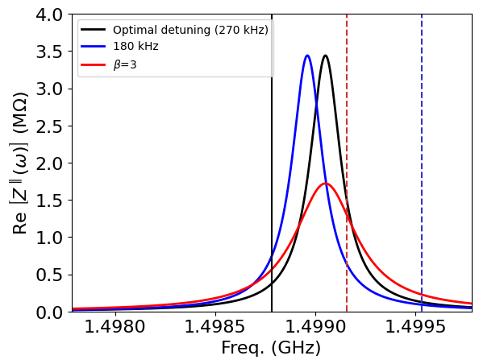
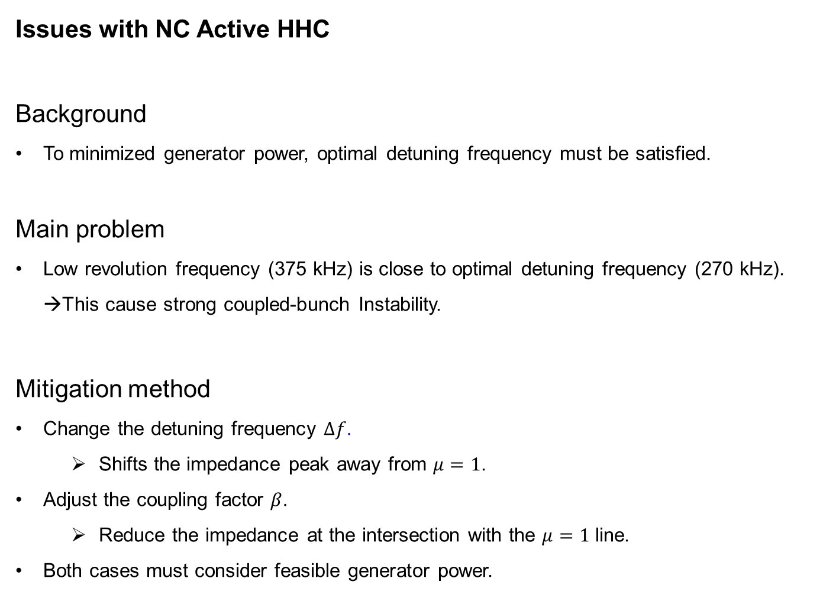

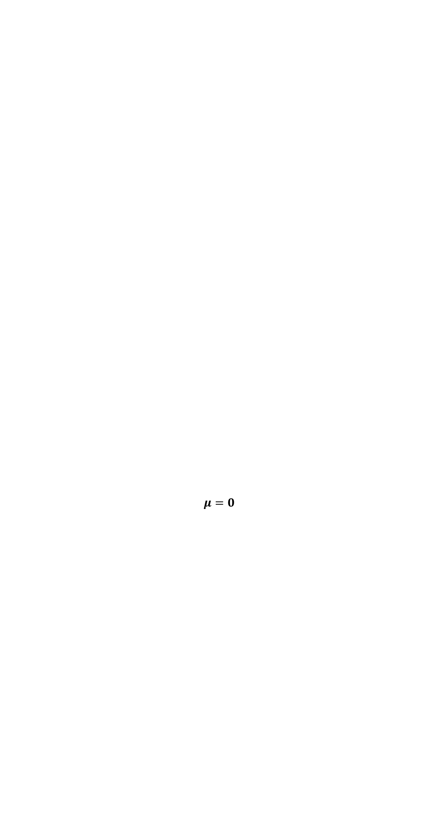

16th International Particle Accelerator Conference, Taipei
NC active HHC
Issues with NC Active HHC
Background
To minimized generator power, optimal detuning frequency must be satisfied.
Main problem
Low revolution frequency (375 kHz) is close to optimal detuning frequency (270 kHz).
→This cause strong coupled-bunch Instability.
Mitigation method
Change the detuning frequency $Δf$.
  Shifts the impedance peak away from $μ=1$.
Adjust the coupling factor $β$.
  Reduce the impedance at the intersection with the $μ=1$ line.
Both cases must consider feasible generator power.
$$μ=0$$
$$μ=1$$
$$μ=2$$
Notes:
As mentioned earlier, several instabilities can occur in NC-active cavities, but the most critical issue is the μ = 1 coupled-bunch instability (CBI).
In active cavities, there exists an optimal detuning frequency that minimizes generator power.
Unfortunately, this optimal detuning turns out to be very close to the revolution frequency of Korea-4GSR, which is 375 kHz.
This leads to severe CBI.
There are two main ways to mitigate this:
Shift the detuning frequency to move the impedance peak,
Increase the coupling factor β to broaden and suppress the impedance peak.
However, both strategies must be balanced with available generator power.

Slide 10
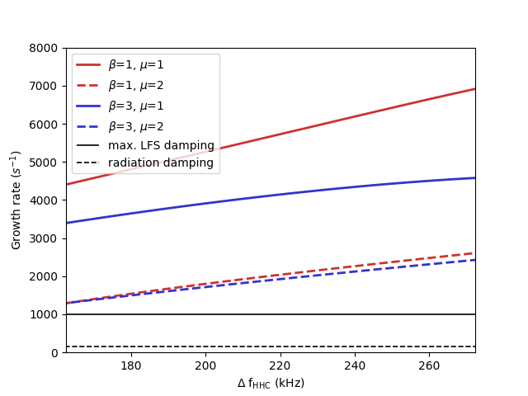
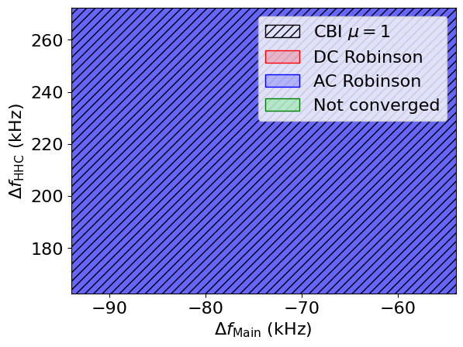
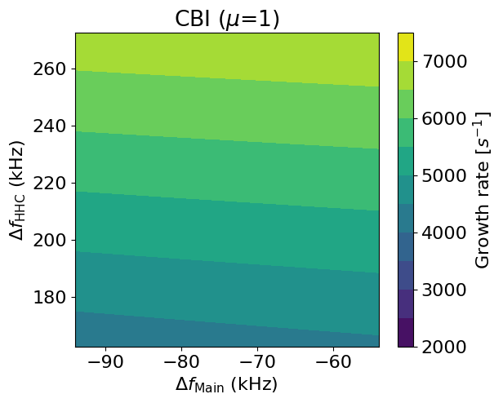
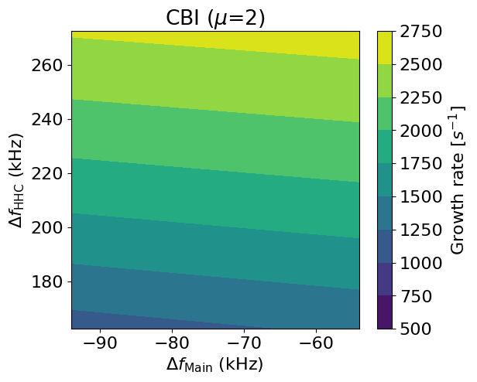
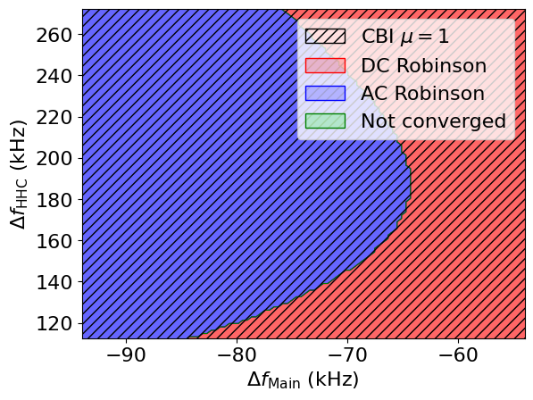
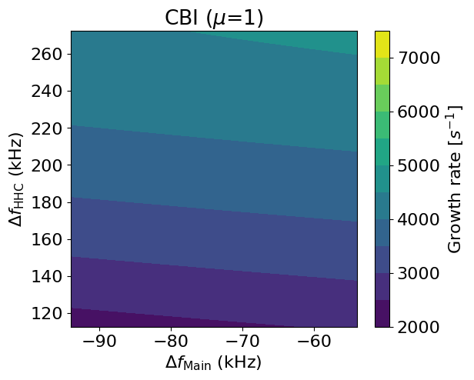
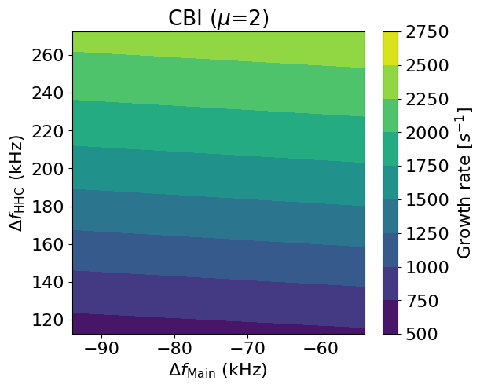


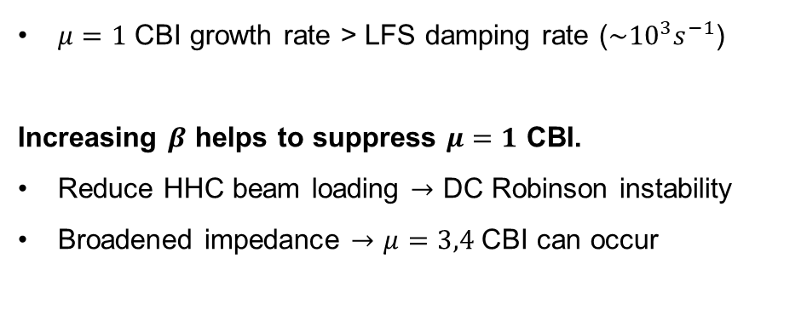
16th International Particle Accelerator Conference, Taipei
4GSR Active Cavity
7 HHC, 400 mA operation, Flat Potential $\left(37.7 ps\right)$
$$β=1$$
$$β=3$$
$μ=1$ CBI growth rate > LFS damping rate ($\sim {10}^{3}s^{−1}$)
Increasing $β$ helps to suppress $μ=1$ CBI.
Reduce HHC beam loading $→$ DC Robinson instability
Broadened impedance $→$ $μ=3,4$ CBI can occur
DC Robinson occurs!!
Notes:
We performed a 2D scan of main cavity and HHC detuning frequencies with 7 HHCs installed.
The color codes in the plot are:
Blue: AC Robinson instability,
Red: DC Robinson instability,
Hatched region: Coupled-bunch instability (CBI).
With β = 1, we observe both AC Robinson and strong μ = 1 CBI, with a growth rate over 5000 s⁻¹, far beyond what can be damped by LFS.
When we increase β to 3, the CBI growth rate drops to around 3000 s⁻¹, but this is still too high.
Moreover, increasing β reduces beam loading effects, making DC Robinson instability appear.
A broader impedance also raises the risk of higher-order CBIs, such as μ = 3 or 4.

Slide 11
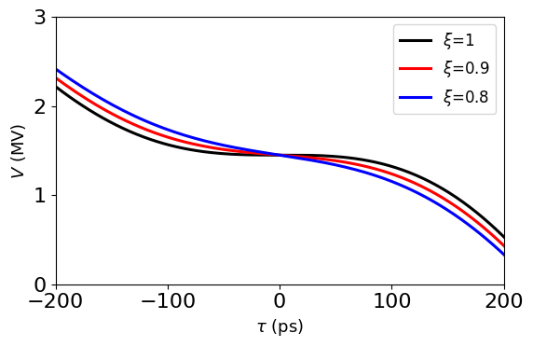
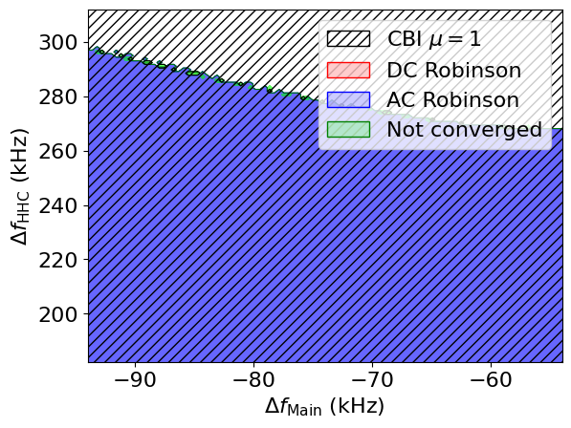
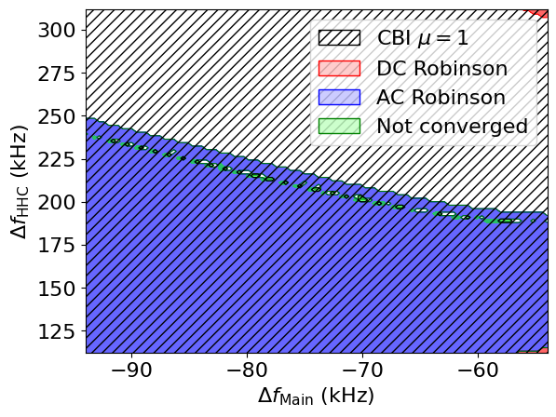

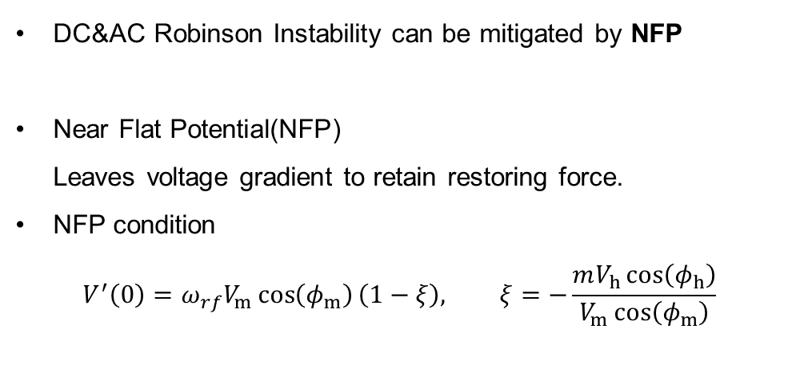

16th International Particle Accelerator Conference, Taipei
4GSR Active Cavity
7 HHC, 400 mA operation, $ξ=0.9\left(22.3 ps\right)$
$$β=1$$
$$β=3$$
DC&AC Robinson Instability can be mitigated by NFP
Near Flat Potential(NFP)
Leaves voltage gradient to retain restoring force.
NFP condition
$$V^{′}\left(0\right)=ω_{rf}V_{m}\cos\left(φ_{m}\right)\left(1−ξ\right), ξ=−\frac{mV_{h}\cos\left(φ_{h}\right)}{V_{m}\cos\left(φ_{m}\right)}$$
CBI growth rate is still too large to be suppressed by LFS.
→ Mitigation studies using bunch filling pattern are in progress.
Notes:
One effective way to suppress AC and DC Robinson instabilities is to avoid making the potential completely flat.
Instead, we allow a small restoring force—this is called the near-flat potential condition.
We define \xi as the ratio of harmonic to main cavity force.
When ξ = 1, the potential is completely flat.
Setting ξ ≈ 0.9 still gives us a 3× longer bunch, while suppressing AC and DC instabilities.
In this configuration, we indeed observe a stable region with no AC or DC Robinson instability.
However, μ = 1 CBI remains strong, and further study, such as optimizing the fill pattern, is currently in progress.

Slide 12
Robinson instability derived by SC passive HHCs in PLS-II

Slide 13
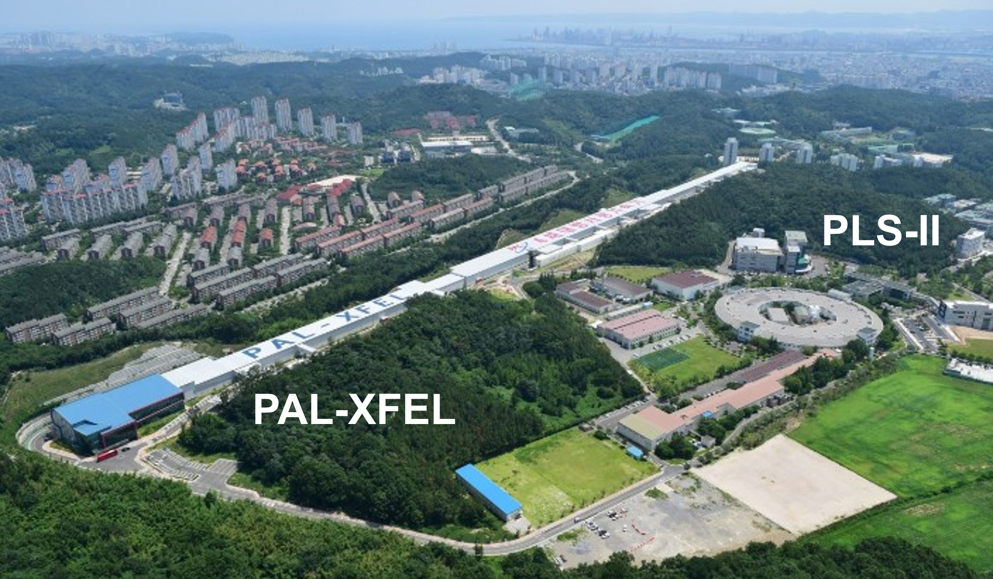
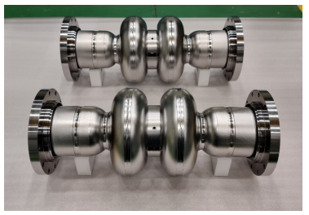
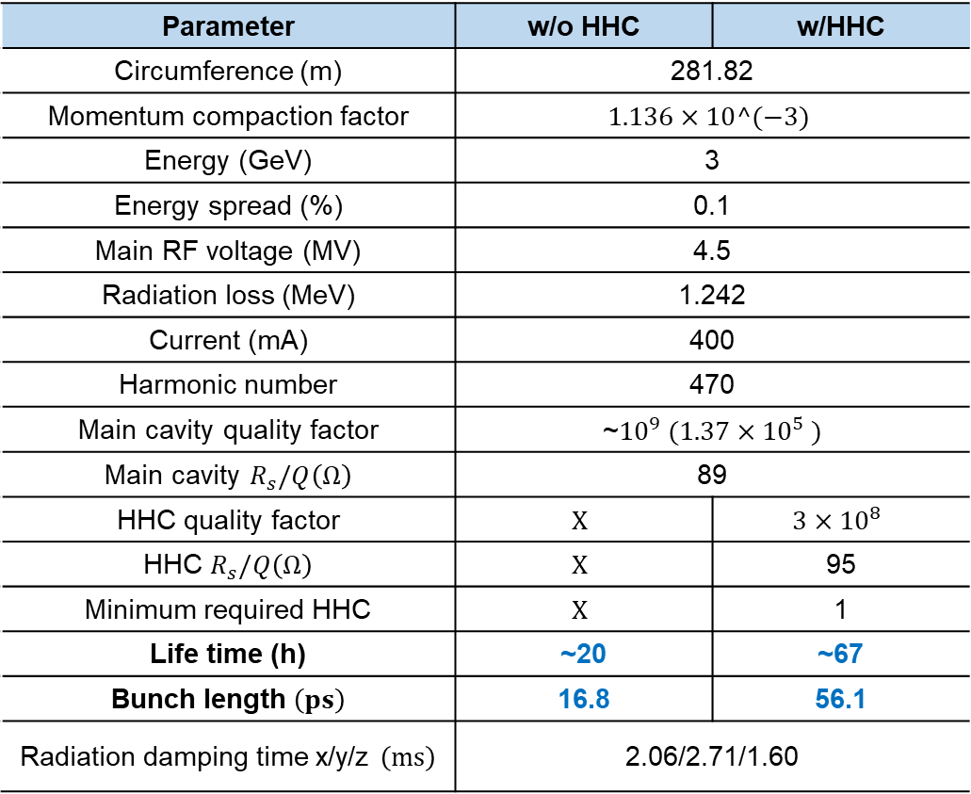
16th International Particle Accelerator Conference, Taipei
PLS-II
PLS-II is a 3rd generation electron storage ring currently in operation.
Although a harmonic cavity is not currently planned, this lattice was used for comprehensive studies.
A SC passive HHC was assumed, as the cryogenic system is already in place.
Parameter | w/o HHC | w/HHC
Circumference (m) | 281.82
Momentum compaction factor | $$1.136×10^(−3)$$
Energy (GeV) | 3
Energy spread (%) | 0.1
Main RF voltage (MV) | 4.5
Radiation loss (MeV) | 1.242
Current (mA) | 400
Harmonic number | 470
Main cavity quality factor | ~${10}^{9} (1.37×{10}^{5} )$
Main cavity $R_{s}/Q\left(Ω\right)$ | 89
HHC quality factor | $$X$$ | $$3×{10}^{8}$$
HHC $R_{s}/Q\left(Ω\right)$ | $$X$$ | 95
Minimum required HHC | $$X$$ | 1
Life time (h) | ~20 | ~67
Bunch length $\left(ps\right)$ | 16.8 | 56.1
Radiation damping time x/y/z $\left(ms\right)$ | 2.06/2.71/1.60
Located in Pohang
SC passive niobium HHC [1]
[1] Hee-su Park et al., INVESTIGATION OF THE FABRICATION METHOD FOR THE 3RD HARMONIC SUPERCONDUCTING DOUBLE-CELL CAVITY, IPAC23, (2023)
Notes:
Now, let’s move on to the case of a superconducting passive cavity in PLS-II.
PLS-II is a third-generation storage ring, currently operational in Pohang.
While no harmonic cavity is installed yet, we use this lattice for comparison.
The main cavity is already superconducting and active, so adding an SC-passive cavity is a practical assumption.
We use past SC passive cavity designs as the basis for parameters in this study.

Slide 14
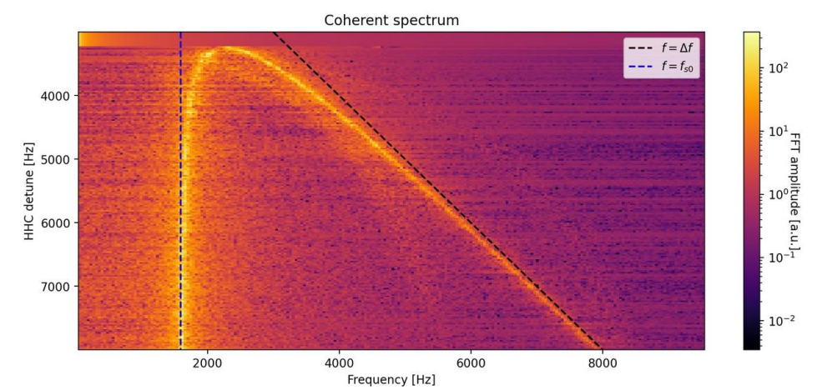
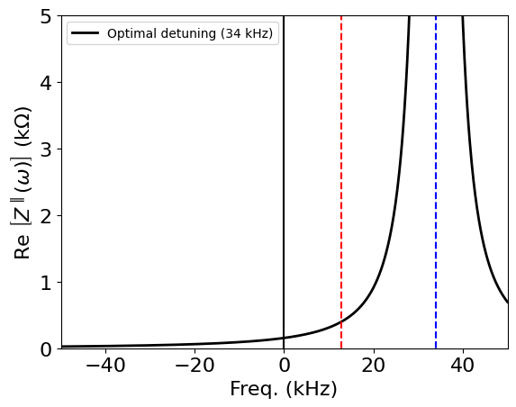
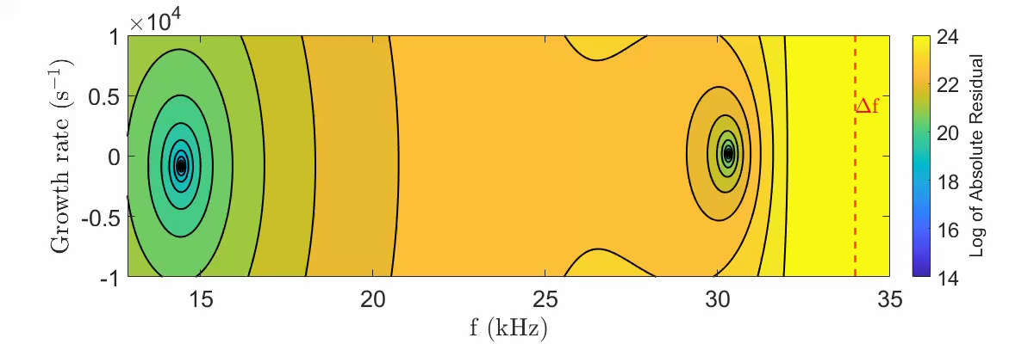



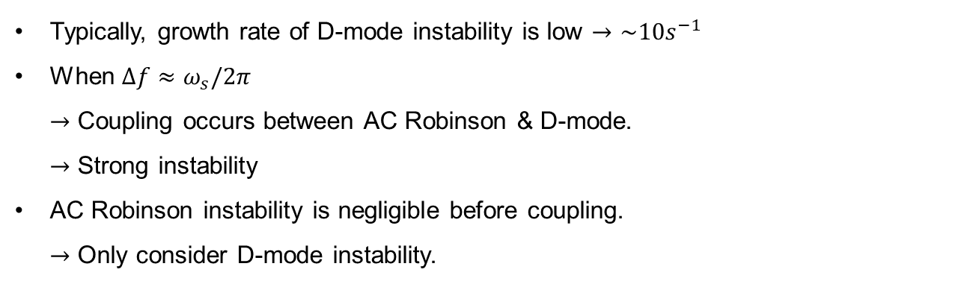
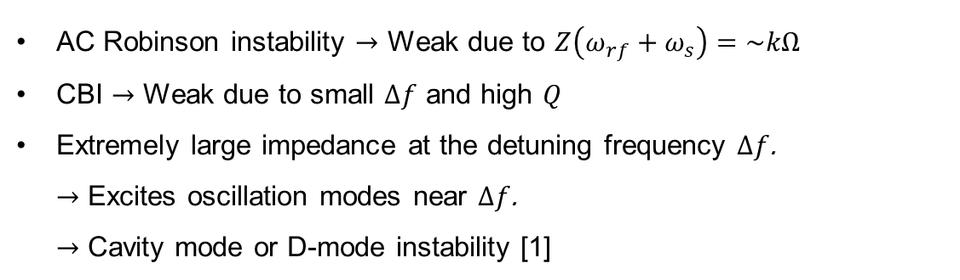
16th International Particle Accelerator Conference, Taipei
Instability in SC passive cavity
$$ω_{rf}$$
$$l=1$$
$$\left(ω_{s}\right)$$
Cavity mode
$$\left(Δω\right)$$
[2]
AC Robinson instability $→$ Weak due to $Z\left(ω_{rf}+ω_{s}\right)=\sim kΩ$
CBI $→$ Weak due to small $Δf$ and high $Q$
Extremely large impedance at the detuning frequency $Δf$.
$→$ Excites oscillation modes near $Δf$.
$→$ Cavity mode or D-mode instability [1]
Typically, growth rate of D-mode instability is low $→\sim 10s^{−1}$
When $Δf≈ω_{s}/2π$
$→$ Coupling occurs between AC Robinson & D-mode.
$→$ Strong instability
AC Robinson instability is negligible before coupling.
$→$ Only consider D-mode instability.
[1] T. He et al., Mode-zero Robinson instability in the presence of passive superconducting harmonic cavities, PARB 26, (2023)
[2] A. Gamelin, Harmonic cavity studies for the SOLEIL Upgrade, IPAST Workshop, (2022)
Notes:
Instabilities in SC cavities differ significantly from NC cavities.
Due to the high Q (~10⁶), the impedance is very low at ωRF+ωs\omega_{\text{RF}} + \omega_sωRF​+ωs​, so AC Robinson instability is weak.
Also, CBI is minimal due to the narrow impedance spectrum.
However, at the detuning frequency, the impedance can reach GΩ levels, leading to a resonant interaction between the beam and cavity field.
This causes a cavity mode instability, or D-mode.
This was discussed in a 2023 PRAB paper, and our simulations confirm the presence of D-mode near the detuning frequency.
D-mode usually shows moderate growth rates (~10–100 s⁻¹), but if Δω\Delta\omegaΔω approaches ωs\omega_sωs​, mode coupling can lead to strong instability.

Slide 15















16th International Particle Accelerator Conference, Taipei
PLS-II Passive Cavity
1 Cav
D-mode
Fit:
$$82.95 s^{−1}$$
Analytic: $=$
$$77.32 s^{−1}$$
1-3 HHC, 400 mA operation, $Q=3×10^{8}$
AC
Unstable
$$×{10}^{4}$$
2 Cav
Stable
D-mode
Fit:
$$10.82 s^{−1}$$
Analytic: $=$
$$10.42 s^{−1}$$
AC
$$×{10}^{4}$$
The $ξ=1$ line defines the condition for optimal bunch lengthening as a function of $R_{s}/Q$.
Possible mitigation methods
Increase detuning frequency
$→$ Lower bunch lengthening efficiency.
Increase number of cavity
$→$ Enhance transient beam loading in the presence of gaps.
3 Cav
D-mode
Fit:
$$−4.83 s^{−1}$$
Analytic: $=$
$$−4.65 s^{−1}$$
AC
$$×{10}^{4}$$
Macroparticle simulation conduced with uniform filling & 10000 particle.
Simulation result match well with analytic prediction.
Notes:
This plot shows the D-mode instability regions and bunch lengthening conditions for various total shunt impedances.
With 1 or 2 HHCs, D-mode instability appears.
Simulations (shown on the right) match well with the analytical predictions.
There are two main ways to suppress D-mode:
Increase detuning frequency, but this worsens bunch lengthening efficiency.
Add more cavities, increasing shunt impedance, but this enhances transient beam loading, especially in gapped fill patterns.

Slide 16

16th International Particle Accelerator Conference, Taipei
Conclusions
This study focused on Robinson instability in both NC-active and SC-passive harmonic cavities, from Korea-4GSR and PLS-II.
NC Active Harmonic Cavity (4GSR)
  Main issue: CBI $μ=1$
  → varying coupling $β$ and adjusting $Δf$ can be partially mitigate.
  Other instabilities (DC Robinson, AC Robinson) occur.
  → can be suppressed by NFP.
SC Passive Harmonic Cavity (PLS-II)
  Cavity mode (D-mode) instability is dominant.
  D-mode arises when: $ω_{s}≈Δω$
  Can be avoided by increasing $Δω$ or $R_{s}/Q$
Future works
  Multi-particle multi-bunch tracking simulation is required for further validation.
  Optimizing the bunch filling pattern is necessary to suppress CBI.
Notes:
To summarize,
this study investigated Robinson instability in both NC-active and SC-passive harmonic cavities using Korea-4GSR and PLS-II cases.
In NC-active cavities, μ = 1 CBI is the main issue, which can be partly mitigated by adjusting coupling β and detuning.
DC and AC instabilities can be suppressed by applying a near-flat potential.
In SC-passive cavities, D-mode instability is dominant when Δω ≈ ωₛ,
but can be avoided by increasing Δω or R/Q.
Future work includes tracking simulations and bunch fill pattern optimization for better stability.

Slide 17
16th International Particle Accelerator Conference, Taipei
Thank you for your attention!

Slide 18






16th International Particle Accelerator Conference, Taipei
Appendix. Generator power
$$V_{cav}$$
$$V_{b}$$
$$V_{g}$$
In an active harmonic cavity $→$consider both generator voltage & beam induced voltage.
The required generator power $P_{g}$ varies with tuning angle $ψ$
$ψ$ is determined by the detuning between the cavity resonant frequency ($ω_{1}$) and rf frequency ($ω_{rf}$)
$$\tan{ψ}=\frac{2Q_{0}}{1+β}⋅\left(\frac{ω_{r}−ω_{rf}}{ω_{rf}}\right)⇒\frac{2R_{s}FI_{0}}{\left(1+β\right)V_{cav}}\cos{φ_{s}}$$
$$R_{s} :Shunt impedance per one cavity, β:coupling factor, F:bunch form factor, φ_{s} :cavity phase, Q:quality factor$$
Main cav $→ψ<0$, HHC cav $→ψ>0$
Optimum condition

Slide 19



16th International Particle Accelerator Conference, Taipei
Appendix. Bosch’s model
Find stationary solution
Set scan parameters
$${\left(Ω^{\left(l,μ\right)}−iα_{R}^{\left(l,μ\right)}\right)}^{2}−{\left(lω_{s}\right)}^{2}=i\frac{αeω_{0}^{2}I}{πE}⋅\frac{l{\left(ω_{0}σ_{τ}\right)}^{2l−2}}{2^{l}\left(l−1\right)!}⋅\sum_{n=±1,3}{{\left(nh+μ\right)}^{2μ−1}{F_{nM+μ}}^{2}Z\left(nhω_{0}+μω_{0}+Ω\right)}$$
Compute RF Potential
[1]
Solve longitudinal bunch distribution
$$Ω^{\left(l,μ\right)}:Coherent frequency, α_{R}:Damping rate, F:Form factor$$
Calculate beam properties
$$\left(σ_{τ}, F, ω_{s}\right)$$
Scan parameters
Active
Main and harmonic cavity tuning angle $ψ$
Harmonic cavity coupling $β$
Passive
Main and harmonic cavity tuning angle $ψ$
Instability onset condition
AC Robinson instability
$\left|α_{R}^{\left(l,0\right)}\right|>\left|τ_{z}^{−1}\right|$
CBI
$\left|α_{R}^{\left(1,μ\right)}\right|>\left|τ_{z}^{−1}\right|$
Mode coupling
$Ω^{\left(1,0\right)}≈Ω^{\left(2,0\right)}$
Check DC Robinson instability
(Zero frequency instability)
Check AC Robinson instability
and mode coupling
Check $μ=1$ CBI
Visualize result
Instability verification
[1] R. A. Bosch et al., “Robinson instabilities with a higher harmonic cavity”, PRAB, (2001)
Notes:
To evaluate whether such instabilities occur, we followed an algorithm based on a method proposed in a 2001 PRAB paper.
We first scan a set of cavity parameters.
At each condition, we compute the stationary longitudinal distribution.
Then, we check for the presence of:
DC Robinson instability,
AC Robinson instability, and
Coupled-bunch instability.
In active cavities, both the tuning angle and coupling factor β\betaβ can be adjusted.
In contrast, passive cavities operate at fixed β=0\beta = 0β=0, so only the tuning angle is adjustable.
To determine if an instability occurs:
For DC and AC Robinson, we compare the growth rate with the radiation damping rate.
For mode coupling, we check if the dipole and quadrupole modes intersect.

Slide 20










16th International Particle Accelerator Conference, Taipei
$$ξ=1$$
Appendix. NFP
In a double RF system using an HHC, the total voltage is given by:
$$V\left(τ\right)=V_{main}\sin\left(ω_{rf}τ+φ_{main}\right)+V_{HHC}\sin\left(mω_{rf}τ+φ_{HHC}\right)$$
$$V_{main,HHC} :Voltage of main\&HHC cavity, ω_{rf}:rf−frequency, τ:bunch−arrival time, φ_{main,HHC} :phase of main\&HHC cavity$$
HHC reduces the voltage gradient at $τ=0$, where the bunch is located, leading to bunch lengthening.
The degree of bunch lengthening can be quantified using a parameter $ξ$, defined as the ratio of the voltage gradient at $τ=0$ between the harmonic cavity and the main cavity.
  $ξ=1,$ Flat potential condition
  $ξ→0$, Similar to initial bunch
Smaller $ξ$leads to less bunch lengthening and requires lower HHC voltage (less number of cavities).
$$ξ=0.5$$
$$ξ=0.1$$
$$ξ=−\frac{V_{main}\cos\left(φ_{main}\right)}{mV_{HHC}\cos\left(φ_{HHC}\right)}$$
$$φ_{1}=\sin^{−1}\left(\frac{m^{2}}{m^{2}−1}\frac{U_{0}}{eV_{1}}\right) \\ φ_{2}=−\tan^{−1}\left(\frac{\tan{φ_{1}}}{mξ}\right) \\ V_{2}=\frac{V_{1}\sin{φ_{1}}}{m^{2}\sin{φ_{2}}}$$
$$V\left(0\right)=\frac{U_{0}}{e}$$
$$V^{′}\left(0\right)=ω_{rf}V_{1}\cos\left(φ_{1}\right)\left(1−ξ\right)$$
$$V^{′′}\left(0\right)=0$$

Slide 21




16th International Particle Accelerator Conference, Taipei
Appendix. NFP
The bunch length can be estimated semi-analytically using the Hamiltonian approach.
$$ℋ\left(τ,δ\right)=\frac{1}{2}αδ^{2}−\frac{e}{E_{0}T_{0}}\int_{0}^{τ}{\left(V\left(τ\right)−\frac{U_{0}}{e}\right)dτ}$$
$$α:Voltage of main\&HHC cavity, δ:momentum deviation, E_{0}:energy, T_{0}:revolution period, U_{0} :energy loss per turn$$
From the Vlasov equation, the stationary distribution must be a function of the Hamiltonian, and assuming a Gaussian distribution in energy deviation:
$$ρ\left(τ\right)∝\exp\left(−\frac{e}{T_{0}E_{0}α}\frac{\int_{0}^{τ}{\left(V\left(τ\right)−\frac{U_{0}}{e}\right)dτ}}{σ_{δ}^{2}}\right)$$
We compared the bunch length variation with respect to $ξ$ using both:
  Semi-analytical formula $σ_{τ}^{2}=\int_{−∞}^{∞}{τ^{2}ρ\left(τ\right)dτ}$
  Particle tracking simulation with 10,000 macro-particles/50000 turns w/o wake field effects
The comparison shows good agreement in the absence of wakefield effects.
Significant bunch lengthening can be achieved when $ξ>0.7$.
$$ξ→0.8$$
$$BL≈2.03$$

Slide 22






16th International Particle Accelerator Conference, Taipei
Appendix. Passive HHC self-consistency
PLS-II with $Q=3×10^{8}, \frac{R_{s}}{Q}=95 Ω, I=400 mA$
Passive harmonic cavity $→$
Equilibrium longitudinal distribution depends on $ψ$.
Self-Consistent method
Set $ψ,$ Initialize $F_{h}⇒1$
$$V\left(τ\right)=V_{m}\sin\left(ω_{rf}τ+φ_{m}\right)−2IR_{h}F_{h}\cos{ψ_{h}}\sin\left(mω_{rf}τ+ψ−\frac{π}{2}\right)$$
Calculate $U\left(τ\right)=−\frac{ηe}{ET_{0}}\left[\int_{0}^{τ}{dτ^{′}\left\{V\left(τ^{′}\right)−U_{0}\right\}}\right]$
Compute $σ_{t}$ using Vlasov equation
Update $F_{h}→\exp\left(−\frac{m^{2}ω_{rf}^{2}σ_{t}^{2}}{2}\right)$
Repeat until $F_{h}$ converges
Notes:
In passive cavities, the beam determines the voltage, so the equilibrium longitudinal distribution depends on the cavity tuning angle.
We apply a self-consistent algorithm:
Set the tuning angle, and initialize form factor as 1
Calculate the cavity voltage and potential,
Solve the Vlasov equation for the bunch distribution,
Update the form factor until convergence.
Using this approach, we obtain the bunch shape for various detuning frequencies, shown on the right.

Slide 23




16th International Particle Accelerator Conference, Taipei
Appendix. Stable operation at low current
1-3 HHC, 400 mA operation, $Q=3×10^{8}$
$D−mode τ^{−1}=0$ line
Projection direction
Stable
Unstable
At low beam current, achieving bunch lengthening requires low $Δf$.
This condition can trigger strong D-mode instability or coupling between AC-Robinson and D-mode instability.
The 3D surface represents the required detuning frequency as a function of $R_{s}/Q$ and $I$.
To operate at low current (250 mA) with bunch lengthening $→$ $\frac{R_{s}}{Q}>318 Ω$ is required.
Notes:
At low beam current, the detuning frequency needed for bunch lengthening approaches zero.
This increases the risk of D-mode instability.
The 3D plot on the left shows the required conditions for bunch lengthening.
The projected 2D view on the right indicates that, to achieve stable operation with bunch lengthening at 250 mA, the total shunt impedance must exceed 320 Ω.

